Slide 1

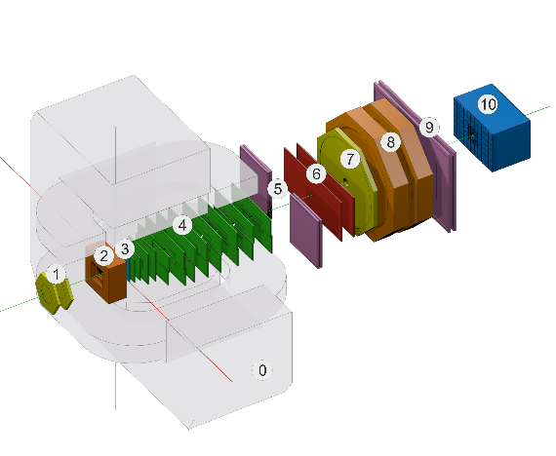


Status of Geometry and Configuration Information Systems
E. Alexandrov¹, I. Alexandrov¹, A. Chebotov¹, I.Filozova¹, K.Gertsenberger¹, D.Priakhina¹, I.Romanov¹, G.Shestakova¹, A. Yakovlev¹
¹JINR, Dubna
15th Collaboration Meeting of the BM@N Experiment at the NICA Facility, Dubna,VBLHEP JINR, 14-16 October, 2025
Joint Institute for Nuclear Research

Slide 2
The Configuration Information System
Notes:
set of various configuration hardware parameters
required for setting the detectors into operation modes (like working voltage)

Slide 3
Configuration: Possibilities
can store and provide configuration data for online processing :
  set of various detectors configuration parameters (working voltage etc.)
  setup data including sequences of software tasks with their dependencies
can start, stop and monitor setup tasks during experiment sessions
can use web interface to supports data bases and operations with setup tasks
Notes:
set of various configuration hardware parameters
required for setting the detectors into operation modes (like working voltage)

Slide 4
BM@N Configuration
Information System and online processes diagram
https://bmn-online.jinr.int/
bmn-config-w1-he.jinr
bmn-config-he.jinr
bmn-config-he.jinr

Slide 5
Tests on production system
Testing of the production system at the end of May
  User knows if manager did not start or was crashed
    periodic (once per several seconds) requests to configuration Manager asking if it's alive
      update command (request from web) bug fixed
  Correction log statuses (ERROR, SERVER_ERROR, WARNING, DEBUG, INFO, SYSTEM_INFO)
  Get session log bug fixed (before was fixed but only in debug mode)
  Small improvements of GUI
Testing of the production system at July
  crashes during start and stop setup fixed (mutex added in some place)
    this multithread bug became reproducible when a lot of "isAlive" requests appeared
  all code clean up
    unused methods removed
    debug comments removed
Testing of the production system at September
  No new items

Slide 6
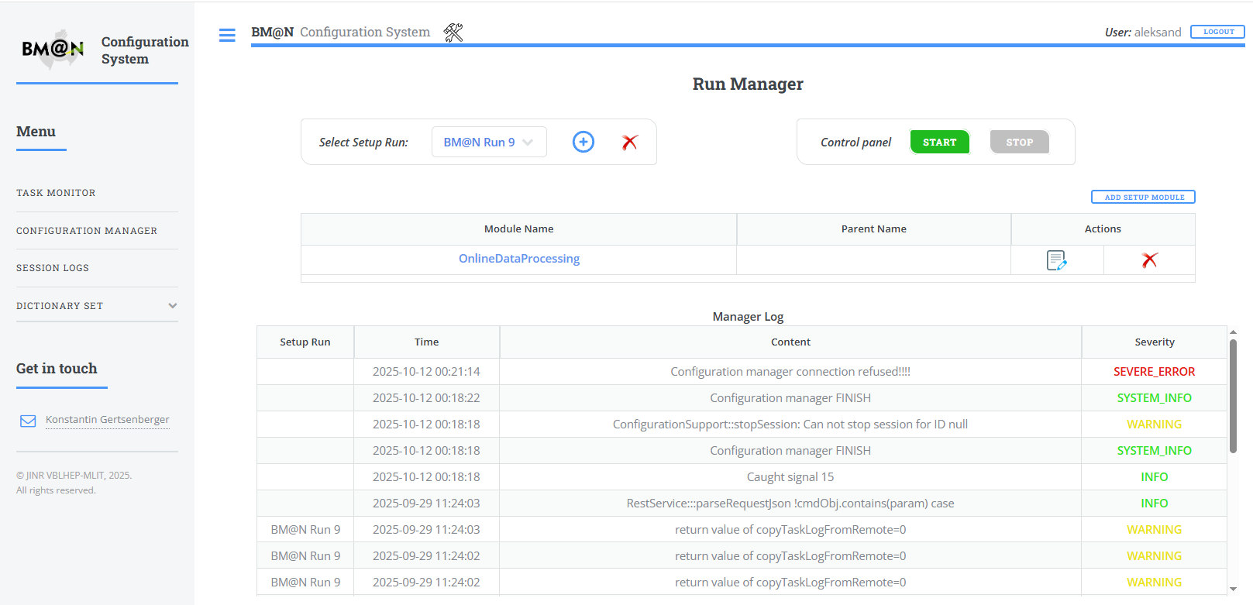
Configuration Manager started panel.
Online processes to be controlled by Configuration manager

Slide 7
Configuration System: Next steps
Wait for feedback on the results of work on run 9
Add Grafana monitoring of both Configuration manager itself and WEB components
Moving to use REST API in all public communications

Slide 8
The Geometry Information System
Notes:
set of various configuration hardware parameters
required for setting the detectors into operation modes (like working voltage)

Slide 9
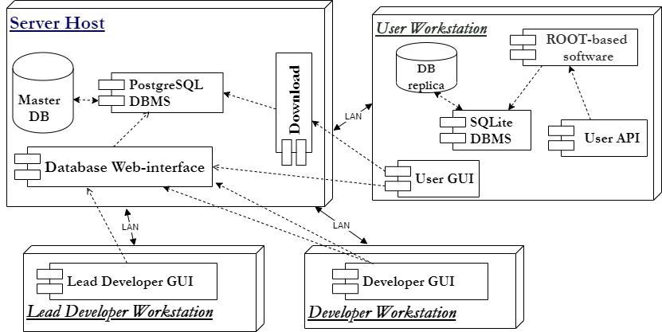
General architecture of the Geometry Information System

Slide 10
Main changes of the Geometry Information System
  Update list of setups
  Bug fix for copy setup (did not working correctly checkbox for setup module)
  Hide revision for setup (in table all values 1)
    Remove from API
    Remove from GUI
  Small bug fix after reconfiguration of DB
    Rename fields
    Small changes on architecture
    Do Tag of setup is case independency
  Bug fix auto download version by tag if selected version is not exists in local repository
Notes:
set of various configuration hardware parameters
required for setting the detectors into operation modes (like working voltage)

Slide 11
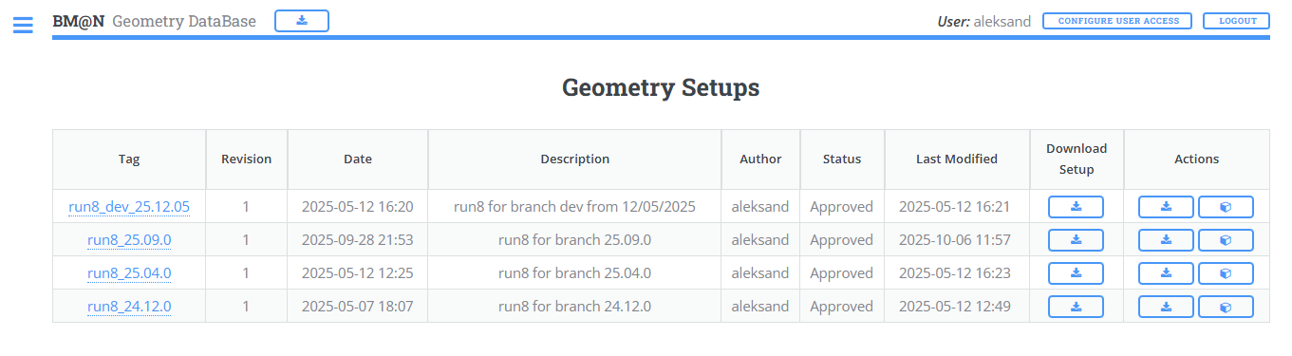
Status of the Geometry Information System
Geometry server is available and last versions are uploaded: https://bmn-geometry.jinr.ru/
Production versions Run8_24.12.0 Run8_25.04.0
Run8_25.09.0
Developer version Run8_dev_25.12.05
Run9_dev_25.12.10 (not approved)
Notes:
set of various configuration hardware parameters
required for setting the detectors into operation modes (like working voltage)

Slide 12
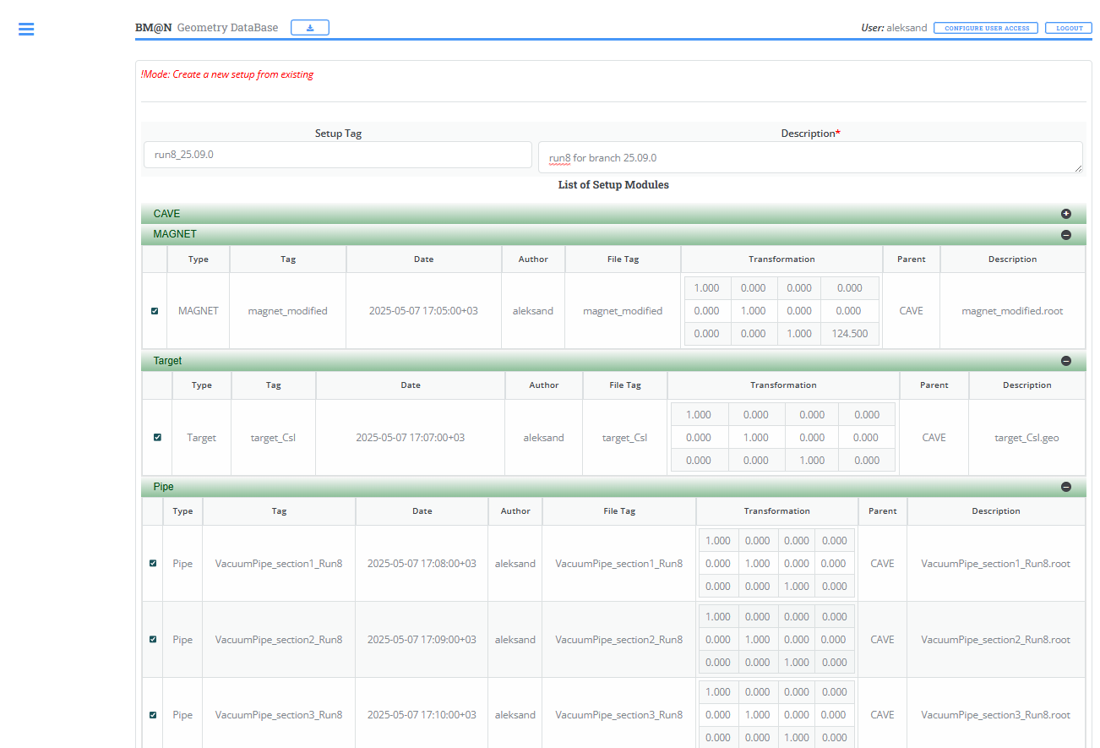
COPY SETUP
Was problem

Slide 13
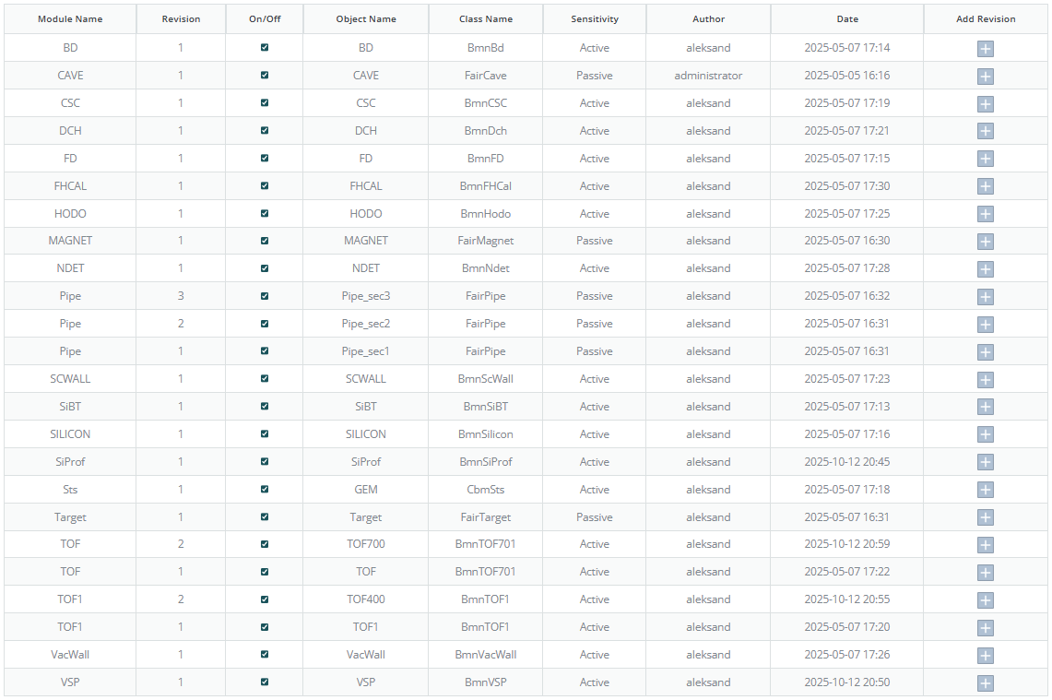
New module/revisions

Slide 14
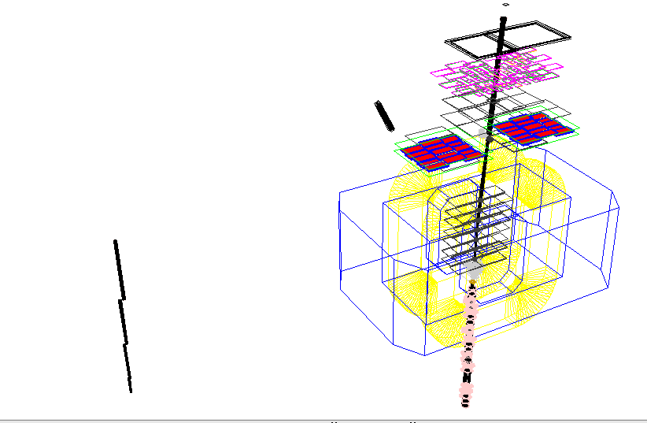
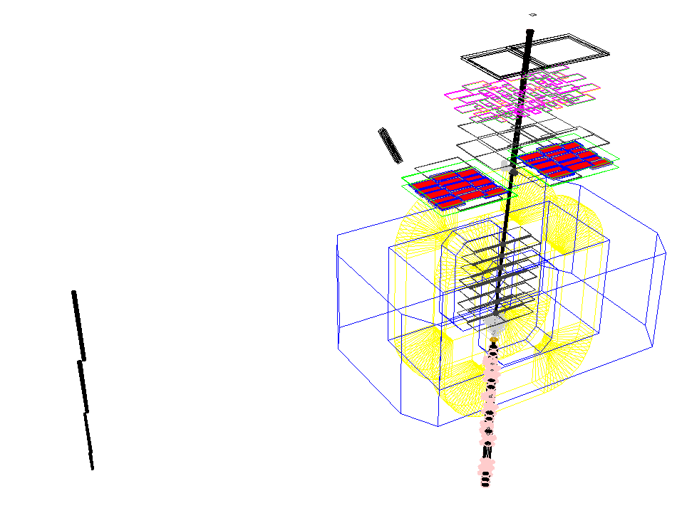
Compare Geometry Run9
Macro (geometry_run9.C) geometry
DB geometry

Slide 15
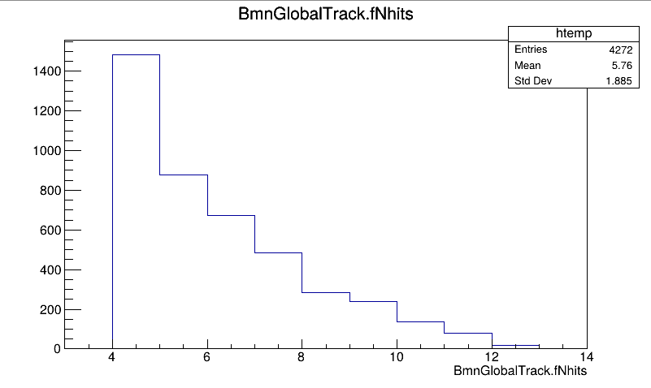
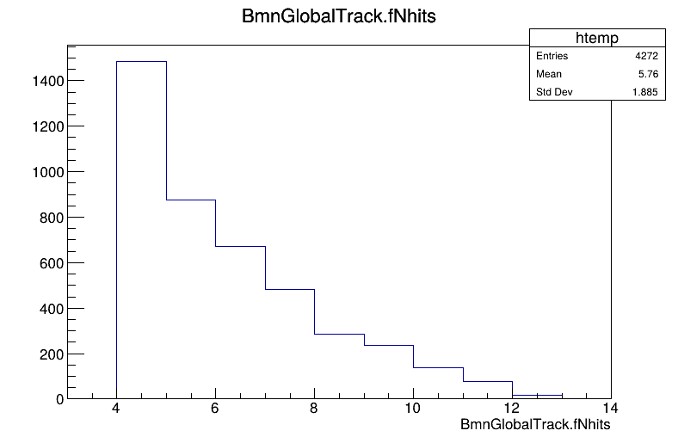
Compare Reconstruction Run8
Use UniDb geometry
Use GeoDb geometry

Slide 16
API
int LoadSetupToGeoManager(string_view setup_tag); // 0 - loaded, not 0 – error code
  It will try to upload geometry from server if local db has not this tag
int LoadSetupToFairRunSim(string_view setup_tag); // 0 - loaded, not 0 – error code
  It will try to upload geometry from server if local db has not this tag
FairField* GetMagneticField(double scale = 0); // nullptr – no Field
string_view GetParameterFile(string_view detector_name); // "" – no parameter file

Slide 17
Usage in run_sim_bmn.C
#ifdef USE_GEODB
GeoSetup gSetup;
int errStatus=gSetup.LoadSetupToFairRunSim("run8_25.09.0");
if(errStatus!=0){
cout << "ERROR: Geometry not loaded. Error status "<<errStatus<< endl;
exit(-1);
}
BmnFieldMap* magField =dynamic_cast<BmnFieldMap*>(gSetup.GetMagneticField());

Slide 18
Geometry System: Next steps
Approve run9 setup (require check config files)
Wait for feedback on new branch with DB
Merge branch to main git (no any changes for users after merge)
Moving to use REST API in all public communications

