Slide 1



Geometrical alignment of the BM@N STS and GEM detectors in 3 coordinate directions
Zarif Sharipov
15th Collaboration Meeting of the BM@N Experiment at the NICA Facility

Slide 2
Introduction to Alignment
y
β
z
γ
α
x

Slide 3
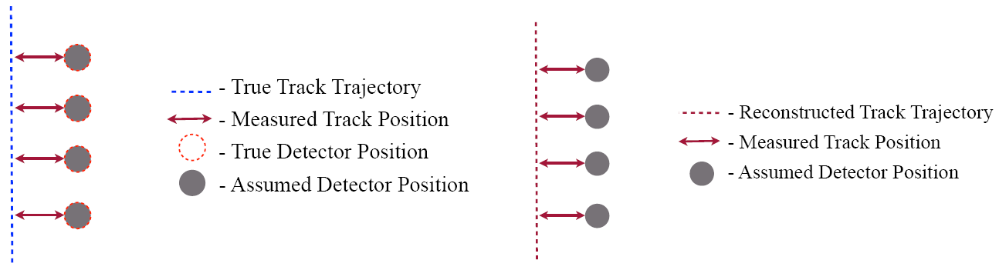
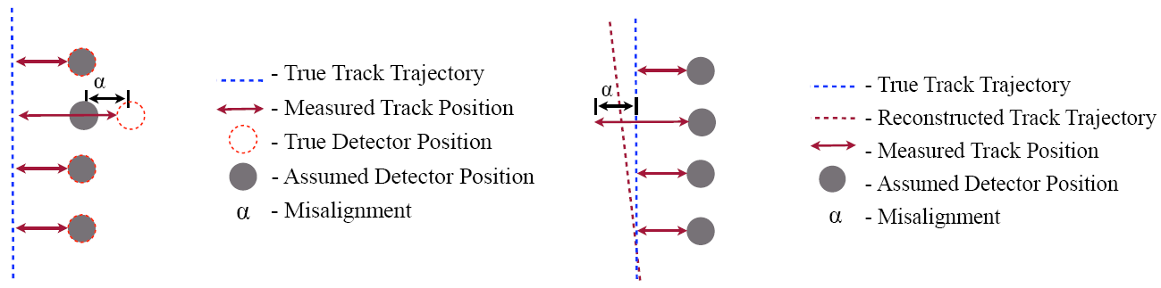
Introduction to Alignment

Slide 4
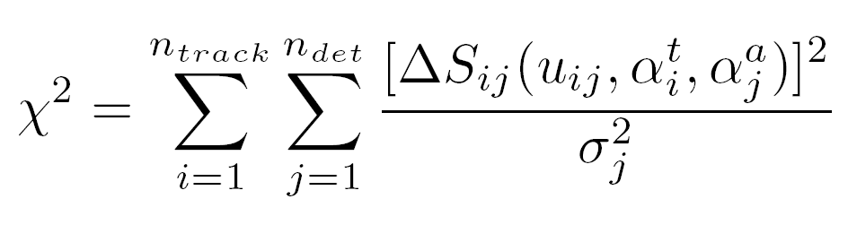
Introduction to Alignment
.
o

Slide 5
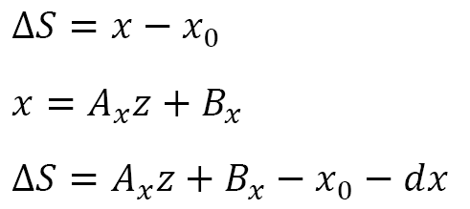
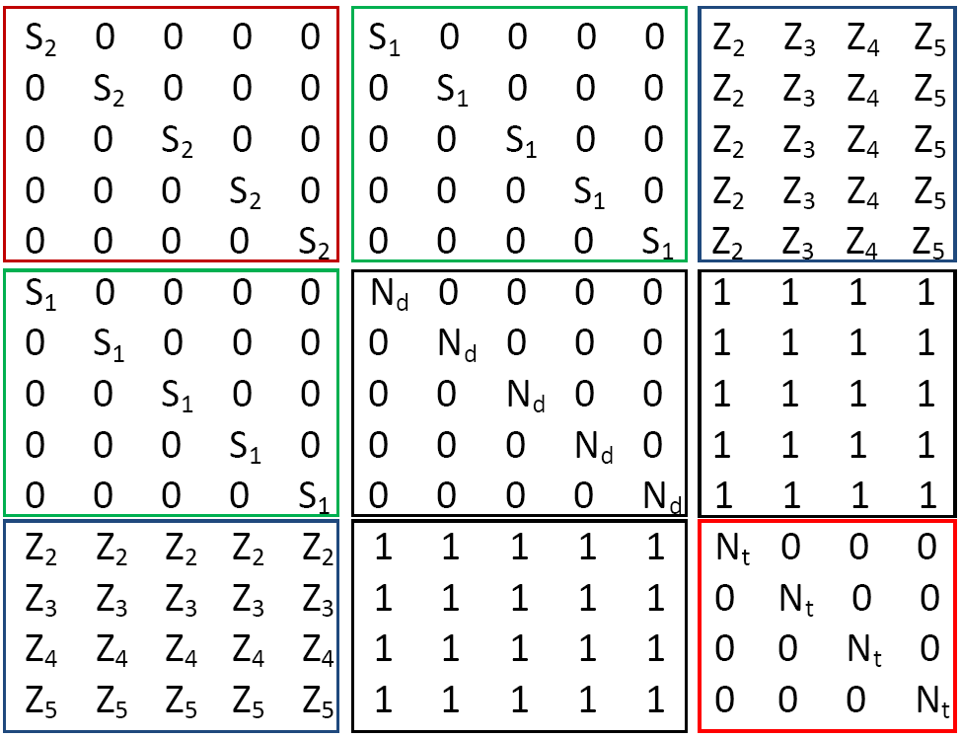
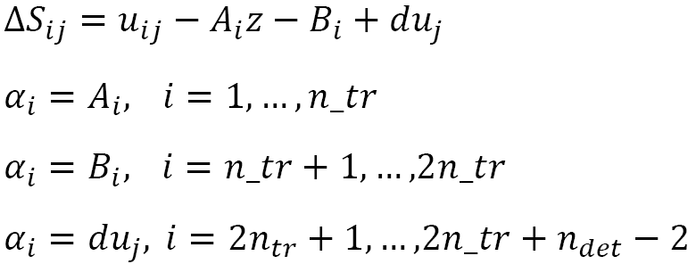
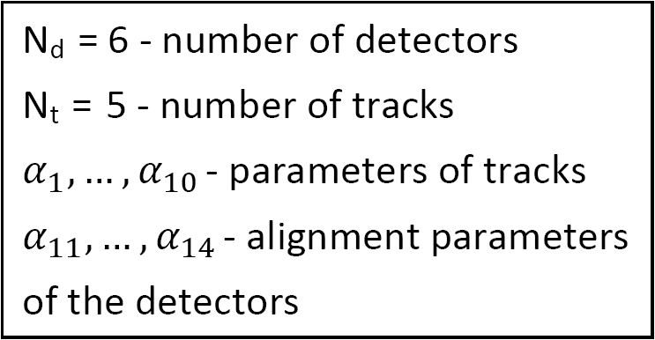
Alignment for x and y
Volker Blobel, Claus Kleinwort. A New method for the high precision alignment of track detectors (https://arxiv.org/abs/hep-ex/0208021)
https://www.desy.de/~kleinwrt/MP2/doc/html/draftman_page.html
Notes:
example

Slide 6
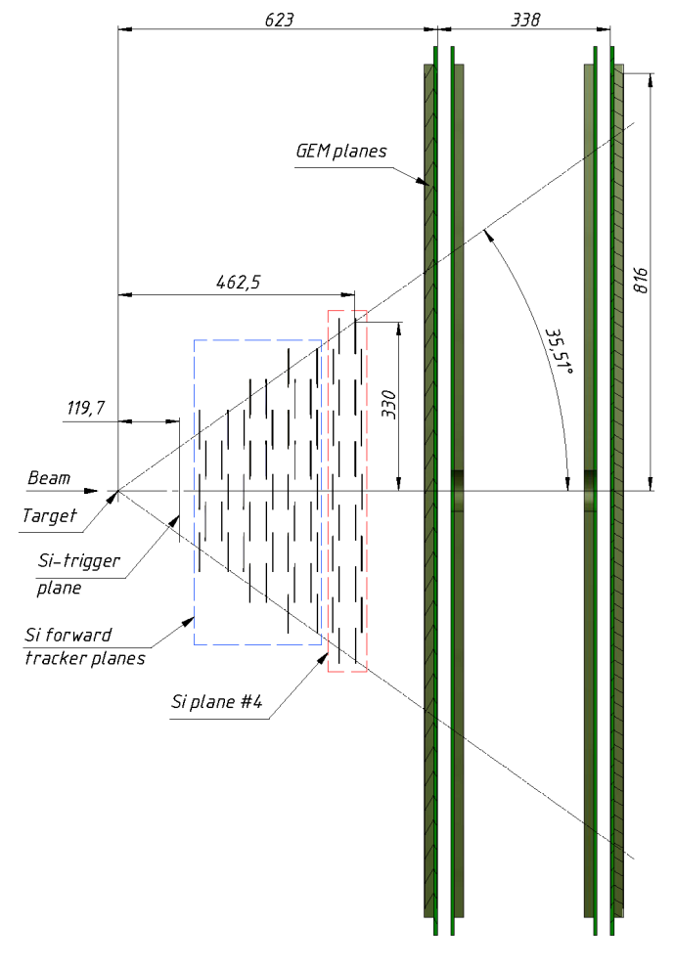
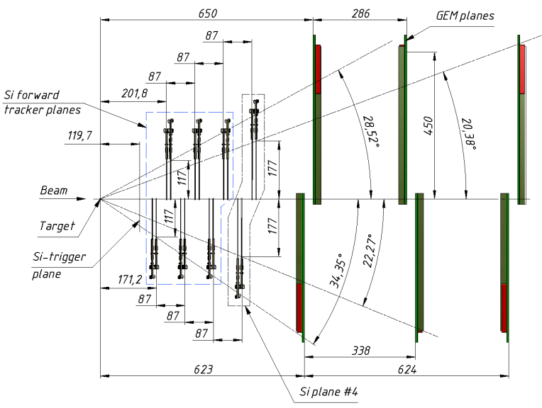
Schematic view of Forward Silicon detectors including 4th Si plane and first large apperture GEM (𝜎=150 mkm[Васильев С.Е. и др. Письма в ЭЧАЯ .2019.Т.16. №6. С.643-652]) stations in YZ (left) and XZ (right) projections.

Slide 7
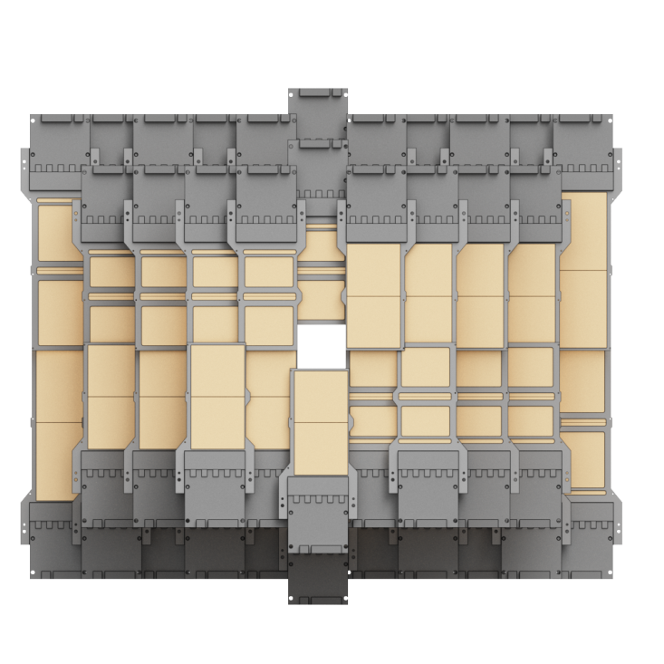
Alignment for x, y and z
Period: 8
Number: 6764
Beam: A = -1, Z = -1
Beam energy: 3.8 GeV
Target: A = -1, Z = -1
Field voltage: 0.2655mV
N_events: ≈300000
N_hits_Si: ≈240000
N_tracks_Si: ≈32000

Slide 9
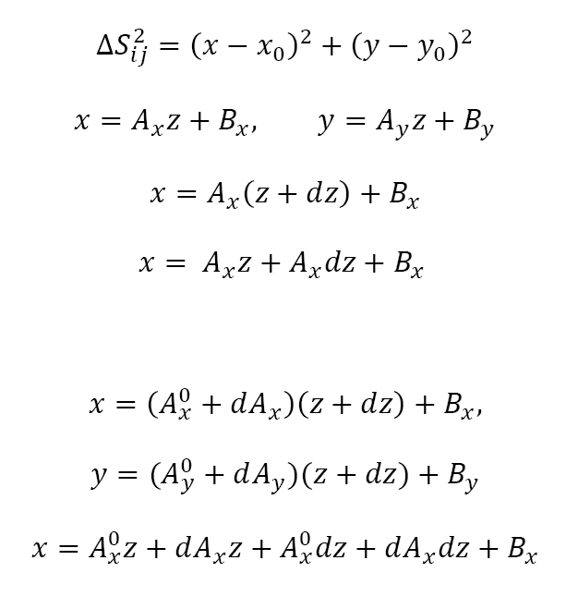
Alignment for x, y and z

Slide 10
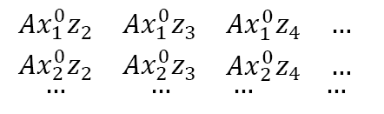
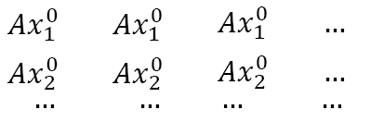
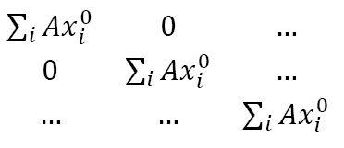
Alignment for x, y and z
dAx_i
Bx_i
dx_i
dz_i

