Slide 1
Distributed computing infrastructure in preparation for Run 9
BM@N 15th collaboration meeting
Konstantin Gertsenberger, Igor Pelevanyuk
LHEP
MLIT

Slide 2


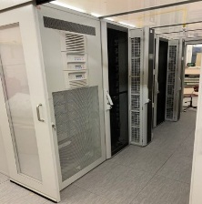




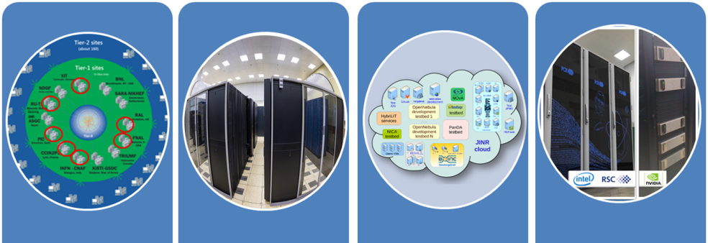

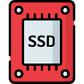















DIRAC in JINR
LHEP resources
MLIT MICC basic facility
DDC cluster
NICA cluster
MLIT EOS
DAQ computing
farm
MLIT CTA
Other/Collaboration resources
JINR Cloud
Tier-1
Tier-2
Govorun
UNAM
MEPHI
Lustre
Ultra-fast storage
Clouds
INP
MSC
Polytech
IMDT
NOSU
ASRT
IPANAS
PRUE
INP
SU
INRNE
INP

Slide 3
DST size reduced!
DST version | Total size | Total files | Avg file size
24.02.0 | 66,5 T | 29830 | 2,23 GB
24.04.0 | 66,1 T | 29887 | 2,21 GB
24.12.0 | 67,1 T | 29877 | 2,24 GB
25.04.0 | 105,3 T | 29715 | 3,55 GB (+60%)
25.09.0 | 67,5 T | 29962 | 2,25 GB (-36%)
DIGI size same!
DIGI version | Total size | Total files | Avg file size
24.02.0 | 34,6 T | 29979 | 1,15 GB
24.04.0 | 34,9 T | 29996 | 1,16 GB
24.12.0 | 34,9 T | 30004 | 1,16 GB
25.04.0 | 44,1 T | 29932 | 1,47 GB (+27%)
25.09.0 | 44,2 T | 29999 | 1,47 GB (+0)

Slide 4
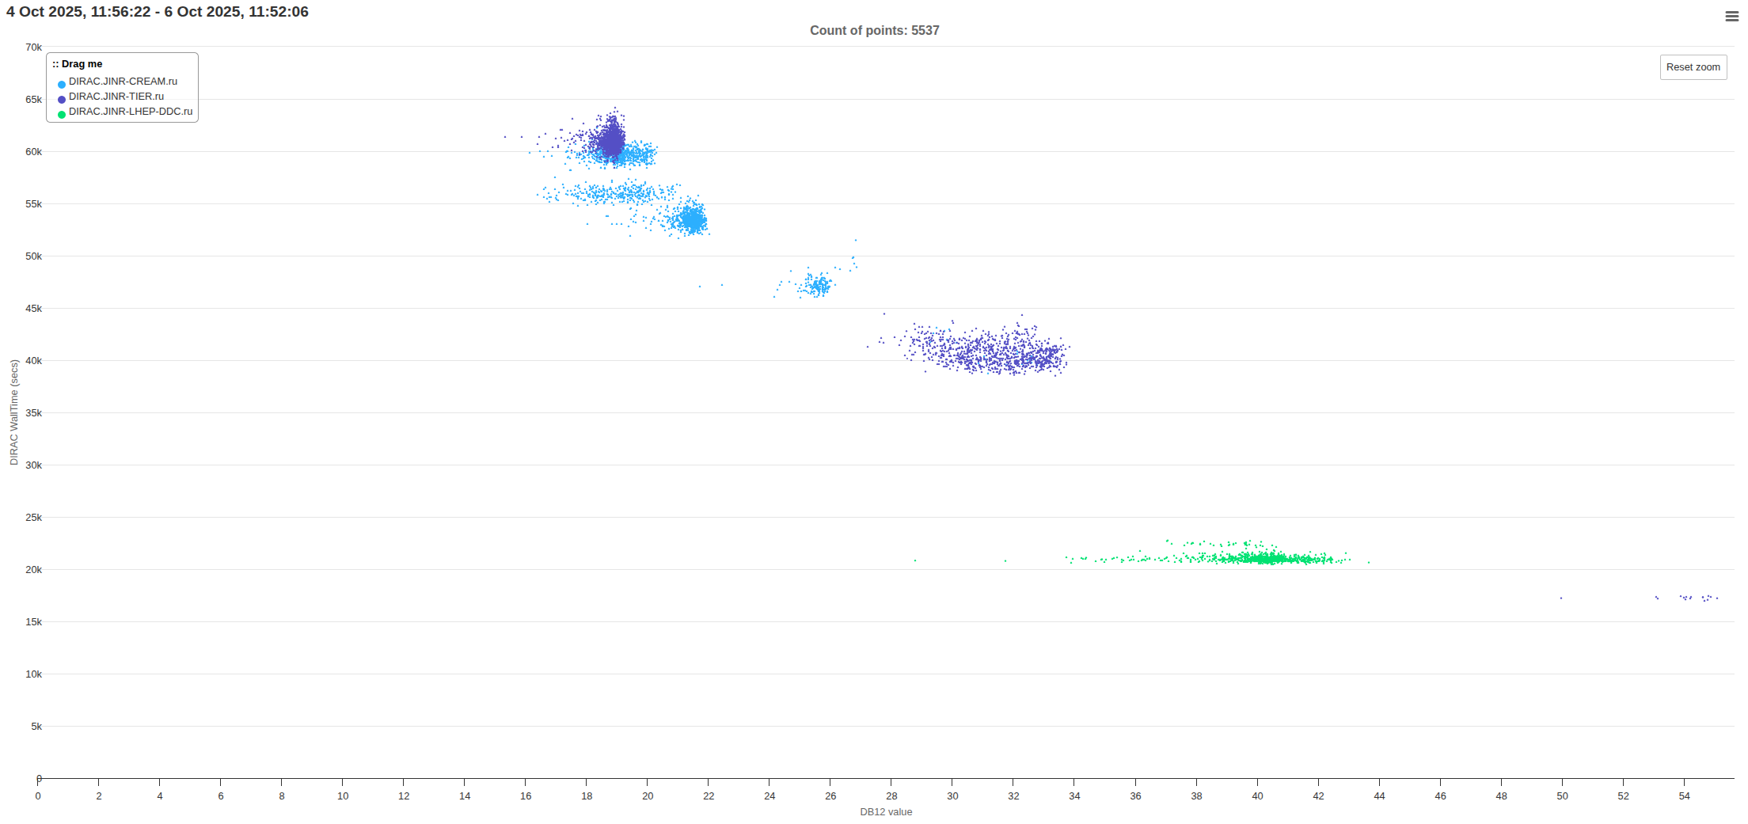
Request 11
200 files of 50k events -> 4000 files of 2.5k events
Job completion took from 5 to 17 hours.
With 50k files it would be 4 days to 14 days!

Slide 5
For distributed processing
Amount of input files
>1000 >4000
Amount of output files
>1000 >4000
Size of input file
0 – 5 GB <12 GB <15 GB
Size of output file
0 – 5 GB <12 GB <15 GB
Job Duration
<30m <1h - 1d <2d
Comfortable size of RAW files is in range 7-12 GB.
Ideal size considering RAW Job Duration is 10 GB.

Slide 6

Job submission automation
DDC cluster
DIRAC File Catalog
DIGI
DST
EOS MLIT
RawToDigi
DigiToDst
Apache Airflow
DIGI
DST
EOS NICA
RawToDigi
DigiToDst
Should we automate backup on tapes? Not sure.
FTS3 file transfers are working!
Now it is possible to get data from tapes “efficiently”.
[ ] – perform read from backup test

Slide 7
Automation plan
To automate job processing the following tasks should be completed:
Wait until we start receive data in DIRAC FileCatalog
Check the size of files and run test RawToDigi and DigiToDst jobs manually for these subset of files.
If everything is ok, run automatic RawToDigi and DigiToDst job submission.
Turn off RawToDigi job execution if raw file has size more than 16 GB.
Tier1 – responsible for RawToDigi
Tier2 – responsible for DigiToDst
This should be done during first week of data taking.

Slide 8



Simulation of job execution during Run9
JobQueue
Monitoring
Parameters
Simulation system
Results
Controller
Written in Python to predict CPU, RAM, network and disk load.
Uses data about performance of resources integrated in DIRAC
It is used to check the behavior of DIRAC jobs in real infrastructure.
Simulation is done every second, but period may be increased for speeding up simulation.
InfluxDB is used for results storage and visualization.
Storage
Cluster
Worknode
Job
Task
Pelevanyuk, I.S., Campis, D. Simulation of Job Execution in Distributed Heterogeneous Computing Infrastructures. Phys. Part. Nuclei Lett. 20, 1276–1278 (2023). https://doi.org/10.1134/S1547477123050618

Slide 9
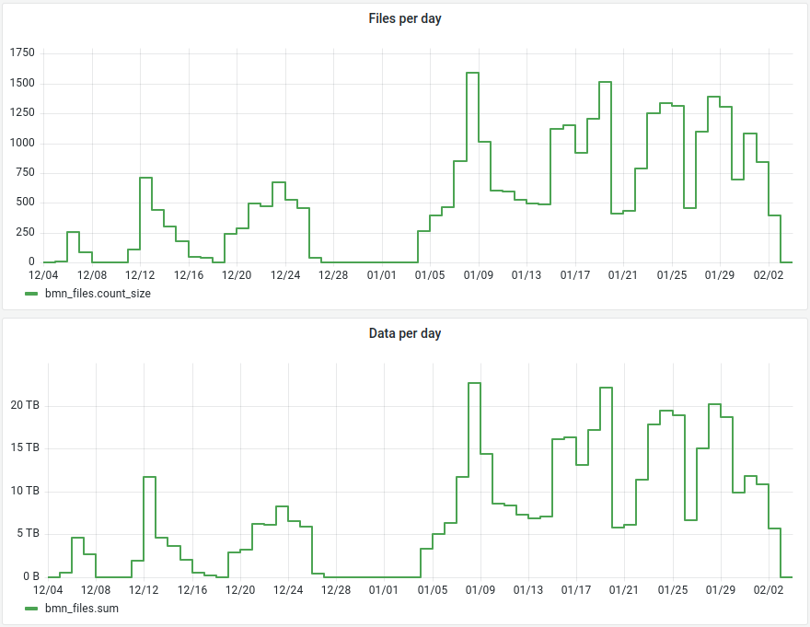
BM@N Run8 data taking
Total files: 31306
Total raw size ~ 436 TB

Slide 10
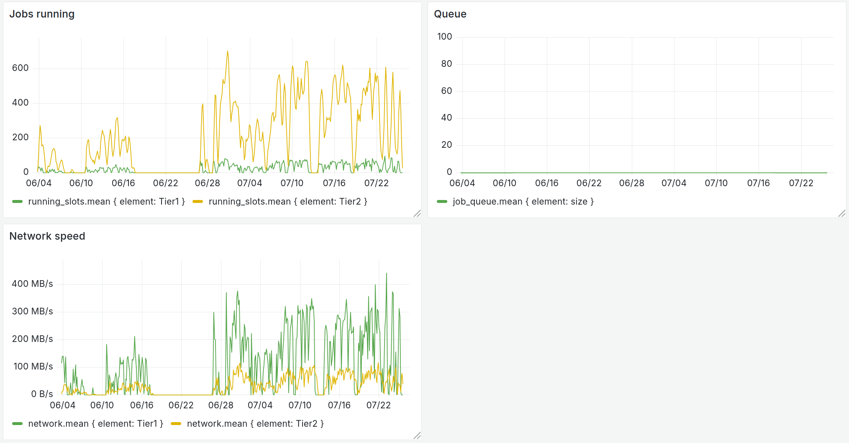
Simulation plots
What if previous data taking was automated?
Data rate from Run8 was taken analyzed and used to simulate the same data flow to the system.

Slide 11
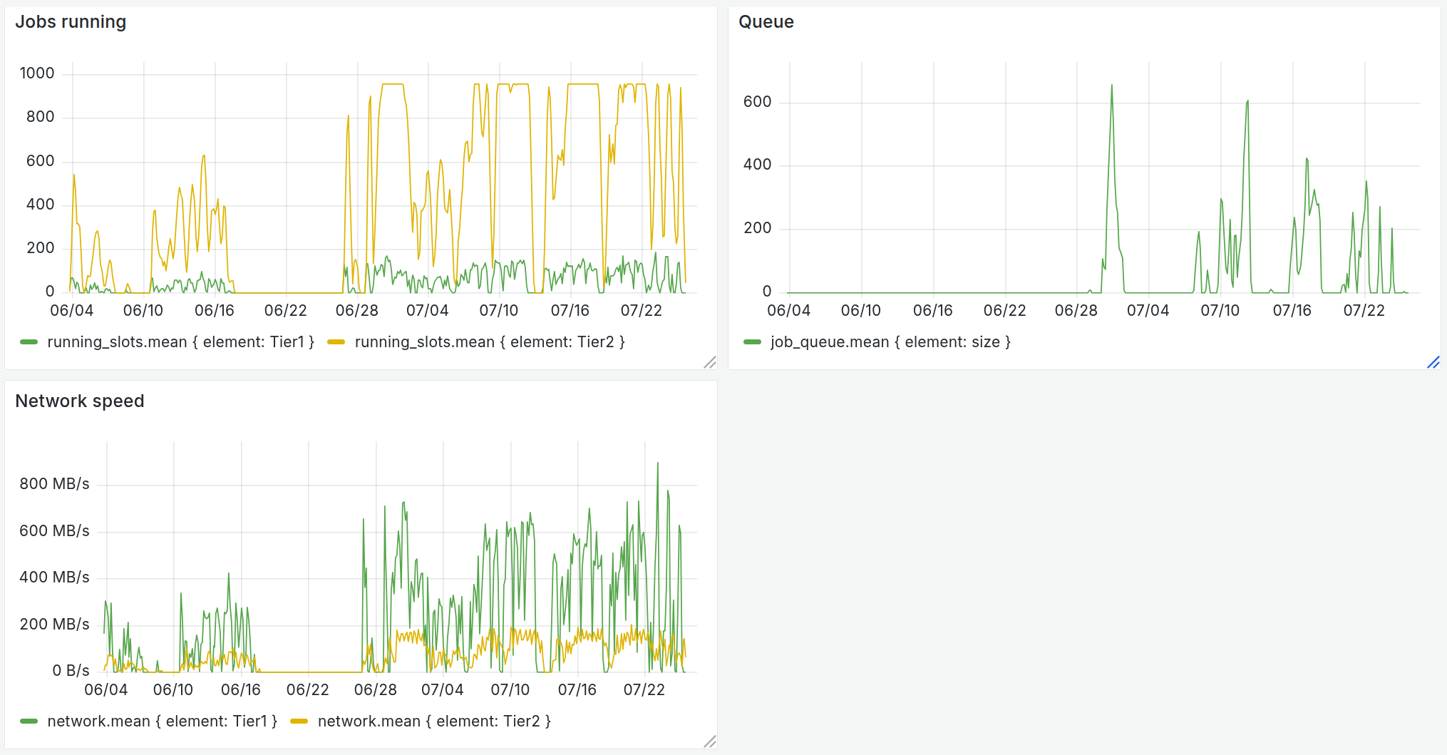
Simulation plots
What if the intensity doubled?
Occasional queues during most intense data taking periods.
Solution: allow Tier1 to process part of DigiToDst jobs

Slide 12
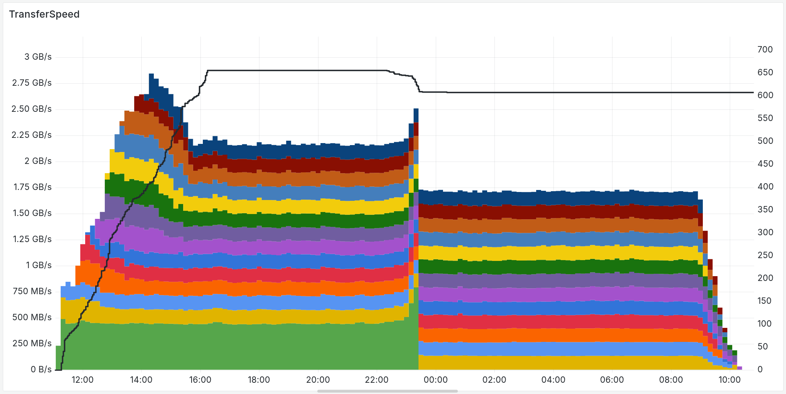
EOS -> DDC speed test
Black line – jobs running on DDC
Colored bars – transfer speed by whole node

Slide 13
DIRAC: Igor Pelevanyk
BM@N: Konstantin Gertsenberger
Responsible for resources:
Tier-1,Tier-2, EOS: Valery Mitsyn
CTA Tape library: Vladimir Trofimov
Govorun: Dmitry Podgainy, Dmitry Belyakov, Aleksandr Kokorev, Maxim Zuev
NICA cluster: Ivan Slepov
DDC cluster: Ilia Slepnev
Network: Andrey Dolbilov
List of participants

Slide 14

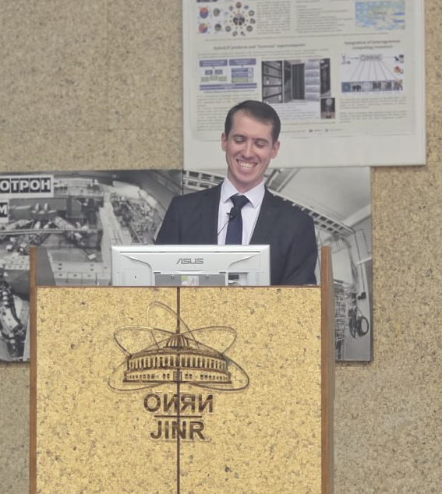
This would be impossible without your help and support!
Thanks to BM@N collaboration
Thank you!

Slide 15
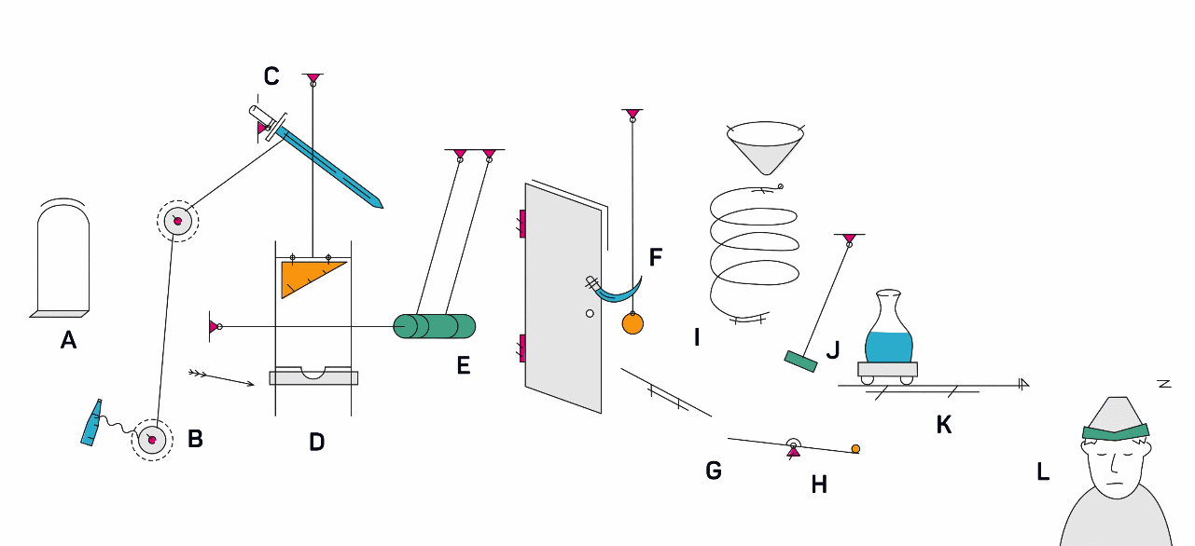
Conclusion for BM@N 15th collaboration meeting
Distributed processing require balance between size of files, amount and processing time.
We are ready to automate processing of incoming RAW data from Run9.
Simulation was performed to ensure that we have enough computing power for offline processing during data taking.

Slide 17
2. DIRAC directory structure
bmn.nica.jinr
├── exp
│ ├── raw
│ │ └── run[number]
│ ├── digi
│ │ └── run[number]
│ │ └── [version]
│ └── dst
│ └── run[number]
│ └── [version]
├── sim
│ ├── gen
│ │ └── [generator]
│ │ └── [campaign]
│ └── dst
│ └── [generator]
│ └── [campaign]
│ └── [version]
└── backup (on CTA tape library)
├── exp (same structure as in exp dir)
└── sim (same structure as in sim dir)
Directory structure in DIRAC is now similar to NCX directory structure.
Still requires some work to do, to make it absolutely the same.

Slide 18
2. DIRAC directory structure
Special metadata applied for run9 data directories. This is crucial for further automatic processing!
bmn.nica.jinr
└── exp
├── raw {type: raw}
│ └── run9 {run_number: 9}
├── digi {type: digi}
│ └── run9 {run_number: 9}
│ └── 25.04.0
└── dst {type: dst}
└── run9 {run_number: 9}
└── 25.04.0
With that schema it is possible to select files by metadata:
$ dirac-dms-find-lfns type=raw run_number=9
/bmn.nica.jinr/exp/raw/run9/file_1_v0_p0.data
/bmn.nica.jinr/exp/raw/run9/file_2_v0_p0.data
/bmn.nica.jinr/exp/raw/run9/file_3_v0_p0.data
…

