Slide 1






Software meeting
Status of the BM@N software infrastructure and Future Plans
14:20
16/10
2025
Alexander Chebotov
Konstantin Gertsenberger
Ilya Romanov
15th Collaboration Meeting of the BM@N Experiment at NICA

Slide 2




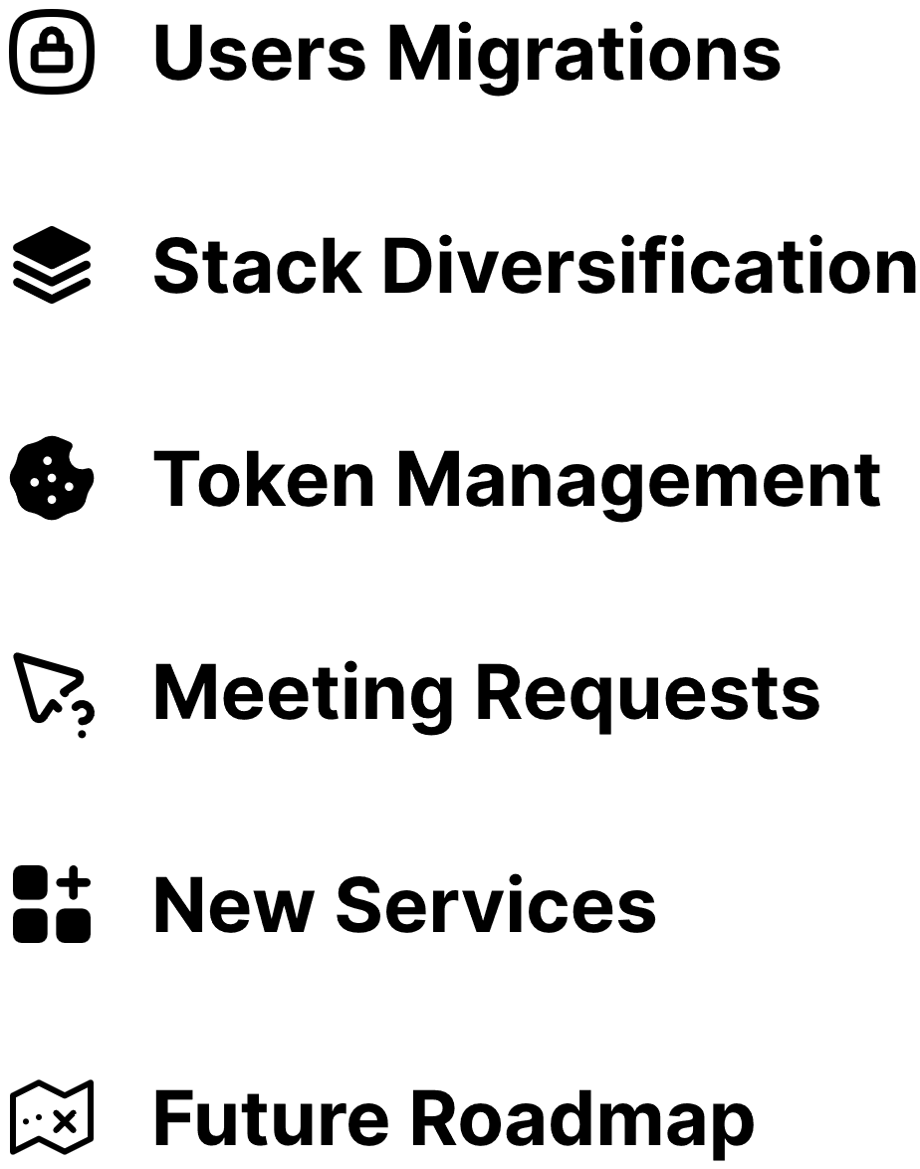
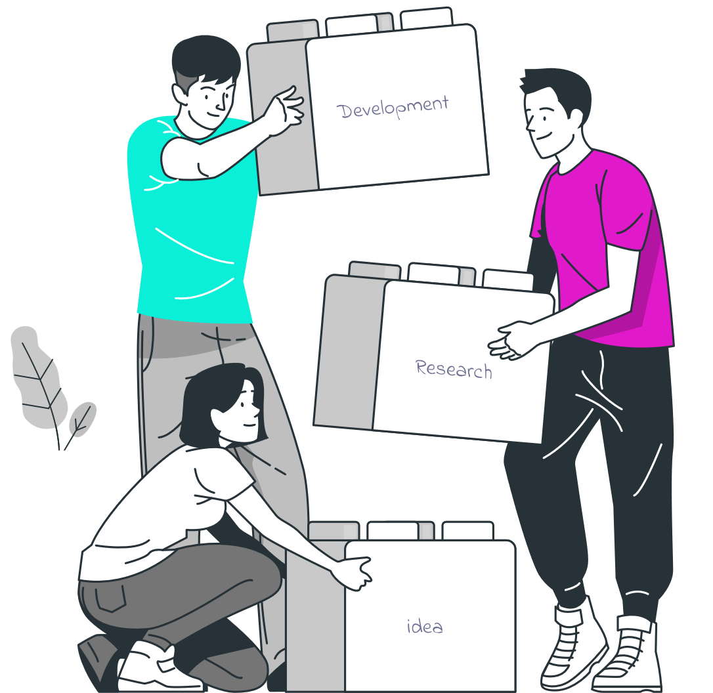


“One step forward, and back to square one.”
OUTLINE

Slide 3

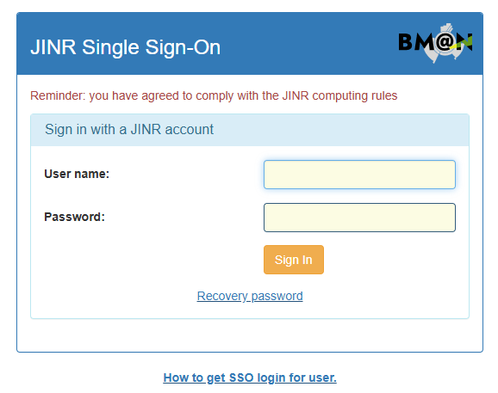

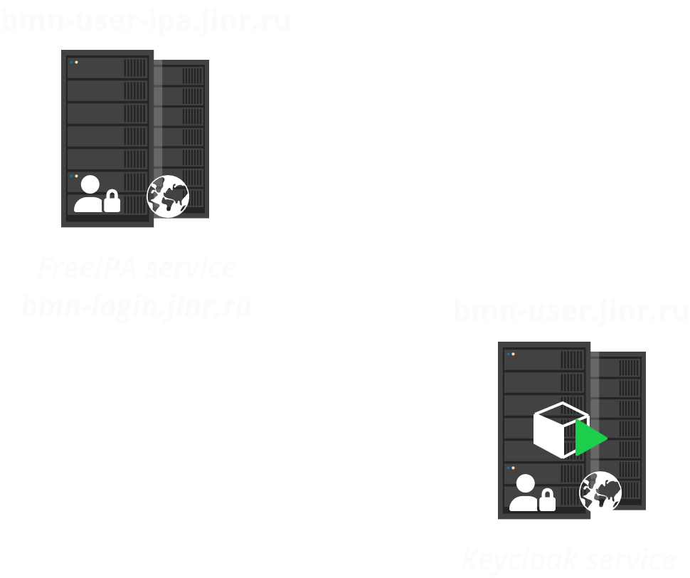

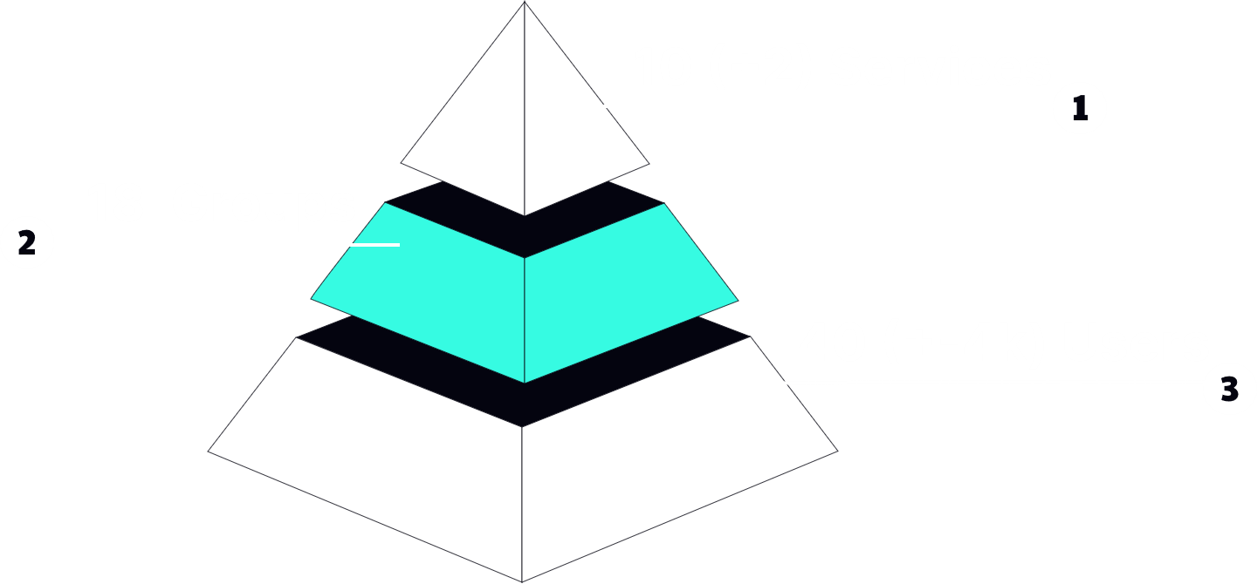


Migration from FreeIPA to JINR SSO (Keycloak)
Keycloak—a modern and reliable solution for identity and access management.
Migrating to Keycloak for implementing Single Sign-On offers numerous benefits, including centralized management, user convenience, and enhanced security.
Keycloak is based on two important protocols, OpenID Connect and OAuth 2.0
JINR User Federations
User Convenience
Enhanced Security
Centralized User Management

Slide 4
















Shift to Delegated Architecture
Project Tools
Frontend
(UI / Client)
77k > 81k stars
Release 2023
UI-components
apikit
Based on
Containerization / Orchestration
Backend
(API / Server)

Slide 5
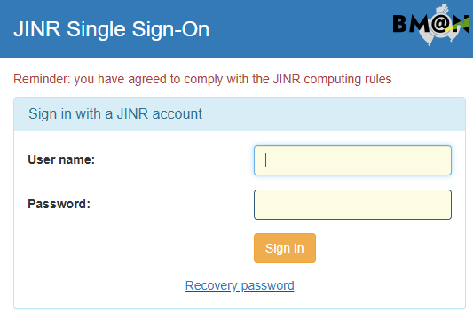




Improving authentication
SPA - Single-Page Application
CSR -Client-Side Rendering
Frontend (UI / Client)
access_token
refresh_token
SSR - Server-Side Rendering
COOKIES
session_id
??? BFF (Backend For Frontend)???
session_id
access_token
expires_at
refresh_token

Slide 6
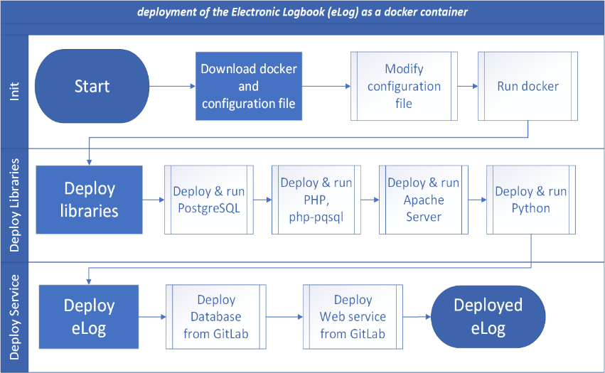

















Optimization of the CoDeS
The Common Deployment System is based on Docker containers and shell scripts
Base server
Server for
Database
Run deploy script
Deploy script
-Registry-
S3 object storage

Slide 7
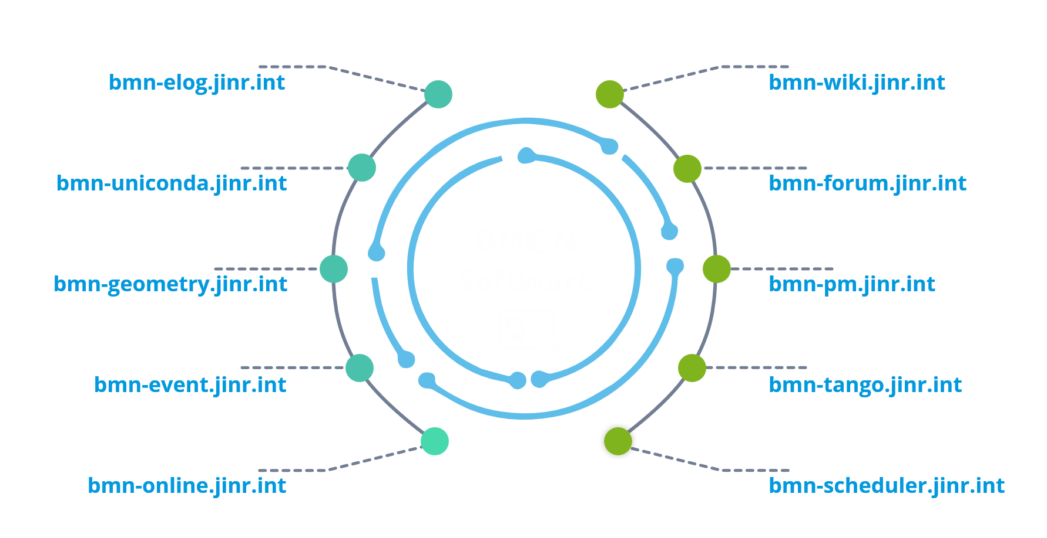

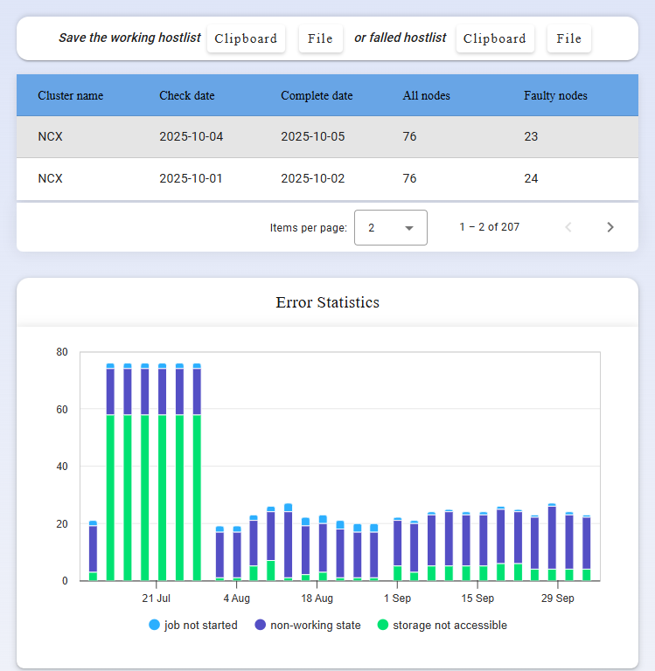




Minor edits and requests
https://bmn.jinr.ru
Virtual assistant for shift operators of the BM@N experiment
https://bmn-elog.jinr.int/assistant/
https://bmn.jinr.int/cluster_inspector

Slide 8
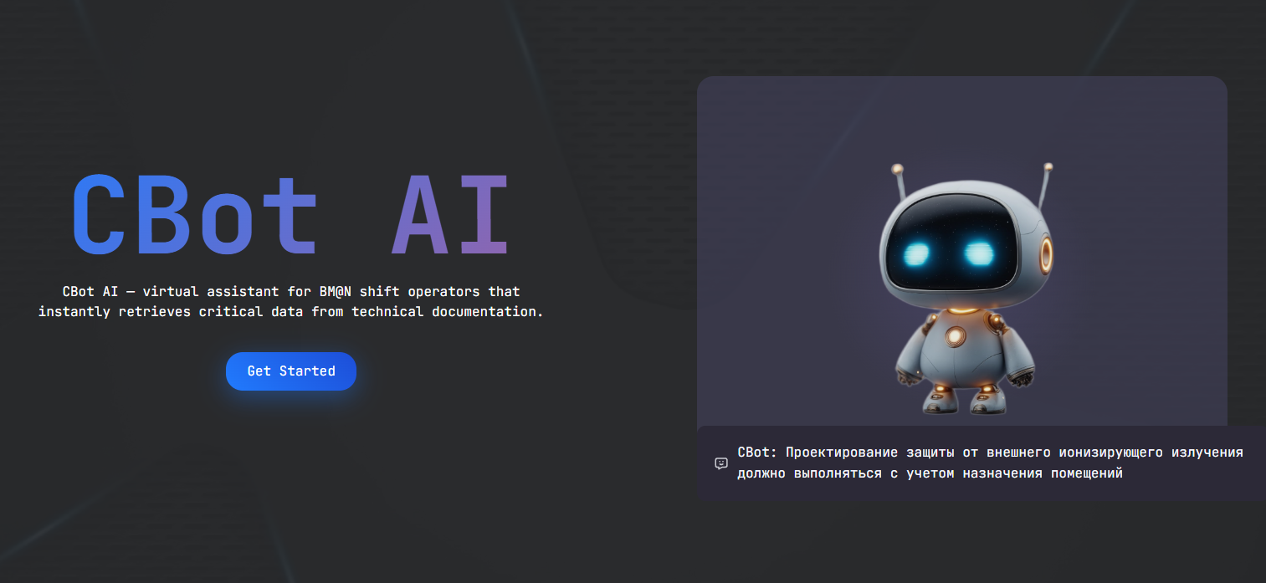

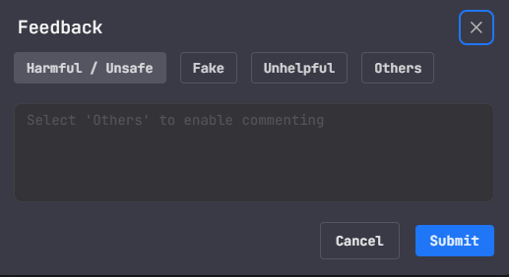
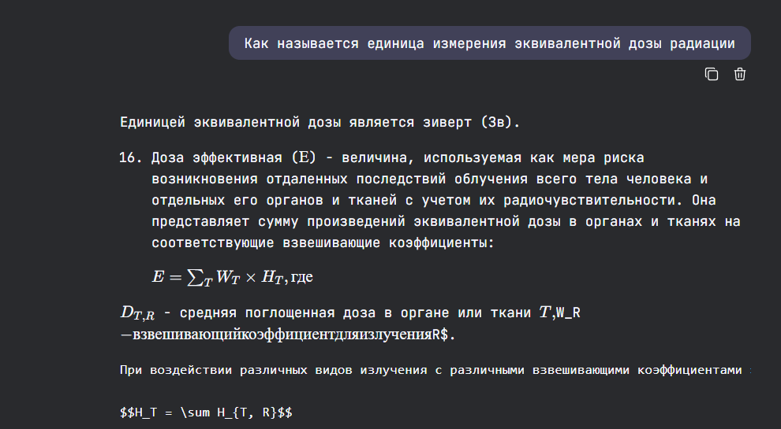


VIRTUAL SHIFT ASSISTANT
Feedback System
Copy to Clipboard Functionality
Rating the usefulness of responses helps improve the system.

Slide 9
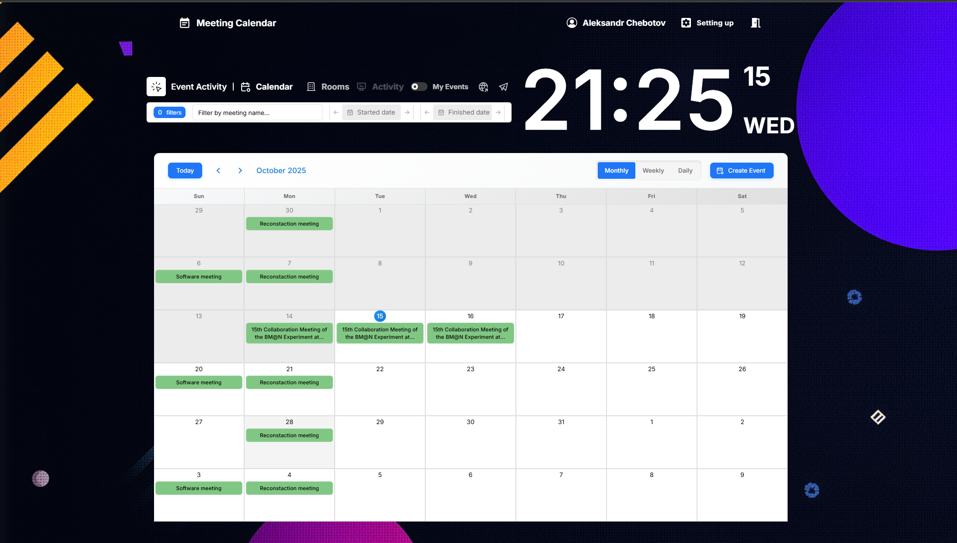
Showcase the BM@N-MEET
https://bmn-meet.jinr.int

Slide 10
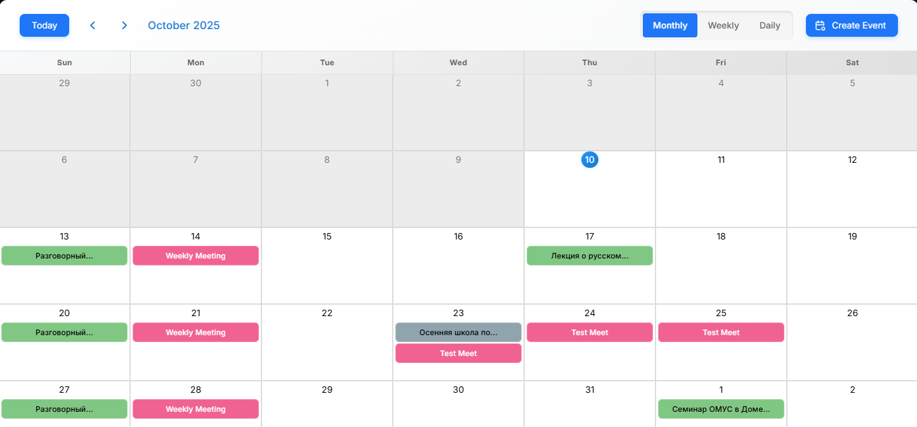
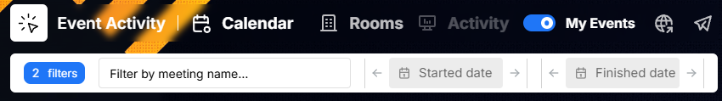
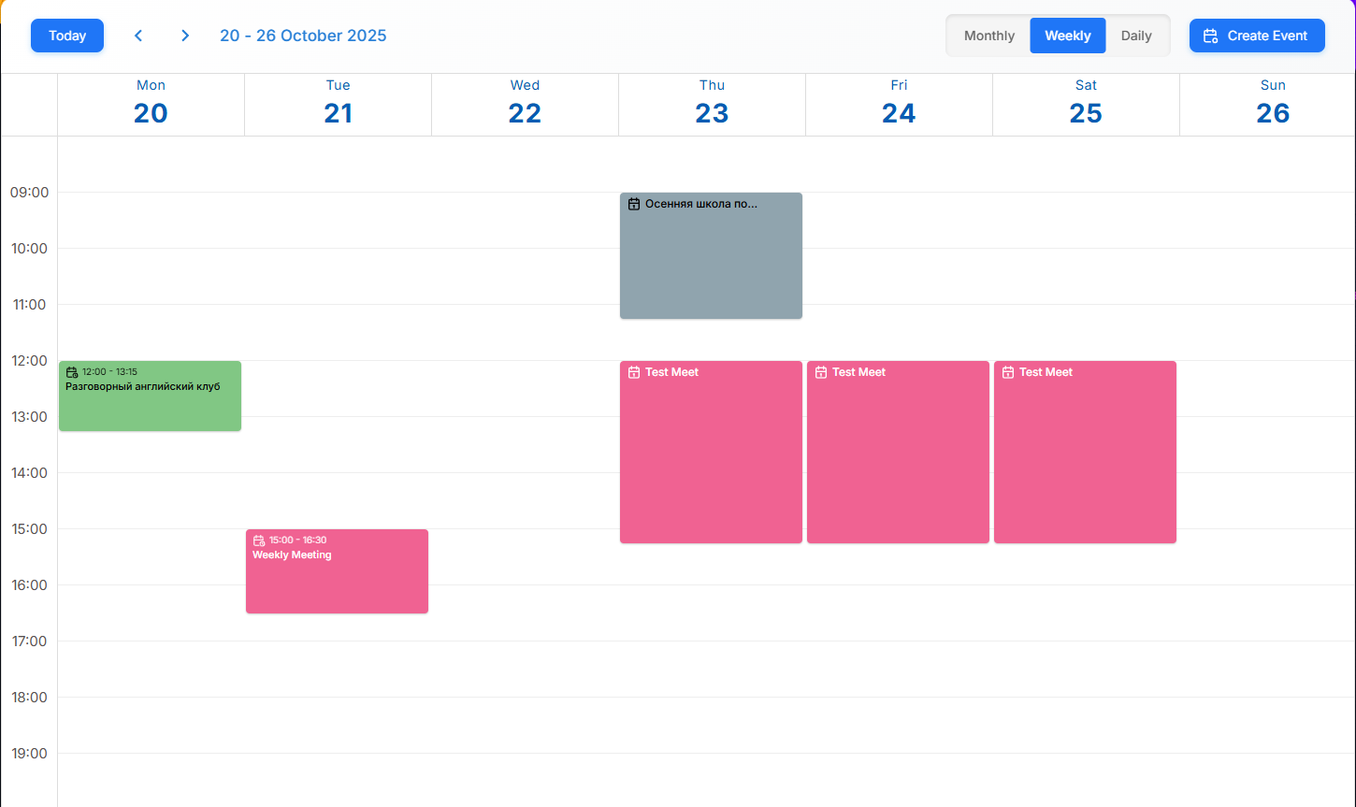
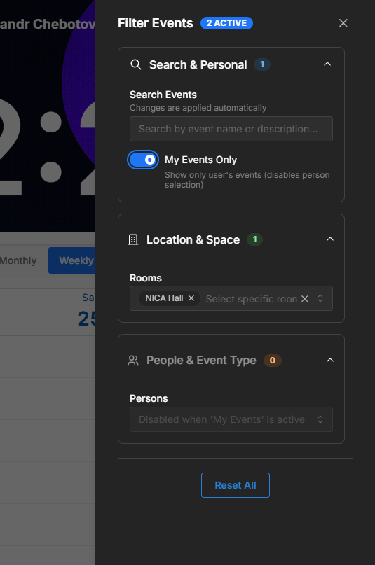
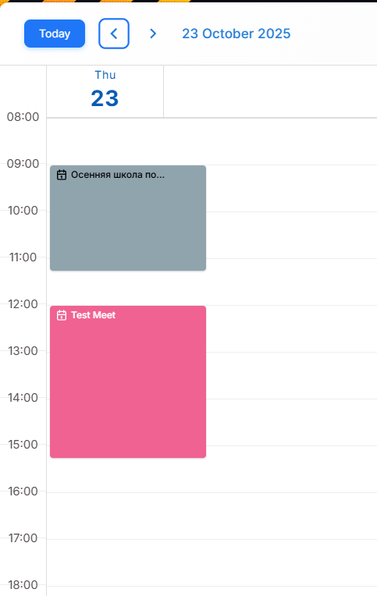


Showcase the BM@N-MEET
Filtering System
View Type

Slide 11
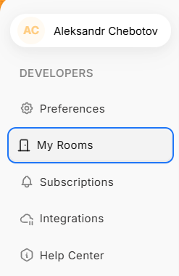

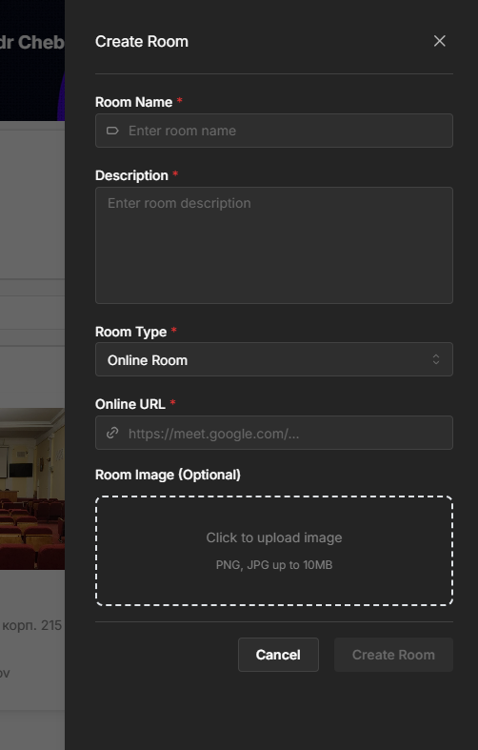
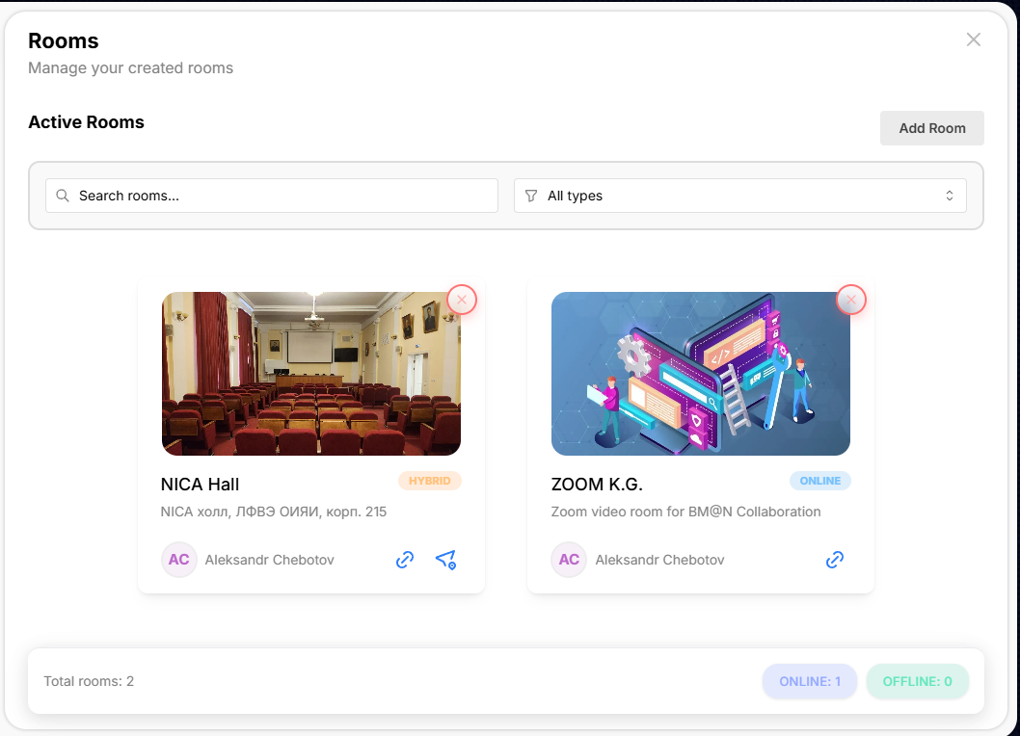
Showcase the BM@N-MEET
Creating Room Process
1
3
2
5
4
7
6

Slide 12
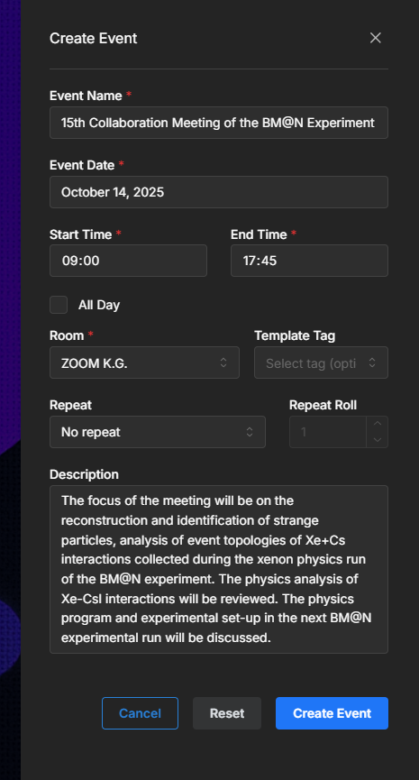

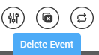

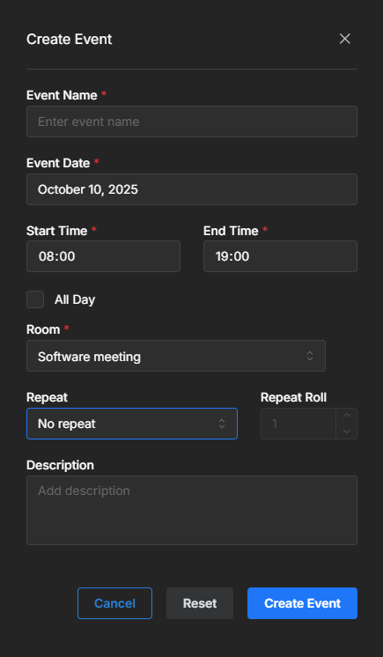
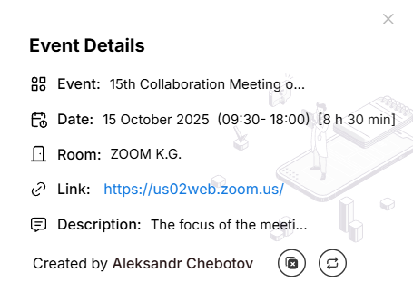

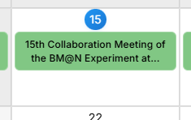
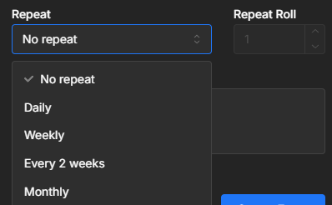
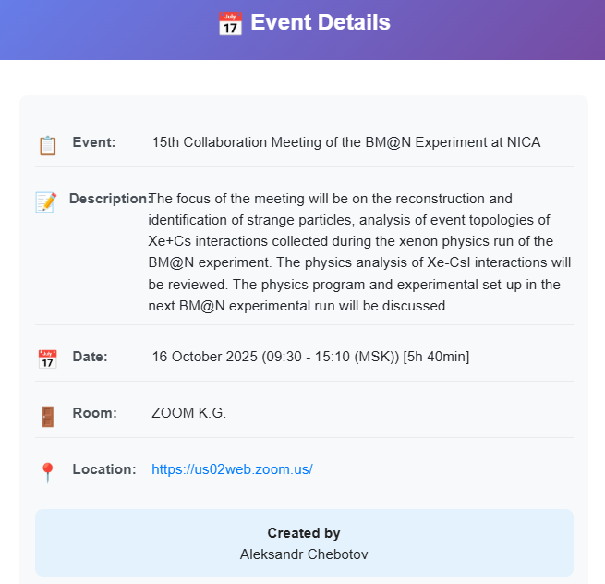



Showcase the BM@N-MEET
4
Creating Events
1
2
Subscription
3
6
5
Event Notification

Slide 13
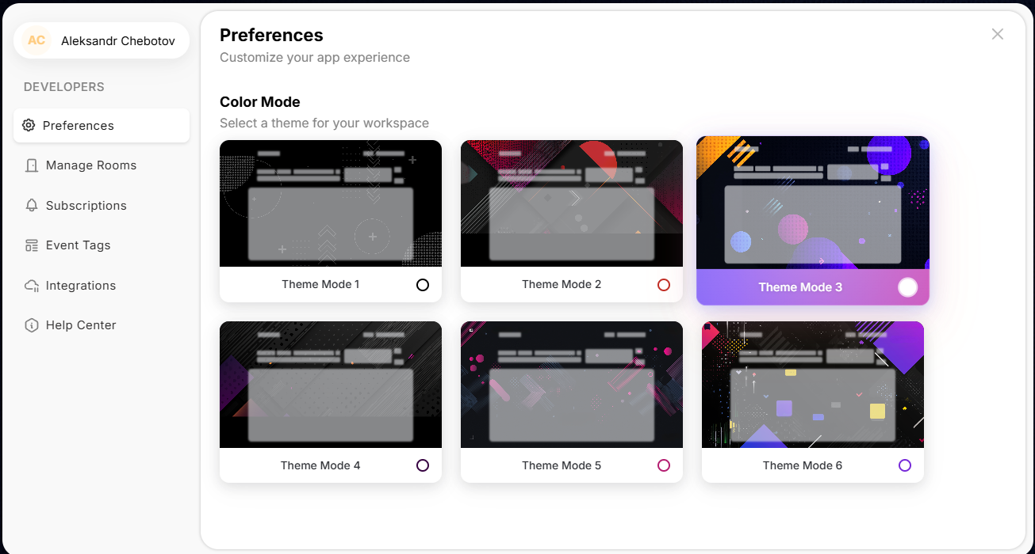
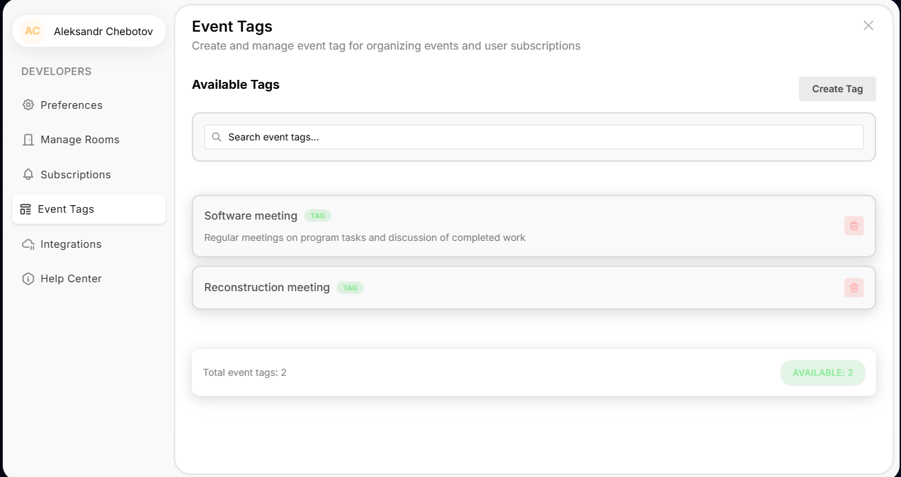
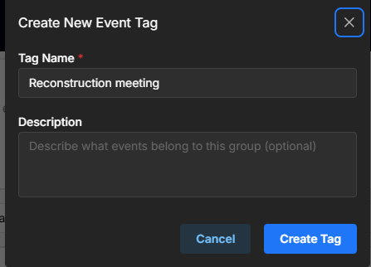
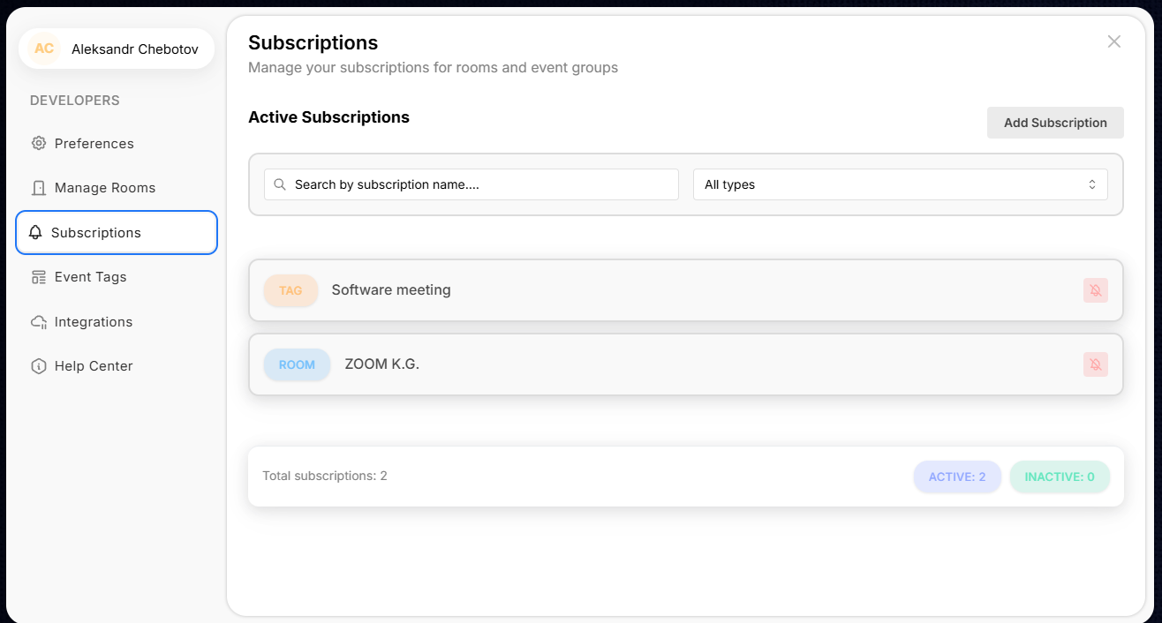
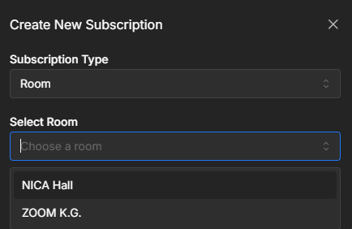
Showcase the BM@N-MEET
Short-Term Roadmap:
Event Notifications.
Calendar Synchronization
Fixed Bugs And Review Code.

Slide 14
Migrated from legacy FreeIPA + Keycloak stack to JINR User Federation (Keycloak-based SSO).
Standardized frontend on React (SPA), aligning with BM@N unified architecture.
Shifted from token-only (access/refresh) to secure cookie-based sessions (session_id) for BFF pattern.
Successfully tested end-to-end deployment pipeline using Ansible + GitLab CI/CD.
BM@N-MEET Tested: Centralized web platform for event planning, room booking, and team collaboration across JINR.
CONCLUSIONS

Slide 15
Software meeting
Thank you
for your attention!
Alexander Chebotov
Konstantin Gertsenberger
Ilya Romanov
15th Collaboration Meeting of the BM@N Experiment at NICA

