Slide 1
Memberships of the PACs
Acad. Grigory V. Trubnikov

Slide 2

PAC for Particle Physics
Prof. RUBTSOV Grigory Igorevich (Corresponding Member of the Russian Academy of Sciences) as a new member of the PAC for Particle Physics for a term of three years.
Prof. Rubtsov graduated from Lomonosov Moscow State University in 2004, received his PhD in physics and mathematics in 2007 and Doctor of Science in physics and mathematics in 2016.
In 2018, Prof. Rubtsov became a Professor of the Russian Academy of Sciences and in 2025 he became Corresponding Member of the Russian Academy of Sciences.
Since November 2014, he has been Deputy Director for Research of the Institute for Nuclear Research of the Russian Academy of Sciences (Moscow).
Since December 2018, Head of the Laboratory for big data analysis in particle physics and astrophysics INR RAS.
Since March 2022, Head of the Department of High Energy Leptons and Neutrino Astrophysics INR RAS.
Prof. Rubtsov has received such awards as Grant of the Russian Science Foundation, Grant of the Inter-University Research Program of the Institute for Cosmic Ray Research of the University of Tokyo, PI, Medal for the 300th Anniversary of the Russian Academy of Sciences.
Prof. Rubtsov has 246 scientific papers (H-index: 37), including 5 copyright certificates.

Slide 3
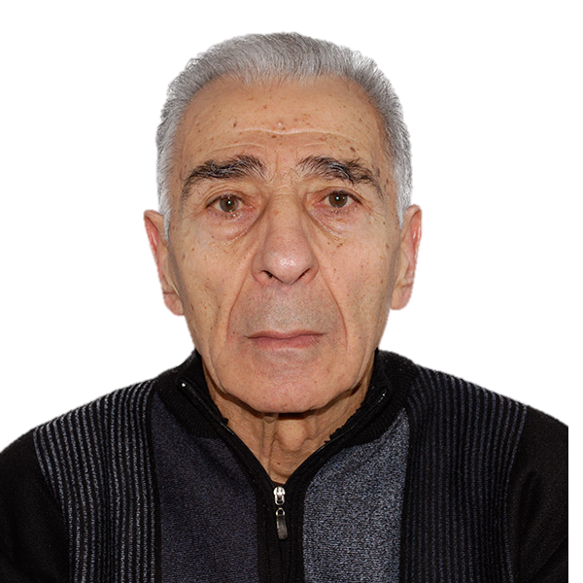
PAC for Particle Physics
Prof. Hamlet G. Mkrtchyan (A.I.Alikhanyan National Science Laboratory (AANL), Yerevan, Armenia) as a new member of the PAC for Particle Physics for a term of three years.
Prof. Mkrtchyan graduated from Yerevan State University (1964), received his PhD at JINR (1973) and his Dr. Hab in 2008 from Yerevan Physics Institute for the study of the structure of hadrons and quark-hadron duality with electrons up to 6 GeV energies.
Prof. Mkrtchyan has been working in the Yerevan Physics Institute (currently known as AANL) since 1964.
In 1964−1974 he worked in DLNP JINR.
Since 2021, Prof. Mkrtchyan is a member of the NICA SPD Collaboration, leader of the AANL group.
Also, he takes part in assembling PbWO4 calorimeter for Hall C Neutral Particle Spectrometer (NPS), performs R&D studies, design and construction prototypes of EEEMCal calorimeter for the Electron-Ion Collider ePIC project, participates in JLab Hall C Pion-LT, Pt-SIDIS, R-SIDIS and CSV experiments and their on-line and off-line data analysis.
Prof. Mkrtchyan has high publication activity indicators: citations (11489), h-index (53), i10-index (115).

Slide 4
The JINR Directorate asks the Scientific Council
to approve this proposal

