Slide 1
Proposal for Awarding the Title “Honorary Doctor of JINR”
Academician Grigory V. Trubnikov
138th Session of the JINR Scientific Council

Slide 2
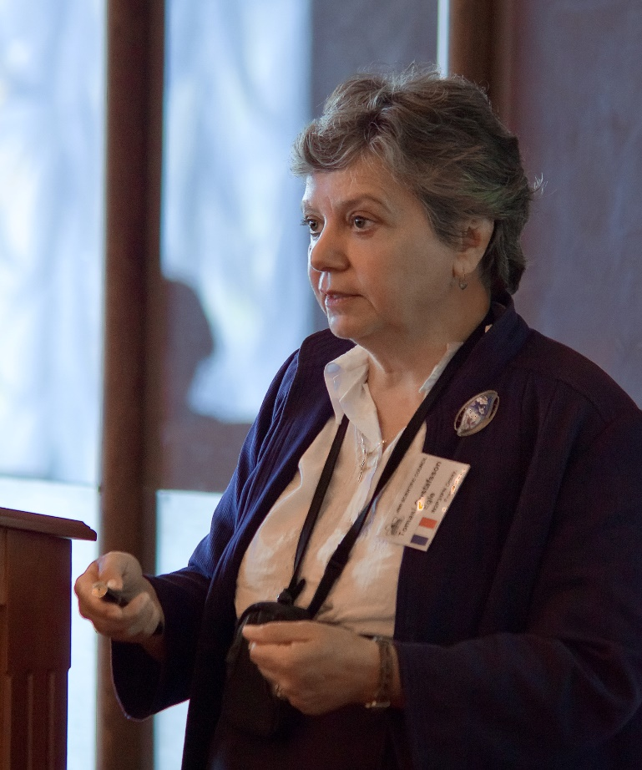
Prof. Egle Tomasi-Gustafsson
NOMINEE
2015 – Present | Leading researcher, IRFU/SPhN, CEA Saclay, France.
Phenomenology of hadronic reactions;
Spokesperson of the ALPOMII experiment;
Chair of NICA-SPD Collaboration Board;
Member of NICA-SPD and PANDA collaborations.
1980 – Present | Researcher in fundamental physics, Commissariat à l’Energie Atomique (CEA), Saclay, France.
Experiment and Phenomenology in hadron and nuclear physics in the intermediate and high energy domains. Original results are reported in more than 200 peer reviewed articles, the scientific activity is presented in more than 200 talks in seminars, workshop and conferences.
2021 – 2024 | Chair of the SPD Collaboration Council.
2009 – 2012 | Chair of PAC for Particle Physics, member since 1999.
Her activity in JINR greatly contributed to strengthening ties between Russian and foreign organizations within the framework of SPD collaboration. Prof. E.Tomasi-Gustafsson was the leader and co-director of several experiments at the Joint Institute, and closely collaborated with VBLHEP and BLTP.
The JINR Directorate proposes to award Professor Egle Tomasi-Gustafsson the title of “Honorary Doctor of JINR”, given her role in the development of spin physics and physics of the hadron structure at JINR, as well as her contribution to strengthening the international cooperation of the Institute.
Notes:
2

Slide 3
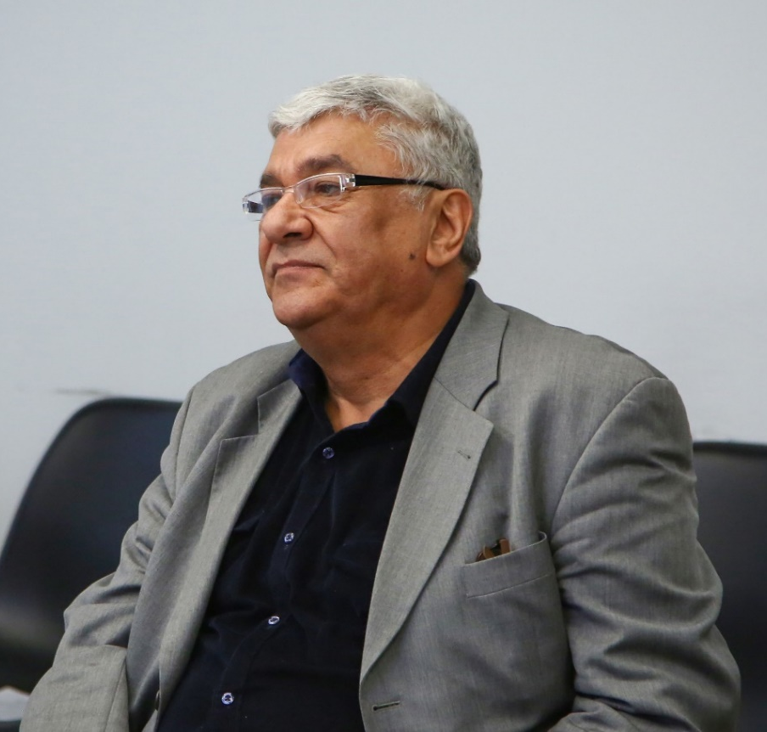
Prof. Samvel Haroutiunian
NOMINEE
2022 – Present | JINR Director’s Special Representative for Educational Policy.
2022 – 2023 | MLIT JINR Deputy Director for the Development of International Cooperation.
2007 – 2019 | Chairman of Committee of Science of Ministry of Education and Science of RA.
2019 – 2024 | Leading researcher in “Physics of Macromolecules” research laboratory (YSU).
Professor of Molecular Physics and Biophysics Samvel Garnikovich actively develops the theory and practice of research related to the study of molecular processes occurring in the structure of DNA. Author of many scientific papers, including key works on the study of the behavior of DNA molecules in the presence of various chemical agents and environmental conditions.
2014 – now | Chairman of the Board of Trustees of the Institute CANDLE (Armenia).
1998 – 2008 | Scientific expert of Ministry of Education and Sciences of Armenia.
1996 – 2007 | Vice-chairman of Ph.D. Honor Council in the field of Solid State Physics and Molecular Physics in Institute of Applied Problems of Physics (IAPP NAS RA).
Prof. Samvel Haroutiunian has unique experience of working at JINR both as a scientist and as a Plenipotentiary Representative of the Republic of Armenia, as well as many years of successful activity in the field of organizing the educational process.
The JINR Directorate proposes to award Professor Samvel Haroutiunian the title of “Honorary Doctor of JINR”, given his contribution to the development of cooperation between the Institute and scientific and educational organizations of the Republic of Armenia, active joint work in the field of personnel training and the development of MLIT JINR and the Laboratory’s scientific programme.
Notes:
3

Slide 4
The JINR Directorate asks the Scientific Council
to approve this proposal

