Slide 1
Programme Advisory Committee for Condensed Matter Physics
61st meeting, 26 June 2025
Dénes Lajos Nagy
138th Session of the JINR Scientific Council, 15-16 September 2025

Slide 2
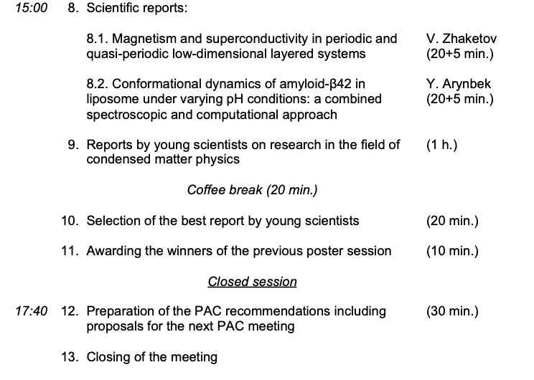
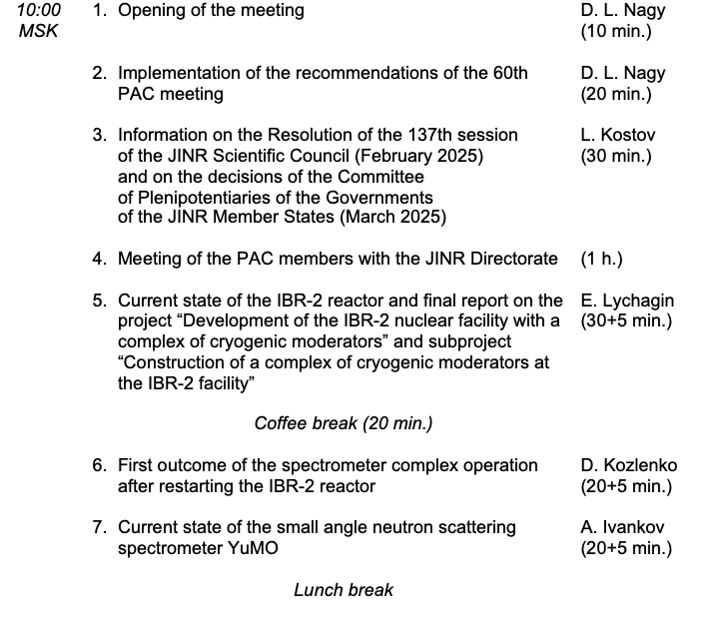
Agenda of the 61st PAC meeting
Thursday, 26 June 2025

Slide 3
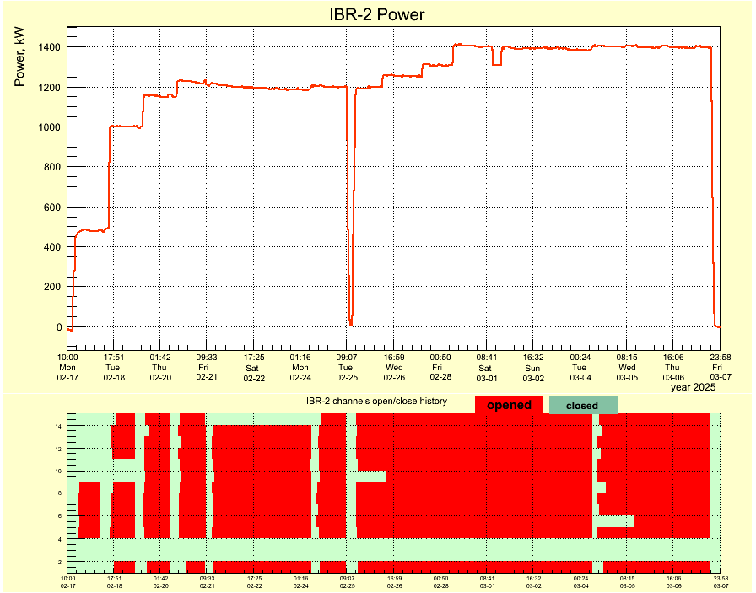
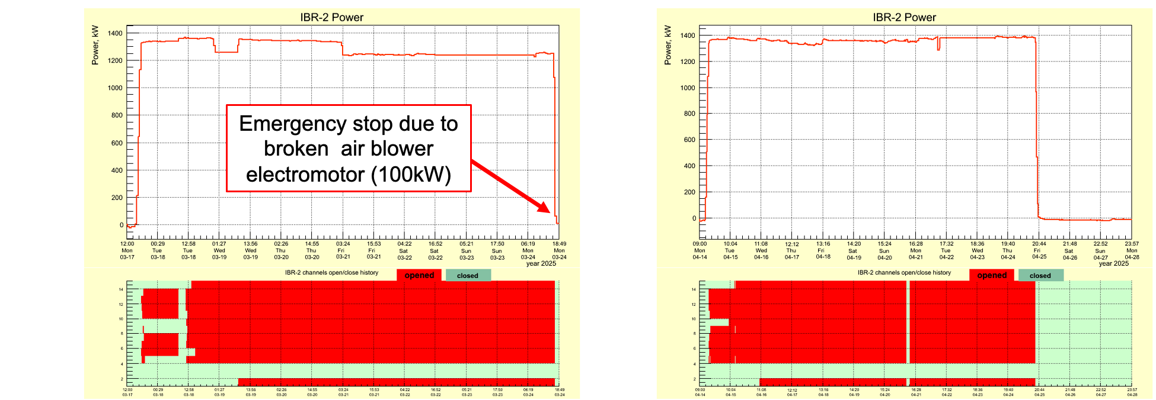
Current state of the IBR-2 reactor and report on the project “Development of the IBR-2 nuclear facility with a complex of cryogenic moderators” and subproject “Construction of a complex of cryogenic moderators at the IBR-2 facility”
The PAC took note of the report presented by Egor Lychagin on the current state of the IBR-2 reactor and on the project “Development of the IBR-2 nuclear facility with a complex of cryogenic moderators” and subproject “Construction of a complex of cryogenic moderators at the IBR-2 facility”.
Reactor operation
I cycle 2025: February, 17 - March, 7 2025
II cycle 2025: March, 17 – 24 (28) 2025
III cycle 2025: April, 14 - 25 2025
In cycle III, both cryogenic moderators operated regular way.
The autumn cycles of reactor operation are planned from October 13, 2025

Slide 4
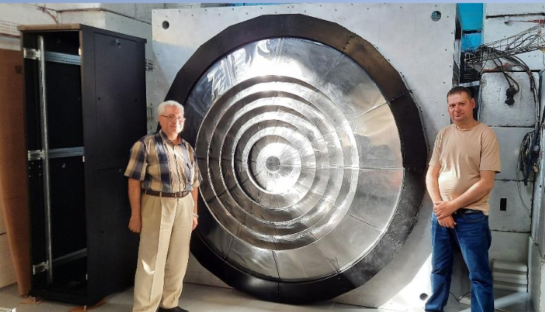
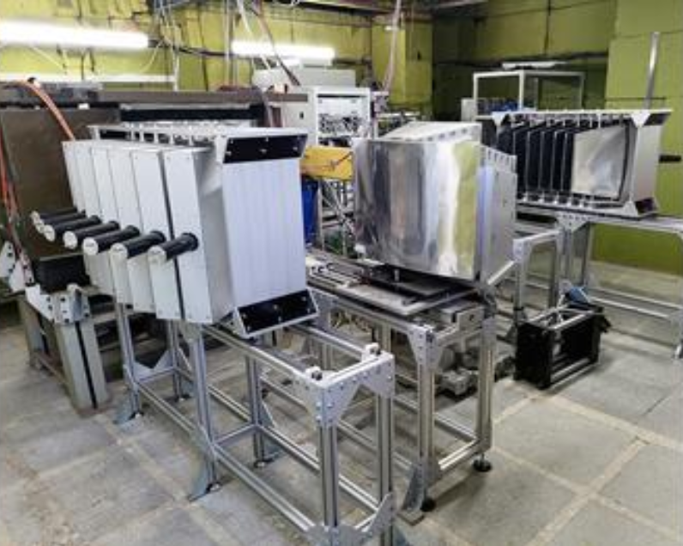
Results of testing neutron instruments
All instruments were tested during the cycles. The first experiments were performed in cycles I-III (by internal users and 4 external experiments via the rapid access system).
As a result of testing, it was found that the new detectors on HRFD and FSD are highly effective, but the new electronics overloaded with signal flow and require modernization.
The EPSILON diffractometer is in the process of adaptation to texture measurements, and this work is not finished yet.
Thus, due to technical reasons, operation of three instruments (HRFD, FSD and EPSILON) for external users is temporarily suspended.
We expect these three instruments to return to the User Program in the spring 2026 call.

Slide 5
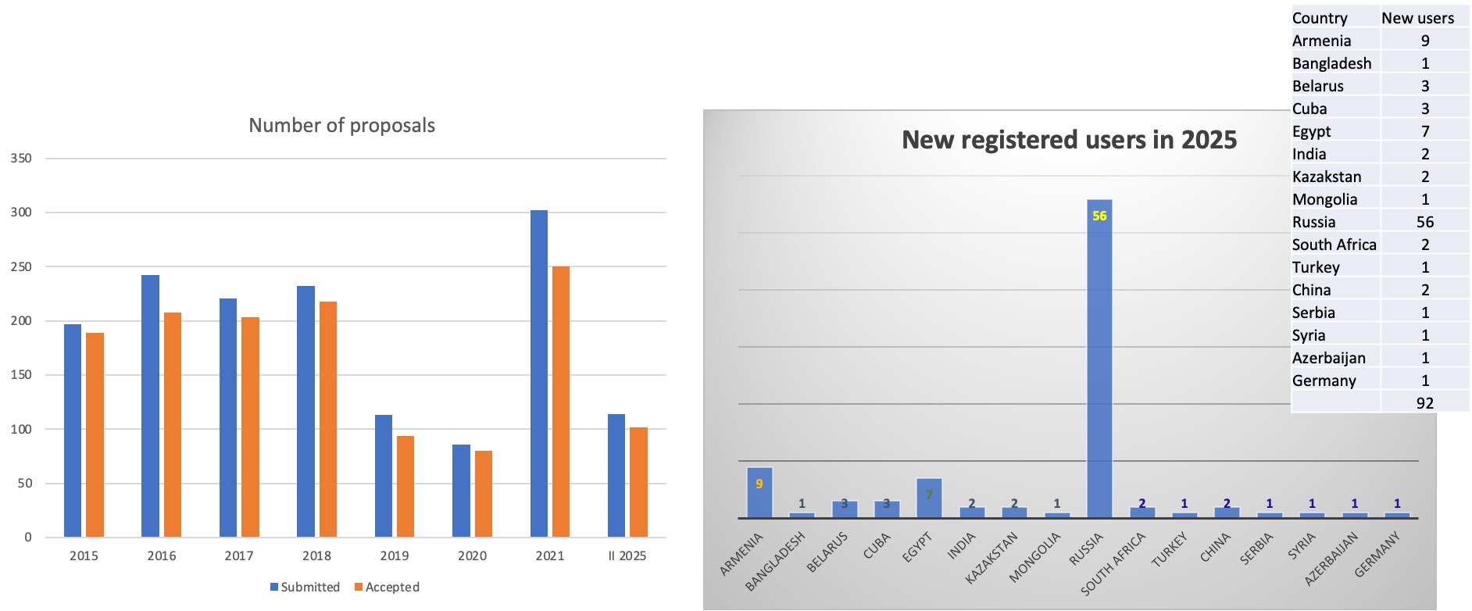
Resumption of User Programme
2025/03/24 the Call was open for the second part 2025 with deadline April 30, 2025
Data for 2025 for proposals that have passed only technical review.

Slide 6
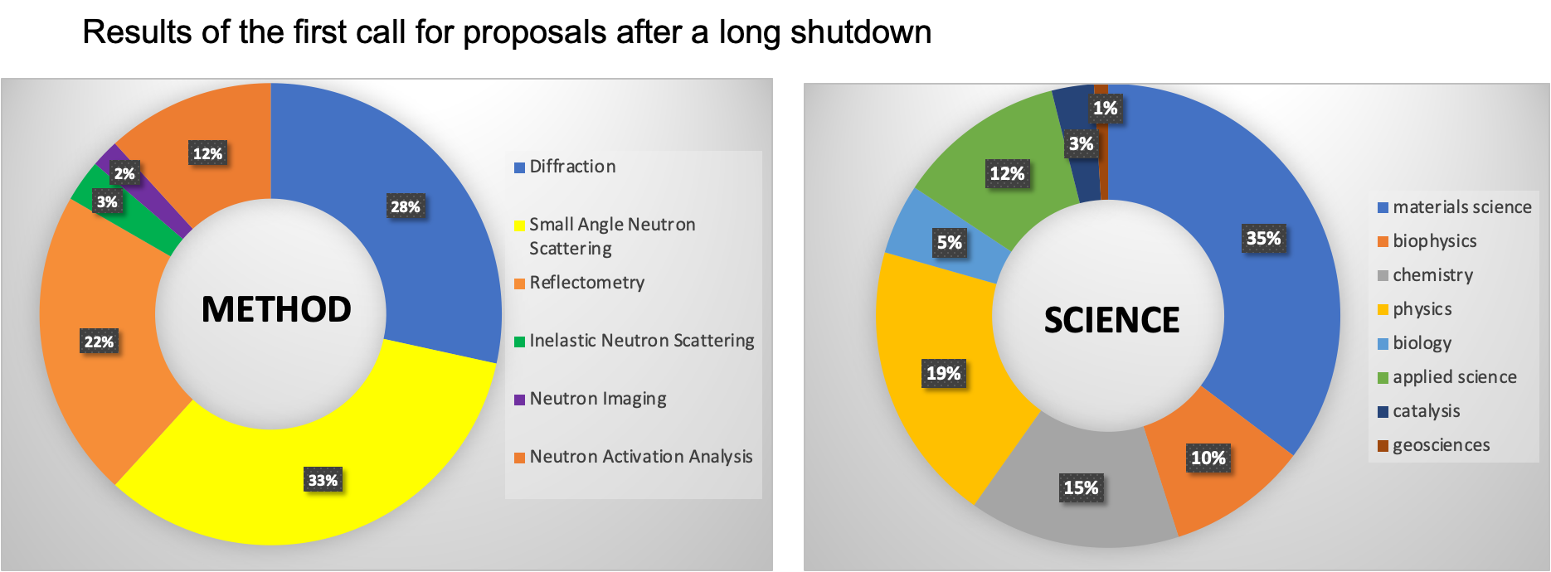
Resumption of User Programme

Slide 7
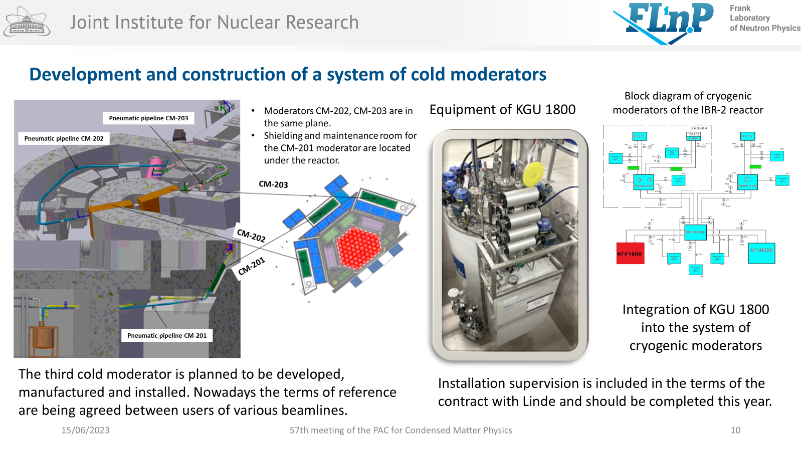
Final report on subproject “Construction of a complex of cryogenic moderators at the IBR-2 facility”
57th meeting of the PAC for Condensed Matter Physics (15/06/2023)
A unique type of moderator was developed based on pelletized frozen hydrocarbons cooled by flowing cold gaseous helium at FLNP. It was reported many times at PAC meetings.

Slide 8
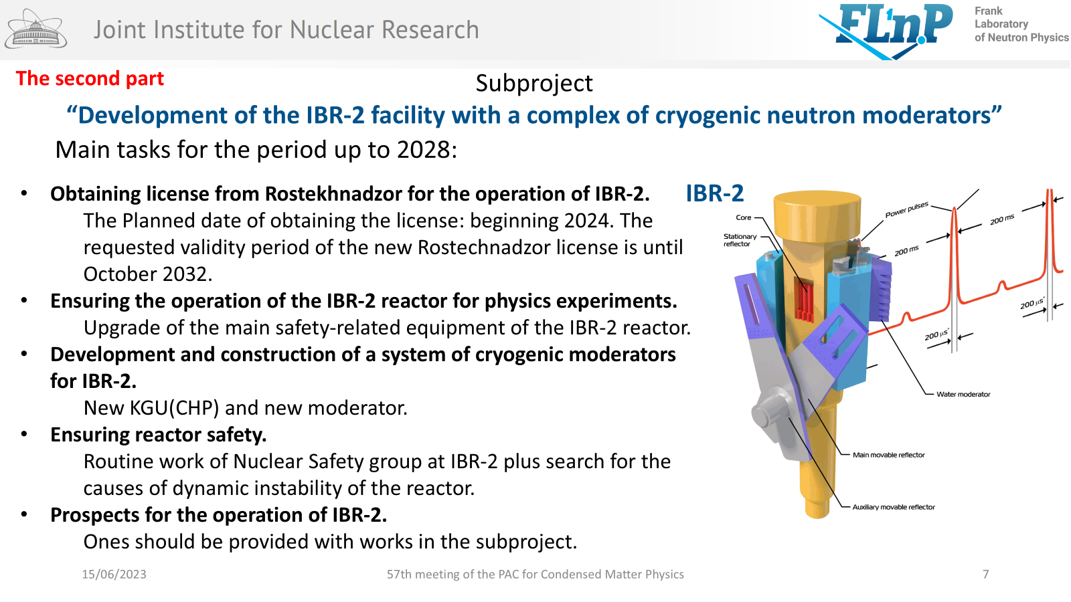
Closing of the project
“Development of the IBR-2 nuclear facility with a complex
of cryogenic moderators”
Some history:
Opening of the project was done at 57th meeting of the PAC for Condensed Matter Physics (15/06/2023)
Was done
Routine exploitation
Routine exploitation

Slide 9
Closing of the project
“Development of the IBR-2 nuclear facility with a complex of cryogenic moderators”
TOPICAL PLAN FOR JINR RESEARCH AND INTERNATIONAL COOPERATION
JINR Larg Research Infrastructure
Pulsed Neutron Source and the Complex of Spectrometers
Within the framework of the scientific project, a complex of 2 moderators has been created in full and it is currently in the normal operation mode.
Development of the…
Investigations of functional materials
and nanosystems using neutron scattering
Scientific and methodological research
and developments for condensed matter
investigations with IBR-2 neutron beams
New advanced neutron source
at JINR
Construction of a complex of cryogenic
moderators
Exploitation and modernization of developed and existed systems
IBR-2
exploitation

Slide 10
PAC recommendation
The PAC noted with satisfaction the information on the successful resumption of operation of the IBR-2 reactor for users, the plans to prepare the reactor for the autumn-winter period of operation and the resumption of the FLNP User Program. The PAC welcomed the inclusion of the Neutron Radiography and Tomography (NRT) facility in the FLNP User Programme, and considered it important to provide external users with access to all the instruments included in the FLNP User Programme as soon as possible.
The PAC took note of the current state of the complex of cryogenic moderators and considers the work on the development of a complex of two cryogenic moderators to provide cold neutrons to practically all IBR-2 research beamlines to be successfully completed. The PAC considered the decision of the FLNP Directorate to stop work on the third cryogenic moderator to be justified and agrees with the closure of the corresponding subproject.
Recommendations. The PAC recommended closing the subproject “Construction of a complex of cryogenic moderators at the IBR-2 facility” and the project “Development of the IBR-2 nuclear facility with a complex of cryogenic moderators”. The PAC also recommended continuing the FLNP efforts to attract new users of IBR-2.

Slide 11
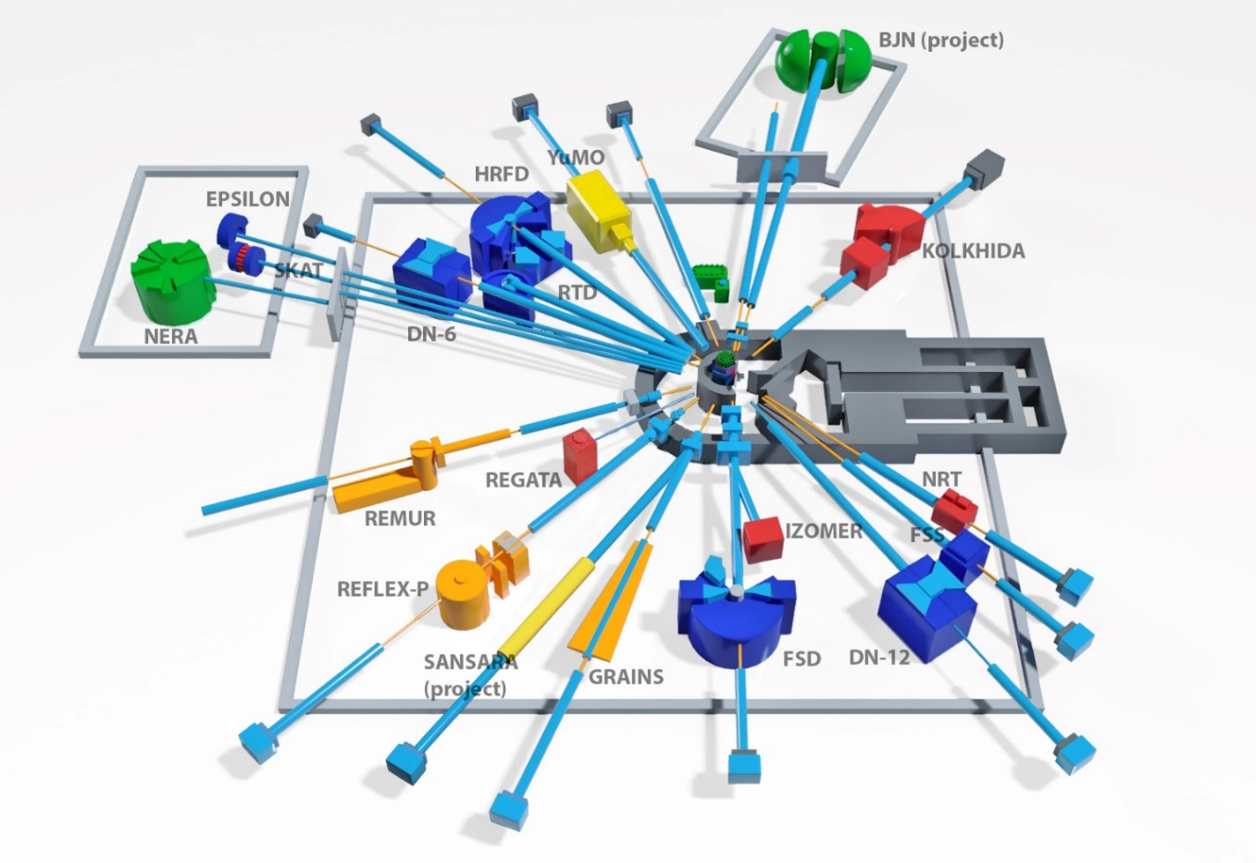
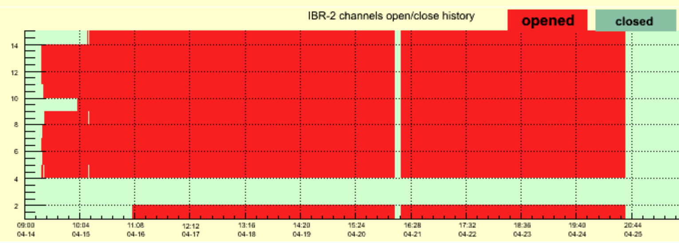
First outcome of the spectrometer complex operation
after restarting the IBR-2 reactor
The PAC was informed by Denis Kozlenko about main results of the spectrometer complex operation renewed after restart of the IBR-2 reactor, aimed at justifying current technical parameters, completing modernization works and conducting first scientific experiments.
Three test cycles of reactor operation
17 February – 07 March 2025;
17 – 28 March 2025;
14 – 25 April 2025 (with cryogenic moderator).
First experiments at all of 14 instruments for condensed matter research were performed
Methodical experiments aimed at putting into operation newly installed and upgraded elements of instruments being in modernization and determination of current technical parameters;
Realization of the first scientific experiments.

Slide 12
Development of a mathematical model for the dynamics of pulsed fast reactors
The PAC appreciated the progress achieved in the upgrade of a number of the instruments, providing the improvement of technical parameters and extension of research possibilities. The current state of the spectrometer complex allows the realization of the FLNP User Programme to be renewed in autumn of 2025 at most of the instruments. The final launch of the new large aperture scintillation detector systems at the HRFD and FSD diffractometers is expected during 2025, and afterwards these instruments will also be available in the framework of the FLNP User Programme.
Recommendations. The PAC appreciates the work on the whole IBR-2 spectrometer complex already done. The PAC encourages the instrument team to continue with the full-scale implementation of the SANSARA instrument.

Slide 13
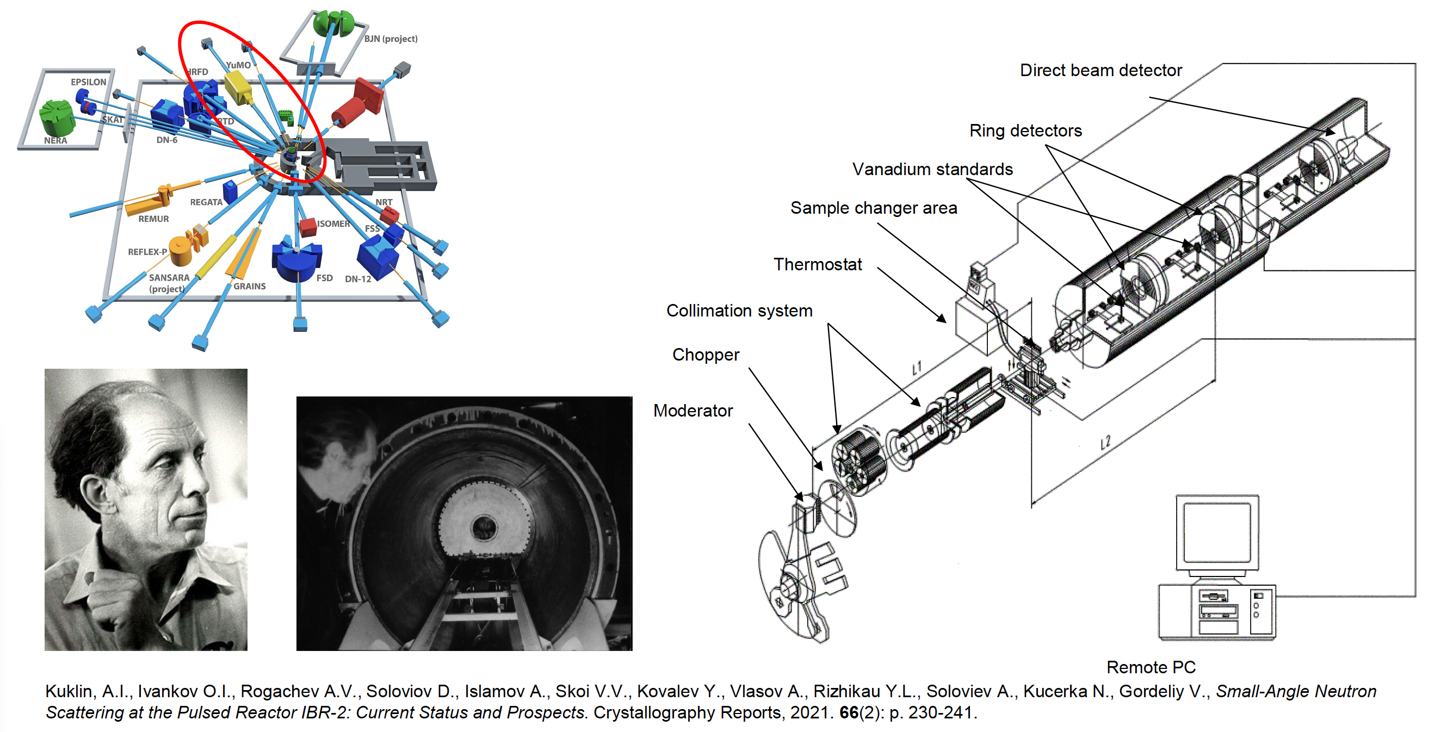
Current state of the small angle neutron scattering spectrometer YuMO
The PAC considered the report by O. Ivankov about the current state of the YuMO small-angle spectrometer at the beamline 4 of the IBR-2 reactor.

Slide 14
Current state of the small angle neutron scattering spectrometer YuMO
Since February 17 to April 25 (3 reactor cycles)
• About 30 scientific experiments including test experiments and fast proposal experiment were done (Moscow, St.-Petersburg, Volgograd, Dolgoprudny, Dubna in collaborations with others)
• Methodological experiments and works:
•the collimator system and chopper adjustment;
•tests of the new electronics for the Positional Sensitive Detector;
•implementation of upgraded Direct Beam Detector;
•the instrument electronics commissioning after instrument long shutdown;
•programs test and updates.
35 proposal were submitted for the second part 2025 (33%)
The PAC noted the high demand for the spectrometer and the importance of the scientific results obtained on it, published in highly rated journals.
Recommendation. The PAC supported further development of small-angle scattering method at the IBR-2 pulsed neutron source. The PAC recommended continuing work on the modernization of the main parts of the YuMO spectrometer and supported ongoing development plans for the sample preparation laboratory, including its modernization and expansion of capabilities.

Slide 15
Scientific reports
The PAC heard with interest the following scientific reports
“Magnetism and superconductivity in periodic and quasi-periodic low-dimensional layered systems” (by Vladimir Zhaketov)
“Conformational dynamics of amyloid-β42 in liposome under varying pH conditions: a combined spectroscopic and computational approach”
(by Yersultan Arynbek).
The PAC thanked the speakers for their excellent talks.
Schematic of the large-aperture backscattering detector.

Slide 16
Meeting of the PAC members with JINR Directorate
The PAC appreciated the outcome of its meeting with the JINR Directorate. Considering a broad spectrum of activities in life sciences being performed in several laboratories of JINR, the PAC shared the idea of the JINR Director Grigory Trubnikov, to establish JINR interlaboratoratory STAC (scientific and technical advisory committee) for life sciences in order to facilitate the elaboration of a coherent and synchronized programme in this field of activity. The PAC took note of the opinion of the JINR Directorate that the main competencies of JINR, which could potentially be offered to the global life sciences community, should be focused on the development of unique facilities, providing a wide range of radiation modalities for experiments in biomedical research.
The PAC also took note of the information of the FLNP Directorate about issuing a book entitled “Directions of Scientific Research at the Advanced Pulsed Neutron Source at FLNP JINR ”. The PAC would like to receive an electronic copy of this book.
The PAC also appreciated the level of international cooperation activity of JINR as presented by Chief Scientific Secretary of JINR Sergey Nedelko.

Slide 17
Presentations by young scientists
The PAC reviewed 4 oral presentations made by young scientists in the field of condensed matter physics. The presentation “Automated segmentation of pores and cracks using a Unet3+ convolutional neural network on neutron, synchrotron, and X-ray tomography data” made by Bulat Bakirov was selected as the best presentation of the session. Its author will be awarded diploma of the PAC.
Recommendation. The PAC recommended the presentation “Automated segmentation of pores and cracks using a Unet3+ convolutional neural network on neutron, synchrotron, and X-ray tomography data” to be presented at this session of the JINR Scientific Council.

Slide 18
Thank you for your attention

