Slide 1
Proposal for Awarding the Title “Honorary Doctor of JINR”
Academician Grigory V. Trubnikov
138th Session of the JINR Scientific Council

Slide 2
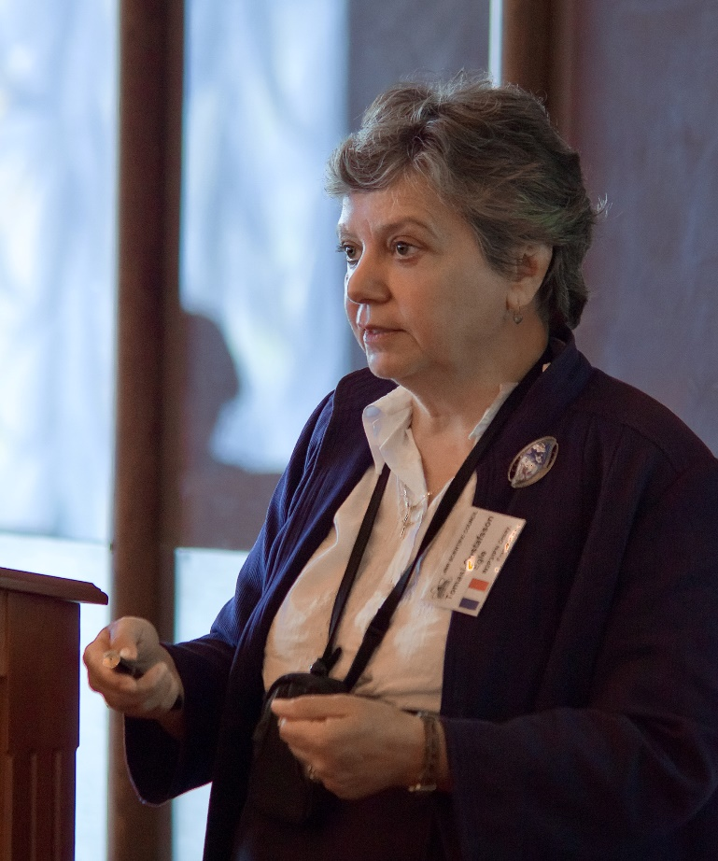
Prof. Egle Tomasi-Gustafsson
NOMINEE
2015 – Present | Leading researcher, IRFU/SPhN, CEA Saclay, France.
Phenomenology of hadronic reactions;
Spokesperson of the ALPOMII experiment;
Chair ff the NICA-SPD Collaboration Board;
Member of the NICA-SPD and PANDA collaborations.
1980 – Present | Researcher in fundamental physics, Commissariat à l’Energie Atomique (CEA), Saclay, France.
Experiment and Phenomenology in hadron and nuclear physics in the intermediate and high energy domains. Original results are reported in more than 200 peer reviewed articles, the scientific activity is presented in more than 200 talks in seminars, workshop and conferences.
2021 – 2024 | Chair of the SPD Collaboration Council.
2009 – 2012 | Chair of the PAC for Particle Physics, member since 1999.
Her activity in JINR greatly contributed to strengthening ties between Russian and foreign organizations within the framework of the SPD collaboration. Prof. E.Tomasi-Gustafsson was the leader and co-director of several experiments at the Joint Institute, and closely collaborated with VBLHEP and BLTP.
The JINR Directorate proposes to award Professor Egle Tomasi-Gustafsson the title of “Honorary Doctor of JINR”, given her role in the development of spin physics and physics of the hadron structure at JINR, as well as her contribution to strengthening the international cooperation of the Institute.
Notes:
2

Slide 3
The JINR Directorate asks the Scientific Council
to approve this proposal

