Slide 1
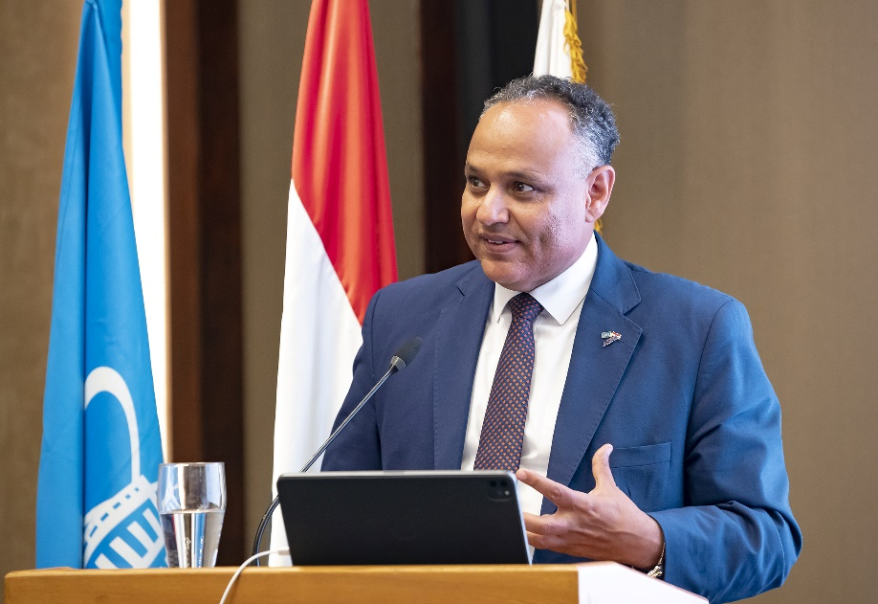
Prof. Mahmoud M. Sakr
Institute of Biotechnology,
National Research Centre, Egypt
Ex-President, Academy of Scientific Research and Technology (ASRT), Egypt (2014–2024)
First Plenipotentiary of the Arab Republic of Egypt
to JINR (2021–2024)
Professor Mahmoud Sakr is awarded the title of “Honorary Doctor of JINR” for his great personal contribution to enhancing the role of the Arab Republic of Egypt in JINR’s scientific life, strengthening scientific cooperation between the Arab Republic of Egypt and JINR.
Notes:
1

