Slide 1
Awarding of the V.Dzhelepov Prize for 2024
G. Trubnikov, N.Russakovich
138th session of the Scientific Council
15‒16 September 2025

Slide 2
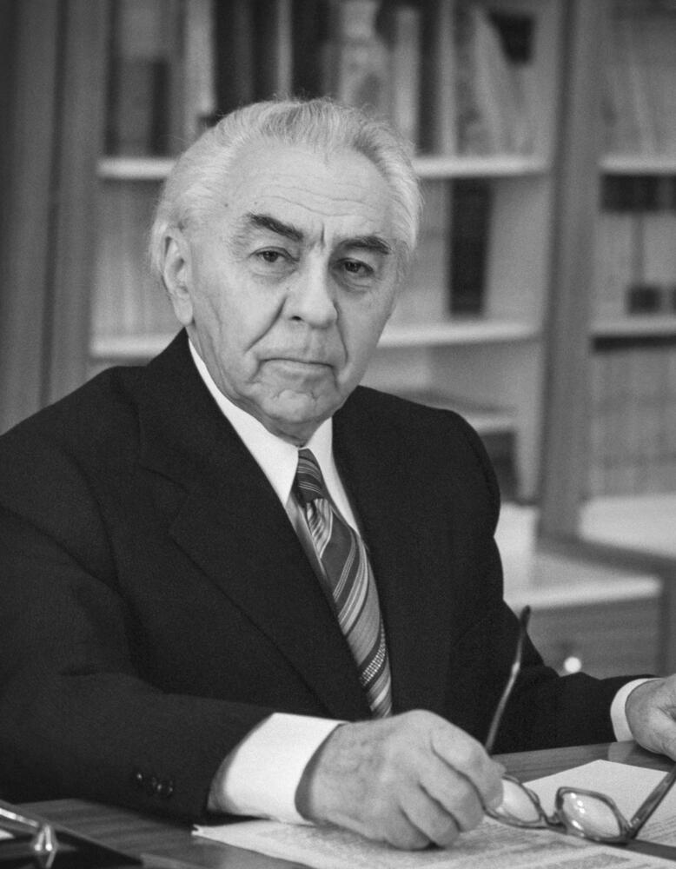
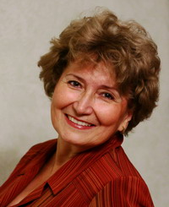
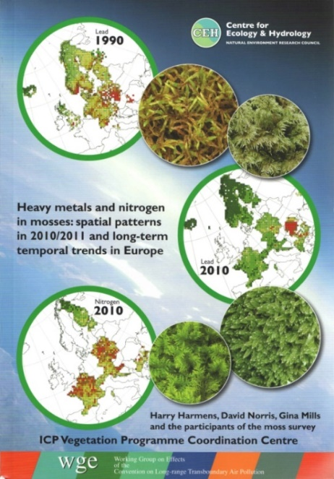
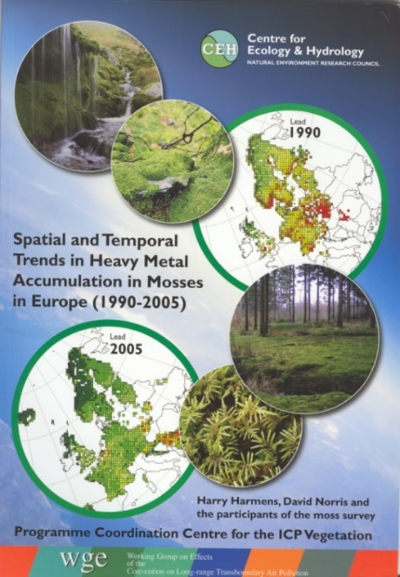

The V.Dzhelepov Prize is awarded for outstanding achievements in the field of experimental and theoretical research addressing applied problems with the use of nuclear physics methods.
The Jury composition:
N.Russakovich (Chair)
E.Yakushev
S.Dmitriev
L.Kostov
E.Lychagin
UNECE International Cooperative Programme (ICP) Vegetation in the framework of the United Nations Convention on Long-Range Transboundary Air Pollution was developed with the aim to identify the main polluted areas of Europe, produce regional maps and further develop the understanding of the long-range transboundary pollution.
Dr. Marina Frontasyeva contributed significantly to the development of the programme by the assessment of heavy metals deposition in JINR member and non-member countries using neutron activation analysis and moss biomonitors.
Dr. Marina Frontasyeva
Being the Coordinator of the United Nations air programme Dr. Marina Frontasyeva, has significantly expanded the geography of countries participating in the programme.
The above Jury has unanimously recommended as follows:
“to award Dr. M.Frontasyeva with the V.Dzhelepov Prize”
for her significant contribution to the development of international programme
on the assessment of air quality using neutron activation analysis.
The Scientific Council at its 136th session has approved the Jury’s recommendations on the award of the V. Dzhelepov Prize for the year 2024 to Marina Frontasyeva (FLNP, JINR).
Congratulations!

