Slide 1



Comparative analysis of behavioral reactions and physiological parameters of rats exposed to accelerated protons
Dubna State University
JINR LRB
S. K. Sakharova, Yu. S. Severyukhin, I. A. Kolesnikova, D. M. Utina, K. N. Golikova, E. V. Pronskikh, S. Despotovic, A. G. Molokanov

Slide 2
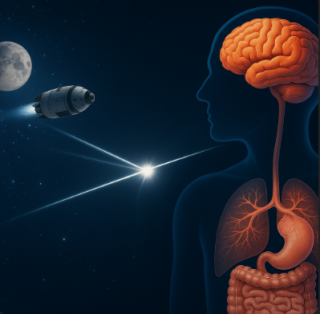
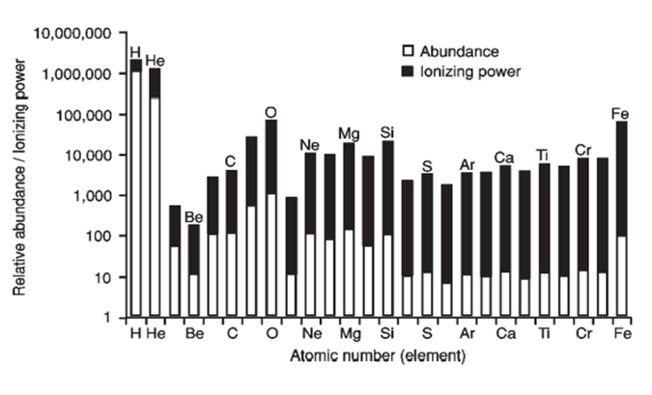
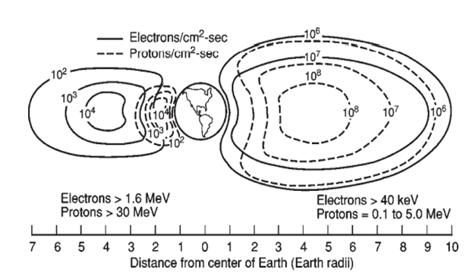
Relevance of the study
M. R. Barratt et al. 2008
Protons of various energies are included in the spectrum of GCL, solar radiation, and the Earth's radiation belts. The energy of protons in solar events can be up to 100 MeV.

Slide 3
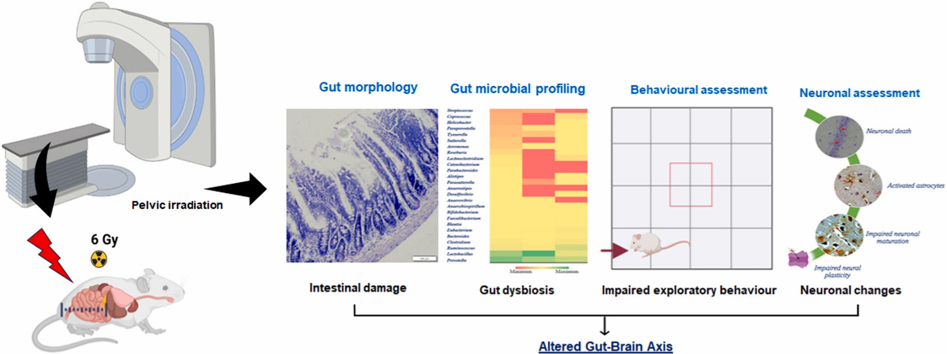
Relevance of the study
Venkidesh BS, Narasimhamurthy RK, Jnana A, et al. Pelvic irradiation induces behavioural and neuronal damage through gut dysbiosis in a rat model. Chem Biol Interact. 2023;386:110775. doi:10.1016/j.cbi.2023.110775

Slide 4
Aim and tasks
Aim: To conduct a comparative analysis of changes in behavioral reactions and physiological parameters after accelerated proton irradiation.
Tasks:
1. Assessment of the behavioral reactions of a control group of rats and a group of rats irradiated with protons at a dose of 3 Gy in the T-maze test system.
2. Assessment of the behavioral reactions of a control group of rats and a group of rats irradiated with protons at a dose of 3 Gy in an Open Field installation.
3. Assessment of the behavioral reactions of a control group of rats and a group of rats irradiated with protons at a dose of 3 Gy in the Water Maze test system.
4. Analysis of physiological parameters (body weight, thymus, spleen, brain, white blood cell count) of all groups of mice.
5. Analysis of histological sections using routine staining and immunohistochemistry methods.

Slide 5
The experimental part

Slide 6
1. Research scheme
Autopsy. Tissue sampling (brain, intestines, blood, spleen, thymus)
The Morris Test
Irradiation
14 days
12 days
4 h
1-2
23 days
57 days
Adaptation of laboratory animals
Tissue sampling (brain, intestines)
4h, 24h, 48h
1-2 days
Open field,
The T-maze
Day 26-33
Open field
The T-maze
The Morris Test
Day 90-97
Open field
The T-maze
The Morris Test

Slide 7
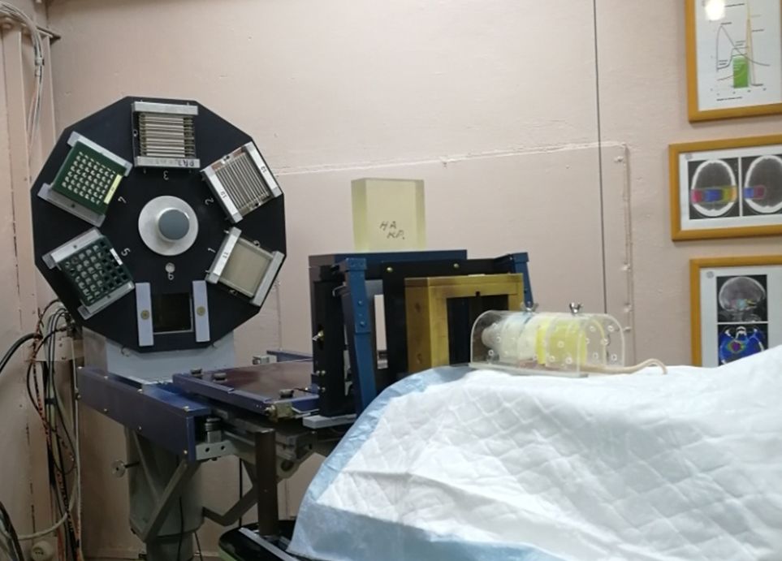
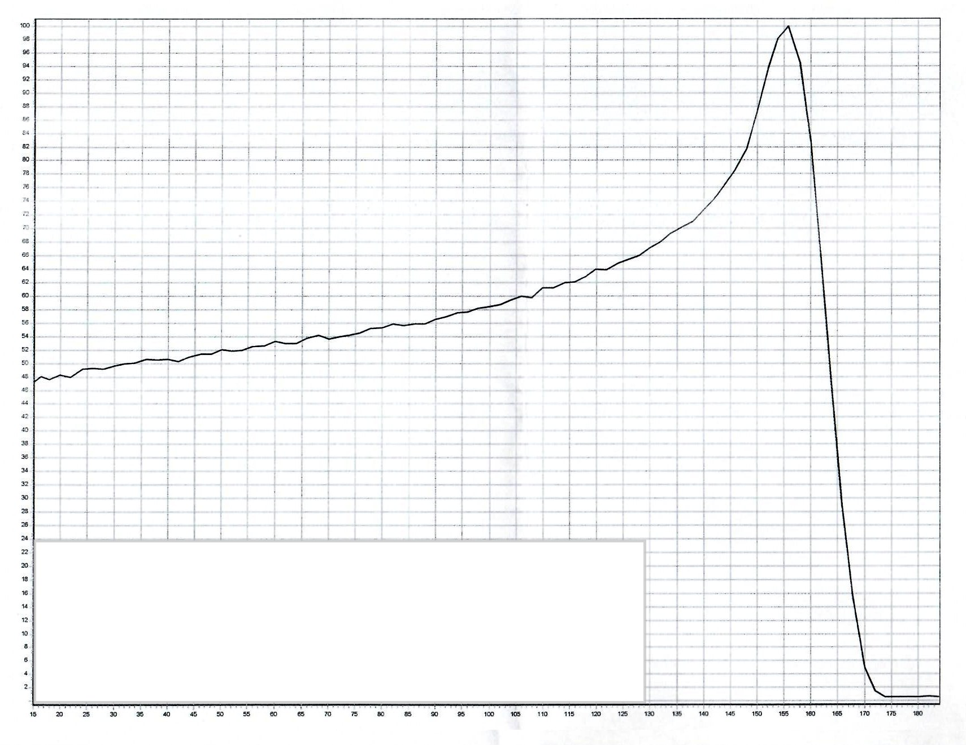
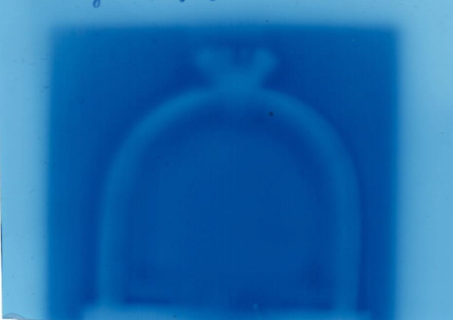
2.Radiation exposure
Location of the animal during irradiation
Deep dose distribution of the proton beam used
Animal strain | Sex | Age | Dose, Gy | Dose rate, Gy/min | Energy at the output of the collimator
SD rats | males | 6-7 weeks | 3 | 0,8 | 150 MeV

Slide 8
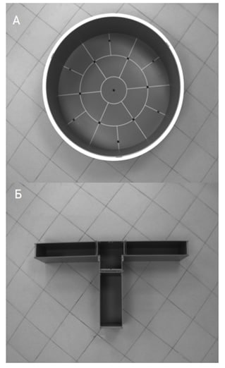
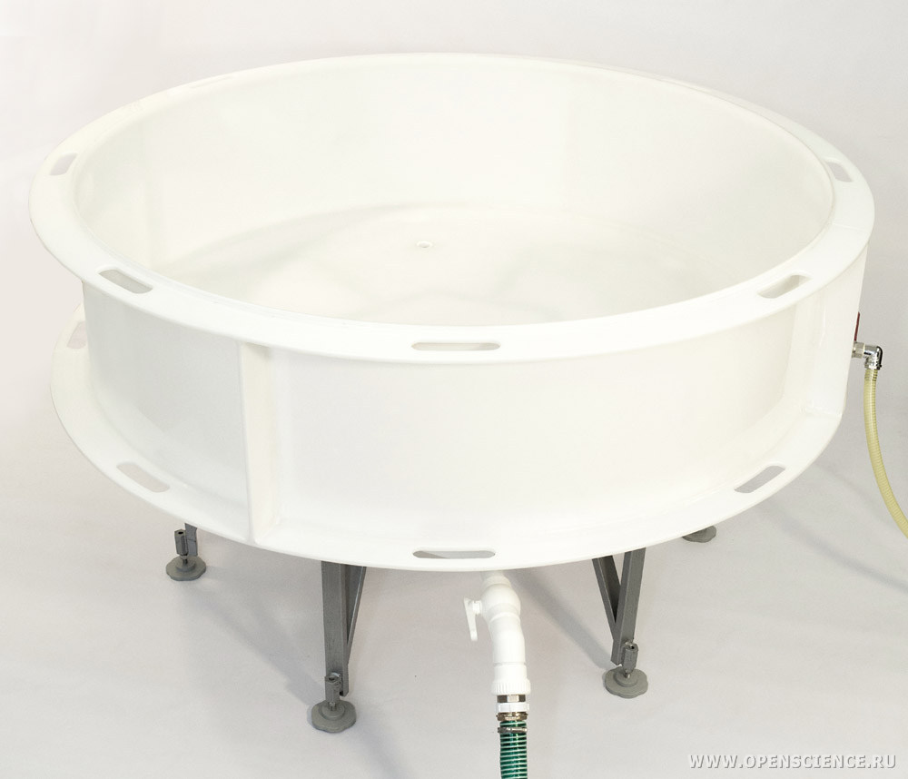
3. Behavioral reaction research
Installation "Open field", round TS0501-MG (Open Science, Russia)
Behavioral tests were performed 12 days before exposure and on the 30th and 90th days after exposure. The differences and dynamics of exploratory behavior were assessed, the level of emotional reactivity was monitored, spatial learning and working memory were assessed, and the values of spontaneous alternation in the T-maze were evaluated.
Installation "T-maze" TS0701-M (Open Science, Russia)
Installation "Water maze" TS10004 (Open Science, Russia)

Slide 9
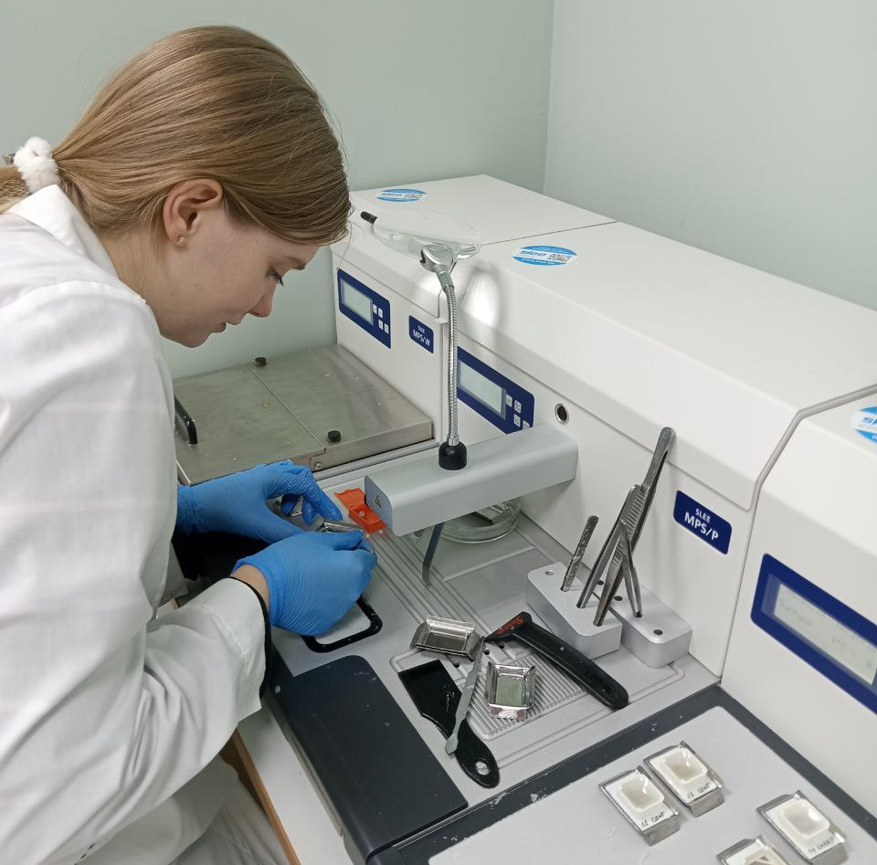
4.Physiological parameters + histology
On the 97 day after irradiation, decapitation was performed, and immunocompetent organs, brain, and intestines were removed.
Autopsy for 97 days
Immersion fixation in Formalin solution 10%
Dehydration in ethanol of ascending concentration, paraffination. Preparation of slices with a thickness of 5-8 microns
Routine and immunohistochemistry staining of small intestine and brain sections

Slide 10
Results

Slide 11
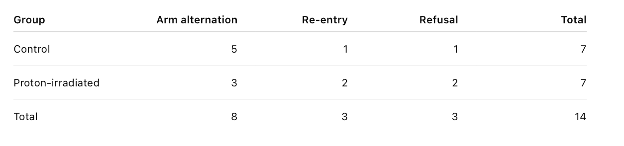
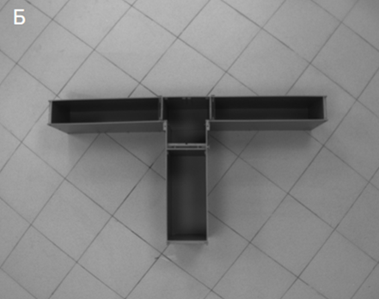
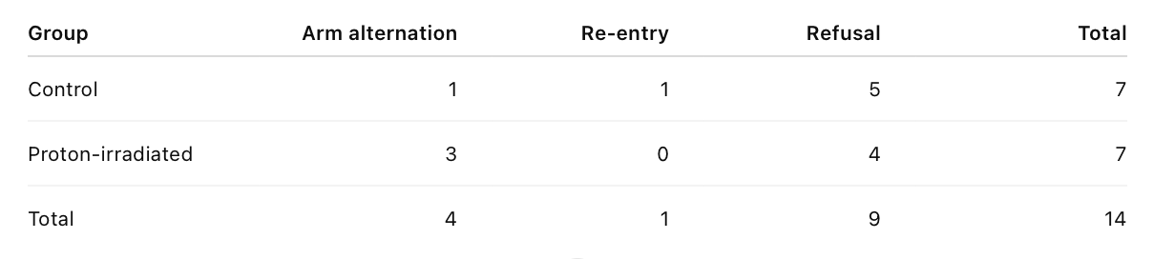
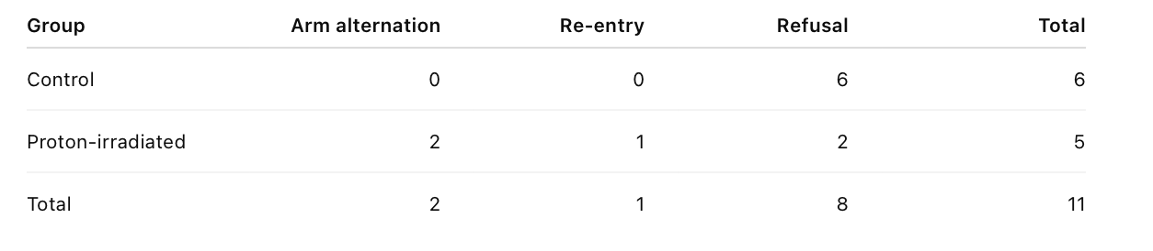
1. Short-term memory research
Results of the spontaneous alternation test on day 2
Results of the spontaneous alternation test on day 26
Results of the spontaneous alternation test on day 91

Slide 12
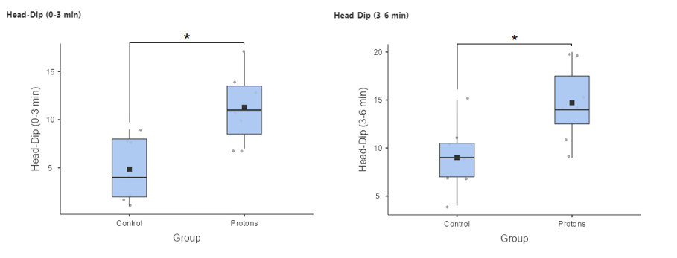
2. Assessment of exploratory behavior and anxiety level
Fig. The number of mink research reports in the "Open Field" test system on the 27th day after irradiation.

Slide 13
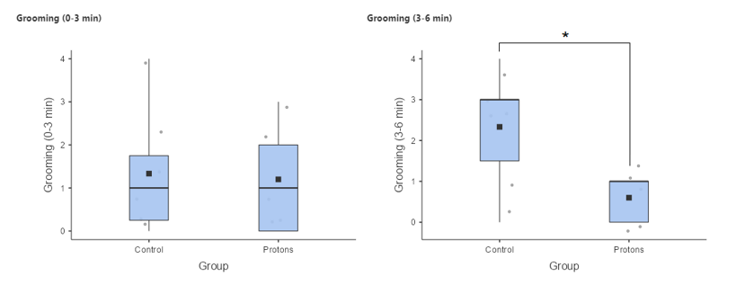
2. Assessment of exploratory behavior and anxiety level
Fig. Number of grooming events in the Open Field test system on the 90th day after irradiation.

Slide 14
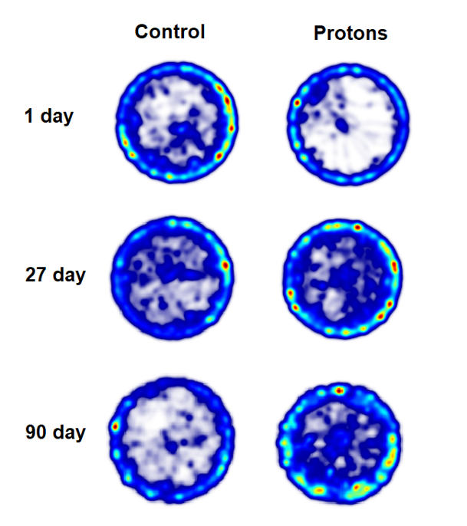
2. Assessment of exploratory behavior and anxiety level
Fig. Integrated heat maps

Slide 15
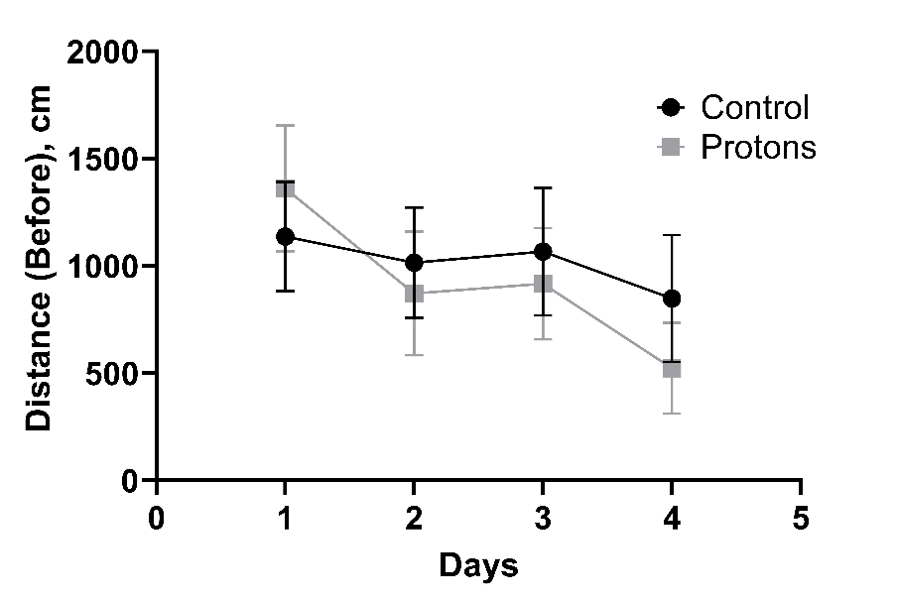
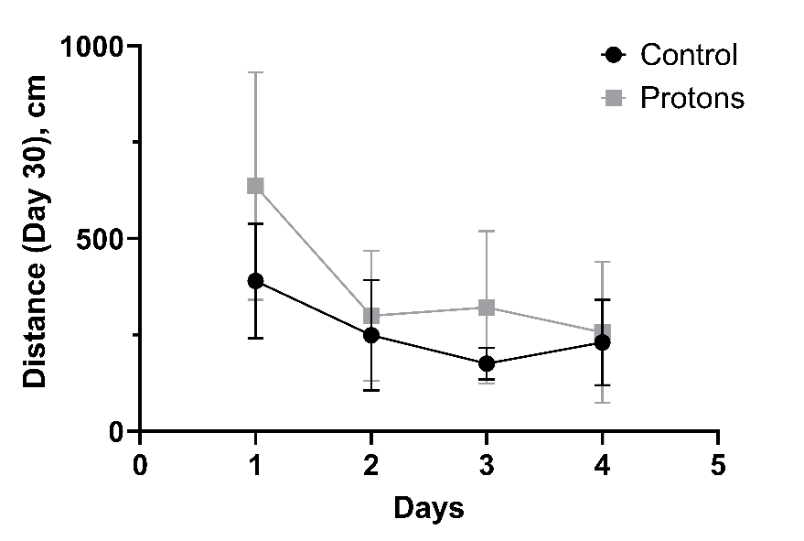
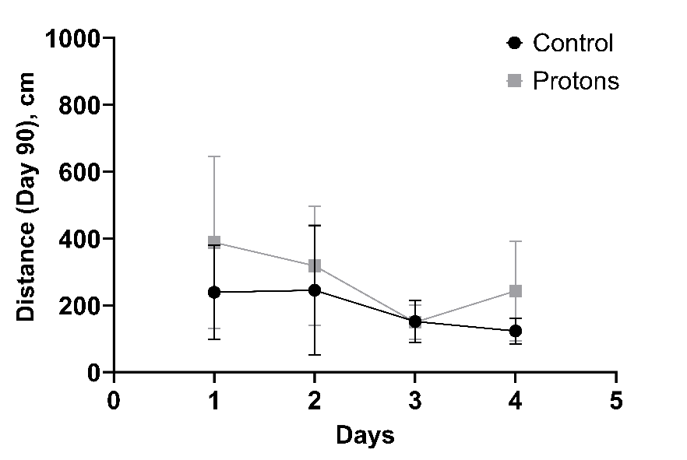
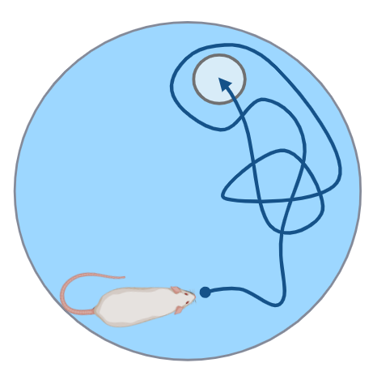
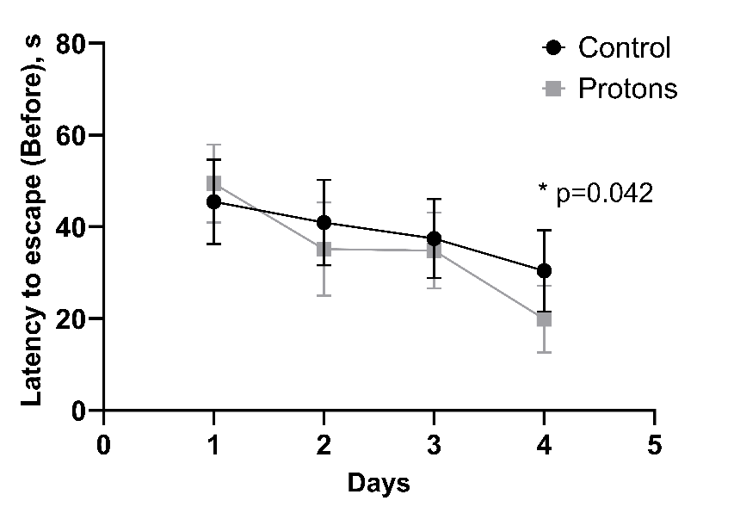
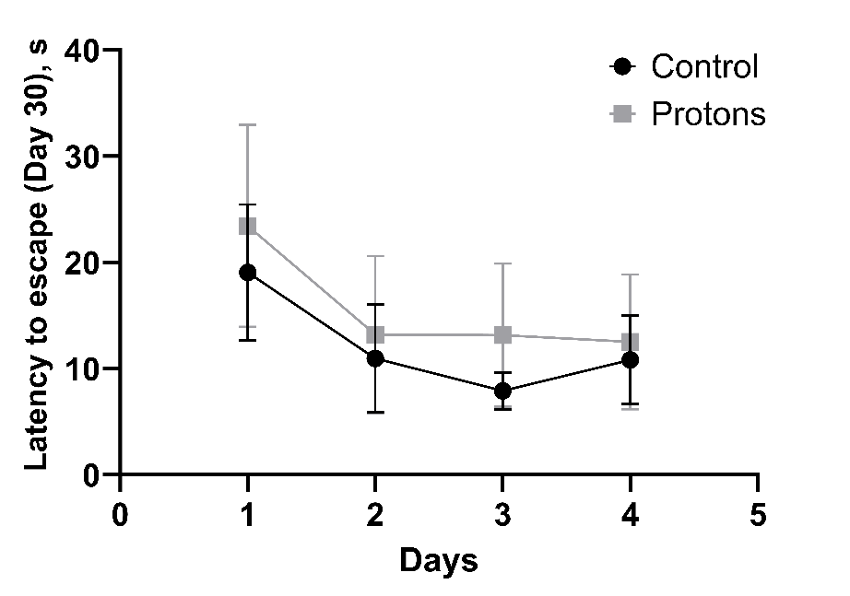
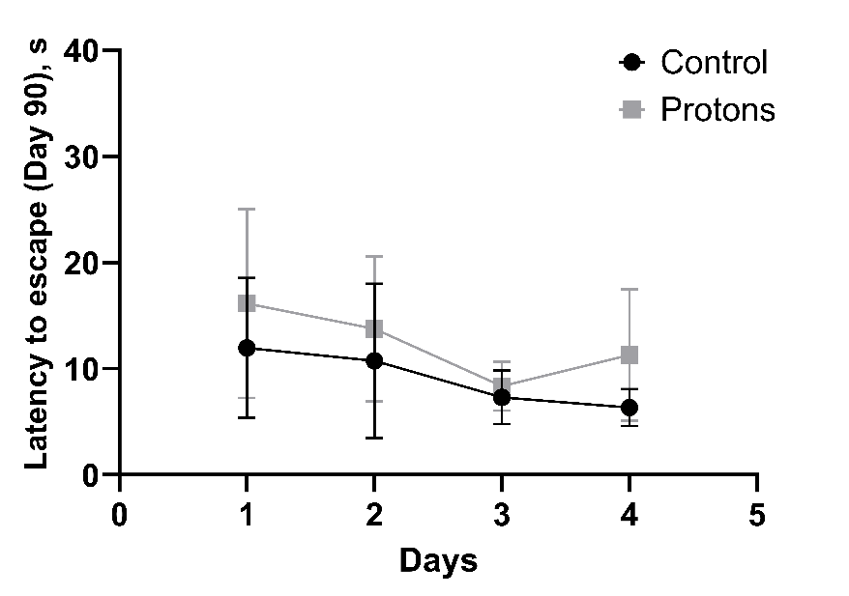
3. Assessment of spatial learning and working memory
Fig. The run distance and the time to find the platform in the Morris test at various times after irradiation with accelerated protons at a dose of 3 Gy.

Slide 16
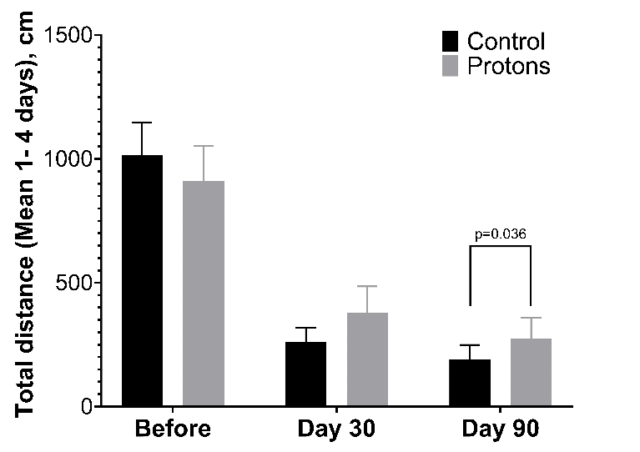
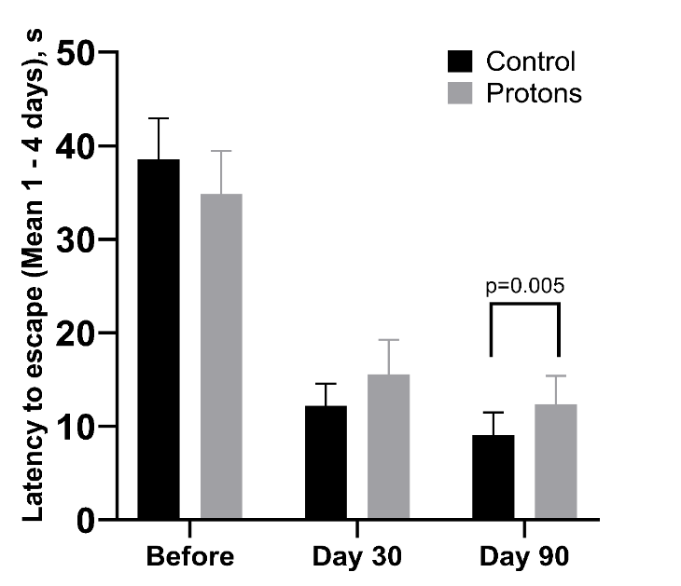
3. Assessment of spatial learning and working memory
Fig. Average distance and platform search time for 4 days of training in the Morris test after irradiation with accelerated protons at a dose of 3 Gy.

Slide 17
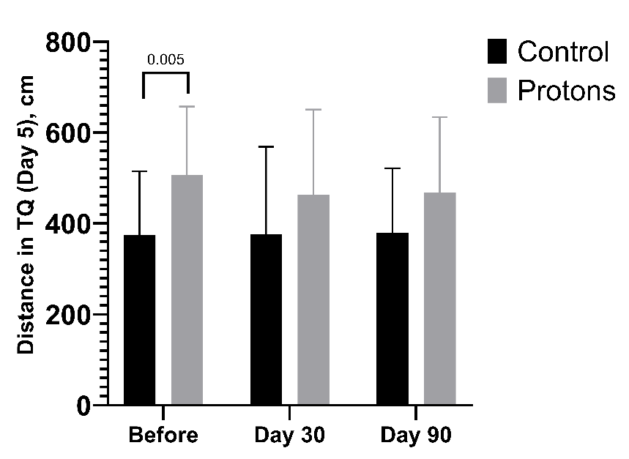
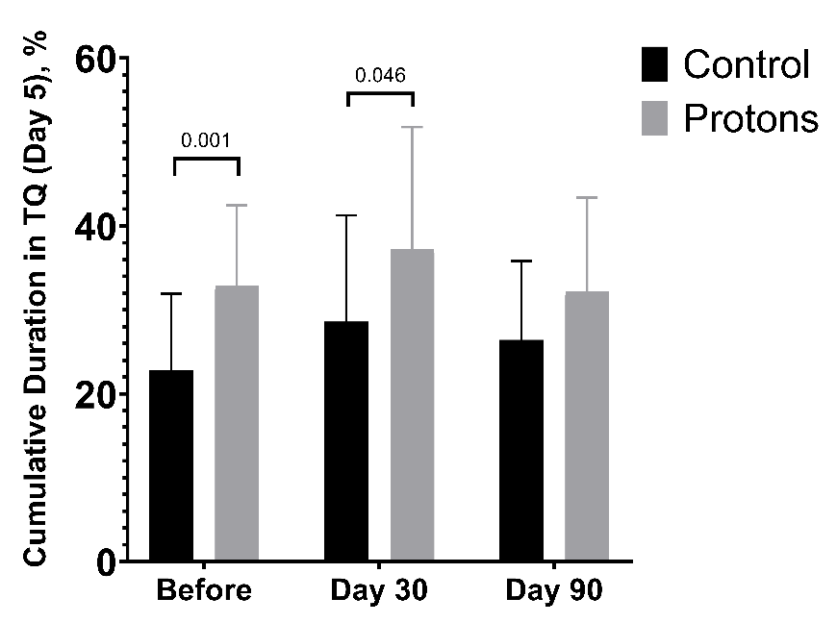
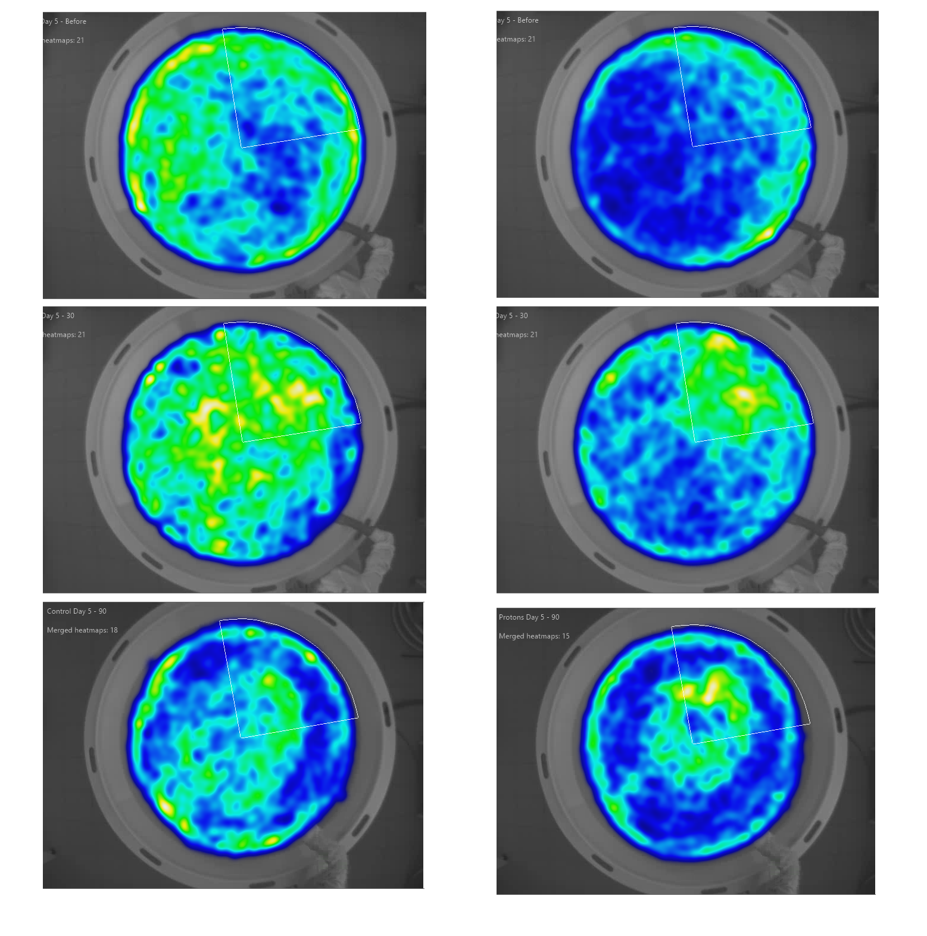
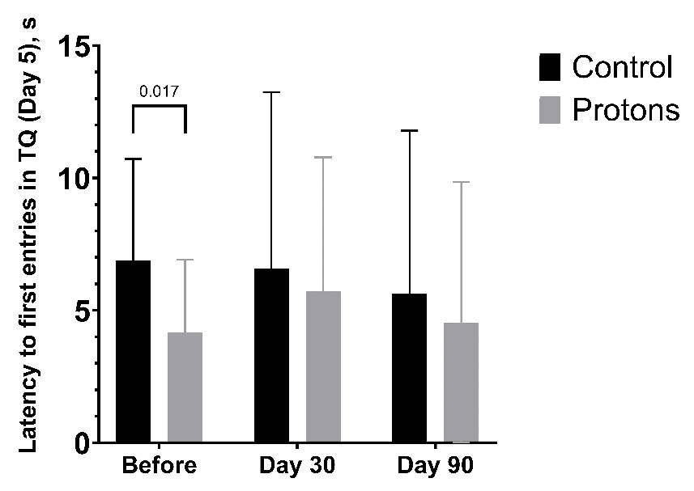
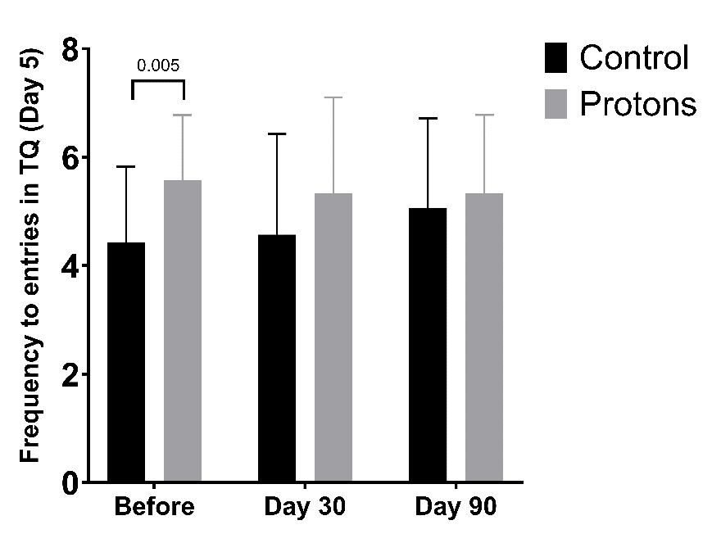
3. Assessment of spatial learning and working memory
Control
Protons
Without platform
Fig. Average distance traveled, time, latency of the first entry and frequency of visits to the target quadrant (TQ) on the 5th day of training in the Morris test after irradiation with accelerated protons at a dose of 3 Gy.

Slide 18
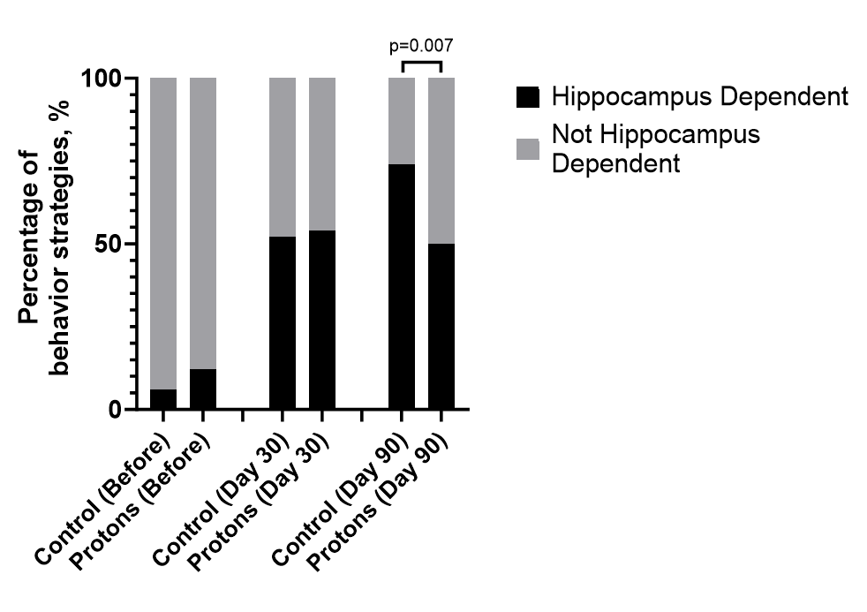
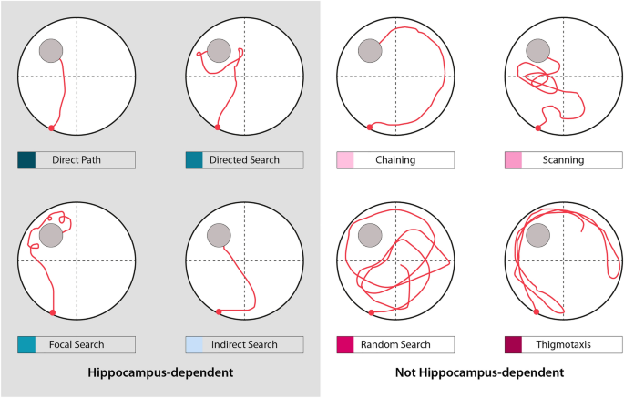
3. Assessment of spatial learning and working memory
Curdt N., Schmitt F.W., Bouter C. et al. (2022) Scientific Reports
Fig. Strategies for finding a platform after irradiation with accelerated protons at a dose of 3 Gy.
Cooke MB, O'Leary TP, Harris P et al. (2019) Pathfinder: open source software for analyzing spatial navigation search strategies. F1000Research, 8:1521. https://doi.org/10.12688/f1000research.20352.2

Slide 19
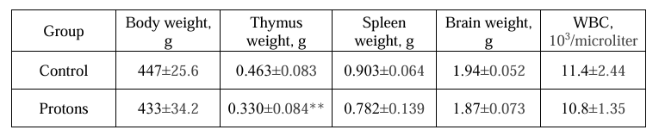
4. Physiological parameters
Table. Physiological parameters

Slide 20
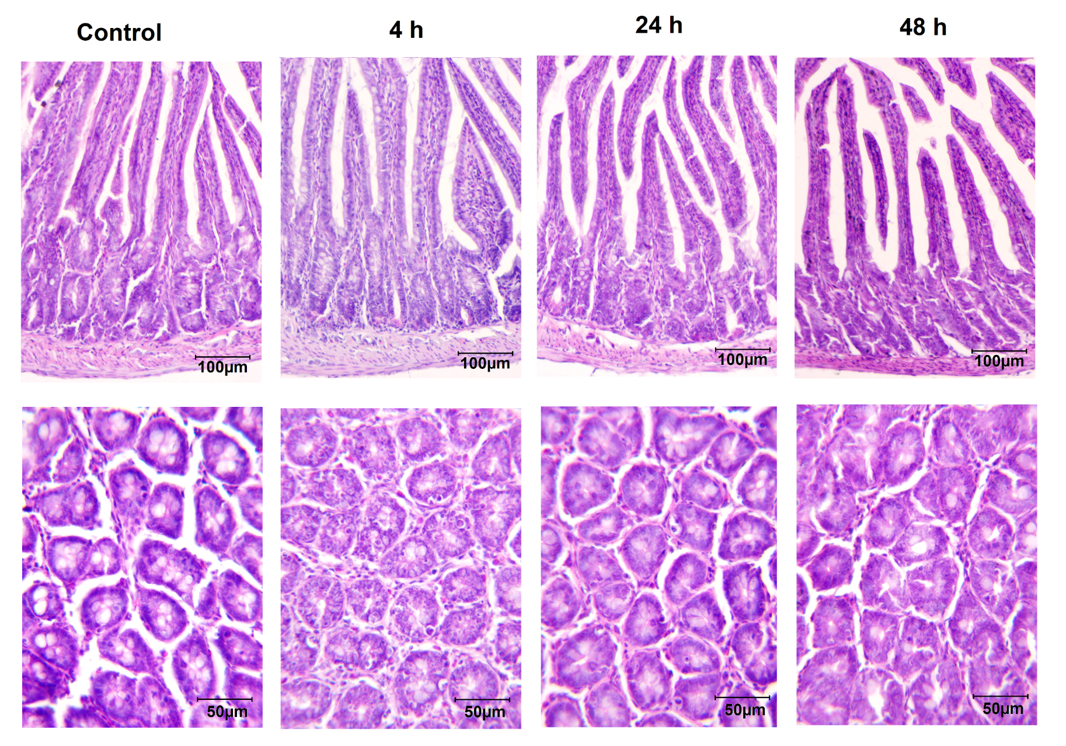
5. Histology
Fig. Micrographs of histological sections of the small intestine of rats after proton irradiation at a dose of 3 Gy. H&E Mayer

Slide 21
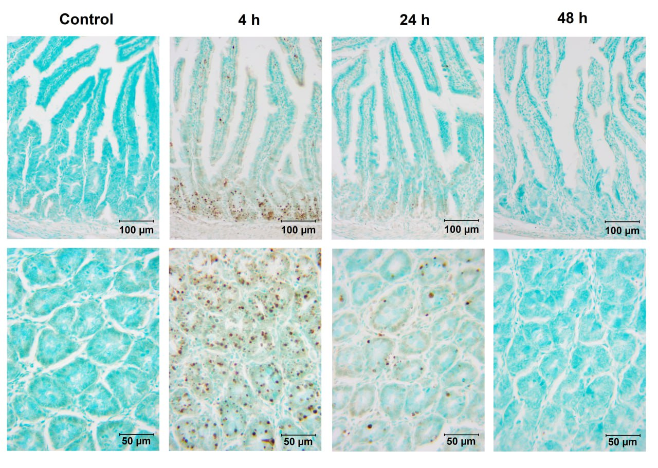
5. Histology
Fig. Micrographs of histological sections of the small intestine of rats after proton irradiation at a dose of 3 Gy. TUNEL Staining (HRP - DAB), Counter-staining – Methyl Green

Slide 22
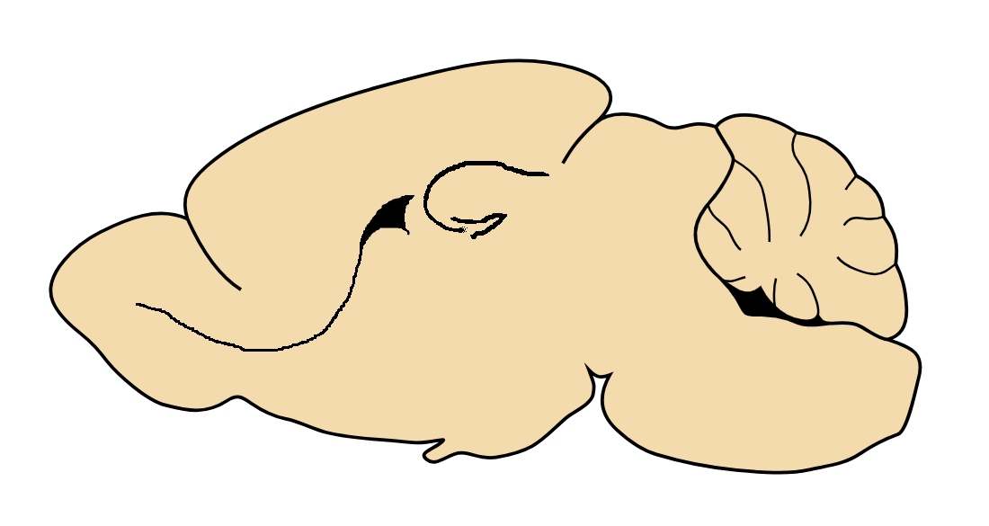
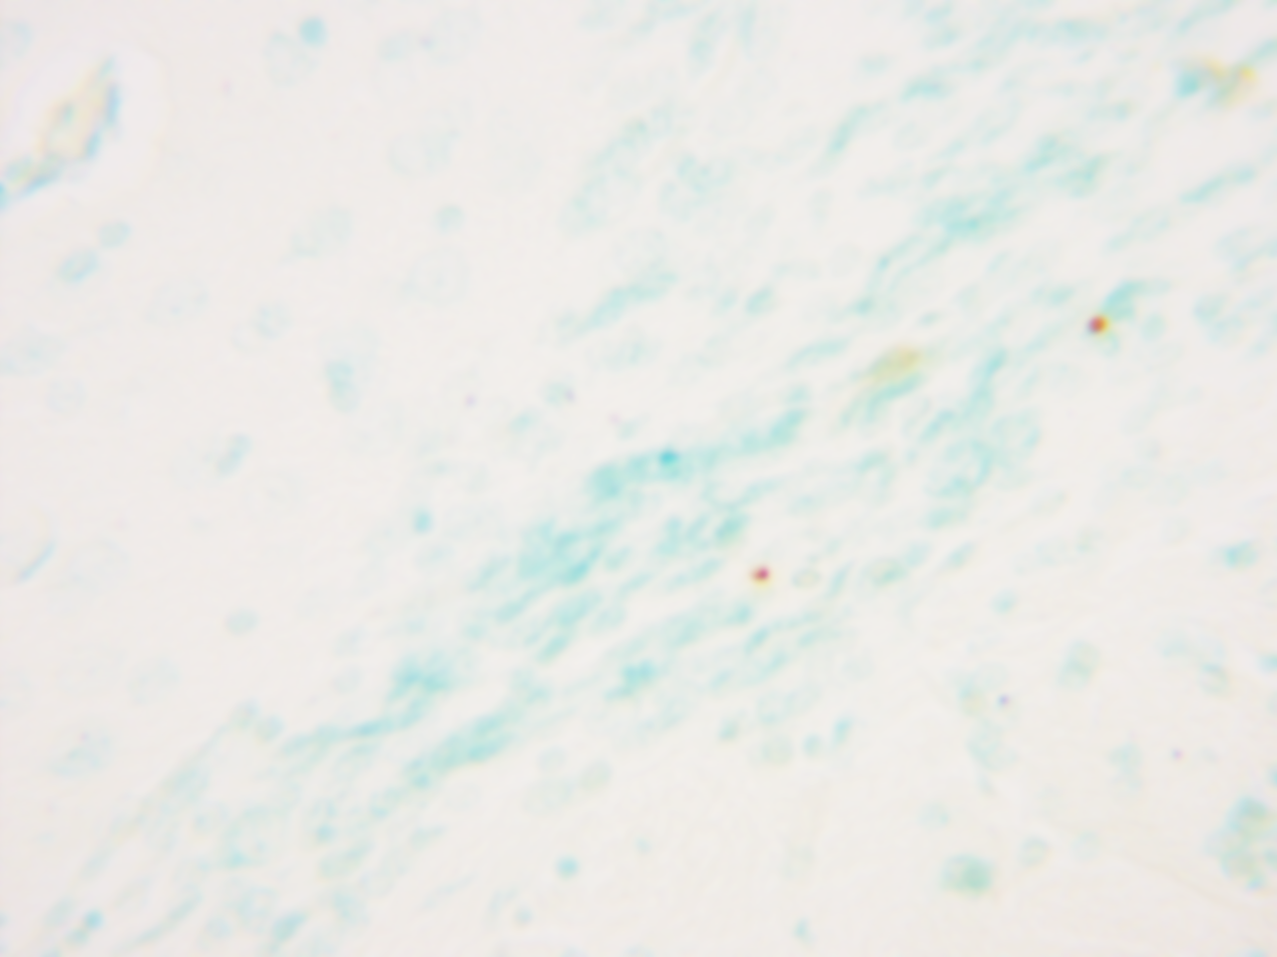
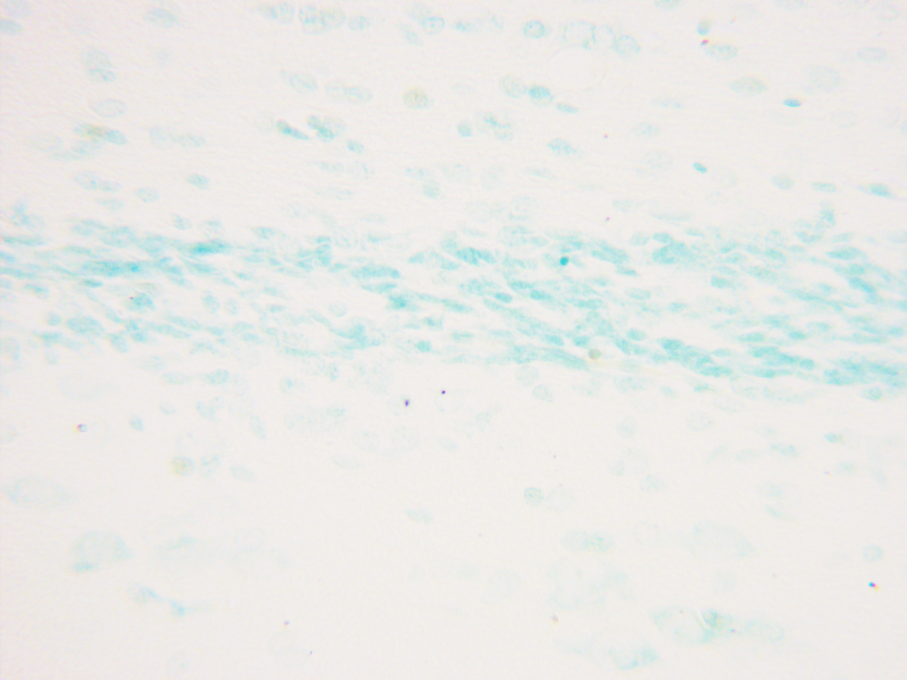
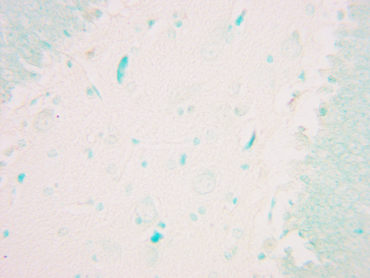
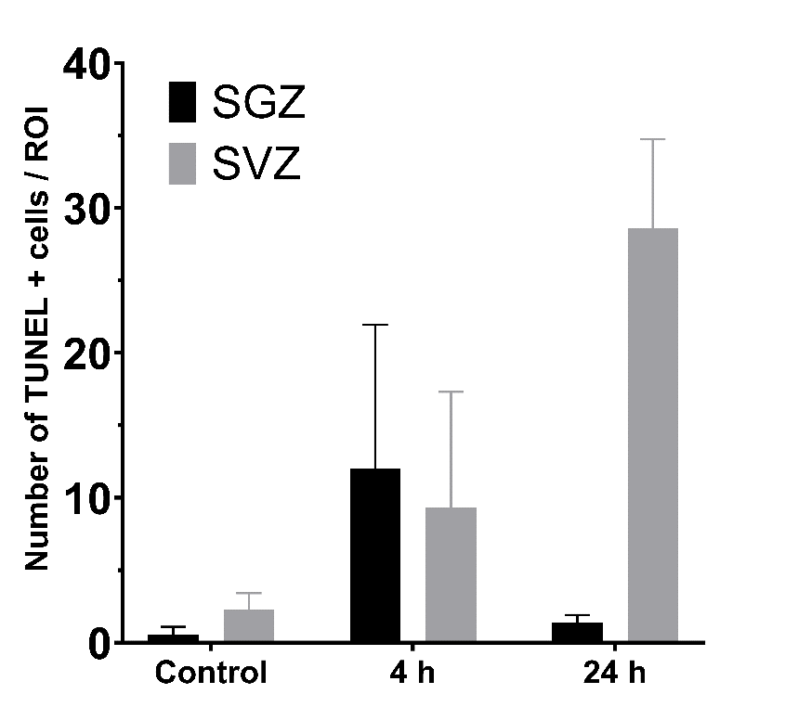
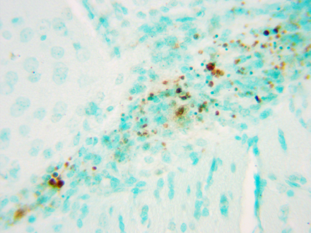
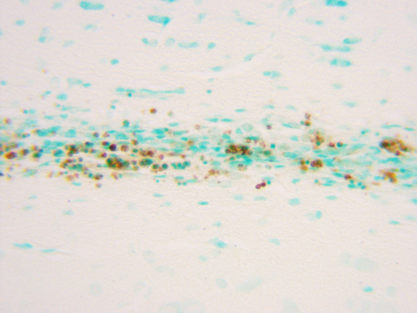
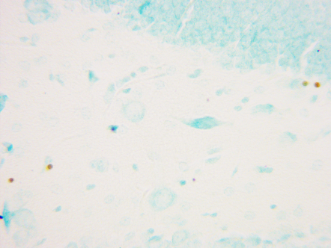
5. Histology
Control
SVZ
RMS
SGZ
SGZ
RMS
SVZ
Protons
SVZ
RMS
SGZ
Fig. TUNEL+ cells in neurogenic niches and the rostral migration tract of the rat brain 24 hours after proton irradiation at a dose of 3 Gy

Slide 23
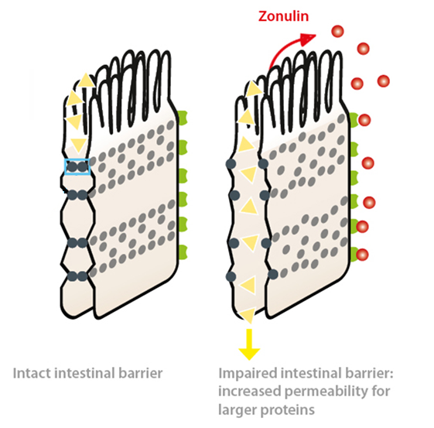
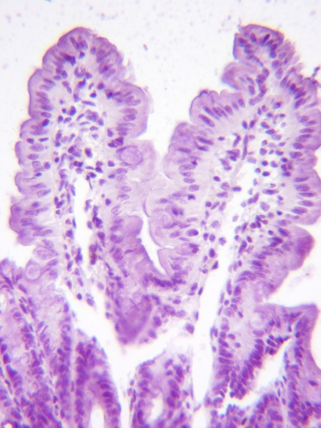
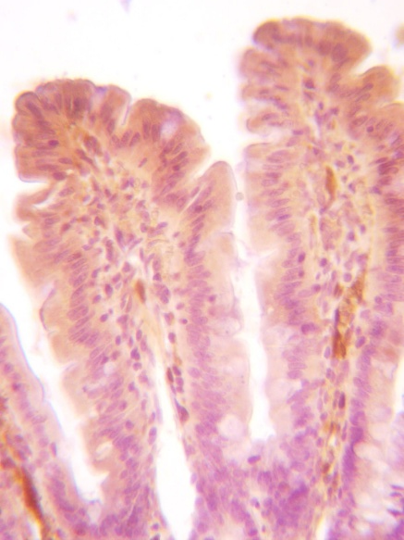
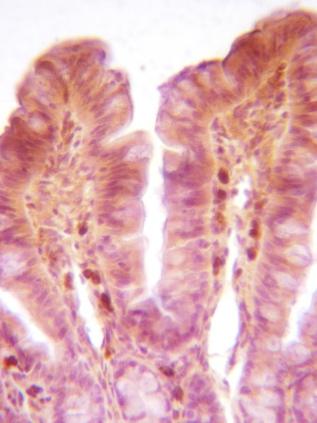
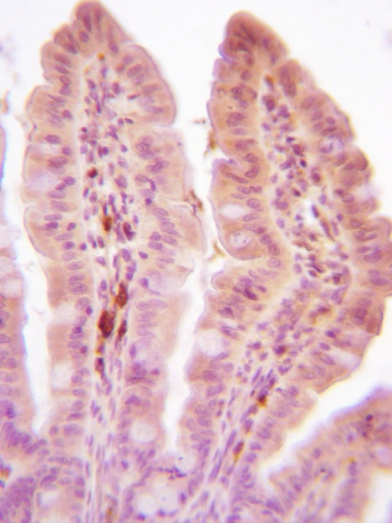
5. Histology
Negative control
Control
24 h
48 h
OD = 0.218
OD = 0.301
OD = 0.176
Fig. Micrographs of histological sections of the rat small intestine after proton irradiation at a dose of 3 G. Immunohistochemical staining for zonulin (DAB). The concentration of primary antibodies is 1:50. Counter–staining - Hematoxylin.

Slide 24
Conclusions
The irradiated animals performed the navigation task much worse and within 2 months they developed a deficit in spatial memory.
An analysis of the number of studies of mink in an Open field on day 27 in irradiated animals showed an increase in this indicator.
At 90 degrees after irradiation, thymus dystrophy was observed as a tendency in irradiated animals.
Total proton irradiation at a dose of 3 Gy leads to a decrease in the learning ability of rats in the Morris test, a pronounced predominance of non-hippocampal-dependent behavioral strategies on the 90th day after irradiation.
Apoptotic death in the neurogenic niches of the brain is observed 4 and 24 hours after irradiation, which has different dynamics.
Early changes in the small intestine are characterized by marked apaptotic death 4 hours after irradiation (crypts and Peyer's plaques), infiltration of immune system cells, and increased zonulin secretion 24 hours after irradiation.

Slide 25

Thanks for your attention!

