Slide 1
Theoretical modeling of two-dimensional molecular structure by laser diffraction of electrons from polyatomic molecules
Anastasia A. Kharlamova
Higher School of Natural Sciences and Technologies
Northern (Arctic) Federal University named after M.V. Lomonosov
Kharlamova.anastasya2015@yandex.ru

Slide 2
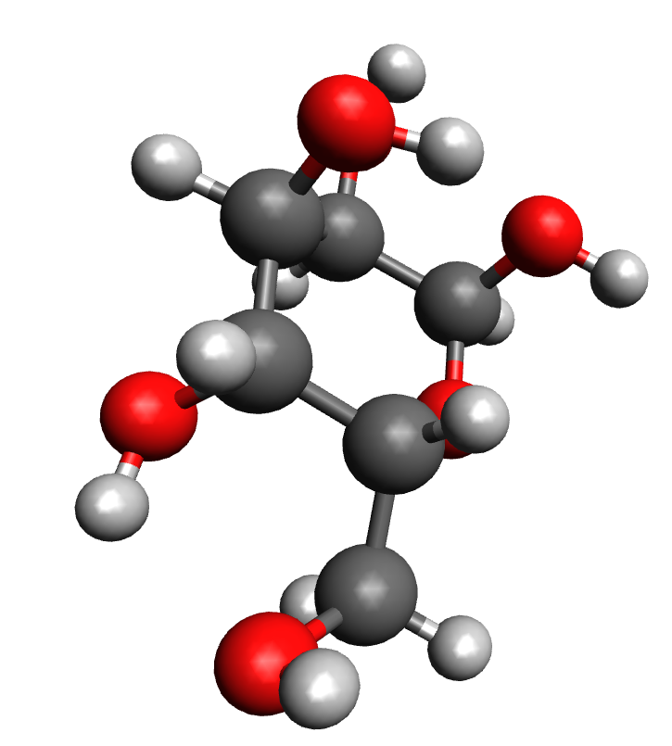
Studying the structure of molecules
Magnetic resonance methods (NMR and EPR)
X-ray diffraction analysis
Physical-chemical methods
Ultrashort laser pulses
2

Slide 3
The main problem
The lifetime of the molecule should coincide with the time of the study.
Why is this necessary?
Studying the dynamics of a molecule
Studying of physical-chemical processes in a molecule
Reduction of the error as a result of the study
3

Slide 4
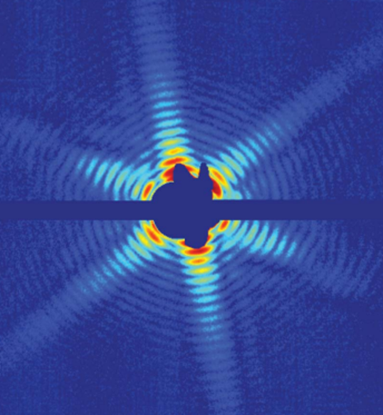
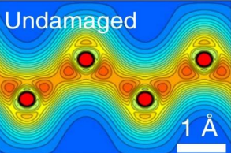
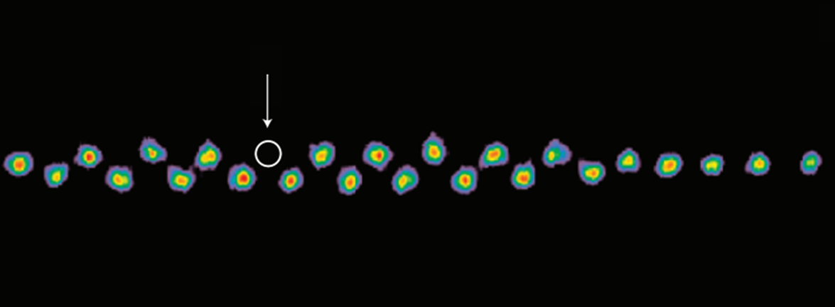
The proposed tool is ultrashort laser pulses
Today, experiments are conducted on a free electron laser
Studying the mimivirus structure
The study of DNA and RNA molecules
Investigation of inorganic structures: diamond defects
4

Slide 5
Problems with the use of ultrashort laser pulses
Decryption of the received data
Visualization of a real object
This work continues the topic of finding an
effective way to decipher the diffraction patterns
by ultrashort laser pulses
5

Slide 6
What will be considered
Description of the proposed mathematical models for modeling the interaction of a pulse with matter
Two calculation options:
Taking into account all the atoms included in the molecule
By the symmetry method
Verification of the proposed calculation methods on the ClCF₃ molecule (Chlorotrifluoromethane)
Comparison of the obtained data with the results of the "Experimental" study
Yu, C. et al. Reconstruction of two-dimensional molecular structure with laser-induced electron diffraction from laser-aligned polyatomic molecules. Sci. Rep. 5. (2015).
6

Slide 7
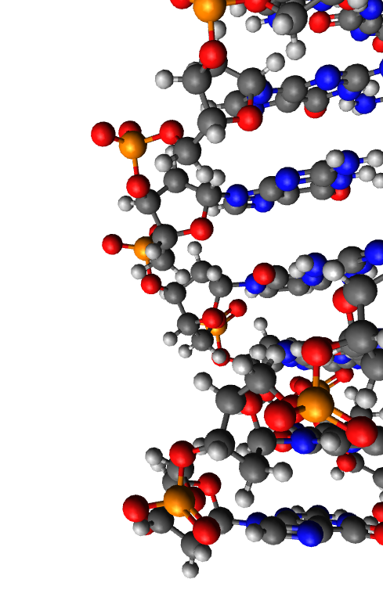
Theory
electromagnetic field strength USPs
interference factor
number of electrons in the atom of the i - grade
number of atoms of the i - grade
form factor of the atom of the i - grade with the corresponding electron density
D.N.Makarov, A.A.Kharlamova, “Scattering of X-ray Ultrashort Pulses by Complex Polyatomic Structures,” International Journal of Molecular Sciences, Vol 163, December 2021.
7

Slide 8
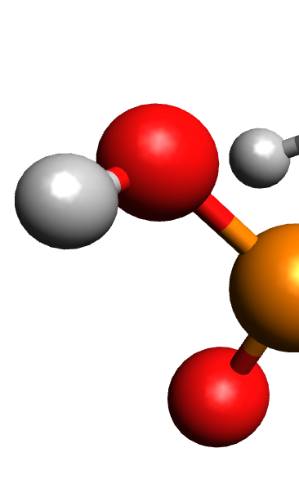


Theory
number of atoms of the i - grade
radius vector specifying the position of the atoms of the corresponding variety
momentum vector of the USPs falling on the multi-atom system
8

Slide 9
Theory
some asymmetry in the system
the number of symmetries in the system
radius is a vector specifying the position of the symmetry α or β
momentum vector of the USPs falling on the multi-atom system
radius is a vector specifying the position of atoms of grade i in symmetry
9

Slide 10
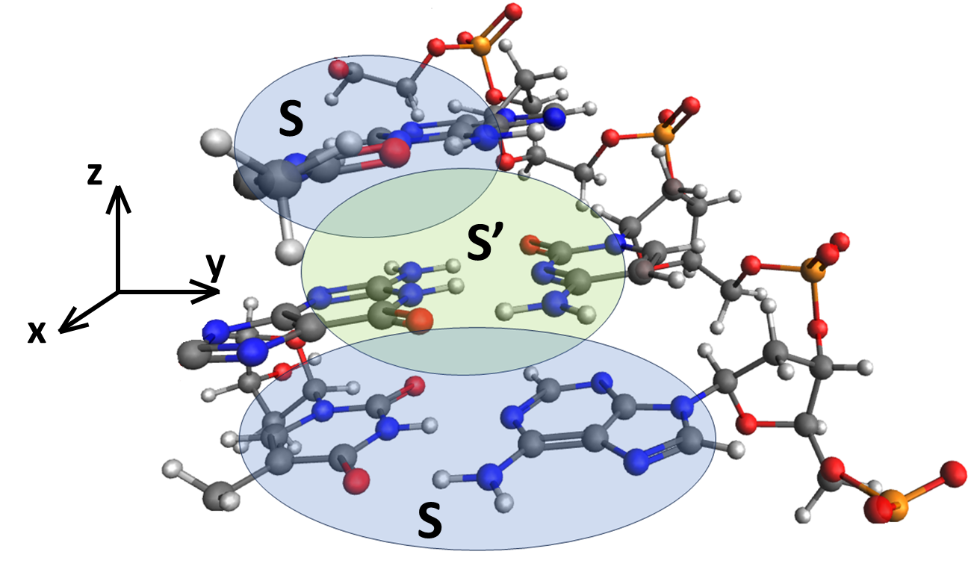
Theory
10

Slide 11
Mathematical modeling is performed on the ClCF₃ molecule
It was interesting to compare the results obtained with the data from other research groups.
The authors of the article are also looking for a way to decode the diffraction pattern data.
The authors investigated the ClCF₃ molecule
The authors have modeled the diffraction pattern by specifying inaccuracies and errors based on their experimental data
Yu, C. et al. Reconstruction of two-dimensional molecular structure with laser-induced electron diffraction from laser-aligned polyatomic molecules. Sci. Rep. 5. (2015).
11

Slide 12
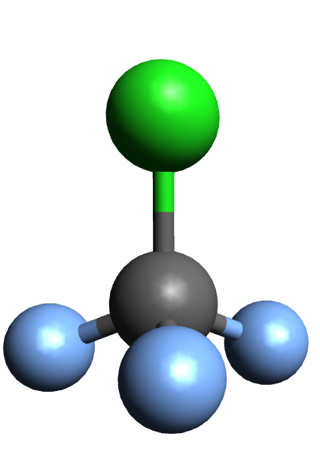
y
Object for Modeling
An ensemble of molecules elongated along
the y axis is considered
The authors of the work set a certain percentage
of the deviation of the molecules from the axis,
as well as the precession of the molecules
Yu, C. et al. Reconstruction of two-dimensional molecular structure with laser-induced electron diffraction from laser-aligned polyatomic molecules. Sci. Rep. 5. (2015).
12

Slide 13
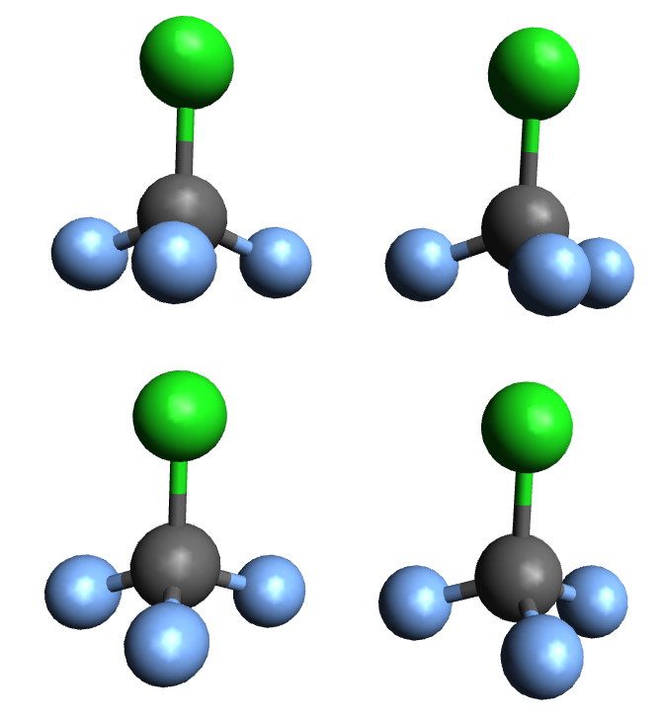
y
Object for Modeling
To account for these errors in my work,
the ensemble of molecules was constructed
as follows
13

Slide 14
Object for Modeling
y
The following parameters were used in the simulation:
The main axis runs along the molecule, perpendicular to its bases
The pulse falls on the system at an angle of 90 degrees to the main axis, system parameter
ϴ angle between the helix axis and the scattering direction
ɸ angle between the x-axis and the projection on the plane perpendicular to the helix axis, the calculations were performed in spherical coordinates
The results in all figures are normalized to the maximum value of the scattering spectrum.
The value = 2c, which corresponds to the photon energy 7.46 keV
14

Slide 15
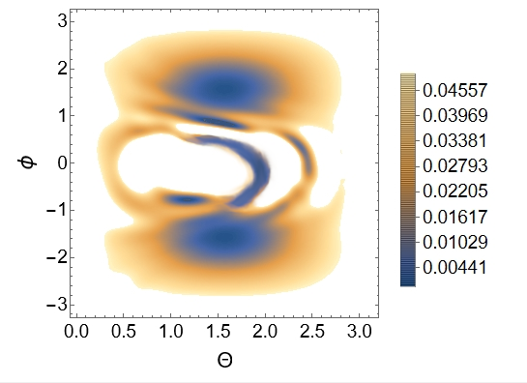
y
Simulation results
15

Slide 16
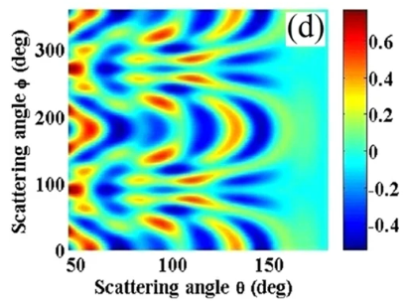
Simulation results
The ensemble of molecules is shown in
motion around the y axis
Therefore, the diagram in the study shows
the "photo of the molecule" from different angles.
Yu, C. et al. Reconstruction of two-dimensional molecular structure with laser-induced electron diffraction from laser-aligned polyatomic molecules. Sci. Rep. 5. (2015).
16

Slide 17
Comparison
Some fragments of the 3D diffraction pattern match our model
17

Slide 18
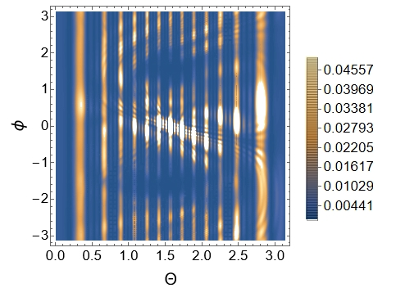
Calculation by symmetry method
One molecule was chosen as the symmetry, and then the result was summed over the four molecules in the ensemble.
The result has no similarity.
18

Slide 19
Why didn't the symmetry method work?
The method was written for DNA molecules, in which the symmetries are always aligned along the axis.
Here, the molecule is located in a "square" near the y-axis, in this case, two molecules had to be selected as the area of symmetry.
In the proposed method, the summation was carried out over certain periods along the y axis, for DNA molecules. Ensembles of molecules with repetition both vertically and horizontally require refinement of the method
19

Slide 20
Conclusion
But! When calculating without taking into account the symmetries, it is possible to build a correct diffraction pattern.
In this case, the calculation is more complicated. Scattering on all atoms must be taken into account.
If it is necessary to obtain a 3D model, it is necessary to perform summation at different angles of laser pulse irradiation.
It is necessary to continue working on refining the methods.
20

Slide 21
Thanks for your attention

