Slide 1
HPGe detector mass calibration with a dissolved uranium source
Khussainov Temirlan
29th International Scientific Conference of Young Scientists and Specialists (AYSS-2025) 27-31.10.25

Slide 2
Introduction
A distributed uranium source was used to calibrate the HPGe detector identical to one from νGeN experiment.
The main advantage of such source is very well known activity of ²³⁸U equal to 12440 ± 12 Bq/g
Belov, V., et al. "New constraints on coherent elastic neutrino–nucleus scattering by the νGeN experiment." Chinese Physics C 49.5 (2025)
2

Slide 3
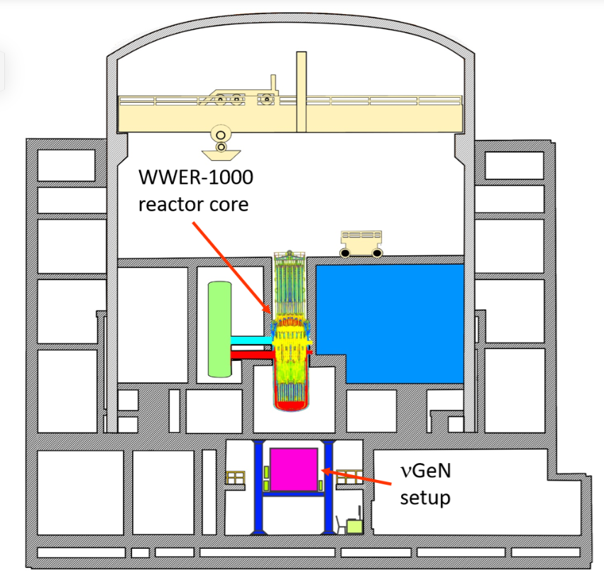
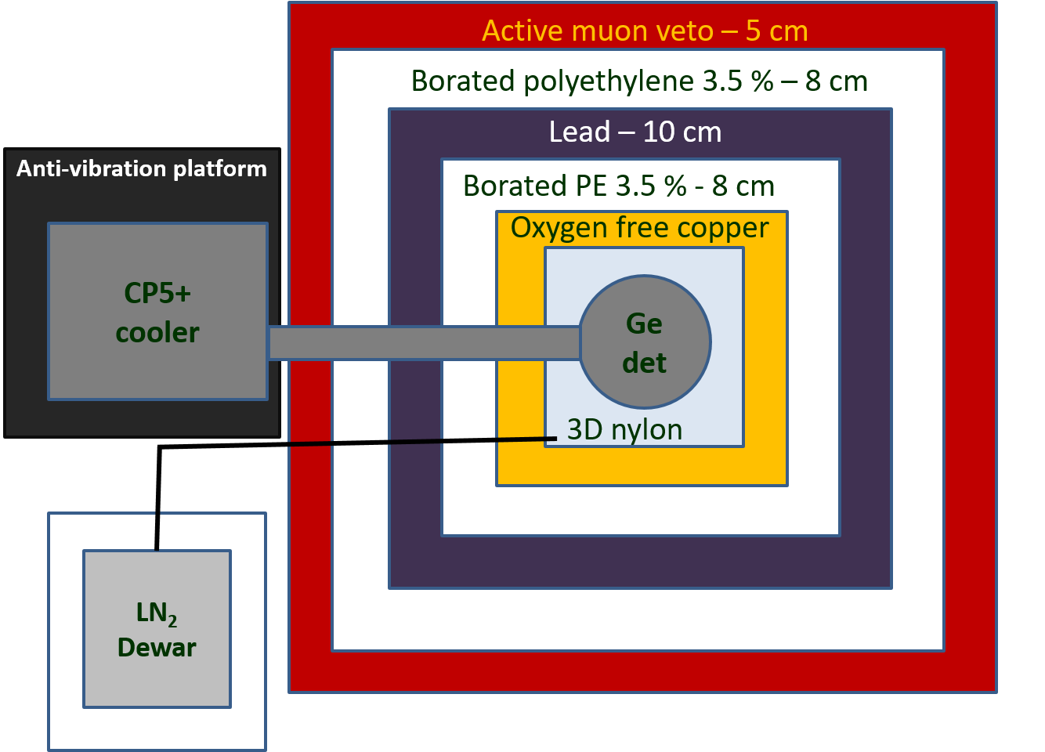
About νGeN
νGeN experiment at the KNPP is aimed at searching for coherent elastic scattering of reactor neutrinos off germanium nuclei.
The detection of CEνNS requires a largeneutrino flux, a low background, large target mass, and a low energy threshold.
Образец
«Coherent effect of a weak neutral current» D. Freedman, PRD v.9, iss.5 (1974)
3

Slide 4

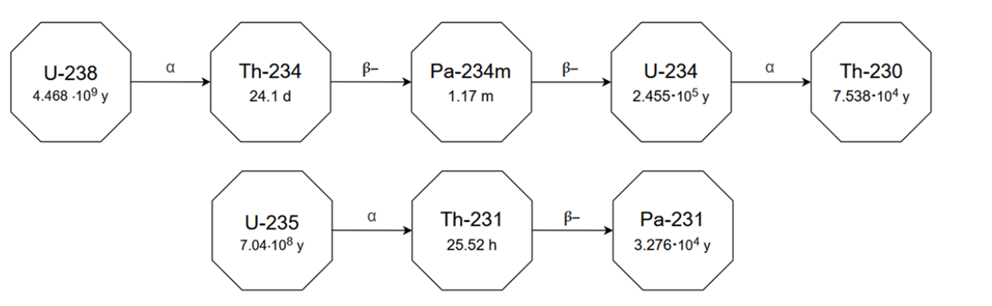
Source description
Parameter | Value
Volume | 125 mL
Density | 1.010 g/mL
Volume concentration HNO₃ | 2 %
Uranium concentration | 1000 ± 5 μg/mL
²³⁸U activity | 1555 ± 8 Bq
National Nuclear Data Center, NuDat Database
4

Slide 5
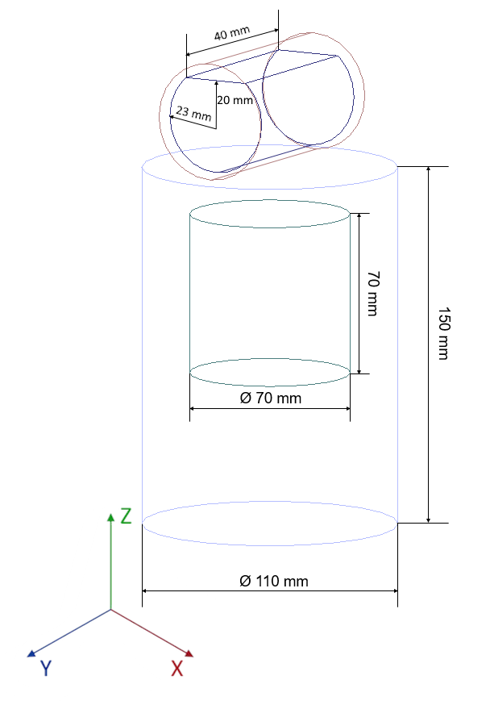
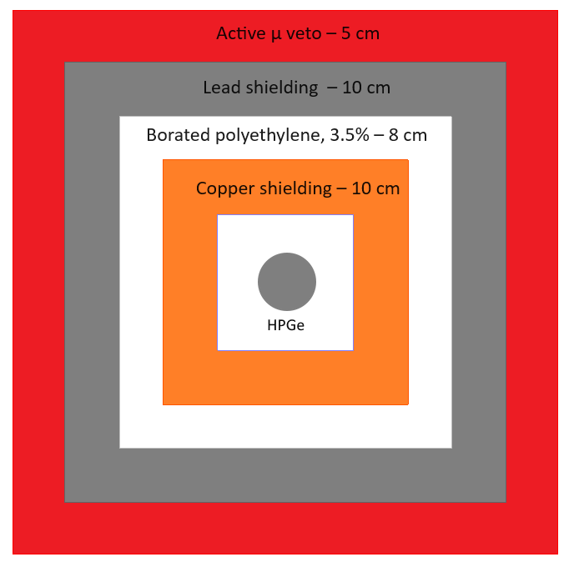
Experimental setup and Monte Carlo
The measurements were carried out on a low-background setup using a HPGe detector identical to the νGeN detector with a declared mass of 1.4 kg and declared dead layer of 0.5 mm.
5

Slide 6
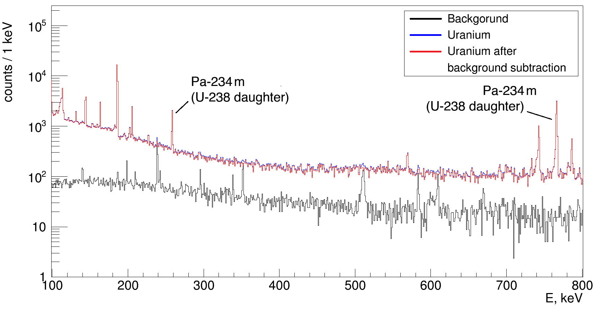
Measurements
The background conditions were measured over 10 days, and the measurements with the uranium source lasted 24.4 hours.
6

Slide 7
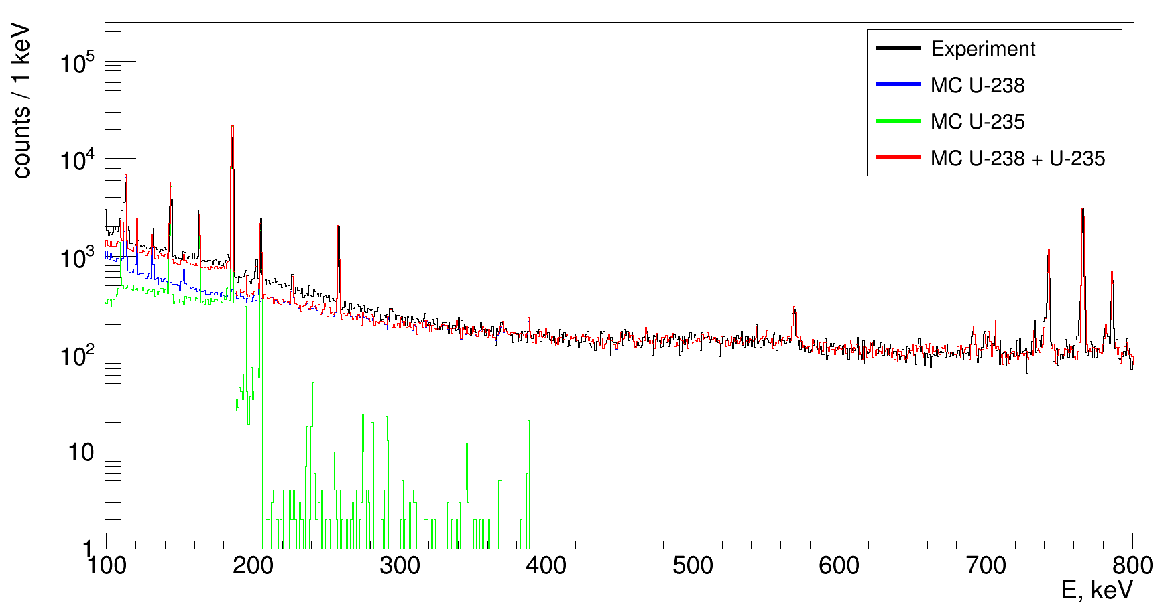
Experimental and MC spectra comparison
7

Slide 8
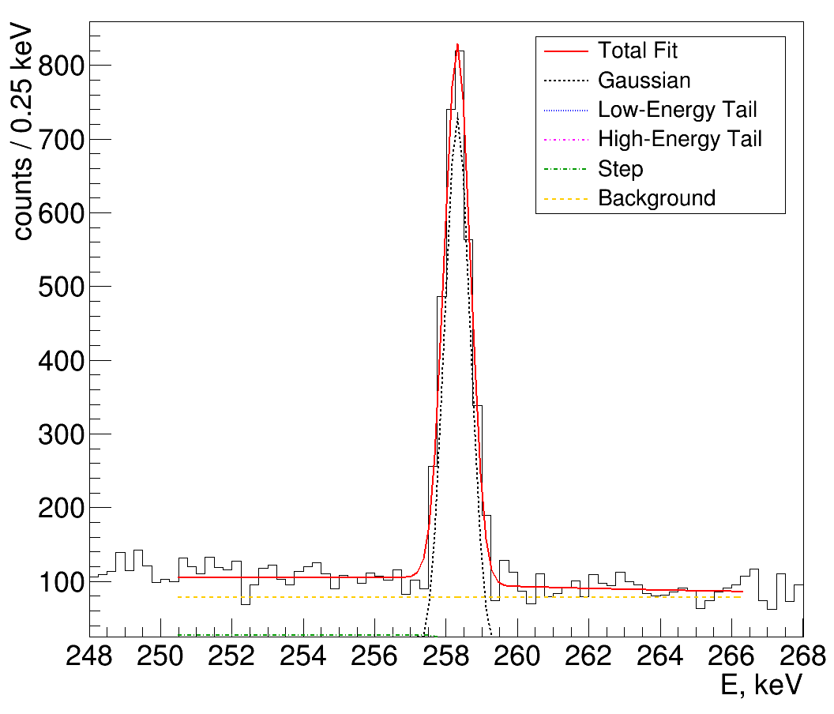
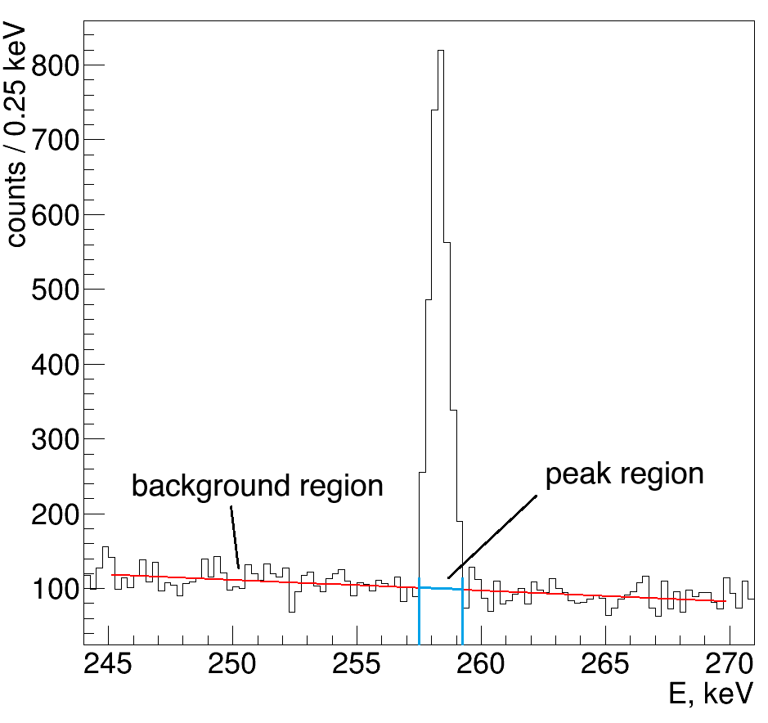
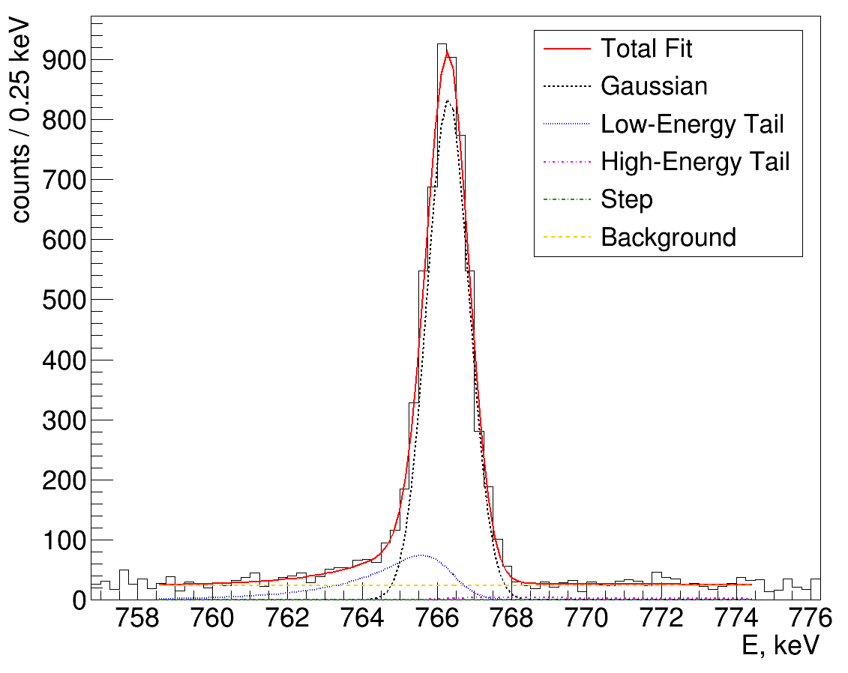
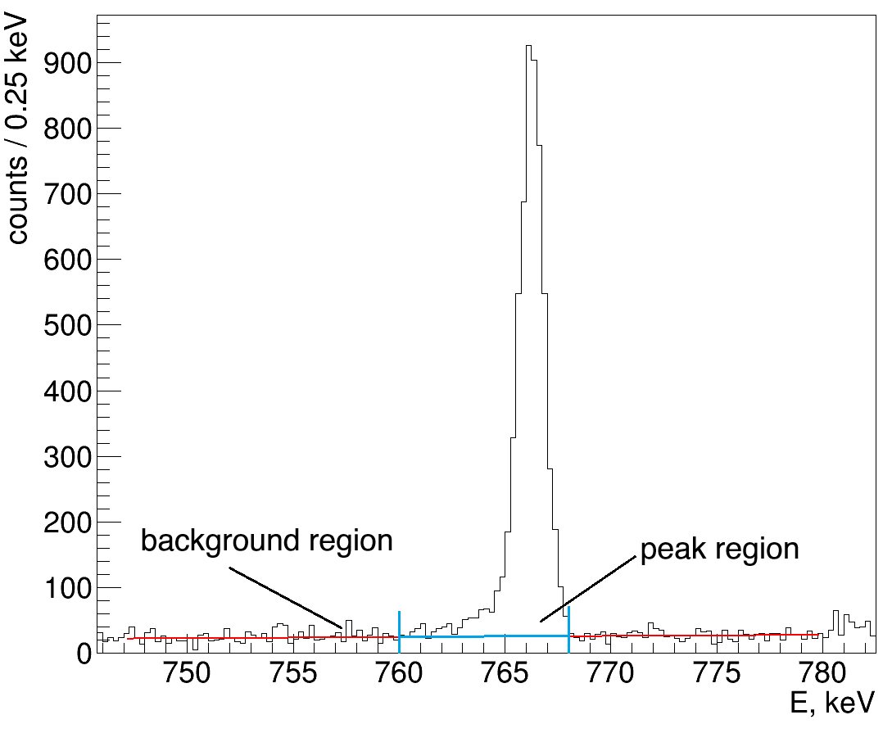
Analysis
Arnquist, I. J., et al. "Energy calibration of germanium detectors for the Majorana Demonstrator." Journal of Instrumentation 18.09 (2023)
8

Slide 9
Results
Comparison of counts (fitting method).
E, keV | Experiment | MC | Ratio
258.26 | 2797 ± 62 | 2731 | 1.02 ± 0.02
766.36 | 5688 ± 108 | 5952 | 0.96 ± 0.02
Comparison of counts (simple method).
E, keV | Experiment | MC | Ratio
258.26 | 2637 ± 76 | 2731 | 0.97 ± 0.03
766.36 | 5735 ± 88 | 5952 | 0.96 ± 0.02
The efficiency calculated in Geant4 is consistent with the experimental data within the errors.
One can consider ~5% as an additional uncertainty in the νGeN experiment related to the effective mass of the crystal.
9

Slide 10
Conclusion
As a result of the calibration measurements performed with the distributed ²³⁸U source of known activity (accuracy at the level of 0.5%), the conformity of the mass of the HPGe detector used in the νGeN experiment with its nominal specification has been verified.
The applicability of the calibration method using a distributed source for determining the effective mass of germanium detectors has been demonstrated.
10

Slide 11
Thank you for attention

Slide 12
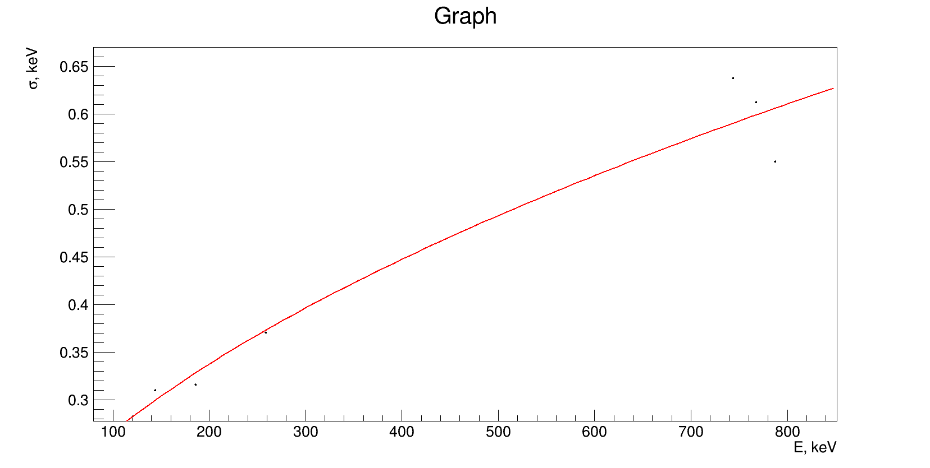
Калибровочная кривая

Slide 13
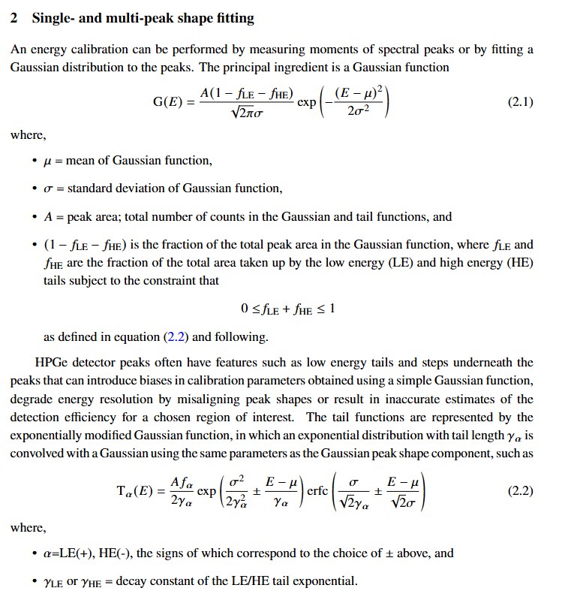
Функция фитирования

Slide 14
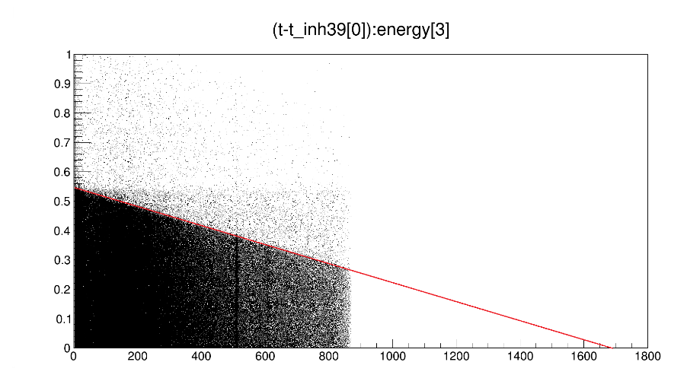
Backup
14

Slide 15
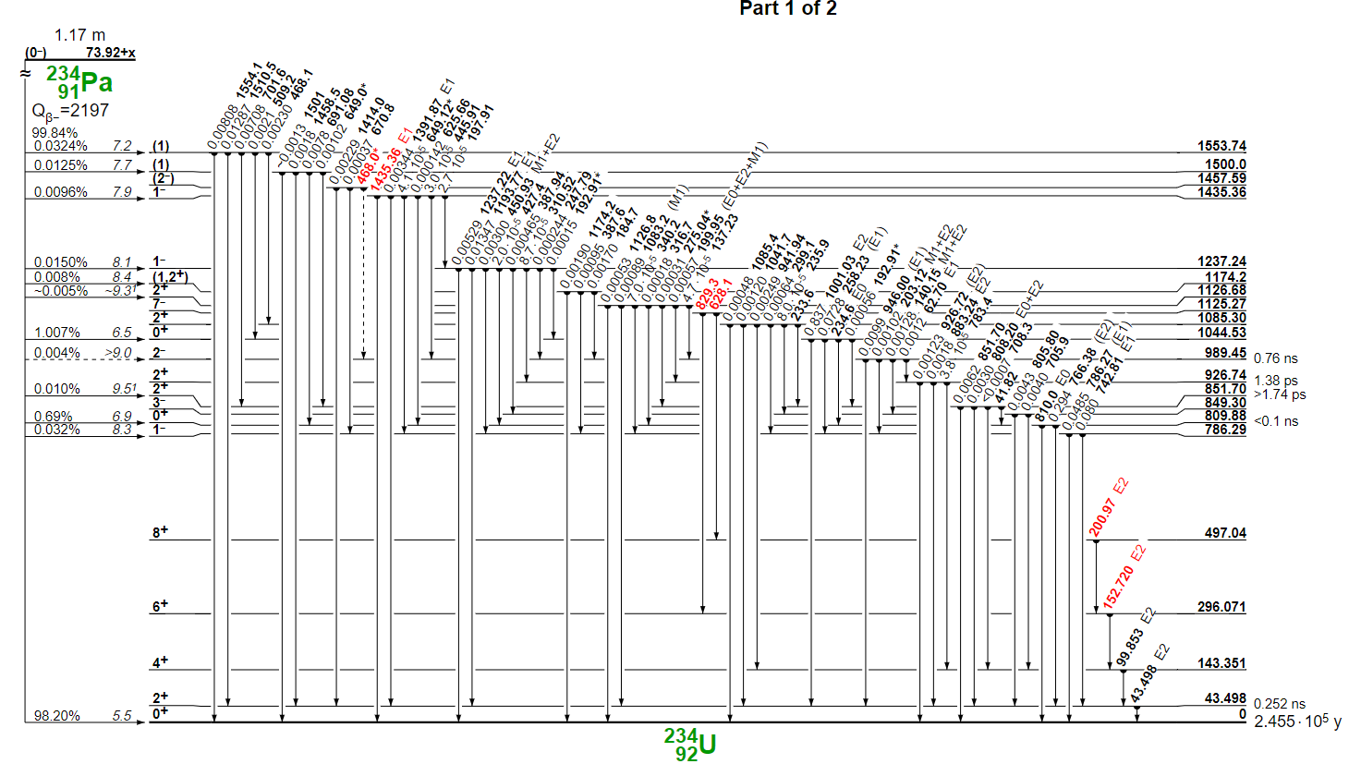
Переходы в Pa-234
15

Slide 16
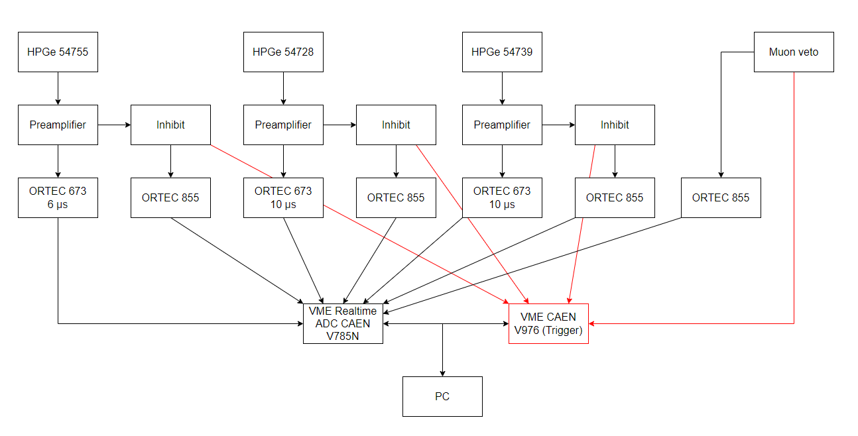
Схема электроники
16

