Slide 1



Measurement of low-energy cosmic muons with multilayer lead-scintillator telescope
Lyapin D.D. (INR RAS, NRNU MEPhI)
AYSS 2025

Slide 2
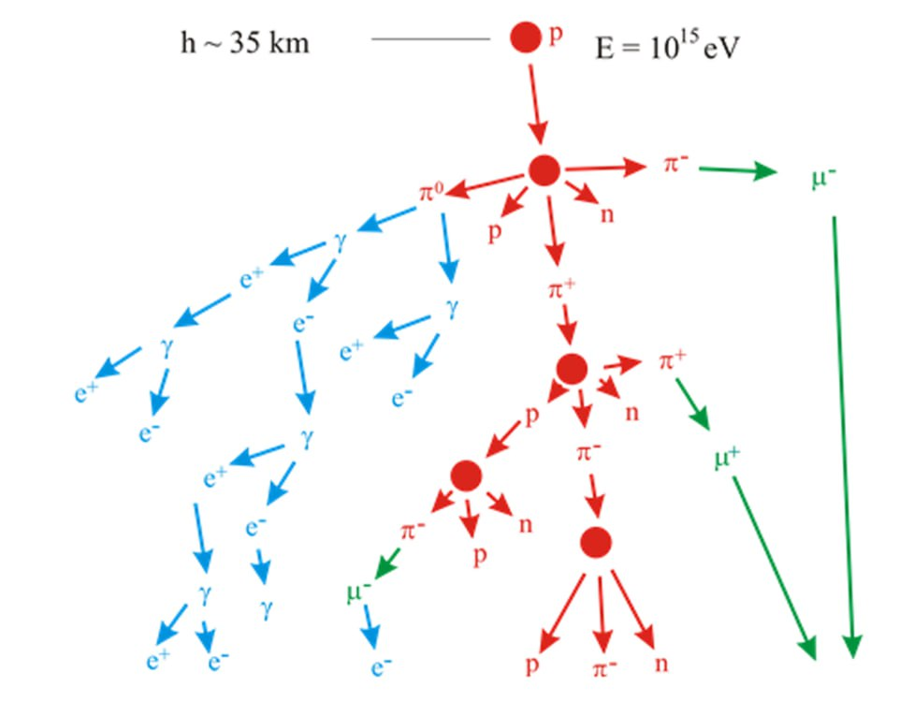
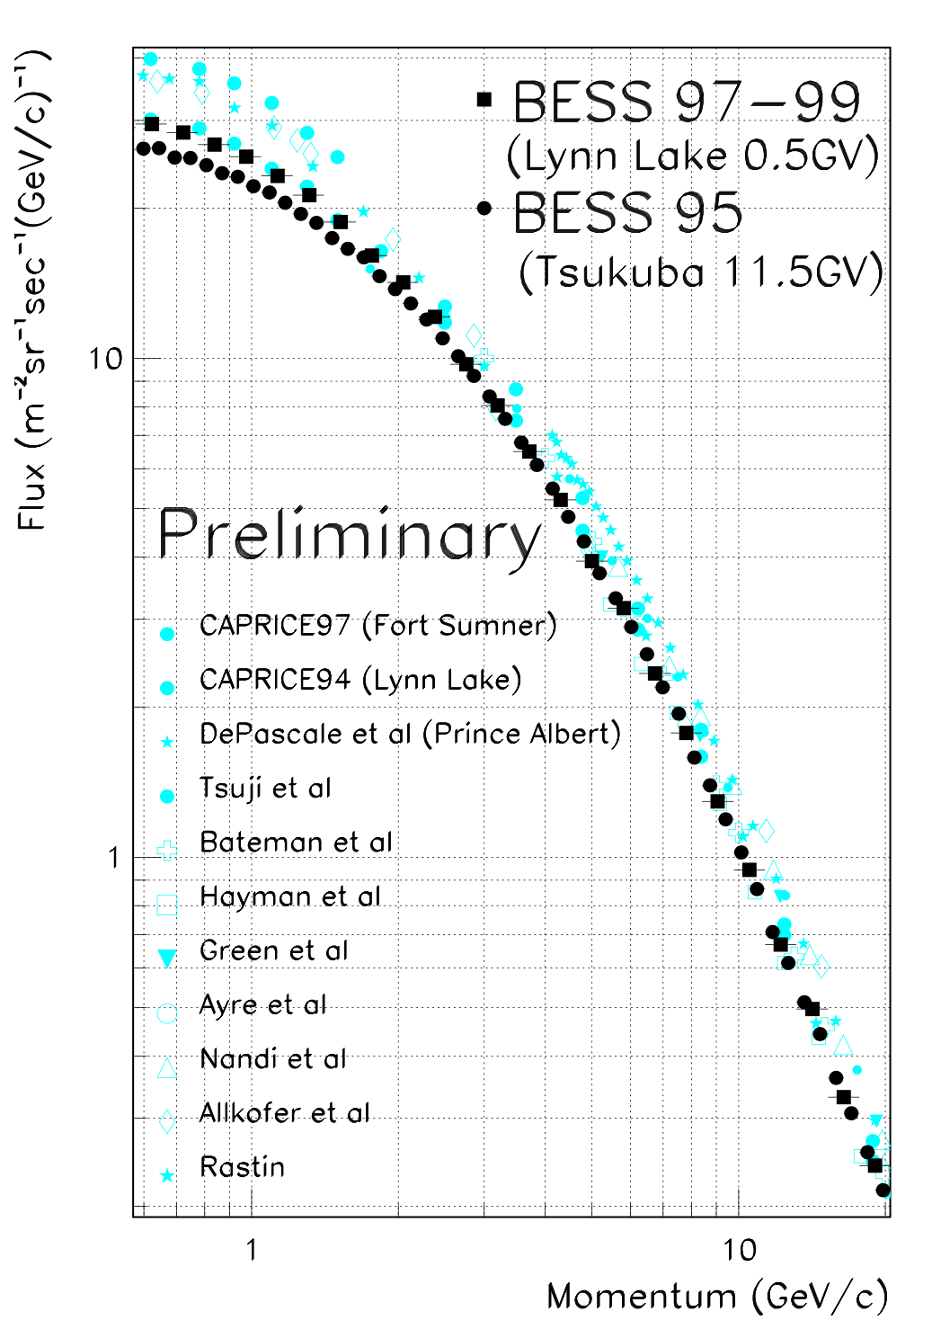
Muons under study
Primary cosmic rays
Worldwide data of cosmic ray muons
The physical sensitivity of low-energy muon research:
Neutrino physics (low-energy muons are the main background)
Dark matter (WIMP can generate neutrino and then low-energy muons)
Primary cosmic rays studies (low-energy mouns depend on models)
Effect of atmospheric variations (low-energy muon flux depends on temperature and density of atmosphere)

Slide 3
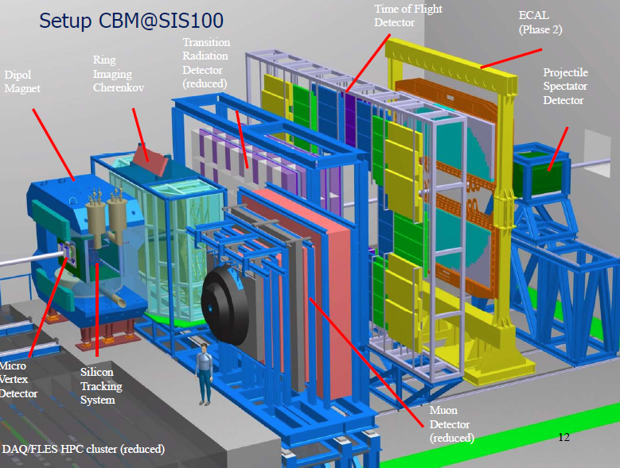
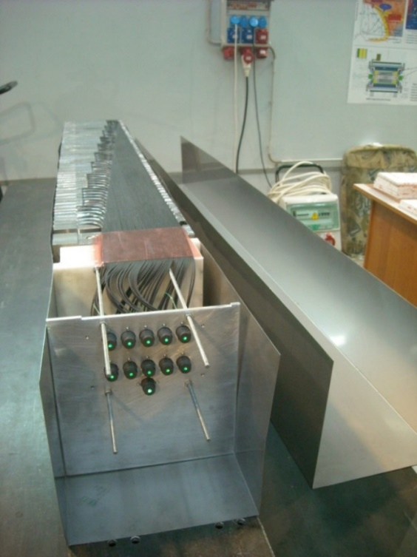
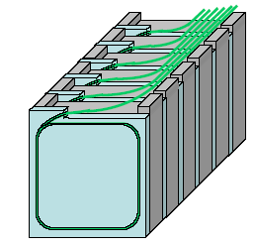
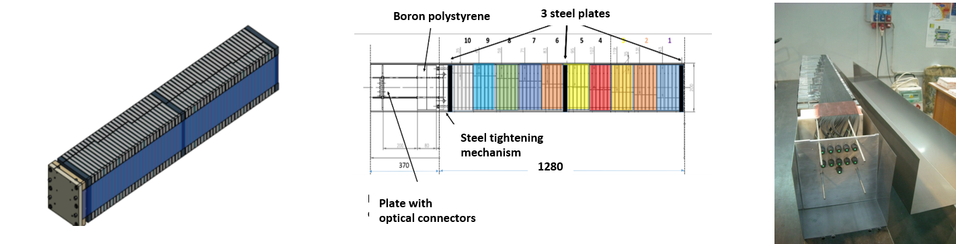
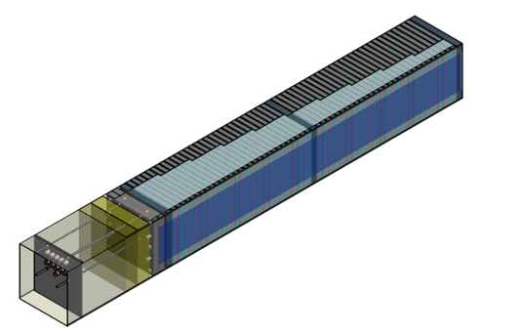
Scintillator/lead calorimeter module design
CBM experiment at FAIR
CBM Projectile Spectator Detector
(modular sampling Pb/scint hadron calorimeter)
CBM module at INR
44 modules, 200x200mm²
Beam hole (20 x 20 cm²).
Total weight – 22t.
Status: CANCELLED
WLSs to SiPM
readout
Scintillator tiles
Lead
Calorimeter module with SiPM readout
Photodetector: SiPM
Hamamatsu S12572-010P
Sensitive area 3 x 3 mm²
Number of pixels 90 000
Nominal gain 1 x 10⁵,
Pixel recovery time - 10 ns

Slide 4
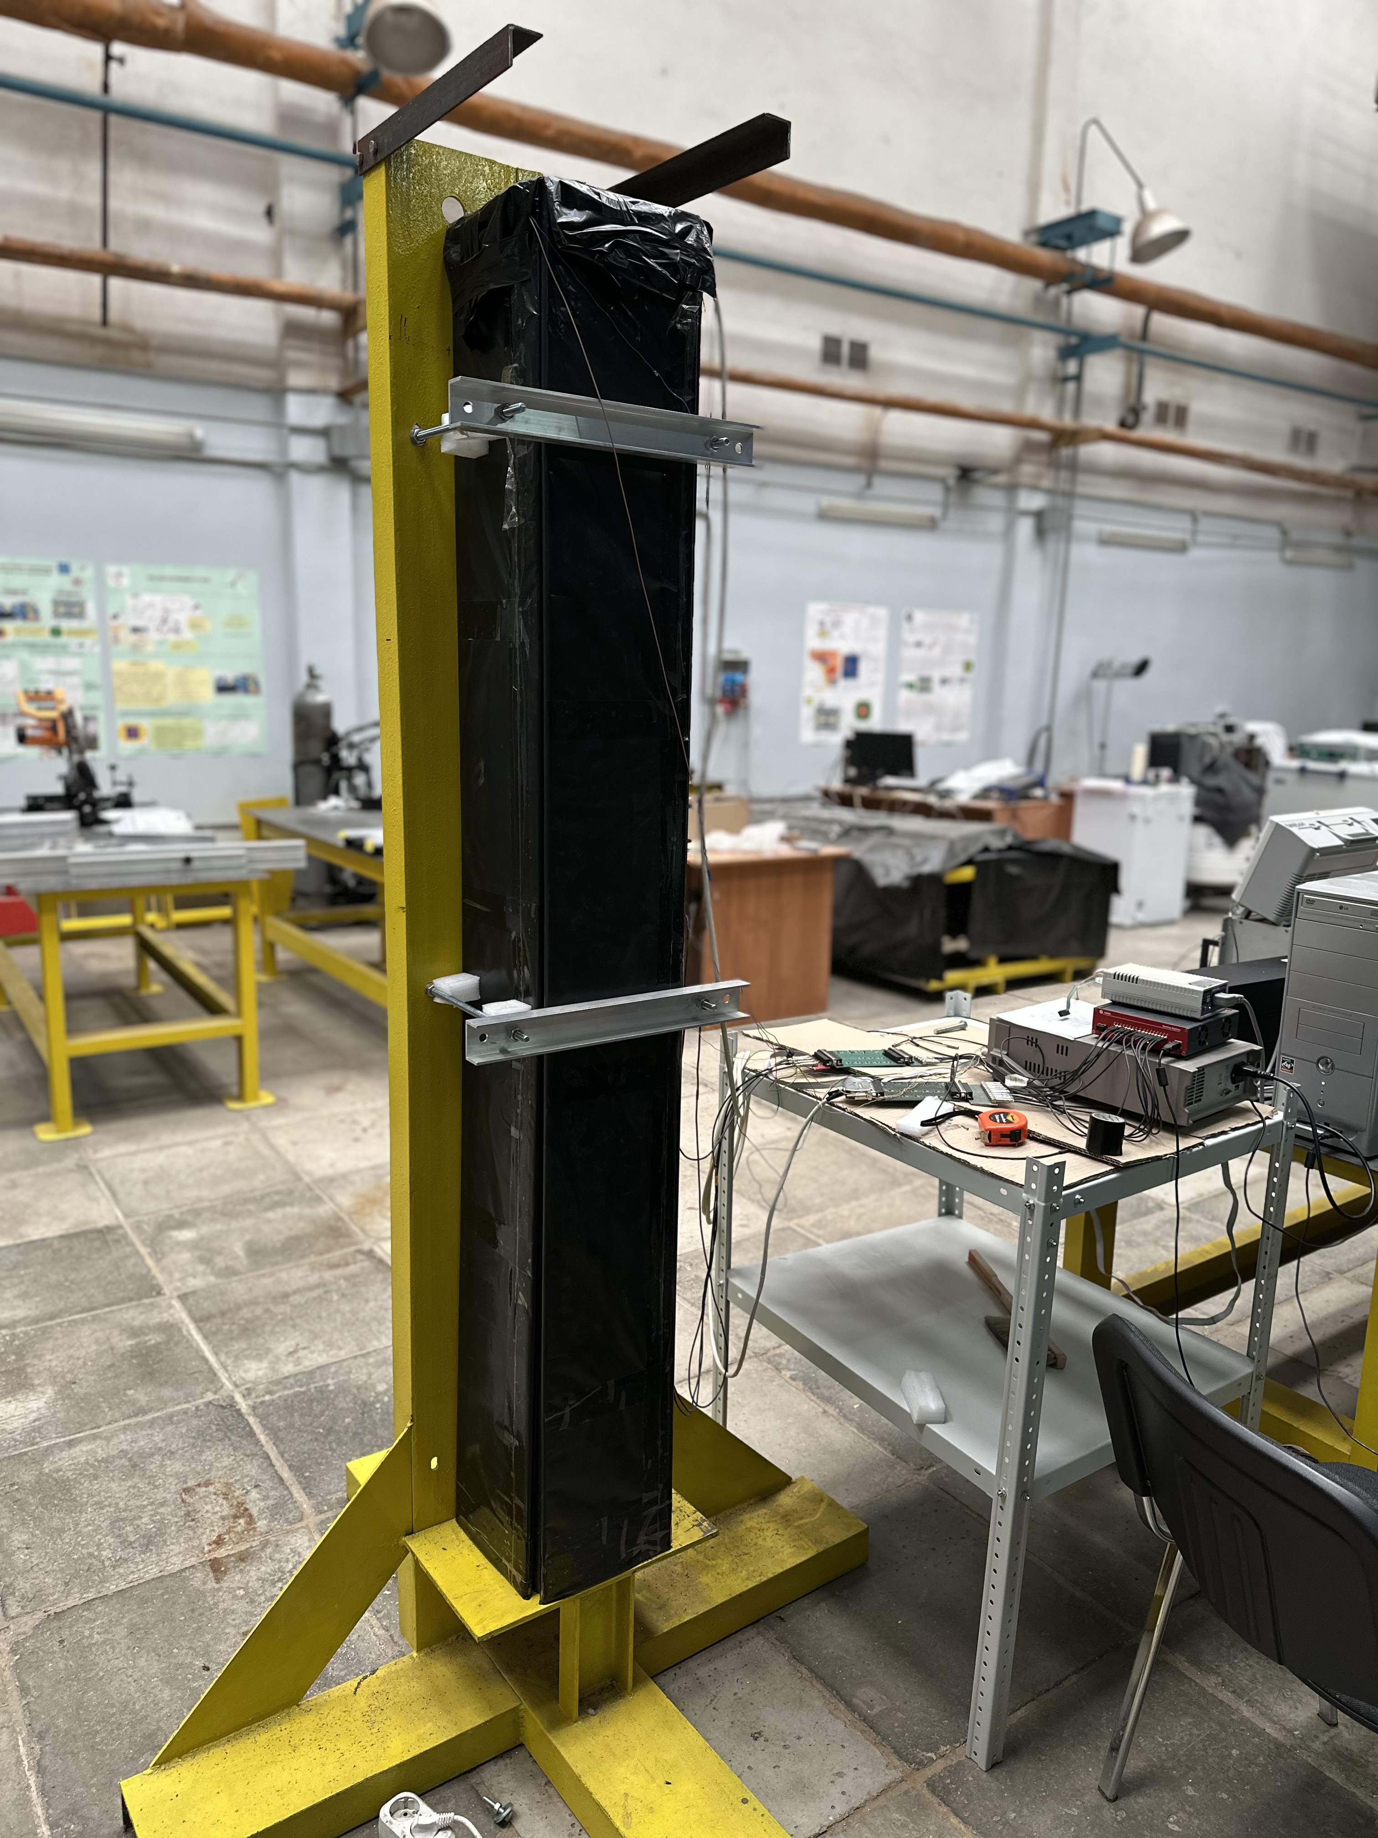
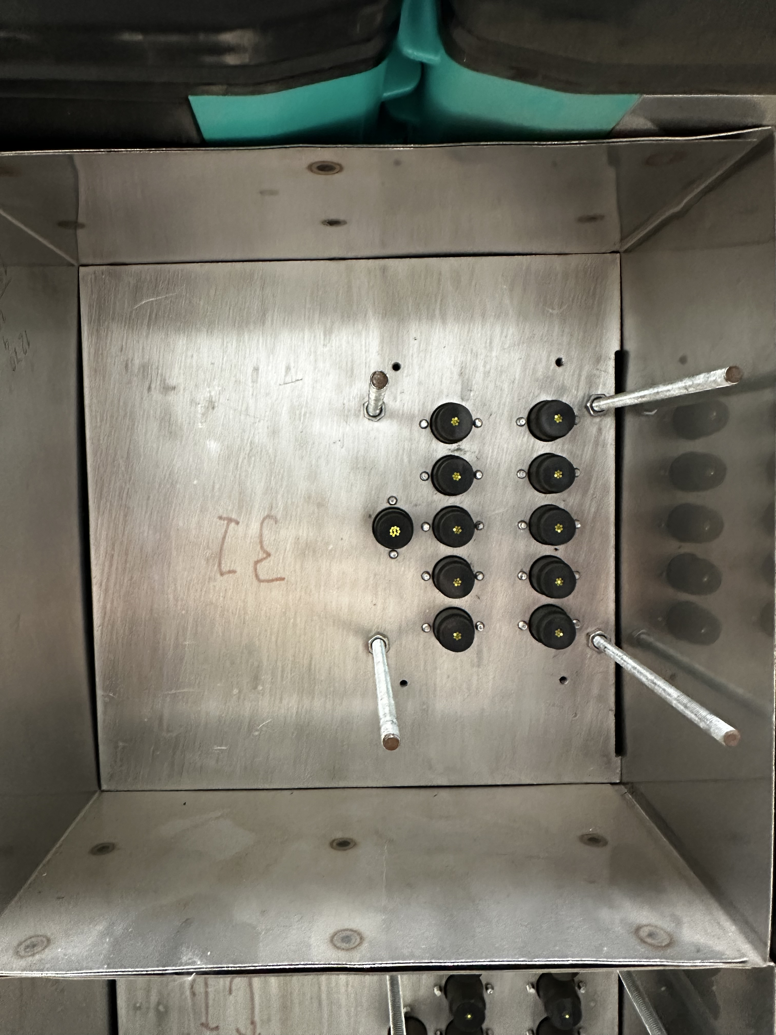
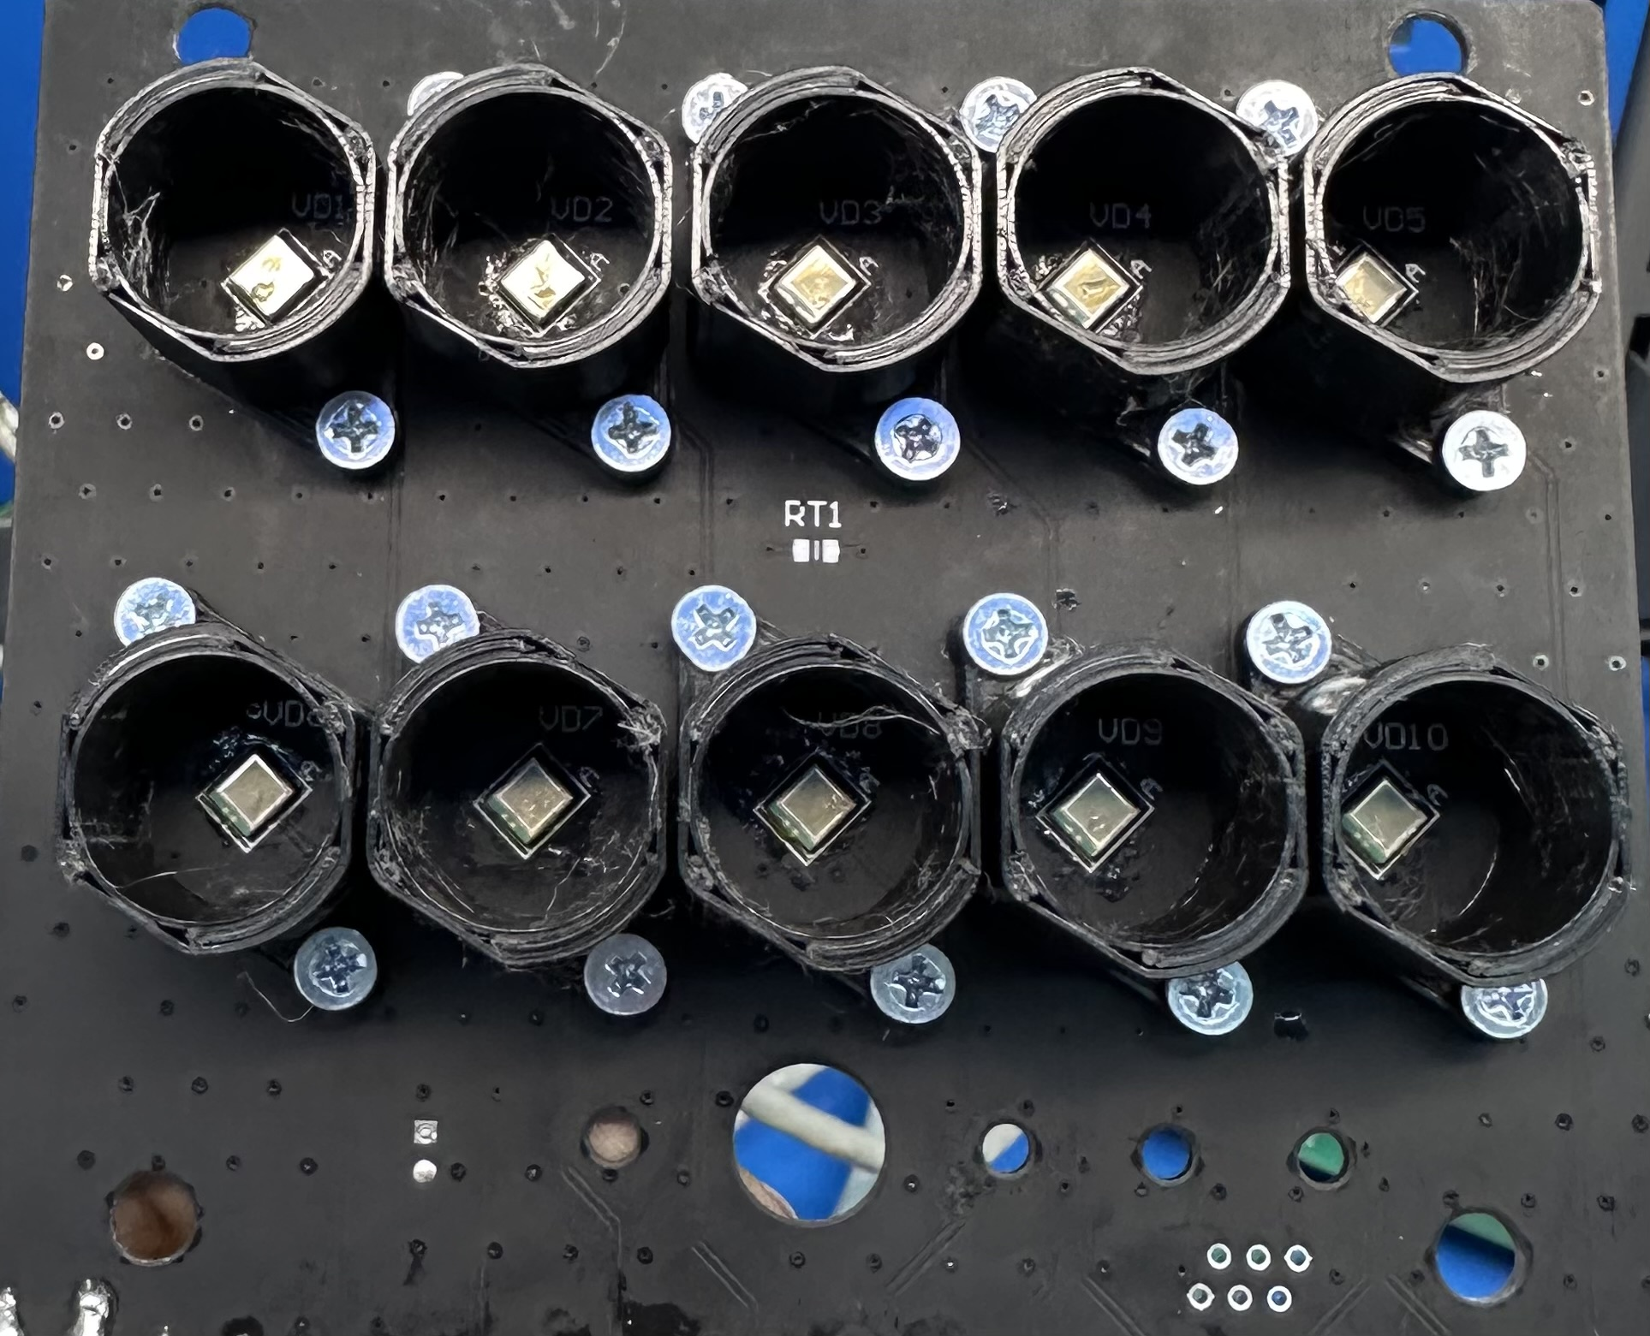
The appearance of the muon telescope
SiPM Hammatsu board adjacent to opto-connectors
Air
polyethylene
Air
FHCal module (Sc+Pb)
plate with
optic connectors
Veto
detector
Fe
Al
Module
housing
Muon telescope with veto detectors in INR

Slide 5
Muon event selection methodology
μ₁
μ₃
μ₂
Section number | Effective solid angle (Sr) | Mean kinetic energy of muons stopped in section (MeV)
1 | 0.0401 | 233
2 | 0.0269 | 367
3 | 0.0179 | 504
4 | 0.0120 | 639
5 | 0.0079 | 780
6 | 0.0051 | 924
7 | 0.0032 | 1067
8 | 0.0018 | 1213
9 | 0.0008 | 1358
Signal from the photodiode
Schematic diagram of the experimental module. The effective solid angles for muons stopping in this section are shown on the table. The effective solid angle was obtained from a simulation taking into account scattering.
Signal amplifier
Summing channel (alternative trigger)
Reading channel
Trigger channel CAEN
CAEN DT5742
(16-channel high-speed digitizer)
Data collection system.

Slide 6
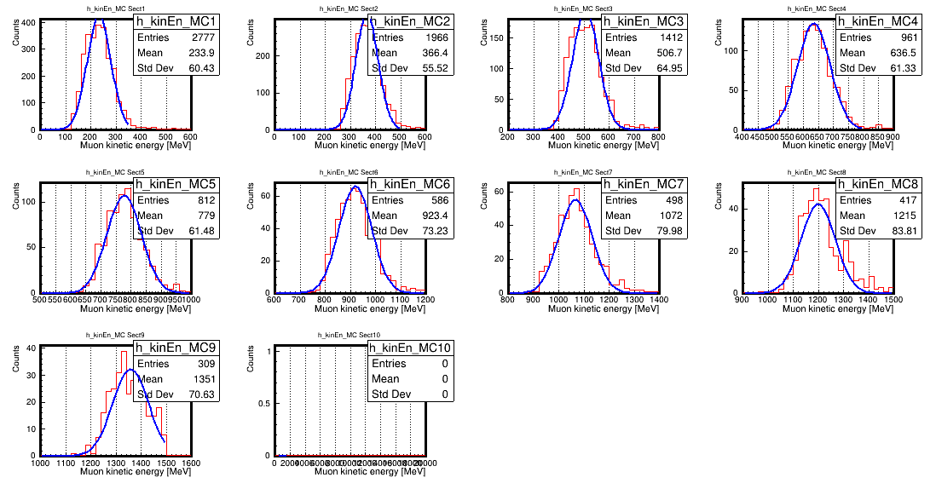
Kinetic energy of muons stopped in sections (Simulation)
Module sections:
1 2 3 4
5 6 7 8
9 10
Distribution of energy released by a muon in each section during simulation in the GEANT4 system. Distribution of muon stopping energies in sections in order.

Slide 7
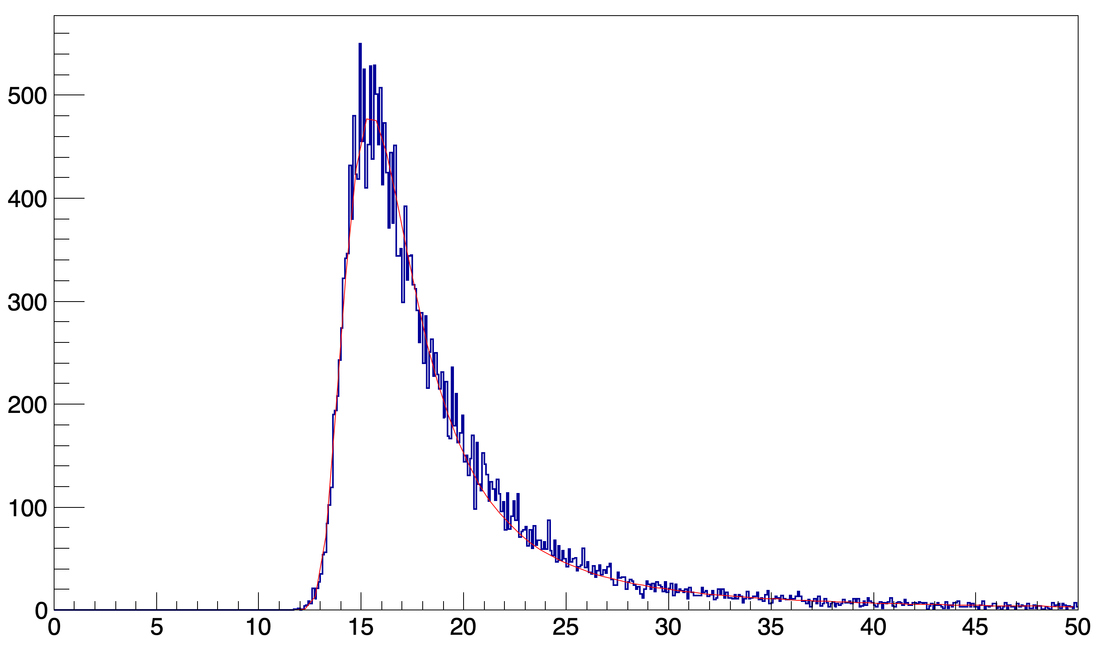
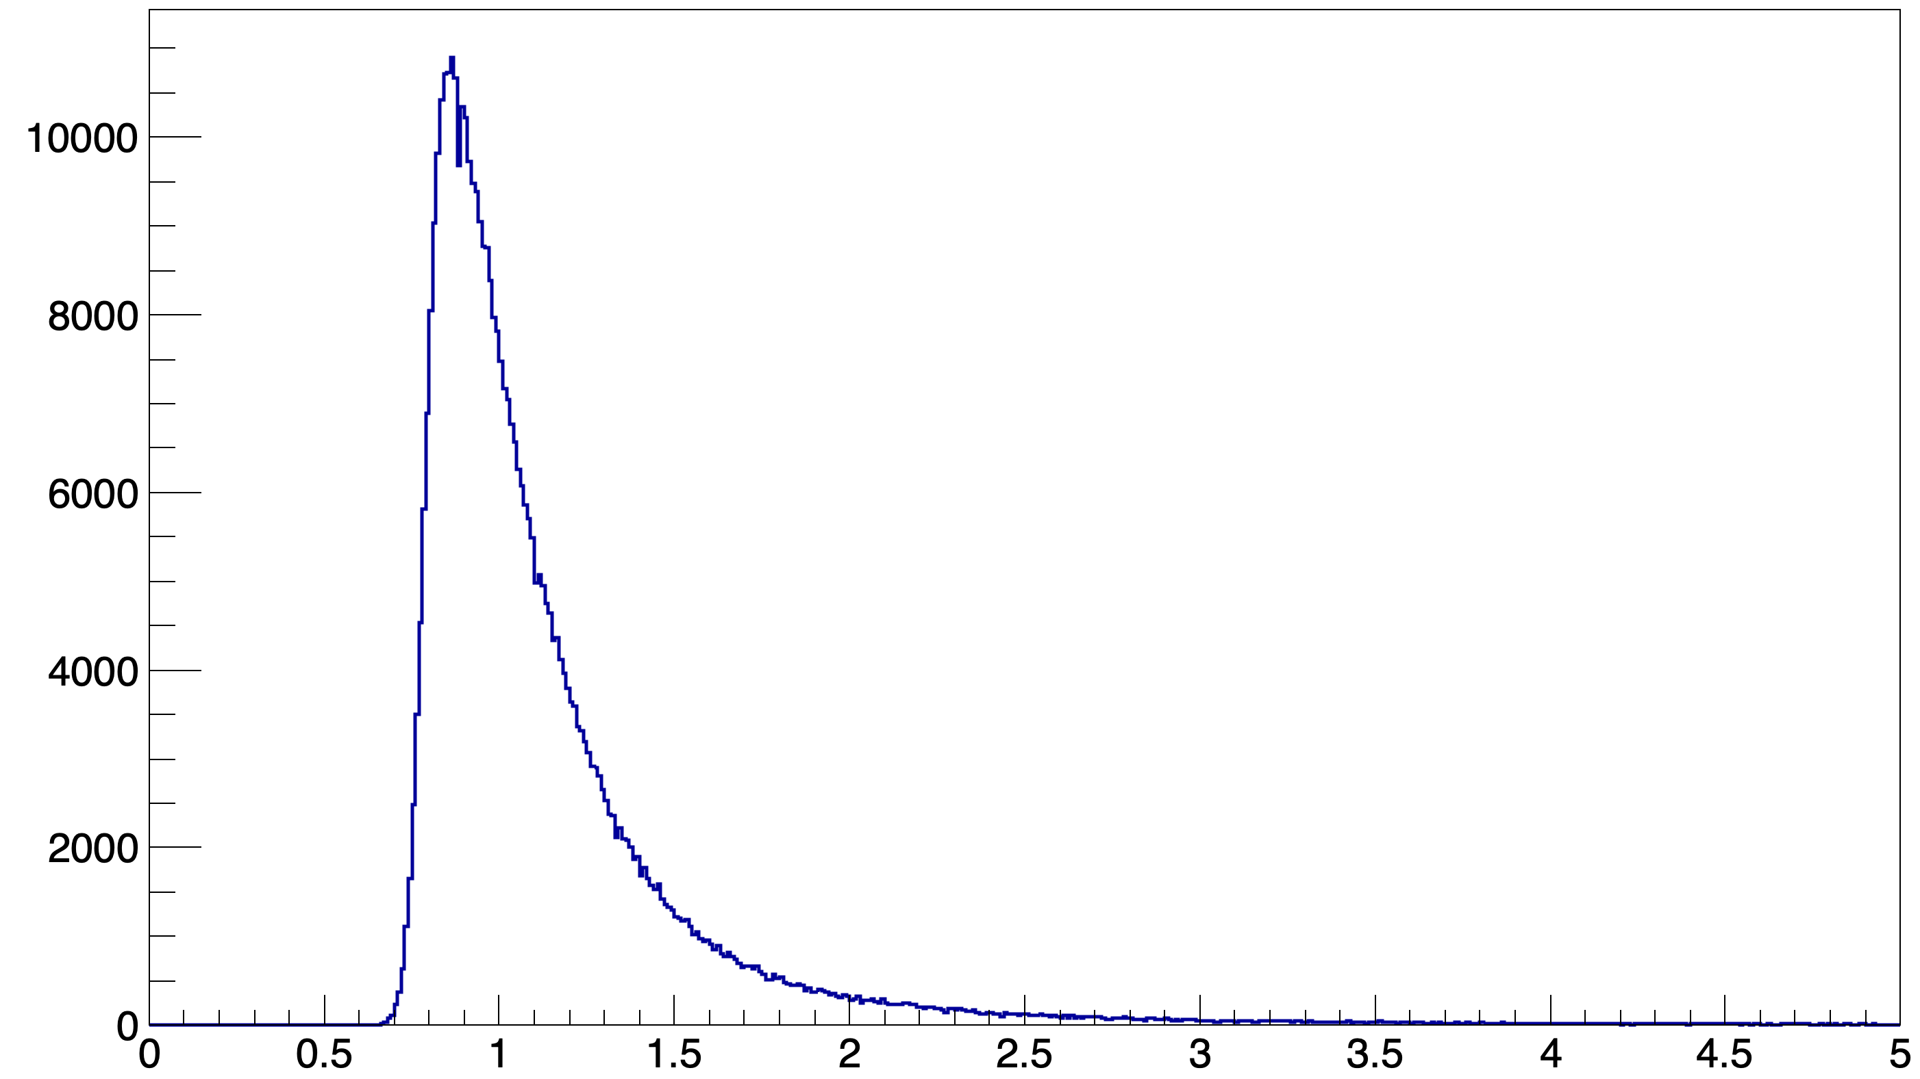
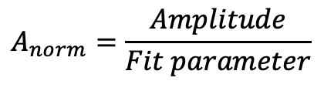
Calibration of signal responses in sections
μ₁
Muon energy release spectrum in the section with a fit. Red is fit parameter.
Counts
Most probable value (MPV)
$$A_{norm}=\frac{Amplitude}{Fit parameter}$$
Amplitude, mV
Counts
MIP

Slide 8
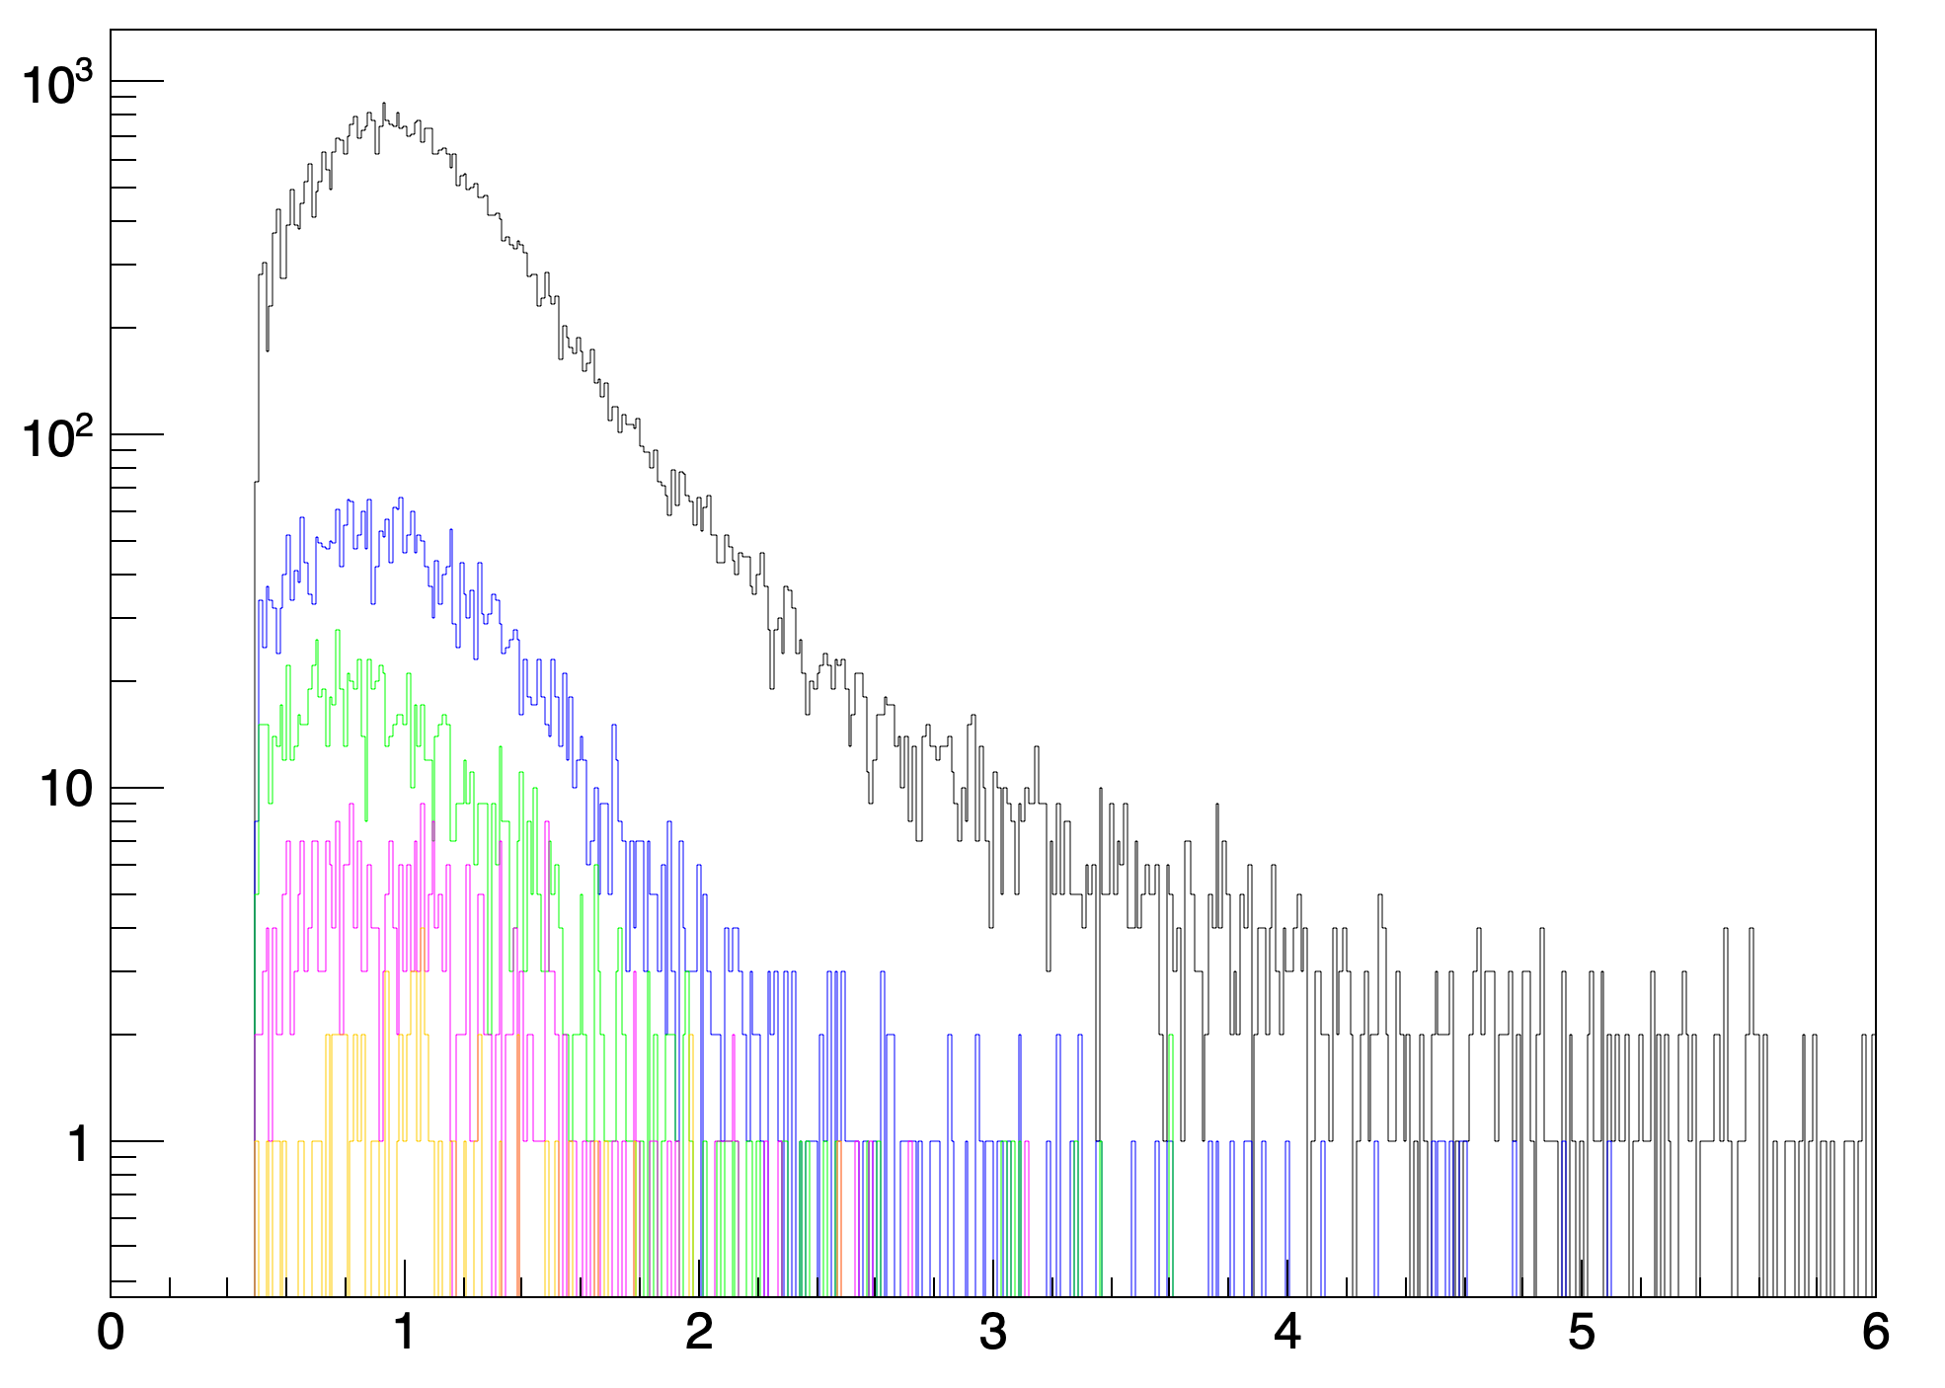
Spectra of stopped muons in the sections
Black – 2 section
Blue – 3 section
Green – 4 section
Magenta – 5 section
Orange – 6 section
Counts
MIP
Spectra of muons stopped in the sections up to in section №2-6. Data for 21 days.
Number of stopped muons in sections. Data for 21 days.

Slide 9
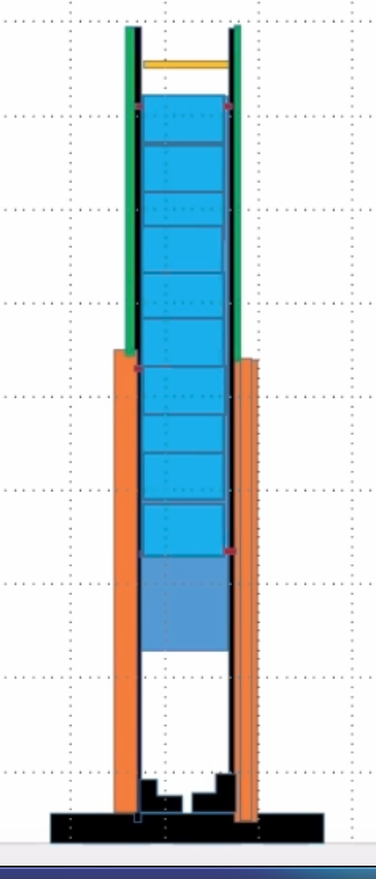
Conclusion
A muon telescope based on a hadron calorimeter module to detect muons from cosmic rays on the Earth's surface has been assembled and tested.
The first muon data were obtained.
Planned work
Improving the design of the muon telescope to extend the muon energy range.
To calculate low-energy muon fluxes corrections for the efficiency of scintillation detectors, system veto, event selection efficiency, trigger, and other parameters should be taken into account.
Improving the design of the muon telescope

Slide 10
References
1. Developmental Programming of Fetal, Growth and Development. S Mishchenko, A Valenti et al. // American Journal of Obstetrics and Gynecology, 2016
2. M. Motoki et al., Precise Measurement of Atmospheric Muon Fluxes at Sea Level Proceedings of ICRC 2001: 927

Slide 11
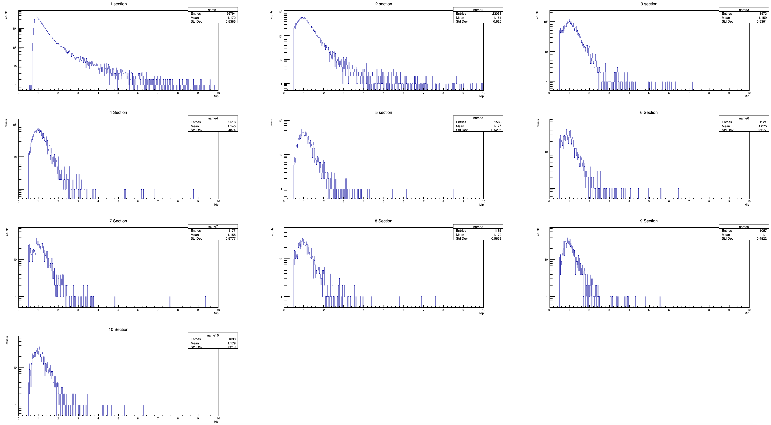
Muon energy release spectra in the section
Figure 6. At the top are the spectra of each section with the energy release of muons. At the right is the number of muons stopped in each section.

