Slide 1
Upgrading the No. 2 and No. 3 thermal neutron beams at the Dalat Nuclear Research Reactor
29th International Scientific Conference of Young Scientists and Specialists (AYSS-2025)
27-31th October, Dubna, Russia
Presenter: Trinh Van Cuong^{1,2}
Co-authors: Phan Bao Quoc Hieu, Pham Ngoc Son, Nguyen Bich Thuy, Truong Phuong Dung
Affilicaion: ¹Center for Nuclear Physics, Dalat Nuclear Research Insitute (DNRI), VINATOM, Viet Nam
²FLNP Lab, Joint Institute for Nuclear Research (JINR), Russia
Email address: cuongtv@dnri.vn or cuong@jinr.ru

Slide 2
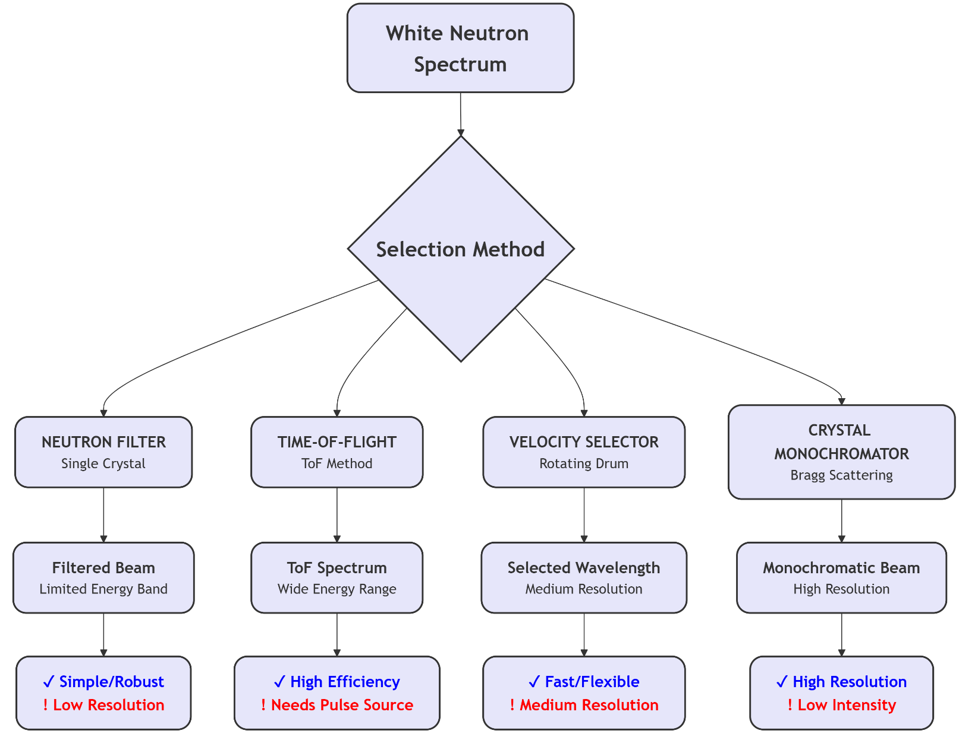
Introduction
High-quality thermal neutron beams are crucial for numerous applications, including nuclear physics, neutron imaging, and diffraction, SANS, PGNAA. However, neutron sources from research reactors emit a broad energy spectrum. Therefore, spectral tailoring techniques are required to maximize the thermal neutron component while suppressing epithermal and fast neutrons, and gamma-ray background.

Slide 3
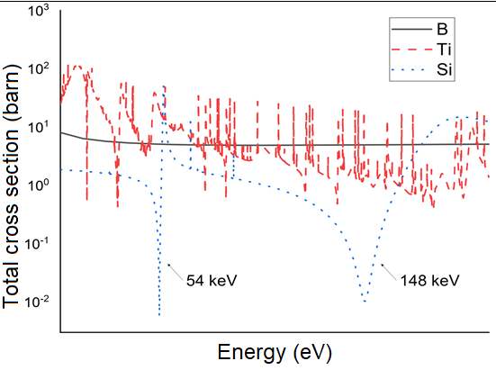
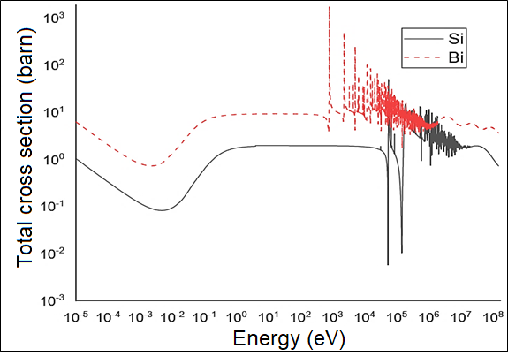

Neutron Filter Technique
Methodology
The principle of neutron filtering is based on selective attenuation through materials with a minimum in their total cross-section. Using a combination of these materials suppresses unwanted neutron energies from a reactor spectrum, yielding a quasi-monoenergetic beam. The transmitted spectrum 𝜙(𝐸) is given by the exponential attenuation law.
$φ\left(E\right)=φ_{0}\left(E\right).e^{−\sum_{k}{\frac{N_{A}}{M_{k}}ρ_{k}d_{k}σ_{t,k}(E)}}$ (1)
where:
$φ_{0}\left(E\right)$ and $φ\left(E\right)$ are the neutron energy spectra before and after the filter, respectively; $N_{A}$ is the Avogadro’s number (1/mol), $M_{k}$ is the molar mass (g/mol), $ρ_{k}$ is the mass density of the k^{th} filter material (g/cm³), $d_{k}$ is the length of the k^{th} filter component (cm), $σ_{t,k}\left(E\right)$ is the total cross-section of the k^{th} filter material at energy E (barn).

Slide 4
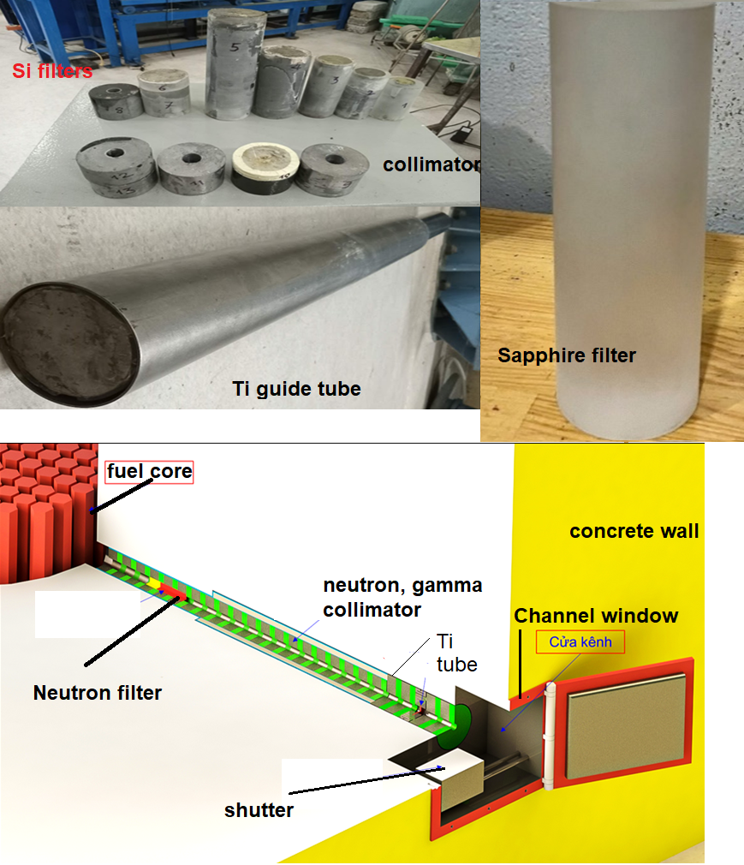
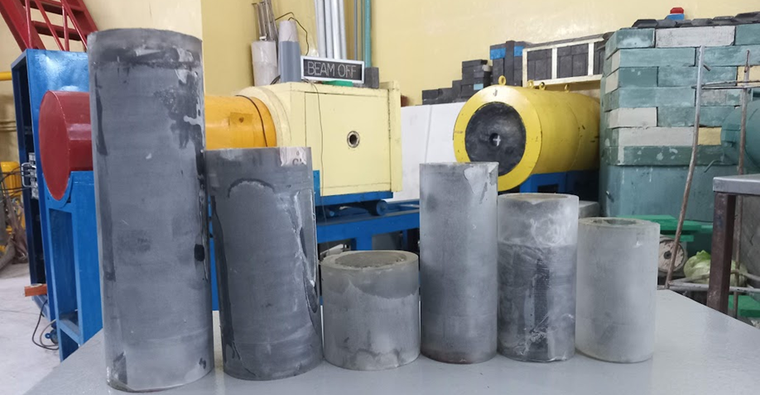
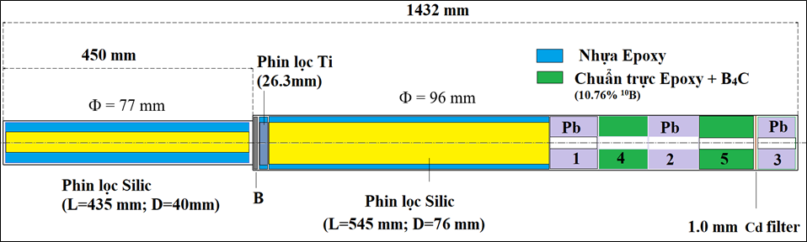

Slide 5
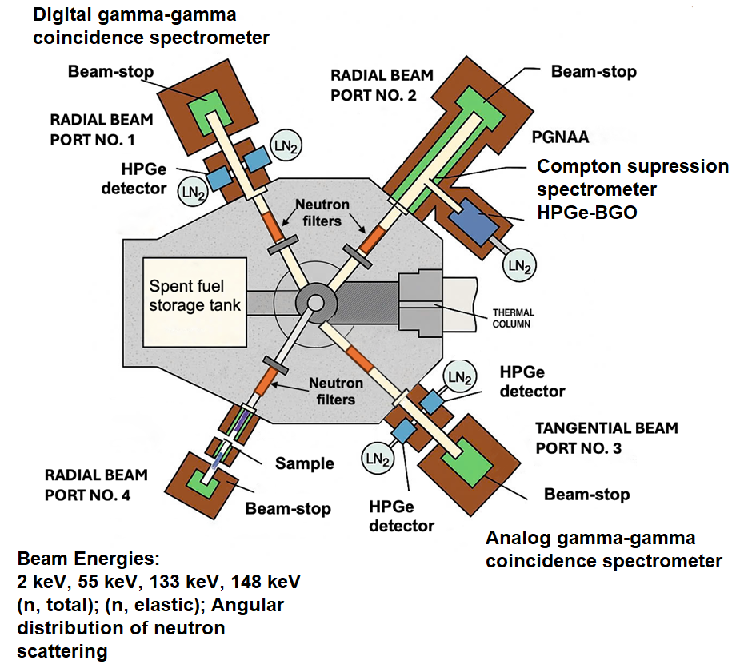
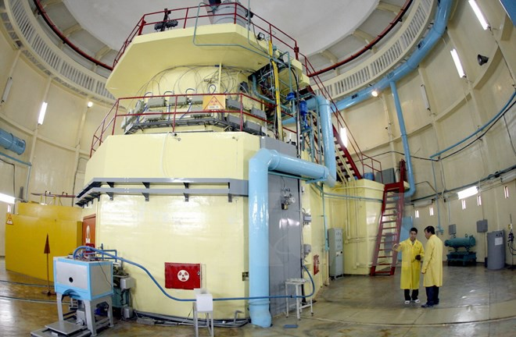
Methodology
Dalat Nuclear Research Reactor (DNRR):
1963 - TRIGA Mark II (USA), 250 kWt
1984 - IVV-9 (USSR), HEU (36%), 500 kWt
2011 - Replaced HEU to LEU (19.75%) by Russia, USA & IAEA, 500 kWt (0.5 MWt)

Slide 6
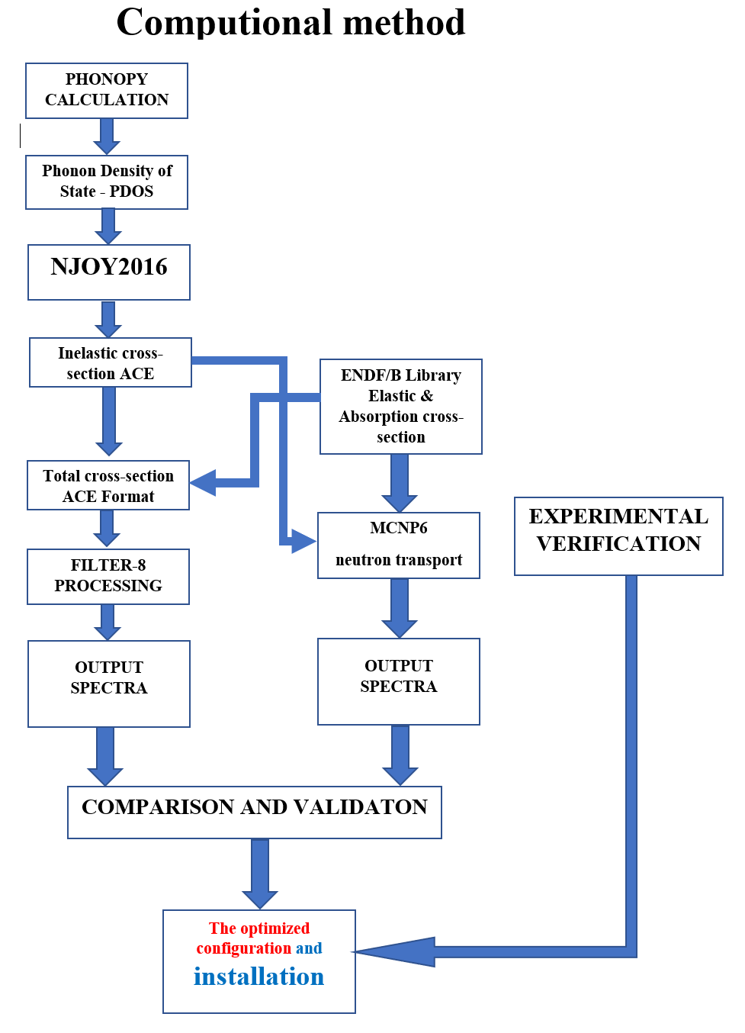
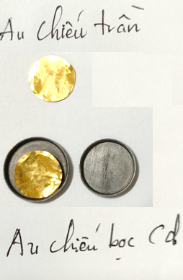
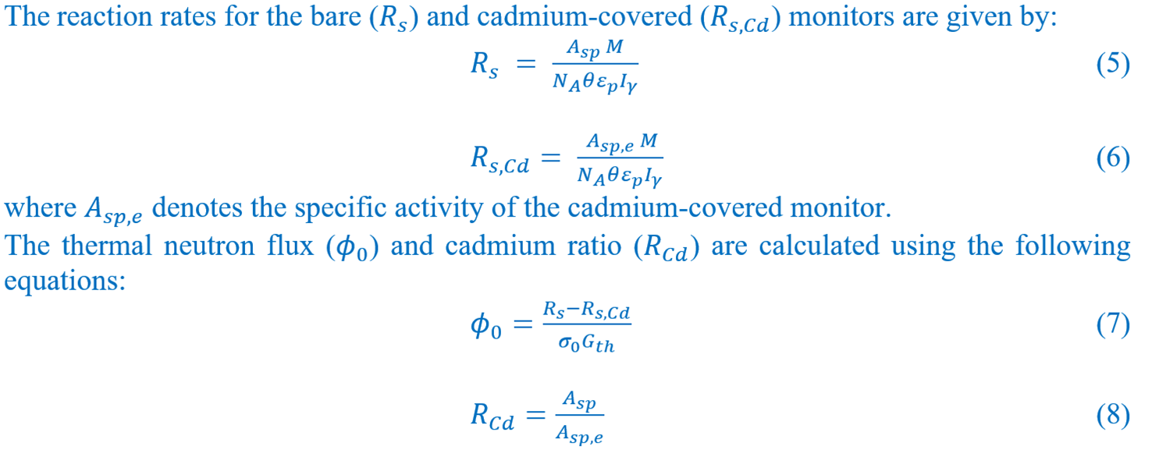

Methodology
- A computational approach for upgrading the thermal neutron beams:
The PDOS of the sapphire C-plane (0001) crystal (mp-1143) was calculated using the PHONOPY code with a supercell dimension matrix of $2×2×1$.
- An experimental verification was carried out with gold foils

Slide 7
PDOS – Total cross-section
Results

Slide 8
FILTER-8 CODE
Results

Slide 9
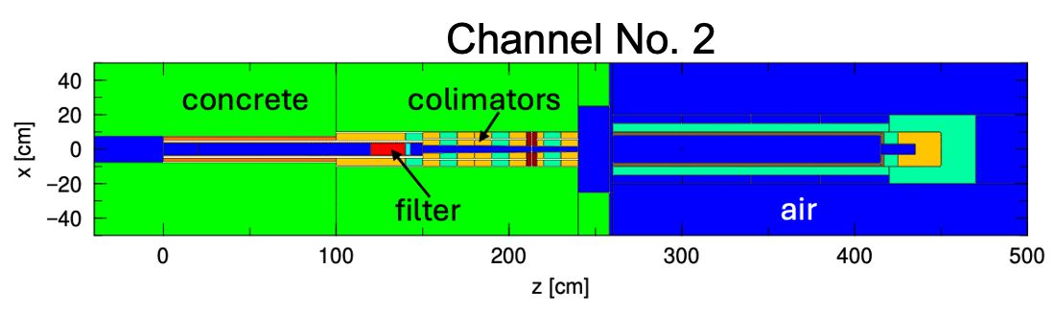
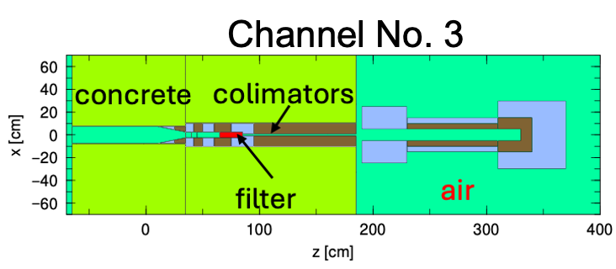
MCNP6 CODE
Results

Slide 10
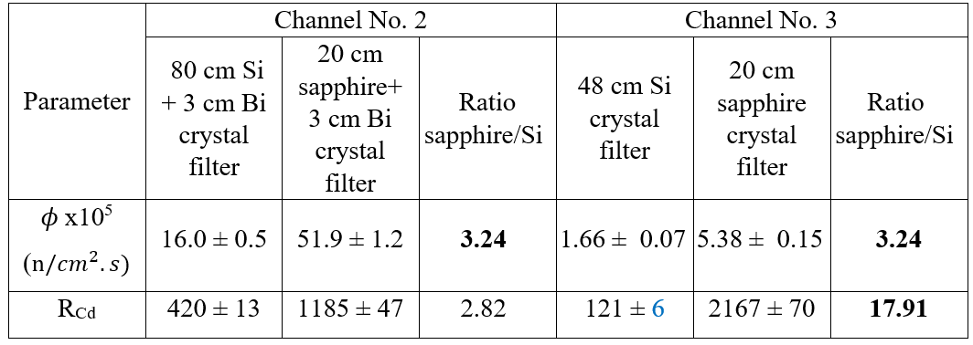
MCNP6 CODE
Results
Experimental measurement

Slide 11
Upgrading the thermal neutron beams
Disscussion
Simulation results obtained from the FILTER-8 and MCNP codes further suggest that a sapphire thickness of 15 cm is optimal for achieving a thermal-to-epithermal neutron flux ratio exceeding 1000.
Both the intensity and quality of thermal neutron beams No. 2 and No. 3 at the DNRR have been significantly improved by using 20 cm length sapphire crystal filters. The thermal neutron flux increased by factors of 3.24 at both channels No. 2 and No. 3, while the cadmium ratio was enhanced by factors of 2.82 and 17.91, respectively.
These results confirm the superior capability of sapphire crystals in suppressing epithermal and fast neutron components and provide an additional option for thermal neutron beam selection at the DNRR.
These improvements are promising for enhancing the accuracy of nuclear data measurements and increasing elemental sensitivity in Prompt Gamma Neutron Activation Analysis (PGNAA) applications.

Slide 12
Thanks for your attention
15 minutes = 2.8539 x ${10}^{−7}$of the human life

