Slide 1
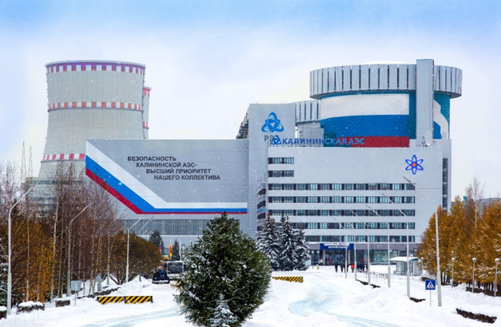

Data Analysis Methods in the νGeN Experiment Searching for Coherent Elastic Neutrino Nucleus Scattering (CEvNS)
ν
GeN
Presenter: Pham Thanh

Slide 2
nuGeN experiments
The main purpose of the νGeN project is the investigation of the neutrino properties with help of low threshold HPGe detectors located close to nuclear power reactor.
Search for coherent elastic neutrino nucleus scattering (CEvNS)
Search for neutrino magnetic moment (NMM)
Search for non-standard neutrino interactions (NSI)
Investigation of the nuclear structure (form factors, Weinberg angle at low energy)
Other processes (axions, sterile neutrinos, non-elastic scattering,…)
Applied usage, reactor monitoring

Slide 3
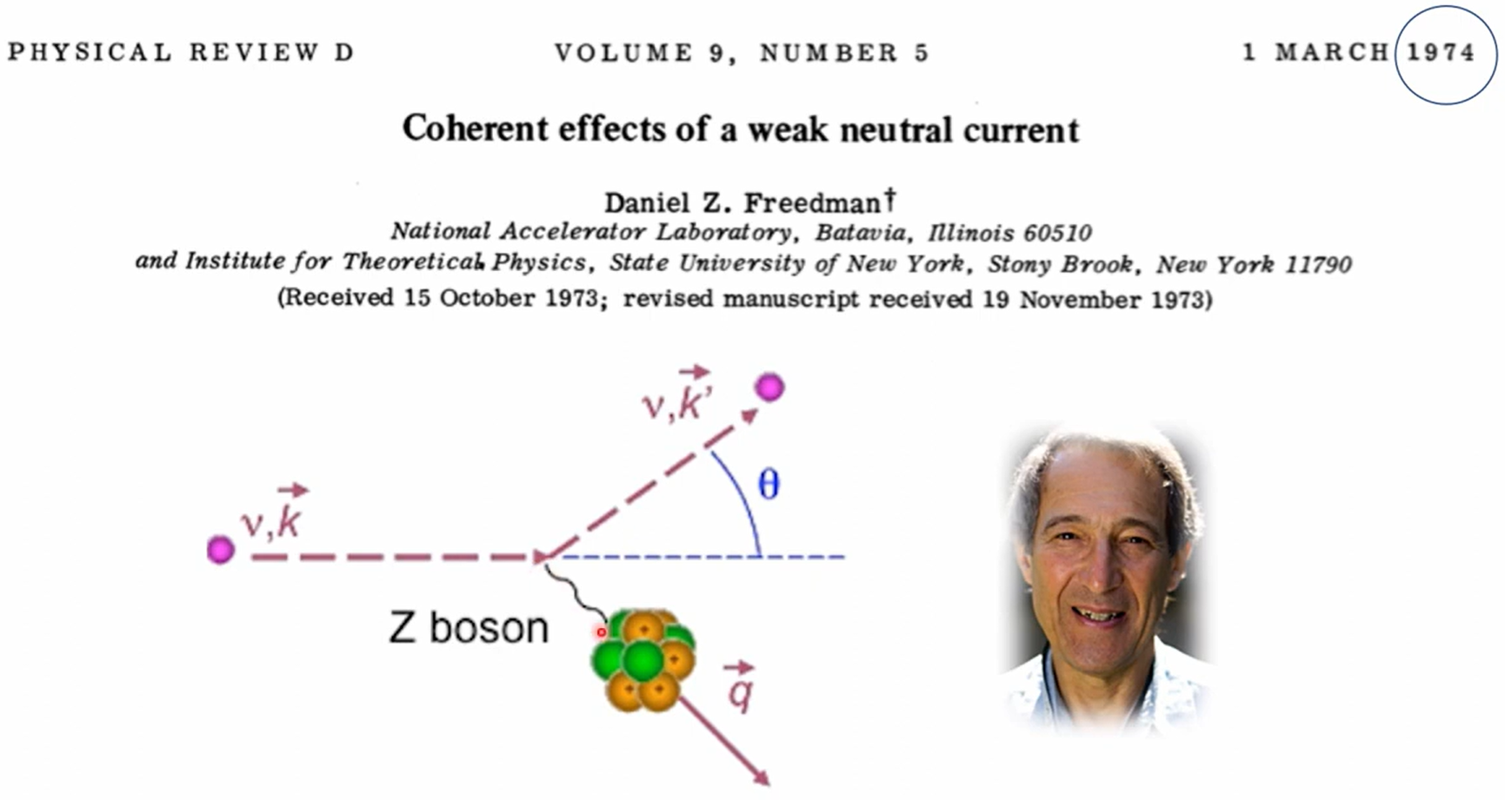
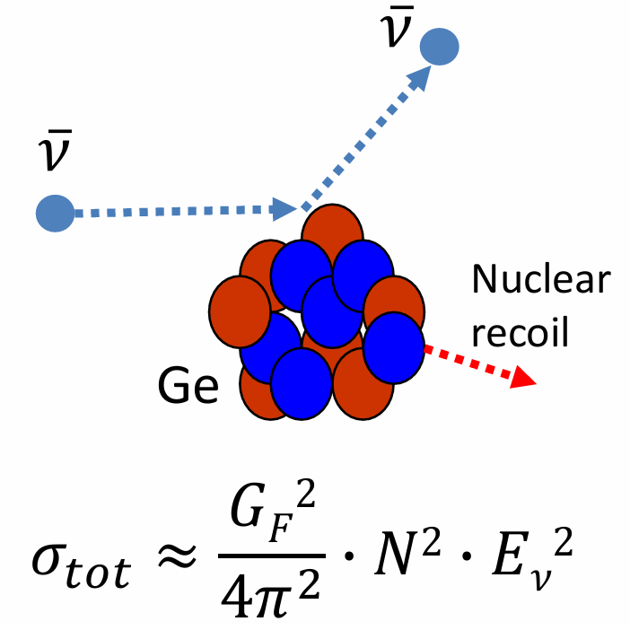
CEνNS
Coherent Elastic Neutrino-Nucleus Scattering (CEνNS) is a process predicted by the Standard Model.
In this interaction, all the nucleons in the nucleus interact as a whole, which gives the process its “coherent” name.

Slide 4
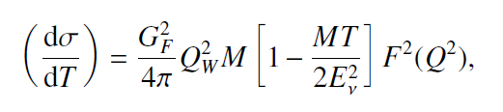
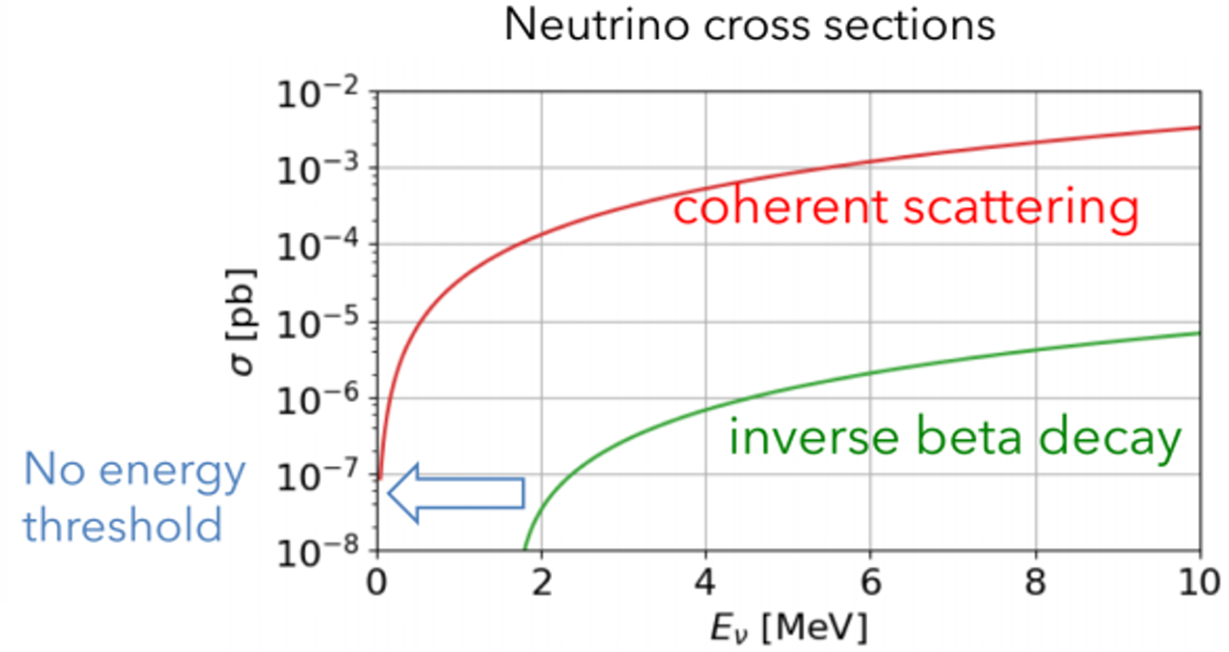


CEνNS
G²_{F} = 1.166×10⁻⁵ GeV⁻² is the Fermi constant
E_{ν} < 50 MeV (full coherency ~ 30 МeV)
Cross-section is being proportional to the number of the neutrons squared in the nuclear target.
Several orders of magnitude higher than “usual” cross-section of neutrino.
Energy of recoils is very low (usually less than few keV).
Moreover, often only part of its energy can be detected (for Ge detector < 20%)
F²(Q²) ~= 1 is the nuclear form factor
of momentum transfer Q
T is the recoil energy of nuclear
σ ∝ N²
is the weak charge of a nucleus
is Weinberg angle at low energies

Slide 5
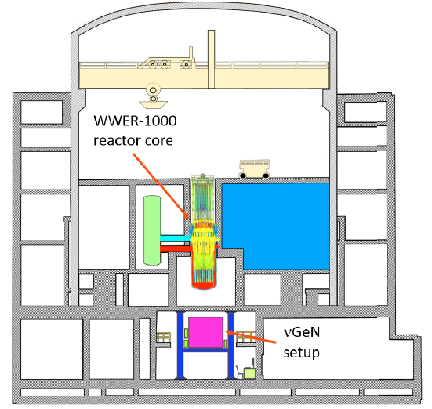
Kalinin Nuclear Power Plant - Neutrino sources
vGeN spectrometer has been constructed close to the reactor core.
It is located at ~11 m from powerful 3.1 GW reactor’s core under an enormous antineutrino flux of 4.4.10¹³/(s.cm²) up to 10 MeV.
Experimental setup is located under the reactor ~50 m w.e. (shielding against cosmic radiation).

Slide 6
Comparison of the reactor sites
Experiment | Location | Neutrino flux [cm².s] | Overburden [m w. e.]
νGeN | KNPP, Russia | 4.4x10¹³ | ~50
CONUS | Brokdorf, Germany | 2.4x10¹³ | 10-45
TEXONO | Kuo-Sheng NPP, Taiwan | 6.4x10¹² | ~30
RED-100 | KNPP, Russia | 1.7x10¹³ | ~50
CONNIE | Angra 2, Brazil | 6.8x10¹² | 0
RICOCHET | ILL, France | 2x10¹² | ~15
MINER | Texas A&M, USA | 2x10¹² | ~5
NUCLEUS | Chooz, France | 2x10¹² | ~3

Slide 7
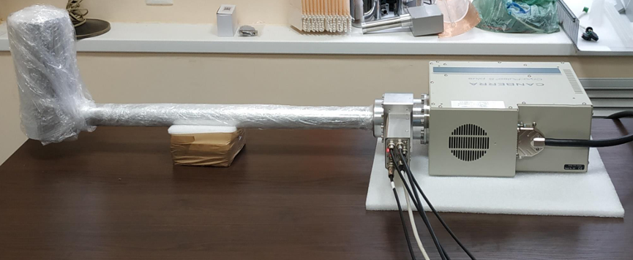
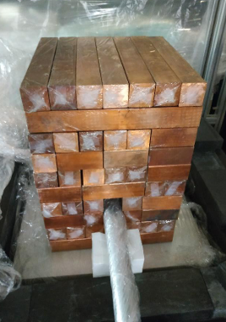
HPGe detector for vGEN
To detect signals from neutrino scattering, specially produced low-threshold, low-background HPGe detectors by CANBERRA (Mirion, Lingolsheim) are used.

Slide 8
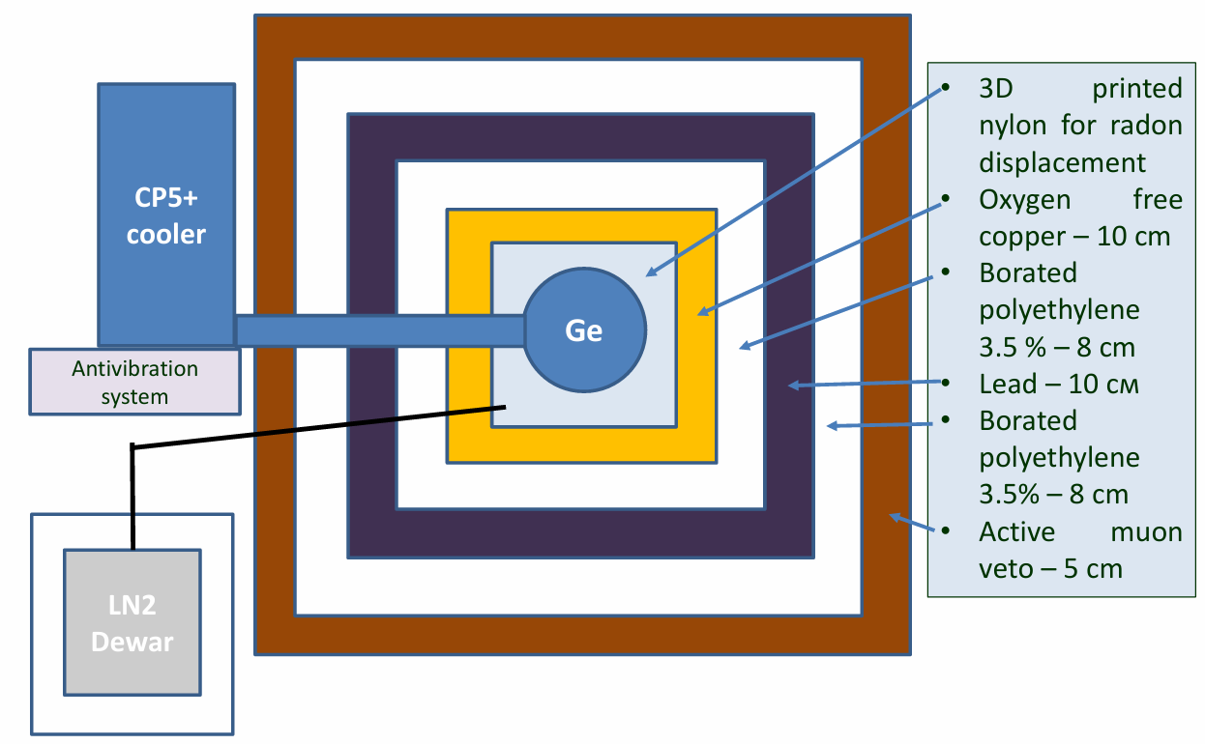
Scheme of shielding

Slide 9
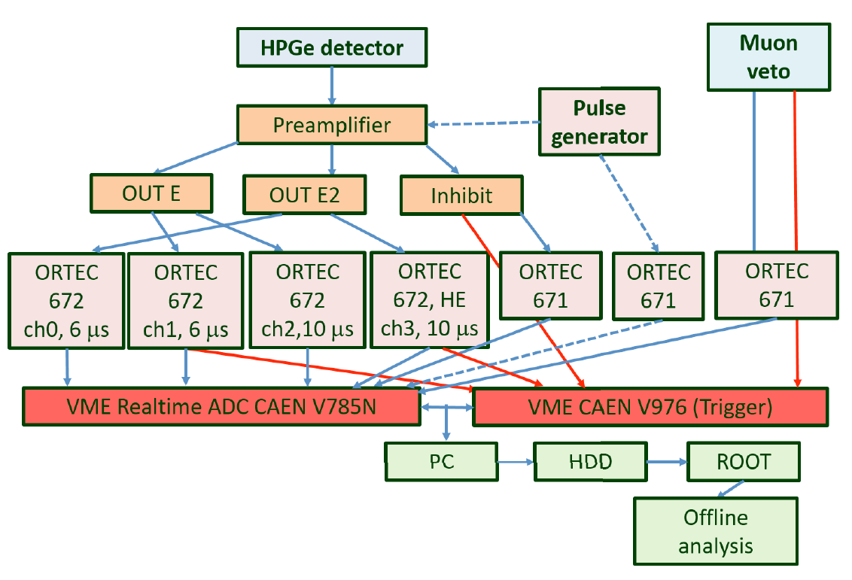
Simplified scheme of measurements
Channel 0, 1, 2 measurements below ∼13 keV
Wide energy region up to 1000 keV is measured with channel 3.
Muon Veto: This system is an external detector that spots muons. When a muon passes through, it sends a signal to the trigger. This lets us 'flag' and reject any events caused by muon into detector.
Inhibit: This signal, from the preamplifier, usually when it resets. It also tells the trigger unit to reject the electronic noise associated with these resets during our analysis.

Slide 10
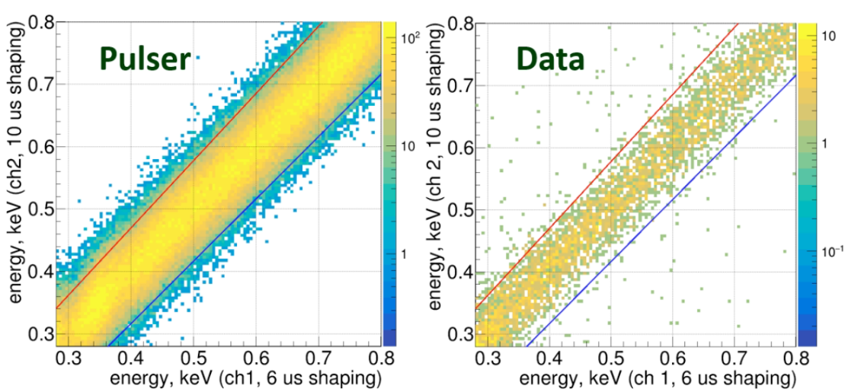
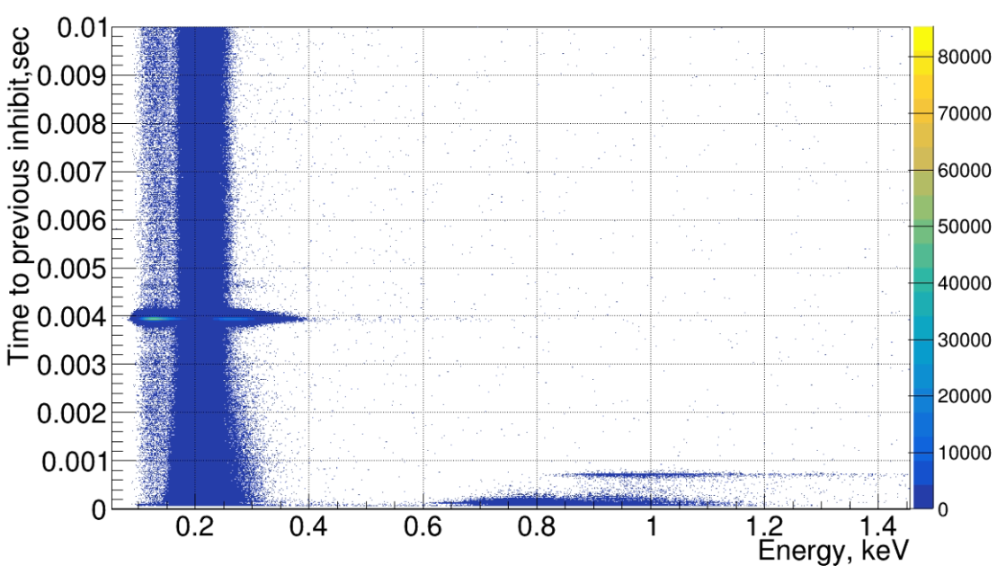
Graphical cuts and inhibit cuts (after reset)
Beyond Fig. shows the two dimensional histograms of the events reconstructed using different preamplifier chains.
The events from the pulse generator are located mostly diagonally, similar to the physical events.
The solid lines are graphical cuts which exclude events outside the diagonal area, nonphysical noise events generated in the electronic chain can be removed from the data.
The reset of the baseline produces small afterpulses, which can also be interpreted as physical signals.
Nonphysical events induced by the reset are clearly visible in the below Fig.
To eliminate these artificial events, a 4.8 ms time window after each reset is removed from the data analysis.

Slide 11
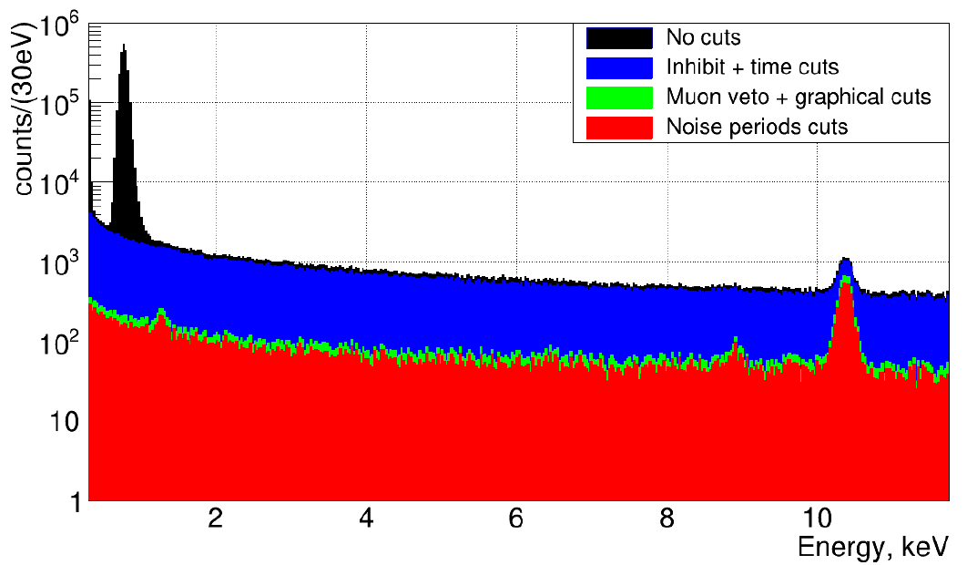
Energy spectrum before after the application of several cuts
The energy spectrum, both before and after applying the cuts, is shown in Fig.
Both the muon and inhibit cuts remove some physical events due to the dead time introduced by the muon or inhibit signals.
A correction for this dead time, calculated to be approximately 9.0%.
^{68,71}Ge (L)
1.3 keV
^{68,71}Ge (K)
10.367 keV

Slide 12
Calibration energy for several RUNs
Alongside applying cuts to remove non-physical events, a precise energy calibration is essential.
The νGeN experiment data is divided into different “RUNs”.
This allows for an analysis appropriate to the specific conditions of each data-taking period.
While the fundamental cuts are similar across all RUNs, the energy calibration method was modified for RUN 8 and RUN 9 compared to previous RUNs.
The non-linear function was applied to the energy calibration to compare the differences and improvements against the linear function.

Slide 13
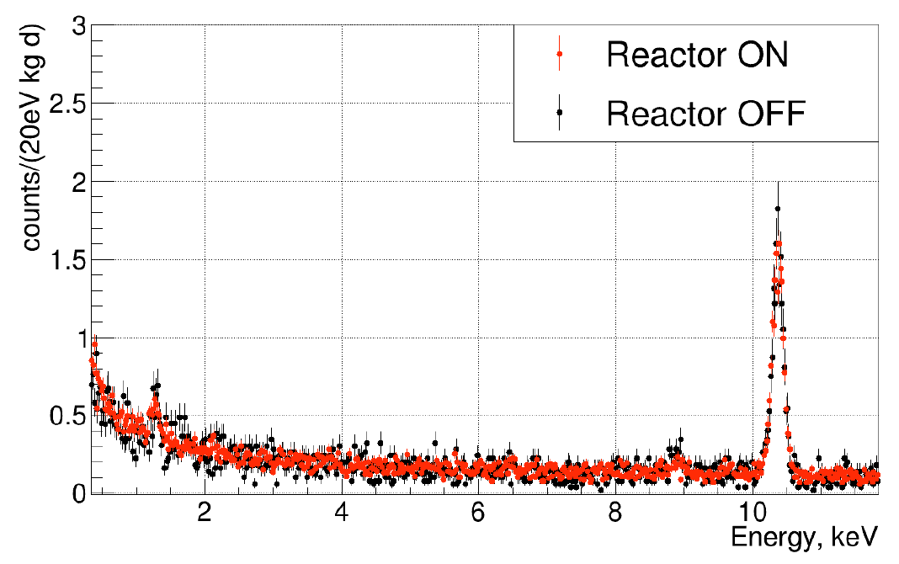
Comparison of the spectra acquired ON and OFF in RUN7
^{68,71}Ge (K)
10.367 keV
^{68,71}Ge (L)
1.3 keV

Slide 14
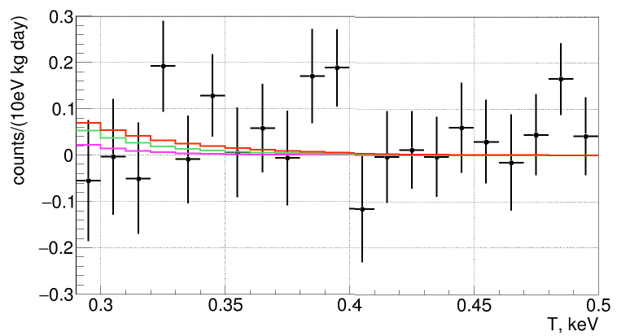
The residual ON-OFF recoil energy spectrum in RUN7

Slide 15
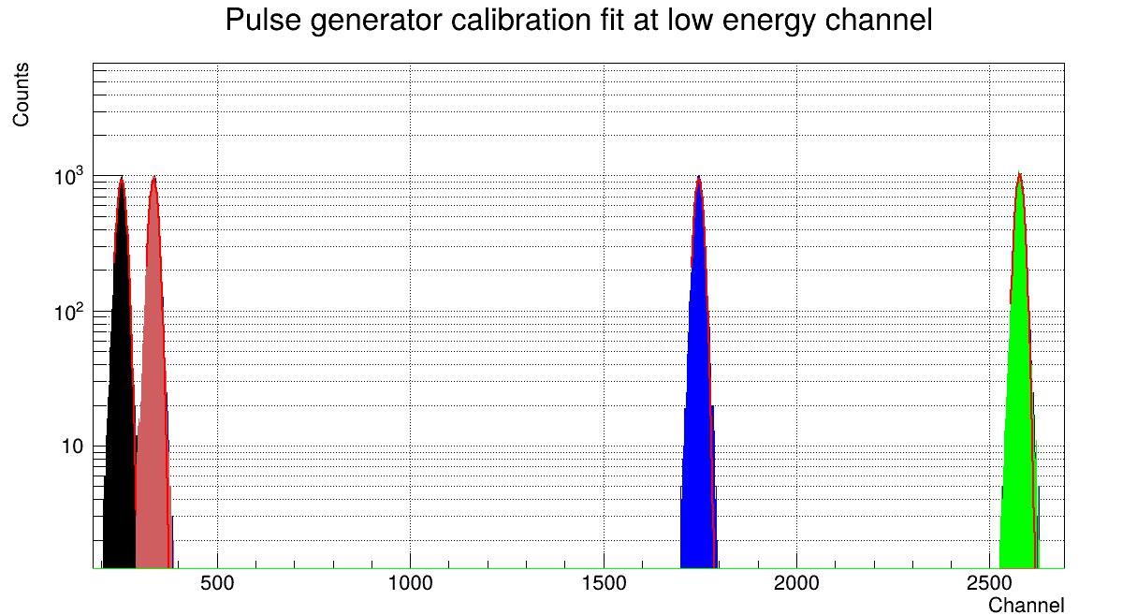
Low energy calibration
^{Pulse generator 0.01 V}
^{Pulse generator 0.1V}
^{Pulse generator 0.15 V}
^{Pulse generator 0.015 V}

Slide 16
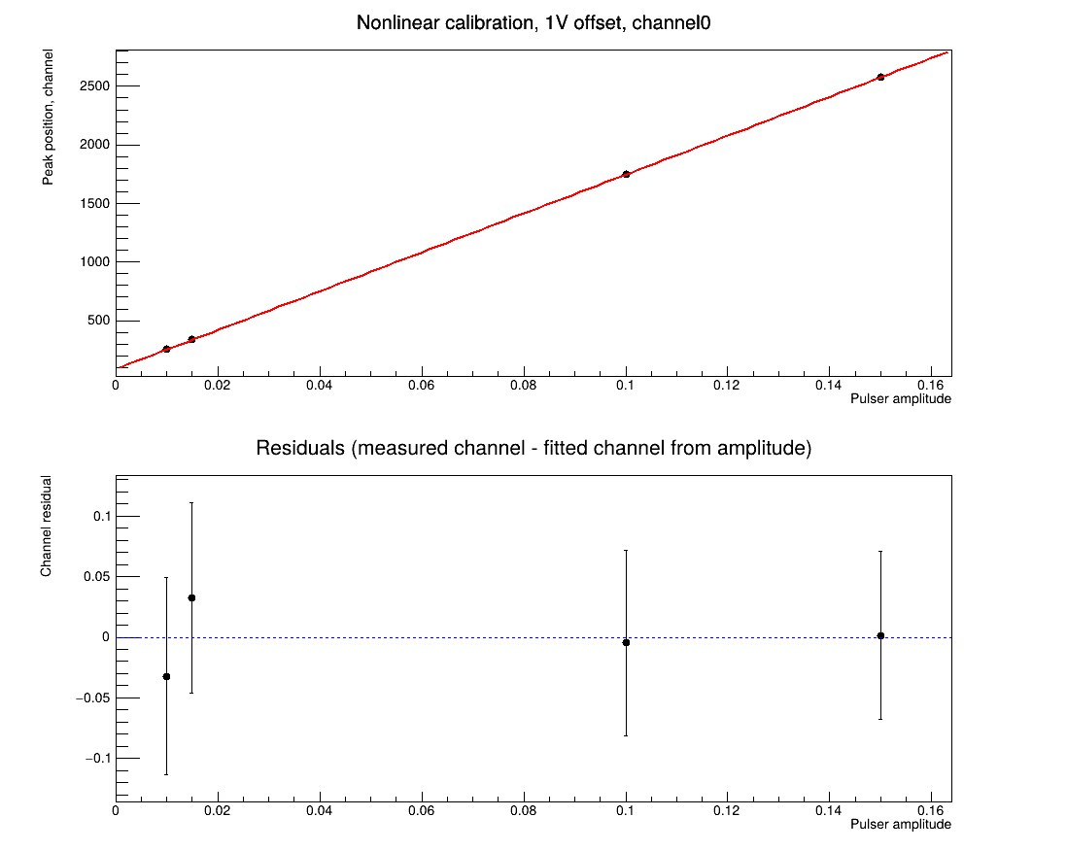
Low energy calibration
Use pulse generator and position of 10.367 keV from spectrum to calibration low energy spectrum.
Instead of using a linear function (y = ax + b) to calibrate the channel - energy in the low energy region, then use a non-linear function (y= ax² + bx + c)
With pulse generator, get parameter a, b, c:
V = a*Channel² + b*Channel + c,
and with position P of peak 10.367 (keV), then got
E’ = a*P² + b*P + c
Parameter for energy calibration curve fit :
A = a*10.367/E’ ~ 10⁻⁸
B = b*10.367/E’
C = c*10.367/E’

Slide 17
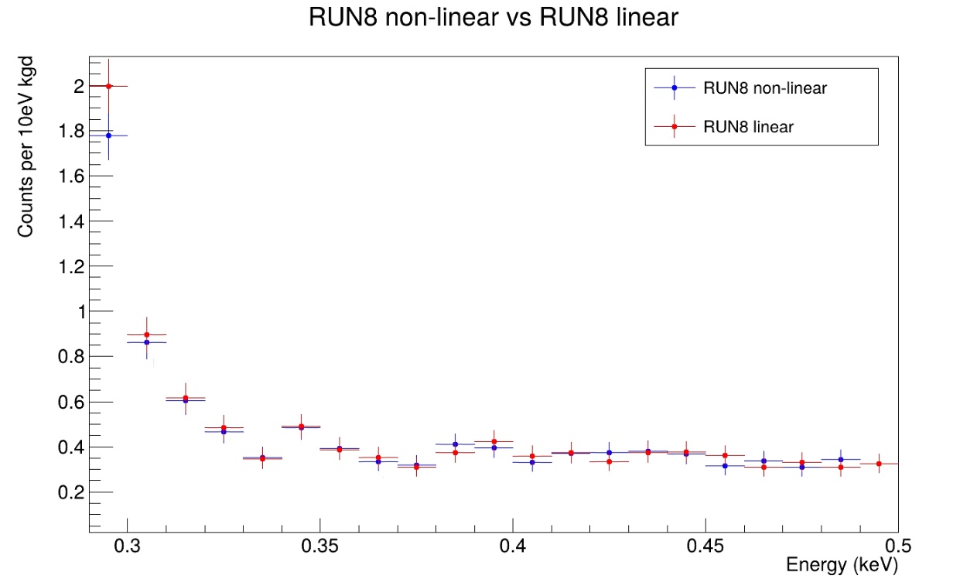
Comparison of the spectrum in RUN8

Slide 18
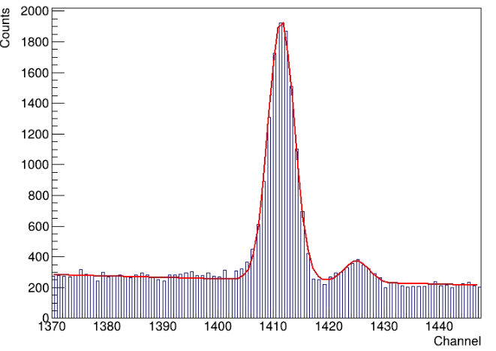
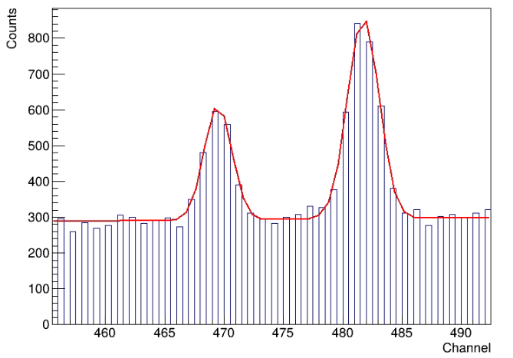
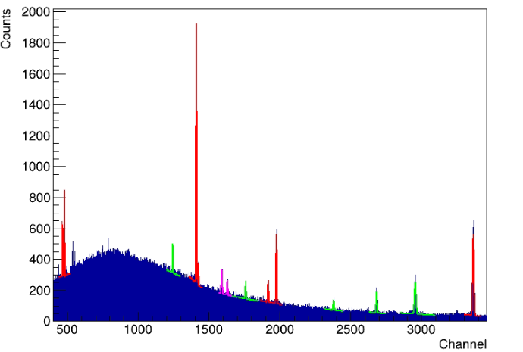
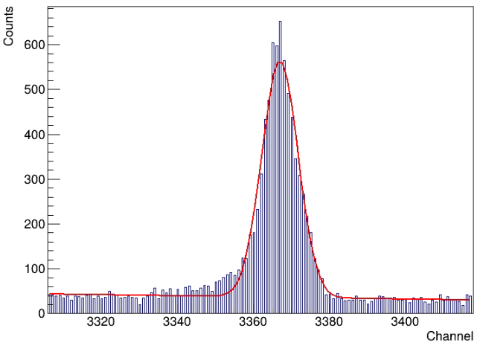
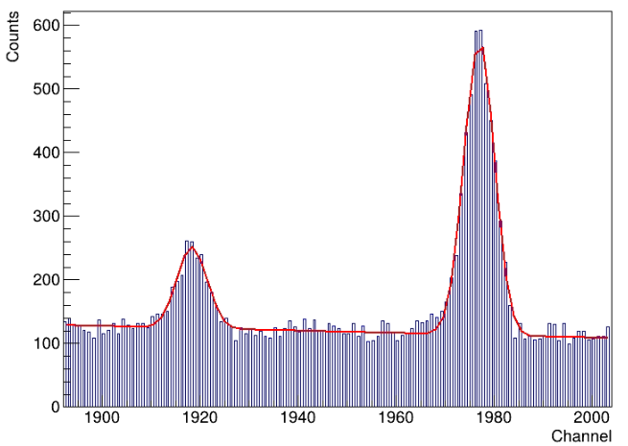
High energy region – Thorium calibration
²¹²Pb peak 238 keV
Pb Xray peaks 72-74keV
²⁰⁸Tl peak 583 keV
²²⁸Ac peak 338 keV

Slide 19
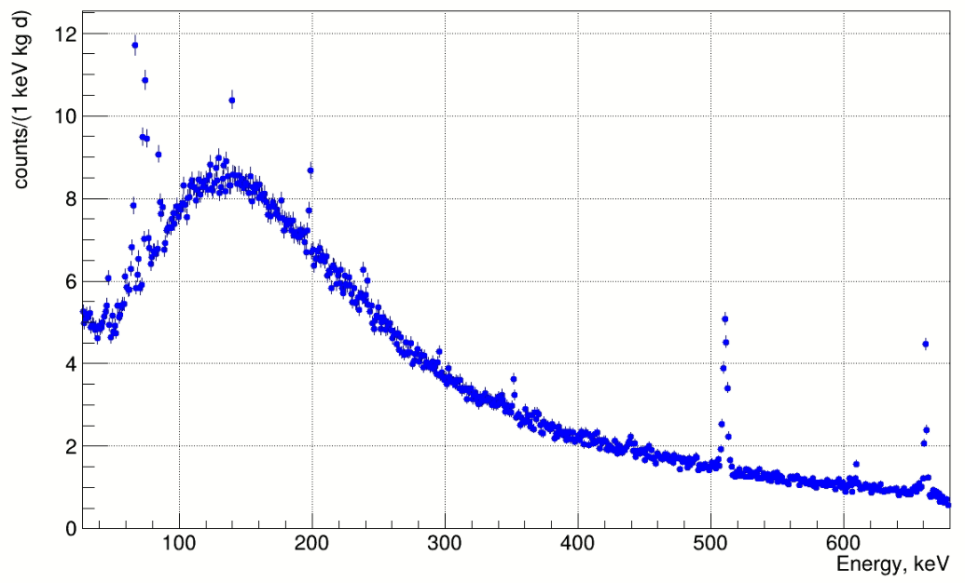
High energy region RUN 8, 152 days
^{71m}Ge (48 s)
139.7 keV
^{71m}Ge (20 ms)
198.4 keV
²¹⁴Pb
242 keV
¹³⁷Cs
661.66 keV
²¹⁴Pb
295.2 keV
²¹⁴Pb
351.9 keV
511 keV
²¹⁴Bi
609.3 keV
X-Rays

Slide 20
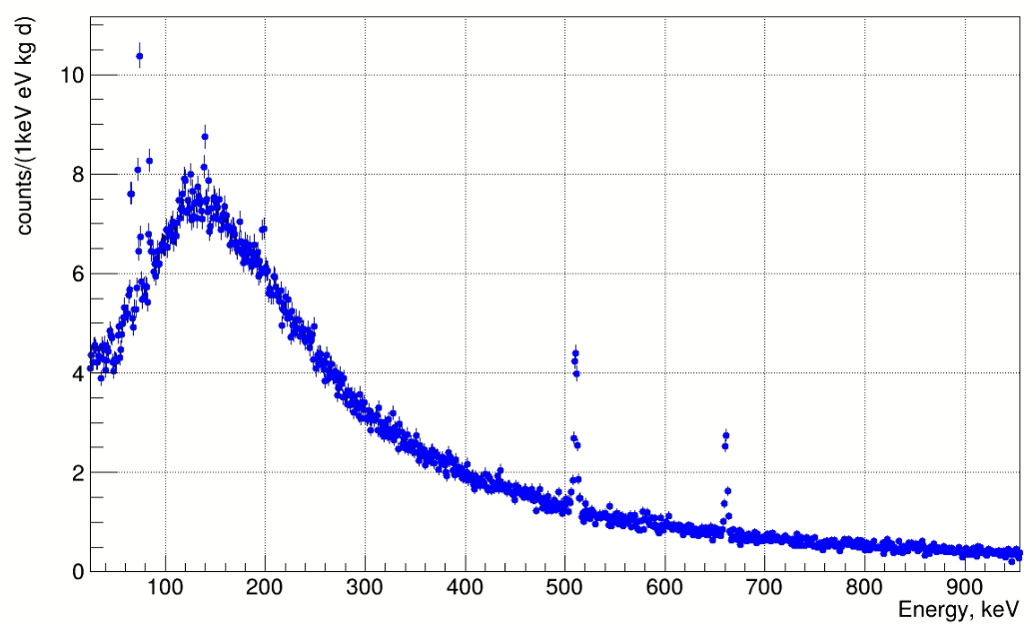
High energy region RUN 9, 119 days
^{71m}Ge (48 s)
139.7 keV
^{71m}Ge (20 ms)
198.4 keV
²¹⁴Pb
242 keV
²¹⁴Pb
295.2 keV
511 keV
¹³⁷Cs
661.66 keV
X-Rays

Slide 21
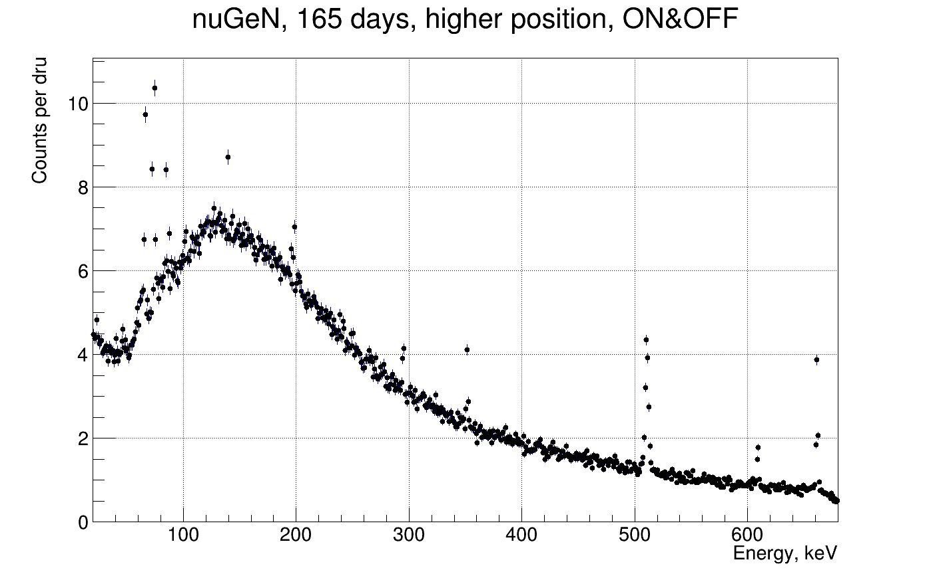
High energy region RUN 7, 165 days
^{71m}Ge (48 s)
139.7 keV
^{71m}Ge (20 ms)
198.4 keV
²¹⁴Pb
295.2 keV
²¹⁴Pb
351.9 keV
¹³⁷Cs
661.66 keV
²¹⁴Bi
609.3 keV
511 keV
X-Rays
²¹⁴Pb
242 keV

Slide 22
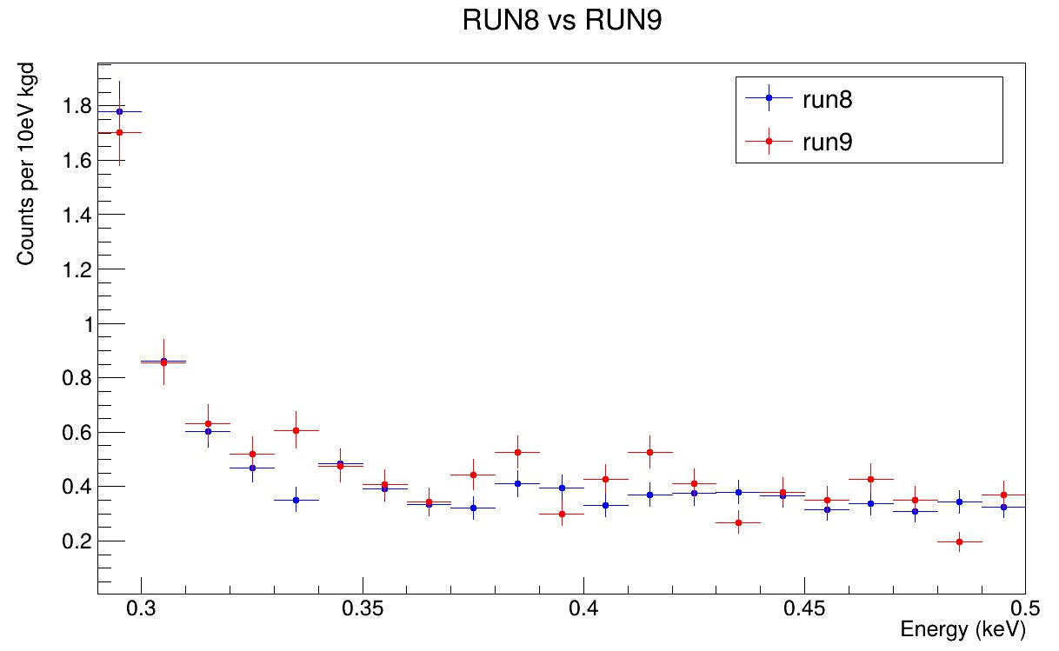
Comparison of the spectrum acquired RUN8 vs RUN9

Slide 23
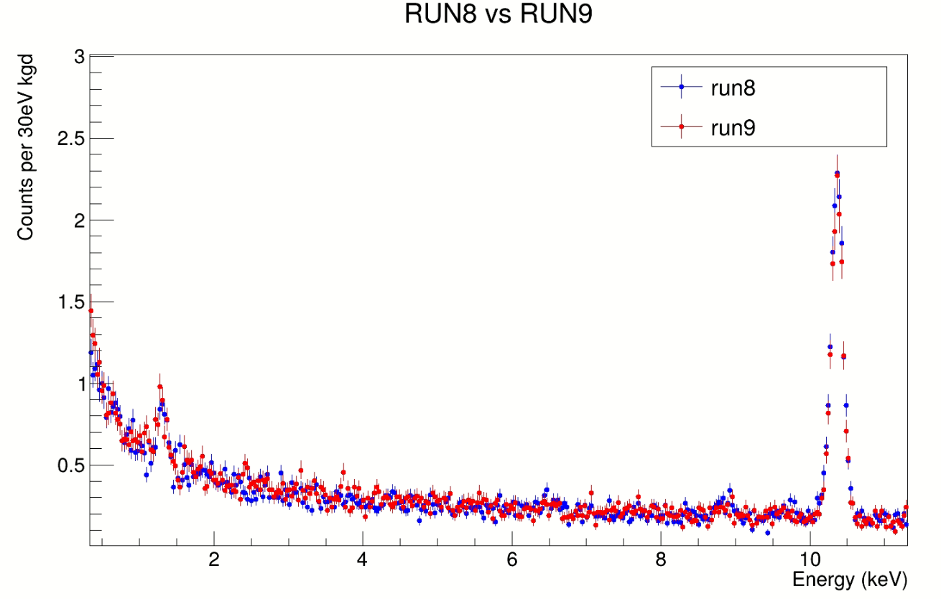
Comparison of the spectrum acquired RUN8 vs RUN9

Slide 24
Conclusion
The nuGeN data processing approach is a key factor that allows the experiment to reach the desired sensitivity.
Raw detector signals are processed, and strict selection cuts are applied to remove background events, allowing recoil energies to be observed down to about 0.29 keV.
During RUN9, upgrades to the experimental setup led to a reduction in Radon background, resulting in cleaner data compared to earlier RUNs.
Significance of Consistent Background Spectra: Confirms that the detector, shielding, and electronics are stable over long periods.
This consistency is critical for the "Reactor ON" versus "Reactor OFF" data subtraction, as it validates the assumption that the background is constant.
Plan:
A crucial step in this framework is the energy calibration, which utilizes a well-defined quenching factor model to convert the measured 'electron-equivalent' (keVee) data into the true nuclear recoil (keVnr) energy scale.
My immediate objective is to gain a solid understanding of this procedure and successfully apply it to the dataset.

Slide 25
Thank you
ν
GeN

Slide 26
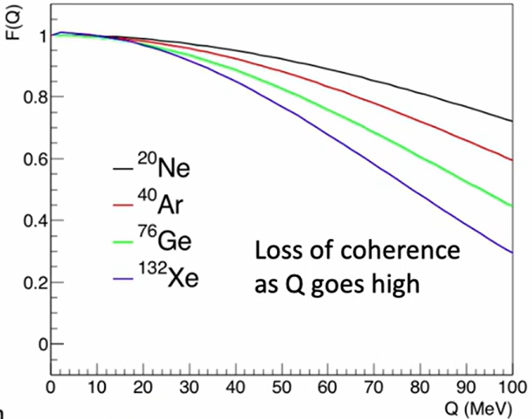
CEνNS
G²_{F} = 1.166×10⁻⁵ GeV⁻² is the Fermi constant
F²(Q²) ~= 1 is the nuclear form factor
σ ∝ N²
is the weak charge of a nucleus
is Weinberg angle at low energies

Slide 27
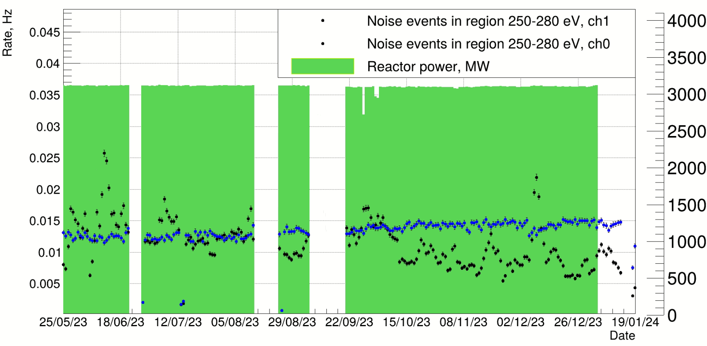
Apply noise period cuts
RUN 8 noise event and reactor power
Stability of the count rates observed in the noise energy region from 0.25 to 0.28 keV and reactor thermal power in time is shown in Fig.
Excluding data of periods when room temperature changes exceeded the mean by 1 ℃.
Excluding the first 30 min of the data of a new run along with the final 10 min of the run to avoid possible noise produced by on-site personnel.

Slide 28
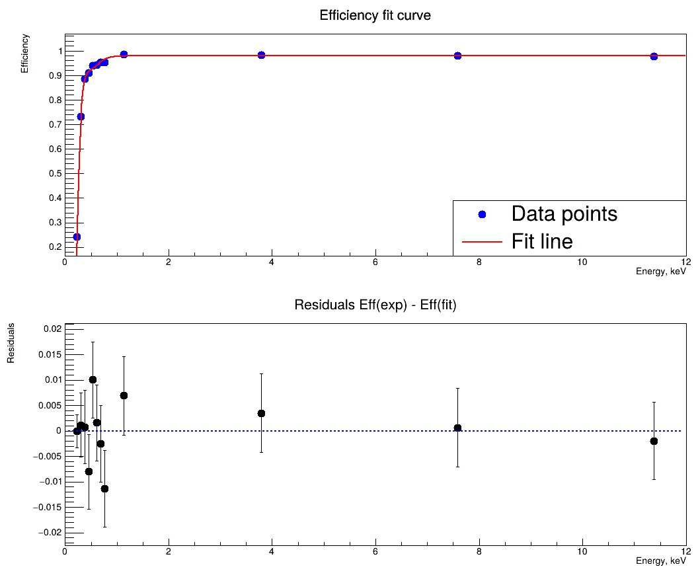
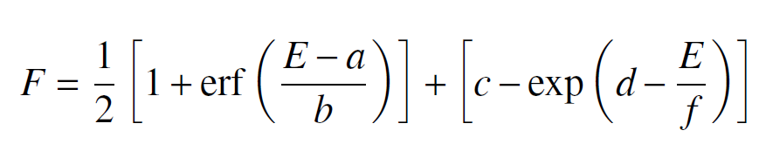
Efficiency of signal detection
a = 0.3014 ± 0.0152
b = -0.1985 ± 0.0088
c = 0.9793 ± 0.0037
d = 2.3487 ± 0.0905
f = 0.1146 ± 0.0065
Efficiency of signal detection measured with the pulse generator

Slide 29
Low energy calibration
RUN8,
10.367 keV peak after fit for linear channel
Channel 0: 10.35774 ± 0.00196
Channel 1: 10.36583 ± 0.00182
Channel 2: 10.36219 ± 0.00187
RUN8,
10.367 keV peak after fit for non-linear channel
Channel 0: 10.35776 ± 0.00197
Channel 1: 10.36579 ± 0.00178
Channel 2: 10.36214 ± 0.00189
^{Total count per kg d:}
^{40428 – 52 -199 – 352 - 174}
RUN9a,
10.367 keV peak after fit for linear channel
Channel 0: 10.36965 ± 0.00341
Channel 1: 10.36944 ± 0.00316
Channel 2: 10.36961 ± 0.00334
RUN9b,
10.367 keV peak after fit for non-linear channel
Channel 0: 10.36909 ± 0.00339
Channel 1: 10.36952 ± 0.00316
Channel 2: 10.36959 ± 0.00336
^{Total count per kg d:}
³⁷³⁰⁹
Peak fit of 10.367 keV in 3 low energy channel with non-linear function is better than linear function.

Slide 30
Thorium Calibration 1 RUN8
Isotope | Table line keV | Linear energy found | Non-linear energy found | Difference Linear peaks | Difference Non-linear peaks
PbKa2 | 72.805 | 72.666(45) | 72.783(48) | 0.139 | 0.022
PbKa1 | 74.969 | 74.819(29) | 74.930(28) | 0.150 | 0.039
²²⁸Ac | 209.253(6) | 209.325(57) | 209.344(57) | -0.072 | -0.091
²¹²Pb | 238.632(2) | 238.638(9) | 238.647(9) | -0.006 | -0.015
²²⁴Ra | 240.986(6) | 241.112(54) | 241.122(50) | -0.126 | -0.136
²²⁸Ac | 328.000(6) | 327.900(61) | 327.889(60) | 0.100 | 0.111
²²⁸Ac | 338.320(3) | 338.283(23) | 338.262(23) | 0.037 | 0.058
²²⁸Ac | 409.462(6) | 409.402(75) | 409.362(75) | 0.060 | 0.100
²²⁸Ac | 463.004(6) | 462.974(40) | 462.933(45) | 0.030 | 0.071
²⁰⁸Tl | 510.77(10) | 510.745(40) | 510.722(41) | 0.025 | 0.048
²⁰⁸Tl | 583.187(2) | 583.181(20) | 583.190(20) | 0.006 | -0.030
 |  |  | Sum of squares | 0.079447 | 0.062937

Slide 31
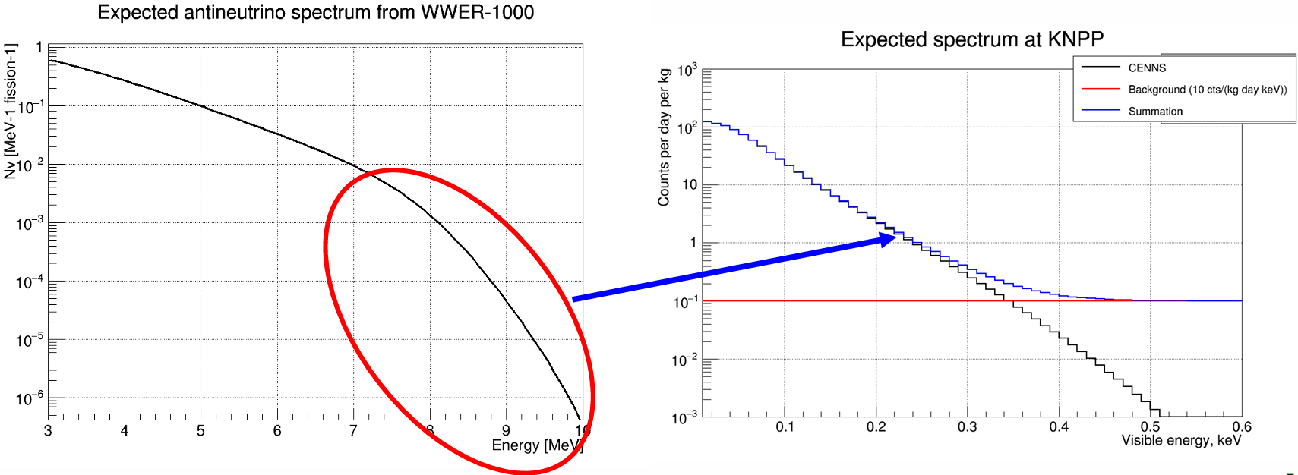
Expected spectrum of nuGeN

Slide 32
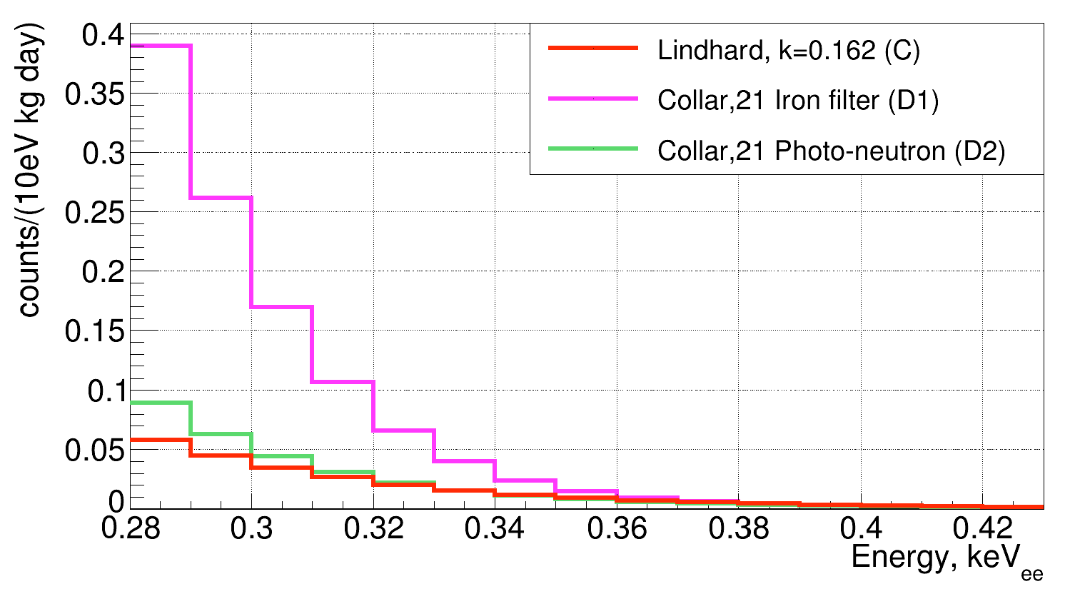
Expected count rates and energy spectra in RUN7

Slide 33
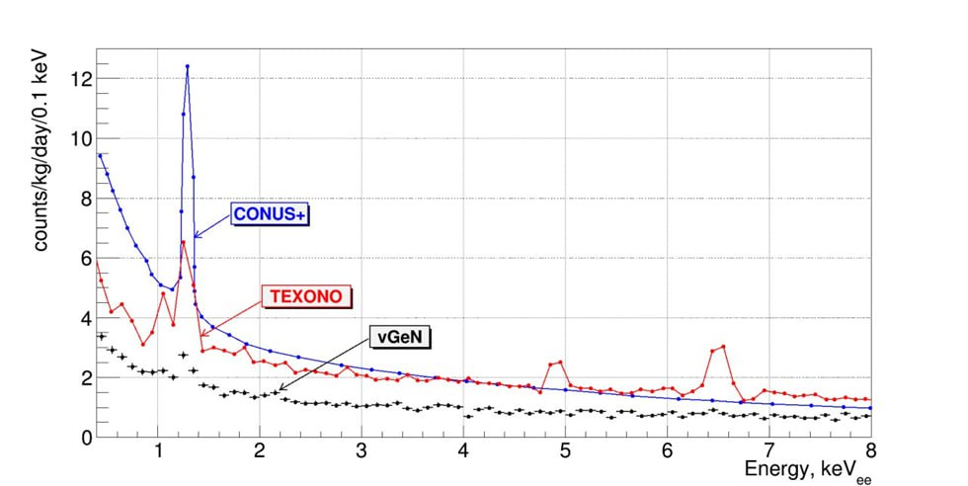
Comparison of spectrum

