Slide 1


Реактор четвертого поколения «Нептун» — шаг к замыканию ядерного топливного цикла
The fourth-generation reactor "Neptune" is a step towards closing the nuclear fuel cycle
ОБЪЕДИНЁННЫЙ ИНСТИТУТ ЯДЕРНЫХ ИССЛЕДОВАНИЙ
JOINT INSTITUTE FOR NUCLEAR RESEARCH
Ahmed Hassan
ahmed.hassan@nf.jinr.ru
Dybna- 2025

Slide 2
PULSED REACTORS (PR)
PR - a device that produces controlled fission pulses.
Periodic pulsed reactors: the fission pulse is initiated by the rapid introduction of excess reactivity with the transfer of the reactor to a supercritical state by prompt neutrons, and is extinguished due to negative temperature feedback.
Aperiodic pulsed reactors: fission bulses are totally formed by external modulation of reactivity with a given period.
Booster reactors: the reactor is in a subcritical state on prompt neutrons, and the pulse develops due to the multiplication of neutrons from an external pulse source (target of electron accelerators).

Slide 3
PULSED REACTORS (PR)
Aperiodic pulsed reactors
Operating principle:
The impulse is formed due to external modulation of reactivity during periodic movement of some element of the reactor, that affects reactivity.
The reactor periodically reaches a state of supercriticality on prompt neutrons for a short time and its power increases rapidly, and then the power decreases after the reactivity decreases.

Slide 4
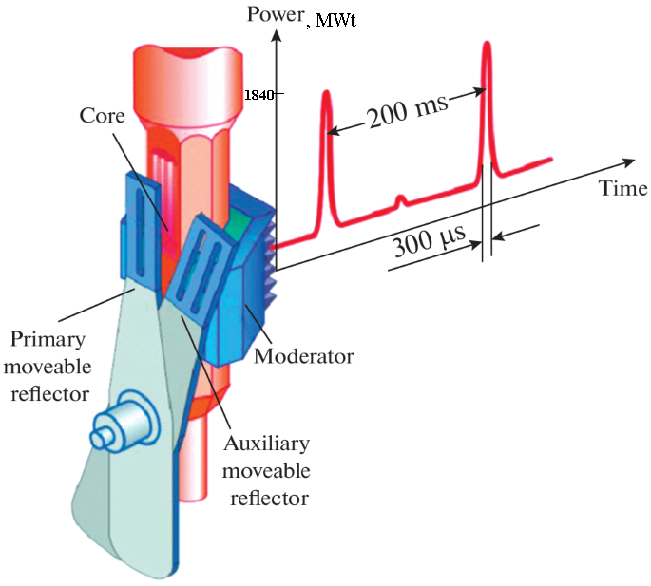
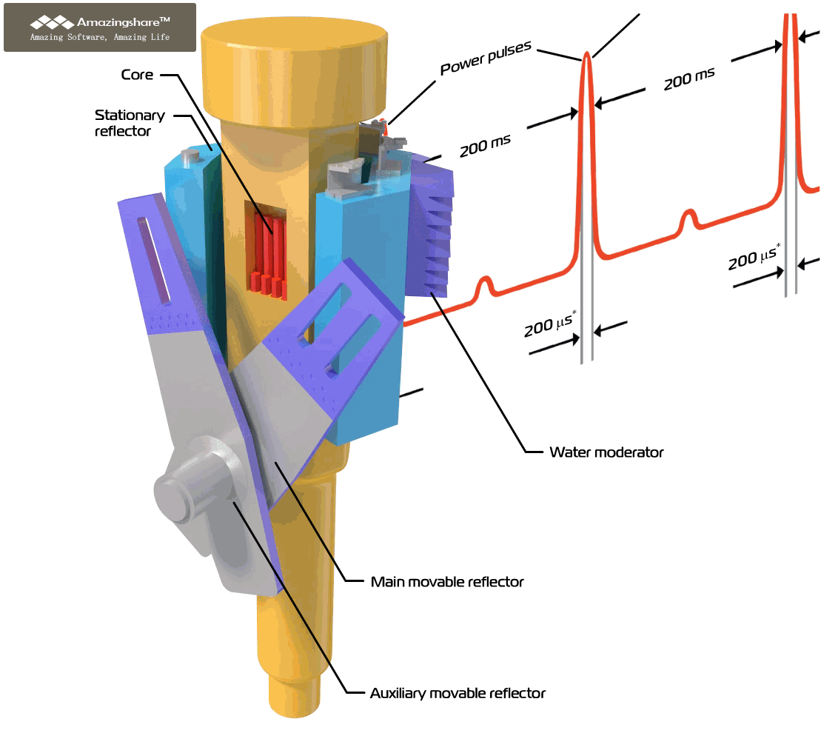
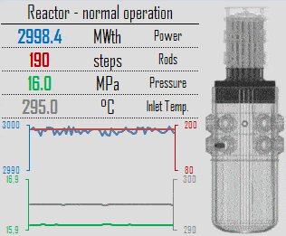
CLASSIFICATION OF NUCLEAR REACTORS
7. By energy release or production: reactors are divided into pulsed (IBR-2) and stationary (steady state) (VVER).
IBR-2
Change in the power of the IBR-2M reactor with an average power of 2 MW
Change in VVER-1000 reactor power over 18 months (reactor company)

Slide 5
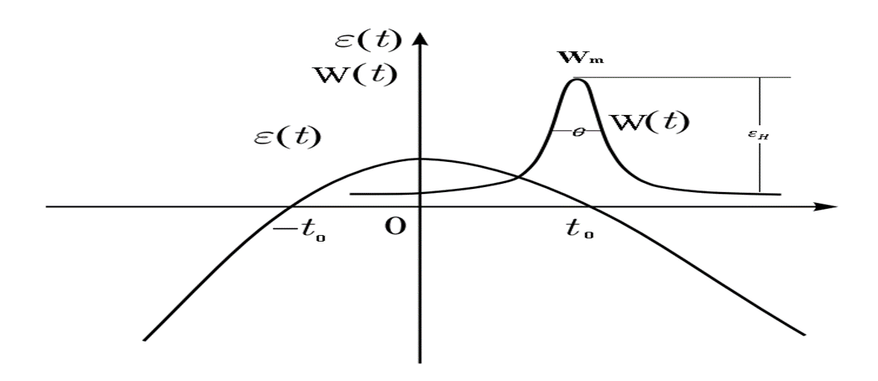
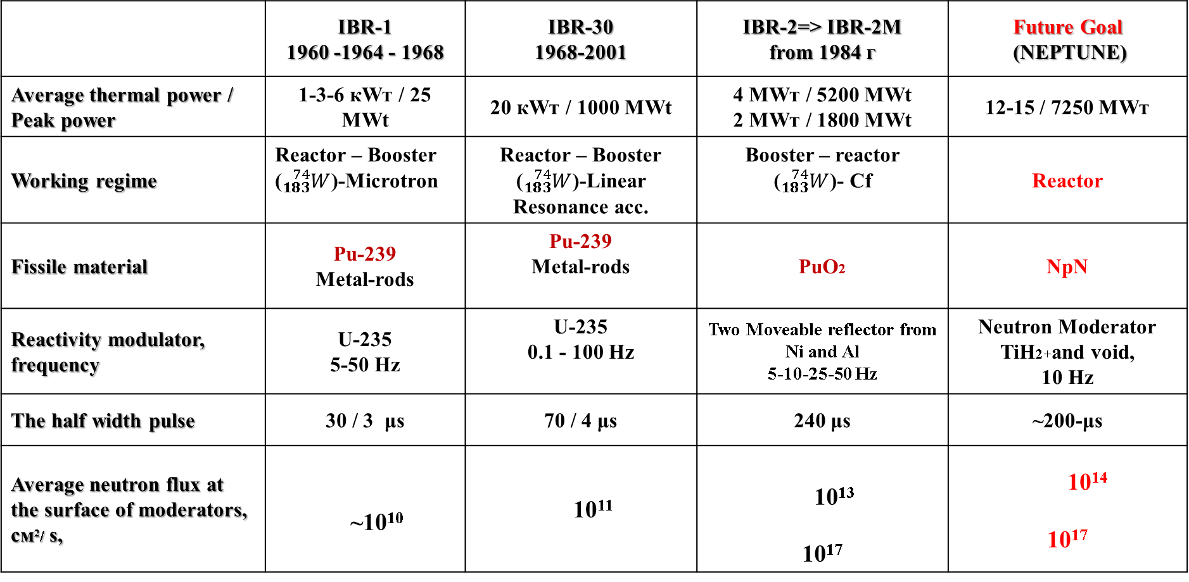
B) Denes sources : 2- Periodic Pulsed power reactors:
Neutron sources
 | IBR-1 1960 -1964 - 1968 | IBR-30 1968-2001 | IBR-2=˃ IBR-2M from 1984 г | Future Goal (NEPTUNE)
Average thermal power / Peak power | 1-3-6 кWт / 25 MWt | 20 кWт / 1000 MWt | 4 МWт / 5200 MWt 2 МWт / 1800 MWt | 12-15 / 7250 МWт
Working regime | Reactor – Booster (${}_{183}^{74}W$)-Microtron | Reactor – Booster (${}_{183}^{74}W$)-Linear Resonance acc. | Booster – reactor (${}_{183}^{74}W$)- Cf | Reactor
Fissile material | Pu-239 Metal-rods | Pu-239 Metal-rods | PuO2 | NpN
Reactivity modulator, frequency | U-235 5-50 Hz | U-235 0.1 - 100 Hz | Two Moveable reflector from Ni and Al 5-10-25-50 Hz | Neutron Moderator TiH2+and void, 10 Hz
The half width pulse | 30 / 3 μs | 70 / 4 μs | 240 μs | ~200-μs
Average neutron flux at the surface of moderators, см²/ s, | ~10¹⁰ | 10¹¹ | 10¹³ 10¹⁷ | 10¹⁴ 10¹⁷

Slide 6
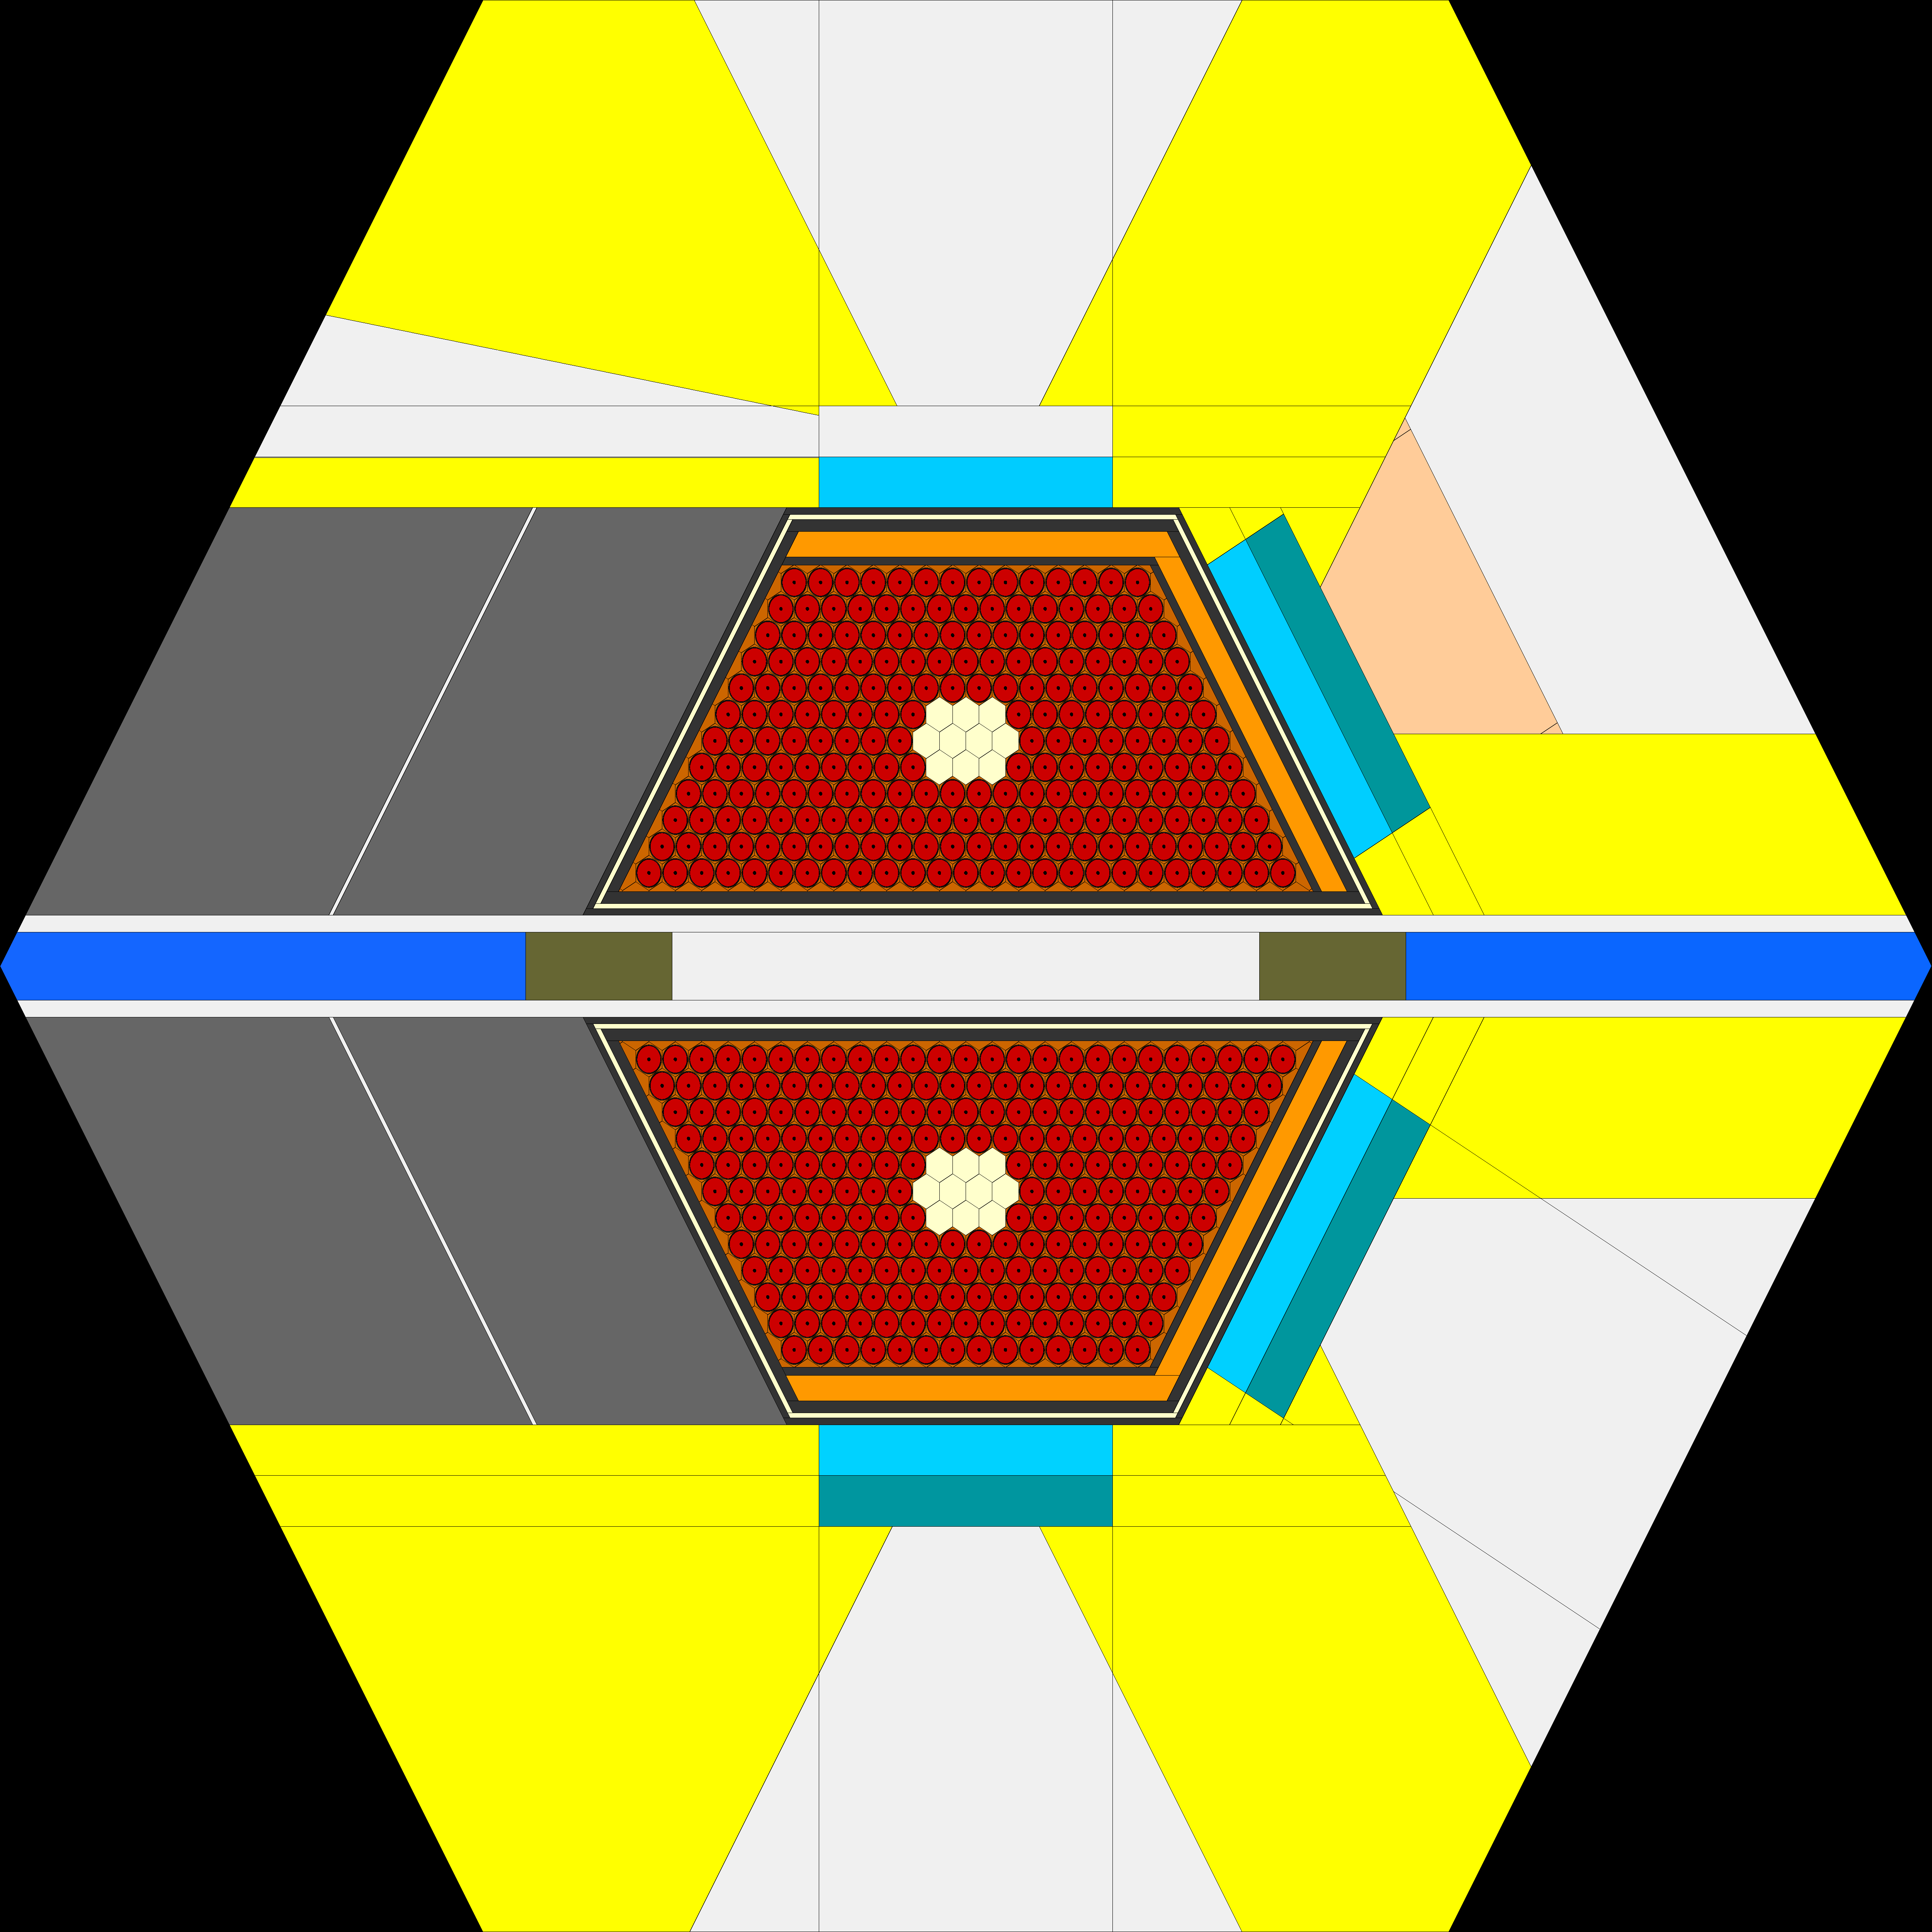
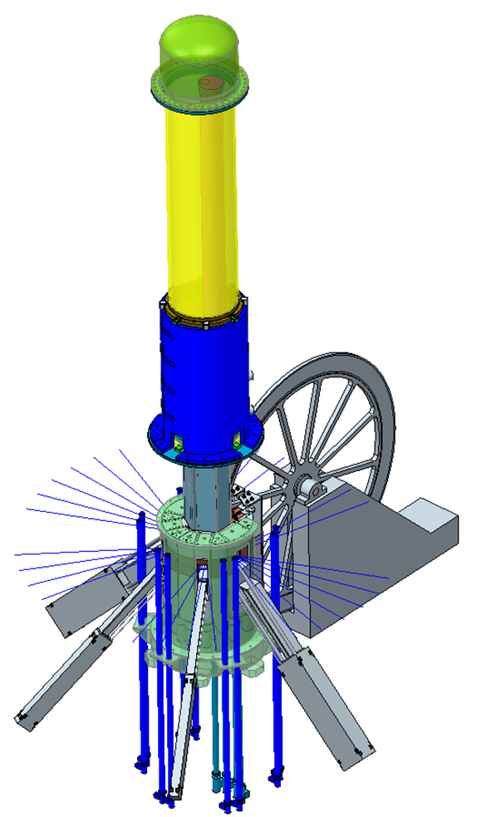
Concept of the NEPTUNE reactor project
The reactor vessel and its core are divided in half, and a reactivity modulator (RM) is located in the space between the halves of the vessel.
The RM is a rotating disk with titanium hydride blocks placed in it.
The disk has a sector containing a vacuum zone. When this sector passes through the core, a neutron pulse is generated.
The reactor vessel is surrounded by a beryllium and nickel reflector, in which water and cold moderators are placed.

Slide 7
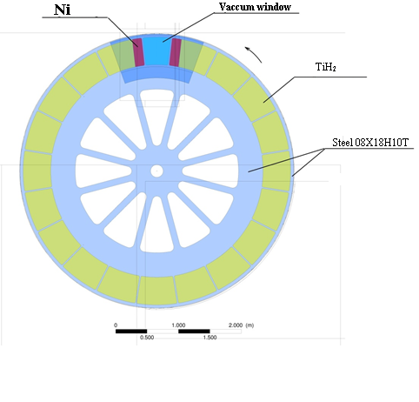
Concept of the NEPTUNE reactor project
Reactivity modulator (RM).
The MR is a rotating disk with titanium hydride blocks placed inside it.
The disk has a sector containing a vacuum zone. When this sector passes through the active zone, a neutron pulse is generated.

Slide 8
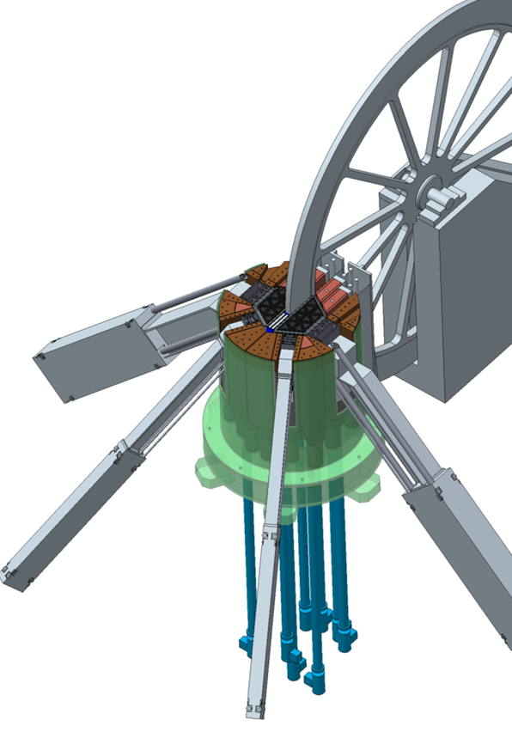
The main parameters of the reactor
Параметр | Значение
AVERAGE THERMAL POWER , MW | 12 - 15
OPERATING MODE | pulsed
PULSE FREQUENCY, Hz | 10
FUEL | NpN
CLADDING MATERIAL OF FUEL RODS | S.Steel ЧС-68
COOLER | Na
REFLECTOR | NICKEL ALLOY + BERYLLIUM
MODERATOR, PREMODERATOR | Hydrides, water, beryllium
COOLANT TEMPERATURE AT THE INLET TO THE CORE AND AT THE OUTLET, ⁰С | 290-390
PRESSURE DROP THROUGH THE CORE, Pa | 0,33·10⁵
FLUENCE ON THE REACTOR SURROUNDING’S FOR 20,000 h, n / СМ² | 4,1·10²²
AVERAGE NEUTRON THERMAL FLUX AT THE SURFACE OF WATER MODERATOR, 2π- equivalent 10¹³ cm⁻²∙sec⁻¹ | 12
EFFECTIVE FRACTION OF DELAYED NEUTRONS | 0,00131
GENERATION TIME OF THE SPONTANEOUS NEUTRONS , n,sec | 10

Slide 9
THE CONCEPT OF RADIO ACTIVE WASTE (RAW) AND RAW TRANSMUTATION
RAW are formed at various stages of production: from U mining to spent nuclear fuel reprocessing.
The most dangerous radioactive waste from spent nuclear fuel are:
long-lived radionuclides,
with high activity and heat generation.
Composition of the spent nuclear fuel in closed nuclear cycle:
fission product (not used);
Minor Actinides (Np, Am, Cm).
U and Pu
What is transmutation (burn up) of radioactive waste?
Transforming them into stable nuclides or into short-lived nuclides that decay fairly quickly into stable ones.
Transmutation of long-lived fission products is carried out by:
changing the number of nucleons in the LLFP nucleus mainly as a result of the radiative capture reaction or threshold (n,2n)- and (n,3n)-reactions, i.e. in 1 stage.
Transmutation of МА is carried out by:
Fission (n,f) of nuclei МА (Np)
and subsequent transmutation, formed during fission of LLFP, i.e. in 2 stages.

Slide 10
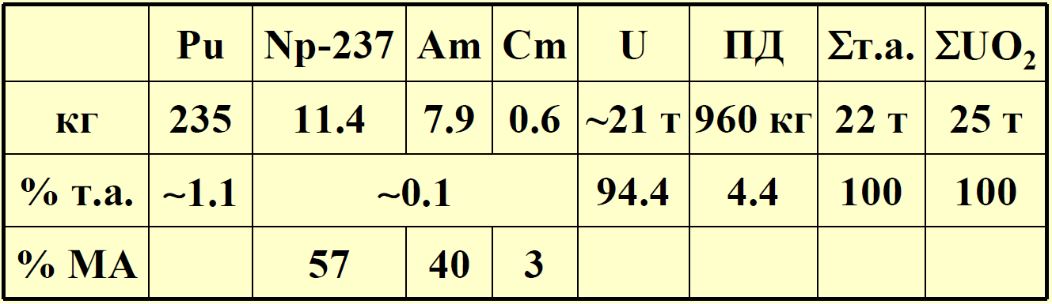
Example of the composition of irradiated fuel
THE CONCEPT OF RADIO ACTIVE WASTE (RAW) AND RAW TRANSMUTATION
Annual composition of Spent Nuclear Fuel (SNF) VVER-1000 after 3 years in reactor core:

Slide 11
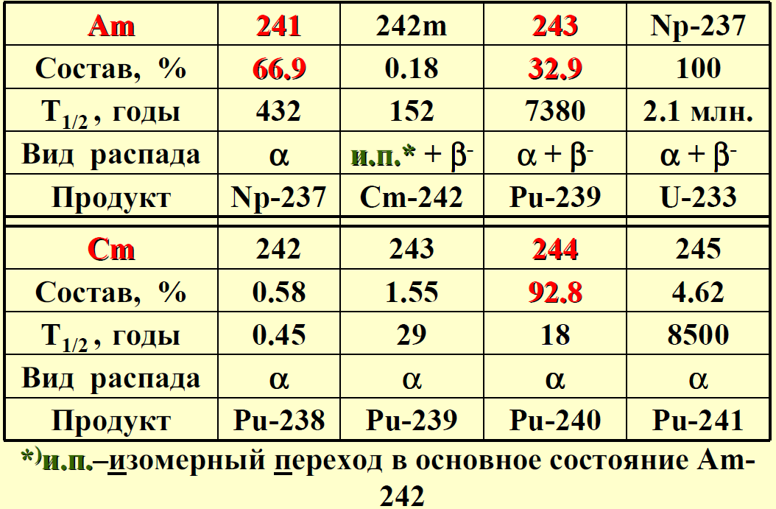

Example of the composition of irradiated fuel
THE CONCEPT OF RADIO ACTIVE WASTE (RAW) AND RAW TRANSMUTATION
Composition,$T_{1/2}$ and the final product of MA decomposition:

Slide 12
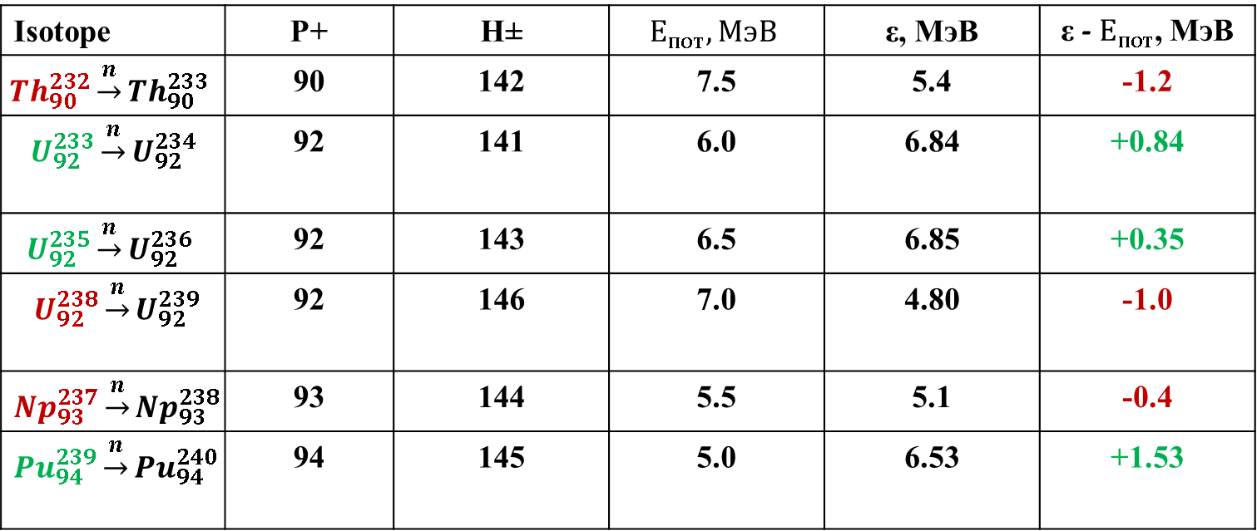
The concept of fissile and threshold nuclei:
BASICS OF NUCLEAR FISSION PHYSICS.
ADVANTAGES AND PROBLEMS OF NUCLEAR ENERGY
For nuclei of heavy elements, the binding energy of a paired neutron is sufficient to overcome the potential barrier of the nucleus.
Isotope | Р+ | Н± | $$Е_{пот}, МэВ$$ | ε, МэВ | ε -$Е_{пот}$, МэВ
$${Th}_{90}^{232}\underset{→}{n}{Th}_{90}^{233}$$ | 90 | 142 | 7.5 | 5.4 | -1.2
$$U_{92}^{233}\underset{→}{n}U_{92}^{234}$$ | 92 | 141 | 6.0 | 6.84 | +0.84
$$U_{92}^{235}\underset{→}{n}U_{92}^{236}$$ | 92 | 143 | 6.5 | 6.85 | +0.35
$U_{92}^{238}\underset{→}{n}U_{92}^{239}$ | 92 | 146 | 7.0 | 4.80 | -1.0
$${Np}_{93}^{237}\underset{→}{n}{Np}_{93}^{238}$$ | 93 | 144 | 5.5 | 5.1 | -0.4
$${Pu}_{94}^{239}\underset{→}{n}{Pu}_{94}^{240}$$ | 94 | 145 | 5.0 | 6.53 | +1.53

Slide 13
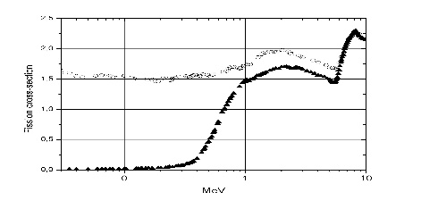
Why neptunium?
The isotope Np-237, unlike traditional nuclear compositions based on U-235 and Pu-239, has a threshold fission cross-section.

Slide 14
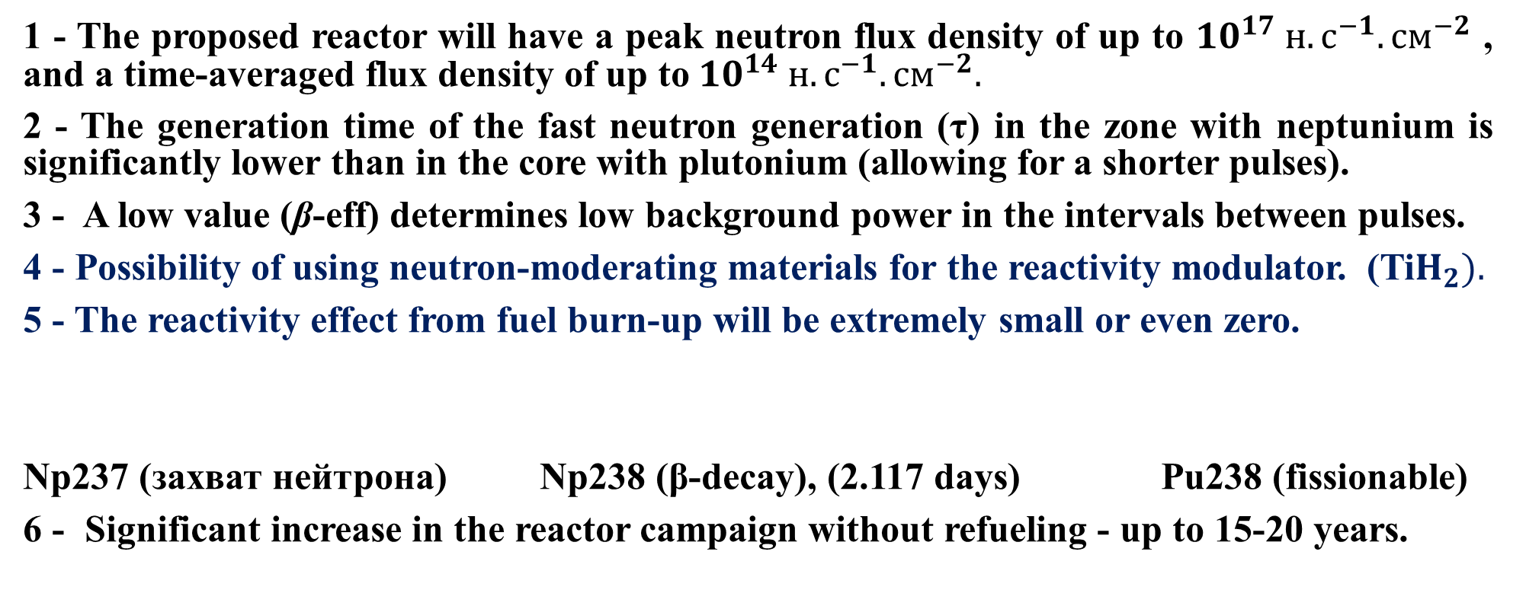
MAIN FEATURES OF THE NEPTUNE REACTOR:
1 - The proposed reactor will have a peak neutron flux density of up to ${10}^{17} н.с^{−1}.{см}^{−2}$ , and a time-averaged flux density of up to${10}^{14} н.с^{−1}.{см}^{−2}.$
2 - The generation time of the fast neutron generation (τ) in the zone with neptunium is significantly lower than in the core with plutonium (allowing for a shorter pulses).
3 - A low value (β-eff) determines low background power in the intervals between pulses.
4 - Possibility of using neutron-moderating materials for the reactivity modulator. (Ti$H_{2}).$
5 - The reactivity effect from fuel burn-up will be extremely small or even zero.
Np237 (захват нейтрона) Np238 (β-decay), (2.117 days) Pu238 (fissionable)
6 - Significant increase in the reactor campaign without refueling - up to 15-20 years.

Slide 15
Change of K-eff with reactor company time

Slide 16
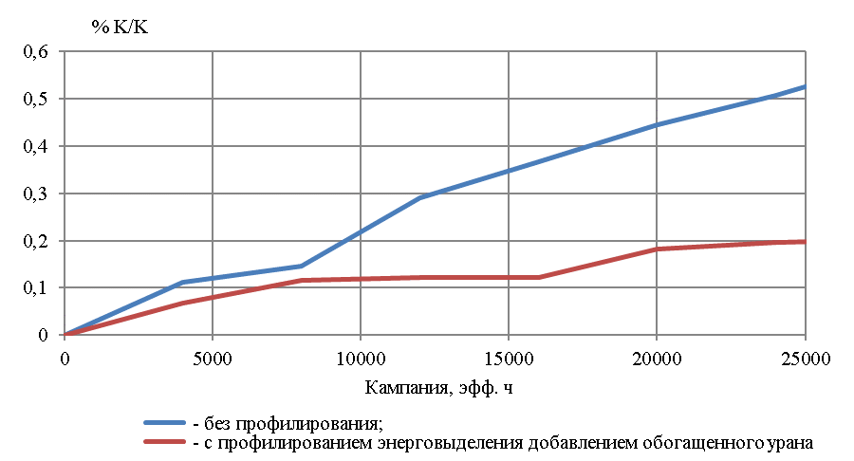
Changing reactivity with burn up

Slide 17
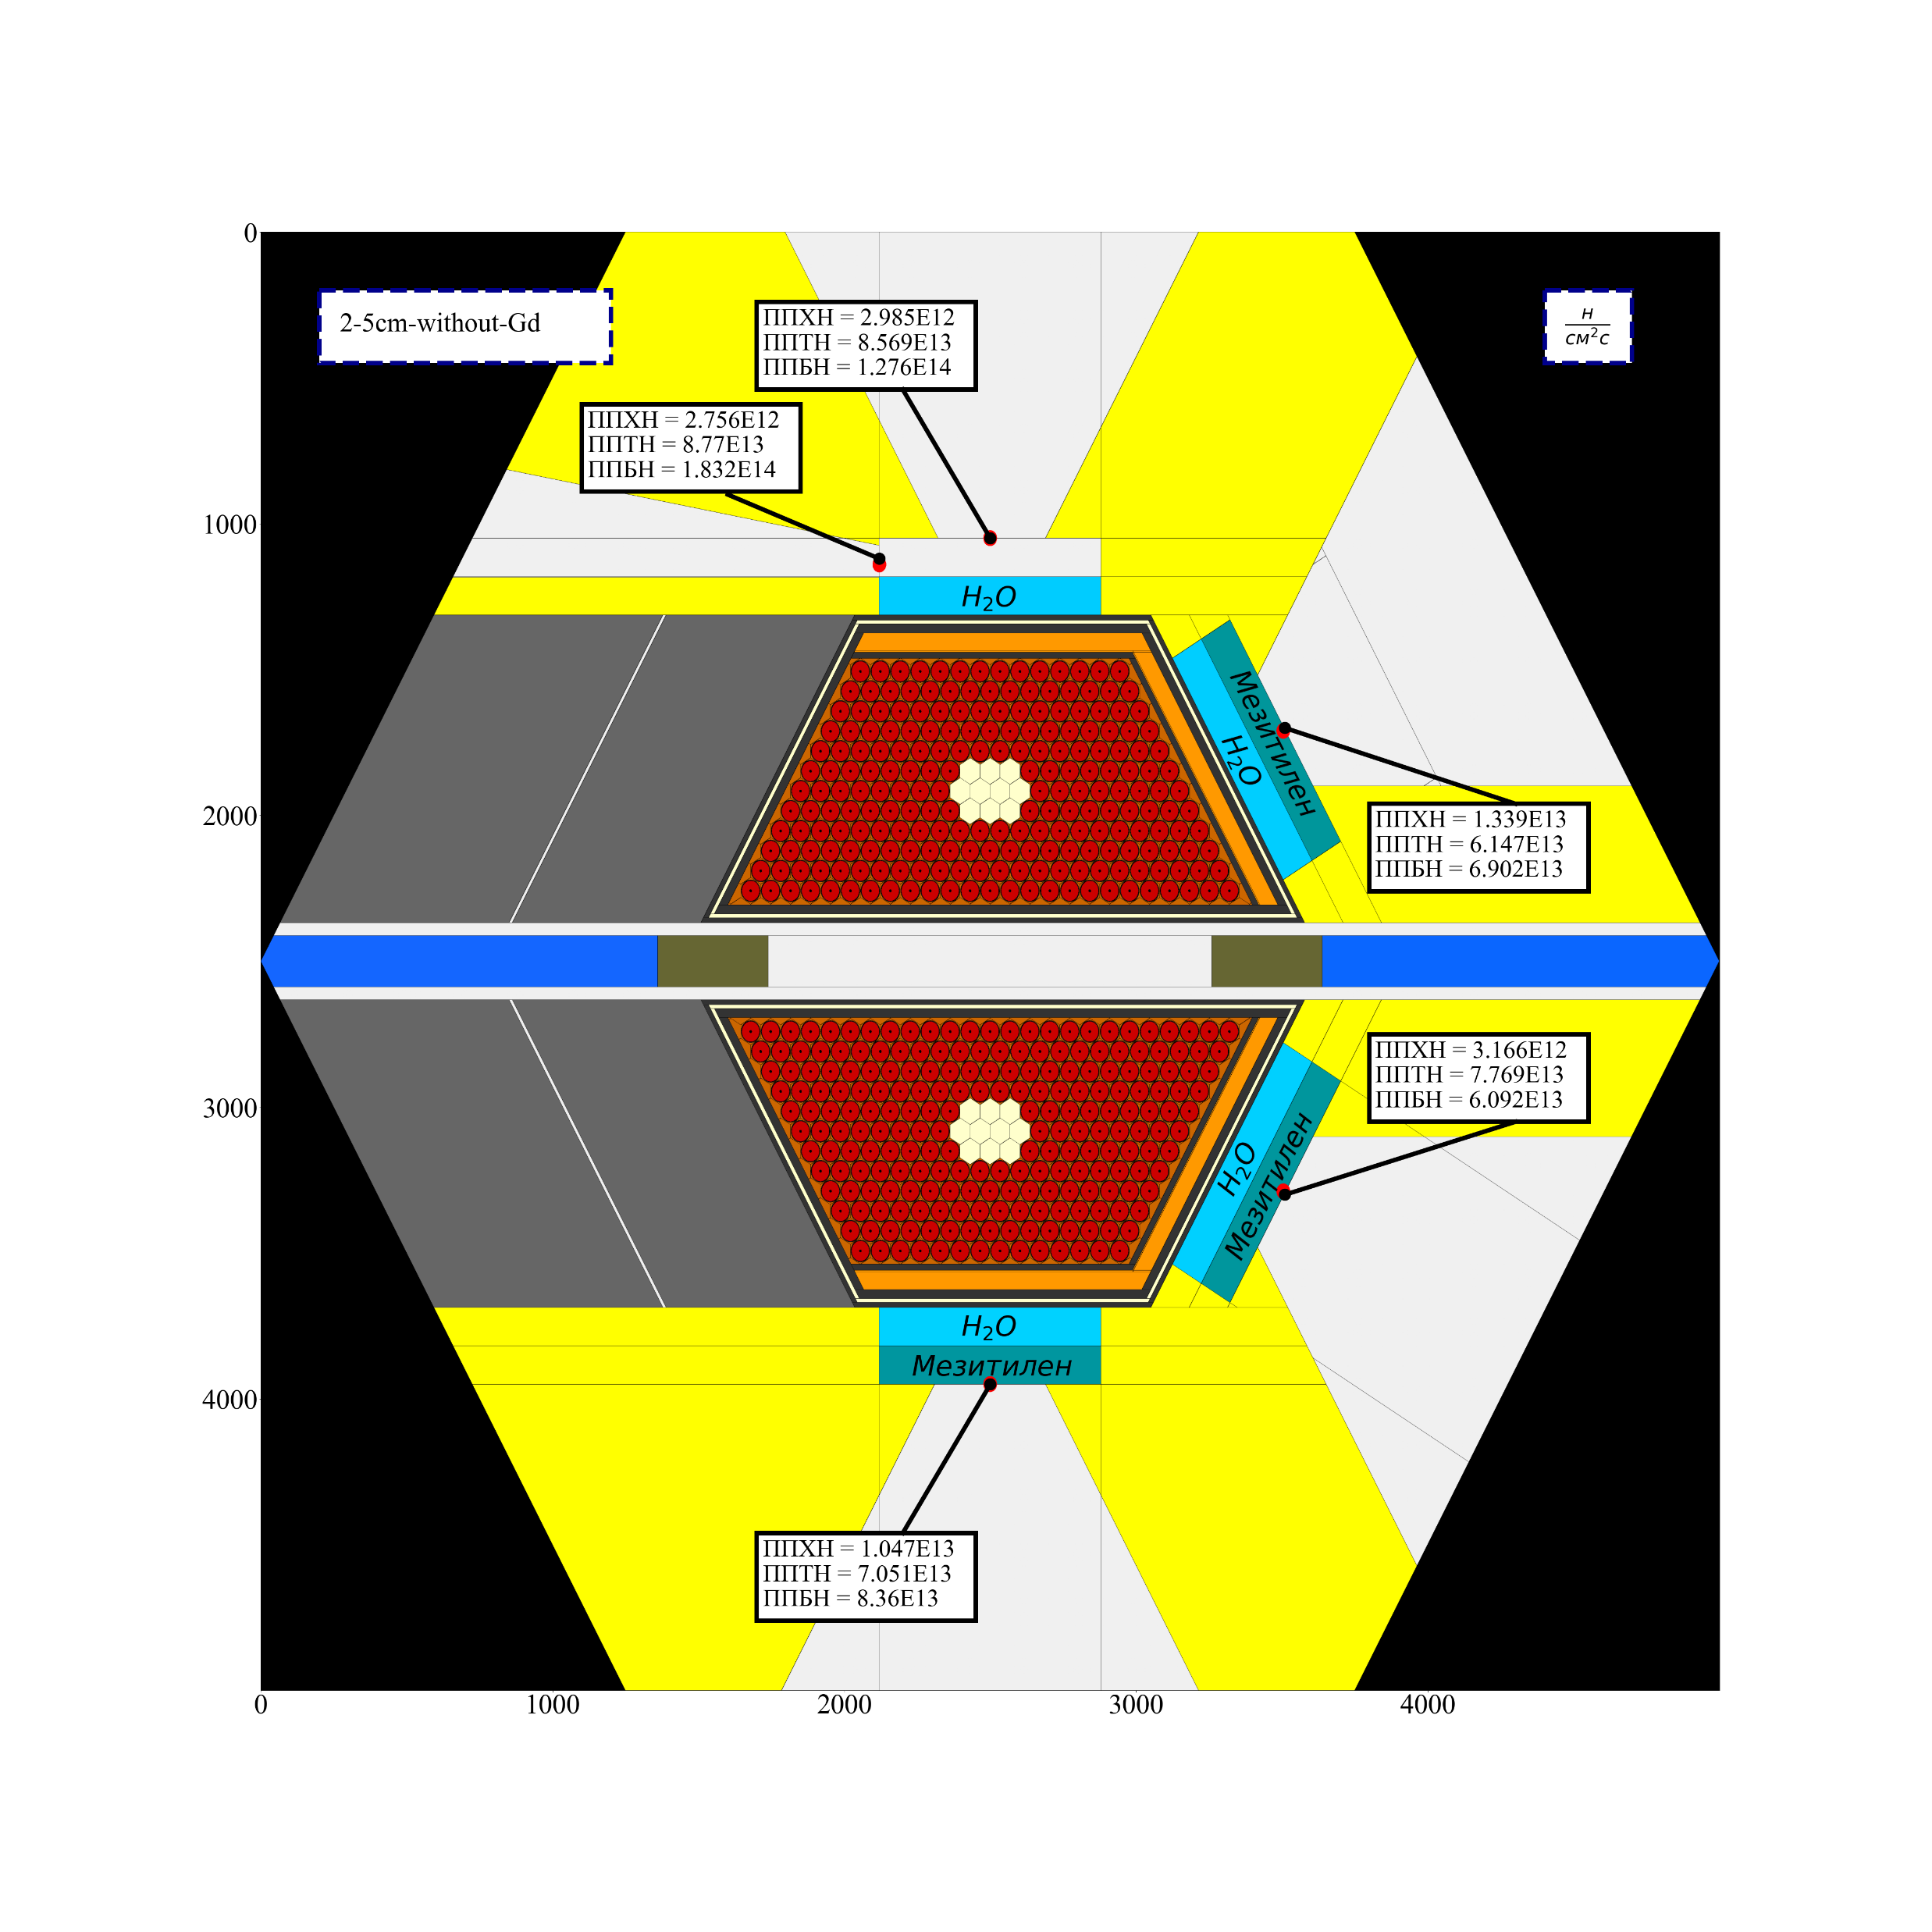
Neutron Flux Density from the Surface of Moderators

Slide 18
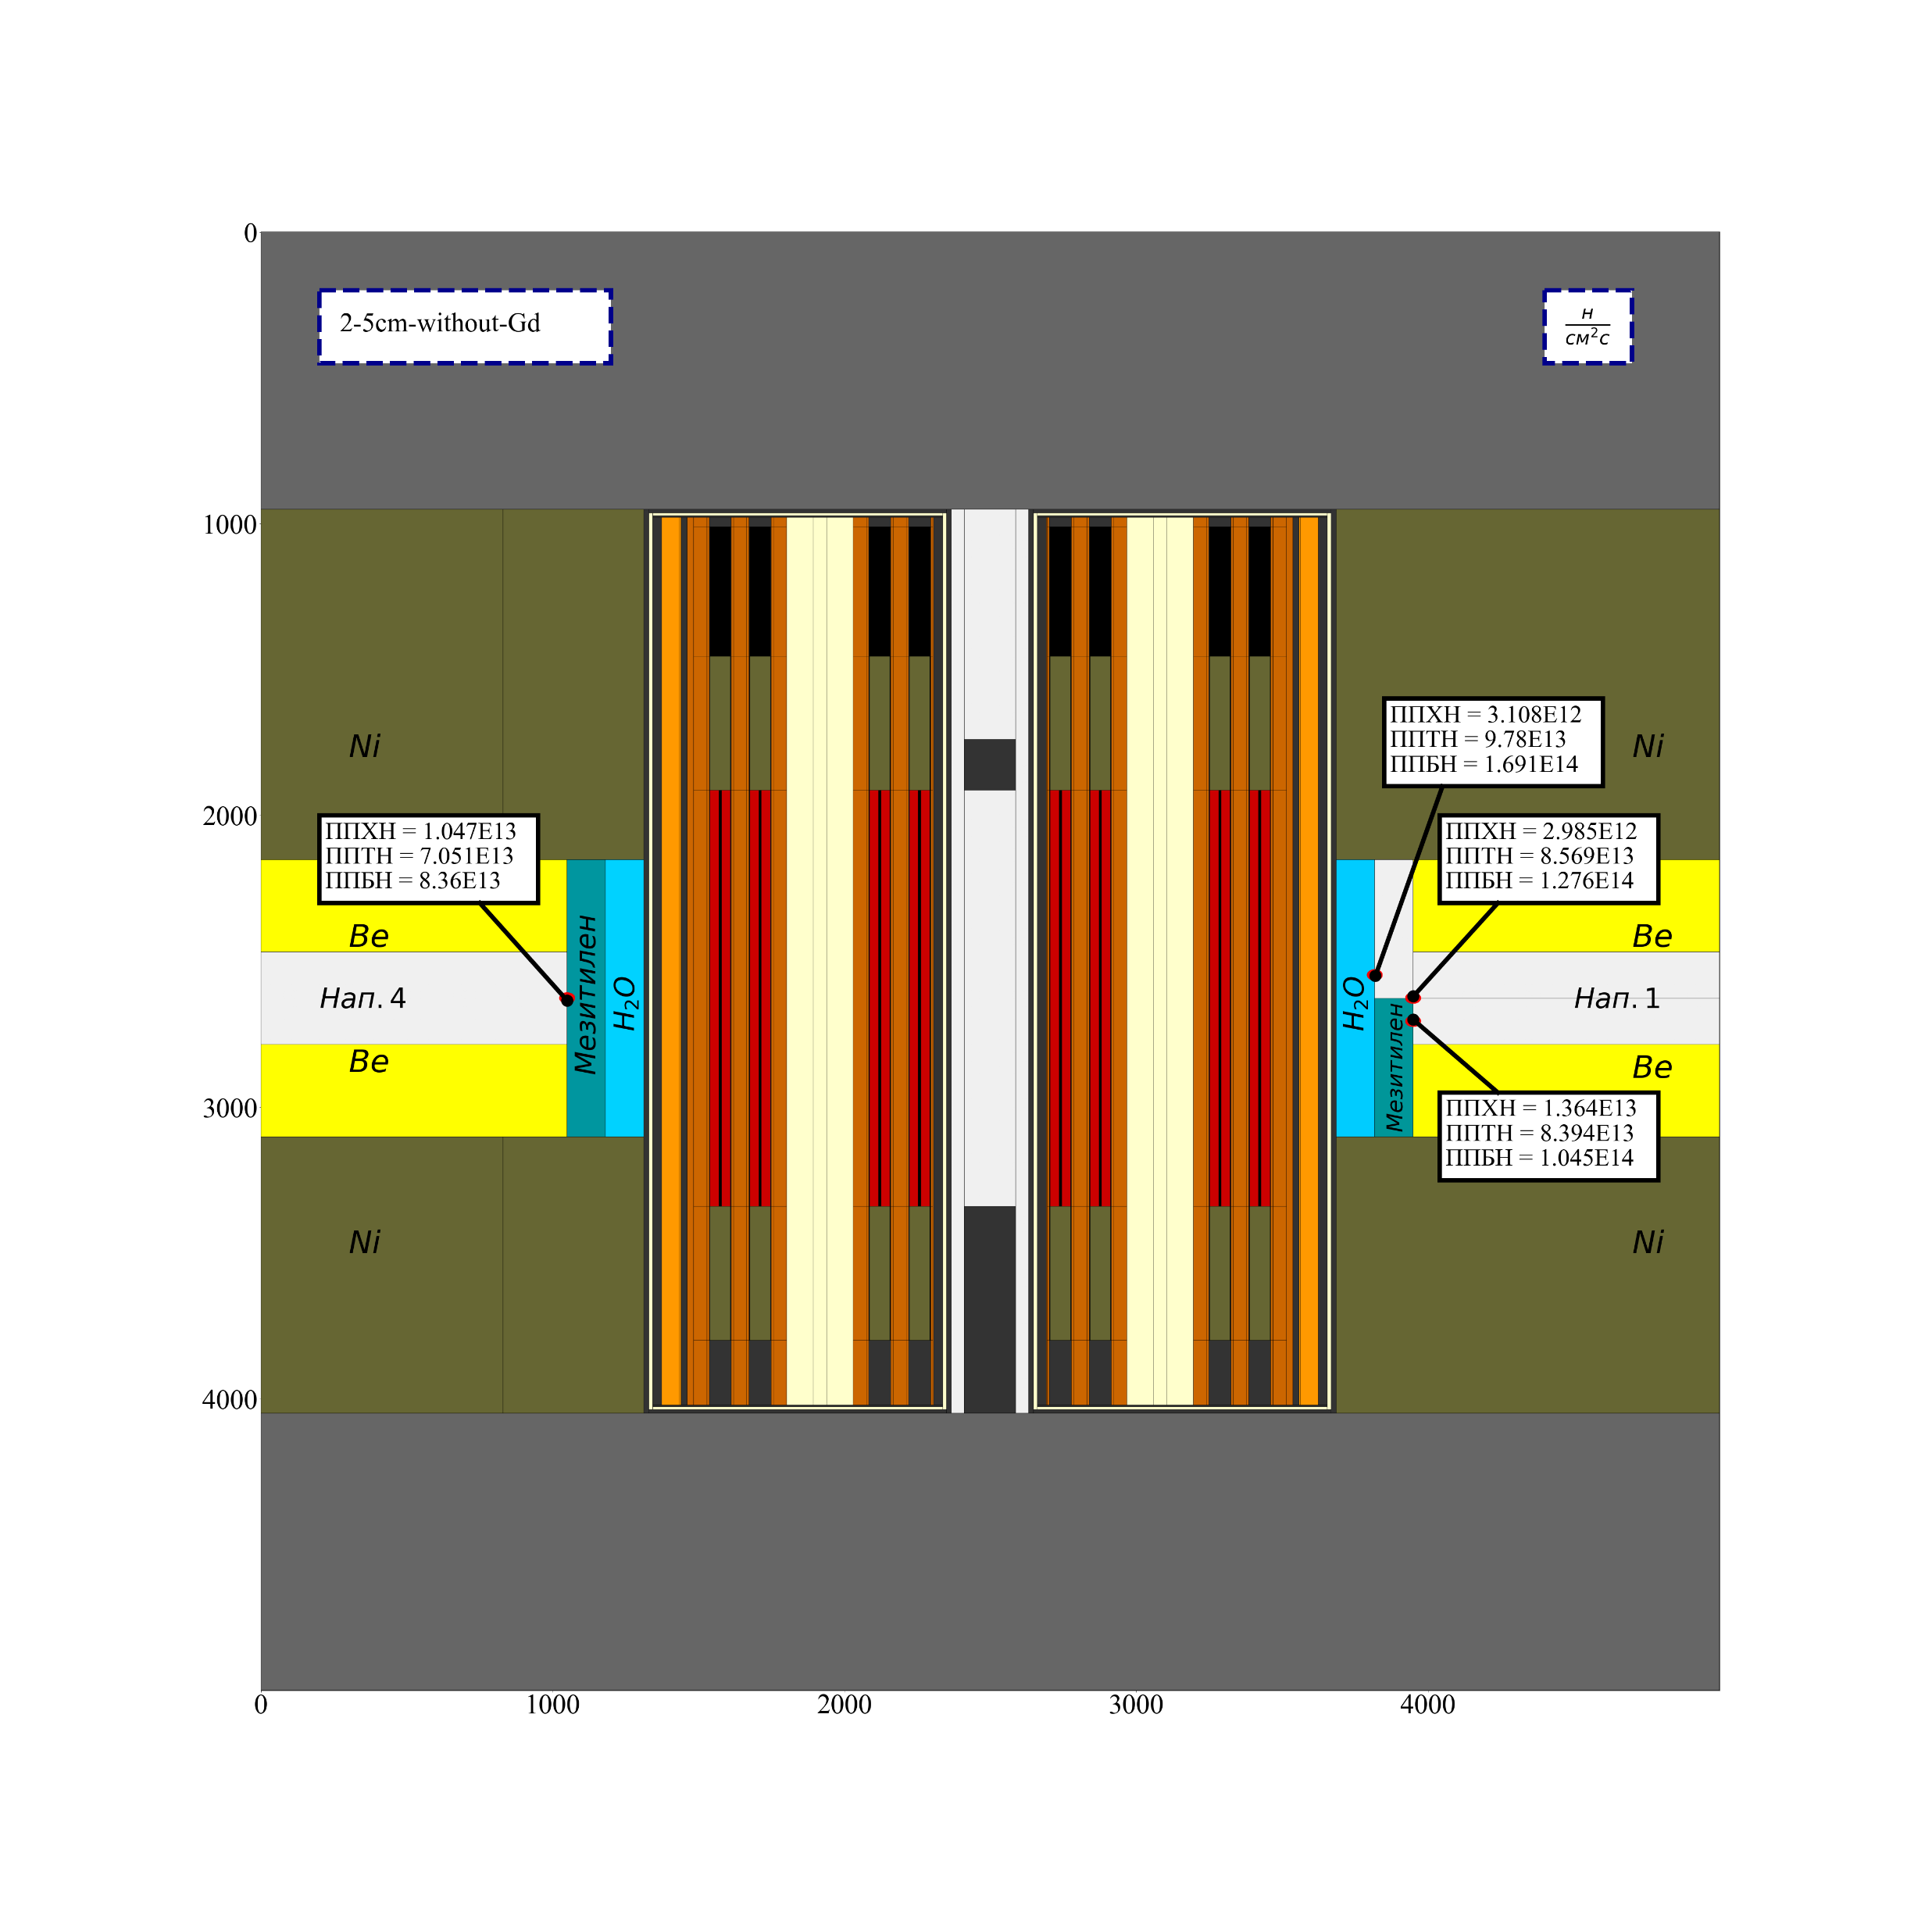
Neutron Flux Density from the Surface of Moderators

Slide 19
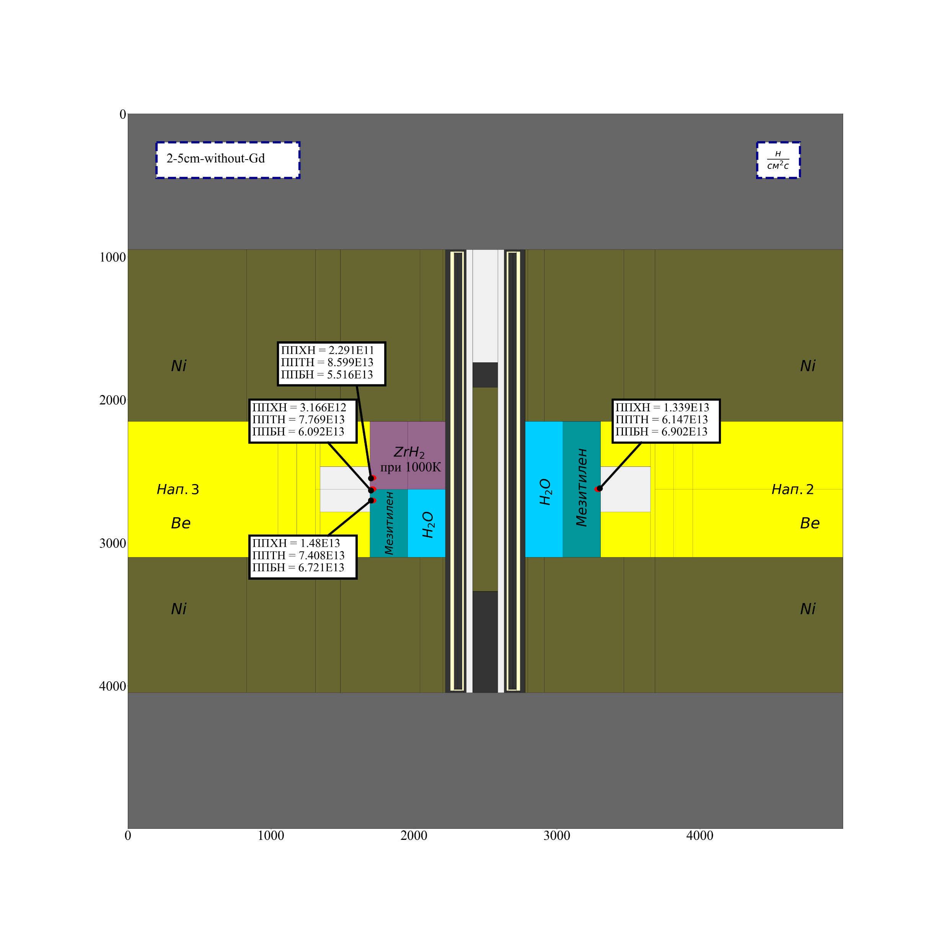
Neutron Flux Density from the Surface of Moderators

Slide 20
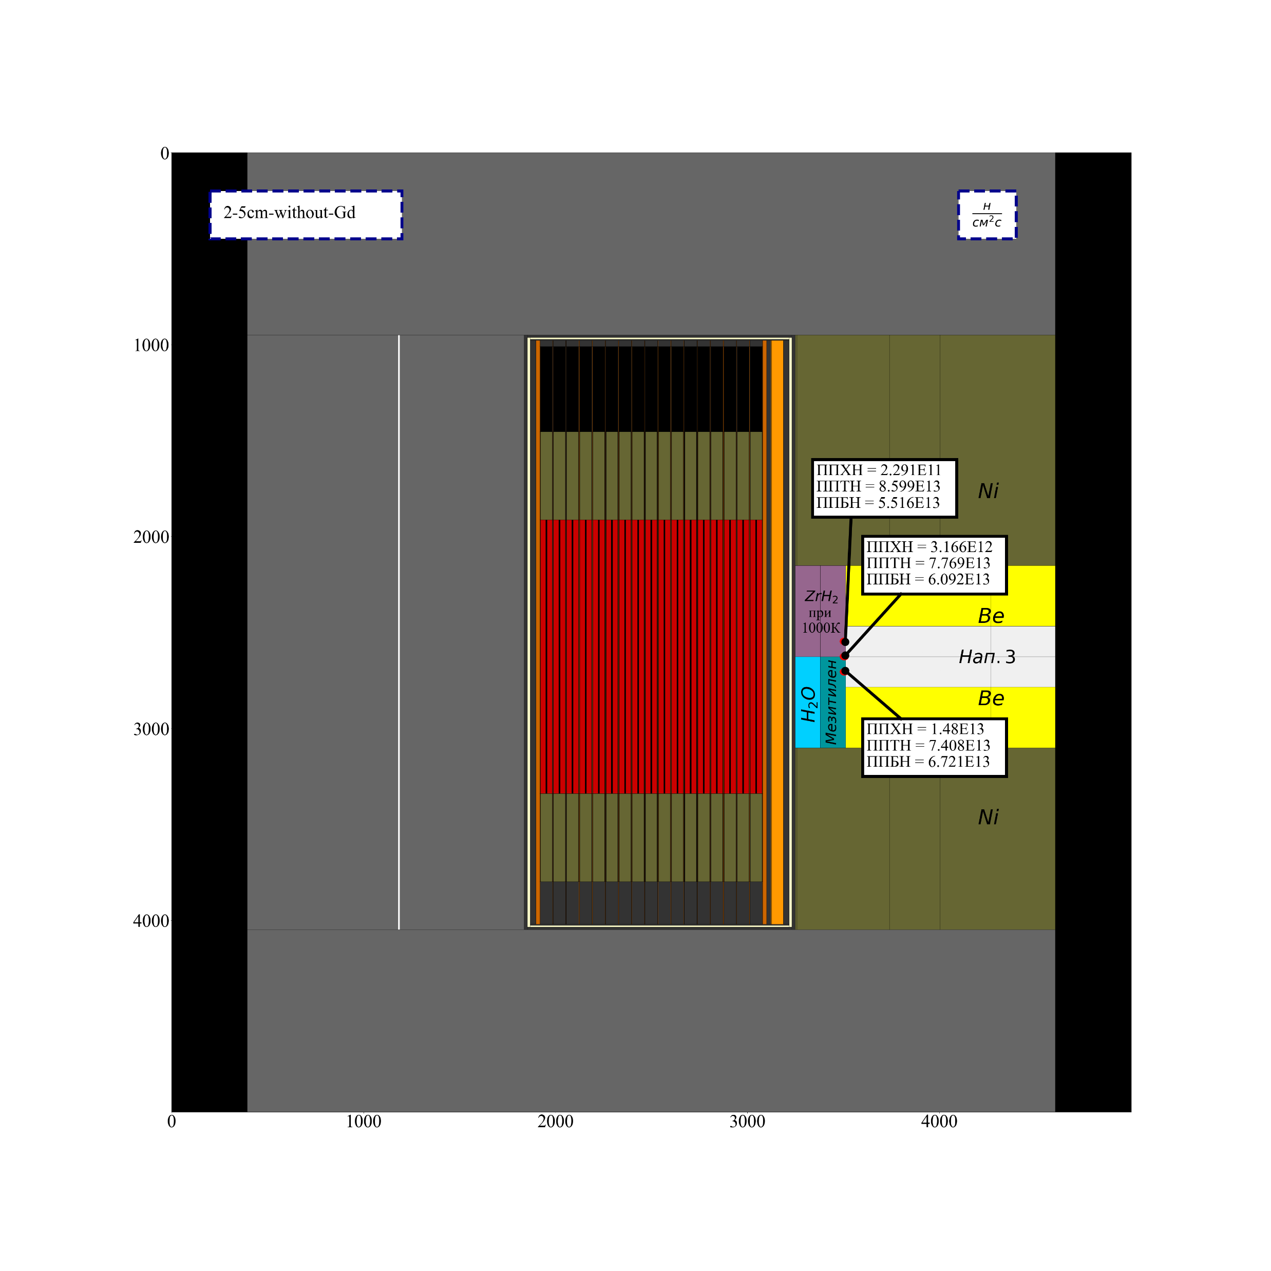
Neutron Flux Density from the Surface of Moderators

Slide 21
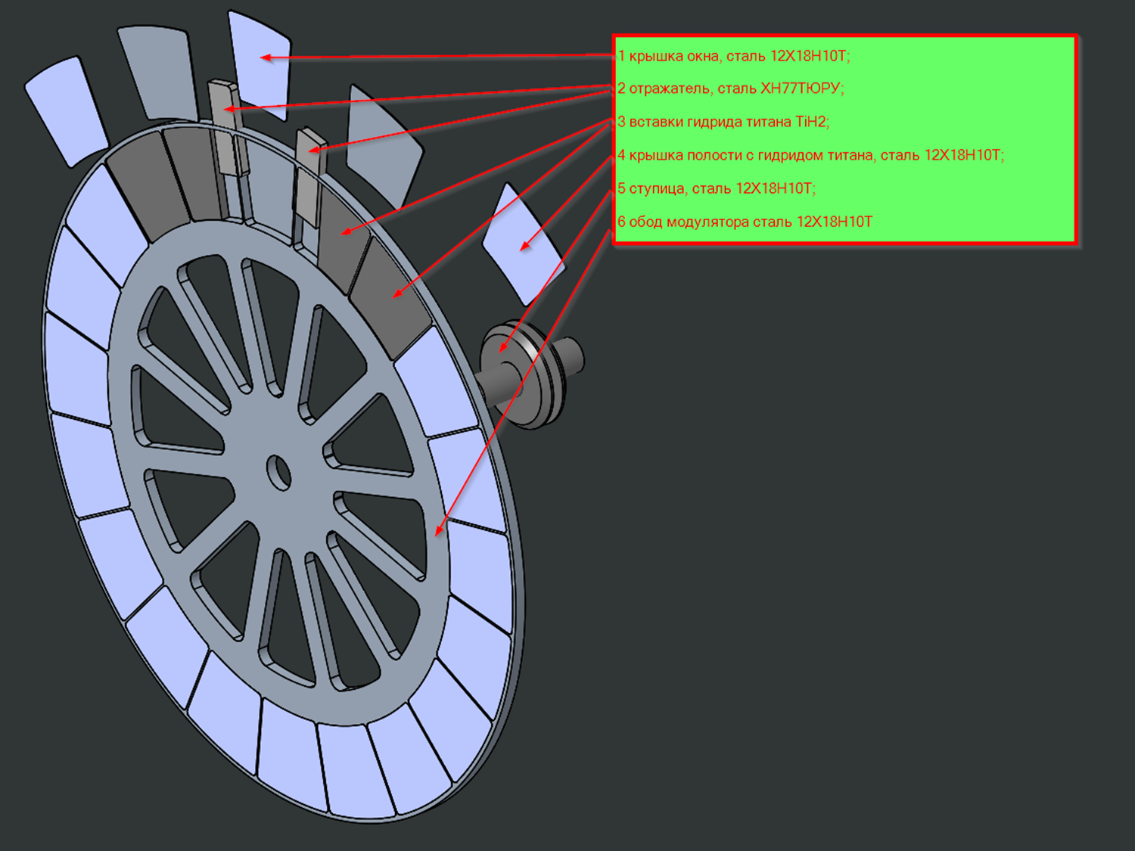
1- Reduce the heat load on Ti𝐇𝟐 in the MR:
Solution
THE MAIN NEUROTIC PROBLEMS THAT FACED REACTOR NEPTUNE, AND THE PROPOSALS TO SOLVE THEM.
it is proposed to install additional nickel reflectors on the border of the empty sector and the sector with titanium hydride.

Slide 22
Dependence of the maximum specific heat release in the modulator disk (W/cm3), the maximum effect of modulator displacement (%) and the α-parameter (cm-2) on the change in the vacuum width and the thickness of Ni
 | Максимальный удельная тепловыделения , Вт/см3
 | 0 cm Ni |  |  | 5 cm Ni |  |  | 10 cm Ni
 | Справа | Слева |  | Справа | Слева |  | Справа | Слева
30 cm вакуум | 9,65634 | 10,5207 |  | 6,66692 | 7,75357 |  | 4,48174 | 5,43119
35 cm вакуум | 8,5089 | 9,52174 |  | 5,55672 | 6,59312 |  | 3,82486 | 4,4615
40 cm вакуум | 7,41187 | 8,45502 |  | 4,71953 | 5,61119 |  | 3,22433 | 3,61275
45 cm вакуум | 6,3444 | 7,32191 |  | 4,00864 | 4,68787 |  | 2,59712 | 2,93969
 | 30 cm Вакуум, 0 см Ni | 30 cm Вакуум, 5 см Ni | 30 cm Вакуум, 10 см Ni |  | 35 cm Вакуум, 0 см Ni | 35 cm Вакуум, 5 см Ni | 35 cm Вакуум, 10 см Ni |  | 40 cm Вакуум, 0 см Ni | 40 cm Вакуум, 5 см Ni | 40 cm Вакуум, 10 см Ni |  | 45 cm Вакуум, 0 см Ni | 45 cm Вакуум, 5 см Ni | 45 cm Вакуум, 10 см Ni
Максимальный эффект смещения модулятора, % | 6,29% | 7,13% | 7,50% |  | 6,73% | 7,37% | 7,59% |  | 7,01% | 7,46% | 7,61% |  | 7,17% | 7,48% | 7,59%
α -параметр, см-2 | 1,37E-04 | 1,24E-04 | 9,82E-05 |  | 1,21E-04 | 9,88E-05 | 6,81E-05 |  | 9,01E-05 | 6,04E-05 | 3,85E-05 |  | 5,40E-05 | 2,92E-05 | 1,28E-05

Slide 23
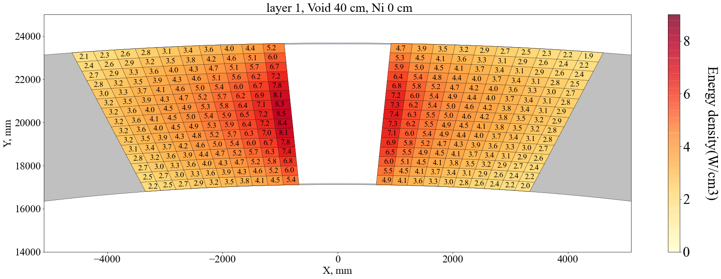
Specific heat generation in the modulator disk without installing an additional nickel reflector, W∙cm-3

Slide 24
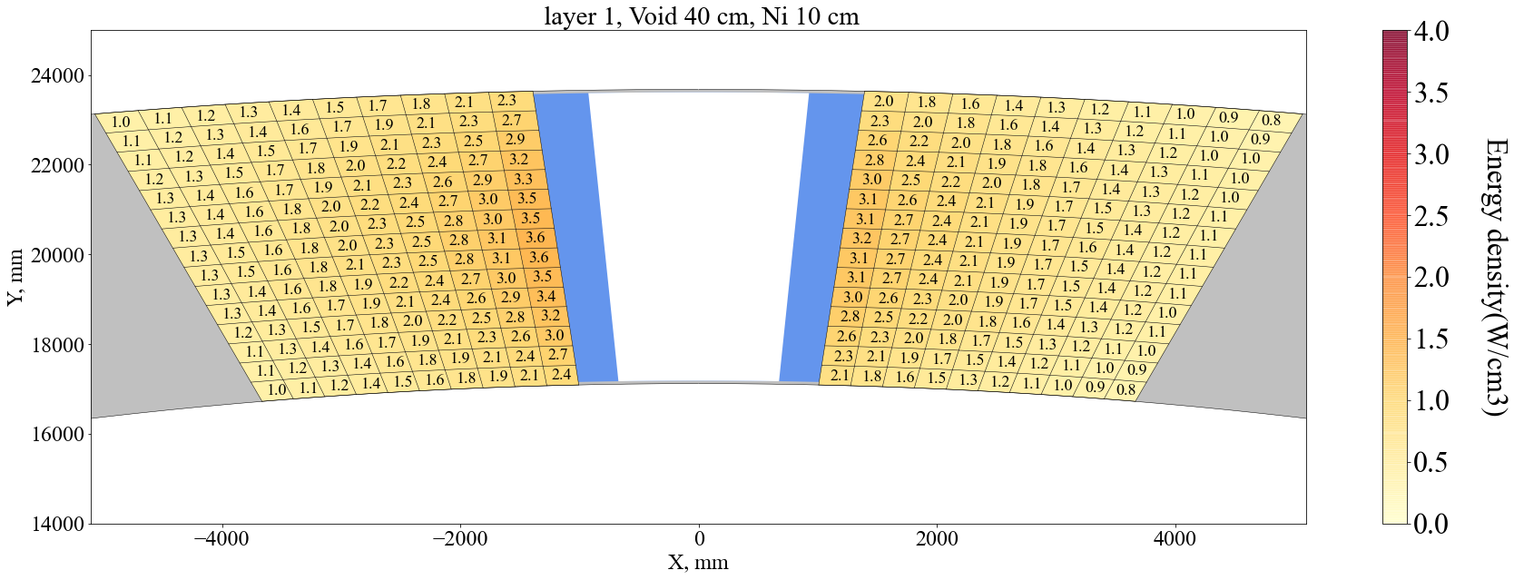
Specific heat generation in the modulator disk with the installation of an additional 10 cm nickel reflector, W∙cm-3

Slide 25
Conclusion
Closing the nuclear fuel cycle: The neptunium isotope was first proposed as a nuclear fuel.
Using Neptune offers numerous advantages, including the possibility of achieving a very high neutron flux.
It also eliminates the need for periodic fuel changes.

Slide 26
Спасибо
Thank you

Slide 27
CLASSIFICATION OF NUCLEAR REACTORS
By purpose: reactors are divided into power, research, transport, …..
By neutron energy spectrum: reactors are divided into thermal, fast and intermediate;
By moderator type: thermal neutron reactors are divided into light water (VVER), heavy water (CANDU) and graphite (RBMK);
By coolant: reactors are classified into light water, gas-cooled, heavy water and liquid metal;
By core structure: reactors are divided into heterogeneous and homogeneous;
By construction design: reactors are divided into vessel and channel;
By energy release or production: reactors are divided into pulsed and stationary (steady state).

Slide 28
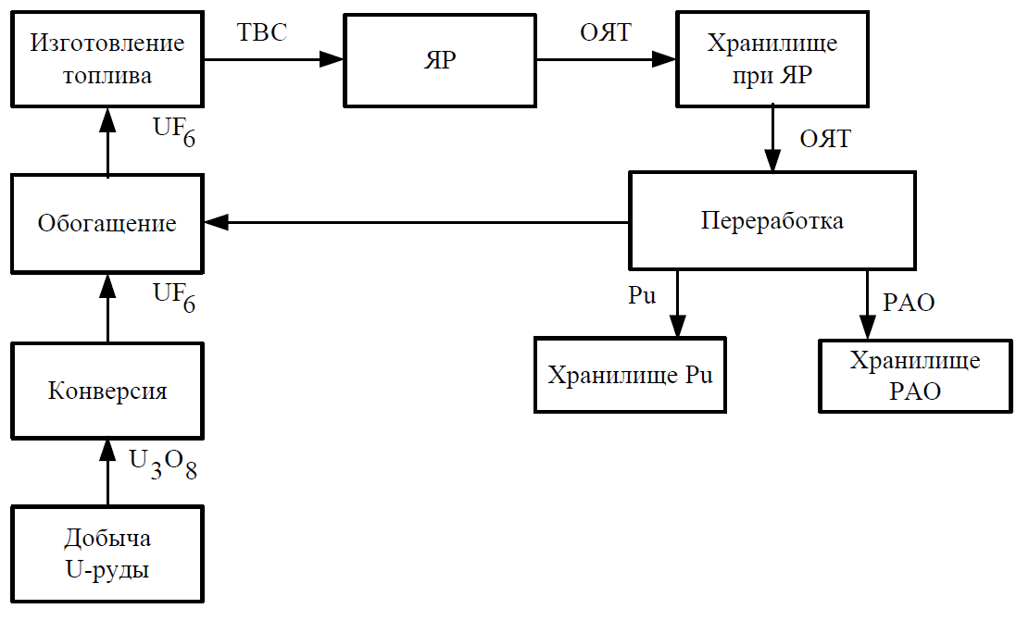
THE CONCEPT OF NUCLEAR FUEL (NFU) AND NUCLEAR FUEL CYCLE (NFC)
The main stages of a closed nuclear fuel cycle: there are two options for a closed nuclear fuel cycle:
Б. Closed nuclear fuel cycle with recycling of separated uranium
Its main stages are:
1. Добыча урановой руды.
2. Производство окта-оксида урана U3O8.
3. Конверсия U3O8 в UF6.
4. Обогащение UF6.
5. Изготовление ядерного топлива (твэлы и ТВС).
6. Использование ядерного топлива в ядерных реакторах.
7. Хранение ОЯТ в при реакторных хранилищах.
8. Reprocessing of spent nuclear fuel with the extraction of uranium, plutonium and radioactive waste.
9. Return of separated uranium at the conversion and enrichment stage.
10. Storage of plutonium in special storage facilities.
11. Final disposal of radioactive waste in geological formations.

Slide 29
CLASSIFICATION OF NUCLEAR REACTORS
7. By energy release or production: reactors are divided into pulsed (IBR-2) and stationary (steady state) (VVER).
Change in the power of the IBR-2M reactor with an average power of 2 MW
Change in VVER-1000 reactor power over 18 months (reactor company)

Slide 30
How can this goal (${10}^{14}\frac{n}{{cm}^{2}.s}$) achieve????
To achieve this goal, there were two ways, either continue to use Pu-39 as a nuclear fuel or consider a new fuel cycle (Np-as example).
Booster reactor based on Pu-239
16 neutron channel
Reactor based on Np-237
25 neutron channel

Slide 31
Neutron Sources
NEUTRON SOURCES
Denes sources
Weak sources
Spallation neutron sources
Nuclear reactors
Fusion
Fission
Steady state power
Pulsed power
Aperiodic
Periodic
Boosters

Slide 32
THE CONCEPT OF NUCLEAR FUEL (NF) AND NUCLEAR FUEL CYCLE (NFC)
Nuclear Materials: nuclides that undergo fission by neutrons.
natural (primary) isotopes of uranium and thorium (235U, 238U, 232Th);
Artificial (secondary) isotopes of plutonium (239Pu, 241Pu);
isotopes of transuranic elements (Np, Am, Cm, Bk, Cf);
artificial (secondary) isotope 233U.
The isotope 235U is the only natural nuclear material that can be fissioned by neutrons of any energy.
The following types of nuclear fuel are used:
pure metals, metal alloys, intermetallic compounds;
ceramics (oxides, carbides, nitrides);
metal ceramics (cermets - particles of metallic fuel dispersed in a ceramic matrix);
dispersed fuel (fuel microparticles in a protective shell are dispersed in an inert, such as graphite, matrix).

Slide 33
THE CONCEPT OF NUCLEAR FUEL (NFU) AND NUCLEAR FUEL CYCLE (NFC)
NFC: the process of manufacturing, using and reprocessing nuclear fuel.
Main stages of NFC
Mining of uranium ore and extraction of uranium from it.
Manufacturing of nuclear fuel
а) obtaining uranium concentrate in the form of U3O8 (uranium octa-oxide);
б) conversion of U3O8 to UF6 (uranium hexafluoride);
в) uranium enrichment with isotope 235U;
г) manufacturing of fuel elements and fuel assemblies.
3. Use of nuclear fuel in nuclear reactors of various types.
4. Temporary storage of irradiated fuel assemblies (FA) at nuclear power plants.
There are two possible options further: OPEN NFC or CLOSED NFC.
In case of open NFC:
5. Transportation and disposal of spent fuel assemblies in geological formations.

Slide 34
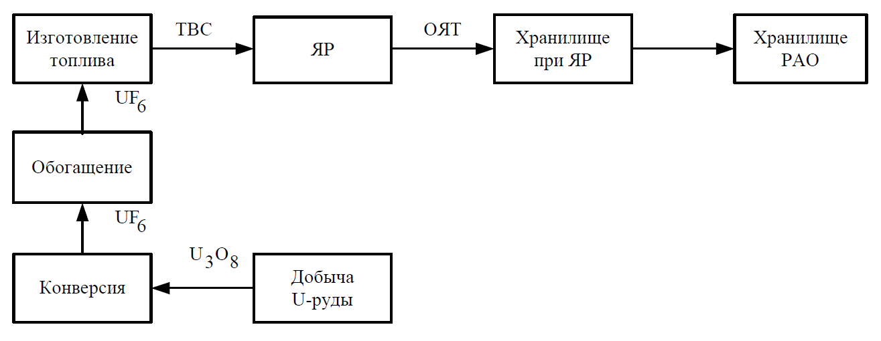
А. Open nuclear fuel cycle
THE CONCEPT OF NUCLEAR FUEL (NFU) AND NUCLEAR FUEL CYCLE (NFC)

Slide 35
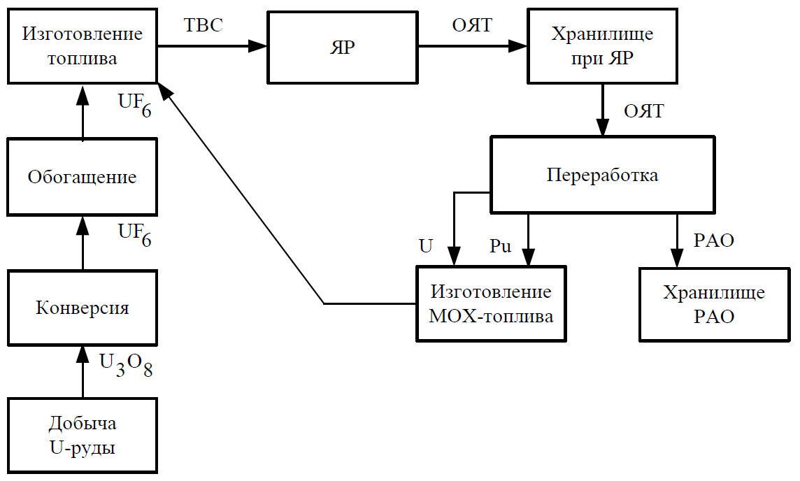
THE CONCEPT OF NUCLEAR FUEL (NFU) AND NUCLEAR FUEL CYCLE (NFC)
Основные стадии замкнутого ЯТЦ: существует два варианта ЗЯТЦ:
В. Closed nuclear fuel cycle with recycling of separated uranium and plutonium
Its main stages are:
1. Добыча урановой руды.
2. Производство окта-оксида урана U3O8.
3. Конверсия U3O8 в UF6.
4. Обогащение UF6.
5. Изготовление ядерного топлива (твэлы и ТВС).
6. Использование ядерного топлива в ядерных реакторах.
7. Хранение ОЯТ в при реакторных хранилищах.
8. Переработка ОЯТ с выделением урана, плутония и РАО.
9. Возвращение выделенного урана на стадии конверсии и обогащения.
9. Return of separated uranium and plutonium to the stage of manufacturing mixed uranium-plutonium oxide fuel (MOX fuel).
10. Final disposal of radioactive waste in geological formations.

Slide 36
PULSED REACTORS (PR)
Aperiodic pulsed reactors
1- Reactor IBR-1:
Reactor core: had fixed and moving parts, the main moving part was 4 kg of U-235 (RM-1 Reactivity Modulator) pressed into a steel disk.
Pulse formation: As the disk rotated, uranium periodically passed between the stationary parts of the core.
Changes in pulse frequency without frequency distortion: An auxiliary disk (MP-2) with a lower mass of U-235 was used.

Slide 37
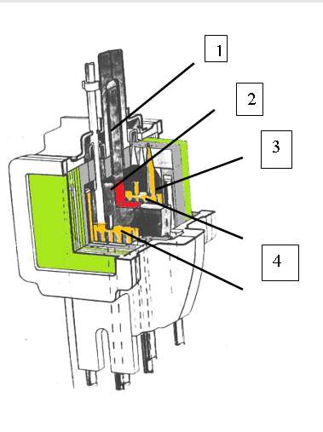
PULSED REACTORS (PR)
Aperiodic pulsed reactors
1- Reactor IBR-1:
IBR diagram.
1 – Reactivity modulator disk;
2 – uranium insert (main mobile zone – MR-1);
3 – auxiliary mobile zone (MR-2);
4 – two parts of the active zone of plutonium.

Slide 38
PULSED REACTORS (PR)
Aperiodic pulsed reactors
2- Reactor IBR-30:
Reactor core: The general layout of the IBR-1 was repeated, with the following changes:
The fuel elements have been modified to provide thermal power output of up to 30 kW.
Basically, the MR is diametrically opposed to two pressed-in U-235 inserts to distribute the thermal load.
A third MR was introduced for slow modulation of reactivity (movable reflector W).

Slide 39
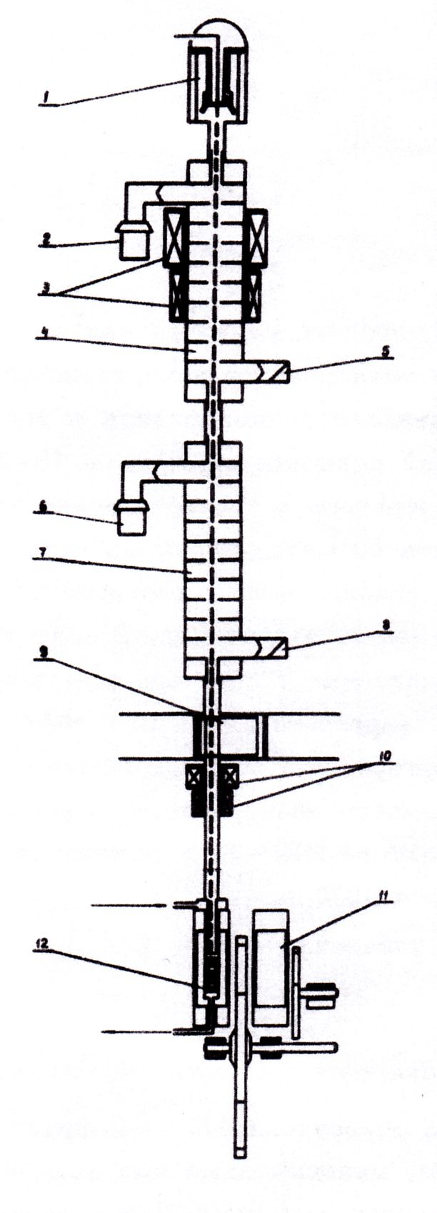
PULSED REACTORS (PR)
Aperiodic pulsed reactors
2- Reactor IBR-30:
IBR-30 diagram with injector
1 – electron gun;
2, 6 – klystrons;
3 – focusing solenoids;
4, 7 – diaphragm waveguides of sections No. 1 and No. 2;
5, 8 – water loads;
9 – vacuum protective gate;
10 ​​– quadrupole lenses;
11 – IBR-30 active zone;
12 – neutron-producing target.

Slide 40
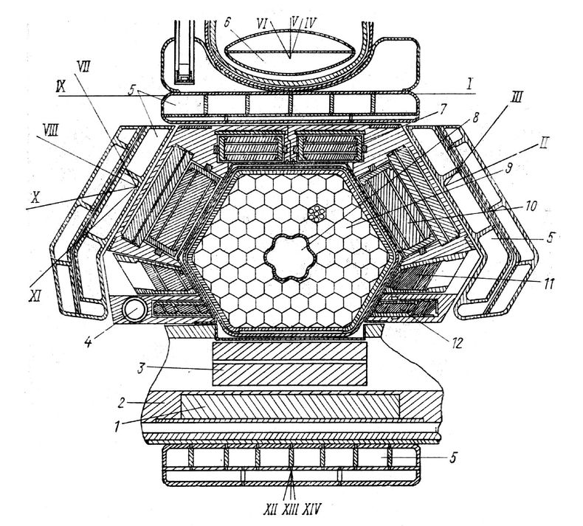
PULSED REACTORS (PR)
Aperiodic pulsed reactors
3- Reactor IBR-2:
Reactor core: In addition to the pulse reactor, it also includes a high-current linear accelerator.
The reactor could operate either as a booster with an accelerator or as a pulse reactor without an injector.
Core – was an irregular hexagon made up of 78 fuel assemblies. 7 fuel assemblies from the center have been removed, and their place is occupied by a channel, in the lower part of which there is a target, and in the upper part there is space for irradiating samples.
МР: main and additional. Adjacent to the largest side of the hexagon core (reflector),

Slide 41
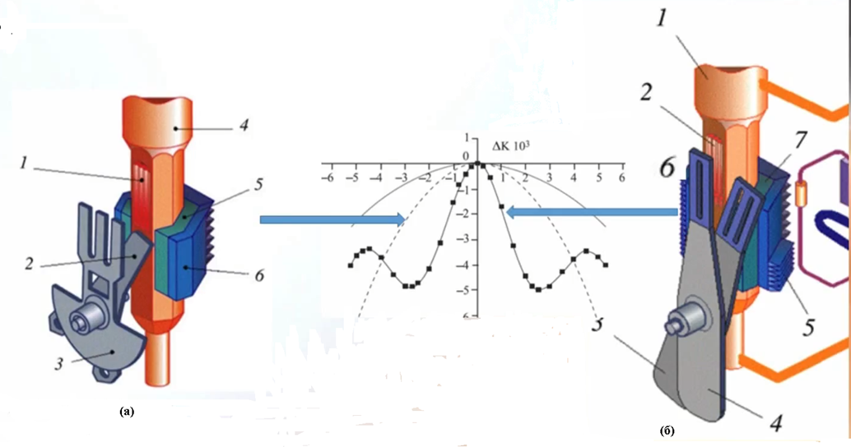
PULSED REACTORS (PR)
Aperiodic pulsed reactors
4- Reactor IBR-2М (Reactor modernization IBR-2):
1- Replacement of the movable reflector made of steel with a new reflector made of Ni:
(а) 1- core, 2- Main MR, 3- Additional MR, 4- Reactor vessel, 5- Reflector, 6- Moderator.
(б) 1- reactor vessel, 2- core, 3- main MR, 4- additional MR, 5- cold moderator, 6- water moderator, 7- reflector.

Slide 42
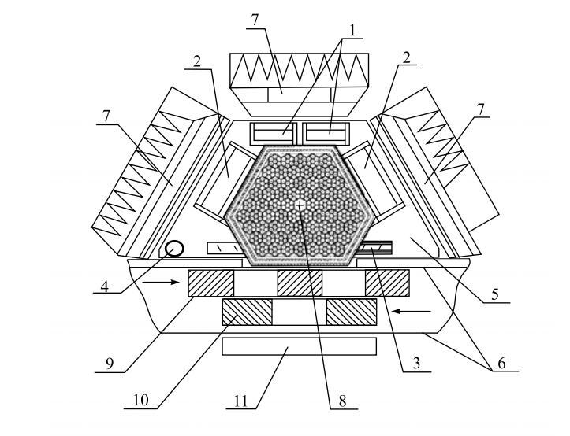
PULSED REACTORS (PR)
Aperiodic pulsed reactors
4- Reactor IBR-2М (Reactor modernization IBR-2):
2- Cross-section of the IBR-2M reactor core:
1- emergency protection unit; 2- compensating units; 3- intermediate regulator unit; 4- automatic regulator rod; 5- stationary reflector matrix. 6- movable reflector casing; 7- water comb moderators; 8- source; 9- main MR; 10- additional MR; 11- water flat moderator.

Slide 43
PULSED REACTORS (PR)
Aperiodic pulsed reactors
4- Reactor IBR-2М (Reactor modernization IBR-2):
Due to the resource depletion. The reactor modernization process consisted of two main stages:
1- Replacement of the movable reflector made of steel with a new reflector made of Ni:
reduce the rotation speed of the main movable reflector from 1500 rpm to 600 rpm;
mechanical stresses were reduced quadratically and the service life, which was previously limited by fast neutron flux, was extended.
2- The IBR-2M reactor core consists of 69 fuel assemblies, which means it is smaller in size and the new reactor core does not have a central channel.
In order to improve the reliability and efficiency of the control system, 2 high-efficiency reactor core blocks are installed.

Slide 44
Characteristics of the IBR-2 and IBR-2M reactors.
Parameters | IBR-2 | IBR-2М
Avarage thermal power, MWт | 4 | 2
Fuel | PuO₂ | PuO2
Number of fuel assimeblies | 78 | 69
Maximum burn up, % | 6.5 | 9
Pulsed frequency, Hz | 5, 10, 15, 20, 25 | 5, 10
Fast neutron pulse half-width at 5 Hz, μs | 215 | 200
reactivity modulator rotation speed, rpm
Basic | 1500 | 600
additional | 300 | 300
Primary and secondary MR material | Special steel | Ni
service life of the MP, 10³ hr | 20 | 55
Coolant | Liquid sodium | Liquid sodium
IBR-2

Slide 45
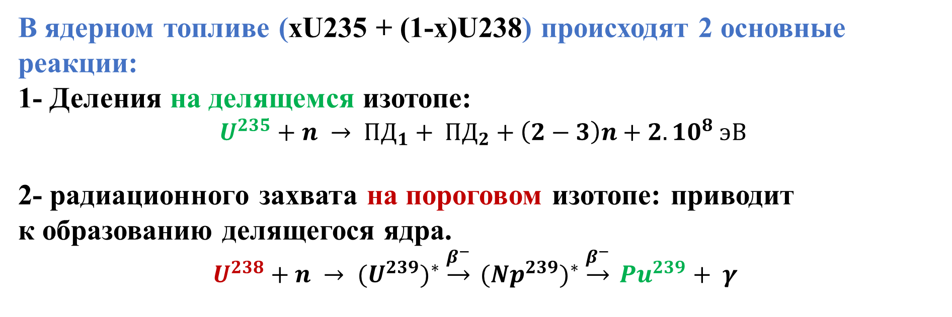
Понятие Коэффициента воспроизводства – КВ:
BASICS OF NUCLEAR FISSION PHYSICS.
ADVANTAGES AND PROBLEMS OF NUCLEAR ENERGY
В ядерном топливе (xU235 + (1-x)U238) происходят 2 основные реакции:
1- Деления на делящемся изотопе:
$U^{235}+n → {ПД}_{1}+ {ПД}_{2}+\left(2−3\right)n+2.{10}^{8} эВ$
2- радиационного захвата на пороговом изотопе: приводит
к образованию делящегося ядра.
$U^{238}+n → {(U^{239})}^{∗} \underset{→}{β^{−}} {({Np}^{239})}^{∗} \underset{→}{β^{−}} {Pu}^{239}+ γ$

Slide 46
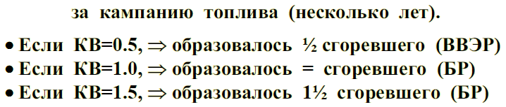
Понятие Коэффициента воспроизводства – КВ:
BASICS OF NUCLEAR FISSION PHYSICS.
ADVANTAGES AND PROBLEMS OF NUCLEAR ENERGY
Реакции, в результате которых образуются искусственные делящиеся нуклиды (239Pu, 233U), называются реакциями воспроизводства ядерного топлива.

Slide 47
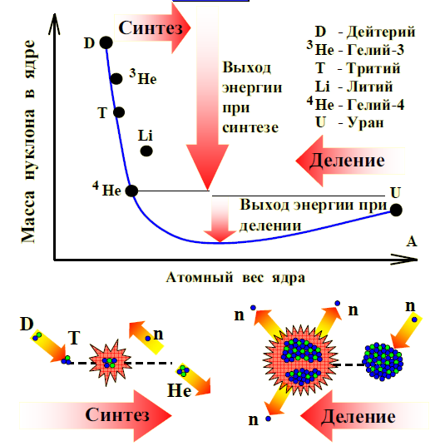
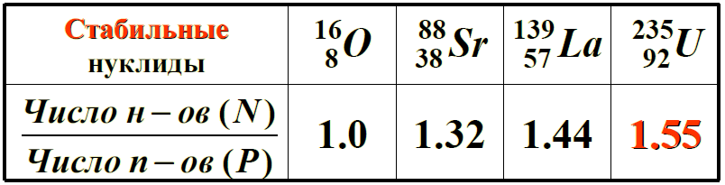
BASICS OF NUCLEAR FISSION PHYSICS.
ADVANTAGES AND PROBLEMS OF NUCLEAR ENERGY
The main purpose of various nuclear reactors is to produce HEAT and NEUTRONS.
Each nucleon in a fusion nucleus or fission fragment is lighter than in the original nucleus: the mass difference is converted into energy
How to release fission energy?
Neutrons are needed, they appear in (α,n)-reactions on light nuclei, for example, Be;
But this is a very weak source of neutrons, the power of the energy source is low.
Where to get a lot of neutrons?
The fragments will emit “extra” neutrons.

Slide 48
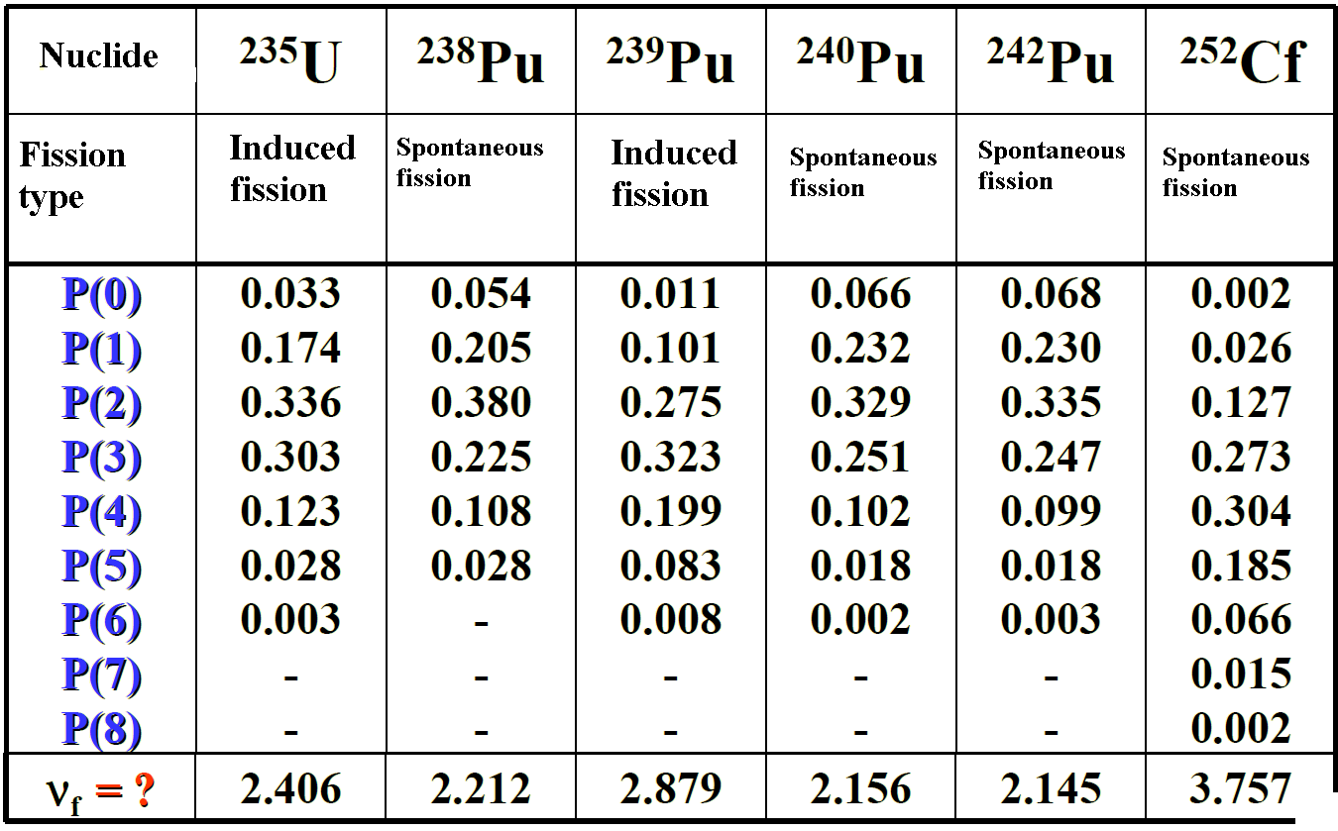
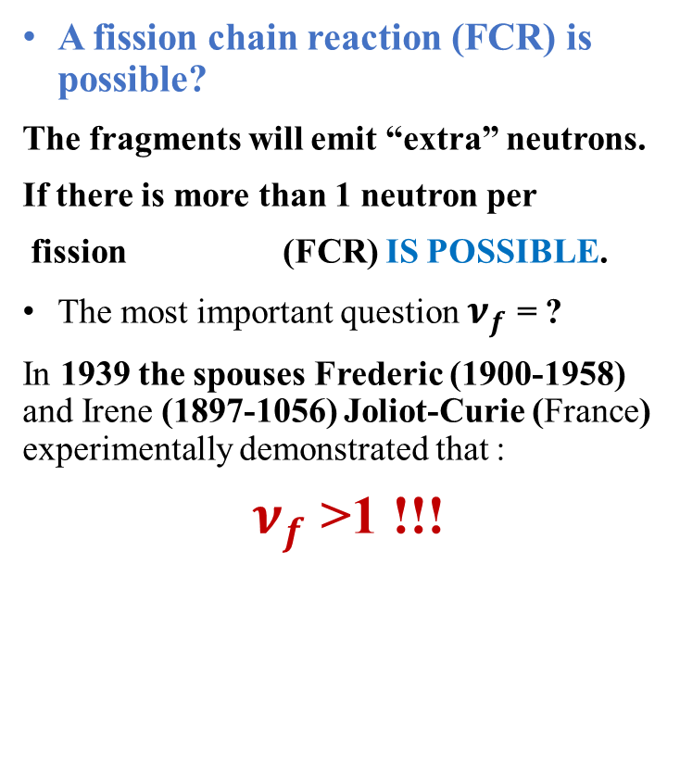
BASICS OF NUCLEAR FISSION PHYSICS.
ADVANTAGES AND PROBLEMS OF NUCLEAR ENERGY
The operation of a nuclear reactor depends not on the fission reaction, but on the FISSION CHAIN ​​REACTION
A fission chain reaction (FCR) is possible?
The fragments will emit “extra” neutrons.
If there is more than 1 neutron per
fission (FCR) IS POSSIBLE.
The most important question $ν_{f}$ = ?
In 1939 the spouses Frederic (1900-1958) and Irene (1897-1056) Joliot-Curie (France) experimentally demonstrated that :
$ν_{f}$ >1 !!!
Experimental Probabilities of Prompt Fission Neutrons [LANL, USA]

Slide 49
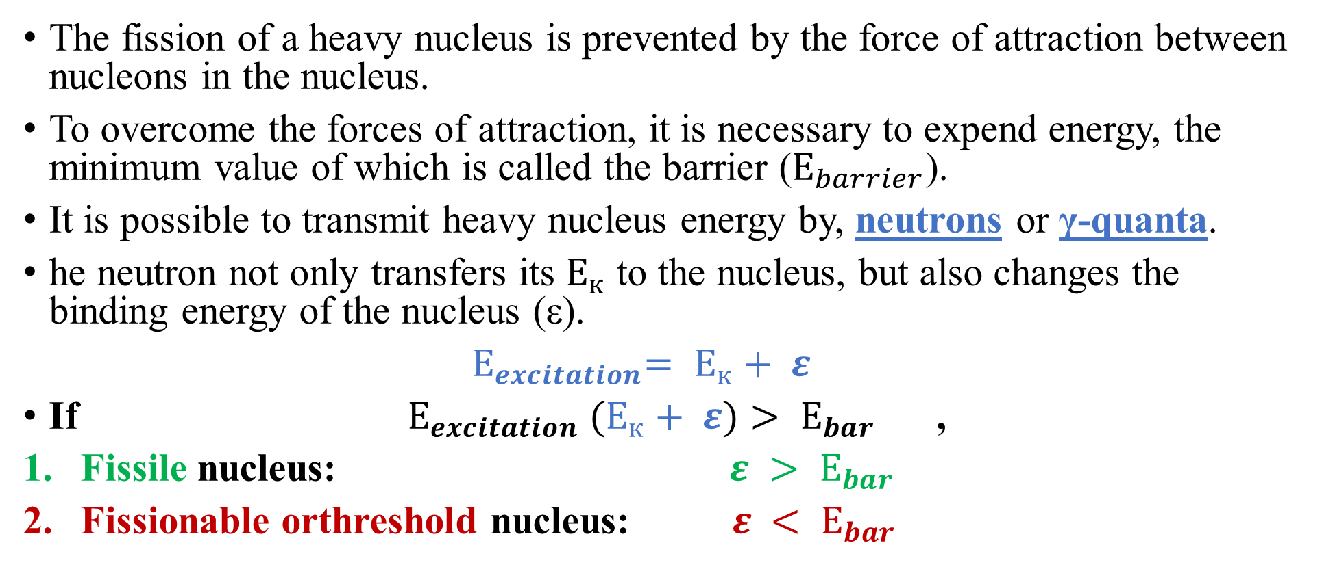
The concept of fissile and threshold nuclei:
BASICS OF NUCLEAR FISSION PHYSICS.
ADVANTAGES AND PROBLEMS OF NUCLEAR ENERGY
The fission of a heavy nucleus is prevented by the force of attraction between nucleons in the nucleus.
To overcome the forces of attraction, it is necessary to expend energy, the minimum value of which is called the barrier ($Е_{barrier}$).
It is possible to transmit heavy nucleus energy by, neutrons or γ-quanta.
he neutron not only transfers its $Е_{к}$ to the nucleus, but also changes the binding energy of the nucleus (ε).
${ Е}_{excitation}= Е_{к}+ ε$
If $Е_{excitation} (Е_{к}+ ε)> Е_{bar}$ ,
Fissile nucleus: $ε > Е_{bar}$
Fissionable orthreshold nucleus: $ε < Е_{bar}$
Пример посмотрите следующий слайд

Slide 50
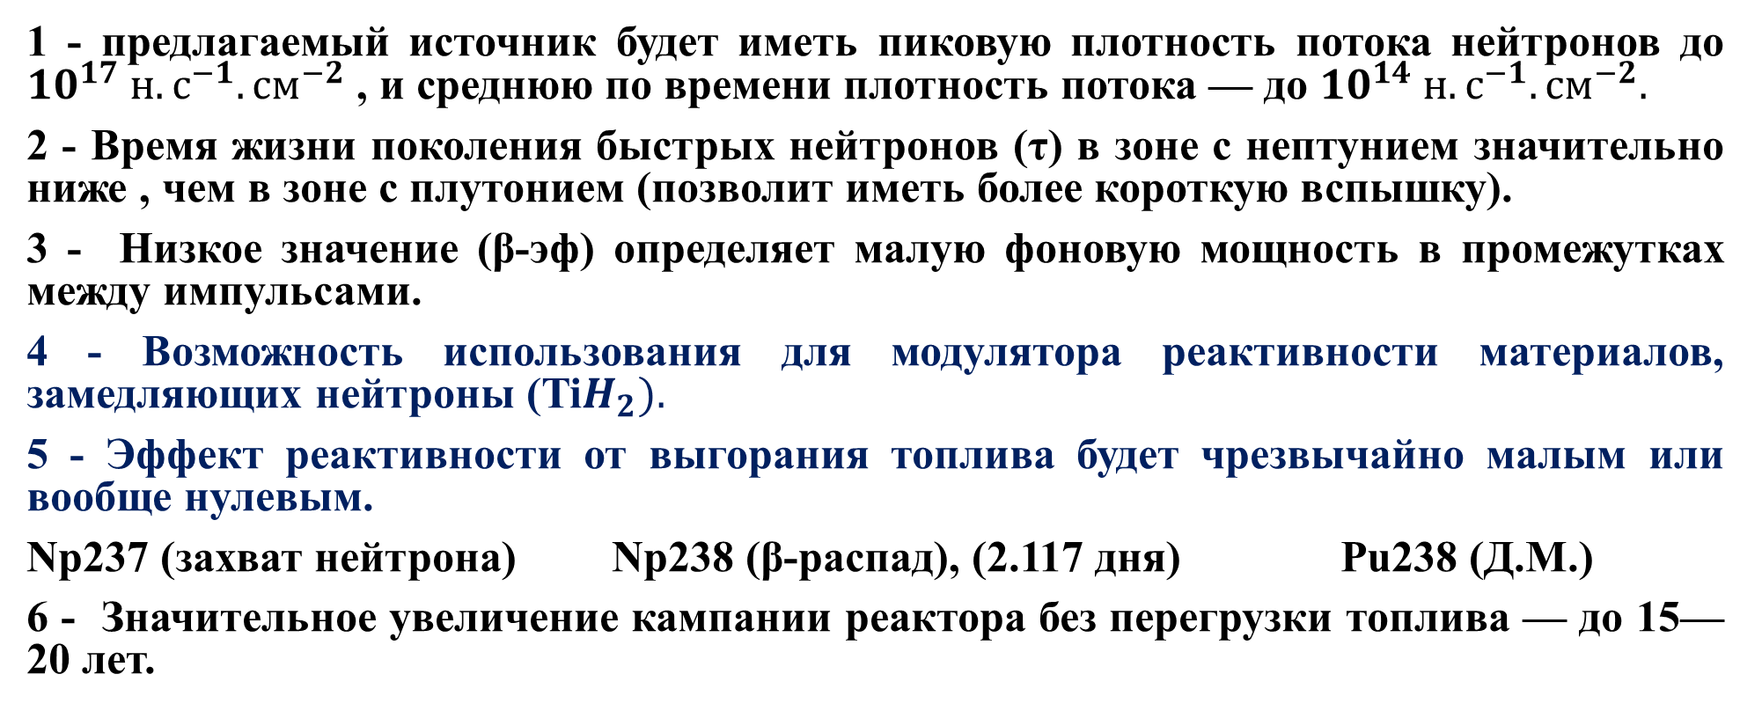
5- ОСНОВНЫЕ ОСОБЕННОСТИ РЕАКТОРА НЕПТУН:
1 - предлагаемый источник будет иметь пиковую плотность потока нейтронов до ${10}^{17} н.с^{−1}.{см}^{−2}$ , и среднюю по времени плотность потока — до ${10}^{14} н.с^{−1}.{см}^{−2}.$
2 - Время жизни поколения быстрых нейтронов (τ) в зоне с нептунием значительно ниже , чем в зоне с плутонием (позволит иметь более короткую вспышку).
3 - Низкое значение (β-эф) определяет малую фоновую мощность в промежутках между импульсами.
4 - Возможность использования для модулятора реактивности материалов, замедляющих нейтроны (Ti$H_{2}).$
5 - Эффект реактивности от выгорания топлива будет чрезвычайно малым или вообще нулевым.
Np237 (захват нейтрона) Np238 (β-распад), (2.117 дня) Pu238 (Д.М.)
6 - Значительное увеличение кампании реактора без перегрузки топлива — до 15—20 лет.

Slide 51
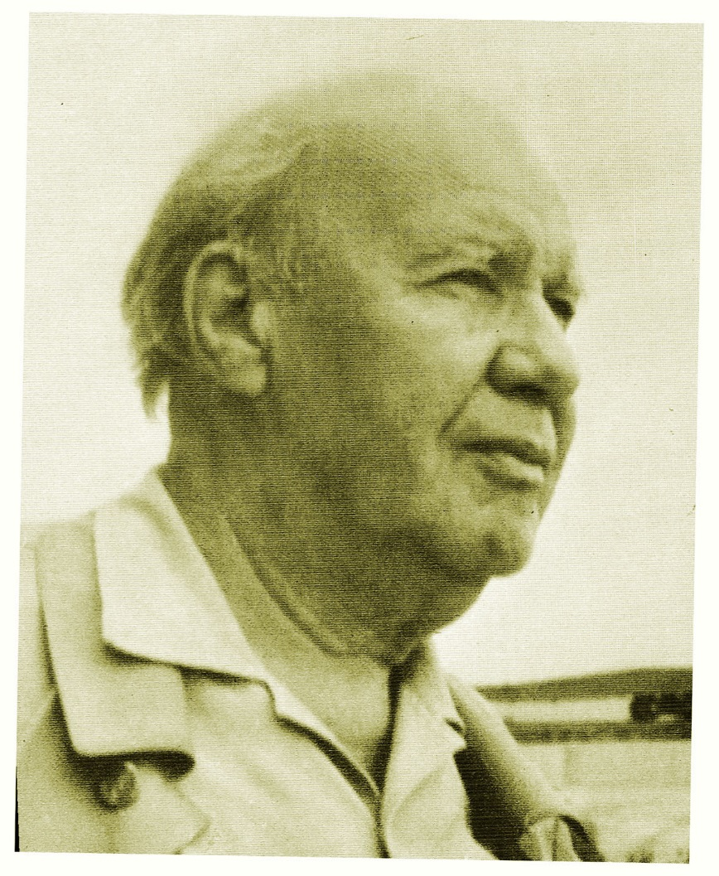
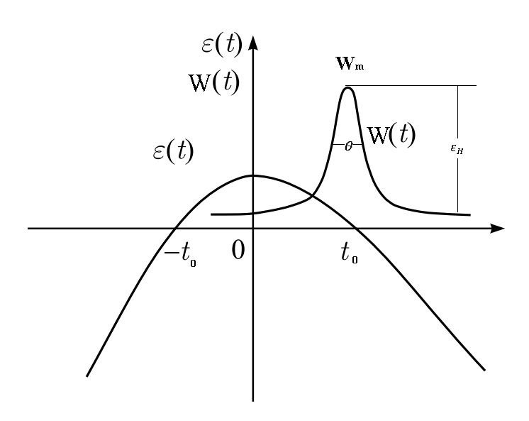
B) Denes sources : 2- Periodic Pulsed power reactors:
Neutron sources
In 1955- in the Obninsk Pysical-Power institute (Russia), D. I. Blokhintsev suggested the idea of a periodic pulsed reactors with mechanically periodically reactivity modulation.
To combines the best features of Aperiodic reactors (pulsed nature without any choppers – time of flight) and steady state power reactors (good enough fluence to neutron spectroscopy).
Dmitry Blokhintsev
(1907-1979)
Reactor Power
Reactor Reactivity
The course of reactivity and power of the reactor during the development of the power pulse

Slide 52
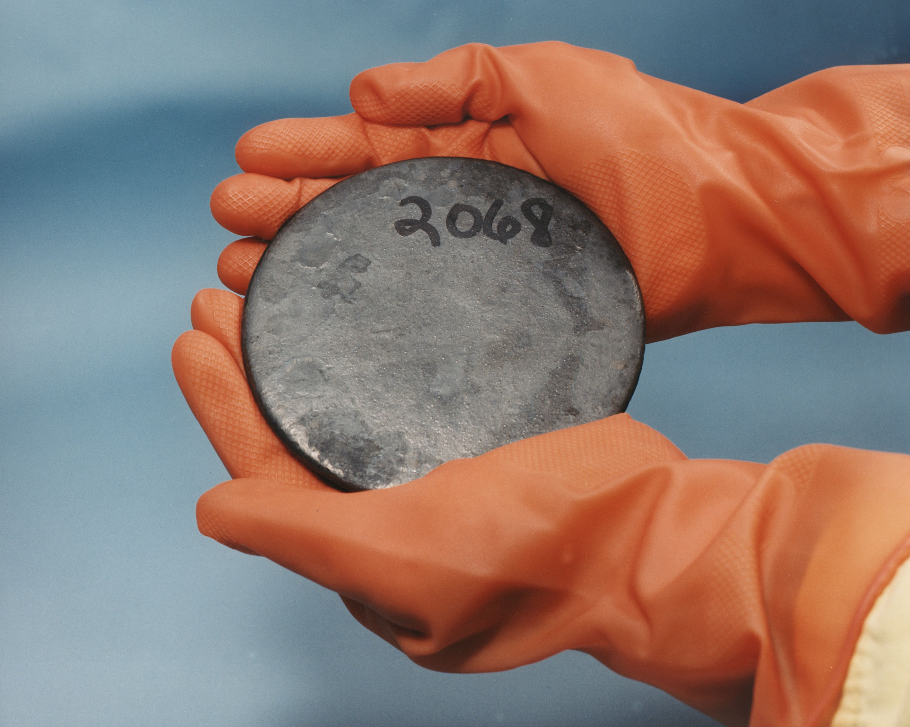
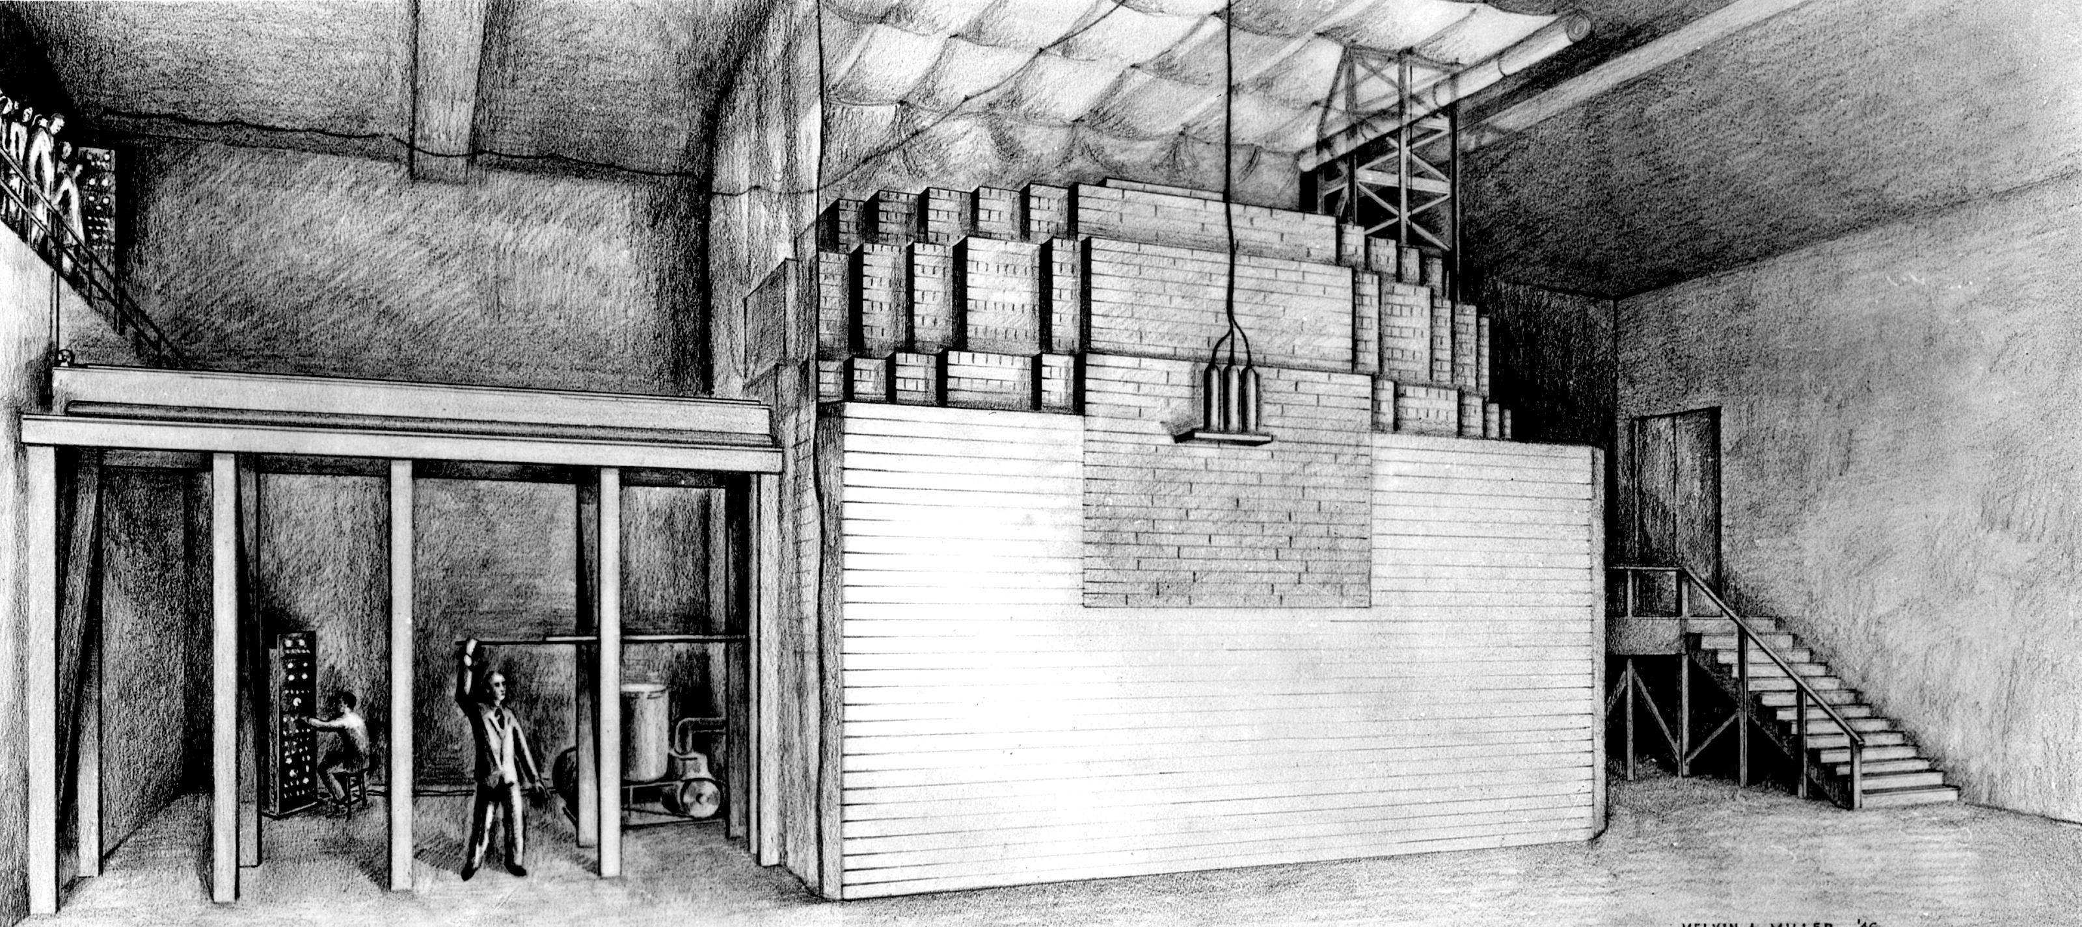
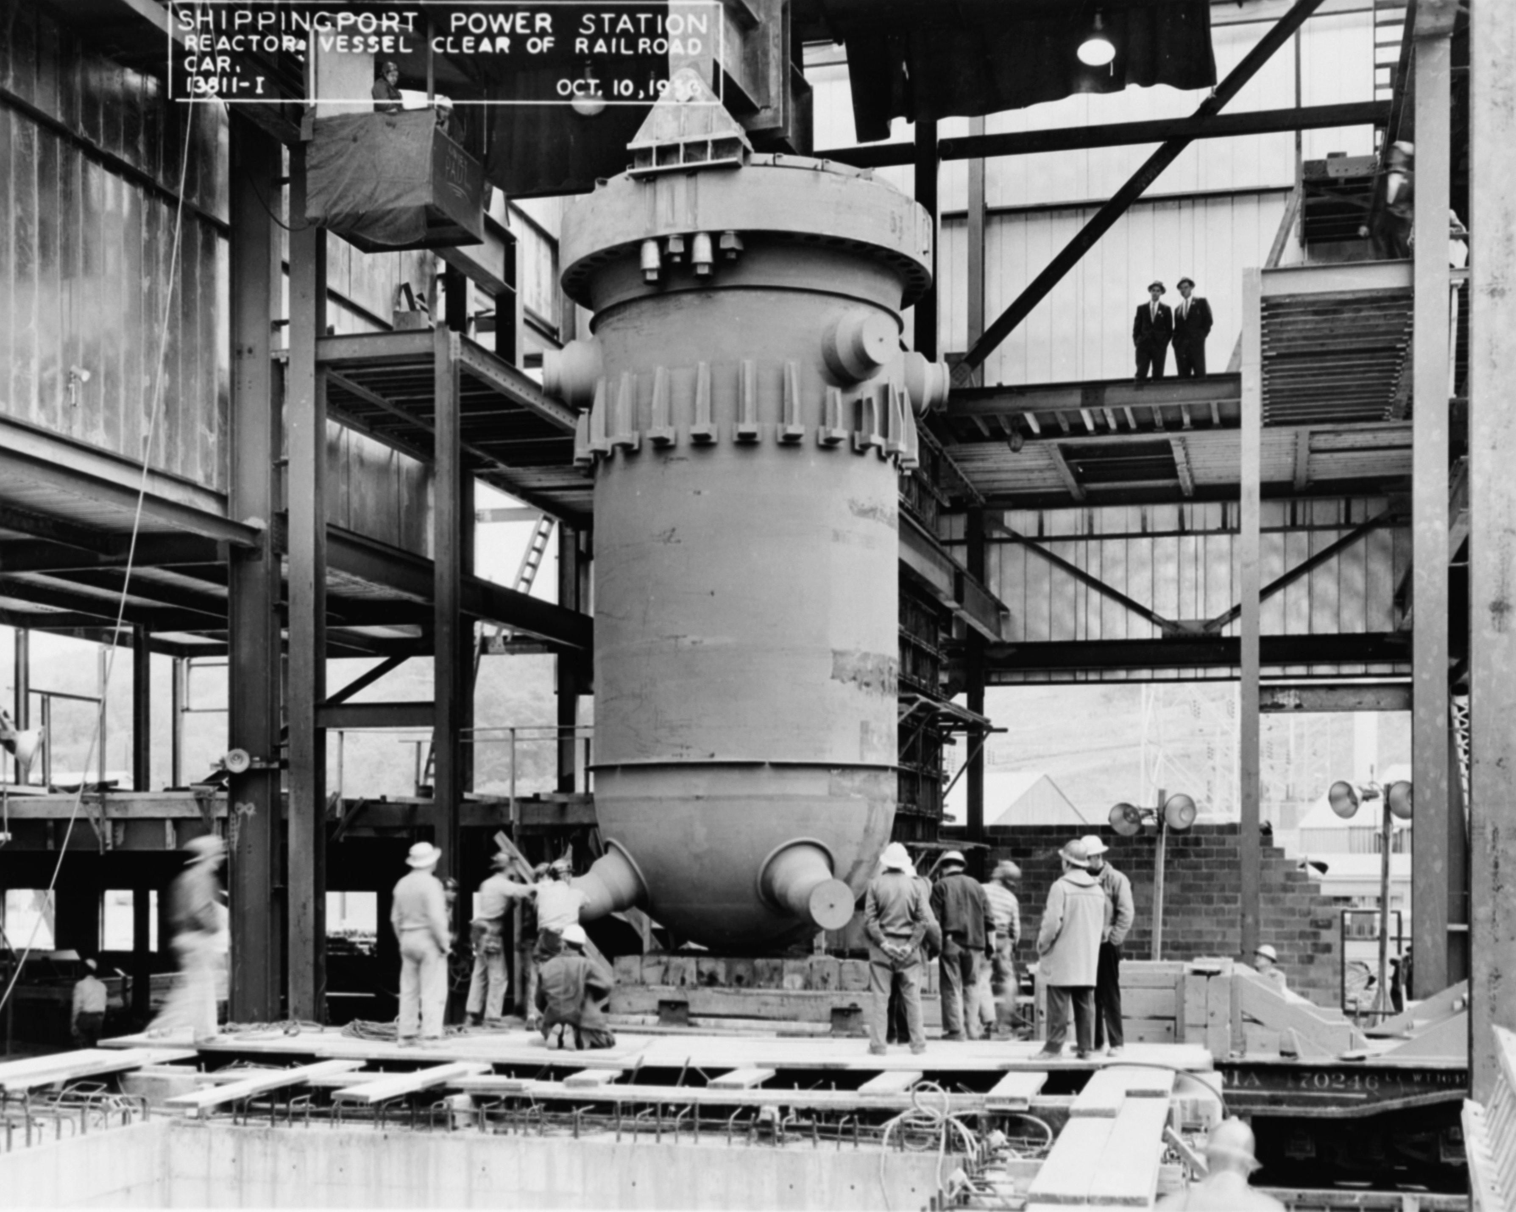
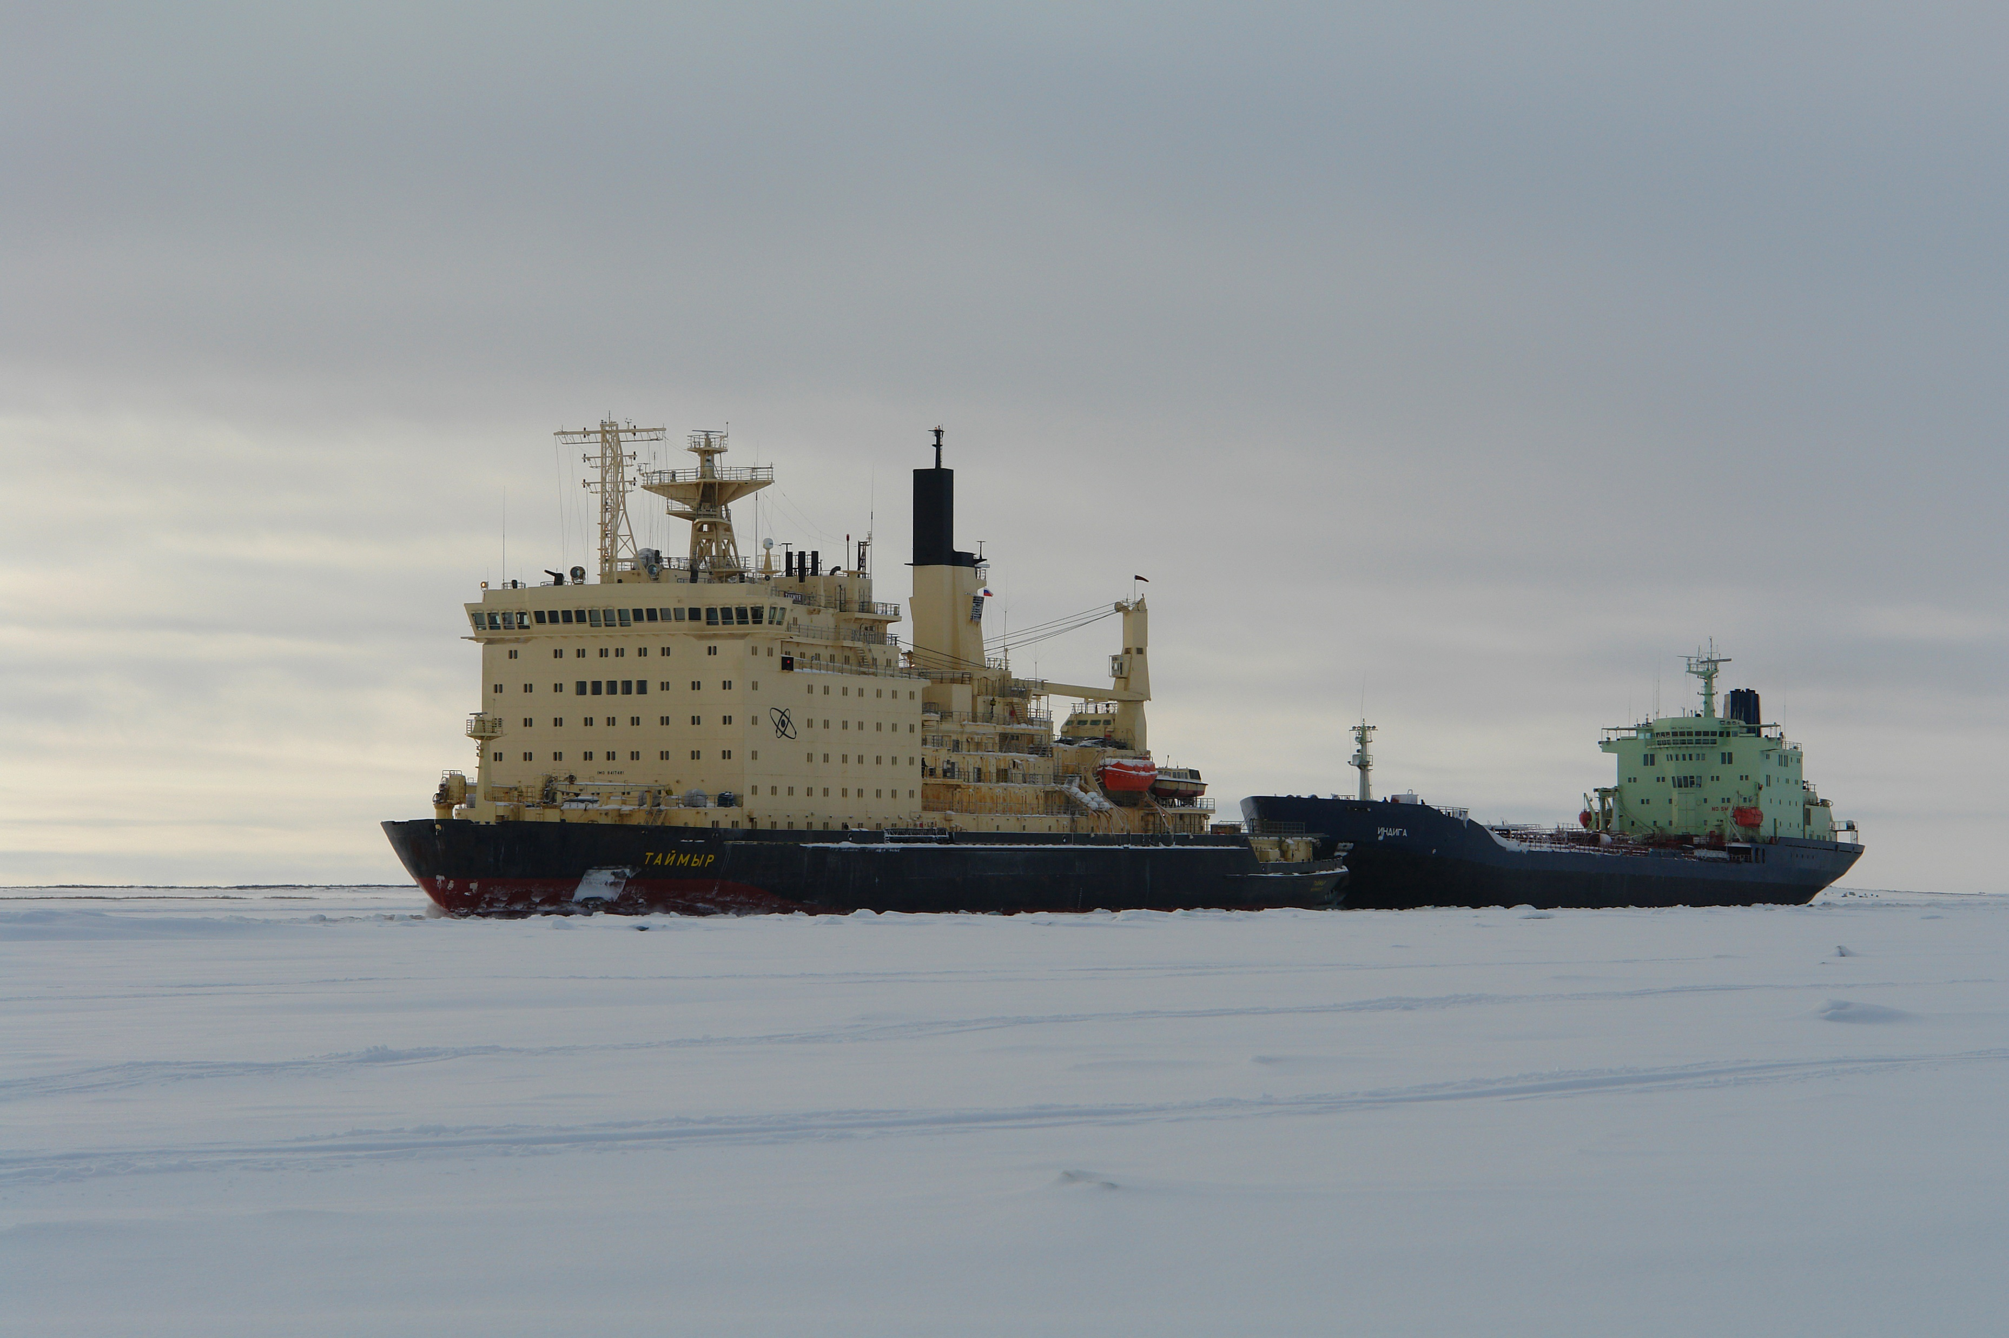
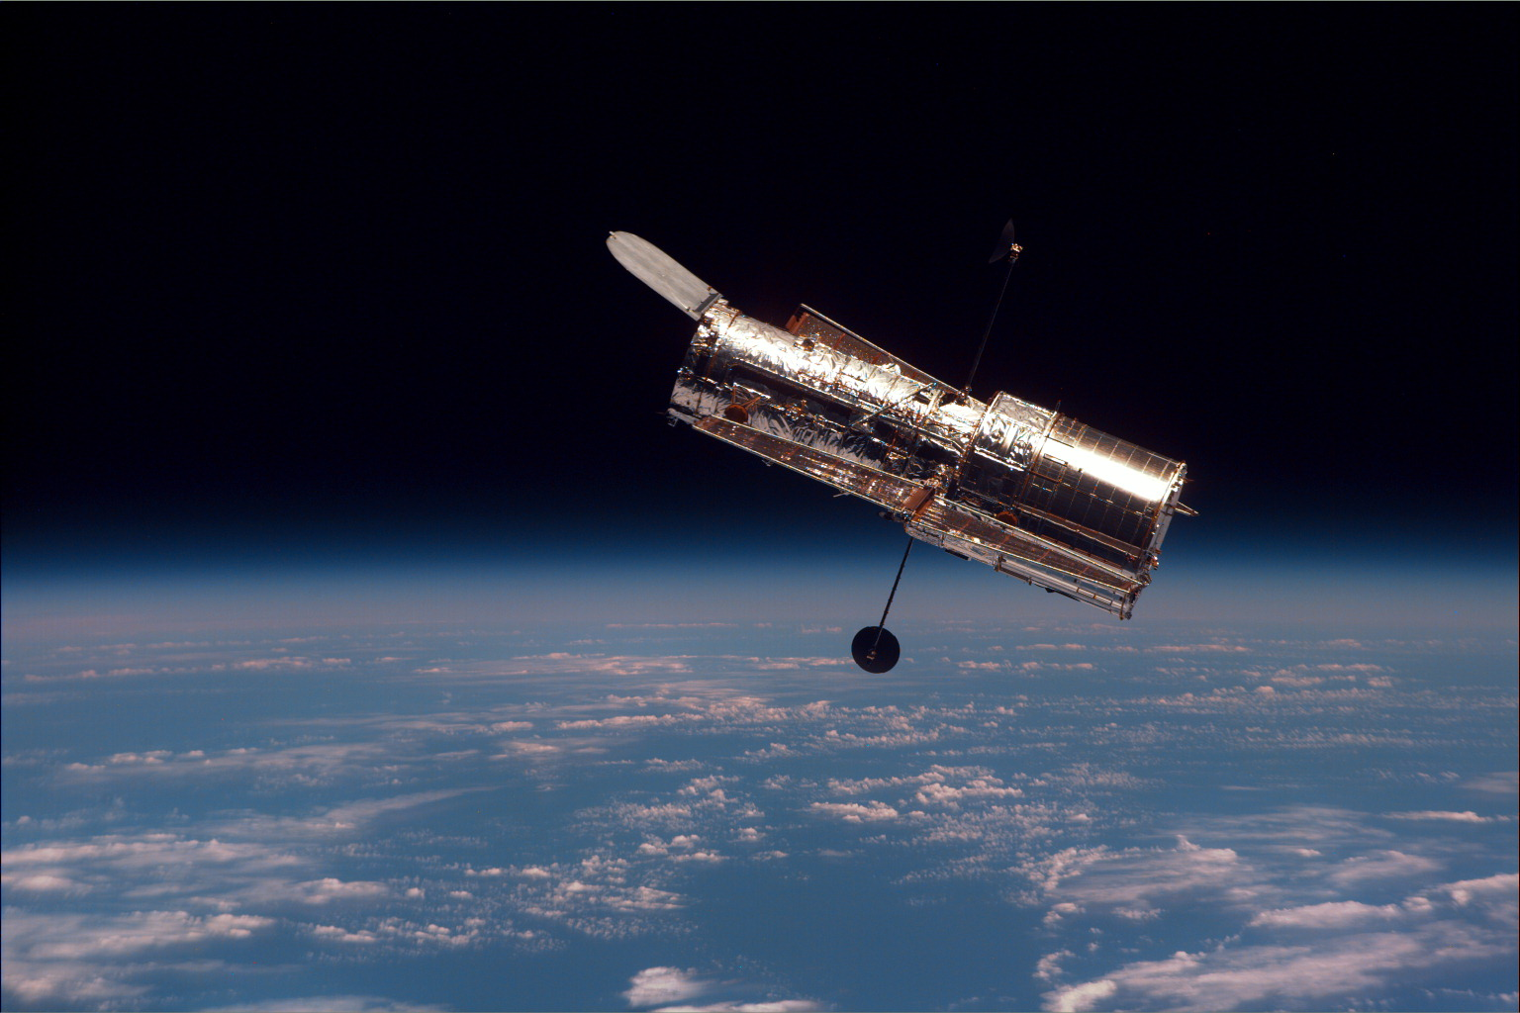
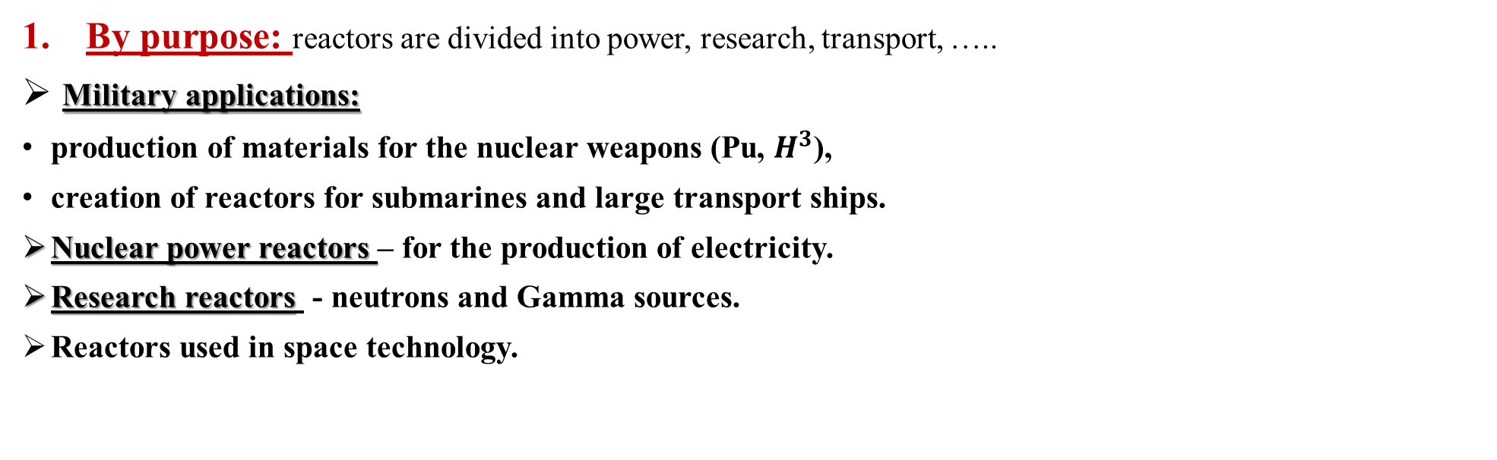
CLASSIFICATION OF NUCLEAR REACTORS
By purpose: reactors are divided into power, research, transport, …..
Military applications:
production of materials for the nuclear weapons (Pu, $H^{3}$),
creation of reactors for submarines and large transport ships.
Nuclear power reactors – for the production of electricity.
Research reactors - neutrons and Gamma sources.
Reactors used in space technology.

Slide 53
CLASSIFICATION OF NUCLEAR REACTORS
By purpose: reactors are divided into power, research, transport, …..
By neutron energy spectrum inside reactor core, reactors divided into:
thermal (VVER-1000), use uranium enriched to 2–5%.
fast (БН-600 и IBR-2), use uranium enriched to 15–20% and 90 % (if research reactors),
intermediate (VVER-SKD) use enriched uranium 25% ;

Slide 54
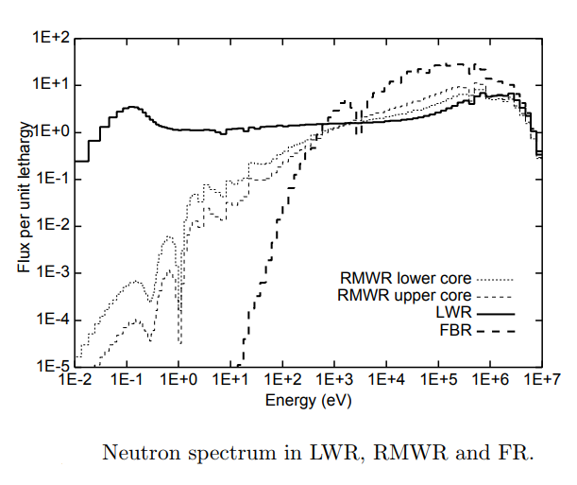
CLASSIFICATION OF NUCLEAR REACTORS
2. By neutron energy spectrum: reactors are classified as thermal (VVER-1000), fast (BN-600 and BREST) ​​and intermediate (VVER-SKD);

Slide 55
CLASSIFICATION OF NUCLEAR REACTORS
By purpose: reactors are divided into power, research, transport, …..
By neutron energy spectrum: reactors are divided into thermal, fast and intermediate;
By moderator type: thermal neutron reactors are divided into light water (VVER), heavy water (CANDU) and graphite (RBMK);
По теплоносителю: реакторы классифицируют на легководные, газо-охлаждаемые, тяжеловодные и жидкометаллические.
По структуре активной зоны: различают реакторы гетерогенные и гомогенные;
По конструктивному исполнению: реакторы подразделяются на корпусные и канальные.
По энерго-выделению: реакторы различают на импульсные и стационарные.

Slide 56
CLASSIFICATION OF NUCLEAR REACTORS
By purpose: reactors are divided into power, research, transport, …..
By neutron energy spectrum: reactors are divided into thermal, fast and intermediate;
By moderator type: thermal neutron reactors are divided into light water (VVER), heavy water (CANDU) and graphite (RBMK);
By coolant: reactors are divided into light water (VVER), gas-cooled reactors (GCFR), heavy water (CANDU) и liquid metal (IBR-2 - BN).
По структуре активной зоны: различают реакторы гетерогенные и гомогенные;
По конструктивному исполнению: реакторы подразделяются на корпусные и канальные.
По энерго-выделению: реакторы различают на импульсные и стационарные.

Slide 57
CLASSIFICATION OF NUCLEAR REACTORS
По назначению: реакторы подразделяются на энергетические, исследовательские, транспортные, …..
По энергетическому спектру нейтронов: реакторы различают на тепловых, быстрых и промежуточных;
По типу замедлителя: реакторы на тепловых нейтронах различаются на легководные (ВВЭР), тяжеловодные (CANDU) и графитовые (РБМК);
По теплоносителю: реакторы классифицируют на легководные, газо-охлаждаемые, тяжеловодные и жидкометаллические.
By core structure: reactors are divided into heterogeneous and homogeneous;
The fuel is placed in the reactor core in the form of blocks (fuel elements), between which there is a coolant.
The fuel and coolant are a homogeneous mixture.

Slide 58
CLASSIFICATION OF NUCLEAR REACTORS
По назначению: реакторы подразделяются на энергетические, исследовательские, транспортные, …..
По энергетическому спектру нейтронов: реакторы различают на тепловых, быстрых и промежуточных;
По типу замедлителя: реакторы на тепловых нейтронах различаются на легководные (ВВЭР), тяжеловодные (CANDU) и графитовые (РБМК);
По теплоносителю: реакторы классифицируют на легководные, газо-охлаждаемые, тяжеловодные и жидкометаллические.
По структуре активной зоны: различают реакторы гетерогенные и гомогенные;
By construction design: reactors are divided into vessel (VVER-1000) and channel (RBMK - CANDU).
По энерго-выделению: реакторы различают на импульсные (ИБР-2) и стационарные (ВВЭР).

Slide 59
CLASSIFICATION OF NUCLEAR REACTORS
По назначению: реакторы подразделяются на энергетические, исследовательские, транспортные, …..
По энергетическому спектру нейтронов: реакторы различают на тепловых, быстрых и промежуточных;
По типу замедлителя: реакторы на тепловых нейтронах различаются на легководные (ВВЭР), тяжеловодные (CANDU) и графитовые (РБМК);
По теплоносителю: реакторы классифицируют на легководные, газо-охлаждаемые, тяжеловодные и жидкометаллические.
По структуре активной зоны: различают реакторы гетерогенные и гомогенные;
По конструктивному исполнению: реакторы подразделяются на корпусные и канальные.
By energy release or production: reactors are divided into pulsed (IBR-2) and stationary (steady state) (VVER).

Slide 60
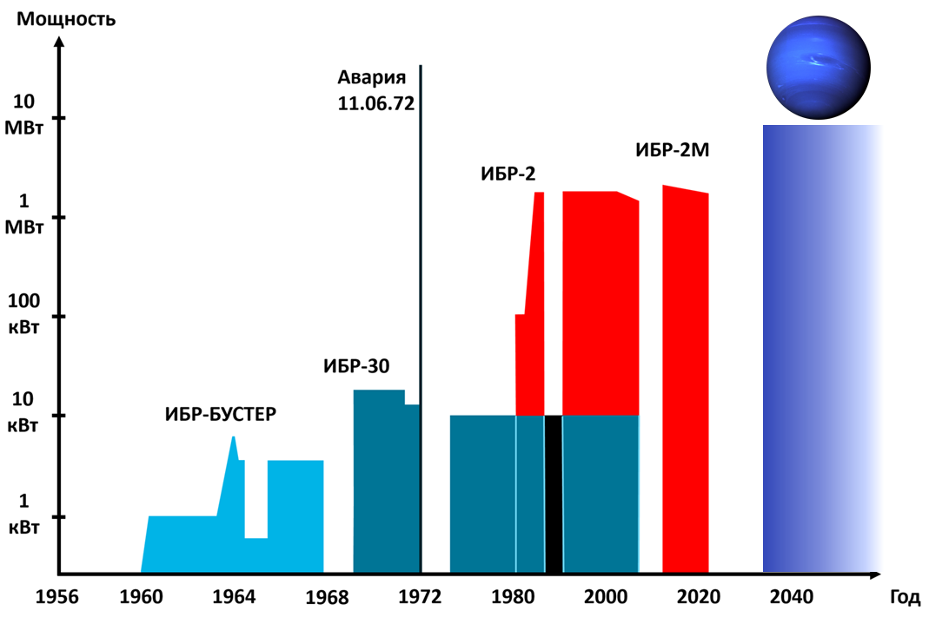

Slide 61
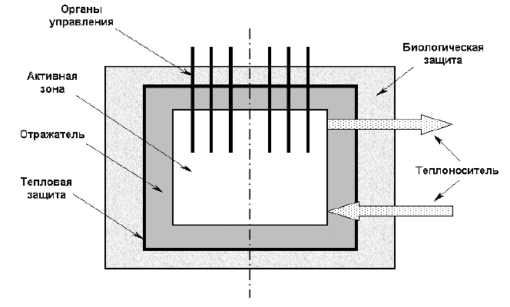
MAIN COMPONENTS OF A NUCLEAR REACTOR
A nuclear reactor is a system in which the chain process of fission of heavy nuclei by neutrons is carried out.
Nuclear reactors: are intended for the generation of thermal energy, the production of various transuranic elements, scientific experimental purposes and other tasks.

Slide 62
MAIN COMPONENTS OF A NUCLEAR REACTOR
1- Reactor core: The place where the nuclear fission chain process occurs;
2- Coolant: removes thermal energy from the reactor core;
3- Moderator: a substance that effectively slows down fission neutrons, whose average energy is about 2 MeV, into thermal neutrons with an energy of about 0.1 eV (found only in thermal reactors).

Slide 63
MAIN COMPONENTS OF A NUCLEAR REACTOR
4- Reflector: To use neutrons economically, the core is surrounded by a reflector, which helps return the emitted neutrons to the core and thus preserve them for the chain process.
5- Biological shielding: surrounds the core to protect personnel from various types of radiation.

Slide 64
MAIN COMPONENTS OF A NUCLEAR REACTOR
6- Control rods: to control the nuclear fission chain process in the reactor.
7- Thermal shielding: a substance with poor thermal conductivity, to avoid destruction of biological protection and reactor mounting structures.

