Slide 1



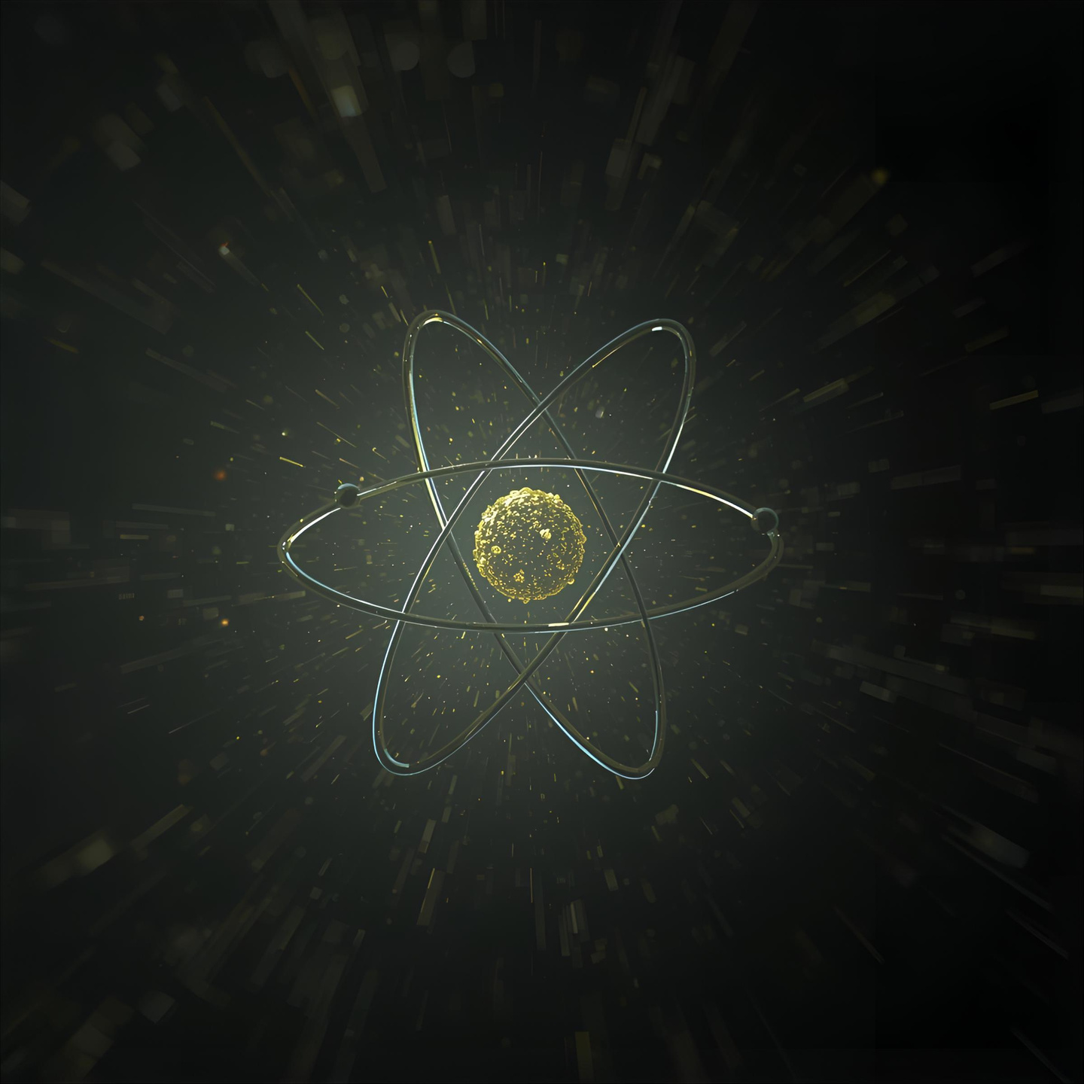

FOBOS GROUP
SEARCH AND ANALYSIS OF “DOUBLE-HIT” EVENTS
Yu.V. Pyatkov, D.V. Kamanin, V.E. Zhuchko, Z.I. Goryainova, E.A. Kuznetsova, Yu.M. Sereda, A.N. Solodov, O.V. Strekalovsky and T.H. Vilane
AYSS (27th - 31st)October 2025

Slide 2
TABLE OF CONTENTS
INTRODUCTION................................................................01
COMETA SET-UP..............................................................02
REGISTRATION OF DH EVENTS..................................03
RETRIEVING DH EVENTS.................................................04
REMOVING RANDOM COINCIDENCES..................05 - 07
ANALYSIS...............................................................................08 - 09
CONCLUSION......................................................................10
AYSS (27th - 31st)October 2025

Slide 3
Double-Hit
The double-hit registration approach means that two fragments were detected in the same PIN diode during one registration gate of 200 ns length.
An open angle between the fragments do not exceed 5⁰.
The minimum time interval between their timestamps should not be below 30 ns[1].
[1] Y. V. Pyatkov, D. Kamanin, V. Zhuchko, Z. Goryainova, E. Kuznetsova, Y. M. Sereda, A. Solodov, O. Strekalovsky, A. Zhukova, and T. Vilane, “Double-hit experimental approach in study of the ternary decays of 252cf(sf),” Physics of Particles and Nuclei Letters, vol. 22, no. 2, pp. 312–315, 2025.
01

Slide 4
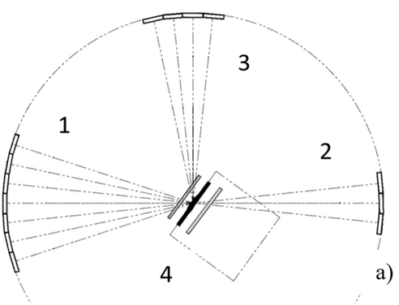
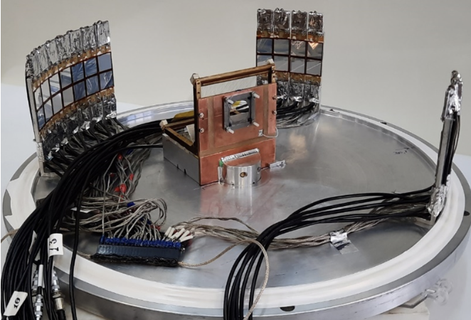
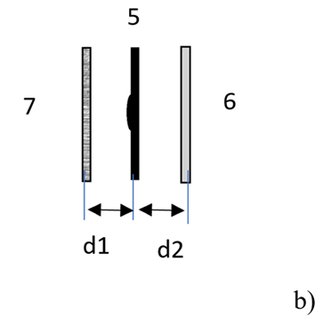
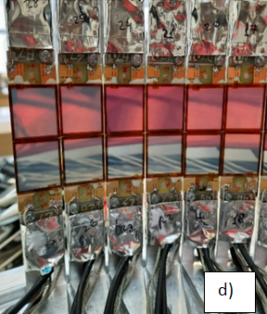

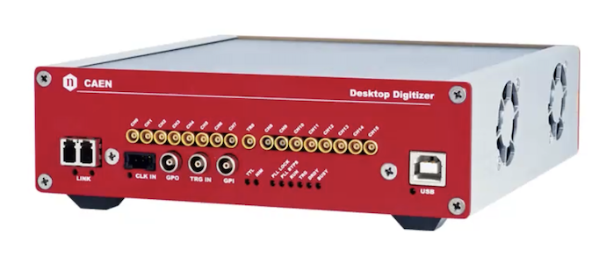
b)
c)
PIN diodes that provide both energy and time-reference signals.
Fast multi channel digitizer provided digital images of all the signals that were processed offline.
COMETA SETUP
Solid-state degrader foil placed at 1.5 mm from the active layer of the ²⁵²Cf source.
MCP time detector gives the “start” signal.
CAEN Flash ADC , Sampling rate of 200ns.
02
AYSS (27th - 31st)October 2025

Slide 5
DOUBLE HIT REGISTRATION
[2] Y. V. Pyatkov, et al., “Collinear cluster tri-partition of 252 Cf
(sf) and in the 235 U (n th, f) reaction,” The European Physical Journal A,
vol. 45, pp. 29–37, 2010.
What ?
CCT is observed while the FF passes through the solid-state foil, i.e. the backing of the Cf-252 source.
the difference between the total mass of the detected fragments and the mass of the mother system serves a sign of at least ternary decay.
How ?
Some fraction of the FFs undergo a break-up while passing through the solid-state foil.
Initial results obtained through the missing-mass method [2].
03

Slide 6
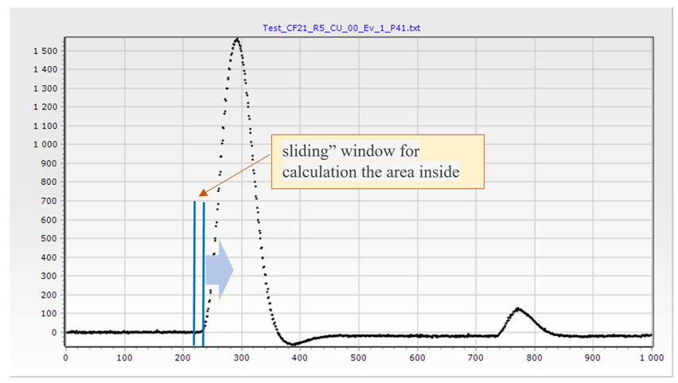
Retrieving the Double-Hit events
Average value computed over 1024 channels. The found peaks must have an amplitude greater than the average value.
1. Area of the first 10 channels calculated and saved.
2. Shifted to the right one channel and area calculated again.
3. Value> Previous, steps 1-2 repeated until we found the maximum value of the integral over 10 channels,
4. Moving further to the right, to look for the minimum value of the integral in a similar way.
5. Search for the second peak using steps 2-3.
6. reaching the end of the spectrum, we have a set of peak positions.
04

Slide 7
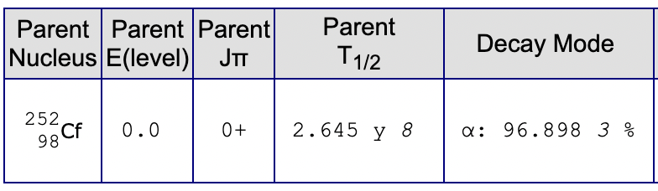
REMOVING RANDOM COINCIDENCES
Random events
α-particles hits a PIN diode almost at the same time as the FF which creates a false double-hit event.
The aim is to remove such events from the data.
Using the energy, mass and velocity of every registered particle in a given double hit event.
α-particles are monoenergetic, it is possible to identify them and remove from the data using their energy values.
The real energy of a particle (E) is summed up from the energy registered by a detector (and its pulse-height defect component R(M,E). Calculating R(M,E) value correctly requires correct velocity for a given particle.
Since the TOF of the α-particles in random coincidence double-hit events are not correctly calculated, their velocity values are off, and the real, or total, energy E should not be used as a criterion for removing alphas from the data.
05

Slide 8
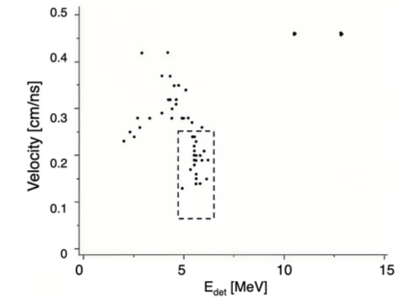
REMOVING RANDOM COINCIDENCES
How they were excluded
Plot for the velocity vs Linear energy of registered particles
E_{lin} values calculated on the table
Values between 5< E_{lin} < 6.14 represent alphas.
They were then boxed and eliminated from plot
E_{lin} [MeV]
06

Slide 9
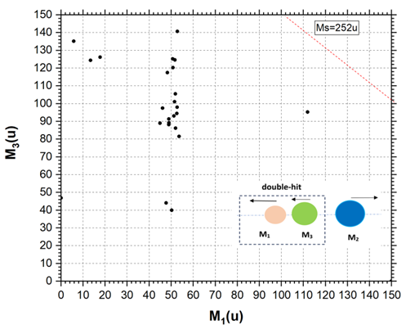
ANALYSIS AFTER REMOVAL OF RANDOM EVENTS
After filtering out the α-particles that hit the PIN diode almost at the same time as the FF, we are sure only the desired results remain.
The distribution of the masses of the first fission fragment (M₁) and the second fission fragment (M₃) are shown on the figure a.
The double-hit events, detected in the experiment with the Ti degrader foil, is presented in Figure a.
The thickness of the foil was about half of the full range of the FFs in Ti.
a
Double-hit events detected in the experiment with the Ti foil. Correlation mass distribution M₁–M₃ of the fragments detected in the same PIN diode during the registration gate (a). The numbering of the partners of the ternary decay is illustrated in the inset (a)
08

Slide 10
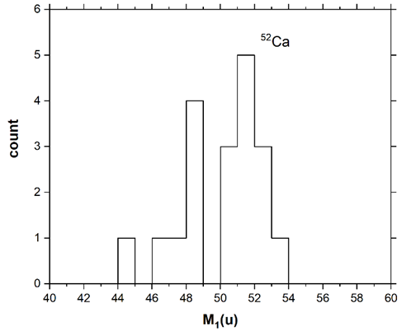
ANALYSIS AFTER REMOVAL OF RANDOM EVENTS
The main feature of the result obtained is an observation of the “Ca-bump”.
That is a peak centred at the mass 52 u in the projection of the mass distribution in previous page onto M₁ axis.
The mass 52u is associated with the magic isotope of ⁵²Ca in the frame of the unchanged charge density hypothesis.
According to this hypothesis the ratio N/Z (number of neutrons to number of protons) is the same in the mother system and in the FFs resulted from fission of this system.
Thus, using the double-hit approach, the possibility of mass-spectrometry of pair of heavy ions hit the same PIN diode with minimal time interval between them ≈ 30ns and open angle < 5⁰ was experimentally demonstrated.
For the first time the experiment demonstrates directly that the partners of the break-up in the solid-state foil fly with very low angular divergence as was supposed earlier for the CCT products.
b
Double-hit events detected in the experiment with the Ti foil. Projection of the plot onto M1 axes (b).
09

Slide 11
CONCLUSION
The present work is dedicated to the investigation of the rare ternary decay mode of low excited heavy nuclei, and specifically of ²⁵²Cf(sf).
Due to its revealed features the effect was dubbed “collinear cluster tri–partition” (CCT).
Experimental evidence of this type of decay was obtained in the frame of the “missing” mass method in which only two decay products out of three are detected in the opposite arms of the time-of-flight mass-spectrometer.
To observe both partners of the binary break-up of one of the CCT products there was developed the “double-hit” experimental approach.
The multi-stage and complex procedure of data processing, including double-hit data processing, have been studied and applied to real experimental data.
Using the double-hit approach, the possibility of mass-spectrometry of pair of heavy ions that hit the same PIN diode with minimal time interval between them ≈ 30ns and open angle < 5⁰ was experimentally demonstrated.
The main physical result obtained from series of the double-hit events is an observation of the bump corresponding to the magic ⁵²Ca nucleus as one of the break-up partners.
Thus, for the first time the experiment demonstrates directly that the partners of the break-up in the solid-state foil fly with very low angular divergence as was hypothesized earlier for the CCT products.
Member
Silver Package
Gold Package
10

Slide 12


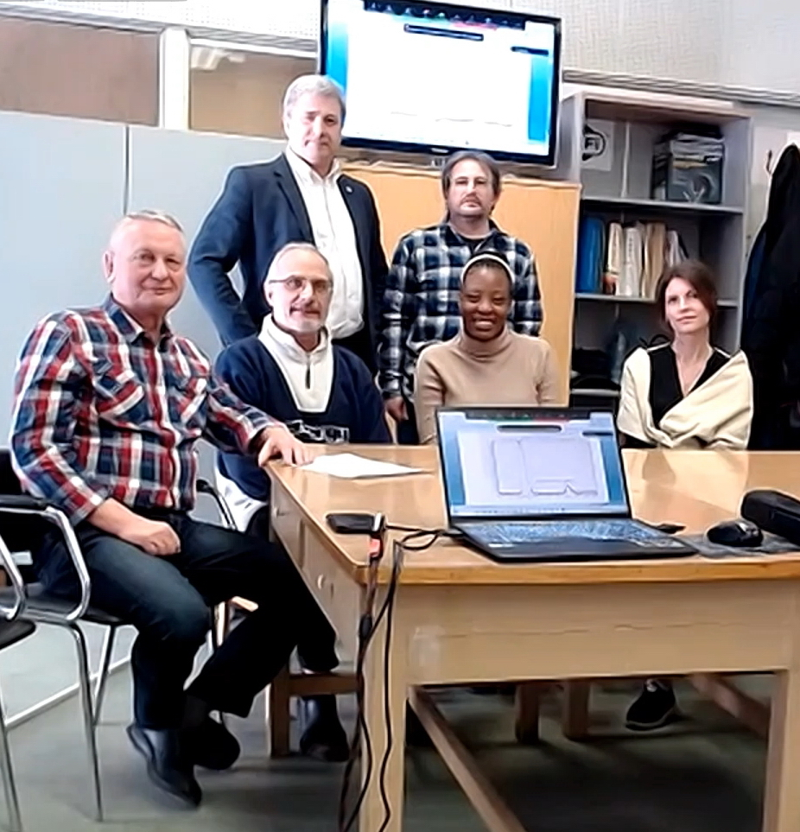

THANK YOU

