Slide 1
PROTOTYPE OF 1D-DETECTOR FOR Thermal NEUTRONS BASED ON A resistive plate CHAMBER with 10B4C: MEASUREMENTS WITH LABORATORY SOURCES
M. A. Samotokhin, M. O. Petrova

Slide 2
Motivation
Study the assembly process and features of the detector.
Determine the parameters and, based on them, substantiate the detector's operational mode.

Slide 3
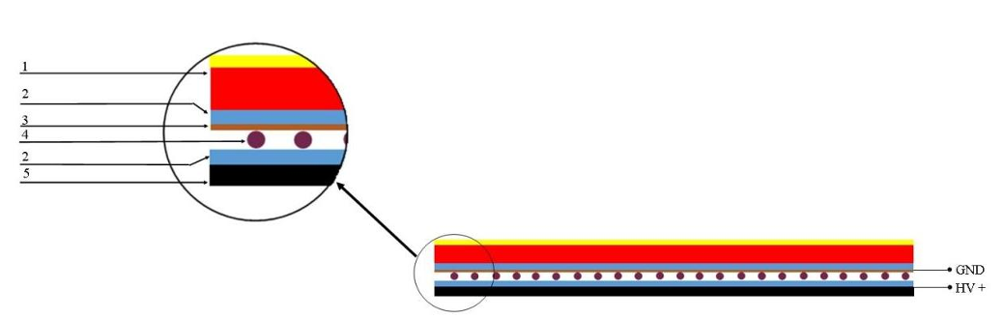
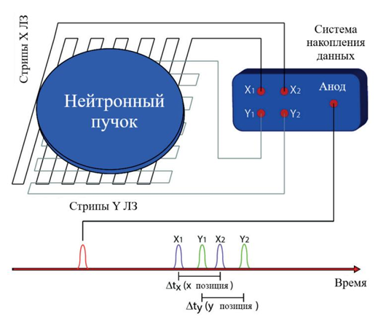
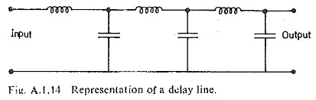
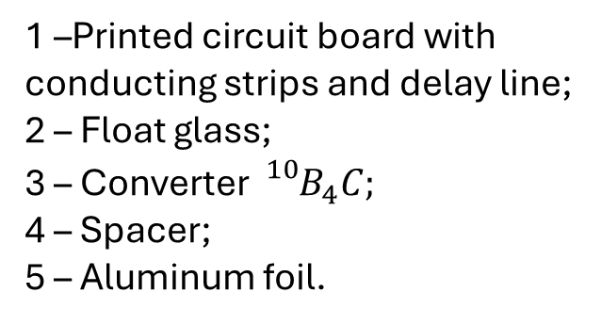
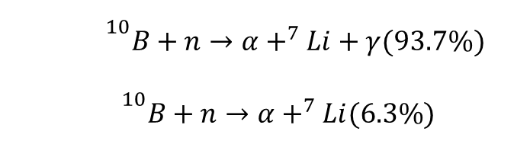
Detector’s construction
1 –Printed circuit board with conducting strips and delay line;
2 – Float glass;
3 – Converter ${{}_{}^{10}B}_{4}C;$
4 – Spacer;
5 – Aluminum foil.
$${}^{10}B+n→α+^{7}Li+γ(93.7\%)$$
$${}^{10}B+n→α+^{7}Li(6.3\%)$$

Slide 4
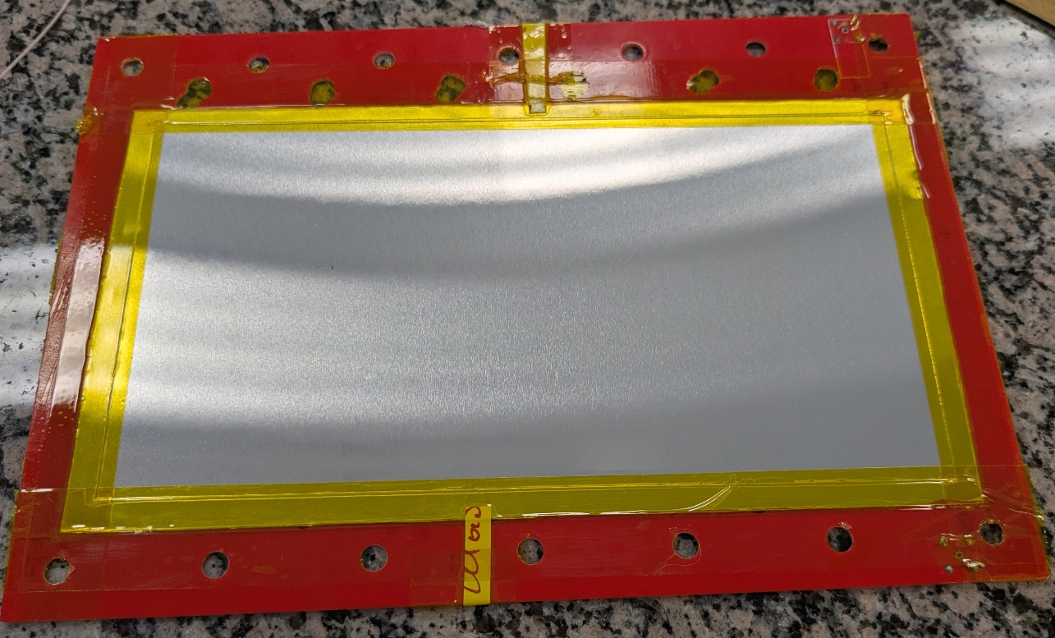
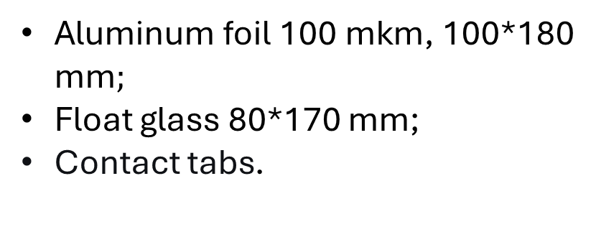
Detector assembly — anode
Aluminum foil 100 mkm, 100*180 mm$;$
Float glass 80*170 mm;
Contact tabs.

Slide 5
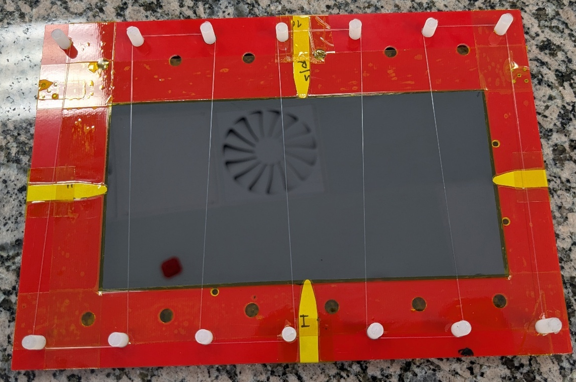
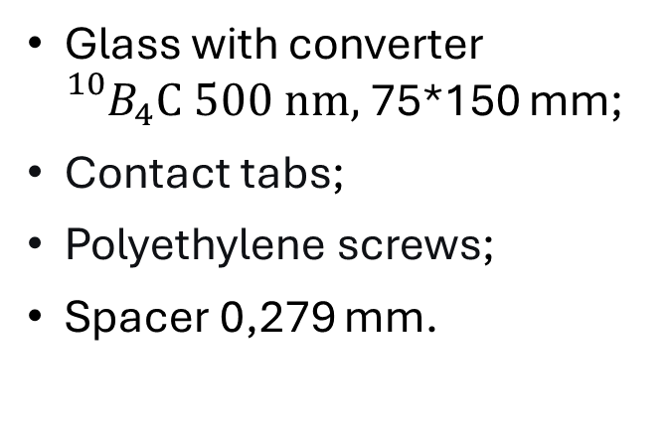
Detector assembly — cathode
Glass with converter ${{}_{}^{10}B}_{4}C 500 nm,$75*150 mm;
Contact tabs;
Polyethylene screws;
Spacer 0,279 mm.

Slide 6
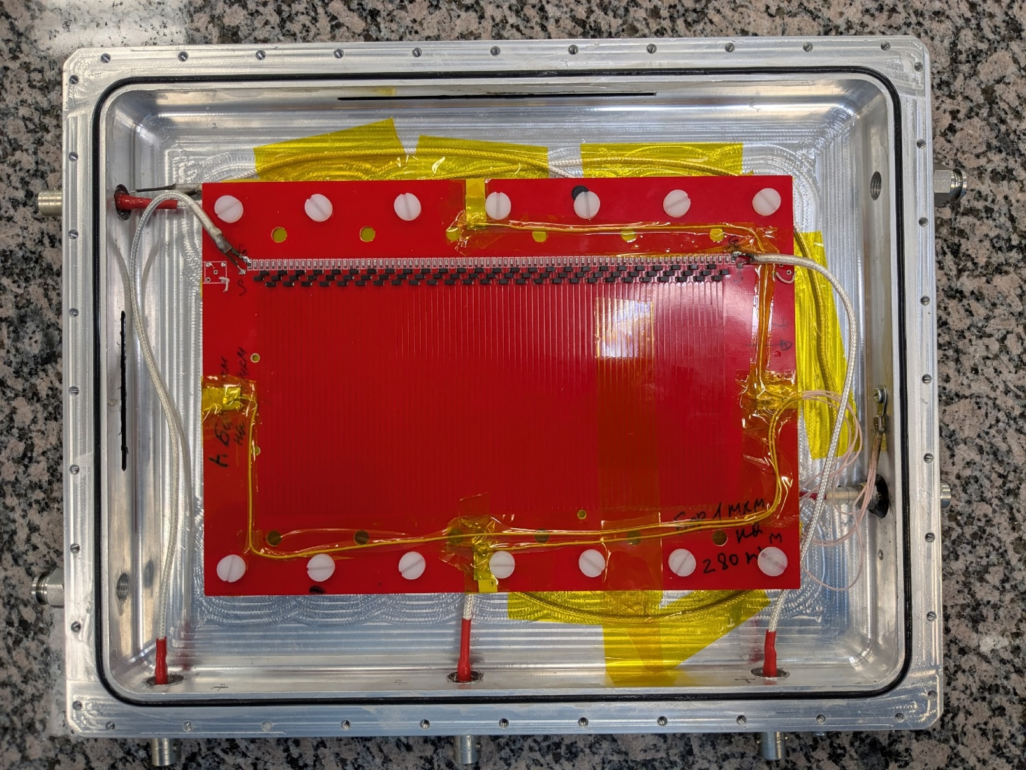
Encased detector

Slide 7
Сounting rate-voltage characteristic

Slide 8

Measurement results with the ${}_{}^{60}Co$

Slide 10
Operational voltage 2600 V

Slide 12
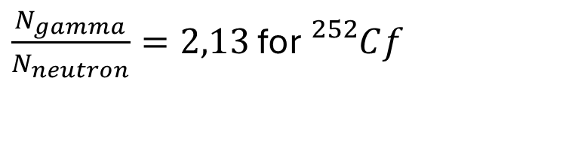

Measurement results with the ${}_{}^{252}Cf$
$\frac{N_{gamma}}{N_{neutron}}=2,13$ for ${}_{}^{252}Cf$

Slide 14
Operational voltage 1900 V

Slide 16
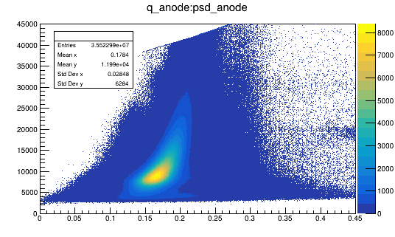
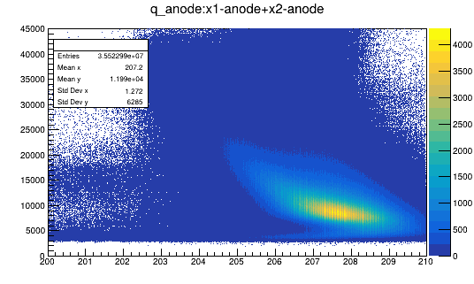
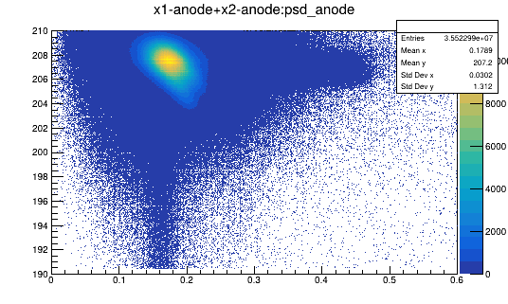
Sum:psd, q:psd, q:sum selection

Slide 17
Measurement results with the cosmic rays

Slide 19
Conclusion
Detector assembly resulted in design improvements and modifications.
Based on the analysis of the results, the operating regime for the fabricated detector was defined and substantiated: 1900 V for neutron and 2600 V for gamma-ray detection.

