Slide 1



Maestro Software Customization for Nulclotron-Collider Beam Transport Channel Control Using SOLID principles
Dubna State University
Authors: A. Noskov, A. Bukharin, I. Zhabin, I. Shirikov. A. Kozlovsky, D. Ivliev
Oral: Artyom Noskov
AYSS 2025

Slide 2
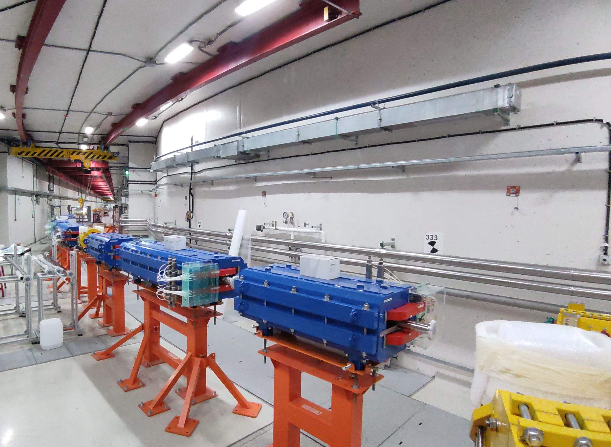
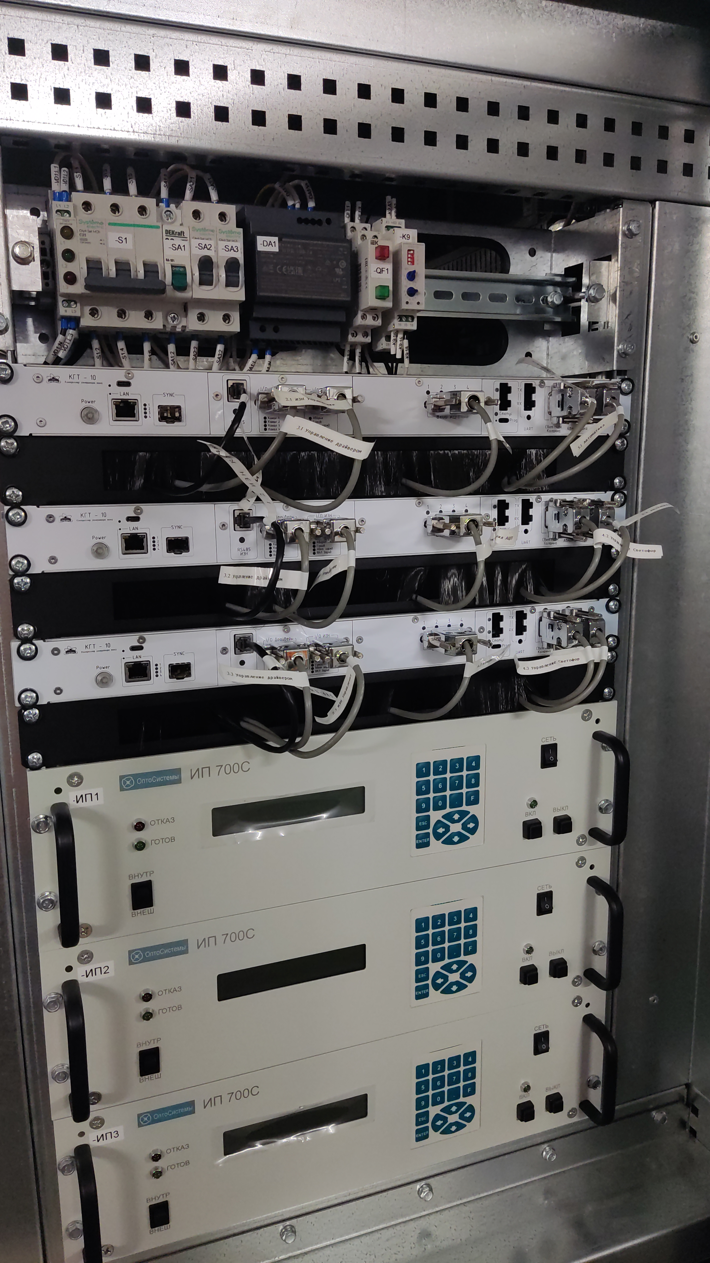
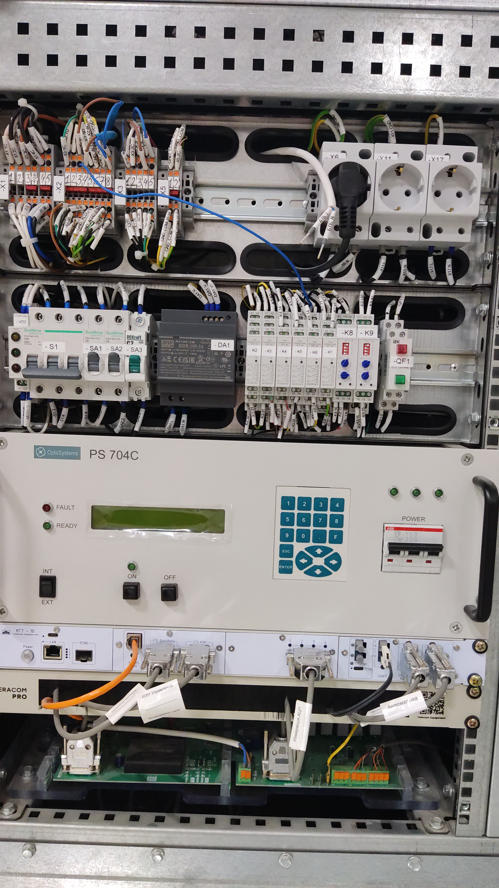
What is NC BTC
Maestro Software Customization for Nulclotron-Collider Beam Transport Channel Control Using SOLID principles
Artyom Noskov
Slide 2/12

Slide 3
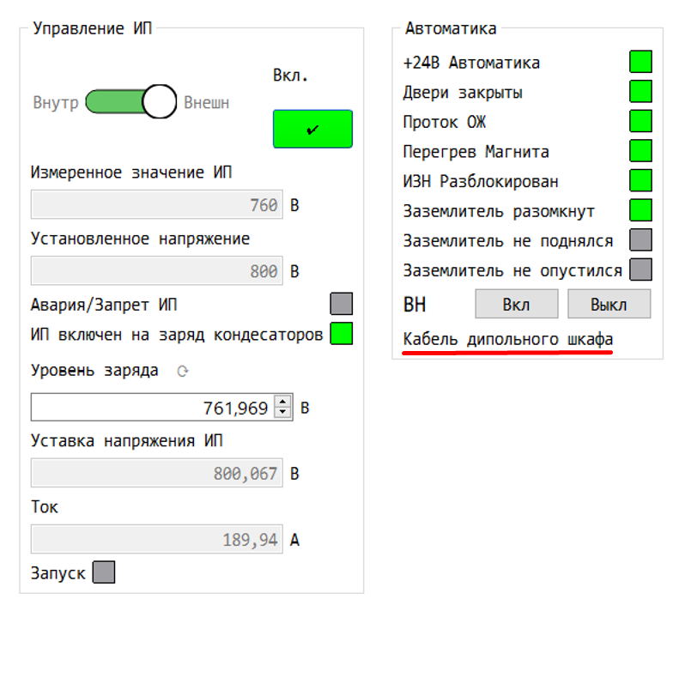
Types of power supplies
There is two types of power supplies – dipole and quadrupole.
On the image you can see that program tells which type of power supply currently connected – it says cable of the dipole supply
Maestro Software Customization for Nulclotron-Collider Beam Transport Channel Control Using SOLID principles
Artyom Noskov
Slide 3/12

Slide 4
Relevance and challenges
Management of around 100 power supply complex with required polling constraint of max 2 seconds period.
Visualizing of 3 datasets, 4096 point per each in a one plot area without losses in performance
Flexibility of a system as the hardware can change many times in production cycle
Maestro Software Customization for Nulclotron-Collider Beam Transport Channel Control Using SOLID principles
Artyom Noskov
Slide 4/12

Slide 5
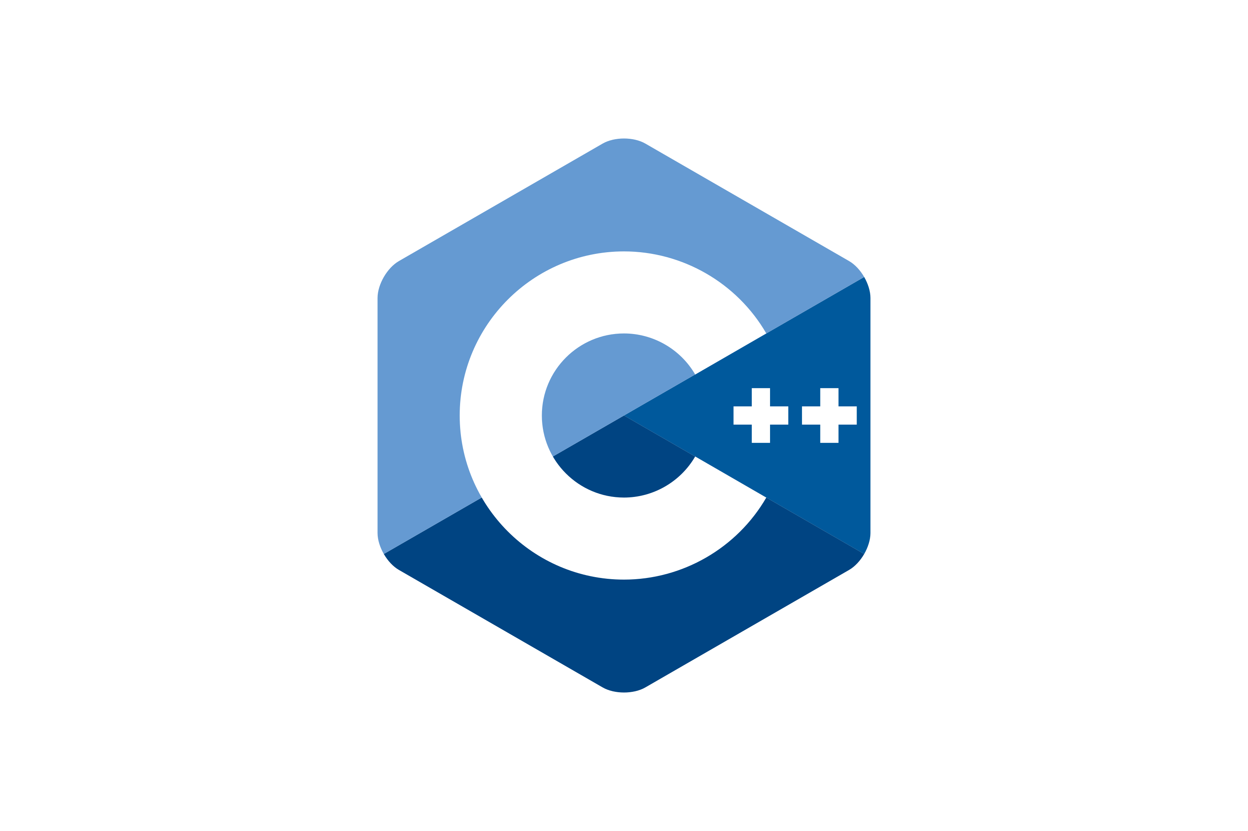

Stack
C++ 17 - for performance and memory control
Qt – for complex and customizable desktop interface
Modbus TCP
SOLID + GoF – for architecture reliability
Maestro Software Customization for Nulclotron-Collider Beam Transport Channel Control Using SOLID principles
Artyom Noskov
Slide 5/12

Slide 6
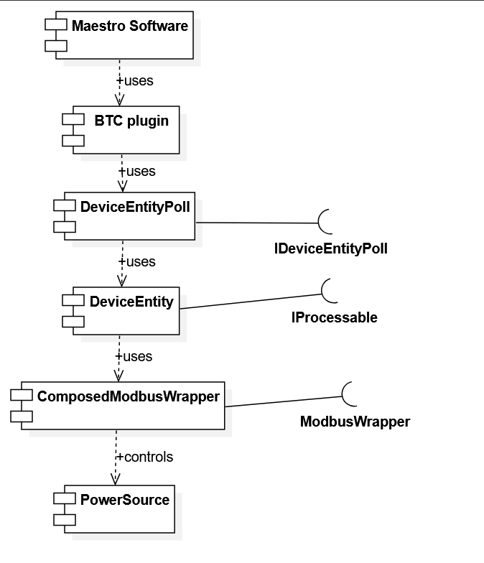
System Architecture
BTC is a plugin that must comply with architecture for plugins in our system
Maestro Software Customization for Nulclotron-Collider Beam Transport Channel Control Using SOLID principles
Artyom Noskov
Slide 6/12

Slide 7
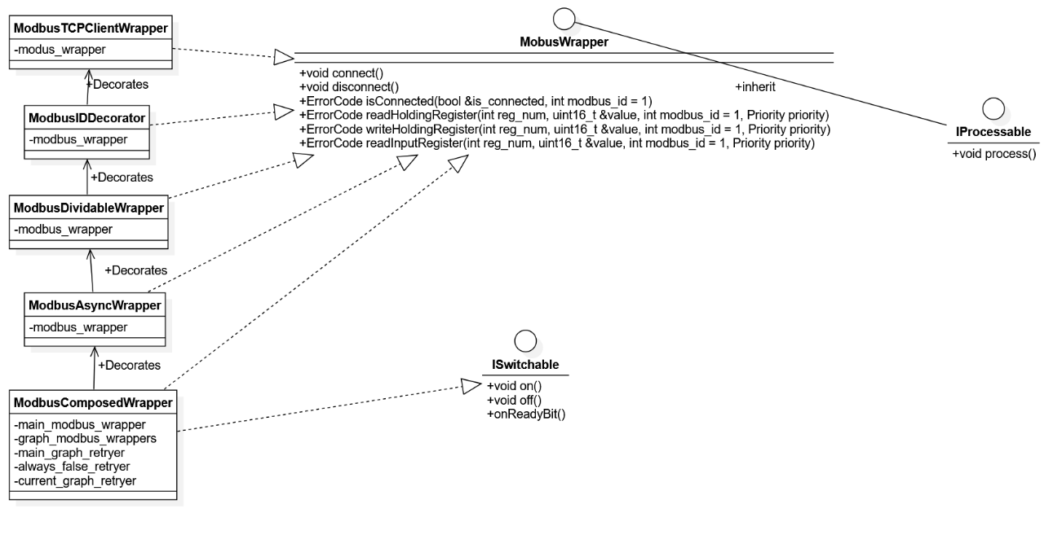
Decorator* pattern solution
* - Decorator is a GoF design pattern
Maestro Software Customization for Nulclotron-Collider Beam Transport Channel Control Using SOLID principles
Artyom Noskov
Slide 7/12

Slide 8
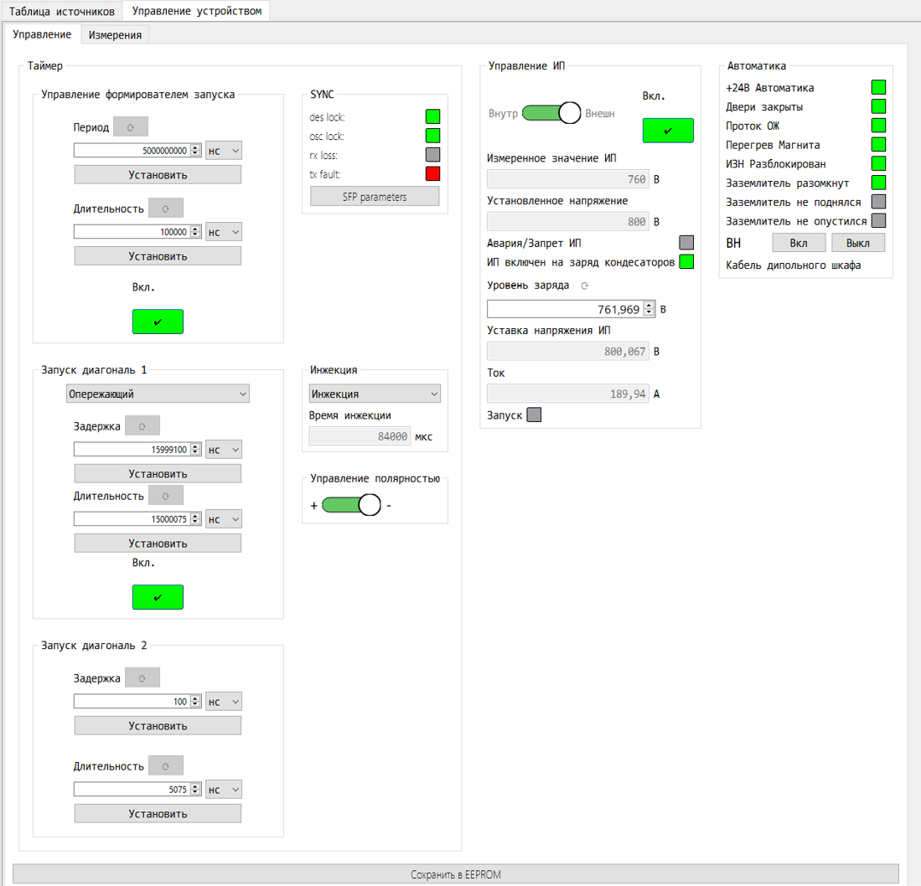
Device Entity UI
All device settings that might be needed during testing and monitoring
Maestro Software Customization for Nulclotron-Collider Beam Transport Channel Control Using SOLID principles
Artyom Noskov
Slide 8/12

Slide 9
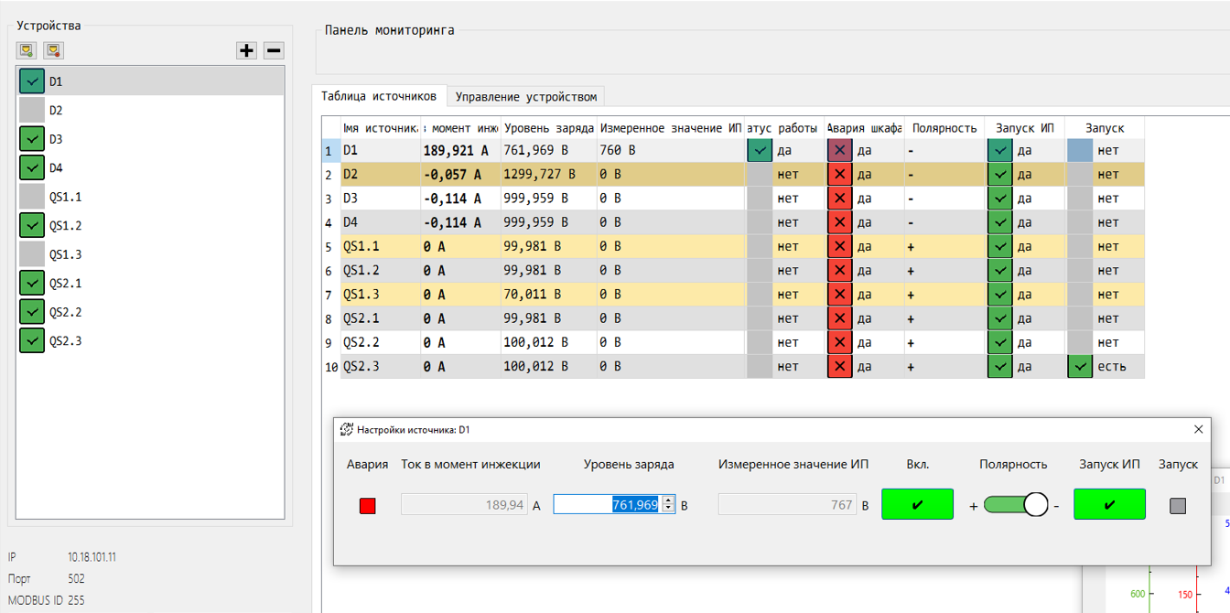
Table UI
Maestro Software Customization for Nulclotron-Collider Beam Transport Channel Control Using SOLID principles
Artyom Noskov
Slide 9/12

Slide 10
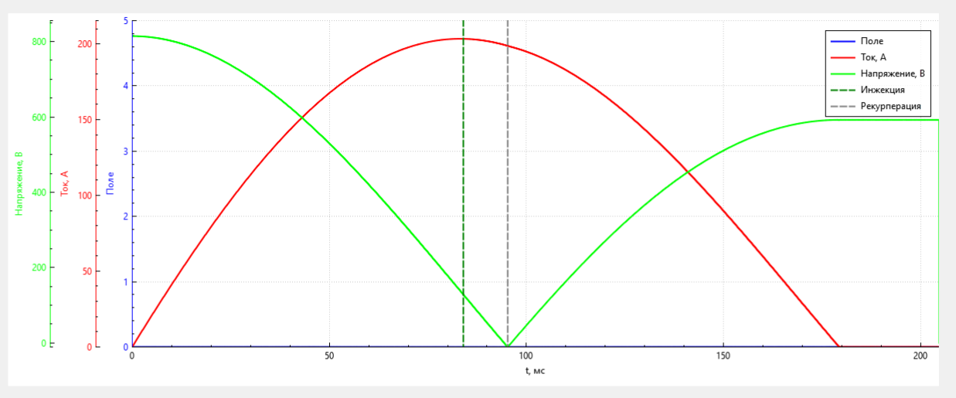
Graphs UI
Maestro Software Customization for Nulclotron-Collider Beam Transport Channel Control Using SOLID principles
Artyom Noskov
Slide 10/12

Slide 11
Results
Multi threaded system that maintains connections with around 100 devices
At maximum configuration needed only 1GB of RAM
Flexible for ongoing changes within the hardware
Logs for data in the table UI in csv format
Maestro Software Customization for Nulclotron-Collider Beam Transport Channel Control Using SOLID principles
Artyom Noskov
Slide 11/12

Slide 12
Thank You For Your Attention
Questions?
Maestro Software Customization for Nulclotron-Collider Beam Transport Channel Control Using SOLID principles
Artyom Noskov
Slide 12/12

