Slide 1

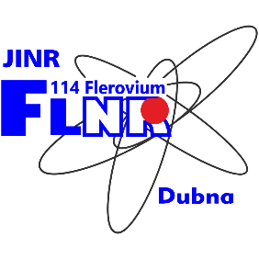
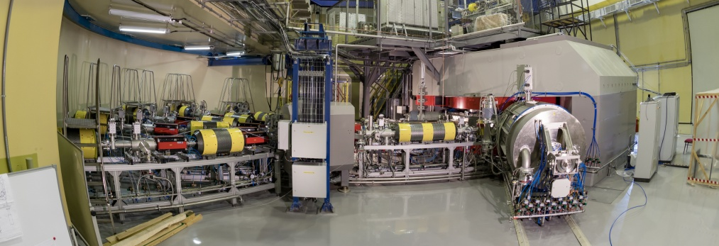
Heavy and Superheavy elements research at the Flerov Laboratory of Nuclear Reactions Alexander Karpov (karpov@jinr.ru) FLNR, Joint Institute for Nuclear Research
ДЦ-280

Slide 2
Main directions of research
Synthesis of new superheavy elements
Synthesis of superheavy nuclei and study of their decay properties
Spectroscopy of the radioactive decay of heavy and superheavy nuclei
Measurement of the masses of superheavy nuclei
Study of the chemical properties of SHE
Dynamics of heavy-ion nuclear reactions

Slide 3
Superheavy elements: synthesis and properties

Slide 4
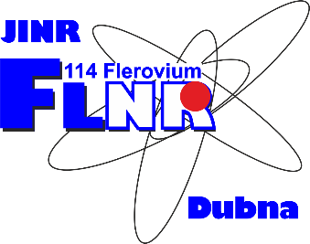
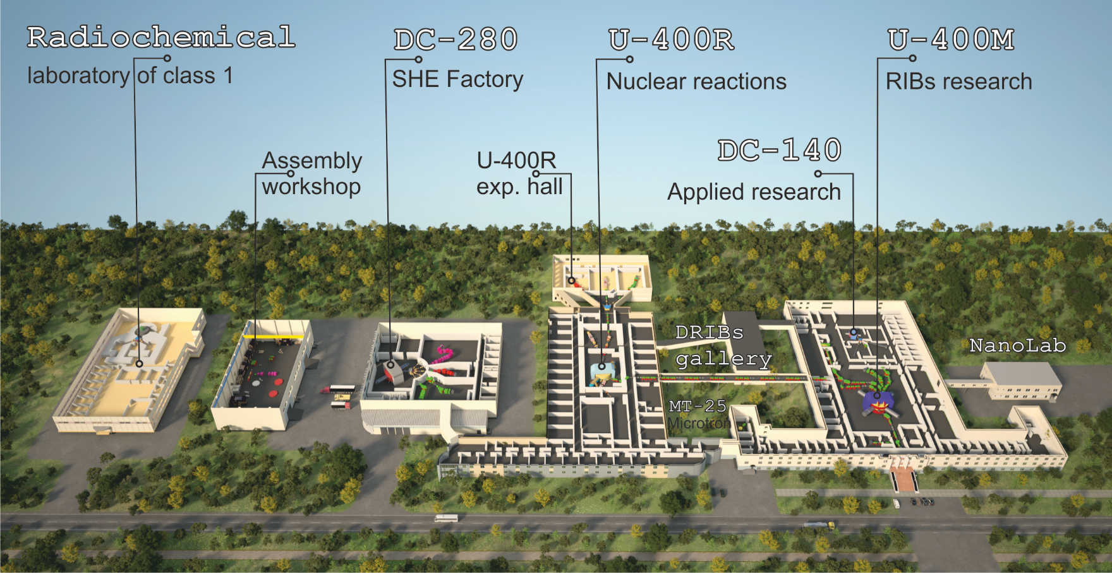
FLNR ACCELERATOR COMPLEX
(planned)

Slide 5
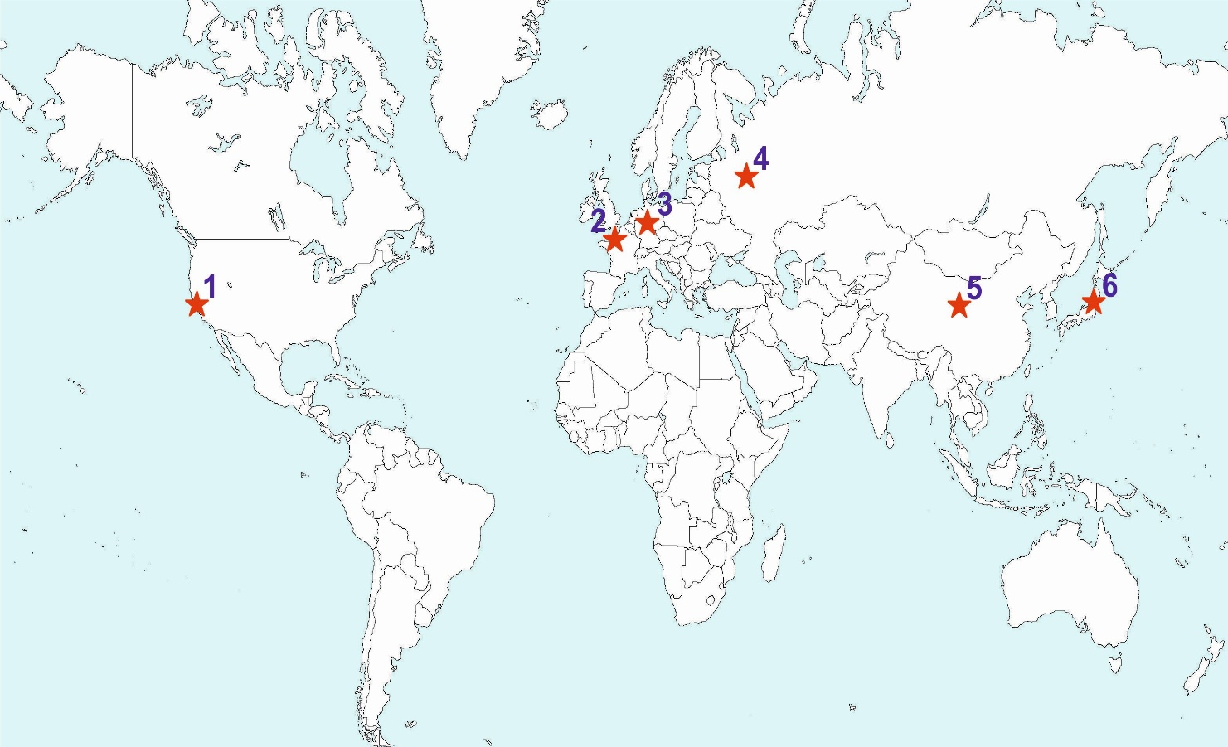
Study of heavy and superheavy elements in the world
1 | Berkeley National Laboratory, USA
2 | GANIL, Caen, France
3 | Helmholtz Centre GSI, Darmstadt, Germany
4 | JINR, Dubna, Russia
5 | IMP, Lanzhou, China
6 | RIKEN, Wako, Japan
Advantages of JINR:
wide range of accelerated ions;
availability of actinide isotopes for targets;
broad international cooperation;
longstanding traditions and a scientific school;
full-time availability of the SHE-Factory accelerator complex.

Slide 6
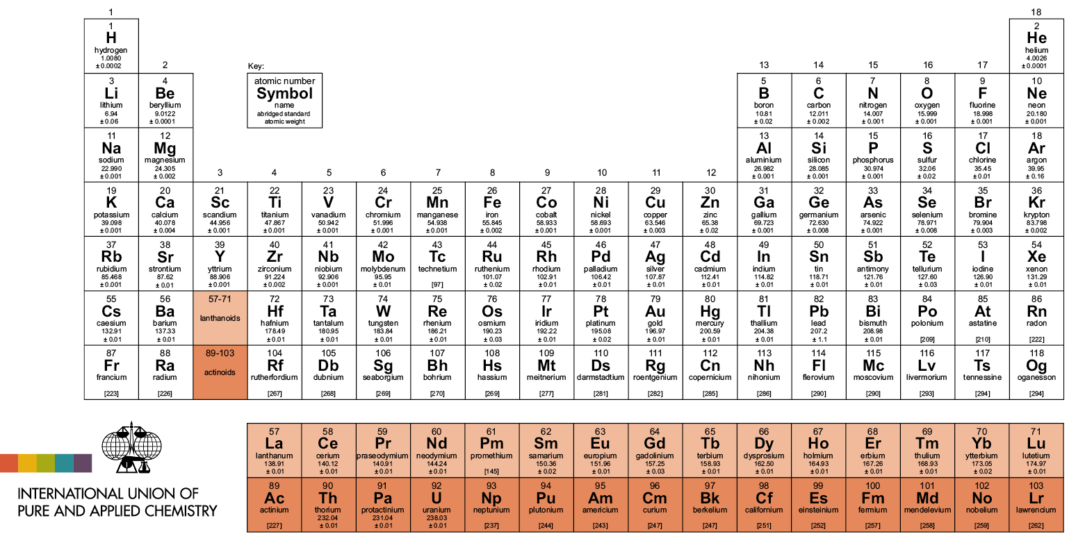
Periodic Table today (since November, 28, 2016)

Slide 7
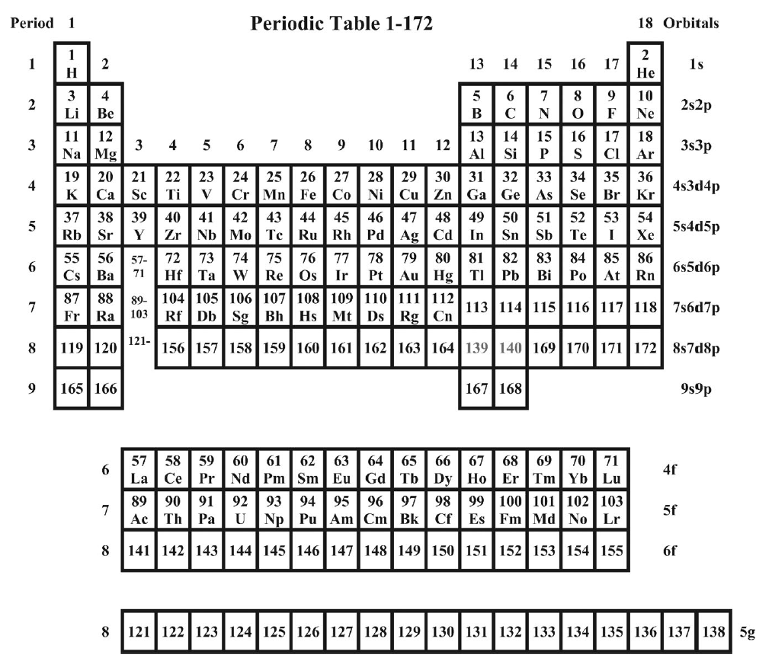
Periodic table ~1960
100 elements are known. How many they are?

Slide 8
Why heavy elements cannot live long
Liquid drop
model

Slide 9
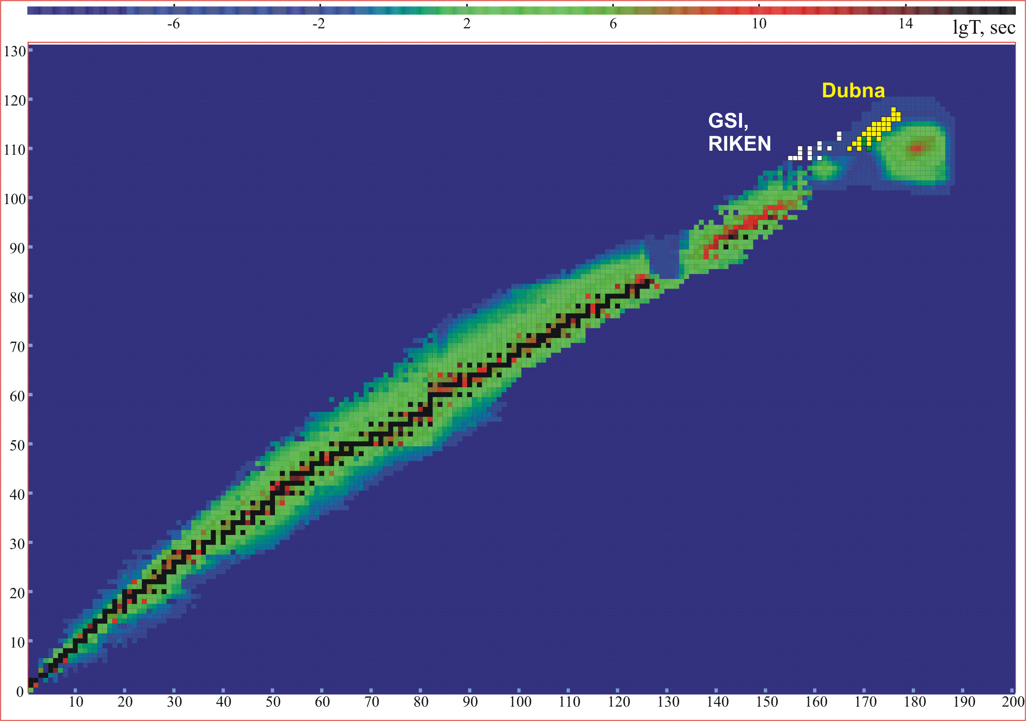
Map of nuclides
protons
neutrons

Slide 10
Chart of nuclei (upper part). Vision in 1950th
Half-lives
-5
0
5
10
15
LogT_{1/2} s
120
1μs
1s
1h
d
1Myear
110
Th, U
A limit of elements
existence
Proton number
T_{1/2} ≤ 10⁻¹⁴ s
Pb
100
Peninsula
90
Sea of Instability
Continent
80
70
110
120
130
140
150
160
170
180
190
Neutron number
Notes:
10

Slide 11
Why heavy elements cannot live long
Liquid drop
model
₉₂U
Liquid drop
+
Shell corrections
SF-isomer (1962)
Z=108

Slide 12
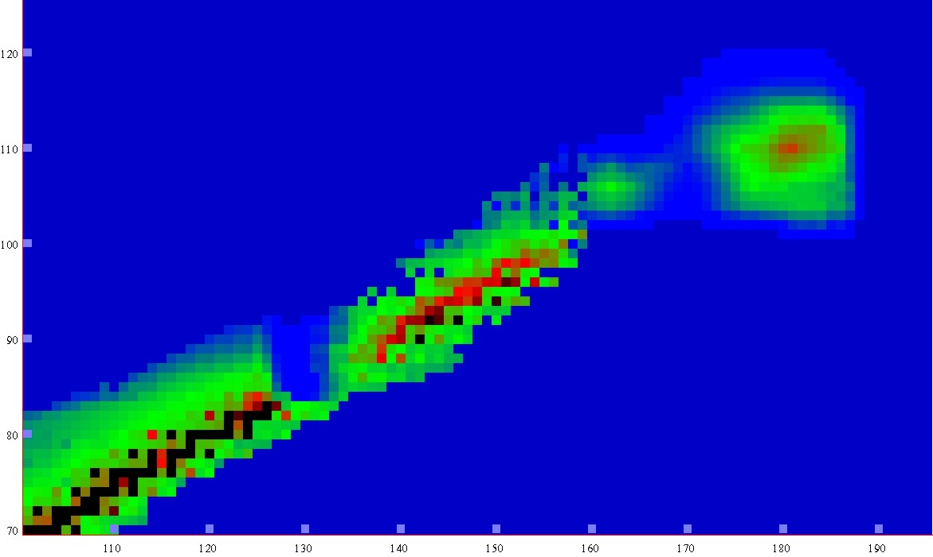
Chart of nuclei (upper part)
Half-lives
-5
0
5
10
15
LogT_{1/2} s
Superheavy
elements
120
1μs
1s
1h
d
1Myear
110
Th, U
Proton number
Pb
100
Peninsula
island of stability predicted in 1960s
Dubna, Frankfurt
90
Continent
Sea of Instability
80
70
110
120
130
140
150
160
170
180
190
Neutron number
Notes:
12

Slide 13
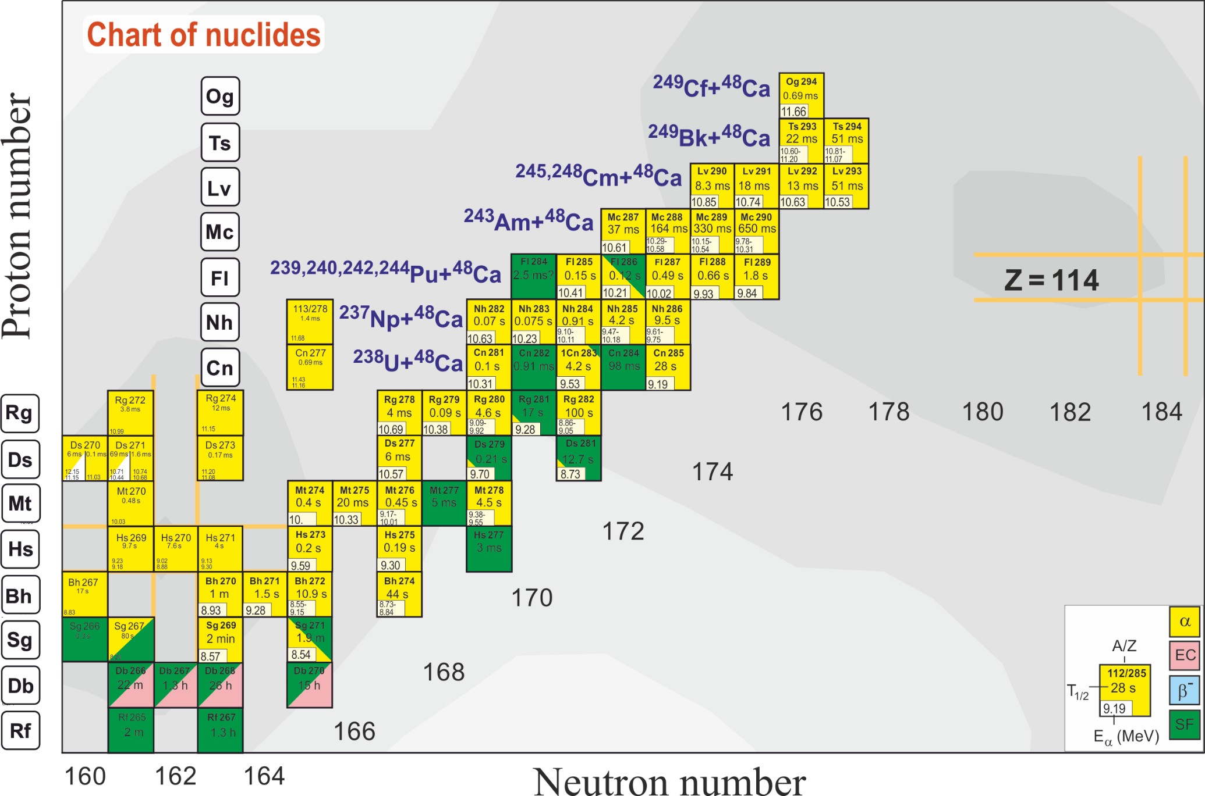
Synthesis of Superheavy Nuclei (1999-2019)

Slide 14
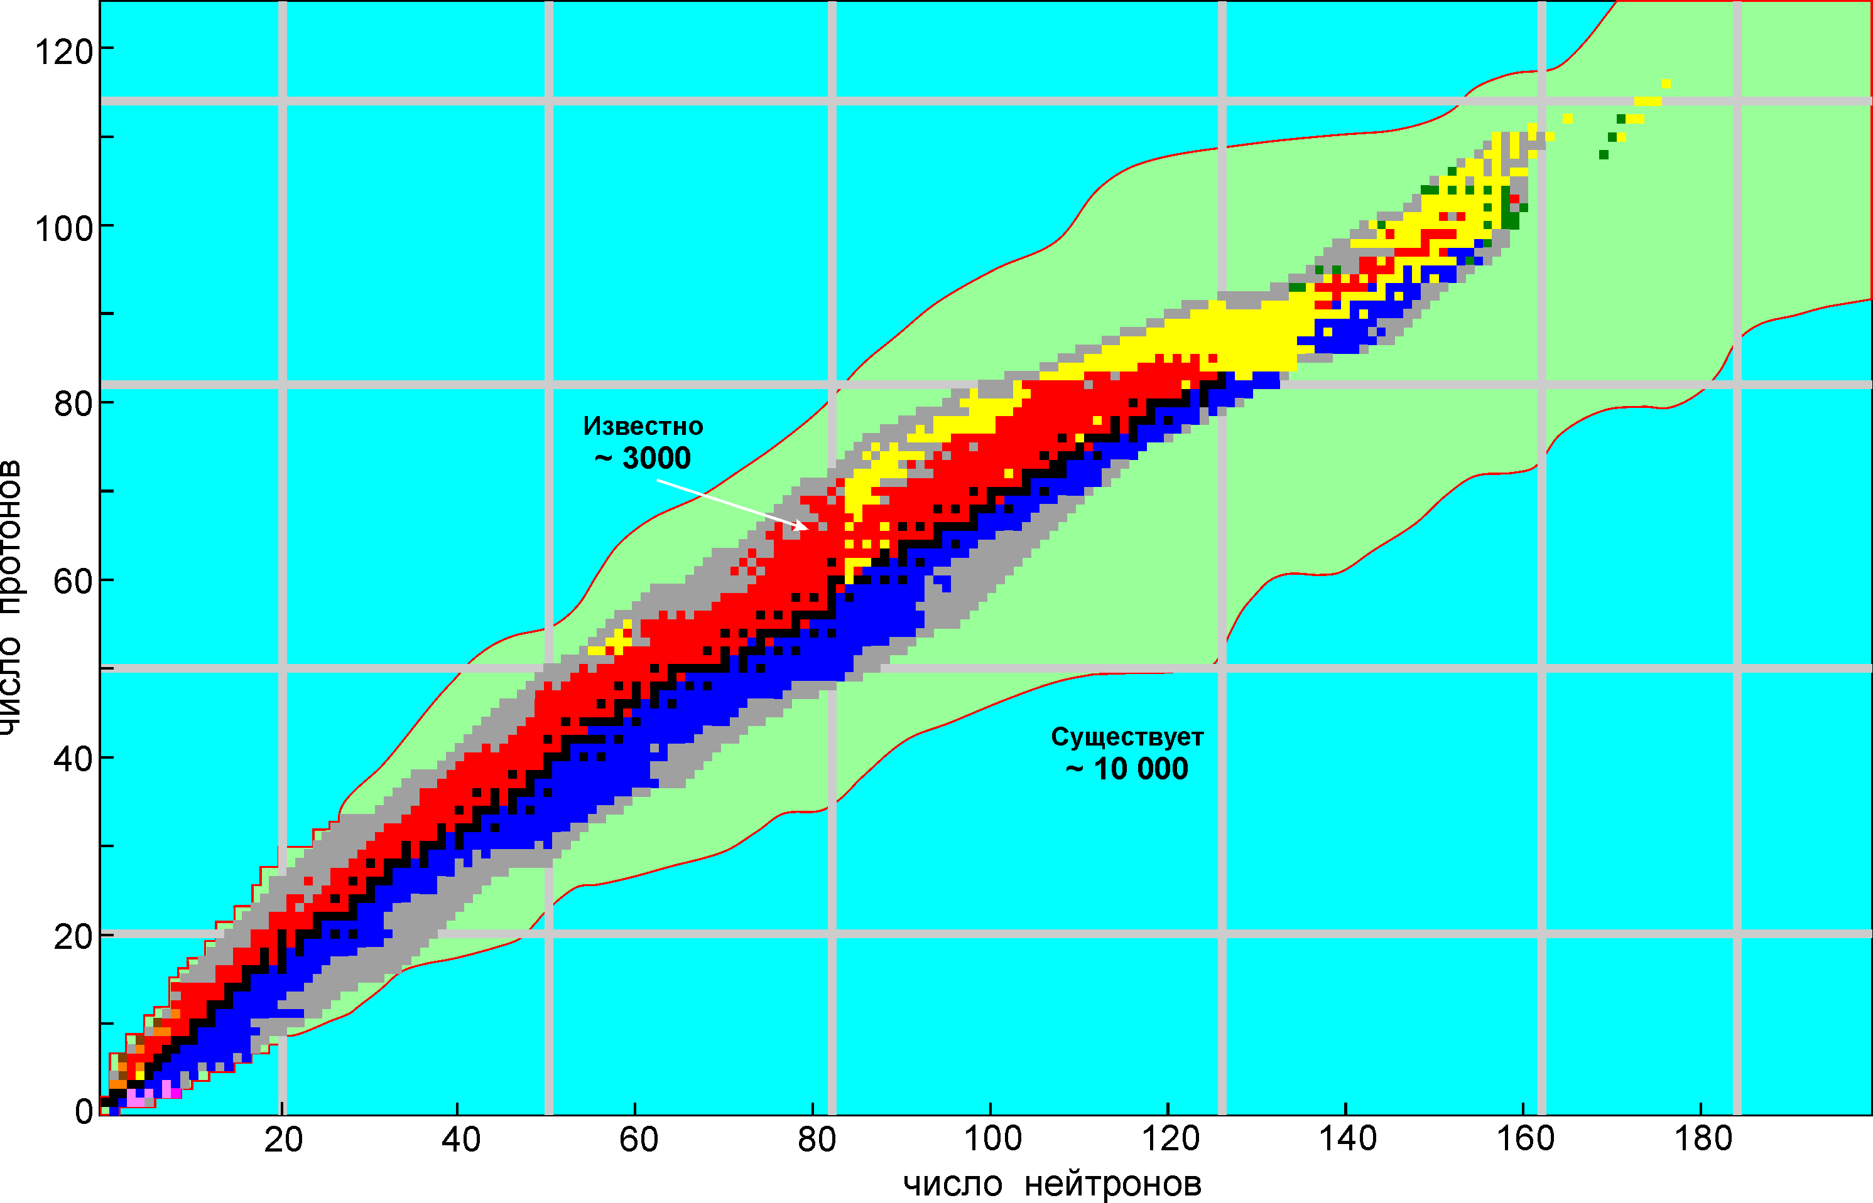
Superheavies by fusion
line of
β-stability
Z=N
²⁷⁹Fl₁₁₄
²³⁹Pu₉₄
protons
⁴⁰Ca₂₀
neutrons

Slide 15
Superheavies by fusion
line of
β-stability
Z=N
²⁹²Fl₁₁₄
²⁷⁹Fl₁₁₄
²⁴⁴Pu₉₄
²³⁹Pu₉₄
protons
⁴⁸Ca₂₀
⁴⁰Ca₂₀
neutrons

Slide 16
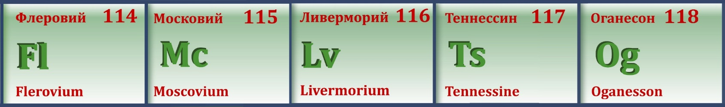
Towards the Island of Stability
1999-2016

Slide 17
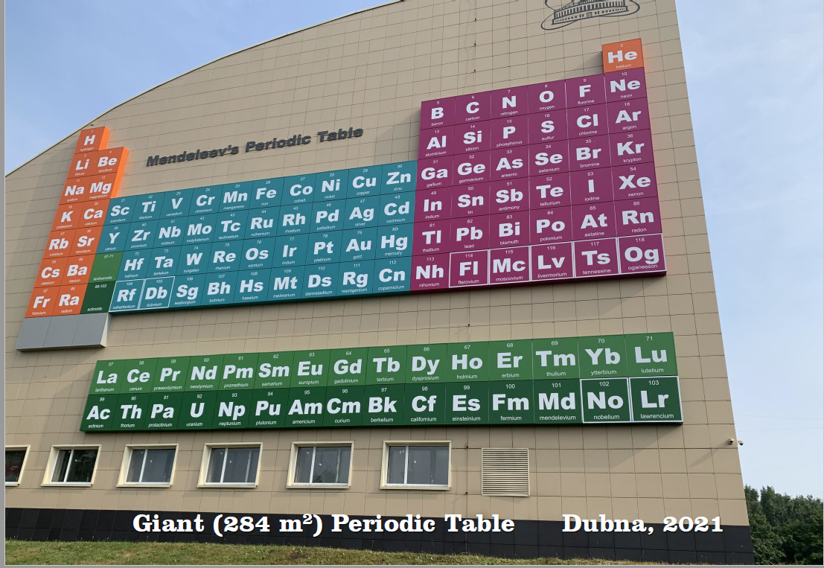
SH Islanders
daughter nuclides
New

Slide 18
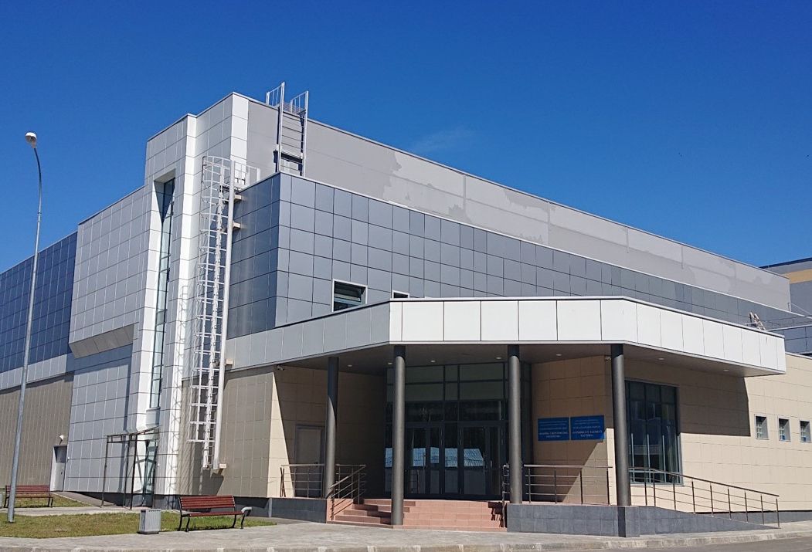
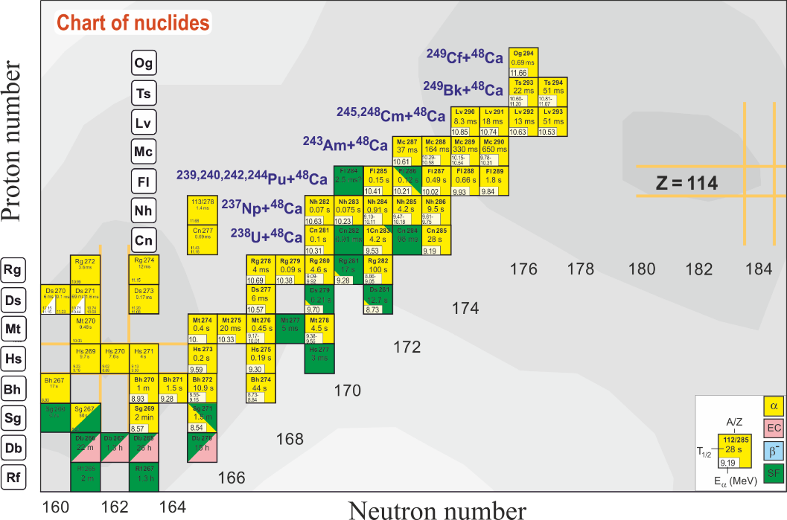
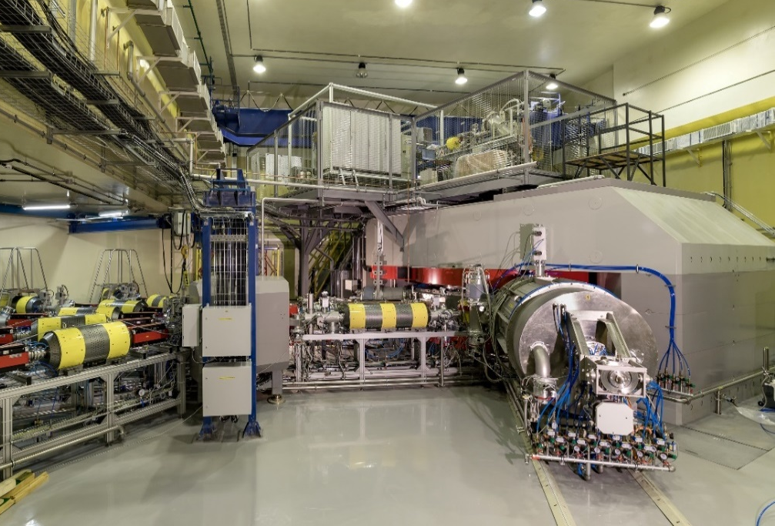
SHE research: Main tasks
Experiments at the extremely low (σ<100 fb) cross sections:
- Synthesis of new SHE with Z = 119 and 120 in reactions with ⁵⁰Ti, ⁵⁴Cr ...;
- Synthesis of new isotopes of SHE;
- Study of decay properties of SHE;
- Exploring limits the Island of Stability;
- Study of excitation functions.
Experiments requiring high statistics:
- Nuclear spectroscopy of SHE;
- Precise mass measurements;
- Study of chemical properties of SHE.
Beam of ⁴⁸Ca @ DC-280:
Intensity: >8 pμA
Energy: 5 - 8 A·MeV
Efficiency: ~50%
Notes:
Ели и задачи Фабрики

Slide 19
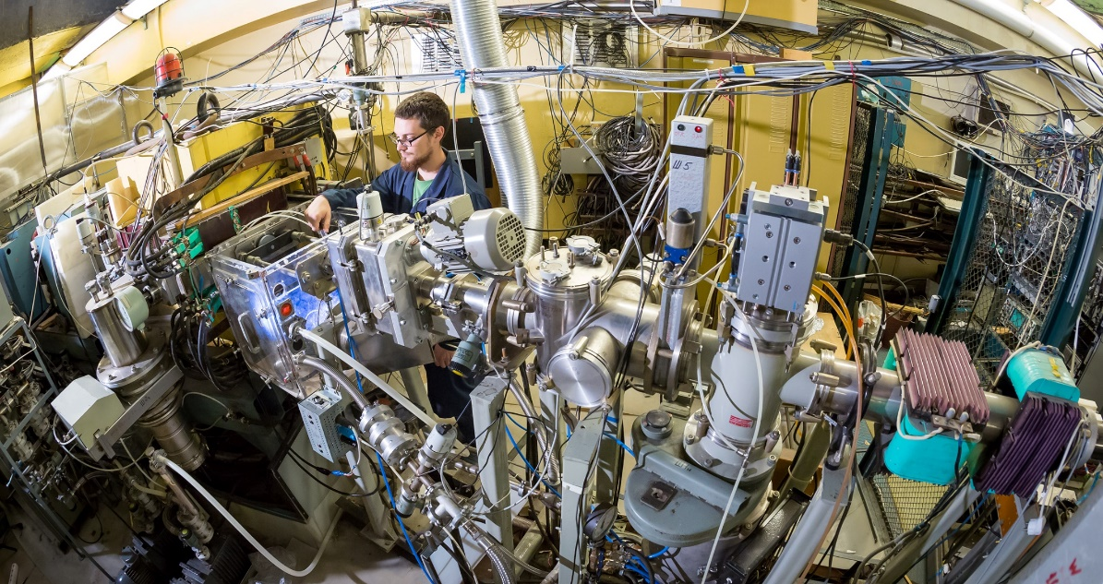
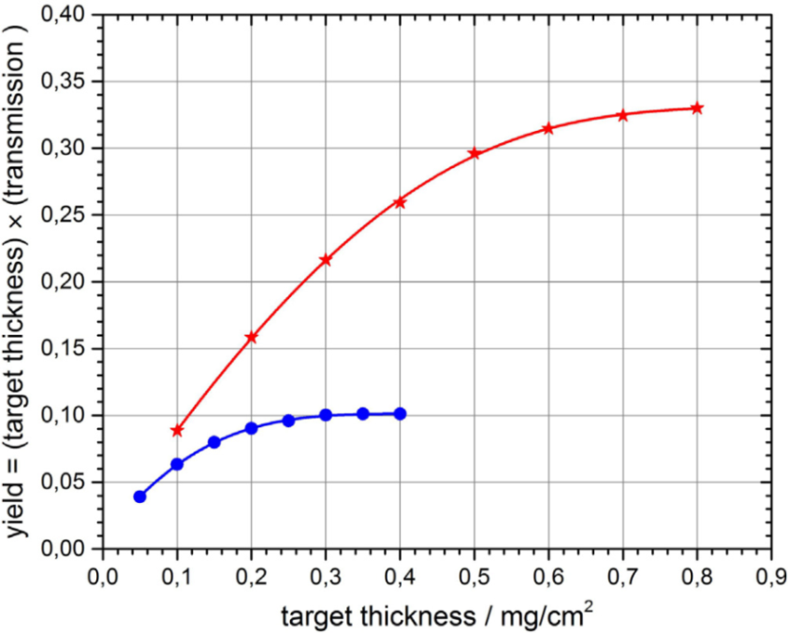
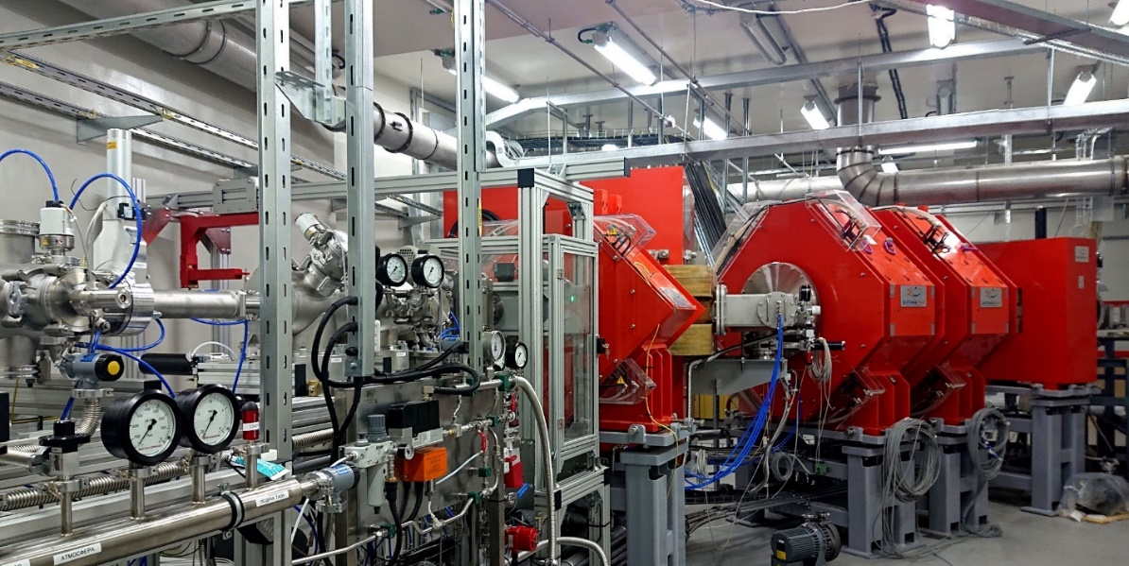
Dubna Gas-Filled Recoil Separators
DGFRS-1 @ U400
DGFRS-2
factor of 3
DGFRS-2 @ DC280
DGFRS-1

Slide 20
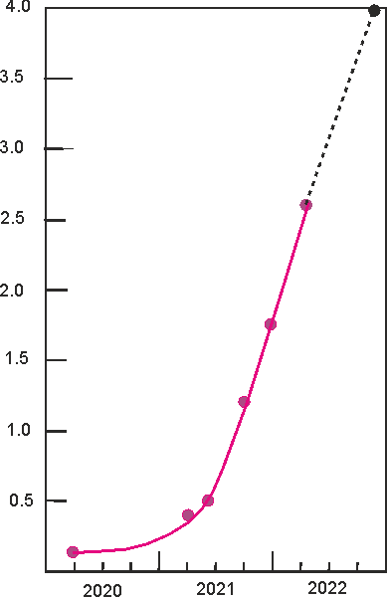
Progress at SHE-Factory
4.0
designed
3.5
Luminosity
(target 30 mg)
3.0
now at the SHE Factory
2.5
Luminosity (10³¹/cm²ˑs)
DC-280 + DGFRS-2
2.0
1.5
1.0
0.5
previous level
U-400 + DGFRS-1
0.0
2000
2020
2021
2022
year
by Yu. Oganessian

Slide 21
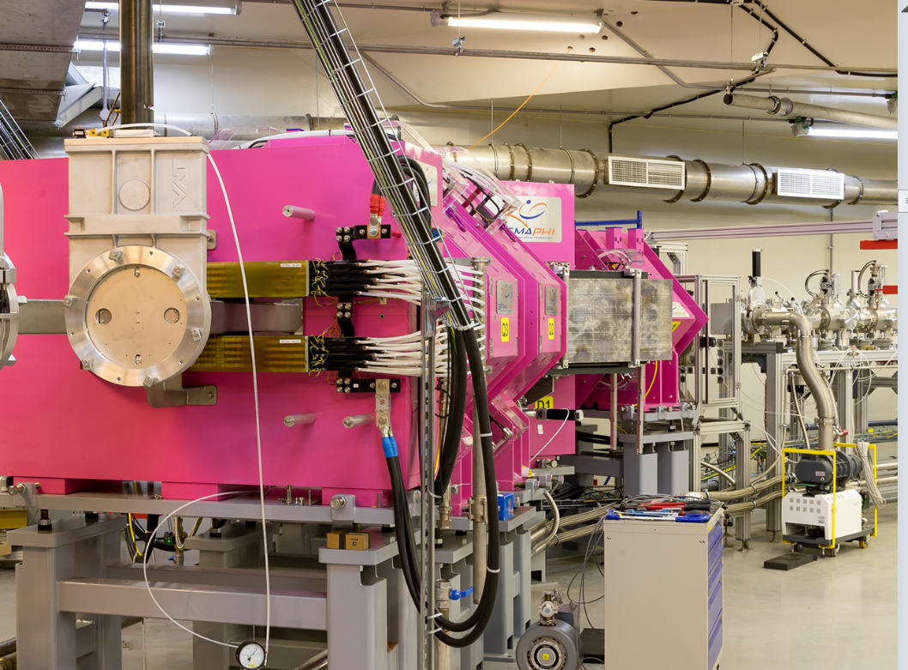
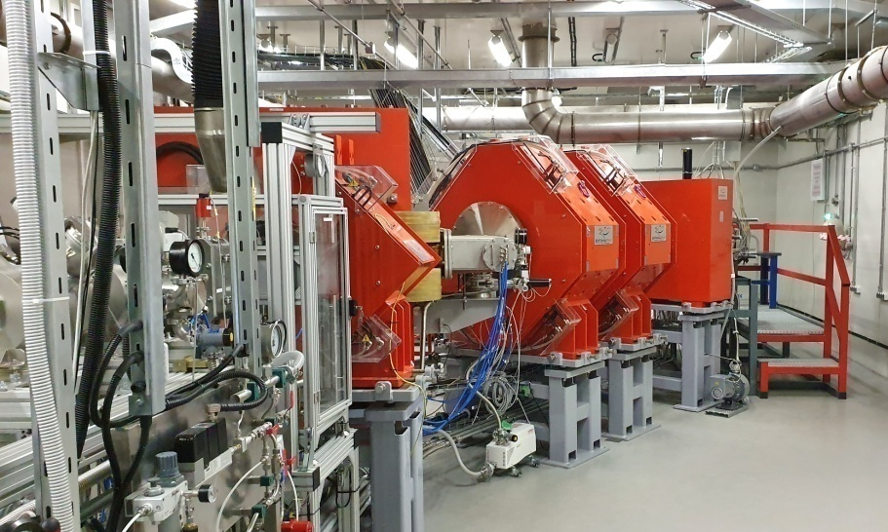
SHE research program with existing separators @ SHE Factory
DGFRS-3:
launched in 2022
DGFRS-2:
launched in 2020
Spectroscopy of SHE;
Chemical studies for SH nuclei with half-lives longer than 1 sec (114 and lighter);
Precise mass measurements (new developments are due);
Synthesis of new SHE;
Synthesis of new neutron-deficient isotopes of SHE: “shaping” of island of stability;
Search for rear decay channels in ⁴⁸Ca-induced reactions (EC, pxn, 1-2n): towards island of stability;
Decay modes, excitation functions, etc.

Slide 22
^{Perspectives}

Slide 23
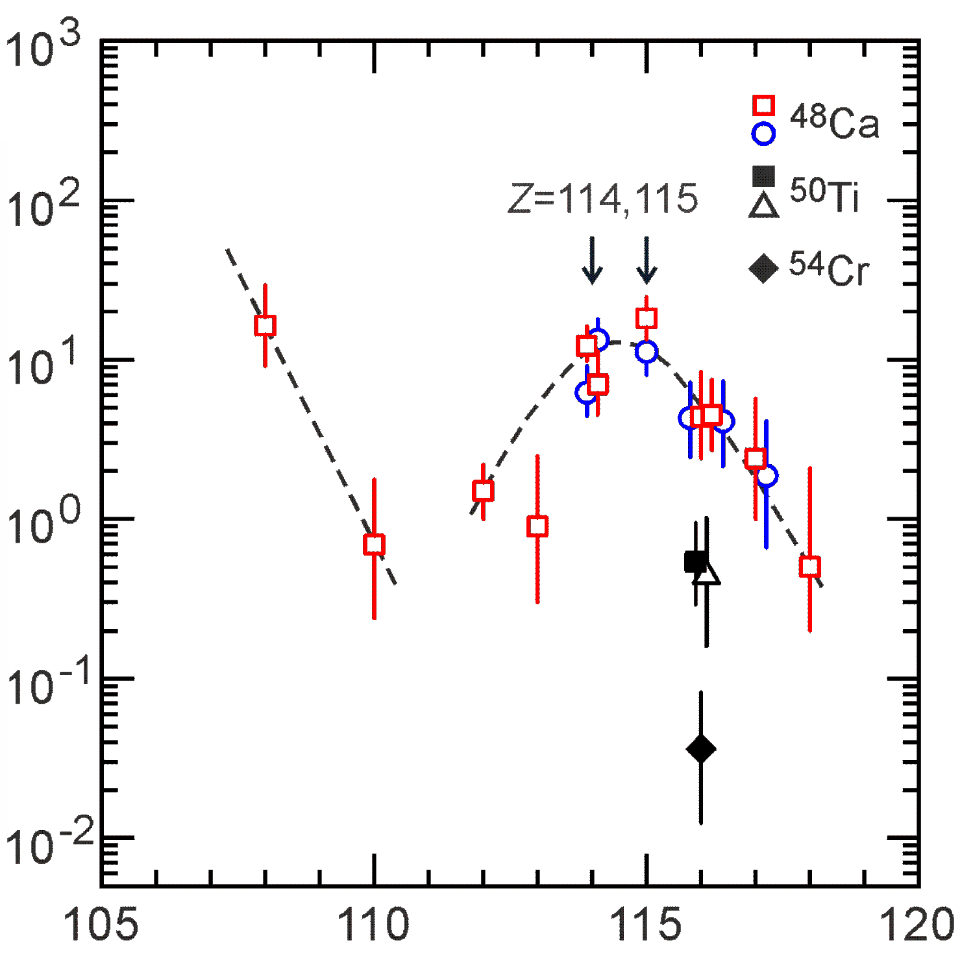
Towards 119 and 120
⁵⁴Cr + ²⁴⁸Cm → 3n + ²⁹⁹120
⁵⁰Ti + ²⁵¹Cf → 3n + ²⁹⁸120
⁵⁰Ti + ²⁴⁹Bk → 3n + ²⁹⁶119
⁴⁸Ca
Fl
302
known
nuclei
⁵⁰Ti
⁵⁴Cr
20fb – 1 event/100 d
cross section decreases by ~10 times (⁵⁰Ti) and ~150 times (⁵⁴Cr) compared to the ⁴⁸Ca case
J.M. Gates et al., PRL 133 (2024) 172502 Yu. Ts. Oganessian, V. K. Utyonkov, et. al, PRC 112 (2025) 014603

Slide 24
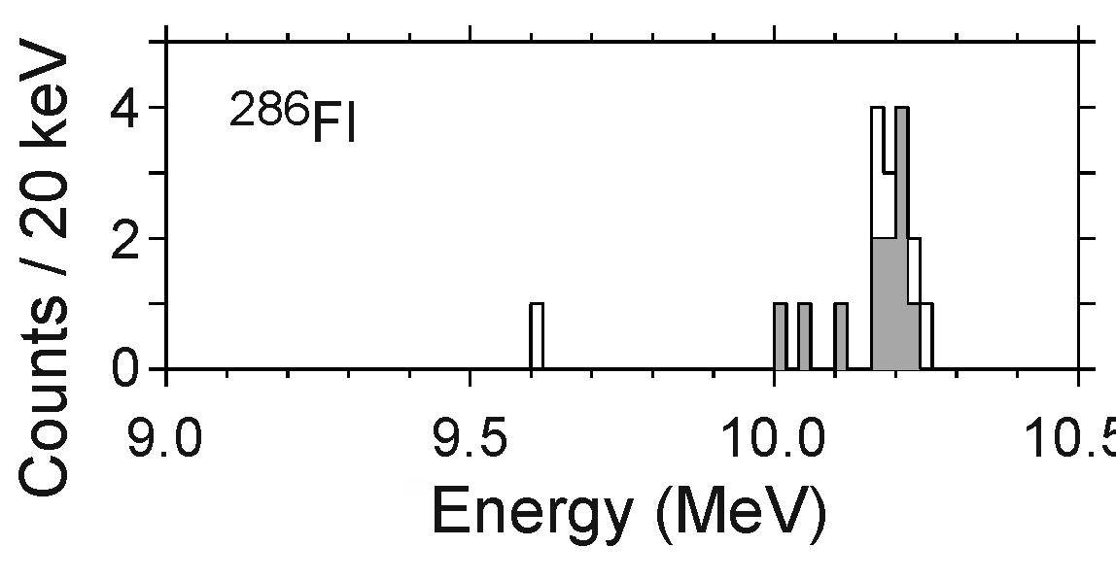
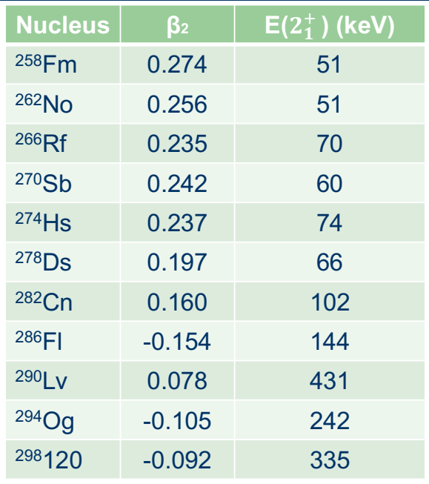
Presumable α-decay of ²⁸⁶Fl on rotational 2⁺-state of ²⁸²Cn
²⁸⁶Fl: decay on 2⁺ rotational state of ²⁸²Cn or through isomeric states
deduced for 0⁺: 82% and 2⁺: 18%
β₂ = 0.13
E₂₊ = 101 keV
β4
“experiment”:
E₂₊ = 100 - 200 keV
0⁺: 82% and 2⁺: 18%
β₂

Slide 25
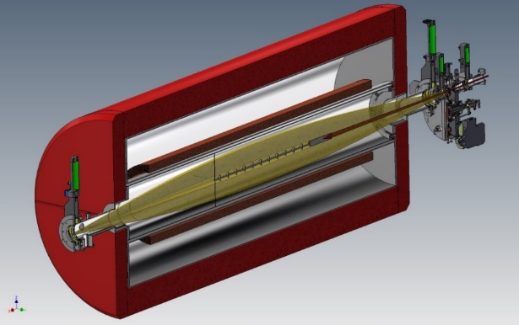
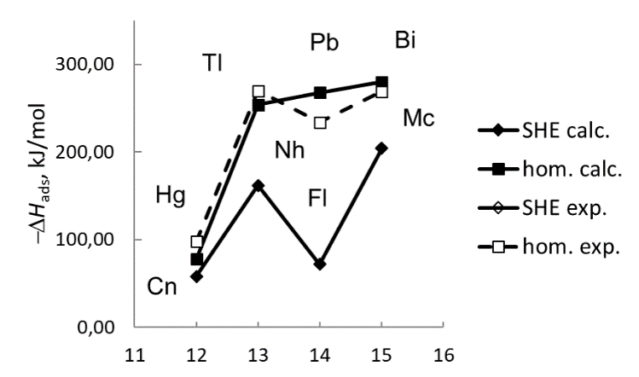
chemistry of SHE
Z | Isotope | Half-life
112 | ²⁸³Cn | 3.6 s
113 | ²⁸⁴Nh | 0.9 s
114 | ²⁸⁷Fl | 0.3 s
115 | ²⁸⁸Mc | 0,16 s
116 | ²⁹³Lv | 57 ms
117 | ²⁹⁴Ts | 51 ms
118 | ²⁹⁴Og | 0.6 ms
He/Ar
GASSOL – Solenoid-based separator
Stopping SH atoms in a small volume of 1-2 cm³
Chemistry of short-lived SHE T_{1/2} ≥ 30 ms (up to elements 116-117)
Shortcoming: a relatively large volume of the stopping cell

Slide 26
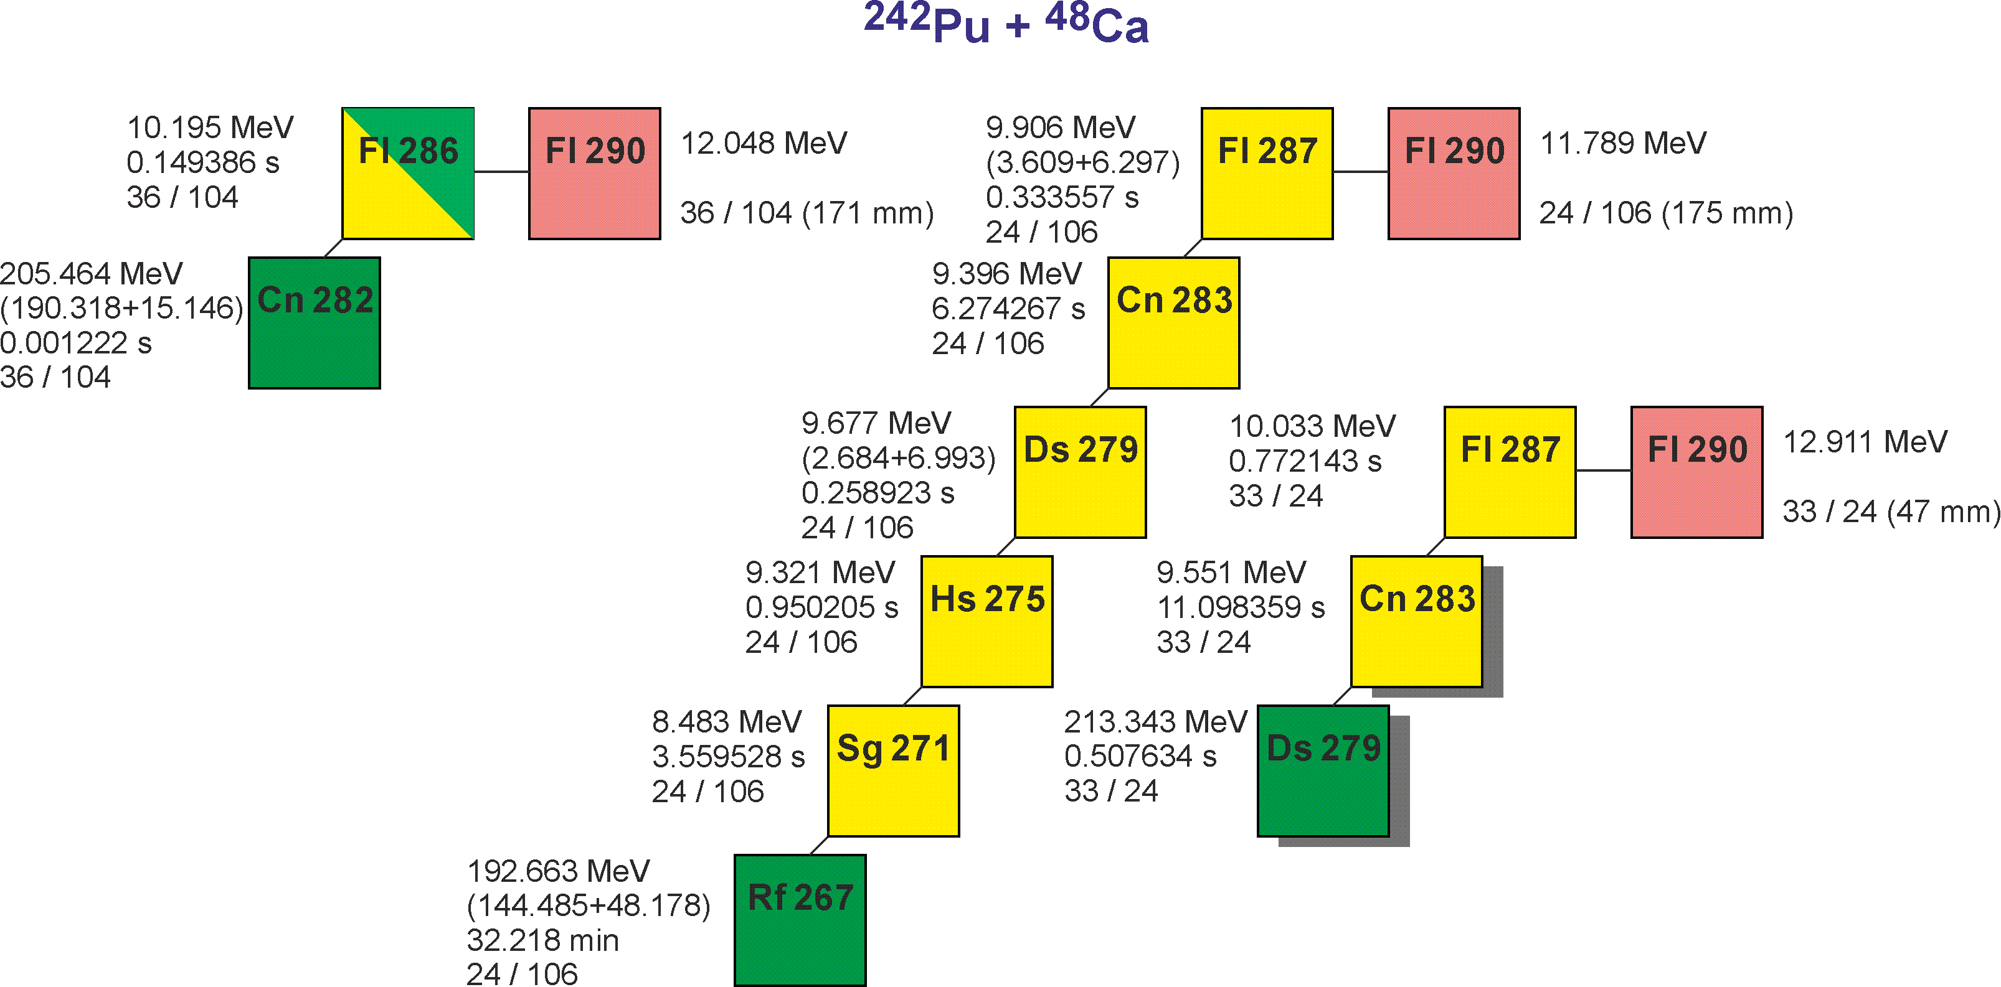
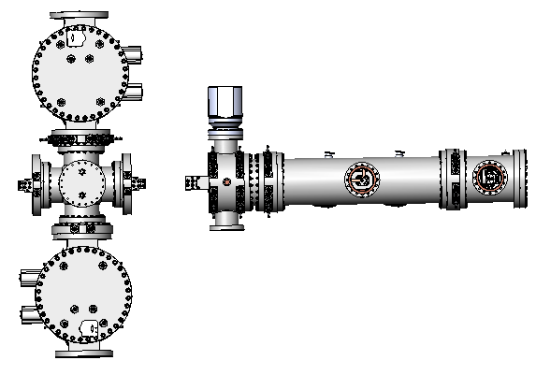
Precise mass measurements of SH nuclei @ SHE Factory
Measuring masses of SH isotopes
with accuracy 10⁻⁷ (30 кeV)
T_{1/2} < 0.5 s
Production rate $\sim$ 1 event/day
Background rate $≥1$ event/s
MR-TOF Mass-Analyzer
M.I. Yavor, Journal of Instrumentation,17 (2022) 11033

Slide 27
Nuclear reactions

Slide 28
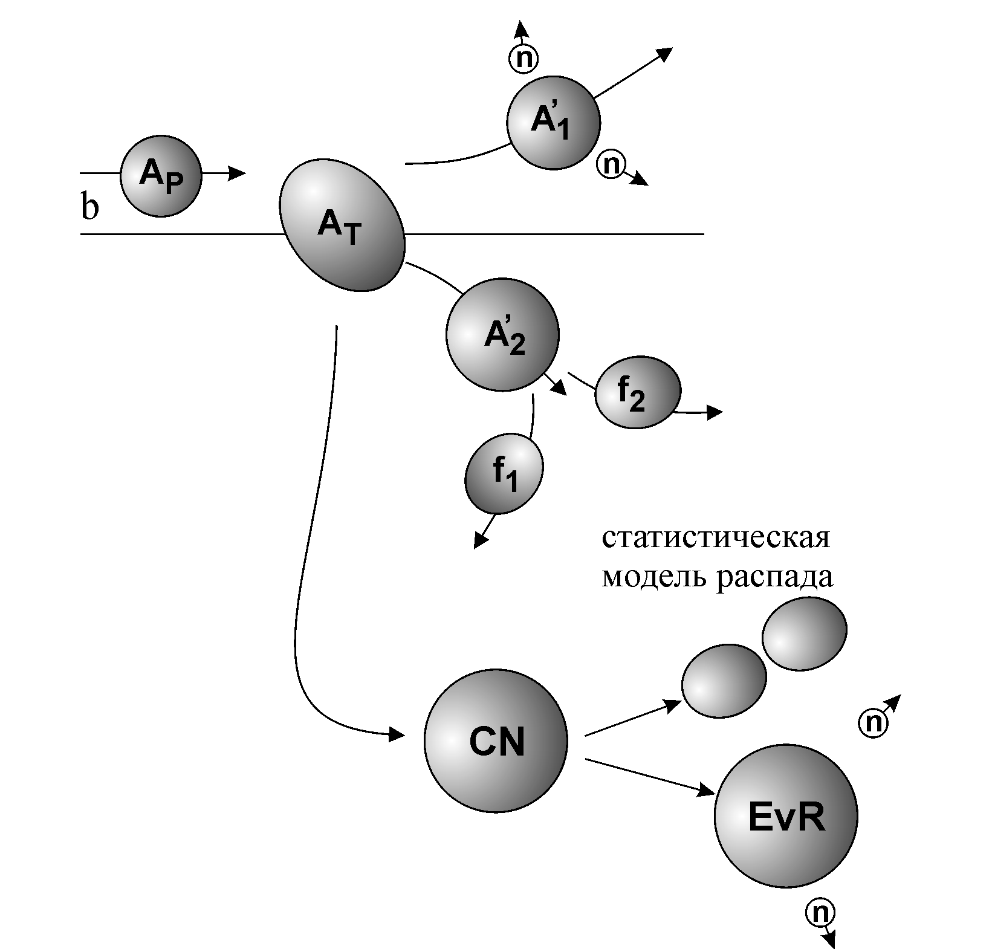
Mechanisms of reactions induced by heavy ions at near barrier energies
Deep inelastic collisions, Quasi-fission
Sequential fission
Fusion-fission
Fusion
Fusion-survival

Slide 29
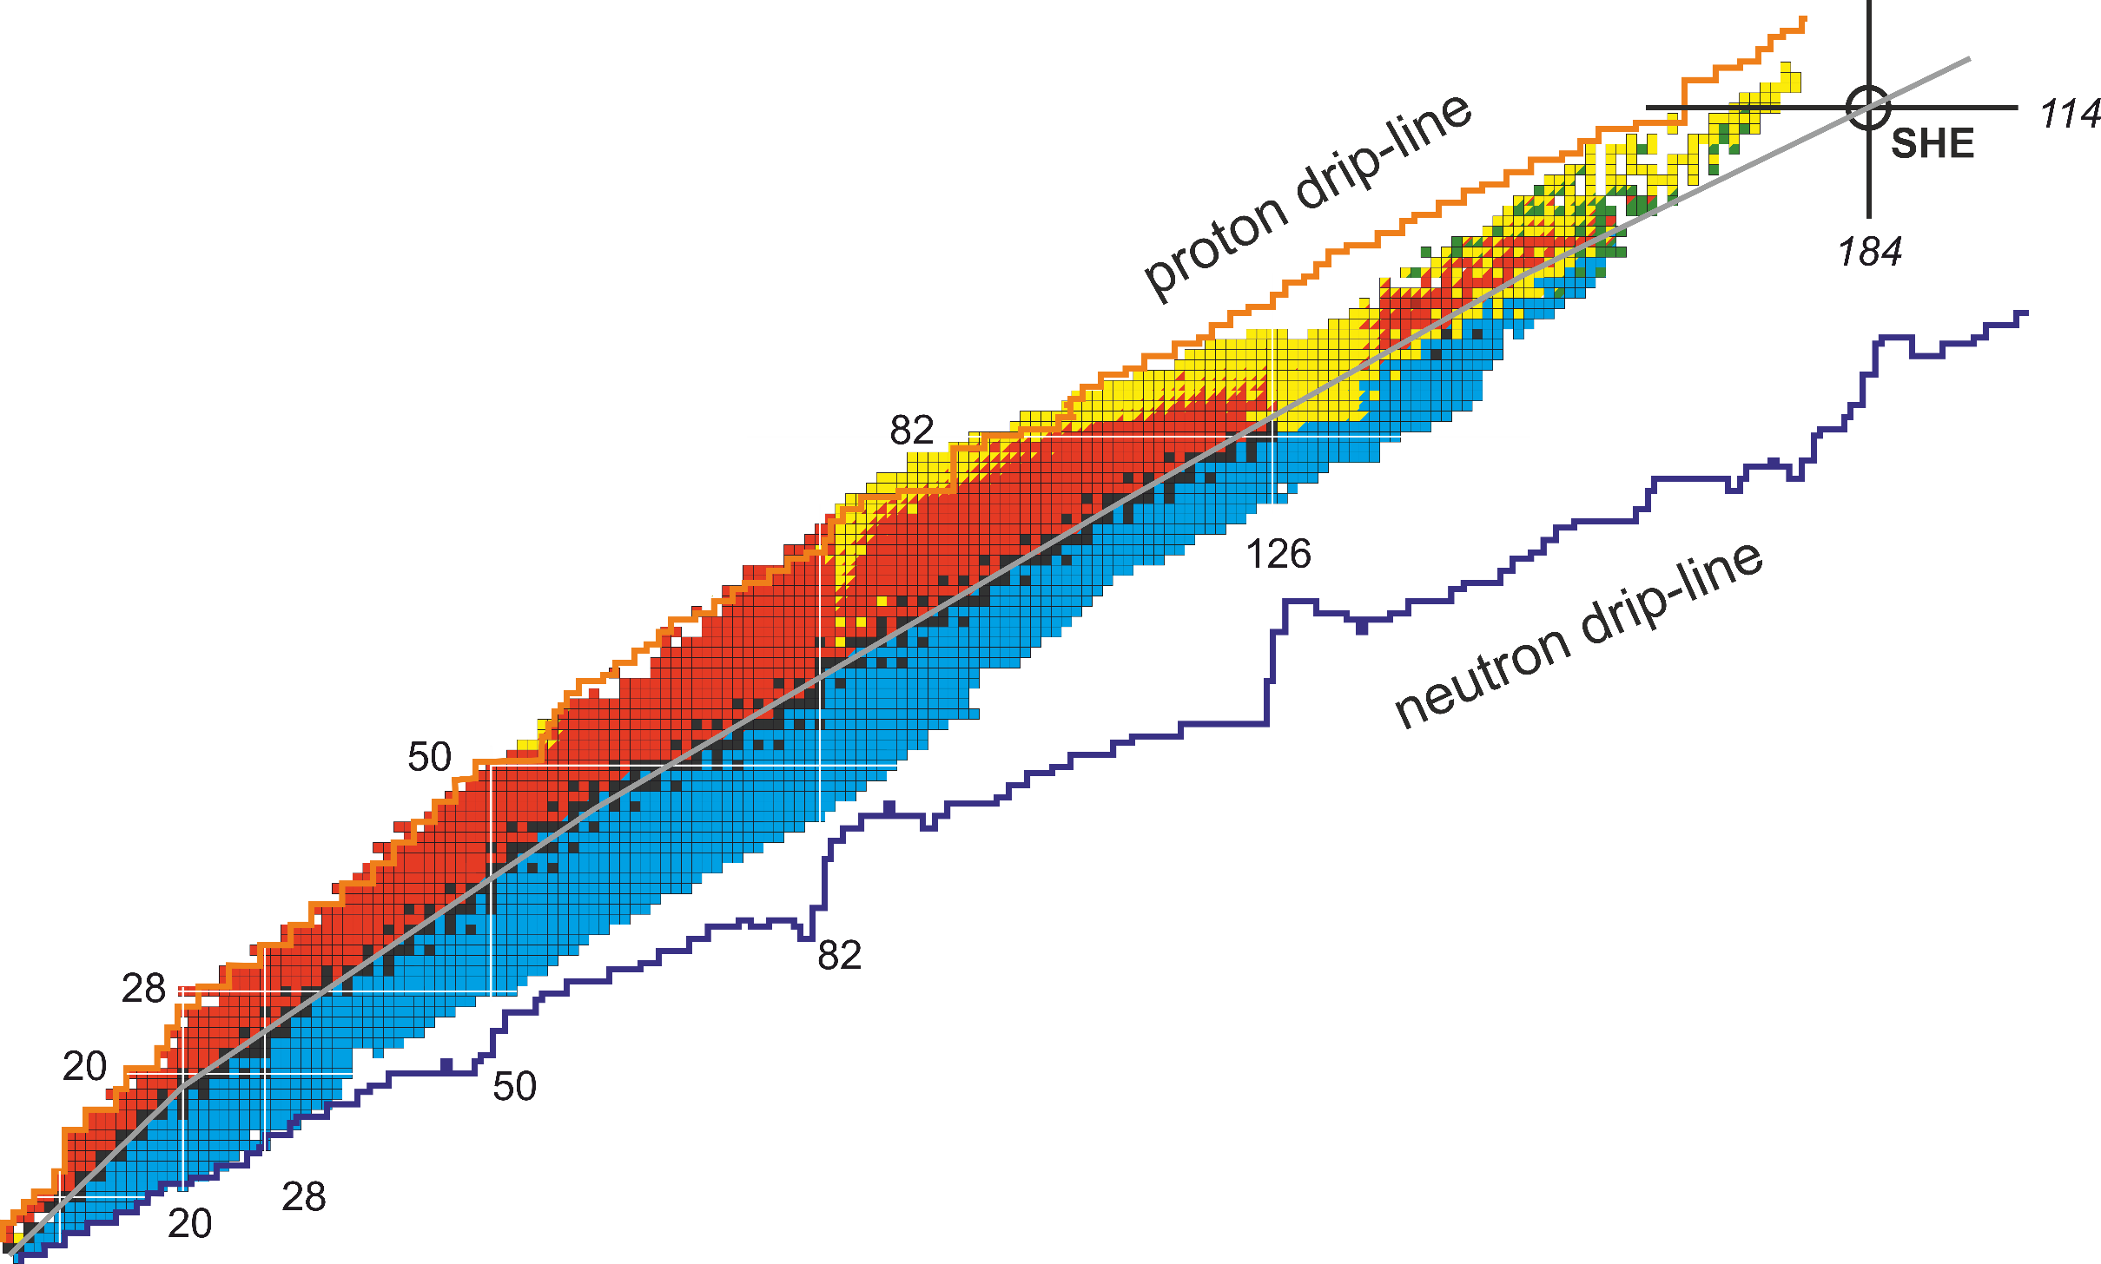





Methods of synthesis of new nuclei
Fusion:
+ any element (question of probability)
- lack of neutrons
Fragmentation:
+ very efficient and universal
- products are lighter than ²³⁸U
Fission:
+ neutron-rich products
- products are much lighter than ²³⁸U
Multinucleon transfer (MNT):
+ a way to unknown regions
very, very complicated technically
lack of experimental data
162
MNT?
Fusion
Fragmentation
Fission

Slide 30
Studying the ²³⁸U + ²³⁸U reaction
²³⁸U
²³⁸U
Z=184
A=476
²⁶⁸No*
2
²⁰⁸Pb
1
Neutrons
EVR
No

Slide 31
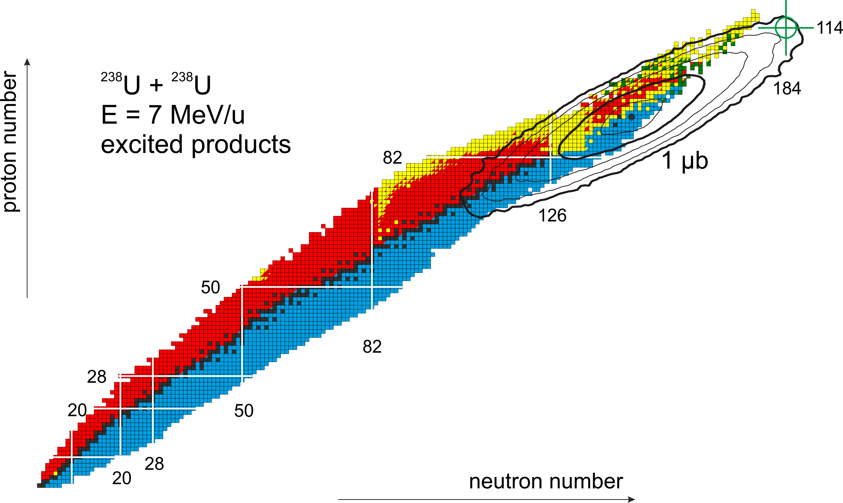
Multinucleon transfer processes in U + U reaction
excited
(!)

Slide 32
Studying the ²³⁸U + ²³⁸U reaction
²³⁸U
²³⁸U
Z=184
A=476
3
fission
²⁶⁸No*
2
4
²⁰⁸Pb
1
Neutrons
EVR
No

Slide 33
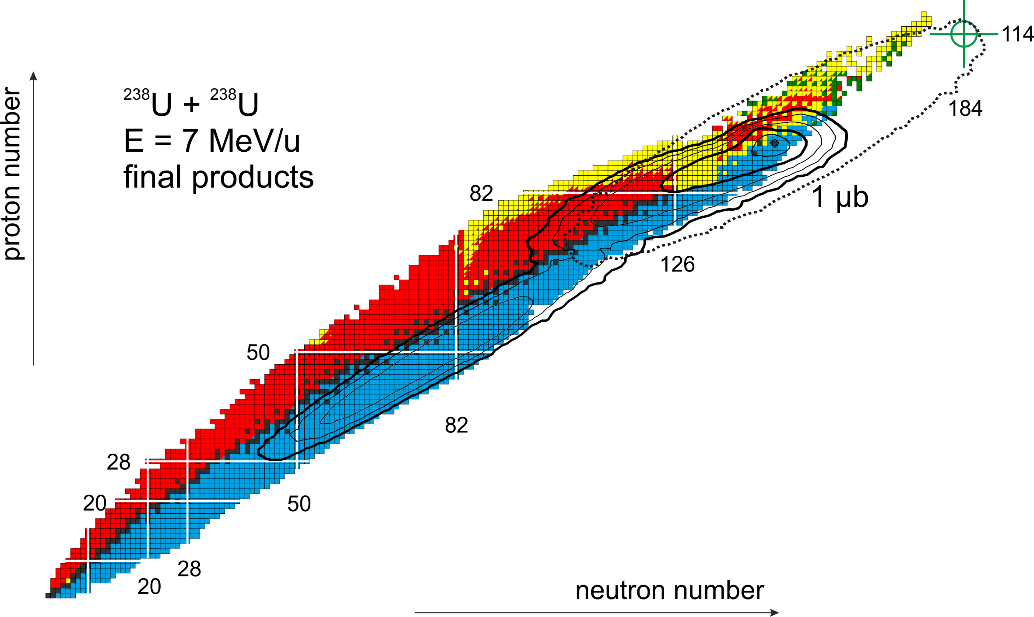
Multinucleon transfer processes in U + U reaction
excited
cold
questions:
cross sections for primary heavy products
cross sections for survived heavy products
excitation energies
various correlations of Z, A, θ, E

Slide 34
FLNR ACCELERATOR COMPLEX
(planned)

Slide 35
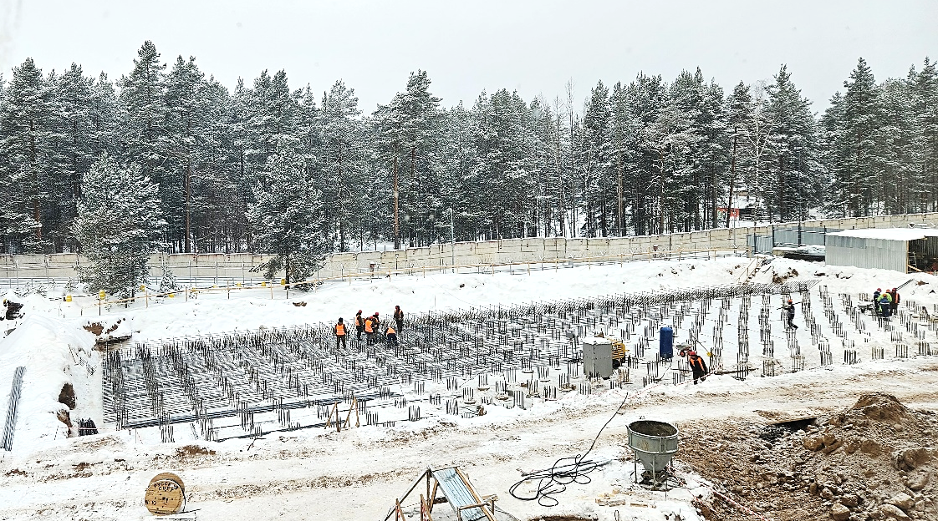
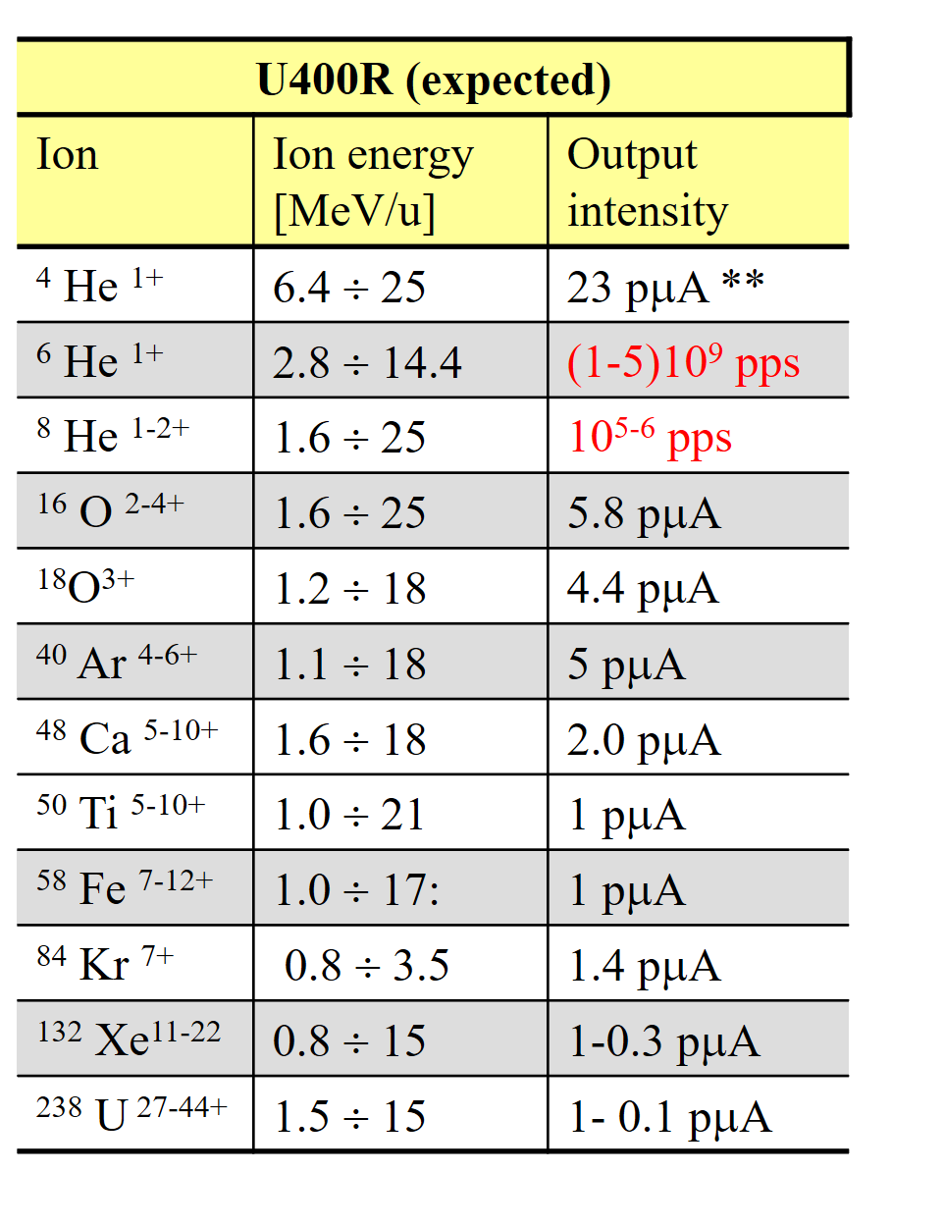
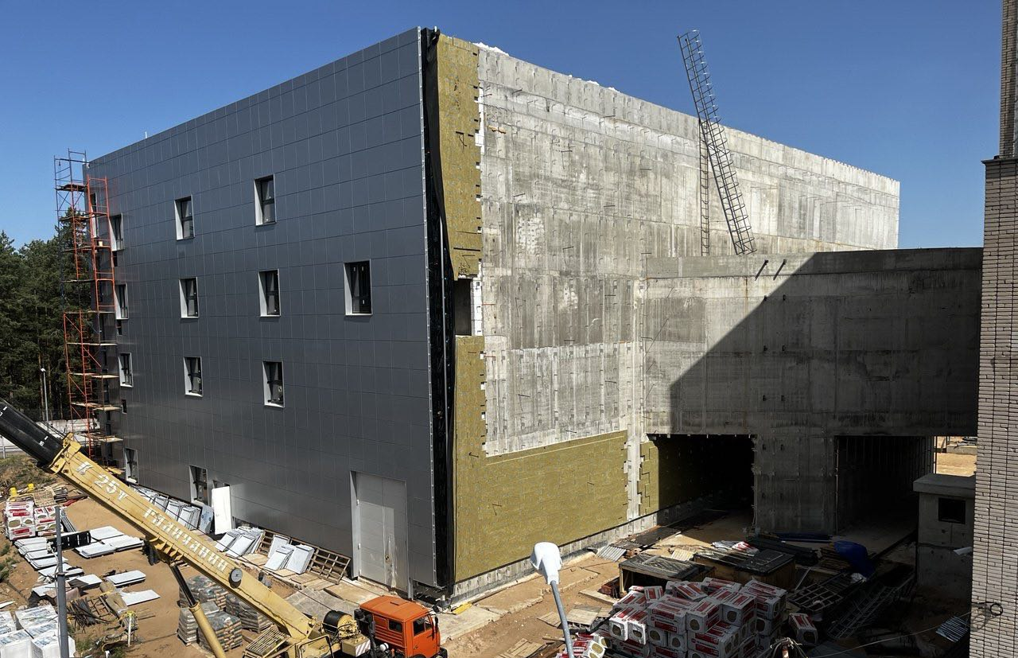
New experimental hall and upgrade of U-400R
Completion of the pile field 08.12.23
21.08.25

Slide 36
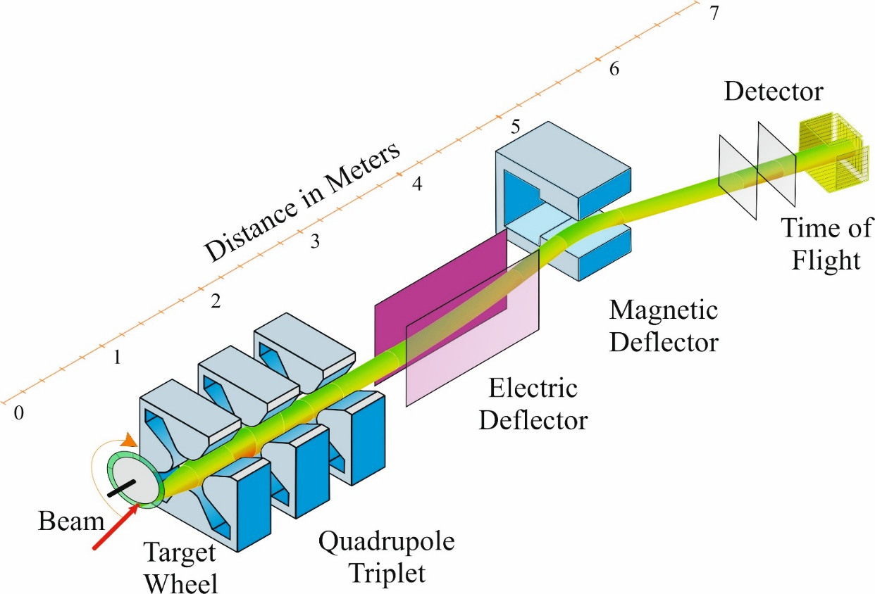
What do we need
Nucl. | Е(МeV) | Bρ (vac. Т∙m) | Bρ (He. Т∙m) | Bρ (H₂. Т∙m) | V (cm/ns) | E/q_{vac} (MV)
²³⁸U | 1666 | 1.33 | 1.63 | 1.63 | 3.67 | 24.4
²⁶⁸No | 1596 | 1.32 | 1.67 | 1.67 | 3.39 | 22.3
²³⁸U + ²³⁸U →
~ ²⁶⁸No + ~ ²⁰⁸Pb
STAR
(Separator for TransActinide Research)
Bρ (T×m) | E/q (MV)
1.5 | 25 | rotatable
What do we have?
Separator | Institute | Bρ(max) T×m | E/q (max) MV
SHIP | GSI | 1.2 | 20 (?)
SHELS | JINR | 1.0 | 10
FMA | ANL | 1.0 | 18
MARA | JYFL | 1.0 | 14
S3 | GANIL | 1.8 | 12

Slide 37
System for Correlated Investigation of Fragments (SCIF)
Study of mechanisms of fusion-fission and incomplete fusion reactions
SСIF consists of:
CORSET spectrometer - measuring mass-energy and angular distributions of reaction fragments;
Bragg chambers - measuring of charge distributions of reaction fragments;
Magnetic spectrometer providing precise (A,Z) identification of fragments with masses up to 200 a.m.u.;
etc.

Slide 38
Thank you for your attention!

