Slide 1
29th International Scientific Conference of Young Scientists and Specialists (AYSS-2025) LIT JINR, Dubna, 27 – 31 October, 2025
Radiobiology of Auger electron emitters
and their potential for radionuclide therapy
Dr Pavel Lobachevsky
Laboratory of Radiation Biology
Joint Institute for Nuclear Research
Dubna, Russian Federation
Notes:
I would like to thank the organisers for the opportunity to speak for the seminar and presents the results of radiobiological research on heavy ions in Laboratory of radiation biology

Slide 2
Radiobiology of Auger Emitters - Topics
1. Auger electron emitters – a special class of radionuclides
(physics of Auger effect and physical properties of Auger emitters)
2. Molecular aspects of Auger decay radiobiology
(DNA damage)
3. Auger emitters potential for radionuclide therapy
(dual targeting strategy)
Notes:
Laboratory of radiation biology incorporates two departments – department of radiation research and department of radiation biology and physiology.
There are quite a lot of research directions in the department, including ….. , and it is very difficult task to cover all of them.

Slide 3
Radiobiology of Auger Emitters - Topics
1. Auger electron emitters – a special class of radionuclides
(physics of Auger effect and physical properties of Auger emitters)
2. Molecular aspects of Auger decay radiobiology
(DNA damage)
3. Auger emitters potential for radionuclide therapy
(dual targeting strategy)
Notes:
Laboratory of radiation biology incorporates two departments – department of radiation research and department of radiation biology and physiology.
There are quite a lot of research directions in the department, including ….. , and it is very difficult task to cover all of them.

Slide 4
Physics of Auger effect
Auger emitters – a special class of radionuclides
each decay event is unique (in contrast to α-, β- and γ-emitters
nuclear and atomic processes are involved
Auger effect – named after Pierre Auger
Notes:
Laboratory of radiation biology incorporates two departments – department of radiation research and department of radiation biology and physiology.
There are quite a lot of research directions in the department, including ….. , and it is very difficult task to cover all of them.

Slide 5
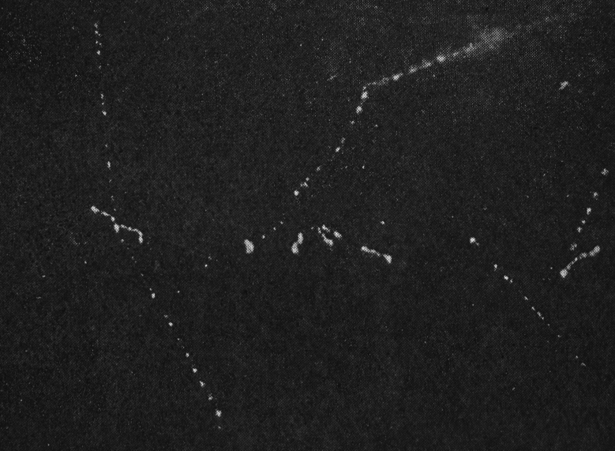
Physics of Auger effect
Auger emitters – a special class of radionuclides
each decay event is unique (in contrast to α-, β- and γ-emitters
nuclear and atomic processes are involved
Auger effect – named after Pierre Auger
Auger P. Sur l'effet photoélectrique composé,1925.
Notes:
Laboratory of radiation biology incorporates two departments – department of radiation research and department of radiation biology and physiology.
There are quite a lot of research directions in the department, including ….. , and it is very difficult task to cover all of them.

Slide 6
Physics of Auger effect
Auger emitters – a special class of radionuclides
each decay event is unique (in contrast to α-, β- and γ-emitters
nuclear and atomic processes are involved
Auger effect – named after Pierre Auger
Auger P. Sur l'effet photoélectrique composé,1925.
Study of photo effect in gaseous phase (Wilson cloud chamber)
Multiple tracks of ionising particles originating from the same point – Auger effect
Pierre Auger interpretation – simultaneous emission of several electrons from ionised atom
Notes:
Laboratory of radiation biology incorporates two departments – department of radiation research and department of radiation biology and physiology.
There are quite a lot of research directions in the department, including ….. , and it is very difficult task to cover all of them.

Slide 7
Physics of Auger effect
Auger emitters – a special class of radionuclides
each decay event is unique (in contrast to α-, β- and γ-emitters
nuclear and atomic processes are involved
Auger effect – named after Pierre Auger
Auger P. Sur l'effet photoélectrique composé,1925.
Study of photo effect in gaseous phase (Wilson cloud chamber)
Multiple tracks of ionising particles originating from the same point – Auger effect
Pierre Auger interpretation – simultaneous emission of several electrons from ionised atom
Main feature of Auger effect – emission of multiple electrons (Auger electrons) initiated by a single atomic event
Notes:
Laboratory of radiation biology incorporates two departments – department of radiation research and department of radiation biology and physiology.
There are quite a lot of research directions in the department, including ….. , and it is very difficult task to cover all of them.

Slide 8
Physics of Auger effect
Auger effect involves:
Formation of a vacancy in an inner atomic shell
Filling of this vacancy by another electron; accompanied by
- formation of a new vacancy, with the transition energy released as:
- X-ray photon or
- emission of another electron with formation of one more vacancy
The process of vacancy filling and electron emission (Auger cascade) continues until
- all vacancies reach the outer shell (in vacuum) and
- are filled with electrons from neighbouring atoms (in medium)
Formation of
a vacancy
Notes:
Laboratory of radiation biology incorporates two departments – department of radiation research and department of radiation biology and physiology.
There are quite a lot of research directions in the department, including ….. , and it is very difficult task to cover all of them.

Slide 9
Physics of Auger effect
Auger effect involves:
Formation of a vacancy in an inner atomic shell
Filling of this vacancy by another electron; accompanied by
- formation of a new vacancy, with the transition energy released as:
- X-ray photon or
- emission of another electron with formation of one more vacancy
The process of vacancy filling and electron emission (Auger cascade) continues until
- all vacancies reach the outer shell (in vacuum) and
- are filled with electrons from neighbouring atoms (in medium)
Formation of
a vacancy
In summary, Auger effect is:
emission from an atom of multiple electrons (Auger electrons) that is
initiated by an inner shell vacancy
Notes:
Laboratory of radiation biology incorporates two departments – department of radiation research and department of radiation biology and physiology.
There are quite a lot of research directions in the department, including ….. , and it is very difficult task to cover all of them.

Slide 10
Physics of Auger effect
Inner shell vacancy formation mechanisms:
photo effect (in Pierre Auger experiments)
electron capture
internal conversion
Notes:
Laboratory of radiation biology incorporates two departments – department of radiation research and department of radiation biology and physiology.
There are quite a lot of research directions in the department, including ….. , and it is very difficult task to cover all of them.

Slide 11
Physics of Auger effect
Inner shell vacancy formation mechanisms:
photo effect (in Pierre Auger experiments)
electron capture
internal conversion
Electron capture (е-capture, К-capture) – a type of radioactive decay (β-decay)
capture by a nucleus of an electron from inner shell
reaction p⁺ + e⁻ -> n + ν (a type of β-decay)
the charge of the nucleus decreases by 1, Z -> Z - 1
Notes:
Laboratory of radiation biology incorporates two departments – department of radiation research and department of radiation biology and physiology.
There are quite a lot of research directions in the department, including ….. , and it is very difficult task to cover all of them.

Slide 12
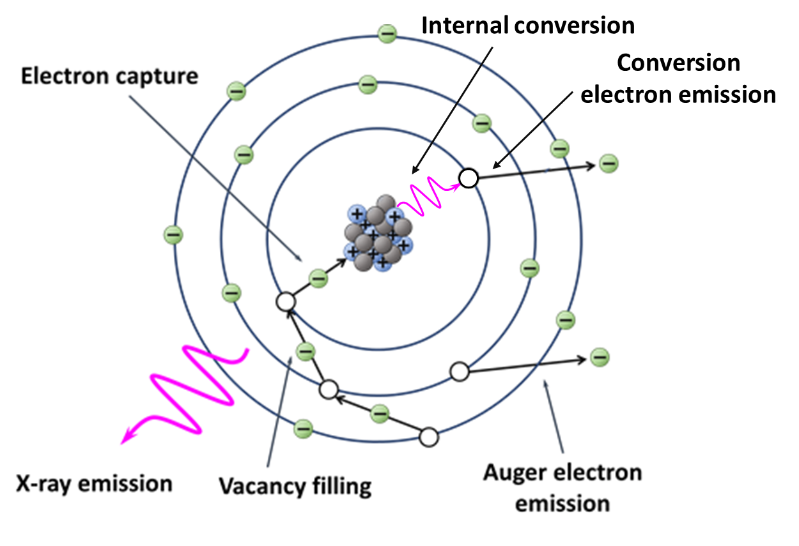
Physics of Auger effect
Inner shell vacancy formation mechanisms:
photo effect (in Pierre Auger experiments)
electron capture
internal conversion
Electron capture (е-capture, К-capture) – a type of radioactive decay (β-decay)
capture by a nucleus of an electron from inner shell
reaction p⁺ + e⁻ -> n + ν (a type of β-decay)
the charge of the nucleus decreases by 1, Z -> Z - 1
Internal conversion – a type of radioactive decay
relaxation of an excited nucleus by transferring energy to the inner shell electron with subsequent emission of this electron
Notes:
Laboratory of radiation biology incorporates two departments – department of radiation research and department of radiation biology and physiology.
There are quite a lot of research directions in the department, including ….. , and it is very difficult task to cover all of them.

Slide 13
Physics of Auger effect
Inner shell vacancy formation mechanisms:
photo effect (in Pierre Auger experiments)
electron capture
internal conversion
Electron capture (е-capture, К-capture) – a type of radioactive decay (β-decay)
capture by a nucleus of an electron from inner shell
reaction p⁺ + e⁻ -> n + ν (a type of β-decay)
the charge of the nucleus decreases by 1, Z -> Z - 1
Internal conversion – a type of radioactive decay
relaxation of an excited nucleus by transferring energy to the inner shell electron with subsequent emission of this electron
Photo effect and formation of a vacancy can occur in any atom (non-radioactive) subjected to photon (X-ray) irradiation
Electron Capture and Internal Conversion – types of radioactive decay –> properties of a range of radionuclides
These radionuclides – Auger electron emitters or Auger emitters
Notes:
Laboratory of radiation biology incorporates two departments – department of radiation research and department of radiation biology and physiology.
There are quite a lot of research directions in the department, including ….. , and it is very difficult task to cover all of them.

Slide 14
Auger emitters – biologically relevant properties
Important physical properties of Auger emitters for radiation biology:
- the energy and range of Auger electrons
- the number of electrons emitted per decay
Notes:
Laboratory of radiation biology incorporates two departments – department of radiation research and department of radiation biology and physiology.
There are quite a lot of research directions in the department, including ….. , and it is very difficult task to cover all of them.

Slide 15
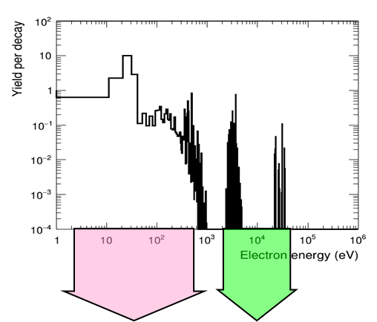
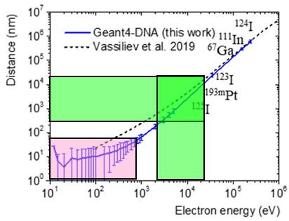
Auger emitters – energy and range of Auger electrons (¹²⁵I)
0.02 - 0.9 keV
1 – 50 nm
2.5 - 35 keV
0.2 - 20 μm
Notes:
Laboratory of radiation biology incorporates two departments – department of radiation research and department of radiation biology and physiology.
There are quite a lot of research directions in the department, including ….. , and it is very difficult task to cover all of them.

Slide 16
Auger emitters – energy and range of Auger electrons (¹²⁵I)
Range of Auger electrons:
for energies < 1 keV – up to 50 nm, dimensions of DNA molecule (2 nm – DNA double helix diameter, 0.3 nm – inter-base distance)
for energies < 30 keV – up to 20 μm, nucleus size (8 μm – nucleus diameter in mammalian cells)
3.4 nm
Cell nucleus diameter 4 – 8 μm
2 nm – DNA double
helix diameter
0.02 - 0.9 keV
1 – 50 nm
2.5 - 35 keV
0.2 - 20 μm
Notes:
Laboratory of radiation biology incorporates two departments – department of radiation research and department of radiation biology and physiology.
There are quite a lot of research directions in the department, including ….. , and it is very difficult task to cover all of them.

Slide 17
Auger emitters – energy and range of Auger electrons (¹²⁵I)
Range of Auger electrons:
for energies < 1 keV – up to 50 nm, dimensions of DNA molecule (2 nm – DNA double helix diameter, 0.3 nm – inter-base distance)
for energies < 30 keV – up to 20 μm, nucleus size (8 μm – nucleus diameter in mammalian cells)
3.4 nm
Cell nucleus diameter 4 – 8 μm
2 nm – DNA double
helix diameter
0.02 - 0.9 keV
1 – 50 nm
2.5 - 35 keV
0.2 - 20 μm
Number of Auger electrons by ¹²⁵I decay – 25 on average
Critical consequences of Auger decay for radiation biology:
the range of Auger electrons is comparable to the size of cell nucleus
high local deposition of absorbed energy from multiple electrons (within the size of DNA and cell nucleus)
Notes:
Laboratory of radiation biology incorporates two departments – department of radiation research and department of radiation biology and physiology.
There are quite a lot of research directions in the department, including ….. , and it is very difficult task to cover all of them.

Slide 18
Auger emitters – biologically relevant properties
Nuclide | Total Decay Energy keV | Half-Life Time | Auger electrons | Conversion electron | X-Rays | γ-Rays
 |  |  | Yield/Decay (Energy, keV) | Yield/Decay (Energy, keV) | Yield/Decay (Energy, keV) | Yield/Decay (Energy, keV)
⁶⁷Ga | 201.6 | 3.26 d | 4.7 (6.26) | 0.32 (28.1) | 0.57 (4.9) | 0.88 (162.3)
¹¹¹In | 419.2 | 2.80 d | 14.7 (6.75) | 0.16 (26.0) | 0.89 (20.0) | 1.84 (366.5)
^{99m}Tc | 142.6 | 6.01 h | 4.0 (0.90) | 1.1 (15.4) | 0.079 (1.37) | 0.89 (125.0)
¹²³I | 200.4 | 13.2 h | 14.9 (7.4) | 0.15 (20.2) | 0.93 (24.1) | 0.87 (148.6)
¹²⁴I* |  | 4.18 d | 8.4 (4.74) | 0.0035 () | 0.65 (17.1) | 0.92 (863)
¹²⁵I | 61.4 | 60.4 d | 24.9 (12.2) | 0.94 (7.2) | 1.53 (39.7) | 0.065 (2.3)
Howell RW, Medical Physics, 1992
Pomplun E, 1992
Humm JL, 1994
Lee BQ, IJRB, 2015
* Positron emission yield 0.23
Notes:
Laboratory of radiation biology incorporates two departments – department of radiation research and department of radiation biology and physiology.
There are quite a lot of research directions in the department, including ….. , and it is very difficult task to cover all of them.

Slide 19
Radiobiology of Auger Emitters - Topics
1. Auger electron emitters – a special class of radionuclides
(physics of Auger effect and physical properties of Auger emitters)
2. Molecular aspects of Auger decay radiobiology
(DNA damage)
3. Auger emitters potential for radionuclide therapy
(dual targeting strategy)
Notes:
Laboratory of radiation biology incorporates two departments – department of radiation research and department of radiation biology and physiology.
There are quite a lot of research directions in the department, including ….. , and it is very difficult task to cover all of them.

Slide 20
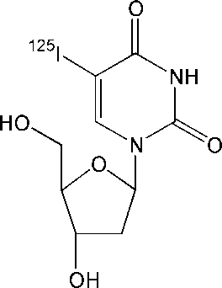
Biological consequences of Auger decay - DNA damage
Early radiobiological experiments with ¹²⁵I
model – bacteriophage Т1 and Т4
end points – survival and induction of single strand and double strand DNA breaks (SSB and DSB)
radionuclide carrier - [¹²⁵I] iodo-deoxyuridine (5-¹²⁵IUdR), thymidine analogue, DNA synthesis precursor
covalent bond of Auger emitter with DNA
Schmidt & Hotz, IJRB, 1973
Krisch & Ley, IJRB, 1974
Krisch & Sauri, IJRB, 1975
Major conclusion
decay of ¹²⁵I, covalently incorporated into DNA results in formation of DNA DSB with a probability close to 1
one DNA DSB induced by ¹²⁵I-decay is a lethal event for bacteriophage
Notes:
Laboratory of radiation biology incorporates two departments – department of radiation research and department of radiation biology and physiology.
There are quite a lot of research directions in the department, including ….. , and it is very difficult task to cover all of them.

Slide 21
Biological consequences of Auger decay - DNA damage
¹²⁵I: One decay event – one DNA DSB – 100% efficiency of DNA damage
Mechanisms?
1. Auger electrons emission (obvious and traditional)
2. Non-traditional mechanism: (not obvious and alternative)
Molecule fragmentation as a result of coulombic explosion of multiply charged (+7-20) daughter atom ¹²⁵Te
Notes:
Laboratory of radiation biology incorporates two departments – department of radiation research and department of radiation biology and physiology.
There are quite a lot of research directions in the department, including ….. , and it is very difficult task to cover all of them.

Slide 22
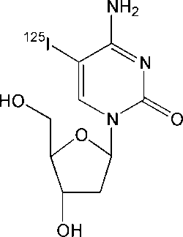
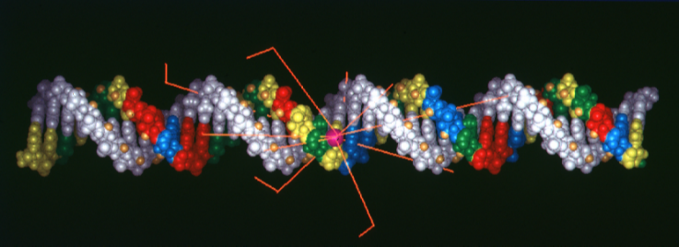
Auger decay DNA damage – mapping DNA breaks
Experiments with synthetic oligodeoxynucleotides
(Lobachevsky & Martin, Rad Res, 2000)
model – 41 bp oligodeoxynucleotide incorporating single ¹²⁵I and complementary 41 bp fragment
end point – induction of DNA SSB +/- DMSO - dimethylsolphoxide
method – sequencing gel electrophoresis (³²P-label for detection)
radionuclide carrier – [¹²⁵I]-iodo-deoxycytidine (5-¹²⁵IdС), incorporated in one DNA strand
³²P
¹²⁵I-dC
5’
3’
5’
3’
3’
5’
3’
5’
¹²⁵I-dC
5’
3’
5’
3’
3’
5’
3’
5’
³²P
³²P
Notes:
Laboratory of radiation biology incorporates two departments – department of radiation research and department of radiation biology and physiology.
There are quite a lot of research directions in the department, including ….. , and it is very difficult task to cover all of them.

Slide 23
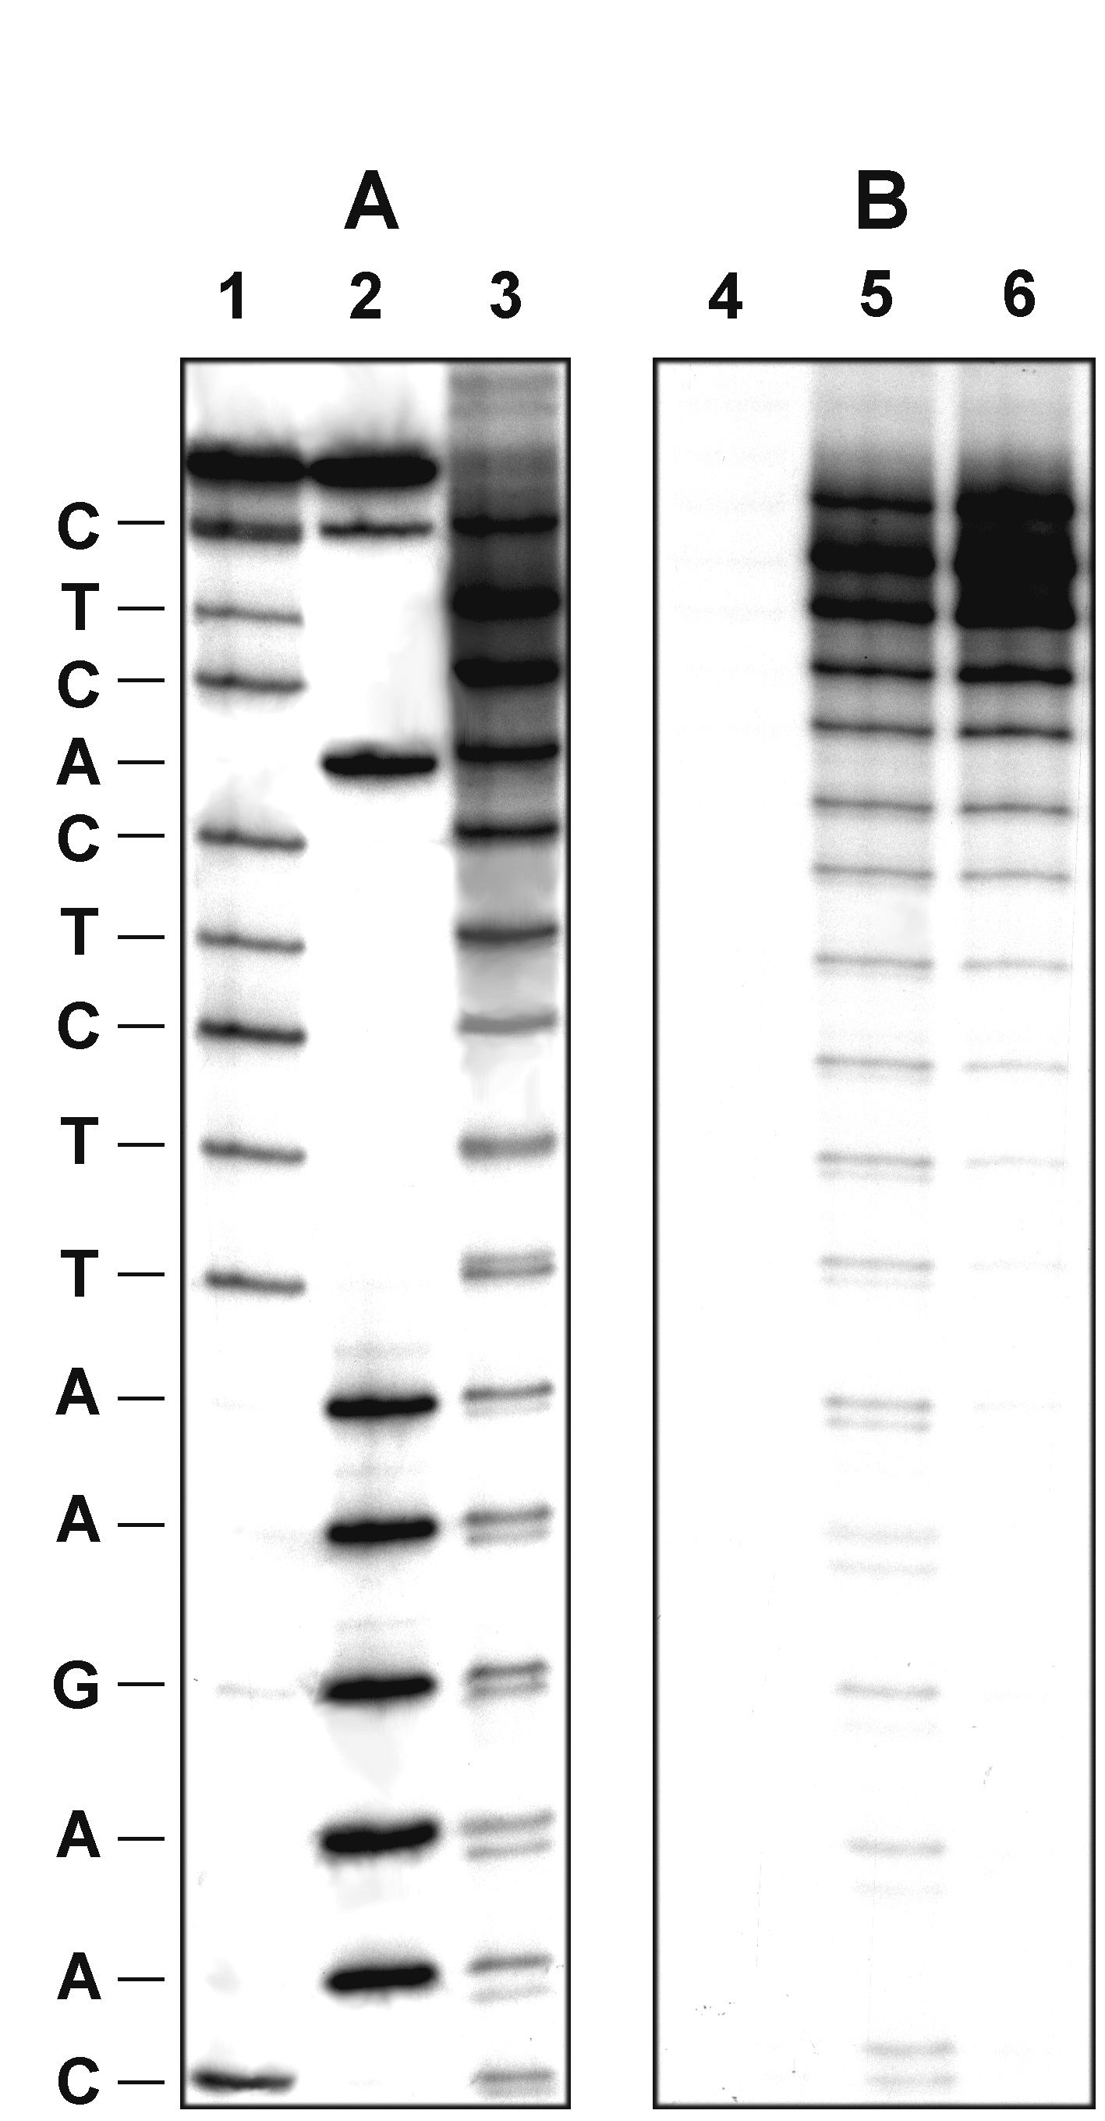
Auger decay DNA damage – mapping DNA breaks
Experiments with synthetic oligodeoxynucleotides
Detection of DNA fragments
³²P
¹²⁵I-dC
5’
3’
5’
3’
3’
5’
3’
5’
¹²⁵I-dC
5’
3’
5’
3’
3’
5’
3’
5’
³²P
³²P
Decay induced fragments of various length
Notes:
Laboratory of radiation biology incorporates two departments – department of radiation research and department of radiation biology and physiology.
There are quite a lot of research directions in the department, including ….. , and it is very difficult task to cover all of them.

Slide 24
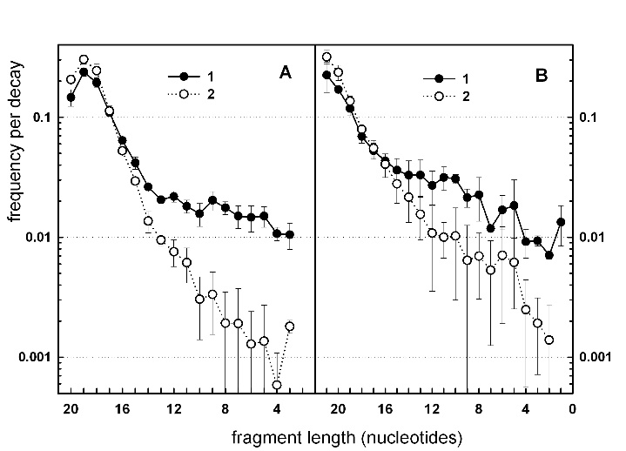
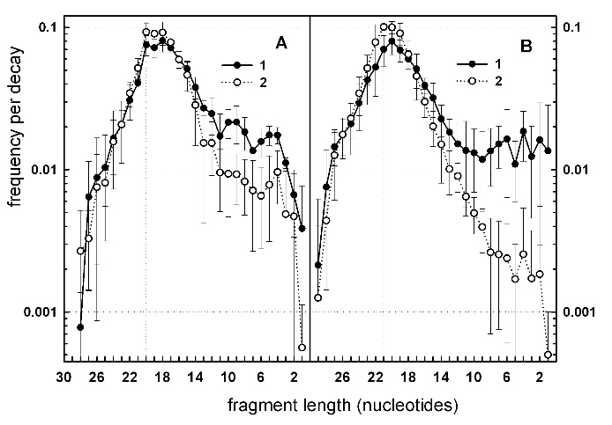
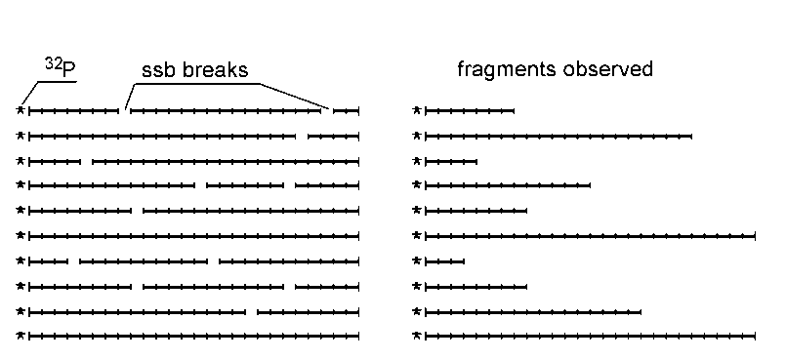
Auger decay DNA damage – mapping DNA breaks
Experiments with synthetic oligodeoxynucleotides
Fragment size distributions
f_{i} – fragment detection frequency
p_{i} – probability of SSB
Notes:
Laboratory of radiation biology incorporates two departments – department of radiation research and department of radiation biology and physiology.
There are quite a lot of research directions in the department, including ….. , and it is very difficult task to cover all of them.

Slide 25

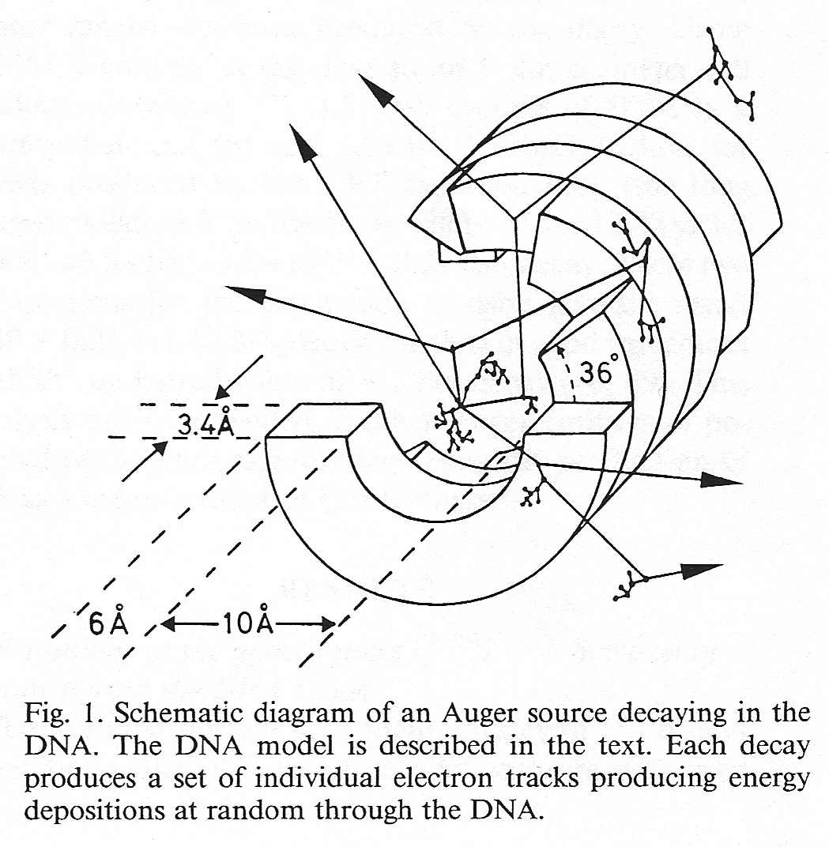
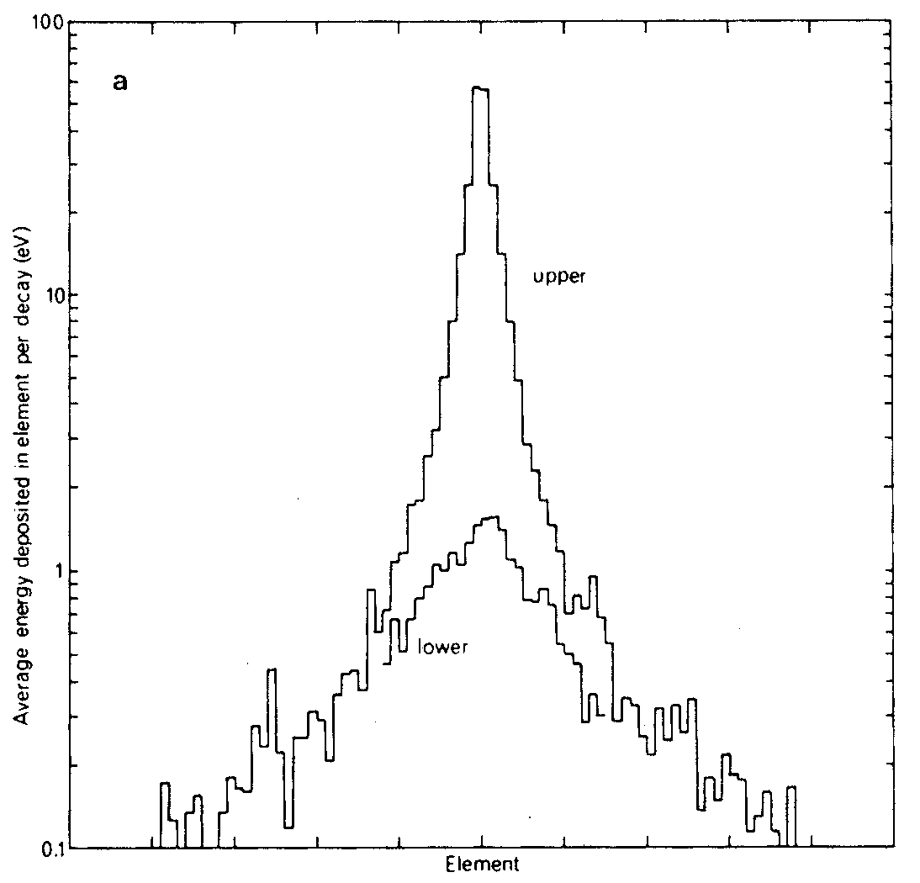
Auger decay DNA damage – mapping DNA breaks
Experiments with synthetic oligodeoxynucleotides
SSB probabilities
Energy deposition in DNA elements per ¹²⁵I decay
Humm & Charlton, 1988
DNA SSB per ¹²⁵I decay probability map
Notes:
Laboratory of radiation biology incorporates two departments – department of radiation research and department of radiation biology and physiology.
There are quite a lot of research directions in the department, including ….. , and it is very difficult task to cover all of them.

Slide 26
Auger decay DNA damage – mapping DNA breaks
Experiments with synthetic oligodeoxynucleotides
Majority of breaks within +/- 5 bp
Probability if DSB – 0.8
On average 3.67 breaks in top strand and 1.53 breaks in complementary strand
Formation of clustered damage – DNA DSB of high complexity – high radiobiological efficiency of ¹²⁵I-decay
DNA SSB per ¹²⁵I decay probability map
Notes:
Laboratory of radiation biology incorporates two departments – department of radiation research and department of radiation biology and physiology.
There are quite a lot of research directions in the department, including ….. , and it is very difficult task to cover all of them.

Slide 27
Direct and indirect mechanism or radiation action
Direct mechanism Indirect mechanism
Ionisation of water molecules
Formation of •OH radicals (2.7/100 eV)
Direct interaction of ionising particle with DNA molecule
H₂O
radiation
H₂O -----------> H₂O^{•+} + e⁻
H₂O -----------> H₂O*
H₂O^{•+} + H₂O -> H₃O⁺ + •OH
H₂O* -> H• + •OH
radiation
•OH
Ionisation of atoms in DNA molecule and formation of radicals
DNA -----------> DNA^{•+} + e⁻
radiation
DNA attack by •OH radicals and formation of DNA radicals
Indirect mechanism can be blocked by addition of radical scavengers, such as DMSO - dimethylsulphoxide
Notes:
Laboratory of radiation biology incorporates two departments – department of radiation research and department of radiation biology and physiology.
There are quite a lot of research directions in the department, including ….. , and it is very difficult task to cover all of them.

Slide 28
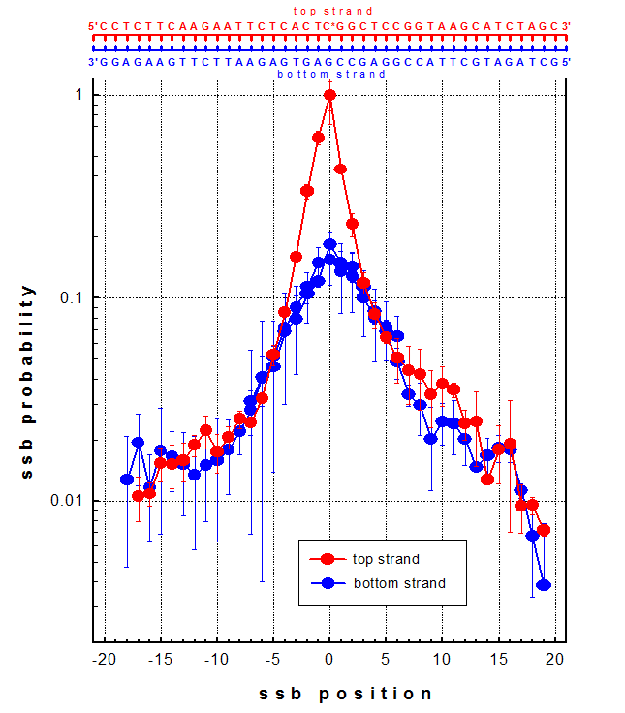
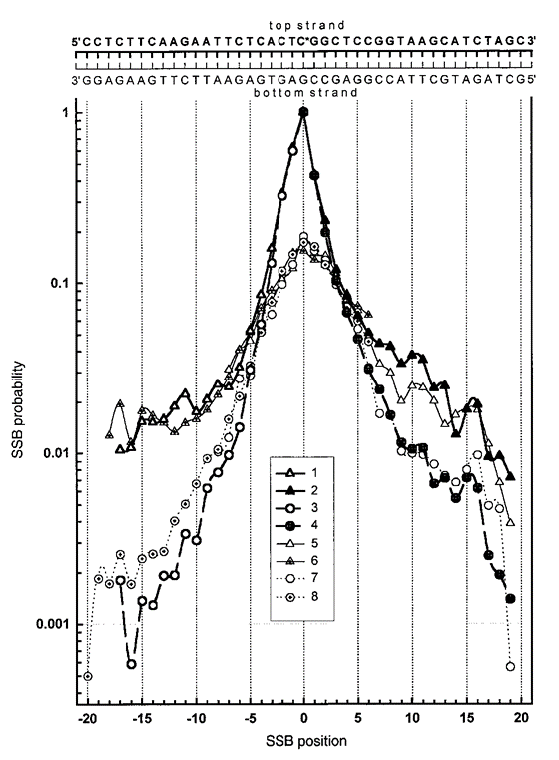
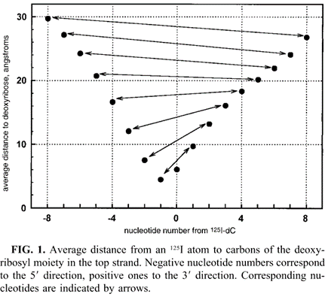
Auger decay – contribution of three DNA damage mechanisms
Contribution of three mechanisms:
Non-radiation mechanism - neutralisation of charged ¹²⁵Te atom
Radiation direct mechanism – direct energy deposition in DNA from Auger electrons
Radiation indirect – (hydroxyl) radical attack of DNA
Component/DNA strand | Non-radiation (charge neutralisation) | Radiation direct | Radiation indirect (DMSO scavengeable)
¹²⁵I-incorporating (top) | 2.37 (55%) | 1.24 (29%) | 0.68 (16%)
Complementary (bottom) | 0.65 (35%) | 0.75 (41%) | 0.43 (24%)
DNA duplex | 3.02 (49%) | 1.99 (33%) | 1.11 (18%)
Notes:
Laboratory of radiation biology incorporates two departments – department of radiation research and department of radiation biology and physiology.
There are quite a lot of research directions in the department, including ….. , and it is very difficult task to cover all of them.

Slide 29
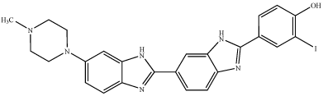
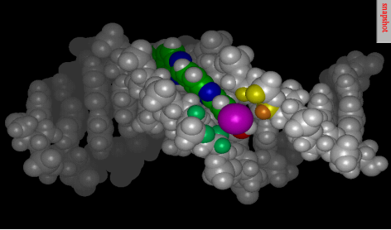
DNA damage – Auger decay in DNA ligand
DNA minor groove binding ligand
¹²⁵I – iodoHoechst 33258
Quantitation of SSB and DSB yield from the fractions of relaxed and linear form in plasmid DNA model
pBR322 – 4361 bp
DSB probability – 0.8-0.9 per decay per molecule
Notes:
Laboratory of radiation biology incorporates two departments – department of radiation research and department of radiation biology and physiology.
There are quite a lot of research directions in the department, including ….. , and it is very difficult task to cover all of them.

Slide 30
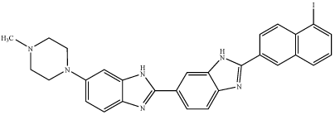
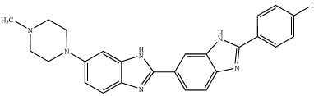
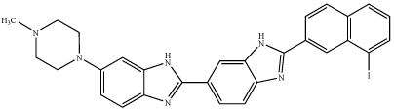
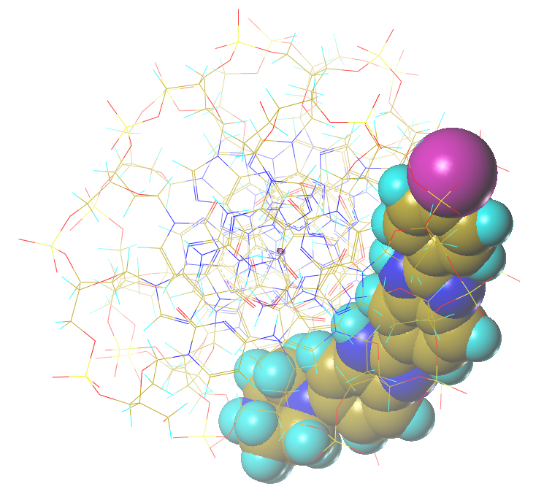
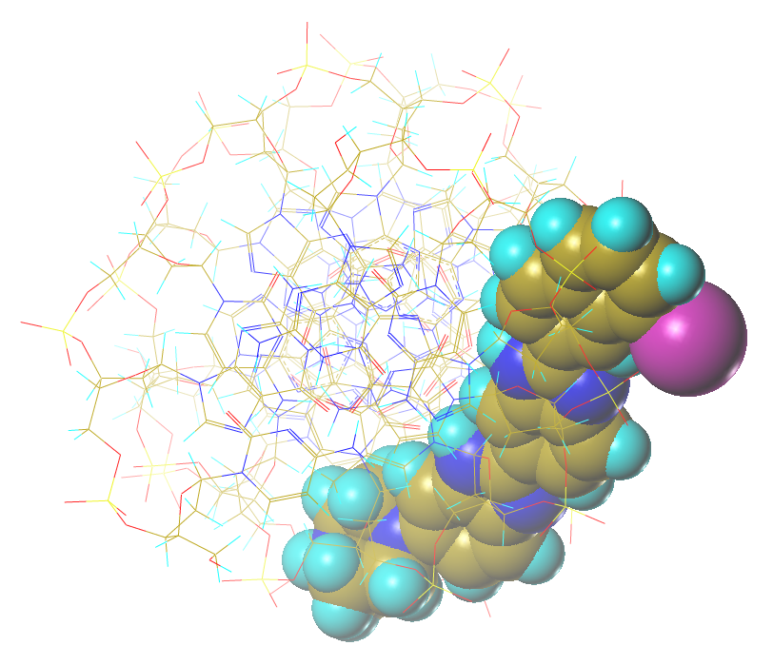
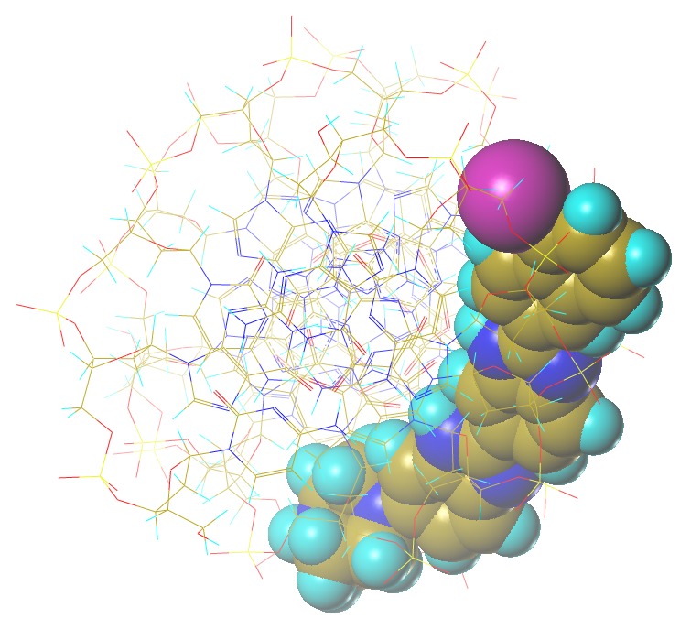
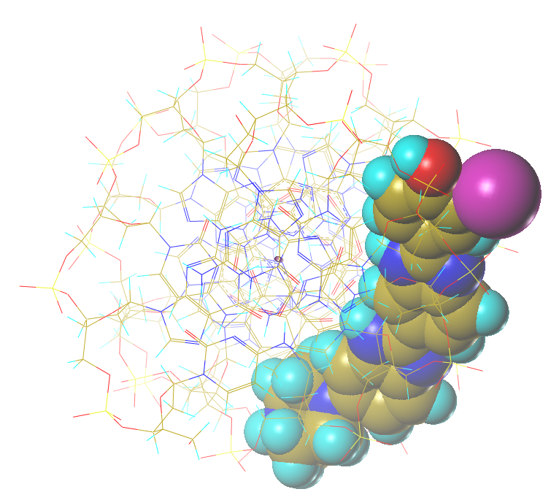
Auger decay in DNA ligand – the role of distance
A series of DNA minor groove ligands that position ¹²⁵I at various distances from DNA axis in plasmid DNA model
7.41 Aº
9.12 Aº
Iodo-Hoechst 33258, R = 9.12 Aº
Bi-Benzimidazole-5-Iodo-Naphthyl, R = 7.41 Aº
Para-Iodo-Hoechst, R = 8.39 Aº
Bi-Benzimidazole-8-Iodo-Naphthyl, R = 11.23 Aº
8.39 Aº
11.23 Aº
(Lobachevsky & Martin, IJRB, 2008)
Notes:
Laboratory of radiation biology incorporates two departments – department of radiation research and department of radiation biology and physiology.
There are quite a lot of research directions in the department, including ….. , and it is very difficult task to cover all of them.

Slide 31
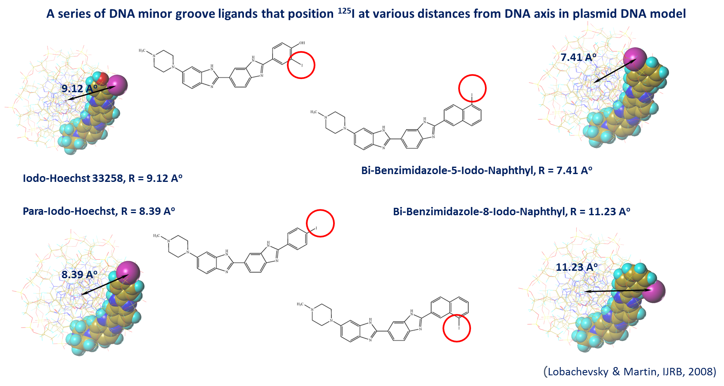
Auger decay in DNA ligand – the role of distance
A series of DNA minor groove ligands that position ¹²⁵I at various distances from DNA axis in plasmid DNA model
(Lobachevsky & Martin, IJRB, 2008)
Ligand | Distance from ¹²⁵I to DNA axis | DSB (TE) | DSB (DMSO)
BB5IN | 7.41 | 0.91 | 0.87
PIH | 8.39 | 0.84 | 0.81
IH33258 | 9.12 | 0.82 | 0.65
BB8IN | 11.22 | 0.47 | 0.157
Decrease of DNA DSB probability with increasing distance to DNA axis
Distance – critical parameter
Discrepancy with Monte Carlo result – non-radiation component
Notes:
Laboratory of radiation biology incorporates two departments – department of radiation research and department of radiation biology and physiology.
There are quite a lot of research directions in the department, including ….. , and it is very difficult task to cover all of them.

Slide 32
Auger decay in DNA ligand – iodine isotopes ¹²³I, ¹²⁴I, ¹²⁵I
 | Buffer | ¹²⁵I | ¹²³I | ¹²⁴I
Auger electrons (Energy, keV) |  | 24.9 (12.2) | 14.9 (7.4) | 8.4 (4.74)
DSB (linearisation) /decay | TE | 0.82 | 0.62 | 0.54
 | TE+DMSO | 0.65 | 0.54 | 0.43
SSB (relaxation) /decay | TE | 0.09 | 0.30 | 0.40
 | TE+DMSO | 0.15 | 0.36 | 0.41
Decay of “weaker” Auger emitters ¹²³I and ¹²⁴I is efficient in induction of DNA breaks
Notes:
Laboratory of radiation biology incorporates two departments – department of radiation research and department of radiation biology and physiology.
There are quite a lot of research directions in the department, including ….. , and it is very difficult task to cover all of them.

Slide 33
Radiobiology of Auger Emitters - Topics
1. Auger electron emitters – a special class of radionuclides
(physics of Auger effect and physical properties of Auger emitters)
2. Molecular aspects of Auger decay radiobiology
(DNA damage)
3. Auger emitters potential for radionuclide therapy
(dual targeting strategy)
Notes:
Laboratory of radiation biology incorporates two departments – department of radiation research and department of radiation biology and physiology.
There are quite a lot of research directions in the department, including ….. , and it is very difficult task to cover all of them.

Slide 34
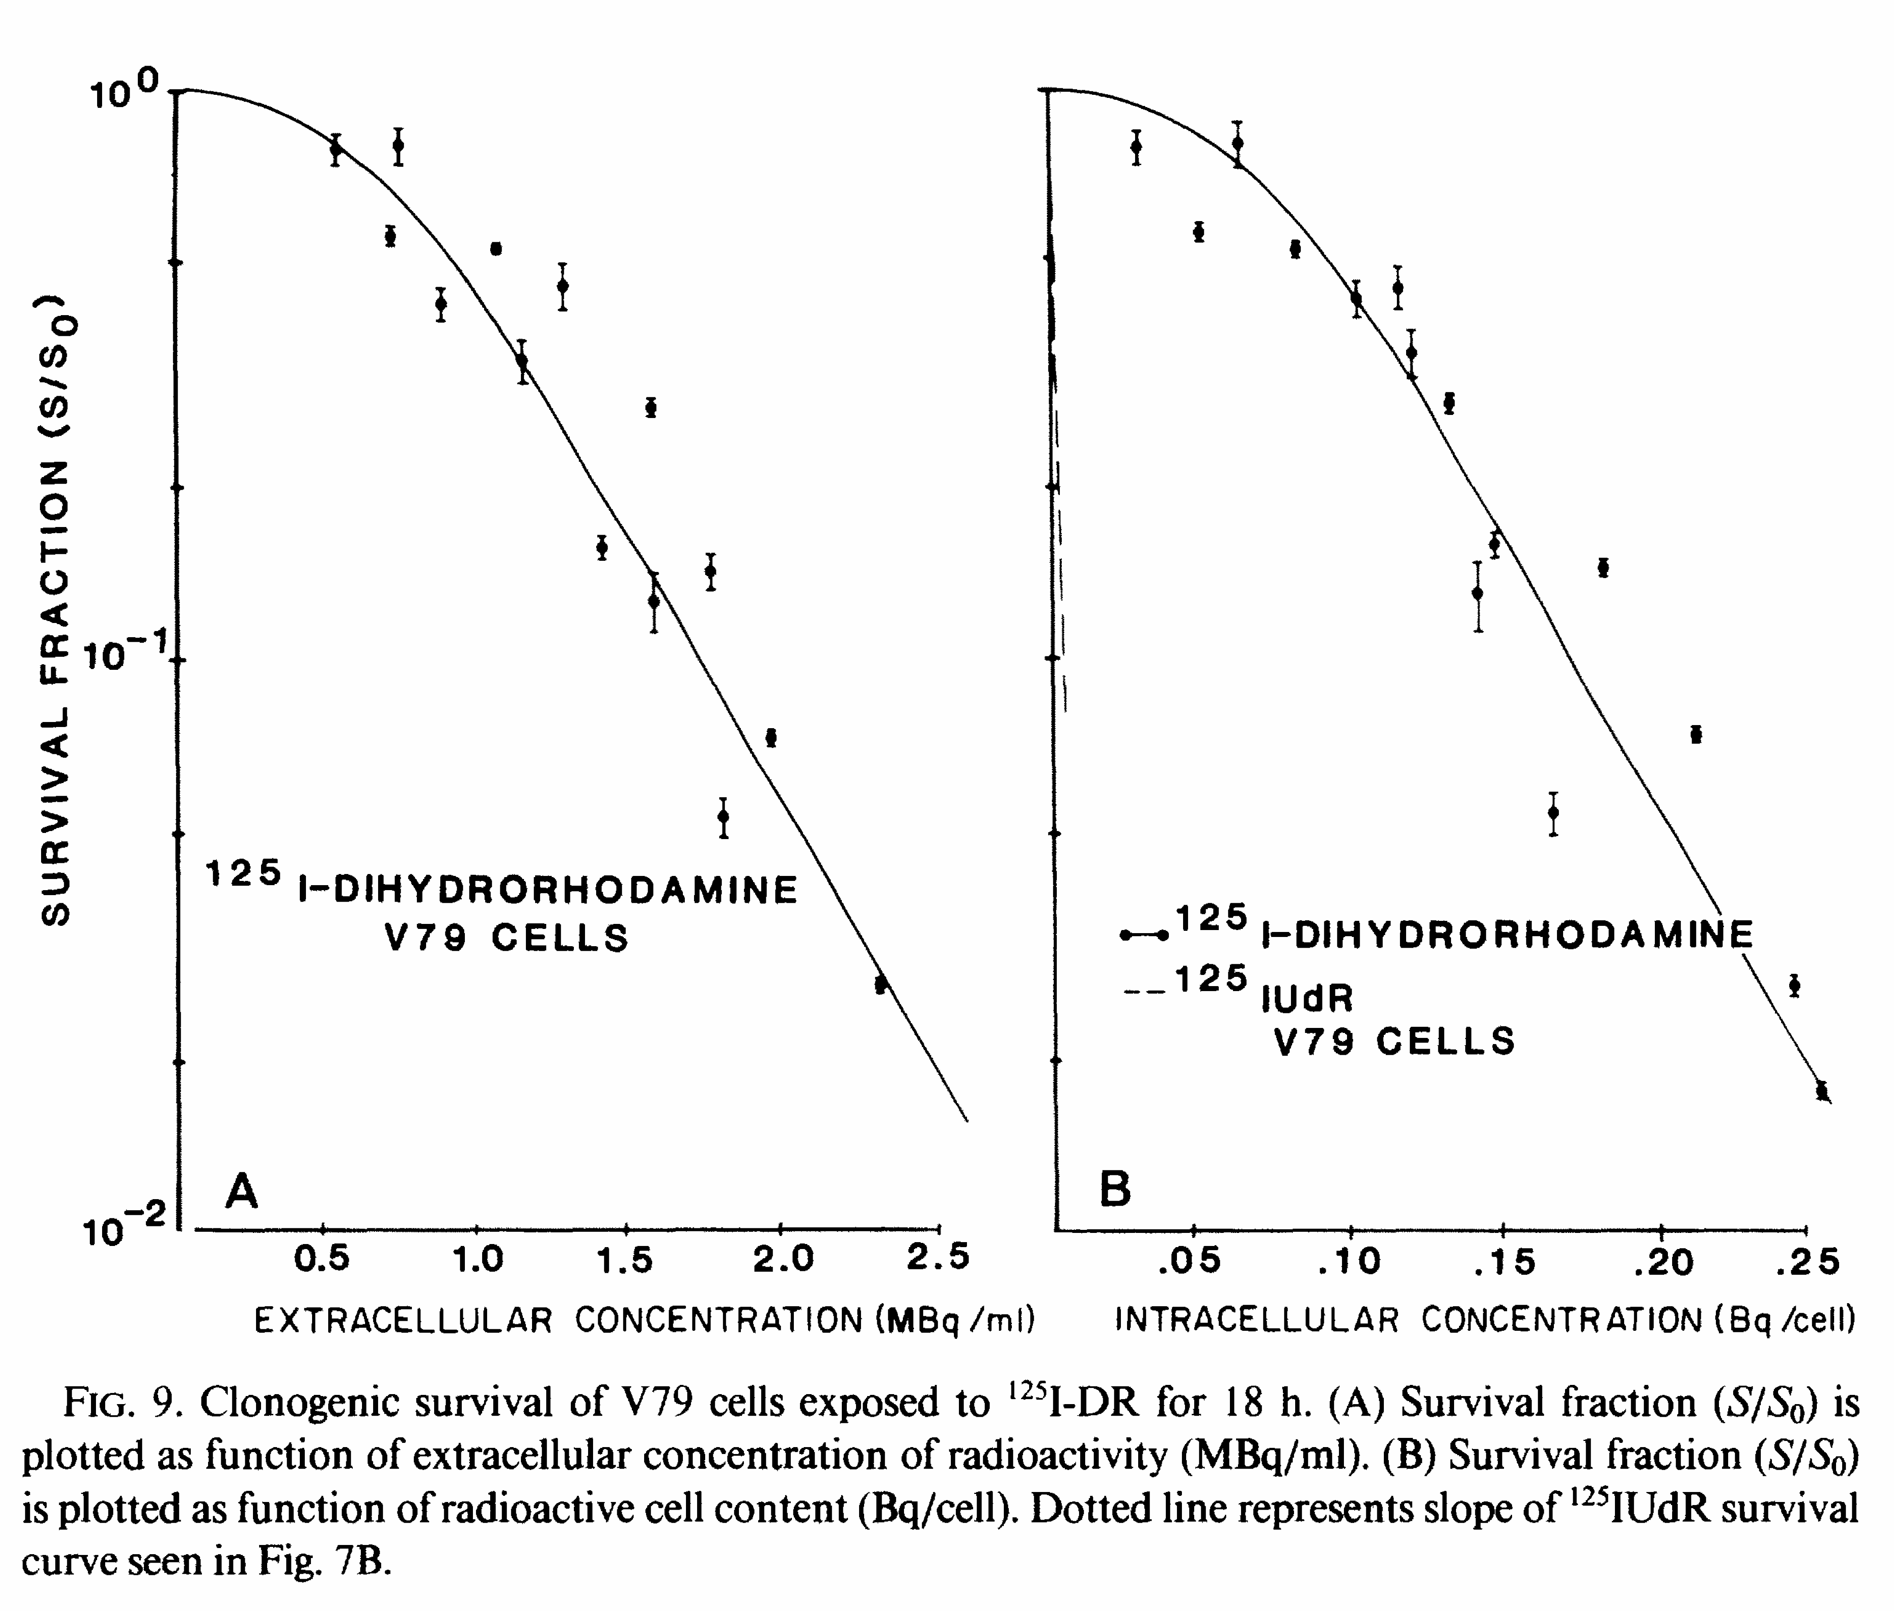
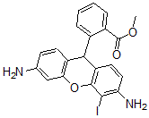
Radiation biology of Auger decay – cellular effects
Localisation of Auger emitter relative to DNA is of critical importance
Experiments with mammalian cells (Kassis & Adelstein, Rad Res, 1987)
Effect of ¹²⁵I decay: extracellular, in cytoplasm, in cell nucleus
Decay of DNA incorporated ¹²⁵I ~ 6 fold more efficient that decay of ¹²⁵I in cytoplasm (based on absorbed dose)
Carrier of ¹²⁵I | Localisation | D₃₇ mBq/cell | D₃₇ Gy
Na¹²⁵I | Extracellular | - | -
[¹²⁵I]-iodo-dihydrorhodamine (¹²⁵I-DR) | Cytoplasm | 109 | 4.62
[¹²⁵I]-iodo-deoxyuridine (5-¹²⁵IUdR) | Nucleus (DNA) | 1.30 | 0.80
Notes:
Laboratory of radiation biology incorporates two departments – department of radiation research and department of radiation biology and physiology.
There are quite a lot of research directions in the department, including ….. , and it is very difficult task to cover all of them.

Slide 35
Auger emitters potential for radionuclide therapy
Properties/Advantages of Auger emitters (iodine-125):
Highly localised energy deposition
Efficient induction of DNA damage (complex DSB) by DNA associated decay -> High cytotoxicity of DNA associated radionuclide
Strong dependence on decay-DNA distance
Strong dependence of radiotoxicity on decay localisation (DNA or cytoplasm) presents a potential for selective action on certain cells or cell types without damage to neighbouring cells
Theranostic opportunities – accompanying gamma (SPECT) or positron (PET) emission
Requirements:
- Localisation of Auger decay in close vicinity to cellular DNA
- Selective delivery of Auger emitters to cells of malignant tumours
Notes:
Laboratory of radiation biology incorporates two departments – department of radiation research and department of radiation biology and physiology.
There are quite a lot of research directions in the department, including ….. , and it is very difficult task to cover all of them.

Slide 36
Auger emitters potential for radionuclide therapy
Approach – Dual targeting strategy
Three-component conjugate – a key element of the strategy
(module transporter)
Auger electron emitter (¹²³I, ¹²⁴I, ¹²⁵I, ¹¹¹In, ^{99m}Tc)
DNA ligand
Peptide/protein/antibody highly specific to tumour cell receptors
(octreotide, transferrin, EGF receptor antibody etc)
Notes:
Laboratory of radiation biology incorporates two departments – department of radiation research and department of radiation biology and physiology.
There are quite a lot of research directions in the department, including ….. , and it is very difficult task to cover all of them.

Slide 37
Auger emitters potential for radionuclide therapy
Dual targeting strategy
Step 1: Tumor cell delivery of conjugate
Step 2: DNA delivery of radiolabelled ligand
Internalisation
Auger-labelled DNA ligand
Tumour specific peptide /antibody
Cleavage of labelled ligand
Binding to DNA
DNA damage
Radiotoxicity
Nuclear accumulation due to multiple rounds of endocytosis and DNA binding
Receptor mediated endocytosis
Notes:
Laboratory of radiation biology incorporates two departments – department of radiation research and department of radiation biology and physiology.
There are quite a lot of research directions in the department, including ….. , and it is very difficult task to cover all of them.

Slide 38
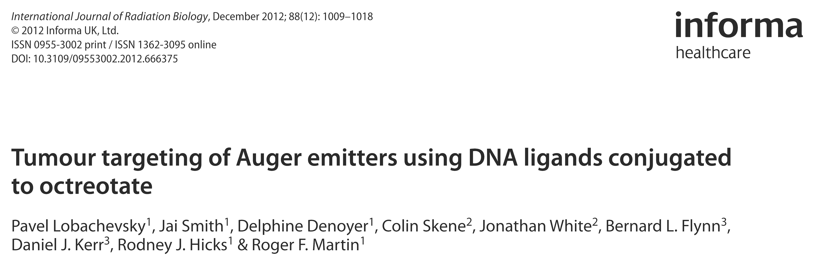
Auger emitters potential for radionuclide therapy
Dual targeting strategy – Octreotide model
Model – Octreotide (octreotate):
- Octreotide - peptide (8 amino acids) – analogue of somatostatin (growth hormone inhibiting hormone) (14 or 28 amino acids)
- somatostatin receptors (SSTR) are over expressed in many tumours (gastrointestinal, prostate, mammary gland, neuroendocrine)
- radiolabelled Octreotide is used in nuclear medicine
Notes:
Laboratory of radiation biology incorporates two departments – department of radiation research and department of radiation biology and physiology.
There are quite a lot of research directions in the department, including ….. , and it is very difficult task to cover all of them.

Slide 39
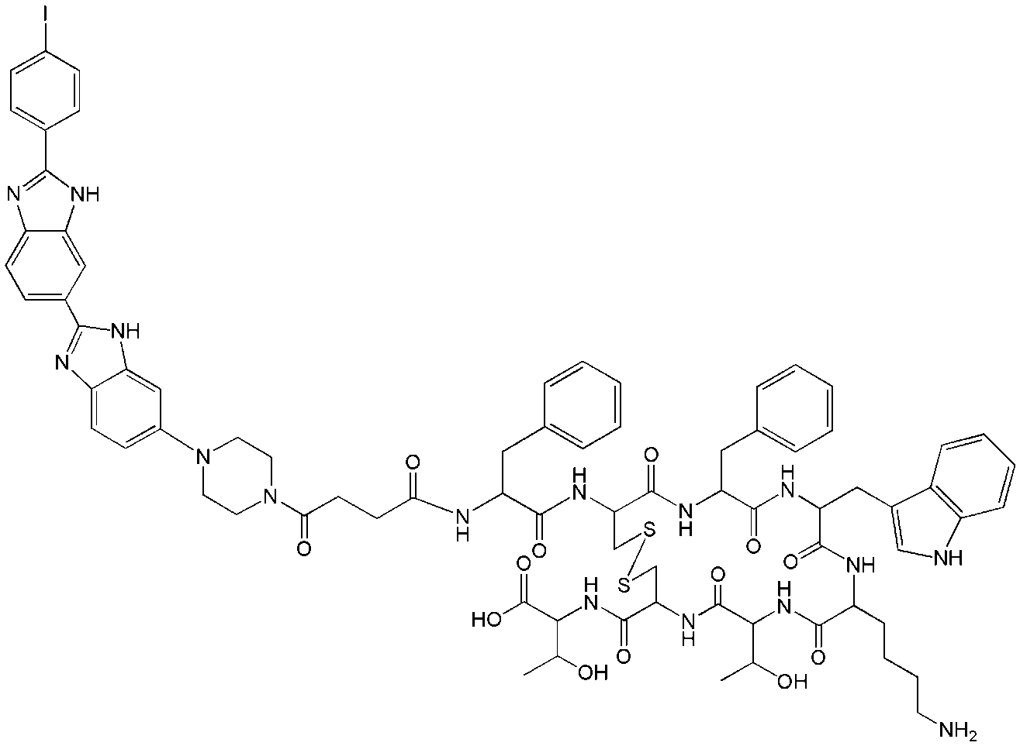
Auger emitters potential for radionuclide therapy
Dual targeting strategy – Octreotide model
Octreotate (OCA)
SSTR targeting vehicle
¹²⁵I
PIH
ОСА
Para-IodoHoechst (PIH)
DNA binding ligand
Three component conjugate (¹²⁵I-PIH-ОСА)
Notes:
Laboratory of radiation biology incorporates two departments – department of radiation research and department of radiation biology and physiology.
There are quite a lot of research directions in the department, including ….. , and it is very difficult task to cover all of them.

Slide 40
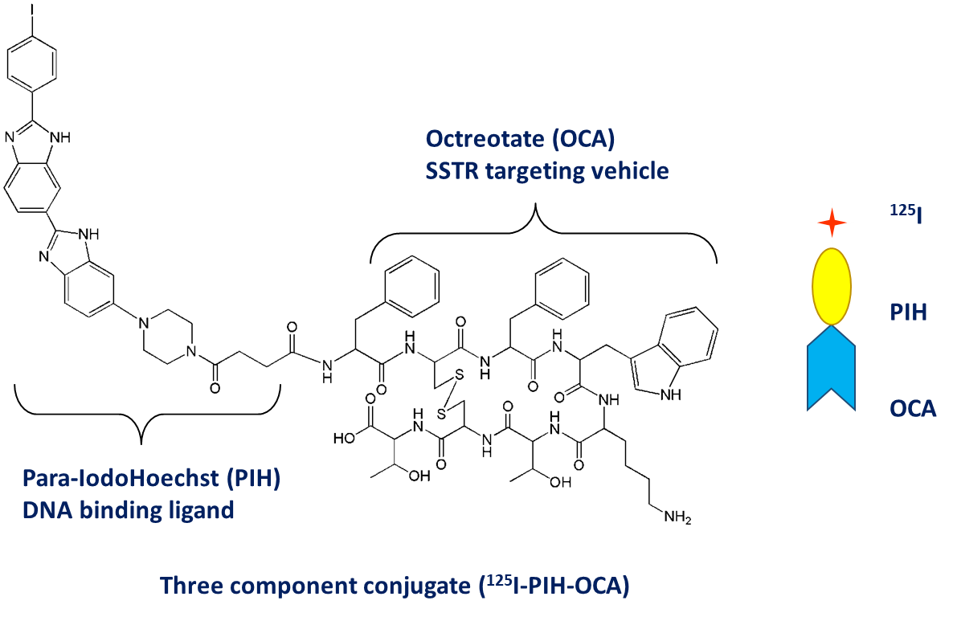
Auger emitters potential for radionuclide therapy
Dual targeting strategy – Octreotide model, in vitro experiments
Accumulation of Auger emitter ¹²⁵I in cells
Open symbols – А427 (parent line)
Black symbols – А427-7 (SSTR2 expressing)
Accumulation is mediated by SSTR2 receptors
Open symbols– directly labelled ¹²⁵I-ТОСА w/o DNA ligand
Black symbols – conjugate (¹²⁵I-PIH-ОСА)
Accumulation is mediated by DNA binding of ¹²⁵I-PIH
Cell culture – А427 (human non-small cell lung carcinoma) and clone А427-7 stably transfected with somatostatin receptor (SSTR2) gene
Notes:
Laboratory of radiation biology incorporates two departments – department of radiation research and department of radiation biology and physiology.
There are quite a lot of research directions in the department, including ….. , and it is very difficult task to cover all of them.

Slide 41
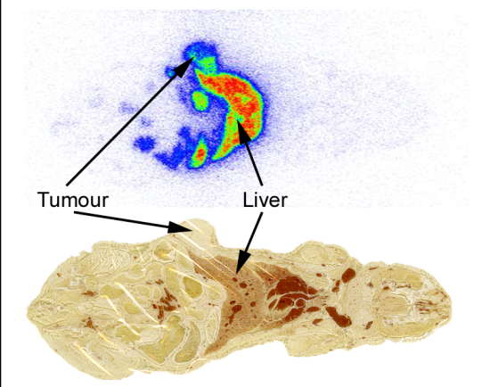
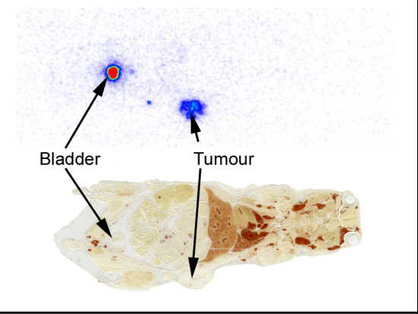

Auger emitters potential for radionuclide therapy
Dual targeting strategy – Octreotide model, in vivo experiments
¹²⁵I -PIH-ОСА
¹²⁵I-ТОСА
¹²⁵I-PIH
Biodistribution of Auger emitter in mouse tissues 24 hr after injection
Accumulation of Auger emitter in tumour following injection of both ¹²⁵I -PIH-ОСА and ¹²⁵I-ТОСА
Accumulation of Auger emitter in liver following injection of ¹²⁵I -PIH-ОСА and ¹²⁵I -PIH
There is targeted delivery of Auger emitter, however:
Premature cleavage of DNA ligand and its accumulation in liver
Notes:
Laboratory of radiation biology incorporates two departments – department of radiation research and department of radiation biology and physiology.
There are quite a lot of research directions in the department, including ….. , and it is very difficult task to cover all of them.

Slide 42
Auger emitters potential for radionuclide therapy
Dual targeting strategy – Octreotide model
Experimental studies demonstrate the feasibility of targeted delivery of Auger emitters to nucleus and DNA of tumour cells
Notes:
Laboratory of radiation biology incorporates two departments – department of radiation research and department of radiation biology and physiology.
There are quite a lot of research directions in the department, including ….. , and it is very difficult task to cover all of them.

Slide 43

Thank you for your attention!

