Slide 1
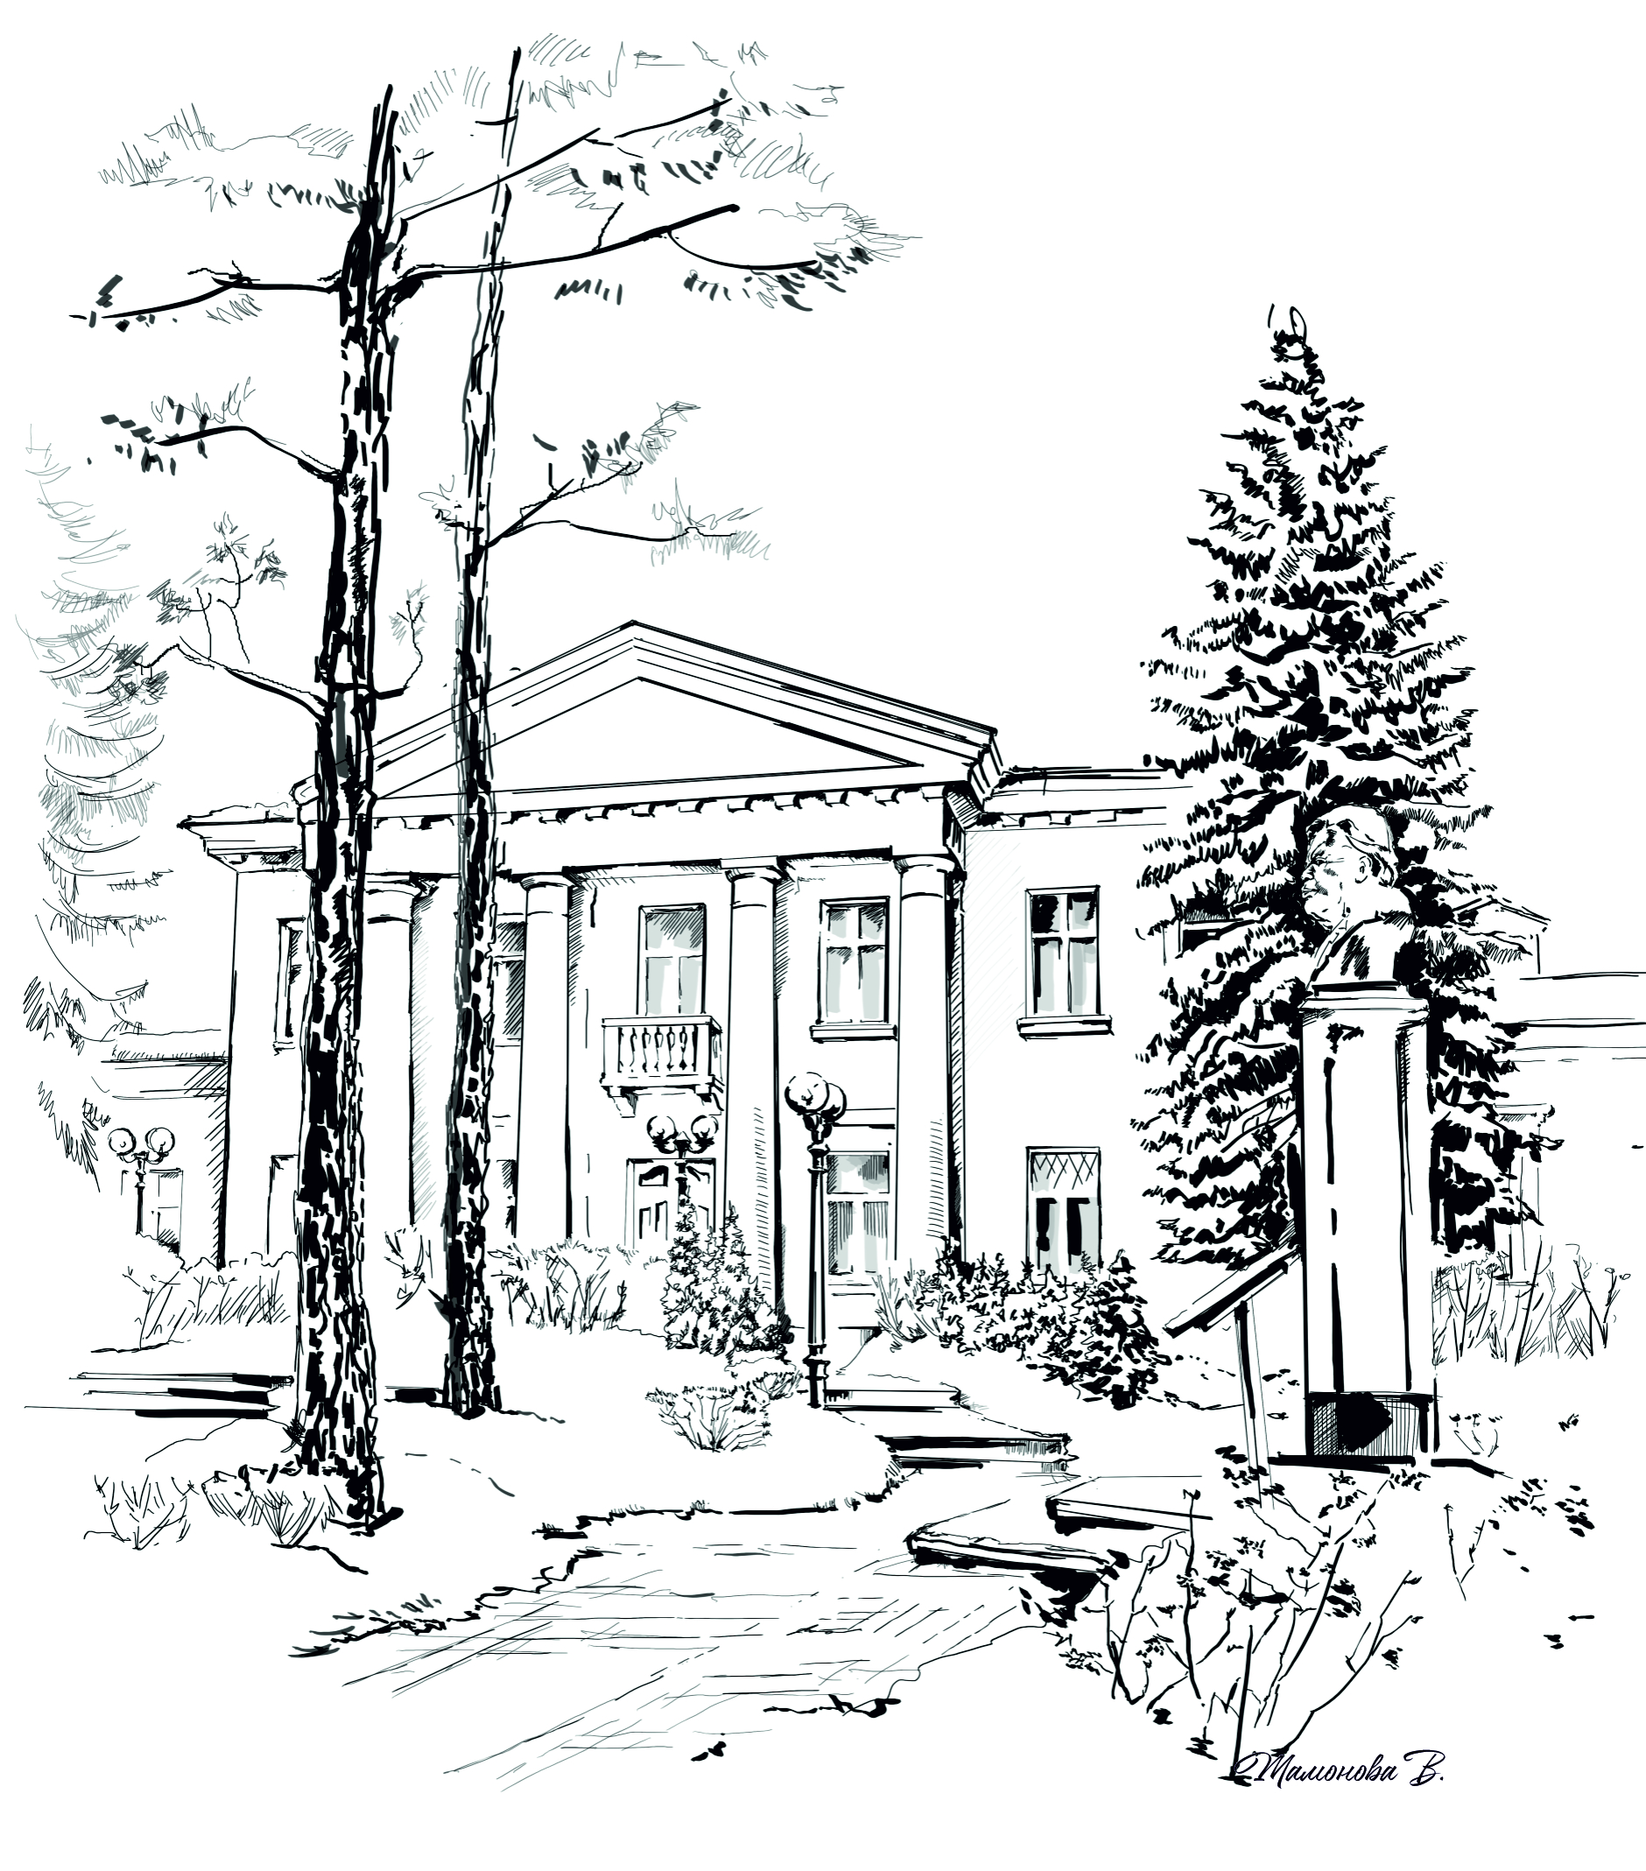


AYSS-2025 Welcome remarks
JINR
Association of Young Scientists and Specialists
Meir Yerdauletov
on behalf of the Organizing Committee

Slide 2

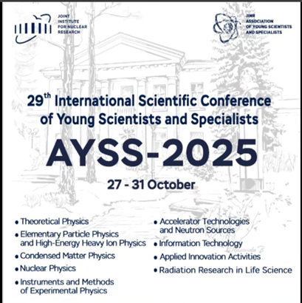
XXVIII International Scientific Conference of Young Scientists and Specialists (AYSS-2025)
October 27 - October 31.
The conference starts at 9:30 every day.
10 plenary sessions (2 each day from Monday).
Parallel sessions with young scientists’ presentations after or right before lunch.
The poster session is on Monday (it is possible to hang your posters from 2 pm today).
Please upload your presentations to Indico timely!
Evening programme on Tuesday and Wednesday.

Slide 3
AYSS-2025 Participants
178 on-site participants: 93 external + 85 JINR young scientists.
1 presentations: 138 oral + 40 posters.
11 countries: Belarus, Egypt, India, Kazakhstan, Russia, Romania, Serbia, South Africa, Tunis, Uzbekistan, Vietnam.
42 scientific institutes and universities + 7 JINR laboratories.
Participants group photo: TODAY, Conference Hall (MLIT, 5th floor), right after the lecture of the director of JINR, 10:10 am.

Slide 4
AYSS-2025 Programme Committee
Co-chairman: Grigory Trubnikov (JINR Director)
Co-chairman: Grigory Shirkov (JINR Directorate)
Aidos Issadykov (BLTP)
Olga Derenovskaya (MLIT)
Alexander Karpov (FLNR)
Ayagoz Baimukhanova (DLNP)
Sergey Merts (VBLHEP)
Sergey Kulikov (FLNP)
Vladimir Chausov (LRB)

Slide 5
AYSS-2025 Organizing Committee
Co-chairman: Yerdauletov Meir (FLNP)
Anna Illina (MLIT)
Alexey Vorontsov (MLIT)
Dinara Bulatova (JINR Press Office)
Grigory Gelenidze (JINR Press Office)
Ksenia Ilina (VBLHEP)
Kambar Ismaiyl (VBLHEP)
Iuliia Gomer (ICD)
Dmitriy Kamanin (UC)
Daria Shamina (LRB)
Mutali Alisher (FLNR)
Kanat Nurlan (BLTP)

Slide 6
AYSS-2025 Organizing Committee
12 members:
10 are the JINR AYSS members;
2 are the members of the JINR AYSS Council (2024/2025).
The Organizing Committee Office is upstairs (MLIT, 6th floor).
A special feature of the OC members is a badge with a red ribbon.
For participants from Russian organizations:
Yerdauletov Meir
+7 (985) 662-73-93
yerdauletov@jinr.ru
For participants from foreign organizations:
Iuliia Gomer
+7 (960) 713-61-93
jvk@jinr.ru

Slide 7
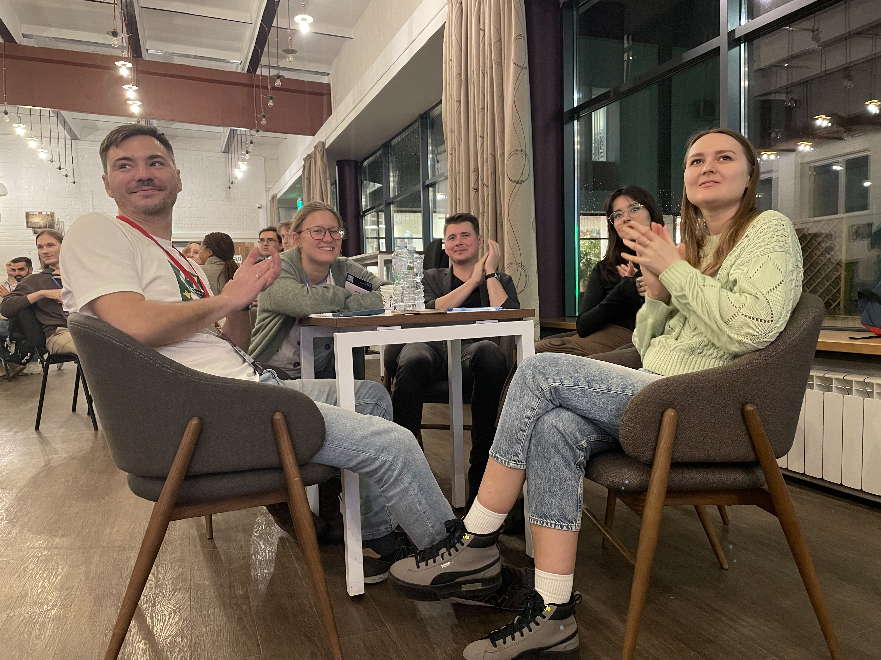
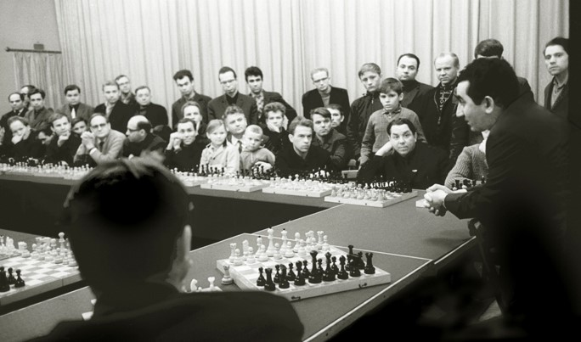
Social & Evening Events
Tuesday: QUIZ.
Wednesday: Chess tournament.

Slide 8
Social & Evening Events
Monday: 18:30 – poster session & welcome drinks
at the JINR International Conference Centre.
Tuesday:
18:30 – QUIZ at Blokhintsev library
Wednesday:
18:30 – Chess tournament at Nauka stadium
Thursday: 19:00 – conference dinner at Baryon with live music.

Slide 9
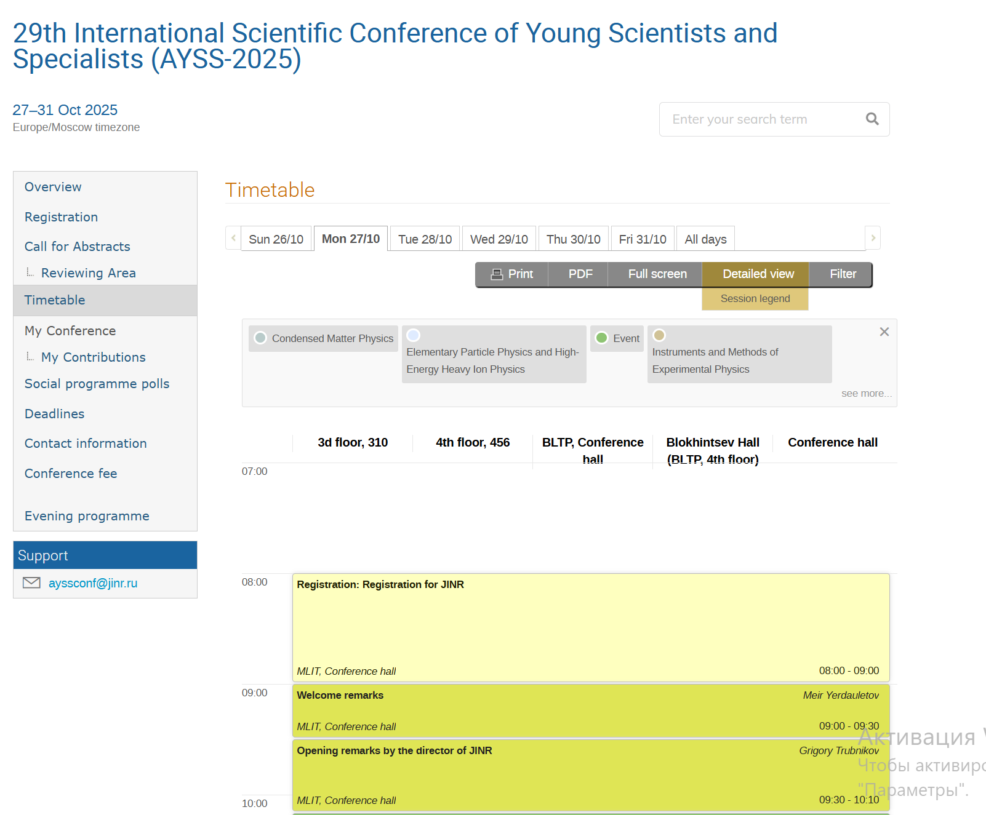
Important organizational remarks!
Due to the queue situation at the entrance to JINR
we encourage you to come earlier to the morning sessions.
Check your time and room of your oral sessions on https://indico.jinr.ru/event/5517/timetable

Slide 10
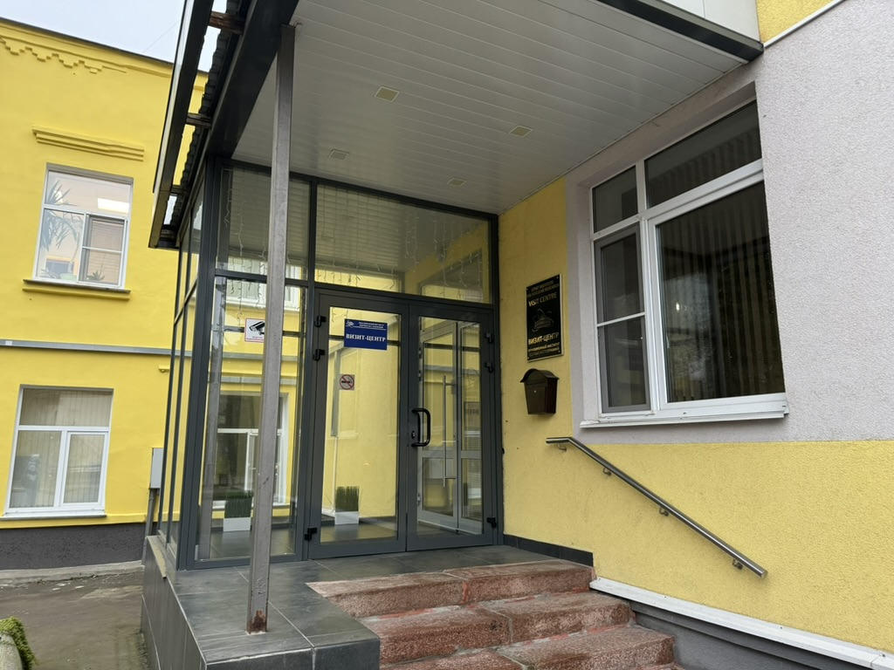
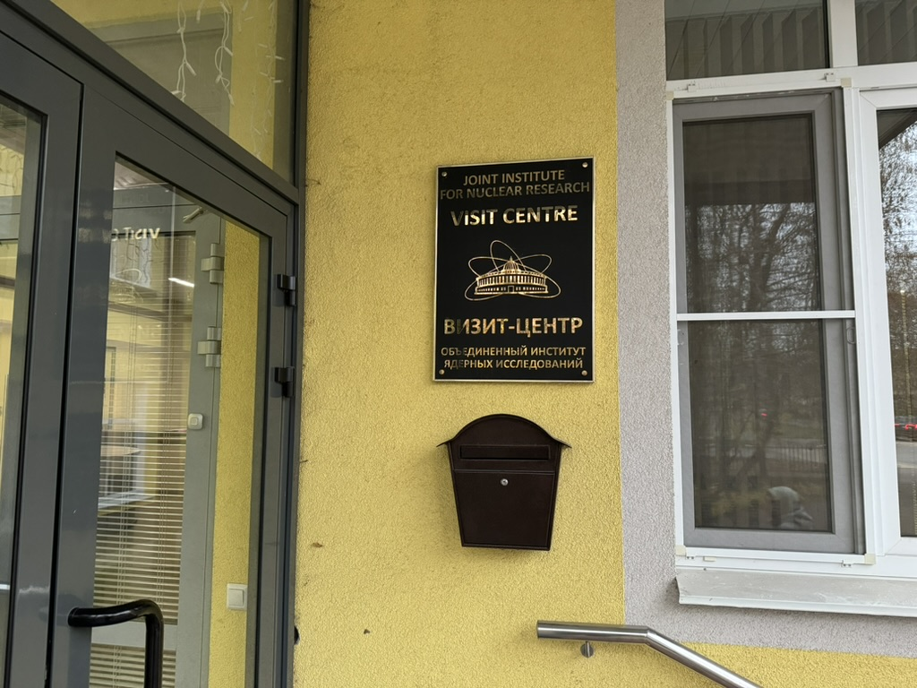
Important organizational remarks!
We will create a new section Proceedings Submission yesterday on indico AYSS-2025 site, which describes sending of the abstracts procedure.
Please, return your entrance cards to the Visitor Centre, Molodyozhnaya Street, 5)

Slide 11
Usual Awarding system: The best talk at parallel sessions
Parallel sessions:
Theoretical Physics
Elementary Particle Physics and High-Energy Heavy Ion Physics
Instruments and methods of Experimental Physics
Accelerator technologies and Neutron Sources
Nuclear Physics
Information Technology
Condensed Matter Physics
Applied Innovation Activities
Radiation research in Life Sciences
As usual, we will award the best talks at parallel sessions chosen by respectful juri.

Slide 12
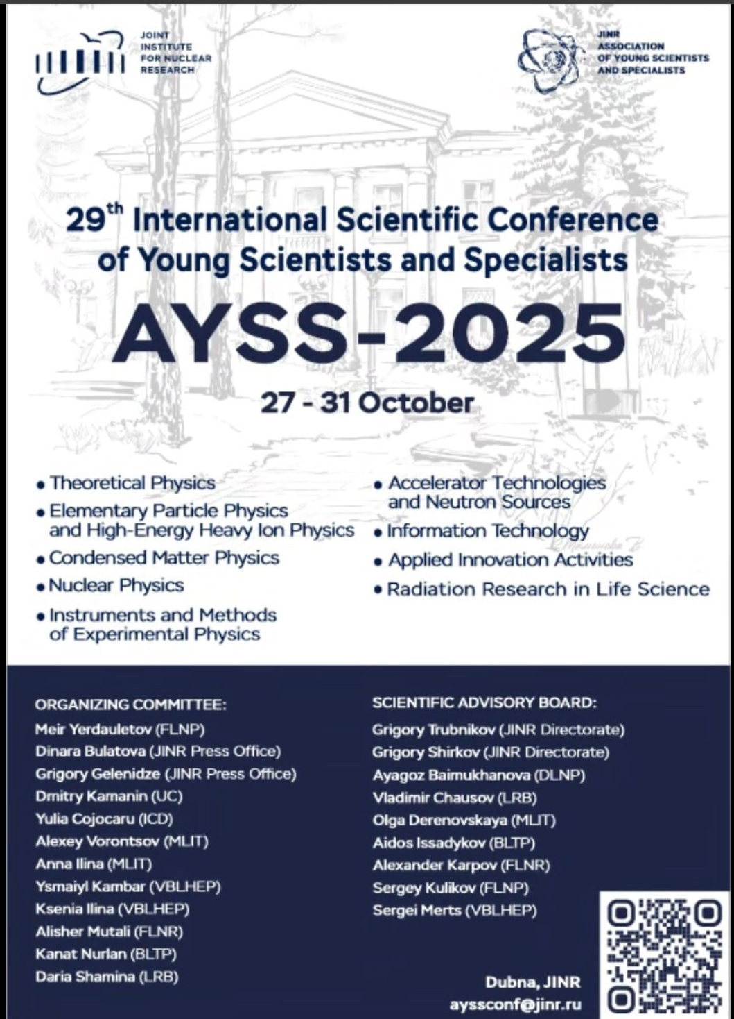
Path towards collaboration
This conference is a first step on the way to creating interdisciplinary, inter-institutional collaborations.
As part of the conference, participants can take a closer look at the place where their theses can be written and start looking for scientific supervisors or places to work.
If you are interested in some JINR group or topic, please reach out to the organizers; we’ll get you in contact with the corresponding people to have a personal excursion and a conversation on possible cooperation and collaboration in future.

Slide 13

Contact info
The information bulletin you collected during registration contains important information on all locations with maps, as well as the program, contacts, lunch places, etc.
If you have issues or questions, don’t hesitate to contact the organizers.
And join the conference
participants Telegram chat
for prompt communication!

Slide 14
Gratitude for the help to organize AYSS-2025 Сonference
Meshcheryakov Laboratory of Information Technologies, University Centre, Bogolyubov laboratory of theoretical physics (conference rooms)
PC, all the laboratories, and JINR Directorate (financial support of the participants)
JINR press office
The International Conference Centre
JINR Scientist’s club
Blokhintsev Library

Slide 15


The organizers wish all of you a good luck and memorable conference!
AYSS-2025 Chat
JINR AYSS Channel
JINR AYSS Group

