Slide 1





AYSS-2025
Closing Remarks
Meir Yerdauletov
on behalf of the Organizing Committee
DUBNA

Slide 2
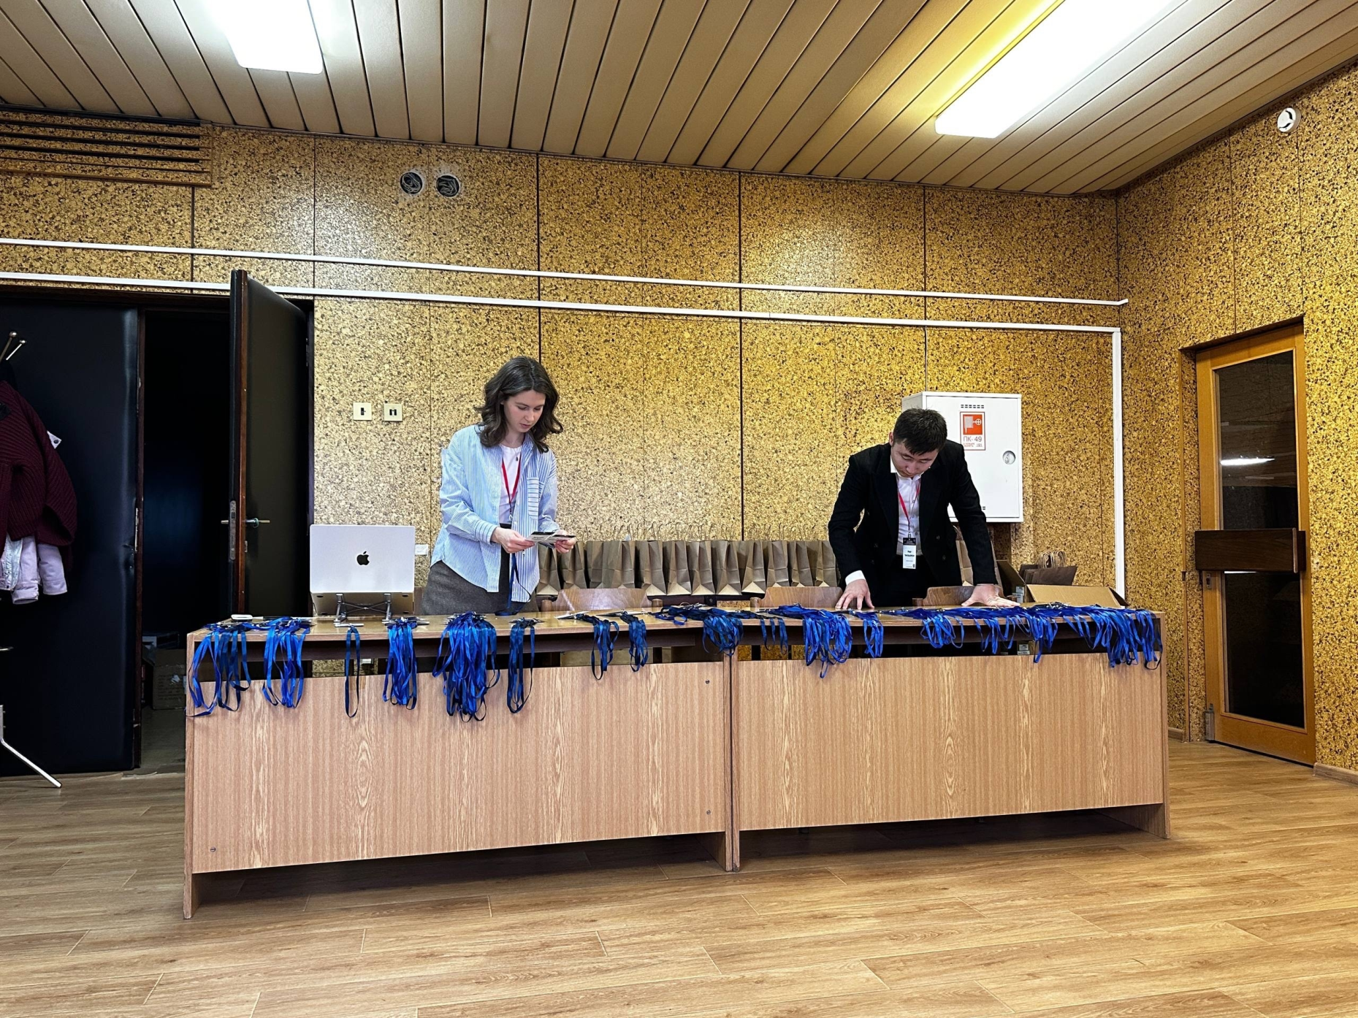
Days Before Start…

Slide 3
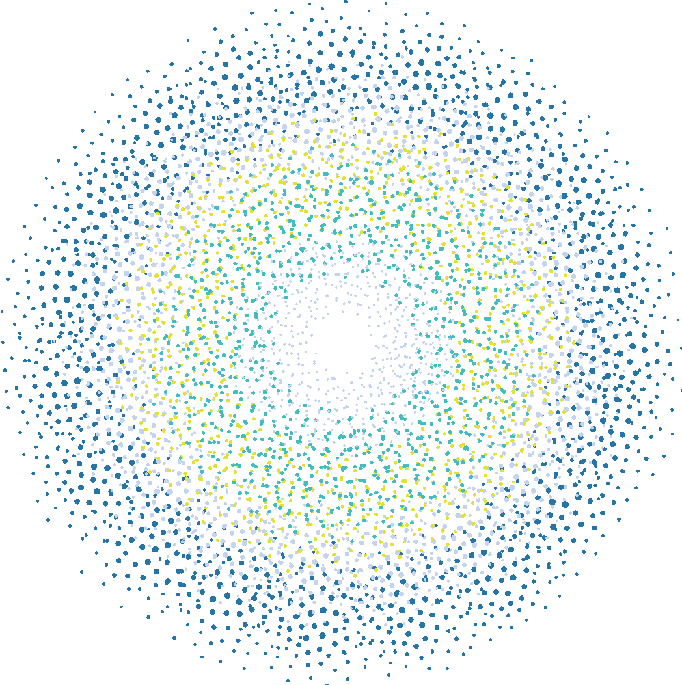
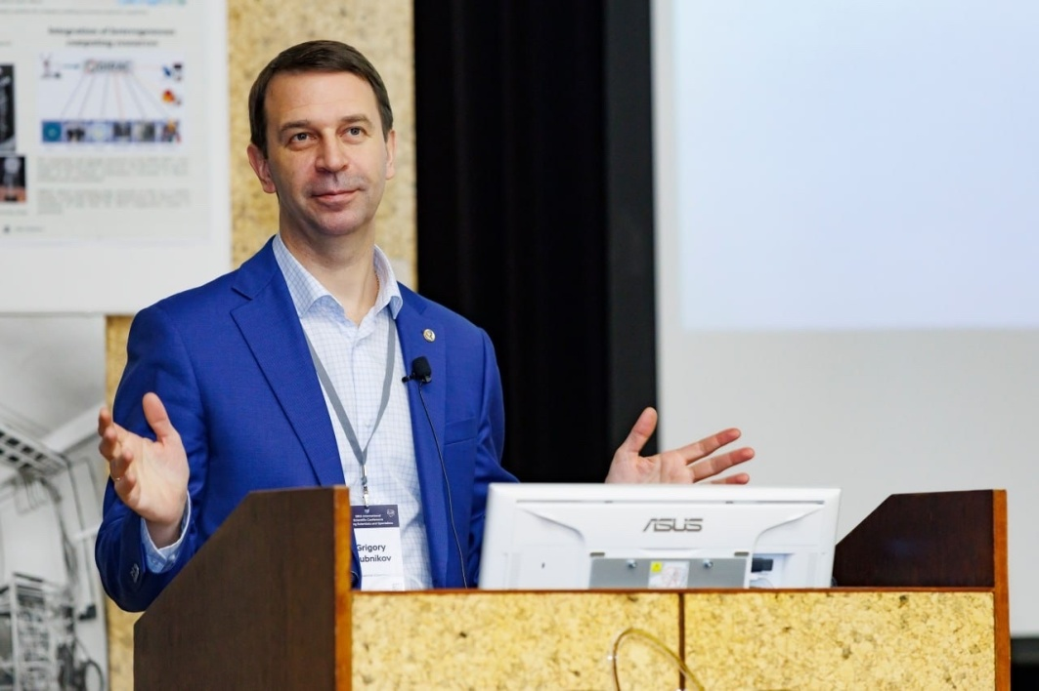
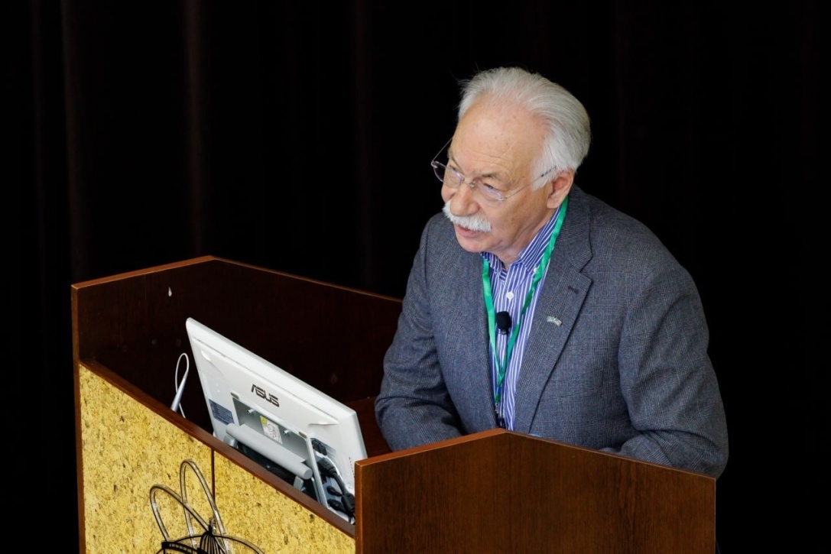
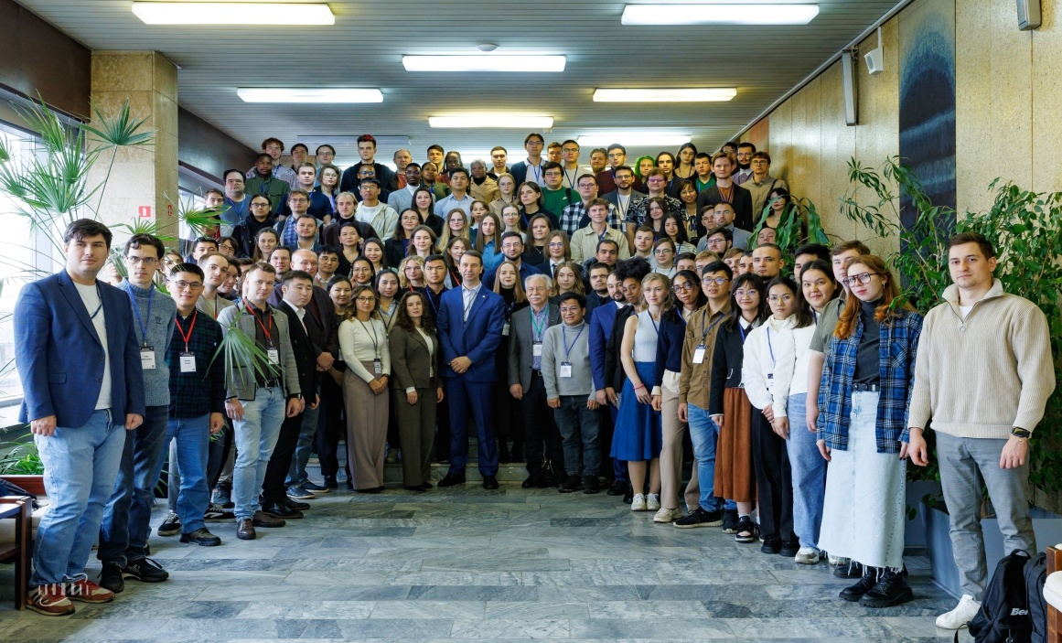
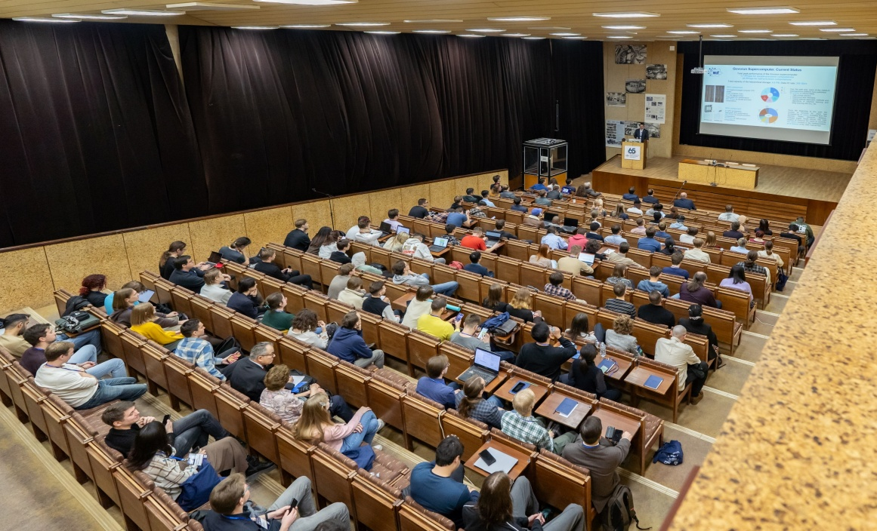
Important Events
10 Plenary talks

Slide 4
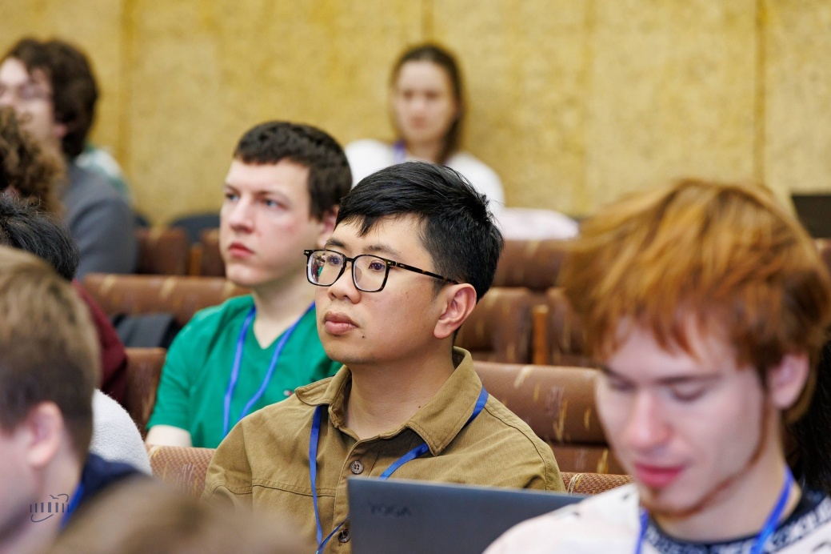
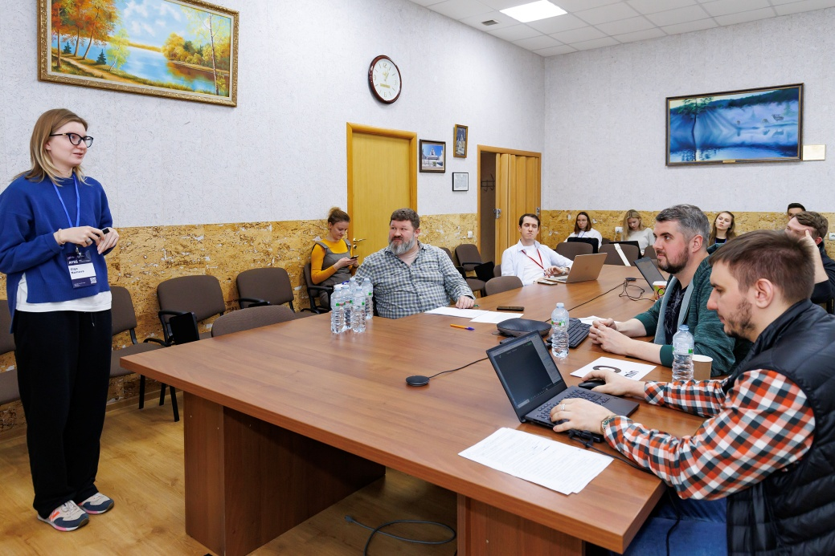
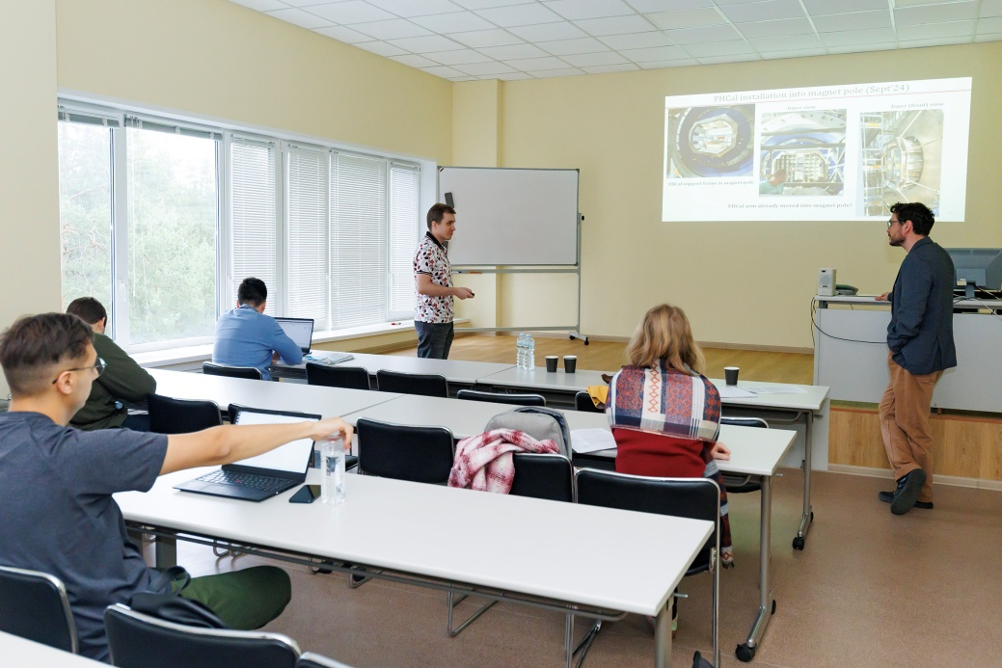
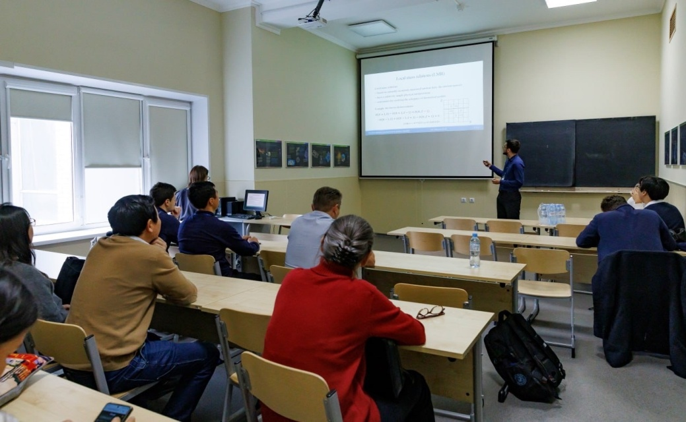
Important Events
138 Sectional
talks

Slide 5
Gratitude
Regina Kozhina
Vlad Rozhkov
Veronica Smirnova
Tanya Zaikina
Dosbol Baygarashev
Nurzada Saktaganov
Aidos Azhibekov
Kairat Mendibayev
Yuri Sobolev
Dastan Ibadulayev
Talgat Issatayev
Igor Lapenko
Ilya Kalagin
Elena Puzynina
Igor Pelevanyuk
Irek Suleimanov
Yurii Kopatch
Ludmila Kolupaeva
Notes:
Co-chairman: Co-chairman:

Slide 6
Gratitude
JINR Directorate
MLIT
BLTP
The Blokhinka library
Hotel and Restaurant Complex Management Office
Nauka Stadium
JINR International Conference Centre
And everyone who might be missed!
Notes:
Co-chairman: Co-chairman:

Slide 7
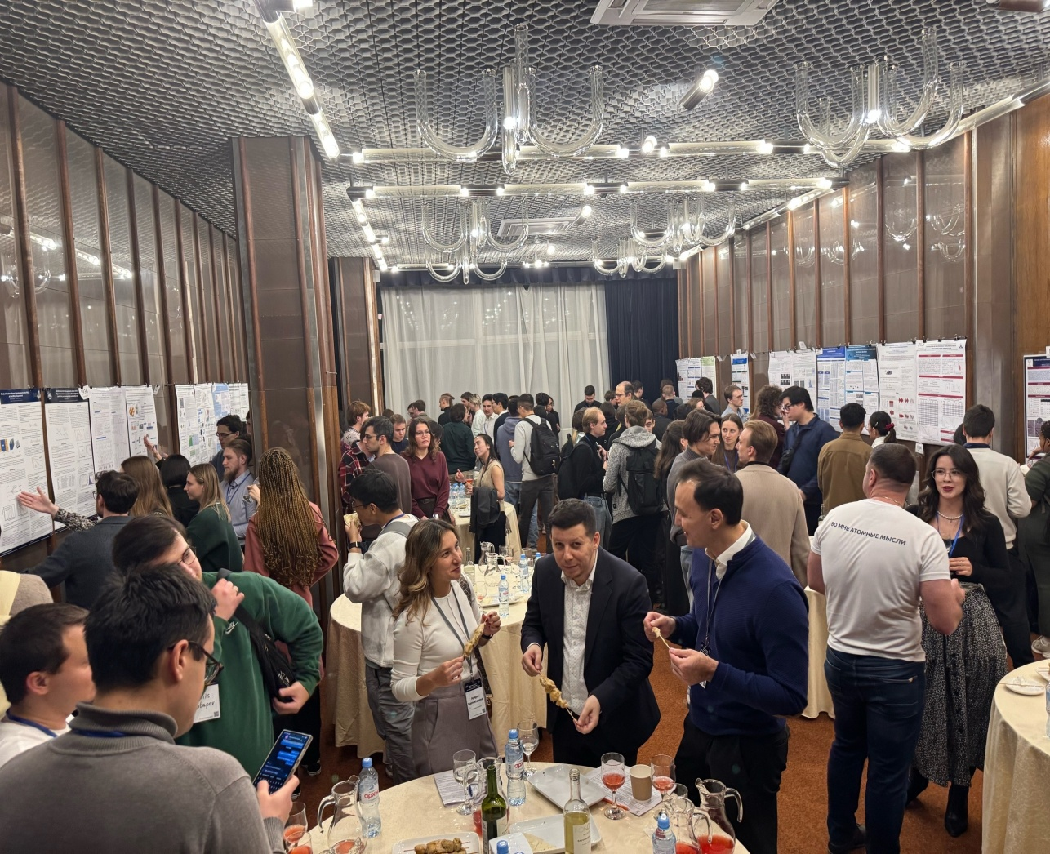
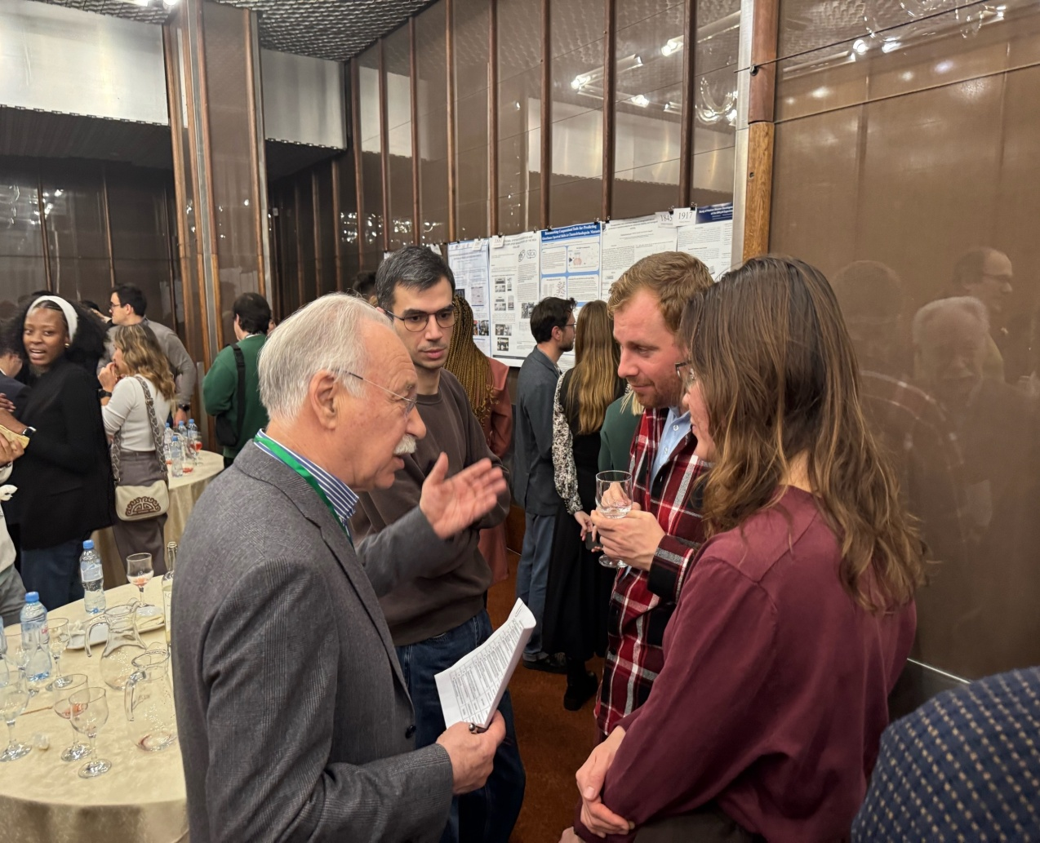
Important Events
40 Posters

Slide 8
Program Сommittee
Co-chairman: Grigory Trubnikov (JINR Director)
Co-chairman: Grigory Shirkov (JINR Directorate)
Aidos Issadykov (BLTP)
Olga Derenovskaya (MLIT)
Alexander Karpov (FLNR)
Ayagoz Baimukhanova (DLNP)
Sergey Merts (VBLHEP)
Sergey Kulikov (FLNP)
Vladimir Chausov (LRB)
Notes:
Co-chairman: Co-chairman:

Slide 9
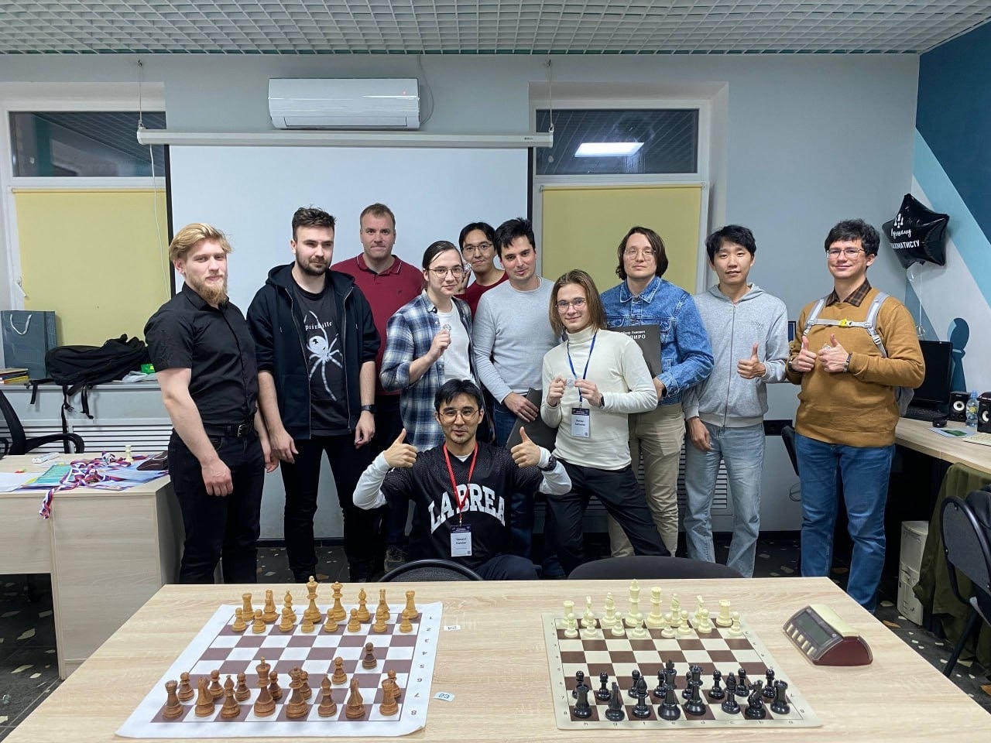
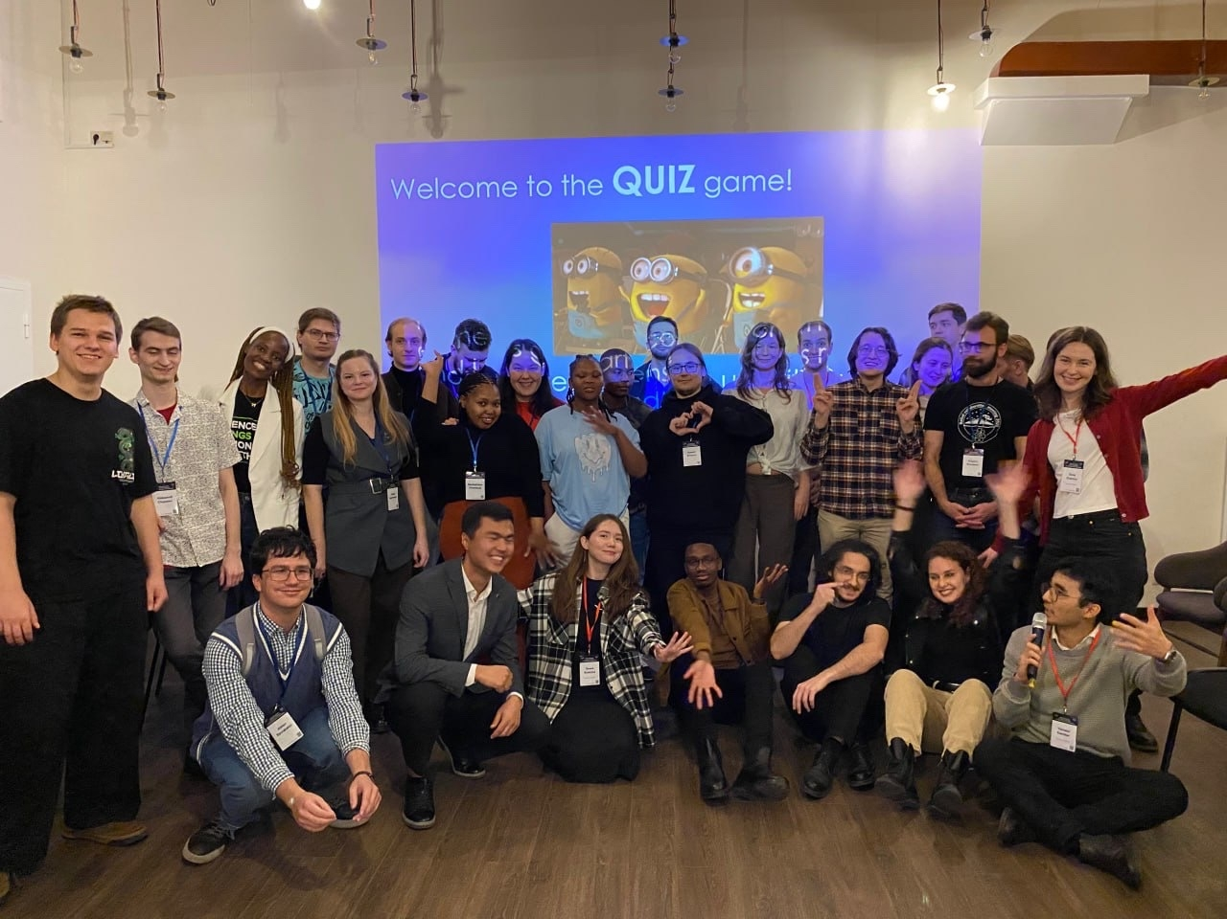
Chess Tournament
Quizz
Notes:
Обложка фильма

Slide 10
Organizing Committee
Co-chairman: Meir Yerdauletov (FLNP)
Anna Illina (MLIT)
Dinara Bulatova (JINR Press Office)
Grigory Gelenidze (JINR Press Office)
Ksenia Ilina (VBLHEP)
Kambar Ismaiyl (VBLHEP)
Daria Shamina (LRB)
Dmitriy Kamanin (UC)
Kanat Nurlan (BLTP)
Alisher Mutali (FLNR)
Alexey Vorontsov (MLIT)
Yulia Gomer (ICD)

Slide 11
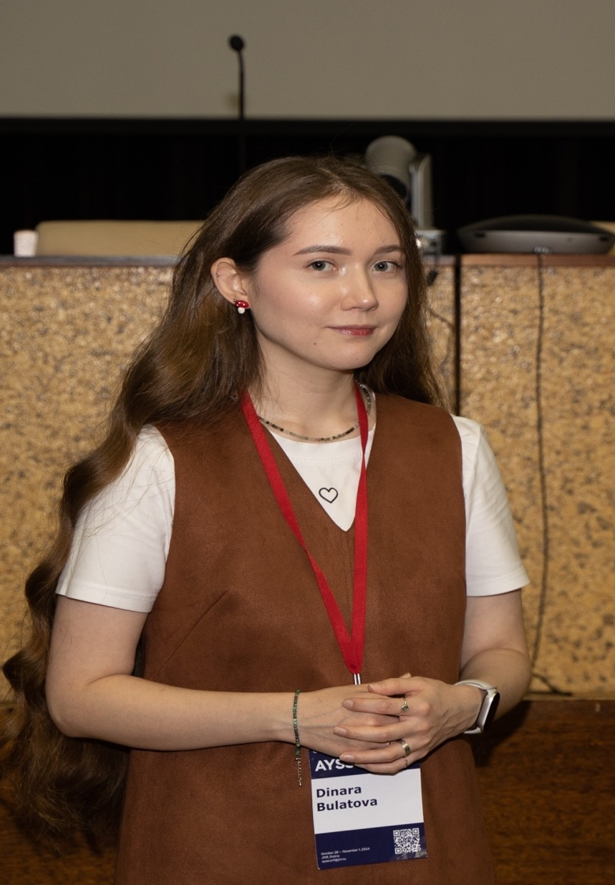
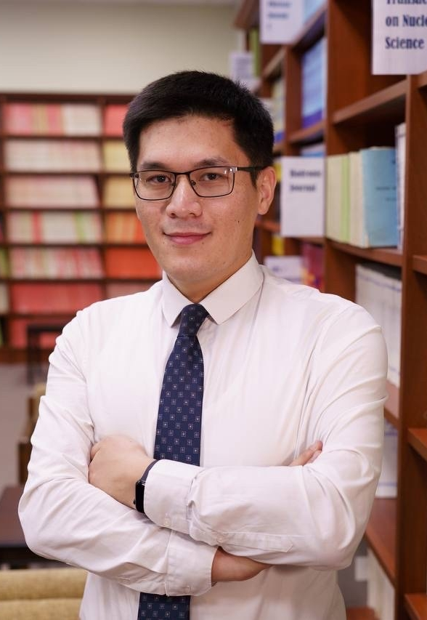
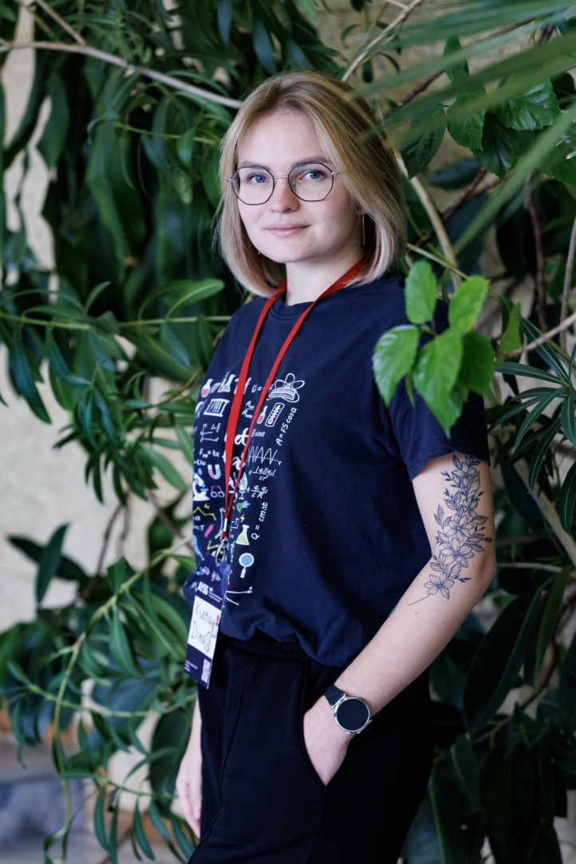
Ksenia Ilina
Dinara Bulatova
Kanat Nurlan

Slide 12

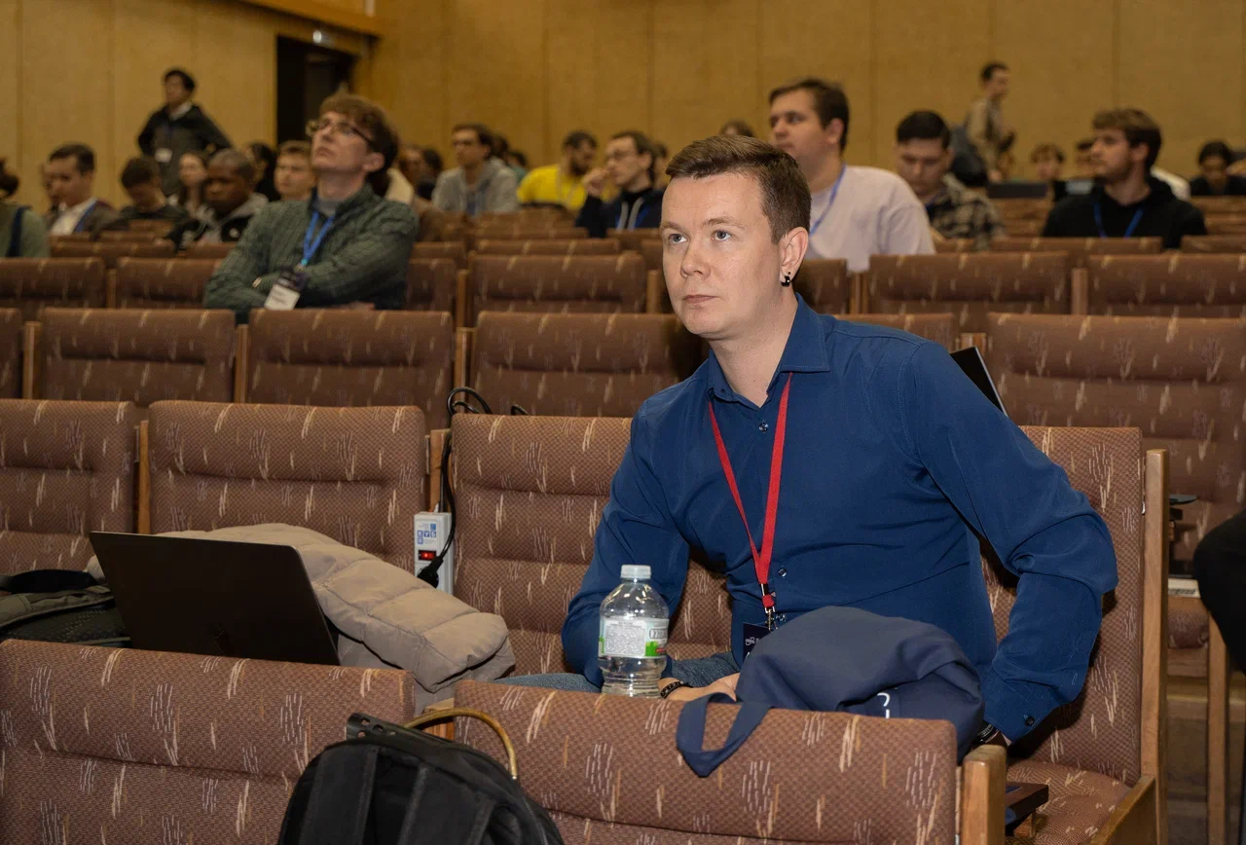
Daria Shamina
Alexey Vorontsov

Slide 13
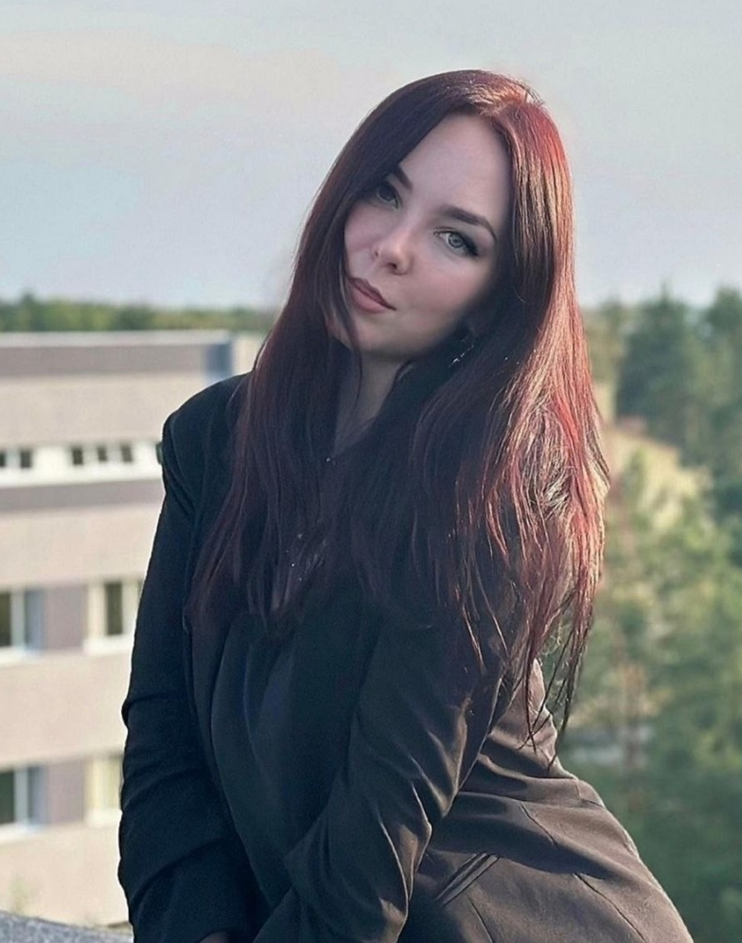
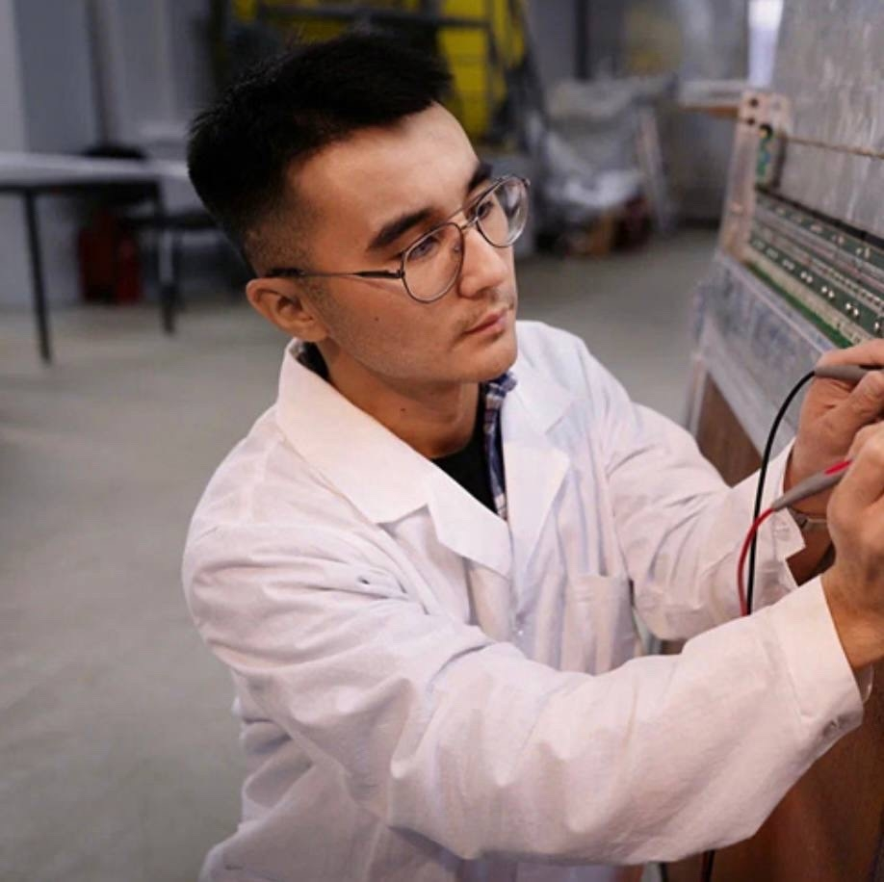
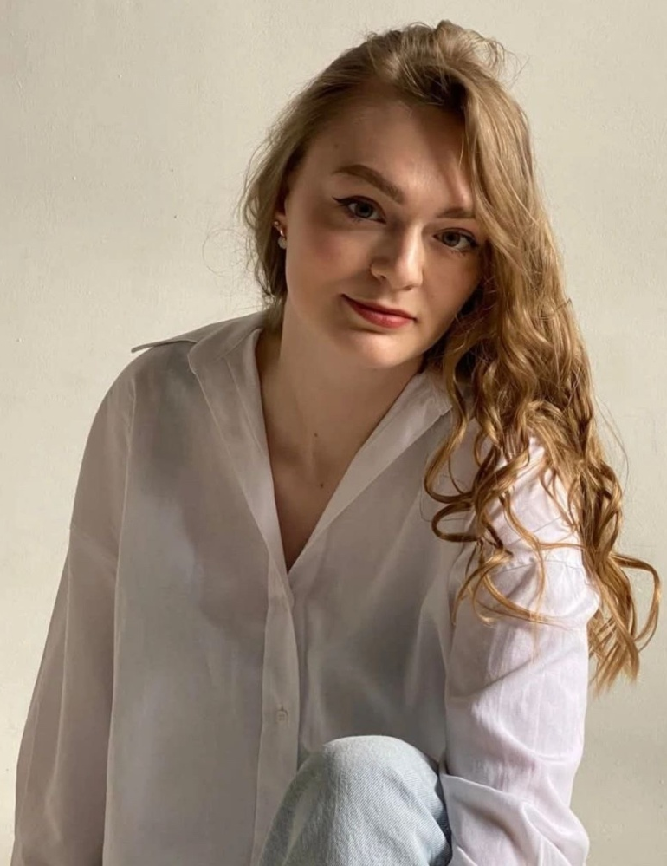
Iuliia Gomer
Kambar Ismaiyl
Anna Ilina

Slide 14
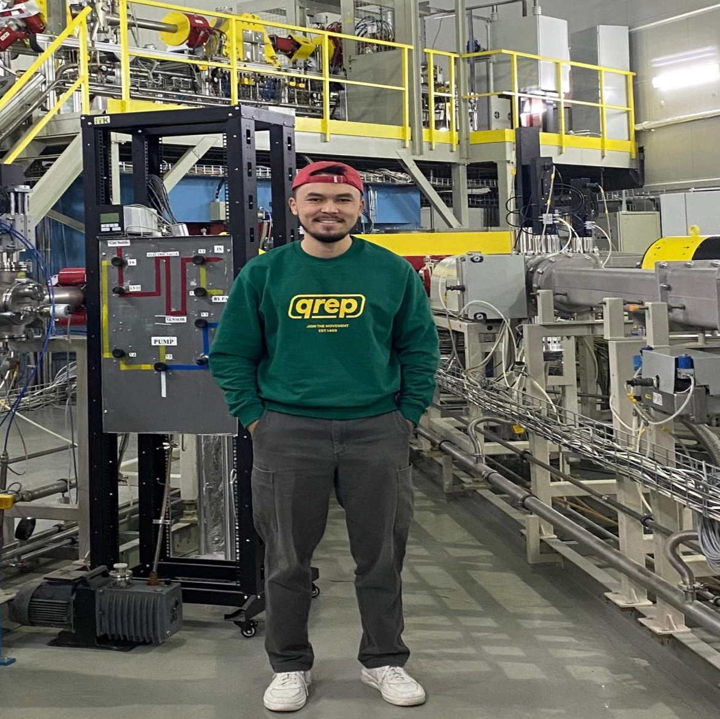
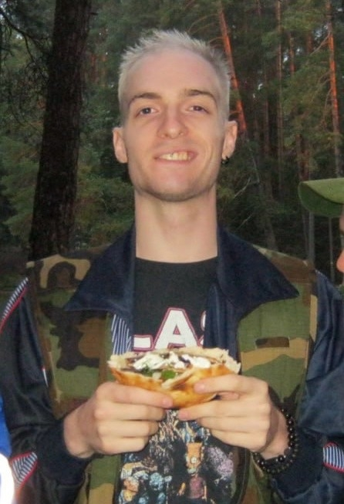
Mutali Alisher
Grigory Gelenidze

Slide 15

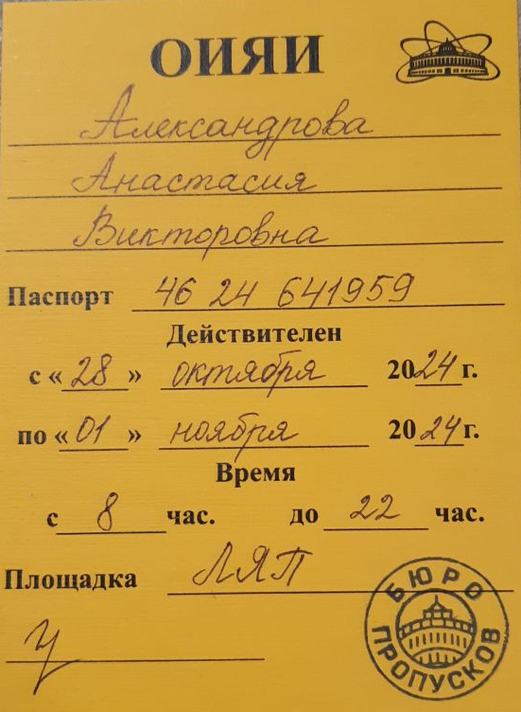
Please LEAVE your PASS
at the JINR Visit Centre
(5 Molodezhnaya str.)

Slide 16

Proceedings
Information
Proceedings will be published in “The journal of Physics of Elementary Particles and Atomic Nuclei, Letters”
All papers are subject to refereeing
Preliminary Submission deadline – November 20, 2025
All proceedings are supposed to be submitted via indico page (submission, instruction)

Slide 17



Contact Info
AYSS-2025 Participants Chat
JINR AYSS Telegram Channel
JINR AYSS
VK Group

Slide 18

Science brings
nations together

Slide 19
The Best Talk at
Parallel Sessions

Slide 20
Theoretical Physics
Diana Davletbaeva:
Application of the parametric integration method with Goncharov polylogarithms in critical dynamics
Nikita Tsegelnik:
The acceleration and the Unruh temperature in the heavy-ion collisions at the NICA complex energies

Slide 21
Condensed matter
Marco Jelic:
From Ion Tracks to Nanoscale Holes in Oxide Semiconductors: Swift Heavy Ion Engineering of BiVO4 for Solar Water Splitting
Bekaris Yerzhnov:
NEUTRON DIFFRACTION STUDIES OF FUNCTIONAL ALLOYS Fe-Ga-RE

Slide 22
Nuclear physics
Fazilat Rasulova:
Isospin splitting of giant dipole resonance in medium and heavy nuclei
Thembi Vilane:
Search and analysis of the Double hit events

Slide 23
Elementary Particle Physics and High-Energy Heavy Ion Physics
Konstantin Gorshanov:
Search for heavy neutral leptons in T2K experiment
Alexander Antoshkin:
Sub-luminal monopole search final results with time-based trigger/selection using the NOvA far detector data
Artem Vasyukov:
Prospects for Studying Hidden-Charm Pentaquark States with the ATLAS Detector

Slide 24
Instruments and Methods of Experimental Physics
Alexander Izvestnyy:
Development of the Readout Board for Highly Granular Neutron Detector at the BM@N experiment
Vitaliy Dronik:
Slow Control System for MPD TOF: Overview, Current Status, and Future Plans

Slide 25
Accelerator Technologies and Neutron Sources
Kirill Berestov:
Current status of the 18 GHz ECR Ion source DECRIS-5M at JINR FLNR

Slide 26
Information Technology
Alexey Kozlovskii:
Integration of Maestro Software Client and Server Components for Hardware Control of the Synchronization System Segment for the Booster Injector at LHEP JINR Using Tango Controls and WebSocket
Alexey Konak:
Monitoring of the SPD data management system

Slide 27
Applied Innovation Activities
Minyar laouini:
Innovative Multifunctional Materials and Nanomaterials for Energy Storage Applications: Composite Electrodes Based on Polypyrrole, Fe₂O₃, and g-C₃N₄ for Supercapacitors
Alexandra Peshkova:
Foliar and Root Exposure to AgNPs: Evaluating Risks to Plant Health, Soil Microbiota and Consumer Safety

Slide 28
Radiation Research in Life Science
Sofya Sakharova:
Study of behavioral reactions, morphological changes in the central nervous system and small intestine after irradiation with protons at a dose of 3 Gy.

Slide 29
The Best Poster

Slide 30
Daniil Gubachev:
Study of the Hyperon reconstruction in the SPD/NICA
Madina Bissenova:
SrTiO₃@SiO₂ Composites with Combined Adsorption and Photocatalysis Mechanisms for Efficient Wastewater Treatment

Slide 31
Hope to see you in future at other JINR and AYSS events!

