Slide 1
Programme Advisory Committee for Nuclear Physics
47-th meeting
Follow-up
17–18 January 2018
Marek Lewitowicz

Slide 2
47th meeting of Programme Advisory Committee for Nuclear Physics
1. Opening of the meeting M. Lewitowicz
2. Implementation of the recommendations of the previous PAC meeting M. Lewitowicz
3. Information on the Resolution of the 120th session of the JINR Scientific Council (September 2017)
and on the decisions of the JINR Committee of Plenipotentiaries (November 2017) M. Itkis
4. Report on the theme "Non-Accelerator Neutrino Physics and Astrophysics" and proposals
for their extension:
4.1 Project GERDA (G&M) K. Gusev
4.2 Project SuperNEMO Yu. Shitov
4.3. Project BAIKAL I. Belolaptikov
4.4. Projects conducted at the Kalinin Nuclear Power Plant:
4.4.1. Project DANSS V. Egorov
4.4.2. Project GEMMA-III A. Lubashevsky
4.5. Project EDELWEISS-LT, summary on the theme "Non-Accelerator Neutrino Physics and
Astrophysics" and proposals for their extension E. Yakushev
5. Visit to the Dzhelepov Laboratory of Nuclear Problems
6. Status of the Factory of Superheavy Elements V. Semin, A. Popeko
7. Commissioning of the ACCULINNA-2 fragment separator A. Fomichev
8. Report on the theme "Theory of Nuclear Structure and Nuclear Reactions" and proposal
for a new theme N. Antonenko
9. Scientific reports:
9.1. "Study of vorticity and hyperon polarization in nuclear collisions within the NICA energy range“ V. Toneev
9.2. "Application of multinucleon transfer reactions to the synthesis of neutron-rich nuclei“ A. Karpov
9.3. "Neutron activation analysis of arsenic and mercury content in human remains of the XVI-XVI A. Dmitriev
centuries from the Moscow Kremlin necropolis“
10. General discussion
11. Meeting of the PAC members with the JINR Directorate (closed discussion)
12. Poster presentations by young scientists
13. Presentation of the PAC recommendations

Slide 3
From resolution of 123rd session of the JINR Scientific Council
on the report by JINR Director V. Matveev
The Scientific Council is pleased to note that the international visibility of JINR and of its flagship projects is ramping up.
Synthesis of superheavy elements by JINR is a world-leading programme. Neutrino research projects at the Kalinin NPP and at Lake Baikal are also flagship programmes and should be on the APPEC roadmap. The Scientific Council supports this trend and appreciates highly the JINR Directorate’s attention to the advice given by the Scientific Council on the integration of these facilities into the European and global research infrastructure landscapes.
The Scientific Council expects that the first phase envisaging construction of the SHE Factory will be completed in July 2018 and that the first experiments will begin in October-November 2018, according to the timeline of commissioning this important complex as presented at the previous session of the Scientific Council.

Slide 4
The theme “Non-Accelerator Neutrino Physics and Astrophysics”
The theme is devoted to the studies of rare phenomena associated with the weak interaction by methods of modern nuclear spectroscopy.
Theme “Non-Accelerator Neutrino Physics and Astrophysics” consists of the six projects.
Projects:
GERDA (G&M) SuperNEMO projects | search for neutrinoless double-beta decay
DANSS GEMMA-III | experiments with reactor antineutrinos
EDELWEISS-LT | direct search for dark matter particles
BAIKAL-GVD | investigations of high-energy neutrinos from space with the deep-water neutrino telescope at Lake Baikal

Slide 5
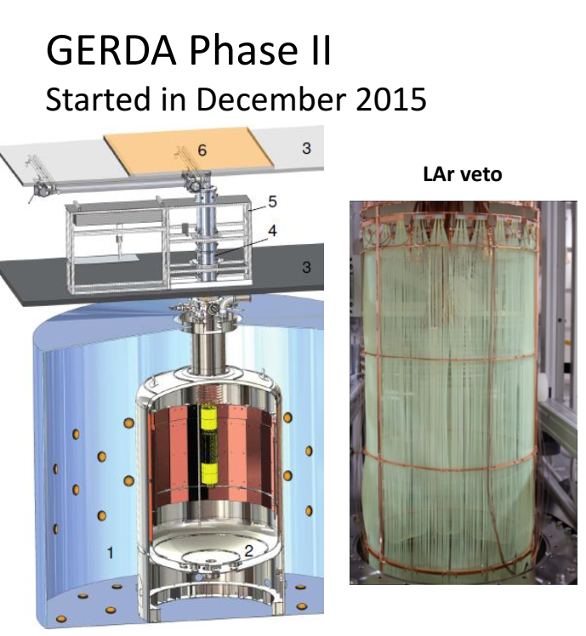
Project GERDA (G&M)
GERDA (G&M) project in Laboratori Nazionali del Gran Sasso is dedicated to search for the neutrinoless double-beta decay of ⁷⁶Ge with open Ge-detectors directly immersed in liquid argon.
Phase-II of the experiment (2015–2021) is being performed by the GERDA collaboration. The most important feature of this phase is the liquid argon instrumentation surrounding the detector array to readout of scintillation light creating an effective active veto system.
A part of the report was dedicated to the new generation ton-scale ⁷⁶Ge experiment LEGEND, which has been recently started. In this experiment, it is planned to achieve an ultimate sensitivity of 10²⁸ years. The aim of this ambitious project is to answer the question about neutrino mass hierarchy.
The PAC recommends continuation of the GERDA (G&M) project in 2019–2021

Slide 6
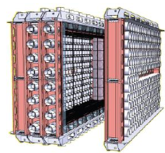
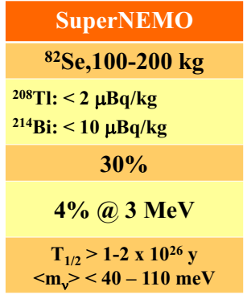
Project SuperNEMO
The long-term successful participation of JINR in the NEMO experiment in Laboratoire Souterrain de Modane, France has led to the obtaining of fundamental world-level results for the two-neutrino and neutrinoless double-beta decay of enriched isotopes ⁴⁸Ca, ⁸²Se, ⁹⁶Zr, ¹⁰⁰Mo, ¹¹⁶Cd, ¹³⁰Te and ¹⁵⁰Nd (measurements at the NEMO-3 spectrometer).
The new-generation SuperNEMO detector will have a modular design (20 modules) with the ability to simultaneously measure several isotopes at a sensitivity level to the half-life T_{1/2} (2β0ν) ≥ 10²⁶ years.
In the starting first module of the SuperNEMO (the demonstrator), 7 kg of ⁸²Se is used.
JINR plays a key role in the project, especially in constructing
The PAC recommends continuation of the SuperNEMO project in 2019–2021

Slide 7
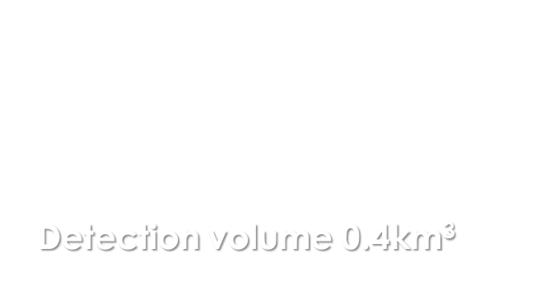
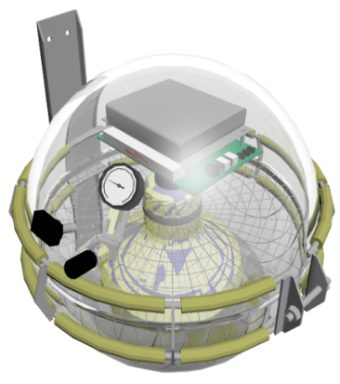
Project BAIKAL
Deployment plan for expedition 2018
April 2017
Taking data
April 2016
Taking data
300 m
During 2016–2017, the BAIKAL collaboration deployed two full-scale clusters with 576 optical modules.
At the end of 2021, the collaboration is planning to put into operation 10 clusters with 2880 optical modules. This will allow about 30 extraterrestrial events with energies above 100 TeV to be accumulated for detailed investigations of “IceCube signal”.
~600 m
“Dubna”
Demonstration
Cluster (2015)
~1 km
120 m
The PAC recommends continuation of the BAIKAL project in 2019–2023 and expects a publication of the first results in due time.

Slide 8
Projects conducted at the Kalinin Nuclear Power Plant
1. Project DANSS
Fundamental purpose: searching for short-range neutrino oscillation to a sterile state.
It is planned to develop and construct two new neutrino detectors S³ (S-cube)
They would be:
smaller, simpler and cheaper than DANSS;
have better energy resolution;
detect about 300-400 IBD events per day each;
The first of them will be constructed by IEAP CTU (Prague) and installed at the Temelín NPP (Czech Republic);
The second one will operate parallel to DANSS at the Kalinin NPP, thus providing more reliable reactor monitoring.
25 Y-Modules
25 X-Modules
2500 independent scintillator strips
The PAC recommends continuation of the DANSS project in 2019–2021, including JINR’s collaboration with the NEOS and Neutrino4 projects, as well as the development and construction of two small S3 detectors

Slide 9
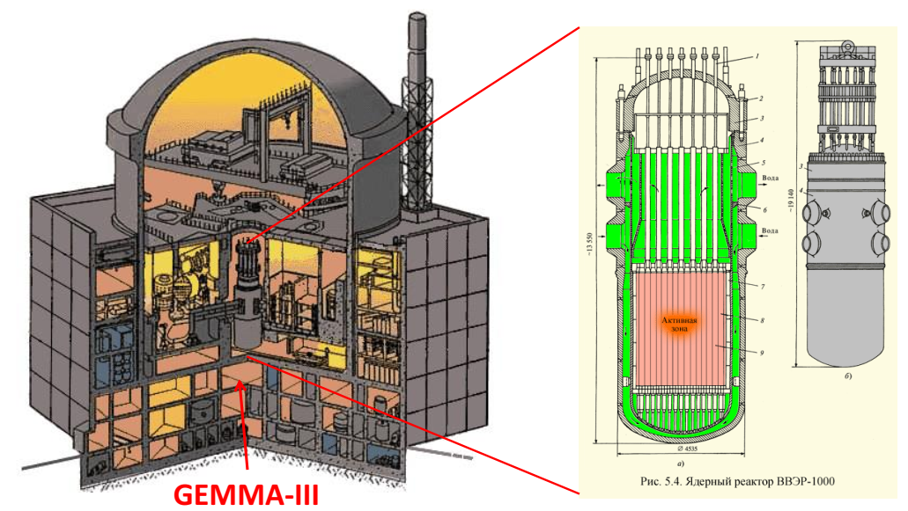
Projects conducted at the Kalinin Nuclear Power Plant
2. Project GEMMA
The aim of the project: investigate reactor neutrino properties using high-purity low-threshold germanium detectors.
the experiments search for the magnetic moment of neutrino (MMN) and coherent elastic neutrino-nucleus scattering (CENNS).
Currently, an experimental set-up is being constructed at the Kalinin NPP.
Within the GEMMA-III project, it is planned to use four new low-threshold detectors (threshold ~ 200 eV) with a total mass of about 5.5 kg.
The experimental set-up will be located under reactor core No.3 at the Kalinin NPP where the distance from the centre of the core is only 10 m leading to an enormous antineutrino flux of >5⋅10¹³ antineutrino/(cm²⋅s).
The PAC recommends continuation of the GEMMA-III project in 2019–2021.
The leading role of the JINR group in this experiment is highly appreciated.

Slide 10
3. Project EDELWEISS-LT
EDELWEISS experiment search for rear events of WIMP-nucleon scattering in Laboratoire Souterrain de Modane (with Ge as the target)
The main objective of the new phase of the experiment named EDELWEISS-LT is to search for spin-independent scattering on nucleons of the so-called light WIMPs.
The PAC notes with satisfaction that the participation in this project provides JINR an important access to the entire low-background infrastructure of EDELWEISS, including the LSM: one of deepest underground laboratories needed for the R&D of neutrino experiments at the Kalinin NPP.
The PAC recommends continuation of the research programme for the direct search of dark matter particles in the EDELWEISS-LT project in 2019–2021.

Slide 11
Summary on the theme “Non-Accelerator Neutrino Physics and Astrophysics”
The PAC General recommendations
The PAC recommends that support of these experiments be rigorously continued.
The PAC is aware about the lack of human resources at JINR on the BAIKAL experiment which can be a problem for a full involvement in the data analysis. It strongly advises to extend international contacts with the KM3NET collaboration to develop common synergies to become part of the ESFRI and APPEC roadmaps.
The PAC recommends that cooperation be supported with deep underground laboratories taking into account the necessity to find the adequate location for both LEGEND and full SuperNEMO detector.
It underlines the necessity to continue the efforts to improve the local infrastructures at JINR and at Lake Baikal.

Slide 12
Summary on the theme “Non-Accelerator Neutrino Physics and Astrophysics”
The Scientific Council highly appreciates the results of scientific research carried out within the theme “Non-Accelerator Neutrino Physics and Astrophysics” consisting of six distinct projects. The theme is devoted to the studies of rare phenomena associated with the weak interaction by methods of modern nuclear spectroscopy. The rare processes under study include search for neutrinoless double-beta decay (GERDA (G&M) and SuperNEMO projects), experiments with reactor antineutrinos (DANSS and GEMMA-III projects), direct search for dark matter particles (EDELWEISS-LT project), and investigations of high-energy neutrinos from space with the deep-water neutrino telescope at Lake Baikal (BAIKAL-GVD project).
The Scientific Council is pleased to note the world-leading results obtained in all these projects.
The Scientific Council supports the general direction in which the theme is developing, when the participation in highly prestigious international projects provides an access to know-how for the development of homebased neutrino experiments at two basic facilities –– the laboratories located at the Kalinin NPP and at Lake Baikal.
The Scientific Council recommends continuation of the rigorous support of these projects and research programmes for 2019–2021, and the Baikal project for a longer period until the end of 2023.
The Scientific Council underlines the necessity to continue the efforts to improve the local infrastructures at JINR and at Lake Baikal and to ensure the sufficient human resource for the timely data analysis.

Slide 13
Neutrino physics issues
After the presentations of the various neutrino experiments reported by the Chairmen of the PAC for Nuclear Physics and of the PAC for Particle Physics, the Scientific Council reiterates its recommendation that all these ongoing and recently planned neutrino experiments be presented and discussed within a joint meeting of the two PACs leading to a more coordinated neutrino physics programme and therefore allowing implementation of priorities in a more concerted and efficient way.

Slide 14
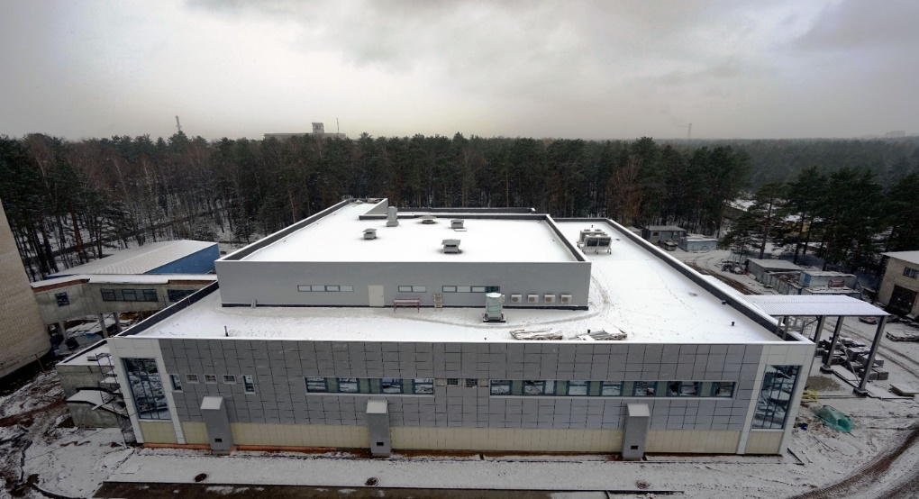
Factory of Superheavy Elements
The PAC would like to congratulate the FLNR team with the well thought-out decisions concerning the continuation of the operation of U-400 for several years in parallel to the operation of experiments at GFS-1. Both experiments, spectroscopy and reaction studies at SHELS and new elements at GFS-1, are complementary.
Recommendations.
In order to meet the deadlines for commissioning and first experiments at the SHE Factory, the PAC recommends that the JINR and FLNR Directorates provide maximum possible resources to accomplish the work for all the systems of the accelerator, the separator, the target and detection units in 2018. The licensing of the facility, which is today on the critical path, should be carefully followed by the management.
Following the recommendations taken at the previous meeting, the PAC would like to hear a presentation on the methodology for the quality control for the construction and commissioning of the SHE Factory subsystems at the next PAC meeting.
Today we will hear about it...

Slide 15
The Scientific Council recommendation: Status of the SHE Factory
The Scientific Council notes the progress of construction of the Factory of Superheavy Elements (SHE). The installation work for the DC-280 cyclotron is well advanced and is now planned to reach an end in the first half of 2018. The start-up and adjustment are to be accomplished by mid-2018. The commissioning of the DC-280 accelerator should start by September 2018.
Significant progress has also been made in the construction of the experimental set-ups including the target system, separators and detection systems. In particular, a new gas-filled recoil separator has been manufactured and delivered to Dubna; its assembly is scheduled for January-March 2018. First test experiments are planned for October-November 2018.
In addition to the technical work, an important effort of FLNR and JINR concentrates on the licensing process, which should be accomplished to begin experiments on the synthesis and studies of superheavy elements.
The Scientific Council supports the well-considered decision of the FLNR Directorate concerning the continuation of the operation of U-400 for several years in parallel to the operation of experiments at GFS-1. Both experiments, spectroscopy and reaction studies at SHELS and new elements at GFS-1, are complementary.
In order to meet the deadlines for commissioning and first experiments at the SHE Factory, the Scientific Council recommends that the JINR and FLNR Directorates provide maximum possible resources to accomplish the work for all the systems of the accelerator, for the separator, the target and detection units in 2018.

Slide 16
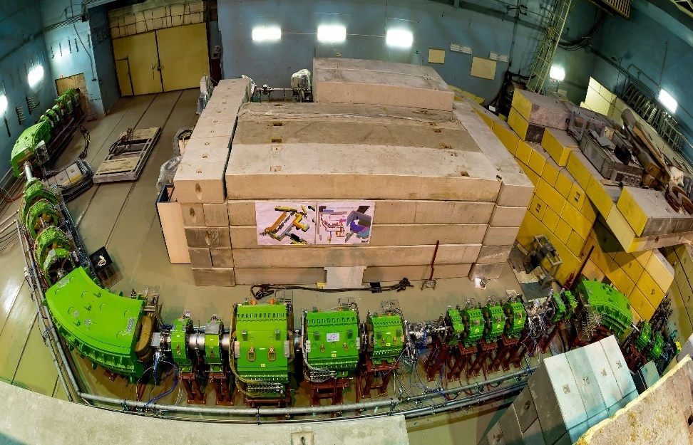
Commissioning of the ACCULINNA-2 fragment separator
ACCULINNA-2 was commissioned at the beam line of the U400M cyclotron.
With the ¹⁵N primary beam, the new fragment separator was tested in 2016 and 2017 to produce various secondary beams of radioactive isotopes.
Intensities of the obtained secondary beams were 25 times higher than those obtained with the previous facility ACCULINNA.
ACCULINNA-2 becomes the basic facility to study exotic nuclei at the Flerov Laboratory. The first experiments for the new facility are proposed to study ⁷H, ¹³Li, ¹⁷Ne, ²⁶S decaying via the 2p, 2n and 4n emissions
Recommendation.
The PAC fully supports the experimental programme for the year 2018 with the ACCULINNA-2 fragment separator. In the first measurements, a deuterium polyethylene target is planned to be used, and the PAC recommends installation of the gas target system to the ACCULINNA-2 experimental area.

Slide 17
The Scientific Council recommendation
commissioning of the ACCULINNA-2
In 2016, a new fragment separator ACCULINNA-2 was constructed on the beam line of the U400M cyclotron. With the 15N primary beam, the fragment separator was tested to produce various secondary beams of radioactive isotopes. Intensities of the obtained secondary beams were 25 times higher than those obtained with the previous facility ACCULINNA-1.
The Scientific Council supports the plan according to which ACCULINNA-2 will become the major facility to study exotic nuclei at the FLNR JINR.

Slide 18
Recommendations on the concluding theme “Theory of Nuclear Structure and Nuclear Reactions” and for a new theme “Theory of Nuclear Systems”
The PAC took note of the report on the concluding theme “Theory of Nuclear Structure and Nuclear Reactions” (01-3-1114-2014/2018) and of the proposal for a new theme entitled “Theory of Nuclear Systems”.
The PAC highly appreciates the results obtained in the main research directions:
structure of nuclei far from stability,
nucleus-nucleus collisions at low energies,
fusion dynamics,
few-body systems,
nuclear dynamics at relativistic energies,
properties of hot and dense nuclear matter.
The PAC appreciates that the topics are strongly connected with the main experimental activities occurring in the main facilities at JINR and abroad. The PAC notes the smooth transition to the new theme “Theory of Nuclear Systems” which promises to be solidly connected with the physics items of strong interest for the SHE Factory and ACCULINNA-2 facilities at JINR and for other facilities operating or in the commissioning phase such as FAIR, SPES, HIE-ISOLDE, SPIRAL2, and ELI-NP. The PAC also appreciates the educational activities of BLTP.
Recommendation.
The PAC recommends closure of the theme “Theory of Nuclear Structure and Nuclear Reactions” after its completion in 2018 and approval of the new theme “Theory of Nuclear Systems” for 2019–2023. The PAC also recommends that international cooperation be tightened with other theory groups, in particular with the ECT* centre in Trento (Italy).

Slide 19
The Scientific Council recommendation
The Scientific Council highly appreciates the results obtained in the main research directions of the concluding theme “Theory of Nuclear Structure and Nuclear Reactions”: structure of nuclei far from stability, nucleus-nucleus collisions at low energies, fusion dynamics, few-body systems, nuclear dynamics at relativistic energies, properties of hot and dense nuclear matter.
The Scientific Council is pleased to note that these topics are strongly connected with the main experimental activities in the main facilities at JINR and other centres.
The Scientific Council supports the smooth transition of nuclear theory activities under the new theme “Theory of Nuclear Systems”for 2019–2023 that should continue incorporating complex and broad views on the various aspects of nuclear structure and reactions in close synergy with the experimental programme of JINR and in other facilities operating or in the construction phase such as FAIR, SPES, HIE-ISOLDE, SPIRAL2, and ELI-NP.

Slide 20
Miscellaneous
The PAC notes the large amount of work carried out by the authors of the E&T project to develop methods for studying the main nuclear physics parameters of the uranium assembly “Quinta” (the neutron field, the plutonium production time, the energy yield of the assembly, the transmutation rates of minor actinides) and to prepare the new programme with the uranium massive BURT target. The target has been recently installed at DLNP for irradiation with the Phasotron beam.
Recommendation:
The PAC recommends that the results obtained with the “Quinta” assembly and the future programme with the BURT target be assessed at a dedicated review meeting to be organized by the JINR Directorate.

Slide 21
Poster session
The PAC appreciated the high quality of presentations of new results and proposals by young scientists in the field of nuclear physics research.
The best posters selected are:
“Sensitive neutron detection method using iodine-containing scintillators” presented by Dmitry Ponomarev
“Utilization of the (p,4n) reaction potential for the production of medical isotopes with medium-energy protons: radionuclide generator 90Mo→90Nb” presented by Atanaska Marinova.
“Active background suppression using argon scintillation for the GERDA Phase II and the LEGEND experiment” presented by Egor Shevchik.
The PAC recommends the poster
“Sensitive neutron detection method using iodine-containing scintillators”
for presentation at the session of the Scientific Council in February 2018.
The Scientific Council appreciates the recommended reports by young scientists.

Slide 22
Memberships of the PACs
As proposed by the JINR Directorate, the Scientific Council appoints
A. Maj (INP, Kraków, Poland)
V. Nesvizhevsky (ILL, Grenoble, France)
as new members of the PAC for Nuclear Physics, each for a term of three years.

Slide 23
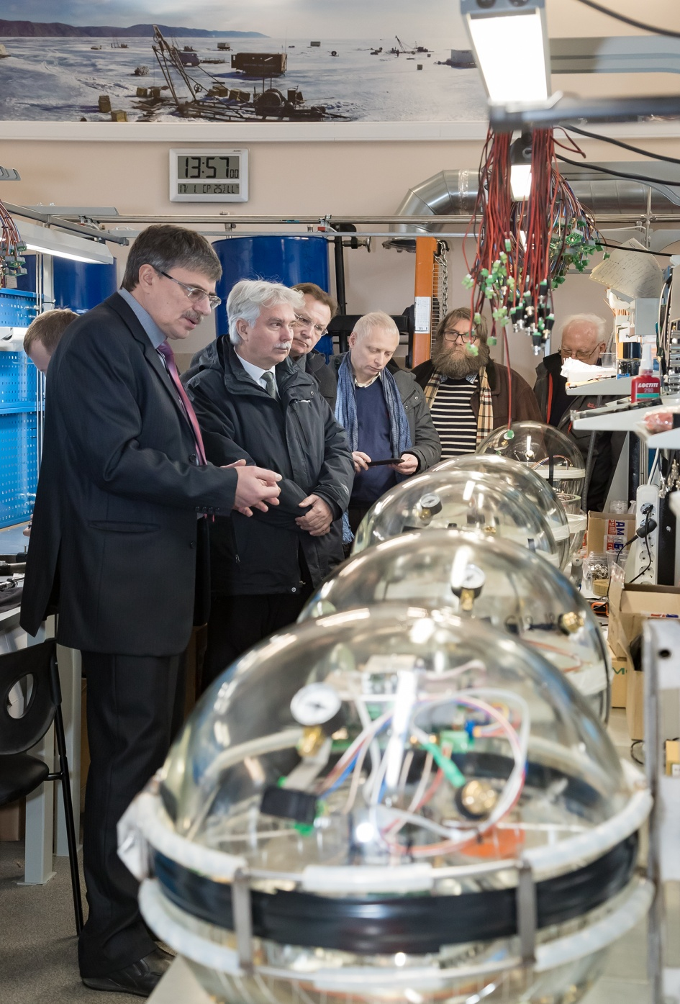
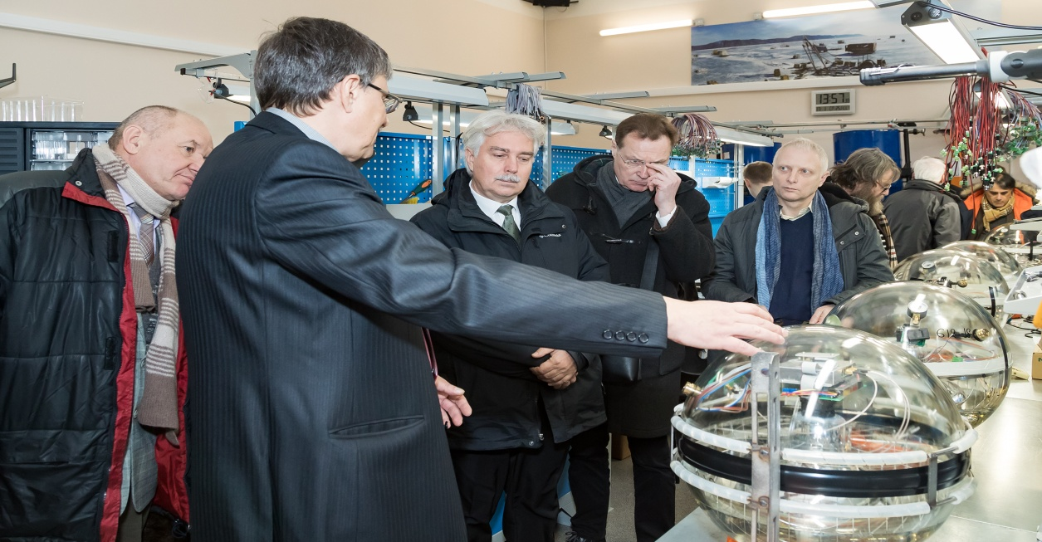
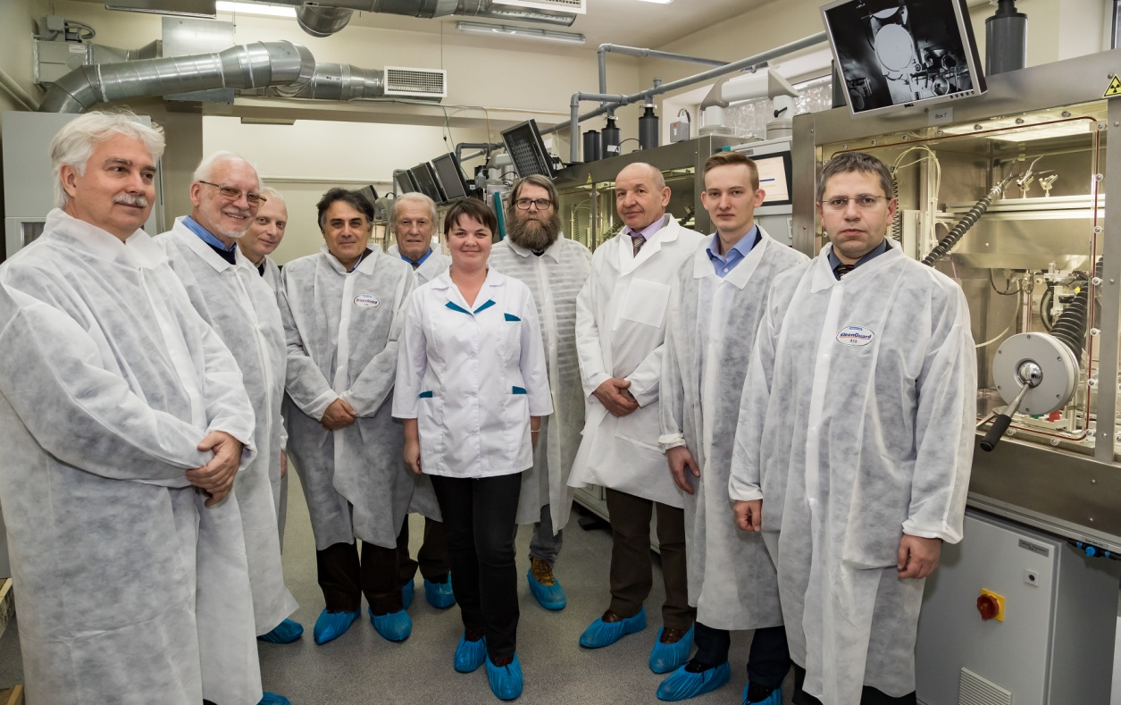
Visit to DLNP
The PAC thanks the Directorate of the Dzhelepov Laboratory of Nuclear Problems for the organization of the visit to this Laboratory.

Slide 24
THANKS FOR YOUR ATTENTION!

Slide 25
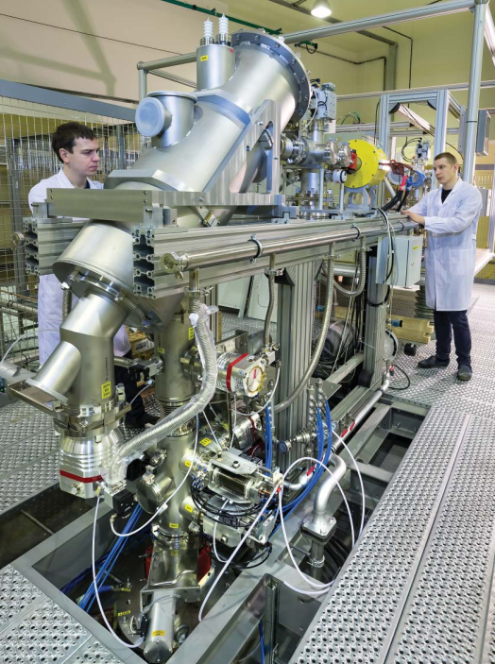
Status of the Factory of Superheavy Elements
The PAC heard a report on the progress of construction of the Factory of Superheavy Elements (SHE)
The installation work for the DC-280 cyclotron is well advanced and is now planned to end in the first half of 2018.
The start-up and adjustment is to be accomplished by mid 2018.
The commissioning of the DC-280 accelerator should start by September 2018.
The construction of the experimental setups including the target system, separators and detection systems has made a very important progress.
In particular, a new gas-filled recoil separator has been manufactured and delivered to Dubna; its assembly is scheduled for January–March 2018.
First test experiments are planned for October–November 2018.
In addition to the technical work, an important effort of FLNR and JINR concentrates on the licensing process, which should be accomplished to begin experiments on the synthesis and studies of superheavy elements.

Slide 26
E&T project
Sergey Tyntyunnikov and Anton Baldin was in Lanzhou, where joint work on the project E&T&RM was discussed
The results of the discussion are structured in the form of an intention protocol, approved by both parties
The Chinese side is ready to participate financially in the works on carrying out of the experiment.

