Slide 1
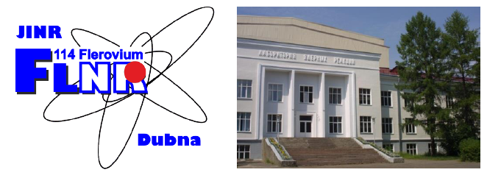
Experiments with RIBs at ACCULINNA-1 and ACCULINNA-2
fragment separators
Andrey Fomichevª
for ACCULINNA-2 Collaboration
a – Flerov Laboratory of Nuclear Reactions, JINR, Dubna, Russia
b – Institute of Physics, Silesian University in Opava, Czech Republic
c – Bogolyubov Laboratory of Theoretical Physics, JINR, Dubna, Russia
d – GSI Helmholtzzentrum fur Schwerionenforschung, Darmstadt, Germany
e – National Research Center “Kurchatov Institute”, Moscow, Russia
f – Institute of Nuclear Physics PAN, Krakow, Poland
g – Skobel’tsyn Institute of Nuclear Physics, Moscow State University, Russia
h – Faculty of Physics, University of Warsaw, Warsaw, Poland
i – Fundamental Physics, Chalmers University of Technology, Goteborg, Sweden
j – All-Russian Research Institute of Experimental Physics, Sarov, Russia
k – Ioffe Physical Technical Institute, St. Petersburg, Russia
l – NSCL, Michigan State University, East Lansing, Michigan, USA
48th PAC meeting, June 20, 2018

Slide 2
Layout of ACCULINNA-1 and ACCULINNA-2 setups at U-400M
1.5 weeks in February 2018
4 weeks in March-April 2018
A.S. Fomichev, L.V. Grigorenko, S.A. Krupko, S.V. Stepantsov and G.M. Ter-Akopian
The ACCULINNA-2 project: The physics case and technical challenges, Eur. Phys. J. A 54, 97 (2018)

Slide 3
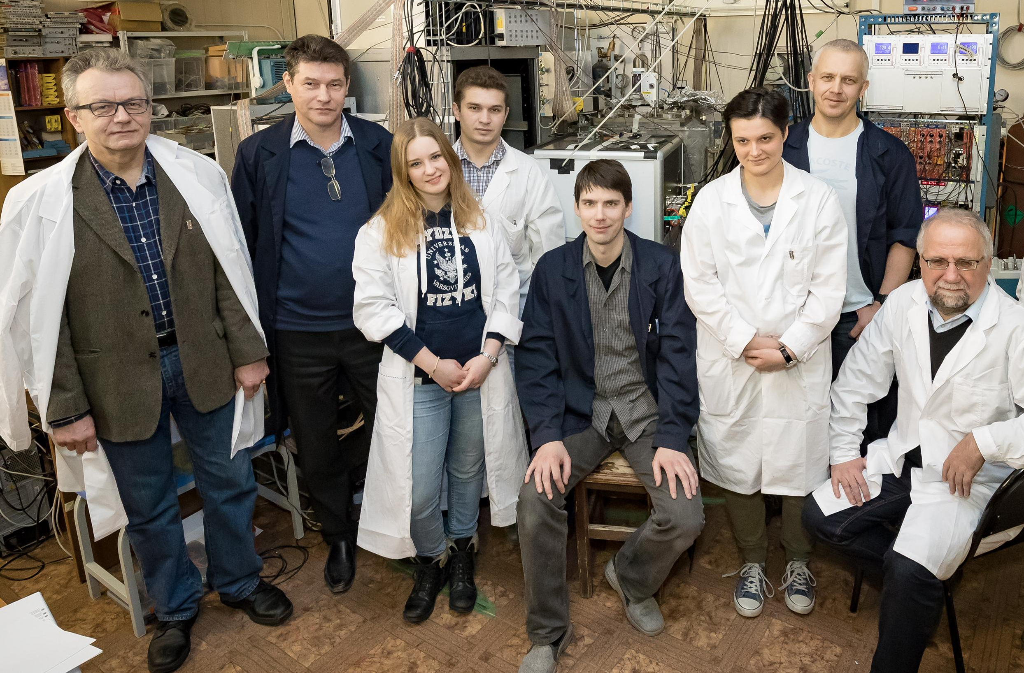
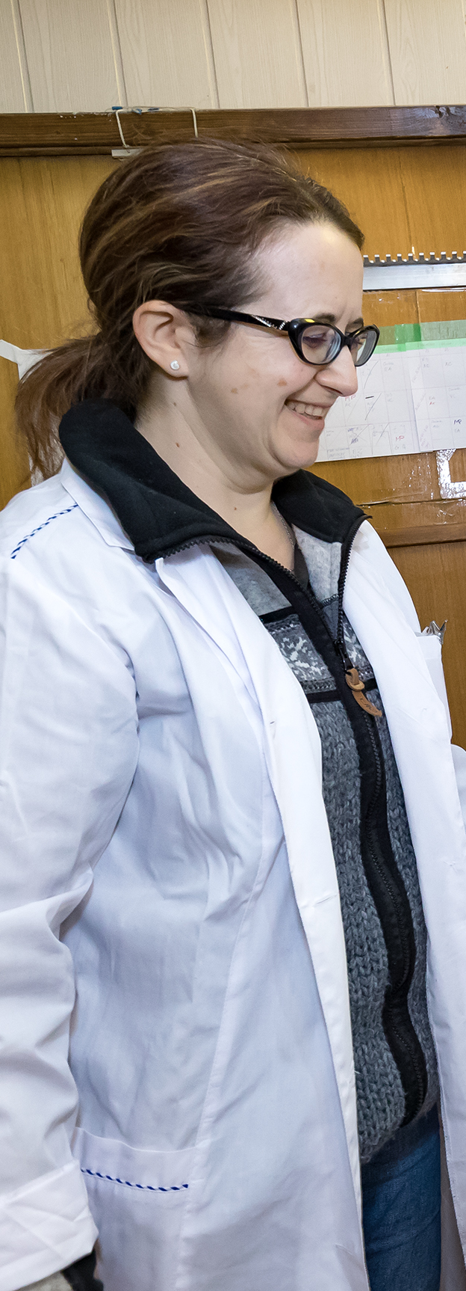
Feb. 2018, ACC-1. β-delayed particle emission of ¹¹Be (T_{1/2} = 13.76 s) was studied. The other isotopes, ⁸Li (T_{1/2} = 0.84 s), ⁸B (T_{1/2} = 0.77 s) and ⁹C (T_{1/2} = 0.126 s), were used for the crosscheck measurements.
The method OTPC works well even in the case of long-lived nuclei.
New data with a good statistics were obtained for ¹¹Be and ⁹C.
Proposal has been done by Warsaw Univ.

Slide 4
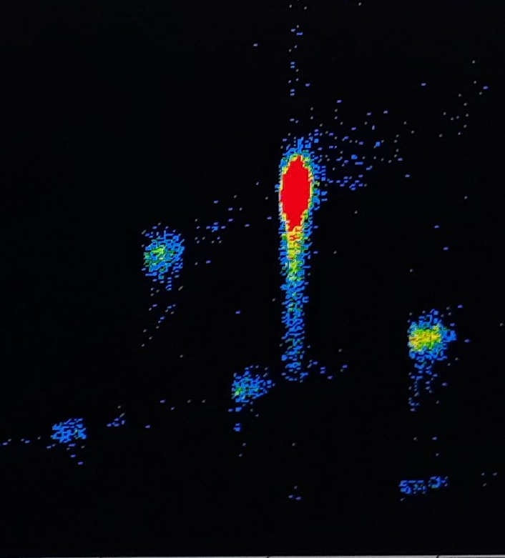
Preliminary results: examples of ⁹C (T_{1/2} = 0.126 s) and ¹¹Be (T_{1/2} = 13.76 s) decay
⁹C
⁹C
¹¹Be case (~10³ 1/s):
so-called “saturation mode”
α
p
α
p
standard mode (Δt ~ 0.5 s)
2s break
needs
to get rid
from ⁸Li
α_2
α_1
α_3
¹¹Be
Example of one events which contains 8 frames (Δt ~ 600 ms)
⁹Li
⁸Li
β-delayed alpha
emission: P ~ 3%

Slide 5
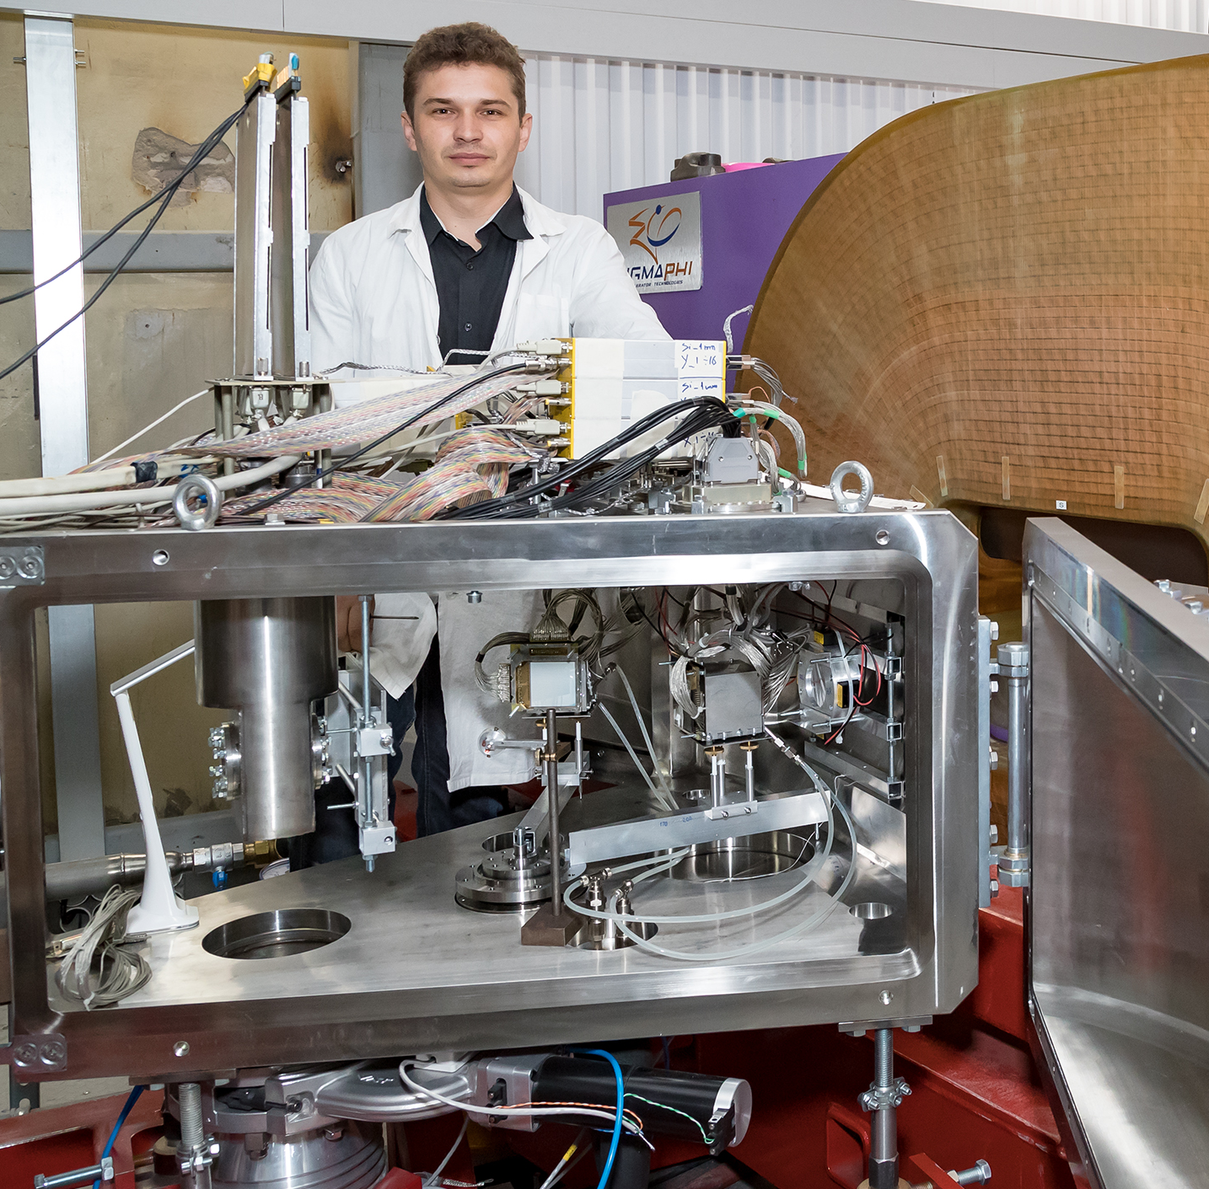
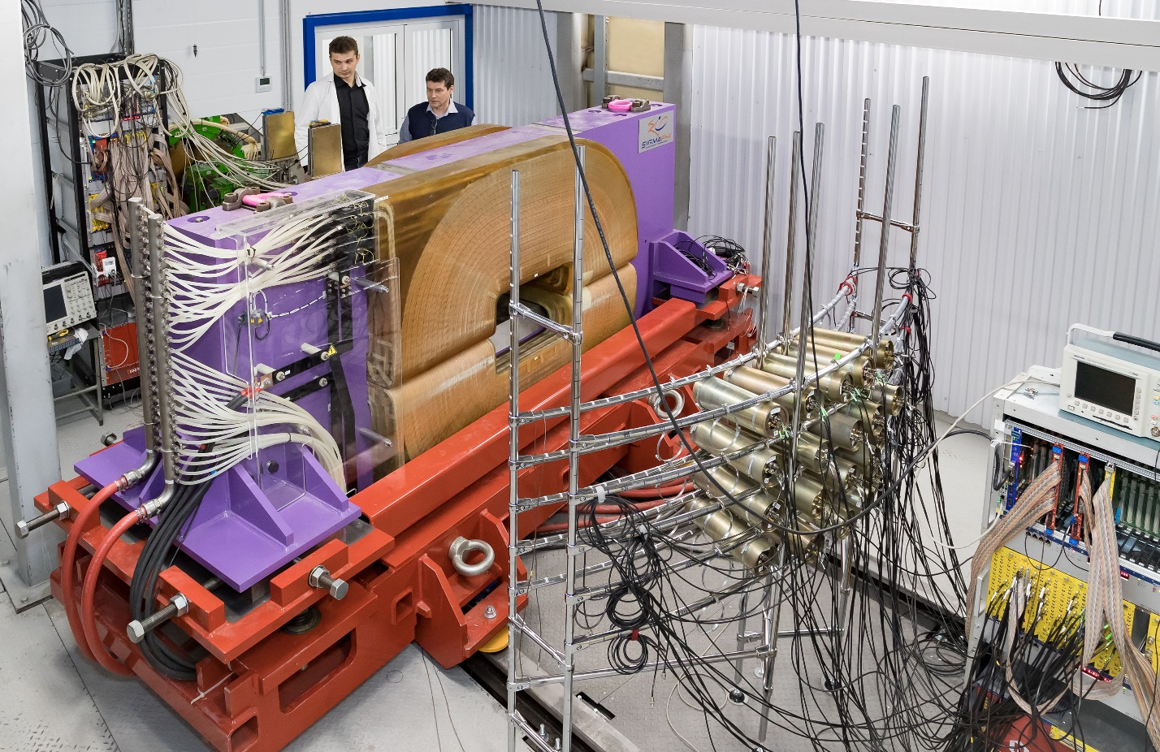
First experiments with ⁶He and ⁹Li on CD₂ target were carried out at ACC-2 in spring:
elastic and inelastic scattering of ⁶He;
d(⁶He,³He)⁵H reaction;
d(⁹Li,p)¹⁰Li → n+⁹Li run.

Slide 6
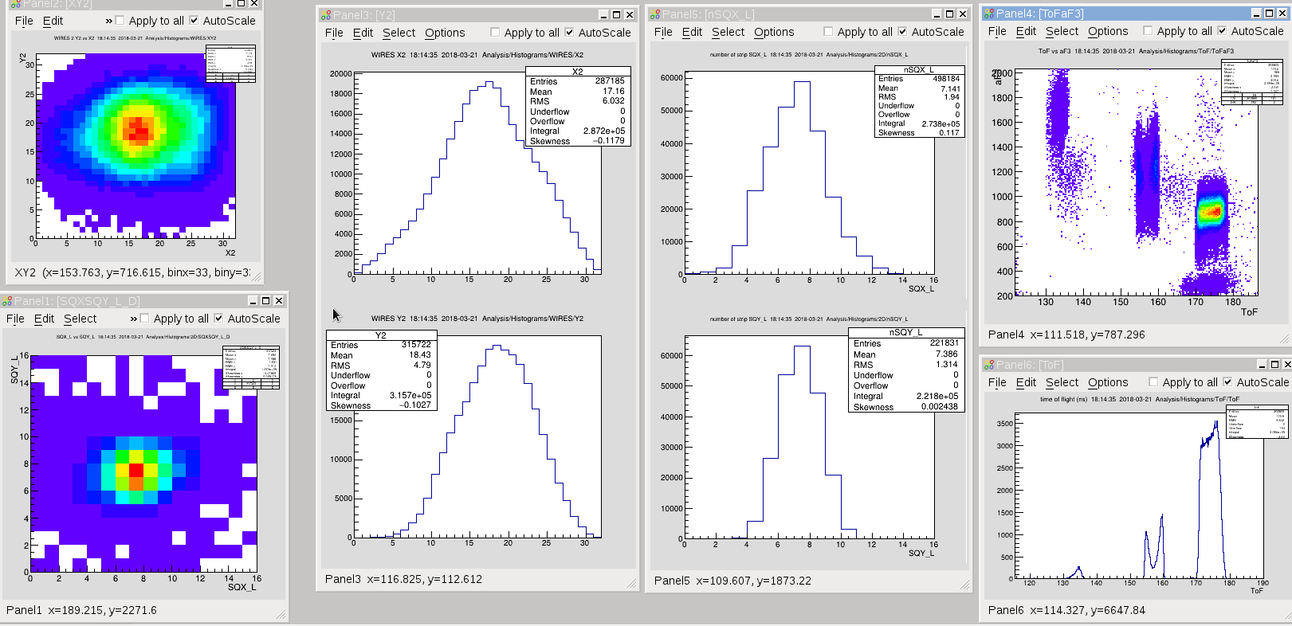
ACCULINNA-2 provides a good quality of ⁶He and ⁹Li obtained in the ¹⁵N (49.7 AMeV) + Be (2 mm) reaction:
I ~ 10⁵ pps @ 0.1 pμA & Δp/p = 6 % (Be wedge 3 mm)
P ~ 92 %, E ~ 25 AMeV, beam spot ~ 17 mm (FWHM)
⁸Li
⁶He
Ø ~ 17 mm

Slide 7
Preliminary results of elastic and inelastic scattering of ⁶He (25 AMeV) on ²H:
dσ/dΏ in a wide angular range (4 runs, θ_{CM} ~ 30÷140º) with a good statistics
⁶He(⁹Li)
Counts
d
⁶He
⁴He
θ_{lab}, deg.

Slide 8
d(⁶He,³He)⁵H reaction as a tool for the main run d(⁸He,³He)⁷H
i) ΔE-E plot for low-energy ³He (E=8.5 ÷ 11.5 MeV) identification;
ii) coincidences between ³He and ³H (E= 117 ÷ 121 MeV);
iii) triggering for ³He moving forward at θ_{lab} < 20 deg.
Eff._{(3He-t)} ~ 70%
one day
exposition
E. Nikolskii’s
simulations
⁶He
ΔE (22 μ Si), MeV
⁴He
³He
ΔE+E (22+1000 μ Si), MeV
Preliminary results:
* ³He separation should be improved;
** several ³He-t coincidences/day;
*** 200 triggers/telescope @ 10⁵ pps

Slide 9
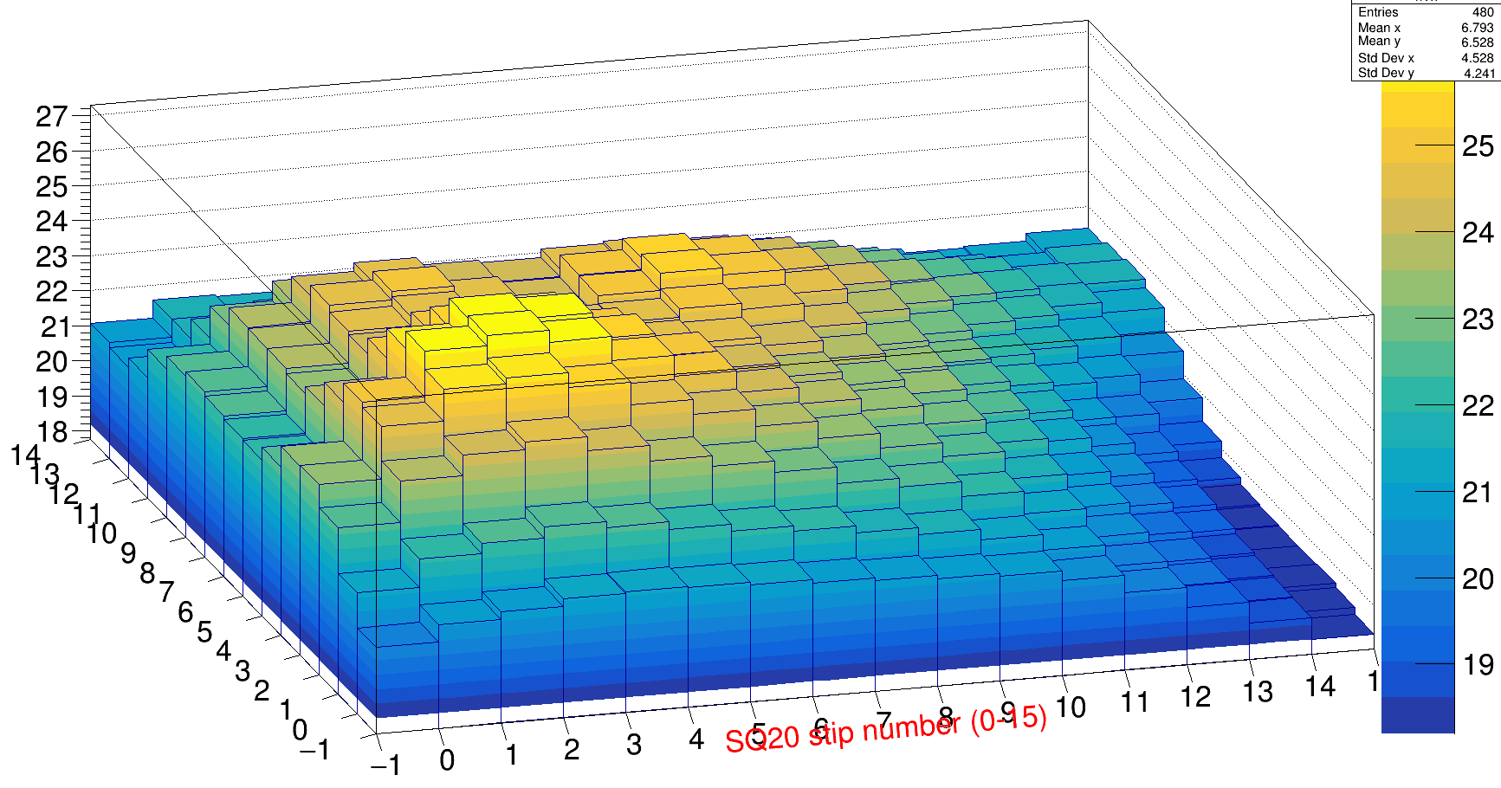
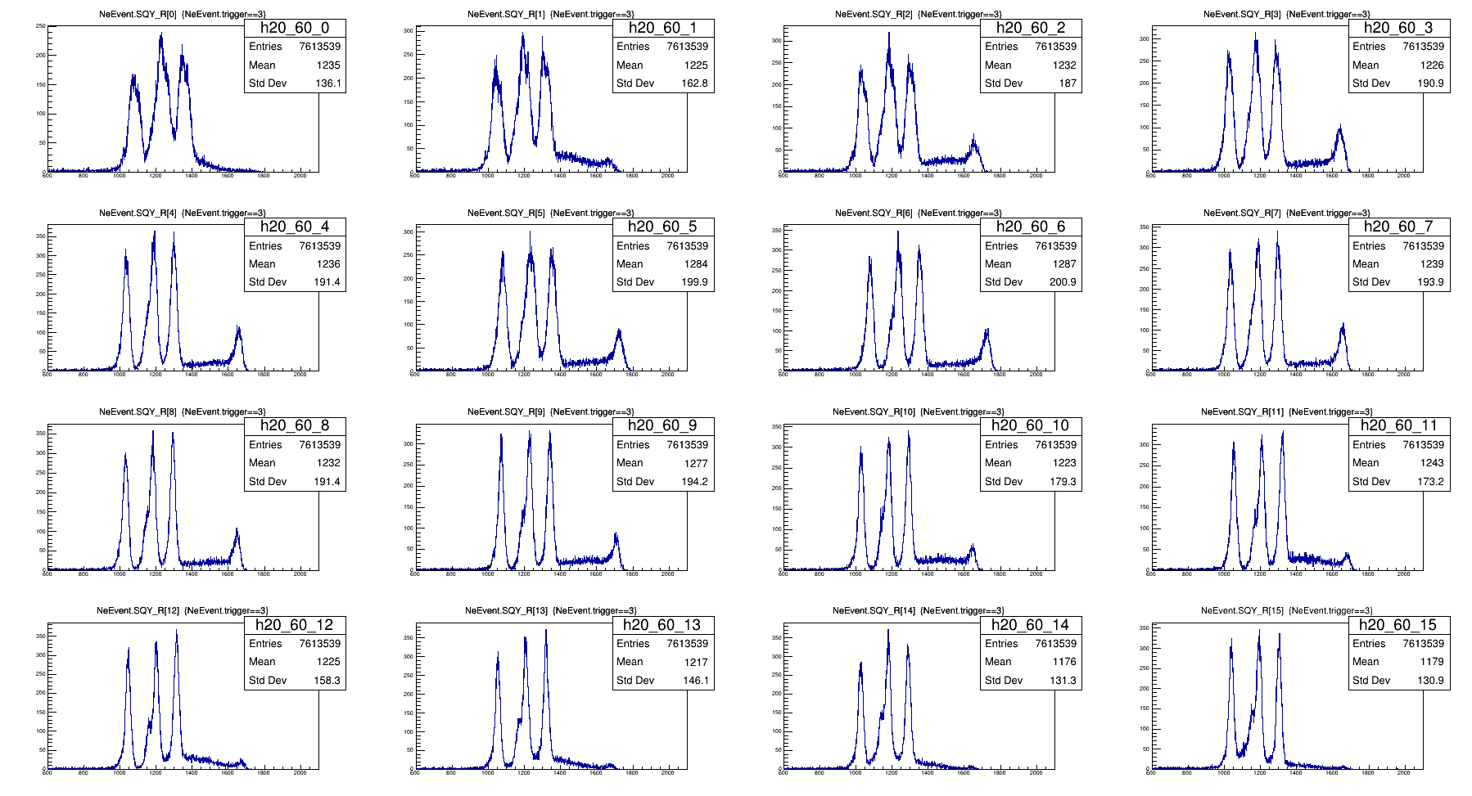
Key points for 22 μ Si : thickness uniformity and energy resolution
Thickness distr.:
from 19 μ
up to 26 μ
(instead of ±1.5 μ)
²²⁶Ra source
Energy resolution:
~ 270 keV (~ 4%)
for E_{α} = 6.0 MeV

Slide 10
E. Nikolskii’s
simulations
d(⁸He,³Het)⁷H
5 events/day
σ~30 μb/sr
E. Nikolskii et al.,
PRC 81 (2010)
~5 ⁷H/day (two telescopes) @ 5*10⁴ ⁸He/s → ~140 ⁷H during 4 weeks

Slide 11
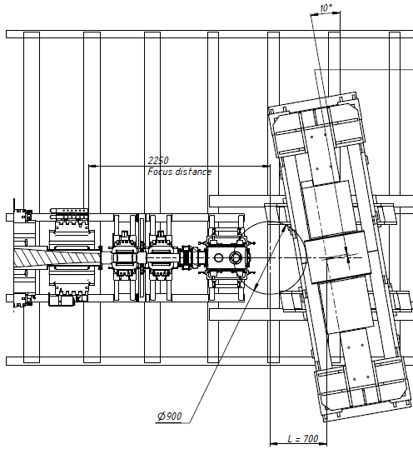
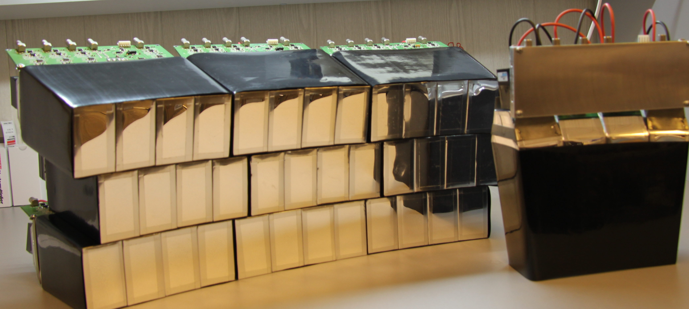
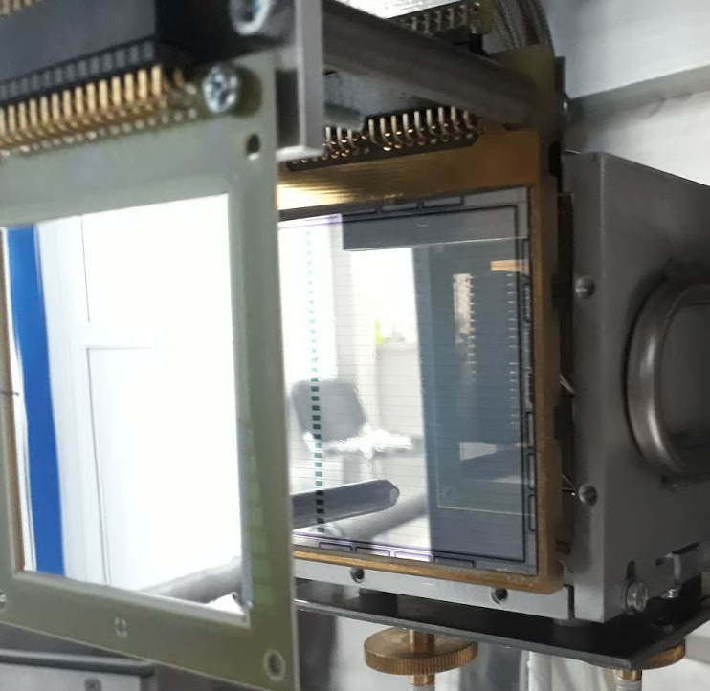
d(⁸He,³He)⁷H: 7 weeks are requested (effect + background)
CsI array GADAST
64 units
³He:
Si - 22 μ
Si - 1000 μ
Energy & position:
decay tritons & RIB
Bρ = 0.4 ~ 1.0 Tm
Cone 0 ~ 14°
⁸He ~50 kps
Stilbene
array
40 units
E~25 AMeV
Neutrons,
Cone 0 ~ 14°
³H: X_Y_DE
Si - 1000 μ
32 x 32 strips
D₂-target
3x10²⁰ at/cm²
Advantages: good energy resolutions (~1.2 MeV) & ³He-t-n coins.
Notes:
SIGMAPHI PRESENTATION - JUNE 2001

Slide 12
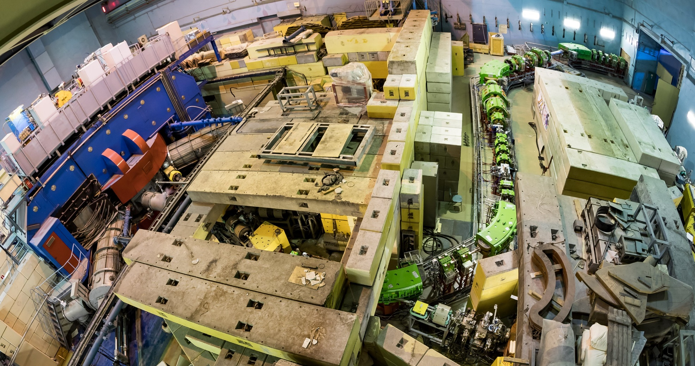
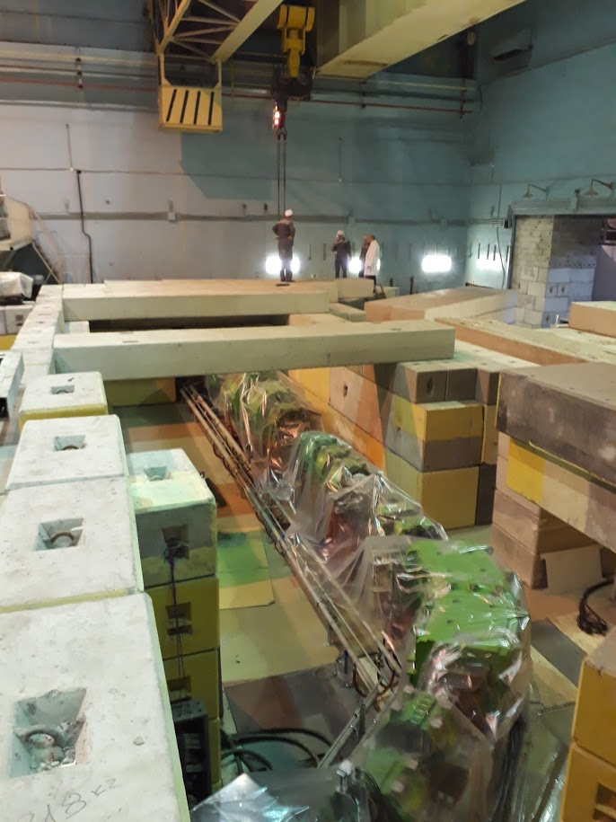
Moving ahead to the flagship experiment ⁷H
F2
F3-F5
F0
F1
Radiation shell around F1-F2 area will be completed in July-August.

Slide 13
Summary and outlook
ACCULINNA-2 fragment separator commissioned in 2017 is now ready for day-one experiments.
In 2018 experimental program with RIBs has been focused on beta-delayed exotic decays of ¹¹Be, ⁶He+d scattering and d(⁶He,³He)⁵H reaction study.
Method to study low-lying states of ¹⁰Li populated in the reaction d(⁹Li,p)¹⁰Li → n+⁹Li was tested too.
(registration of protons, emitted backward in laboratory system, in coincidence with neutrons moving in forward direction)
The study of the ⁷H and its 4n-decay in the reaction d(⁸He,³He)⁷H is proposed for the fall 2018.
Thanks for your attention

Slide 14
Energy resolution in the flagship experiment ⁷H

Slide 15
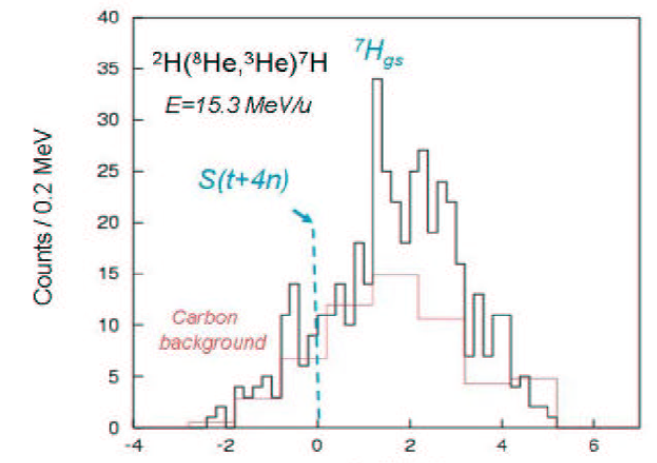
⁷H puzzle: each time only limits of σ were observed
p(⁸He,pp)⁷H
E=25 AMeV
Golovkov et al.,
EXON-2006 p.32
E=61 AMeV
coincidences
σ~15 μb/sr
Counts/1.5 MeV
Counts/0.6 MeV
Korsheninnikov et al.,
PRL 90(2003)
d(⁸He,³He)⁷H
d(⁸He,³Het)⁷H
E=15.3 AMeV
Fortier et al.,
EXON-2006 p.3
Nikolskii et al.,
PRC 81 (2010)
Counts/0.2 MeV
σ~30 μb/sr
σ~10 μb/sr
⁷H missing mass (MeV)
Caamaño et al. PRL 99(2007) ¹²C(⁸He,¹³N)⁷H ==>
E = 0.57
+0.42
MeV, Γ = 0.09
+0.94
MeV
-0.21
-0.06
 Drastically improvement of sensitivity in d(⁸He,³He)⁷H or p(⁸He,pp)⁷H
 ¹¹Li as a projectile and alpha transfer reaction d(¹¹Li,⁶Li)⁷H

Slide 16
ACC-2 @ U400M advantages:
Room temperature operating
Relatively low cost beam time
Runs during 3 and even more weeks are possible
Cryogenic targets ³He, ⁴He and all hydrogen isotopes
ToF length ~15 m
E_{RIB}, AMeV
Z

Slide 17
Beta-delayed alpha decay of ¹¹Be. Proposal given by Warsaw Univ.

