Slide 1
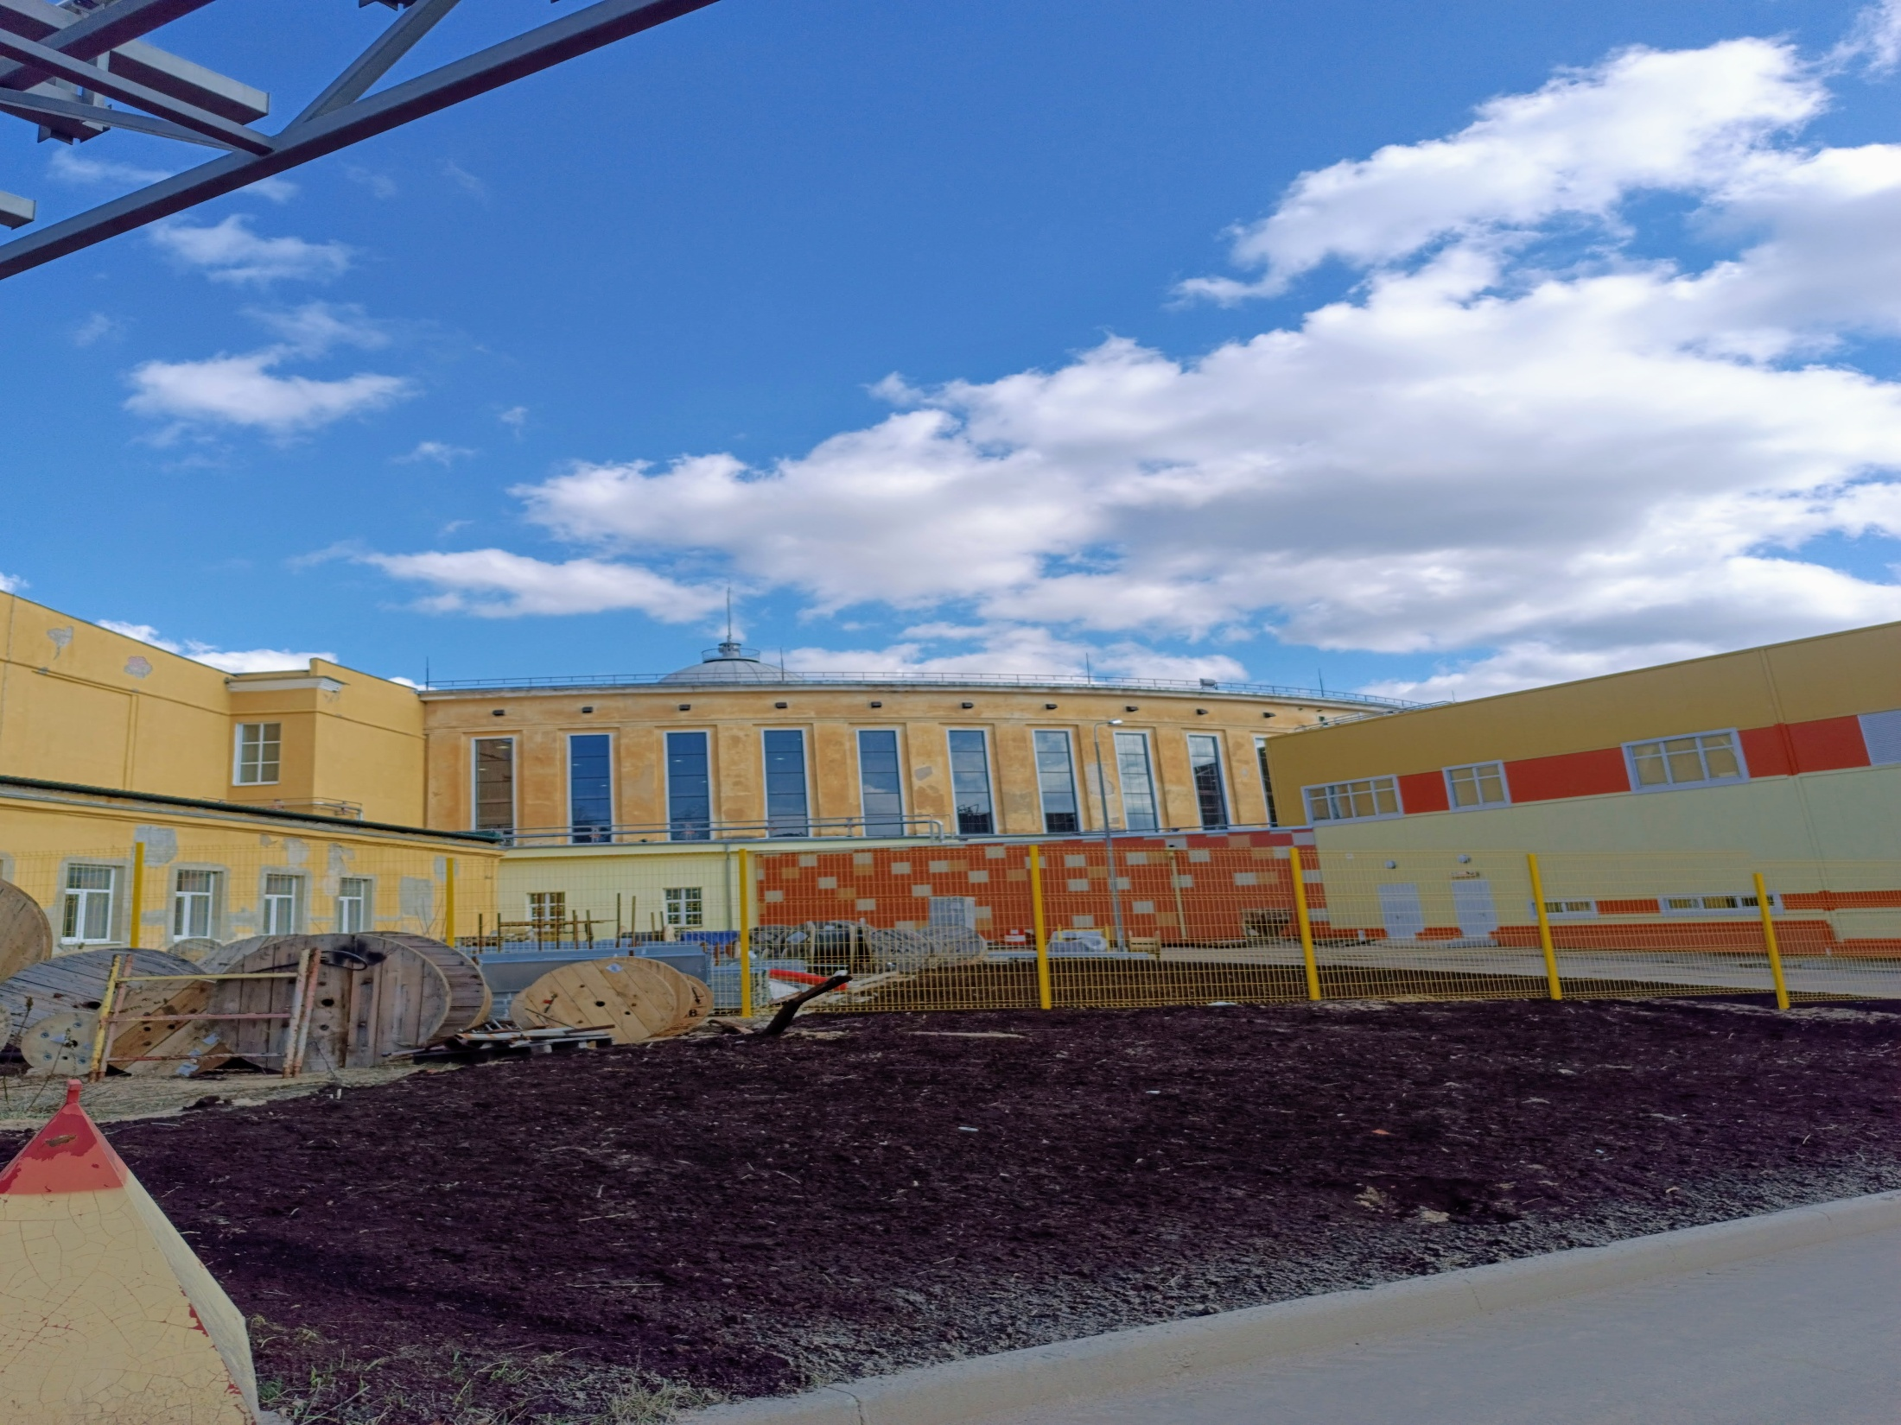

SPD ECAL Status Report
X SPD collaboration meeting
Dubna, October 20 of 2025
Oleg Gavrishuk, Laboratory of High Energy Physics, Dubna

Slide 2
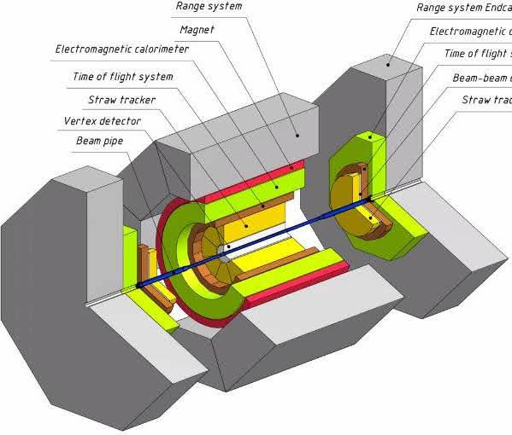
Overview of the SPD ECAL
The calorimeter placed inside of Cryostat (Red) and shown in layout Green color.
The calorimeter is designed for efficient registration of electrons and gamma quanta in the energy range up to 10 GeV.
The transverse size of the calorimeter cell should be on the order of the effective Moliere radius of the calorimeter medium: ~58 mm.
The cells in the End-Cup part of the calorimeter have a rectangular shape 40x40 mm².
The cells in the barrel part of the calorimeter have a trapezoidal shape in the azimuthal direction with vertex angle of the trapezoid equals 1.87 and 40 mm in beam direction.
19.10.2025
Oleg Gavrishchuk
2
Notes:
2
2

Slide 3
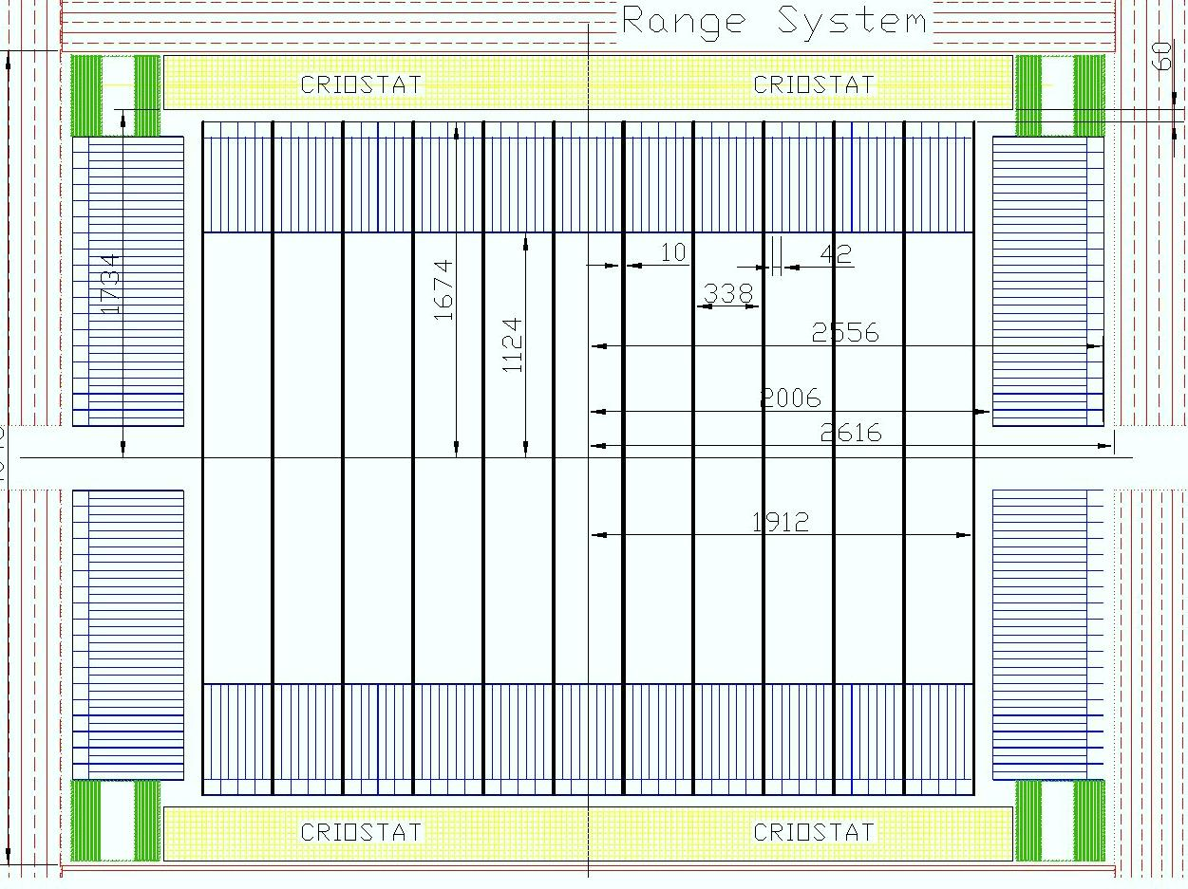
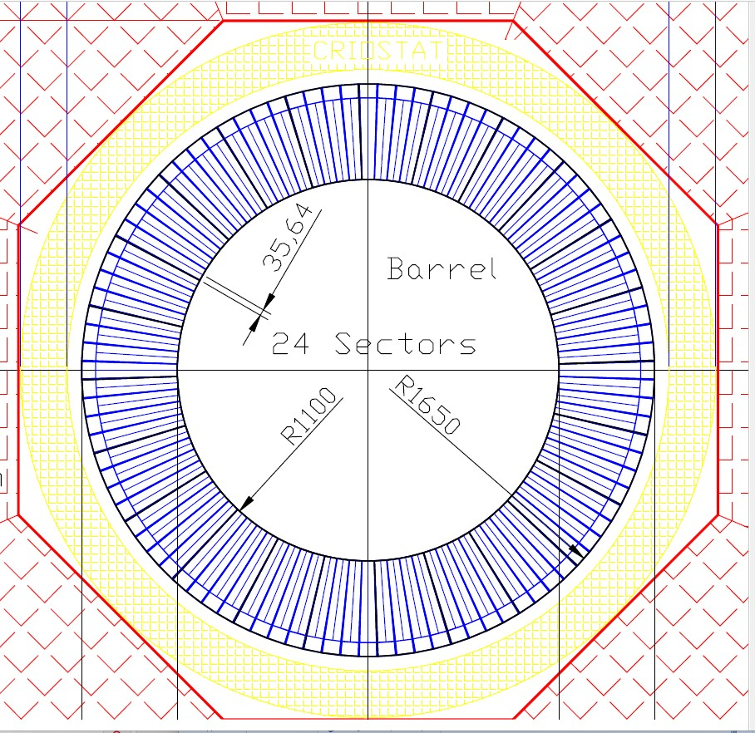
Schematic view of a calorimeter placed inside of cryostat.
Criostat
Barrel
End-Cup
Barrel
Criostat
19.10.2025
Oleg Gavrishchuk
3
Notes:
3
3

Slide 4
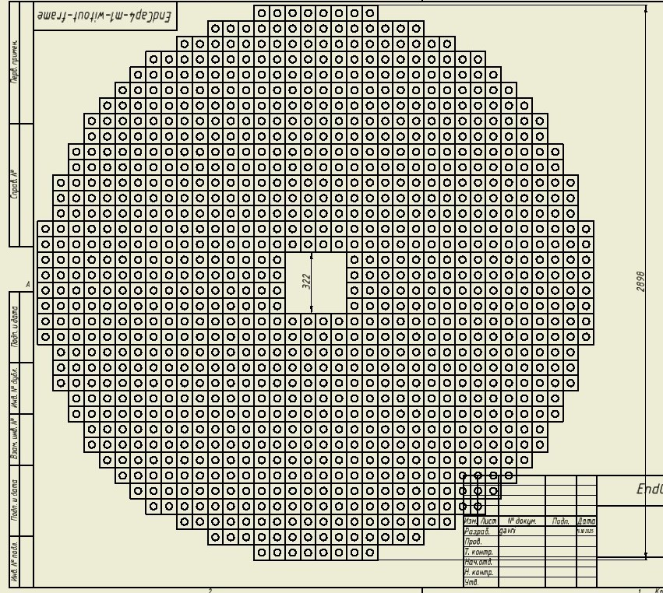
End Cup drawing, produced by Valery Shvetsov consist of 1020 modules 80x80 mm² or 4080 cells 40x40 mm²

Slide 5
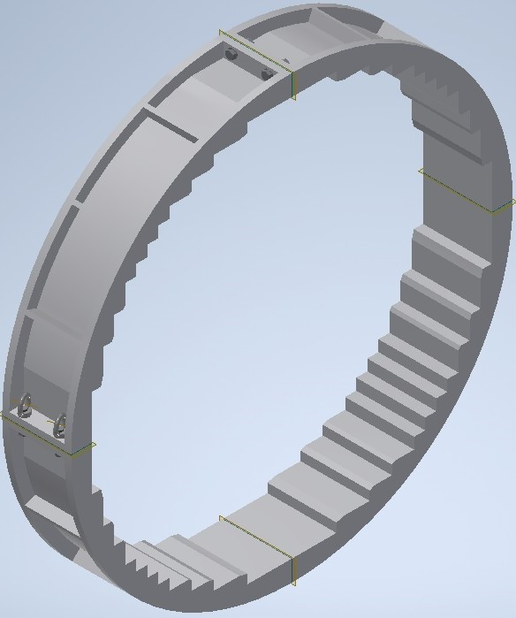
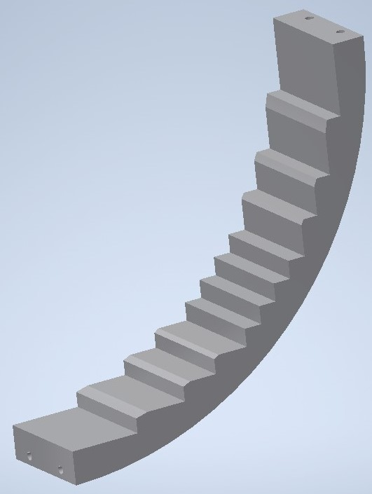
End-Cup calorimeter support.
Frame design.
Aluminum frame composed from 4 details made by casting into a mold

Slide 6
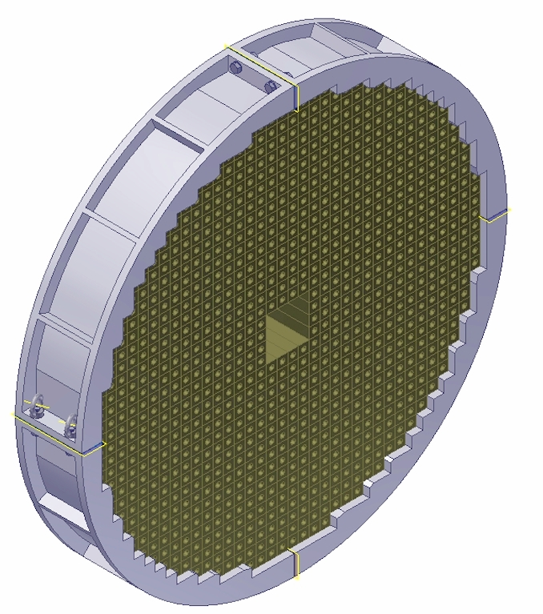
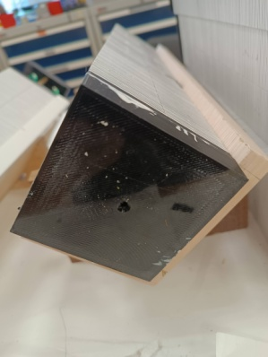
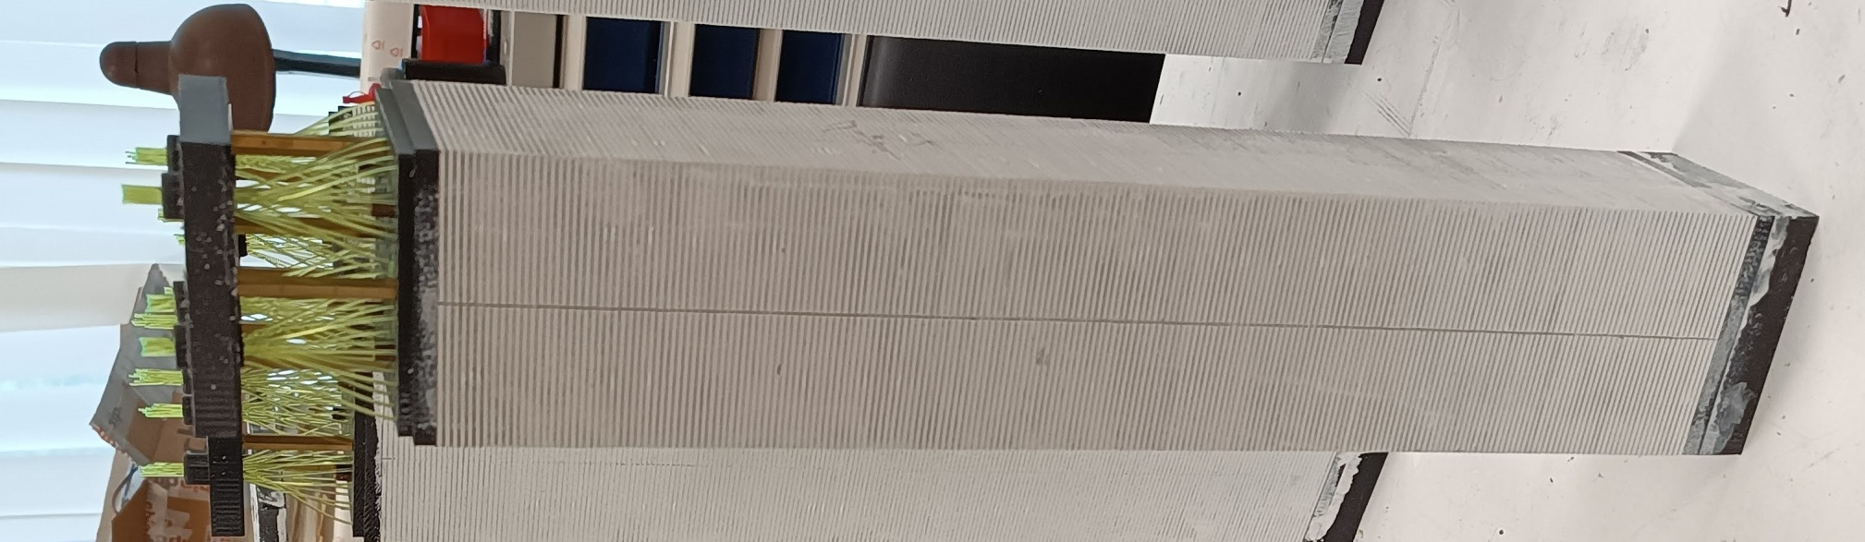
End-Cup calorimeter placed into frme.
ECAL’s modules placed inside of frame

Slide 7
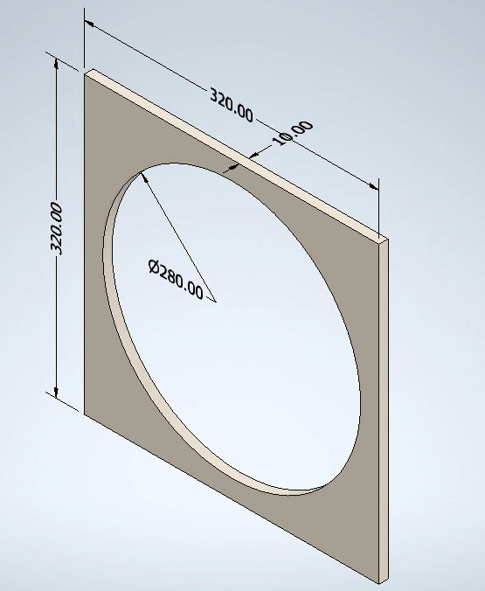
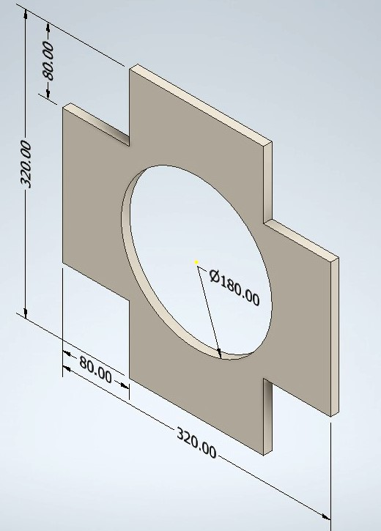
The plates for central widows support, printed by 3-D printer from ABS plastic with density of 50% .
Plate thick is equal 10 mm.
Windows with 4
modules 80x80 mm²
Windows squire of 320x230 mm²

Slide 8
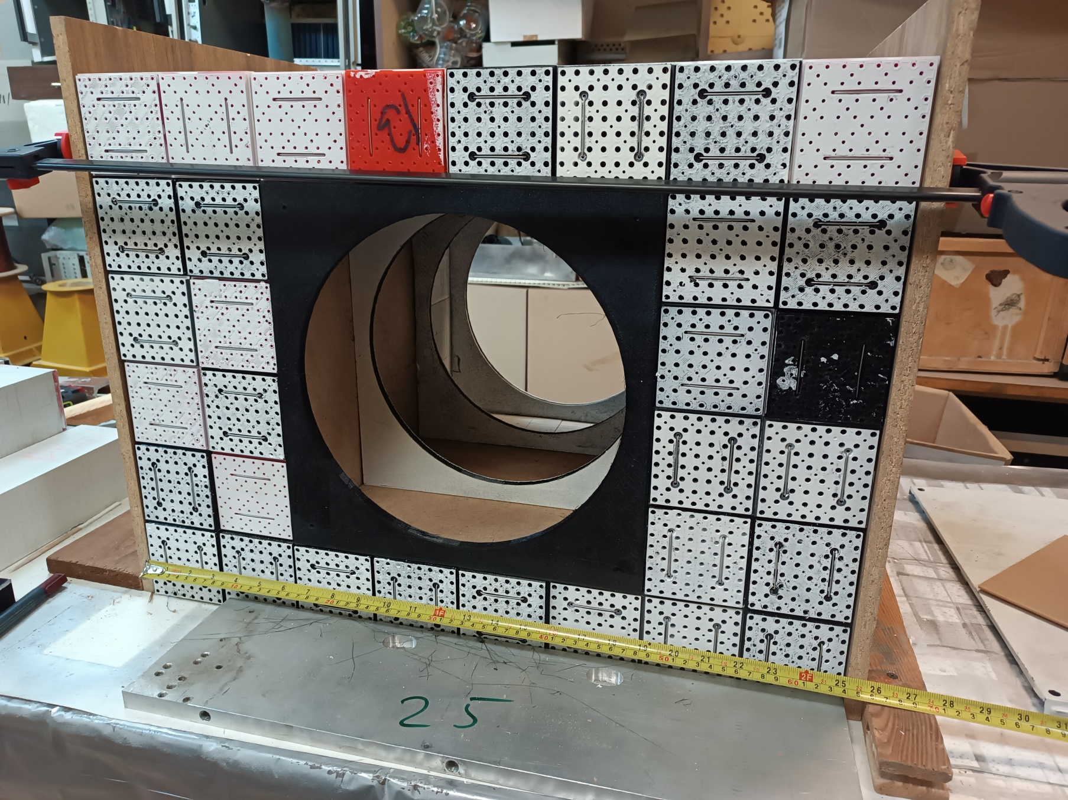
Windows 320x320 mm² assembling with 4 ABS plates
380x380x10 mm³.
Фрагмент окна (3-д модель)
Сделано
Будет Испытано
Валера прорисует

Slide 9
Calorimeters cell composition
Calorimeter has sampling structure of 200 layers of 1.5-mm polystyrene scintillator and 0.5-mm lead, the length of the active part ~403 mm, which corresponds to ~18X0.
The Cells in the End-Cup part of the calorimeter have a rectangular shape 40x40 mm².
4 calorimeter cells are composed into a single Module, where four 40x40 mm scintillators cells are joint by a common 80x80 mm lead plate.
800 Polystyrene scintillator plates with 1.5% P-terphenyl and 0.05% POPOP is used.
199 Lead plates 0.5 mm: alloy Cca with 0.5% antimony is used as an absorber.
64 WLS fibers (1 mm diam.) collect light onto the SiPm of 6x6 mm² with 15 micron pith size. Its corresponded to 160.000 pixels. 32 metest of WLS used pes one module/
SiPm EQR15 11-6060D-S - it is a novel China design of NDL technology. NDL SiPM employs intrinsic epitaxial layer as the quenching resistors
19.10.2025
Oleg Gavrishchuk
9
Notes:
9
9

Slide 10
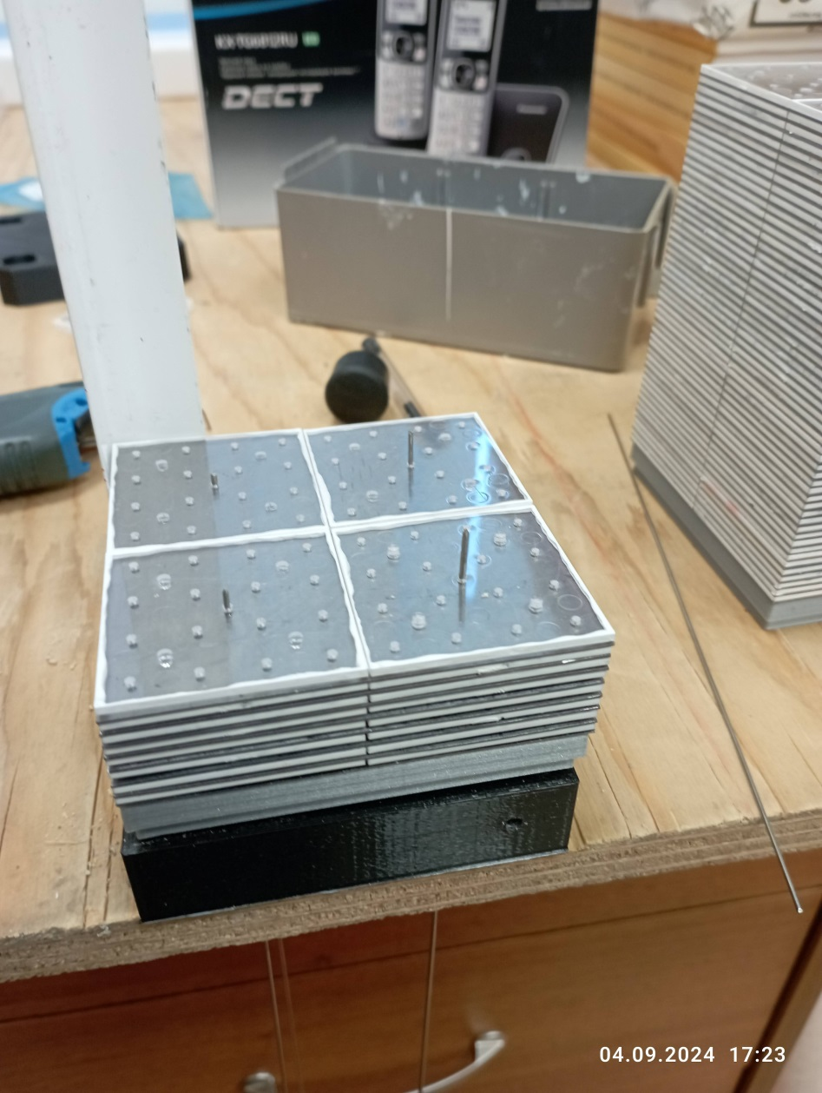
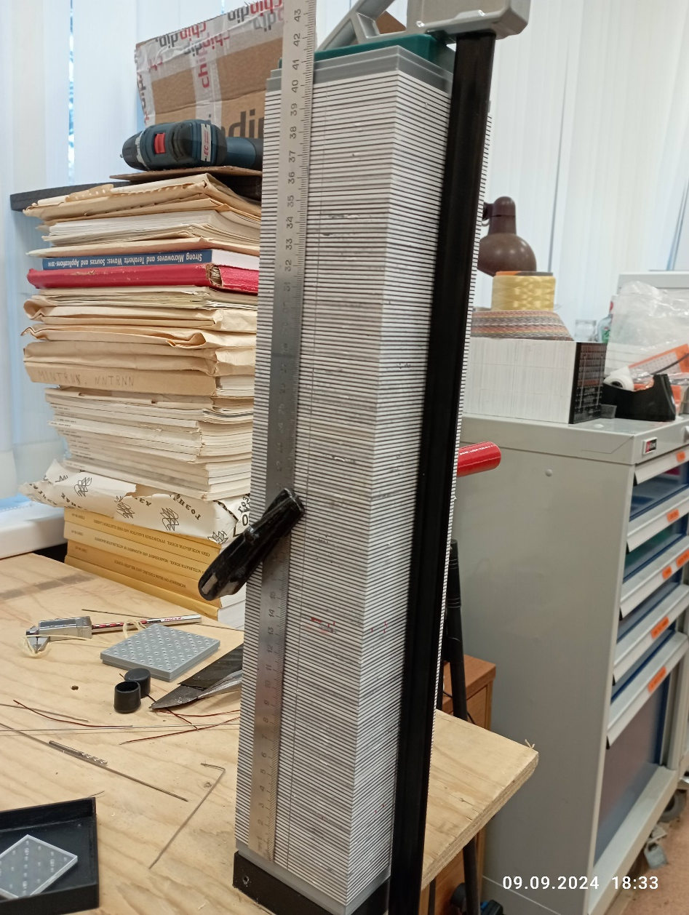
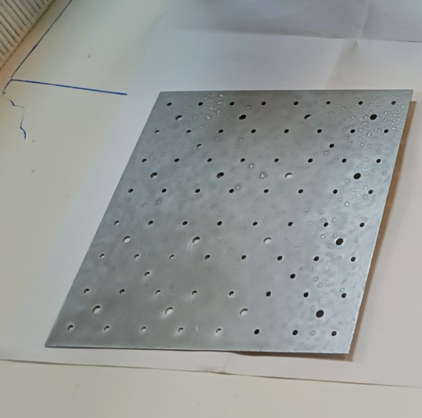
Modules assembling
4-cells module assembling - in beginning stage.
Final stage of module stacking with 200 layers of 1.5+0.5 mm scintillators
And Led plates. The length of Active volume is equal 403 mm , that corresponded to the estimated period 2.02 mm
Led plate 80x80 mm² to joint 4 Scintillator plates
40x40 mm².

Slide 11
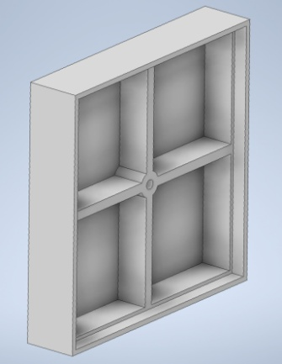
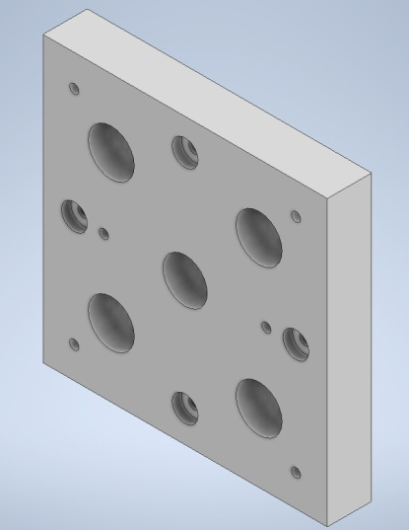
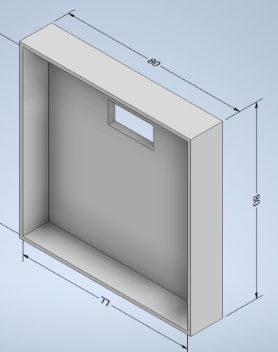
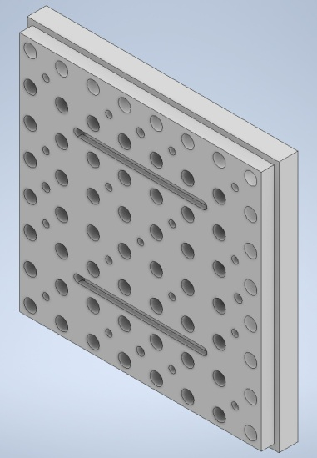
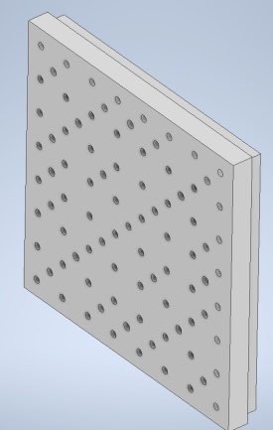
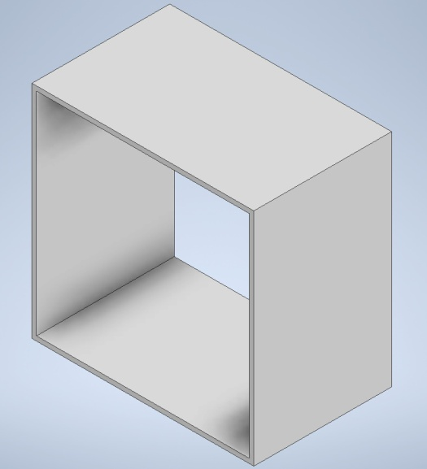
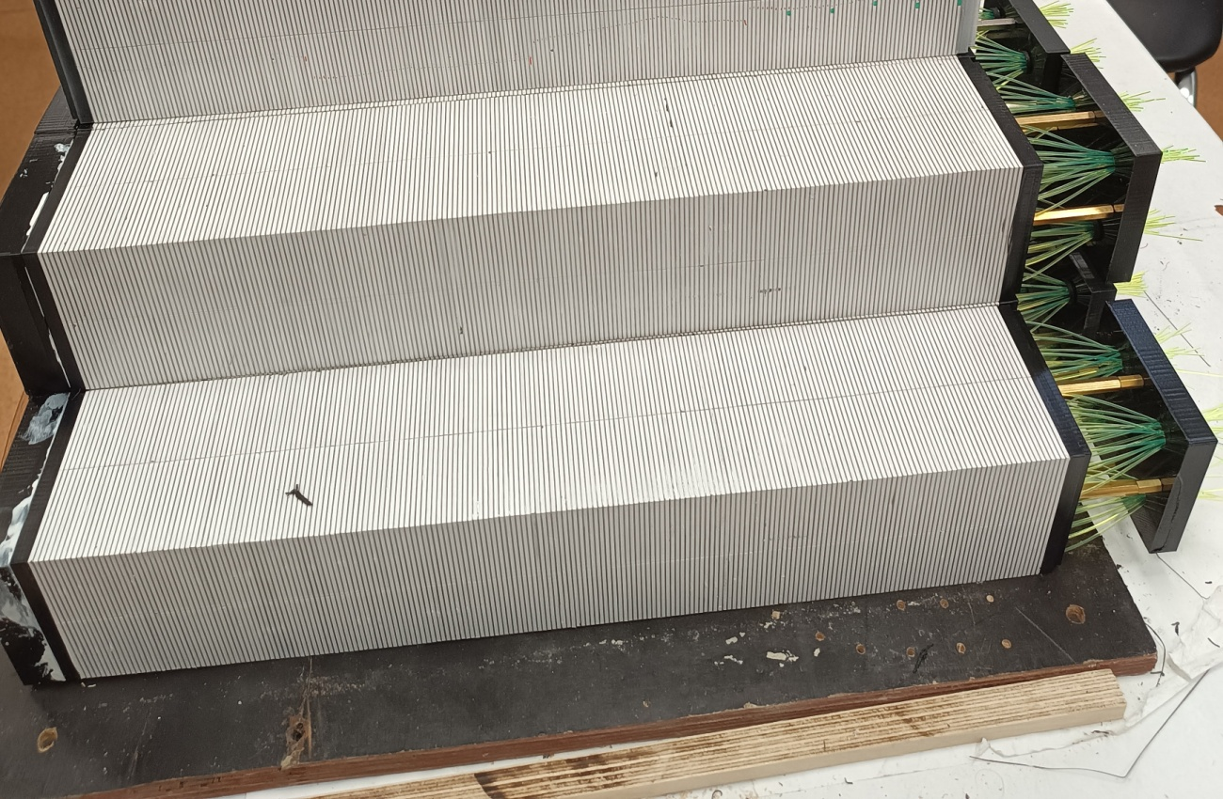
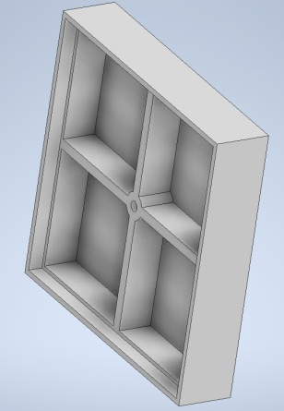
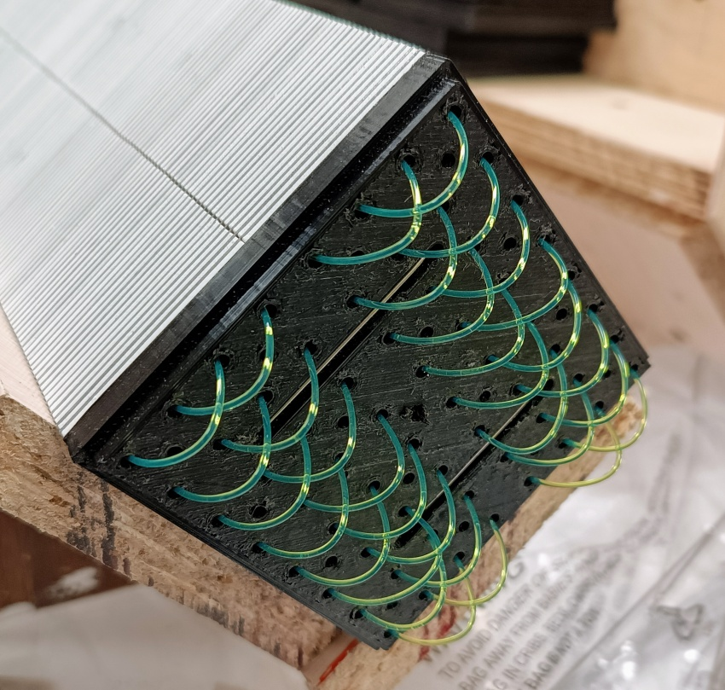
Assembling Details
ABS plastic,
3-D Printer,
density=0.6 gr/cm³

Slide 12
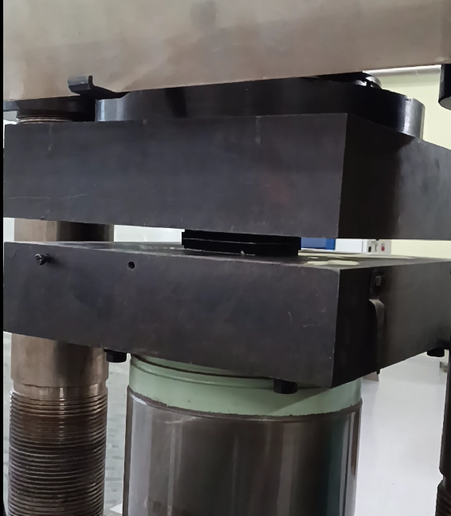
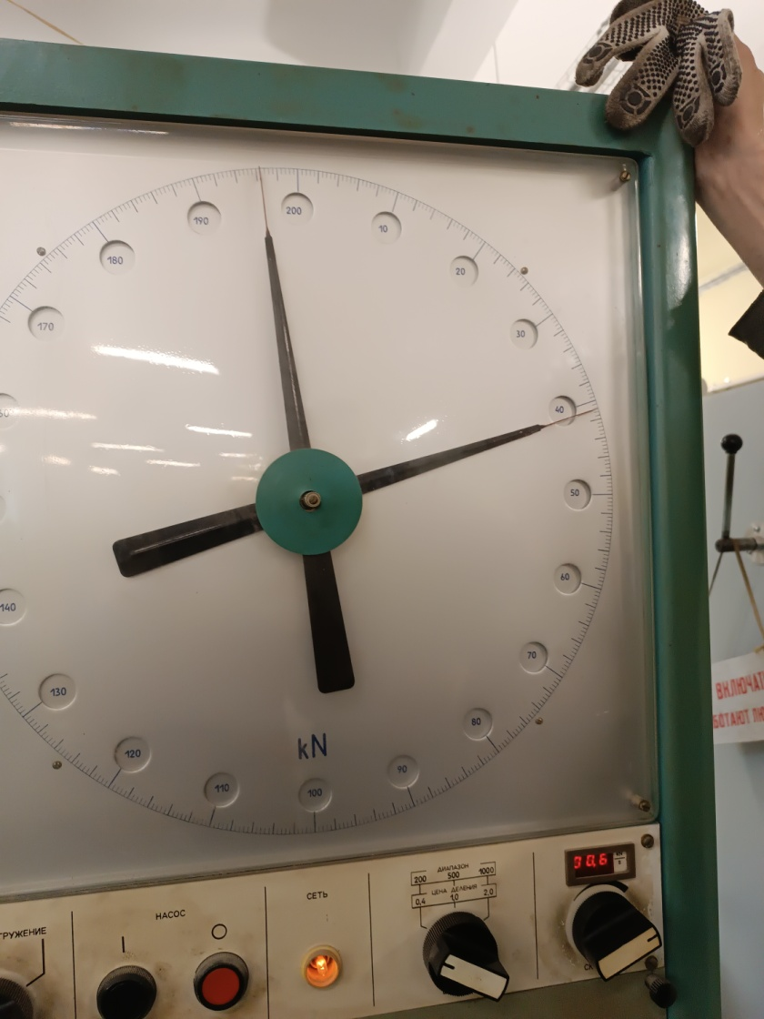
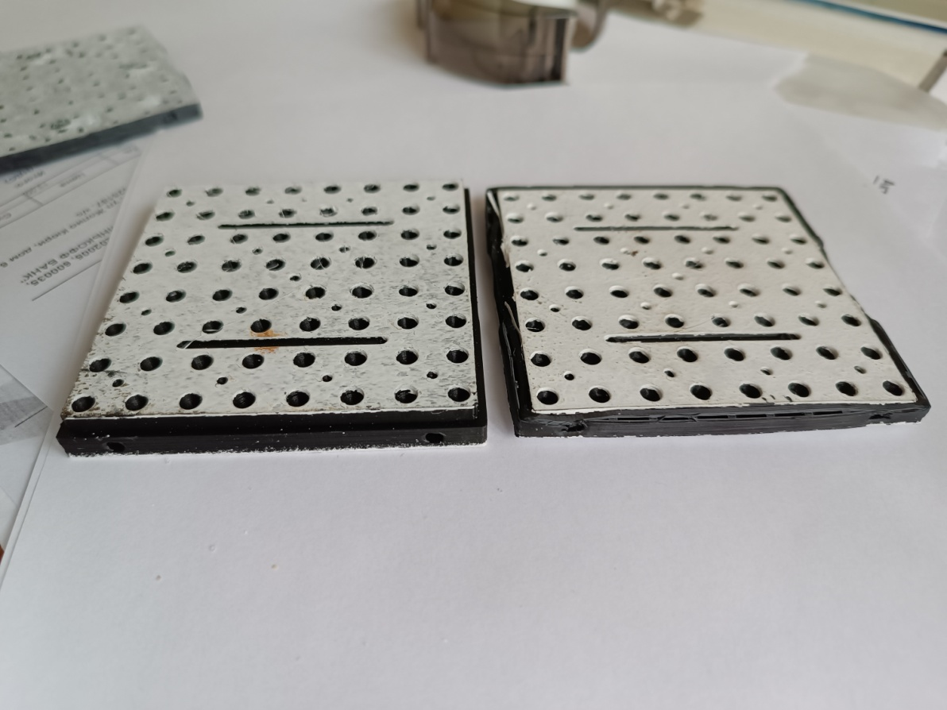
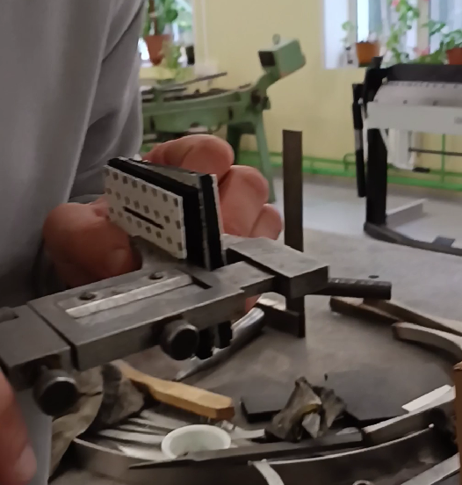
Crash tests for assembling plates was done.
The plates deformation measured after 600 kg load was about 0.2 mm.
The plastic deformation - is approximately 900-1000 kg.
600 kg load
1000 kg load

Slide 13
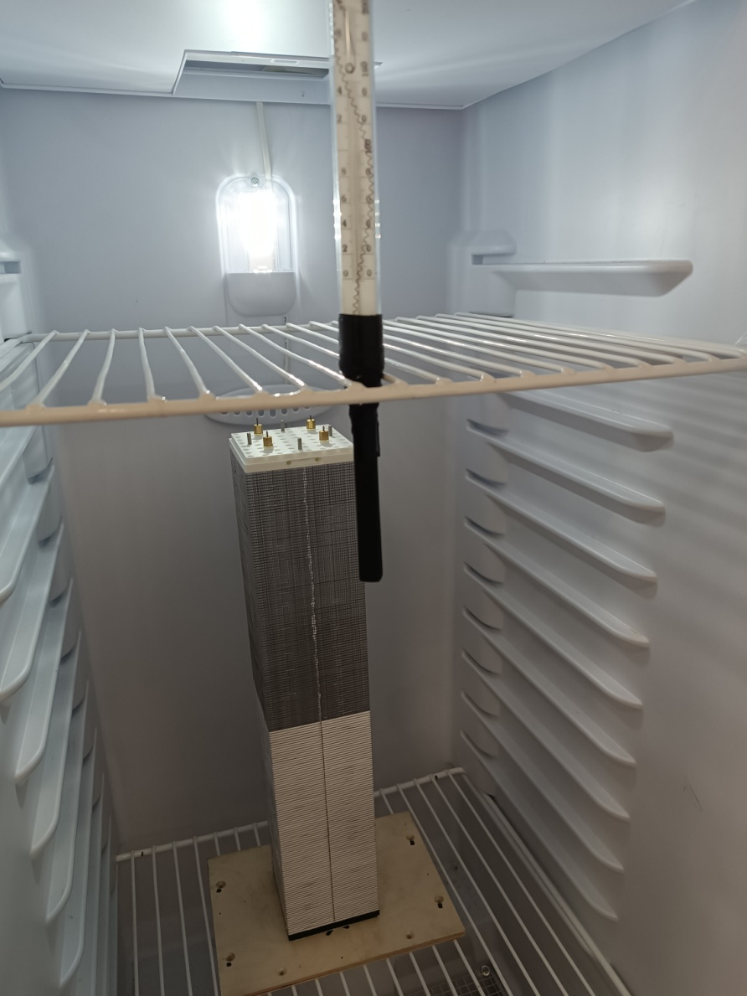
Temperature tests for assembled module was started in 08 October 2025 at temperature 40 Celsius degree.
The long time test for one Year.

Slide 14
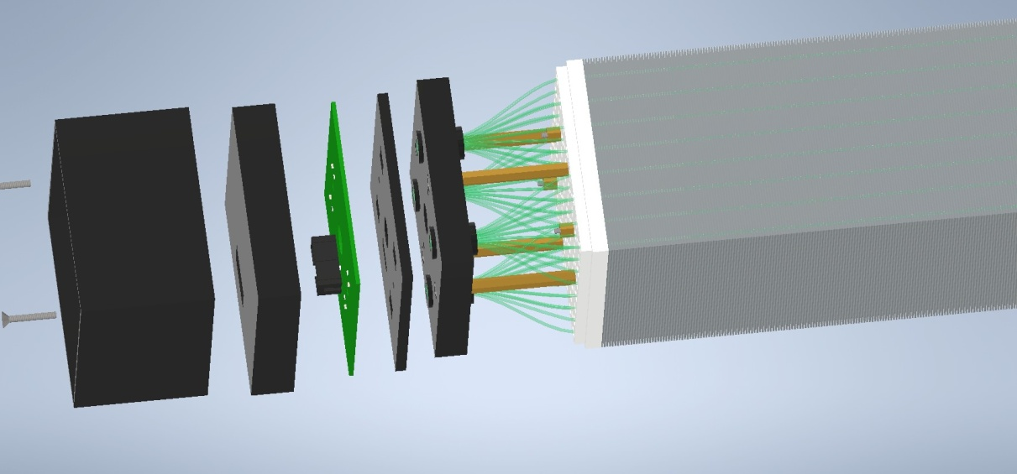
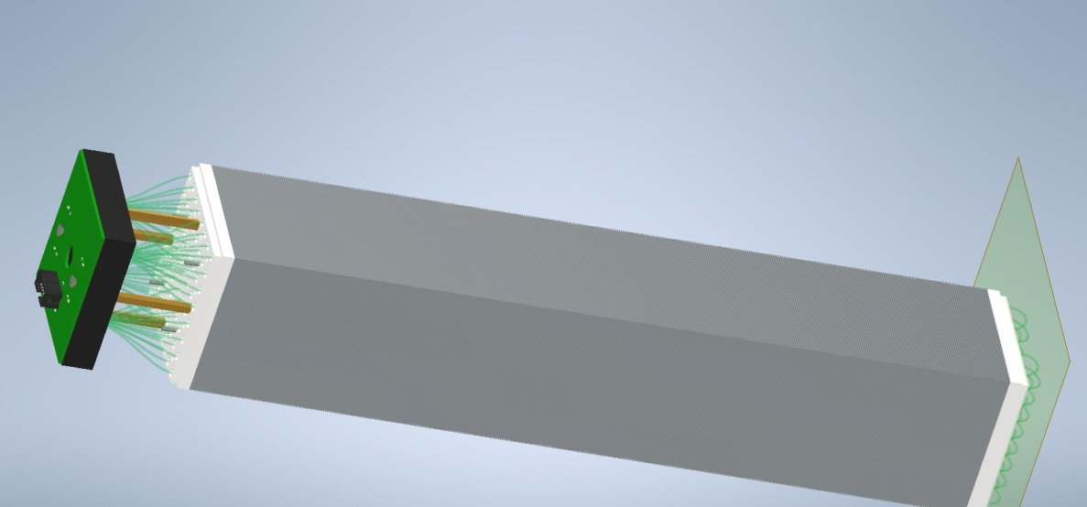
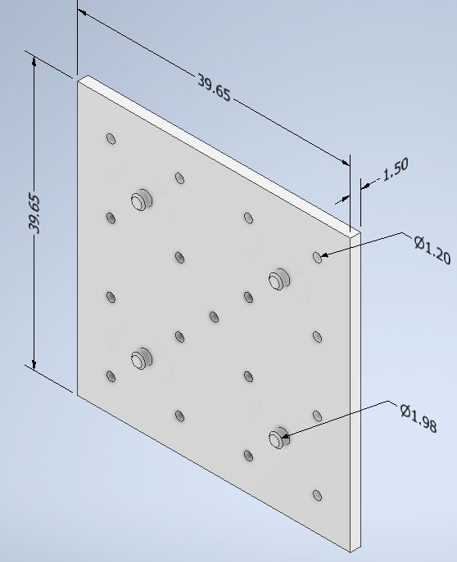
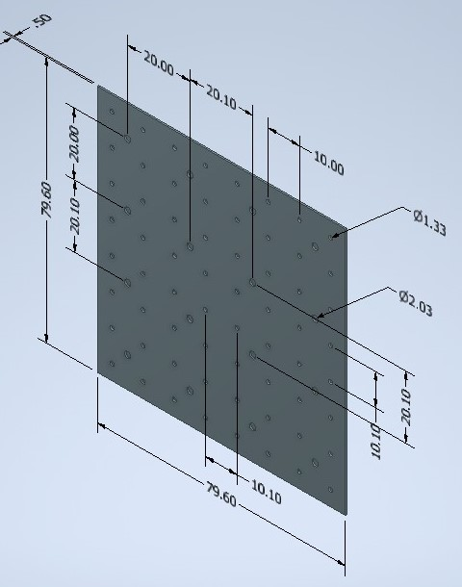
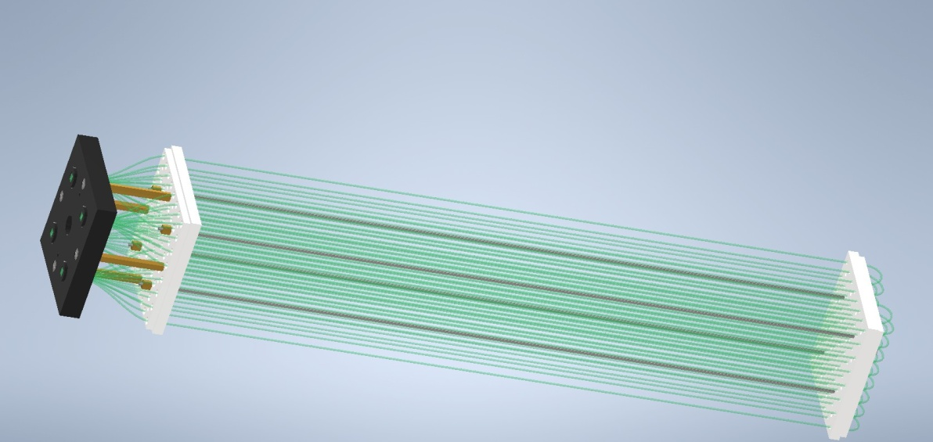
3-D Model
ECAL SPD END CUP module 3-D Design
3-D ECAL model should be implemented in SPD Data base by help of Valery Shvetsov
SiPm
electonic board
Scint. and Lead absorber
Scintillator and Led Plates
WLS fibers

Slide 15
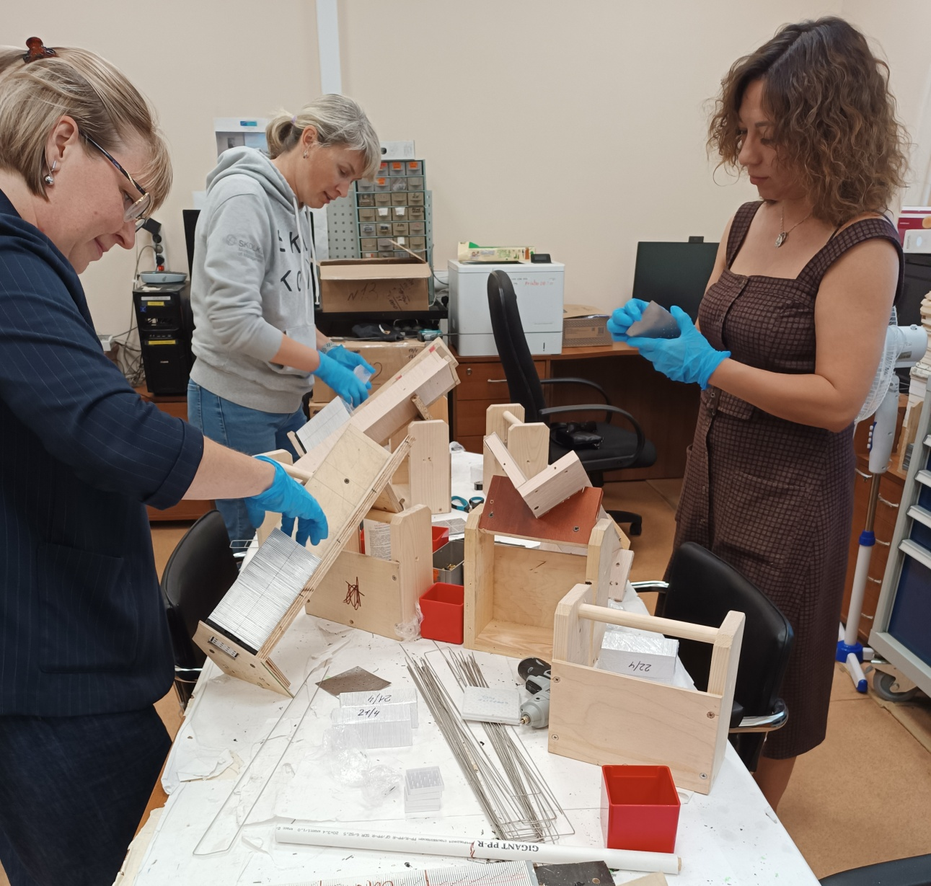
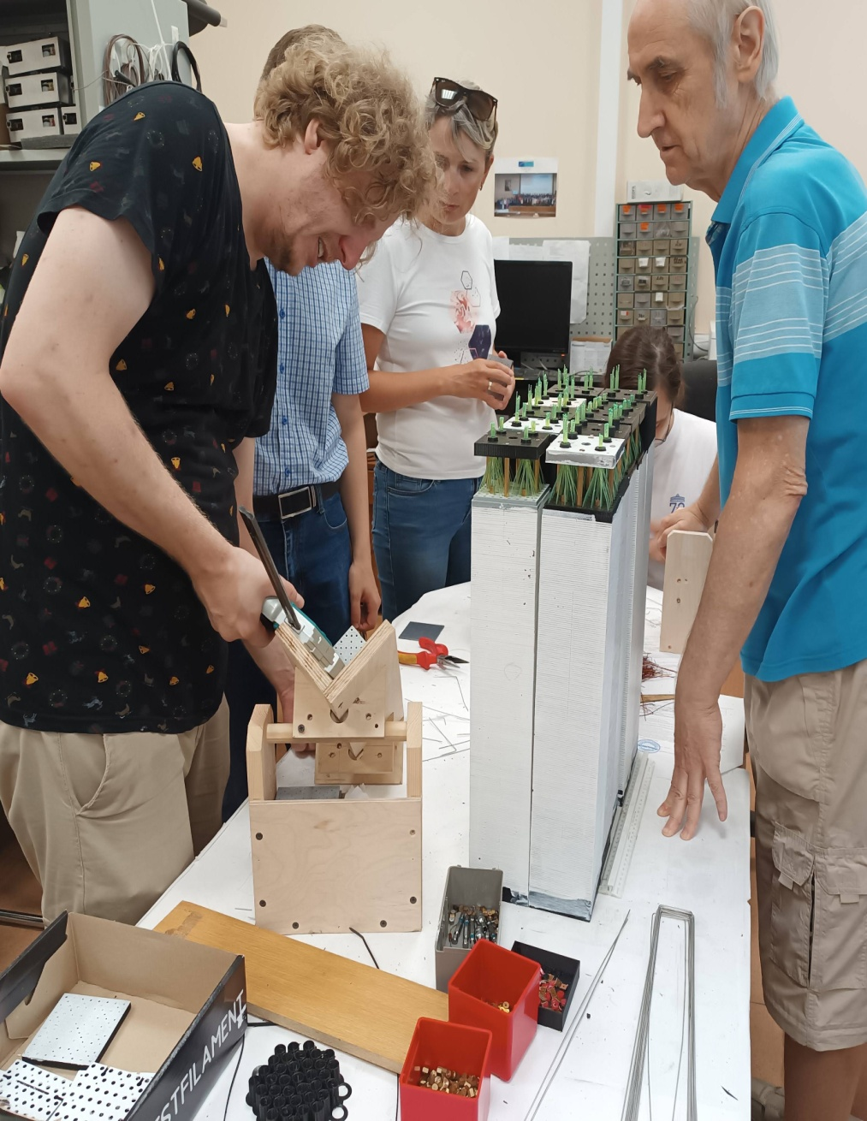
Modules Assembling in Bld. 205, office 122 by help of volunteers from LHEP

Slide 16
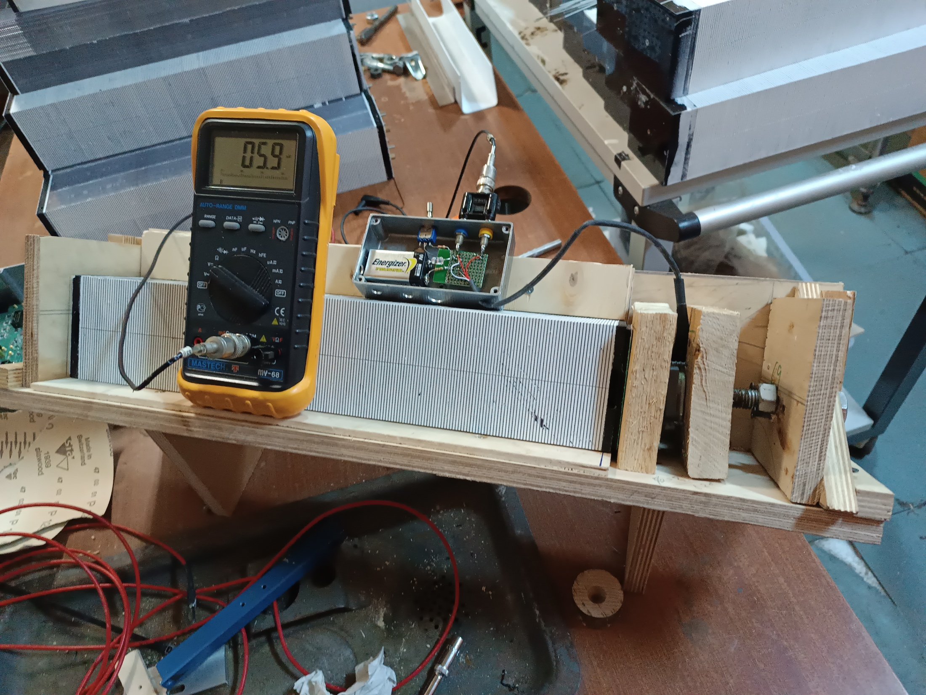
ECAL model compressed with load about 100 kg to obtain the necessary size of 403 mm for active part.
Controlled by tens sensor.

Slide 17
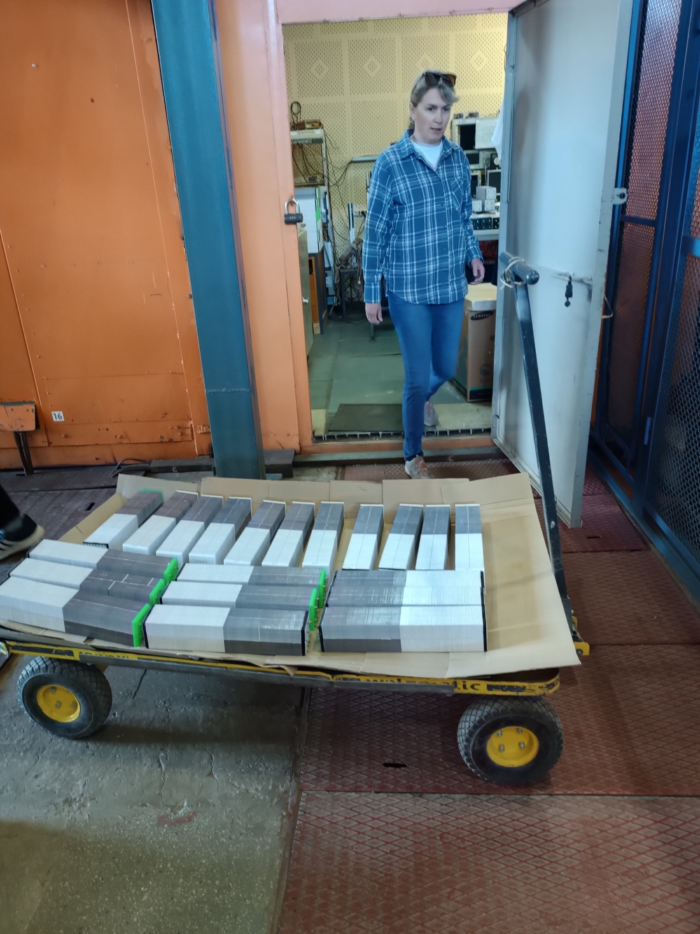
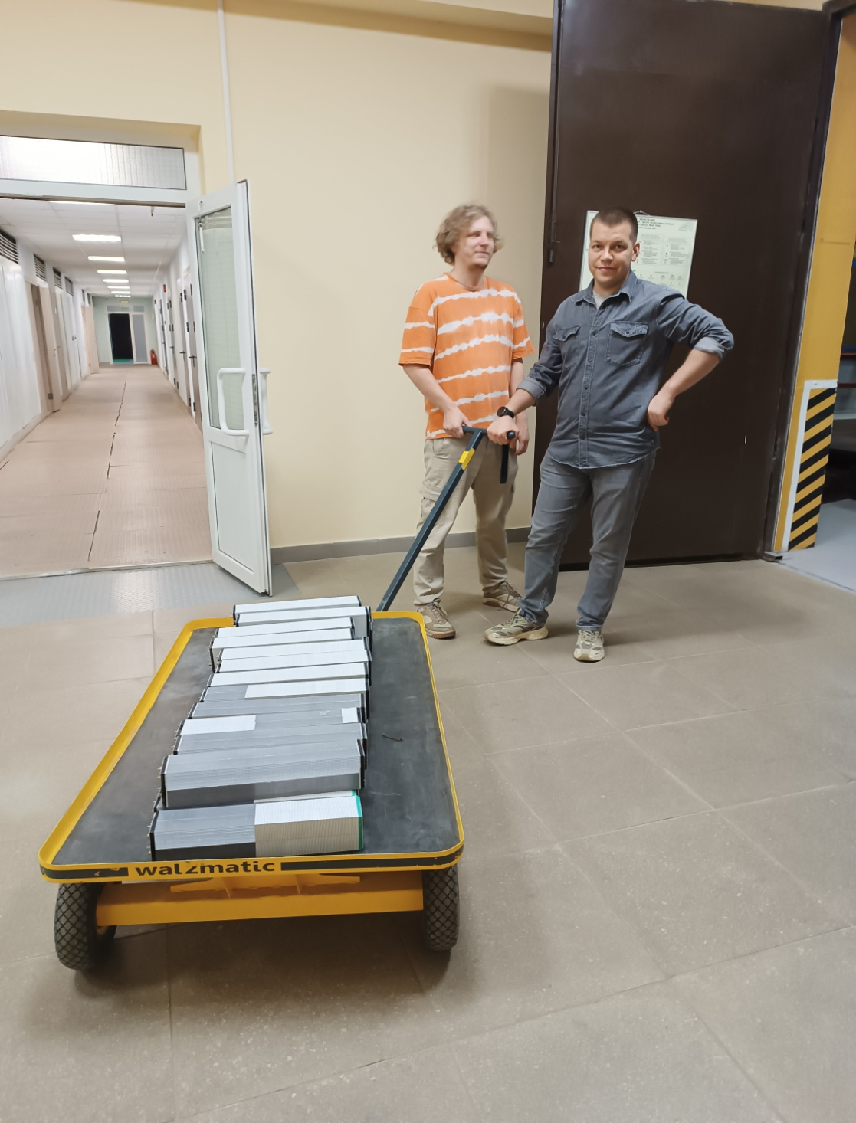
Modules transportation and store in Bld. 205

Slide 18
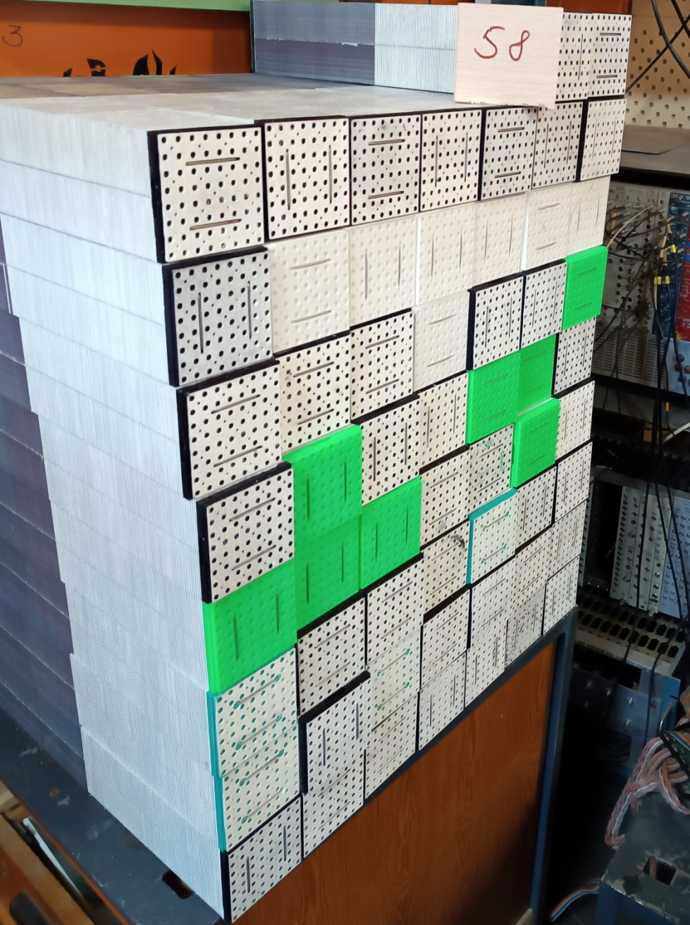
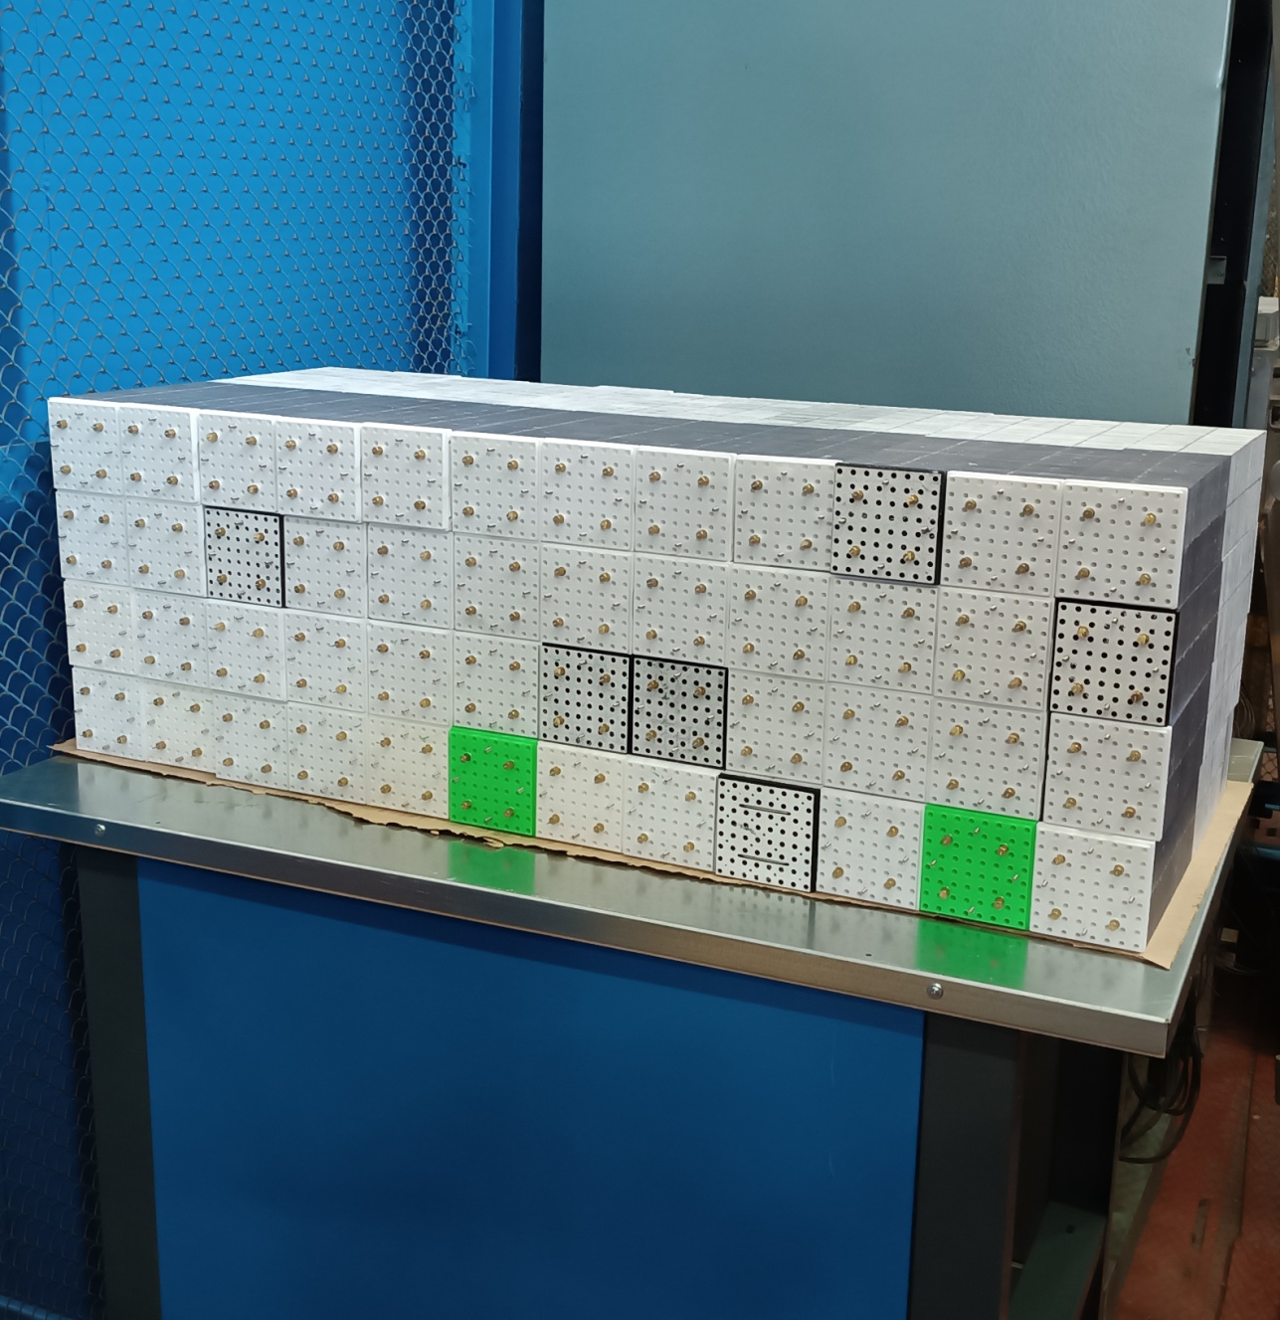
Stored modules in Bld. 205 to be delivered in to NICA SPD Hall 17

Slide 19
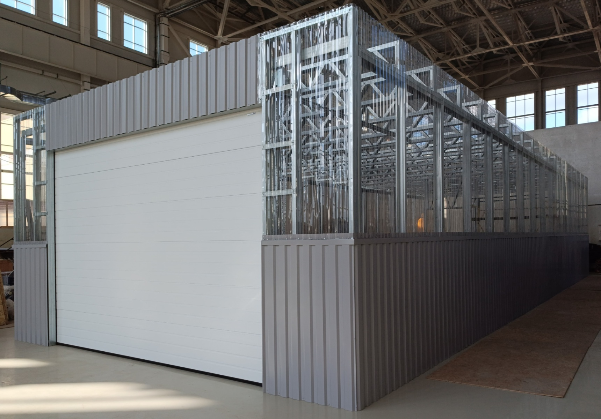
NICA SPD clean room in Hall 17.
To store ECAL modules.

Slide 20
Was done :
Scintillator tiles production in Vladimir, Uniplast.
  400.000 tiles of 40x40 mm - produced already (for 500 modules)
  200.000 tiles – painted edges – is ready
  200.000 tiles – painted should be in November
Lead absorber plates 80x80x0.5 mm³ :
  Lead plate blanks 85x168 mm² are produced in LHEP
  Lead plates 80x80 mm² stamping procedure is in Vladimir, MARAL.
Modules assembling:
  320 – JINR VBLHE – 2025 – assembled.
  300 Modules assembling in Vladimir should be made complete with WLS .
Plans:
Scintillator tiles : 240.000 tiles of 40x40 mm² - for 300 modules) – 800 per/mod
Led: 64.000 plates of 80x80 mm² - for 320 modules – 200 per/mod
Modules assembling with WLS : about 100 for beam test
10/19/2025
Oleg Gavrishuk, JINR, Dubna , Russia
20

Slide 21
End of Report
Thanks for attention to All
10/19/2025
Oleg Gavrishuk, JINR, Dubna , Russia
21

