Slide 1
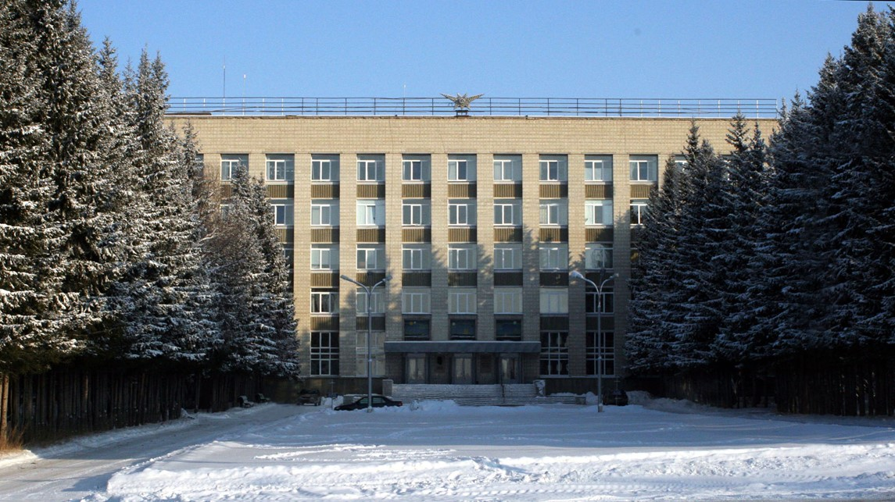
The Budker Institute of Nuclear Physics

Slide 2

SPD magnet
Status of the SPD superconductive solenoid design development

Slide 3
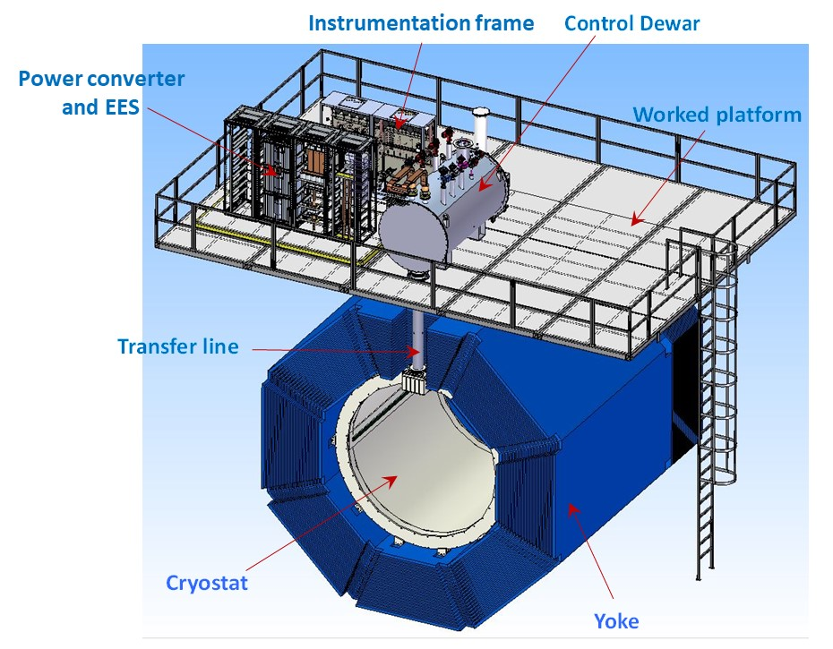
SPD solenoid
The magnetic field along the solenoid axis should be 1.0 T.
BINP presents our participation in SPD project with the following items:
Magnetic and engineering design of the magnet including tools and support;
Production and delivery of the magnet (consisting of the cryostat with cold mass, alignment components, proximity cryogenics, supports);
Power converter, energy extraction system, quench protection and instrumentation.

Slide 4
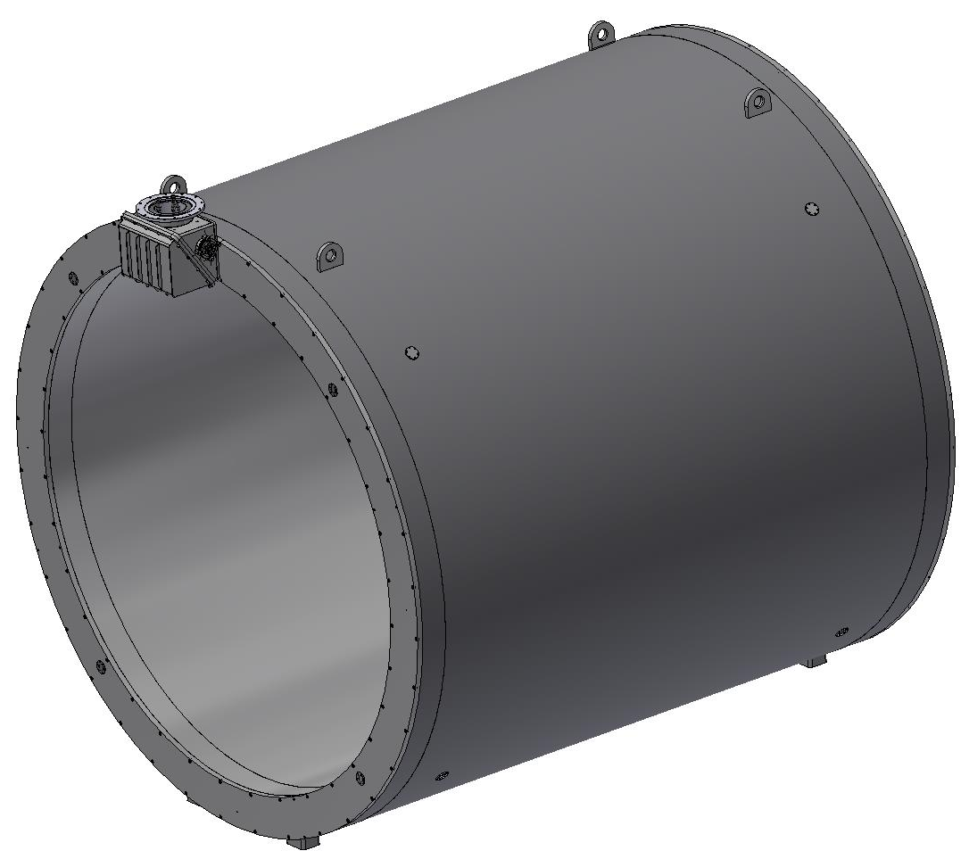
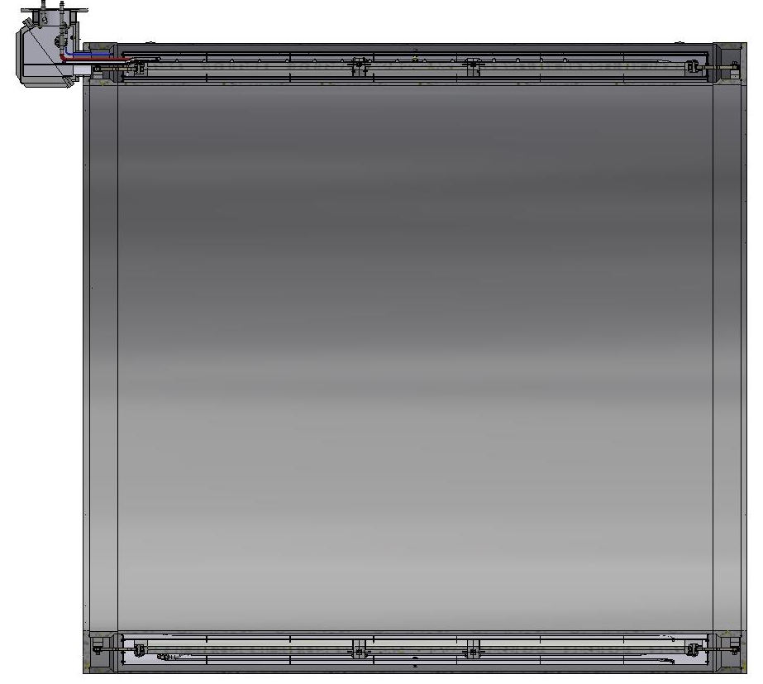
SPD Magnet
The main characteristics of the magnet:
Magnetic field along the axis - 1.0T with uniformity ± 2%;
The current is 5200 A.
Conductor type: Rutherford type cable consists of 8 strands with a diameter of 1.4 mm and a Cu / NbTi ratio of one, extruded into a matrix of high purity aluminum Al996, the conductor cross-section at a temperature of 4.5K is 7.90mm in width and 10.90mm in height;
Coil
Cryostat
Shield
Switching box

Slide 5
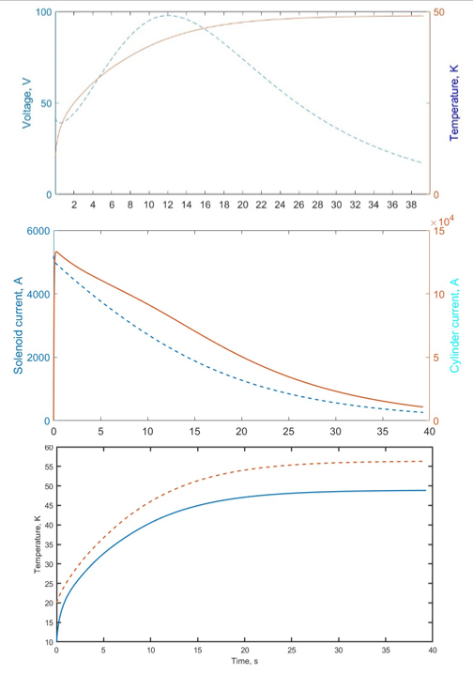
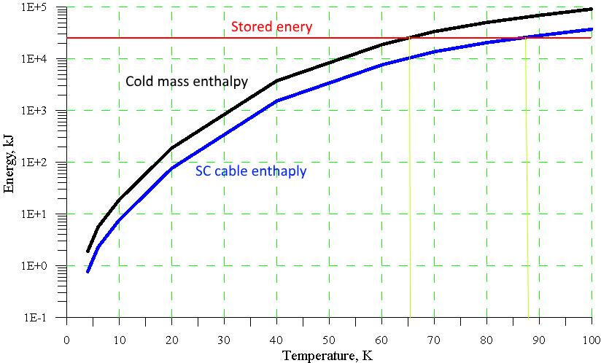
SPD Magnet Quench Analysis
When energy 25,6 MJ is released in the cold mass, the temperature of the cold mass will increase to 65 K.
The enthalpy of the cold mass and the cable versus temperature. The stored energy is 25.6 MJ.
Current 5000A; 0,1 Ohm Dump Resistor with the grounded middle point; support cylinder with specific electrical resistance of 3 μOhm*cm.
The transition to normal state calculations show that the solenoid will operate in a safe mode.

Slide 6
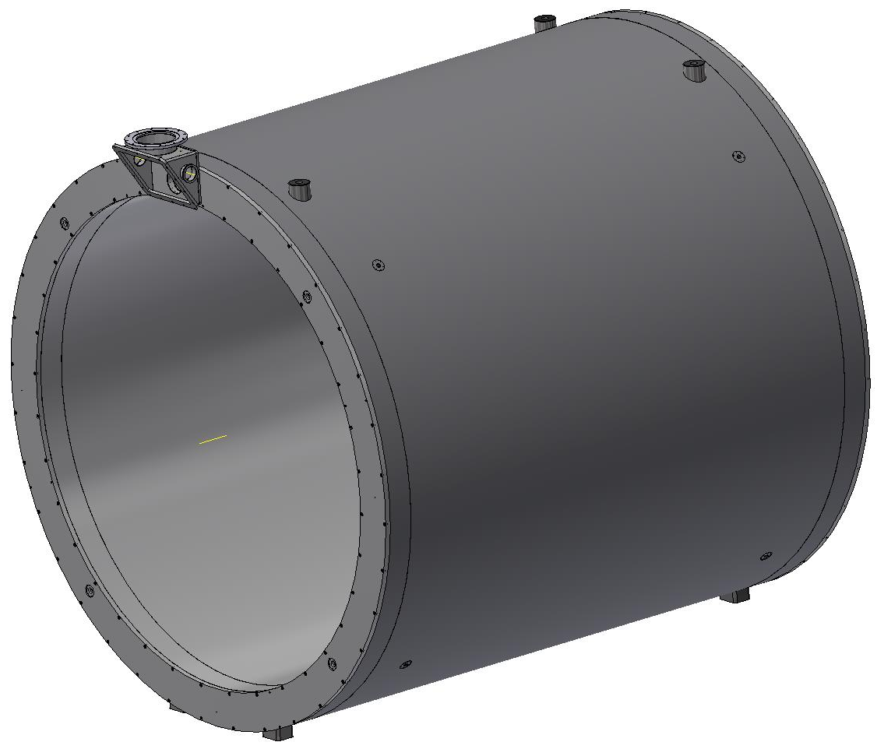
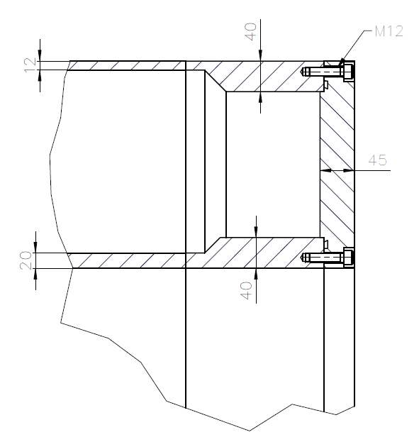
Inner diameter is 4008 mm, Outer diameter is 3468 mm, length is 4220 mm. The thickness of the outer shell is 12 mm, the inner shell is 20 mm, the thickness of the flanges is 45 mm. The thickness at the ends of the shells is 40 mm. Material: St. Steel. The weight of Cryostat is ~16.7 t
Cryostat design

Slide 7
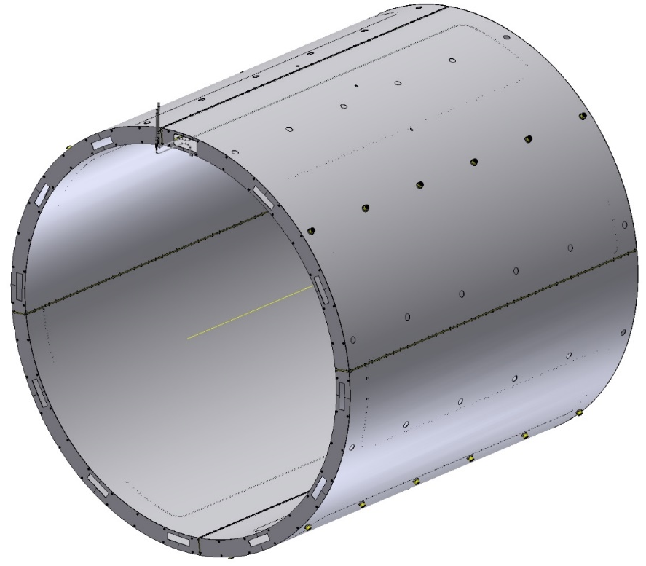
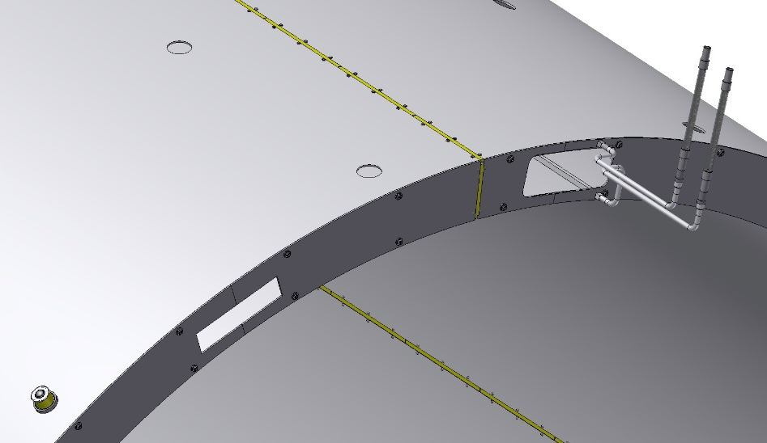
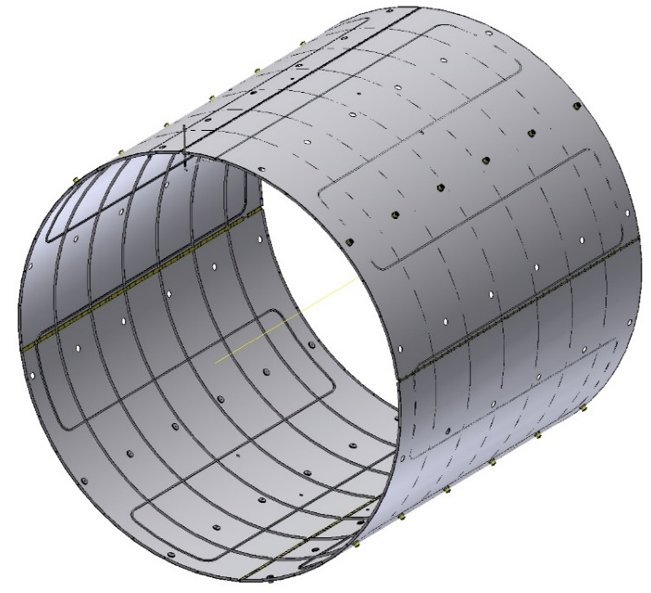
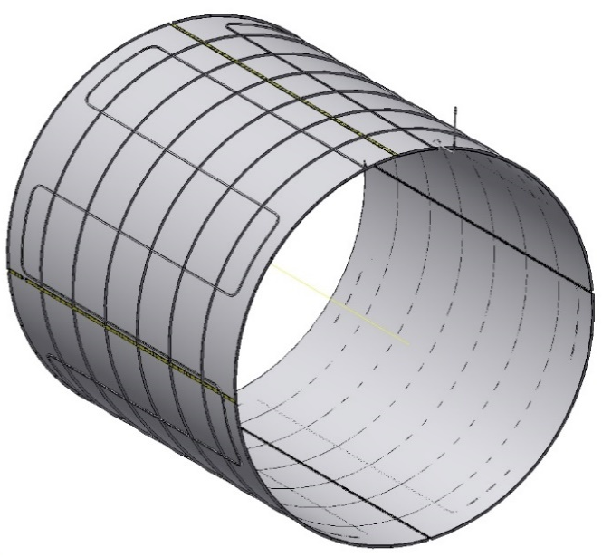
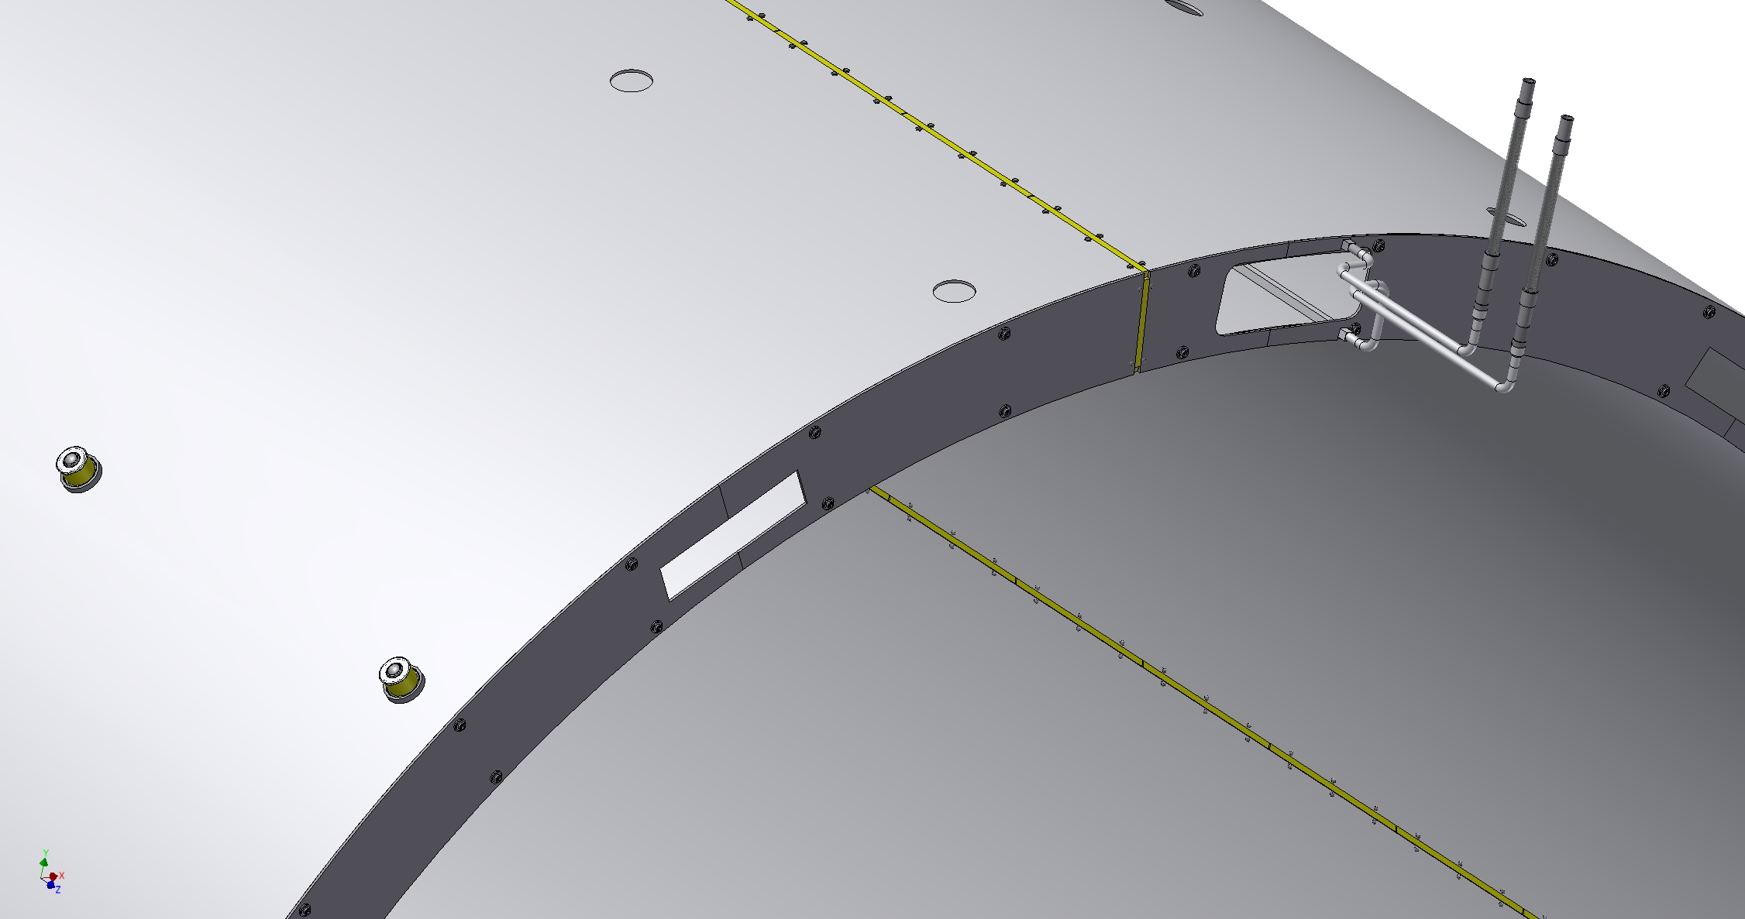
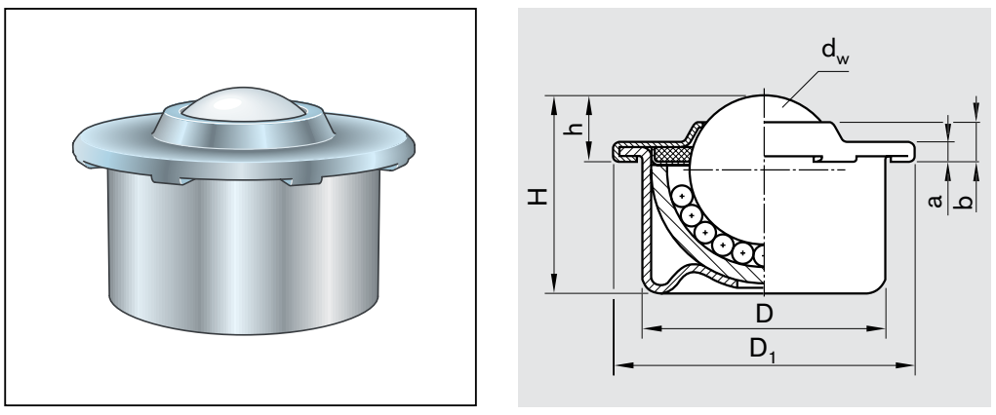
Thermal shield 80K
Gap
Insulator G10
Collectors
ball-bearing
Material - aluminum alloy AMg-5. Outer diameter - 3898 mm, inner diameter - 3568 mm, length - 3720 mm. Wall thickness - 4 mm, Shield weight ~1 t
For the collector, a 12x12 with 8 mm hole Al profile welded to the shell of the shields is used. The shield is divided around the perimeter into 4 parts using СТЭФ insulators. The shield is positioned in the cryostat using ball bearings with an insulating ring (4 rows at the bottom and 2 rows at the top). Outside the shield is covered with 30 layers of MLI and inside surface of the shield is covered with 10 layers of MLI .

Slide 8
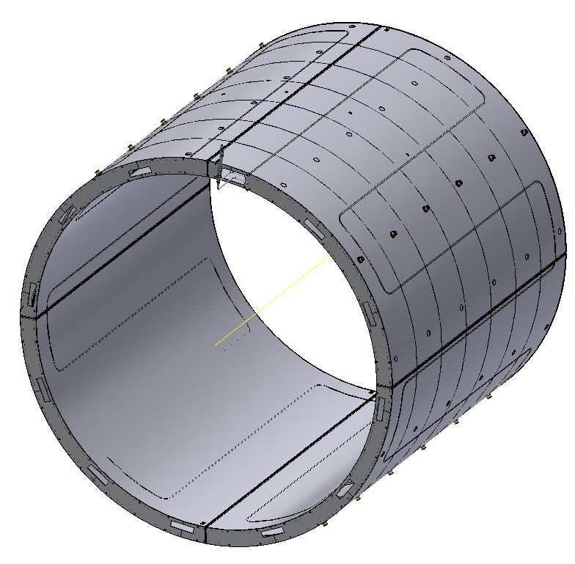
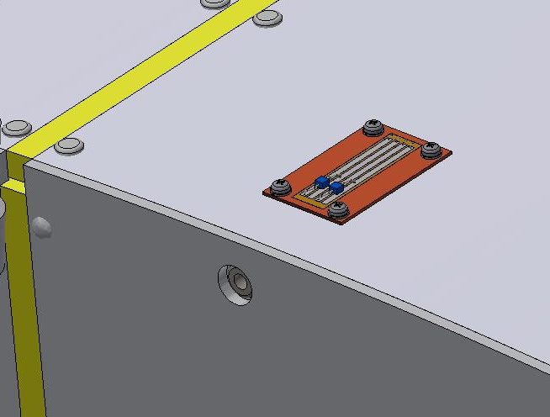
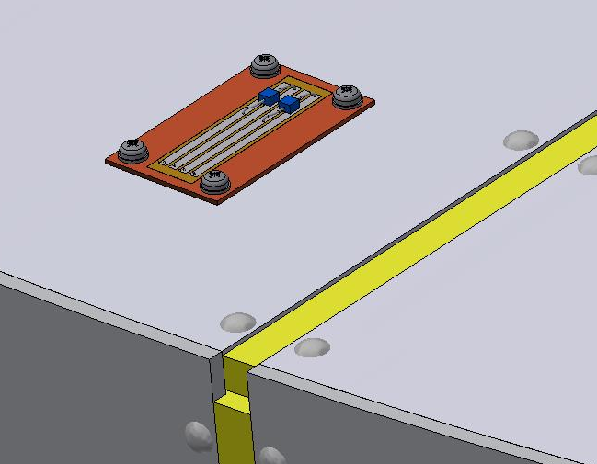
Shield. Temperature Sensor (PT1000) Position.
It is planned to place 8 sensors PT1000 on the Shield on the outer and inner shield.

Slide 9
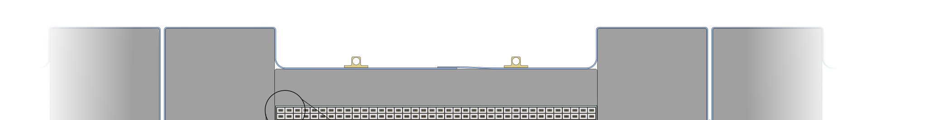
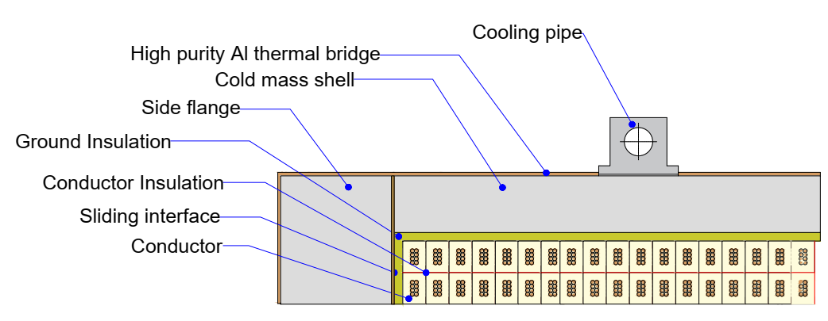
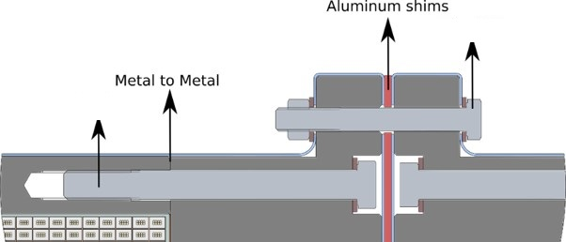
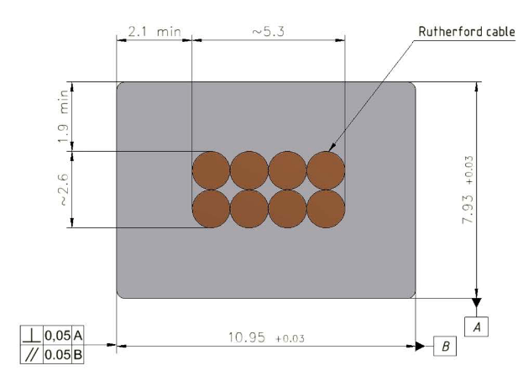
Cold Mass (design)
2 coils x 2 layers - 312 turns
1 coil x 2 layers - 156 turns
Magnetic field - 1 T
Current - 5.2 kA
Conductor mechanical and electrical parameters.
Thickness (after cold work) at 300 K | mm | 7.93 | ± 0.03
Width (after cold work) at 300 K | mm | 10.95 | ± 0.03
Critical current (at 4.2 K, 5 T) | A | > 14690
Critical current (at 4.5 K, 3 T) | A | > 16750
Overall Al/Cu/sc ratio |  | 10.5/1.0/1.0
Aluminum RRR (at 4.2 K, 0 T) |  | > 600
Al 0.2% yield strength at 300 K | MPa | > 30
36 x M12
Rutherford cable, 8 strands, extruded in Al matrix
64 x M12
10.95 мм x 7.93 мм,
NbTi / Cu d=1.4 мм
Rutherford cable is used to wind the coils. The cold mass consists of three coils, The coils are fixed together using bolts. If necessary, we will use special shims between the sections of the coils.

Slide 10
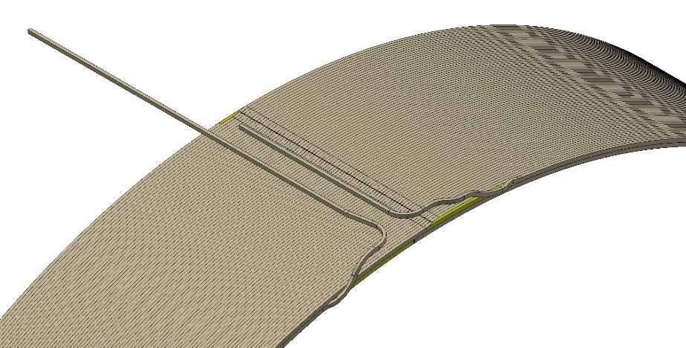
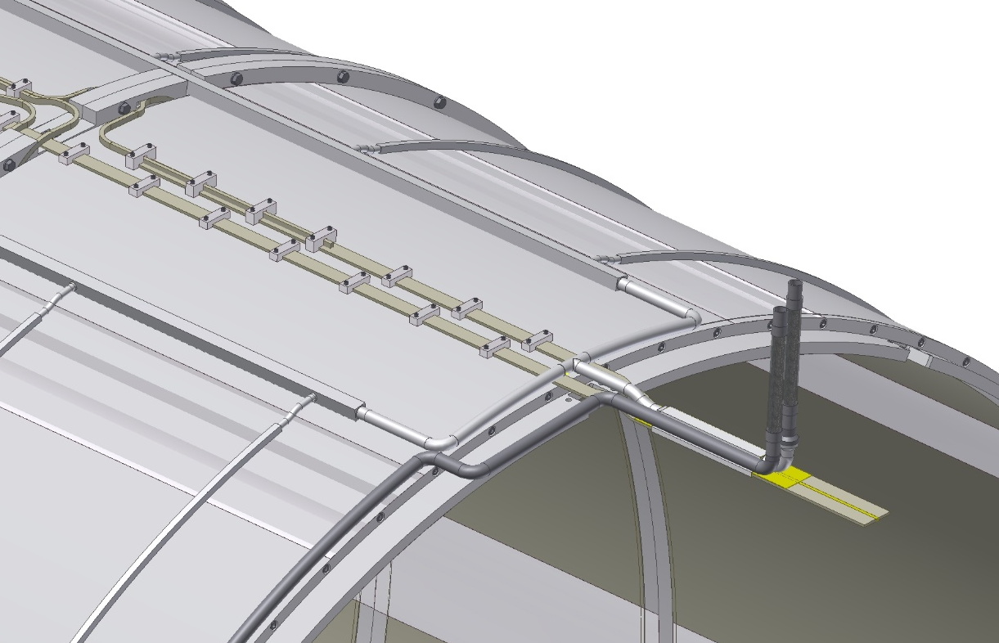
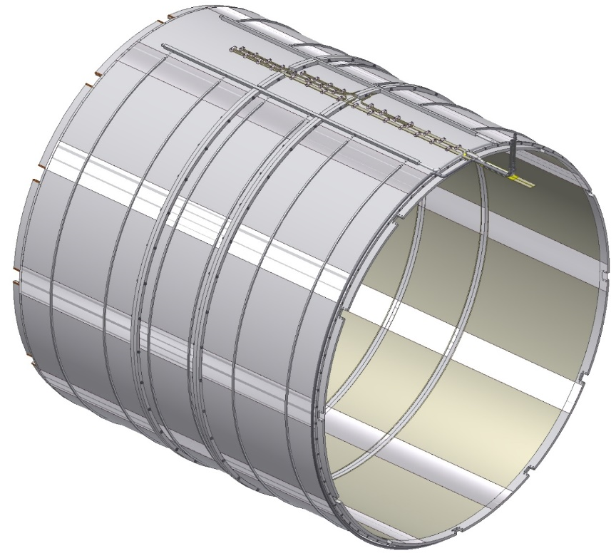
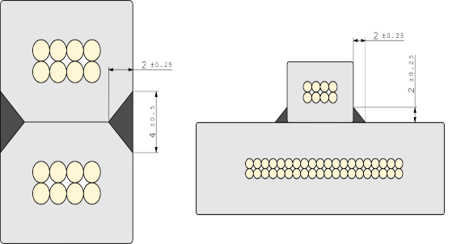
The connection of the coils to the current leads is made through bas-bars with a cross section of 32 by 5.6 mm. The connection is made by welding. Thermal bridges made of high purity aluminum are used for temperature equalization.
Cold Mass
Support brackets
Bus-bars
Manifold
Coil winding
For front and back coils, cable length ~ 3600 meters;
for the central coil the cable length is ~1800 meters
Central coil
Back coil
Front coil
coil-to-coil and layer-to-layer joints
Thermobriges

Slide 11
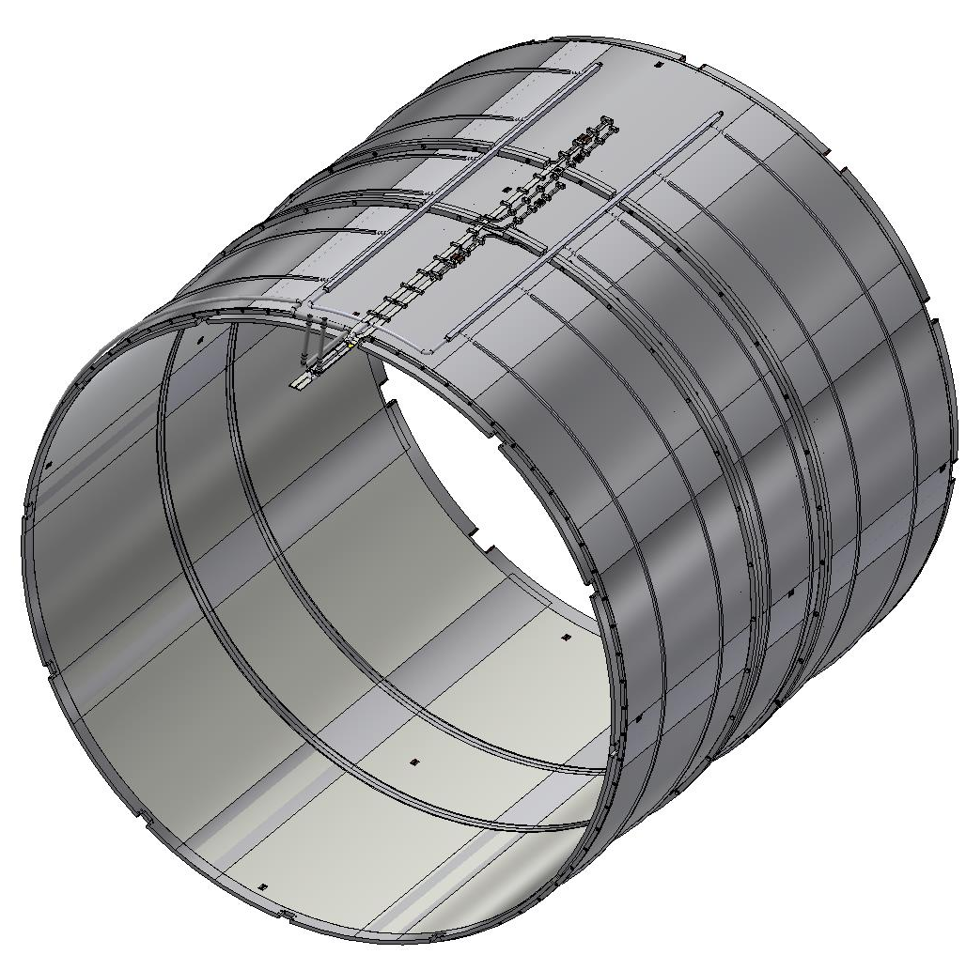
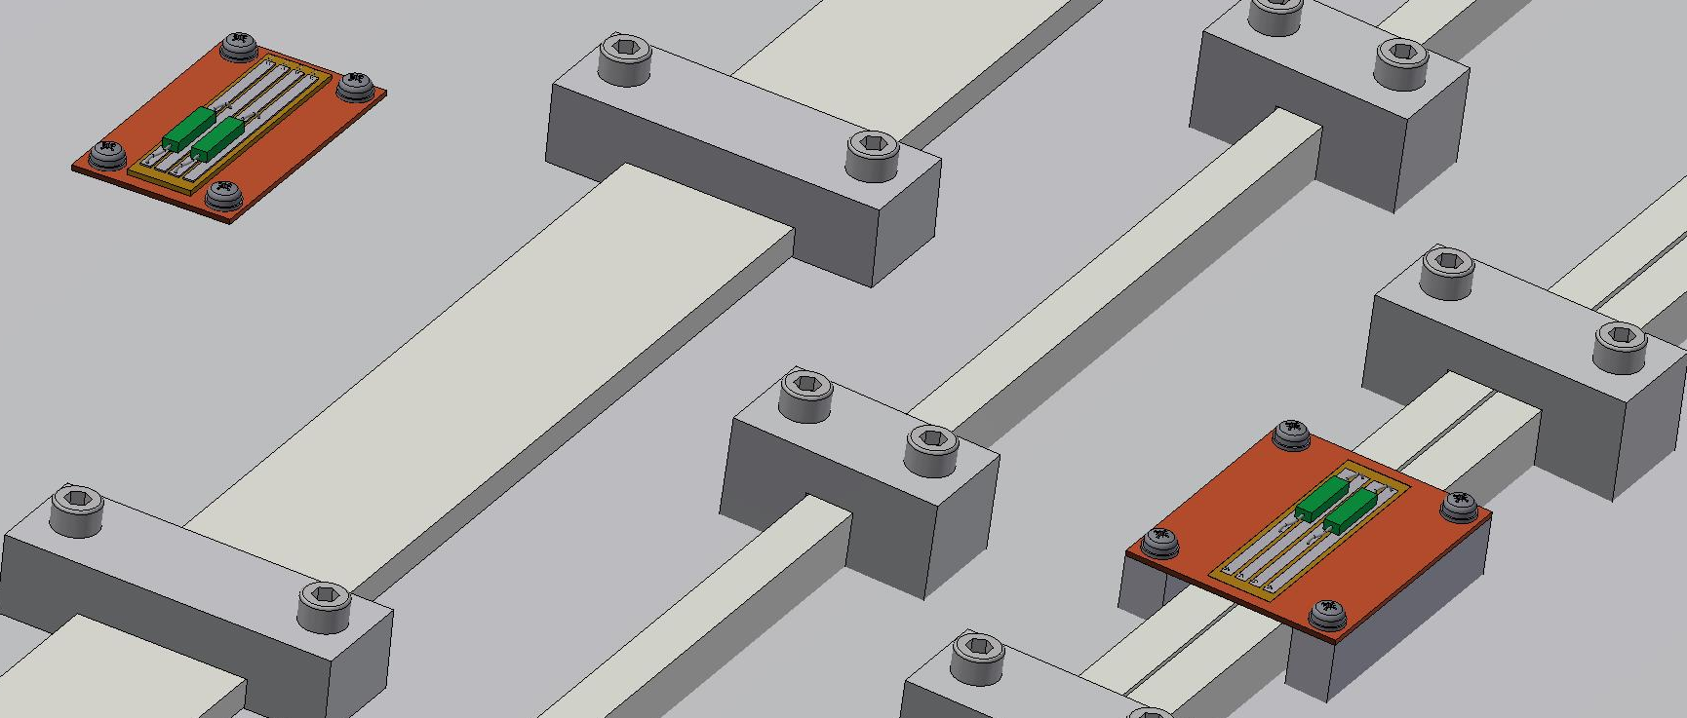
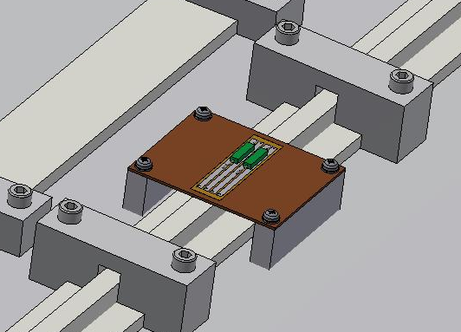
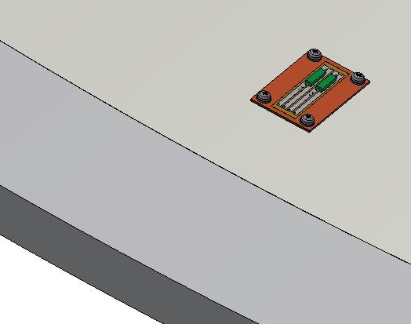
The Cold mass of the Magnet. Temperature Sensor (TVO) Position.
It is planned to place about 30 sensors TVO on the Cold mass on the outer and inner shell and bus-bars.

Slide 12
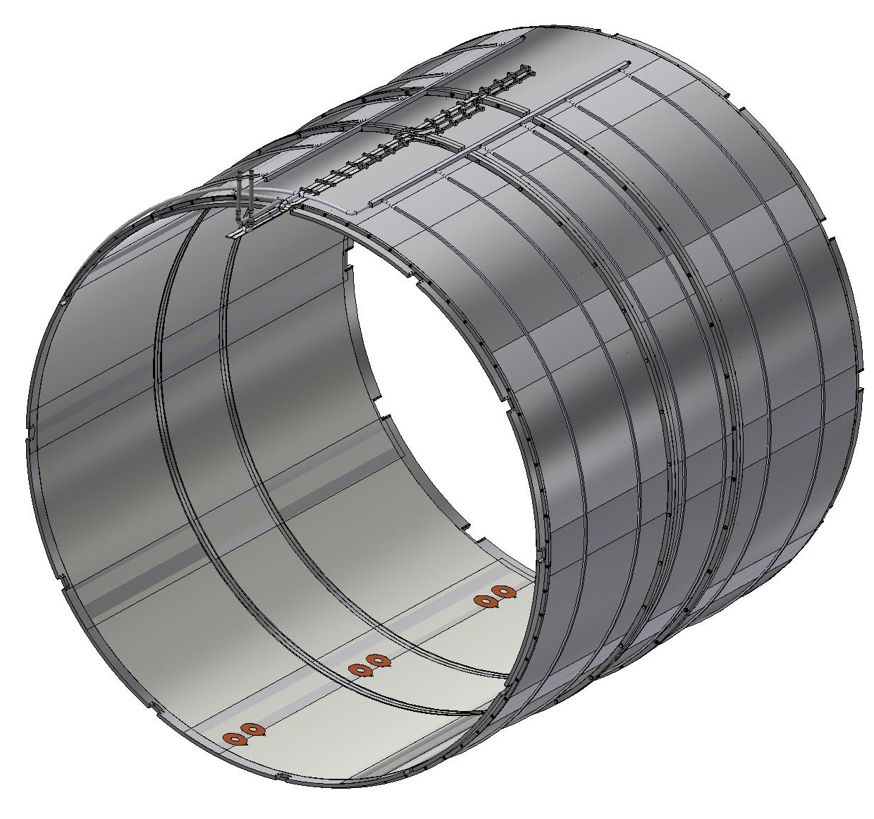
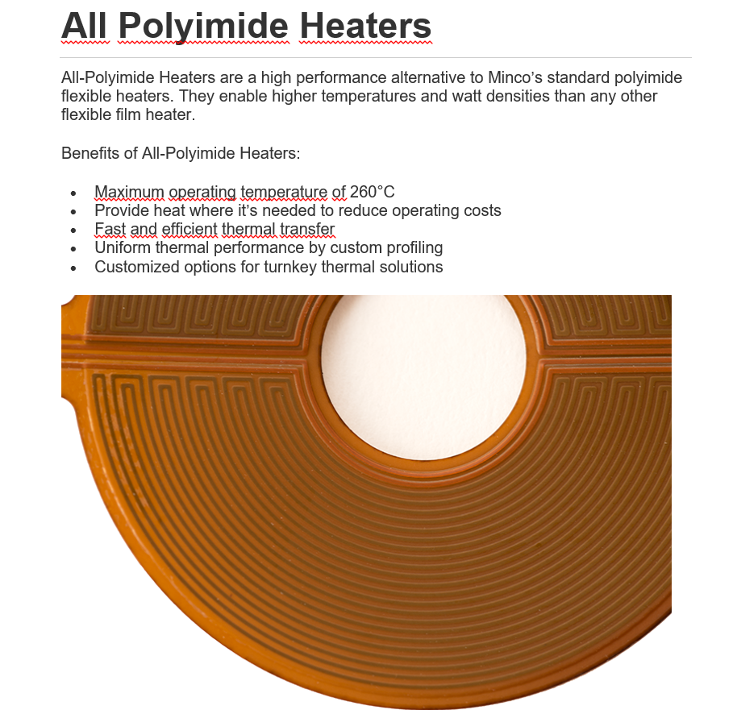
The Cold mass of the Magnet. (Quench heaters)
Also It is planned to place three double Quench heaters

Slide 13
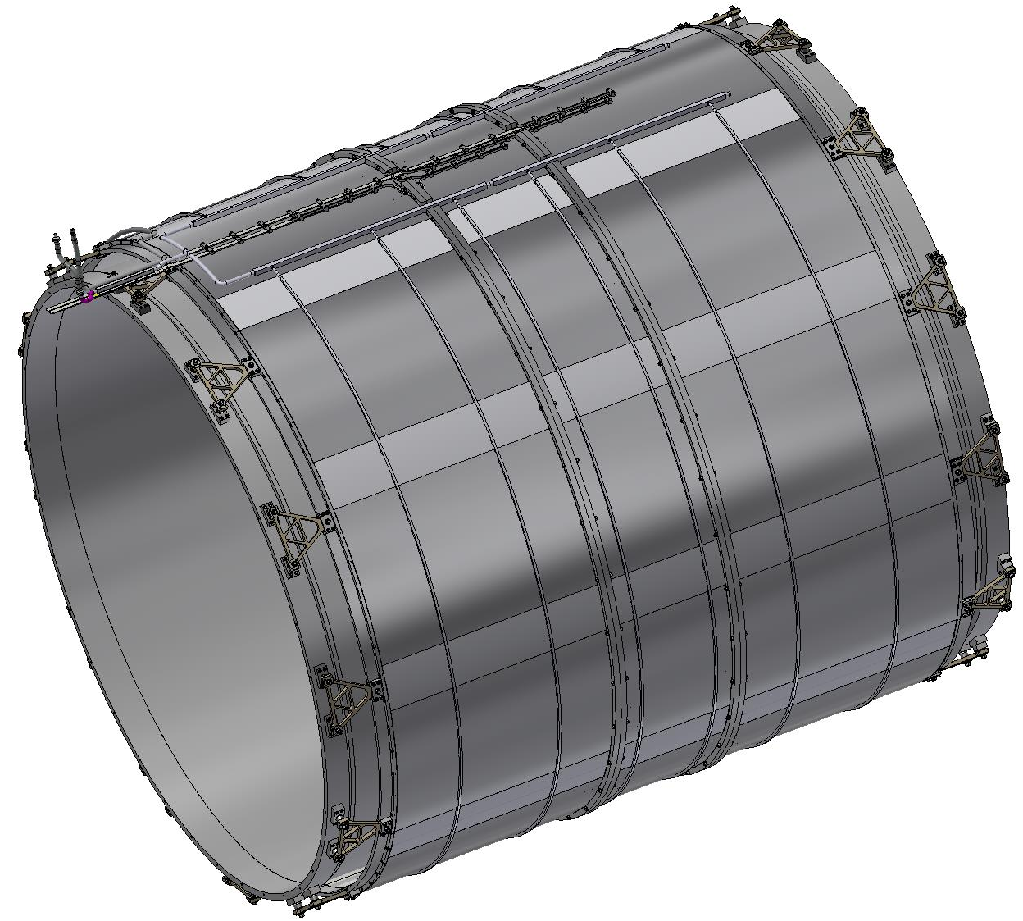
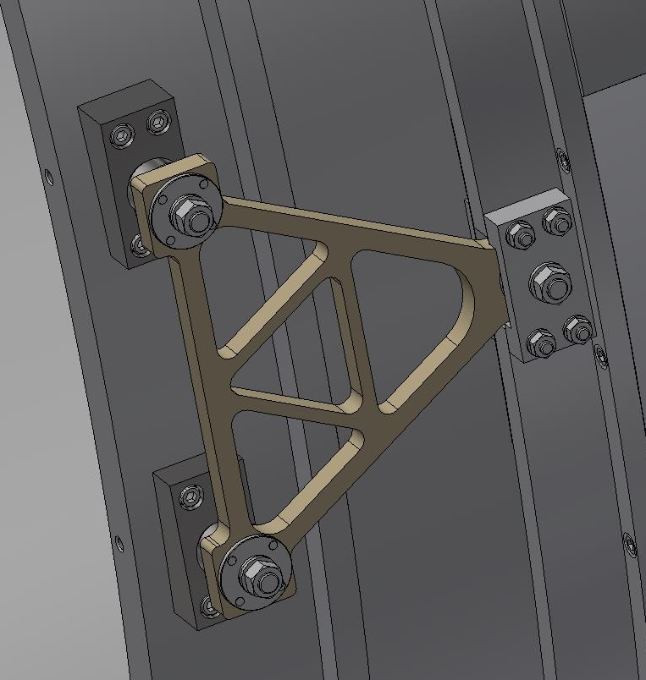
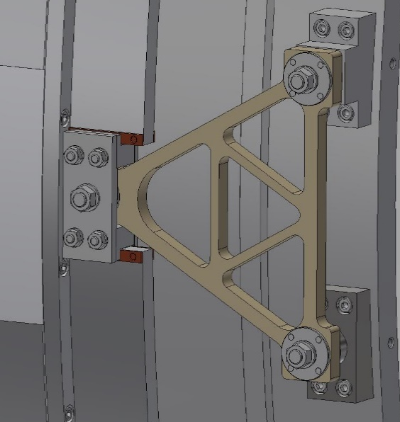
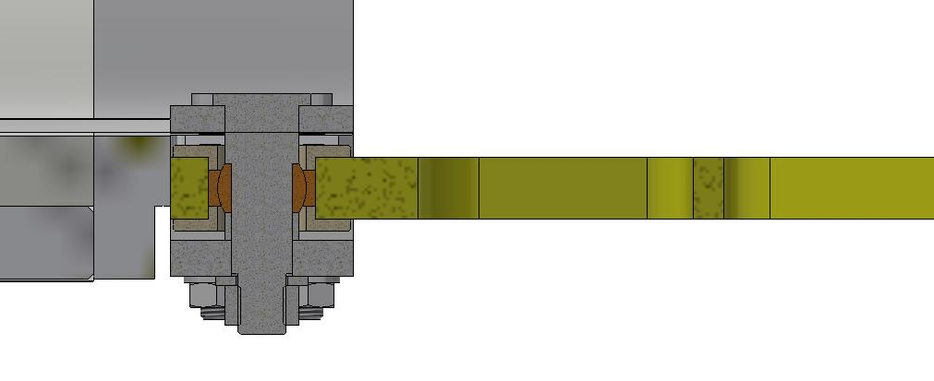
Fixed support
SPD Magnet (Suspension system)
Sliding support
Spherical bearing
Fixation of the cold mass is made with help of triangular suspensions made of fiberglass, 12 pieces on each side. On one side the supports are fixed, on the other side its are sliding to compensate for temperature changes in the length of the coil. The Suspensions have spherical bearings to avoid bending during thermal changes in the dimensions of the cold mass.

Slide 14
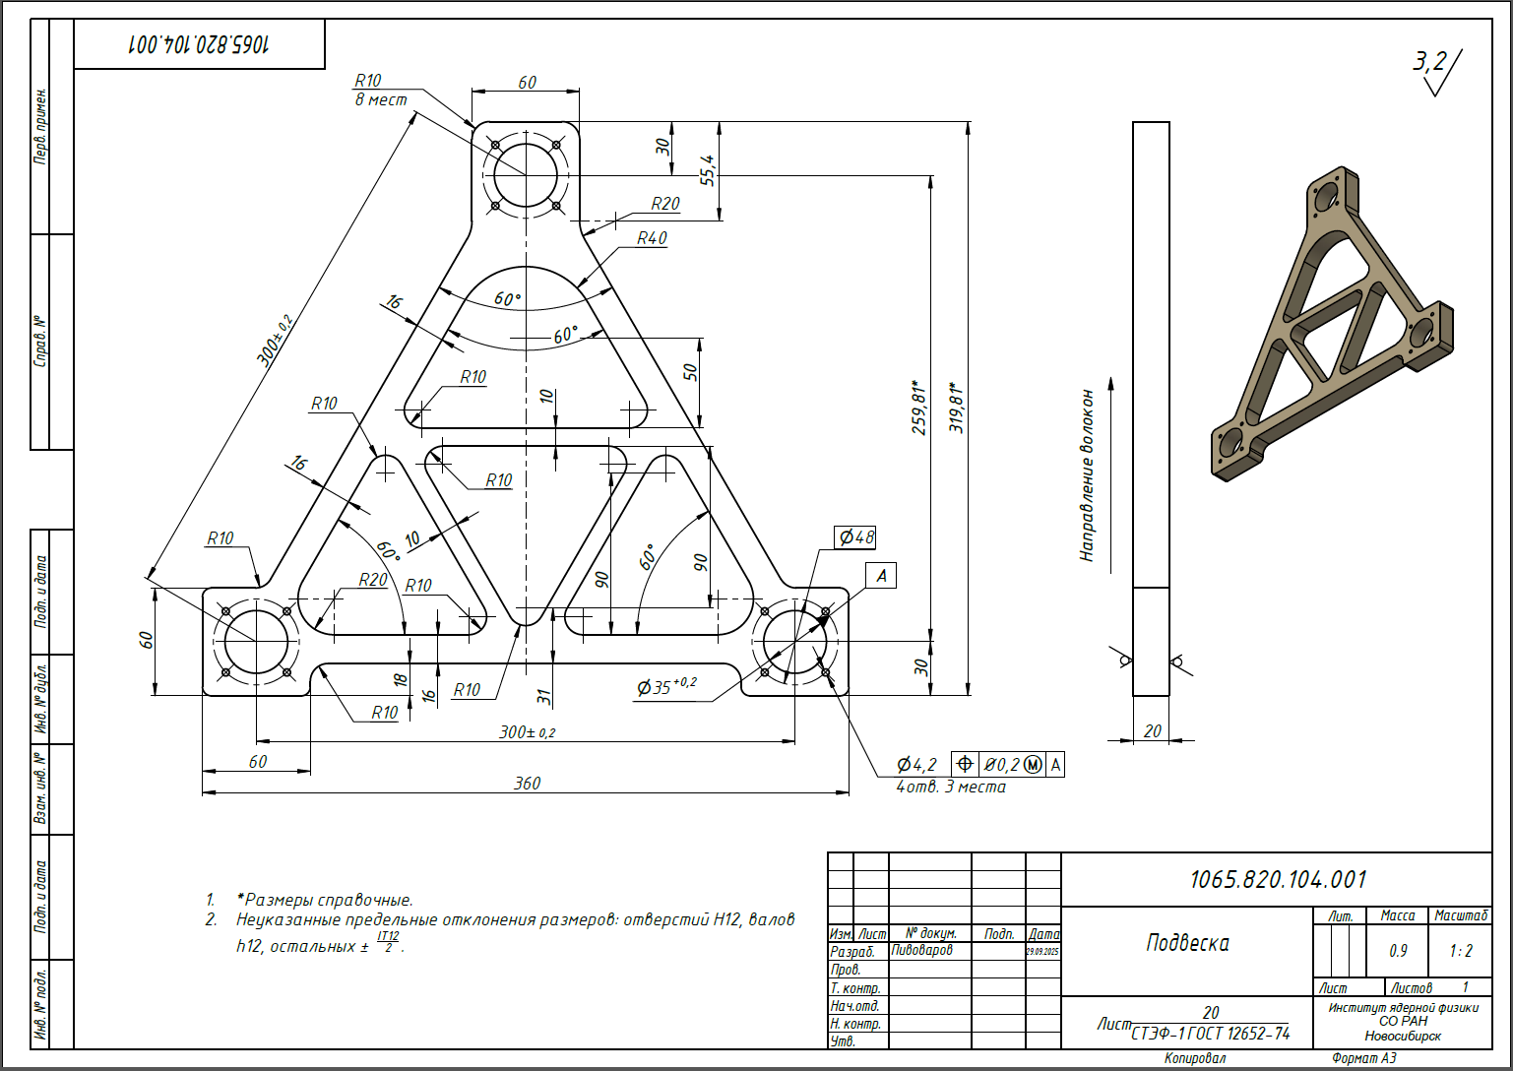
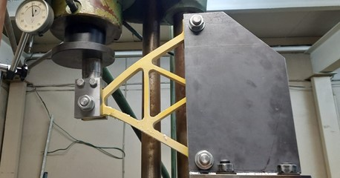
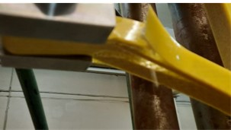
Drawing of suspension
We have made and tested the suspension (СТЭФ-1) at 300K and 100K.
After testing, I modified the triangle design. We bought fiberglass with good properties and plan to manufacture the triangle and test it again.
Destruction of the suspension 300К - 3920 kg
Destruction of the suspension 100К - 4250 kg

Slide 15
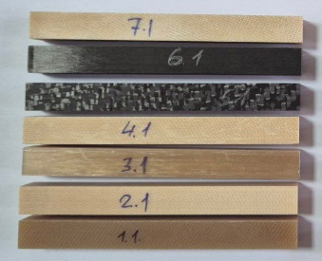
Selection of material for triangular suspension
The NIIKAM Institute has studied various materials with high strength and low thermal conductivity for use at cryogenic temperatures. The results of the study are presented in the table.
№ | Material | Modulus of elasticity (MOE), GPa | Thermal conductivity 25°C, W/(m⋅K)
1 | Fiberglass based on structural fabric made of high-molecular-weight glass fibers | 31,9 | 0,568
2 | Glass-reinforced plastic based on structural fabric made of hollow glass fibers | 26,8 | 0,464
3 | Fiberglass based on high-molecular-weight glass fibers | 59,7 | 0,786
4 | Fiberglass based on structural fabric made of hollow glass fibers with controlled porosity | 23,9 | 0,377
5 | Carbon fiber reinforced plastic based on twill carbon fabric | 52,7 | 2,29
6 | Carbon fiber-based carbon fiber | 110,9
7 | Fiberglass-based structural fabric made of hollow glass fibers with an experimental binder with low thermal conductivity | 21,1 | 0,367
8 | STEF – 1/G10 (for comparison) | 20 | 0,6
The most suitable material is No. 3 and the combination of materials 3+6; 7+6

Slide 16
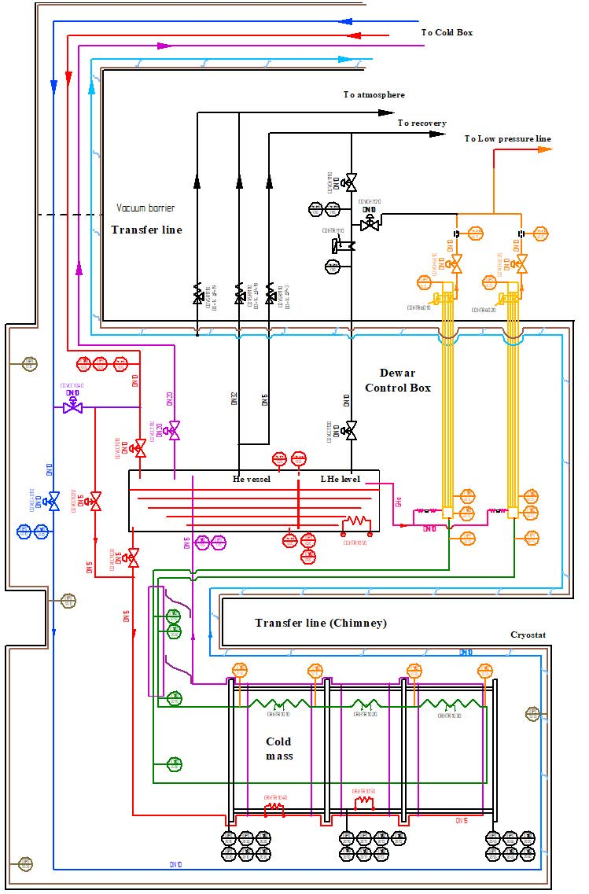
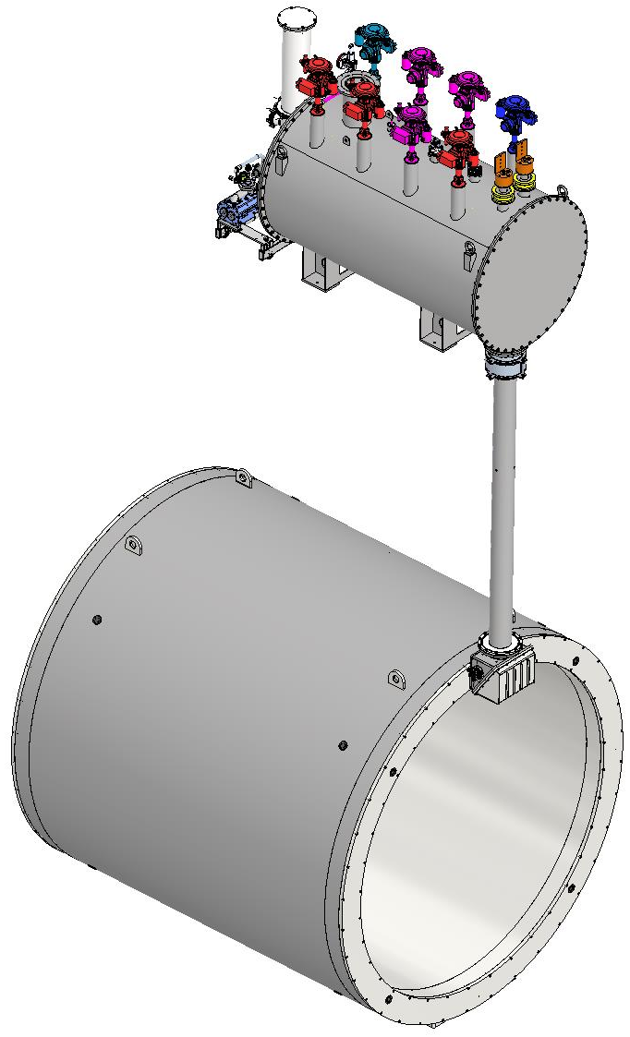
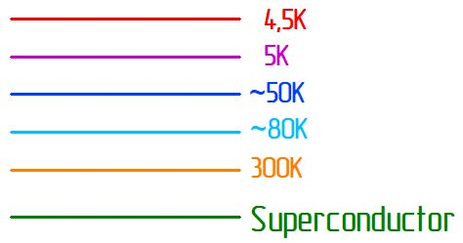
Flow Scheme Magnet-Control Dewar.
Control Dewar
Transfer line
Magnet

Slide 17
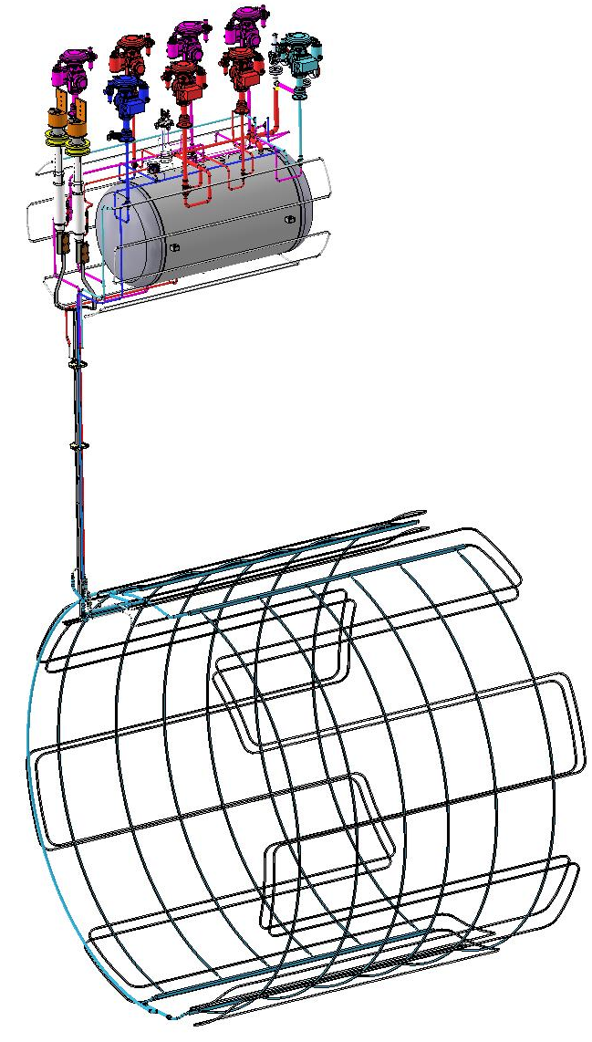
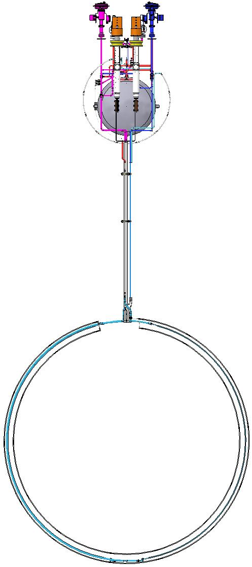
SPD solenoid. Cold mass cooling design.
Volume for liquid helium
Cooling Shield of Control Dewar
It is planned to use the thermosiphon method of cooling the superconducting coil due to the natural convection of two-phase helium.
The volume of liquid helium is 10 - 20 liters
Helium mass flow SPD - 9-10 g/sec.
Cooling Shield of Magnet
Cooling Magnet

Slide 18
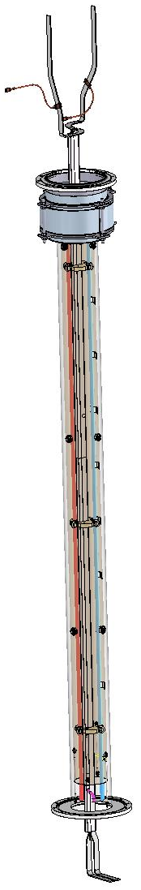
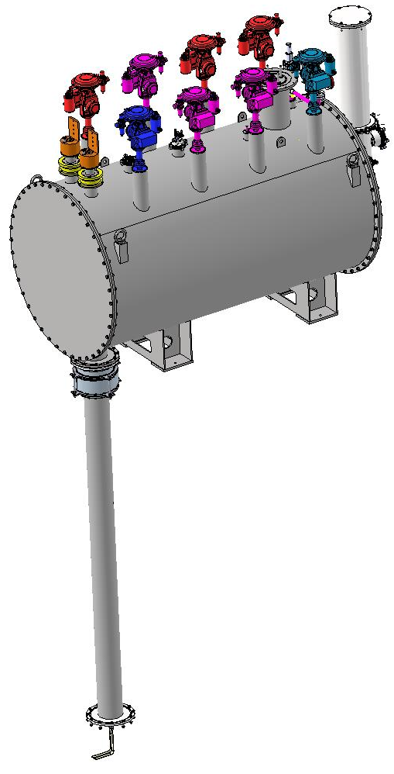
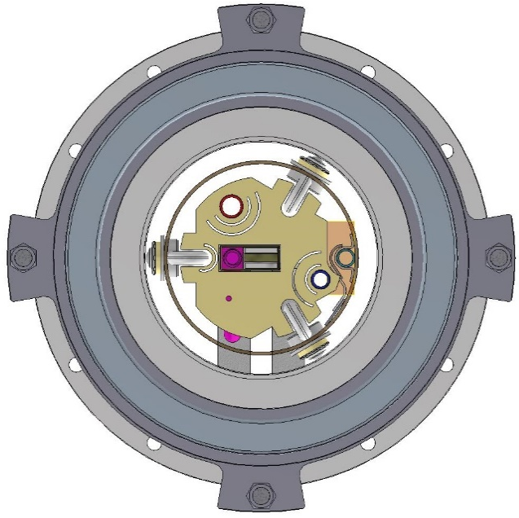
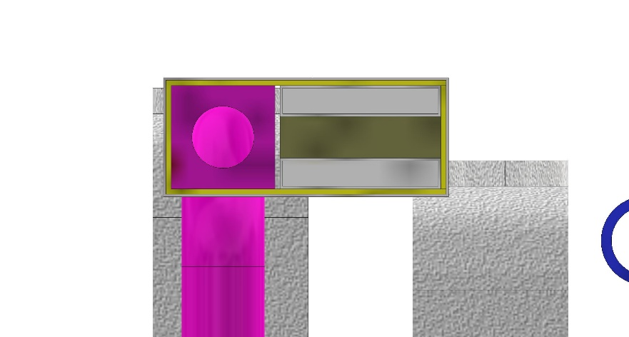
Control Dewar with Transfer Line.
Transfer line
Thermal bridges
Shell of TL
Spacer
Reverse flow
Bus Bars
Shell (Al)
Shield of TL
Insulator (СТЭФ)
Pipelines
The transfer line connects the vacuum volumes of the cryostat and the control Dewar.
The transfer line has an outer diameter of 219.1 mm and the new length of ~3400 mm (increased by more than 1 m at the request of JINR).
It contains the superconducting bus bars, direct and return pipes for gaseous and liquid helium flows. The superconducting bus bars in the transfer line is cooled by a reverse flow of helium and thermal bridges.
Conductive
Bus Bars

Slide 19
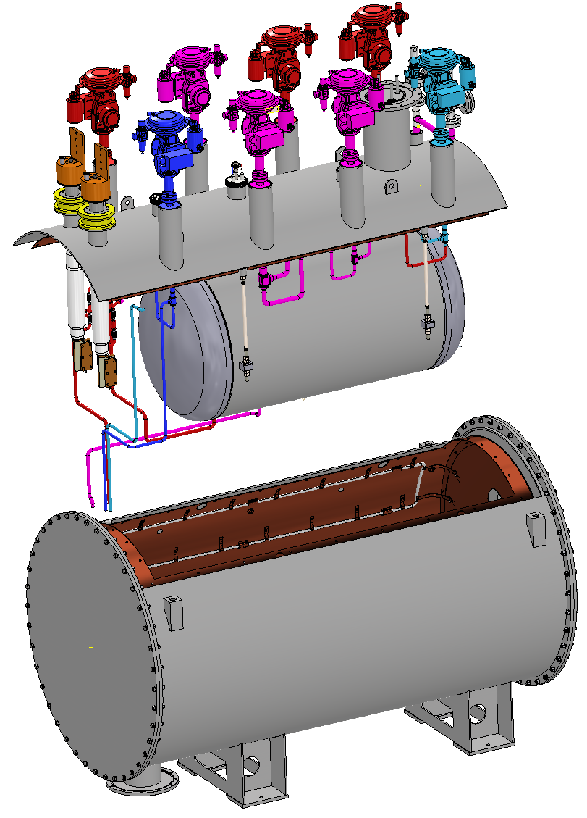
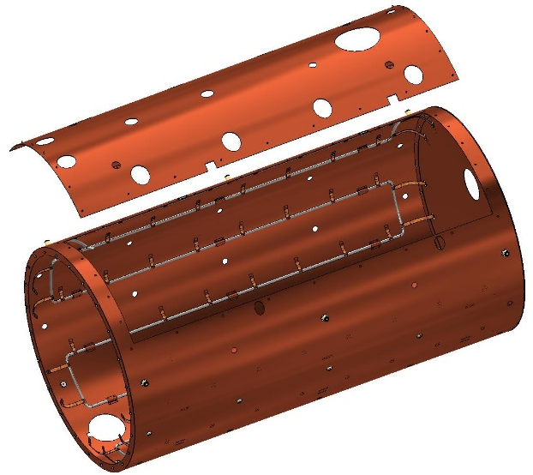


Control Dewar.
Top and bottom Shields
Valves
Current leads
Safety
Valves
Pipelines
Volume for liquid helium
70%
594
230
20%
Ø1600
The Сontrol Dewar consists of a lower cryostat with a shield and an upper part with a volume for liquid helium, valves, pipelines and current leads.
2780
The volume of liquid helium in the vessel is 800 litres. The maximum LHe level must be less than 594 mm from the bottom of the vessel.The minimum LHe level must be more than 230 mm.

Slide 20

SPD heat loads (recalculated)

Slide 21


Position of equipment on the Platform.
Current Leads
Bus Bar
Power converter and Energy Extraction System
Supporting Frame
Control Dewar
Control Sensors System
Capillaries for pressure sensors
Flexible Copper Connector
Diagnostic connectors
Platform

Slide 22



Magnet assembly Stand
Roller skate Boerkey
Assembly Stand
To assemble the magnet, a special Stand with an I-beam - 700 GOST 26020-83, 10 meters long, with a guide rail and a roller system (Roller skate Boerkey model AM-H) for rolling up the magnet elements, is used.
The stand design is shown on the slide. 3D model of the stand is ready.

Slide 23



Container for transportation SPD Magnet.
4960
Weight : - Container – 15 т
- Magnet – 24 т
Total: ~39 т
4750
5520

Slide 24
Status of SPD solenoid design
• Magnetic design of the magnet including of calculations of the magnetic forces. Magnetic map is ready.
• Engineering design of the magnet including of calculations of all loads and forces is ready;
• Design of the superconductive conductors, coils and cold mass is ready;
Magnet Quench Analysis is ready;
• Design of the cryostat with alignment components, supports and suspend system is ready;
• The procedures for assembly of the magnet is ready.
• Assembly drawings of the main assemblies are ready.
Planning 2025
To finish the contract for Development superconductive solenoid of SPD detector including for:
Design of the proximity cryogenics with flow scheme and all instrumentation for cryogenics and insulation vacuum for the cryostat and control Dewar, current leads;
• Design of the power supply system and energy extraction system;
• Development quench protection and detection scheme;
• Development of the worked conditions of the cryogenic system;
• Define the list of FAT and SAT and requirements for tests;
• Thermal calculations, calculations of the thermo-syphon circuit, mechanical calculations and a mechanical analysis with failure modes (e.g. loss of insulation vacuum), description of the cryogenic control system as well as Process and Instrumentation Diagrams for the cryogenic process.
Planning 2026
Preparation of an agreement for the production of SPD superconducting strange in cooperation with VNIINM;
Preparation of an agreement for the production of SPD cryostat and cold mass.

Slide 25

Thank you for your attention!

