Slide 1

Cryogenic system of SPD
Speaker: Andrey Ponomarev
1

Slide 2

Outline
Elements of the cryogenic system
Placement of cryogenic equipment
3. Cryogenic liquid tanks and related work
4. Steps of creation
5. Conclusions
2

Slide 3
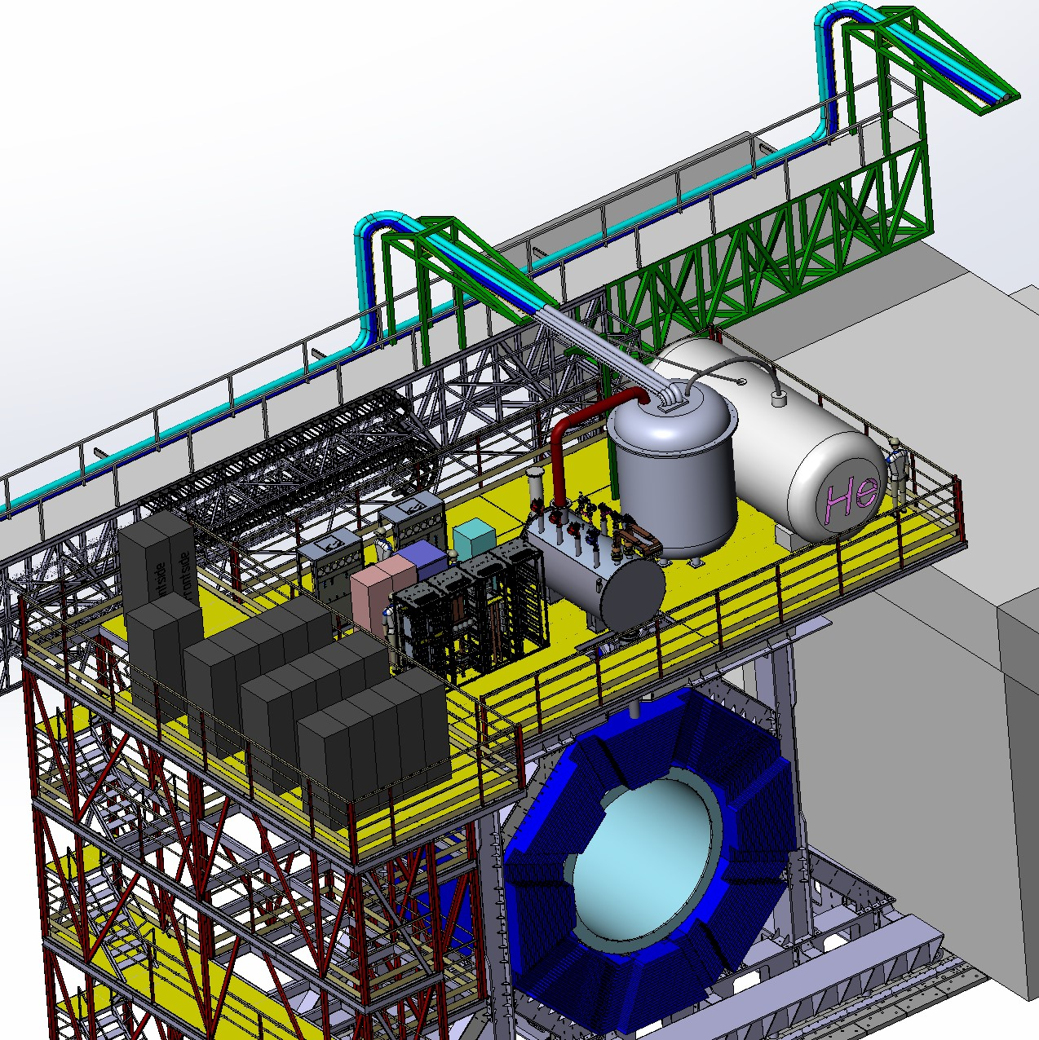
Cryogenic system
Helium, nitrogen, water and pneumatics pipelines
Cryogenic tank
Satellite refrigerator
Control cryostat
SPD

Slide 4
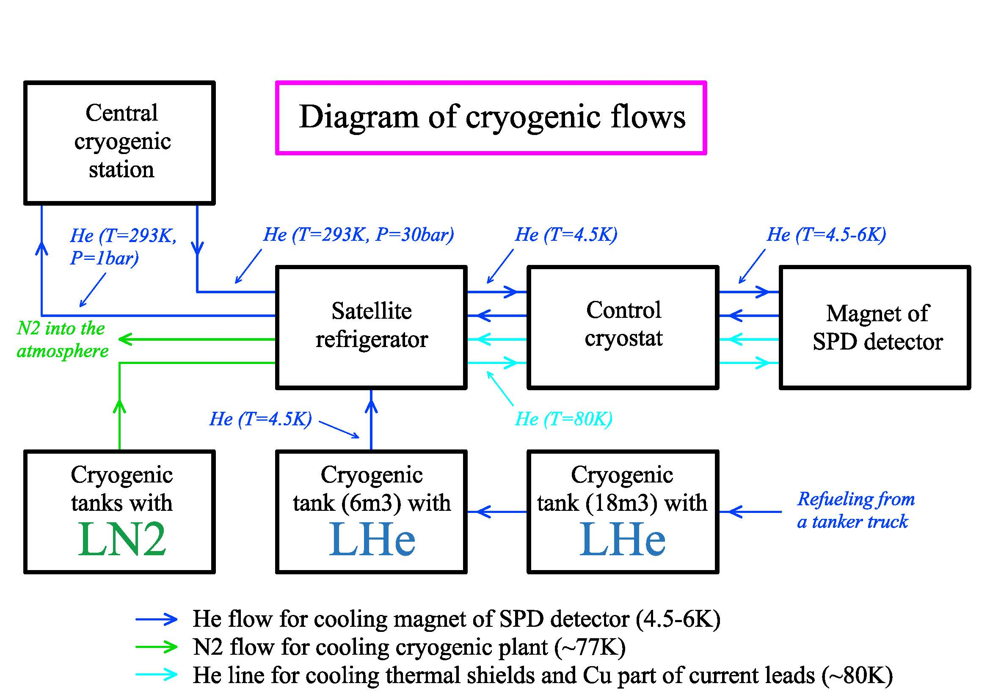
Cryogenic system
4

Slide 5
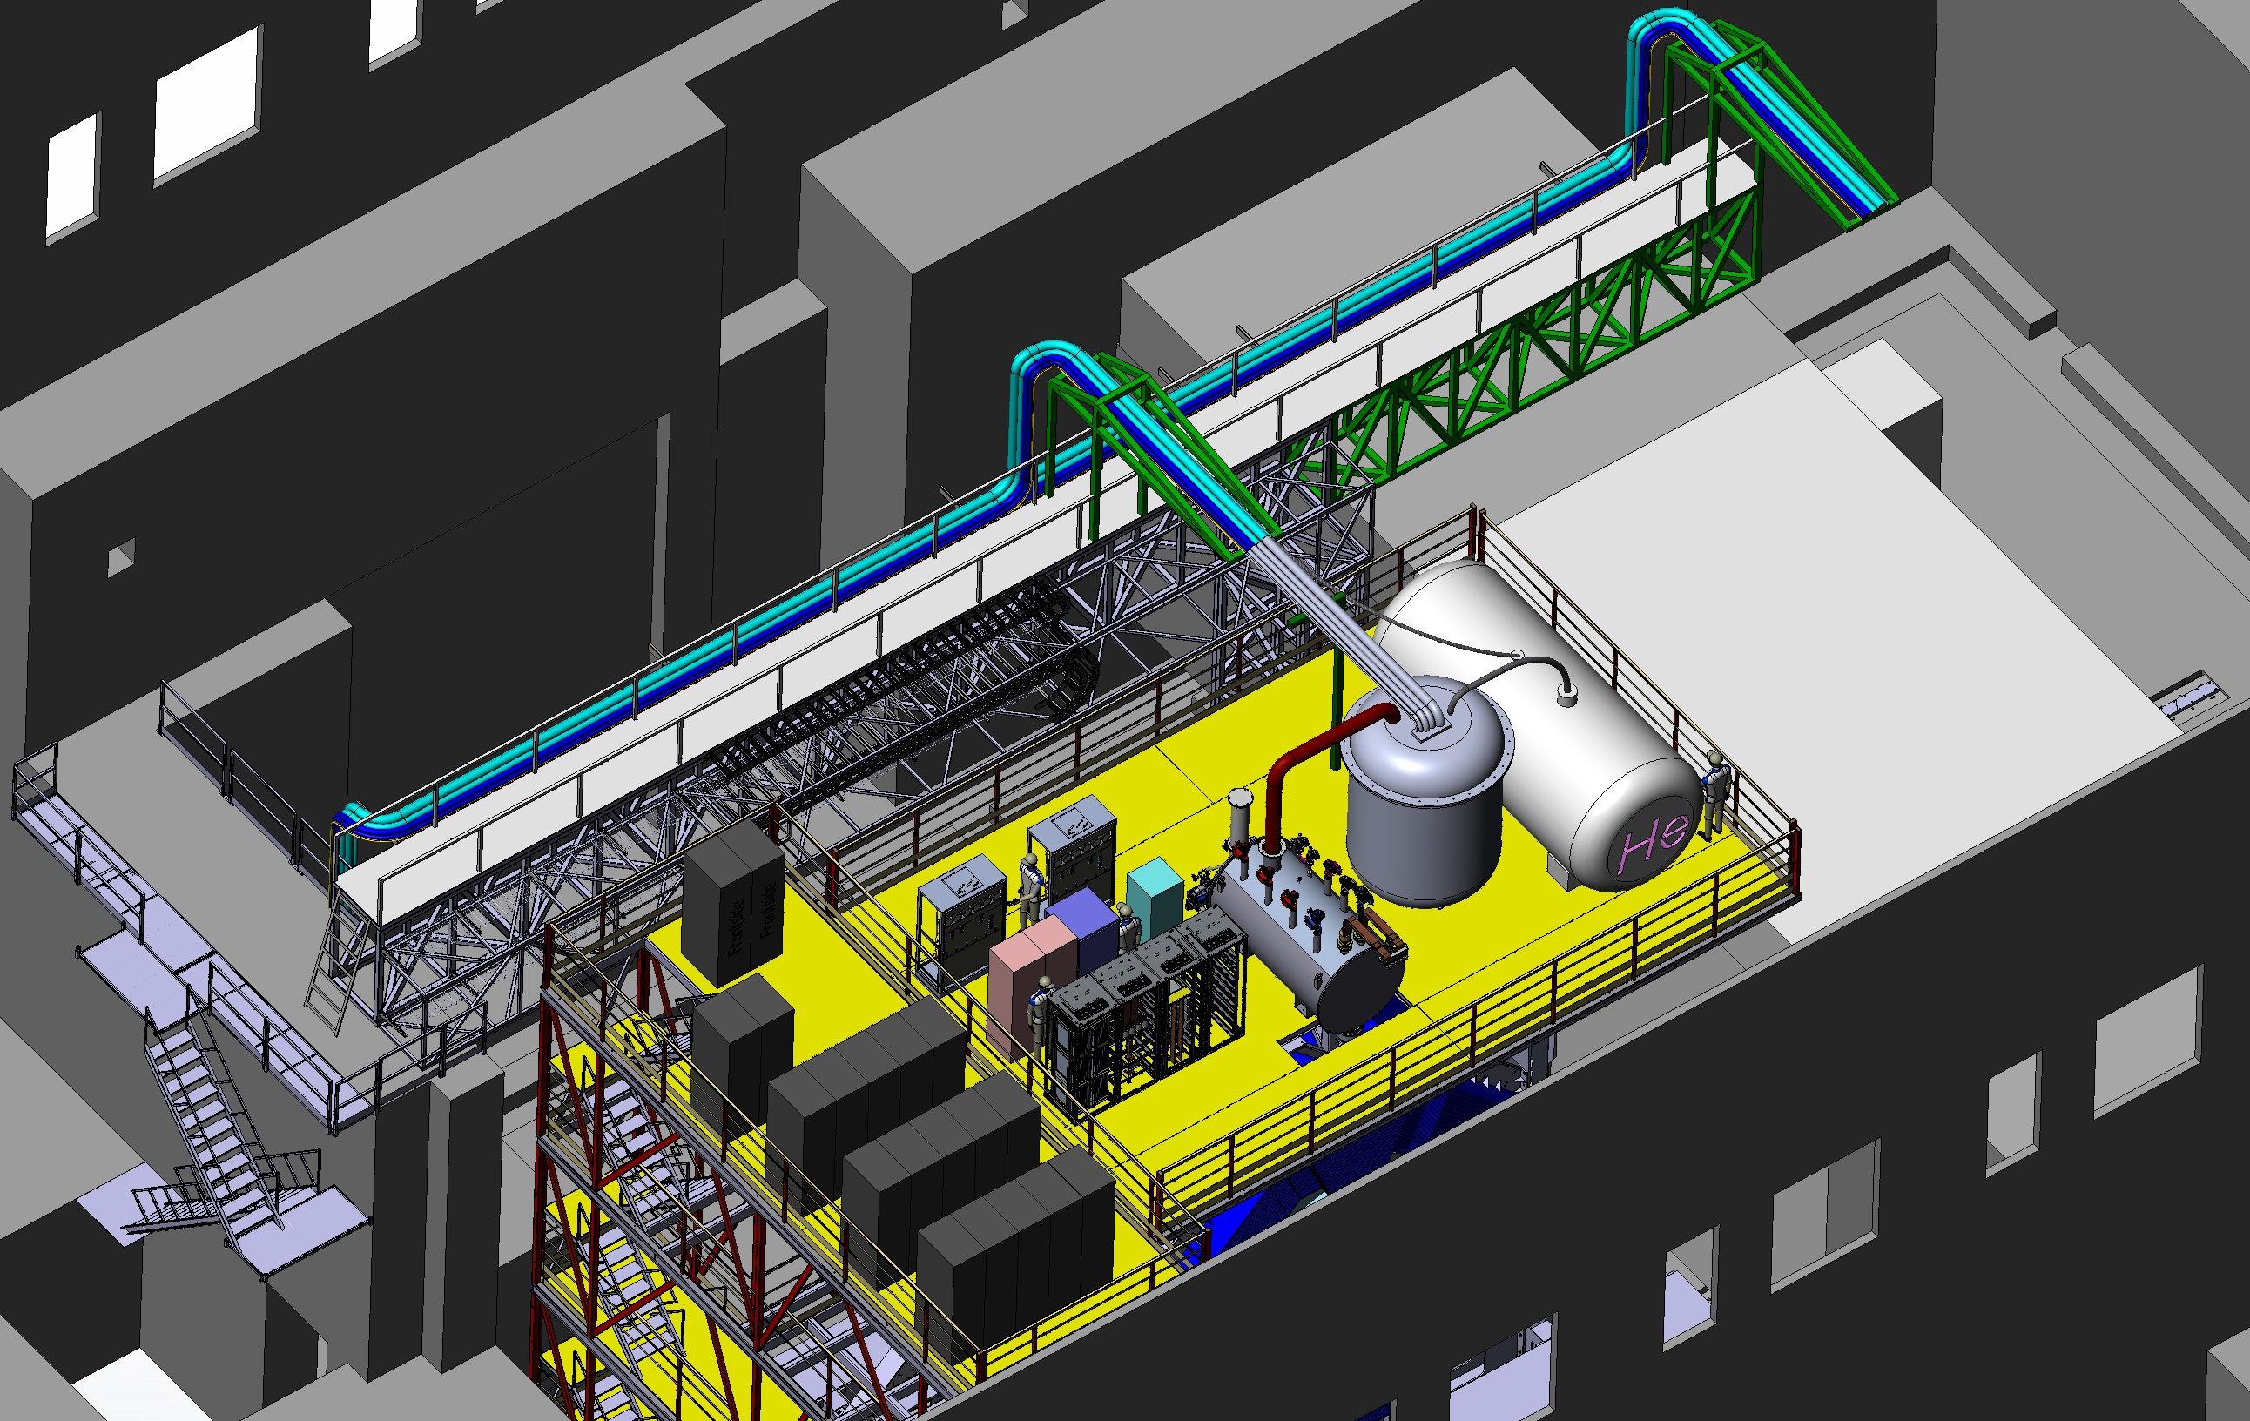
Cryogenic system service position
Working position
Service position
5

Slide 6
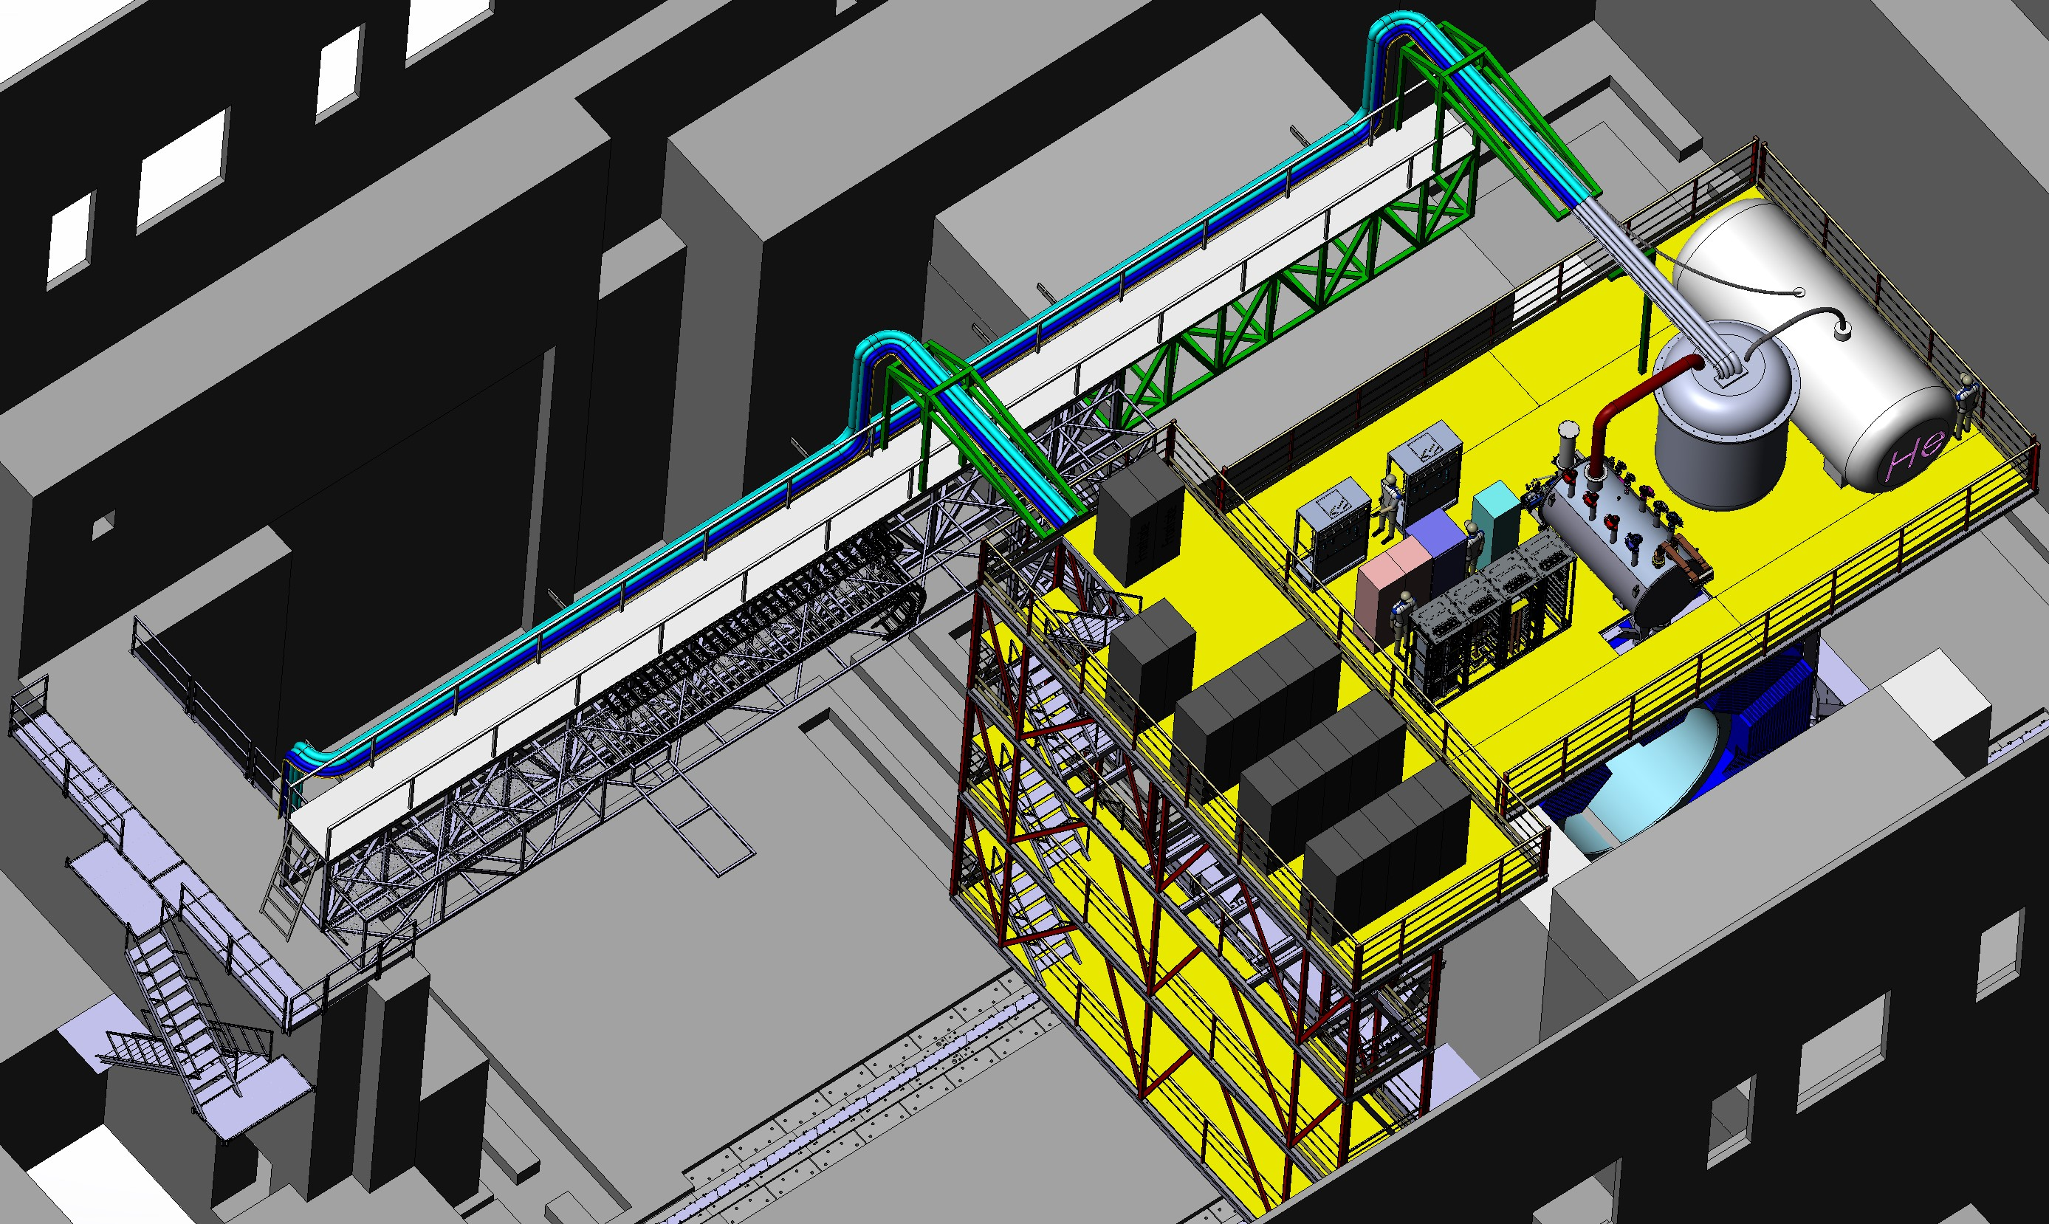
Cryogenic system working position
Working position
Service position
6

Slide 7
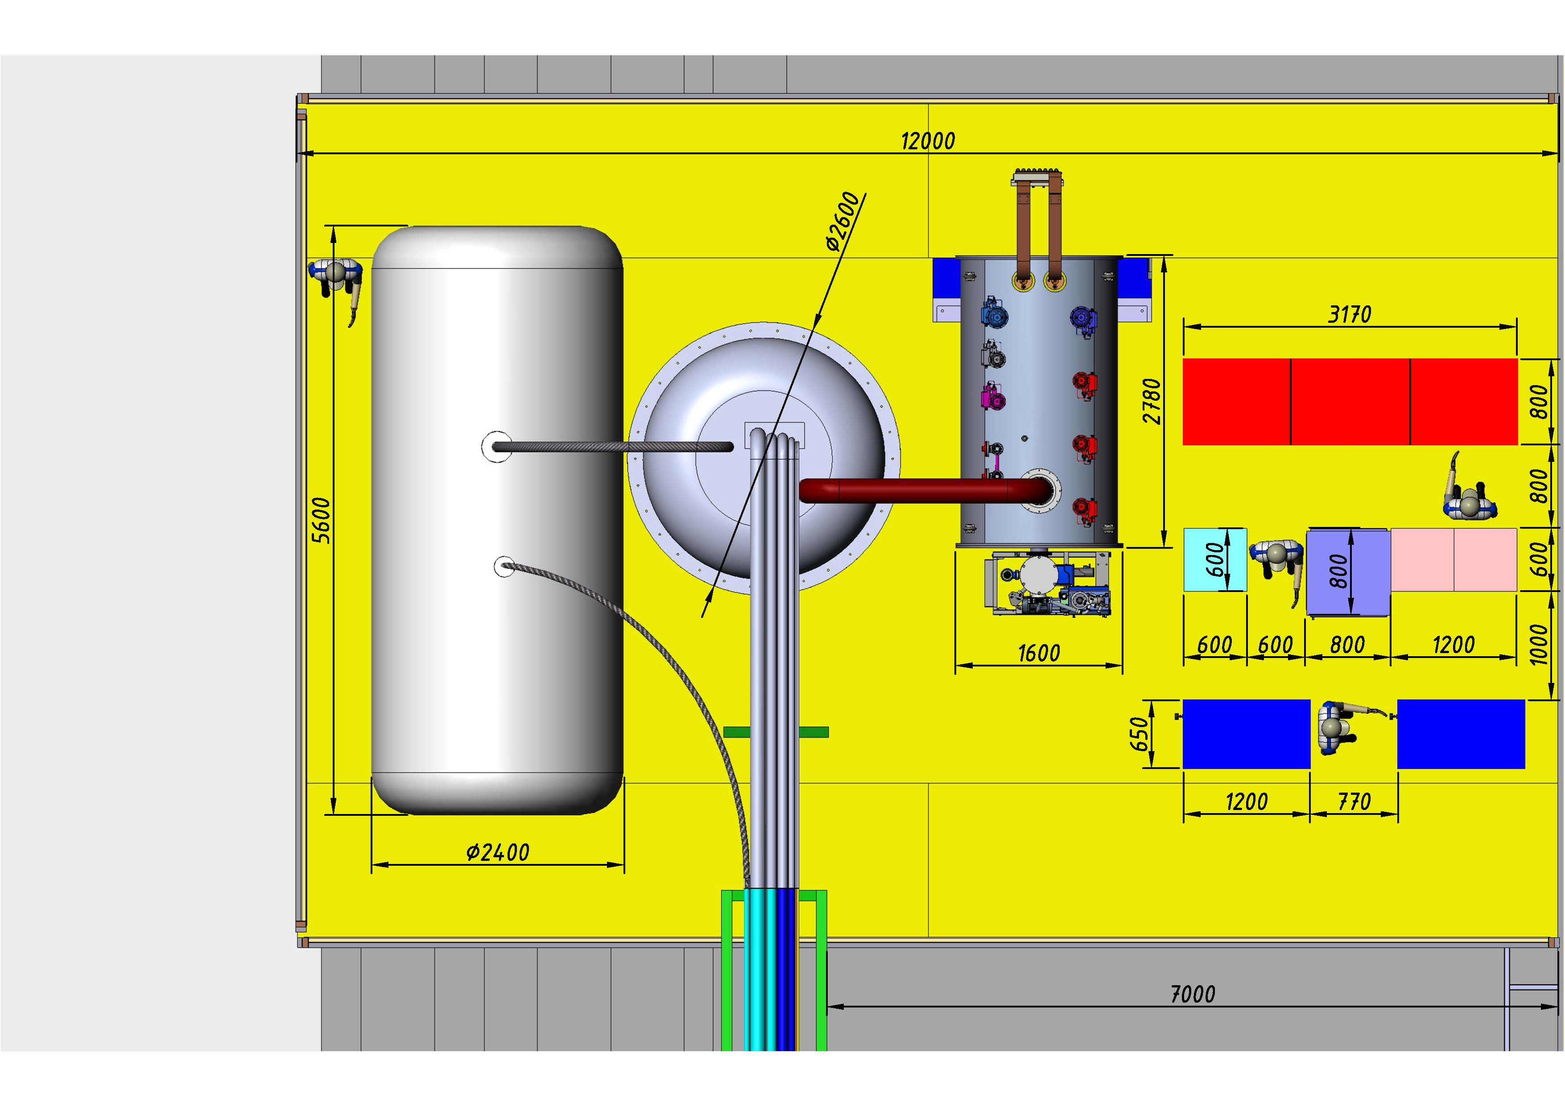
Cryogenic system
Measuring cabinet
Power supply cabinet
Protection system cabinet
Thermometry system cabinet
Vacuum cabinet
7

Slide 8
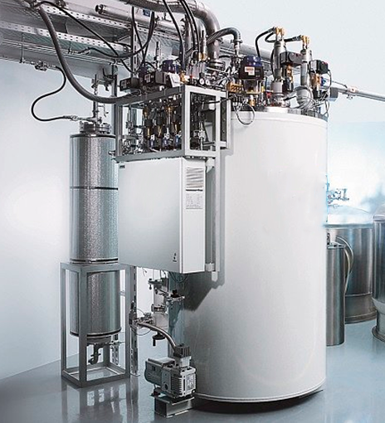
Helium system
 | Operating parameters | Unit
1 | Cooling capacity (for 4.5 K) | 100 W
2 | Cooling capacity (for 80 K) | 150 W
3 | Temperature of outlet flow from the SPD | 4.3 K (1.05 bar)
4 | Temperature of inlet flow from the SPD | 4.5 К (1.15 bar)
5 | Hydraulic resistance of the SC coil | 0.1 bar
6 | Cold weight | 5200 kg
7 | Maximum pressure in coil | 5 MPa
8 | Heat load | 40 W(4.5 K), 264 W(80 K)
9 | Equipment Requirement | Maximum reliability, energy efficiency, compactness, automatic mode
10 | Interval of repair/regulatory work of the plant | Not more than once a year
8

Slide 9
Cryogenic system control
Cryogenic system control
2 storage cryogenic tanks for LHe
Vacuum system
Pneumatic system
Satellite refrigerator
2 storage cryogenic tank for LN2
SC coil system control
1 storage cryogenic tank for LAr
1 storage cryogenic tank for LCO2
9

Slide 10
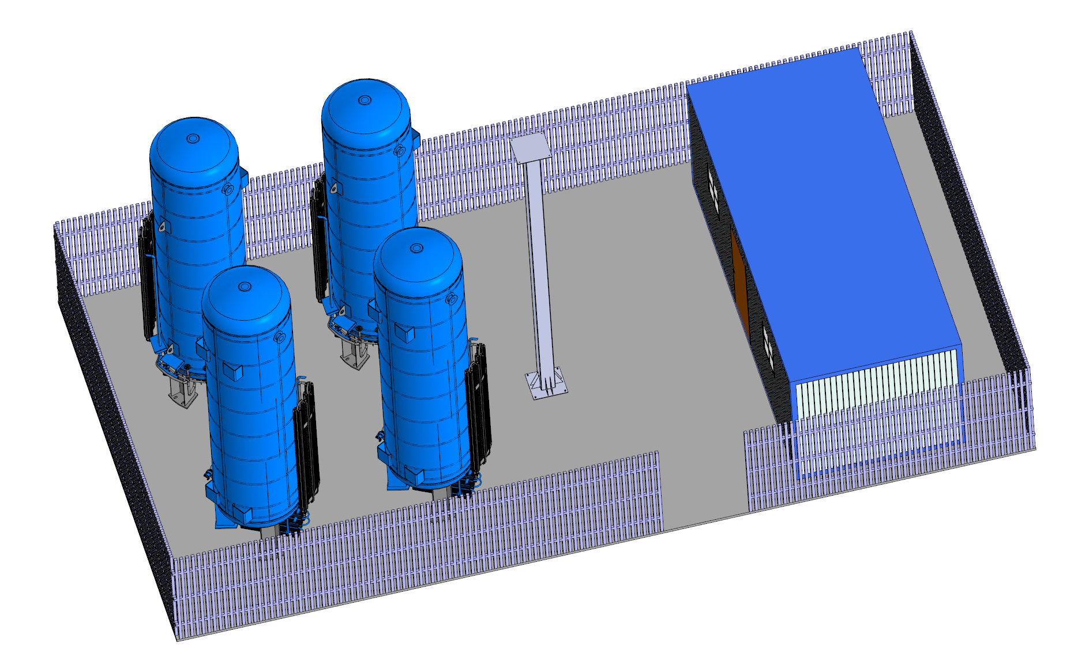
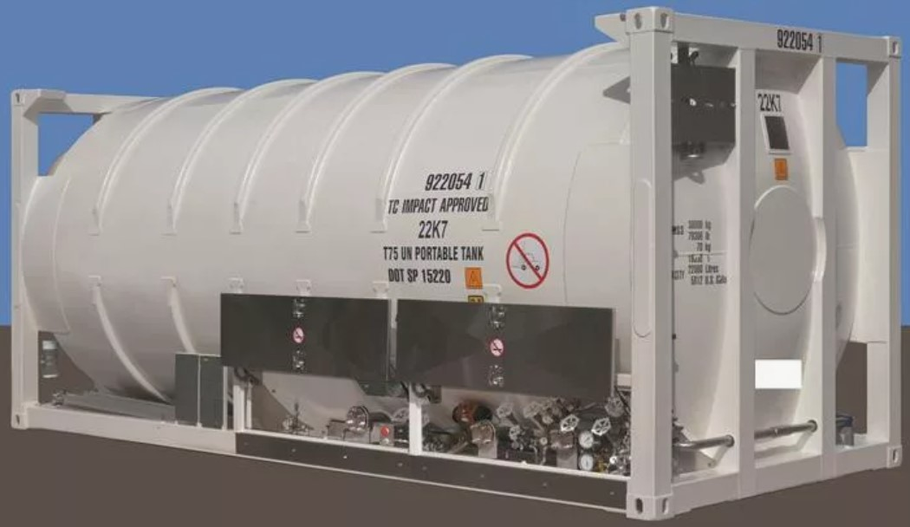

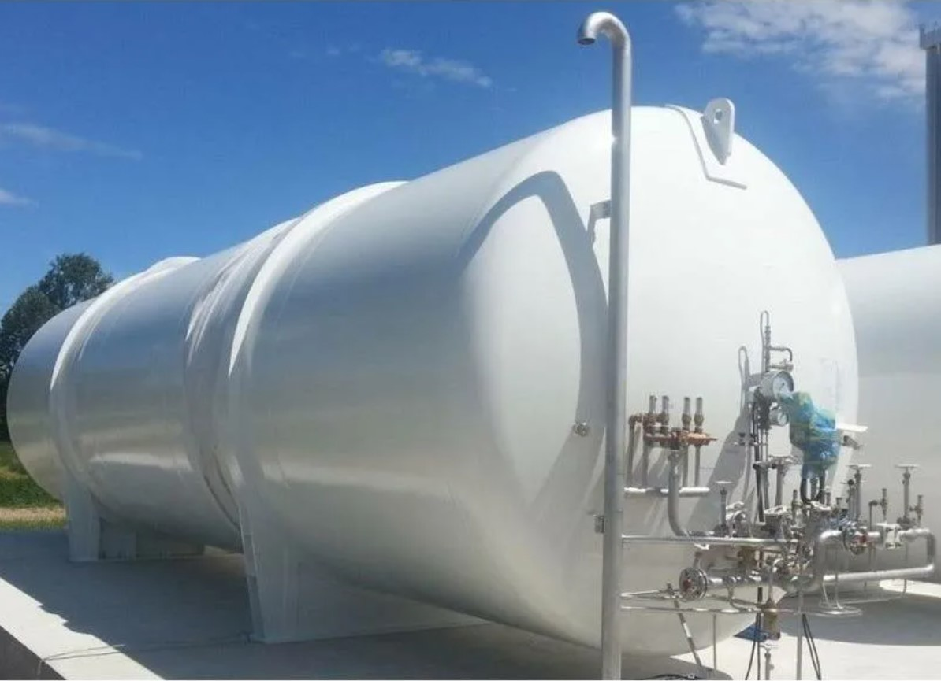
Cryogenic storage tanks
6
1
1
4
2
3
5
Pipelines
1 – Two storage tanks for LN2;
2 – Storage tank for LAr;
3 – Storage tank for LCO2;
4 – Technical room;
5 – Storage tank (18 m3) for LHe;
6 - Storage tank (6 m3) for LHe
Cryogenic line:
LN2 – 150 m (rigid tube)
LHe – 100 m (rigid tube)
Warm line:
Ar – 120 m (rigid tube)
N2 – 120 m (rigid tube)
CO2 – 120 m (rigid tube)
10

Slide 11
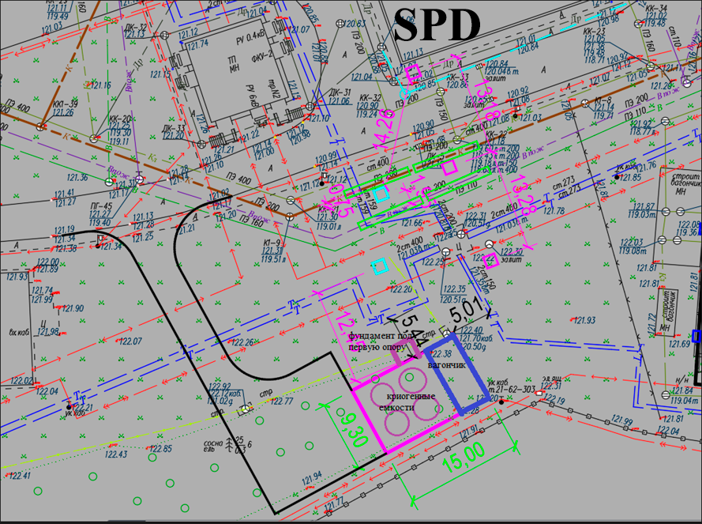
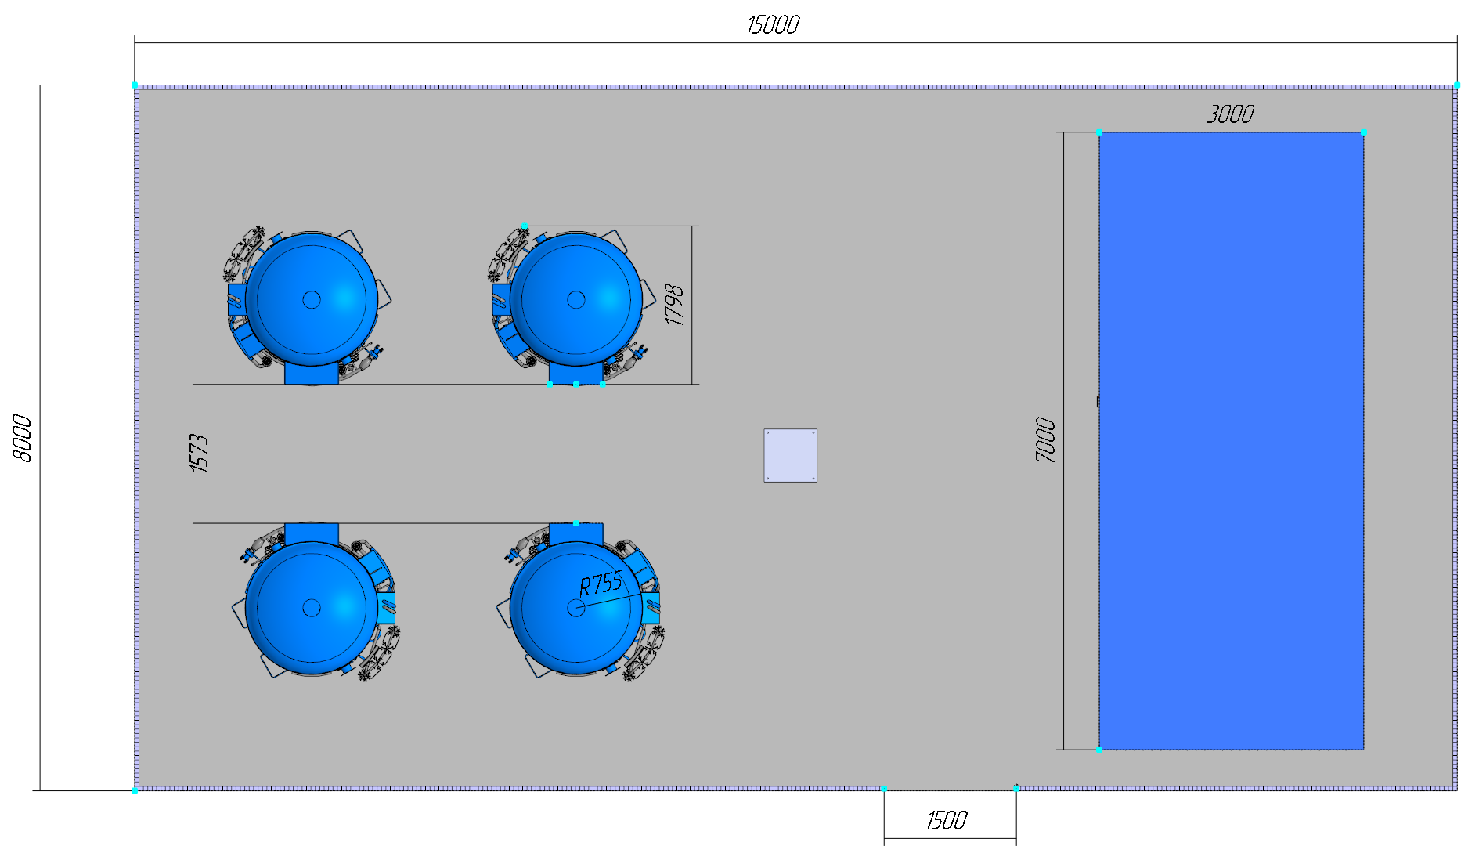
Cryogenic tanks platform
Cryogenics tanks:
20 000 liters of nitrogen will be spent in 1 month of work;
Refueling of nitrogen tanks can be carried out without stopping the experiment;
10 000 liters of Ar will be spent in 2.6 months of work;
10 000 liters of CO₂ will be spent in 4.7 month of work;
Isobutane will be stored in ballons volume of 20 m³(one ballon – 2.5 month of work.
11

Slide 12
Steps of creation
Steps of creation
SPD | 2025 |  |  |  | 2026 |  |  |  | 2027 |  |  |  | 2028
 | I | II | III | IV | I | II | III | IV | I | II | III | IV | I | II | III | IV
Cryogenic plant
Helium system
Nitrogen system
Vacuum system
Pneumatic system
Cryogenic system control
Cryogenic tests
 |  |  | Technical design |  |  | Technical task |  |  |  |  | Contract execution |  |  |  |  |  | Assembly & Test |  |  |  |  | Commissioning
12

Slide 13
Conclusions:
The new location of cryogenic equipment on the technical platform has been approved.
The new location of cryogenic tanks platform has been determined and the project is ready.
Changes in the conceptual design of the cryogenic system and transition to a satellite refrigerator.
The development of technical task for the manufacture of cryogenic tanks is in an active phase 18 m3 and 6 m3.
13

Slide 14
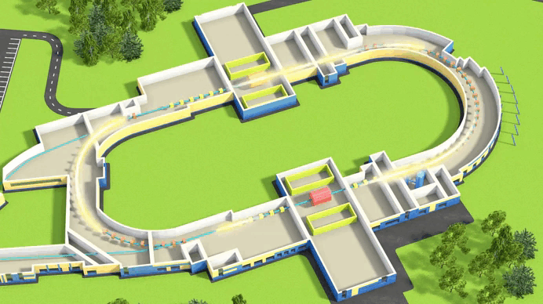
Thank you for your attention!

