Slide 1

Status of DAQ system
Leonid Afanasyev on behalf of DAQ group

Slide 2
Why triggerless DAQ
Bunch crossing each 76 ns; crossing rate 13.1 MHz,
Collision rate ~3–4 MHz (1st stage about 100kHz)→
Triggerless (or streaming, or free-running) DAQ to avoid any hardware biases
Data flux was estimated for the maximum luminosity L = 10³² cm⁻²c⁻¹ and maximum energy √s = 27 GeV. Within simplified simulation and some safety margin the data flux is estimated as 20 GBytes/s.

Slide 3
Why triggerless DAQ
No fast detectors to form a “classic” trigger signal
No 4π detector with 100% efficiency to detect the collisions
The wide SPD physical program eliminates a possibility of rejecting events at a hardware level
SPD is the triggerless detector setup
Bunch crossing time we will get from NICA via White Rabbit protocol (probably). It will be used at event reconstructions to speed up the procedure.
Probably the “Bunch crossing signal” can be used to reject a background/noise signal between the bunch crossing for the fast (SiPM based) detectors as a suppression signal to the Frond-End electronics or as a hardware filter based on the recorded time at the stage of data transfer.
It is the only possible “hardware trigger”, better say “data rejection”

Slide 4
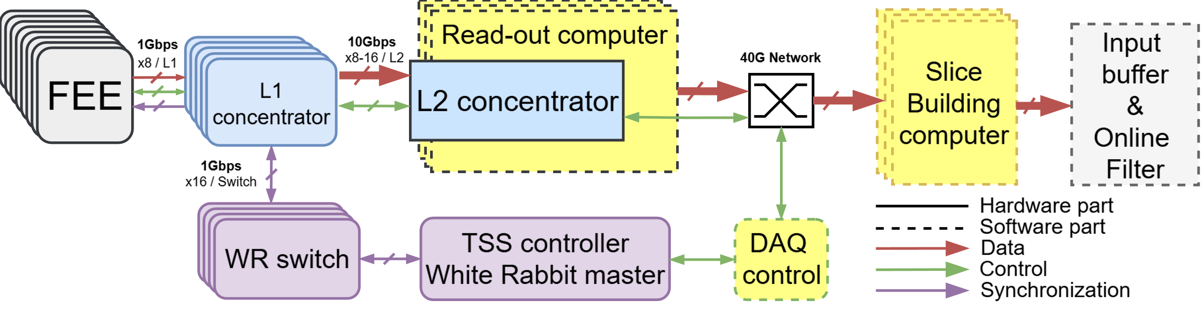
DAQ structure
SPD Stage | FEE Outputs | L1 (8 ports) | L2 (16 ports) | Read-out PC | Slice Builders
First | ~1292 | >165 | >12 | >6-12 | >5
Second | ~5800 | >730 | >50 | >25-50 | >40
L1 concentrator
L2 concentrator
TSS – synchronization system
Computer Read-out and Slice Building system.

Slide 5
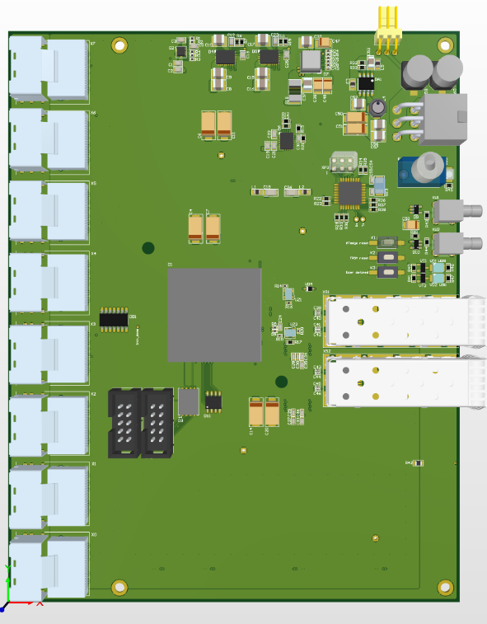
L1 concentrator (Current prototype)
Cyclone 10GX (105YF780E6G)
8x Links for connect front-end boards (miniSAS connectors) 8 diff pairs per connector
SFP+ 10Gb transceiver for data transmission to L2
SFP+ transceiver for TSS (White Rabbit)
This prototype allowed to test main conceptions for the firmware development and interference with FEE and L2 concentrator.

Slide 6
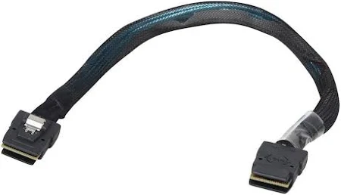
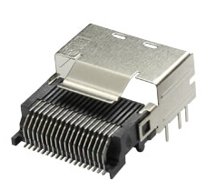
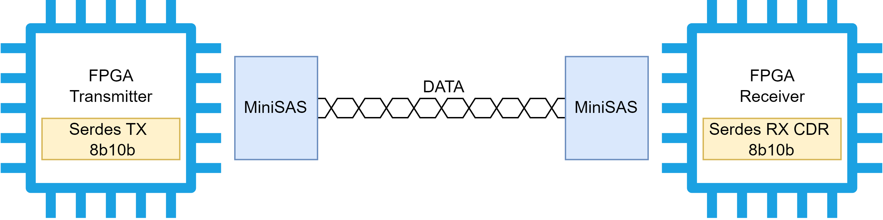
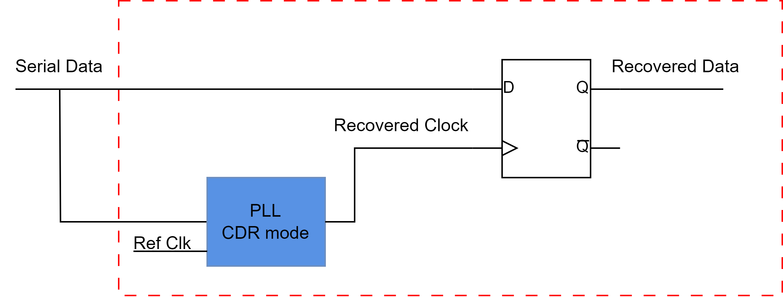
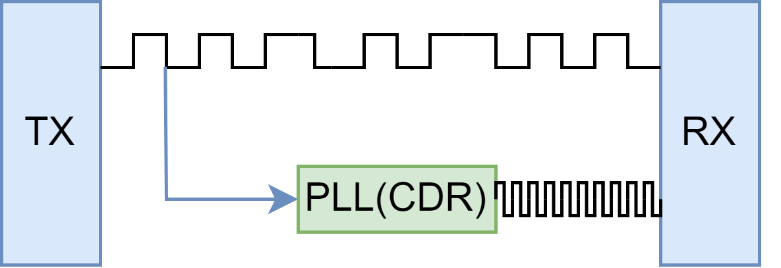
L1 next prototype (Hardware) JINR
MiniSAS
Global changes:
Integration WR requirements
Two external VCXO
Two 16-bit ADC
Jitter cleaner
Transition to CDR-mode for FEE-L1 data line.
E-Link line mapping
We’re plan to manufacture it by the end of the year.
CDR Mode
Pin function | Side B Pin | Side A Pin | Pin function
GND | B1 | A1 | GND
Tx0+ | B2 | A2 | Rx0+
Tx0- | B3 | A3 | Rx0-
GND | B4 | A4 | GND
Tx1+ | B5 | A5 | Rx1+
Tx1- | B6 | A6 | Rx1-
GND | B7 | A7 | GND
Unipolar 0 | B8 | A8 | Unipolar 7
Unipolar 1 | B9 | A9 | Unipolar 3
Unipolar 2 | B10 | A10 | Unipolar 4
Unipolar 6 | B11 | A11 | Unipolar 5
GND | B12 | A12 | GND
Tx2+ | B13 | A13 | Rx2+
Tx2- | B14 | A14 | Rx2-
GND | B15 | A15 | GND
Tx3+ | B16 | A16 | Rx3+
Tx3- | B17 | A17 | Rx3-
GND | B18 | A18 | GND
Link bandwidth per line: 150 Mbps – OK
500 Mbps – OK
750 Mbps – OK
1000 Mbps – OK
1250 Mbps – OK

Slide 7
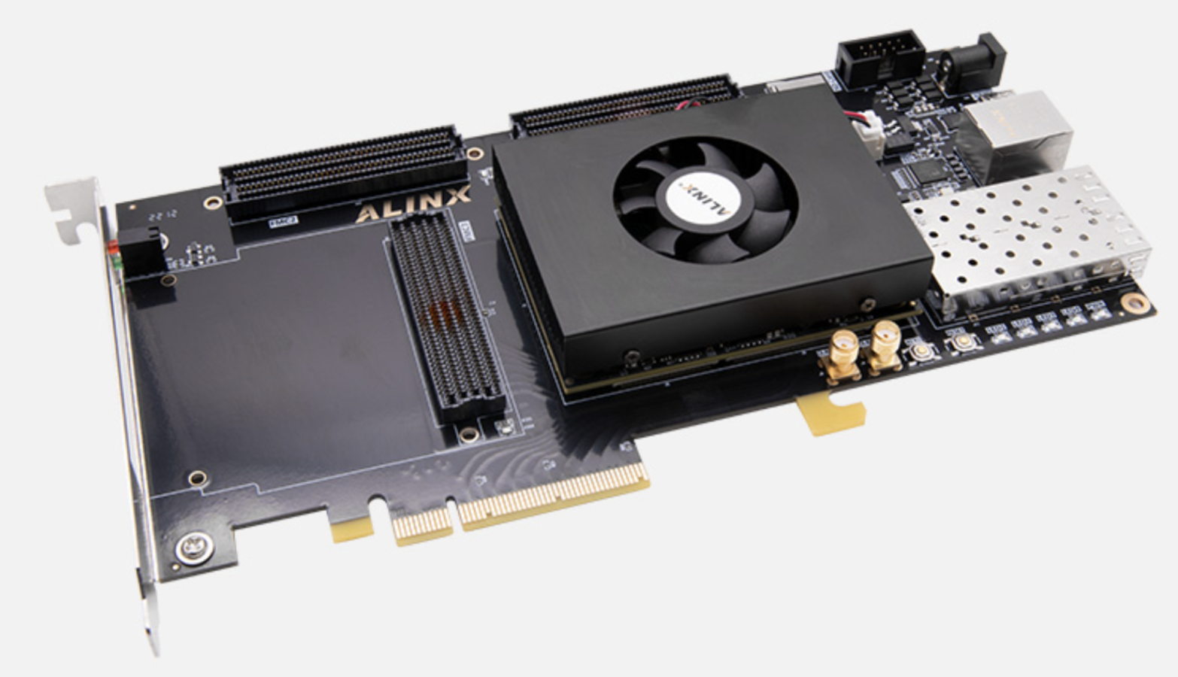
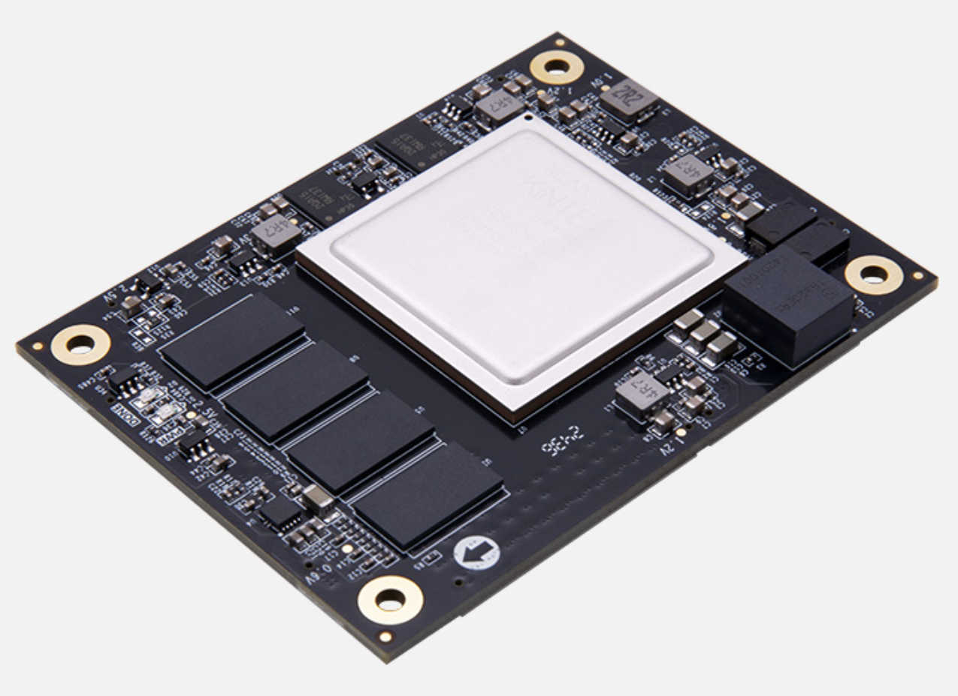
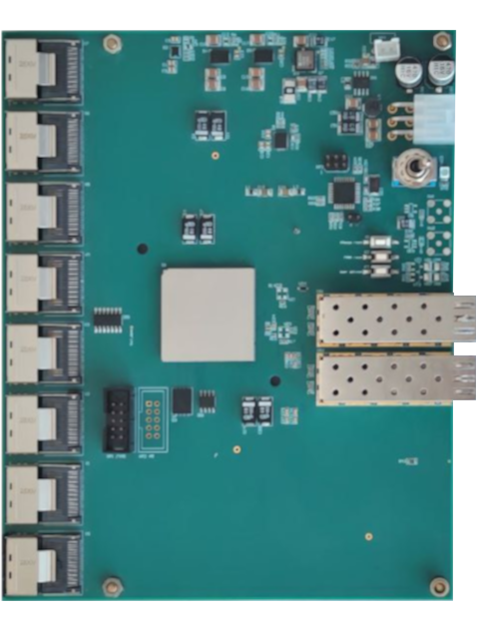
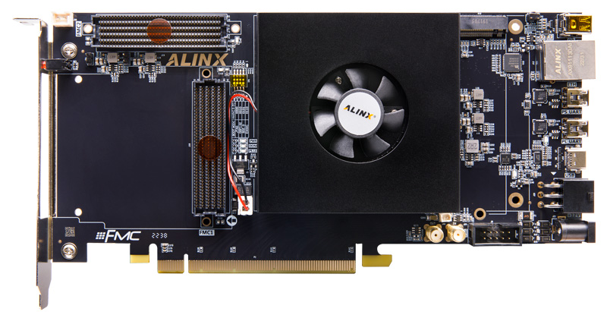
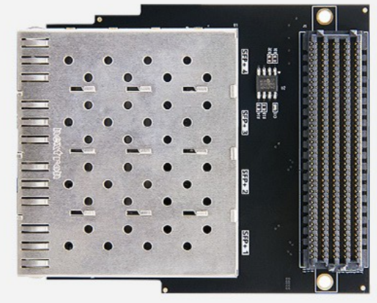
FEE emulator
Plans:
Study Kintex US (ACKU060 V2.0) chip for FEE emulator
Create custom PCB for emulator
8 MiniSAS for test E-Link
SFP+ for 10G link (For software data generator)
8 SMA for sync verification
Firmware
Eth -> MiniSAS data sender
TSS command reader
Slow configuration procedure L1-FEE
Test Firmware update procedure
FEE Emulator (Need custom PCB)
L1
L2

Slide 8
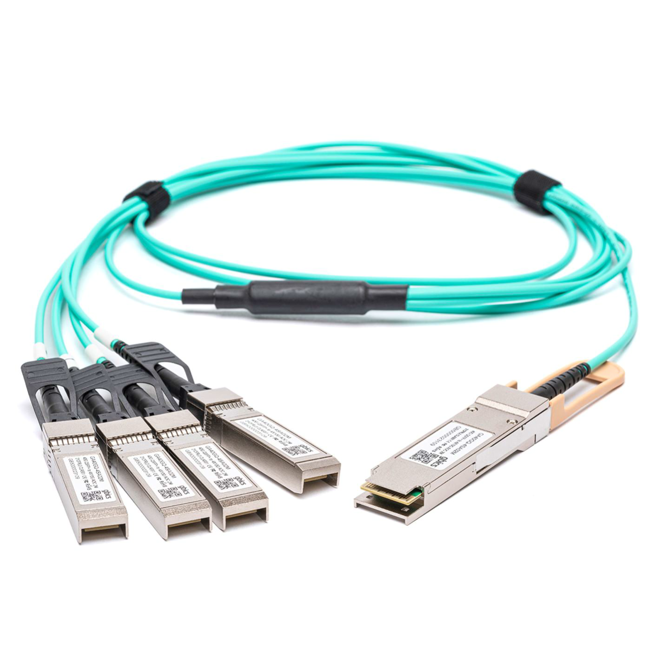
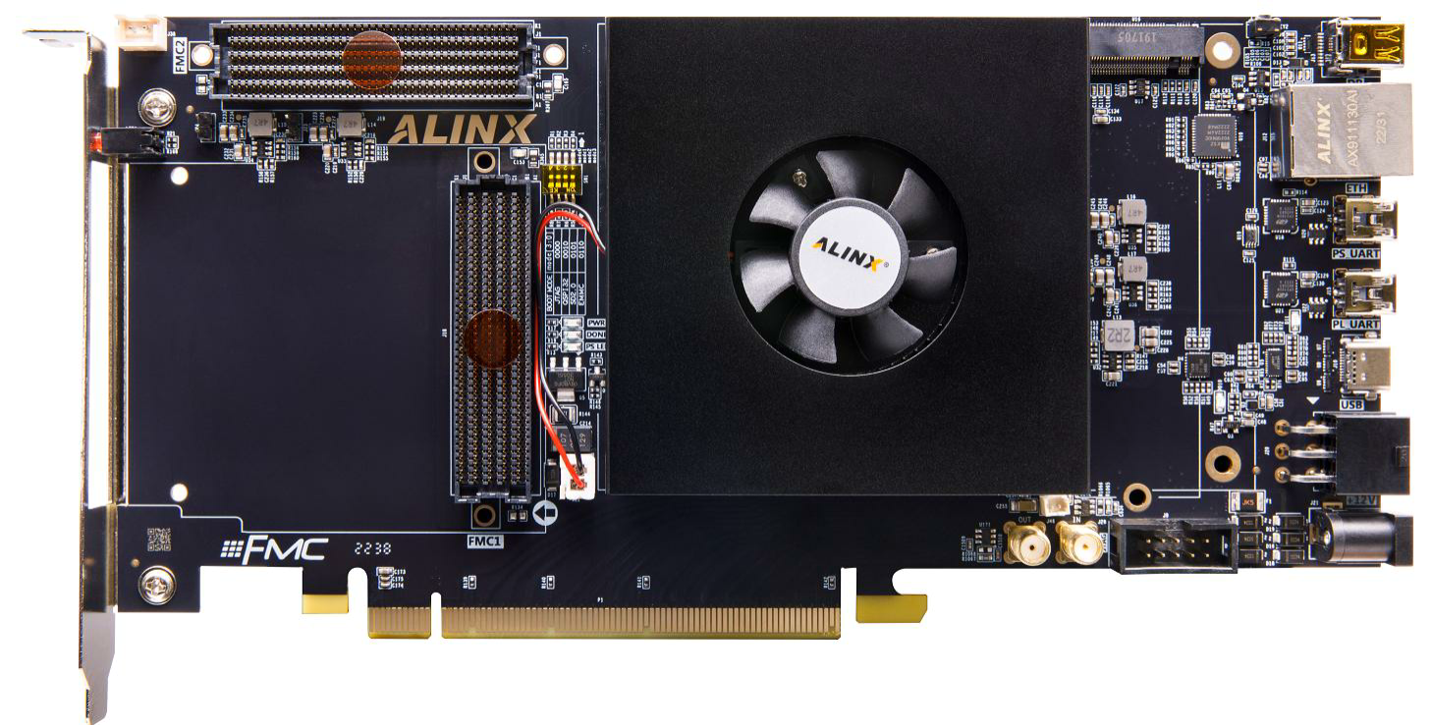
L2 concentrator TSU
Prototype of L2 concentrator card: ZYNQ UltraScale+ FPGA Development Board Z19-P form Alinx. Firmware is being developed.
Instead of the mesonin board with 4 SFPs the board to connect 2 qSFP modules is developed.
8 or 16 L1 connected to L2

Slide 9
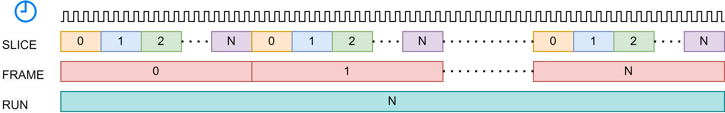
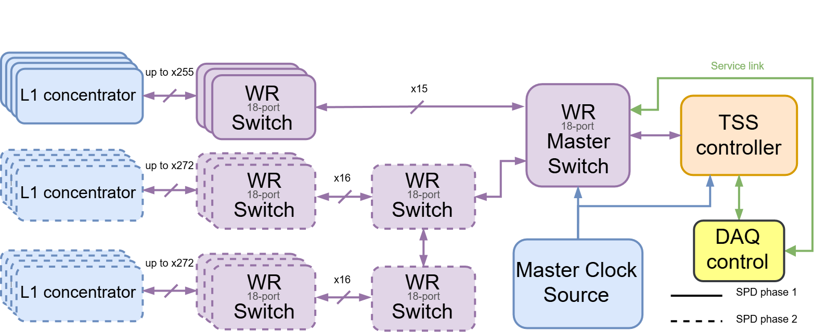
Time Synchronization System – TSS SPbPU
The achieved time synchronization accuracy with the development nodes is better that 10ps!

Slide 10
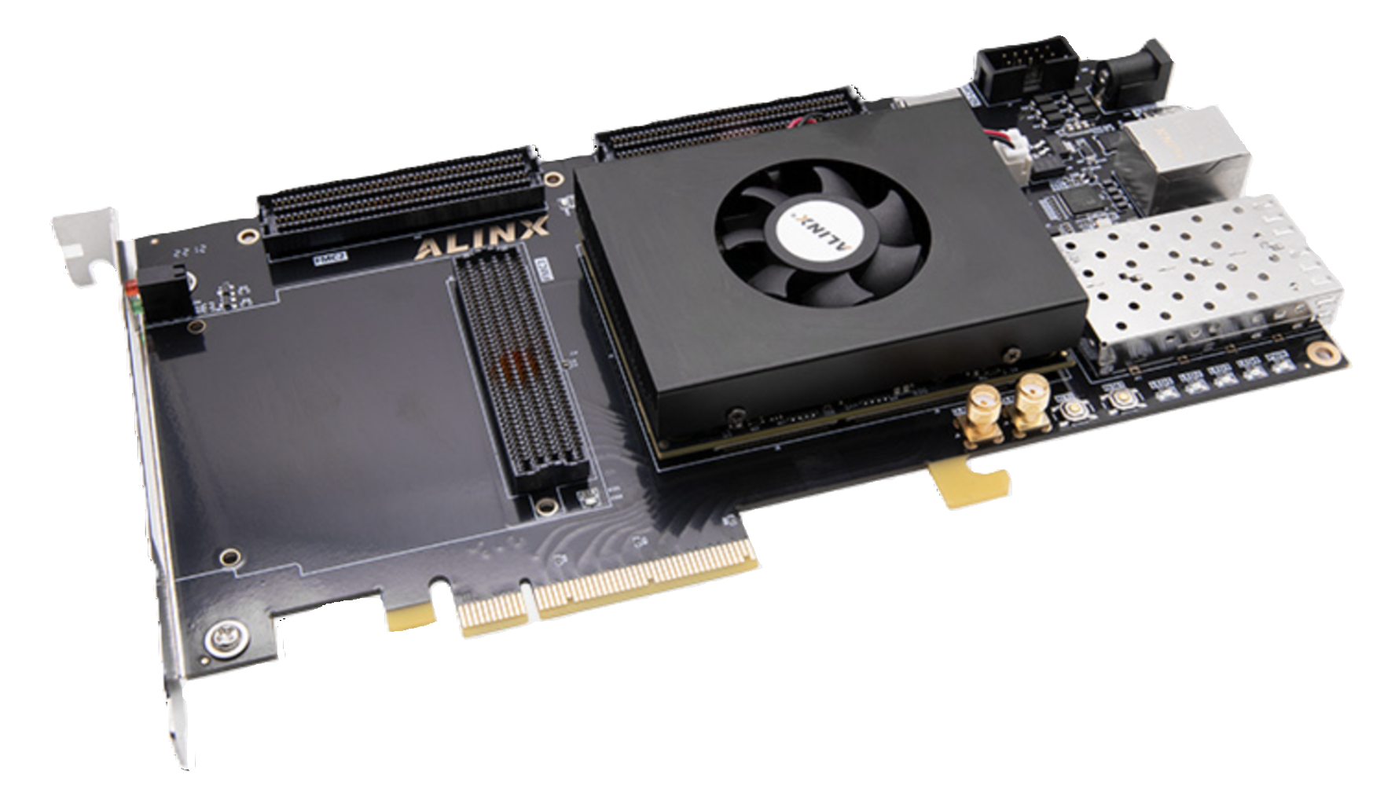
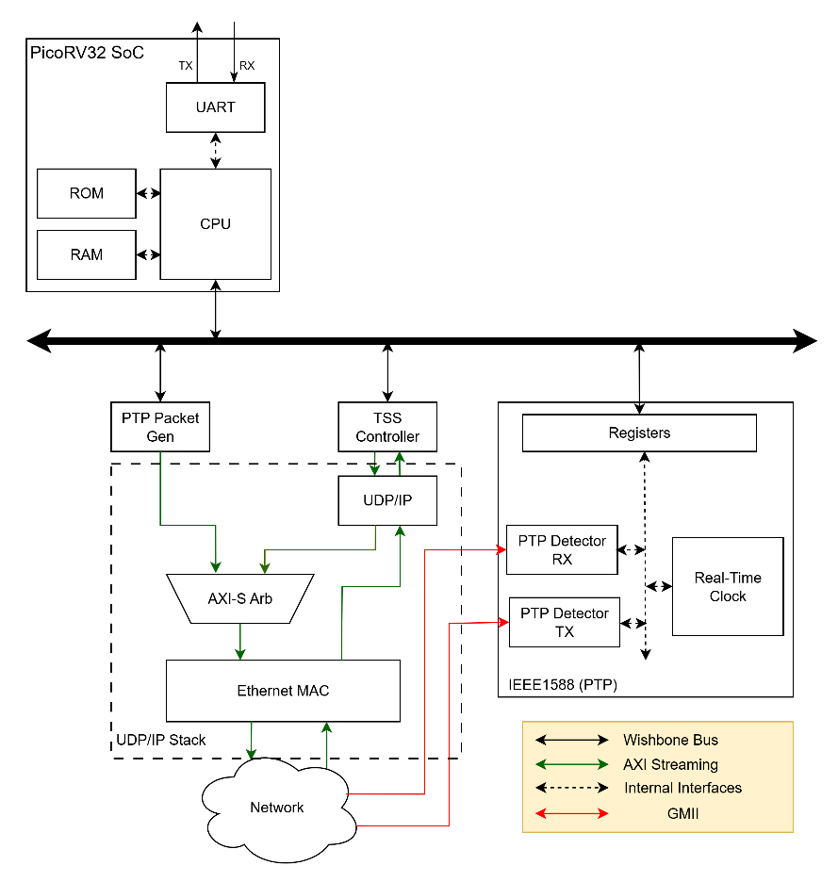
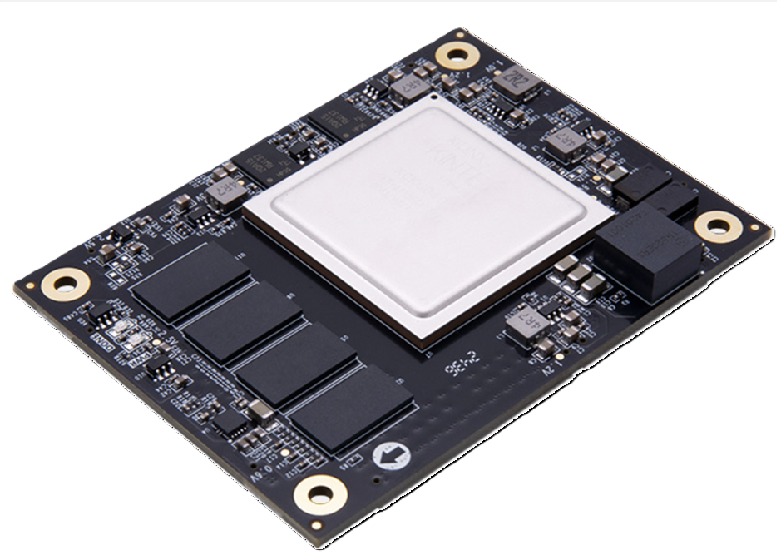
TSS controller prototype SPbPU
Platform:
Alinx AXKU062 V2.0 (Kintex Ultrascale XCKU060)
2 x SFP+ (per line 12.5Gbps)
Planed for 2026

Slide 11
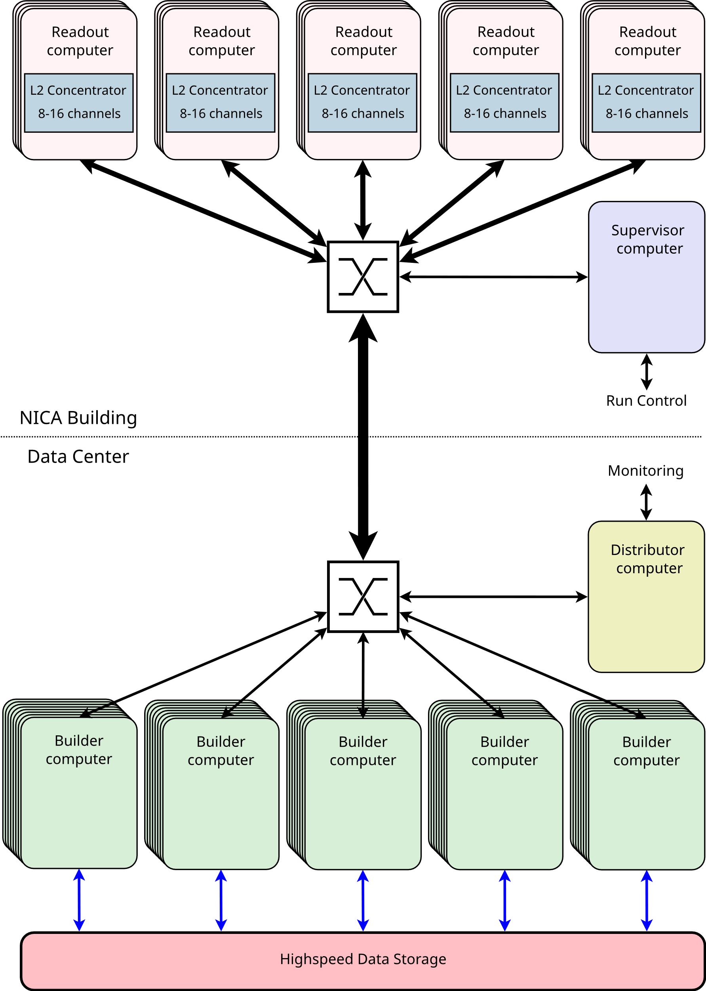
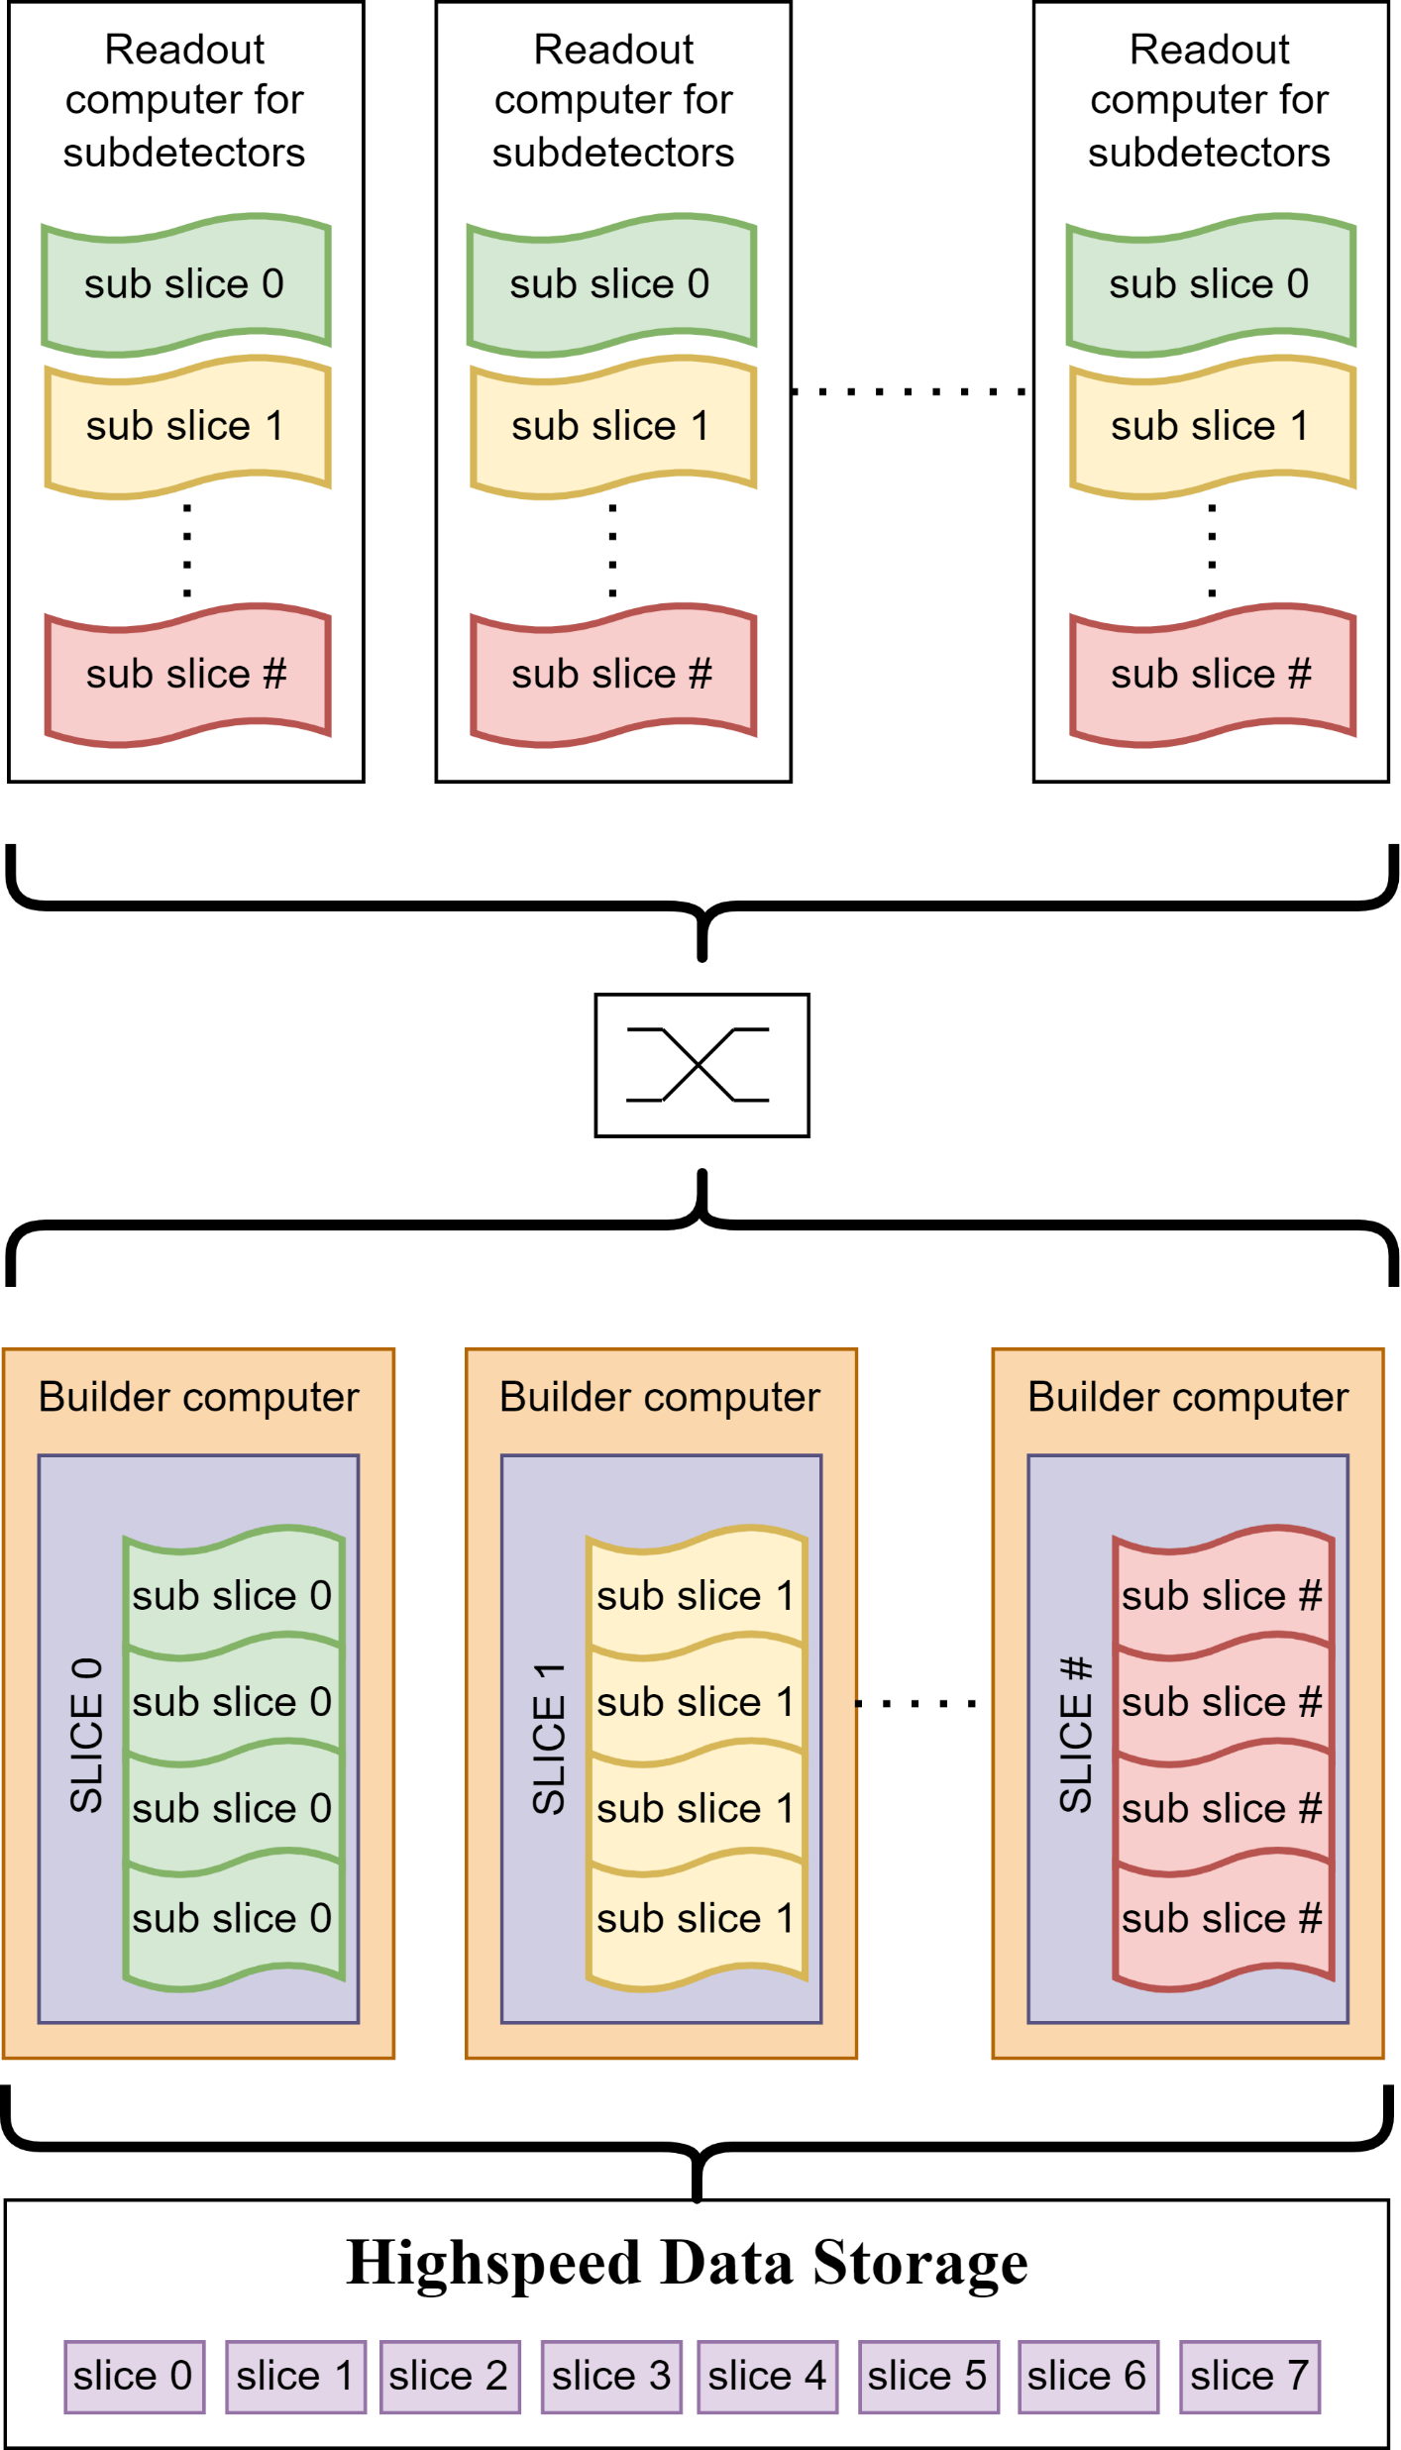
Computer Read-out and Slice Building system
Only industrial standard equipment will be used
The purpose of slice building systems is to collect data (sub-slices) from all readout computers, build a complete slice and write it to the fast intermediate storage.
Additionally, the system will provide access to raw data (sub-slice) for detector groups in order to monitor the collected data before processing in the online filter.
Components:
Read-out – getting a sub-slice from each detector system
Builder – combining sub-slices and forming a single data structure
Supervisor – arbitration of the slice construction system
Distributor – provides raw data for monitoring

Slide 12
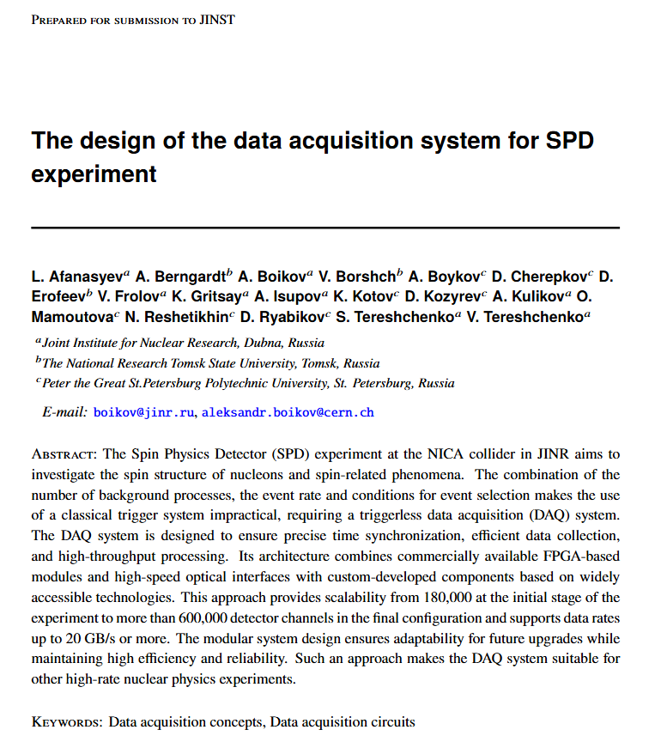
The paper submitted to JINST
The design of the data acquisition system for SPD experiment
http://arxiv.org/abs/2509.12790

Slide 13
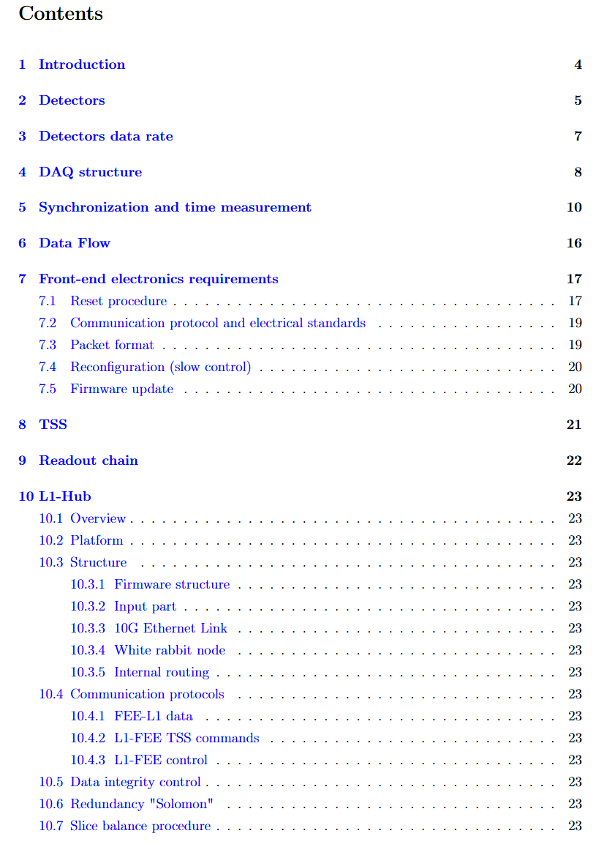
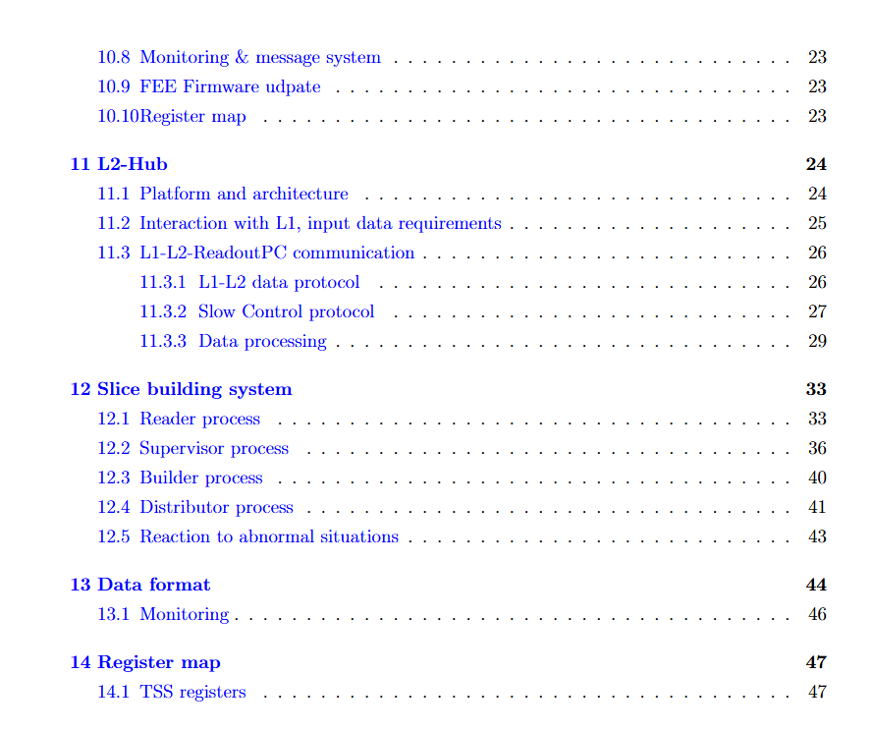
DAQ specification
The current and next versions of the
specification will be published in the
JINR document management system
(docs.jinr.ru).
Available to JINR employees and
collaborators via JINR Single Sign-On
(SSO) → docs.jinr.ru
docs.jinr.ru/spd-experiment/spd-daq/specification

Slide 14
2026 plans
Production of the next L1 concentrator prototype
Production of the TSS controller prototype
The firmware development for L1, L2 and TSS
It will include further development of integration with all FEE.
Software development
Test of radiation hardness of FPGA and optical connections need to be foreseen.

Slide 15
Thank you for your attentions.

