Slide 1





BBC detection and readout system R&D and QA/QC setups for mass production
S. Doronin, F. Dubinin, K. Krivokhin, A. Kuzmin, D. Shafikova, K. Tertyshnaya, P. Teterin, A. Zakharov

Slide 2
R&D introduction
The goal:
Find optimal configuration of the detector and the front-end electronics
Study detector and electronics performance
Main activities:
Effect of WLS number of loops and outer length on tile detector performance
Measurements with cosmic rays

Slide 3
Effect of WLS number of loops and outer length on tile detector performance

Slide 4
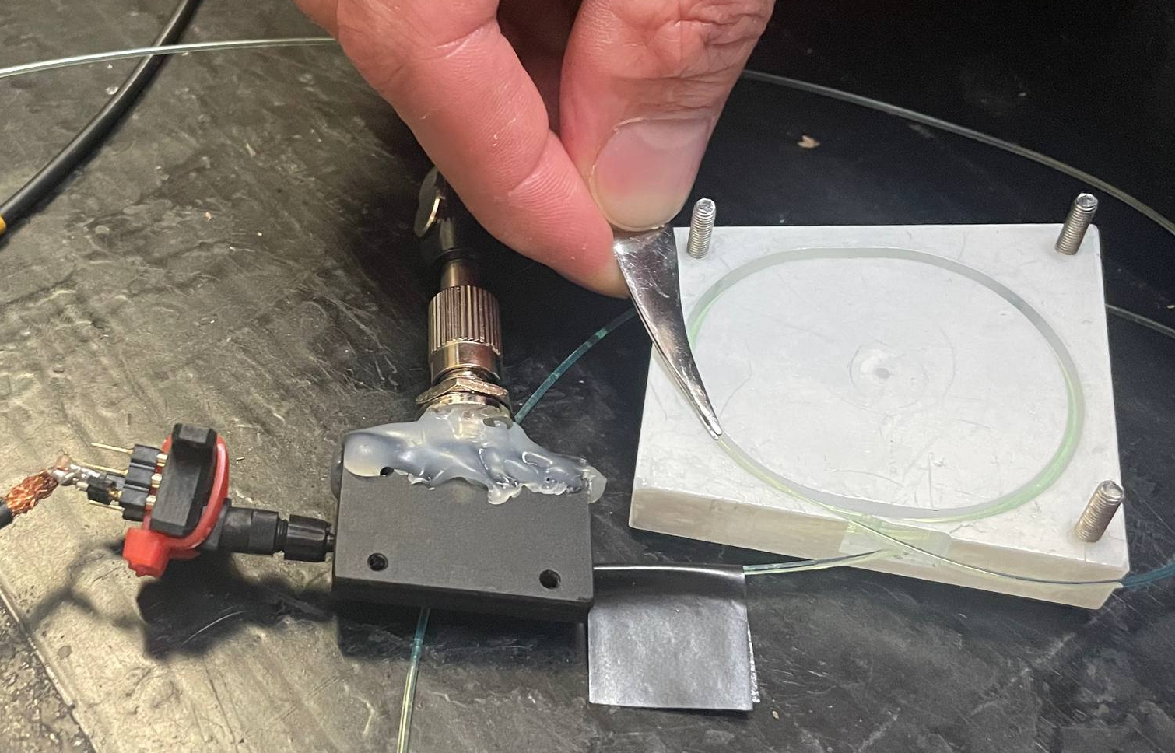
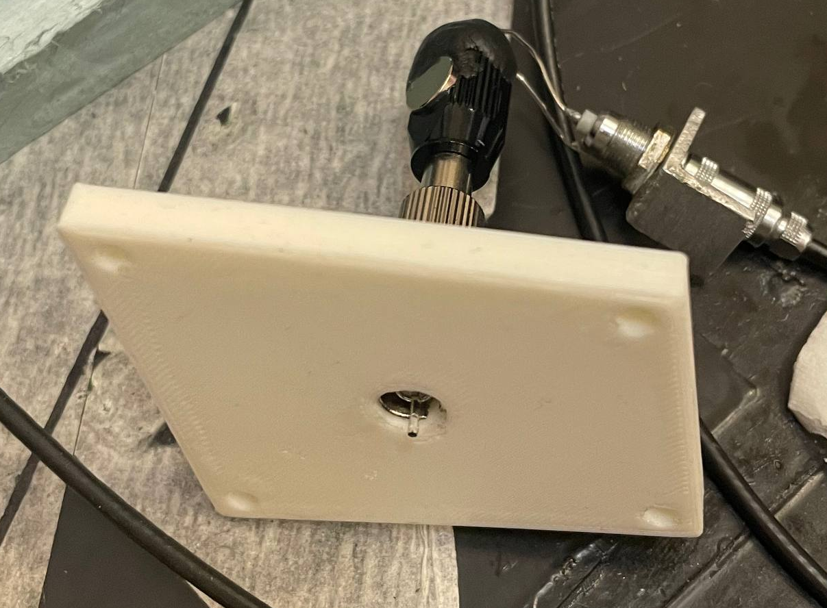
Tile for light collection tests
Light entre to the tile
Optical connector
LED 410nm
SiPM
Reference LED
WLS extra out hole
Clear fiber, tale 2mm

Slide 5
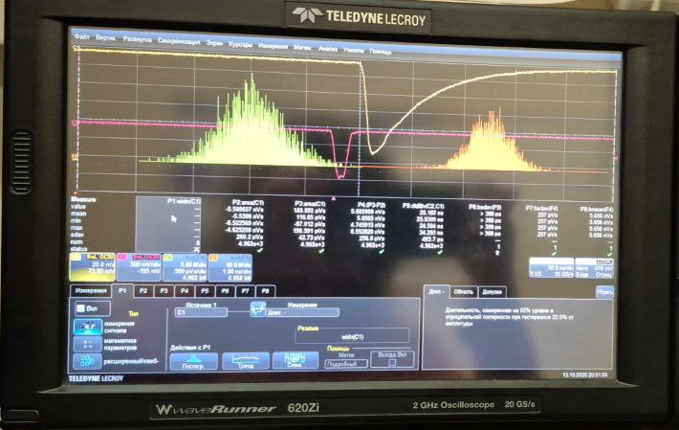
Test setup
Power supply: Keithley 2400
Pulse generator: Rigol DG4102
Pulse analyzer: Lecroy 620Zi
Measured values:
SiPM charge response
Charge RMS
Trigger to SiPM pulse delay RMS
SiPM pulse width
Oscilloscope input impedance: 50 Ohm
Driving pulse for LED:
Amplitude: 5V
Width: 15ns
SiPM – tile distance (WLS tale width): 5cm

Slide 6
Charge vs number of loops

Slide 7
Time resolution and pulse width

Slide 8
Outlook and plans
Signal charge increase with the number of loops but the dependence is not linear
The width/center ration of charge distribution decrease with the number of loops
Time resolution and pulse width are weekly sensitive to the number of loops
Measurements with long WLS tale are in progress
Measurement of light losses into the tile expect to provide better understanding of light collection by rolled WLS

Slide 9
Measurements with cosmic rays

Slide 10
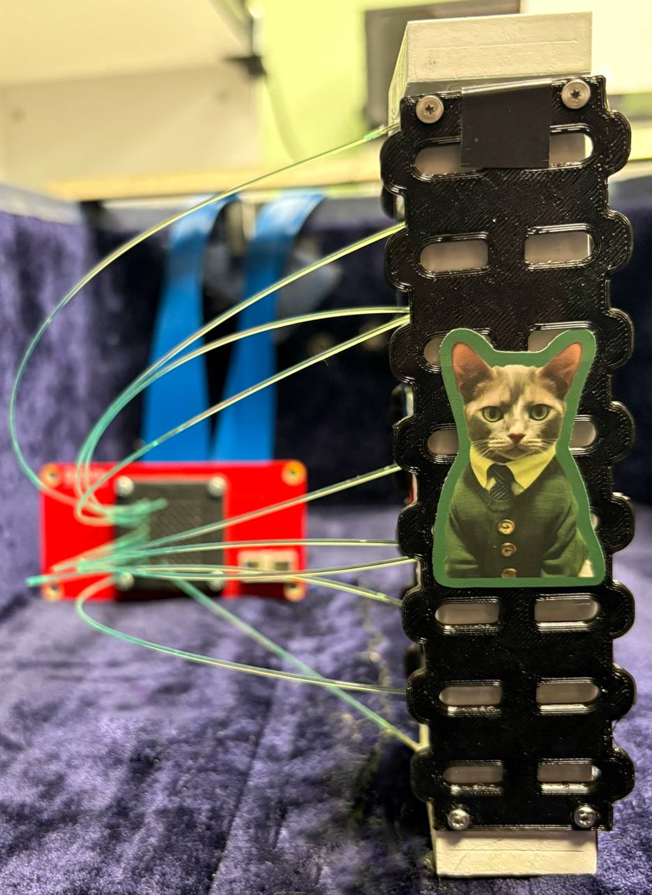
Test setup
10 tiles of 2nd row with similar WLS
WLS: SG BCF-92, 3 loops, ~30cm tail length
Readout by Hamamatsu S13361‐3050AE‐08 matrix coupled to CAEN DT5202
10 SiPMs at 7V overvoltage, the rest 54 SiPMs are at lower voltage
Overall height: 16cm
CAEN DT5202 configuration:
Low gain input, 20 mV/pC amplification
Discriminator: 240 DACu
Trigger: Top and bottom tiles in coincidence by internal logic unit
Pulse height + ToT measurement

Slide 11
SiPM bias voltage calibration
Calibration performed with LED in pulse mode by obtaining single-photoelectron spectra at different bias voltages
Zero extrapolated distance between neighboring peaks corresponds to the breakdown voltage of the SiPM

Slide 12
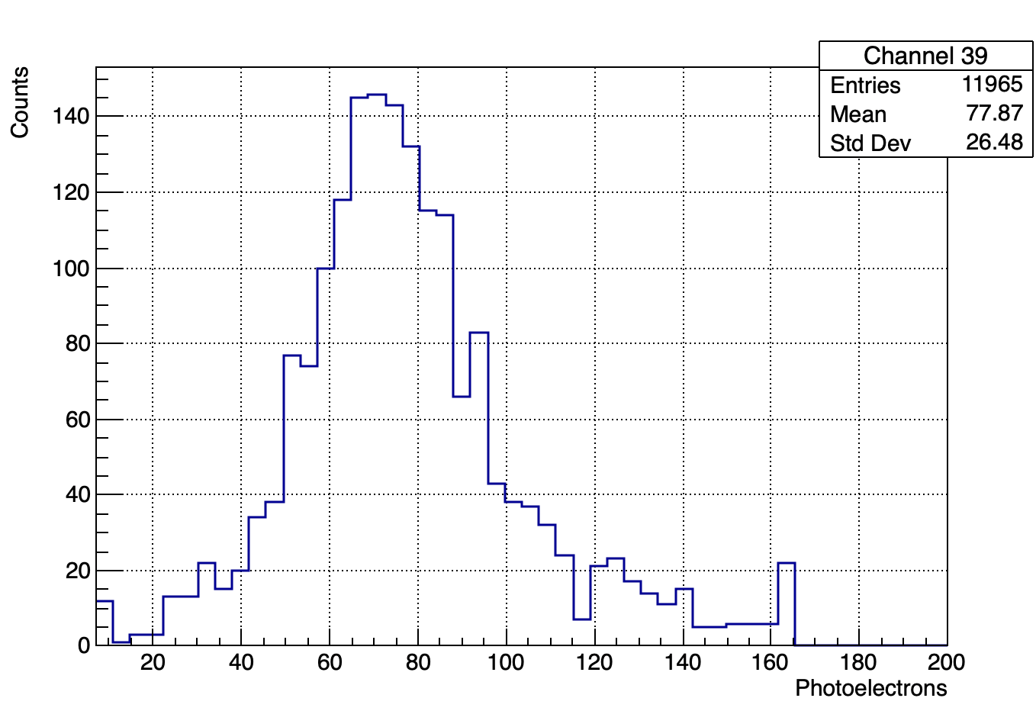
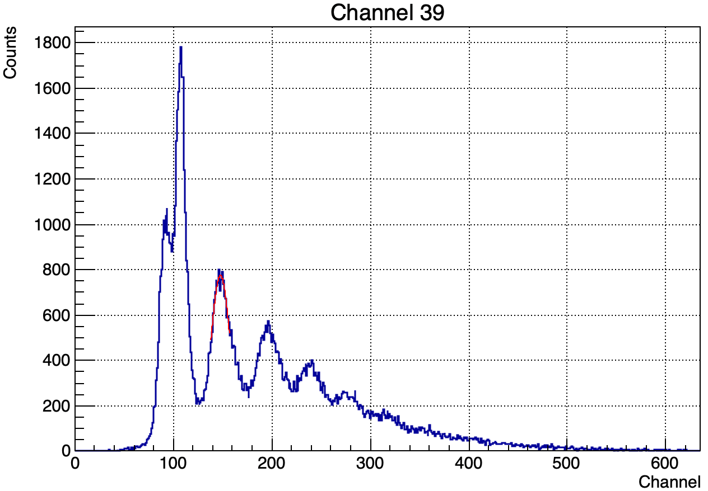
Scale calibration in pulse height mode
Distance between neighboring peaks corresponds to SiPM gain in pulse height value:
MIP pulse height distribution

Slide 13
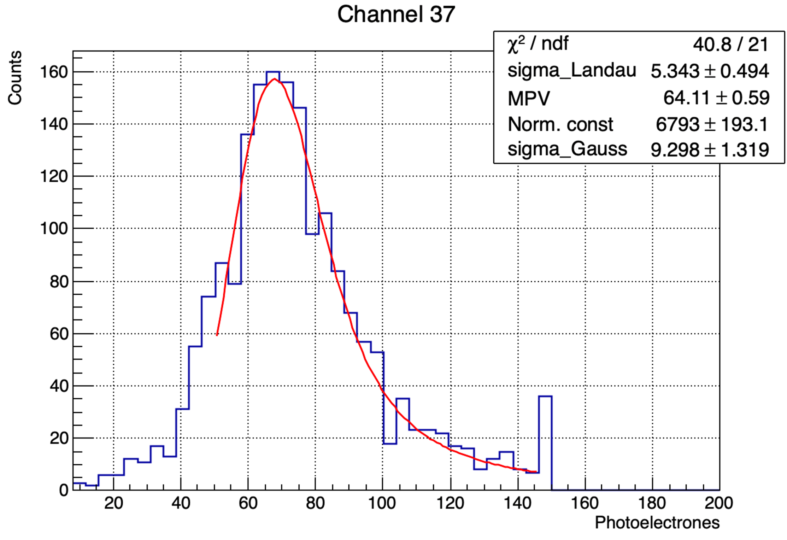
Pulse height distribution analysis
The distribution assumes to be approximated by Landau and Gaussian convoluted function:
Channel | MPV
4 | 61
5 | 81
6 | 74
7 | 76
36 | 63
37 | 64
38 | 63
39 | 67
Response variation is within ±15%
2 times larger compared to previous measurements!
To be cross-checked…

Slide 14
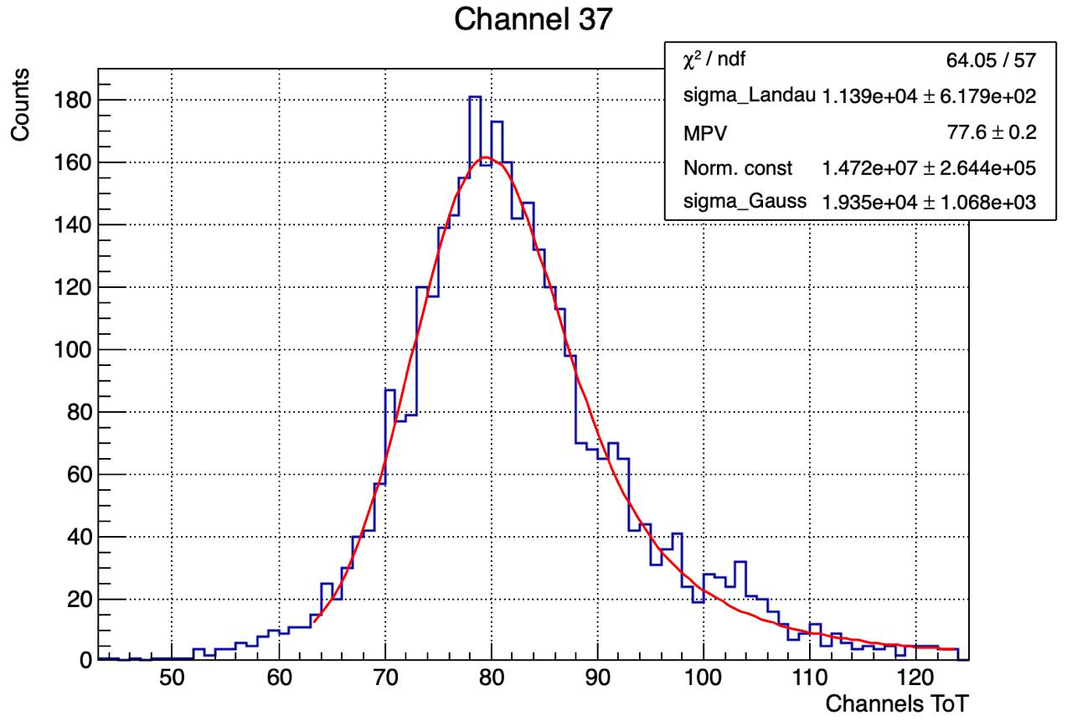
ToT distributions
ToT scale of DT5202 is strongly non-linear → we cannot use Landau-Gaussian convolution function directly
Modification of the function by change of variable according to ToT calibration allows to fit the distribution
Channel | MPV
4 | 72
5 | 78
6 | 75
7 | 76
36 | 77
37 | 78
38 | 76
39 | 74

Slide 15
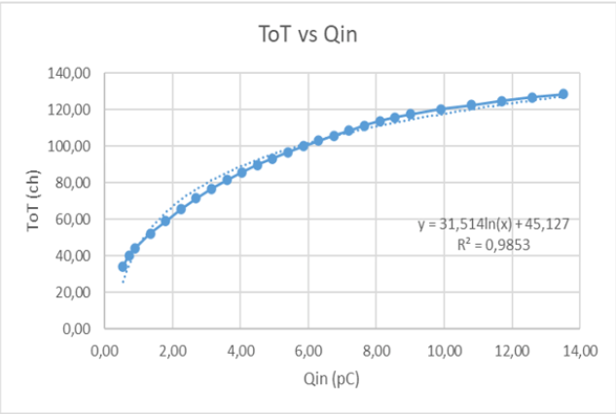
ToT scale calibration
ToT scale expect to be able to calibrate in Coulombs (in accordance to the DT5202 datasheet)
ToT could be calibrated in photoelectrons by means of pulse height analysis
Input channel | Channels ToT | Photoelectrons
4 | 72 | 61
5 | 78 | 81
6 | 75 | 74
7 | 76 | 76
36 | 77 | 63
37 | 77 | 64
38 | 76 | 63
39 | 74 | 67
CAEN example

Slide 16
Outlook and plans
Showed principal capability to calibrate ToT in number of photoelectrons (the units independent to electronics configuration and SiPM gain)
Procedure of ToT calibration in charge values is in progress
Calibration of ToT in photoelectrons is the next step

Slide 17
Test setups for mass production

Slide 18
Setup for tests of SiPMs at carrier boards

Slide 19
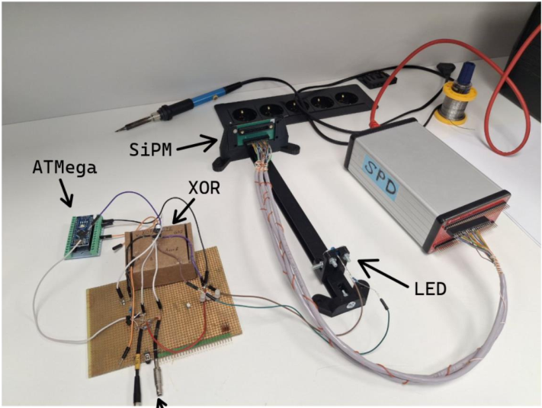
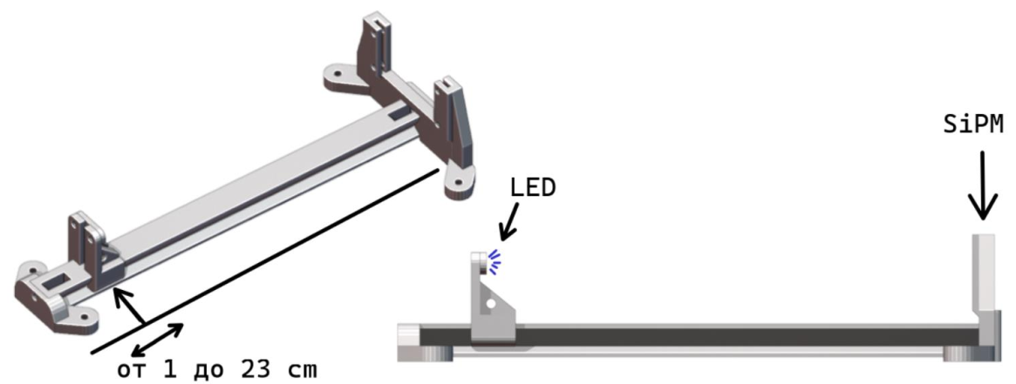
Setup overview
Light source: blue LED in pulse mode
External trigger
Adjustable distance to SiPM
Readout system: CAEN DT5202

Slide 20
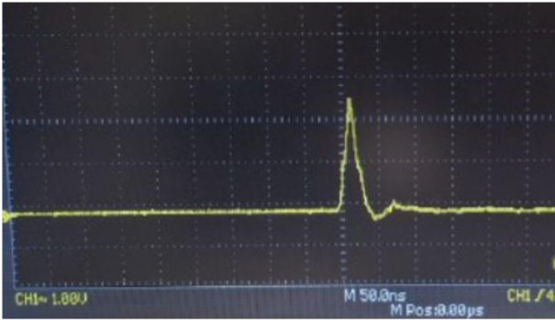
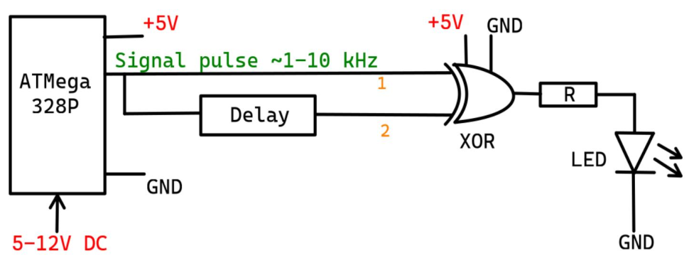
LED driver
Pulse source: ATMega 328P
Pulse rate: 1-10kHz
Pulse amplitude: depends on pulse width, 5V max
Pulse width determined by the delay: 10ns, will have coarse adjustment

Slide 21
Setup for fiber test

Slide 22
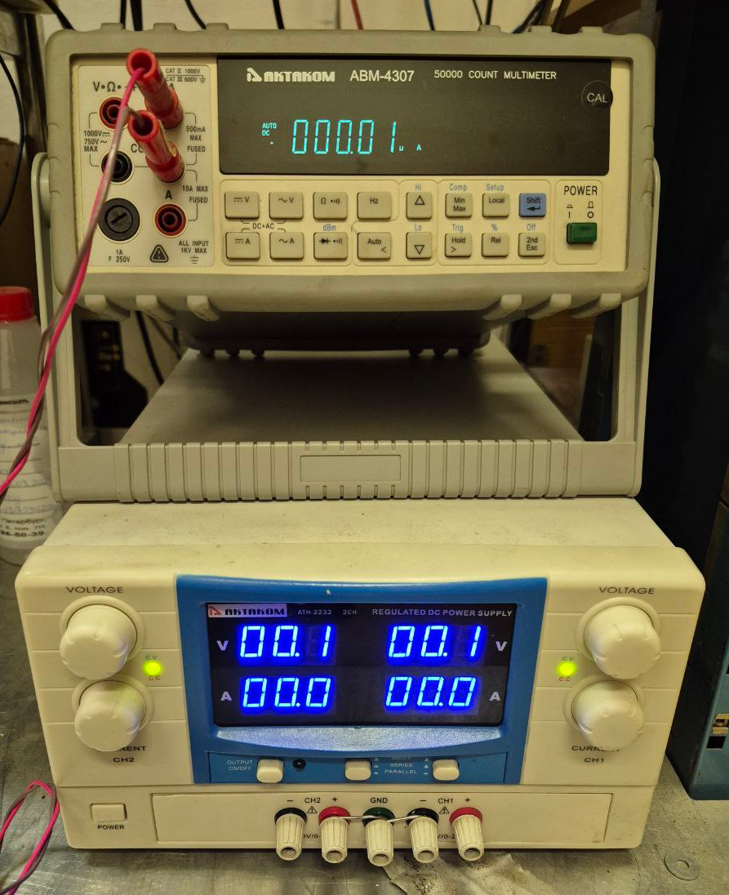
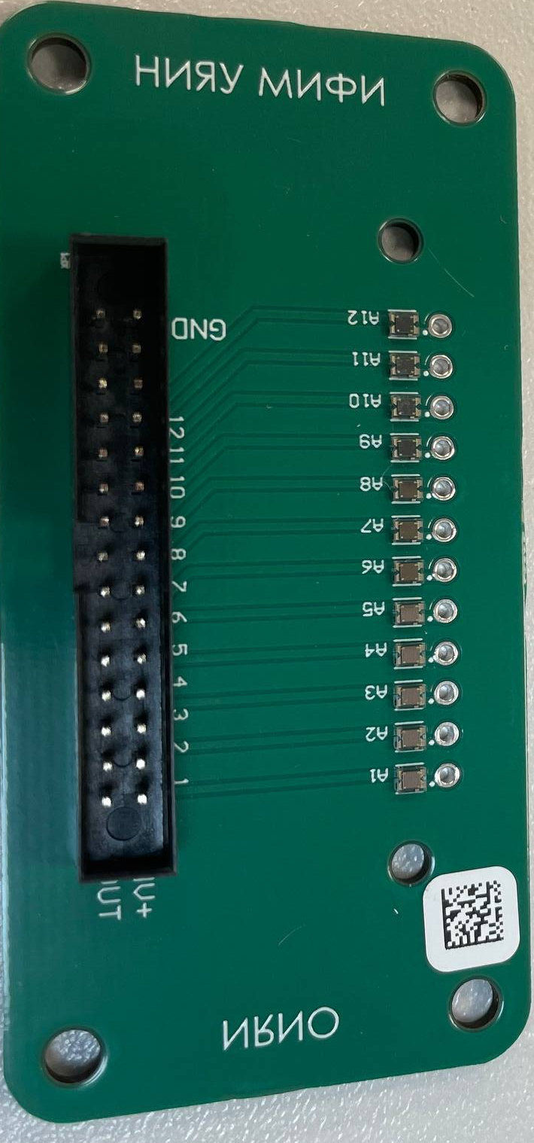
Proposal
Ampermeter
Power Supply
Power Supply
x12 channels
…
…
I/O switches
…
…
Fiber under test
I/O switches
…
…
…
x12 channels
SiPM
LED
Connector
Connector
…

Slide 23
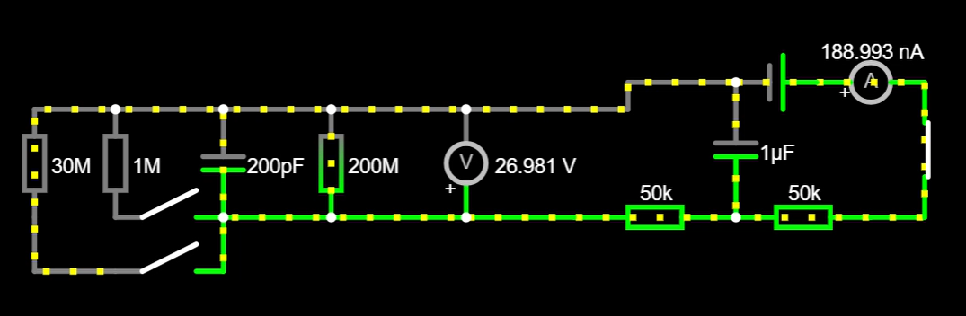
Hot swapping of test sample
50k + 50k resistors limits current by 25μA per SiPM
12 SiPM → 300μA
Power consumption by open SiPM: W = 25V * 25μA = 625μW
FR4 thermal conductivity: 0,3mW/(mm*K) along thickness
Voltage drop during regular operations: 0,1V @ 1μA
- not negligible but reasonable

Slide 24
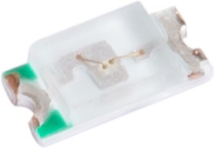
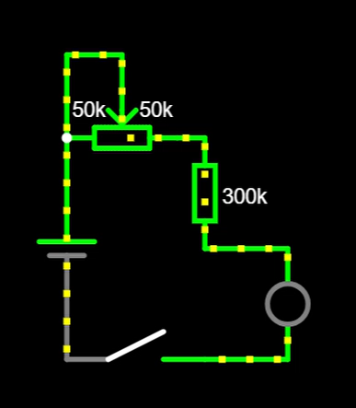
LED circuit
GNL-0603UBC
λ_max = 470nm
S = 1,6 x 0,8 mm²
Circuit designed to run LED at very beginning of open part of IV curve
Potentiometer allows to adjust LED brightness to get SiPM response of 1 μA

Slide 25
Conclusion
Increase of number of WLS loops embedded to a tile gains light collection and relative energy resolution
Number of WLS loops doesn’t affect significantly on timing performance
Average response of tiles with Saint-Gobain WLS, SKTN glue and Hamamatsu S13361 SiPMs is 71phe with variation over 8 tiles within ±15%
ToT distribution can be fitted with modified Landau-Gauss function
ToT scale can be calibrated in charge value → photoelectrons
Development of setups for test of SiPMs on carrier board and fiber bundles for mass production tests are in progress

Slide 26
Thank you for your attention!

Slide 27
КАЛИБРОВКА СИГНАЛОМ С ВНЕШНЕГО ГЕНЕРАТОРА
Калибровочные кривые для одного канала (№60) при различном времени формирования для максимального (63) и минимального (1) коэффициентов усиления.

Slide 28
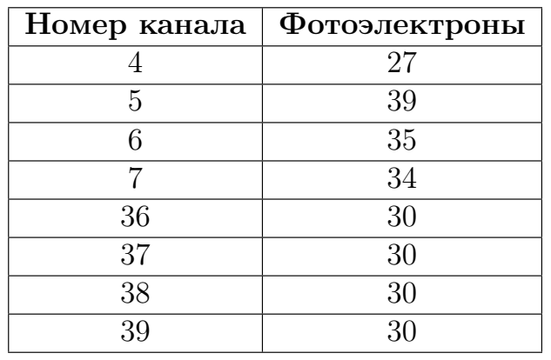
Previous measurements with cosmic setup

