Slide 1


Engineering infrastructure of the NICA complex
X SPD
collaboration meeting
Speaker: K. Mukhin
20 October 2025
JINR

Slide 2
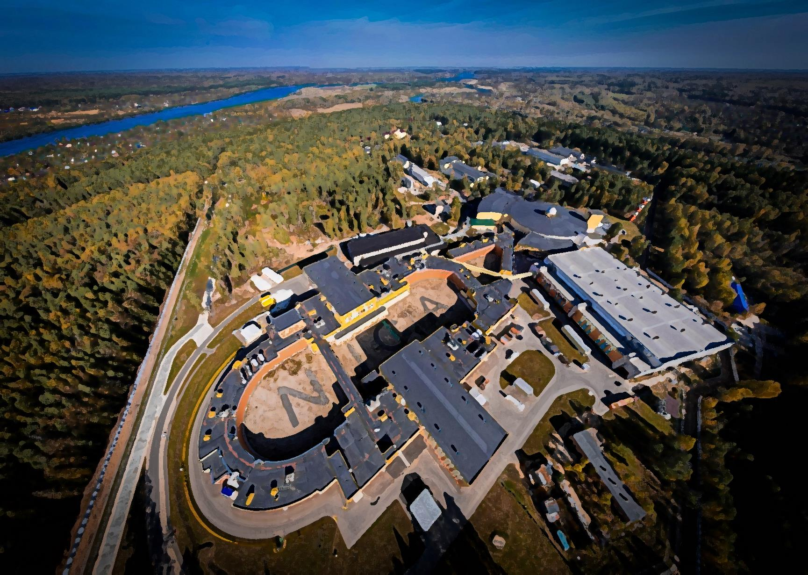
Plan of talk
Construction of the collider building #17
Status of engineering systems
-water including SPD,
- power electricity including SPD,
- other infrastructure and life support systems for the NICA complex
Upgrading and status of liquid helium and nitrogen production
Status of MPD engineering system and cooling progress, magnetic field mapping
Main power station GPP1
Site infrastructure development
- reconstruction of the entrance gate
- new parking area

Slide 3
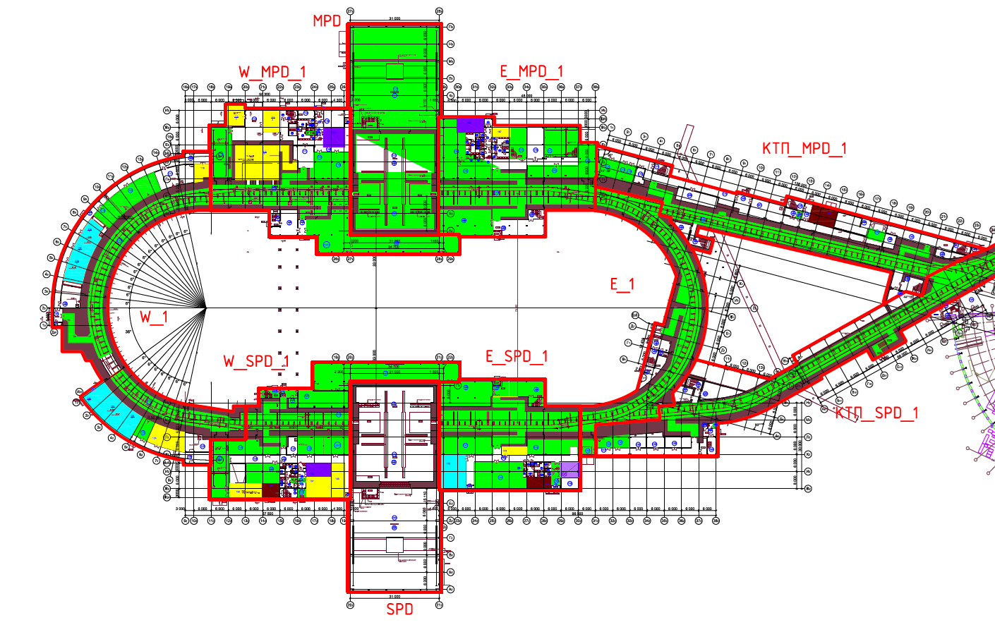
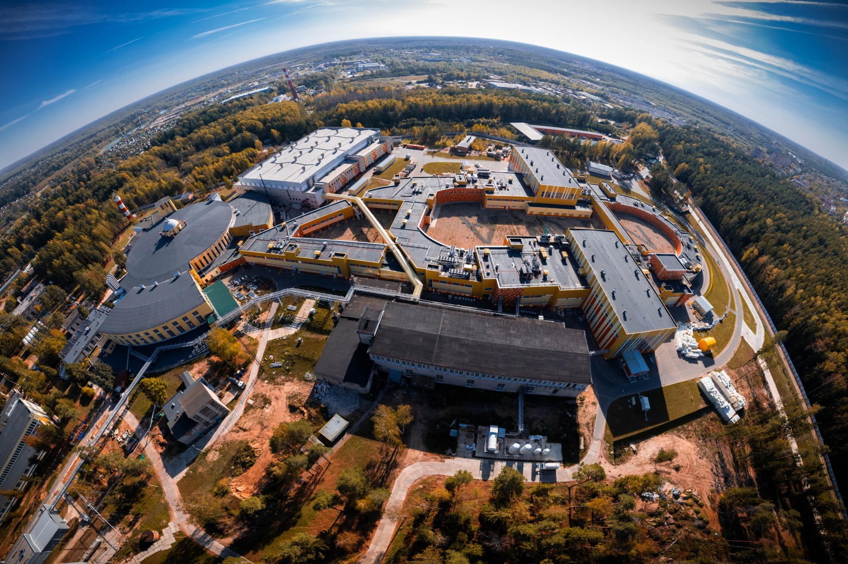
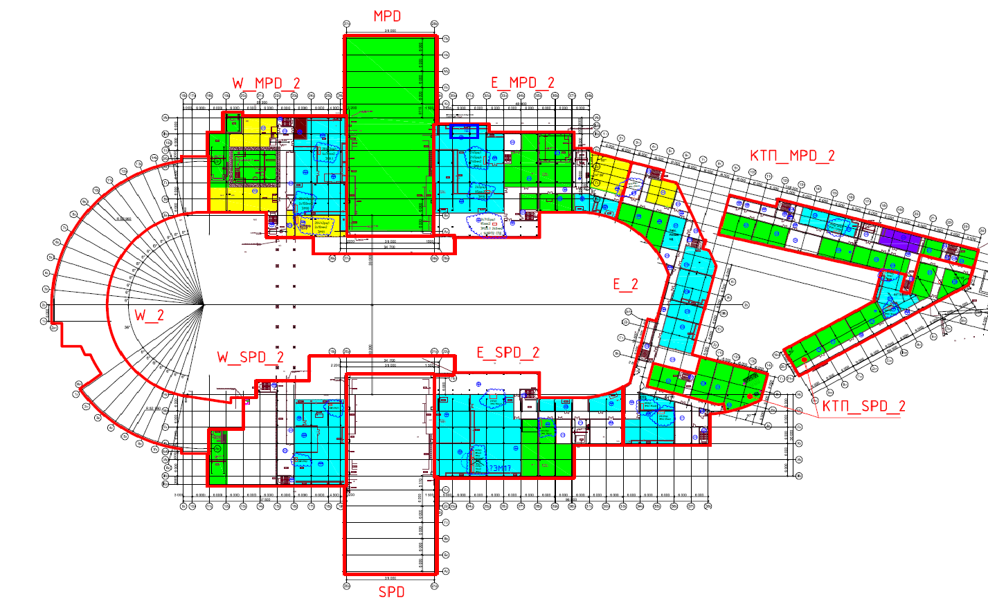
Collider building #17
Ground floor
Some data of building parameters
Total area of the building, m2 | 30 800
Covered area, m2 | 22150
Number of floors | 2
Building construction volume, m3 | 293500
BM@N
Extracted beam
SPD
First floor
Booster and Nuclotron
MPD
Cryogenic area

Slide 4
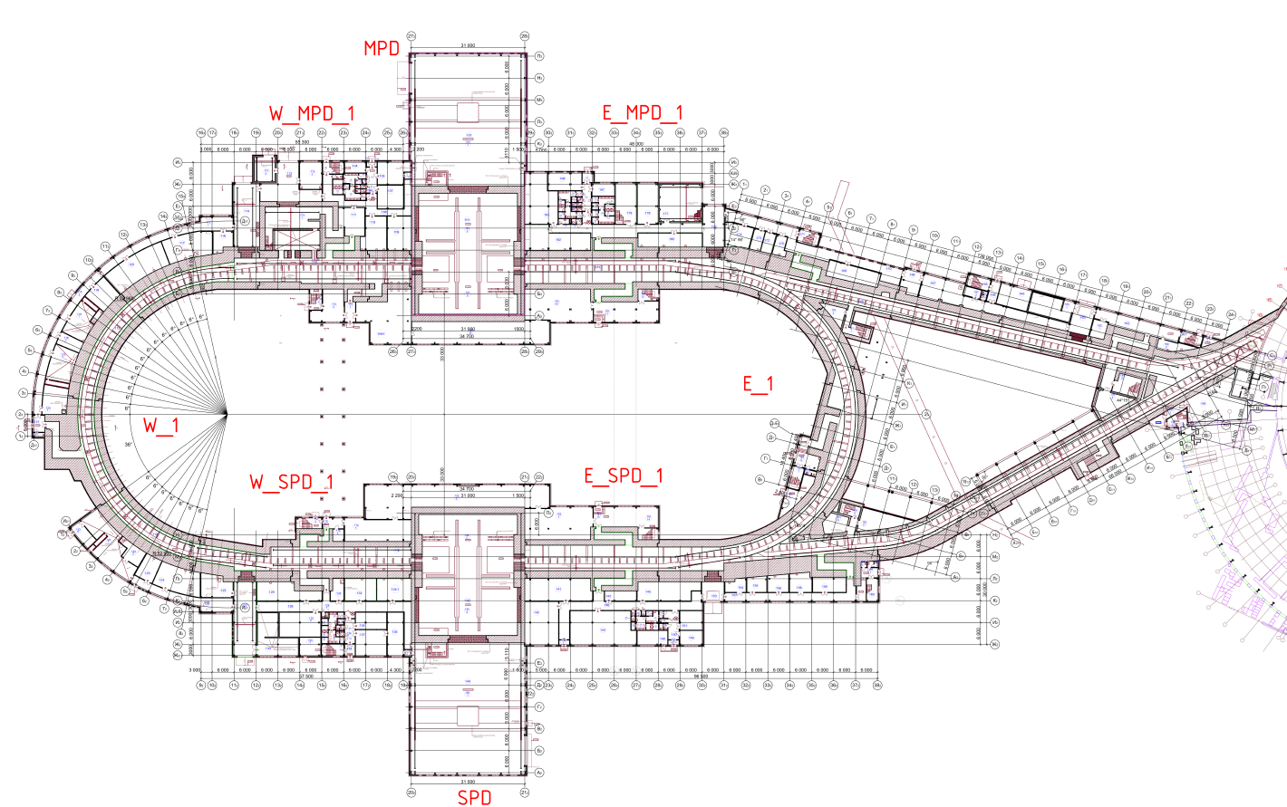
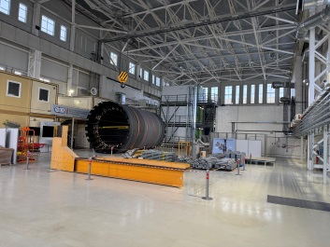
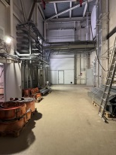
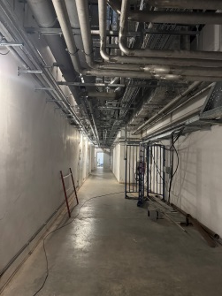
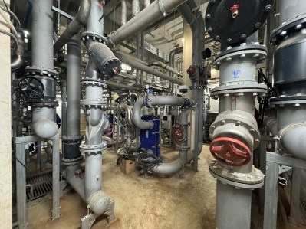
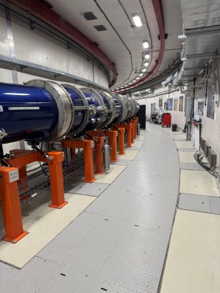
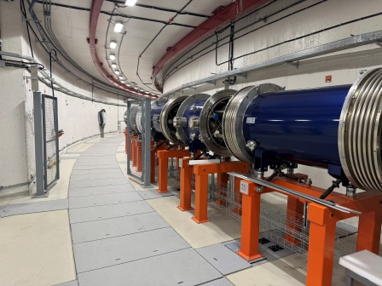
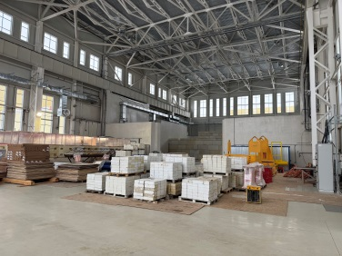
Collider building #17 Ground floor
One of the hallways with engineering communications on the ceiling and entrance gates
MPD hall
Water cooling area
Ground floor parameters
Name | Unit, m²
Tunnel area | 5182
MPD hall | 1996,5
SPD Hall | 1996,5
Electron cooling | 106
Water cooling | 420
Power supply area | 450
Total control rooms (PS, MPD, SPD, EC…) | 180
Engineering equipment technical rooms | 395
Technical staff rooms | 450
Collider tunnel
Collider tunnel

Slide 5
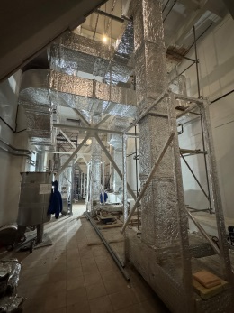
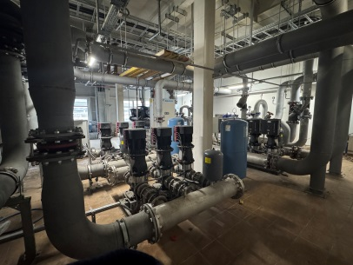
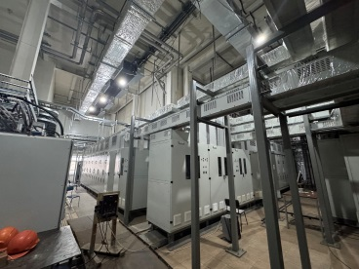
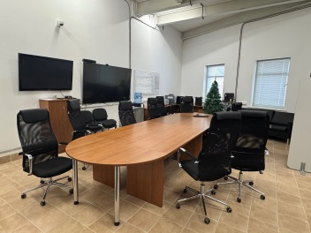
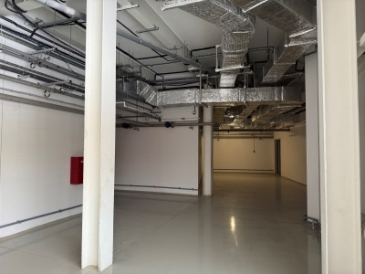
Collider building #17 First floor
Climate control system
First floor parameters
Name | Unit, m²
Electron cooling power area | 380
Water cooling | 210
Power supply area | 450
Office area, temporary collider control rooms | 220
Engineering equipment technical rooms | 5500
Technical staff rooms | 450
Cooling system
Electrical power racks
Control and office rooms
Civil works of the collider building is ready for technical run
Example of one of the hallways

Slide 6
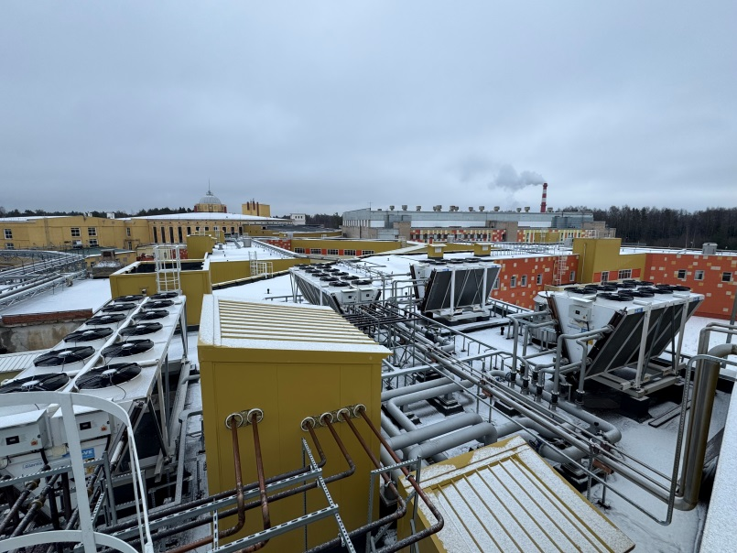
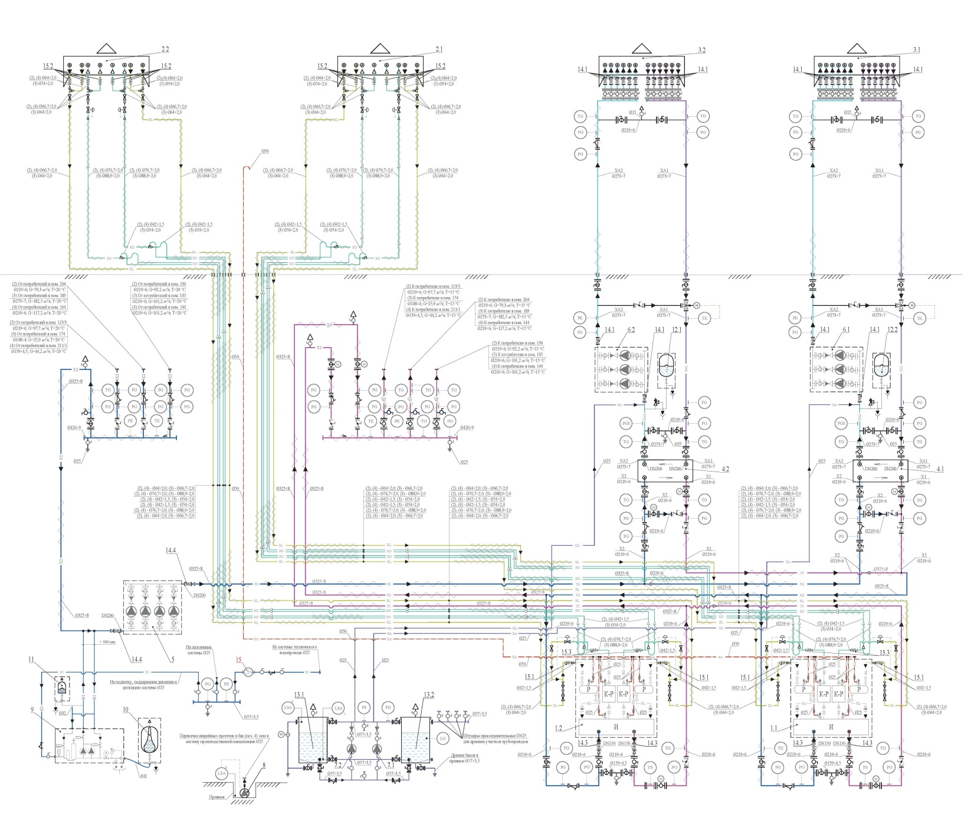
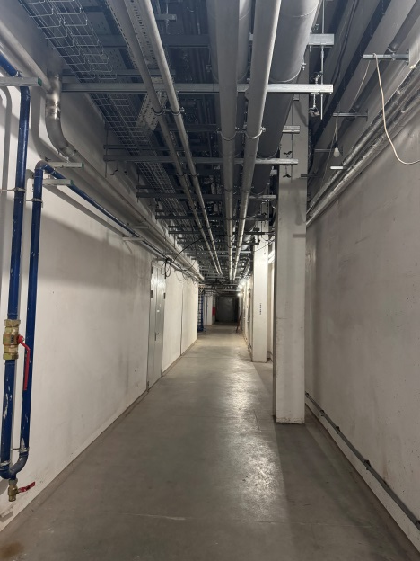
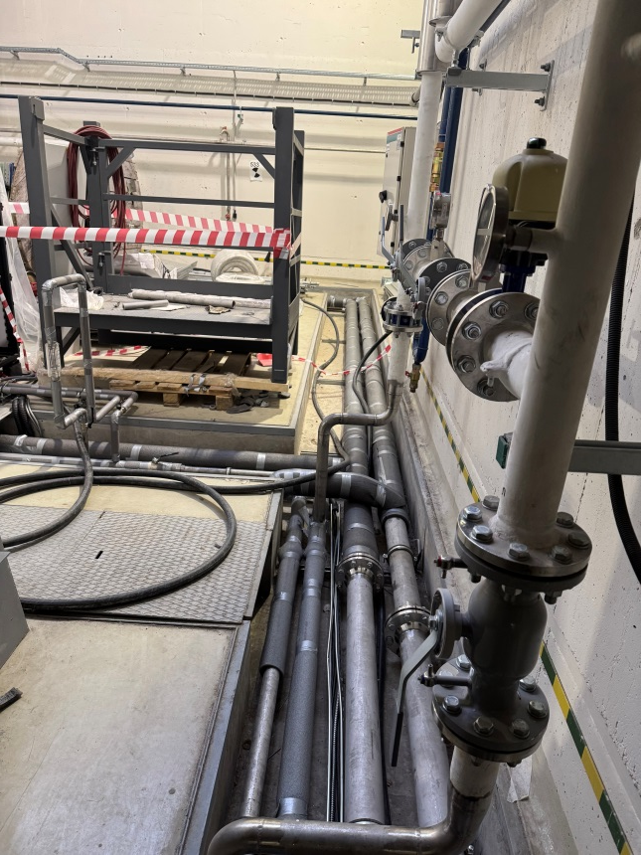
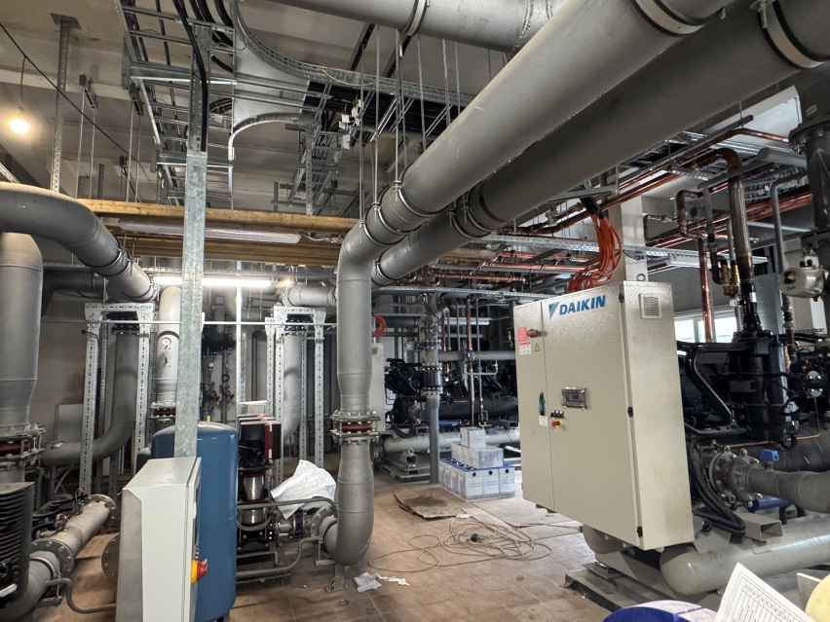
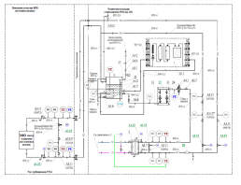
Engineering systems Cooling water system
Water cooling consumers
Electrical power of the collider
MPD detector and subdetectors
Cryogenic and vacuum systems
Electron cooling systems
SPD detector
Dry cooling
Water cooling system including 4 similar cooling centers. Cooling center is complicated and uses 4 different coolants. Three operation options are available depending on the ambient temperature. This scheme allows obtaining stable temperature at the collider and detector equipment in the whole operation range regardless of the season.
Cooling system parameters
Index number of cooling center | 1 | 2 | 3 (SPD is here) | 4
Cooling capacity | 1335 kW | 1540 kW | 1290 kW | 453 kW
Refrigerant | Antifreeze, still water, freon, purified water
Number of consumers | 10 | 10 | 9 | 2
Range of water temperature | 18 - 30⁰C | 15 - 55⁰C | 15 - 25⁰C | 18 - 24⁰C
Operation modes* | Dry cooling, cooling machine, mix mode
* depends on consumers
** depends on ambient temperature
For technical run of the collider, #1 and #2 cooling centers are required. Cooling center #3 are assembling (December 2025)
Cooling centers are ready for operation by the local automatization system

Slide 7
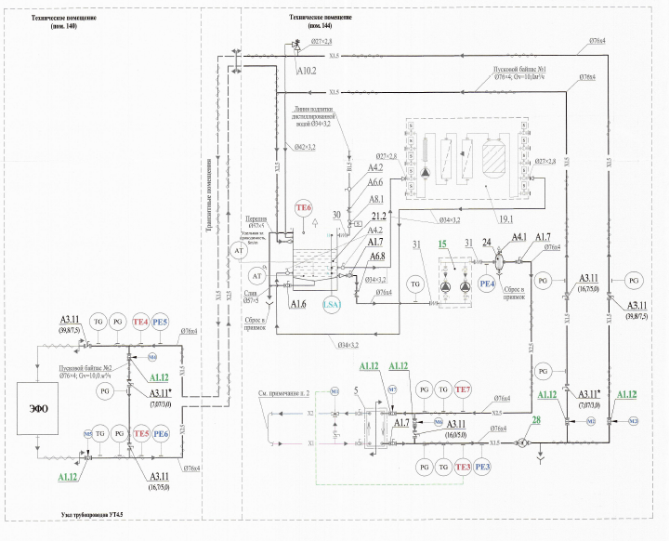
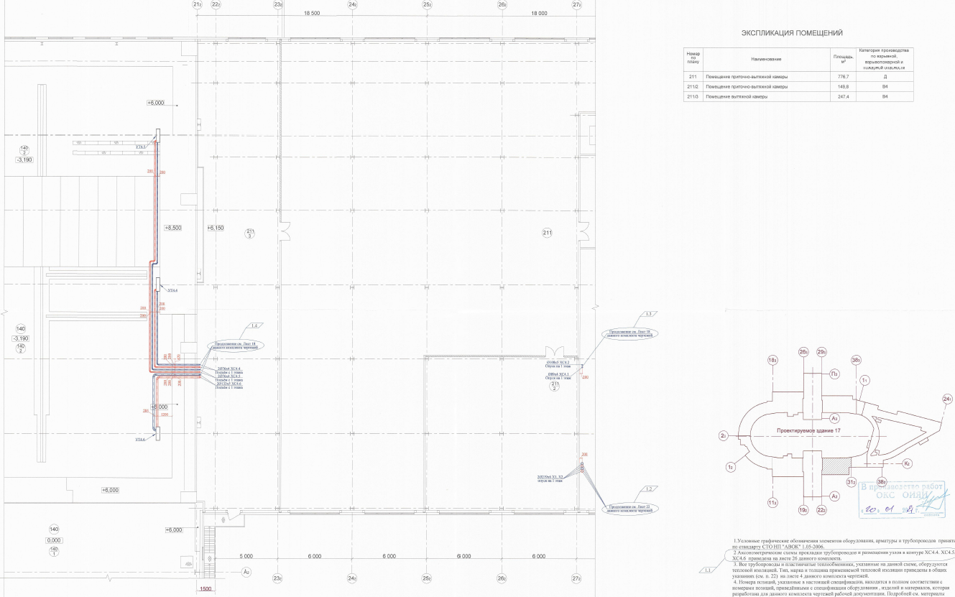
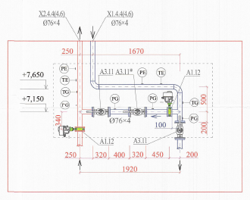
Water cooling for the SPD hall
Schematic diagram of water cooling for points 4.4 - 4.6
Point /Parameter | Water point 4.4 | Water point 4.5 | Water point 4.6
Power (kW) | 340 | 50 | 250
Flow (m3/h) | 9,8 | 10 | 40
Temp. before equipment (⁰C) | 25 | 25 | 15-20
Pressure before equipment (bar) | 7,7 | 3 | 3
Pressure drop (bar) | 4,7 | 2 | 1
WP 4.5
WP 4.4
Water points
4.4-4.6
WP 4.6
SPD

Slide 8
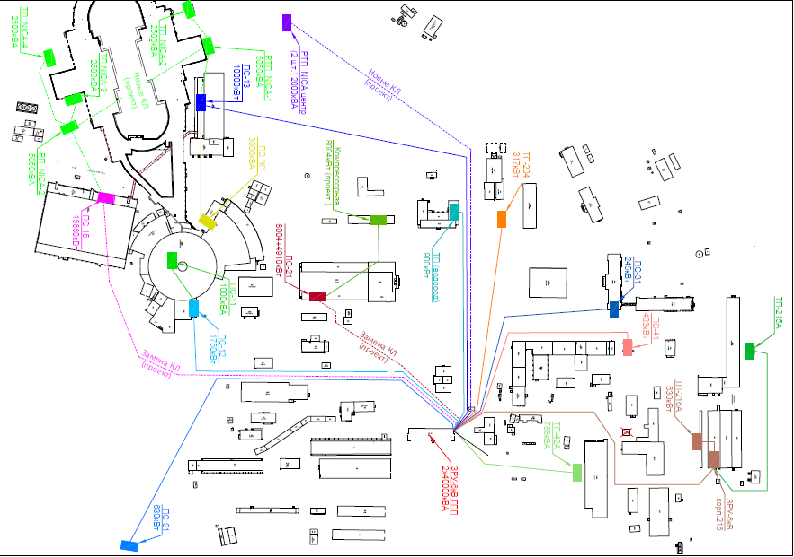
Engineering systems Power electricity of NICA complex
Situational plan of the LHEP site power supply
Total power for NICA – 10000 kW
Include
Transformer substation – 3 un. (2500 kW each (TS 2, TS 3, TS 4))
Distribution substation DS NICA 2 -1 un. (5050 kW (supplies TS 3, TS 4))
Distribution transformer substation DTS NICA 1 – 1 un. (5050 kW (TS 2))

Slide 9
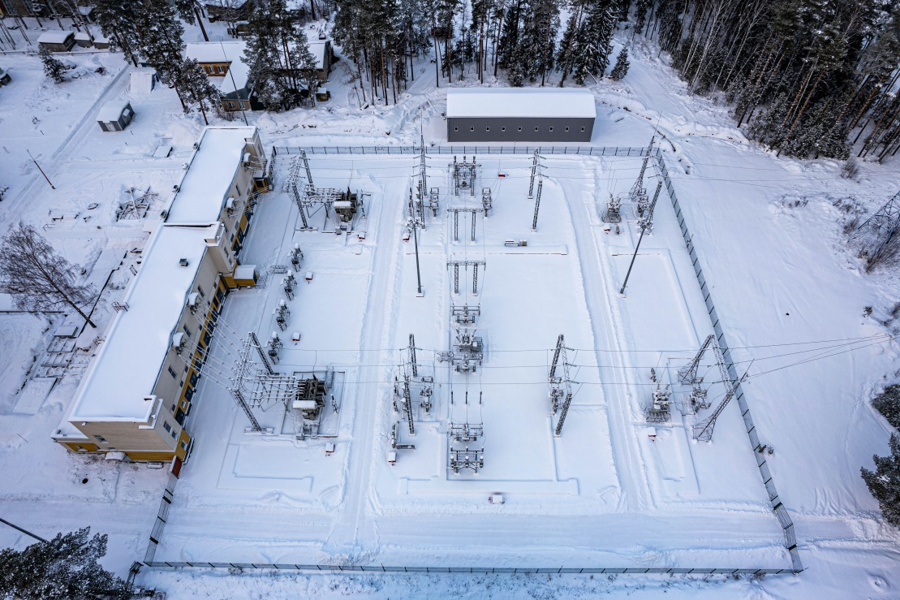
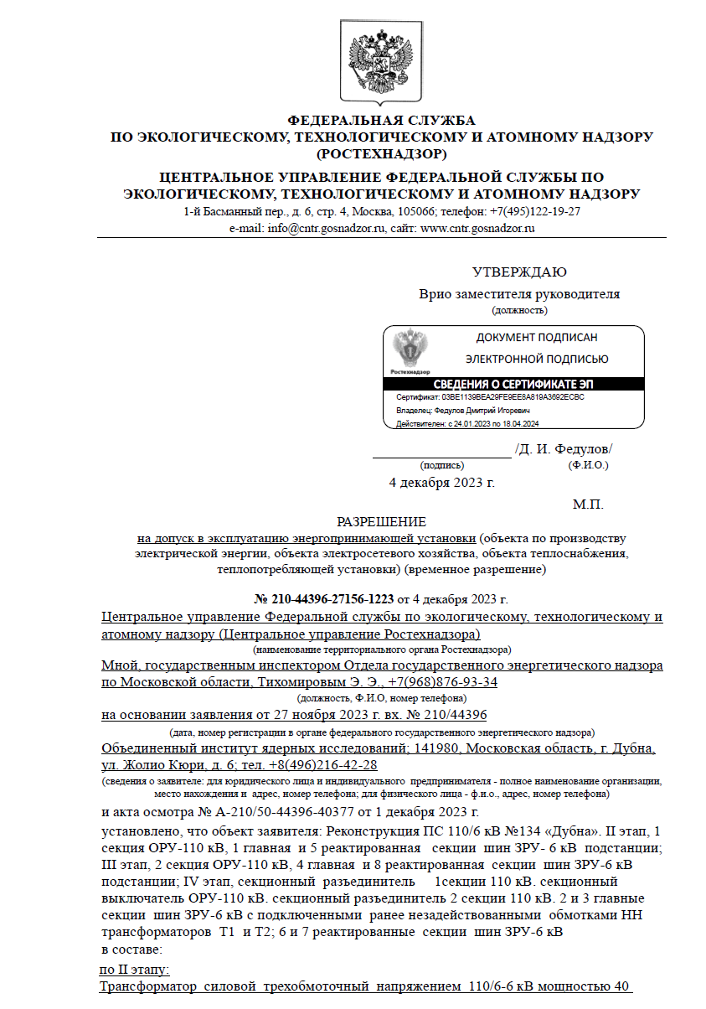
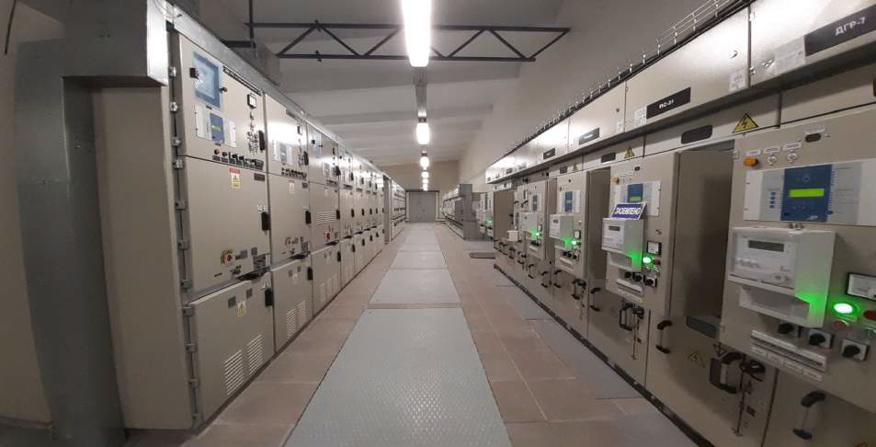
Main power station GGP1
Upgrade of the GPP 1 was the twofold increase in electricity power.
From 22396 kV (40 MW) to 40800 kV (80 MW).
Out of the 40800 kV, 34300 kV for JINR and 6500 - for Dubna city.
The final successful commission from Rostechnadzor was carried out in the December 2024.
Permission
for admission to the operation of a power receiving unit

Slide 10
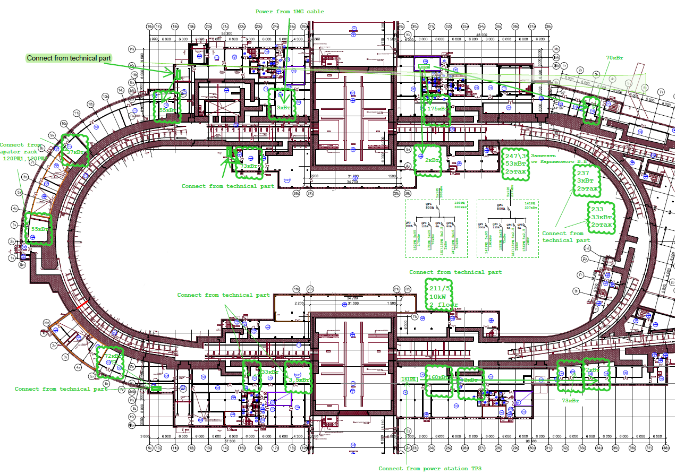
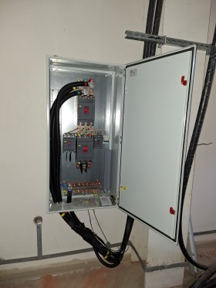
Engineering systems Power electricity of NICA complex
Temporary scheme of the collider power supply for the technical run
29 Apator power racks and 56 Laboratory power racks were ordered for the operation of the collider power supply. Unfortunately, the delivery of racks from Apator has been delayed.
Developed temporary scheme of the collider power supply for the technical run involves the use of 19 Laboratory racks and 2 main power racks (300 kW and 237 kW electricity power).
Collider power system parameters
Name | Total | Technical start | Notes
Apator power rack | 29 | 2 | Reorder in TES company (installed at JINR)
Laboratory power rack | 56 | 19 | Order in TES company (delivery 10/02/2025)
Two temporary main power rack instead of 29 Apator
All power supply equipment for the collider technical run is ready

Slide 11
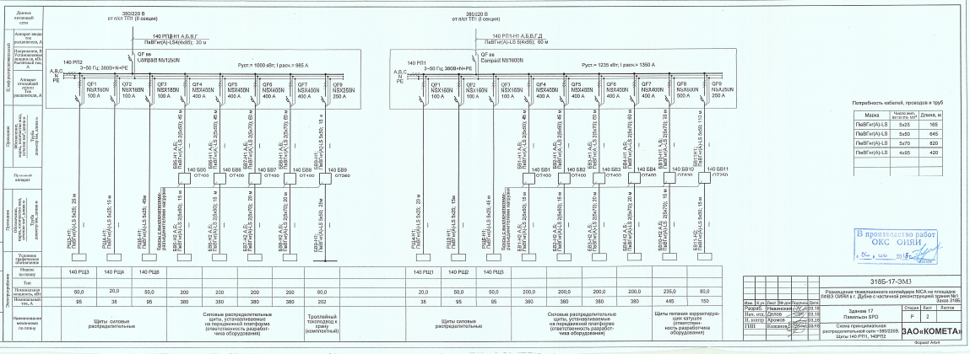
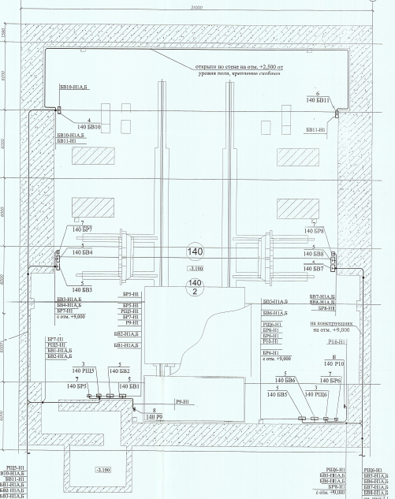
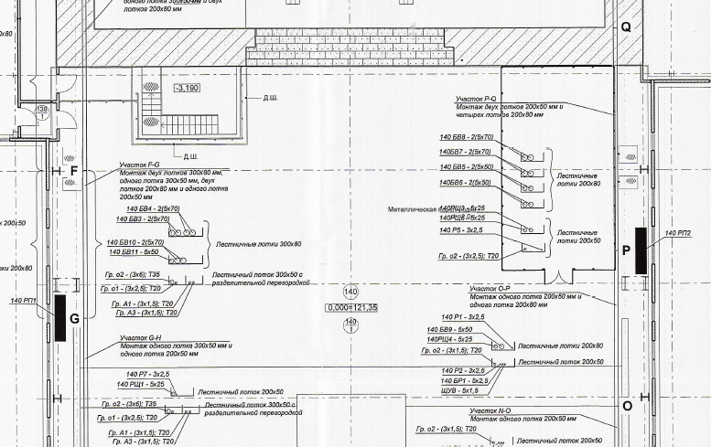
Power electricity in SPD hall
Power section II – 1000 kW (I – 985 A)
Power section I – 1235 kW (I – 1350 A)
Automatic reserve power entry rack

Slide 12
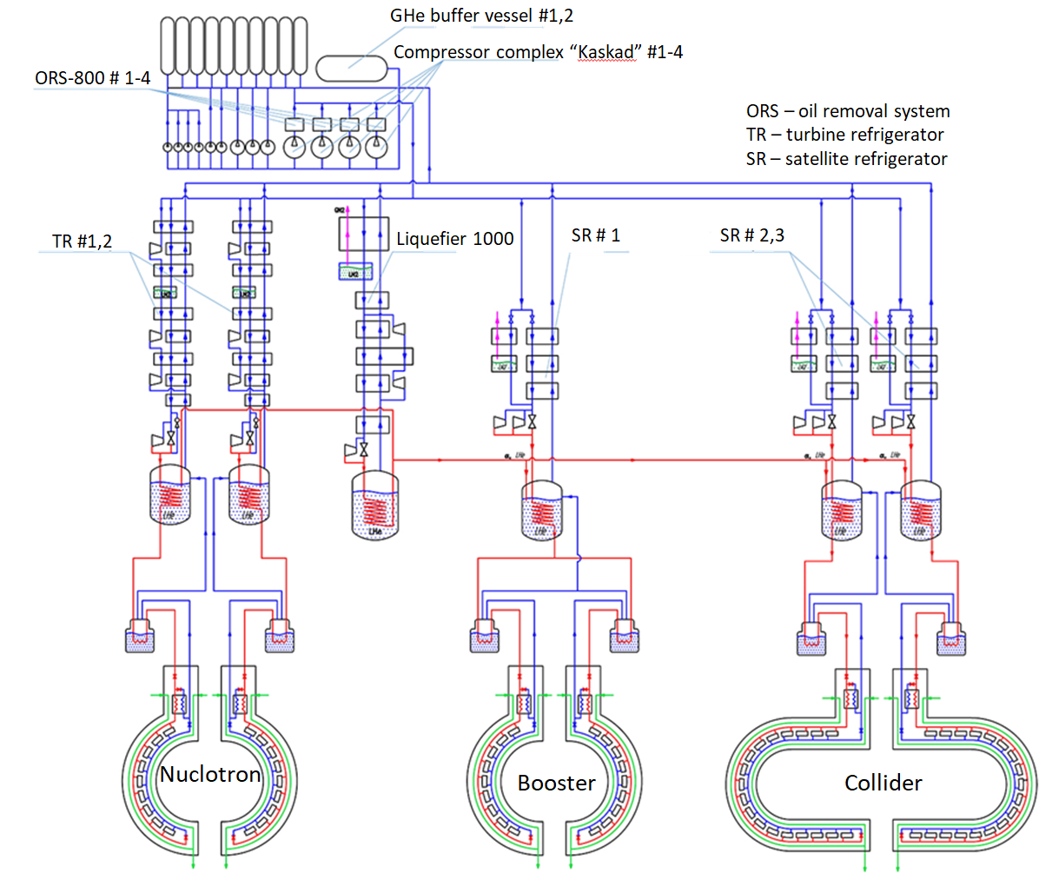
Cryogenic system of NICA complex Ready for the technical launch of the collider in 2025
Scheme of cryogenic NICA complex
The main goal of the cryogenic department for 2025 is to ensure the cooling of all rings of the NICA complex, as well as the operation of liquid helium consumers (Cryon, MPD, magnet test stand).
Main cryogenic equipment of the
NICA complex
3 Satellite refrigerators (each cooling capacity is 2000 W at 4.5K);
2 Turbine refrigerators (each cooling capacity is 2000 W at 4.5K);
Liquefier (capacity of LHe is 1000 l/h)
Compressor complex;
Oil removal system for each of the compressor
Cryogenic LN2 and LHe pipes
Warm straight and return pipelines
Nuclotron
*Drawings and information by A. Konstantinov

Slide 13
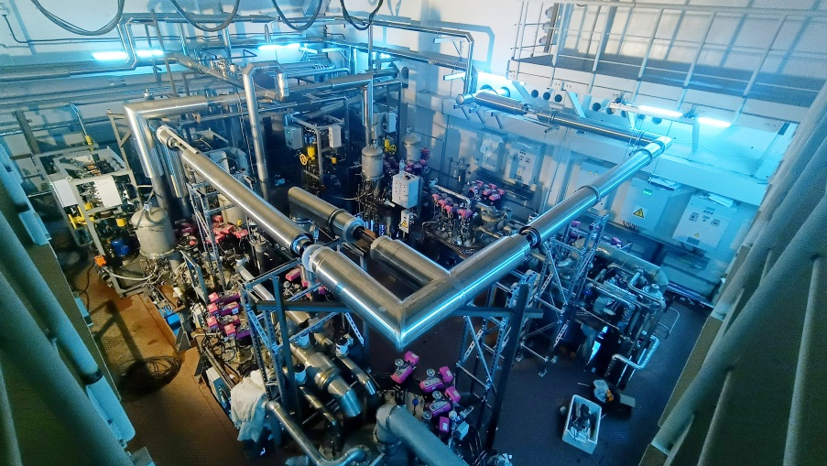
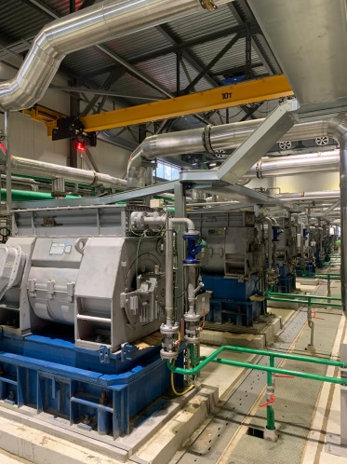
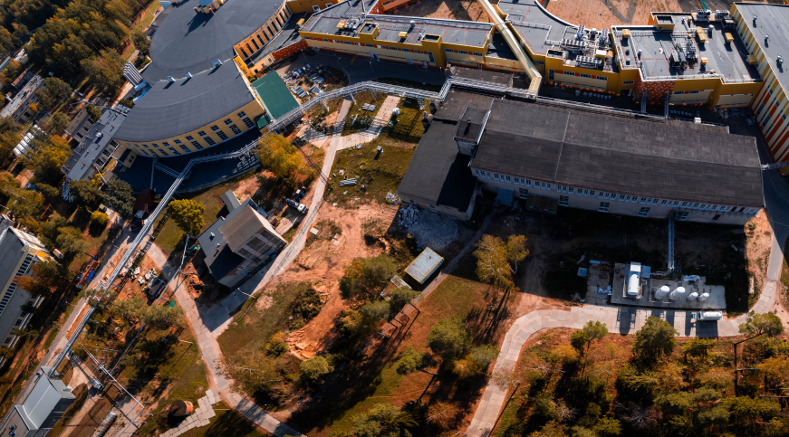
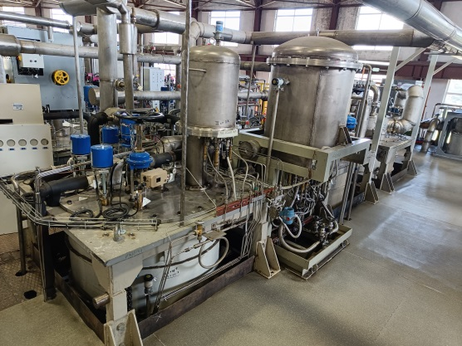
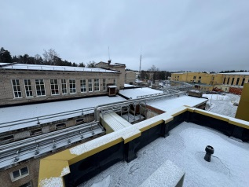
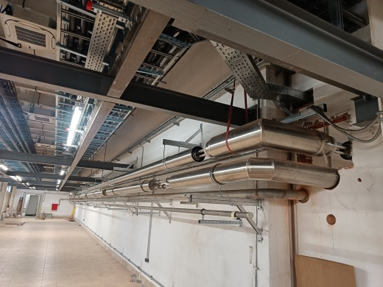
Cryogenic system of NICA complex Ready for the technical launch of the collider in 2025
Satellite refrigerators in the collider building
Liquefier 1000 and compressor complex
Cryogenic LHe, LN2, warm straight and return pipelines
- Liquefier 1000 successfully operated at the MPD detector cooling during the run, filling 12 m3 of tank containers with liquid helium.
- The staff of the cryogenic department optimized the starting modes of the liquefier, which reduced the cooling time of the tanks and reduced energy costs.
- Liquefier has confirmed the design capacity of 1000 l/h of liquid helium.
- Two new compressors “Kaskad -110/30” successfully operated during the MPD cooling session.
- To cool the collider, 2 satellite helium refrigerators #2, 3 were installed in room 177 of collider building #17.
- In December 2024, they were successfully launched with cooling to the temperature of liquid helium.
- The cooling capacity of each unit is 2000 W at 4.5 K.
- In January, the refrigeration control circuits will be adjusted.
LHe
LN2
- Warm pipe is ready and tested.
- LN2 pipes are progressing as planned and will be finished in January 2025.
- LHe pipe in the west side
- LHe pipe in the east side
*Drawings and information by A. Konstantinov

Slide 14
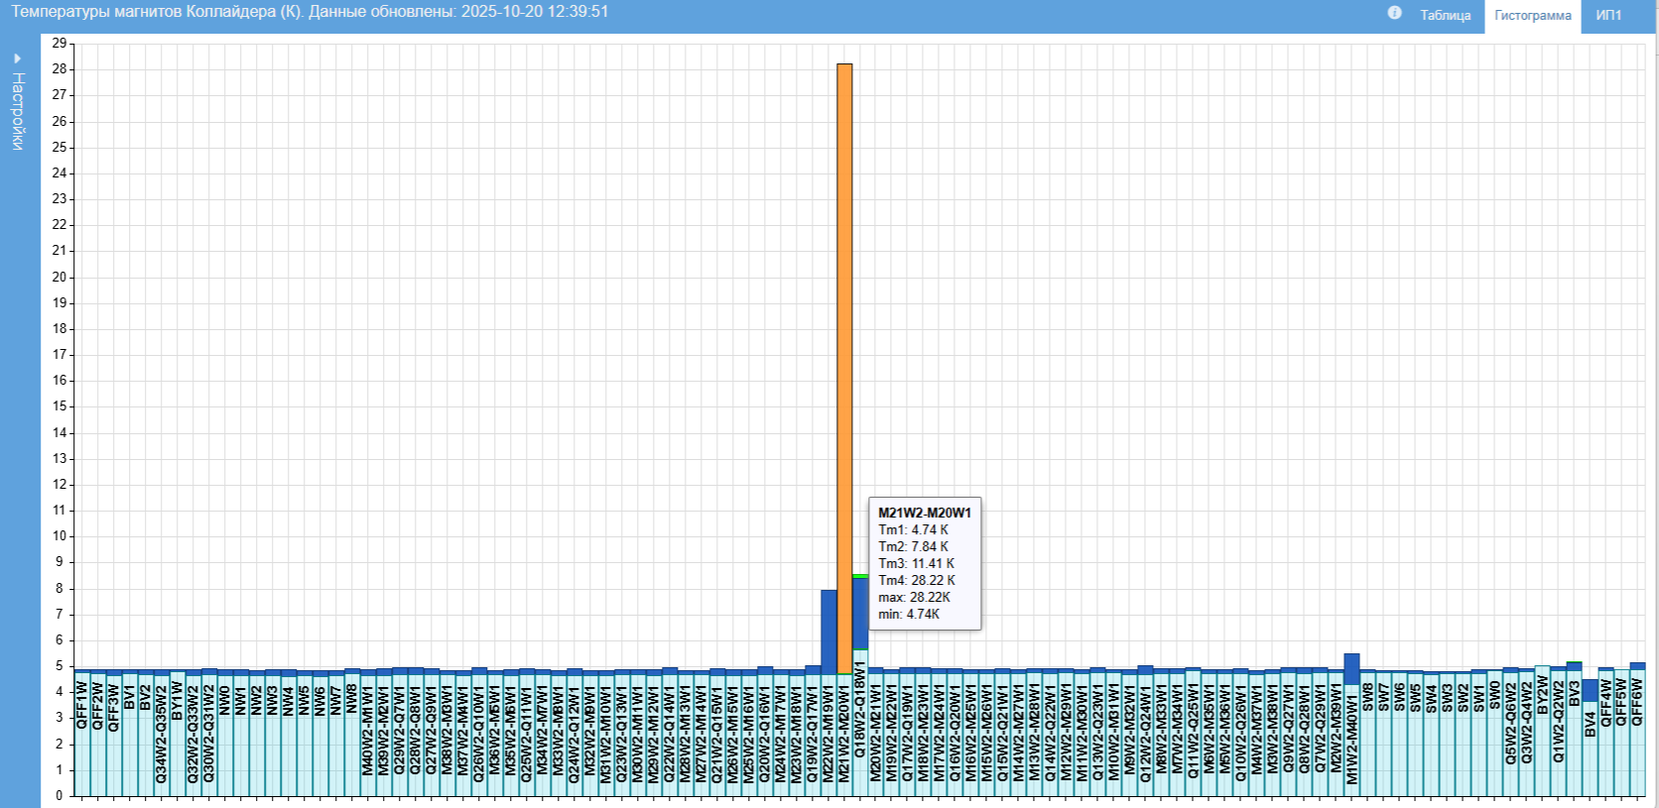
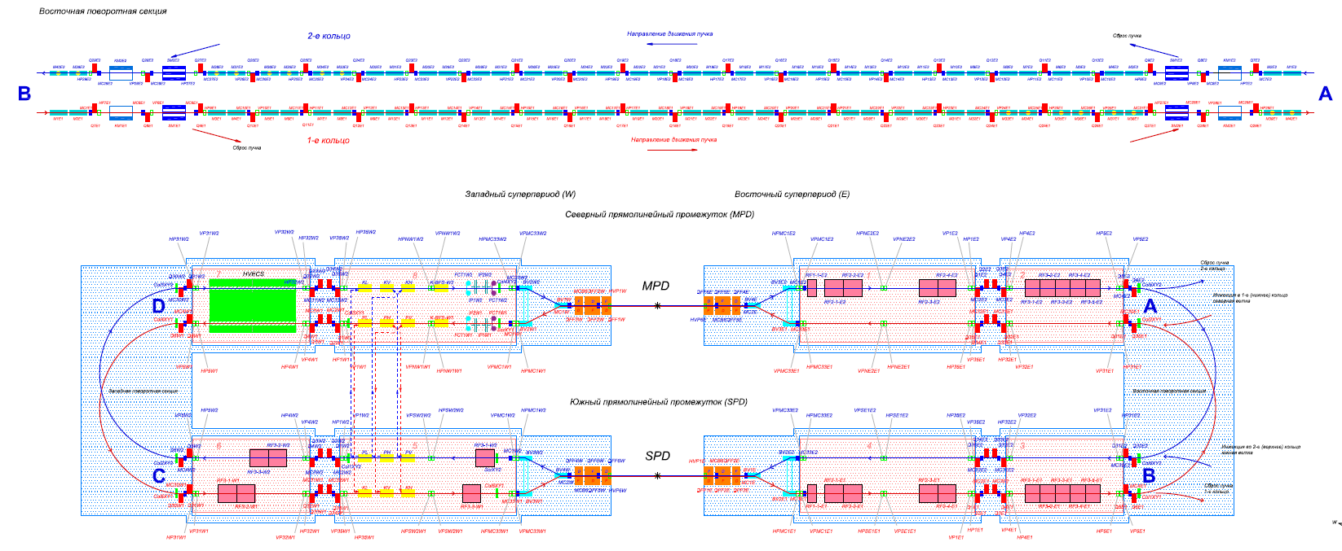
Histogram of cooling of collider magnets 17/10/2025
W
E

Slide 15
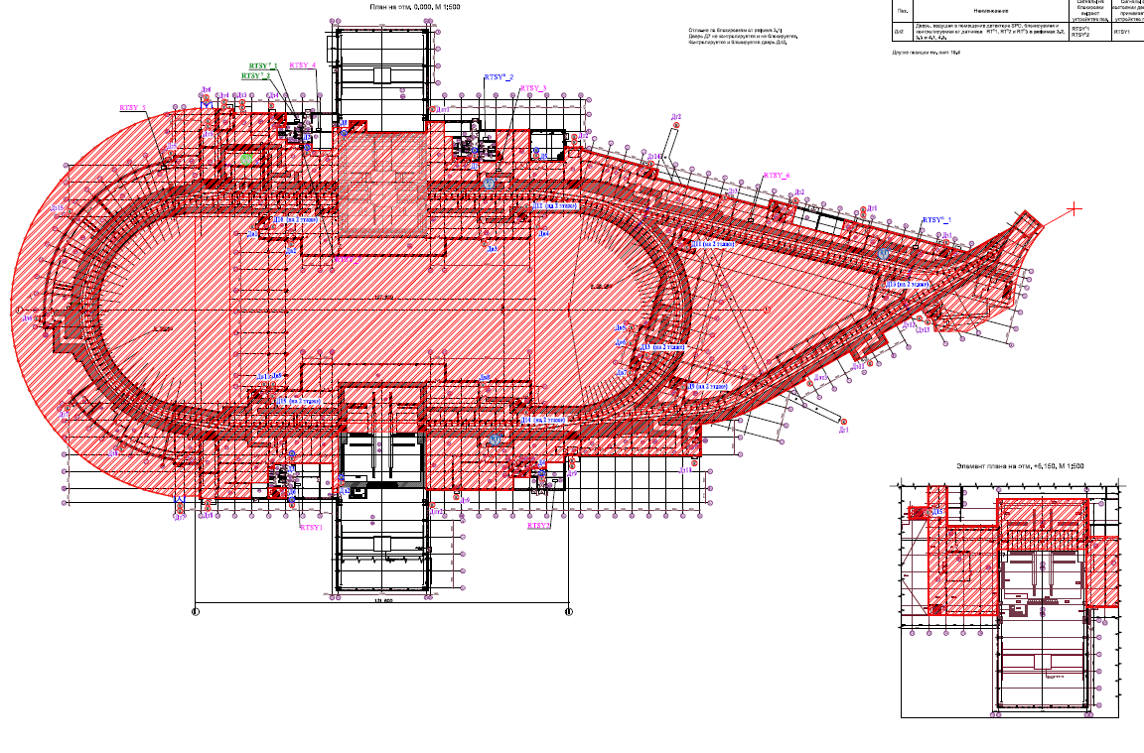
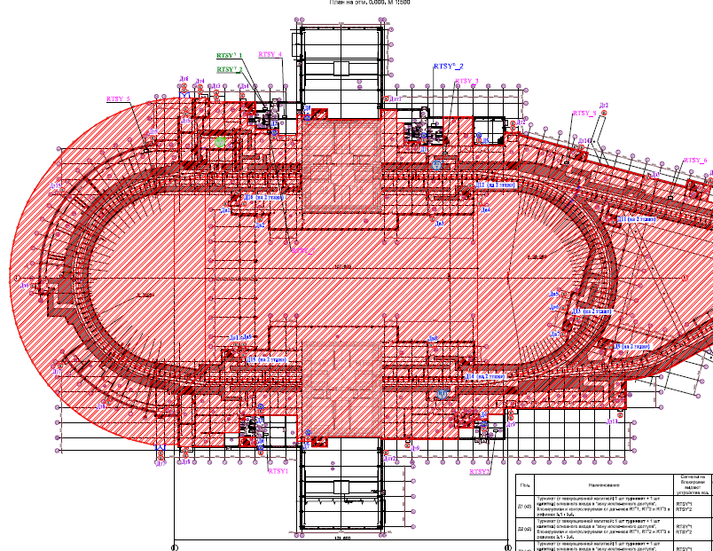
Radiation control and access zone
Collider on operation SPD on test zone
(biological shield along the canal)
Collider on operation SPD on beam zone
SPD
SPD

Slide 16
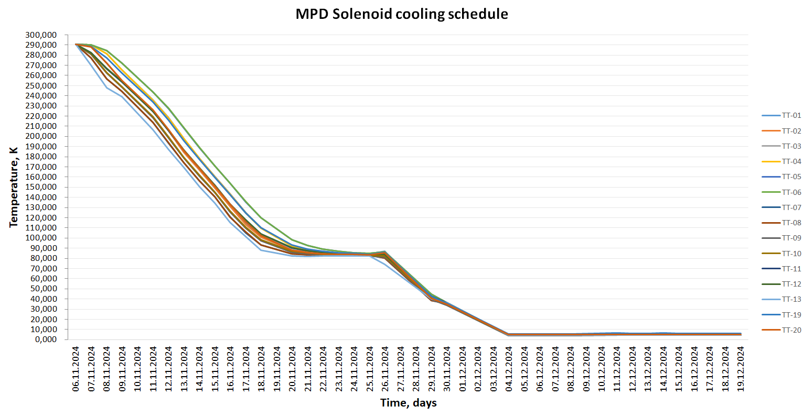
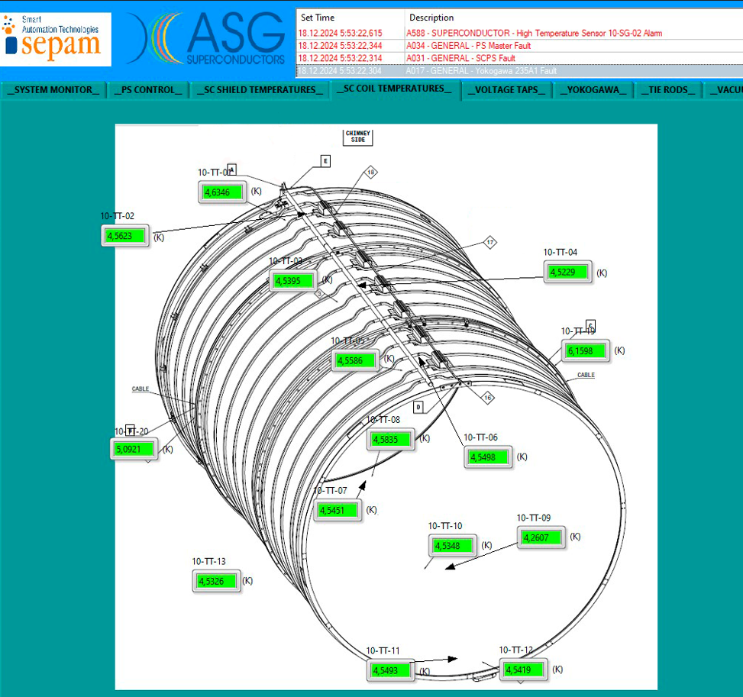
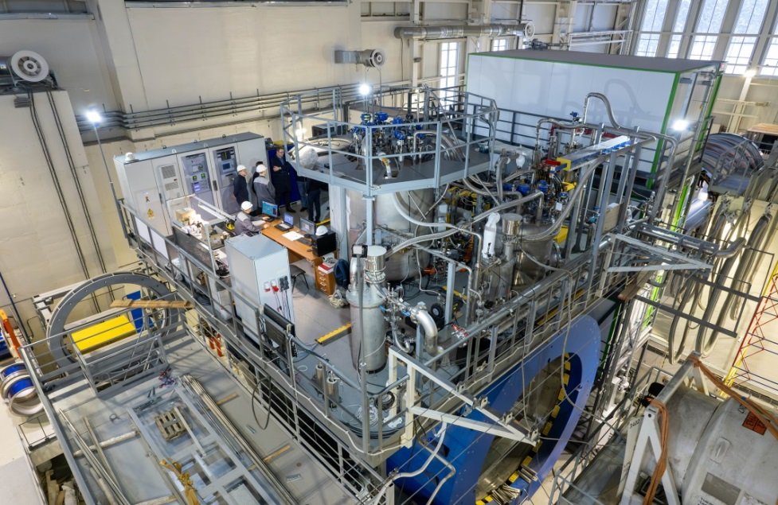
MPD detector engineering system and cooling status
Screen of the temperature at the solenoid
Main engineering equipment
- Cryogenic system complete.
- Power supply system (connected, started test in the December 2024).
- Quench and protection system (started test in the end of January).
- Water cooling system (ready).
- Magnetic field measurement equipment should be installed inside solenoid from 30/10/2025.
- In December 2024, cooling of the MPD solenoid was performed to an operating temperature of 4.5K.
- The cooling lasted 15 days to nitrogen temperature and 6 days to operating temperature.
- No cold helium and nitrogen leaks were detected.
- Operation magnetic field 0,2 – 0,5 T
- Homogeneity – 3*10⁻⁴.
- Magnetic field mapping will be start from 0,2 T with founding magnetic axis and homogeneity.

Slide 17
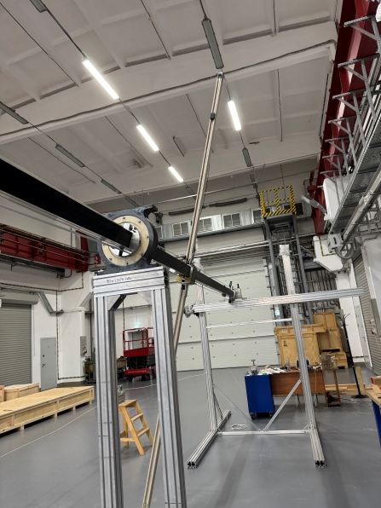



MPD magnetic field mapper
Magnetic field measured by 3D hall sensor
Total error rate – about 0,3 Gs

Slide 18

Stationary magnetic field monitor
40 – sensors evenly distributed over the inner surface of the solenoid.

Slide 19




Development of VBLHEP area
The development of the new checkpoint is ongoing.
Development includes new transport ways.
In 2024, two parking areas with 400 spaces were constructed.
The traffic reorganization

Slide 20

Thank you for attention

