Slide 1



Development of a measurement methodology
for the excess noise factor of avalanche multiplication below breakdown for APD, LGAD, SiPM
Sergey Vinogradov
P.N. Lebedev Physical Institute of the Russian Academy of Sciences

Slide 2
Motivation to study avalanche noise
Pixel detector => Monolithic Active Pixel Sensors (MAPS)
high granularity ~ 50 um
low scattering – low material budget
on-chip ROIC
Timing detector => Low Gain APD (LGAD)
time resolution ~ 10 – 30 ps
low granularity ~ 1 - 2 mm
4D tracking detector: MAPS + LGAD => Monolithic LGAD
Avalanche multiplication trade-off: Gain vs Excess Noise Factor (ENF)
No studies on ENF of LGAD except [1]
[1] Bertuccio, et al. (2024). Current Noise Spectral Density and Excess Noise of a Silicon Low-Gain Avalanche Diode (LGAD). IEEE Trans. Electron Devices, 71(10), 5845–5851.
No studies on ENF of SiPM below breakdown (avalanche with negative feedback)
LPI basic studies of ANF APD (1980s – 1990s)
No studies on ENF of TAPD below breakdown (deep spherical junction SiPM)
TAPD + MAPS concept reported on SPD meetings 2023, 2024
Time resolution ~ energy resolution ~ ENF [2]
[2] Vinogradov, S. (2015). Analytical model of SiPM time resolution and order statistics with crosstalk. Nuclear Instruments and Methods in Physics Research A, 787, 229–233.

Slide 3
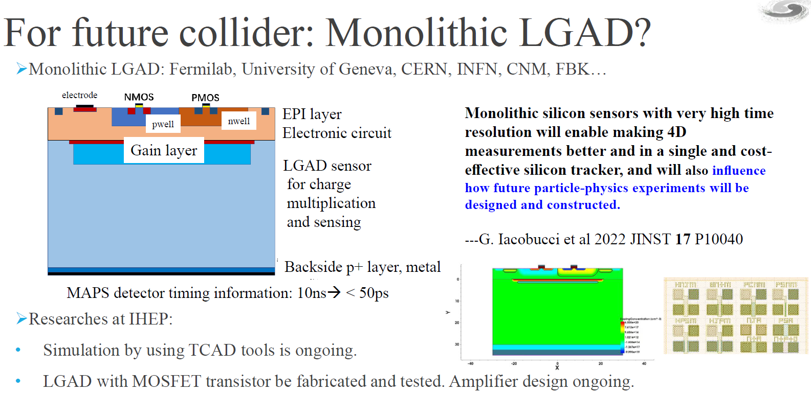
MAPS + LGAD => Monolithic LGAD
Mei Zhao, LGAD sensor development : From ATLAS high granularity timing detector to future collider, CEPC International Workshop 2024.
ЦЕРН, проект PicoLGAD: матрица пикселей размером 65 мкм, 2022 г.
IHEP, проект AC coupled Strip LGAD: разрешение около 15 мкм, 2024 г.

Slide 4
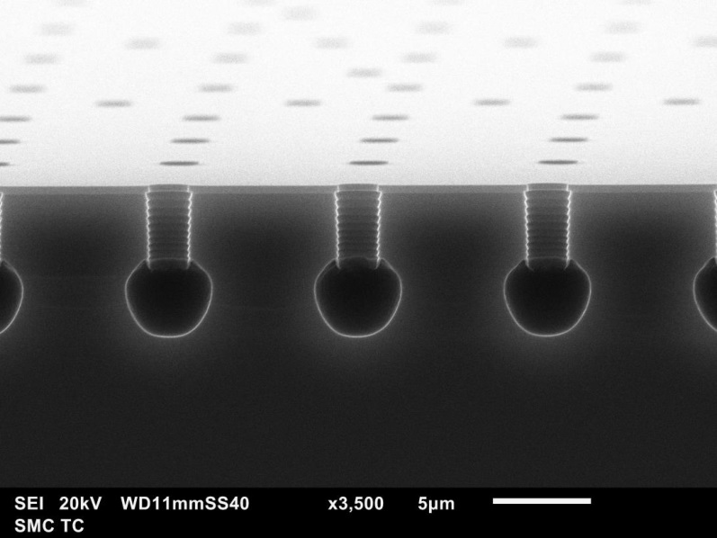
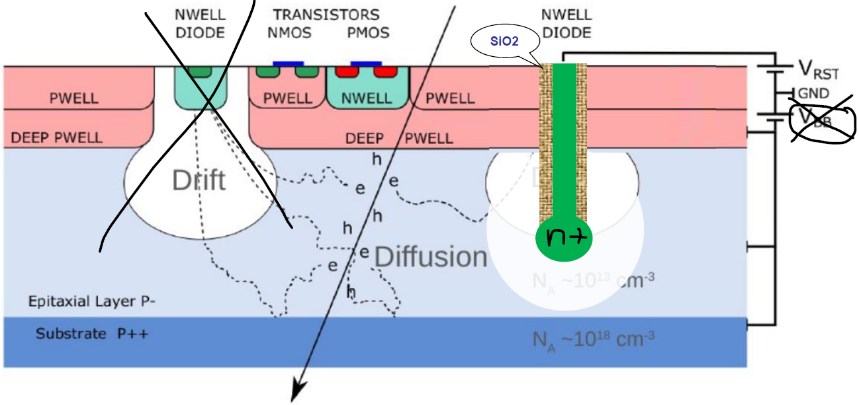
MAPS + TAPD (R&D by LPI + MIET)
S. Vinogradov, On possible development of MAPS based on spherical p-n junction, SPD collaboration meeting 2024, 2023.
Sensor and FEE are isolated and independent
All front-side area is available for FEE
High efficiency with lowest capacitance
High radiation hardness is demonstrated

Slide 5
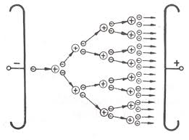
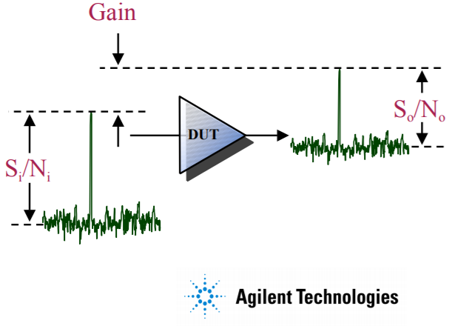
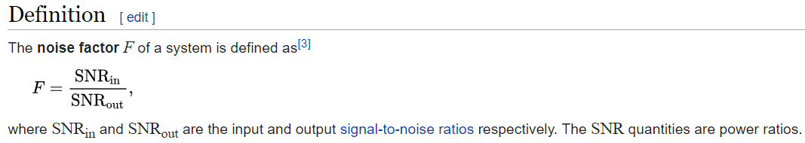
Excess noise factor (ENF) = measure of noisiness of multipliers and amplifiers
ENF in multipliers (APD, PMT, SiPM):
ENF in amplifiers:
1 electron → M electrons
High ENF
Low ENF
Noise factor (F) measures degradation of the signal-to-noise ratio (SNR), caused by components in a signal chain.

Slide 6
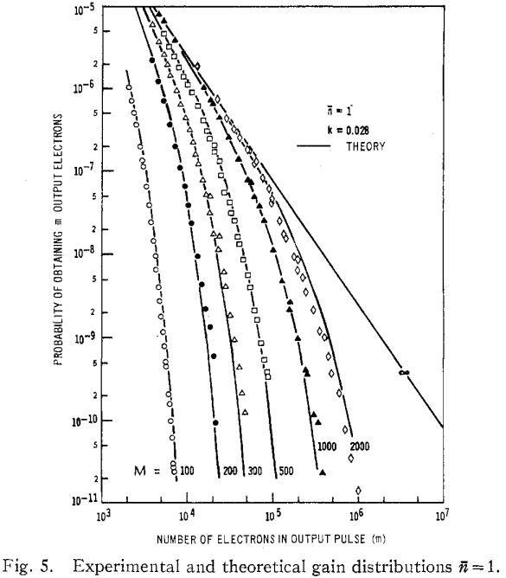
Main APD trade-off: Gain vs Excess Noise Factor
Excess noise of avalanche multiplication => Gain ~ ENF @ Gain > 10; Max Gain ~ 30
σ_{Gain}
Gain = FWHM = 2.35 σ_{Gain}
=>
ENF ≤ 1.18 to resolve 1 phe
δ(1)
Gain
Conradi, J. IEEE Trans. ED, 19(6), 713 (1972)
L. Yan et al. Appl. Phys. Lett. 111, 101104 (2017)

Slide 7
Single photon detection output charge distribution in 1 GHz BW with electronic noise 10⁴ e
Gain =1
ENF ~ 1
Gain ~ 100
ENF ~ 3…10
σ_{noise}
SiPM
Gain ~ 1 M
ENF ~ 1.2
Gain ~ 1 M
ENF ~ 1.01
σ(N_{out})
N=0
N=2

Slide 8
Methods
Measurements of
Charge response (typical in HEP)
DC current (typical in R&D of APD)

Slide 9
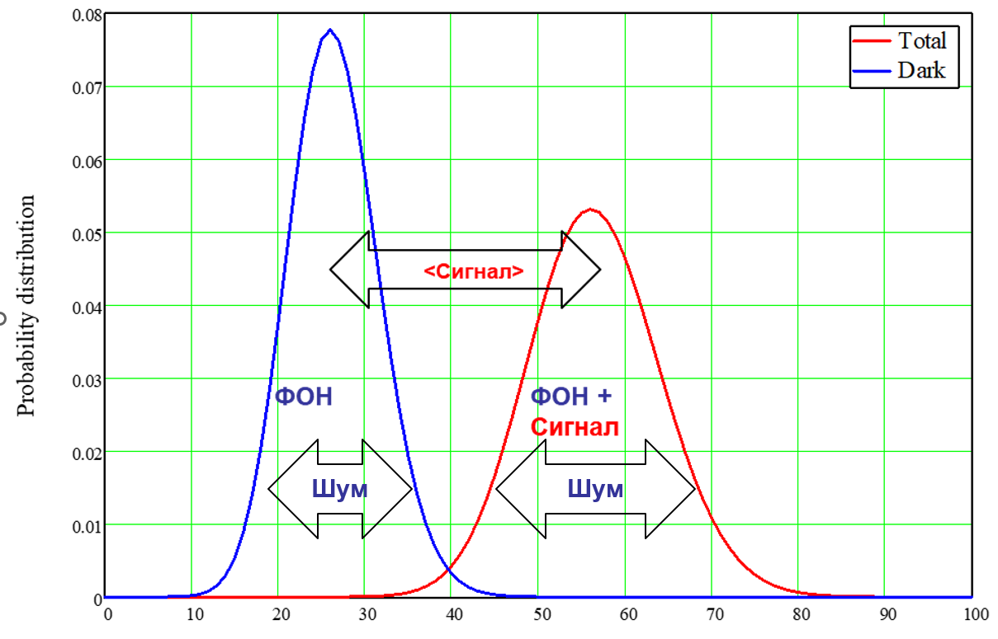
ENF measurement method in HEP: charge response in photoelectrons on light pulse
Light (LED) and Dark (PED) measurements of charge histograms

Slide 10
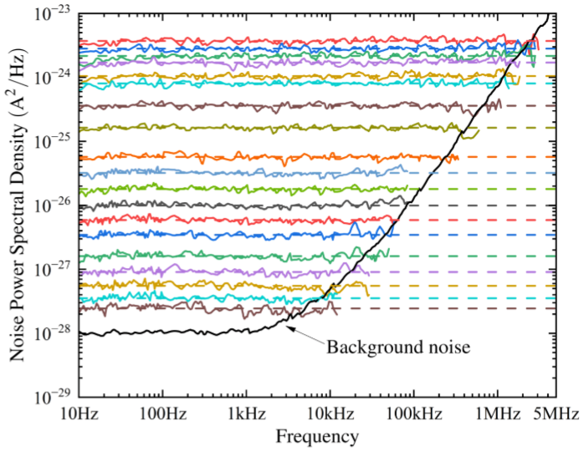
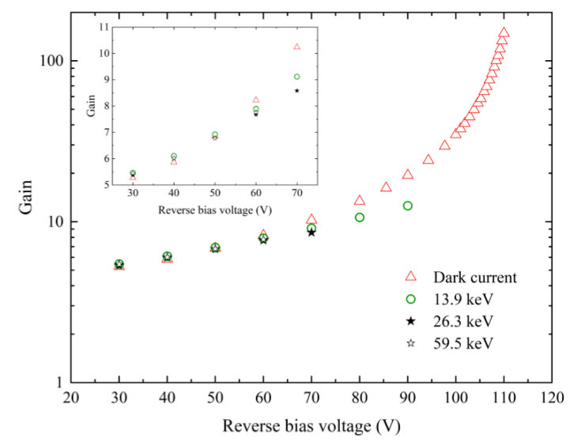
ENF measurement method in APD: dark and photocurrent mean and RMS
Y-factor Method (switchable noise source)
Cold Source & Network Analyzer
Calibrated Noise Generator
Power Spectral Density
[1] Bertuccio, et al. (2024). Current Noise Spectral Density and Excess Noise of a Silicon Low-Gain Avalanche Diode (LGAD). IEEE Trans. Electron Devices, 71(10), 5845–5851.

Slide 11
Results
Charge response measurements
by a short light pulse
Hamamatsu MPPC
Thorlabs FDS010
TAPD

Slide 12
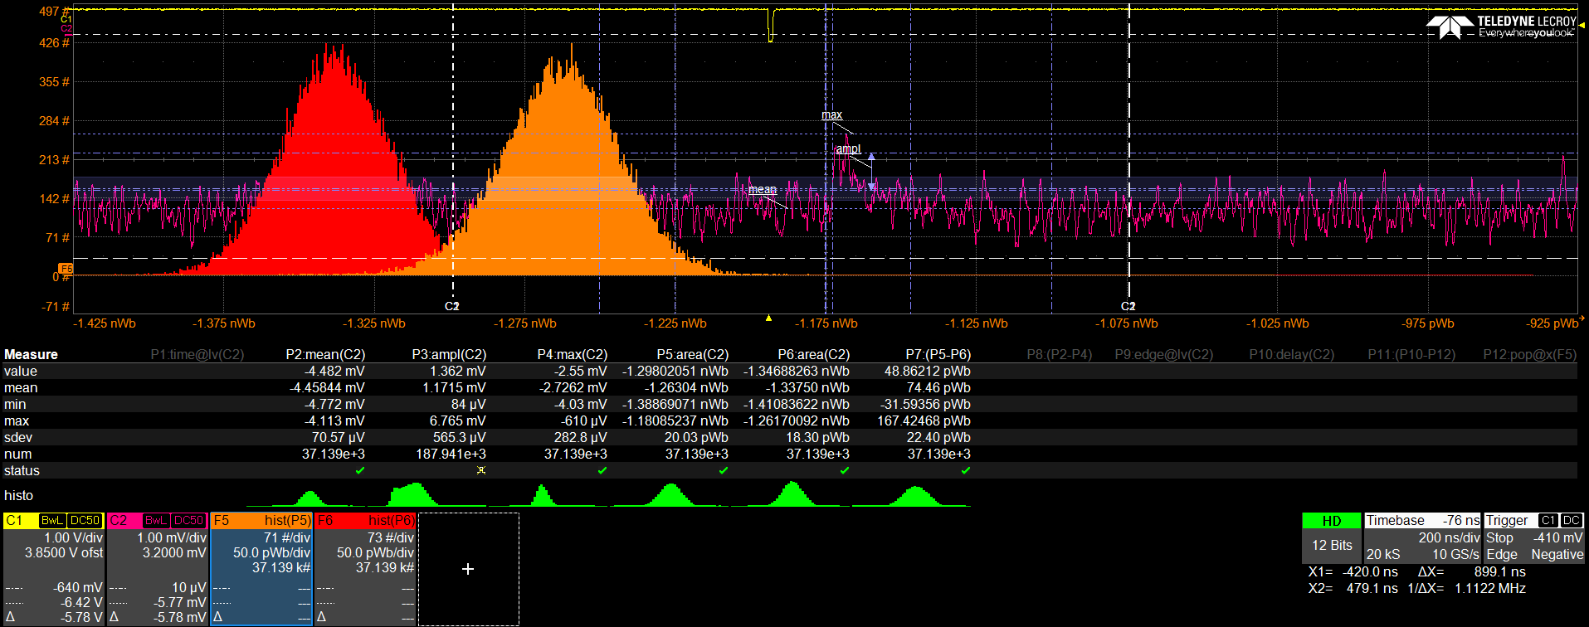

Photodiode mode (Gain = 1), oscilloscope LeCroy 6 GHz, Laser 535 nm, 40 ps, low intensity
Hamamatsu МРРС @10 V, Preamp 20 dB, 0.5 GHz BW
Minimum signal ≈ 1 mV ≈ Electronic noise RMS
Area (Charge) $\text{is} \text{measured}$in a time gate 300 ns (white dotted line С2)
$\text{P}\text{edestal} \text{Charge}\text{ (}\text{red}\text{) }\text{is} \text{measured} \text{before}$Laser Charge (orange)

Slide 13
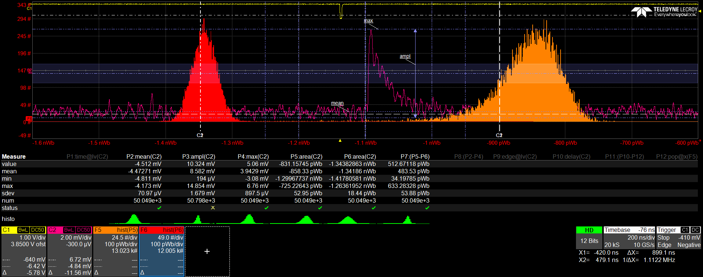

Photodiode mode (Gain = 1), oscilloscope LeCroy 6 GHz, Laser 535 nm, 40 ps, medium intensity
Hamamatsu МРРС @10 V, Preamp 20 dB, 0.5 GHz BW
Medium signal ≈ 8 mV >> Electronic noise RMS ≈ 1 mV
$Area=\int{V\left(t\right)dt=}Kamp∙Rload∙\int{I\left(t\right)dt=}Kamp∙Rload∙Q\left(Tgate\right)= =q∙Kamp∙Rload∙Gain∙Npe$

Slide 14
Results in photodiode mode (Gain = 1)
Signal Sigma σ(Npe) ~ 10% Mean μ(Npe) – blue dots
Pedestal σ(Electronic noise) ~ 10⁵ е – black dots
Poisson model – green line

Slide 15
Photodiode (Gain = 1) and Avalanche (Gain = 2.3) modes
Sigma(Npe) ~10% Mean(Npe) confirmed for Gain = 2.3
MPPC is measured @ 50 V – two orange dots @ two Laser intensities
No avalanche noise is observed

Slide 16
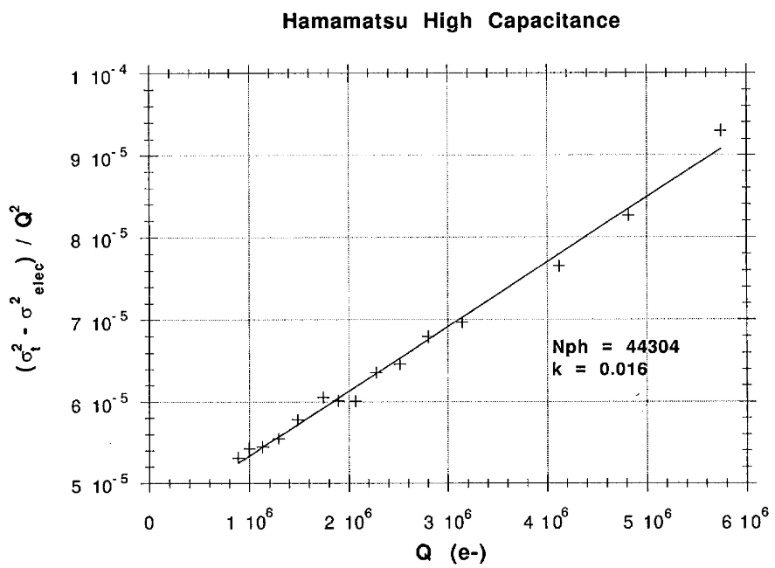
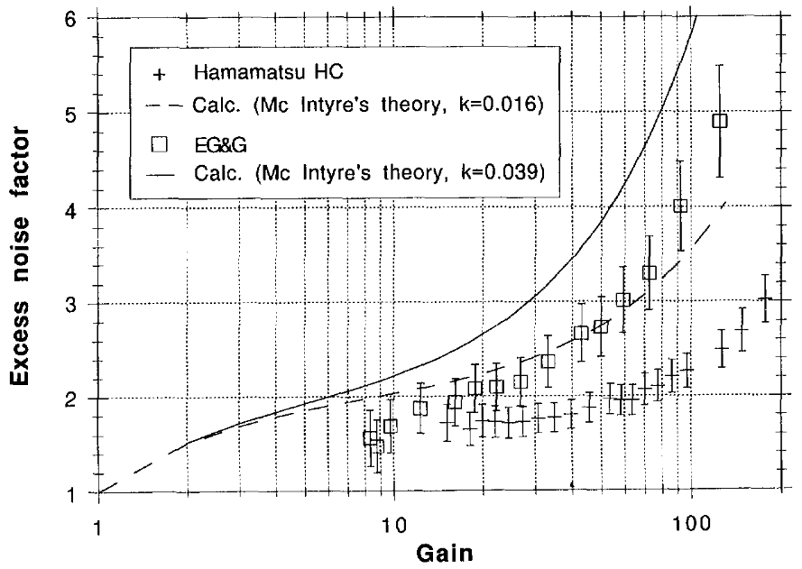
Advices from Yu. Musienko (CMS CERN) based on experience in ENF APD 1990-2000е [3]
Electronic noise to be as low as 10² е
Low noise FE electronics is a must
Low BW
Shaping
Cooling
Low noise power supply
Instability to be as low as 0.1%
Laser instability as high as ~ 3%
LED is typically preferable
LED to be carefully selected
LED driver to be carefully selected
Thermal stabilization of preamp
[3] A. Karar, Y. Musienko, J. Vanel, Characterization of avalanche photodiodes for calorimetry, Nucl. Instr. Meth. Phys. Res. Sect. A, 428 (1999) 413–431.

Slide 17
Analysis of the problems
Suppression of absolute noise of electronics
=> σ(Npe) = √μ(Npe) > σ(Electronic noise) ~ 10⁵ е
=> μ(Npe) = σ(Npe)² > 10¹⁰ е
Suppression of relative signal instability
=> σ(Npe)/μ(Npe) = 1/√μ(Npe) > δ(Non-Stab) ~ 0.1
=> μ(Npe) < 1/δ(Non-Stab)² = 10² е
Trade-off for μ(Npe)
σ(Electronic noise)² < μ(Npe) < 1/δ(Non-Stab)²
To be resolved only if σ(Electronic noise) ⋅ δ(Non-Stab) < 1
E.g. Musienko’s example: σ(Electronic noise) = 100, δ(Non-Stab) = 10⁻³
The trade off is also resolvable at high avalanche gain

Slide 18
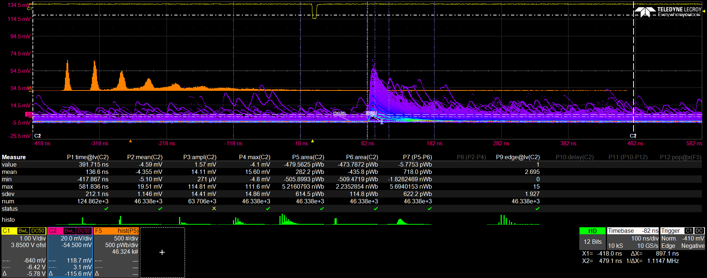
Geiger mode (Gain ~ 1M), oscilloscope LeCroy 6 GHz, Laser 535 nm, 40 ps, a few photon intensity
МРРС (Hamamatsu) 1х1 mm² @ 73 V (+1.5 V overvoltage)
μ(Npe) ~ 1, ENF ~ 1.5 (optical crosstalk ~ 30%)
σ(Npe)/μ(Npe) ~ 100% >> δ(Non-Stab) , σ(Npe) ~ 10⁶ е >> σ(Noise)

Slide 19
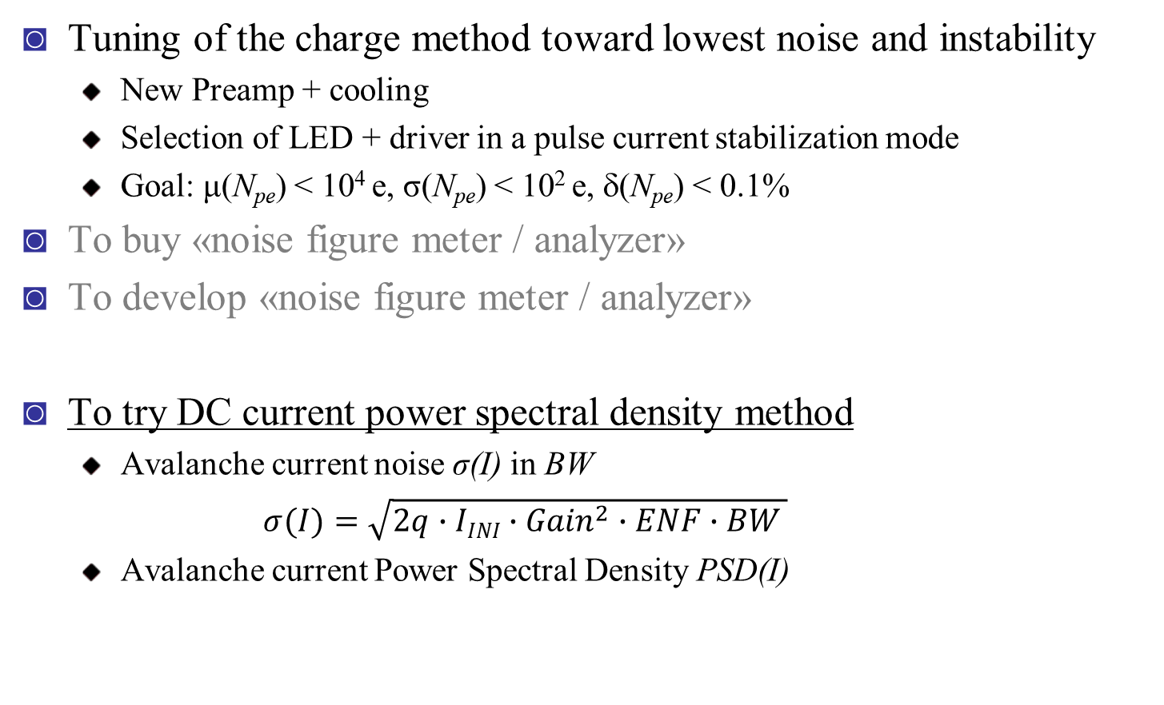
Possible solutions for low-gain ENF measurements
Tuning of the charge method toward lowest noise and instability
New Preamp + cooling
Selection of LED + driver in a pulse current stabilization mode
Goal: μ(N_{pe}) < 10⁴ e, σ(N_{pe}) < 10² e, δ(N_{pe}) < 0.1%
To buy «noise figure meter / analyzer»
To develop «noise figure meter / analyzer»
To try DC current power spectral density method
Avalanche current noise σ(I) in BW
$σ(I)=\sqrt{2q∙IINI∙{Gain}^{2}∙ENF∙BW }$
Avalanche current Power Spectral Density PSD(I)

Slide 20
Thank you for your attention!
Sergey Vinogradov
vinоgradovsl@lebedev.ru

Slide 21
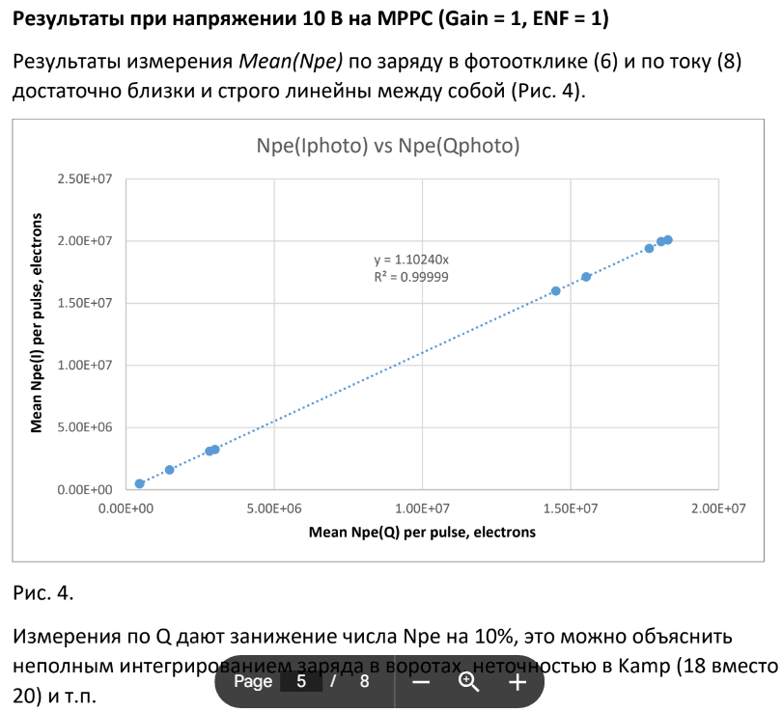

Slide 22
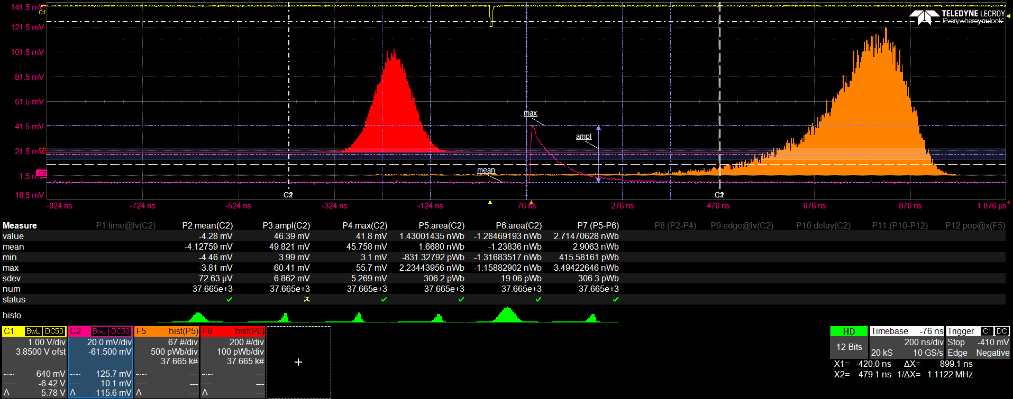
Результаты измерений SiPM от лазера 40 пс 535 нм осциллограф LeCroy, фотодиодный режим
Измерения МРРС в фотодиодном режиме при 10 В (Gain = 1)
Максимальный сигнал около 50 мВ >> шума
шкалы гистограмм отличаются в 5 раз

Slide 23
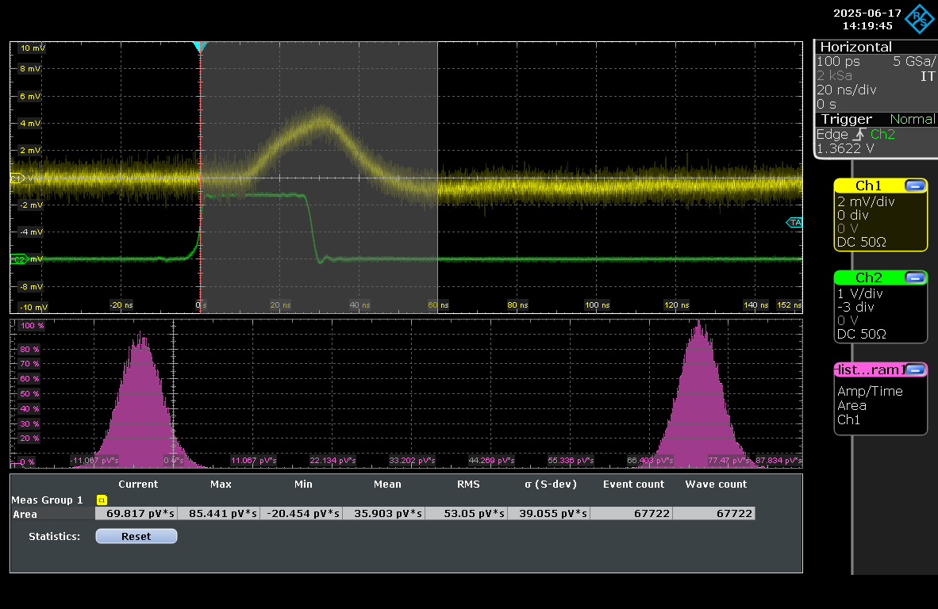
Результаты измерений TAPD от белого LED 30 нс осциллограф R&S, фотодиодный режим
Измерения TAPD – почти нет зависимости σ(Qpe) от μ(Qpe)
Разброс, нечеткие результаты (нестабильность TAPD?)
Часто σ(Qdark) @LED=OFF > σ(Qphoto) @LED=ON

Slide 24
Input-dependent characteristics of output (SNR, RES) Internal characteristics of photodetection (DQE, ENF)
Resolution → ENF
Signal-to-Noise Ratio → DQE
Signal (μ_{N}, σ_{N})
Total Signal (μ_{K}, σ_{K}) + Noise(0, ENC)
Noise (μ = 0, σ = ENC)

Slide 25
Resolution (RES) and Excess Noise Factor (ENF) of stochastic processes in photodetection
Resolution at output = Total ENF-times degraded Resolution at input
Total ENF is a product of Specific ENFs
ENF_{Gain}
RES(K)
RES(N)
ENF_{PDE}
Input photon distribution Photodetection processes Output charge distribution

Slide 26
ENF of simple specific processes
PDF(Yout)
Multiplication (Xin=1)
Yout of any distribution
Photon count (Xin=1)
Bernoulli distribution
Dark counts (Xin=Npe)
Npe and Ndark ~ Poisson distribution
PDF(Xin)=δ(x)
Xin=1
Yout=Gain
PDF(Xin)=δ(x)
PDF(Yout) = Bernoulli
Xin=1
Yout = PDE
RES(Yout)
Photoelectrons
Yout = Npe+Ndark
Dark counts

Slide 27
Ideal detector
Ideal detector: conversion of any input light signal starting from single photon to recognizable output without noise and distortion in amplitude and timing of the signal
Real photon detector
Ideal photon detector
W. Farr, SPIE LEOS 2009

Slide 28
SiPM calibration for CMS
Npe, Gain, ENF, Crosstalk = ECF:
4 unknown @ 2 measured (Mean & Var)
Unresolved SER and PE spectrum = unresolved unknowns
Assumptions / models to be applied to resolve the problem

Slide 29
APD calibration for ENF
Npe, Gain, ENF, Crosstalk = ECF:
3 unknown @ 2 measured (Mean & Var)
PDF(Yout)
PDF(Xin)=δ(x)
Xin=1

Slide 30
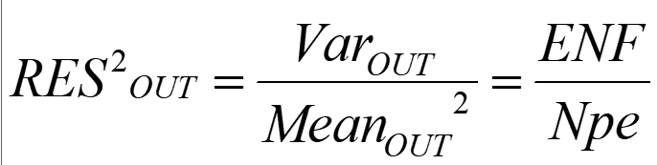
Методика измерений ENF по току и заряду от световых импульсов с частотой F
Npe, Gain, ENF - 3 unknown
1, 2 = Mean & Var – по гистограмме заряда на осциллографе
3 = Npe = Ipe/F/q – по току Keithley при Gain = 1
=> ENF = Npe*Res² (референс: ENF = 1 при Gain = 1)

Slide 31
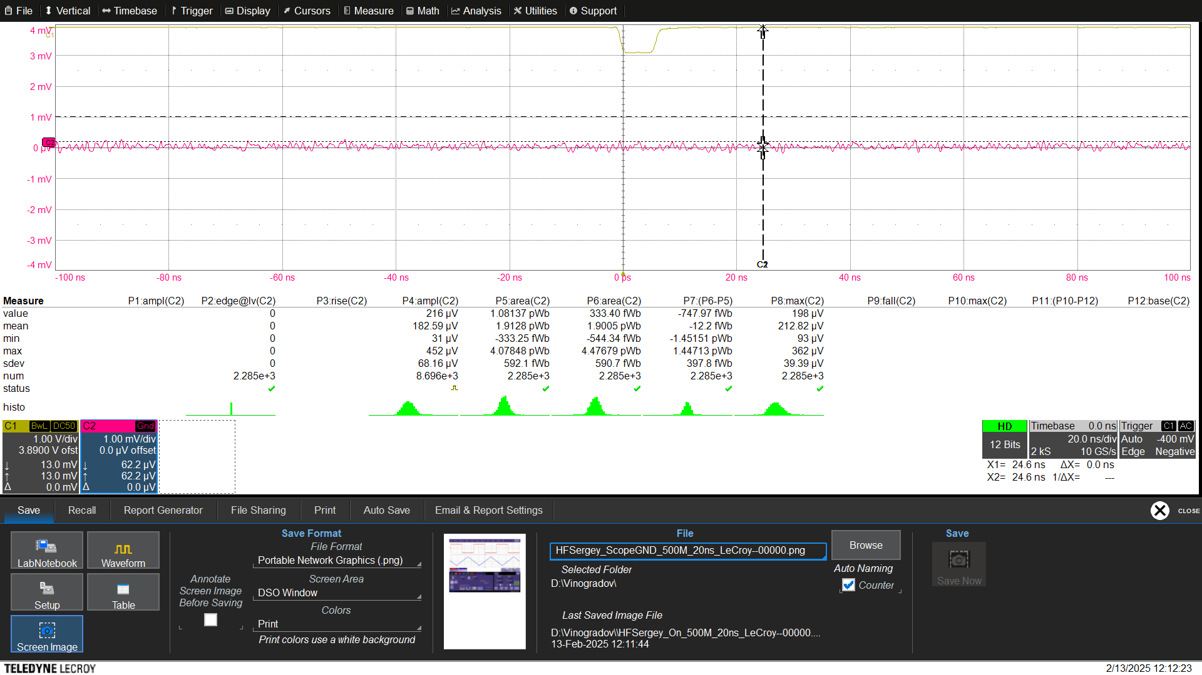
Шум осциллографа LeCroy @ 500МГц ~ 68 мкВ ~ 3 нВ/√Гц

Slide 32
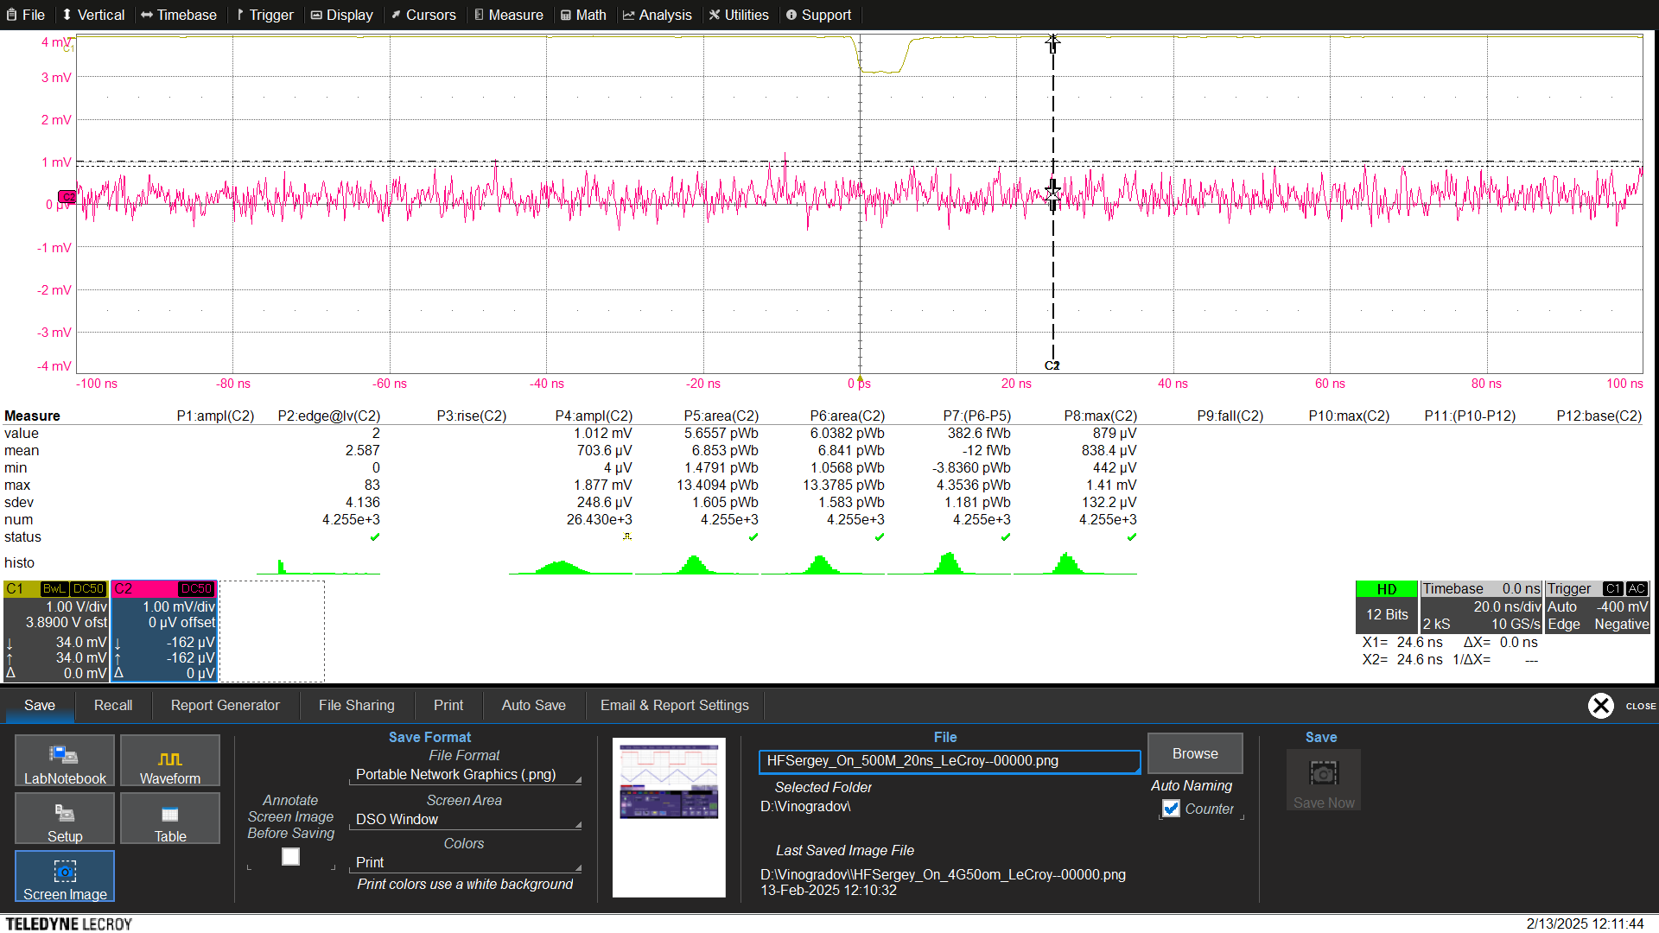
Шум предусилителя (4 ГГц 20 dB) ~ 248 мкВ ~ 11 нВ/√Гц

Slide 33
Оценки возможности измерений по постоянному току
Сигма тока 1 мкА ~ 10 нВ @ BW = 100 KГц, R = 50 Ohm
+ предусилитель ~ 20 dB
+ селективный нановольтметр с частотным фильтром (Unipan)

