Slide 1


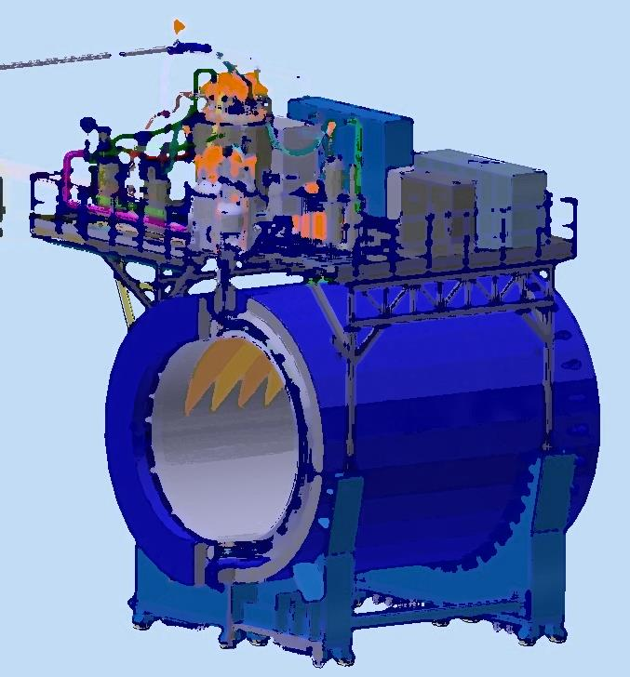
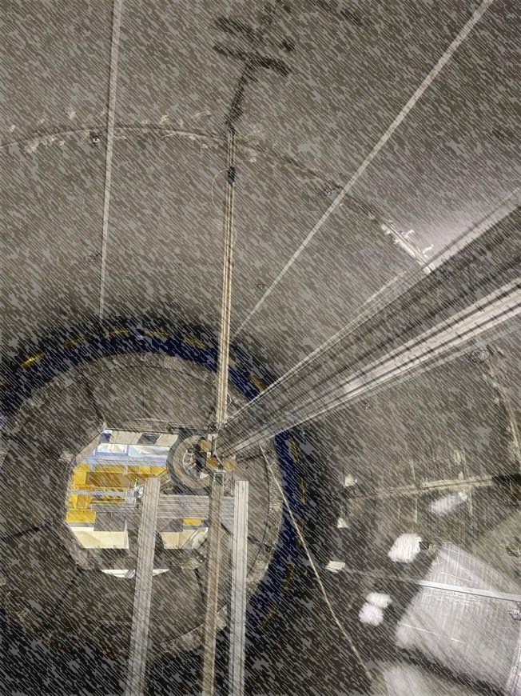
Status of the solenoid start-up
XVI Collaboration Meeting of the MPD Experiment at NICA
28/10/2025
From drawing
to detector
Speaker: K. Mukhin
JINR, LHEP 2025

Slide 2
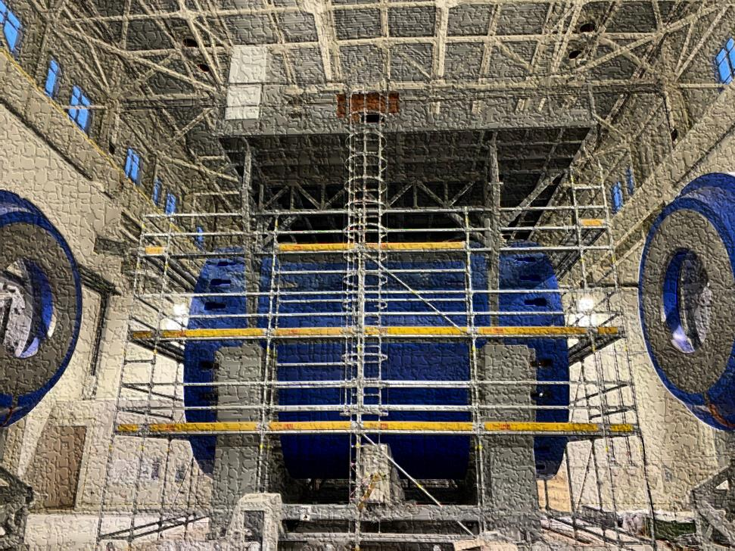
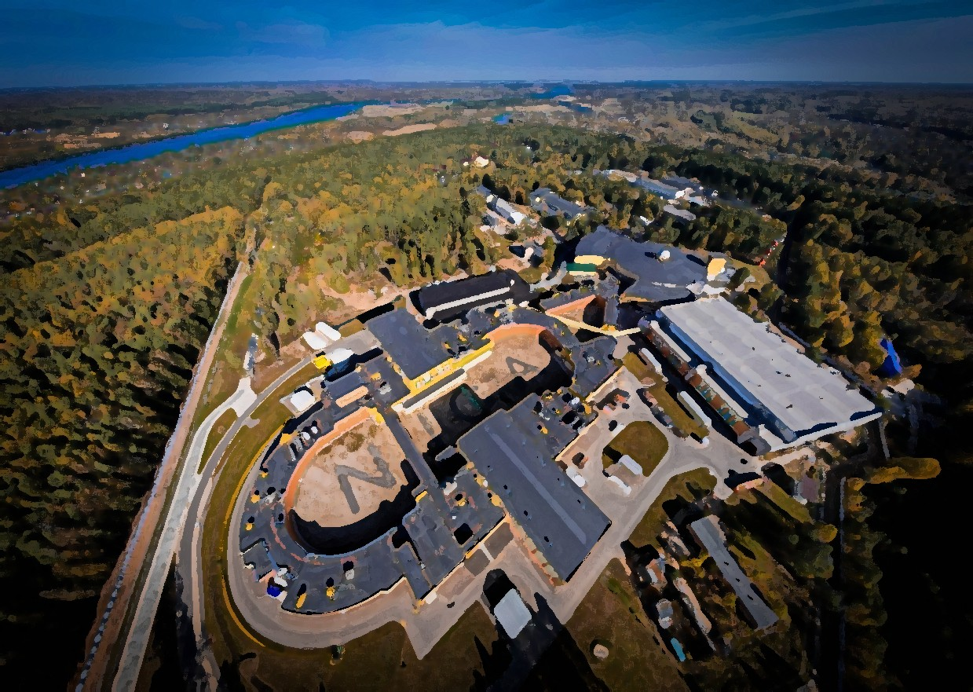
Plan of talk
Magnet construction and some parameters
Chimney area and determination a problem after cooling
-Power supply system
-Power supply at CS coil
-Current leads problem
Feld mapper
Timeline

Slide 3
Chapter 1 Magnet construction and parameters

Slide 4
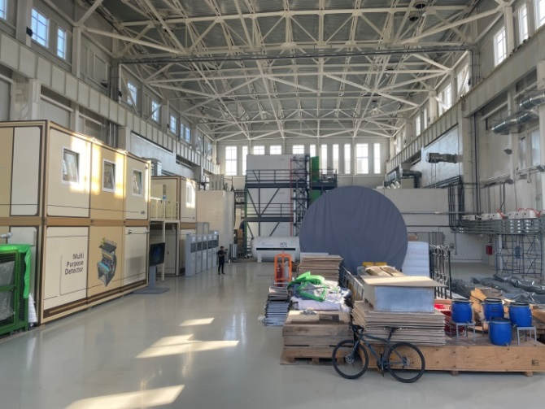
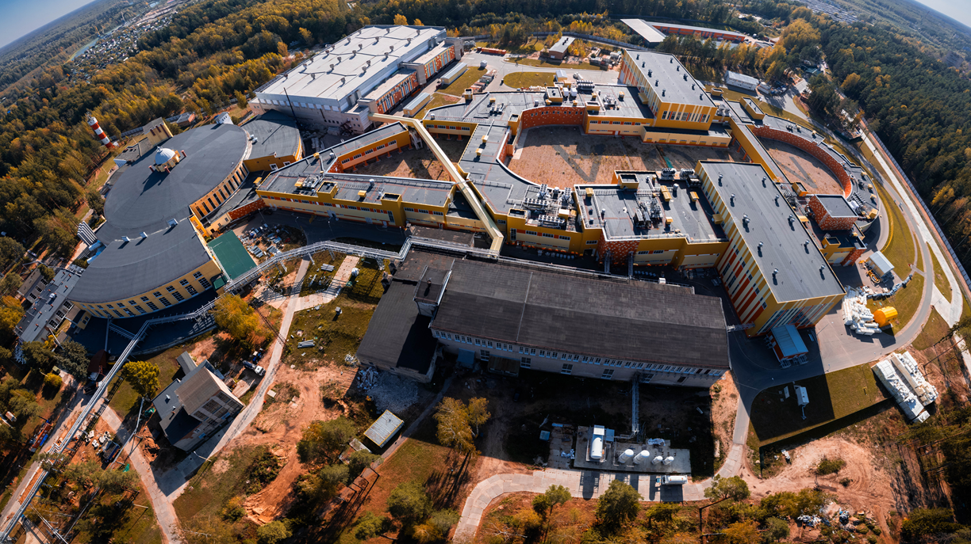
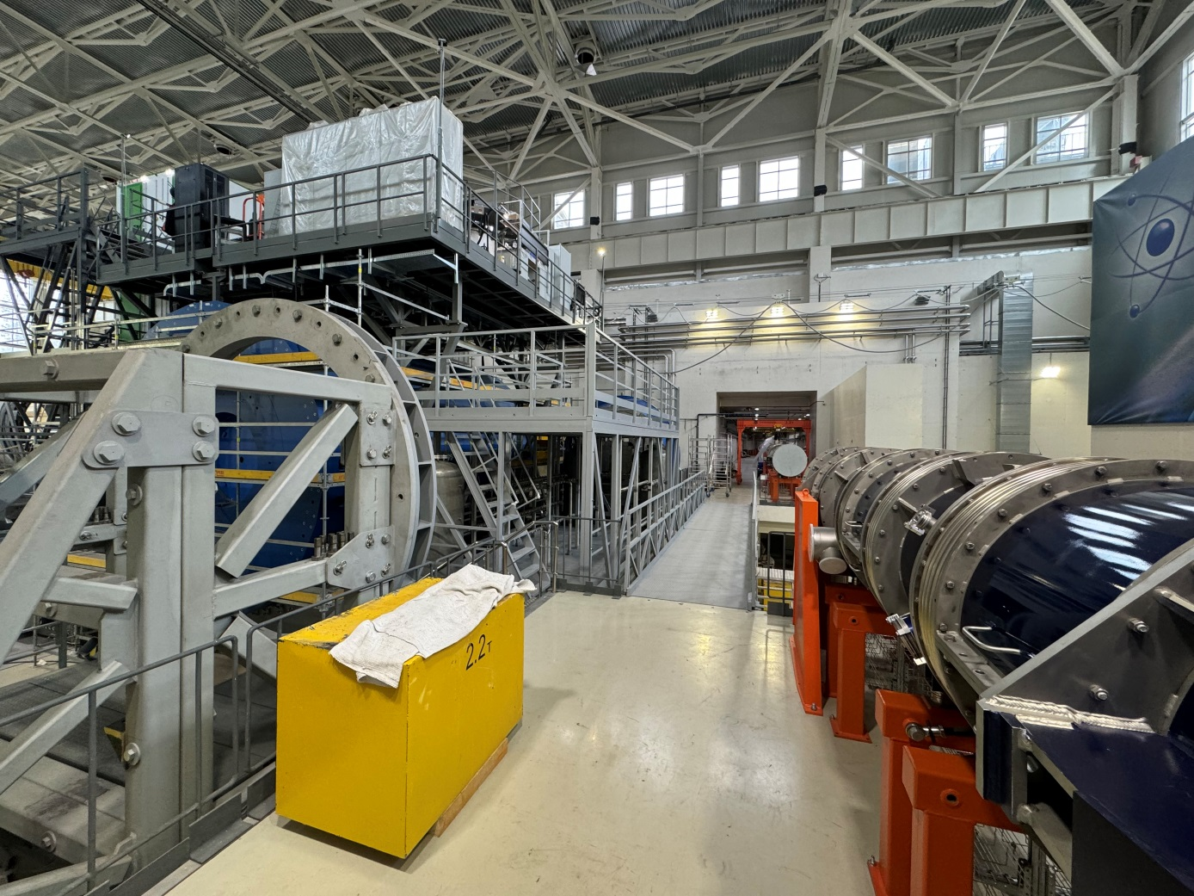
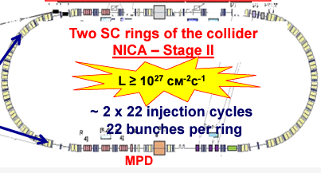
MPD in NICA complex
BM@N
SPD
Booster
Nuclotron
N I C A
MPD

Slide 5
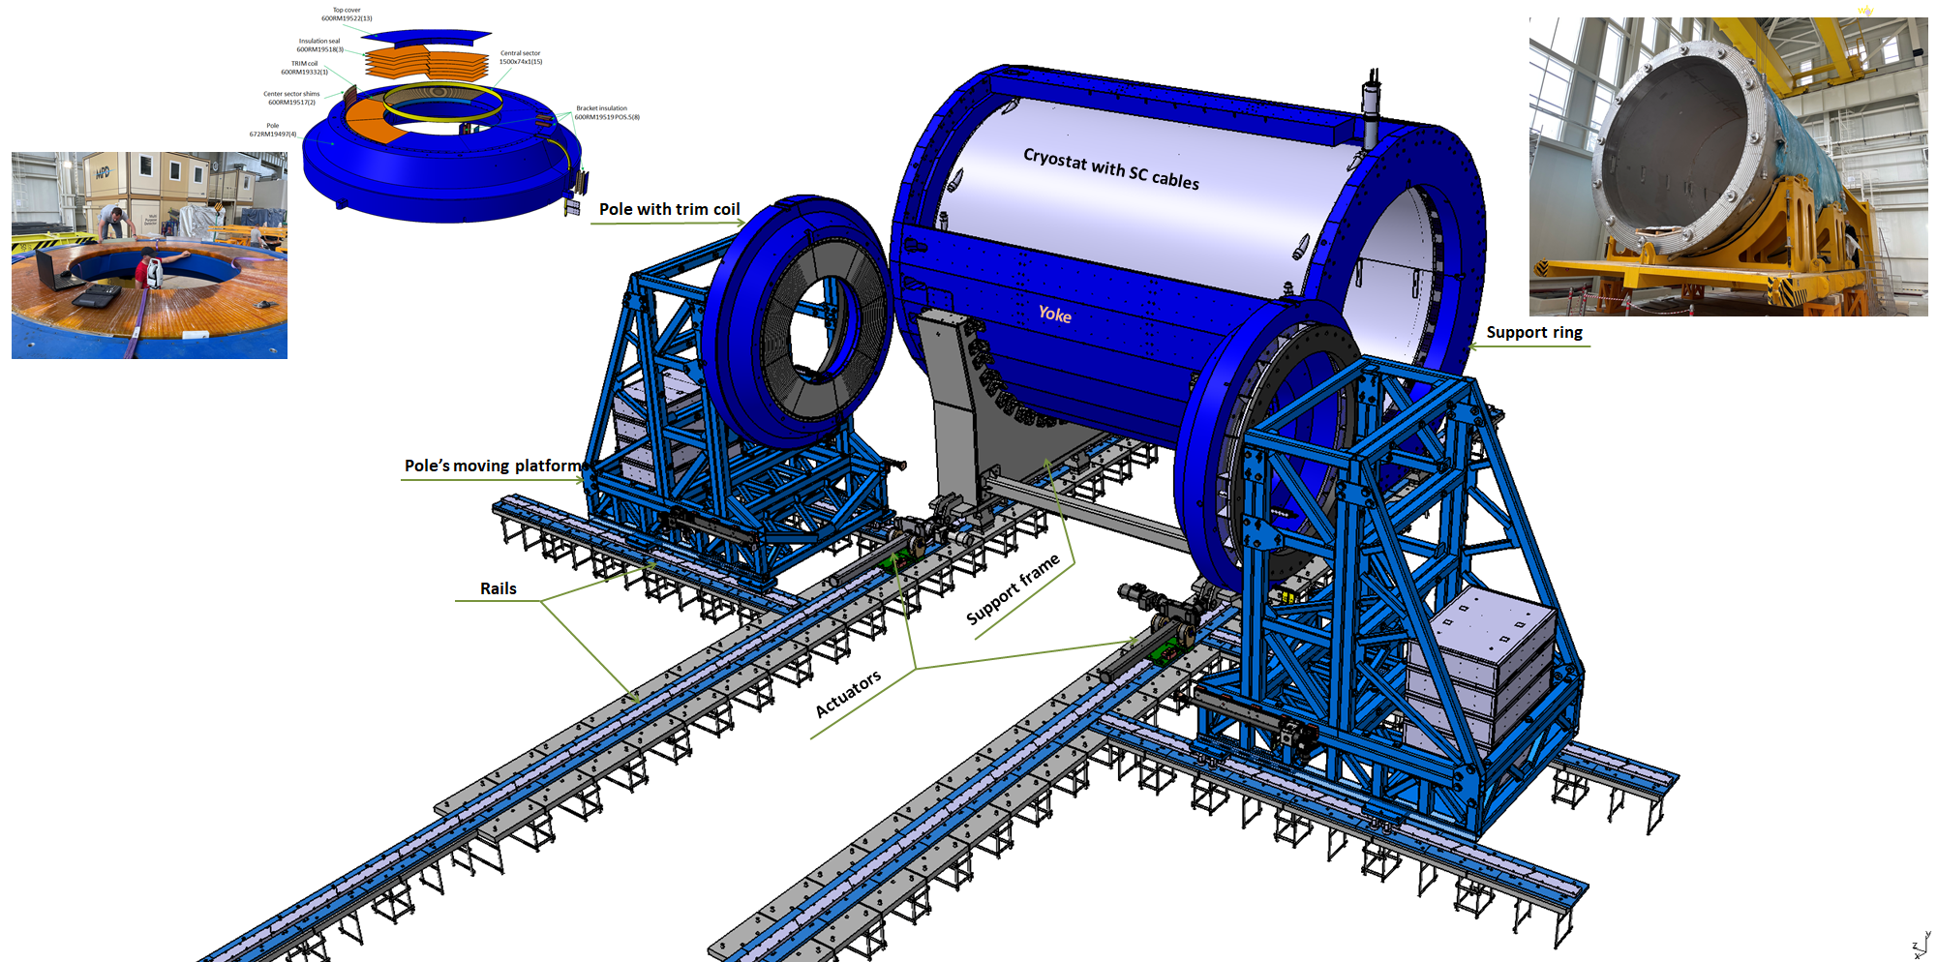
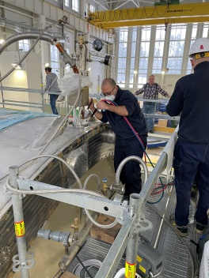
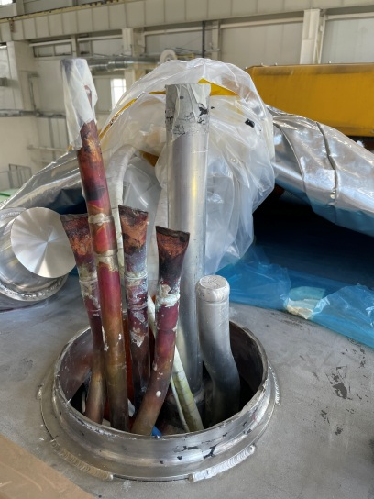
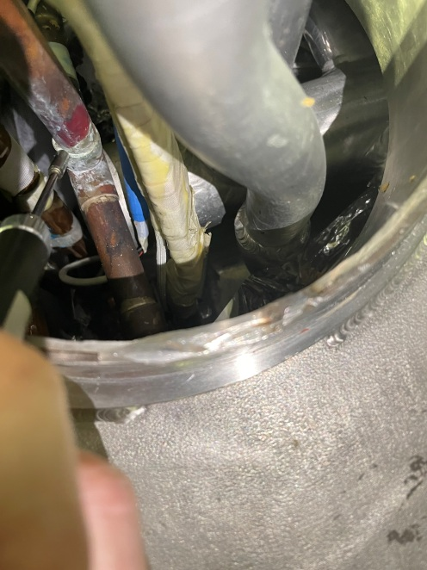
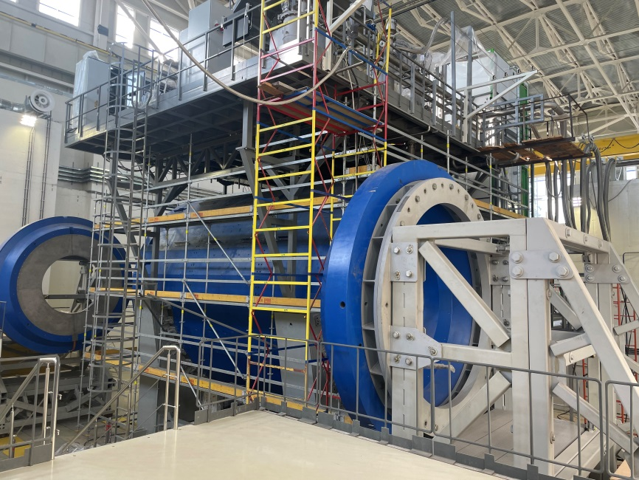
MPD magnet construction and surprise from ASG
Parameters of the magnet
Magnetic field | 0,57 T
Cryostat weight and size (diameter/length) mm | 66 tons 5443/7910
Yoke weight and size (diameter/length) mm | 630 tons 6583/8970
Current Voltage | 1790 A 10V
Each pole weight | 45 tons
Total weight with support equipment | 800 tons

Slide 6
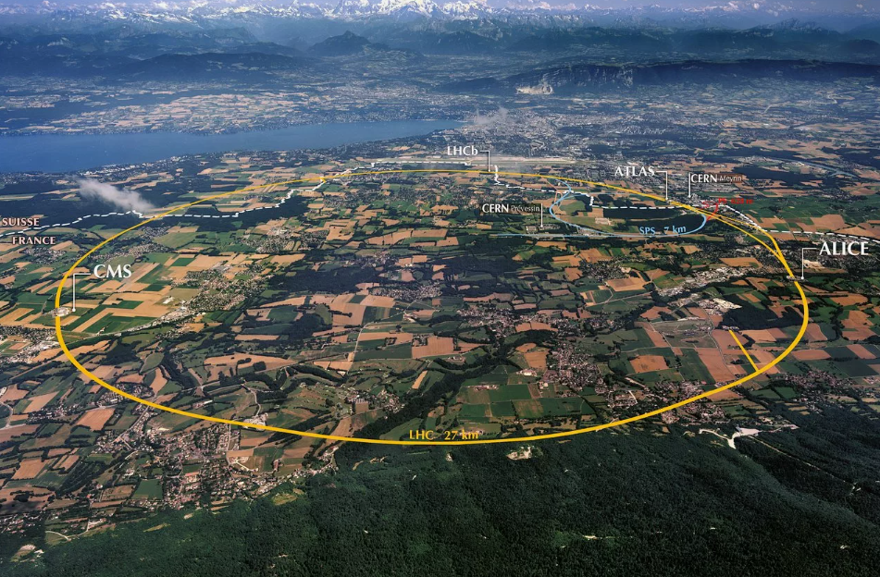
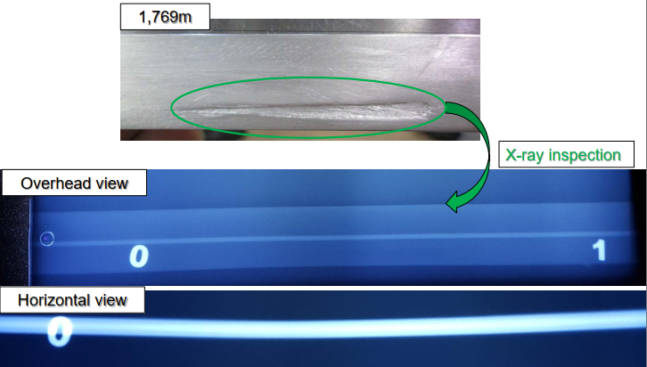
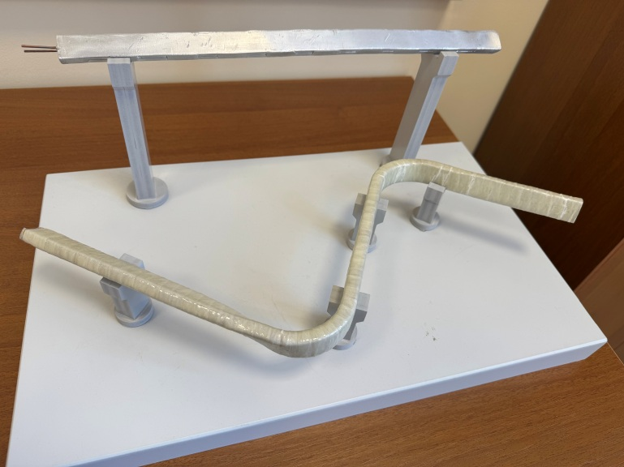
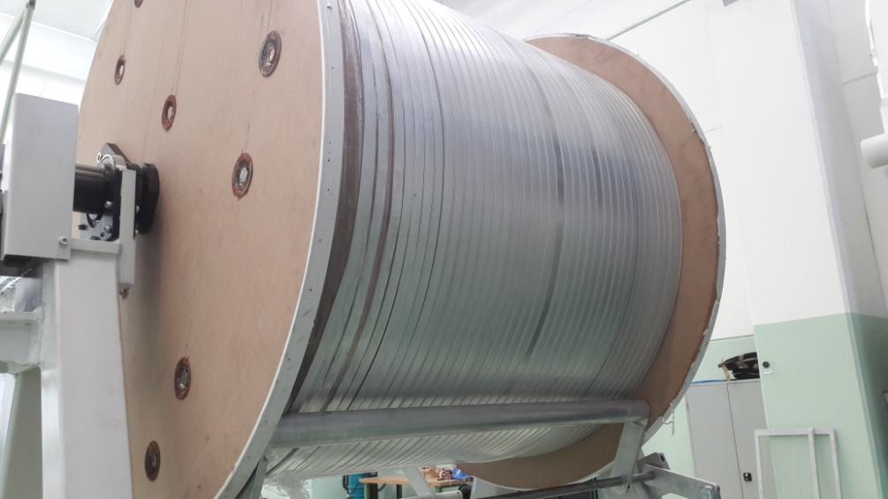
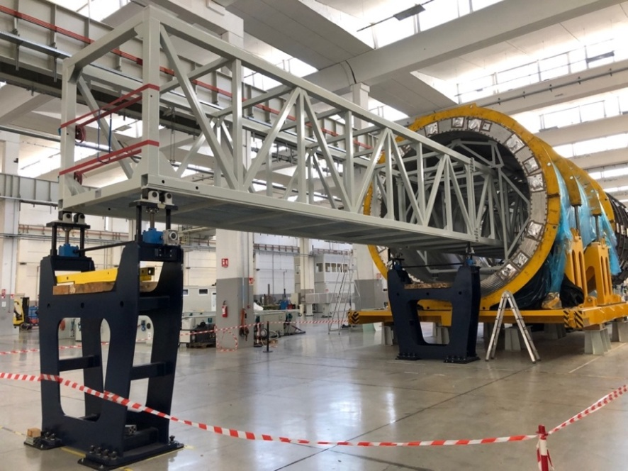
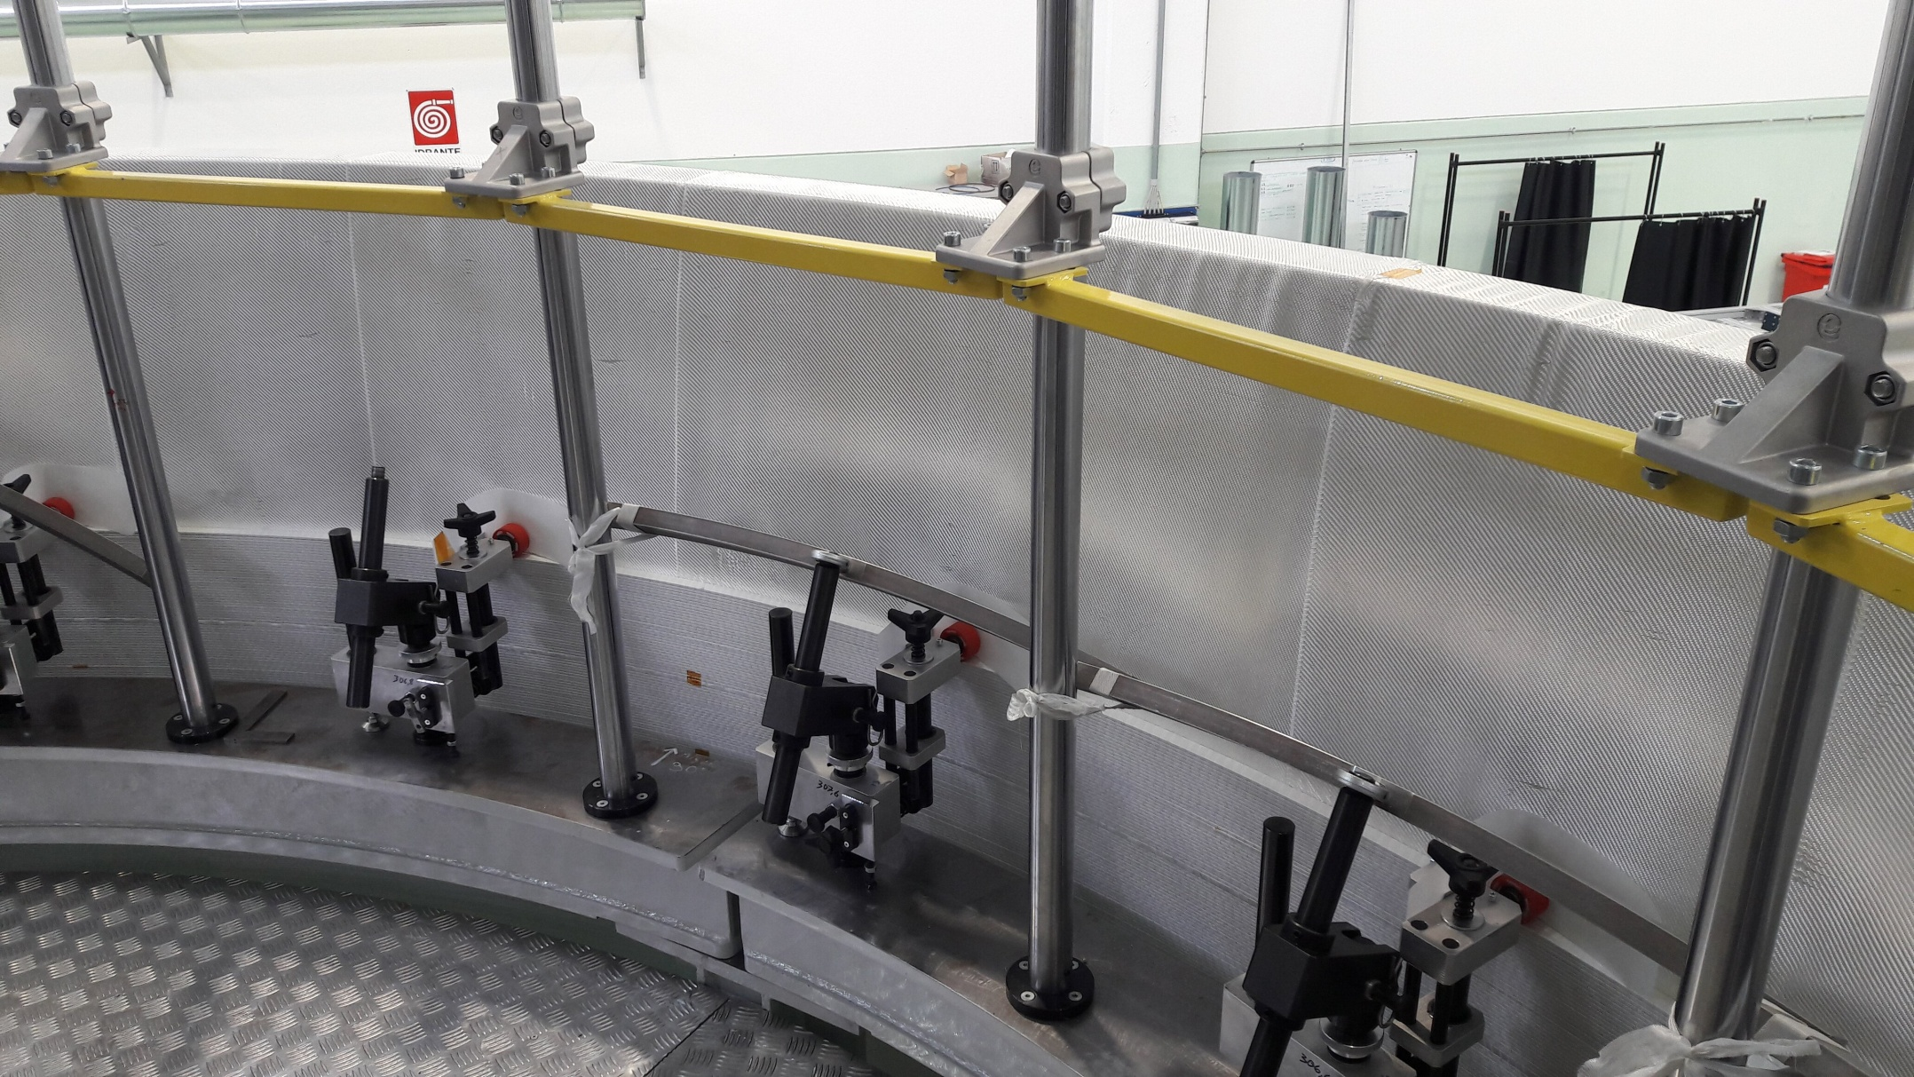
Superconductor cable
Original SC cables for MPD
Winding and tests of SC cable in ASG
LHC 27 km
SC cables parameters
SC Materials – NbTi/Cu.
Cable composition is pure aluminum matrix (4,1 x 20 mm) and inside string of Cu/SC ratio 0,9/1 (d – 1,5 mm).
Insulation – kapton tape, glass tape and epoxy resin.
Critical current (1,2 T, 4,5 K) – 6,9 kA
Cable length - 27 km.
Cable weight – 6,3 tons

Slide 7
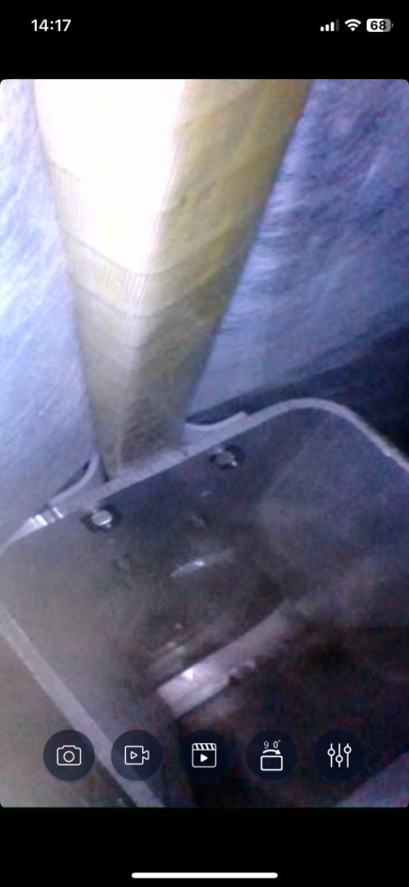
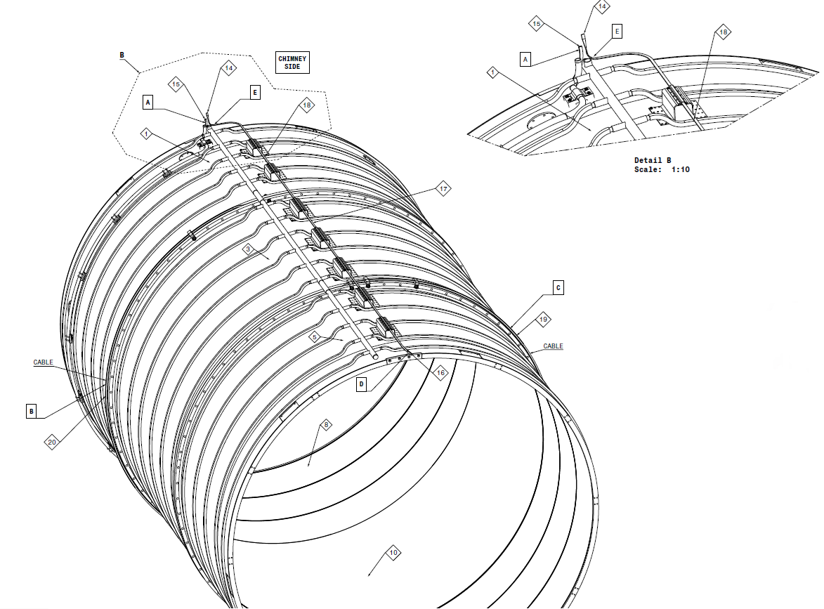
CS coil winding
-
+

Slide 8
Chapter 2 Chimney area and determination a problem after cooling -Power supply system -Power supply at CS coil -Current leads problem

Slide 9
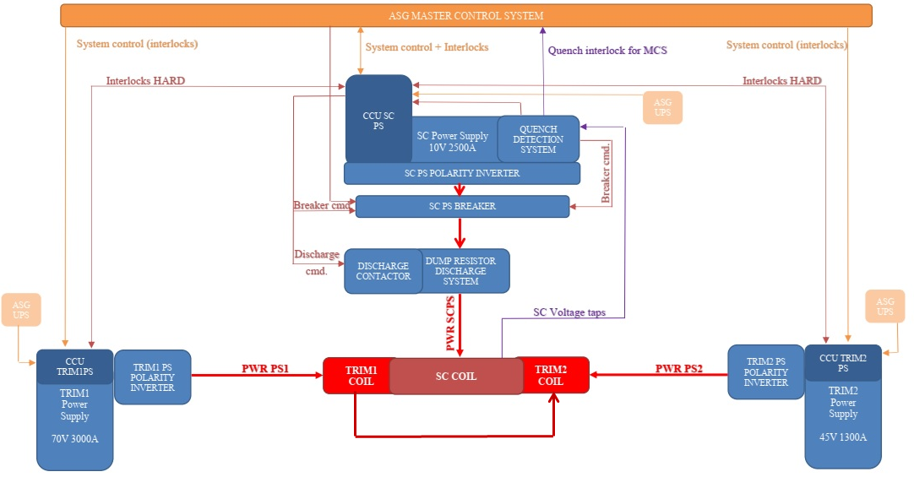
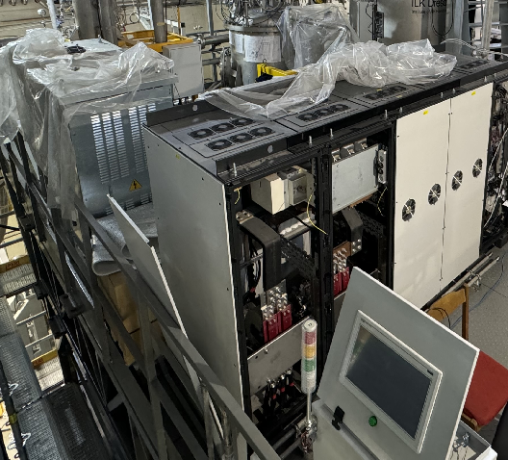
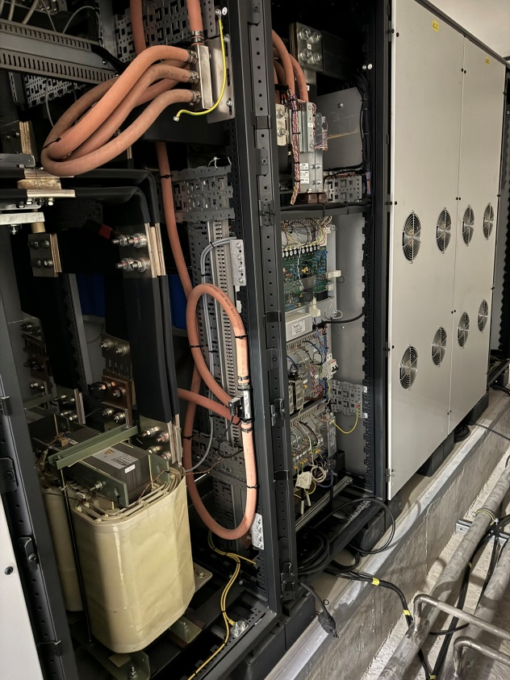
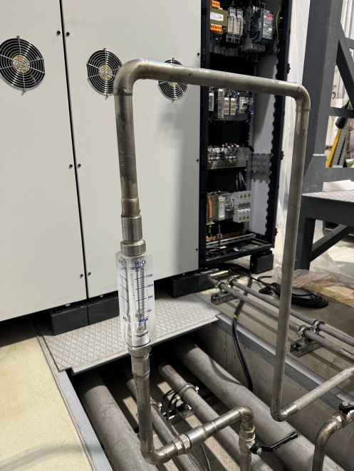
Power supply system

Slide 10
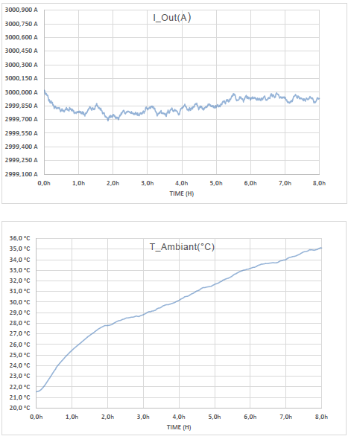
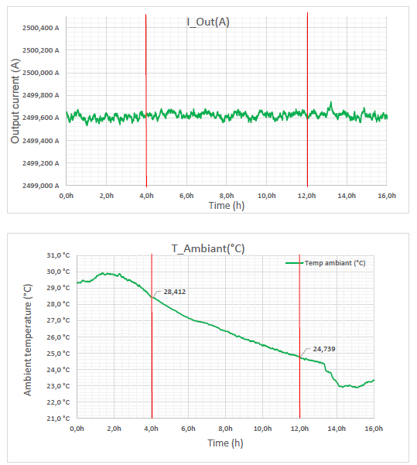
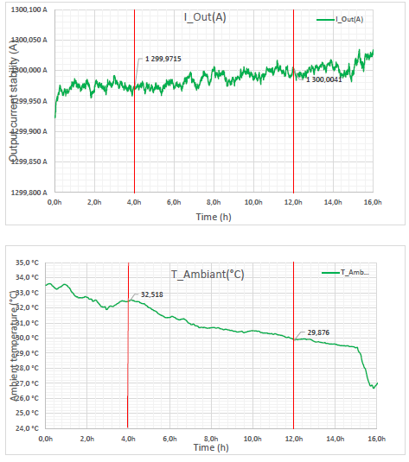
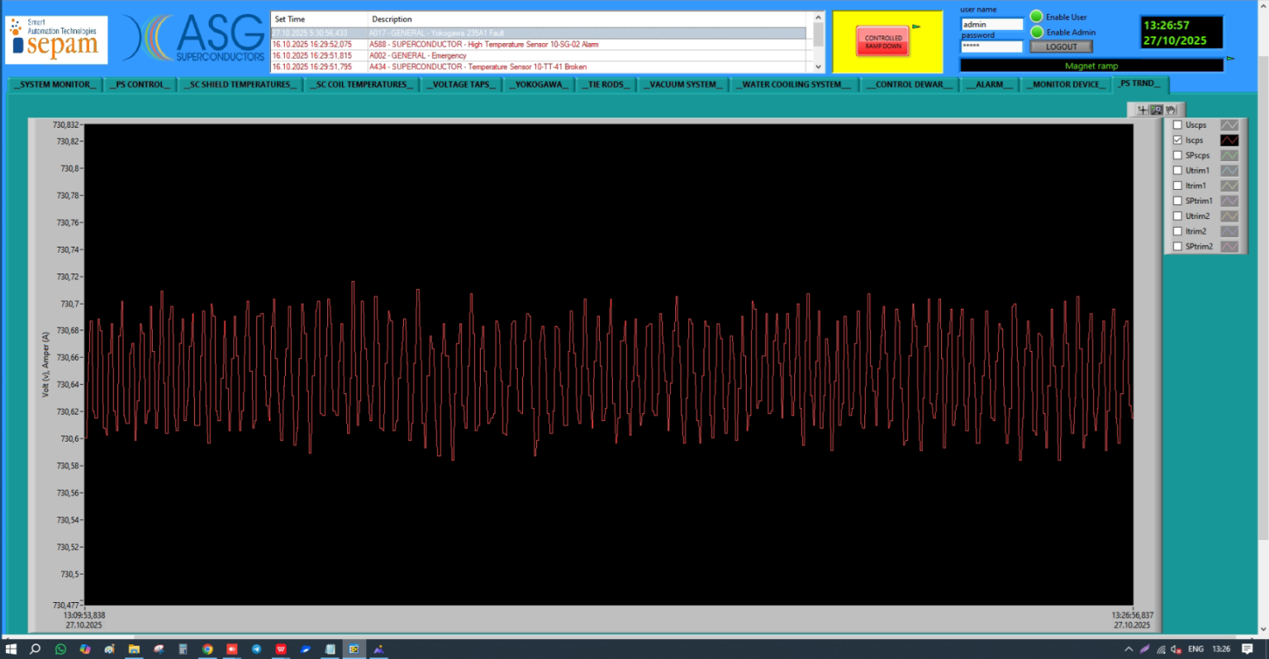
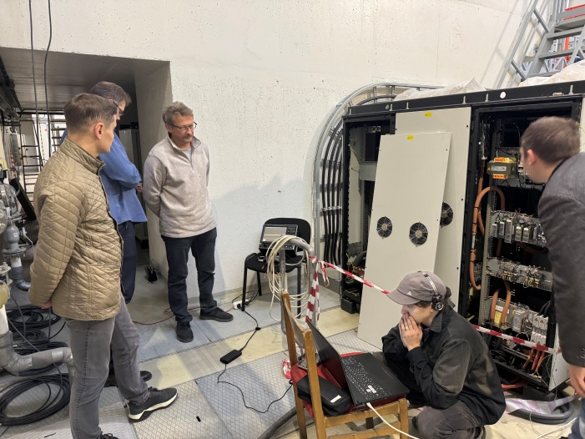
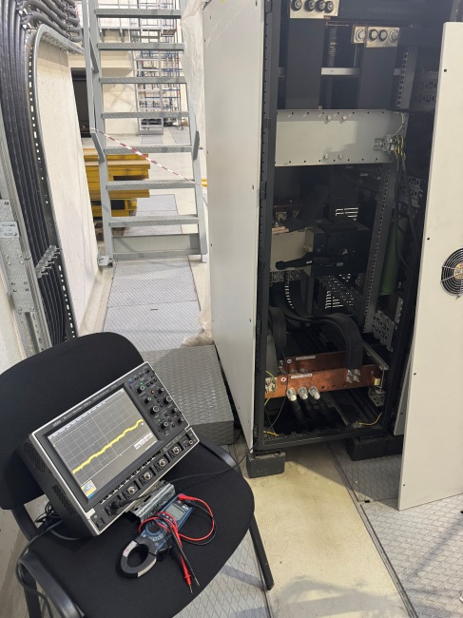
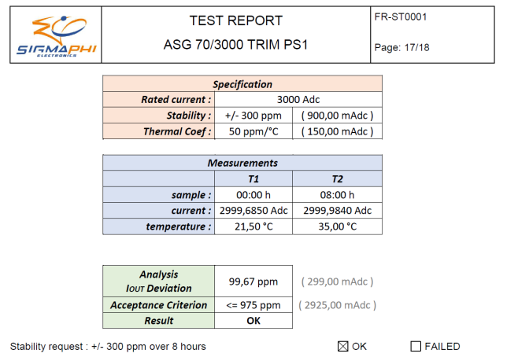
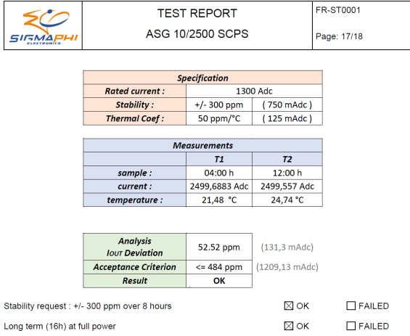
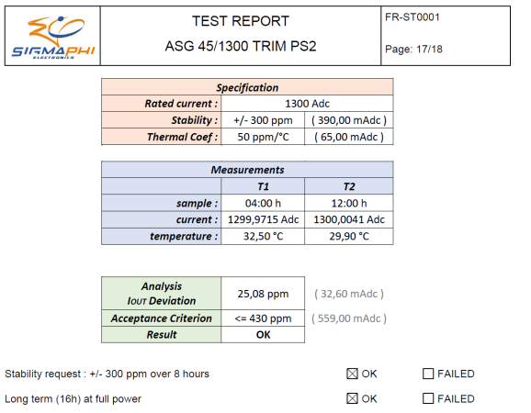
Stability test of power supplies
Power supply of TRIM1
I = 3000A V= 70V
Power supply of solenoid I = 2500A V= 10V
Power supply of TRIM2
I = 1300A V= 45V

Slide 11
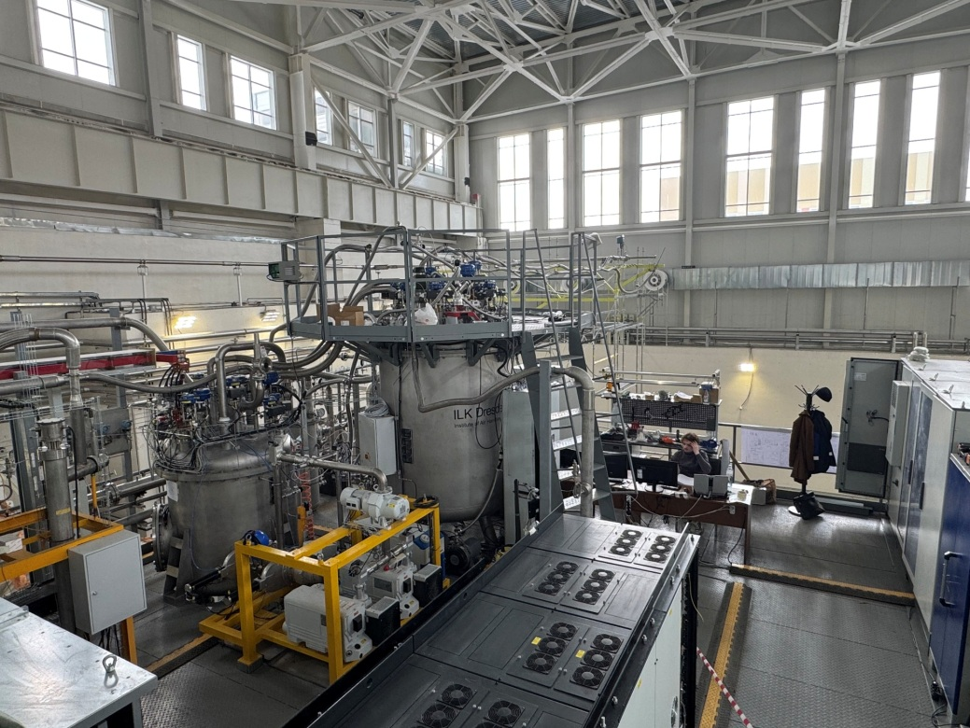
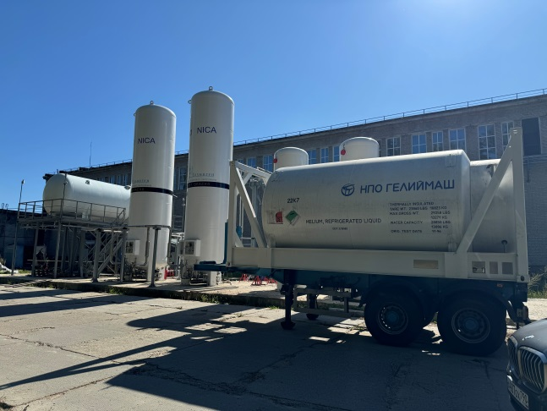
Cryogenic infrastructure
Control Dewar
Refrigerator
NTCS (Nitrogen temperature correction system)
LN2 and LHe heaters
LHe pipe
Cryogenic flexible connection pipes
LN2 Tanks (2 pc)
LHe Tanks (2 pc)
LN2 transfer pipe 120 m
Warm pipes for He, N2 and instrumentation Air
Flexible warm pipes
Support system for flexible pipes

Slide 12
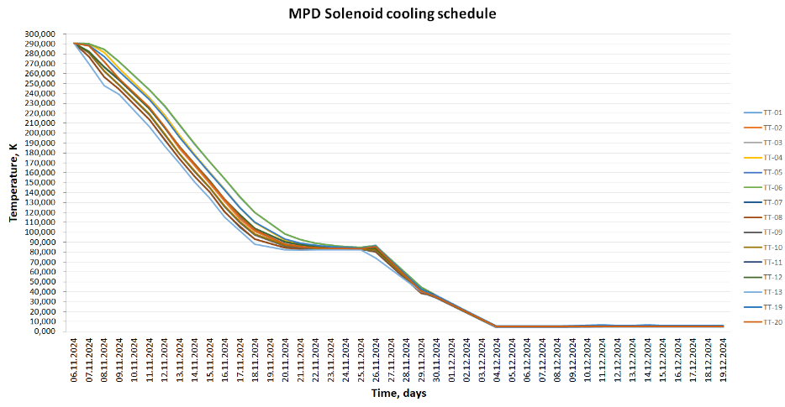
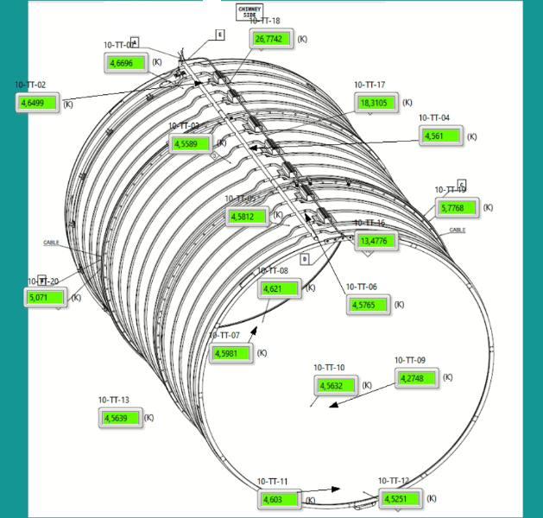
Cooling process scheduled
Total cooling time – 28 days
Nitrogen mode – 14 days
Transient mode – 6 days
Helium mode – 8 days

Slide 13
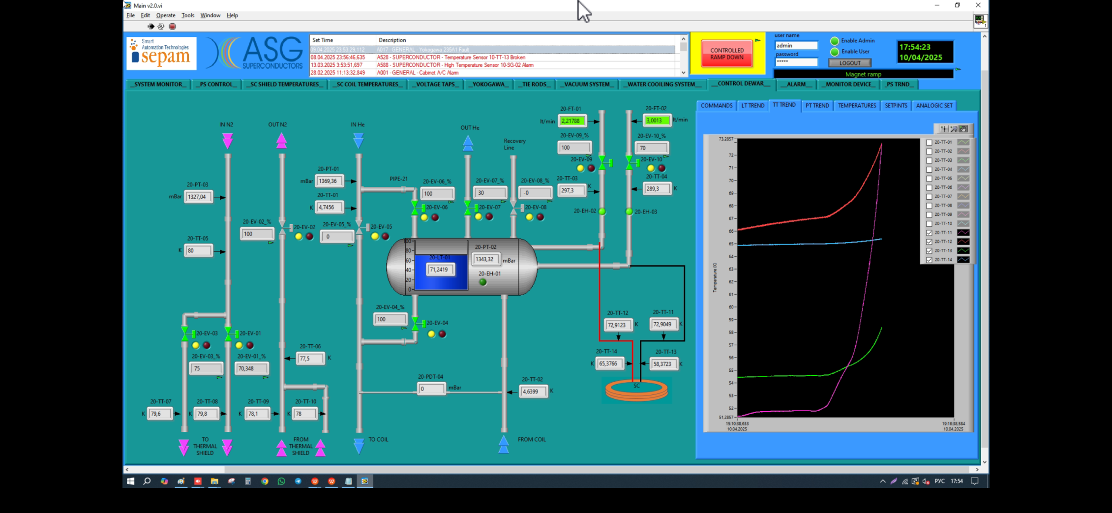
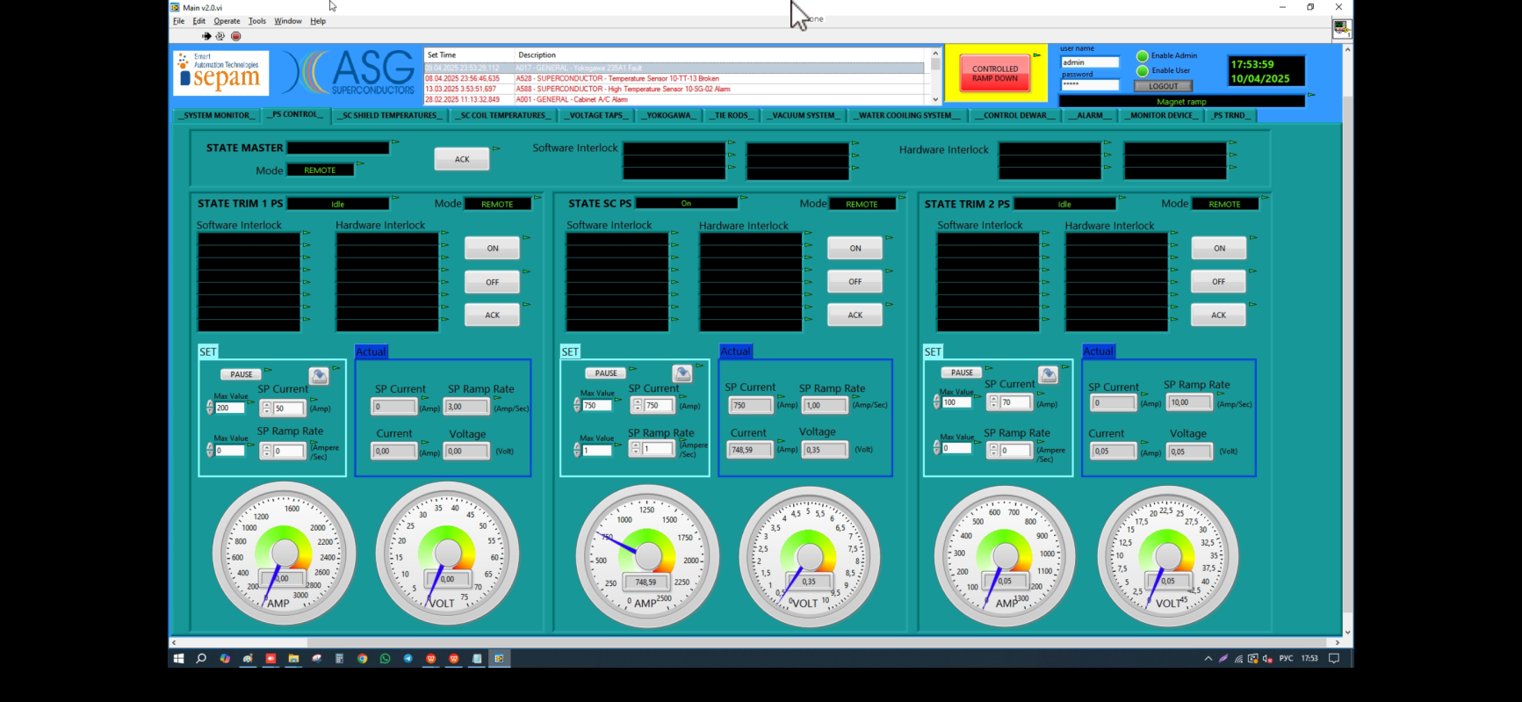
10/04/2025 current 750A (0,2 T)

Slide 14
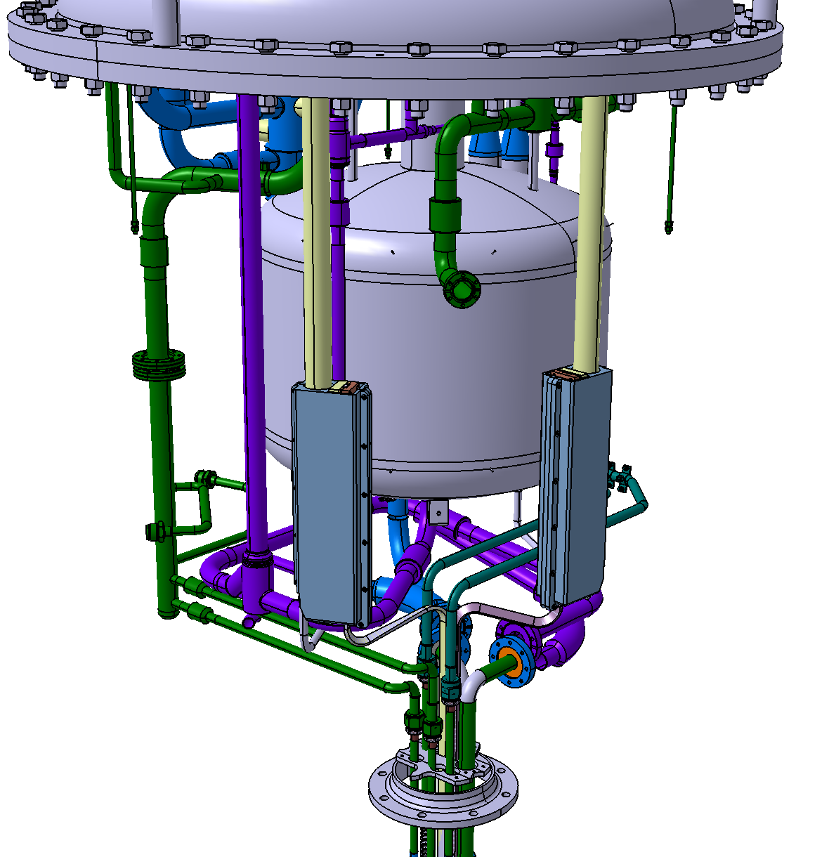
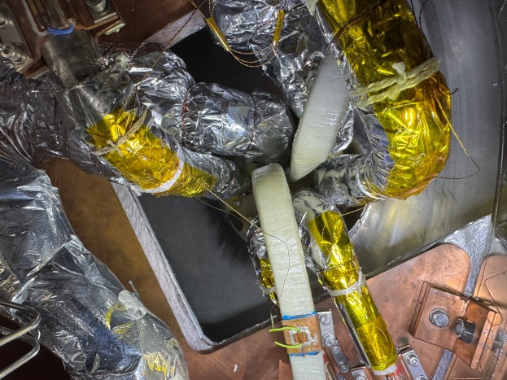
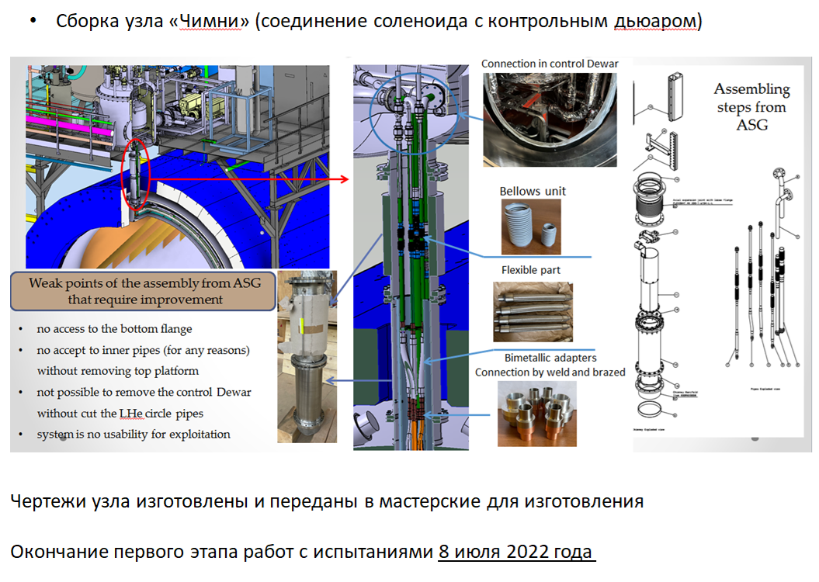
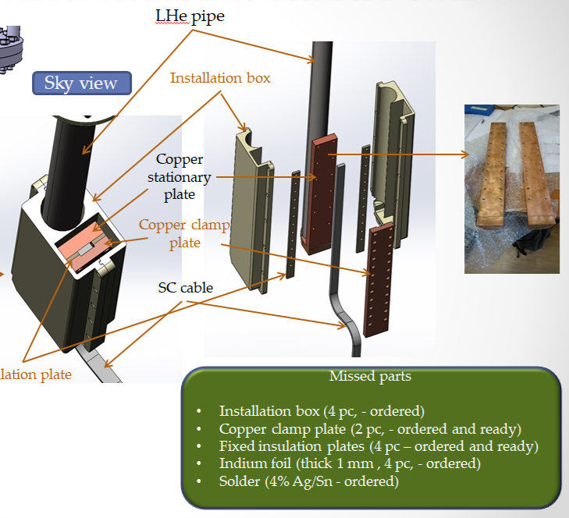
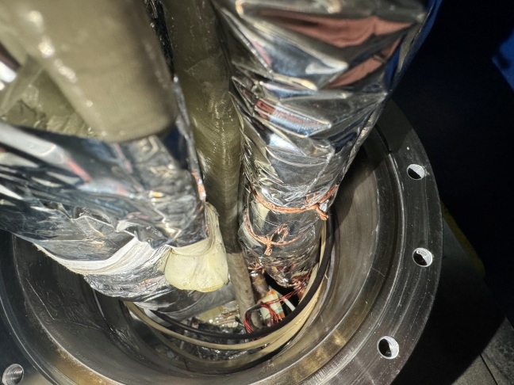
Superconductor cable, Dewar, chimney area
LHC 27 km
Chimney area assembling

Slide 15
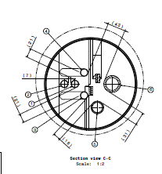
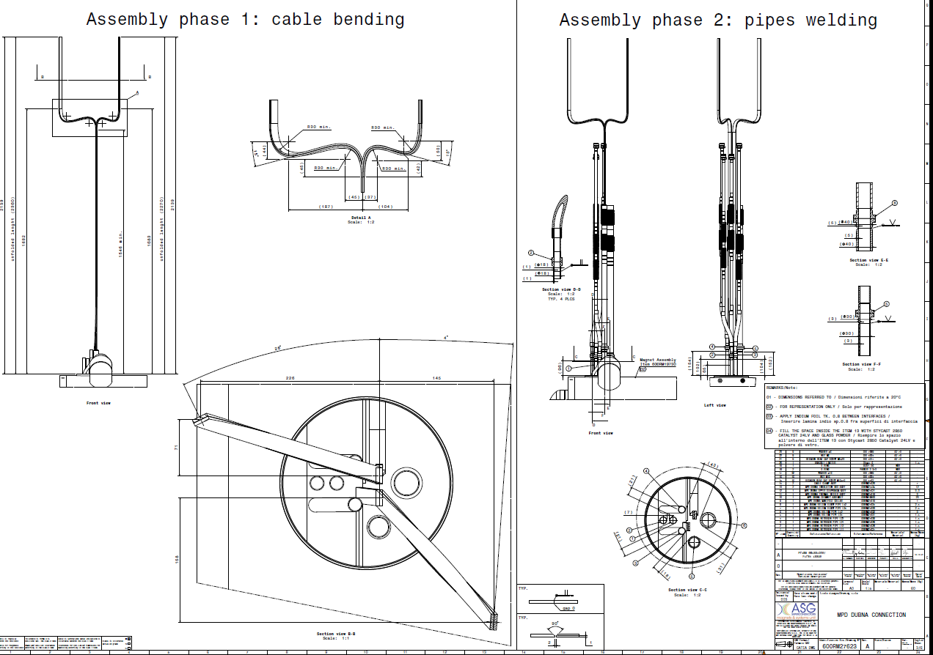
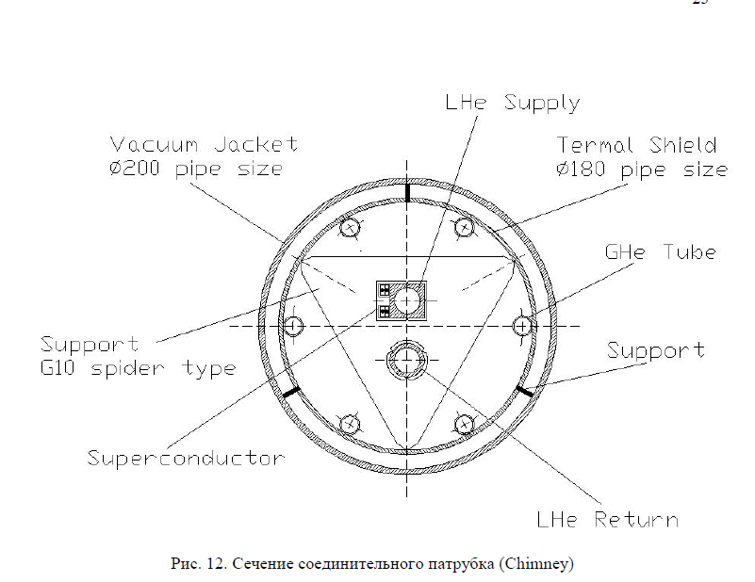
Chimney area
CS cable
No thermal contact to LH pipe
LH pipe have square cross-section for maximum contact with the CS

Slide 16
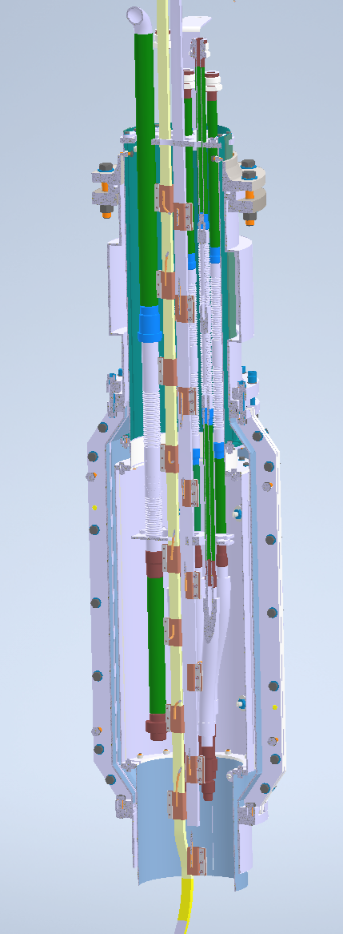
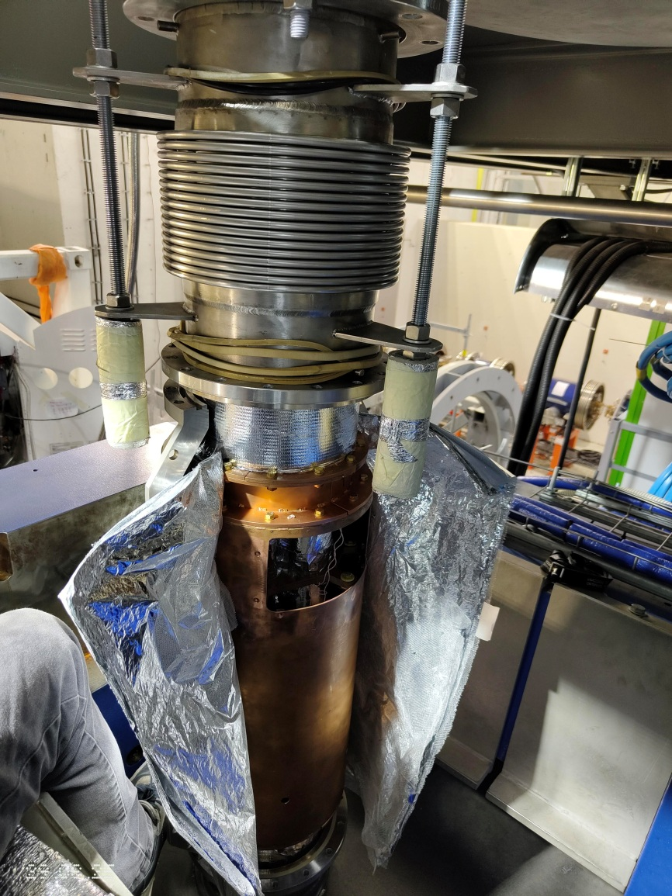






New chimney area

Slide 17




Additional temperature sensors in Dewar and chimney area

Slide 18





Additional temperature sensors 29/05/2025
Additional temperature sensors in chimney area
15, 14, 1, 18 – cernox temperature sensors
A, E – voltage taps sensors
- Positions of new temperature sensors

Slide 19




Chimney area
Touching SC cable of LHe manifold circle pipes on cold mass
It was lucky that the electrical insulation was not broken!
Available area
There are NO any supports
Mechanically fixation cable into control Dewar

Slide 20



Current 1050 A – 0,3 T (13/10/2025)
Current 1050A
0,3T
Current 0

Slide 21




SC cables connect to current leads into control Dewar
LHe pipe
Sky view
Installation box
Copper stationary plate
Copper clamp plate
SC cable
Insulation plate
SC cables

Slide 22






Current leads
Project by TS Neva magnet
Actual CL by ASG
Current lead test (ASG)
Electrical and thermal contact by 2 screw m6

Slide 23
Chapter 3 Field mapper

Slide 24




Stationary magnetic field monitors
Current 1050A

Slide 25






Field mapper in solenoid
From 06/10/2025 assembling and test in MPD solenoid
16/07/2025 test mapper in Novosibirsk
04/09/2025 mapper was delivered to MPD hall
26-27/10/2025
Measuring in one stationary point (730,6 A)

Slide 26

Timeline
For present day we ready to mapping magnetic field to 1050 A (0,3 T)
27/10/25 – 31/10/25 – test measurement 0,2 T
0,3 – 0,7/11/2025 – processing of results and determination of magnetic axis
10 – 12/11/2025 – mapping by correction current 0,2 T
12 – 24/11/2025 – processing of results and confirmation of homogeneity (3*10-4) by 0,2 T
0,1 – 12/12/2025 – mapping, processing of results and confirmation of homogeneity (3*10-4) by 0,3 T
15 – 19/12/2025 – calculations and presents of results a number of current to 0,25 T (homogeneity (3*10-4))
19-25/12/2025 – checking calculations and mapping the 0.25T field
25/12/2025 – 10/01/2026 – warming and open Dewar
10 – 25/01/2026 – modernization of current leads
26/01 – 12/02/2026 – cooling and current up
13/02 – 20/02/2026 – mapping 0,4 T (1400A) field by calculations from Novosibirsk group
20/02 – 28/02/2026 – mapping, processing of results and confirmation of homogeneity (3*10-4) by 0,5 T

Slide 27

Thank you for attention

