Slide 1



L2 hub current status: PCIe
Erofeev Dmitriy
12.09.2025

Slide 2
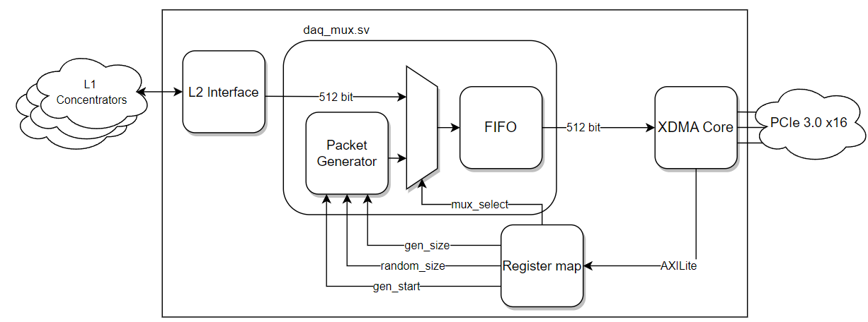
Variable-Length packet challenge
Figure 1 – Architecture of the L2 hub PCIe-Interface

Slide 3
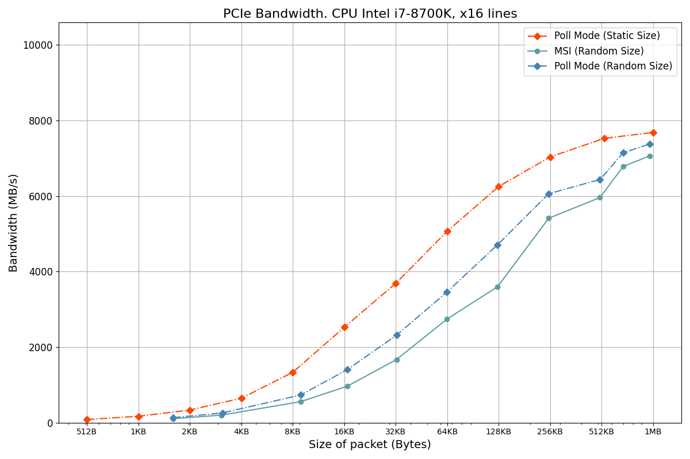
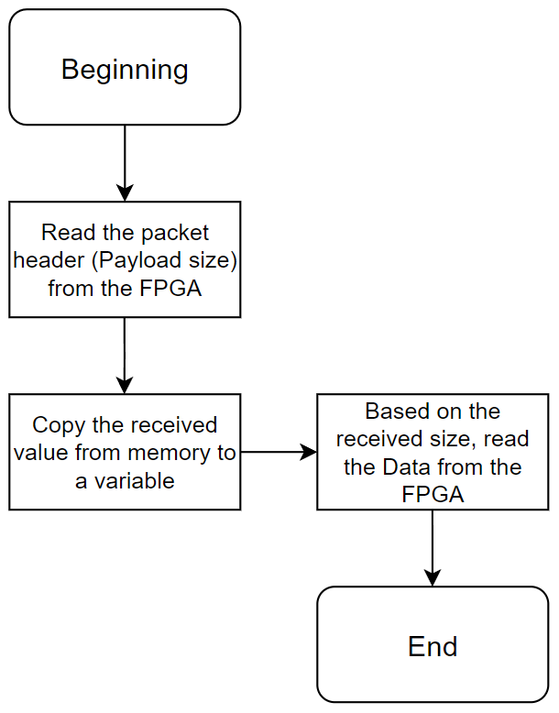
Throughput performance (bandwidth)
Figure 3 – Simplified API block-diagram for downloading Variable-Length packets
Figure 2 – Bandwidth PCIe 3.0 x16

Slide 4
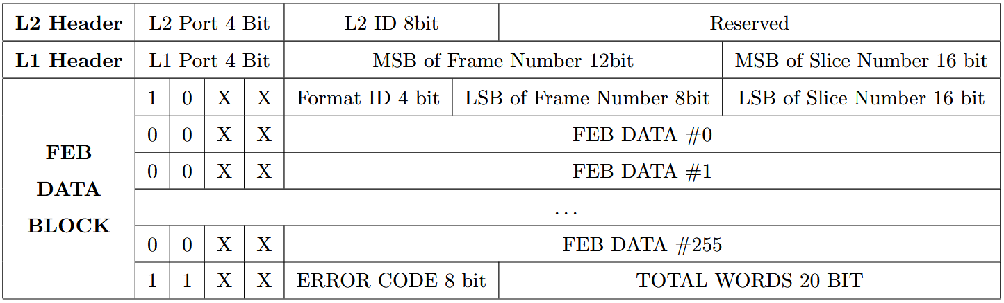
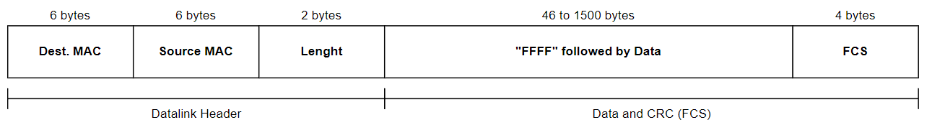
Data format
Figure 4 – Payload
Figure 5 – Ethernet 802.3 “raw”

Slide 5
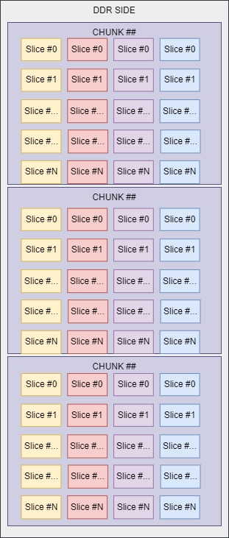
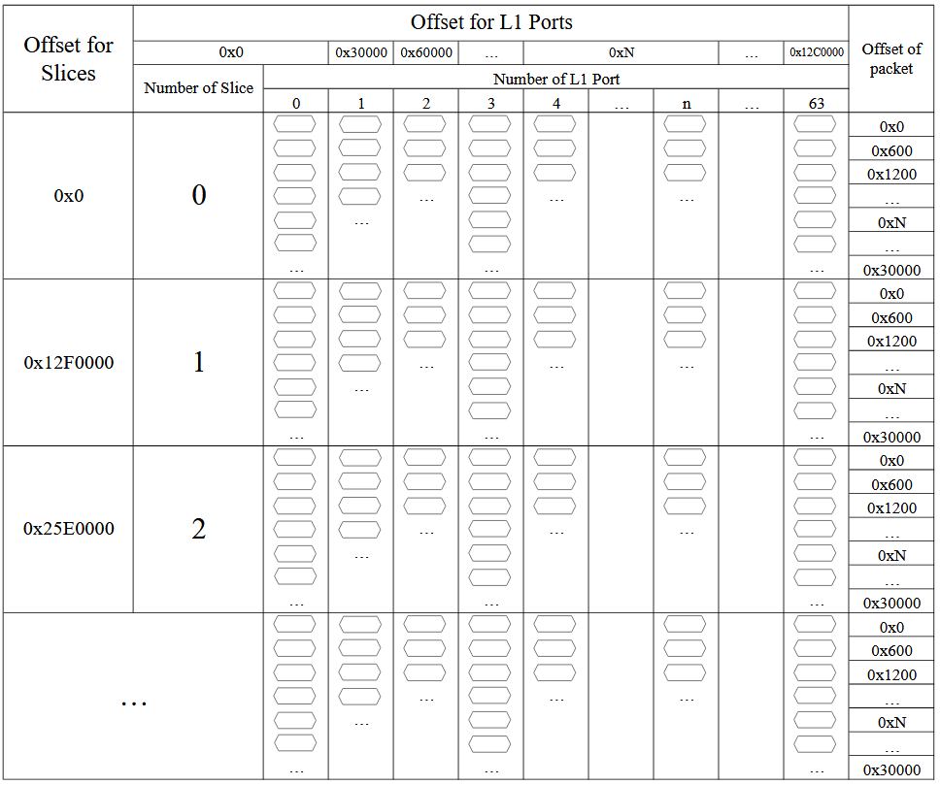
Data Clustering (Sorting)
Figure 6 – DDR memory markup

Slide 6
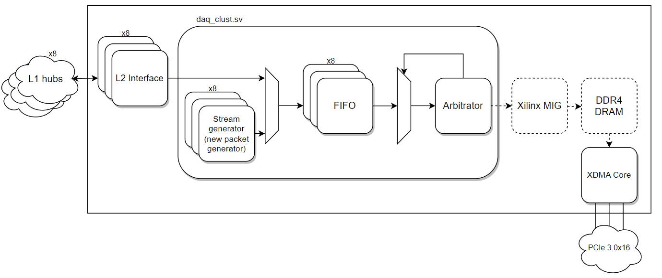
Data Clustering (Sorting)
Figure 7 – Architecture of the clustering (sorting) module prototype

