Slide 1

Advisory Board meeting, 16.09.2025

Slide 2
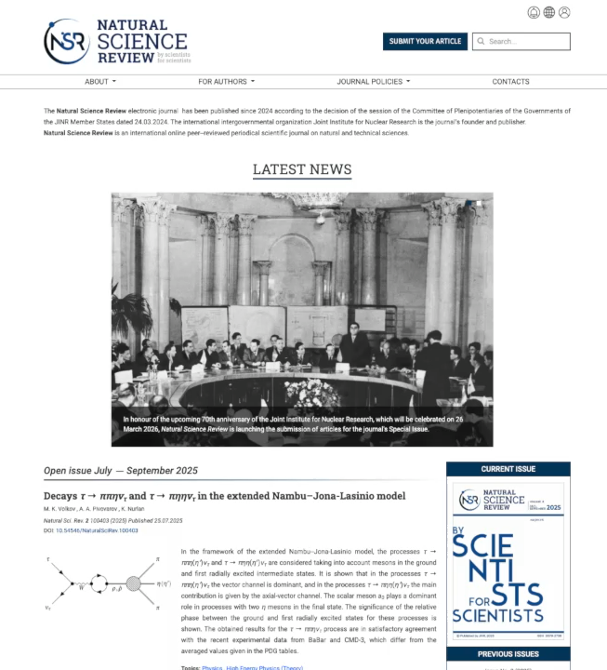
Website
- Since it’s an online journal, the website is of the greatest importance as the main way of communication between the authors, editors and reviewers
- OJS platform was chosen:
- Open-source software, site is hosted at MLIT JINR
- MLIT JINR personnel is involved in website development and support
- Articles are available in PDF as well as in HTML viewer on the website
- DOI is assigned to each paper automatically

Slide 3
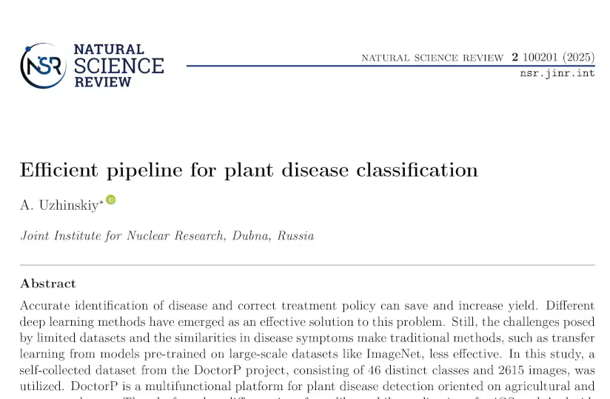
How it looks like: articles in pdf
- JINR Publishing Department works carefully with every accepted paper
- 1 week for copyediting and layout stage
- On practice it depends on paper size

Slide 4
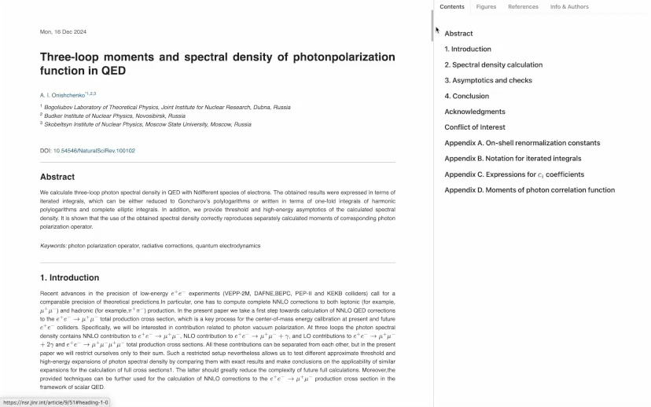
How it looks like: articles in HTML viewer

Slide 5
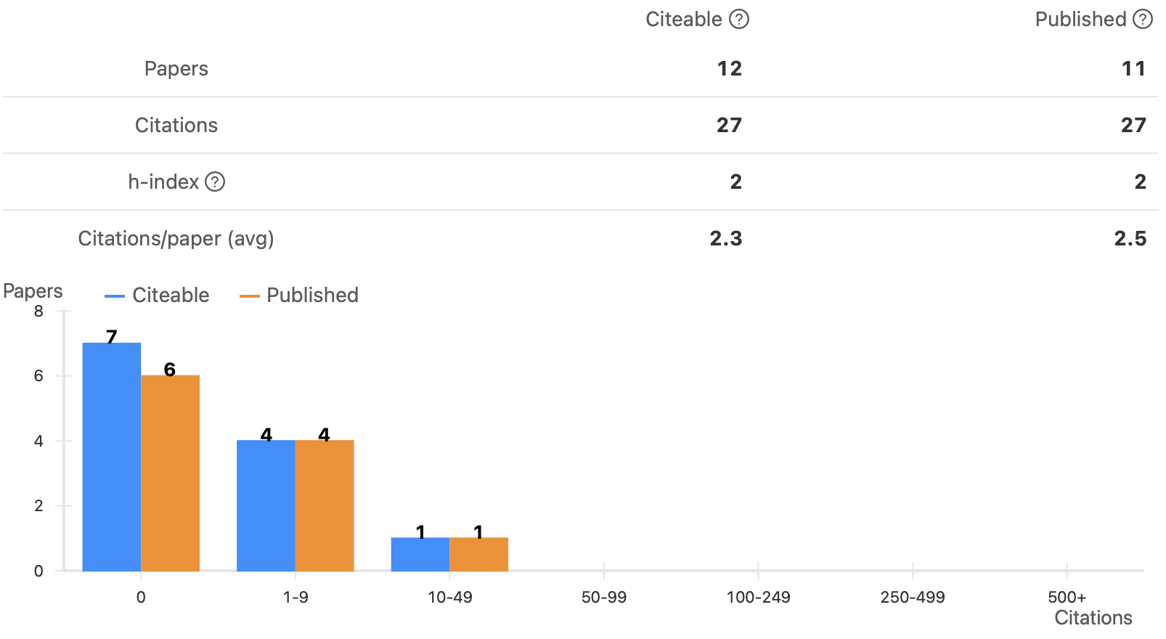
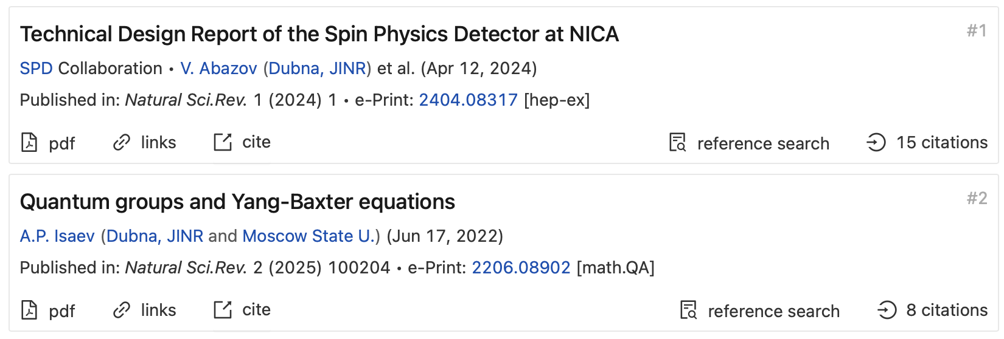
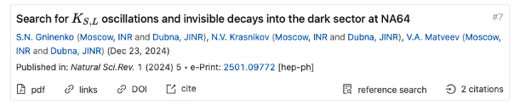
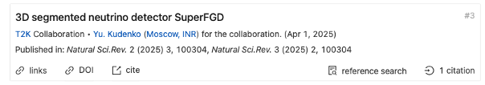
Content statistics
- 19 published papers at the moment in total
Some papers already got citations (according to InspireHEP statistics that is indexing only some parts of physics)

Slide 6
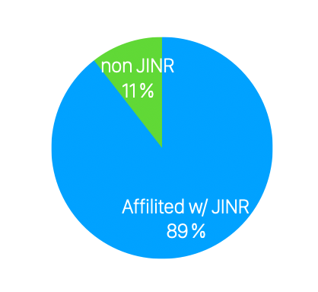
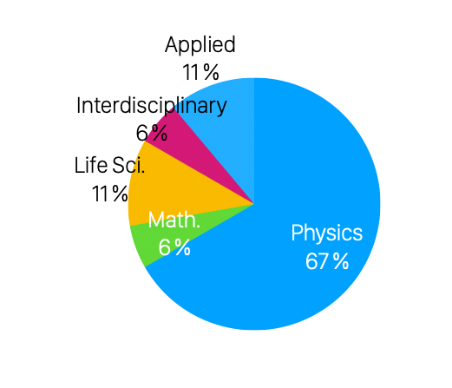
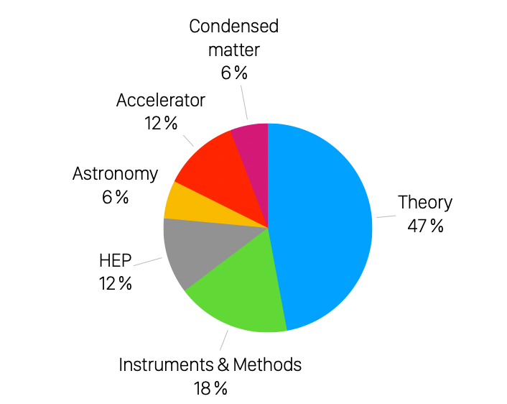
Content statistics
- 19 published papers at the moment in total
- Will not be considered in any statistics:
- 6 papers currently under review
- 5 declined papers
- Takeaways:
- Most of the papers are affiliated with JINR
- Understandable but not good for upcoming application to Scopus
- Majority of papers belong to Physics category
- Among these physics papers most of the works are in Theory subcategory
- Given that journal is interdisciplinary more papers from other natural science categories will be better
NB: some papers belong to several categories

Slide 7
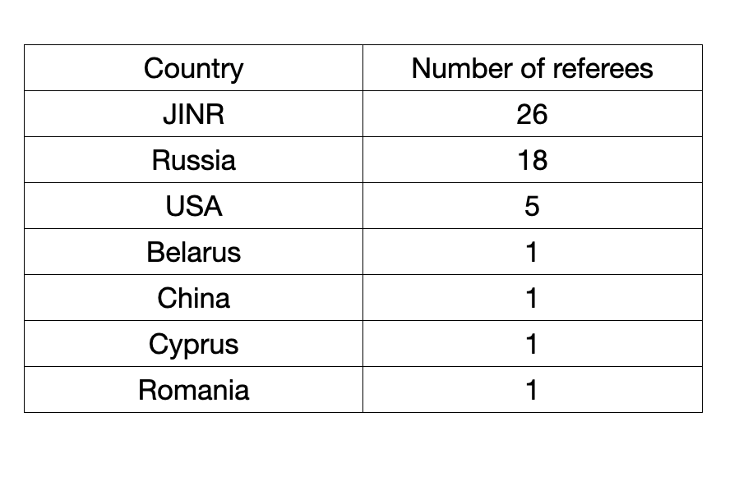
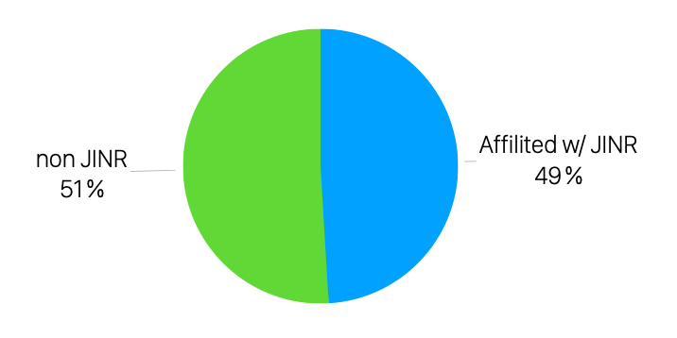
Paper reviewing statistics
Based on
- 19 published papers (two positive reviews required for a paper)
- 6 papers currently under review (consider here only those that got review)
- 5 declined papers (those reached reviewing stage)
Summary:
- We’re trying to expand the geography of reviewers (when possible) as one more way to promote the journal
- But reviewer’s best scientific match with the paper theme is a priority

Slide 8
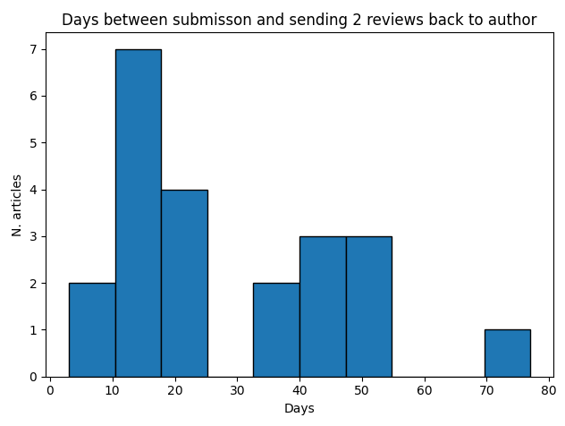
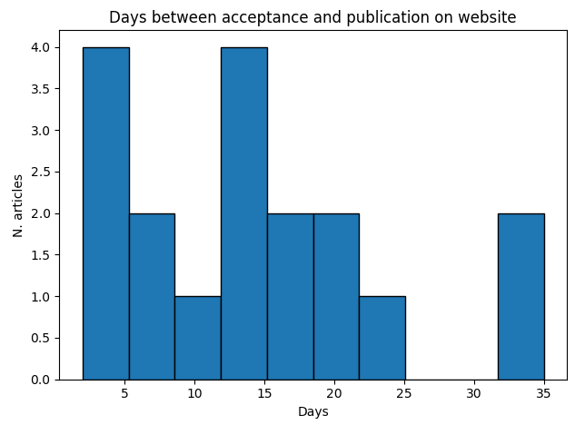
Timeline statistics
- 2 weeks for the first round of review in policies
(but the good quality of review is a priority)
- Copyediting and layout is declared to take 1 week
- On practice, based on 19 published papers, statistics is the following (plots on the right)
- Median: 20 days for the 1st round of review
- Median: 14 days for a paper to be published on the website
after being accepted for publication
Conclusions:
- The timeline depends heavily on the number of pages in the article
Reminder: 19 published papers on 808 pages in total
- We plan to reformulate more clearly the promised timeline in journal policies, e. g. 2 weeks for reviewing makes sense for short articles

Slide 9
Plans
The next big goal is to submit an application in 2026 to be indexed in Scopus and WoS
  The only obstacle is the geography of editors and authors
Meanwhile a big challenge in a good sense will be a special issue dedicated to JINR’s anniversary in 2026
  A lot of invitations were sent to prepare scientific papers on various remarkable topics related
  to the JINR scientific achievements over the last 70 years
  Articles from the JINR Member States are very welcome and absolutely necessary for completeness
We plan to apply to the Russian “White list” of the scientific journal database (ВАК/Белый список/ЕГПНИ) as soon as this opportunity will be available
We omit here a variety of our internal short and medium-term goals on stable website operation, policies etc. improvements. We do these small steps everyday
Our ultimate goal is to create a very good academic journal specializing in natural and technical sciences
  That means we have to publish many good articles
This is a marathon, the result will be clear only in ~5 years

Slide 10
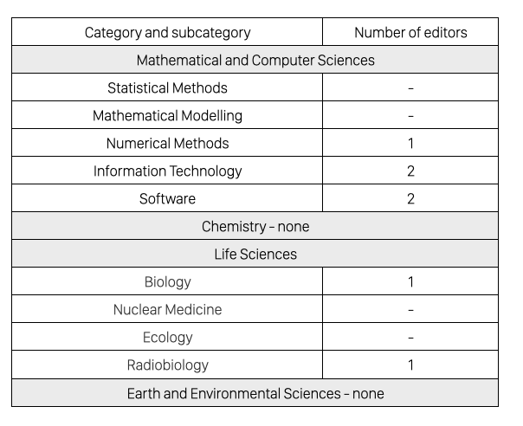
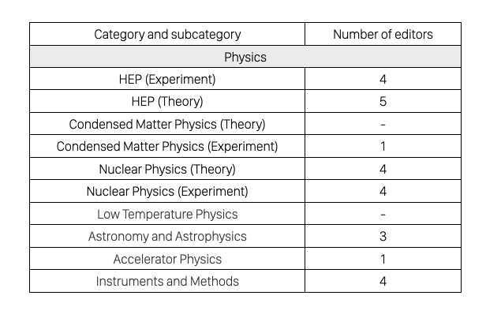
Pain points and limitations
- We need more papers from different countries and different organizations, that will be the main thing for Scopus judgement
- According to Scopus rules it would be better if editors were from different organizations and different countries
- So far, out of 17 people in the Editorial Board, 14 are from JINR
- For stable work we need at least 2 editors per topic

