Slide 1

3D hit reconstruction in the End-Cap
resolution

Slide 2




Contents
End-Cap geometry
Tg plane construct / intersect
Resolution
Conclusions + Next

Slide 3



Contents
End-Cap geometry
Tg plane construct / intersect
Resolution
Conclusions + Next

Slide 4
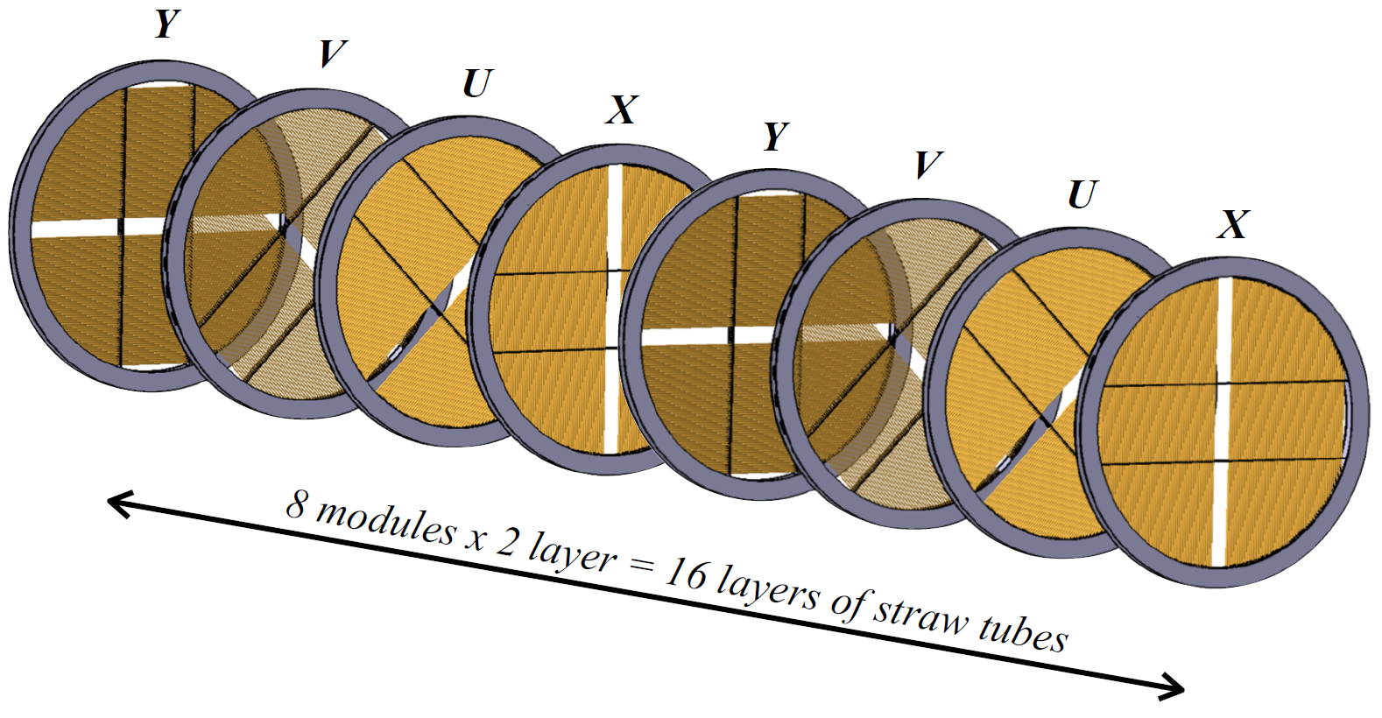
Geometry
End Cap
8 double-layers
pair
double-hit upstream + double-hit downstream = 3D hit
@ good angle difference
=> intrinsic resolution = good

Slide 5
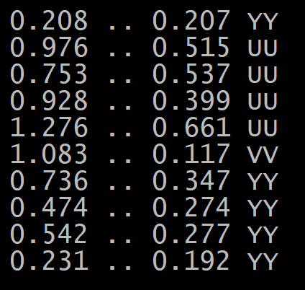
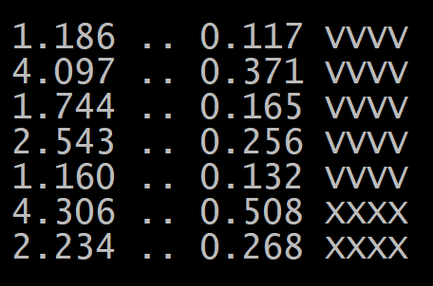
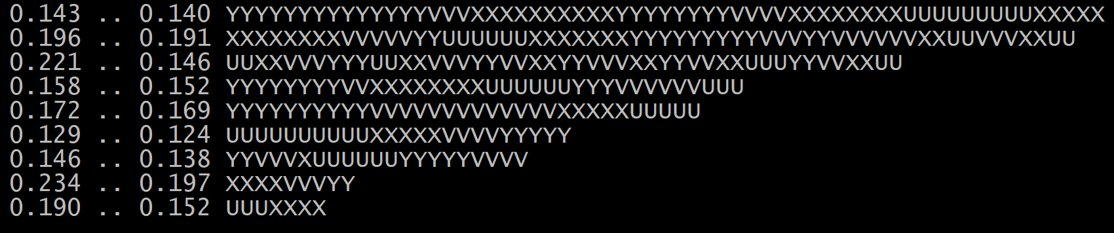
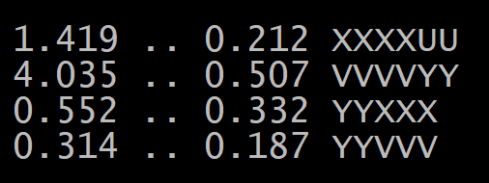
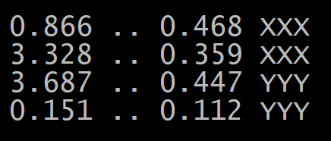
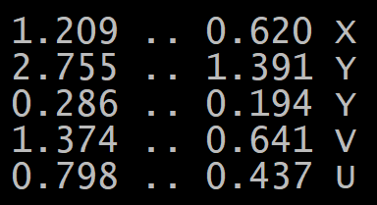
Selection
Track selection
p > 0.1 GeV/c
p⊥ > 0.1 GeV/c
weed out weird End-Cap tracks

Slide 6

Contents
End-Cap geometry
Tg plane construct / intersect
Resolution
Conclusions + Next

Slide 7
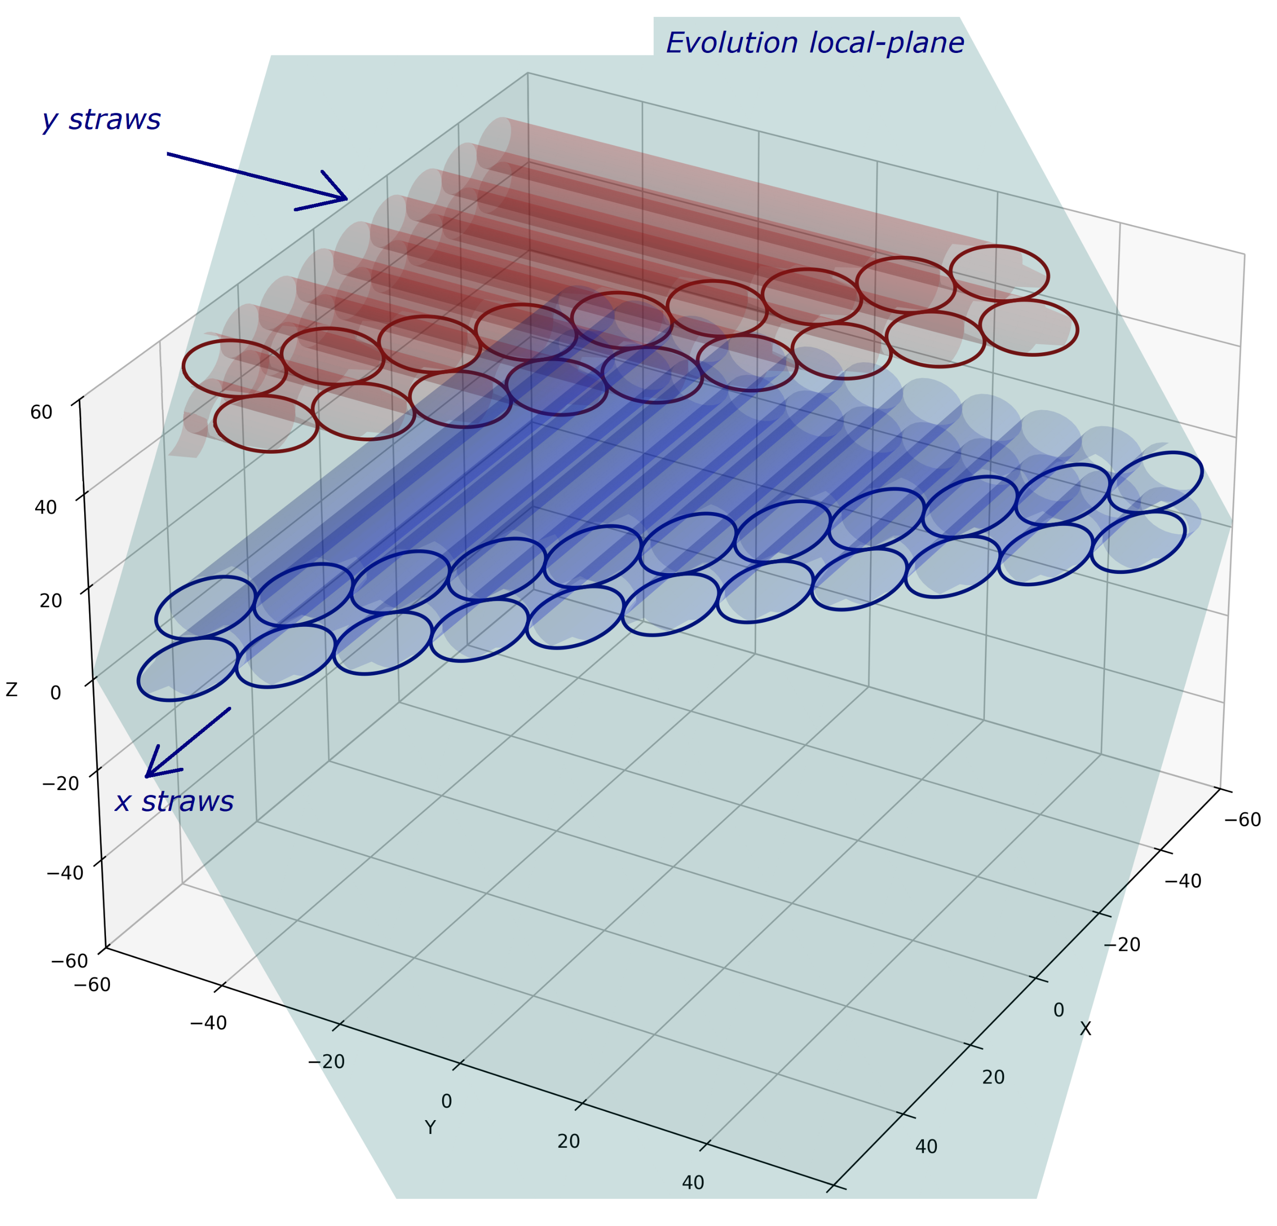

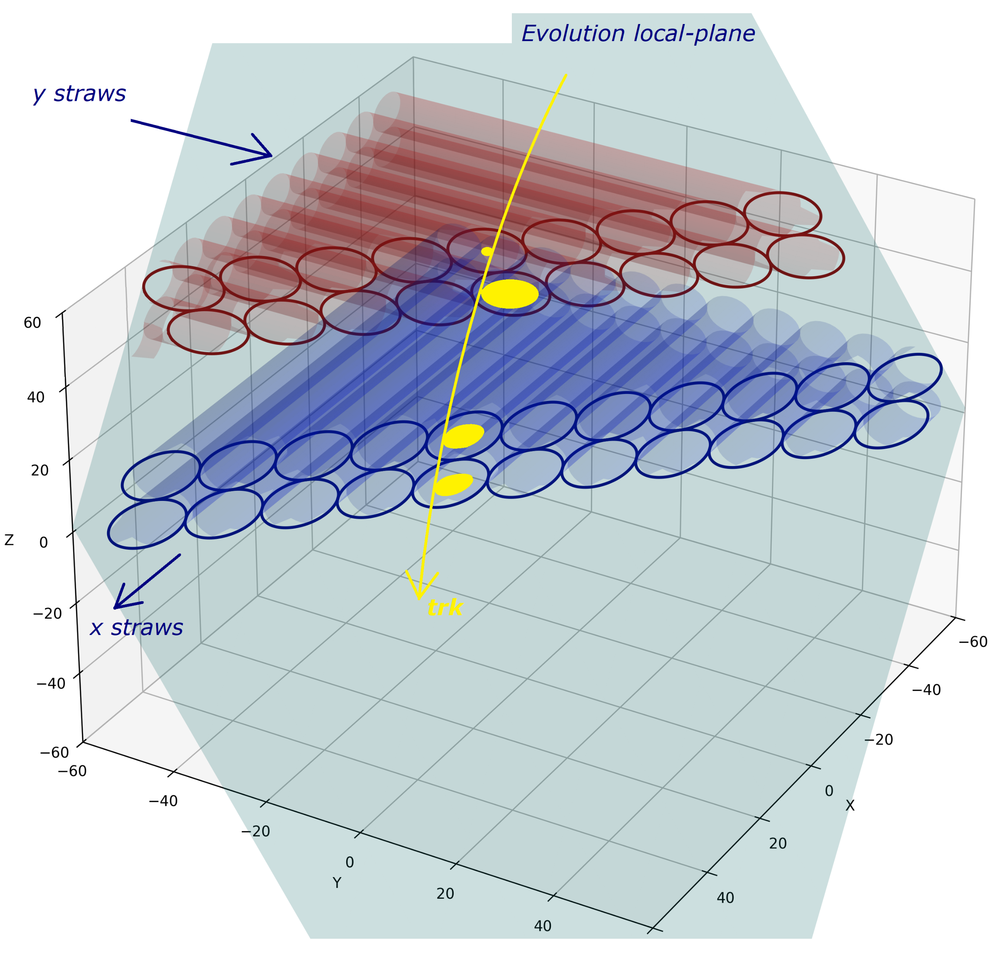
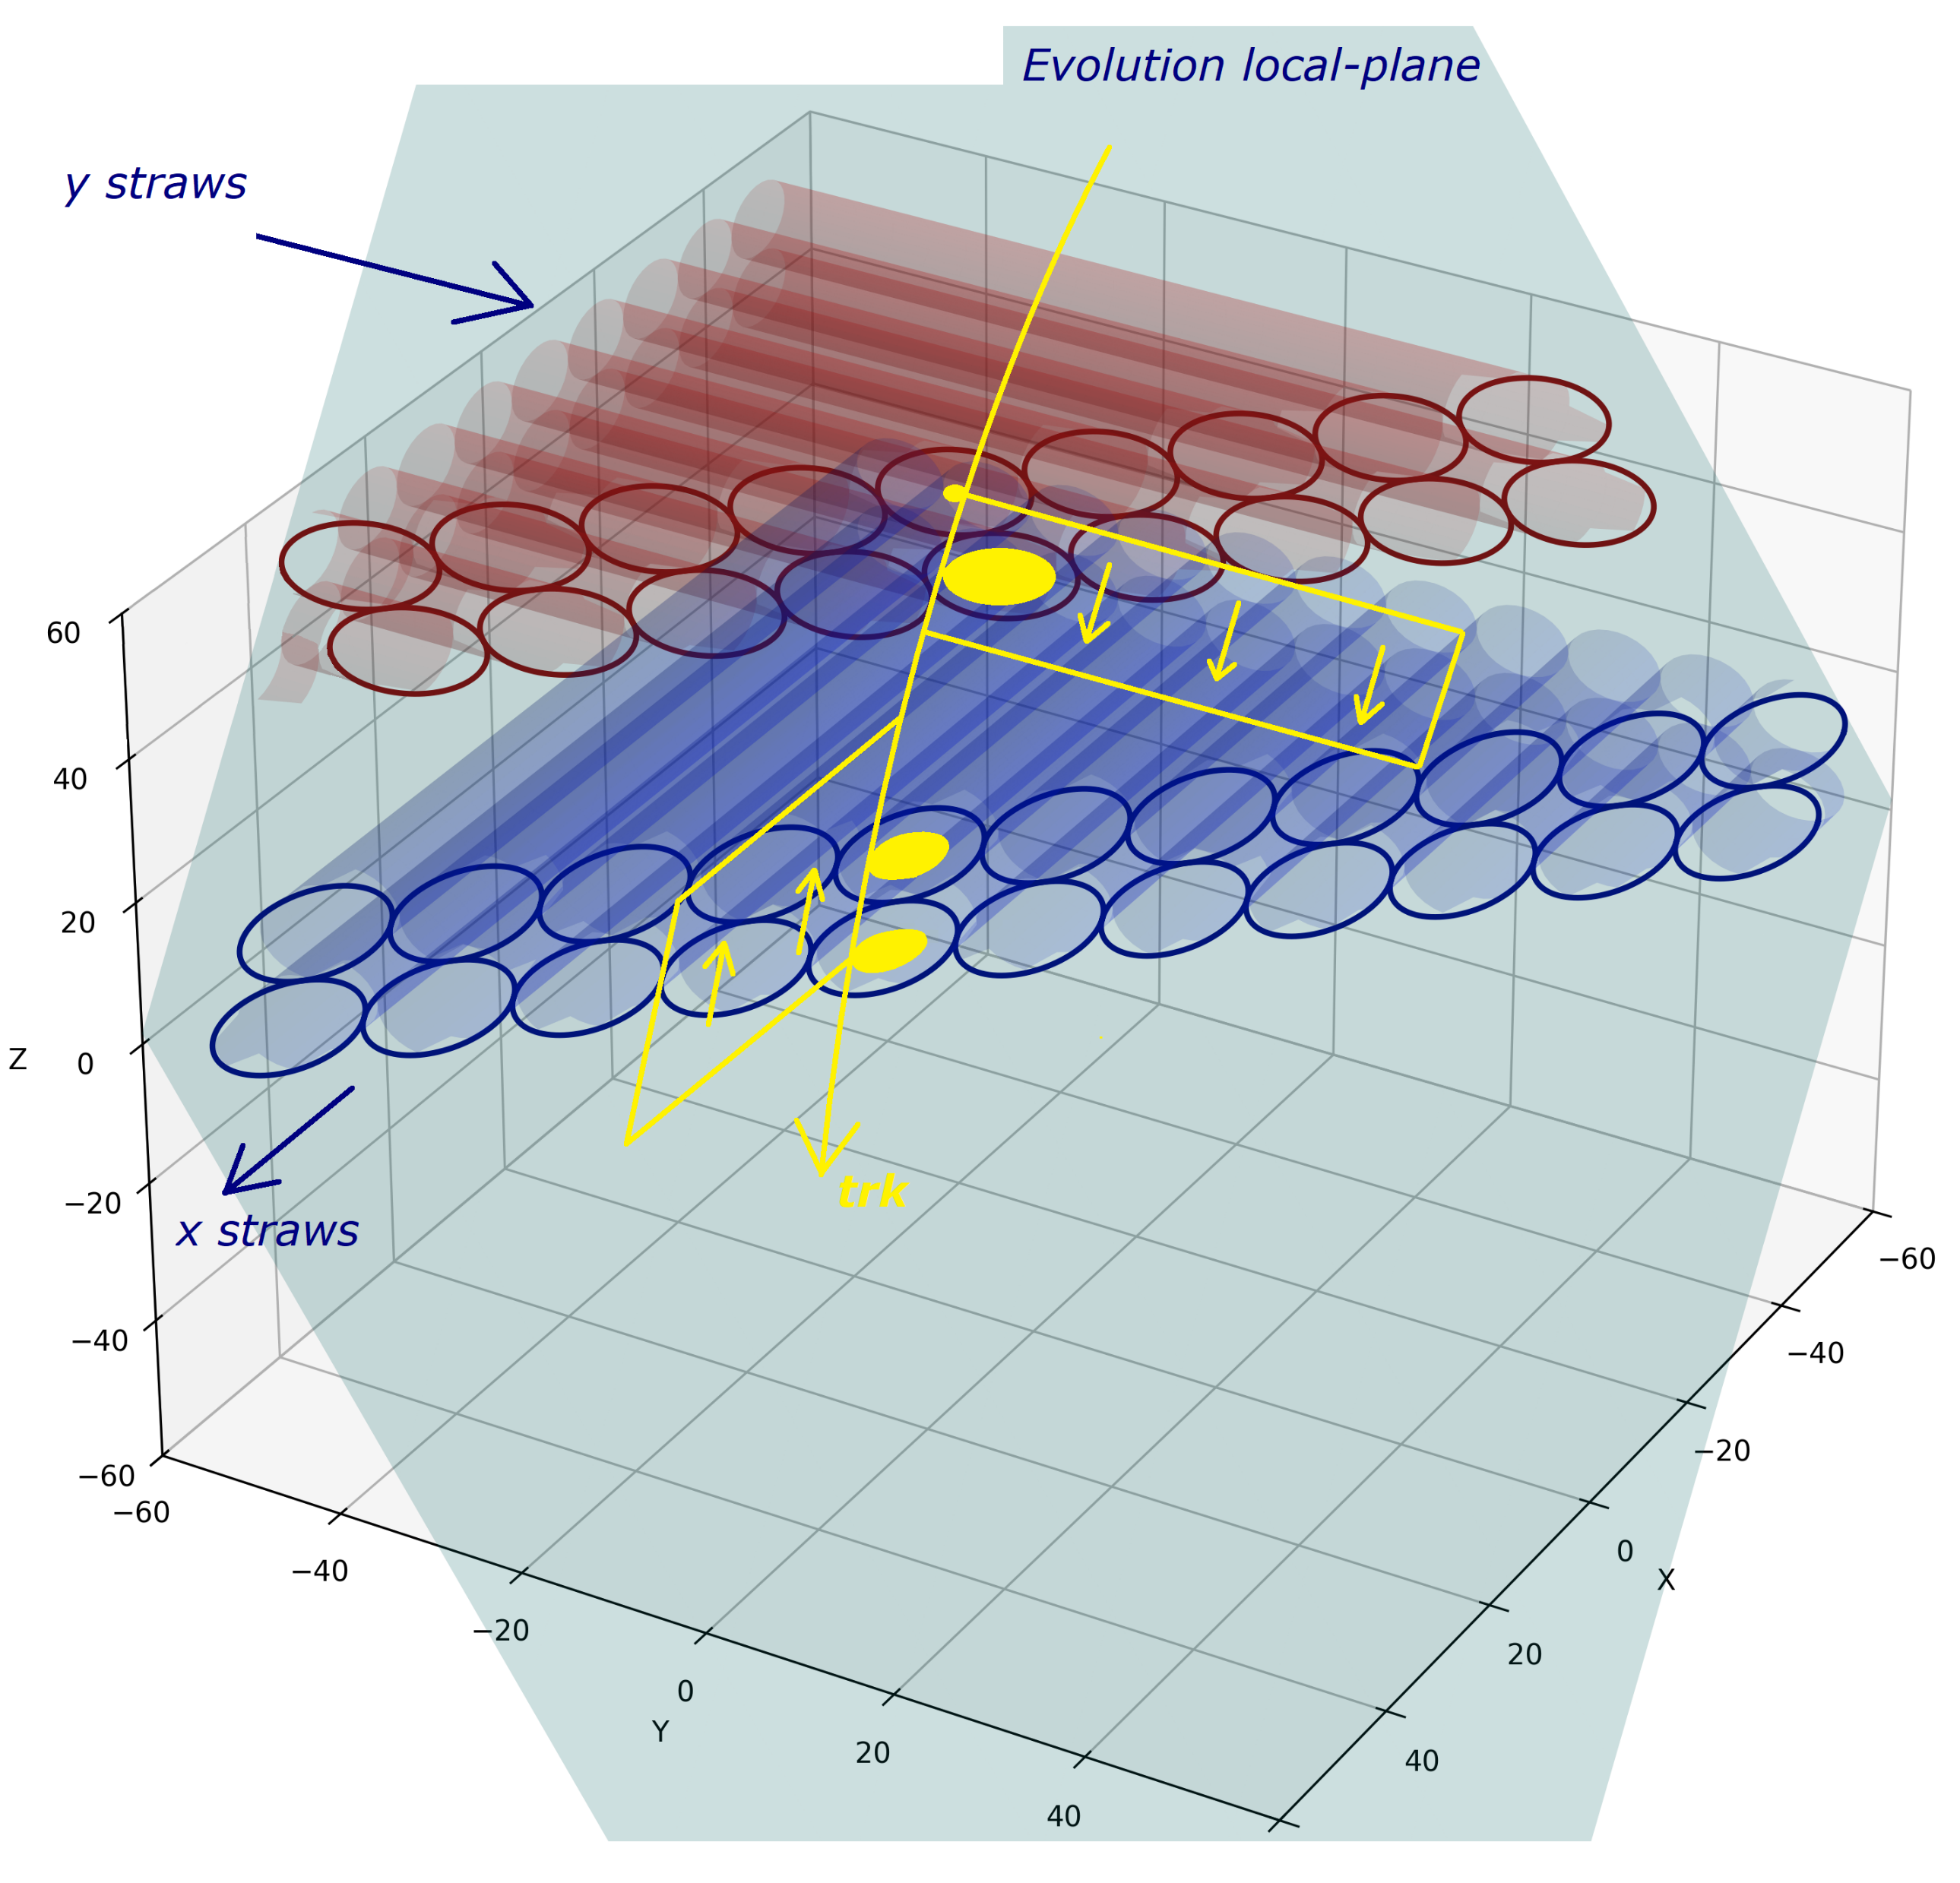


Reco method

Slide 8
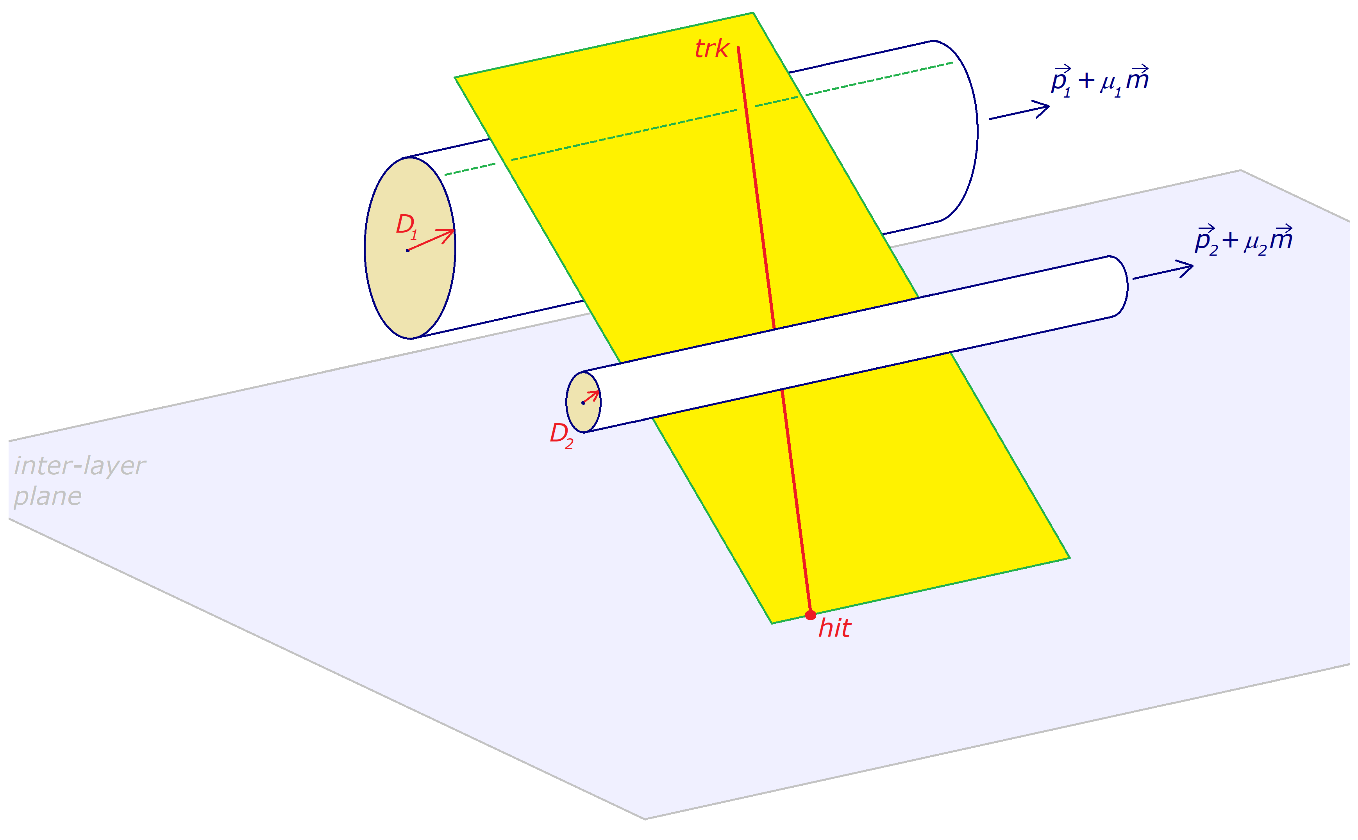
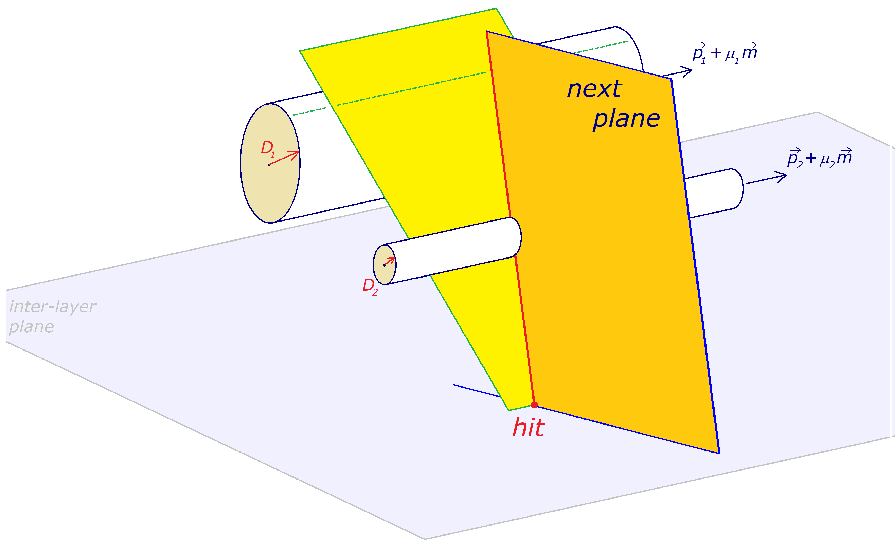
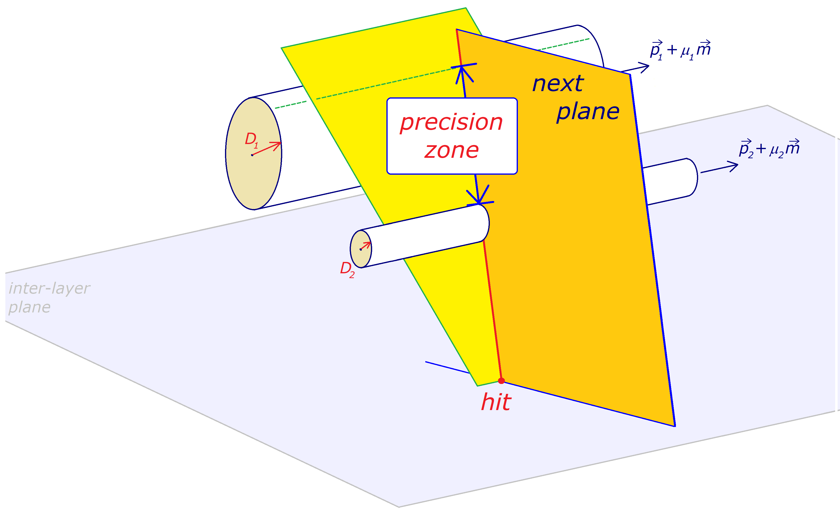
Reco procedure
compute hit in:
- precision zone, or
- inter-layer plane ?

Slide 9
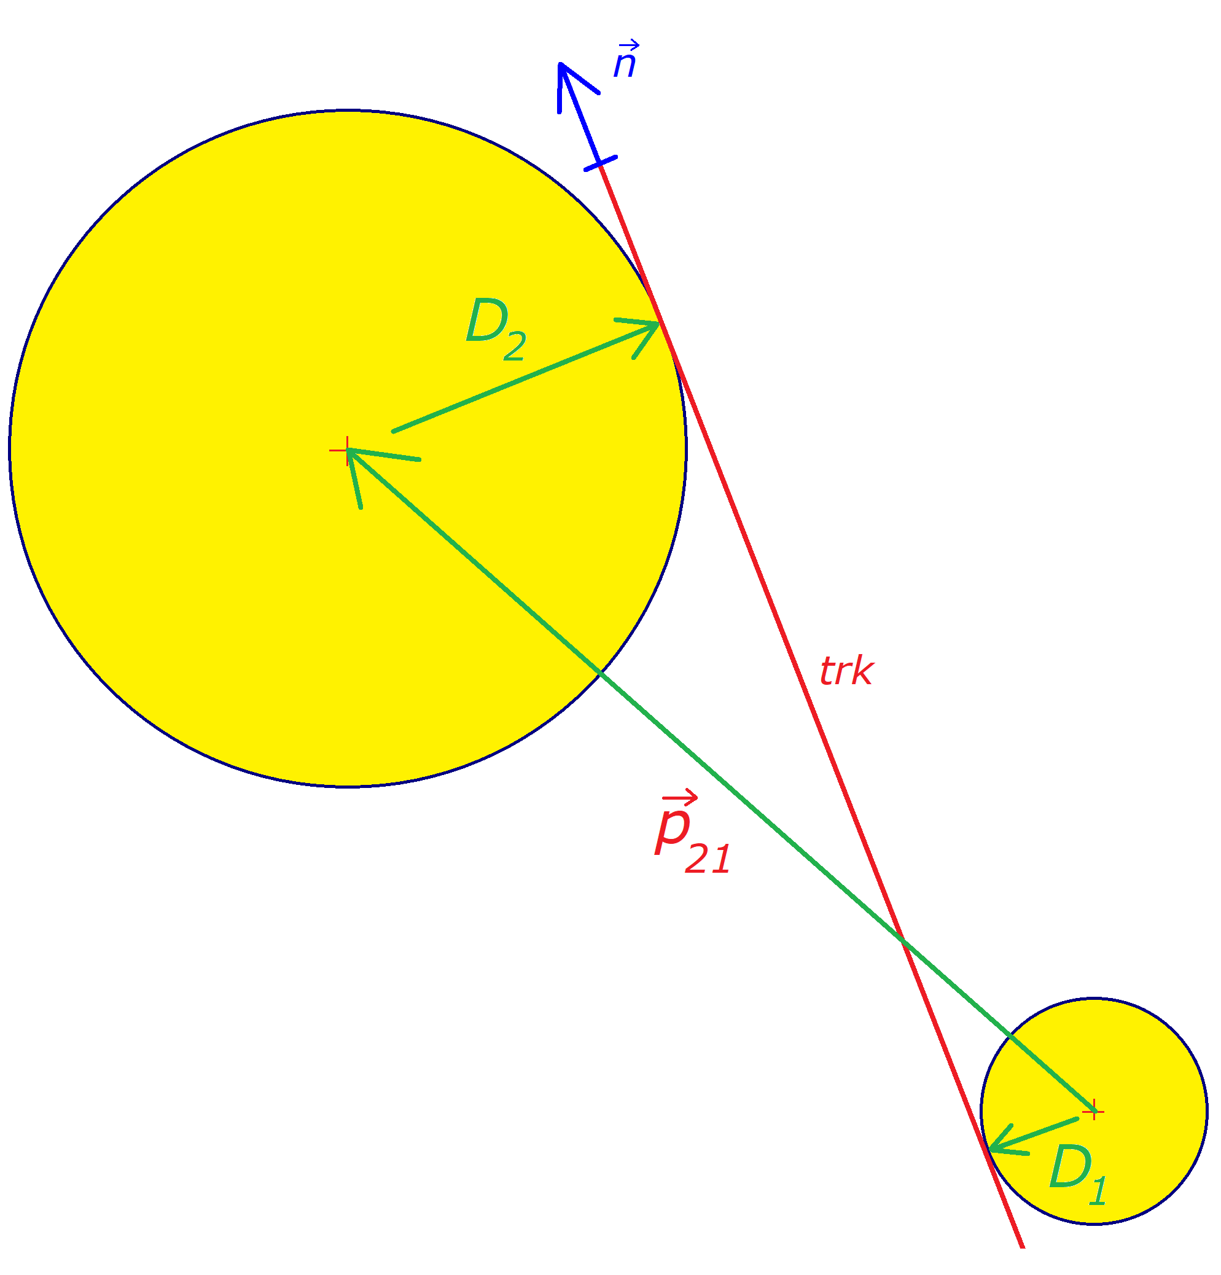
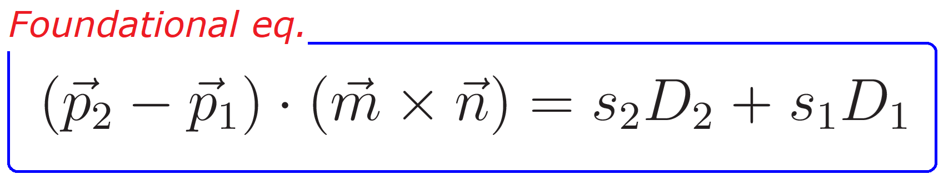
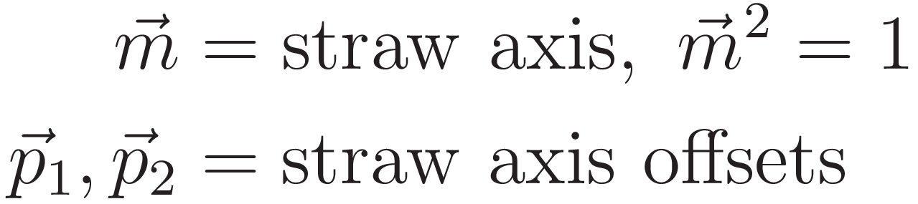
Tangent planes
Plane ⊥ to straw

Slide 10
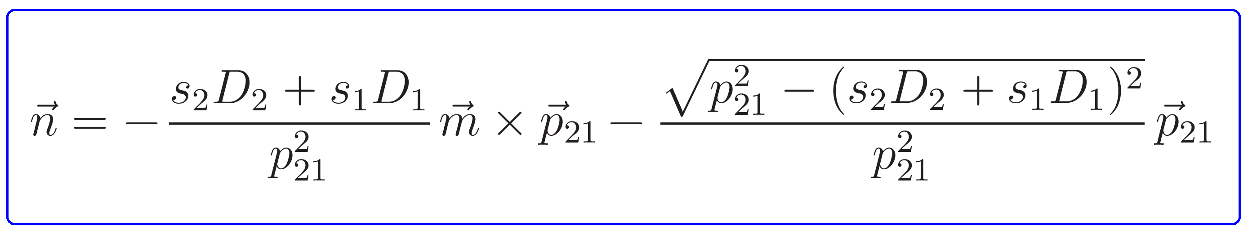
Tangent planes
Solution
4 solutions, for:
s₁ = s
s₂ = ss’
s = ±1, side
s’ = ±1, cross/straight

Slide 11
Contents
End-Cap geometry
Tg plane construct / intersect
Resolution
Conclusions + Next

Slide 12
Resolution
How to calculate
Reco point = ?
reco = 3D line
what to do with it ?
for now: make 3D point @ mid-plane
refine this later
MC point = ?
for now: (upstream_{last} + downstream_{first} ) / 2
refine this later
take difference & plot

Slide 13
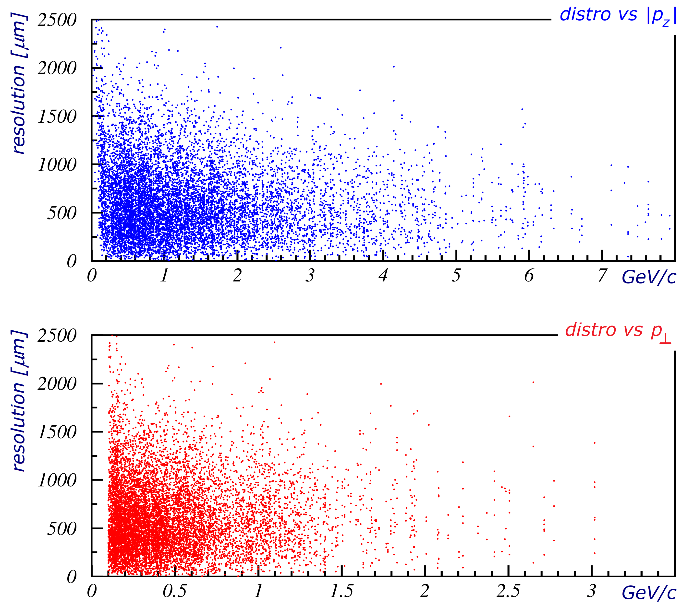
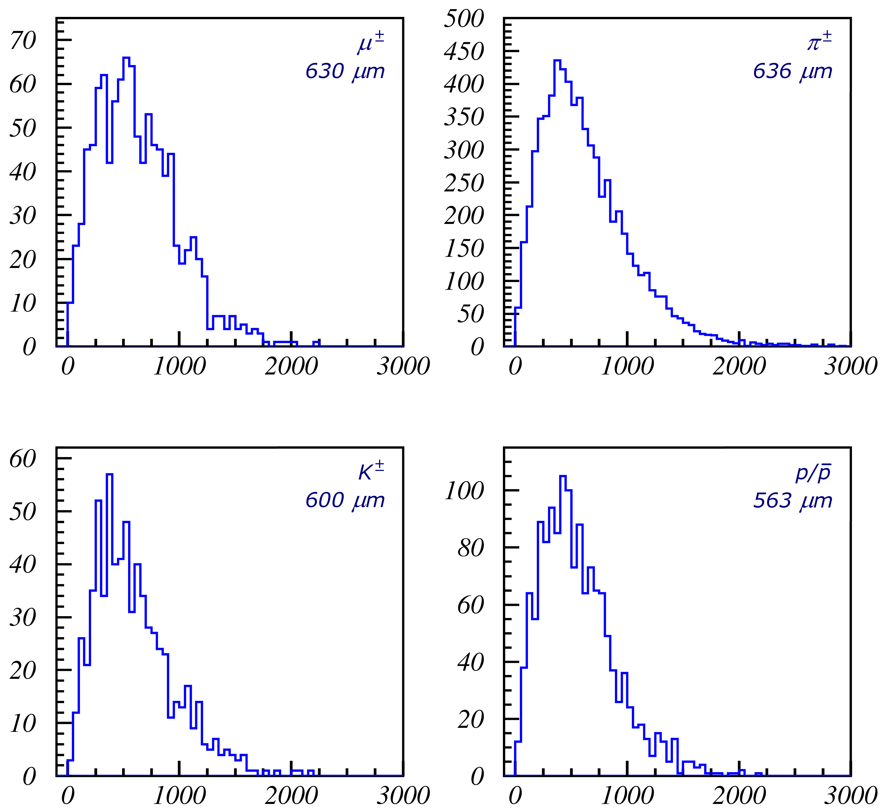
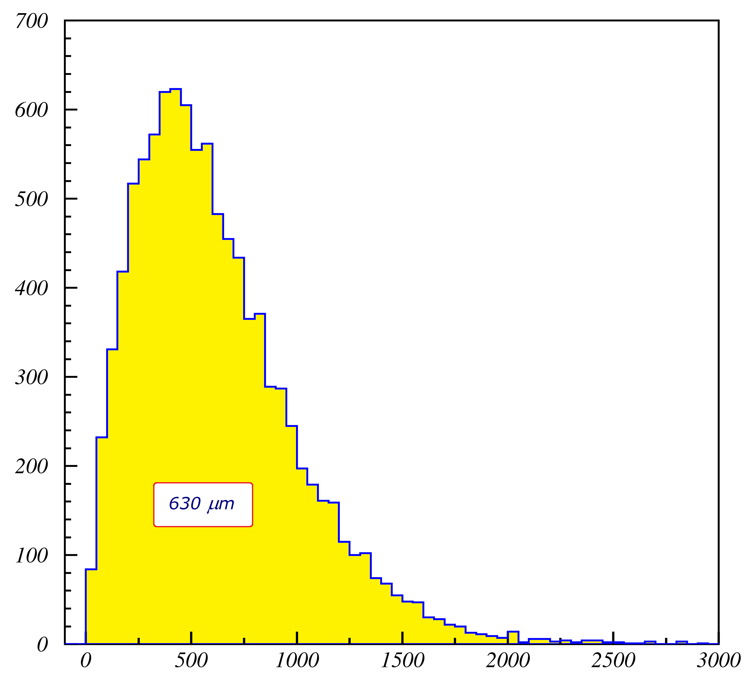
Resolution
Preliminary
- need to refine
MC “hit” = ?
Reco “hit” = ?

Slide 14
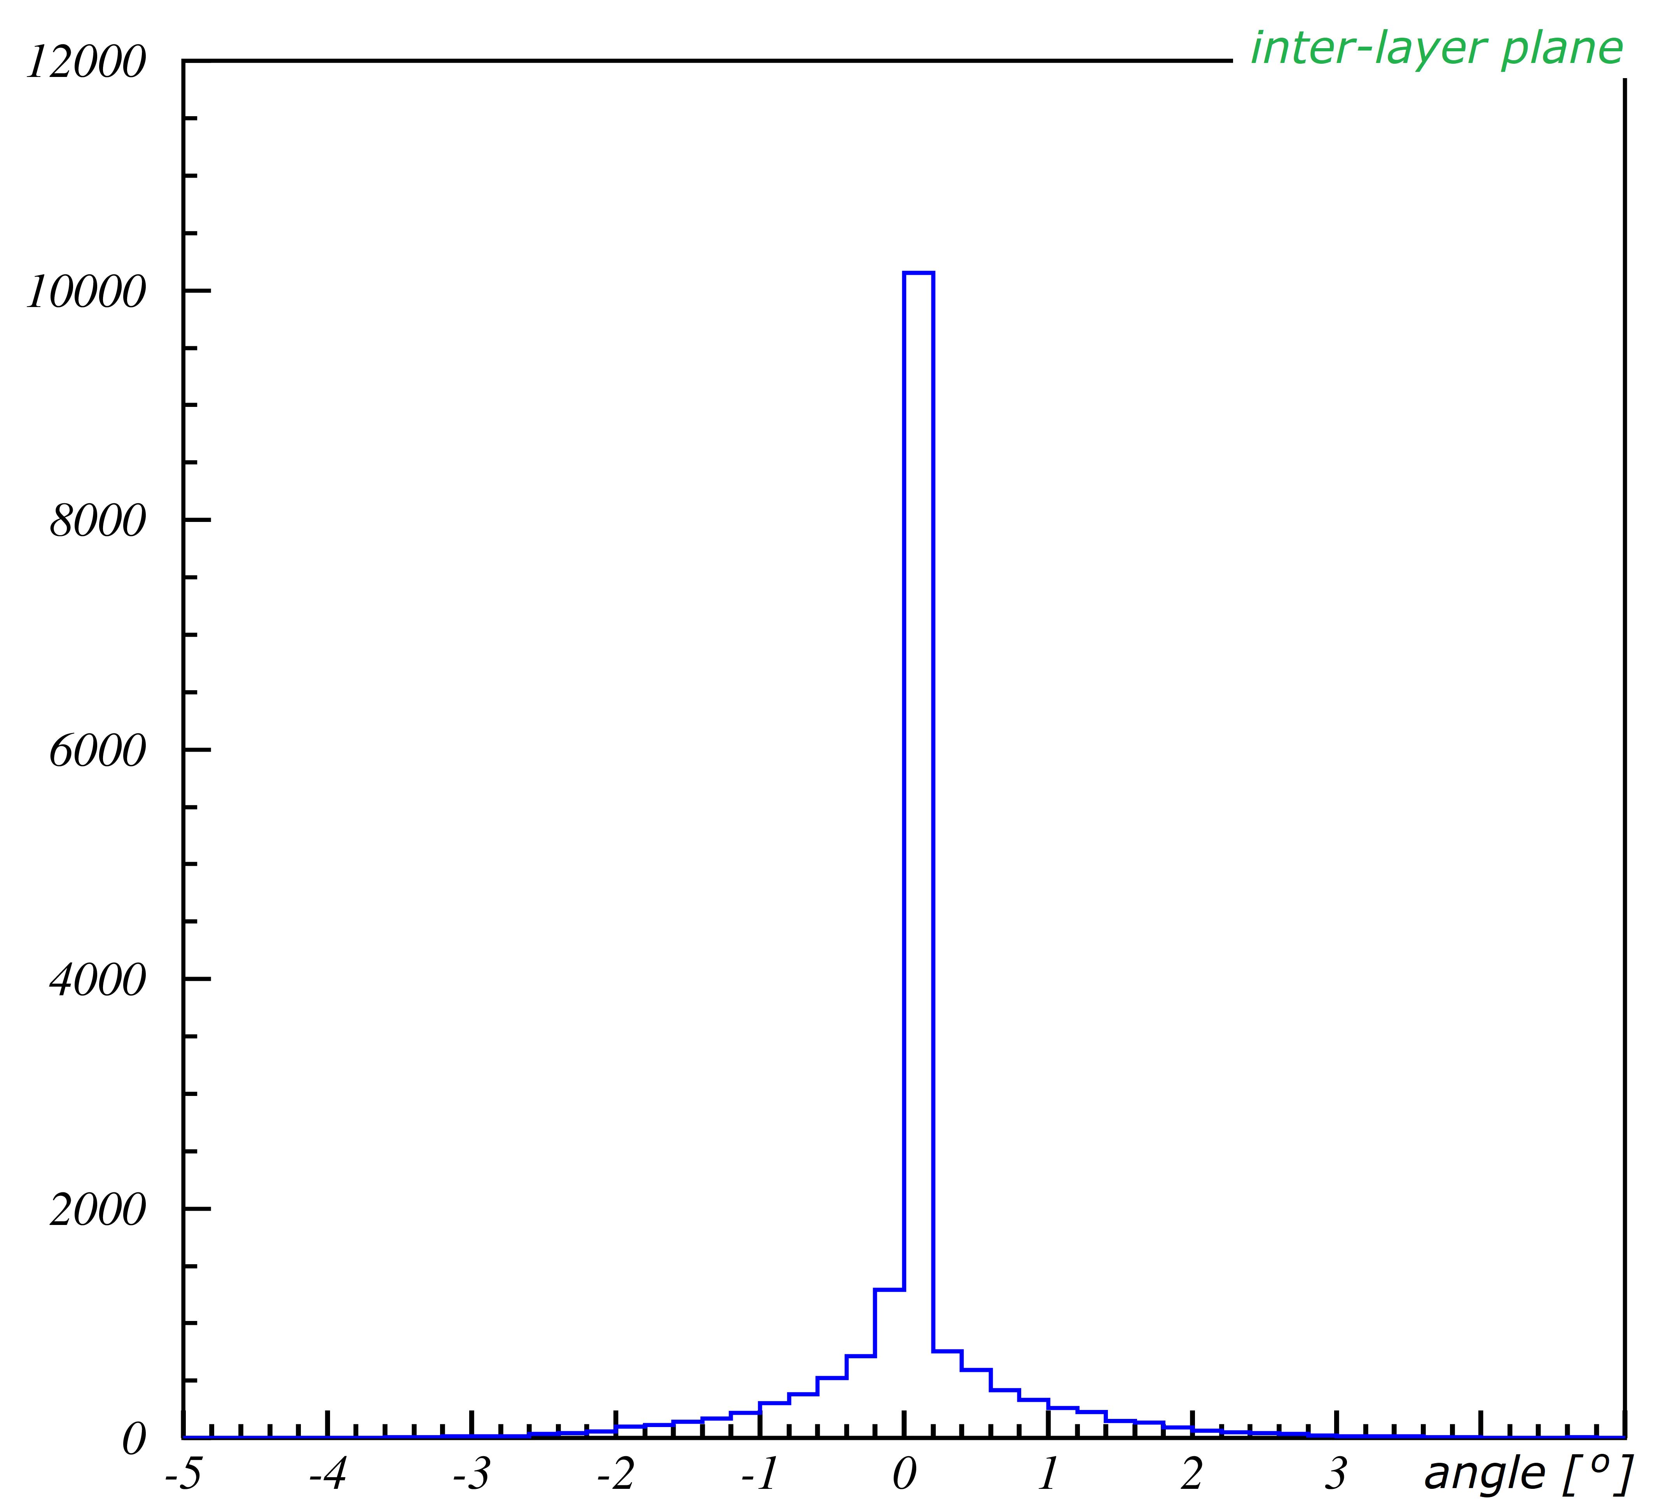
Key remarks
MC “hit”
Reco line
fit curve to real MC hits: r_{1a}, r_{1b}, r_{2a}, r_{2b}
dir. = good !
get parameters
get point on-track closest to reco-hit
this = MC “hit”
not implem. yet

Slide 15
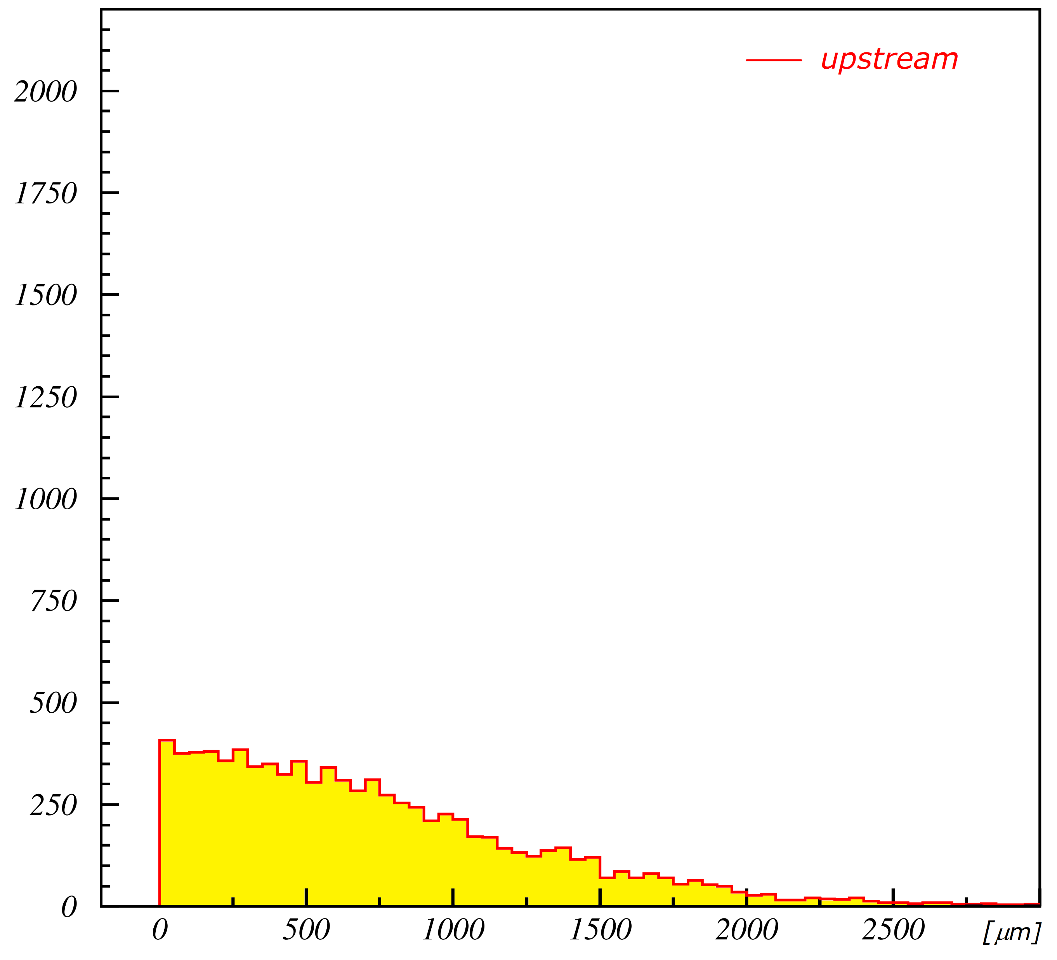
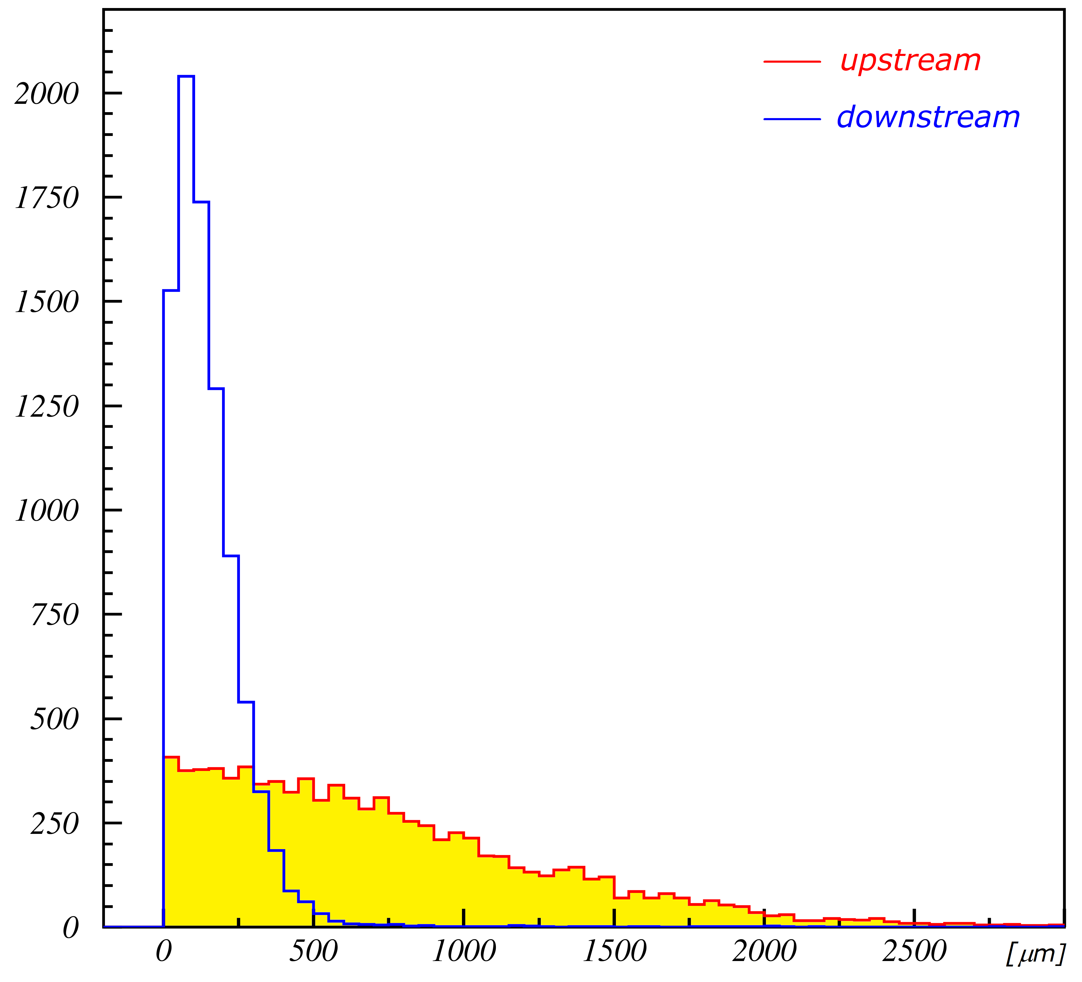
Key remarks
Offsets
not that great @ bi-layers
better downstream

Slide 16
Track view

Slide 17
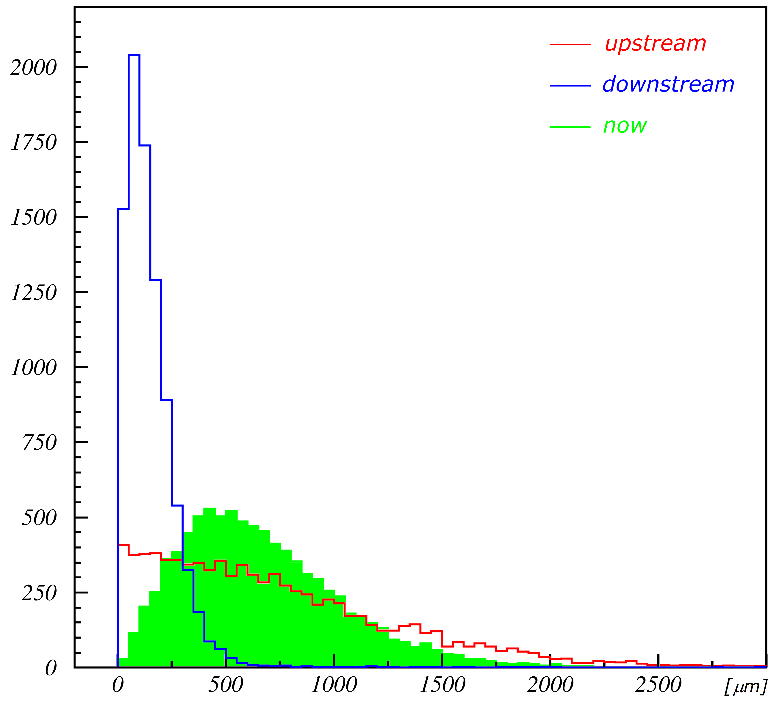
Key remarks
Offsets
not that great @ bi-layers
better downstream
⇒ promising to investigate where best to place reco-hit

Slide 18
Contents
End-Cap geometry
Mini straw simulation
Resolution
Conclusions + Next

Slide 19
Conclusions
3D point reconstruction @ End-Caps
- generally in range of expected resolution
- reco-line good direction
- timing resolution ==(not-automatically)==> 3D resolution !
Next
- need to think where on reco-line to best place reco-hit
- advantage of downstream better resolution
Спасибо !

