Slide 1
SIMULATION AND RECONSTRUCTION OF EVENTS IN THE SPD MUON SYSTEM
Alexander Osetrov

Slide 2
Work accomplished
System prototype simulation
Clustering of hits
Testing machine learning algorithms
Comparative analysis of muon identification algorithms
2

Slide 3
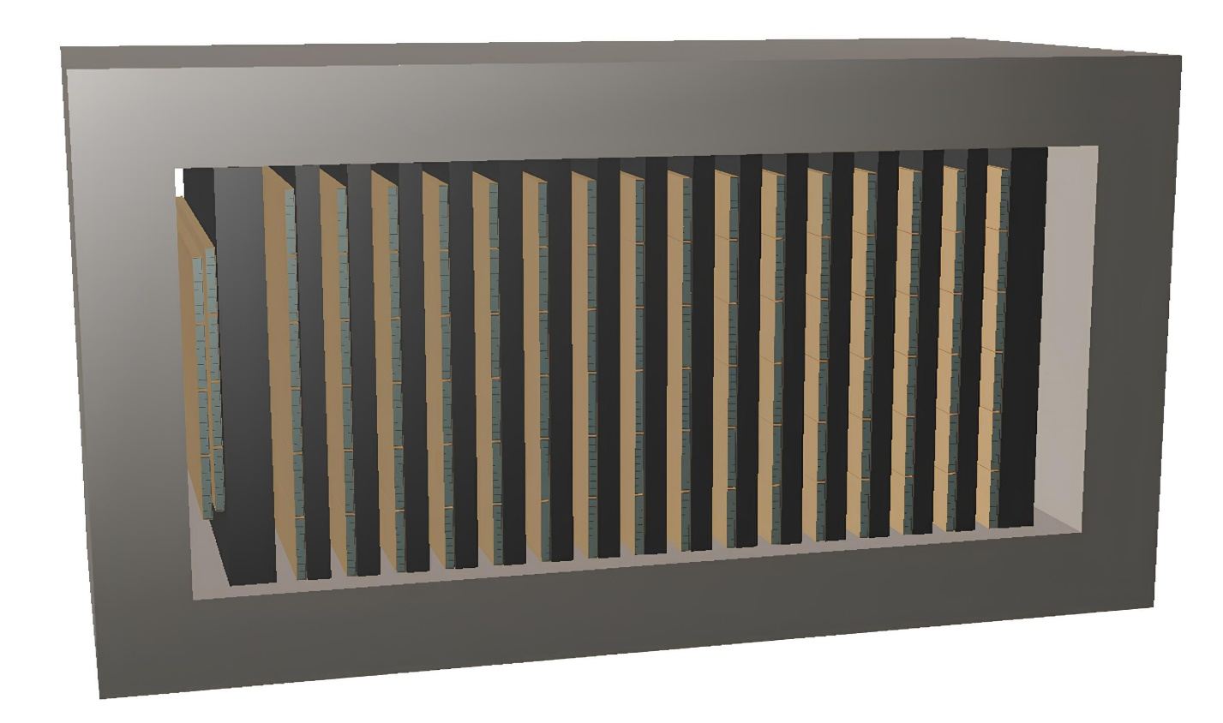

Geometric model of the prototype
MDT detector of eight cells filled with gas mixture Ar + ${CO}_{2}$.
6 MDT combined into one detector plane.
The iron case contains 16 detector planes with iron absorbers with a pitch of 35 mm for placing the reading electronics.
Bilayer, consisting of two detector planes, each containing 4 MDT detector. A 60 mm thick iron sheet is behind them.
The model was created using the ROOT geometric package and then integrated into SpdRoot.
3

Slide 4
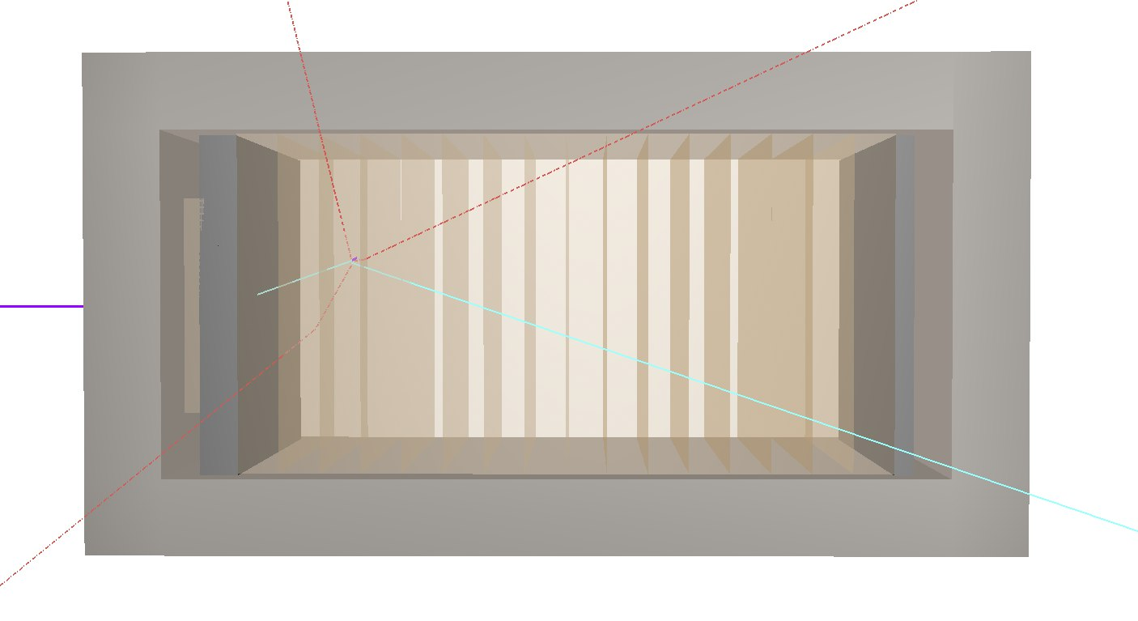
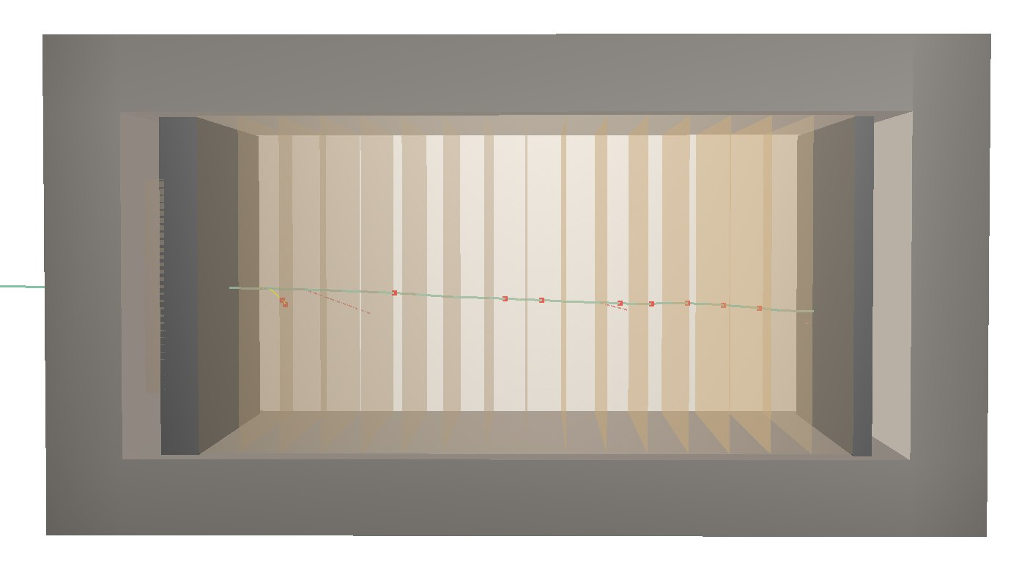
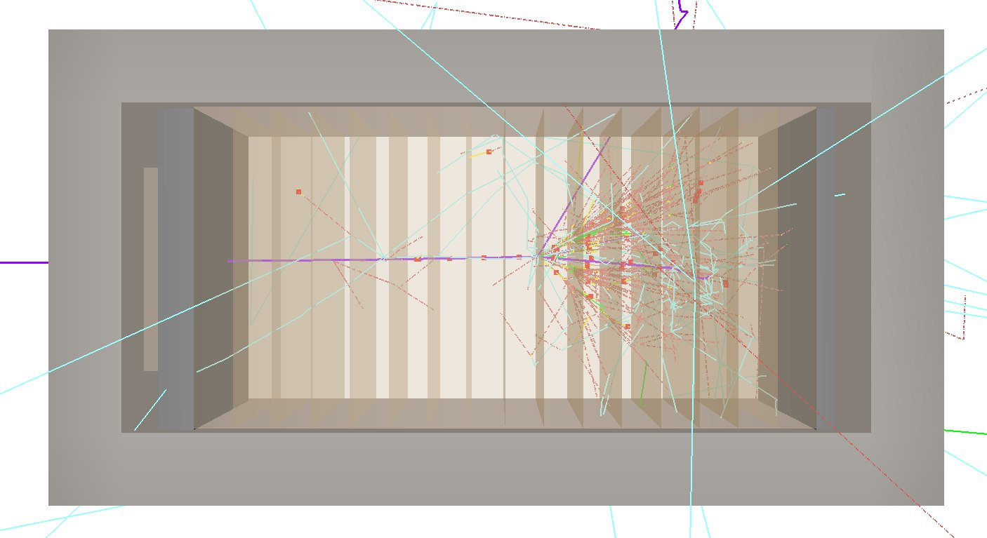
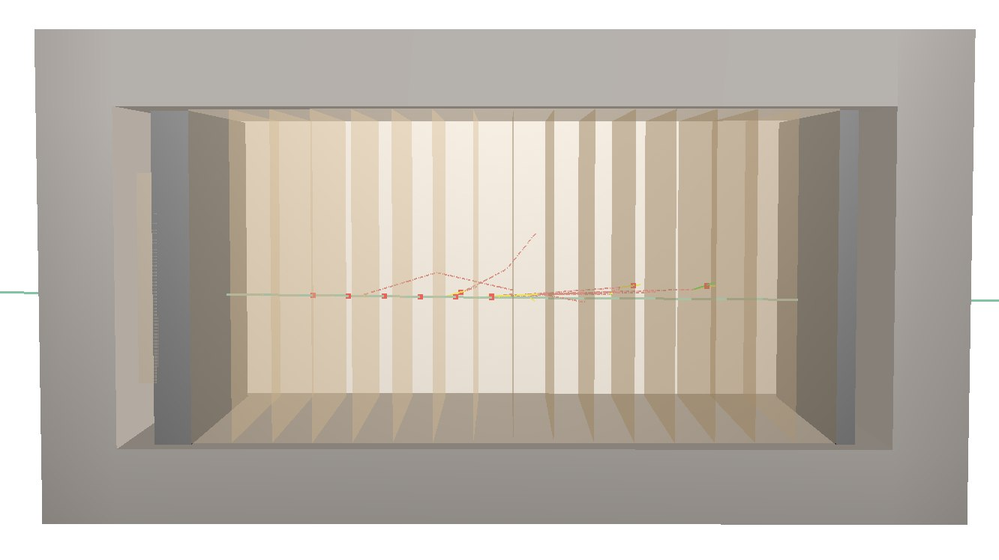
4

Slide 5
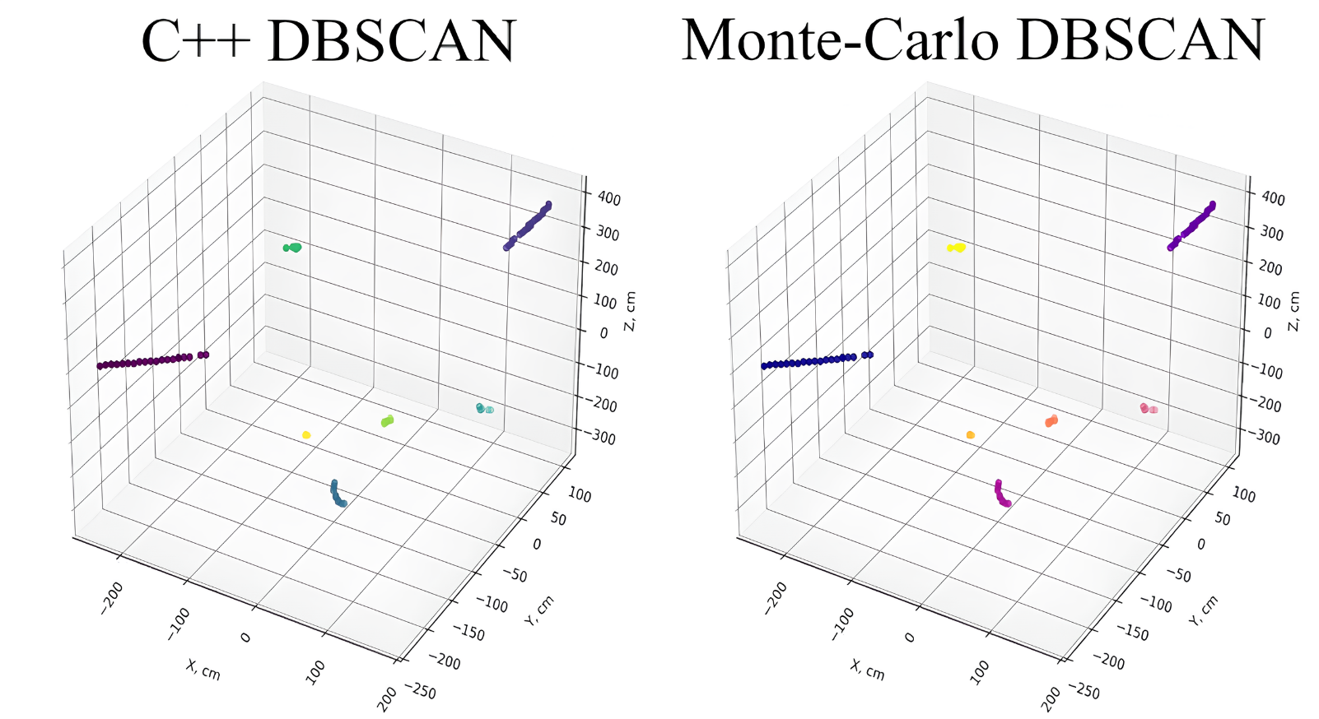
DBSCAN Clustering Algorithm
Since the standard C++ libraries do not include a ready-made implementation of DBSCAN, this algorithm has been adapted from other libraries with subsequent integration into SpdRoot.
The figure shows an example of comparing the result of DBSCAN algorithm implemented in C++ with the result of standard version from the library scikit-learn language Python for modeled event J/ψ.
С++ DBSCAN scikit-learn DBSCAN
5

Slide 6
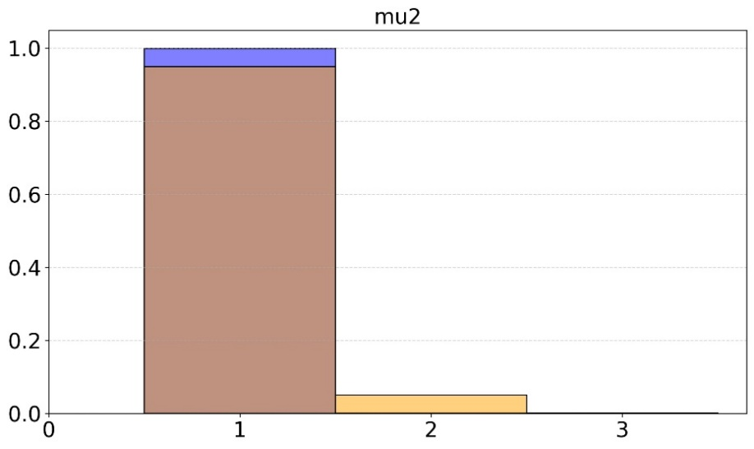
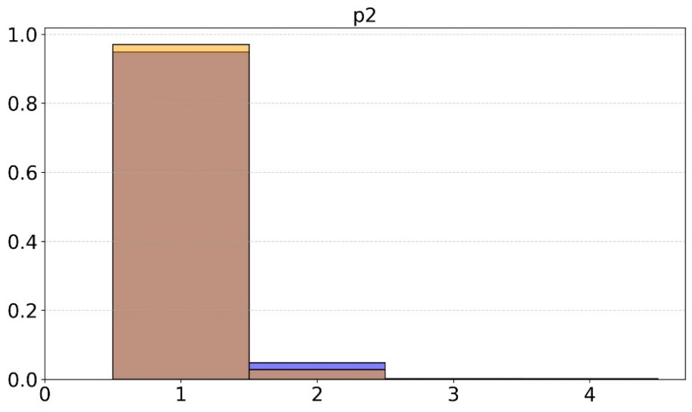

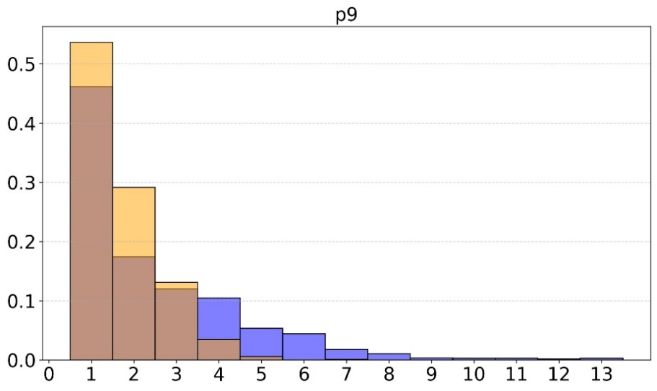
Monte Carlo clustering
DBSCAN clustering
A comparative analysis of the DBSCAN algorithm adapted for SpdRoot was conducted with an existing implementation based on Monte Carlo simulation data. Distributions of the number of clusters per event were constructed for muons and protons with characteristic energies of 2 and 9 GeV.
Proportion of events
Number of clusters
6

Slide 7
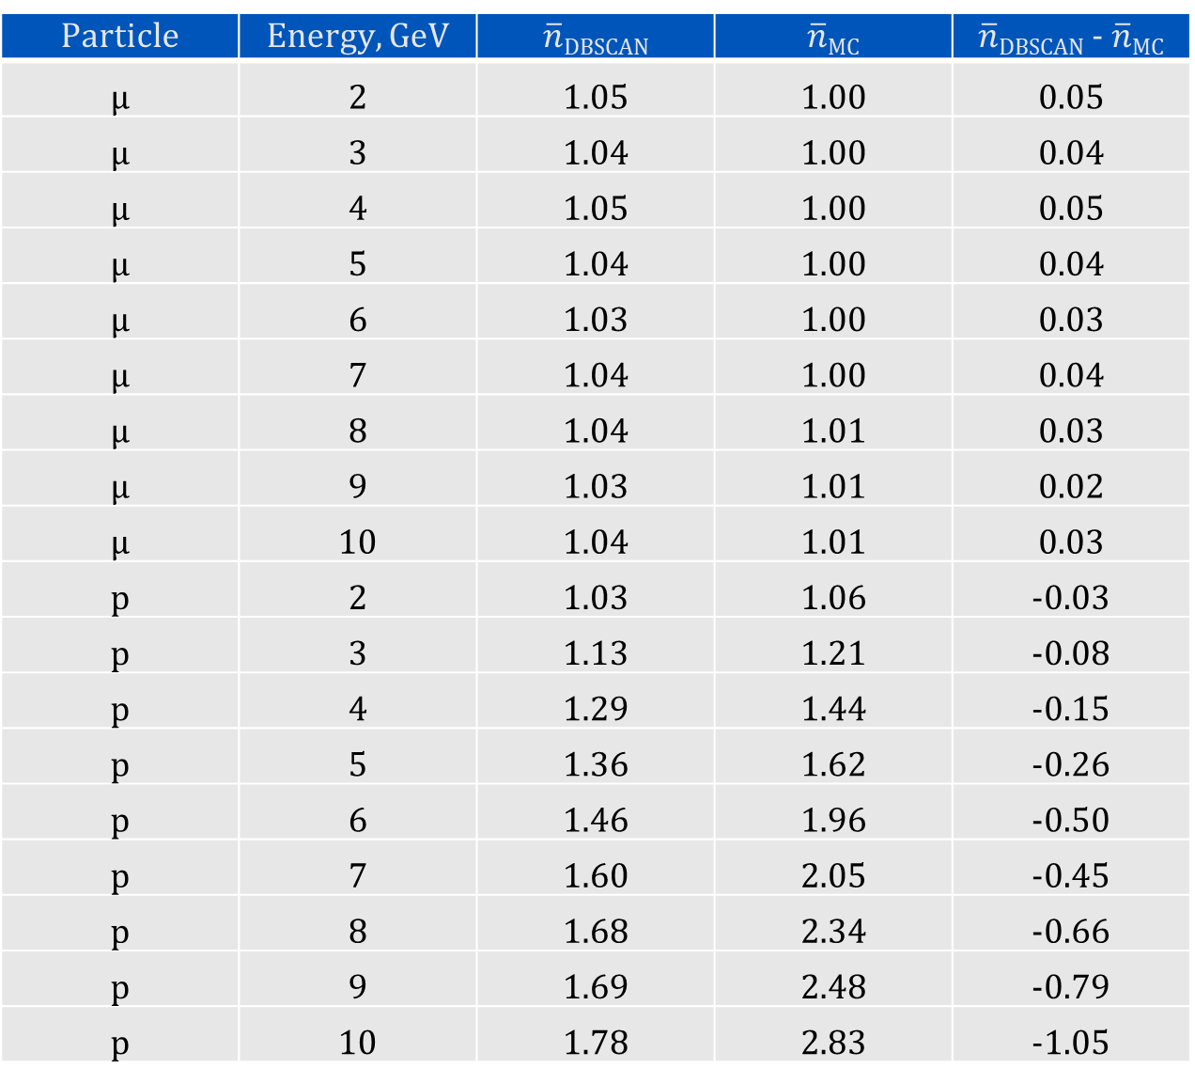
Particle | Energy, GeV | $\overline{n}$_{DBSCAN} | $\overline{n}$_{MC} | $\overline{n}$_{DBSCAN} - $\overline{n}$_{MC}
μ | 2 | 1.05 | 1.00 | 0.05
μ | 3 | 1.04 | 1.00 | 0.04
μ | 4 | 1.05 | 1.00 | 0.05
μ | 5 | 1.04 | 1.00 | 0.04
μ | 6 | 1.03 | 1.00 | 0.03
μ | 7 | 1.04 | 1.00 | 0.04
μ | 8 | 1.04 | 1.01 | 0.03
μ | 9 | 1.03 | 1.01 | 0.02
μ | 10 | 1.04 | 1.01 | 0.03
p | 2 | 1.03 | 1.06 | -0.03
p | 3 | 1.13 | 1.21 | -0.08
p | 4 | 1.29 | 1.44 | -0.15
p | 5 | 1.36 | 1.62 | -0.26
p | 6 | 1.46 | 1.96 | -0.50
p | 7 | 1.60 | 2.05 | -0.45
p | 8 | 1.68 | 2.34 | -0.66
p | 9 | 1.69 | 2.48 | -0.79
p | 10 | 1.78 | 2.83 | -1.05
7

Slide 8
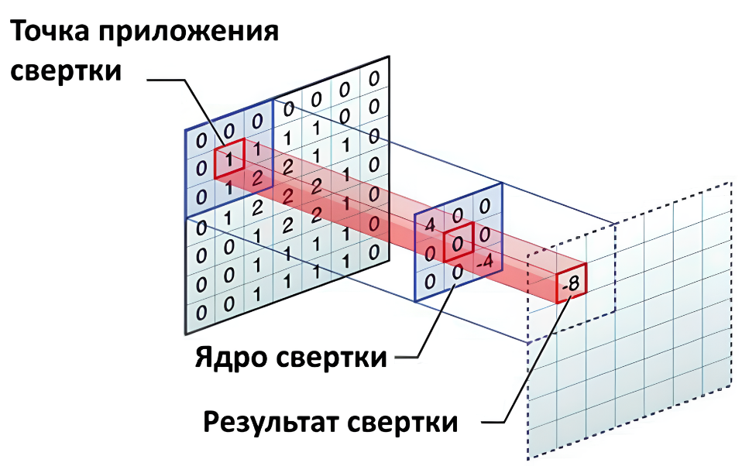
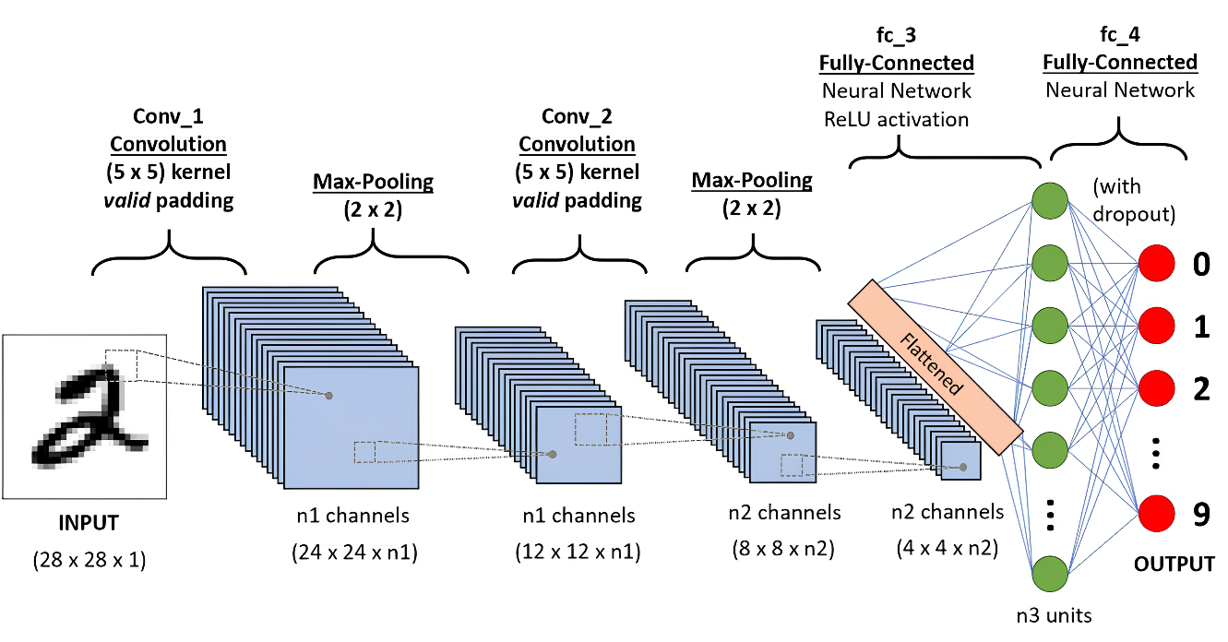
Convolutional neural networks
Convolutional neural networks (CNNs) are a specialized artificial neural network architecture designed to efficiently recognize and process data with a grid structure, such as images.
Convolution application point
Convolution kernel
Result of convolution
8

Slide 9
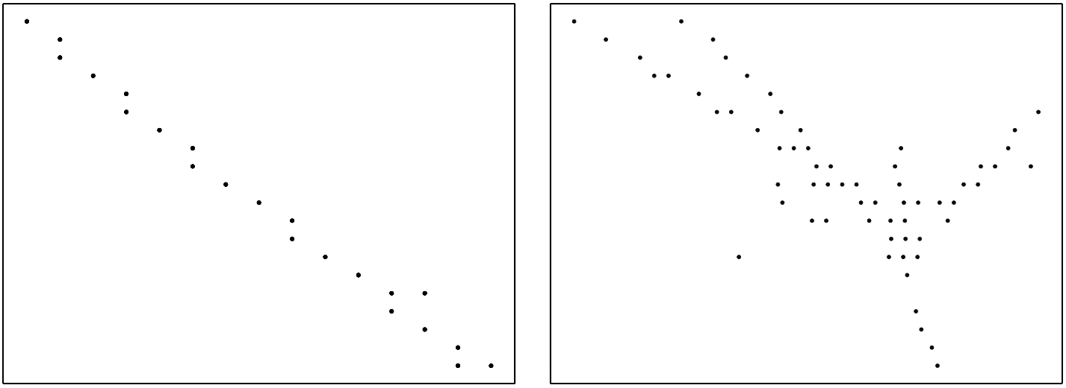
Classification Algorithm: CNN
9

Slide 10
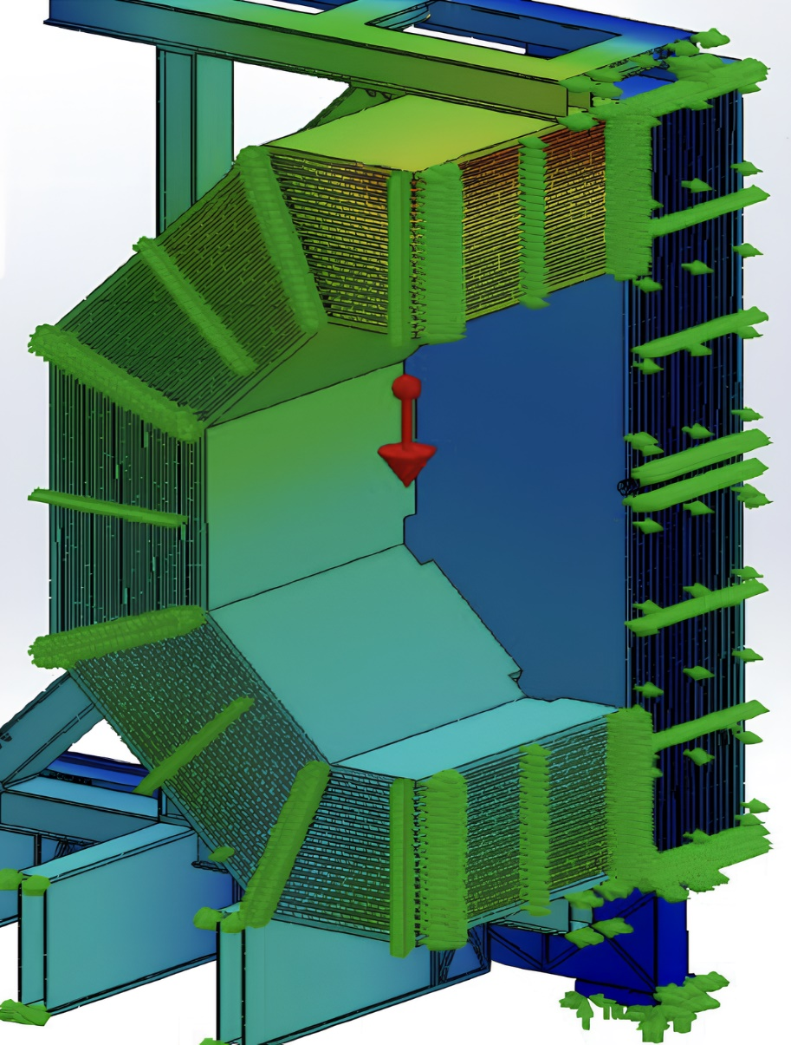
10

Slide 11
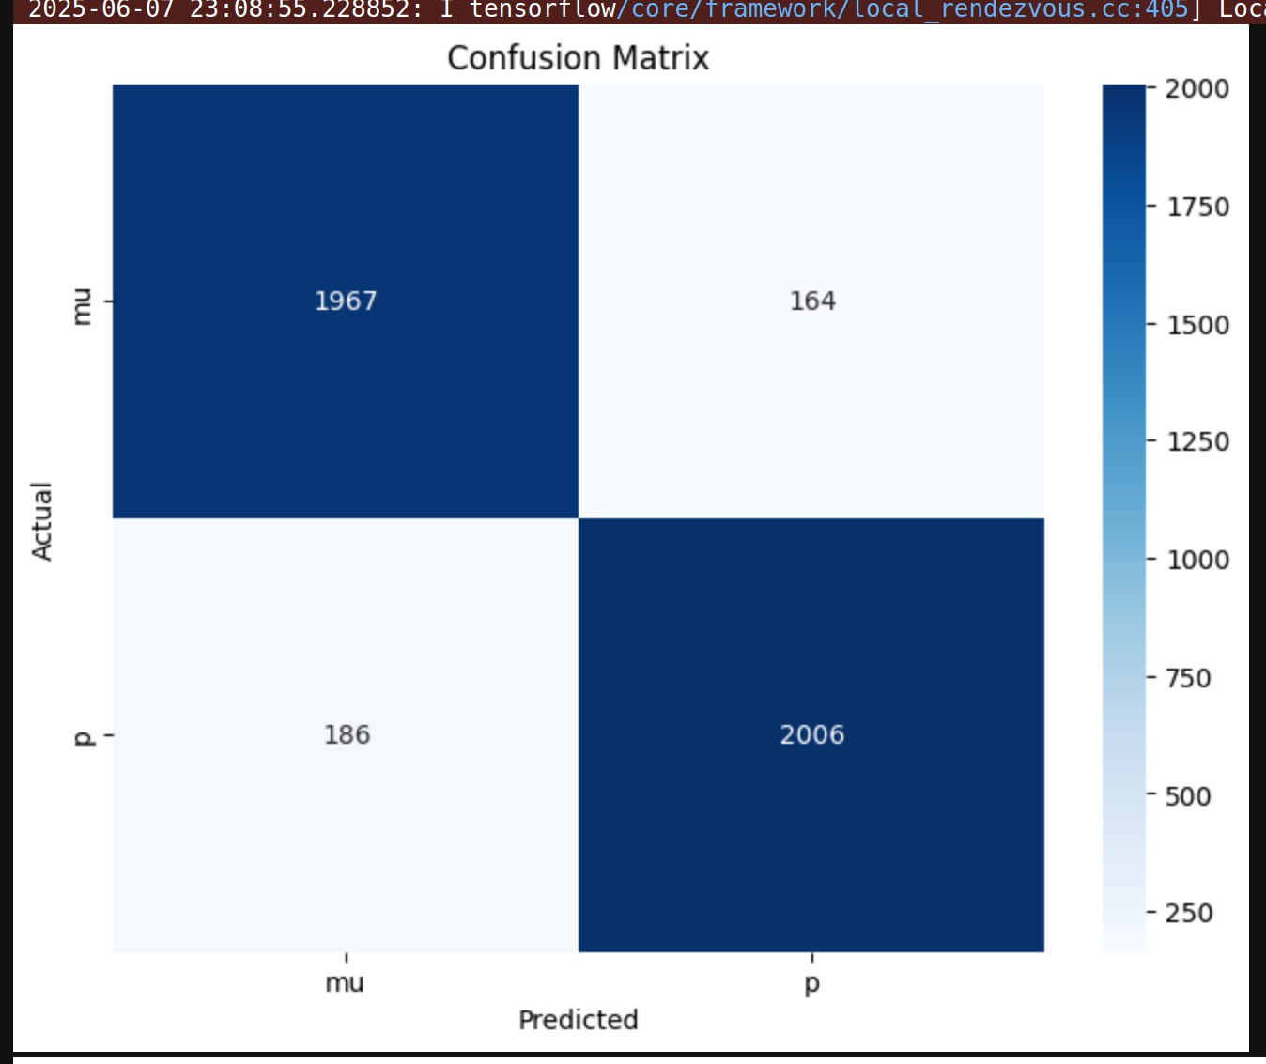
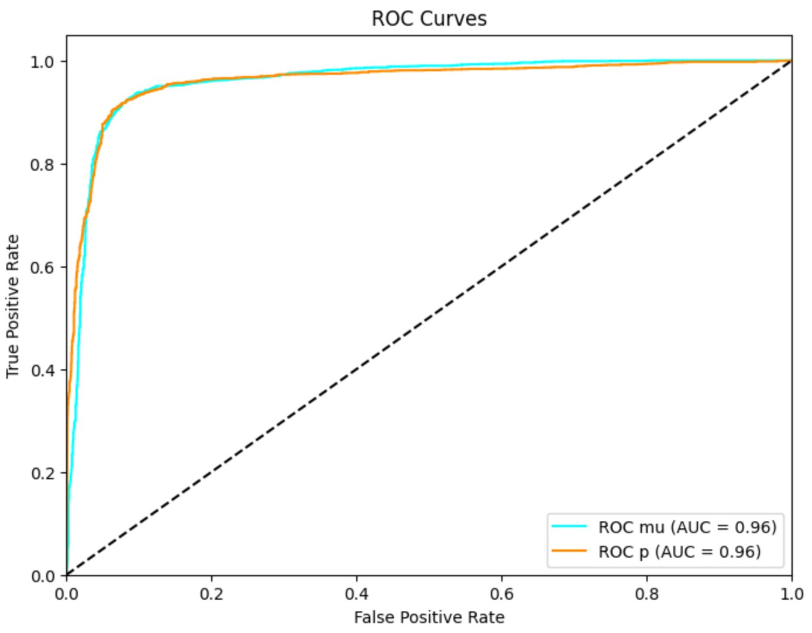
Confusion matrix and ROC curves for CNN
11

Slide 12
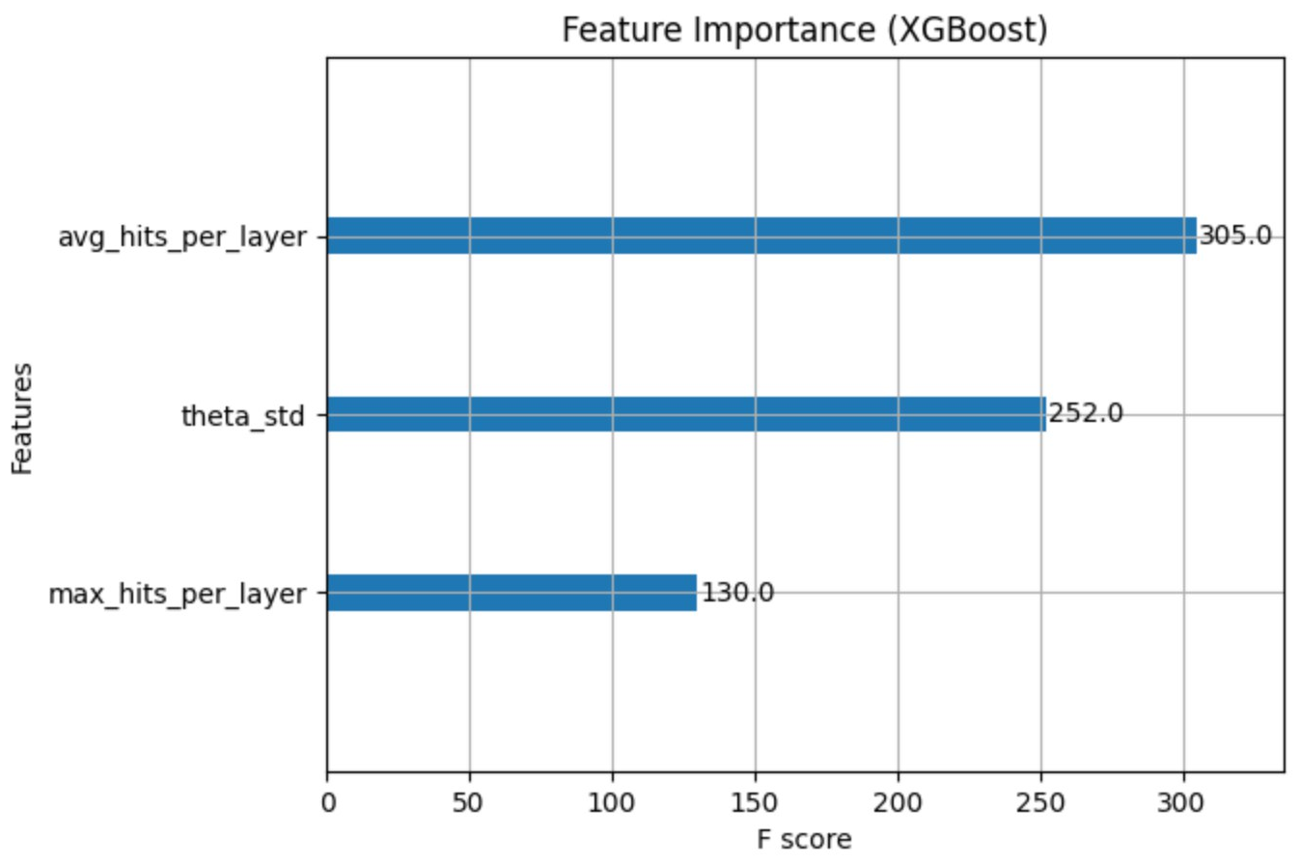
Classification Algorithm: XGBoost
Classification variables:
Average number of hits per detector plane
Maximum number of hits in one plane
Standard deviation of the angular distribution
12

Slide 13
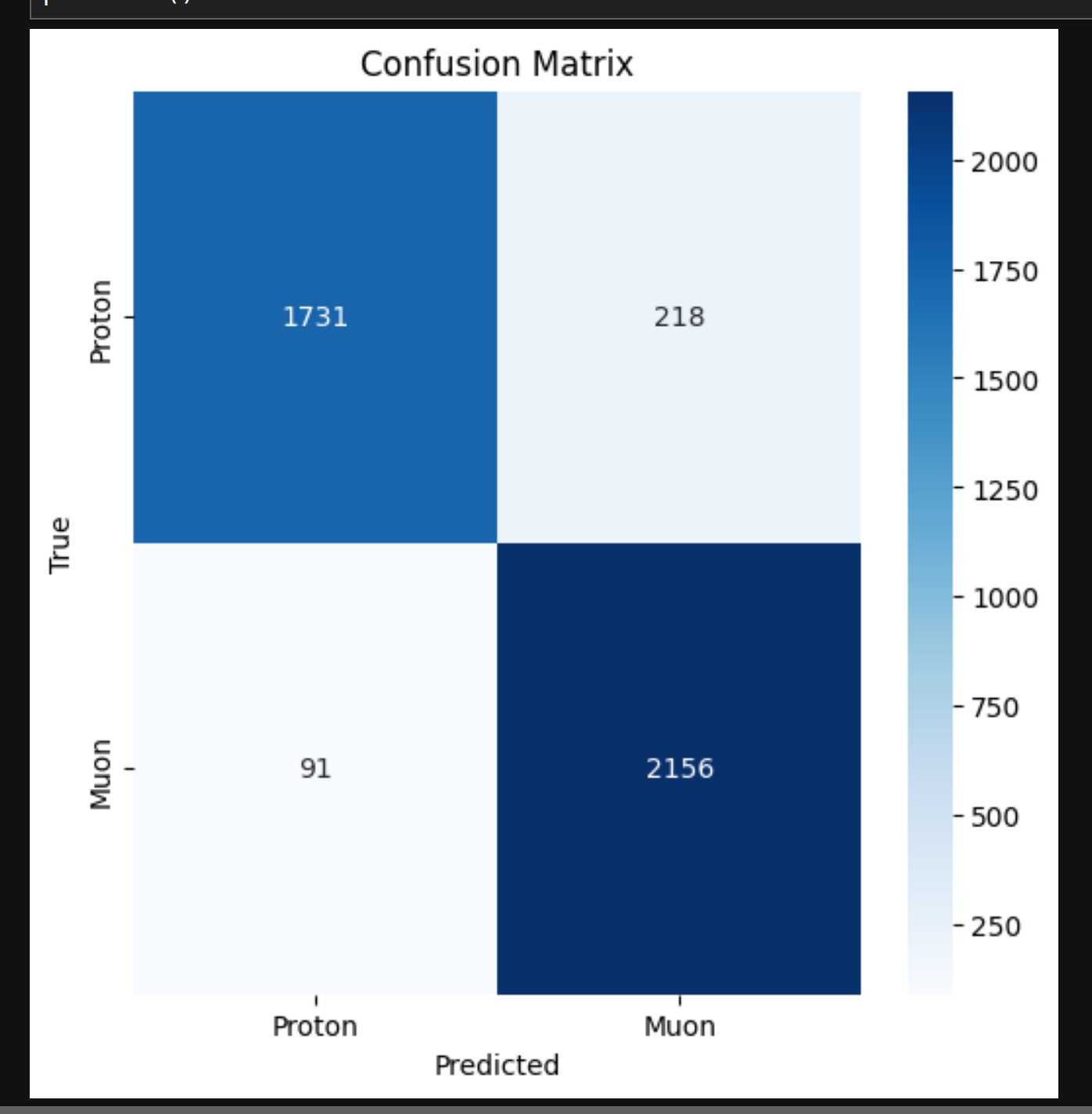
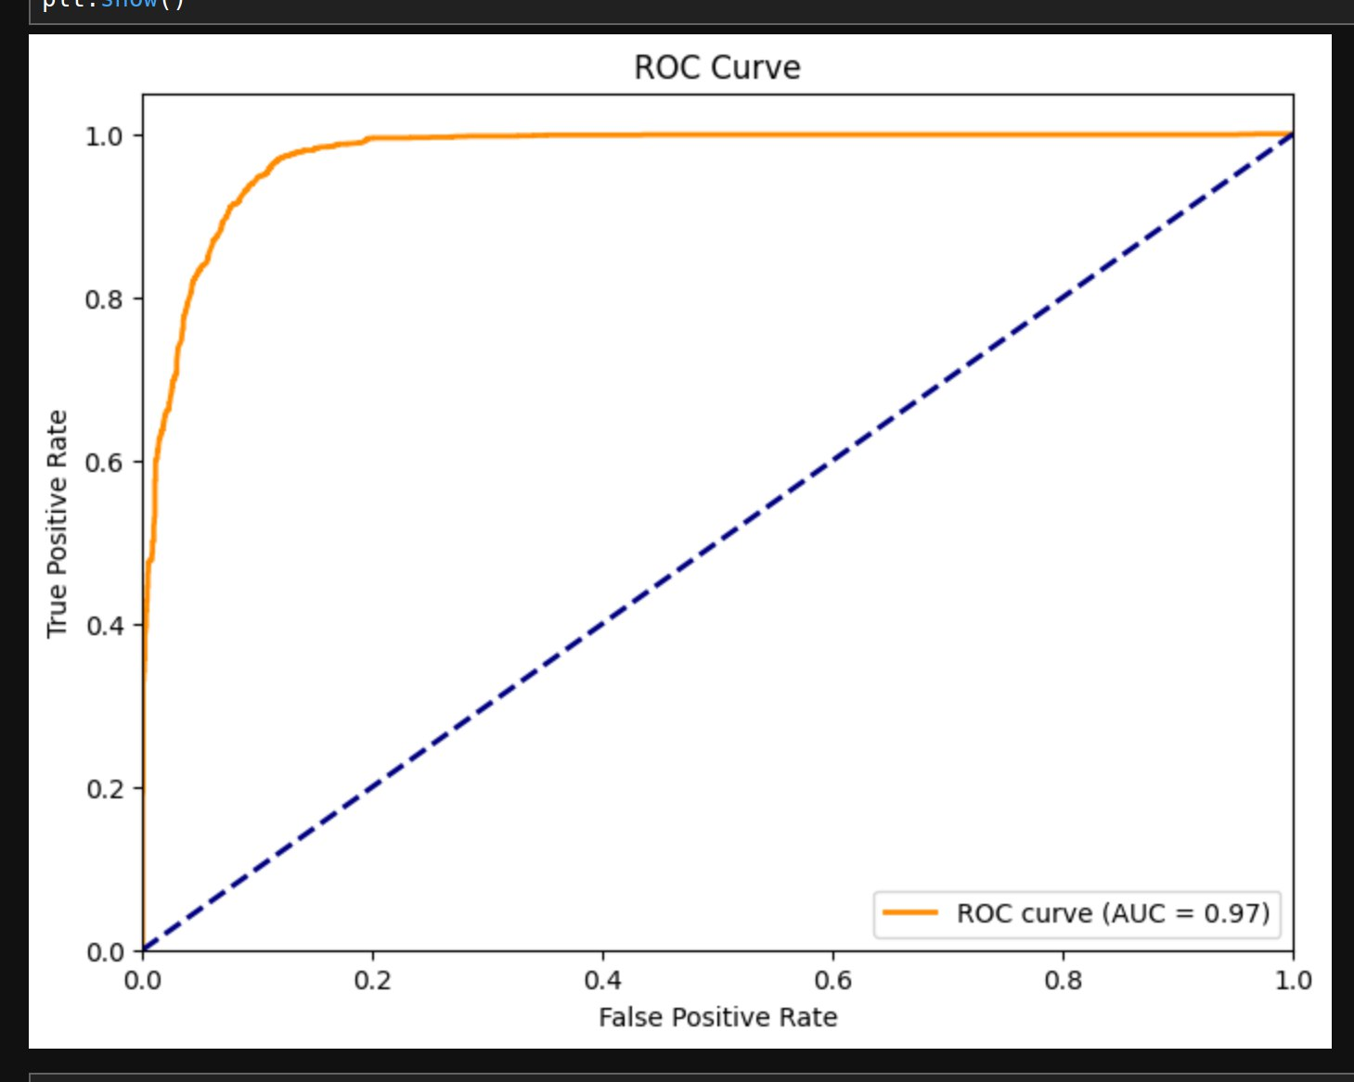
Confusion matrix and ROC curve for XGBoost
13

Slide 14
Comparative analysis of models
Metrics | CNN | XGBoost
Accuracy | 0.92 | 0.93
Precision | 0.91 | 0.91
Recall | 0.92 | 0.96
F1-score | 0.92 | 0.93
14

Slide 15
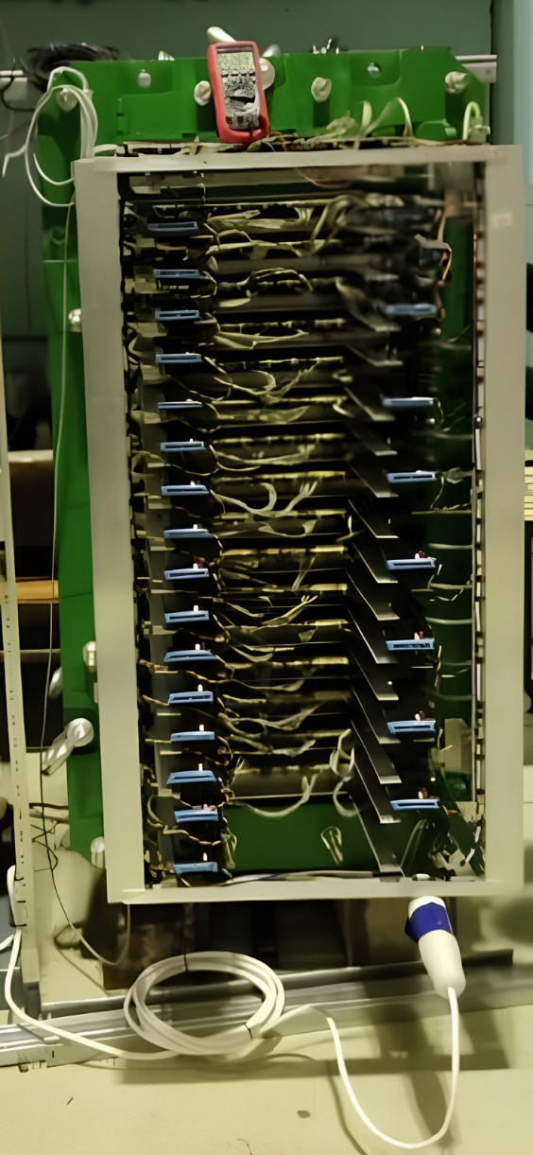
15

