Slide 1
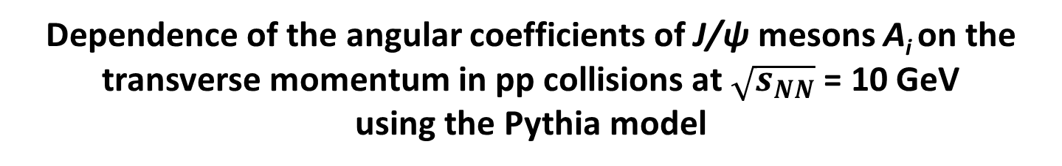
Dependence of the angular coefficients of J/ψ mesons A_{i} on the transverse momentum in pp collisions at $\sqrt{s_{NN}}$ = 10 GeV
using the Pythia model
M. Bykovskii, O. Bulekov
SPD Physics Weekly meeting #63, 14.10.2025

Slide 2
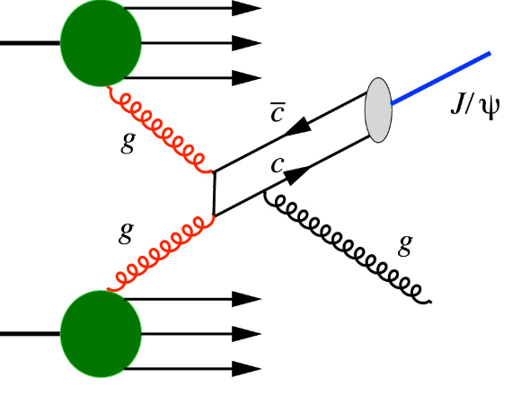
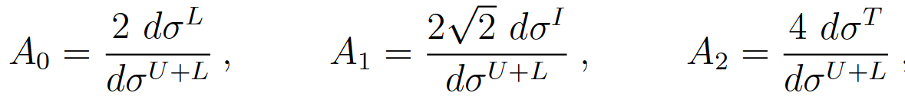
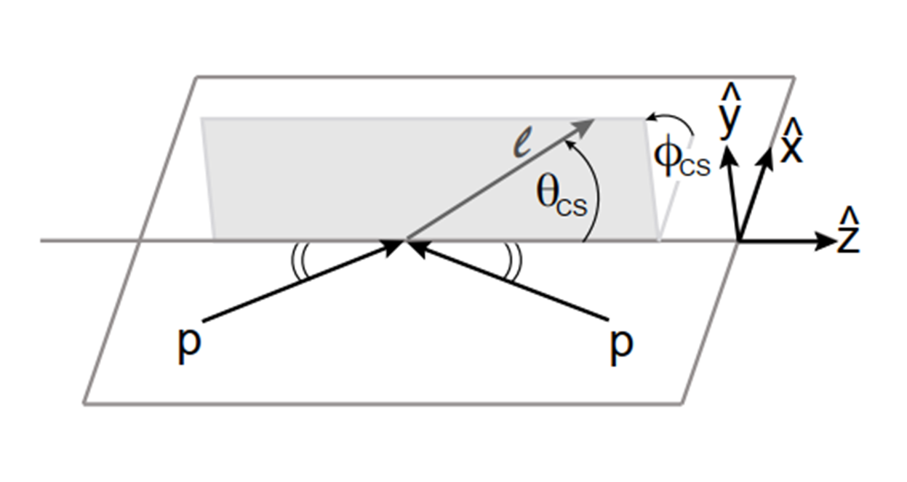
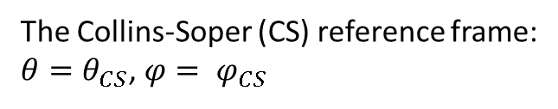
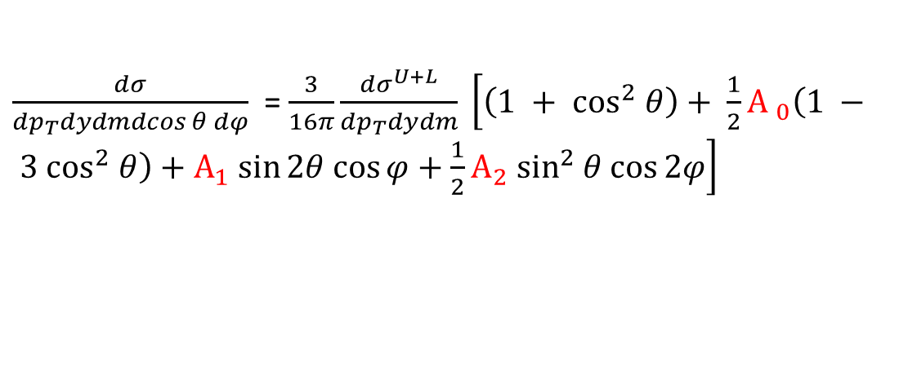
Measurement of the angular coefficients in J/ψ events using muon pairs
J/ψ → μ⁺ μ⁻ ; BF = 5.96 ± 0.03%, Γ = 304 ± 9 keV
$\frac{dσ}{{dp}_{T}dydmdcos θ dφ}$ = $\frac{3}{16π}\frac{{dσ}^{U+L}}{{dp}_{T}dydm} \left[\left(1 + \cos^{2} θ\right)+ \frac{1}{2}{A }_{0}\left(1 − 3 \cos^{2} θ\right)+А_{1} sin⁡2θ cos⁡φ+\frac{1}{2}A_{2} \sin^{2} θ cos⁡2φ\right]$
The Collins-Soper (CS) reference frame:
$θ=θ_{CS}$, $φ= φ_{CS}$
σ^{L}, σ^{T}, σ^{I} - the longitudinal, the transverse and the longitudinal-transverse interference cross sections
σ^{U+L} - the unpolarized production cross section
Mirkes E., Kim C. S. J/Ψ decay lepton distribution in hadronic collisions //Physics Letters B. – 1995. – Т. 346. – №. 1-2. – С. 124-128.

Slide 3
Dataset and Production
Monte-Carlo signal sample’s features are :
Generator: Pythia 8
Beams: UU pp at 10 GeV
PDF: NNPDF2.3 QCD+QED LO alpha_s(M_Z) = 0.130 (Pythia default PDF)
Process: J/ψ → μμ
Subdetectors: Micromegas, TS, ECal, RS, BBC, ZDC (sketch) (TOF/Aeg/FaRICH not added)
For this analysis 100 000 events (our estimation of the signal for 1 year First Phase) were produced using SPDROOT 4.1.7 (development branch).

Slide 4
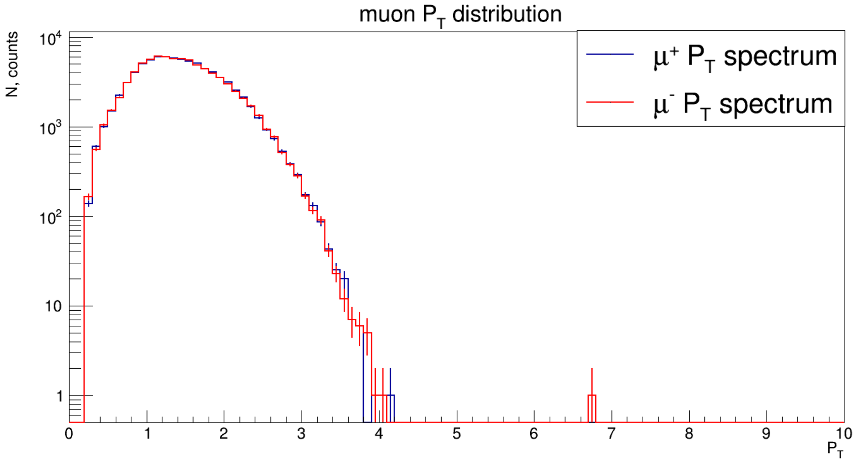
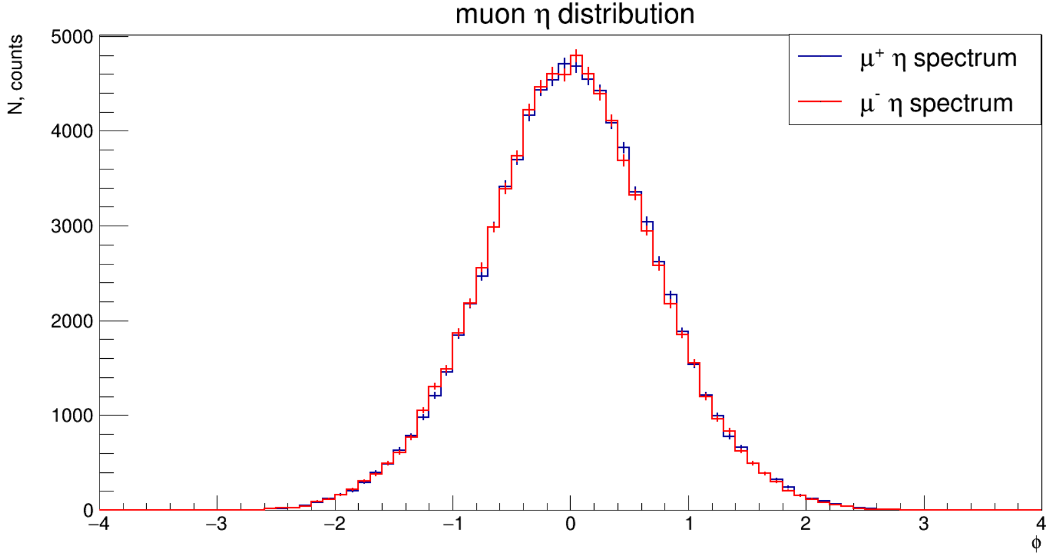
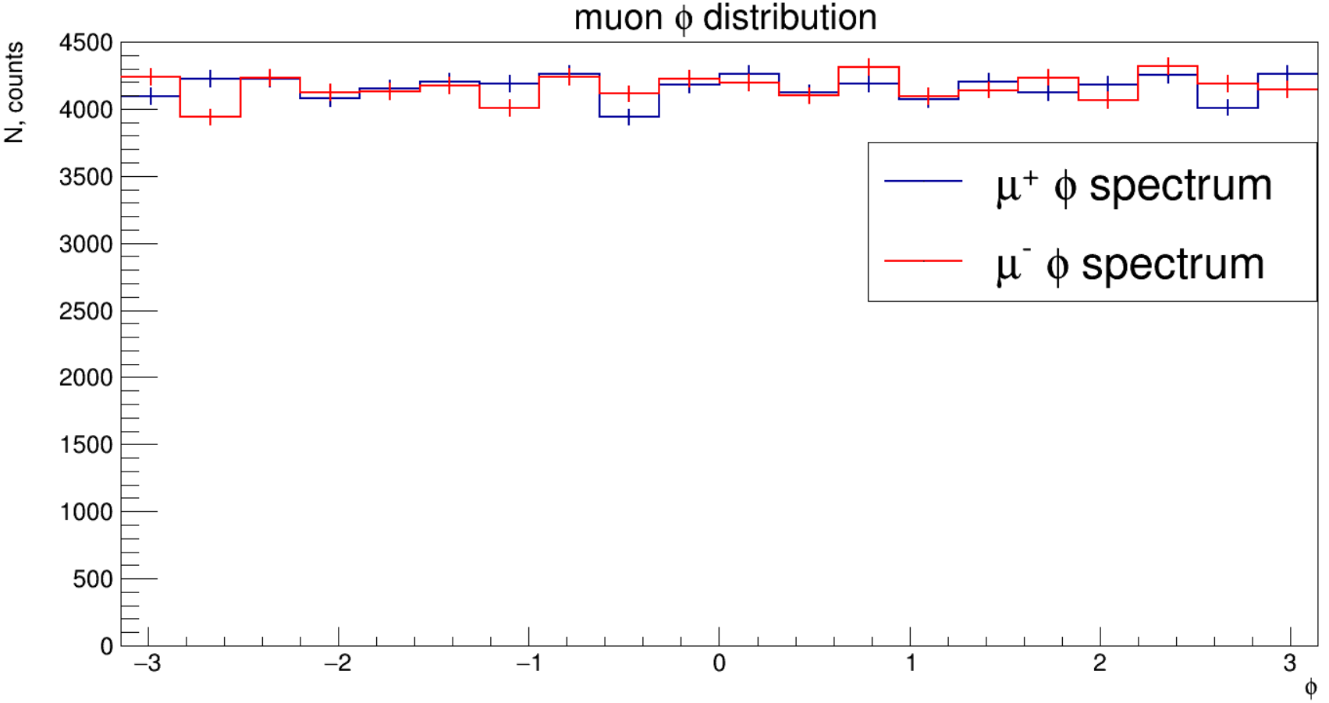
Kinematic distributions for muons
Currently, no RS info implemented into the analysis.
Muon tracks were selected (SpdTrackMC).
State of the track: FinalState, if it’s available; if not – extrapolation to PV with SpdTrackPropagatorGF.
particle PDG and mother PDG were checked
N_{ST} (B + EC) > 12
χ²/ndf < 3
P_{T} > 0.25
|η| < 3.3

Slide 5
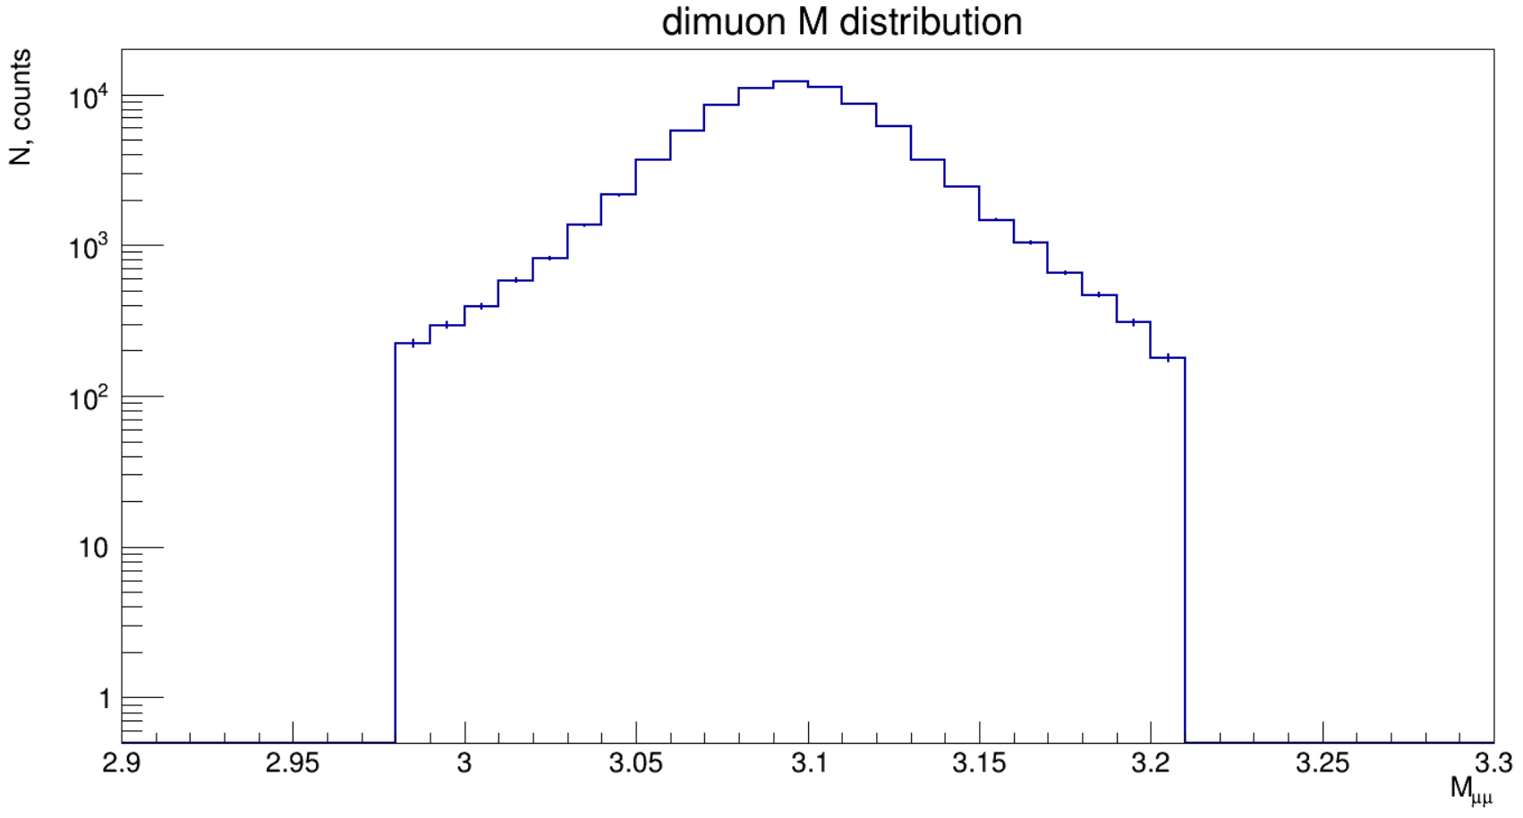
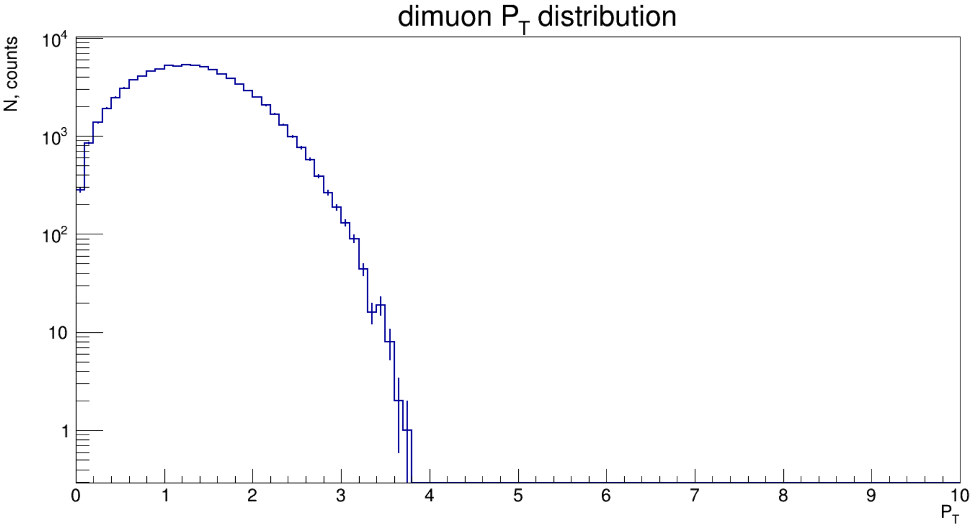
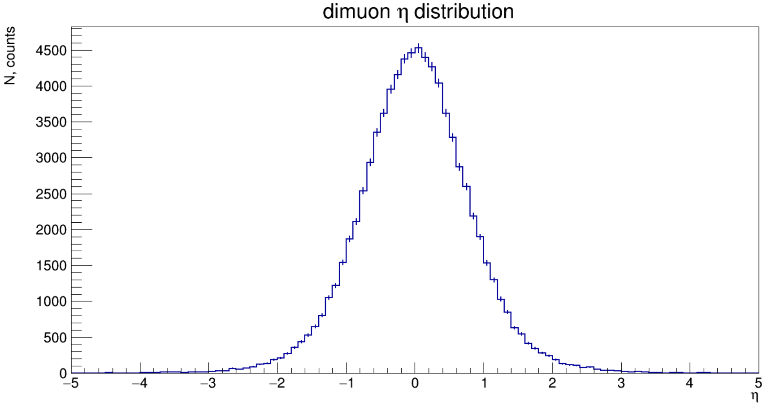
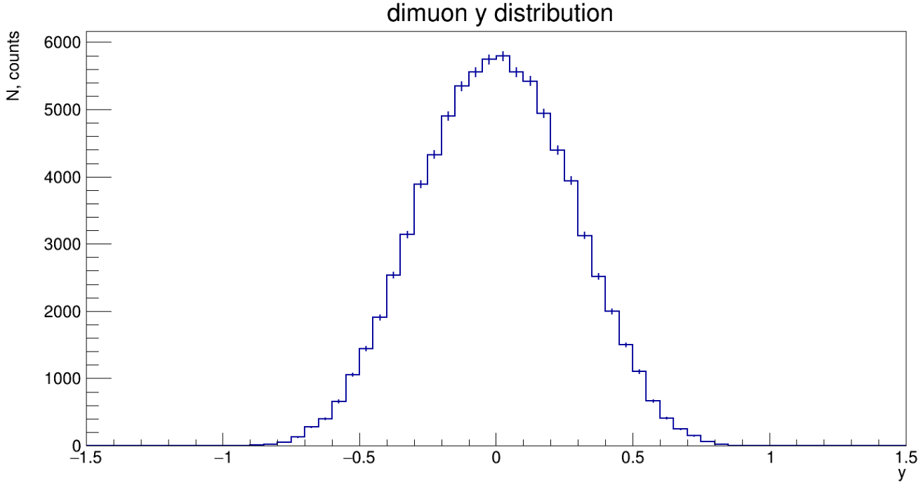
J/ψ kinematical distributions
J/ψ was constructed by its μ⁺μ⁻ pair. Only J/ψ from invariant mass window 3.097 – 3*σ < M_{J/ψ} < 3.097 + 3*σ were accepted. (σ = 40 MeV from 2 Gauss functions fit).

Slide 6
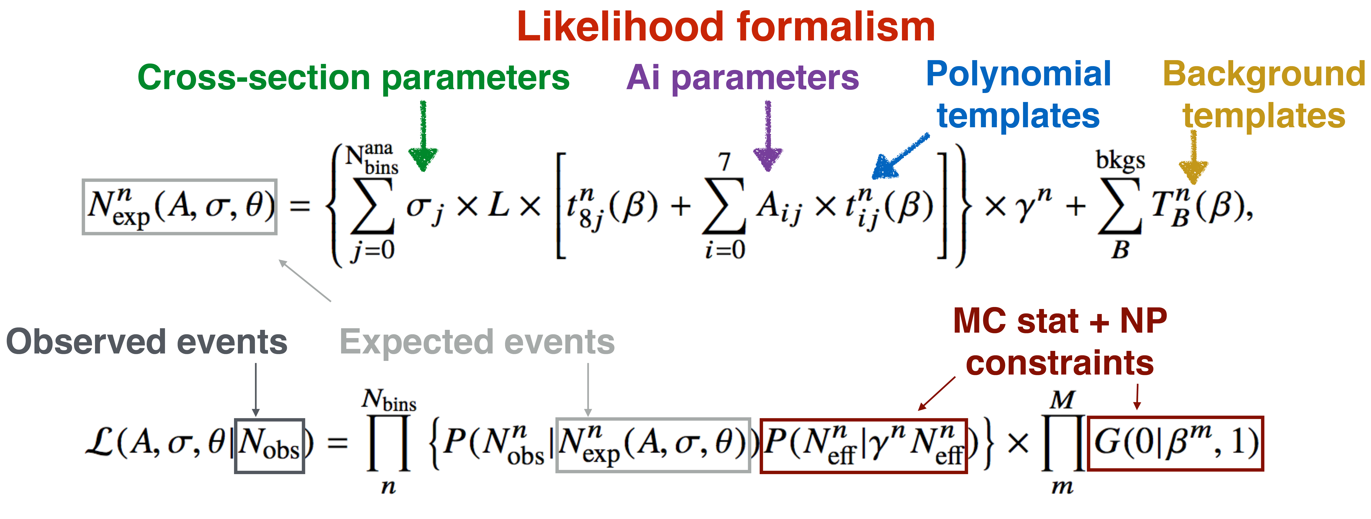
Methodology overview
Build reference coefficients Airef with moments method from MC predictions
Fold signal templates using Ai_{ref} and MC simulation
Build background, data templates
Make workspace (containing likelihood, data, parameters)
Fit Ais, σ, NPs
Folded polynomial templates are used to build a likelihood
Variational templates also present to take into account systematic uncertainties
Angular coefficients are parameters that normalize the polynomial templates
Cross-section scales all signal templates independently in each measurement bin
Background templates are added to likelihood
Maximum likelihood fit is performed to the reconstructed data to determine the coefficients and cross-sections in full phase space of leptons

Slide 7

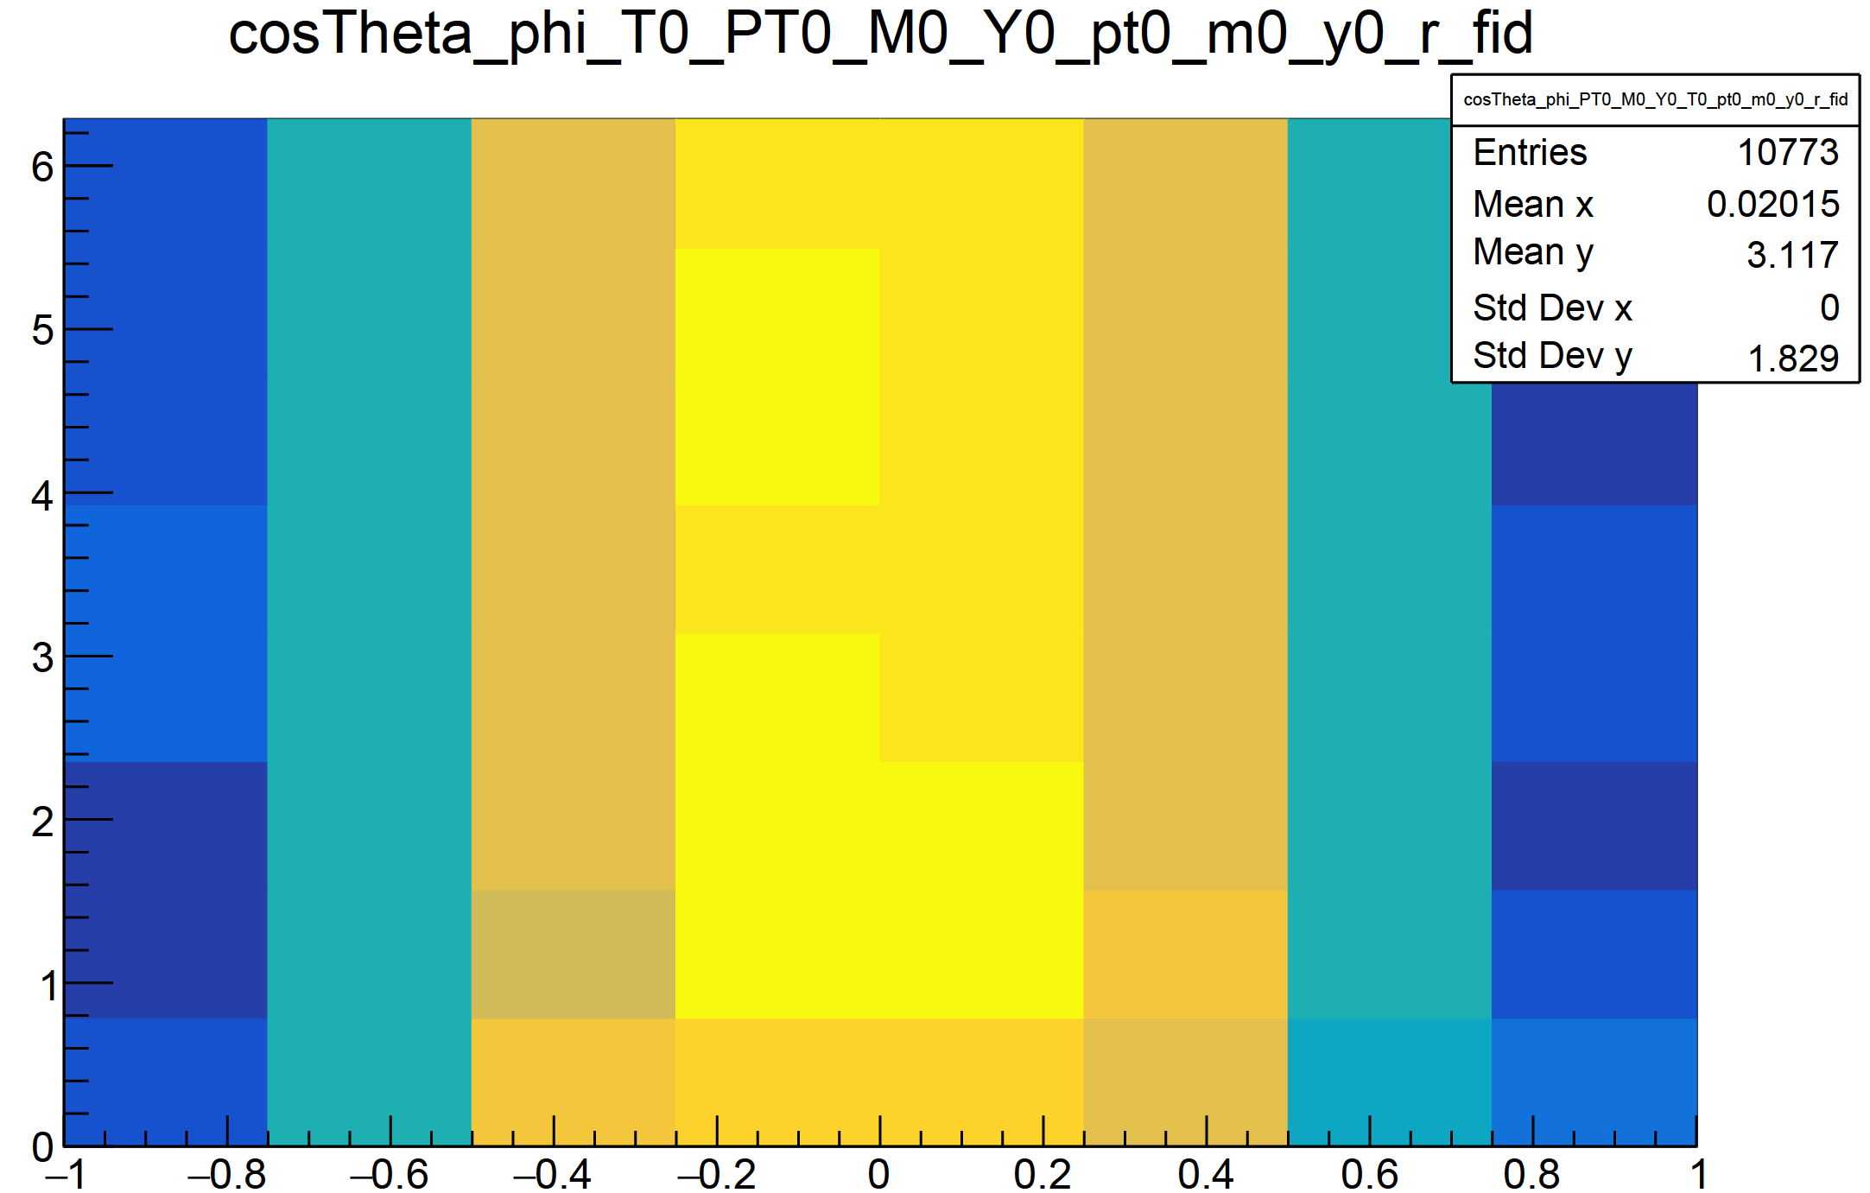
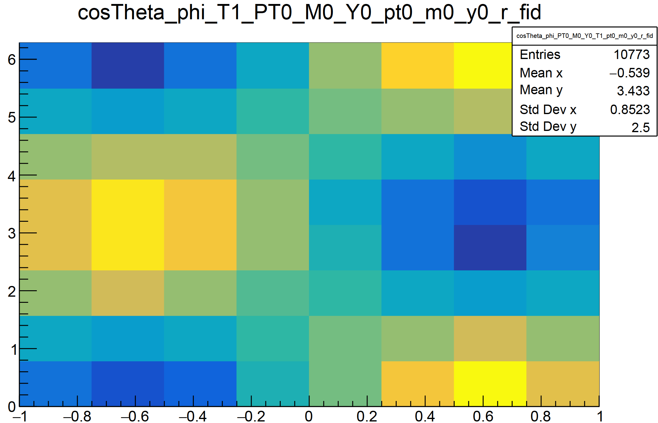
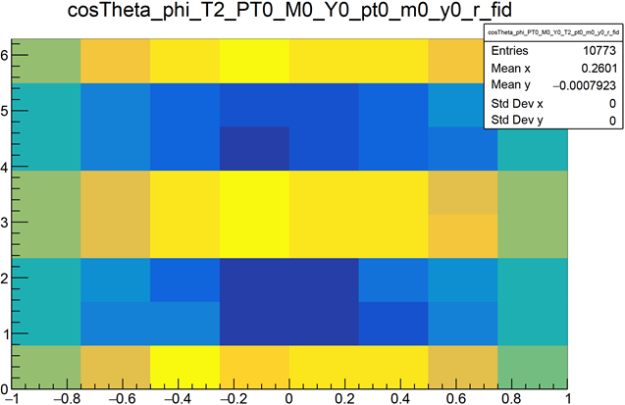

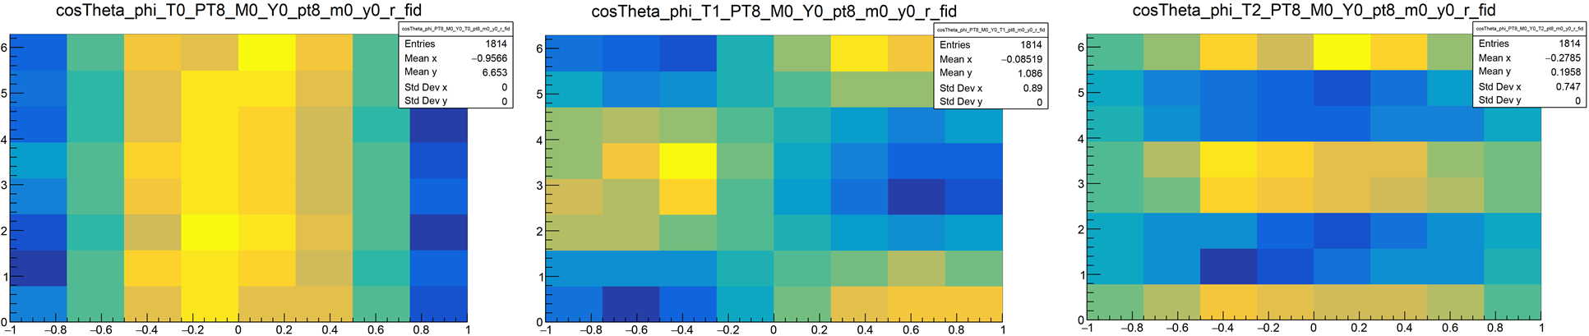
Templates: cosThetaCS vs phiCS
9 PT bins are [0; 0.6], [0.6; 0.84], [0.84; 1.1], [1.1; 1.32], [1.32; 1.51], [1.51; 1.75], [1.75; 2.0], [2.0; 2.6], [2.6; 4.0]

Slide 8
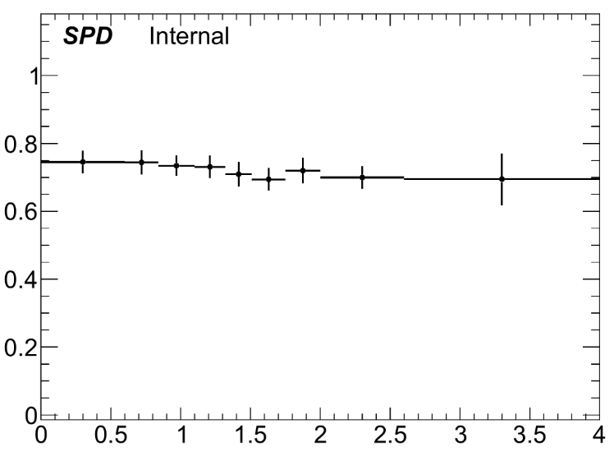
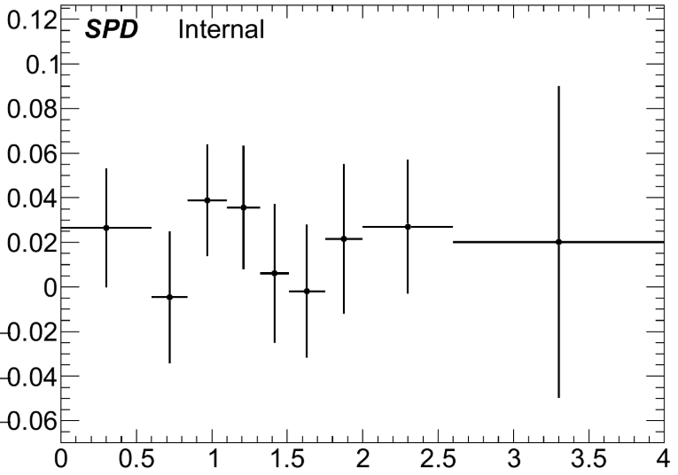
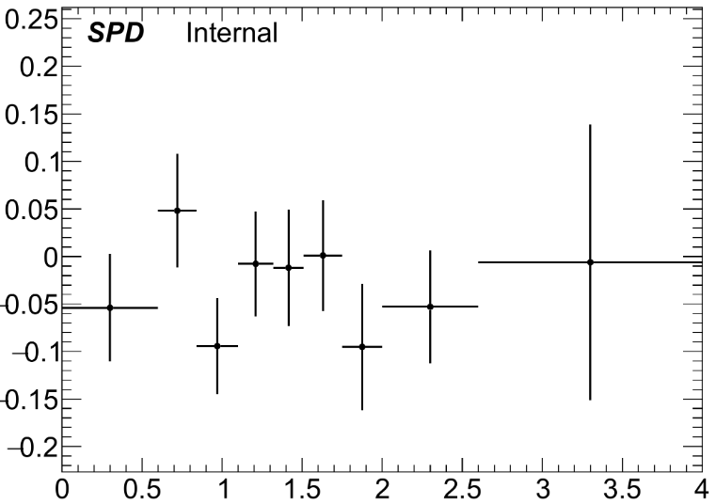
The PT-dependence of angular coefficients Ai
A_{i} were obtained using the Asimov pseudo data.
A₀₋₂ must be equal to zero at LO.
Lam – Tung relation (A₀ = A₂) must be valid as well.
A₀ differs from the expected value.
Trying to figure out the reason.
A₀
P_{T}
A₁
A₂
P_{T}
P_{T}

Slide 9
Results
At the moment we have:
The methodology was implemented, the expected values of the A_{i} were obtained using the Asimov pseudo data.
A_{i} statistical errors for 1 year of the First Phase SPD number of events were estimated.
A₁₋₂ are in agreement with the theoretical predictions.
A₀ differs from the expected value.
We plan:
The estimation of the coefficients using PID info and background.

Slide 10
BACKUP SLIDES

Slide 11
Dataset and Production
Pythia 8 instructions for J/ψ → μμ:
P8gen->SetParameters("Charmonium:gg2ccbar(3S1)[3S1(1)]g = on,off");
P8gen->SetParameters("Charmonium:gg2ccbar(3S1)[3S1(8)]g = on,off");
P8gen->SetParameters("Charmonium:qg2ccbar(3S1)[3S1(8)]q = on,off");
P8gen->SetParameters("Charmonium:qqbar2ccbar(3S1)[3S1(8)]g = on,off");
P8gen->SetParameters("Charmonium:gg2ccbar(3S1)[1S0(8)]g = on,off");
P8gen->SetParameters("Charmonium:qg2ccbar(3S1)[1S0(8)]q = on,off");
P8gen->SetParameters("Charmonium:qqbar2ccbar(3S1)[1S0(8)]g = on,off");
P8gen->SetParameters("Charmonium:gg2ccbar(3S1)[3PJ(8)]g = on,off");
P8gen->SetParameters("Charmonium:qg2ccbar(3S1)[3PJ(8)]q = on,off");
P8gen->SetParameters("Charmonium:qqbar2ccbar(3S1)[3PJ(8)]g = on,off");

