Slide 1
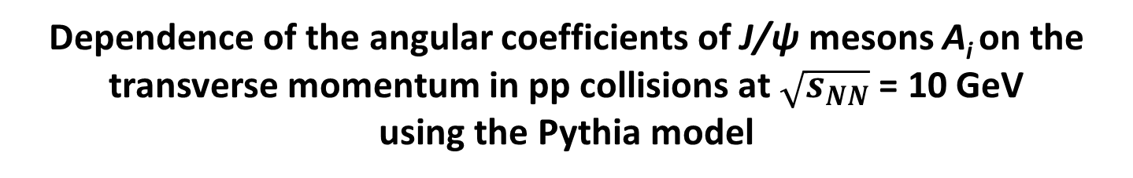
Dependence of the angular coefficients of J/ψ mesons A_{i} on the transverse momentum in pp collisions at $\sqrt{s_{NN}}$ = 10 GeV
using the Pythia model
M. Bykovskii, O. Bulekov
SPD Physics Weekly meeting #63, 14.10.2025

Slide 2
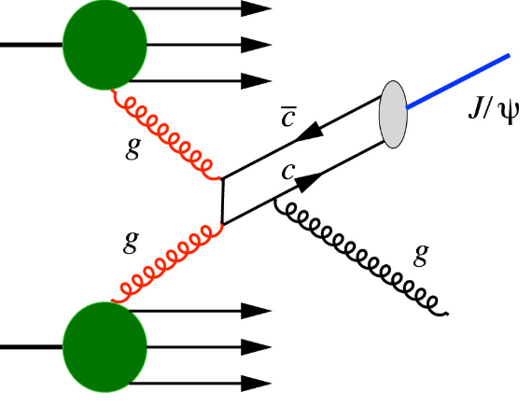
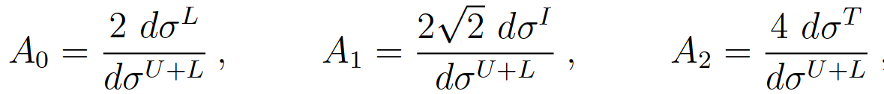
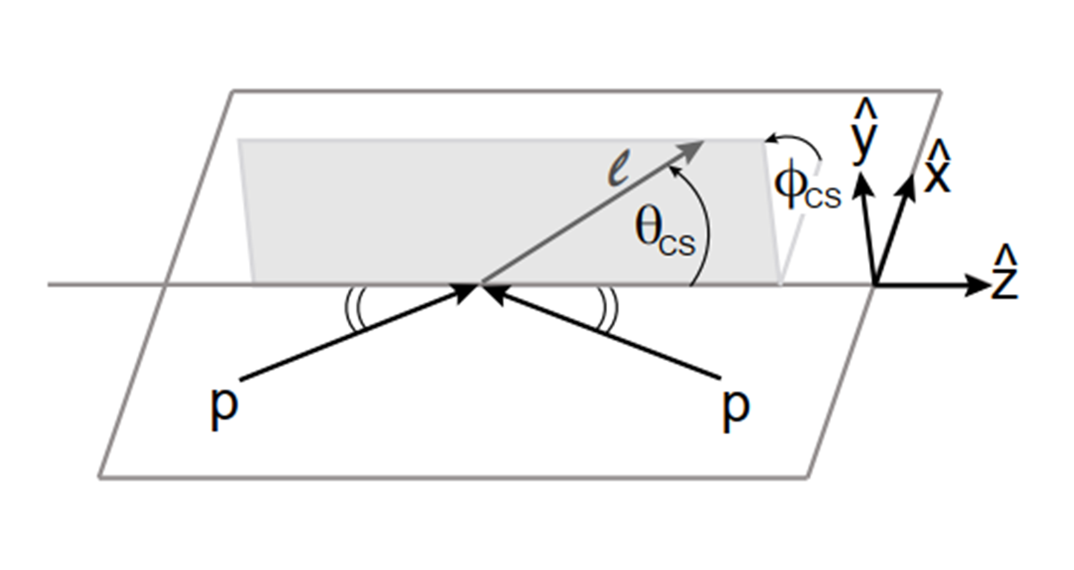
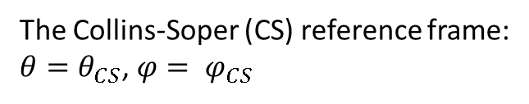
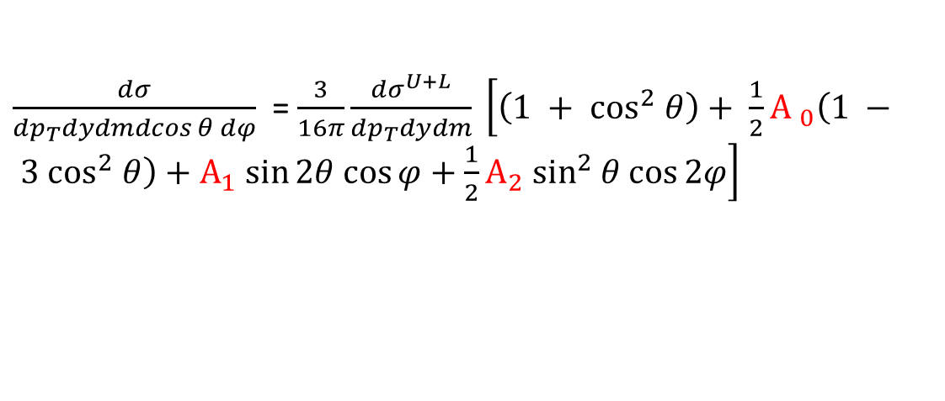
Measurement of the angular coefficients in J/ψ events using muon pairs
J/ψ → μ⁺ μ⁻ ; BF = 5.96 ± 0.03%, Γ = 5.1 ± 0.5 keV
$\frac{dσ}{{dp}_{T}dydmdcos θ dφ}$ = $\frac{3}{16π}\frac{{dσ}^{U+L}}{{dp}_{T}dydm} \left[\left(1 + \cos^{2} θ\right)+ \frac{1}{2}{A }_{0}\left(1 − 3 \cos^{2} θ\right)+А_{1} sin⁡2θ cos⁡φ+\frac{1}{2}A_{2} \sin^{2} θ cos⁡2φ\right]$
The Collins-Soper (CS) reference frame:
$θ=θ_{CS}$, $φ= φ_{CS}$
σ^{L}, σ^{T}, σ^{I} - the longitudinal, the transverse and the longitudinal-transverse interference cross sections
σ^{U+L} - the unpolarized production cross section
Mirkes E., Kim C. S. J/Ψ decay lepton distribution in hadronic collisions //Physics Letters B. – 1995. – Т. 346. – №. 1-2. – С. 124-128.

Slide 3
Dataset and Production
Monte-Carlo sample’s features are :
Generator: Pythia 8
Beams: UU pp at 10 GeV
PDF: NNPDF2.3 QCD+QED LO alpha_s(M_Z) = 0.130 (Pythia default PDF)
Process: J/ψ → μμ
Subdetectors: Micromegas, TS, ECal, RS, BBC, ZDC (sketch) (TOF/Aeg/FaRICH not added)
For this analysis 100 000 events (our estimation of the signal for 1 year First Phase) were produced using SPDROOT 4.1.7 (development branch).

Slide 4
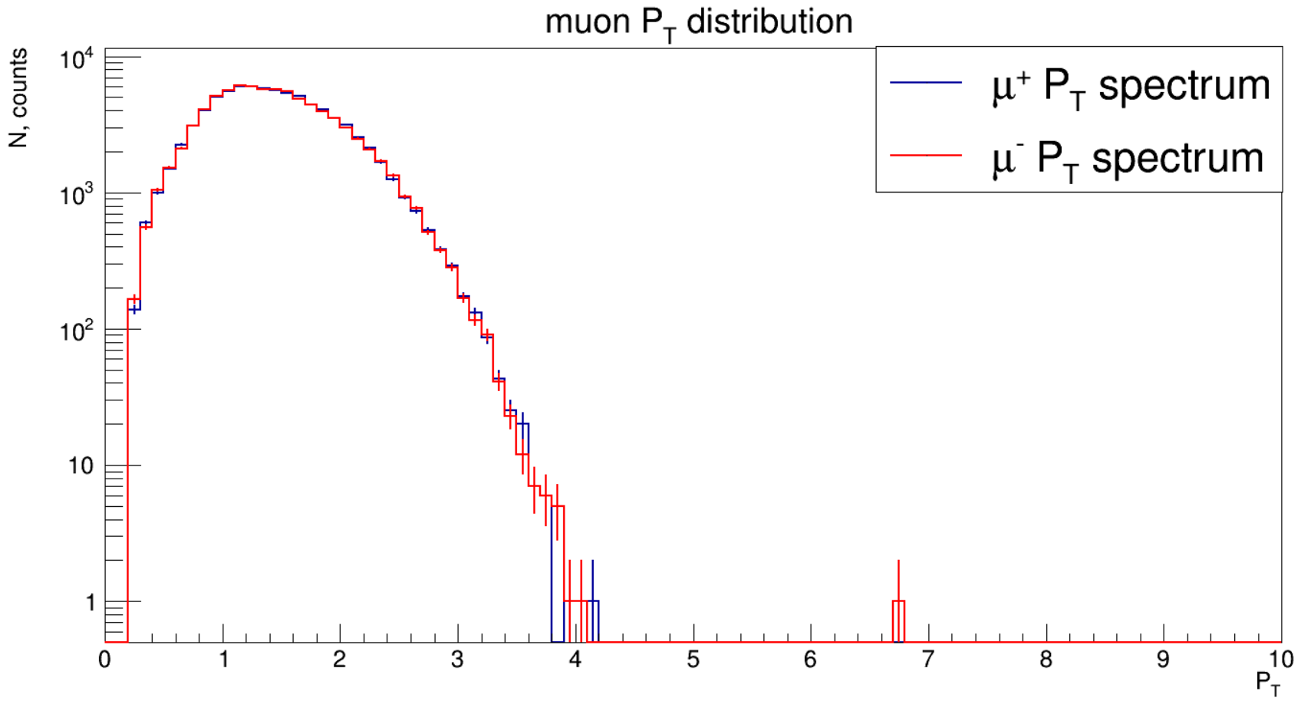
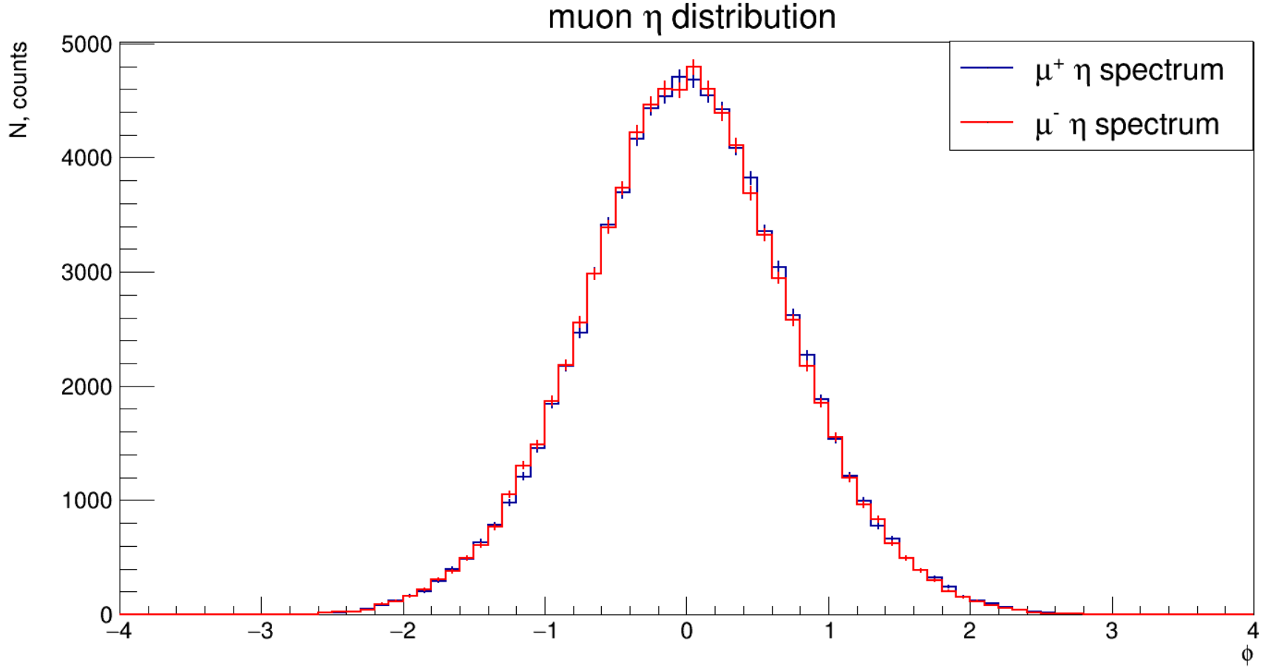
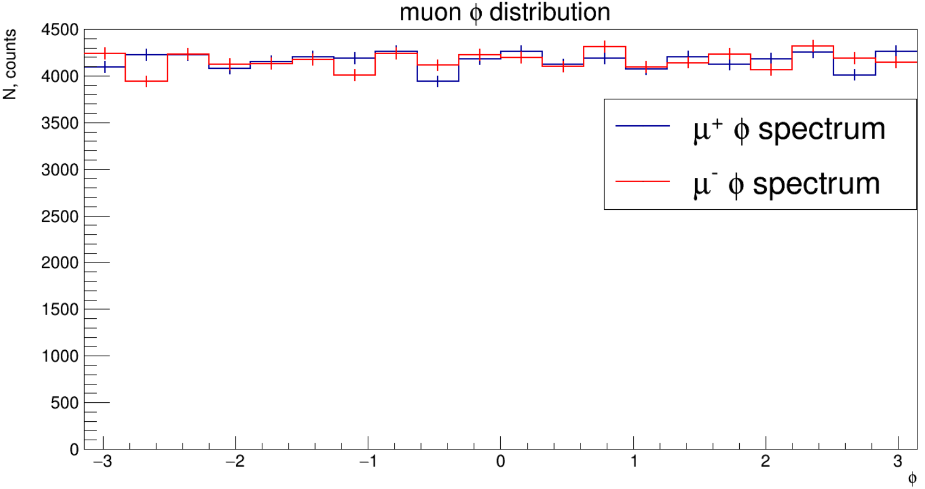
Kinematic distributions for muons
Currently, no RS info implemented into the analysis.
Muon tracks were selected (SpdTrackMC).
State of the track: FinalState, if it’s available; if not – extrapolation to PV with SpdTrackPropagatorGF.
particle PDG and mother PDG were checked
N_{ST} (B + EC) > 12
χ²/ndf < 3
P_{T} > 0.25
|η| < 3.3

Slide 5
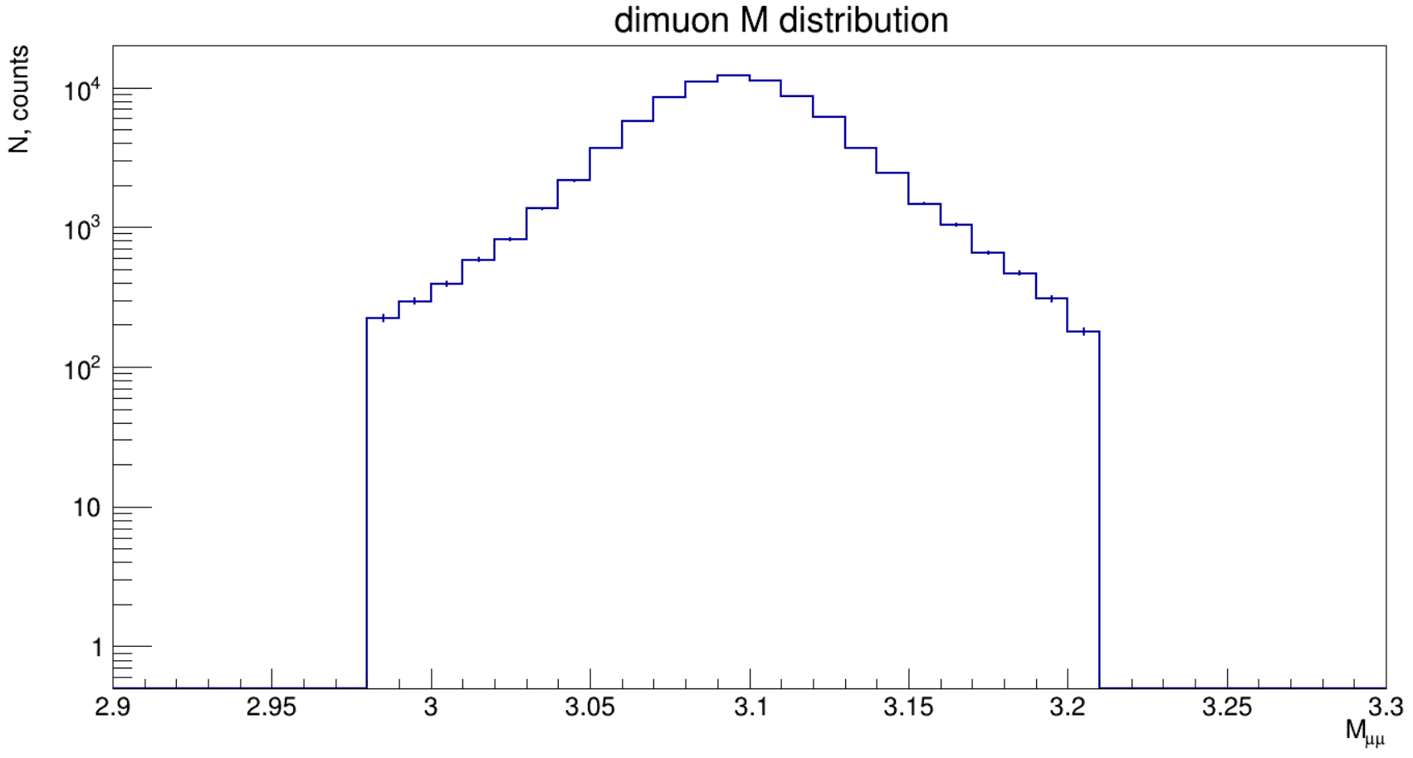
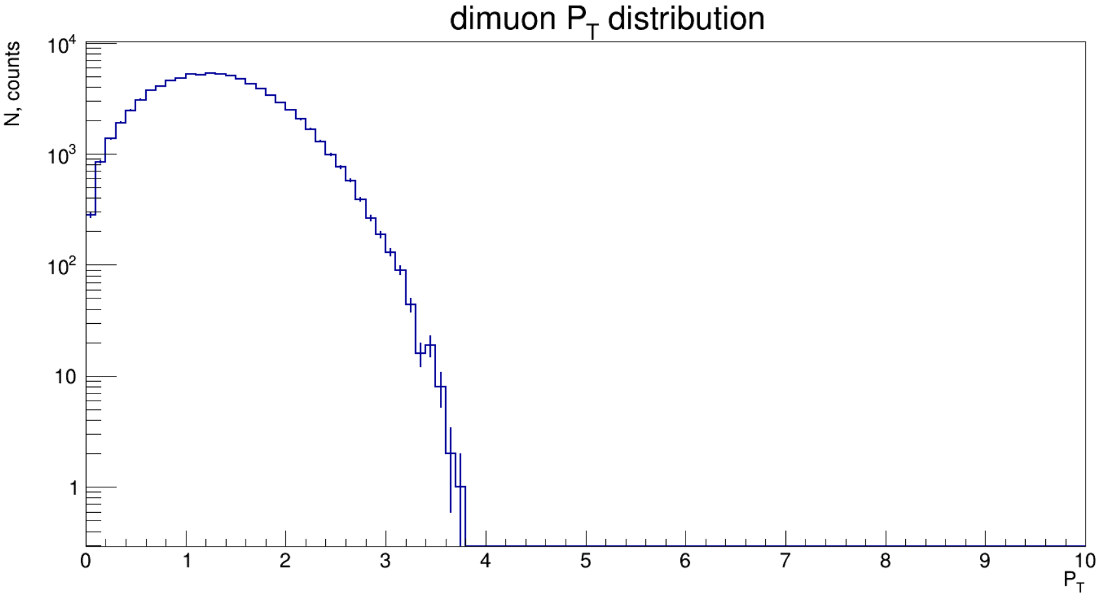
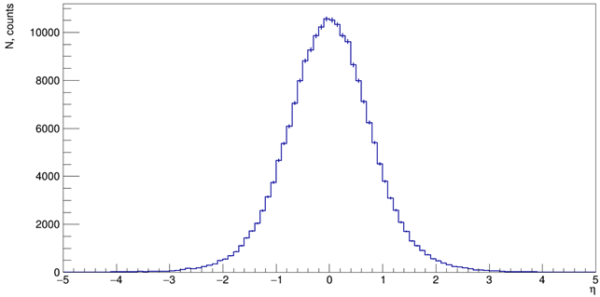
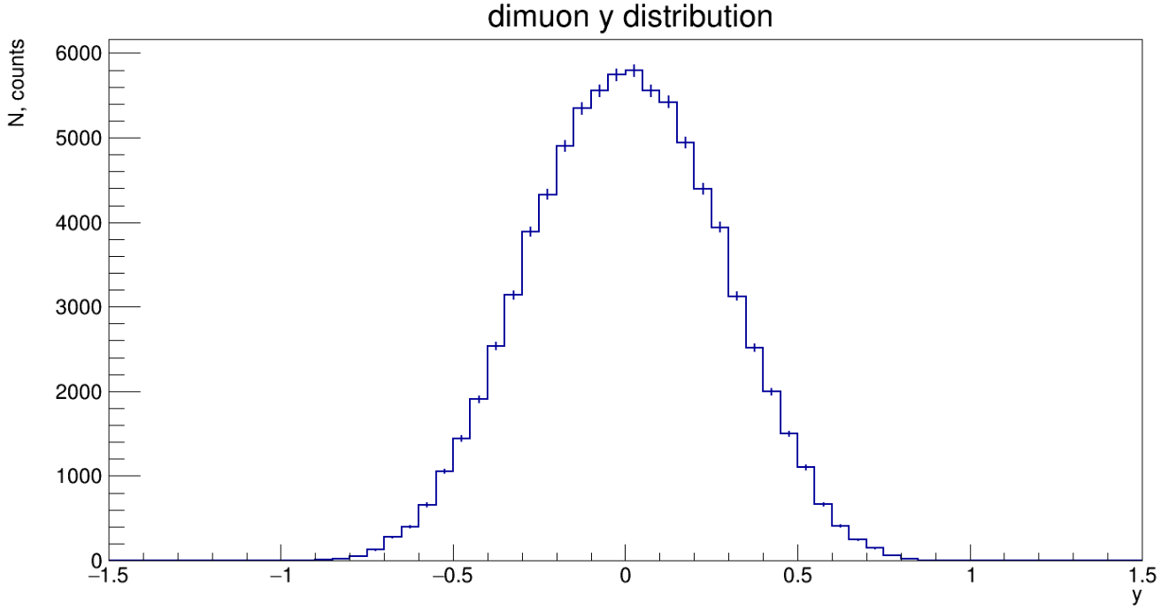
J/ψ kinematical distributions
J/ψ was constructed by its μ⁺μ⁻ pair. Only J/ψ from invariant mass window 3.097 – 3*σ < M_{J/ψ} < 3.097 + 3*σ were accepted. (σ = 40 MeV from 2 Gauss functions fit).

Slide 6
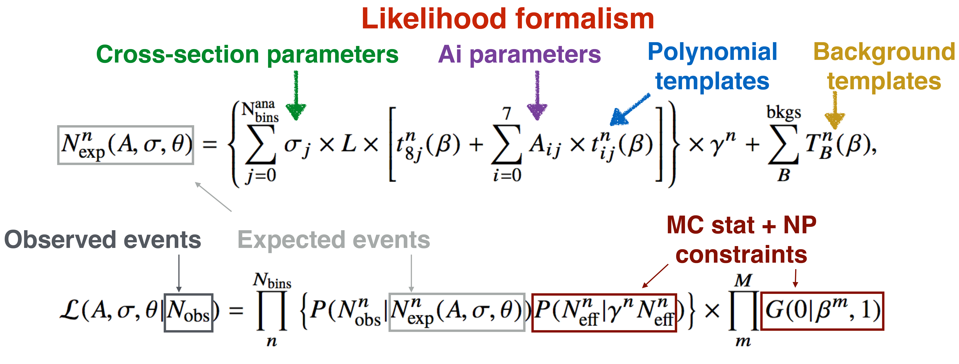
Methodology overview
Build reference coefficients Airef with moments method from MC predictions
Fold signal templates using Ai_{ref} and MC simulation
Build background, data templates
Make workspace (containing likelihood, data, parameters)
Fit Ais, σ, NPs
Folded polynomial templates are used to build a likelihood
Variational templates also present to take into account systematic uncertainties
Angular coefficients are parameters that normalize the polynomial templates
Cross-section scales all signal templates independently in each measurement bin
Background templates are added to likelihood
Maximum likelihood fit is performed to the reconstructed data to determine the coefficients and cross-sections in full phase space of leptons

Slide 7
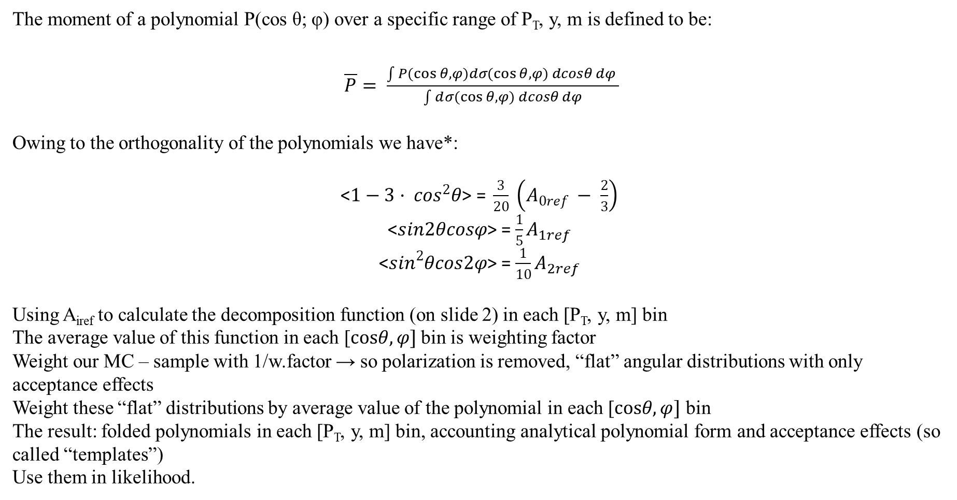
Building reference coefficients A_{iref} and folding polynomials
The moment of a polynomial P(cos θ; φ) over a specific range of P_{T}, y, m is defined to be:
$\overline{P}= \frac{\int{P(\cos{θ, φ)dσ(\cos{θ, φ) dcosθ dφ} }}}{\int{d}σ(\cos{θ, φ) dcosθ dφ}}$
Owing to the orthogonality of the polynomials we have*:
<$1−3· \cos^{2}θ\text{> = }\frac{3}{20} \left(A_{0ref} − \frac{2}{3}\right)$
<$sin2θcosφ$> = $\frac{1}{5}A_{1ref}$
<$\sin^{2}θcos2φ$> = $\frac{1}{10}A_{2ref}$
Using A_{iref} to calculate the decomposition function (on slide 2) in each [P_{T}, y, m] bin
The average value of this function in each [$cosθ,φ]$bin is weighting factor
Weight our MC – sample with 1/w.factor → so polarization is removed, “flat” angular distributions with only acceptance effects
Weight these “flat” distributions by average value of the polynomial in each [$cosθ,φ]$ bin
The result: folded polynomials in each [P_{T}, y, m] bin, accounting analytical polynomial form and acceptance effects (so called “templates”)
Use them in likelihood.
* - Mirkes E., Ohnemus J. W and Z polarization effects in hadronic collisions //Physical Review D. – 1994. – Т. 50. – №. 9. – С. 5692.

Slide 8

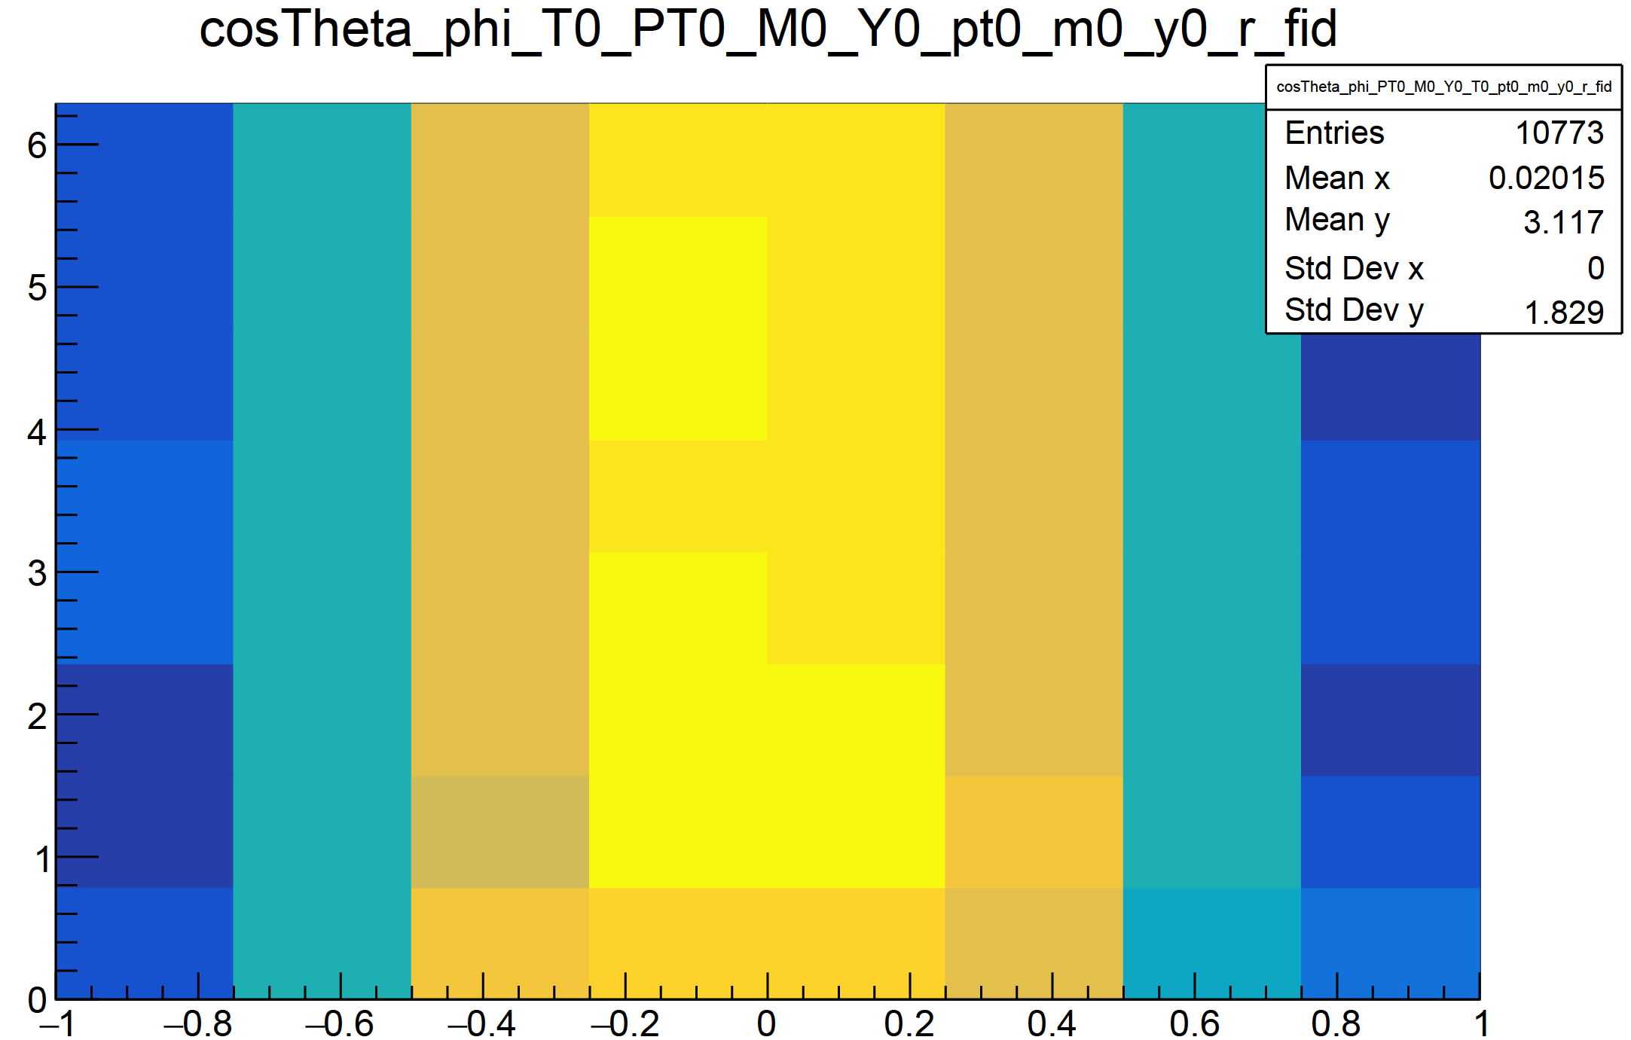
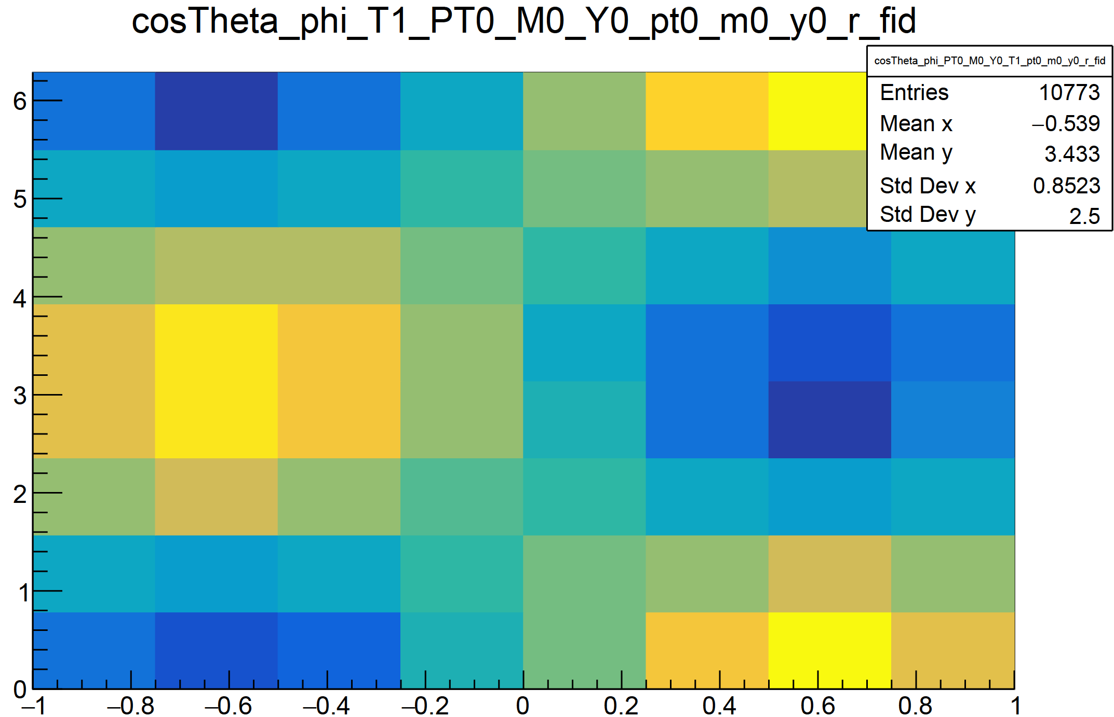
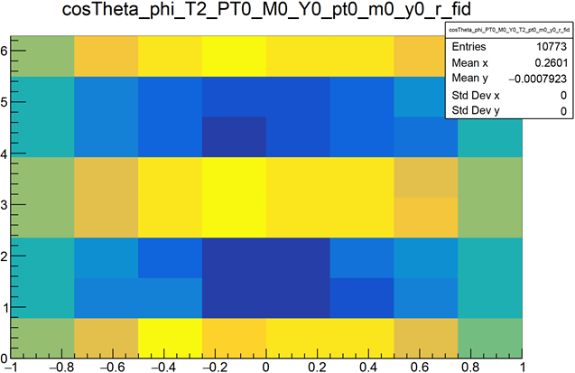

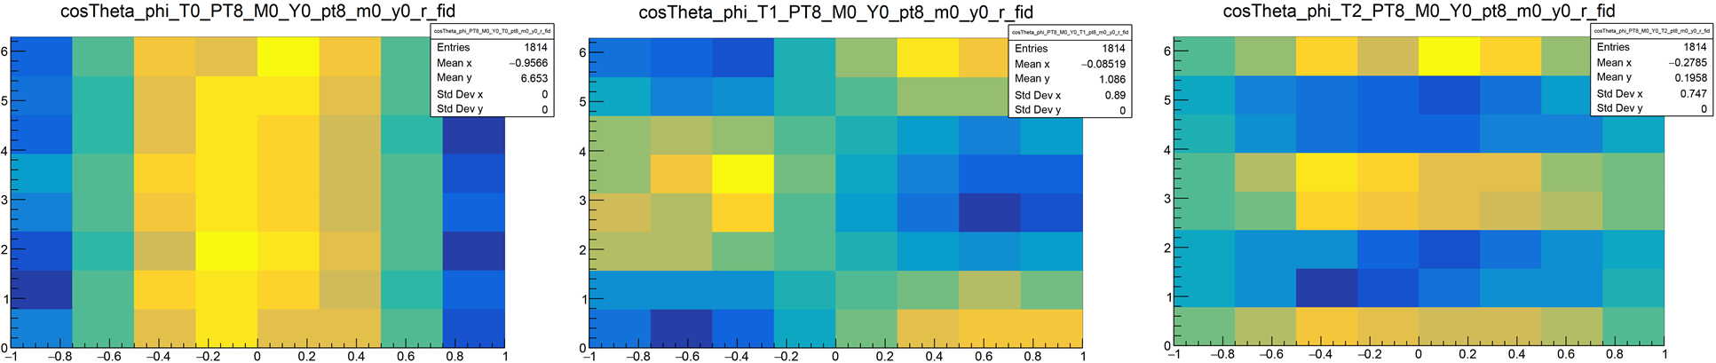
Templates: cosThetaCS vs phiCS
9 PT bins are [0; 0.6], [0.6; 0.84], [0.84; 1.1], [1.1; 1.32], [1.32; 1.51], [1.51; 1.75], [1.75; 2.0], [2.0; 2.6], [2.6; 4.0]

Slide 9
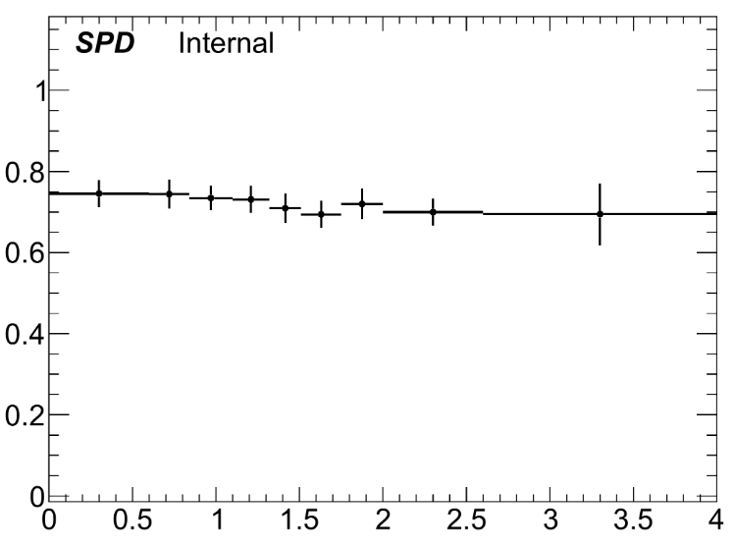
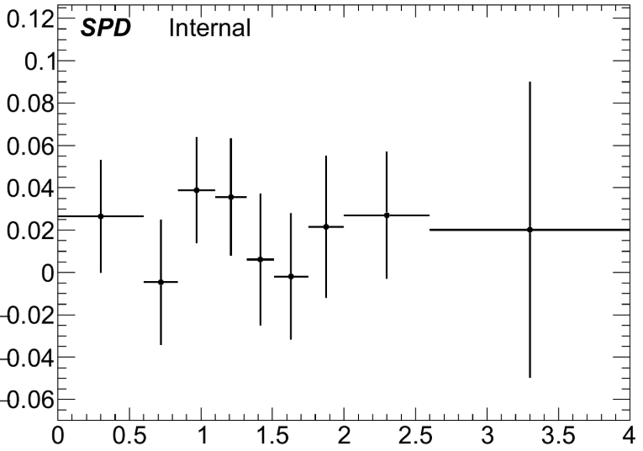
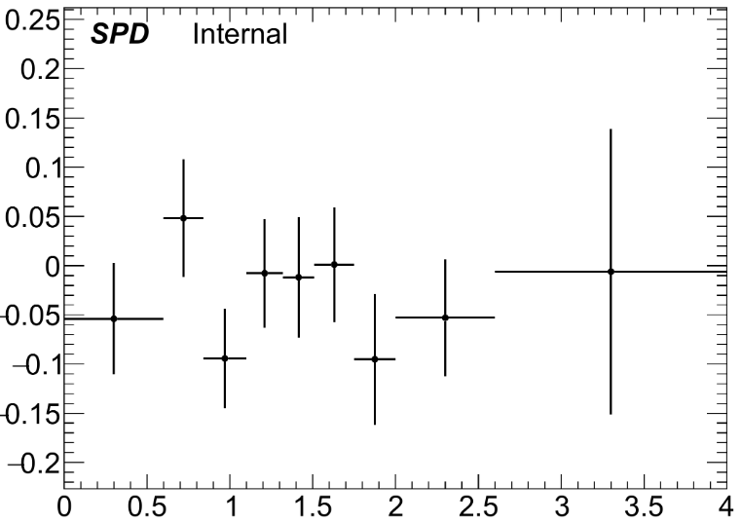
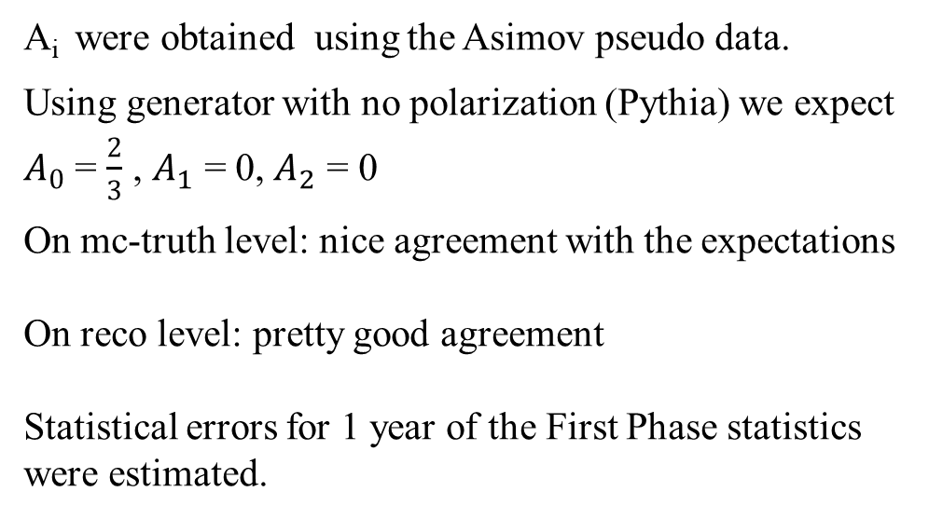
The PT-dependence of angular coefficients Ai
A₀
A_{i} were obtained using the Asimov pseudo data.
Using generator with no polarization (Pythia) we expect $A_{0}$ = $\frac{2}{3}$ , $A_{1}$ = 0, $A_{2}$ = 0
On mc-truth level: nice agreement with the expectations
On reco level: pretty good agreement
Statistical errors for 1 year of the First Phase statistics were estimated.
P_{T}
A₁
A₂
P_{T}
P_{T}

Slide 10
Results
At the moment we have:
The methodology was implemented, the expected values of the A_{i} were obtained using the Asimov pseudo data.
A_{i} are in agreement with the expected values on mc-truth level
A_{i} statistical errors for 1 year of the First Phase SPD number of events were estimated.
We plan:
The estimation of the coefficients using PID info and background.

Slide 11
BACKUP SLIDES

Slide 12
Dataset and Production
Pythia 8 instructions for J/ψ → μμ:
P8gen->SetParameters("Charmonium:gg2ccbar(3S1)[3S1(1)]g = on,off");
P8gen->SetParameters("Charmonium:gg2ccbar(3S1)[3S1(8)]g = on,off");
P8gen->SetParameters("Charmonium:qg2ccbar(3S1)[3S1(8)]q = on,off");
P8gen->SetParameters("Charmonium:qqbar2ccbar(3S1)[3S1(8)]g = on,off");
P8gen->SetParameters("Charmonium:gg2ccbar(3S1)[1S0(8)]g = on,off");
P8gen->SetParameters("Charmonium:qg2ccbar(3S1)[1S0(8)]q = on,off");
P8gen->SetParameters("Charmonium:qqbar2ccbar(3S1)[1S0(8)]g = on,off");
P8gen->SetParameters("Charmonium:gg2ccbar(3S1)[3PJ(8)]g = on,off");
P8gen->SetParameters("Charmonium:qg2ccbar(3S1)[3PJ(8)]q = on,off");
P8gen->SetParameters("Charmonium:qqbar2ccbar(3S1)[3PJ(8)]g = on,off");

