Slide 1
CNI-поляриметры в ускорительно –коллайдерном комплексе NICA
А.Н. Зеленский -МФТИ
ОИЯИ, 12 ноября, 2025

Slide 2
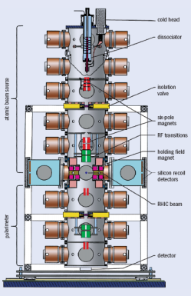
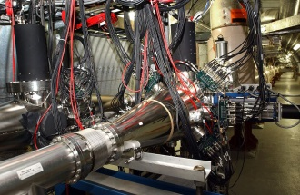
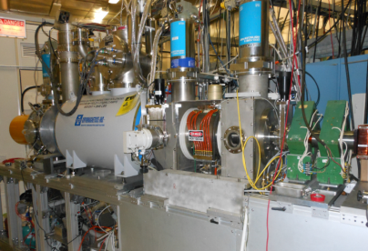
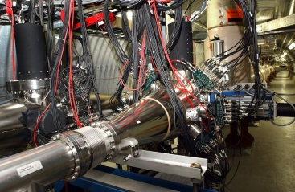
Polarization facilities at RHIC
L _{max} = 1.6 × 10³² s⁻¹cm⁻² 50 < √s < 510 GeV
Absolute H-jet
CNI-polarimeter
RHIC pC “CNI” polarimeters
RHIC
PHENIX
STAR
Siberian Snakes
Spin Rotators
Pol. H⁻ ion source
EBIS
LSP
LINAC
AGS, 24GeV
AGS pC “CNI” polarimeter
200 MeV polarimeter
BOOSTER, 2.5 GeV
Notes:
2

Slide 3

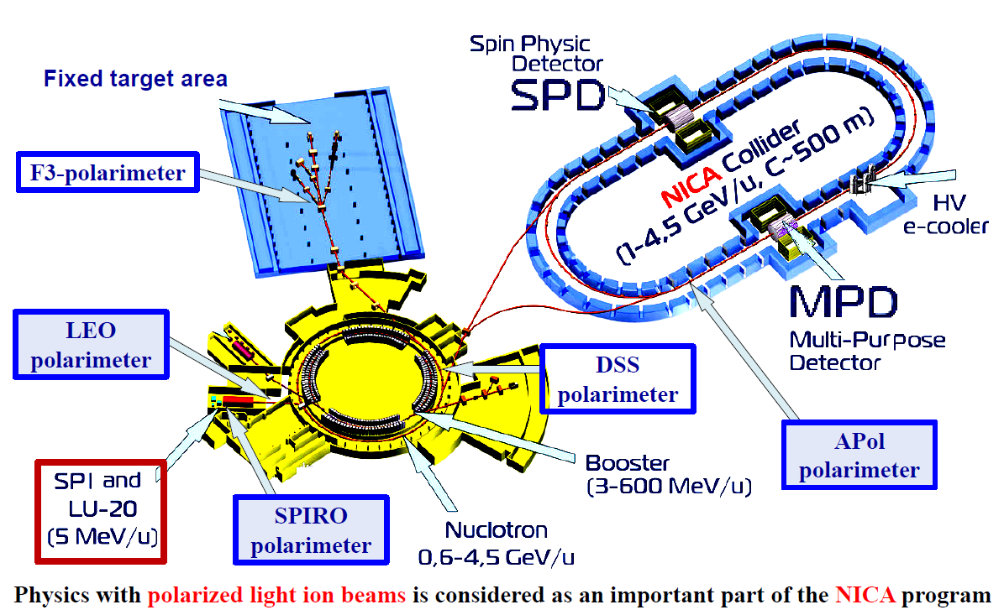
Пучки поляризованных протонов/дейтронов в коллайдере NICA
p-C CNI
p-C CNI
В.В. Фимушкин

Slide 4
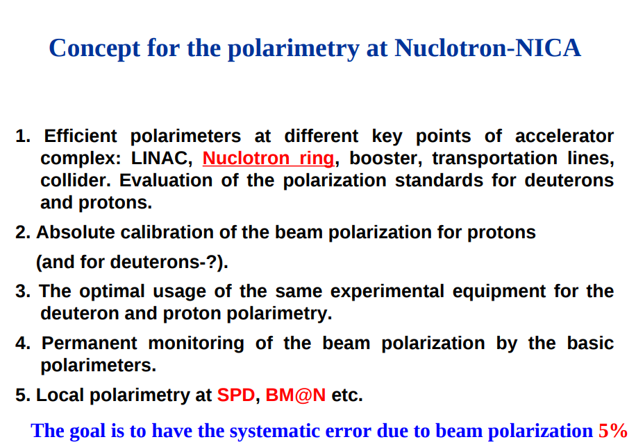
V.P.Ladygin, JINR

Slide 5
Proton-Carbon CNI polarimeters in AGS and RHIC.

Slide 6
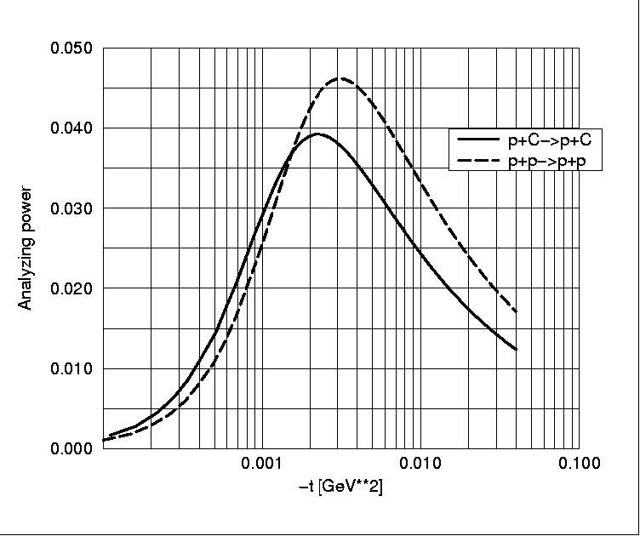
A_{N} for Coulomb -Nuclear Interference.
the left – right scattering asymmetry A_{N} arises from the interference of
the spin non-flip amplitude with the spin flip amplitude (Schwinger)
in absence of hadronic spin – flip contributions
A_{N} is exactly calculable (Kopeliovich & Lapidus):
hadronic spin- flip modifies the QED
“predictions”
interpreted in terms of Pomeron spin – flip
and parametrized as
∝(μ−1)_{p} ∝√σ^{pp}_{had}
A_{N} (t)
B.Z. Kopeliovich and L.I. Lapidus, Soviet. J. Nucl. Physics, 19, 114, (1974)
Notes:
6

Slide 7
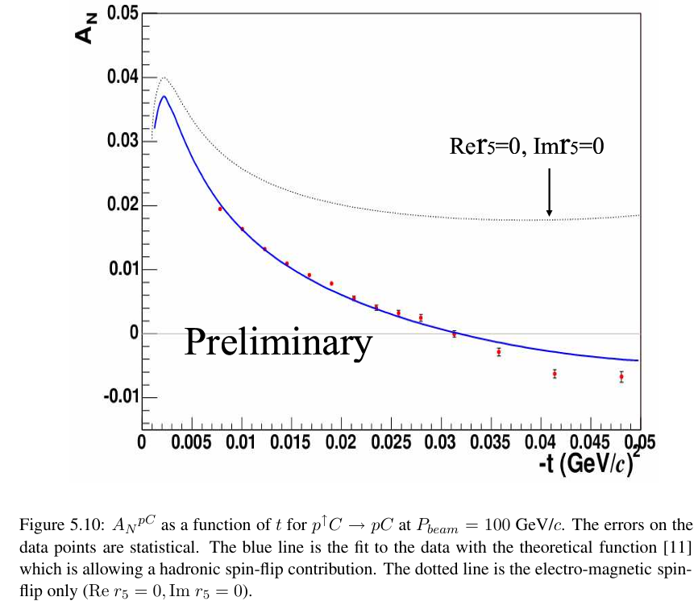
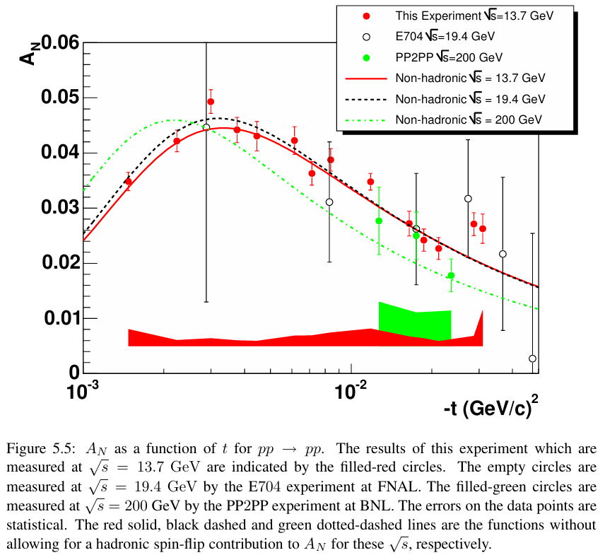
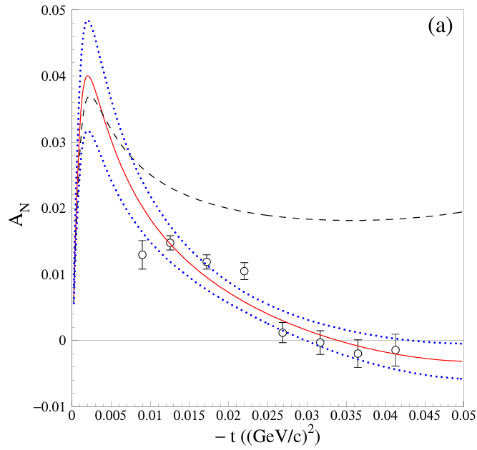
CNI –An experiments

Slide 8
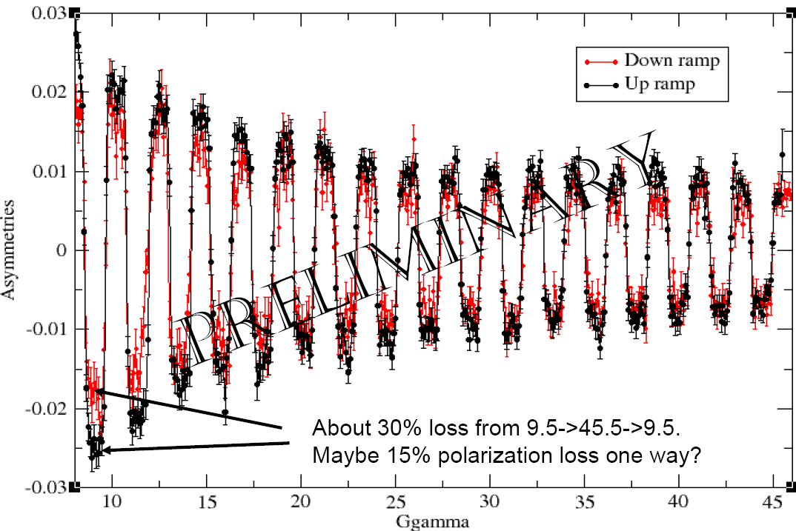
Polarization measurements on the energy ramp in AGS.
Notes:
8

Slide 9
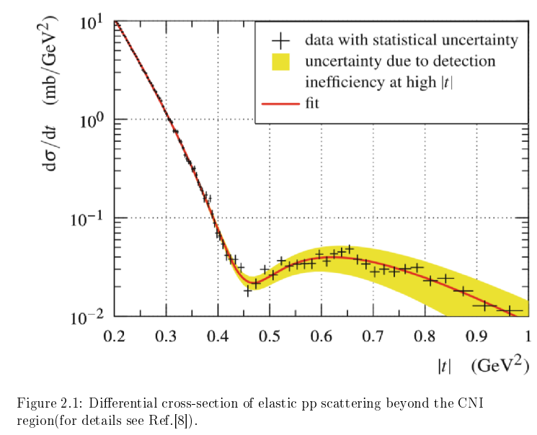
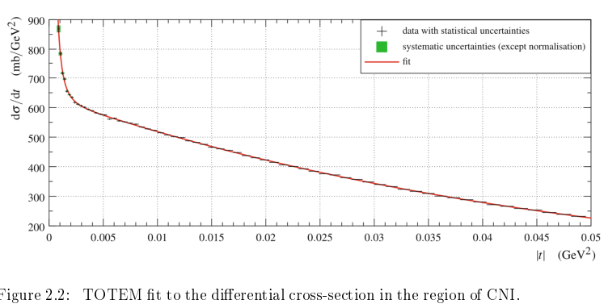

Slide 10
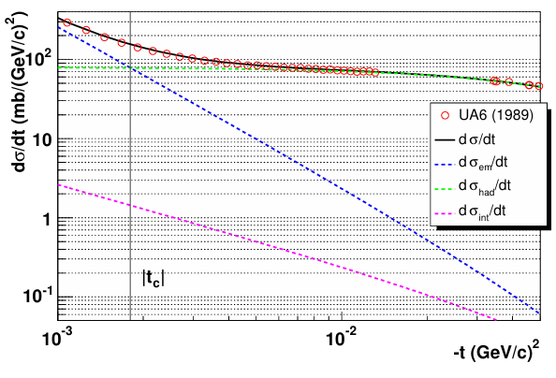
An experimental plot of dσ/dt vs. −t for pp elastic scattering at √s = 24.3 GeV.
0.003

Slide 11
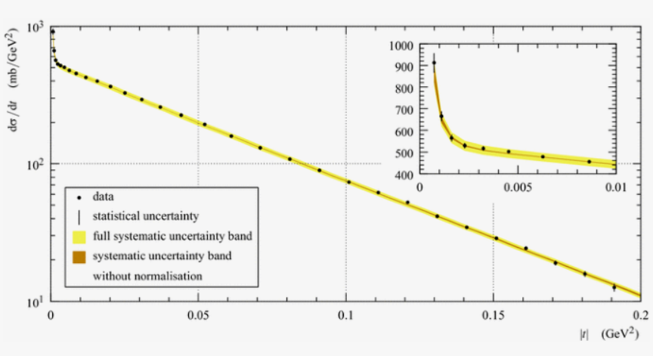
CNI = cross-section at 8 TeV LHC

Slide 12
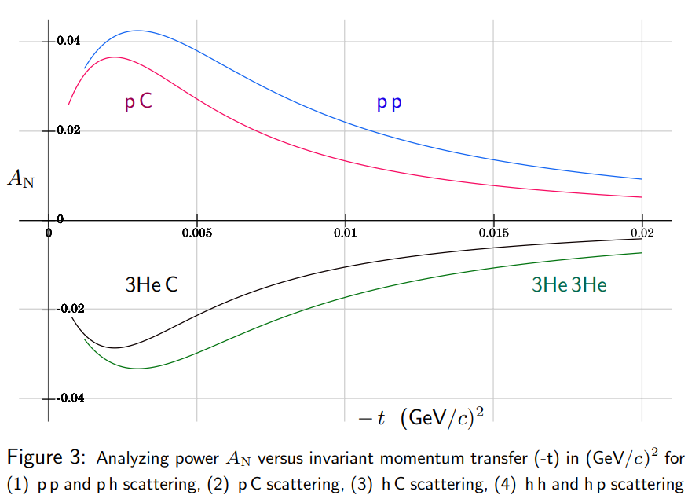

P-Carbon, 3He-Carbon analyzing power in CNI region

Slide 13
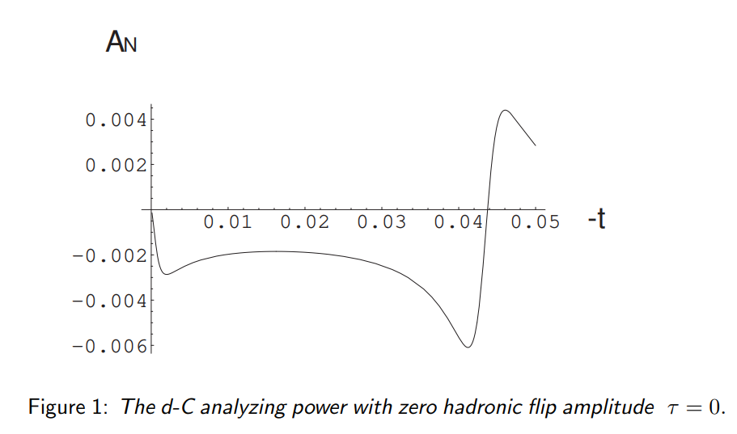
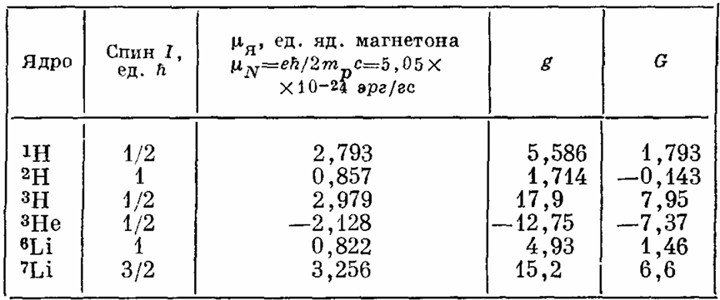
Deuteron-Carbon analyzing power in CNI region

Slide 14
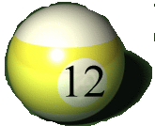
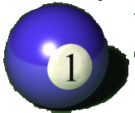

p-Carbon Polarimetry at RHIC
Carbon target
P_{beam} Required Accuracy ~5%
90º in Lab frame
Polarized proton
Recoil carbon

Slide 15
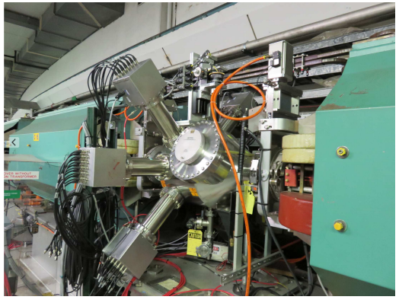
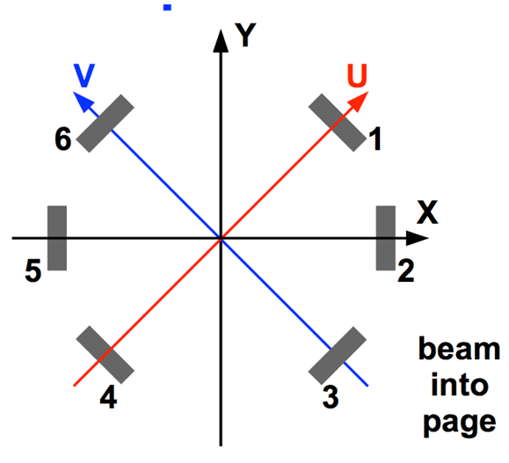
AGS –p-Carbon CNI polarimeter
Carbon ribbon Target, 50 -150 um wide
3.5 μg/cm² ~ 1.8*10^17 atoms/cm2
There are three pairs of detectors. The pairs
at ±45◦ measure both horizontal and vertical polarization components. The pair at 90◦ measures vertical component only.
A typical measurement (40M events) takes ~ 40 spills x 3.5 s ~3 min. and provides the statistical accuracy of the measured polarization of about P ~ 2%.
Bunch intensity – 2-3 *10^11 protons/bunch. One bunch in the ring.
810 m/c ~2.6 us. ~0.2*10^6 – target crossings in 600 ms ramp time
AGS –beam size
~ 1.0 mm -sigma

Slide 16
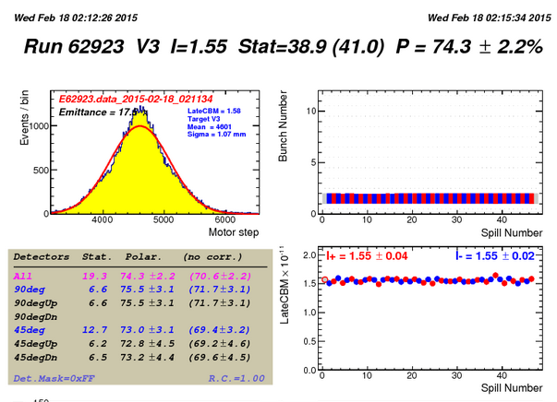
Polarization in AGS, 23 GeV
Beam size
Sigma ~1.0 mm

Slide 17
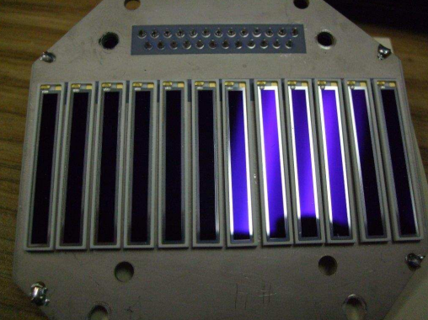
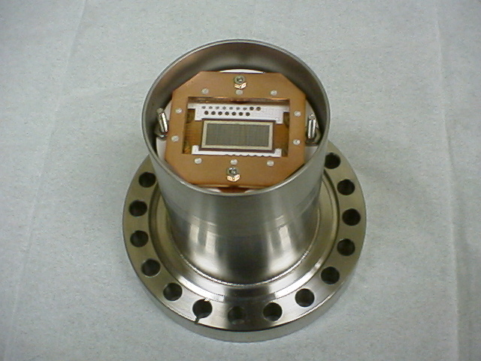
Детектор поляриметра AGS -это сборка из 12-ти Hamamatsu кремниевых пластин размером-50х5 мм2. Сигналы выводятся из вакуумной камеры наружу, где размещён 12-канальный предусилитель.

Slide 18
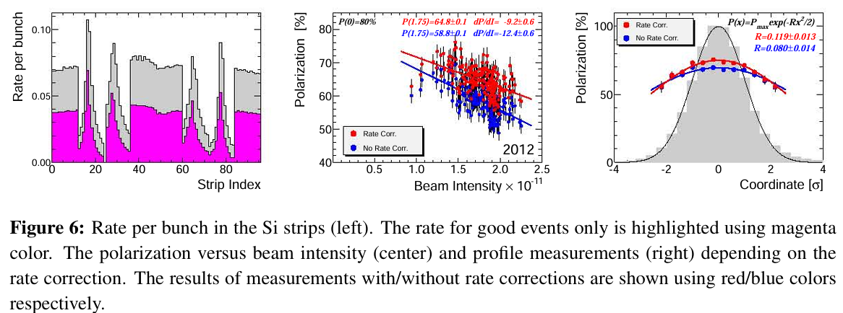
Rate corrections

Slide 19
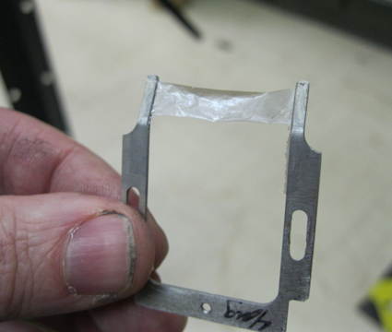
Wide target produced by laser ablation technique ~3 times stronger
~ 25-30 nm thickness,
~ 4 micro-gram/ cm2

Slide 20
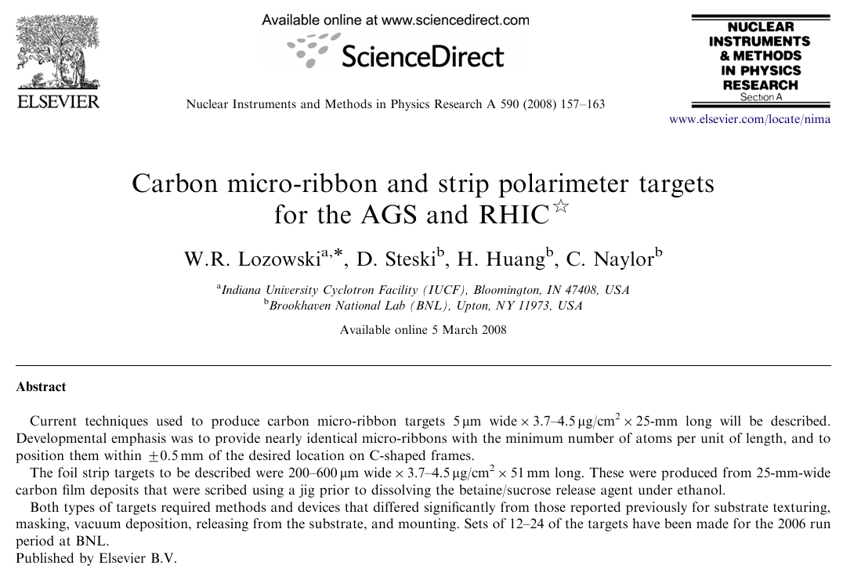

Slide 21
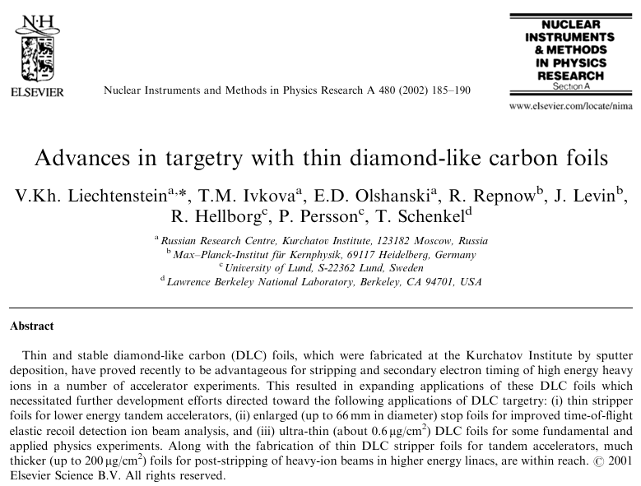

Slide 22
Скорость счёта в AGS-один банч
При типичной интенсивности поляризованных протонов в банче -2.5·10¹¹ р/банч и времени измерения на flattop AGS -1 сек, число зарегистрированных событий во всех параллельно включенных детекторах составляет 1 млн/цикл ускорения AGS,
0.6 сек флаттоп.
При этом ширина мишени всего -50 мкм, чтобы не превысить порог ограничений на скорость счёта системы сбора данных. При меньшей интенсивности пучка (как это может быть на начальном этапе работы в Нуклотроне), возможно компенсировать уменьшение скорости счёта увеличением ширины мишени в 10-100 раз, причём надёжность работы мишеней только возрастёт.
Для измерения с 2%-статистической точностью необходимо набрать 40 млн. событий, что требует 40 циклов ускорителя по 5 сек т.е. примерно 200 сек.
При типичной интенсивности поляризованных протонов в банче -2.5·10¹¹ р/банч и времени измерения на flattop AGS -1 сек, число зарегистрированных событий (ядер углерода в заданном кинематическом диапазоне, Рис.6) во всех параллельно включенных детекторах составляет 1 млн/цикл ускорения AGS. При этом ширина мишени всего -50 мкм, чтобы не превысить порог ограничений на скорость счёта системы сбора данных. При меньшей интенсивности пучка (как это может быть на начальном этапе работы в Нуклотроне), возможно компенсировать уменьшение скорости счёта увеличением ширины мишени в 10-100 раз, причём надёжность работы мишеней только возрастёт. Для измерения с 2%-статистической точностью необходимо набрать 40 млн. событий, что требует 40 циклов AGS ускорителя по 4 сек т.е. примерно 160 сек.

Slide 23
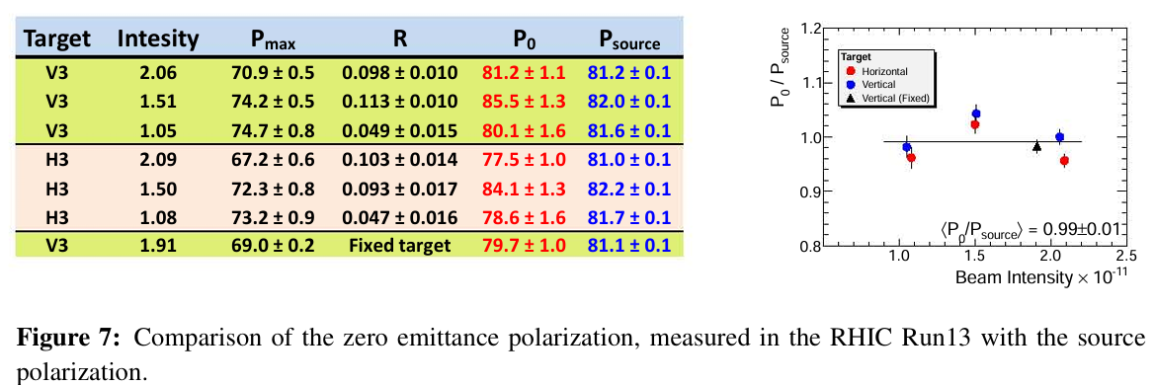
Comparison of the zero -emittance polarization, measured in the RHIC Run13 with the source polarization.

Slide 24
Polarization measurements on the energy ramp in AGS.
Notes:
24

Slide 25
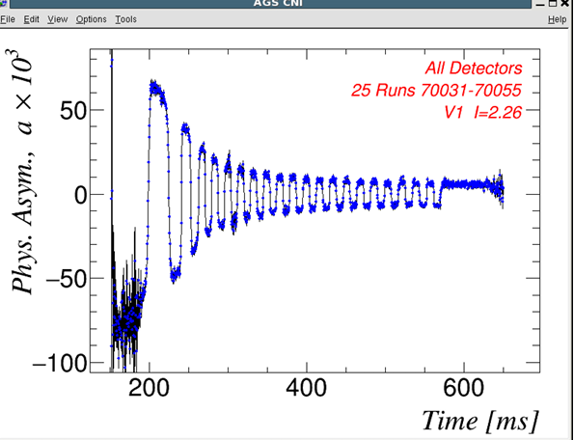
The asymmetry measured on the AGS ramp as function real time. The spin flips at every integer of Gγ are due to the presence of two partial Siberian snakes.
2.3 to 23.4 GeV energy ramp.
Polarization losses -80 to 70 %

Slide 26
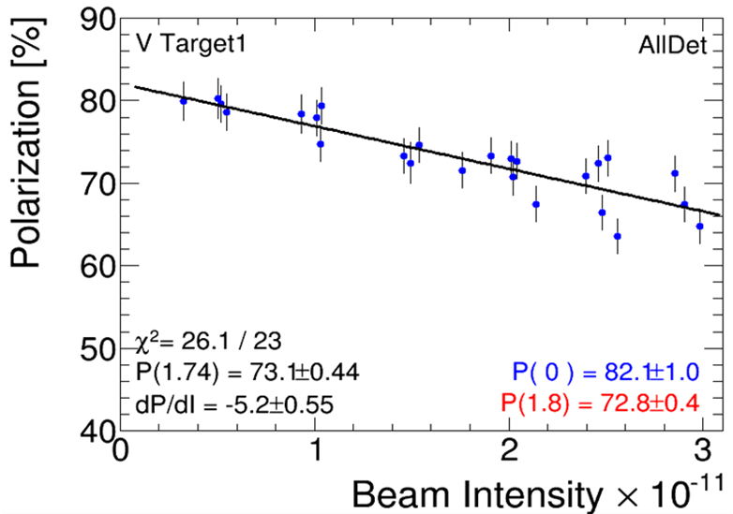
Polarization at 23 GeV in AGS, Run-2017

Slide 27
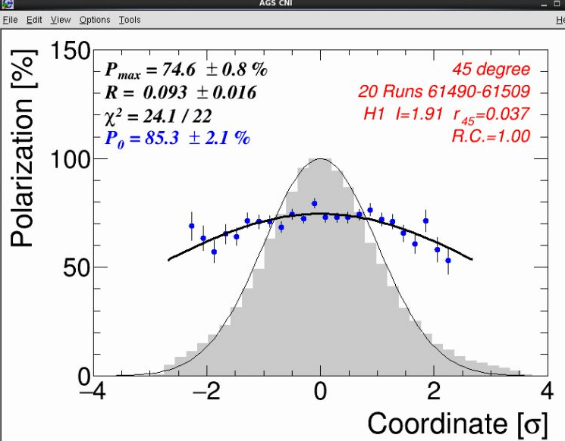

Slide 28
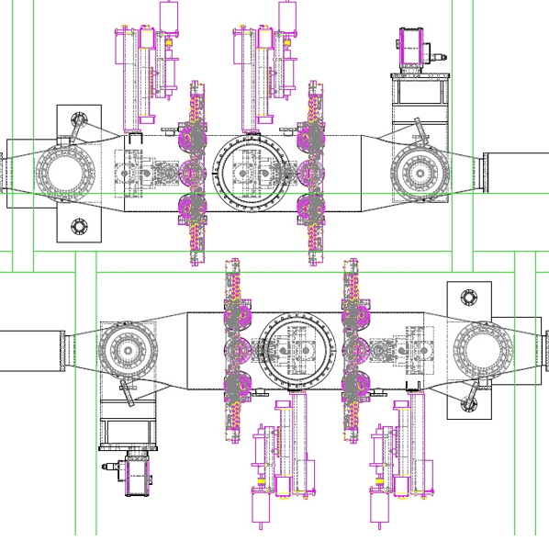
Схема вакуумной системы, мишенных узлов и детекторов поляриметров RHIC.

Slide 29
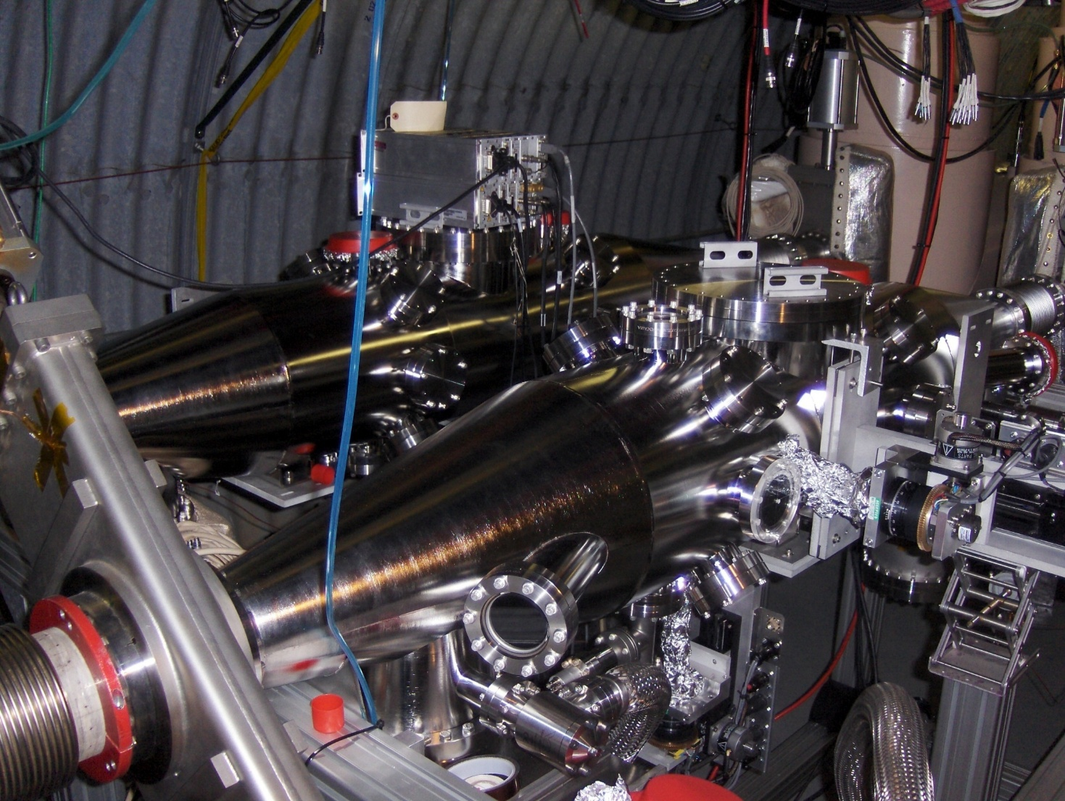
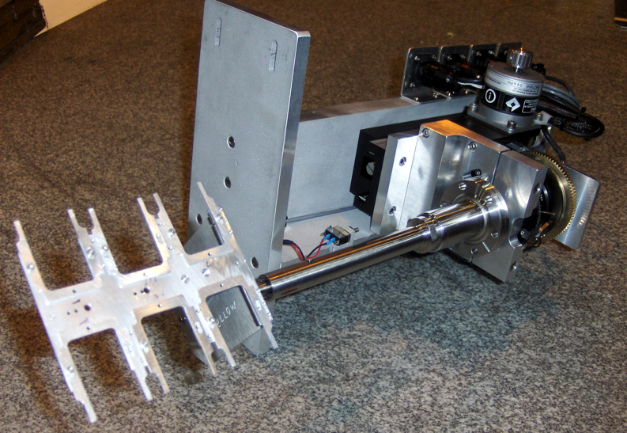
RHIC p-Carbon CNI polarimeter

Slide 30
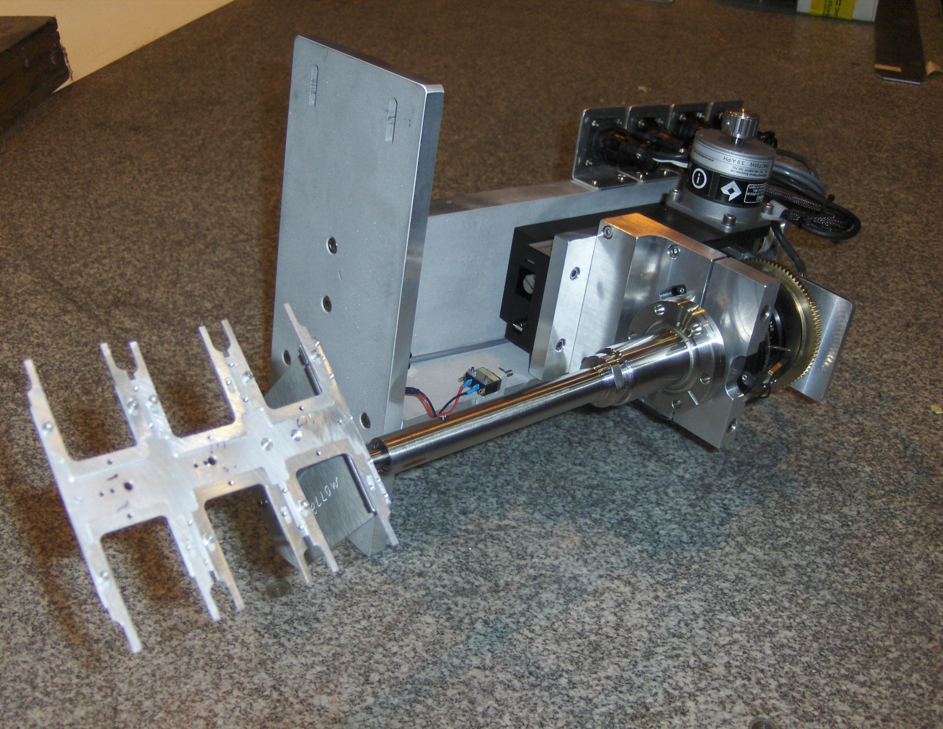
New target motion mechanism
Notes:
30

Slide 31
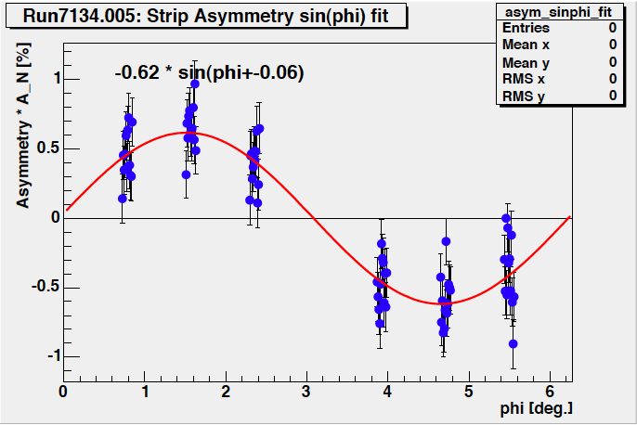
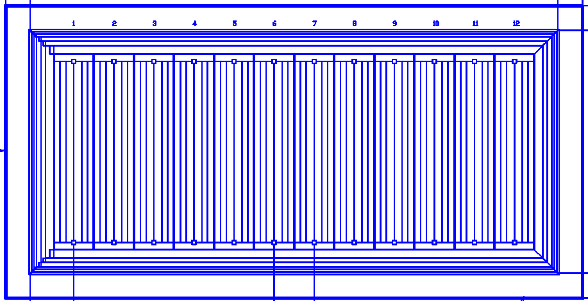
Detector Setup
2mm pitch 12 strips
6
1
10mm
18cm
72 strips in total
5
2
Si strip detectors
(TOF, E_{C})
4
3
Detector port (inner view)
SSD
Ultra thin Carbon ribbon Target, 20 um wide
3.5 μg/cm² ~ 1.8*10^17 atoms/cm2
Bunch intensity – 2-3 *10^11 protons/bunch.
112 bunches in the RHIC ring,
~ 100 ns bunch time spacing. ~10 MHz crossing rate
~ 2*10^18 (0.3A)-number of the beam target crossings

Slide 32
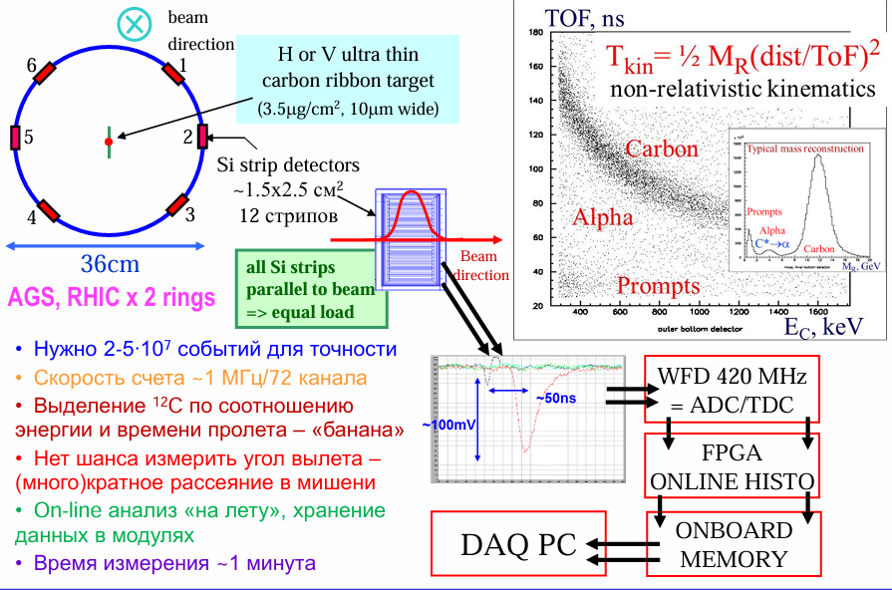

Slide 33
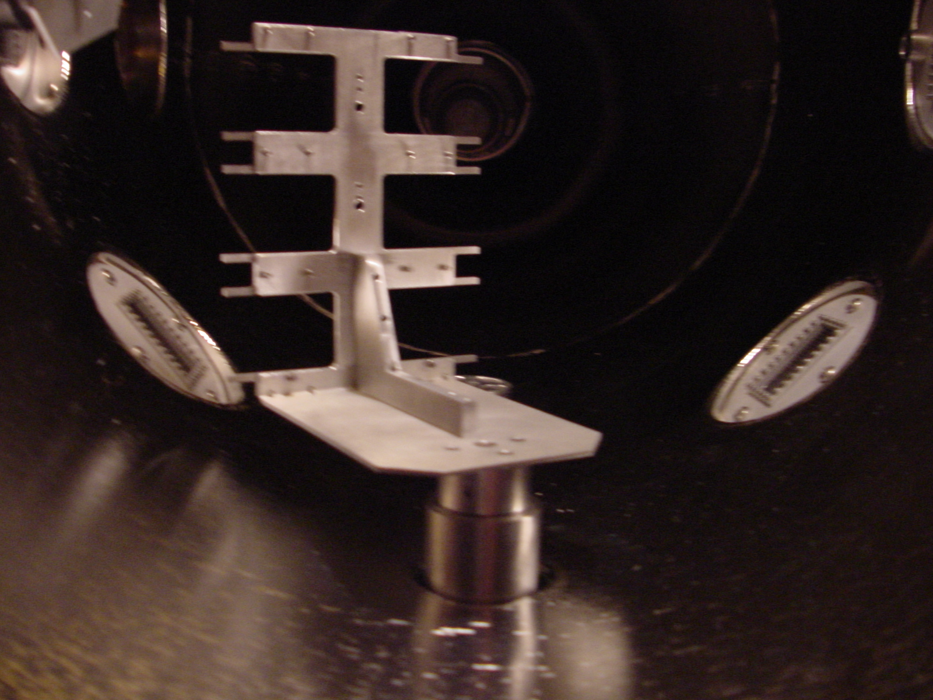
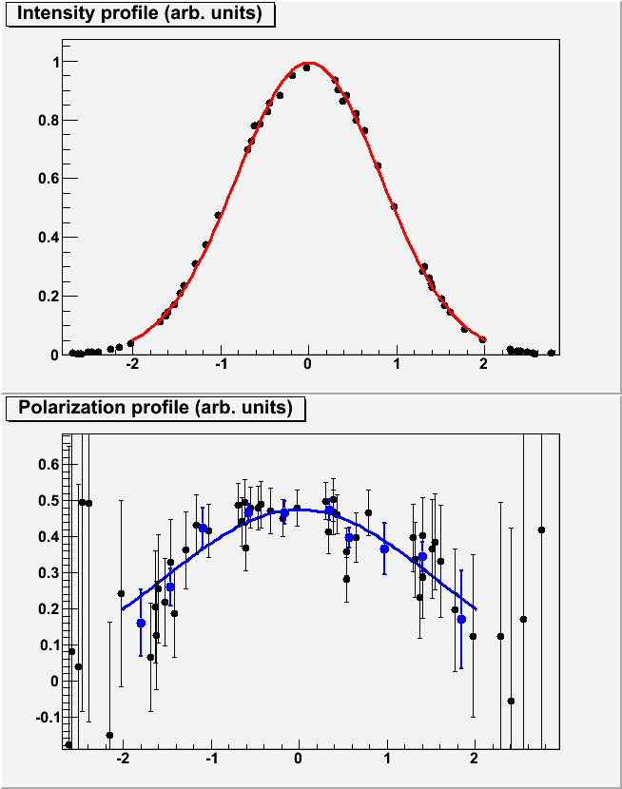
The target ladder.
Notes:
33
33

Slide 34
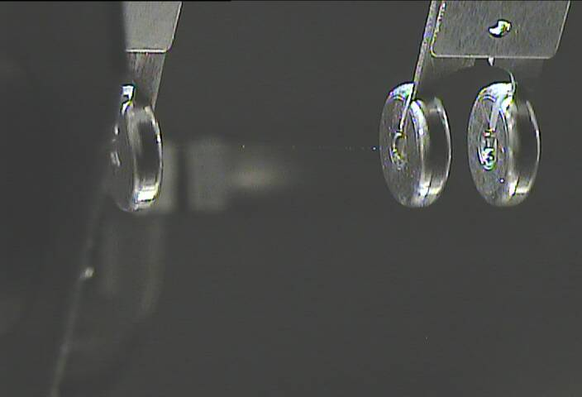
Very thin Carbon strip target-20um x 25 nm L=25 mm

Slide 35
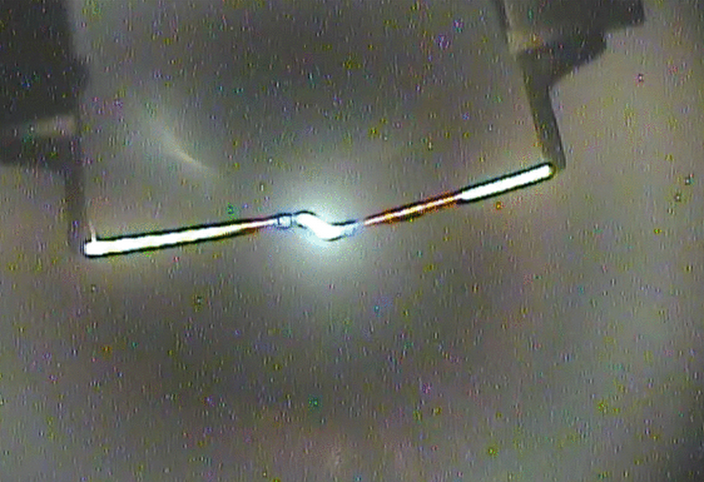
Carbon strip target deformation due to electrostatic interaction with the beam at 255 GeV.

Slide 36
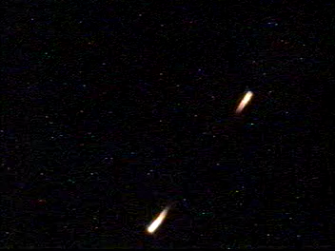

Slide 37
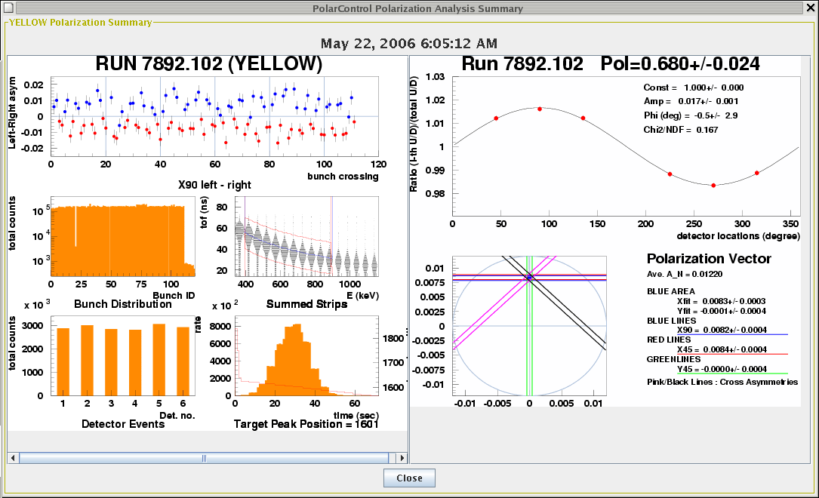
Polarization measurements in RHIC at 100 GeV
Polarization at 100 GeV
in RHIC 60-65%.
Notes:
37

Slide 38
H-jet CNI- polarimeter

Slide 39
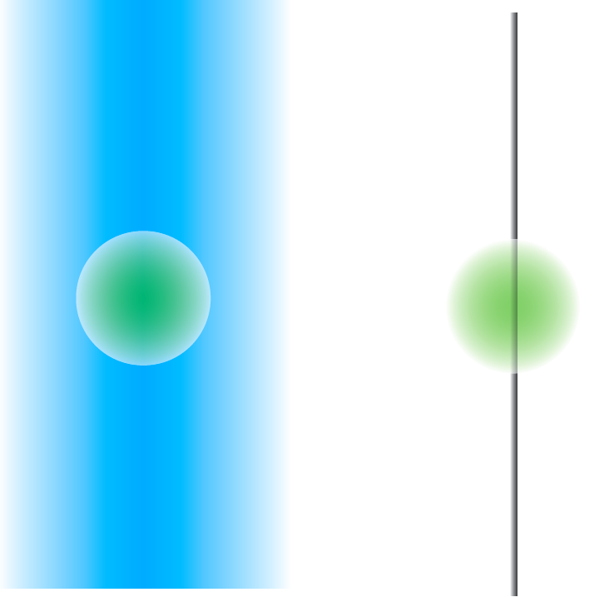
Hydrogen Gas Jet and Carbon Wire Targets.
Gas Jet Target
Carbon Wire Target
Beam Cross Section
⬇
FWHM~1.8mm
Average P_{ave}
Peak P_{peak}
Notes:
39

Slide 40

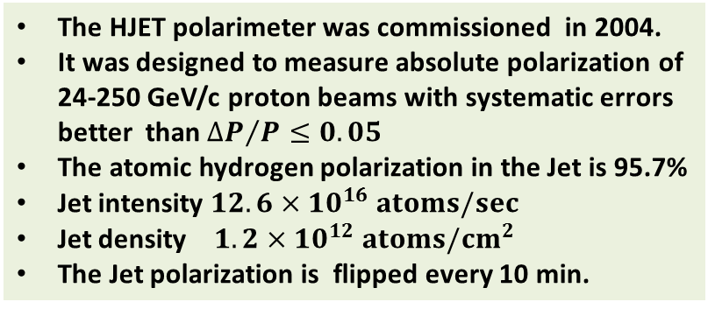
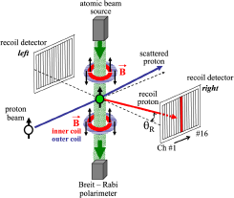

H-jet polarimeter
17 October 2017
PSTP 2017. HJET in RHIC Run17.
40
Notes:
40

Slide 41
H-Jet polarimeter.
Elastic scattering: Interference between electromagnetic and hadronic amplitudes in the Coulumb-Nuclear Interference (CNI) region.
Forward scattered
proton
RHIC proton beam
H-jet target
recoil proton
<5%
P_{target} is measured by Breit- Rabi Polarimeter
Notes:
41

Slide 42
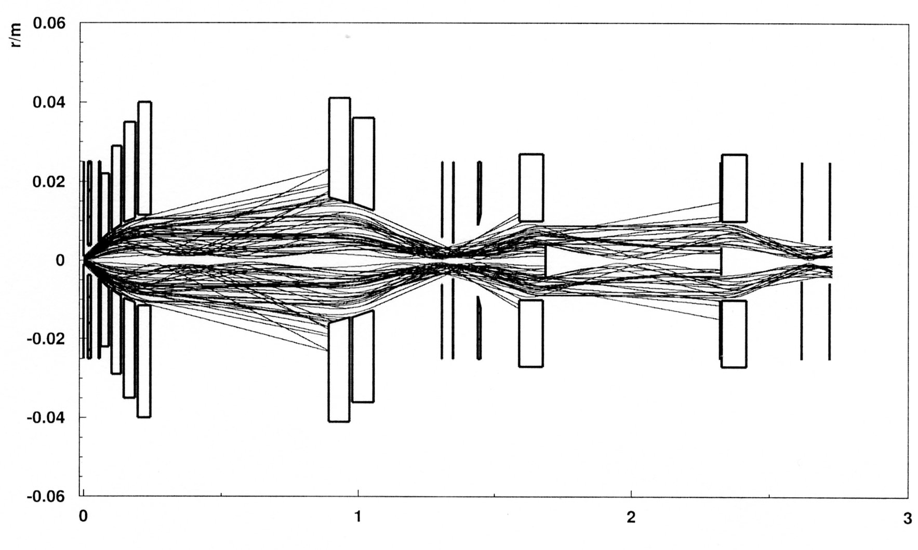

Spin filtering technique. Atomic Beam Sources.
Hydrogen atoms with electron polarization: m_{J}=+1/2 trajectories
Breit-Rabi polarimeter
RHIC beam crossing
RF transition, polarization transfer
from electrons to protons
Magnet system design, NIM A256, (2006)
T.Wise, W.Haeberli, H.Kolster et al.
Ne-Fe-B permanent magnet
sextupole - 1.7 T
gradient 5.7 T/cm
Notes:
42

Slide 43


Recoil detector can detect H-Jet-target !
Using 2.0 mm diameter compression tube
Using RHIC-beam and Recoil detector
Fix RHIC proton beam position (diameter σ ~1mm).
Move H-Jet-target system for every 1.5 mm step.
Find the best collision point !

Slide 44


H-jet as a luminescence beam intensity profile monitor

Slide 45
















How to identify elastic events ?
Forward scattered
proton
Ch# ∝ θ_{R}, θ_{R} big ⇒ T_{R} big ⇒ fast protons
proton beam
proton target
Ch#1
Ch#2
Ch#3
Ch#14
Ch#15
Ch#9
Ch#6
Ch#11,12
Ch#13
Ch#16
Ch#7
Ch#8
Ch#5
recoil proton
Ch#4
Ch#10
Ch#1-16
source for energy calibration
²⁴¹Am(5.486 MeV)
θ_{R}
#16
Ch#1
Array of Si detectors measures T_{R} & ToF of recoil particles.
Channel # corresponds to recoil angle θ_{R}.
2 correlations (T_{R} & ToF ) and (T_{R} & θ_{R} ) → the elastic process

Slide 46





P-P Collision chamber

Slide 47




New Si-strips detector assembly. Better energy resolution. Large solid angle and kinematic range.
47

Slide 48


Slide 49



Absolute Beam Polarization measurement in Run 2017, 255 GeV
A typical result for 8-hrs store: ‹ P › = (~ 56 ± 2.0 stat ± 0.3syst) %
Statistical error summary:
PSTP 2017. HJET in RHIC Run17.
49
Notes:
49

Slide 50
H-jet polarimeter at RHIC
The polarized H-jet target thickness is 1.2∙ 10¹² atoms/cm2 and with RHIC circulating current ~ 0.3 A (110 bunches 2∙ 10¹¹ bunch intensity, 1.8∙10¹⁸ protons/s) the luminosity is 2.2 ∙10³⁰ cm⁻²s⁻¹
“Point” like target is greatly beneficial for elastic event identification.
The polarimeter Si-strip detectors covers all kinematic range of recoil protons (in CNI region) and about 20% solid angle which gives the statistical accuracy for one 8 hrs store about 2.0%.
The proton polarization is mostly determined by the holding field magnetic field 1.2 kG and is equal to 95.5% (efficiency of the RF transitions are 99.88 % and the polarization dilution by the molecular gas contamination does not exceed 0.5%). At 1.5 kG polarization is 97%.

Slide 51





Slide 52
H-jet is the absolute high precision polarimeter !
High (~4.5%) analyzing power in a wide energy range (23-255 GeV).
High event rate due to high intensity (~300 mA) circulated beam current in the storage ring and high polarized H-jet thickness in the collision point.
Non-destructive.
No scattering for recoil protons.- windowless.
“Point” like target. Clean elastic scattering event identification.
Straightforward calibration with Breit-Rabi polarimeter.
Most of the false asymmetries are cancelled out in the ratio:
P _{beam} =( 1/A)Beam _{asym} / Target _{asym}
A typical result for 8-hrs store: ‹ P › = (~ 56 ± 2.0 stat ± 0.3syst) %
Notes:
52

Slide 53
CNI – H-jet polarimeter with the unpolarized hydrogen cluster-jet
The accuracy achieved in determining A_{N}(t) allows one to use a higher density unpolarized hydrogen jet target in a high precision absolute polarimeter.
The unpolarized H-jet thickness of a 10¹⁴ -10¹⁵ H2/ cm2 can be produced by the cluster-jet technique, which was developed for the PANDA experiment at GSI[29].
Considering a possibility to increase the recoil proton detectors solid angle, one can expect 1000 times higher elastic pp event rate compared to that in the RHIC HJET measurements.
For such a polarimeter, only a 3 min. exposure is needed to determine the beam polarization with a statistical accuracy of stat P~ 1%, while the systematic uncertainty can be kept as low as ΔP /P ~1%.
Therefore, an unpolarized jet can also provide accurate measurement of the polarization decay time and, with additional detectors at different azimuthal angles, the beams spin tilt.

Slide 54
Back-up slides

Slide 55



Slide 56

A.Poblaguev, PSTP 2017

Slide 57
Proton polarization measurements in AGS and RHIC at the beam energies 24-250 GeV) are based on Proton-Carbon and Proton-Proton ( H-jet polarimeter) elastic scattering in the Coulomb Nuclear Interference (CNI) region.
The CNI polarimeters are the essential tools for polarized proton acceleration setup and operation and provide polarization values for RHIC experiments.
Polarimeter operation in the scanning mode also gives polarization profile and beam intensity profile (beam emittance) measurements. Bunch by bunch emittance measurements is a very powerful tool for the machine setup.

Slide 58
Polarized Proton Polarimetry from the Source to RHIC energies
A polarimeter has to satisfy the following requirements:
Beam polarization monitor for Physics ( < 2% )
Several samples over a reasonable time period, one fill (pol.decay)
Beam polarization diagnostic and Machine tuning tool
Sample on demand and online, fast/within minutes
Low systematic errors.
A large dynamic range & Energy independence
Large analyzing power, large cross section, & low background

Slide 59


Slide 60

Polarization measurement in AGS at 24 GeV.
72.7%
Polarization out of AGS
60-70%
Notes:
60

Slide 61

RHIC CNI polarimeter

Slide 62

RHIC CNI polarimeter

Slide 63

Polarization measurements in the AGS p-Carbon polarimeter
В этом случае углеродная ленточная мишень с поверхностной плотностью ~3,5 мкг/см2 [Jinnouchi (2004)] содержит 1,75⋅1017 атомов углерода/см2,
что позволяет достигнуть светимости порядка - L = 3,5⋅10³⁴ см–2 с–1.
Считая сечение для установки порядка 9,5 мб, можно
ожидать темп счета порядка 3,3⋅108 событий/с.

Slide 64

Polarization measurements in the AGS p-Carbon polarimeter
The p-Carbon analyzing power used in data analysis(left). The filled area highlights the kinetic
energy range for the polarization measurements. A typical events distribution in one Si-strip accepted by the DAQ (center).

Slide 65
Rate corrections

Slide 66

AN for p-p elastic scattering at −t=0.15(GeV/c)2 as a function of laboratory beam momentum.

Slide 67
Схема вакуумной системы, мишенных узлов и детекторов поляриметров RHIC.

Slide 68


