Slide 1
Scientific Report for 2020 -2025
Genis Musulmanbekov
genis@jinr.ru
Notes:
There are two aims of my presentation.
Almost 99 % of nuclear society believes that quarks don't play any role in nuclear structure.
I'll try to convince you in the opposite.
Second, I'll demonstrate that SM is inconsistent.
With these aims I want to propose you my view on nuclear structure.
As you read from the announcement it is based on so-called Srongly Correlated Quark Model of nucleon structure.

Slide 2
Activity
1.
Development and maintenance of MC-generator DCM-QGSM-SMM
Simulation and analysis of HIC in BM&N, SRC and MPD experiments
2.
Development of the Strongly Correlated Quark Model (SCQM)
Nucleon Structure
Nucleus Structure (SCQM + FCC)
Application of SCQM-FCC to build nuclei and analyze nuclear properties.
2
Notes:
First, I'll give motivations that lead me to this view. Than I'll describe the SCQM of nucleon structure and apply it to build the nuclear structure.
You will see further that nucleons turns out to locate the nodes of FCC.
Than I'll compare SM with SCQM
I'll conclude my presentation with summary and plans for future

Slide 3
Activity 1
Development and maintenance of MC-generator DCM-QGSM-SMM
Simulation and analysis of HIC in BM&N, SRC and MPD experiments
3
Notes:
First, I'll give motivations that lead me to this view. Than I'll describe the SCQM of nucleon structure and apply it to build the nuclear structure.
You will see further that nucleons turns out to locate the nodes of FCC.
Than I'll compare SM with SCQM
I'll conclude my presentation with summary and plans for future

Slide 4
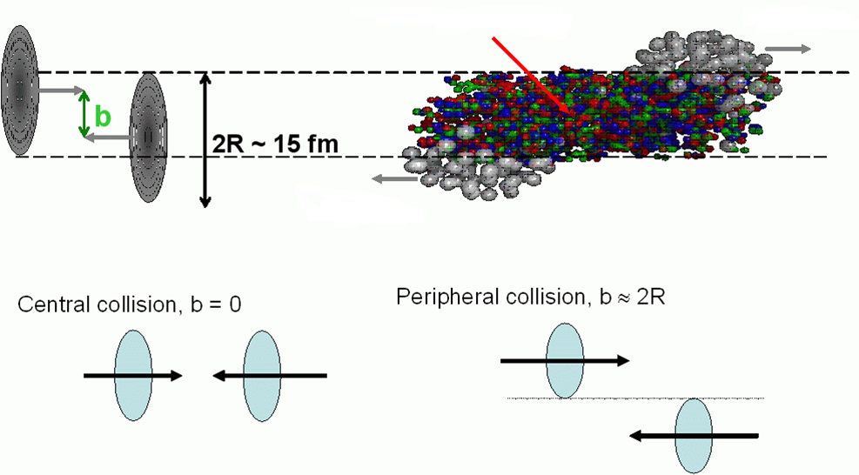
Heavy Ion Collision
Participants
Spectators
Residual Nuclei
Spectators
Residual Nuclei
A
Particle production zone
b
B
We need theoretical models to
simulate particle production
calculate the centrality of collision
the number of participants
the number of spectators
calculate spallation of excited Residual Nuclei (RN)
and many other things …

Slide 5
Heavy ion collisions
Participant/overlap region – many models
Production of species (mesons, nucleons, resonances, hyperons, …) in binary collisions;
Coalescence of nucleons and hyperons
Spectator region – a few models:
LAQGSM – LosAlamos–Quark -Gluon-String model
DCM-QGSM – DubnaCascadeModel–Quark-Gluon-String Model
Nuclear Spallation of excited Residual Nuclei (RN):
Preequilibrium emission
Multifragmentation
Fermi break-up
Evaporation
Excited RN
A
b
B

Slide 6
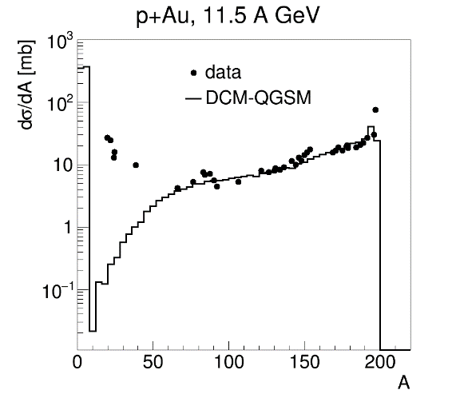
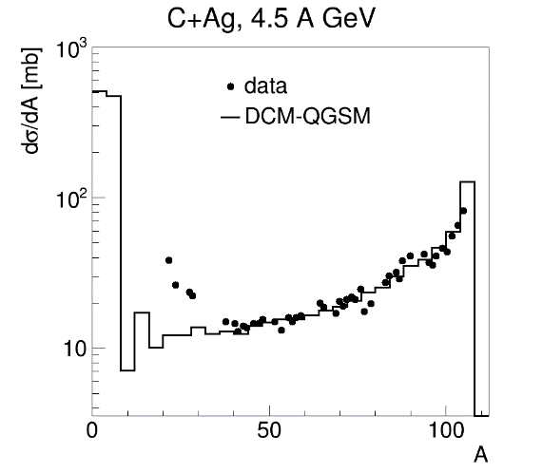
Determination of Centrality in models
Multiplicity of produced particles: all Monte-Carlo models
Number of Participants: Glauber models, UrQMD, LAQGSM, DCM-QGSM
protons
neutrons
Number of Spectators: LAQGSM, DCM-QGSM
protons
neutrons
nuclear fragments (stable and radioactive)
Not satisfactory description of fragmentation data by LAQGSM and DCM-QGSM!

Slide 7
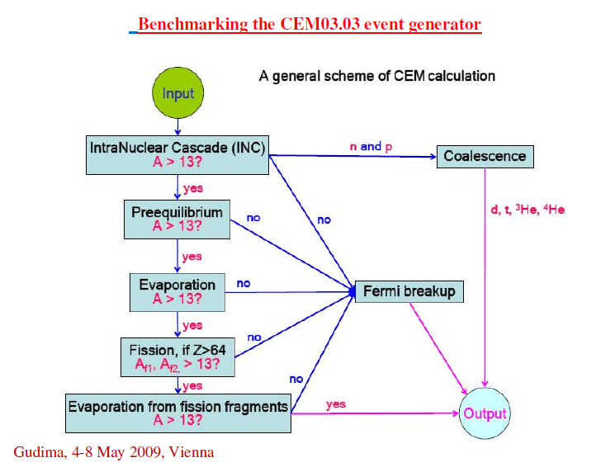
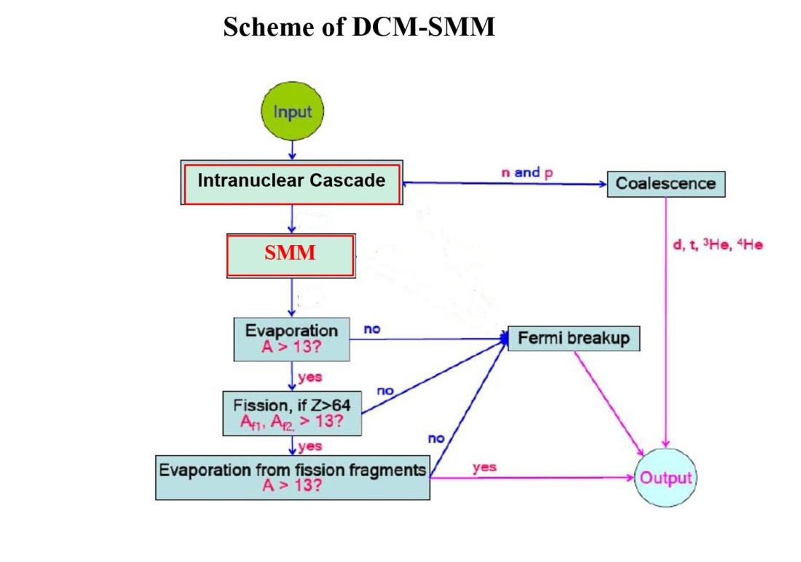
Two versions of DCM DCM-QGSM DCM-SMM
Scheme of DCM-QGSM
no
no
Generalized
Evaporation
A > 13?
Modernization of DCM-QGSM
Reducing the number of input parameters
Improving particle yield
Creation of DCM-SMM
on the basis of DCM-QGSM
and
SMM – Statistical Multifragmentation Model,
J. Bondorf, A. Botvina, A. Ilyinov, et, al., PR 1995

Slide 8
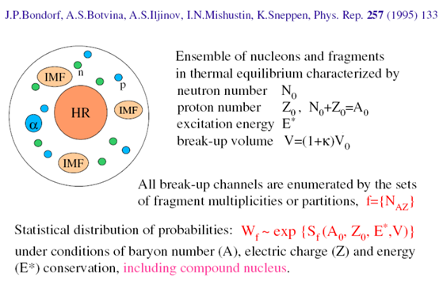
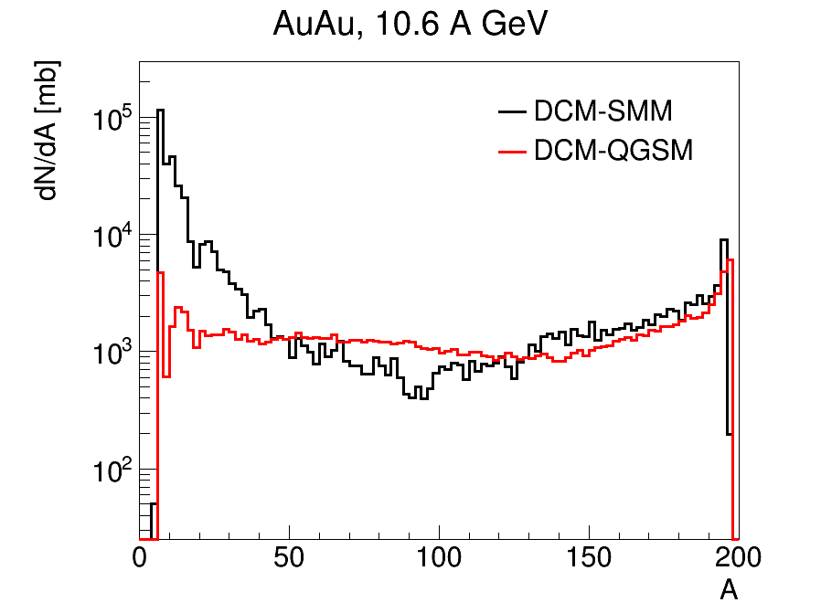

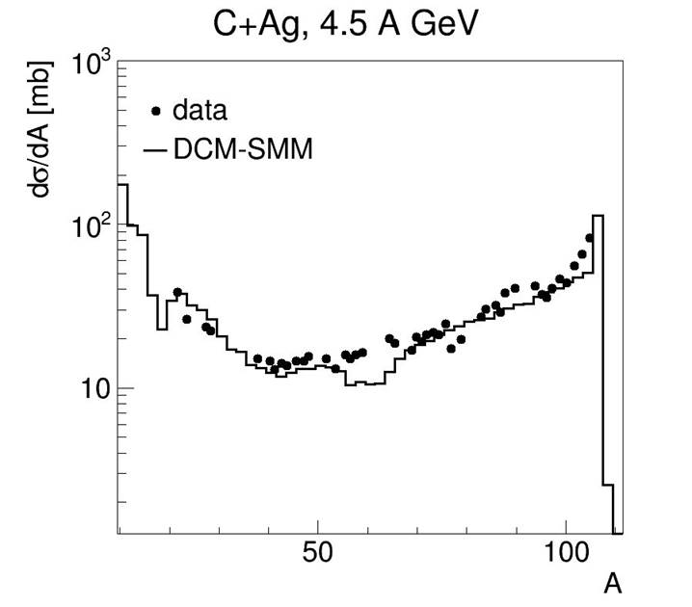
Models: DCM-QGSM vs DCM-SMM

Slide 9
DCM-QGSM-SMM
1. M. Baznat, A. Botvina, G. Musulmanbekov, V. Toneev, V. Zhezher, “Monte-Carlo generator of heavy ion collisons DCM-SMM”, PEPAN, Letters, Vol. 17, p.265, 2020.
74 citations. 1-st prize of 2020 competition among PEPAN Lett. publs.
G. Musulmanbekov and V. Zhezher, “Simulation of Nuclear Fragments in Heavy Ion Collisions by Monte-Carlo Generators”, PEPAN, Vol. 52, стр.598 - 603, 2021г.
G. Musulmanbekov, “Hadron Modifications in a Dense Baryonic Matter”
PEPAN Lett., Vol., № 5, 2021, p. 548
Notes:
9

Slide 10
Participation in collaborations BM@N, SRC, MPD
Publications
1. Application of Machine Learning methods for centrality determination in heavy ion reactions at the BM@N and MPD@NICA, N Karpushkin et al for BMN and MPD collab., Journal of Physics: Conference Series, ISSN:1742-6588, eISSN:1742-6596, v. 1690, р.012121, 2020г.
2. Feasibility of thermal photon measurements in heavy ion collisions at NICA energies, D Ivanishchev et al for the MPD Collaboration, Journal of Physics: Conference Series, ISSN:1742-6588, eISSN:1742-6596, Изд:IOP Publishing, v. 1690, р.012109, 2020г.
3. Methods for anisotropic flow measurements with the MPD Experiment at NICA, D Idrisov et al for MPD collab., Journal of Physics: Conference Series, ISSN:1742-6588, eISSN:1742-6596, v. 1690, р.012129, 2020г.
4. Monte-Carlo generator of heavy ion collisons DCM-SMM, M. Baznat, A. Botvina, G. Musulmanbekov, V. Toneev, V. Zhezher, Physics of Elementary Particles and Atomic Nuclei, Letters, Изд:Изд:Pleiades Publishing, Ltd., v. 17, р.265, 2020г.
5. Reconstruction and simulation of the performance of the Electromagnetic Calorimeter on MPD, Y. Huang on behalf of the MPD collaboration, Journal of Instrumentation, ISSN:1748-0221, Изд:IOP Publishing, v. 15, р.C06027, 2020г.
6. Feasibility Study for the Net-Proton and Net-Kaon Event-by-Event Fluctuations Measurements with the MPD Detector, A. Mudrokh et al for MPD Collaboration, Physics of Particles and Nuclei, ISSN:1063-7796, Изд:Pleiades Publishing Ltd., v. 52, р.644, 2021г.
7. Hadron Modification in a Dense Baryonic Matter, G. Musulmanbekov, Physics of Elementary Particles and Atomic Nuclei, Letters, Изд:Изд:Pleiades Publishing, Ltd., v. 18, р.548 - 558, 2021г.
8. Neutral Mesons and Dielectrons, E. Kryshen et al for MPD Collaboration, Physics of Particles and Nuclei, ISSN:1063-7796, Изд:Pleiades Publishing Ltd., v. 52, р.686, 2021г.
9. Simulation of Nuclear Fragments in Heavy Ion Collisions by Monte-Carlo Generators, G. Musulmanbekov and V. Zhezher, Physics of Elementary Particles and Atomic Nuclei, ISSN:0367-2026, eISSN:1814-7445, Изд:JINR Publishing Department, v. 52, р.598 - 603, 2021г.
Notes:
10

Slide 11
Participation in collaborations BM@N, SRC, MPD
10. Thermal Photon and Neutral Meson Measurements Using the Photon Conversion Method in the MPD Experiment at the NICA Collider, E. Kryshen et al for the MPD Collaboration, Physics of Particles and Nuclei, ISSN:1063-7796, Изд:Pleiades Publishing Ltd., v. 52, р.669, 2021г.
11. Unperturbed inverse kinematics nucleon knockout measurements with a 48 GeV/c carbon beam, BM@N Collaboration, Nature Physics, ISSN:1745-2473, eISSN:1745-2481, Изд:Macmillan Publishers Limited., v. 17, р.693-699, 2021г.
12. Centrality Determination in Heavy-Ion Collisions with MPD Detector at NICA, MPD Collabor., Moscow University Physics Bulletin.(Вестник МГУ. Серия 3 Физика. Астрономия), ISSN:0027-1349, Изд:Издательство МГУ Allerton Press Inc, v. 77, р.206 - 207, 2022г.
13. Centrality Determination in MPD at NICA, A. Aparin et al. for MPD Collab., Particles and Nuclei, Letters, Изд:JINR, Dubna, v. 19, р.489-492, 2022г.
14. Comparison of Methods for Elliptic Flow Measurements at NICA Energy Range, Vinh Ba Luong for the MPD Collaboration, Moscow University Physics Bulletin.(Вестник МГУ. Серия 3 Физика. Астрономия), ISSN:0027-1349, Изд:Издательство МГУ Allerton Press Inc, v. 77, р.237, 2022г.
15. From Quark Correlations to Nuclear Drip Line, G. Musulmanbekov, Physics of Elementary Particles and Atomic Nuclei, ISSN:0367-2026, eISSN:1814-7445, Изд:JINR Publishing Department, 2022г.
16. MPD Prospects for the Study of Hadron and (hyper)nuclei Production at NICA Energies, A. Mudrokh et al for MPD Collaboration, Physics of atomic nuclei, ISSN:1063-7788, eISSN:1562-692X, Изд:MAIK Nauka/Interperiodica, Pleiades Publishing, Ltd, v. 85, р.1007, 2022г.
17. Status and initial physics performance studies of the MPD experiment at NICA, MPD Collaboration, The European Physical Journal (EPJ), р.140-189, 2022г.
18. Status and initial physics performance studies of the MPD experiment at NICA, MPD Collaboration, The European Physical Journal (EPJ), р.140-189, 2022г.
Notes:
11

Slide 12
Participation in collaborations BM@N, SRC, MPD
19. Production of pi+ and K+ mesons in argon-nucleus interactions at 3.2 A GeV, BM@N collaboration, Journal of High Energy Physics, ISSN:1126-6708, eISSN:1029-8479, Изд:Springer Berlin Heidelberg, v. 2023, р.174, 2023.
20. The BM@N spectrometer at the NICA accelerator complex, BM@N collaboration, Nuclear Instruments & Methods in Physics Research A, ELSEVIER, v. 1065, p.169532, 2024г.
21. MPD physics performance studies in $Bi+Bi$ collisions at $\sqrt{s_{NN}}$= 9.2 GeV, R. Abdulin et al., Revista Mexicana de F ́ısica, v. 71, p.1-, 2025г.
22. Production of protons, deuterons and tritons in argon-nucleus interactions at 3.2 A GeV, BM@N collaboration, Journal of High Energy Physics, Springer Berlin Heidelberg, 2025г.
Notes:
12

Slide 13
Activity 2
SCQM – Strongly Correlated Quark Model
of Nucleon and Nucleus Structures
Quark Structure of Nucleon
G. Musulmanbekov, Quarks as Vortices in Vacuum. In: Frontiers of Fundamental Physics 4. Springer, Boston, MA, 2001. doi.org/10.1007/978-1-4615-1339-1_10
G. Musulmanbekov, “Hadron Modifications in a Dense Baryonic Matter”
PEPAN Lett., Vol., № 5, 2021, p. 548
G. Musulmanbekov, “Quarks in Hadrons and Nuclei: The Structure of Nucleon”
Adv. Nucl. Sci. Appl., Vol. 1, № 2, 2025, p.
Quark Structure of Nuclei
G. Musulmanbekov and N. Cook, “Quark Degrees of Freedom inside Nuclei” Phys. Atom. Nucl., vol. 17, № 7, 2008, p. 1226
G. Musulmanbekov, “From quark and nucleon correlations to discrete
symmetry and clustering in nuclei” in Exotic Nuclei, Singapore: World
Scientic, 2016, p. 58.
G. Musulmanbekov, “Quarks in Hadrons and Nuclei: The Structure of Nucleus”
Adv. Nucl. Sci. Appl., Vol. 1, № 4, 2025, p. ? To be published
Notes:
13

Slide 14
Diversity of models of Nuclear Structure
Nuclear Models in terms of low energy QCD approximations, EFTs:
EFTs don’t touch quark degrees of freedom and reduce the quark and gluon fields to a set of meson fields.
Nuclear Models in terms of nucleons and mesons:
Conventional models
Independent Particle Models (Shell Model, …)
Collective models (Liquid Drop Model, …)
Cluster models (alpha clusters)
Modifications of above models
Non-conventional models
There is enormous number of models … (W.Greiner et al.)
14
Notes:
It is widely acknowledged that no single model will suffice to explain all of the phenomena relating to the nuclear structure.
The three most successful models, the shell, liquid-drop and cluster models, are based on differing assumptions about the phase state of the nucleus.
1. The independent-particle model requiring a gaseous nuclear interior (long mean-free-path, point nucleons) utilizes a central potential well and thus predicts the existence of nucleon orbitals and shell-like orbital-filling.
2. In contrast, the liquid-drop model requires a dense liquid nuclear interior (short mean-free-path, local nucleon interactions and space-occupying nucleons) in order to predict nuclear binding energies, radii, collective oscillations, etc.
3. Furthermore, the cluster models require the assumption of strong local-clustering of particularly the 4-nucleon alpha-particle within a liquid or gaseous nuclear interior in order to make predictions about the ground and excited states of cluster configurations (4).
The dilemma of nuclear structure theory is that these mutually exclusive models work surprisingly well for qualitative and quantitative explanation of certain limited data sets, but each model is utterly inappropriate for application to other data sets.
14

Slide 15
Is it possible to build a model composing the features of all conventional models?
Do Quarks Play an Explicit Role in Nuclear Structure?
Yes!
The Model: SCQM
Notes:
15

Slide 16
Quarks – Solitons
SCQM ≡ Breather Solution of Sine- Gordon equation
Breather – oscillating soliton-antisoliton pair, the periodic solution of SG:
is identical to our quark-antiquark system.
16
Notes:
It turned out that our quar-antiquark system behaves similar to the breather solution of Sine-Gordon equation.

Slide 17
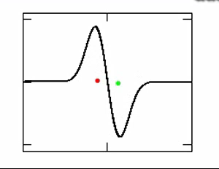
Soliton – antisoliton quark – antiquark
φ(x,t)
quark–antiquark as
non-linear standing wave
Notes:
And the system quark- antiquark start to oscillate

Slide 18
The SCQM
Hamiltonian of the quark – antiquark system
- current masses of quarks,
β = β(x) – velocity of the quark (antiquark),
- quark–antiquark potential.
is the potential energy of a single quark/antiquark.
18
Notes:
18

Slide 19
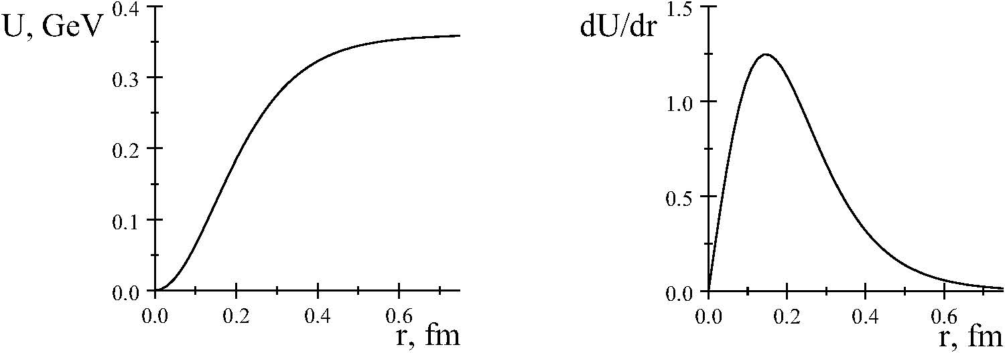
Quark Potential Force
of quark-antiquark interaction
U_{q} = 0.36tanh²(ax)
19

Slide 20
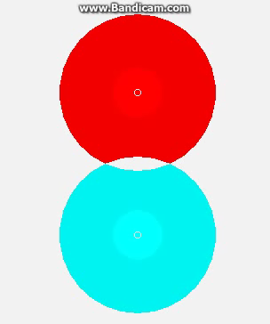
quark–antiquark pair
meson
QCD: Exchange by gluons
SCQM: Overlap of color fields
20

Slide 21
Generalization to the 3 – quark system (baryons)
21
Notes:
21

Slide 22
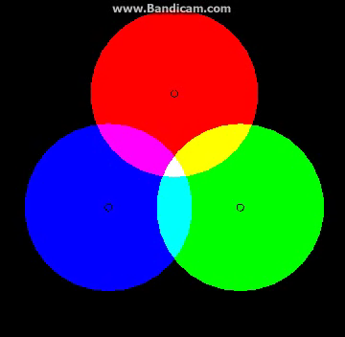
Nucleon as profile of energies of 3 nonlinear “standing” waves
“The wave packet solution of time-dependent Schrodinger equation for harmonic oscillator moves in exactly the same way as corresponding classical oscillator”
E. Schrodinger, 1926
22

Slide 23
Parameters of SCQM for the Nucleon
1.Mass of Consituent Quark
2.Amplitude of VQs oscillations : x_{max}=0.64 fm,
3.Constituent quark dimensions (parameters of gaussian distribution): σ_{x,y}=0.24 fm, σ_{z} =0.12 fm
Parameters 2 and 3 are derived from comparison of Inelastic Overlap Function (IOF) and in and pp – collisions.
Nucleons are deformed, oblate objects!
It is very important in building the nuclear structure!
23
Notes:
23

Slide 24
Quark Arrangements inside Nuclei
Strongly Correlated Quark Model
Lattice-like arrangement of Nuclear Structure
24

Slide 25
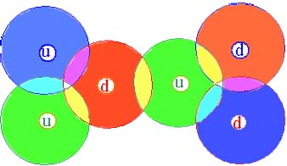
Two Nucleon System in SCQM
Interaction between nucleons is due to overlap of their quark color fields
25

Slide 26
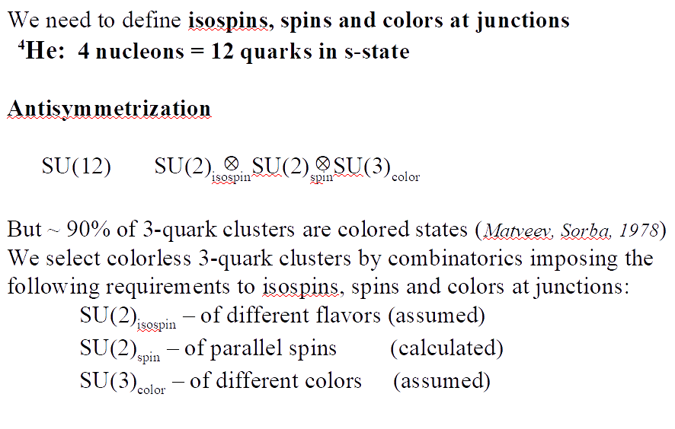
Antisymmetrization
26

Slide 27
Two Nucleon System in SCQM
Quark Potential Inside Nuclei
27

Slide 28
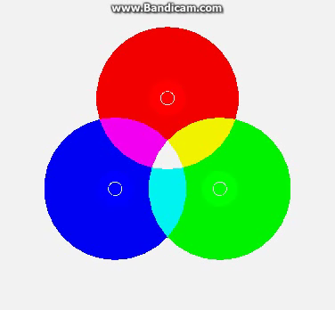
Quarks inside nucleus
Quarks oscillate with small amplitudes
near maximal displacements
28

Slide 29
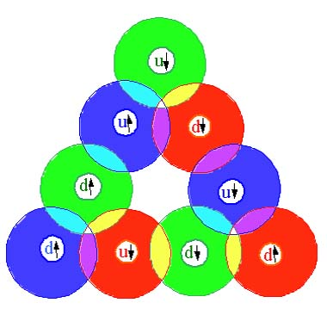
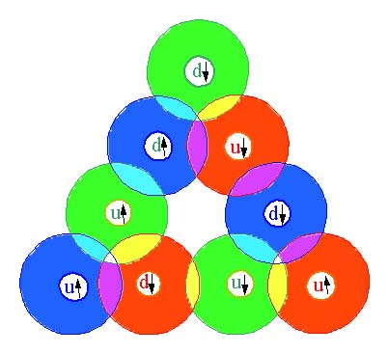
Multi-Nucleon Systems in SCQM
³H
³He
p
n
n
n
p
p
p
n
Summary color
of 3 junctions is white, total color charge = zero!
n
n
p
p
Quark loop formed by 3 nucleons → 3–body force
29

Slide 30
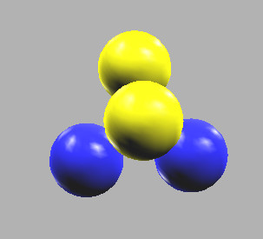
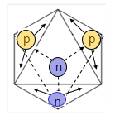
⁴He – s-shell
4 Quark loop
30
Notes:
30

Slide 31
Building blocks in Shell Structure
³He
³H
n
p
p
p
n
n
³He – block
³H – block
Forms Neutron Halo
31

Slide 32
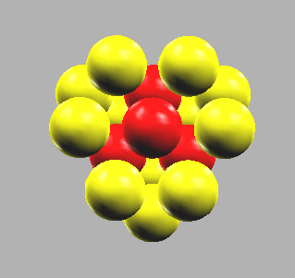
¹⁶O
RED – s-shell
YELLOW – p-shell
32

Slide 33
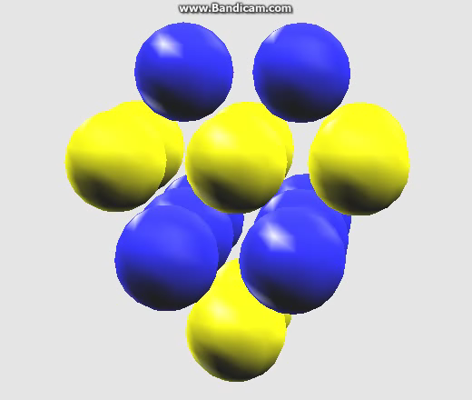
¹⁶O
Yellow – protons
Blue – neutrons
33

Slide 34
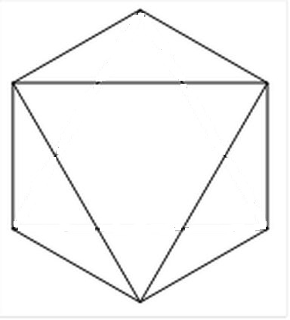
The closed shell n = 2, ⁴⁰Ca
Shell Closure
d-shell of ⁴⁰Ca octahedron
n
p
³He
³H
p
p
n
n
n
n
n
p
p
p
34

Slide 35
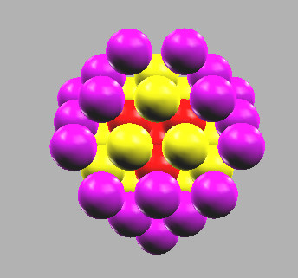
⁴⁰Ca
via principal number
s–shell – red
p-shell – yellow
d-shell - lilac
35

Slide 36
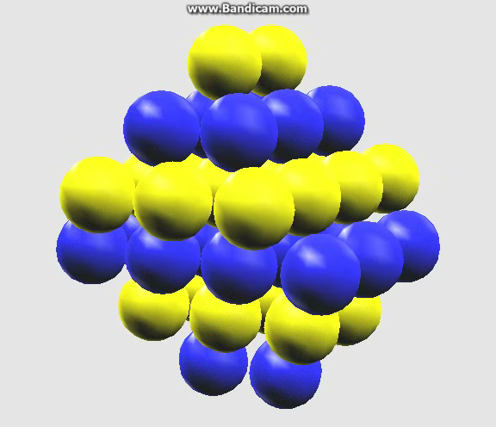
⁴⁰Ca
via isospin
protons – yellow
neutrons – blue
36

Slide 37
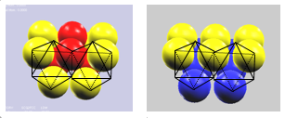
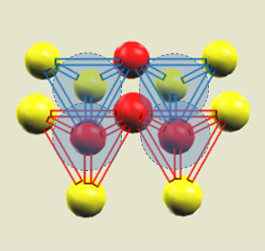
¹²C
Forming virtual α-clusters
Nucleons of s-shell (red) are exchangeable
yellow – protons
blue – neutrons
Formation of 4 virtual
α-clusters
Nucleons of s-shell (red) are exchangeable

Slide 38
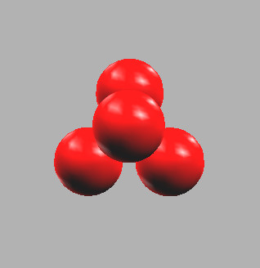
Virtual α-clusters
J= 1/2
J = 1/2, 3/2
J = 1/2, 3/2, 5/2
s: n=1, l=1
6 virtual alphas
s: n=0, l=0
1 real alpha
s: n=2, l=0, 2
22 virtual alphas

Slide 39
FCC Lattice Model (N. Cook, 1987) Particle in 3D box
-(ћ/2m) d²Ψ/dr² + V(r) Ψ(r) = EΨ(r)
For harmonic oscillator
E = ћω₀(n_{x} + n_{y} + n_{z} + 3/2) = ћω₀(N + 3/2)
N = 0, 1, 2, 3, ,,,
Different combinations n_{x},n_{y}, n_{z}, giving the same total N, denote the number of “degenerate” states with the same energy

Slide 40
FCC Lattice Model (N. Cook, 1987)
Principal quantum number, N
Assuming x, y and z coordinates of nucleons
are odd – integers,
N = (|x| + |y| + |z| - 3)/2
The first shell (s-shell, N = 0) contains 4 nucleons
with coordinates 111, -1-11, 1-1-1, -11-1.
The second shell (p-shell, N = 1): 12 nucleons
31-1, 3-11, -311, -3-1-1, 1-31, -131, 13-1, -1-3-1, -113,
11-3, 1-13, -1-1-3
The d-shell …
and so on ...
Total angular momentum, j
j = (|x| + |y| - 1)/2
Magnetic quantum number, m
m = |x|/2
z
y
x
40

Slide 41
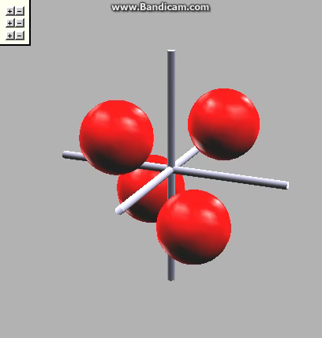
FCC Lattice Model (N. Cook, 1987)
s, p, d - shells
z
y
x
Origin of the coordinate system - at the center of the central tetrahedron
The closure of each consecutive, symmetrical (x=y=z) shell in the lattice composes precisely the numbers of nucleons in the shells derived from Schrodinger equation
Notes:
If the origin of the coordinate system is taken as the center of the central tetrahedron, then the closure of each consecutive, symmetrical (x=y=z) geometrical shell in the lattice composes precisely the numbers of nucleons in the shells derived from the three-dimensional Schrodinger equation

Slide 42
FCC-SCQM vs Shell Model
Close relation between
nucleon location in FCC-SCQM and quantum numbers of SM
n = (|x| + |y| + |z| - 3)/2
j = |l + s| =(|x| + |y| - 1)/2
m = (|x|/2)(-1)^{(x-1)}
s = (-1)^{(x-1)}/2
i = (-1)^{(z-1)}/2
and reversely
x = |2m|(-1)(m + ½)
y = (2j + 1 - |x|)(-1)^{(i+j+m+1/2)}
z = (2n + 3 - |x|- |y|)(-1)^{(i+n-j-1)}

Slide 43
The Role of Quarks in Nuclear Structure
Color fields of quarks are responsible for strong interactions of nucleons inside nuclei.
Strong interactions are tensorial
Quark loops form virtual 3- and 4-nucleon clusters inside bound nuclei
Evidence of quark loops is an enhanced separation energy in even-even nuclei
Halo nuclei are formed by core and virtual 3-nucleon clusters (³H-type)
Bound nuclei are formed by virtual ³H- and ⁴He-type clusters.
SCQM+FCC
combines the properties of all three conventional models
allows to build any bound and some excited nuclei, including halo nuclei and high spin isomers
allows to estimate size, shape and deformation of nuclei
43

Slide 44
Activity in 2020 – 2025
Int. Conferences, invited talks
1. 8th Collaboration Meeting of the BM@N Experiment at the NICA Facility, Joint Institute for Nuclear Research, Dubna, Russia, 1. Monte-Carlo generators DCM-QGSM and DCM-SMM, G. Musulmanbekov, 2021г.
2. III International Scientific Forum “NUCLEAR SCIENCE AND TECHNOLOGIES” dedicated to the 30th anniversary of Independence of the Republic of Kazakhstan, Ministry of Energy of the Republic of Kazakhstan Institute of Nuclear Physics, Алматы, Казахстан, QUARKS IN NUCLEI: FROM NEUTRON HALO TO THE BOUNDARY OF NUCLEAR STABILITY, G. Musulmanbekov, 2021г.
3. The IV International Scientific Forum “Nuclear science and Technologies” dedicated to the 65th anniversary of Institute of Nuclear Physics (INP), Institute of Nuclear Physics (INP) of the Ministry of Energy of the Republic of Kazakhstan, Almaty, Kazakhstan, From Quark Correlations to Halo Nuclei and Nuclear Drip Line, G. Musulmanbekov, 2022г.
4. 10th Collaboration Meeting of the BM@N Experiment at the NIСA Facility, Joint Institute for Nuclear Research, Dubna, Russia, ОИЯИ совместно с СПбГУ, Санкт-Петербург, Россия, Modification of Hadron Properties in a Dense Baryonic Matter, G. Musulmanbekov, 2023г.
5. 12th Collaboration Meeting of the BM@N Experiment at the NICA Facility, JINR, Satbayev University, Almaty, Kazakhstan, Modification of MC generator DCM-QGSM-SMM, G. Musulmanbekov, 2024г.
6. The V International Scientific Forum "Nuclear Science and Technologies", INP, Almaty, Almaty, Kazakhstan, THE ROLE OF QUARKS IN FORMATION OF NUCLEAR STRUCTURE: SUPER-HEAVY NUCLEI, G. Musulmanbekov, 2024г.
7. BLTP/JINR– ITP/CAS, Joint Workshop on Physics of Strong Interacting Systems, Almaty, August 17-22, 2025, Role of quarks in formation of nuclear structure: superheavy nuclei, G. Musulmanbekov, 2025г.
Notes:
44

Slide 45
Activity cont.
Int. Conferences, oral talks
1. V-th Collaboration Meeting of the MPD Experiment at the NICA Facility, ОИЯИ, Дубна, Россия, 12C fragmentation in carbon - proton collisions. Comparison of SRC data with DCM-SMM generator (status of work), 2020г.
2. The LXXI International conference "NUCLEUS – 2021. Nuclear physics and elementary particle physics. Nuclear physics technologies", St. Petersburg State University, National Research Center, St.Petersburg, Russia, FROM QUARK AND NUCLEON CORRELATIONS TO NUCEAR DRIP LINE, G. Musulmanbekov, 2021г. по текущее
3. LXXII International conference "Nucleus-2022", Lomonosov Moscow State University, Moscow, Russia, Role of Quarks in Nuclear Structure, G. Musulmanbekov, 2022г. по текущее
4. LXXIV International Conference: Nucleus 2024, , Dubna, Russia, Size, Shape and Deformation of Nuclei, G. Musulmanbekov, 2024г.
5. 7th International Conference on Particle Physics and Astrophysics (ICPPA-2024), Moscow Engineering Physics Institute, Moscow, Russia, THE ROLE OF QUARKS IN NUCLEAR STRUCTURE: ALPHA-CLUSTERING AND NUCLEOSYNTHESIS IN STARS, G. Musulmanbekov, 2024г. по текущее
6. 15th Collaboration Meeting of the BM@N Experiment at NICA, DCM-QGSM-SMM: Yield of neutrons, G. Musulmanbekov, 2025г. по текущее
7. XXVI Международный Балдинский семинар по проблемам физики высоких энергий «Релятивистская ядерная физика и квантовая хромодинамика», The Structure of Light Nuclei in Strongly Correlated Quark Model, G. Musulmanbekov, 2025г. по текущее
Notes:
45

Slide 46
Activity cont.
Presentations on seminars
1. Webinar of BM&N coll., April 6, 2020, Dubna “Carbon fragmentation in DCM-SMM”, 2020г.
2. Meeting of BM&N coll., April 20 - 21, 2020, Dubna “12C fragmentation in carbon-proton collisions. Comparison of data with generator DCM-SMM”, 2020г.
3. Webinar “Centrality determination and Reaction Plane reconstruction in heavy ion collisions by DCM-SMM”, 2020г.
4. “Modification of hadron properties in a dense and hot baryonic matter”, LHEP 2020г.
5. Webinar “Monte Carlo event generators DCM-QGSM and DCM-SMM: similarity and difference”, PWG1, MPD, 2020г.
6. Webinar Spectator matter in M-C generators DCM-QGSM and DCM-SMM, PWG1, MPD, 2020г.
7. Webinar “Nuclear fragments deposited in FHCal: DCM-QGSM or DCM-SMM?”, PWG1, MPD, 2021г.
8. Webinar “On difference between DCM-SMM and Glauber models”, PWG1, MPD, 2021г.
9. BLTP “Role of Quarks in Nuclear Structure”, 2021г.
10. Webinar Spectator matter in Monte-Carlo generators DCM-QGSM and DCM-SMM, PWG1, MPD, 2021г.
11. Institute of Physics and Technology, Almaty, Kazakhstan “Monte Carlo Simulation at BM&N NICA”, 2023г.
12. Institute of Nuclear Physics, Almaty, Kazakhstan “Role of Quarks in Nuclear Structure”, 2023г.
13. MLIT “Nuclear Size, Shape and Deformation”, 2024.
Notes:
46

Slide 47
Thank You!
47

Slide 48
QCD – fundamental theory of strong interactions
Constituents of hadrons – quarks of different flavors carrying spin, charge, color.
flavors: u, d, s, c, b, t
spin: ½
charge: ⅓ , ⅔
color: SU(3)_{Color} -
Fields – gluons – different combinations of quark-antiquark perform interactions between quarks.
Nucleons – 3–quark (u/d), color-singlet systems
Mesons – quark-antiquark systems
Notes:
I
48

Slide 49
QCD (cont.)
QCD is non-abelian theory
Hadronic processes with high Q²
pQCD: α_{S} < 1, m_{q} → 0, chiral symmetry
Low energy hadron and nuclear physics
non-pQCD: α_{S} > 1, m_{q} ≠ 0, chiral symmetry breaking
Low energy approx. of QCD, effective theories., ...
QCD–inspired phenomenology
NR constituent quark models
Bag models
Chiral quark models
Soliton models
Notes:
QCD is non-abelian theory → hard to derive the features of hadrons and nuclei from the first principles of QCD. In dependence of usability of QCD there are three areas of research: Hard processes, Low energy hadron physics, and nuclear physics.
Noting the impossibility to deduce the properties of hadrons from the first principles of QCD, one known physicist has told “magnificent colour the phenomenology bog has blossomed”
49

Slide 50
pQCD → Low energy physics
Hard processes
m_{q} = 0
Chiral Symmetry
SU(2)_{L} × SU(2)_{R} for ψ_{L,R} = u, d – current quarks
Low energy, hadron properties
Chiral symmetry breaking ≡ quark or chiral condensate:
≃ - (250 MeV)³, ψ = u,d
As a consequence massless valence quarks (u, d) acquire dynamical masses which we call constituent quarks
M_{C} ≈ 350 – 400 MeV
Notes:
Transition from pQCD to low energy physics is performed via CSB.
From my point of view this mechanism is rather artificial.
I'll show you that this transition can be made dynamically.
So, let us proceed to description of SCQM

Slide 51
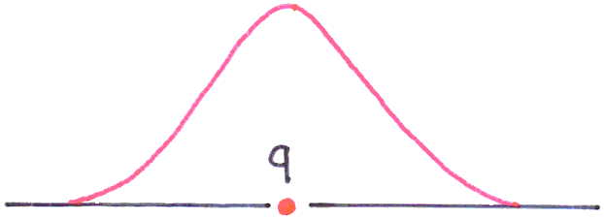
“Elementary particles are
no more than holes in
vacuum.”
Henry Poincare
SCQM Single Colored Quark inside Vacuum
ϕ (x)
Quark color field
Vacuum polarization
by color field of a single quark
Quark and Gluon
Condensate
51
Notes:
Let us imagine (hypotetically) a single color quark in vacuum. This single quark acts on the surrounding vacuum as a dislocation in solid. I.e. it creates tension field around that is back reaction of vacuum. Taking into account quantum nature this tension field could be associated with quark and gluon condensate.
51

Slide 52
Strongly Correlated Quark Model (SCQM)
ϕ (x)
Vacuum fluctuations
(radiation) pressure
Vacuum fluctuations
(radiation) pressure
Vacuum polarization
by color field of a single quark
Quark and Gluon
Condensate
Notes:
Moreover, because of quantum fluctuations of vacuum the quark experiences radiation pressure

Slide 53
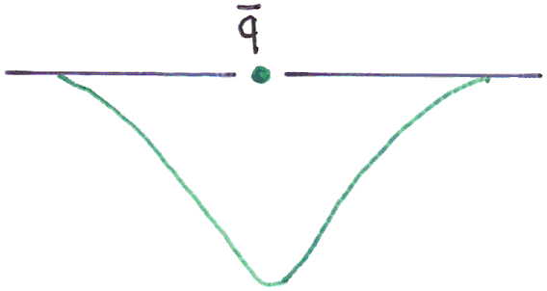
Strongly Correlated Quark Model (SCQM)
ϕ (x)
Vacuum fluctuations
(radiation) pressure
Vacuum fluctuations
(radiation) pressure
Notes:
The same effects takes place for antiquark immersed in vacuum

Slide 54
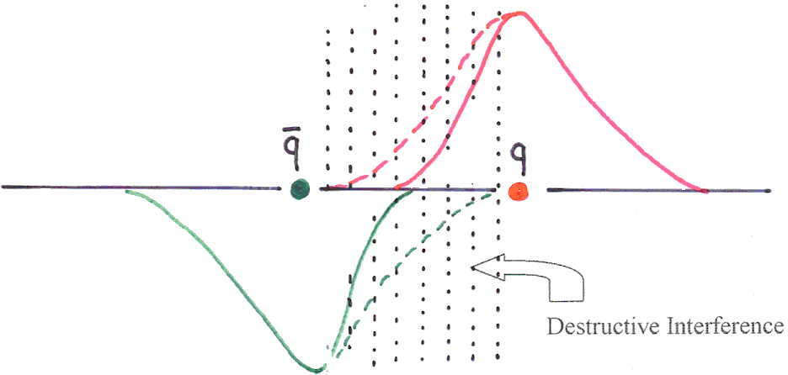
Strongly Correlated Quark Model (SCQM)
Attractive Force
Attractive Force
Destructive interference
Overlap of opposite color fields → attraction force between quark and antiquark
Notes:
Let us place quark and anti quark next to each other. Their fields of opposite color starts to interfere destructively reducing and eliminating each other in space between them.
As a result, quark and antiquark start to attract each other.

Slide 55
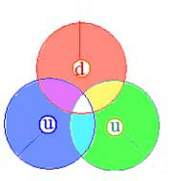
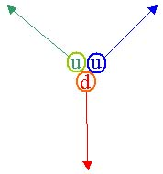
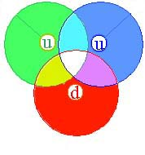
Interplay between constituent and current quark states
Chiral Symmetry Breaking Restoration
t = 0
x = xmax
t = T/4
x = 0
t = T/2
x = - xmax
Constituent quaks current quarks Constituent quarks
Asymptotic freedom
During the valence quarks oscillations:

Slide 58
Nucleon
Nucleon wave function composed of color quarks
Where are orthonormal states with i,j,k → R,G,B
58

Slide 59
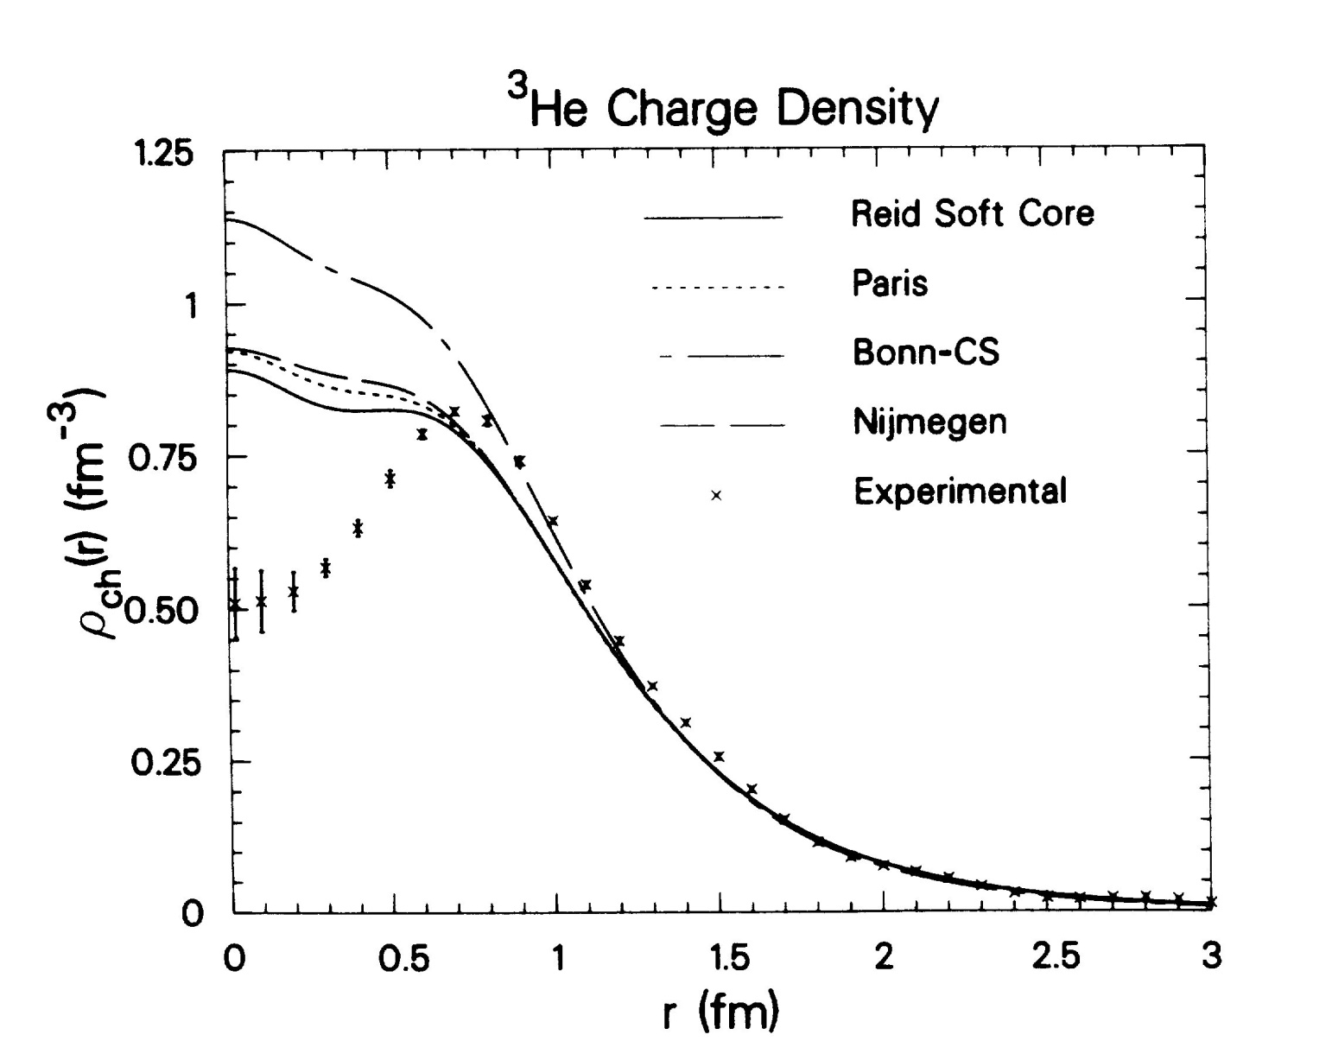
Point-nucleon charge distributions Hole inside ³H and ³He I. Sick, PRC, vol. 15, No.4; LNP, vol. 87, p.236
59
Notes:
He3 point-nucleon charge densities.
59

Slide 60
⁴⁰Ca
3 Nested Octahedra – s, p, d -shells
60

Slide 61
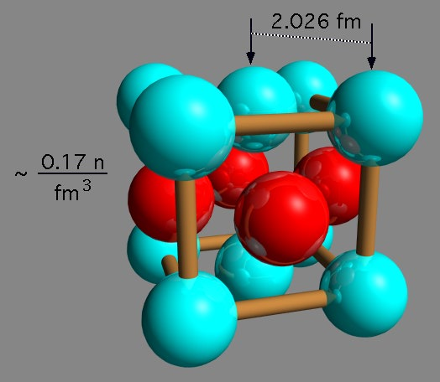
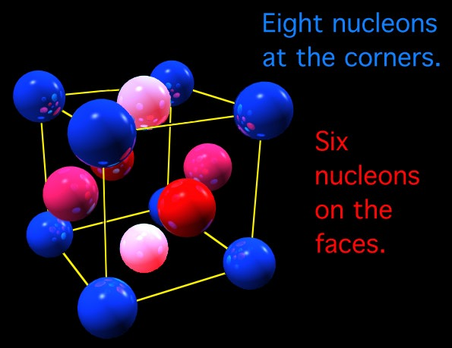
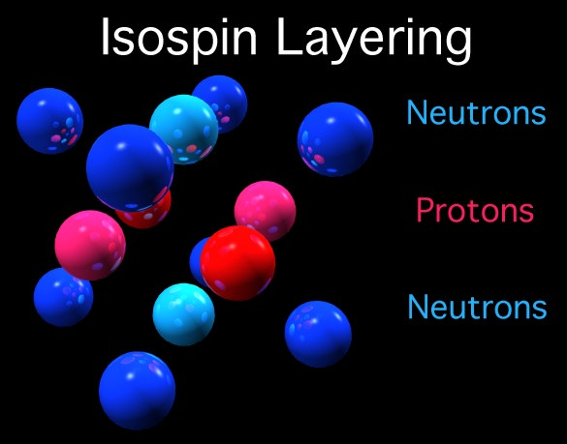
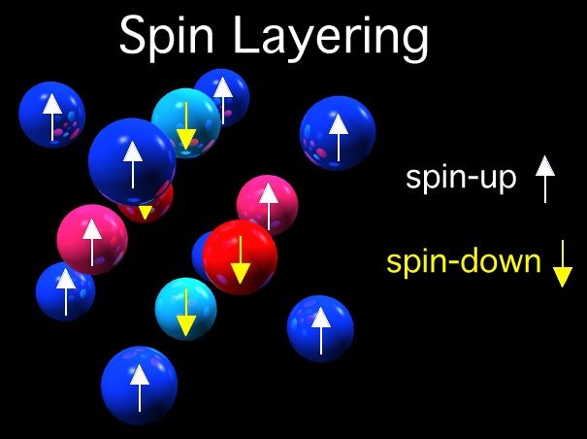
SCQM → Face-Centered Cubic Lattice
Nucleons are arranged in face-centered cubic lattice
61

Slide 62
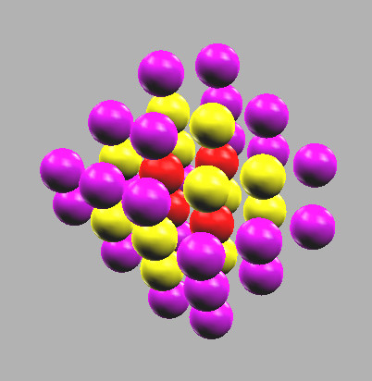
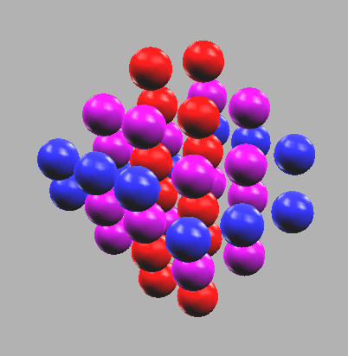
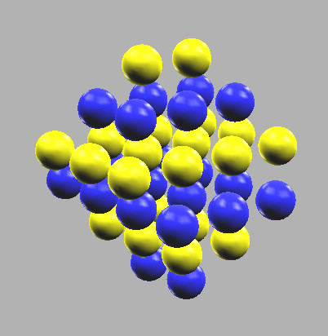
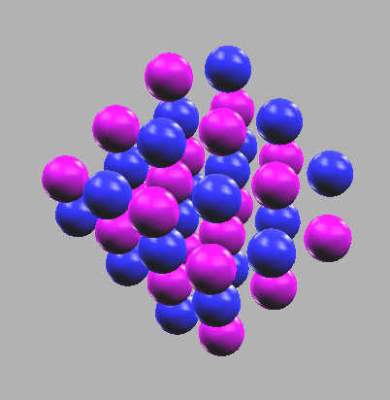
FCC Lattice Model (N. Cook, 1987)
N
j
i
s

Slide 63
FCC-SCQM vs SM What about spin-orbital coupling (SOC)?
SOC
Splitting of nuclear levels
Lowering of levels with higher J
Description of observed magic numbers of protons and neutrons
2, 8, 20, 28, 50, 82, 126
Is it possible get the same numbers in FCC-SCQM?
YES !

Slide 64
FCC-SCQM vs SM Spin-orbital coupling
In SCQM Increasing number of exchange nucleons leads to
Lowering of levels with higher J
J= 1/2
J = 1/2, 3/2
J = 1/2, 3/2, 5/2
s: n=1, l=1
6 virtual alpha
1/2 - 0 exch. nucl.
3/2 - 2 exch. nucl.
s: n=2, l=0, 2
22 virtual alpha
1/2 – 0 exch. nucl
3/2 - 2 exch. nucl.
5/2 – 4 exch. nucl.
s: n=0, l=0
1 alpha
1/2 - 0 exchange nucleons

Slide 65


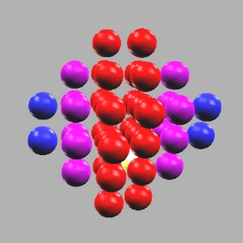


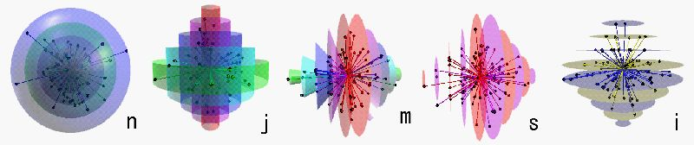
Different colors correspond to different quantum numbers
FCC Lattice Model (N. Cook, 1987)
N
j
m
s
i

Slide 66
FCC-SCQM vs SM
Increasing number of exchange nucleons, belonging to adjacent virtual alpha clusters with increasing J-value of sub-shells.
Lowering of levels with higher J
Splitting of nuclear levels
Source of spin-orbital coupling in FCC-SCQM

Slide 67
FCC-SCQM vs SM What about magic numbers?
SM
Describes observed magic numbers of protons and neutrons
2, 8, 20, 28, 50, 82, 126
FCC-SCQM
Closed Shells – Octahedra with filled faces
2, 8, 20, 40, 70, 112, … as given by HO potential

Slide 68
FCC-SCQM vs SM What about magic numbers?
SM: 2, 8, 20, 28, 50, 82, 126
FCC-SCQM: 2, 8, 20, 40, 70, 112, …
But, in FCC-SCQM the more preferable to start filling the next shell by the subshell with highest J (from the base of octahedron).
If these subsells are filled, we get the following magic numbers:
2, 6, 8, 14, 20, 28, 40, 50, 70, 82, 112, 126, …
Red numbers arise from adding to filled faces (closure-shells) of octahedra the subshells with highest value J.

Slide 69
Neutron Drip-line
SCQM | ⁷H_{4h} | ⁸He_{4h} | ¹¹Li_{2h} | ¹⁴Be | ¹⁹B_{4h} | ²²C | ²³N | ²⁸O | ³¹F_{2h} | ³⁴Ne
NuBASE | ⁷H | ¹⁰He ? | ¹¹Li | ¹⁴Be | ¹⁹B | ²²C | ²³N | ²⁴O | ³¹F | ³⁴Ne
SCQM | ³⁷Na | ⁴⁰Mg | ⁴¹Al_{2h} | ⁴⁶Si_{4h} | ⁴⁷P_{4h} | ⁴⁸S_{4h} | ⁵³Cl | ⁵⁴Ar | ⁵⁹K_{2h} | ⁶⁰Ca
NuBASE | ³⁷Na | ⁴⁰Mg | ⁴¹Al | ⁴⁶Si | ⁴⁷P | ⁴⁹S | ⁵²Cl | ⁵⁴Ar | ⁵⁹K | ⁶⁰Ca
SCQM | ⁶⁵Sc | ⁶⁸Ti | ⁷³Mn | ⁷⁴Fe | ⁸²Ni | ⁸³Cu
NuBASE | ⁶¹Sc | ⁶³Ti | ⁶⁹Mn | ⁷²Fe | ⁸⁰Ni | ⁸³Cu

Slide 70
Nuclear Isotopes
Neutron Drip Line
70

Slide 71
Bound nuclei
A_{bound} – all nucleons should be arranged in virtual triton and virtual α-clusters
Rules for location of additional nucleons above a filled shell
j_{A} = j_{A}^{min}
E^{coul} =(E^{coul})_{min} for protons
A > A_{bound} – last excess neutrons arranged in triton-like clusters are halo neutrons
71

Slide 72
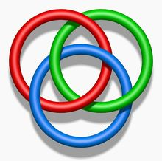
Bound Hydrogen Isotopes
Not bound: no quark loop for 4-th neutron
¹H
²H
n
³H
p
⁴H
p
p
n
p
n
n
n
n
2 virtual ³H-clusters
3 virtual ³H-clusters
⁵H
n
⁶H
⁷H
n
n
n
p
n
n
p
n
n
p
n
n
n
n
n
n
n
Borromean nucleus:
t + 2n
Not bound: no quark loop for 6-th neutron
Borromean nucleus:
t + 4n
72

Slide 73
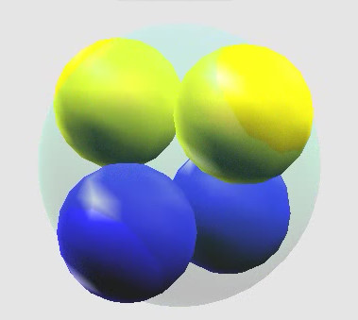
Bound Helium Isotopes
⁶He
⁸He
⁴He
Core
4 Quark loops
73
Notes:
73

Slide 74
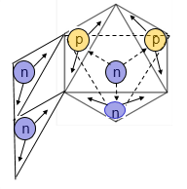
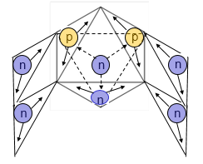
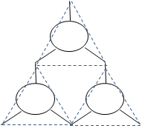
Borromean nuclei ⁶He, ⁸He
⁶He
⁸He
⁴He
Core
⁴He
Core
p
p
p
Quark loops
n
n
n
n
n
n
No bound states for ⁵He, ⁷He, ⁹He (resonances)
¹⁰He does not exist!
⁸He – the last bound He isotope
74
Notes:
74

