Slide 1
Laboratory of Methods for Big Data Analysis
“LAMBDA”
National Research University Higher School of Economics,
Faculty of Computing Science
MPD@NICA Physics WG Meeting
May 25, 2018

Slide 2
Mission
Solve tough natural science challenges with aid of advanced data analysis and machine learning
Develop new data analysis methods
Bridge the gap between CS and HEP communities

Slide 3
Group in HEP
Member of LHCb Collaboration
trigger
charged and neutral particles ID
monitoring
anomalies detection
computing resources
Member of SHIP Collaboration
detector optimisation
computing resources
Active participation in CRAYFIS
Cooperating with CMS Collaboration
data certification
Particular projects with Atlas, Opera

Slide 4
Group PhD
Fedor Ratnikov - physicists
ARGUS - HERA-B - CDF - CMS - LHCb - SHiP
triggers, data handling, calo reco, offline reco, simulation
heavy flavour, tau-physics, searches: rare decays, exotica, SUSY
Andrey Ustyuzhanin (head of the lab) - computer scientist
LHCb - Opera - SHiP - CRAYFIS
applying different aspects of ML to different problems in science
Denis Derkach - physicist
Alice - NA61 - BaBar - LHCb
heavy flavour, SM combination
Andrey Sapronov - physicist (JINR PhD)
ATLAS
numerical computation of higher order corrections

Slide 5
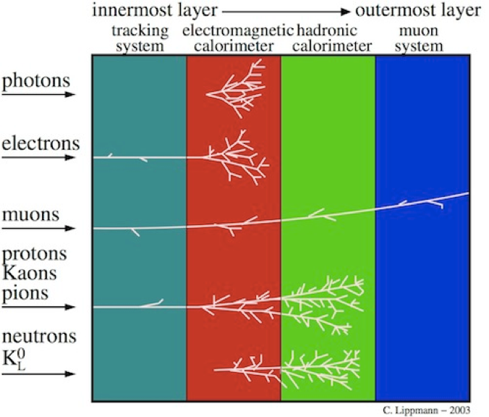
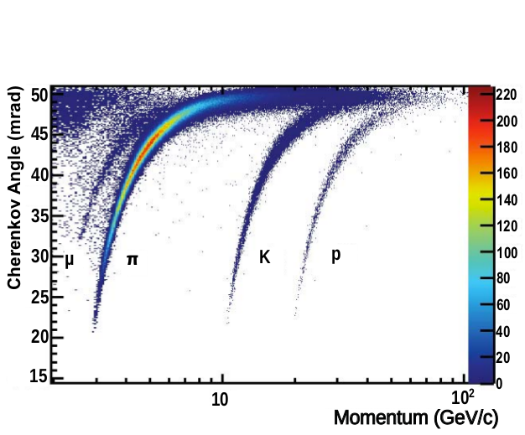
PID at LHCb
Problem: identify particle type associated with a track/energy deposited in the subdetectors
Charged: π, e, 𝜇, K, p
Neutral: π⁰, γ, n
Better PID performance → better bkg rejection → more precise results.
PID also used for trigger (in particular for upgrade): less background → less resources (less bandwidth)
High-level info from subdetectors + track quality info → multi-class classification in machine learning

Slide 6
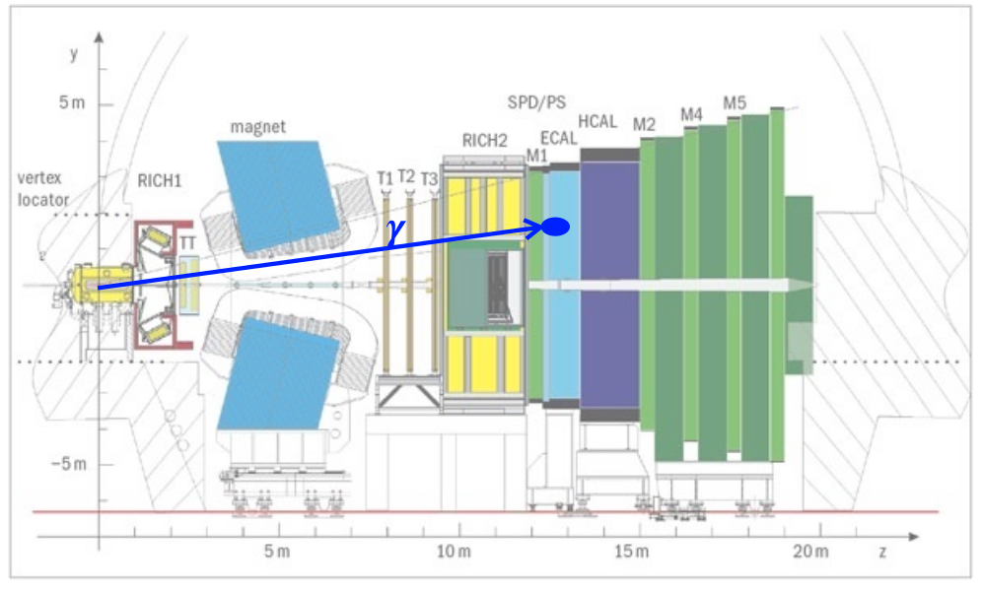
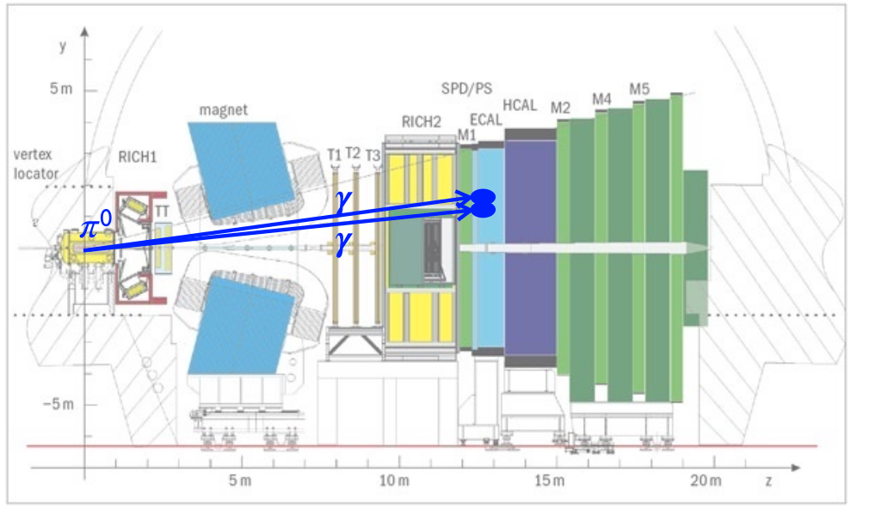
Neutral PID
π⁰ copiously produced at LHCb , decay to γγ
high momentum π⁰ → merge of ECAL clusters → huge background for
radiative decays
Need for a powerful tool to discriminate signal (γ) from background π⁰→ γγ

Slide 7
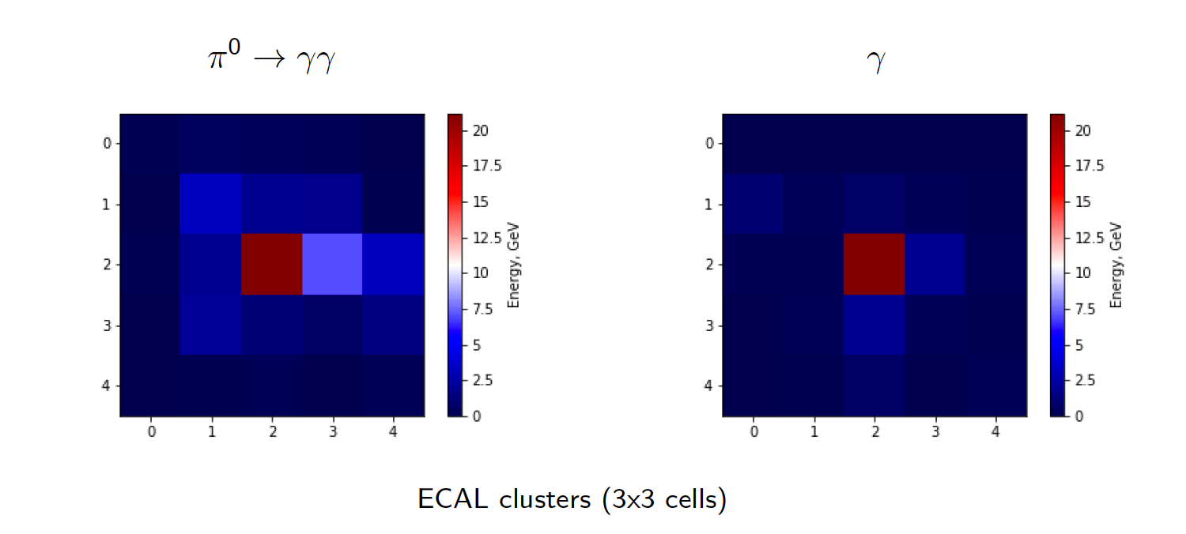
ECAL Signatures
Coarse granularity → separation is not straightforward

Slide 8
Baseline approach [LHCb-PUB-2015-016]
Neural Network with 2 hidden layers (TMVA MLP)
14 ECAL and Pre-Shower cluster parameters (grouped under shape and
symmetry )
4 variables that account for the size & tails, semiaxes and orientation of the
ellipse in the ECAL
2 variables related to the energy of the most (seed) and the second most
energetic cells of the cluster
4 variables for multiplicities of hits in the PS cells matrix in front of the seed
of the electromagnetic cluster
4 shape and asymmetry variables in the 3x3 PS cells

Slide 9
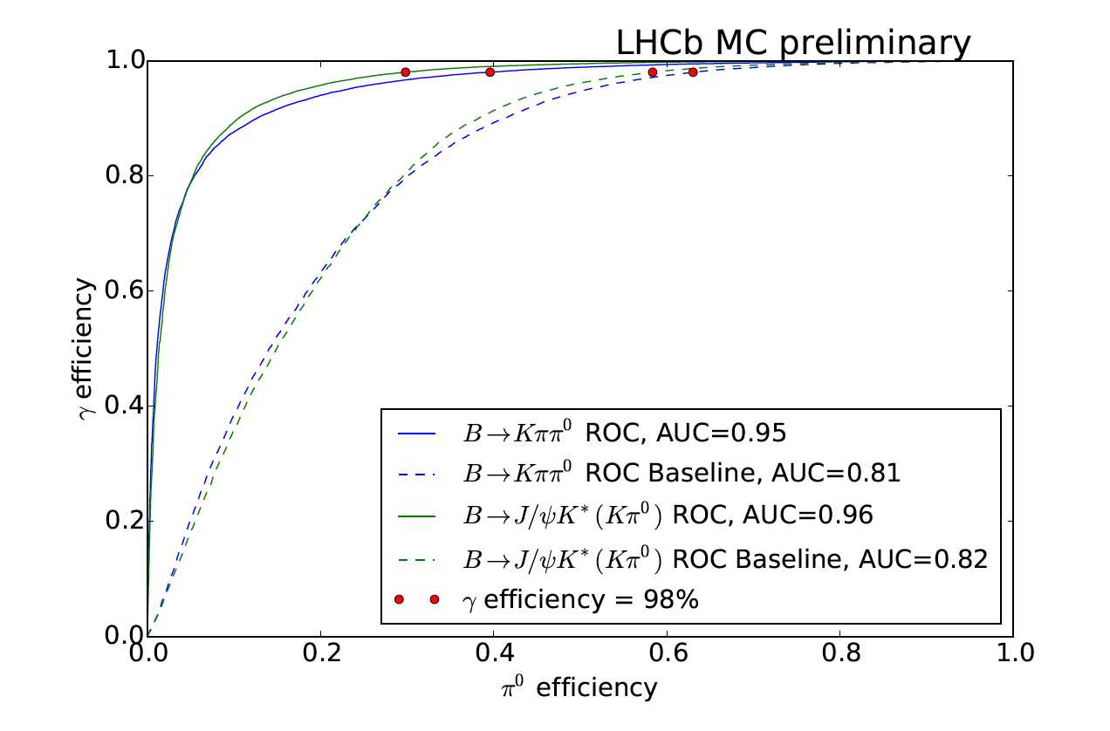
Our approach
New method: XGBoost classifier which is a Gradient Boosting over Decision Trees classifier. Inputs
are raw energy values in 5 5 ECAL and PS cells around the cell seed. There are no any additional input features

Slide 10
Charged PID
Problem: identify particle type associated with a track/energy deposited in the subdetectors
Charged: π, e, 𝜇, K, p also we have ghosts
Standard MVA used for PID LHCb
Artificial neural networks with 6 binary classification models
(One-versus-rest approach: separate one type from the others)
1 hidden layer, TMVA MLP [arXiv:0703039]
Gradient boosting:
CatBoost [arXiv:1706.09516]
Artificial neural networks (NN)
Deep neural networks, miulti-class approach

Slide 11
Flat efficiency approach

Slide 12
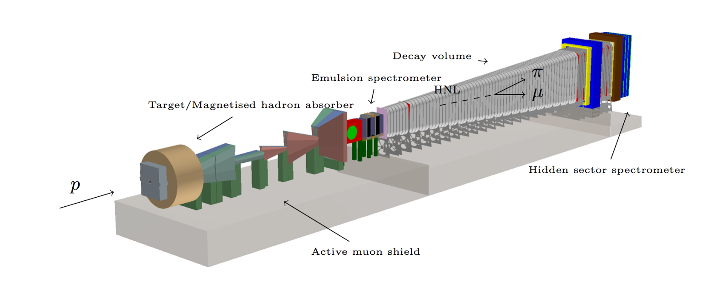
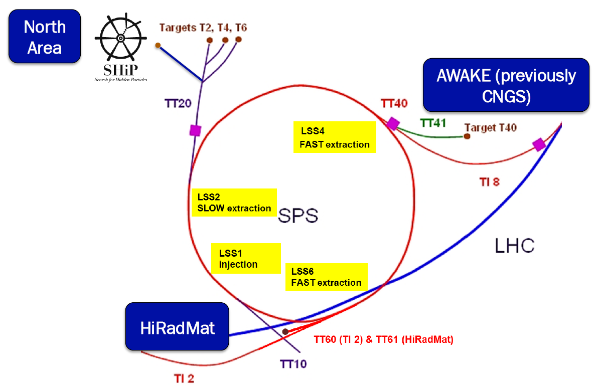
SHiP Experiment
Search for Hidden Particles
Post-LHC era experiment for direct search of very weakly interacting light particles

Slide 13
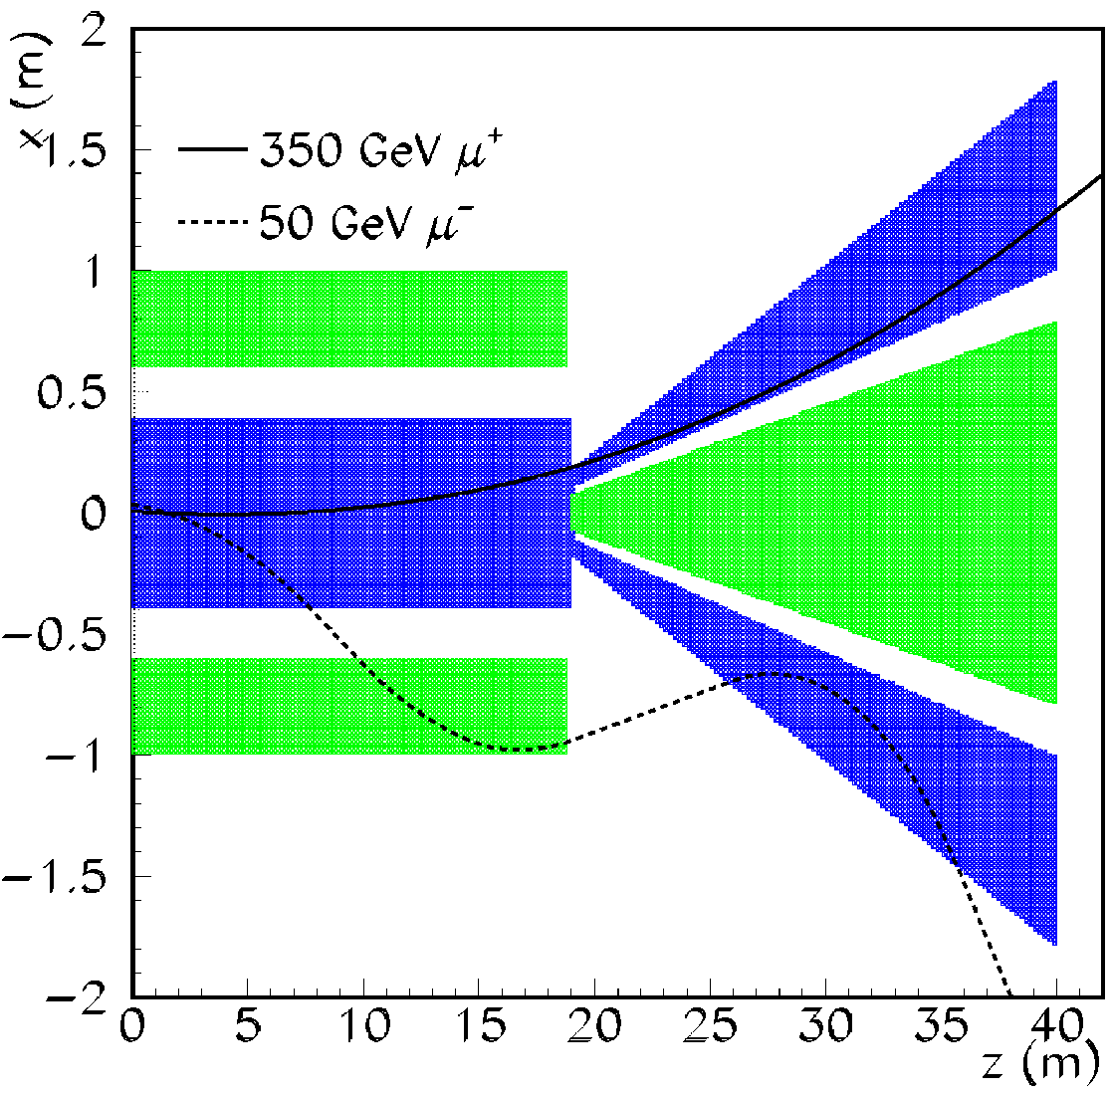
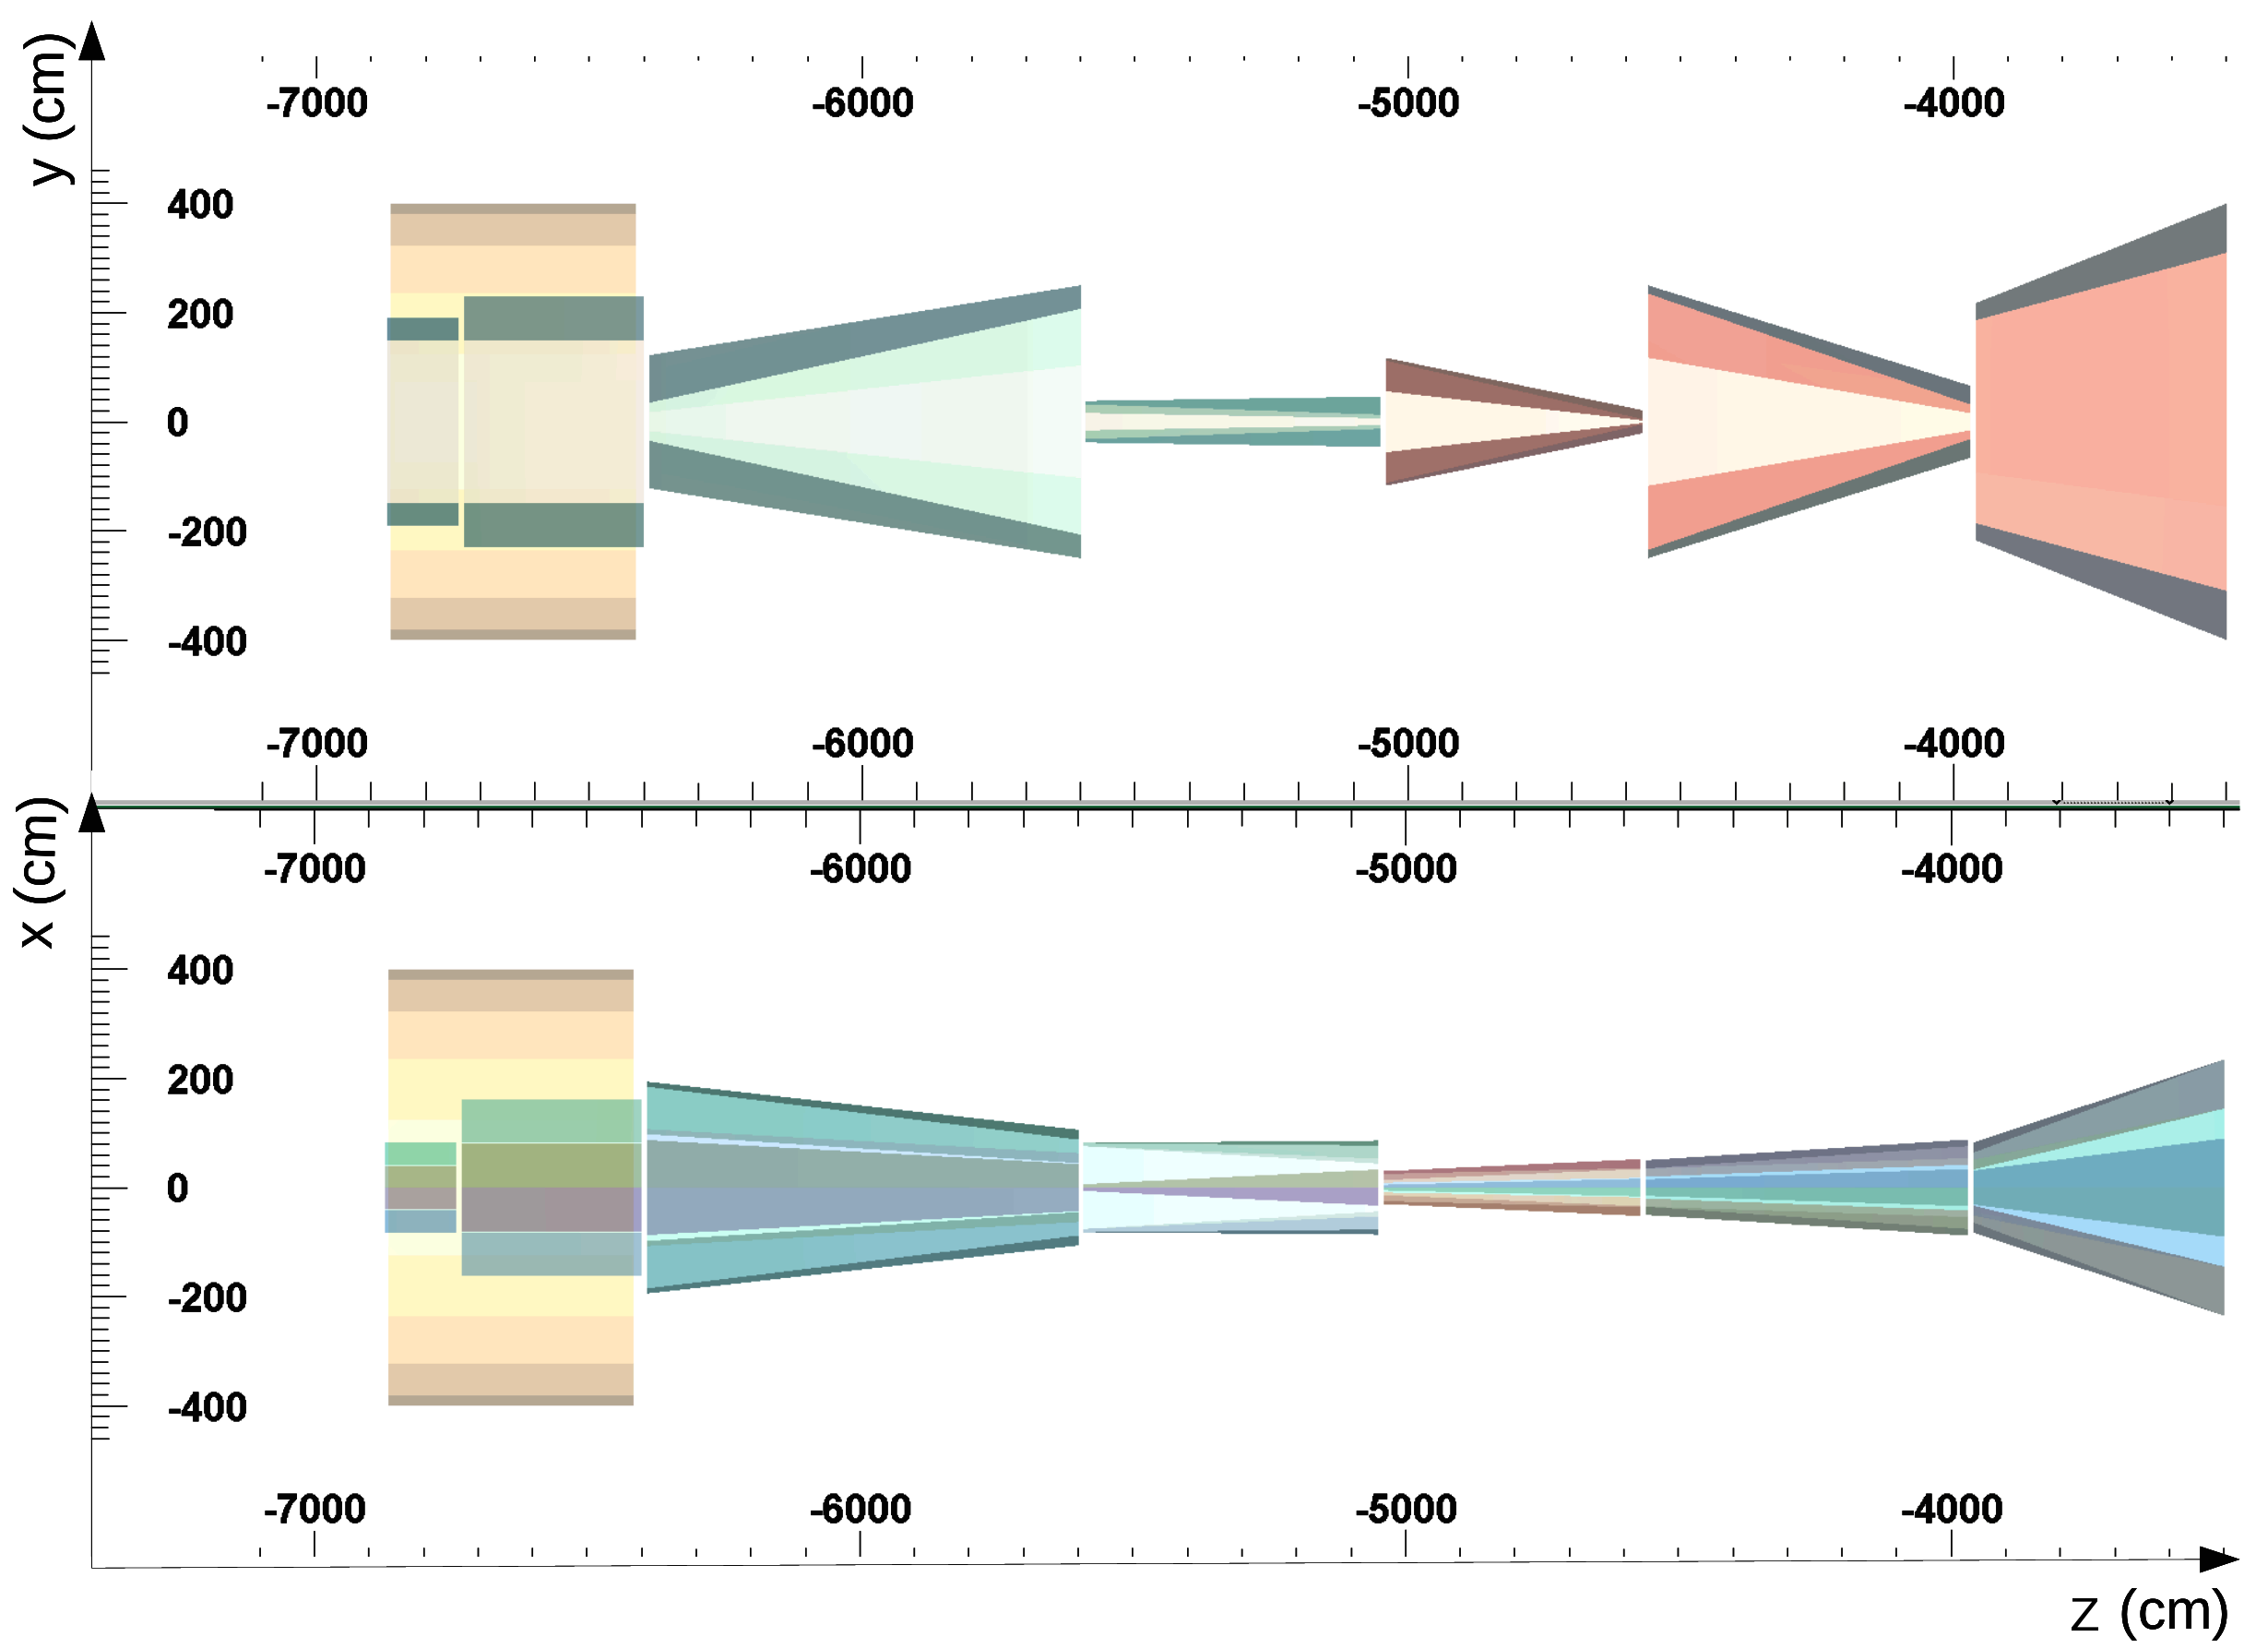
Active Magnetic Shield
Absorber shape optimization: background suppression at reasonable cost

Slide 14
Gaussian Process Optimization
Loss function includes both background level and cost
50+ configuration parameters
estimation in every point takes significant time
full GEANT simulation of 10+M muons passing through iron
loss function is very irregular in the multidimensional parameter space
Use Gaussian Processes

Slide 15
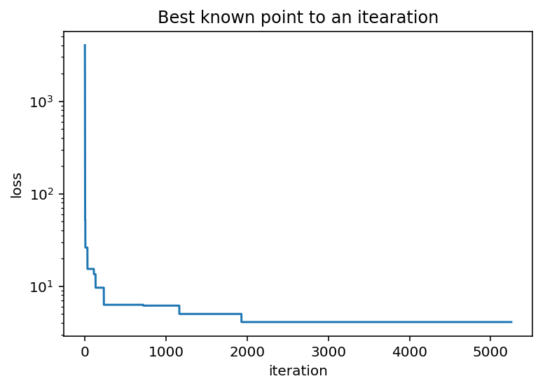
Shield Optimization
The same background suppression
Twice lighter
save $$
Advanced optimization methods rule in multidimensional space

Slide 19
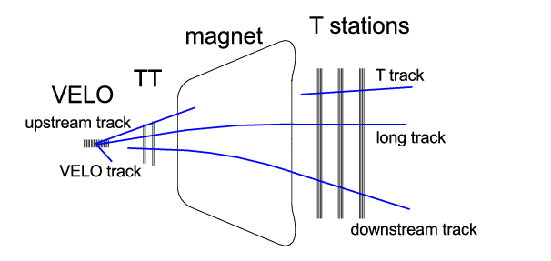

Slide 20
Downstream Tracking
Downstream tracking contains two Multivariate classifiers
reject as much fake T-seeds as possible: avoiding unnecessary reconstruction
BBDT
final accepting tracks: further reducing fake tracks
MLP
Improved both fake tracks reduction and signal efficiency gain by 3-5%
implemented for 2017 operation

Slide 21
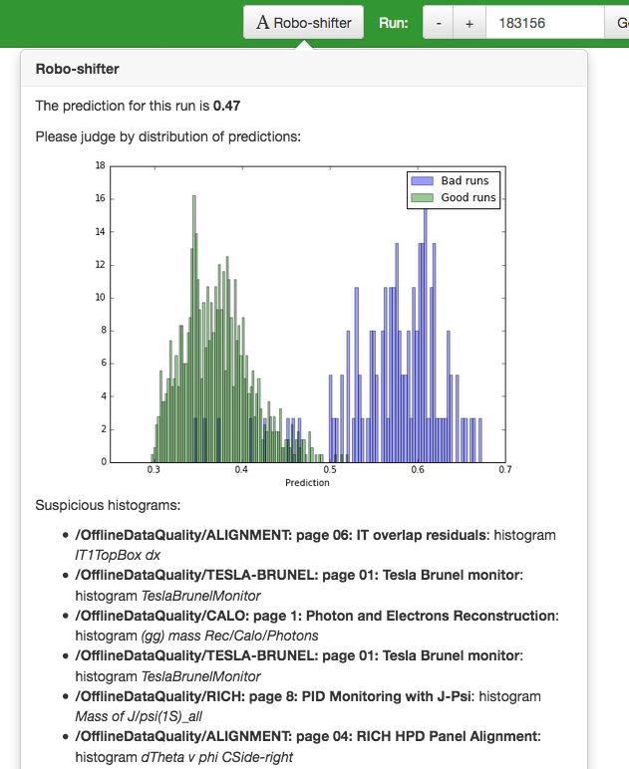
Monitoring Robo-shifter
Robo-shifter is machine-learning based system designed to assists the DQ shifter
Given run data it can predict probability of run being good or bad
Hint for potential problem sources is extracted from decision trees
Commissioned for LHCb Data Quality Monitoring

Slide 22
Generative Models
Computationally heavy tasks
e.g. simulating shower development in the calorimeter
May be substituted by generative models trained on the original task
save orders of magnitude in computing performance
challenge is to keep physics performance high

Slide 25
Very Preliminary Results
GEANT Simulated
GAN Generated
GEANT Simulated
GAN Generated

Slide 26
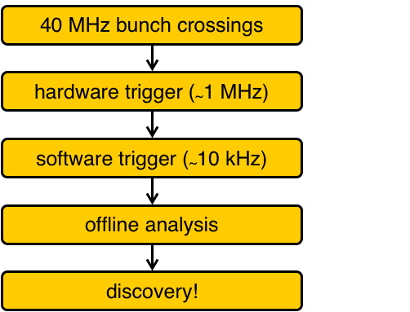
Triggers at LHCb
Need to collect many different interesting events
For this, we need to cut very hard in order to collect enriched data sample

Slide 27
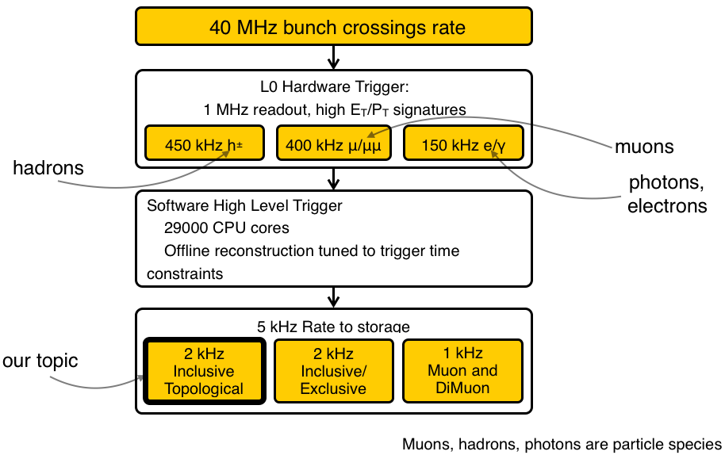
Triggers at LHCb

Slide 28
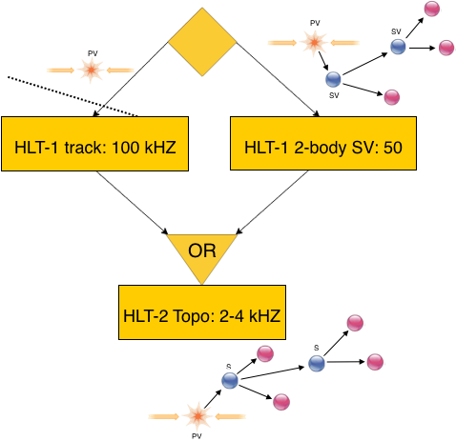
LHCb topo-trigger
HLT-1 track is looking for either one super high PT or high displaced track
HLT-1 2-body SV classifier is looking for two tracks making a vertex
HLT-2 improved topological classifier uses full reconstructed event to look for 2, 3, 4 and more tracks making a vertex

Slide 30
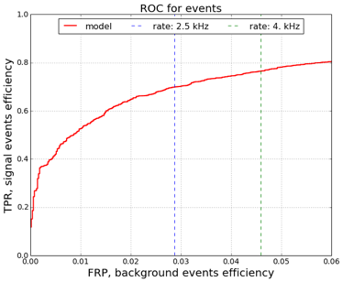
ROC curve, computed for events
Output rate = false positive rate (FPR) for events (since background = generic event)
Optimise true positive rate (TPR) for fixed FPR for events
Weight signal events in such way that channels have the same amount of events.
Optimise ROC curve in a small FPR region

Slide 31
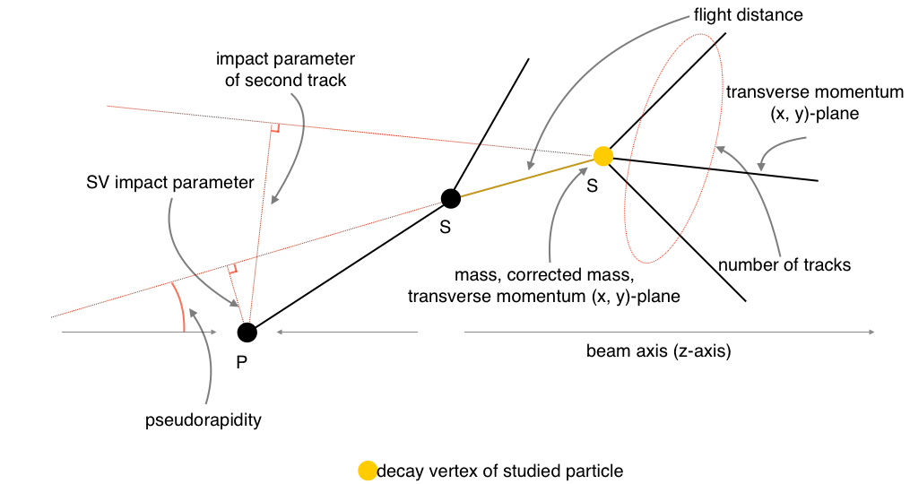
Available decision variables

Slide 32
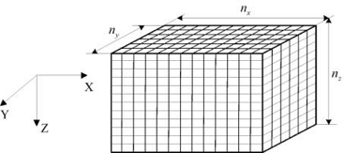
Online part using Bonsai BDT
Features hashing using bins before training
Converting decision trees to n-dimensional table (lookup table)
Table size is limited in RAM (1Gb), thus count of bins for each features should be small (5 bins for each of 12 features)
Discretisation reduces the quality

Slide 34
Summary
Our group has quite a lot of successful stories to demonstrate power of modern CS approaches to the High Energy Physics
MPD@NICA is a very interesting project
attractive physics program
active development phase
nice and convenient location
many possibilities for applying our expertise
We would like to discuss a possible task(s) to get involved into the detector R&D in the most efficient way

