Slide 1
Status of Forward Hadron Calorimeter (FHCal) at MPD
A.Ivashkin
on behalf of the FHCal MPD group
Dubna - Moscow

Slide 2
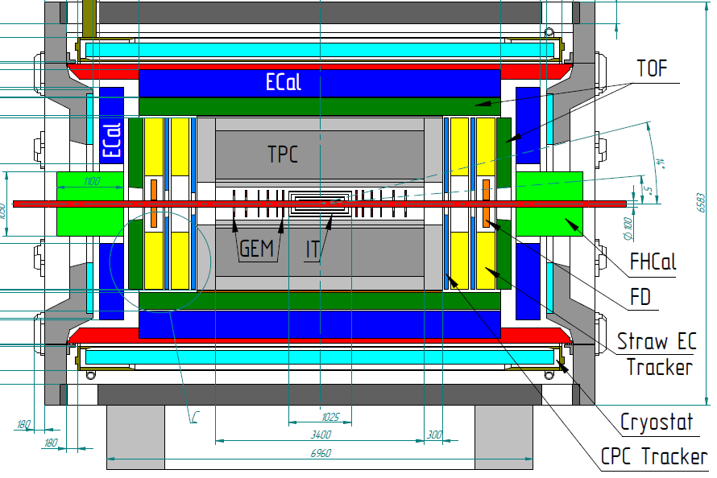
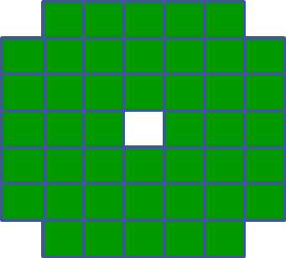
The forward hadron calorimeter in MPD setup
Tasks: measurement of the geometry of heavy ion collisions:
The centrality of the collision;
b) The reaction plane orientation.
FHCAL
Two arms of hadron calorimeters at opposite sides in forward regions.
At the distance 3.2 meters from the interaction point.
Available acceptance corresponds to pseudorapidity 2.0<η <5.0
FHCAL consists of 2x44 modules of ~1.1x1.1 m² each part.

Slide 3
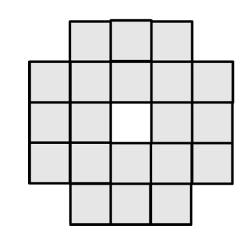
Evolution of FHCAL geometry.
Extended HCAL of 120 modules with high granularity
Compact ZDC of 20 modules with high granularity.
transverse sizes 10x10 cm²
Simple, cheap.
Low acceptance,
Poor event plane resolution,
Problem with centrality,
Excessive segmentation.
Final structure
High acceptance,
Nice event plane resolution.
Very expensive,
Complicated,
Excessive segmentation.
FHCAL of 44 modules:
Optimum segmentation,
High acceptance,
Nice event plane resolution, Centrality measurement,
Reasonably simple and cheap.
transverse sizes 15x15 cm²
Interaction length Λ_{i}~20 cm defines both longitudinal and transverse sizes of hadron shower.

Slide 4
Structure of FHCal – two left/right arms.
Modular Lead/Scintillator sandwich compensating calorimeter. Sampling ratio Pb:Scint=4:1.
Each arm:
44 modules;
Beam hole;
Weight – 9 tons.
Each module:
Transverse size - 15x15cm² ;
Total length - 106 cm.
Interaction length ~4 λ_{int};
Longitudinal segmentation – 7 sections;
1 section ~ 0.56λ_{int};
7 photodetectors/module;
Photodetectors – silicon photomultipliers (SiPM).
Light from scintillator tiles is captured by WLS-fibers and transported to SiPM.

Slide 5
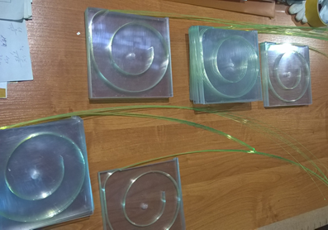
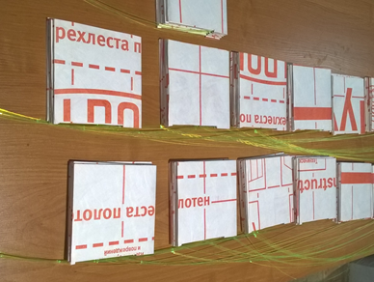
Stages of FHCal production: scintillators.
FHCal scintillator tiles and modules are assembled in workshop of INR, Moscow.
Scintillator tiles with WLS-fibers.
Scintillator tiles in TYVEC reflector.
Tests of different grooves and reflectors
Permanent quality control of scintillator tiles,
WLS-fibers and gluing is performing with ⁹⁰Sr β-source.

Slide 6
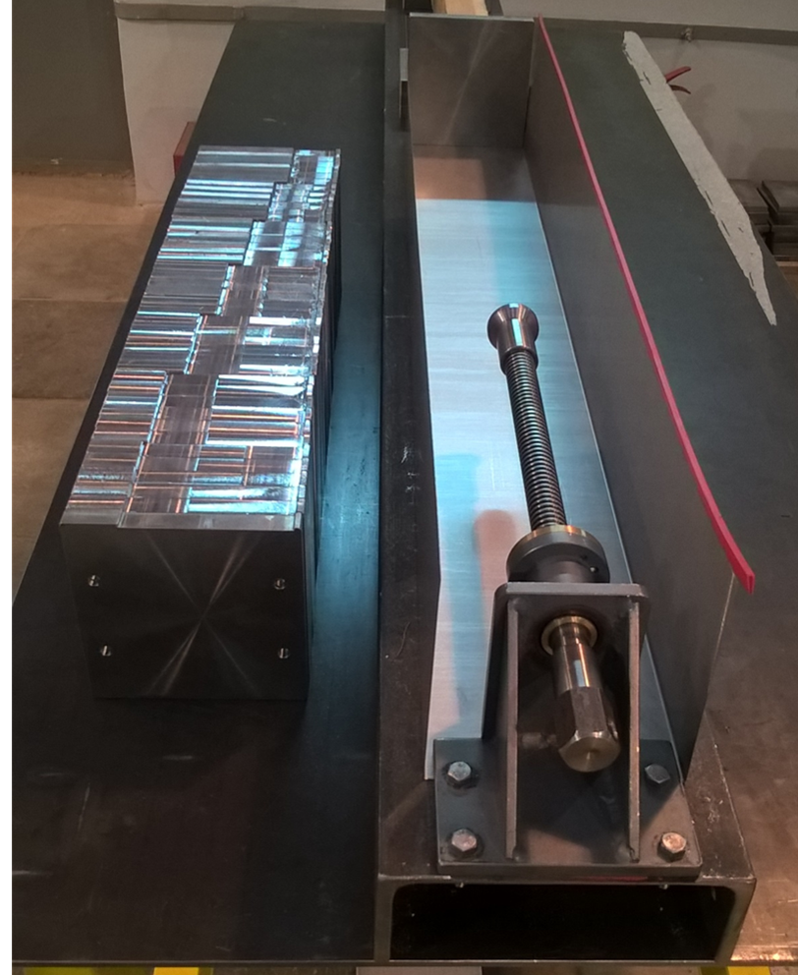
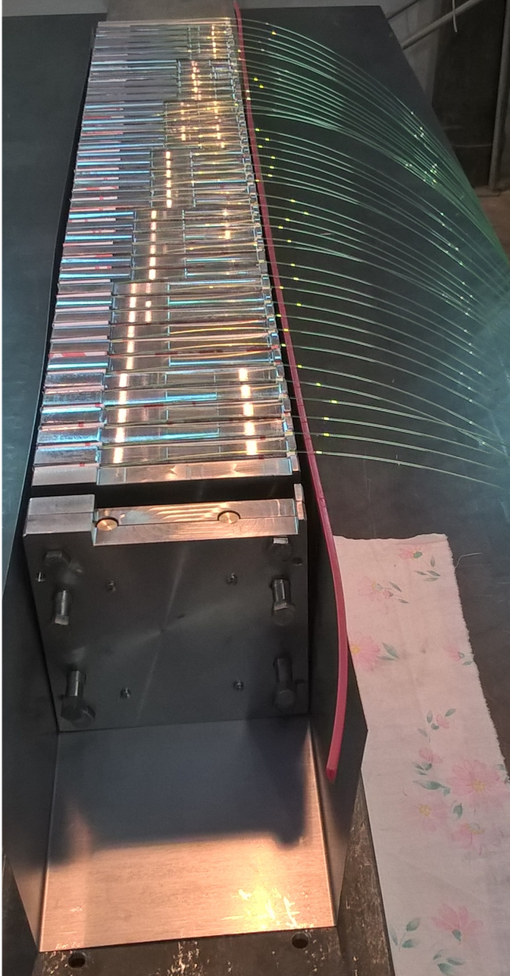
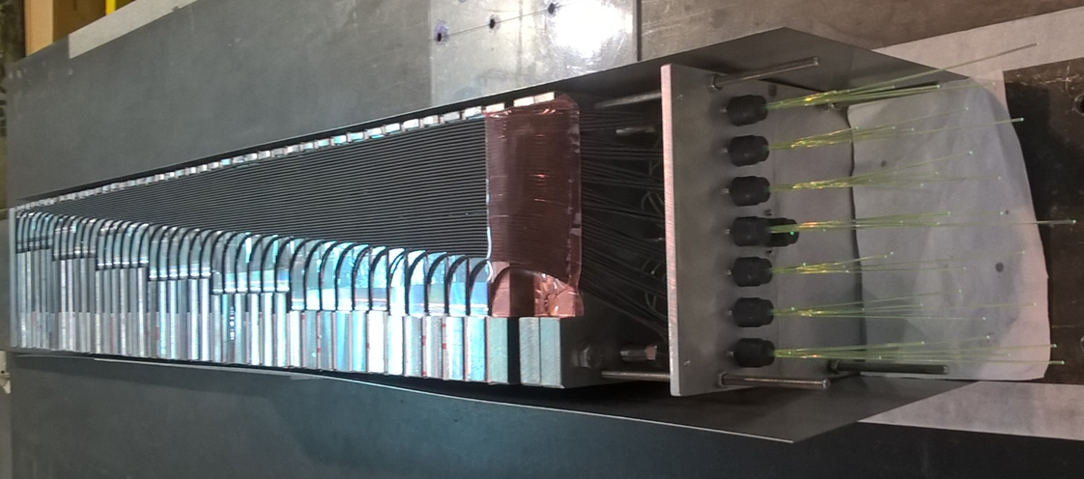
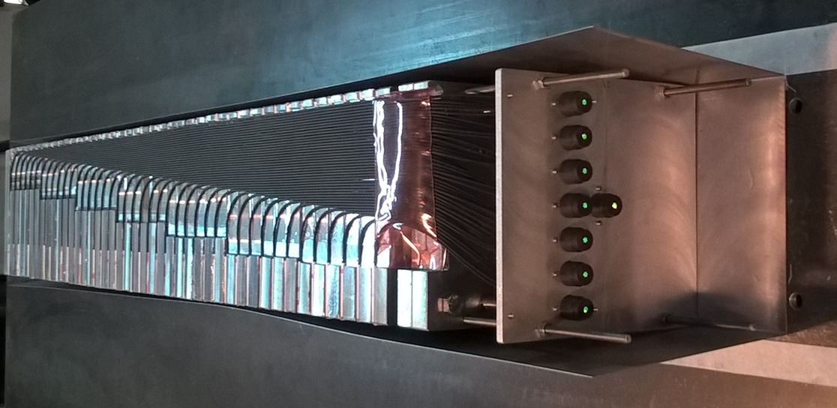
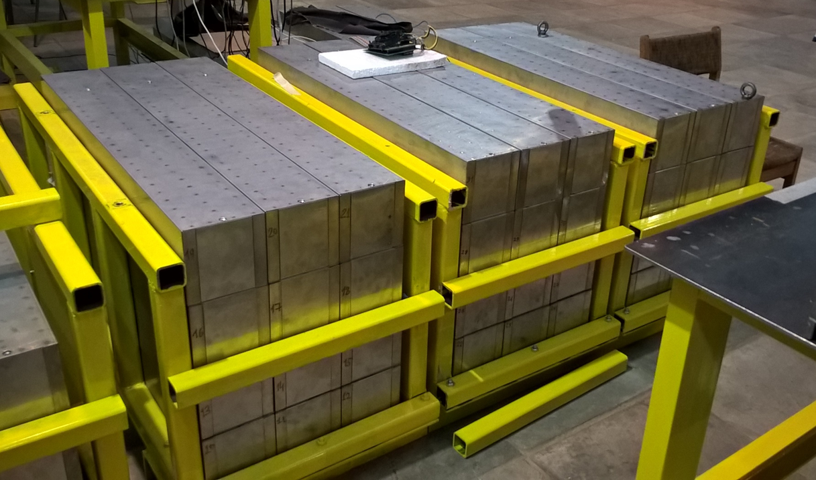
Stages of FHCal production: modules.
Lead and scintillators sandwiches in box.
Lead absorbers and mechanics.
WLS-fibers are aligned.
Optical connectors are polished.
At present, almost half of FHCal modules are ready for the tests.
All FHCal modules will be ready in 2019.
Tests of modules with cosmic muons are done in parallel with the development of Front-End-Electronics and readout.

Slide 7
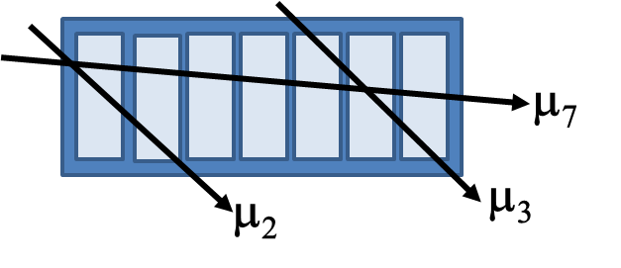
Tests of FHCal modules with cosmic muons.
A few track geometries are considered:
Horizontal muons (low statistics),
Inclined tracks passed through 2 or 3 sections.
Dependence of light yield in modules
Higher light yield for shorter WLS-fibers
Section #
Section #
Light yield ~40 ph.e. per 5 MeV of deposited energy is rather high for reliable energy calibration with muons.

Slide 8
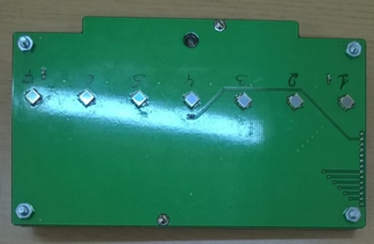
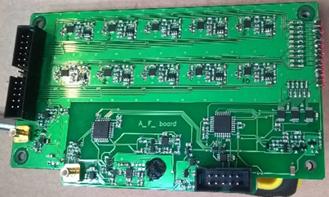
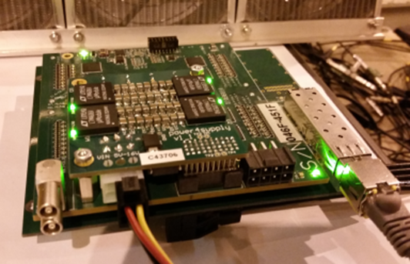
Photodiodes, FEE and readout electronics.
A first samples of FEE with MPPC photodetectors were developed and produced.
Photodetectors:
Hamamatsu MPPC: size – 3x3 mm²;
pixel -10x10 µm²;
PDE~12%.
Front-End-Electronics:
7 channels:
two-stage amplifiers; HV channels;
LED calibration source.
Amp
Integrator
ADC
MPPC
FEE
Δt ~ 50 ns
Δt ~ 200 ns
τ ~ 20ns
The readout electronics: FPGA based 64 channel ADC64 board, 62.5MS/s (AFI Electronics, JINR, Dubna).
Full readout chain was tested with cosmic muons and at beam!

Slide 9
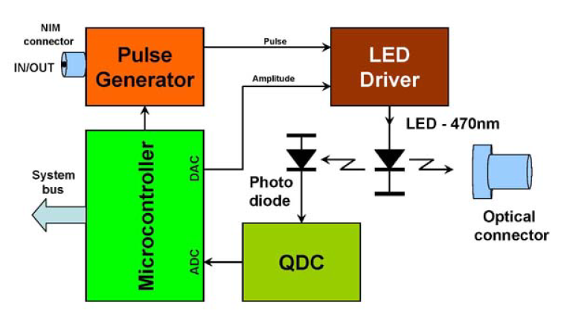
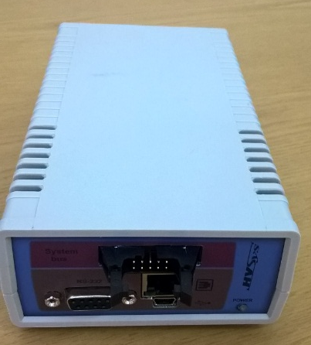
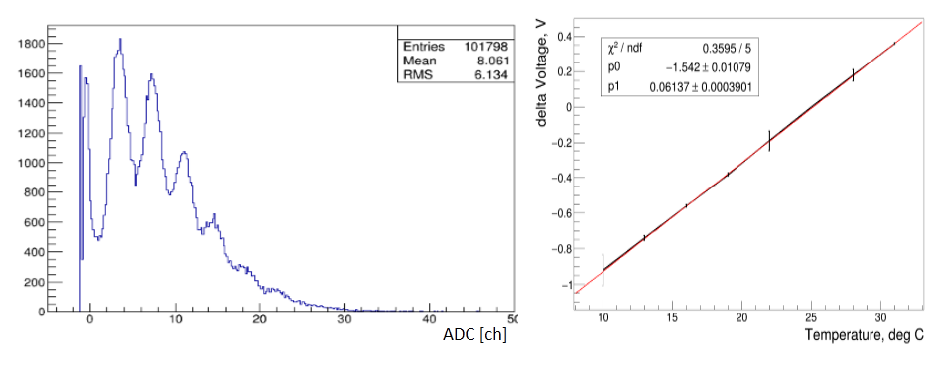
Slow control and monitoring system.
HV system and LED-monitoring is based on the developments of HVSYS Co., Dubna
HV and SC-box
MPPC gain stabilization – by HV correction with temperature.
T-sensor
All MPPC are placed on Al-plate.
Dependence of MPPC gain on temperature.

Slide 10
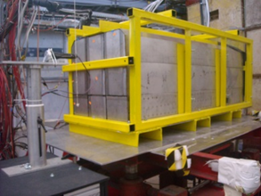
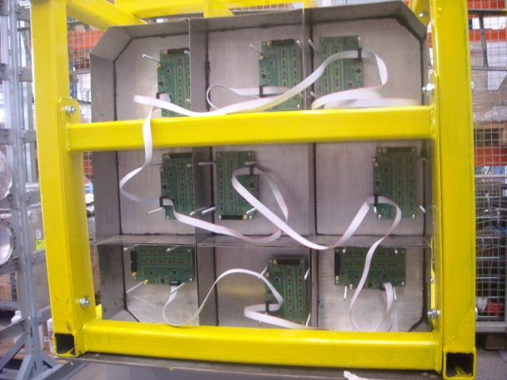
Test of calorimeter supermodule at CERN T9 line.
Proton momentum range: 3-10 GeV/c
Supermodule consists of 9 (3x3) CBM modules.
The FEE and readout are designed for MPD (BM@N) experiment.
Each module has 10 longitudinal sections with 10 SiPMs at the end.
Full size 60x60x160 cm³.
Weight ~ 4.5 tons.

Slide 11
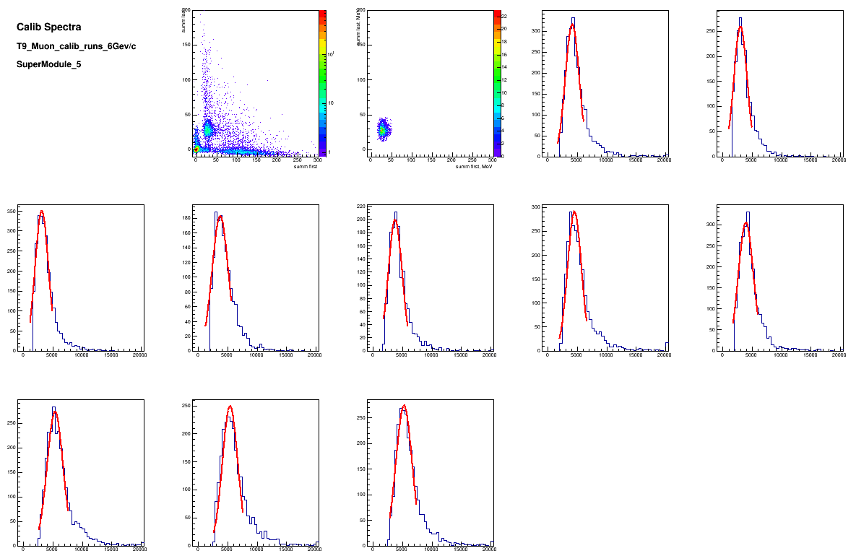
Calibration of longitudinal sections with beam muons, 6 GeV/c
Identification of muons – equal energy deposition in first and last half of modules.
Muons deposit
~5 MeV
in one section
E₂ [MeV]
Sect. 1
Sect. 2
E₂ [MeV]
E₁ [MeV]
E₁ [MeV]
Sect. 3
Sect.4
Sect. 5
Sect. 6
Sect. 7
Sect. 8
Sect. 9
Sect. 10
Muons energy deposition spectra in 10 sections
of central module.

Slide 12
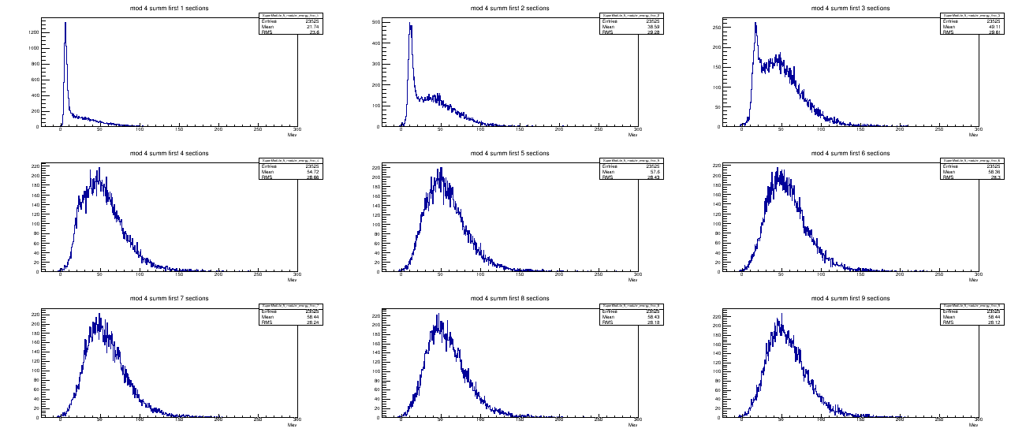
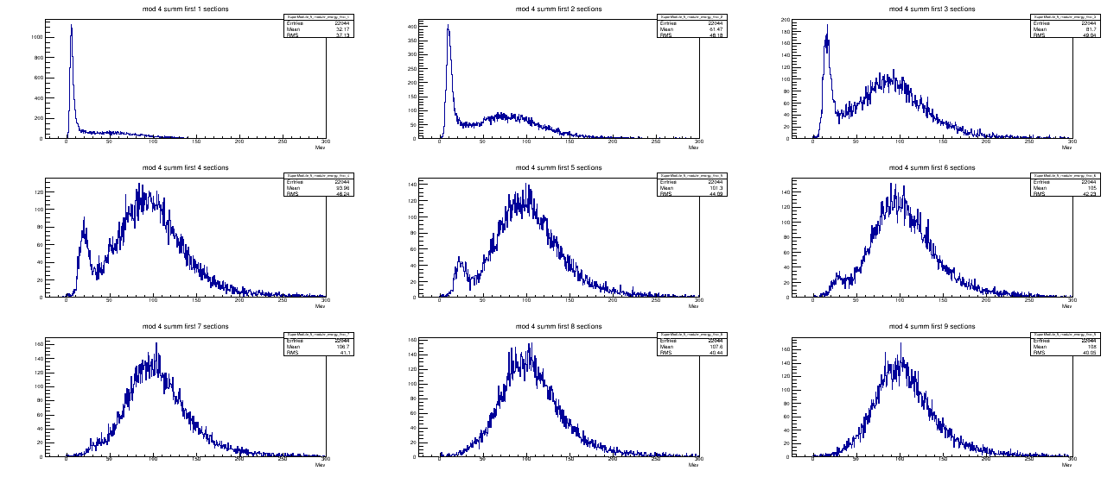
Spectra of energy sum in first n sections in central module,
protons 3 and 6 GeV/c.
p= 3 GeV/c
$$\sum_{i=1}^{n=1}{Ei}$$
$$\sum_{i=1}^{n=2}{Ei}$$
$$\sum_{i=1}^{n=3}{Ei}$$
Some part of protons has only ionizing energy loss without hadron shower in first sections.
MeV
MeV
MeV
$$\sum_{i=1}^{n=4}{Ei}$$
$$\sum_{i=1}^{n=5}{Ei}$$
$$\sum_{i=1}^{n=6}{Ei}$$
MeV
MeV
MeV
$$\sum_{i=1}^{n=7}{Ei}$$
$$\sum_{i=1}^{n=8}{Ei}$$
$$\sum_{i=1}^{n=9}{Ei}$$
MeV
MeV
p= 6 GeV/c
MeV
$$\sum_{i=1}^{n=1}{Ei}$$
$$\sum_{i=1}^{n=2}{Ei}$$
$$\sum_{i=1}^{n=3}{Ei}$$
In 7th section the low energy ionizing peak is disappeared. Energy spectrum has Gaussian shape.
MeV
MeV
MeV
$$\sum_{i=1}^{n=4}{Ei}$$
$$\sum_{i=1}^{n=5}{Ei}$$
$$\sum_{i=1}^{n=6}{Ei}$$
MeV
MeV
MeV
$$\sum_{i=1}^{n=7}{Ei}$$
$$\sum_{i=1}^{n=8}{Ei}$$
$$\sum_{i=1}^{n=9}{Ei}$$
MeV
MeV
MeV

Slide 13
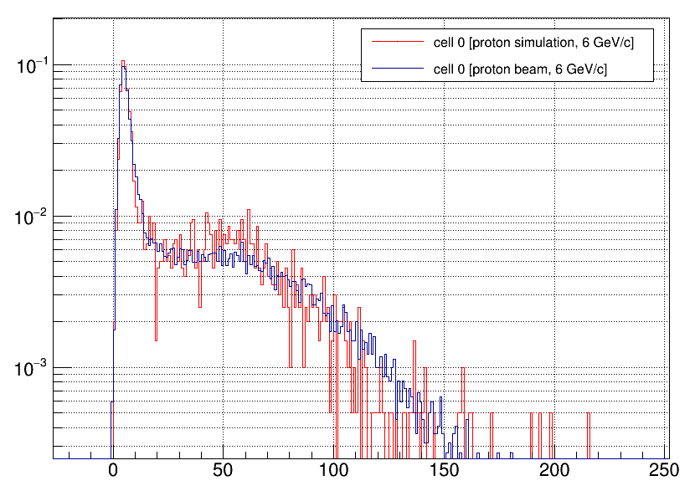
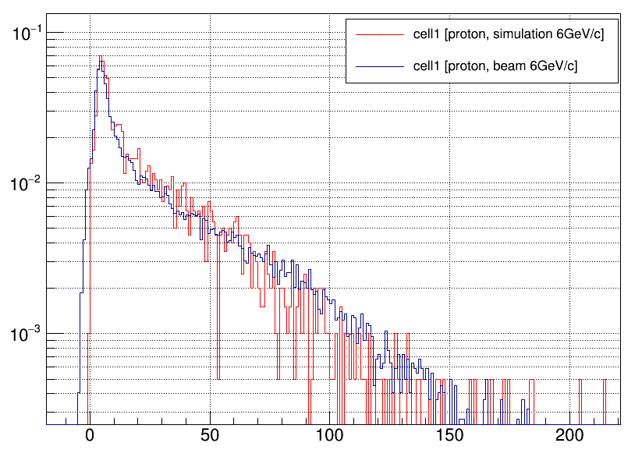
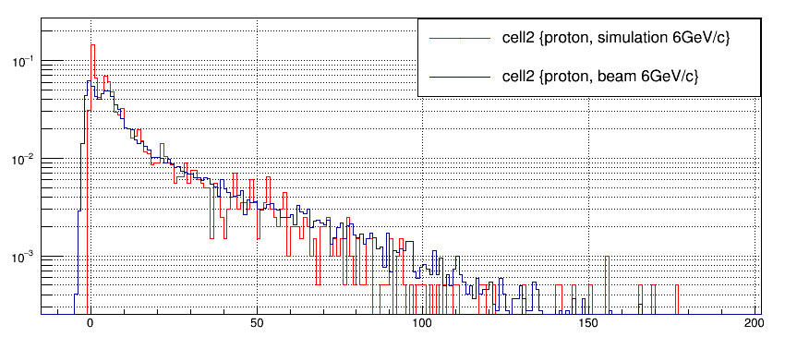
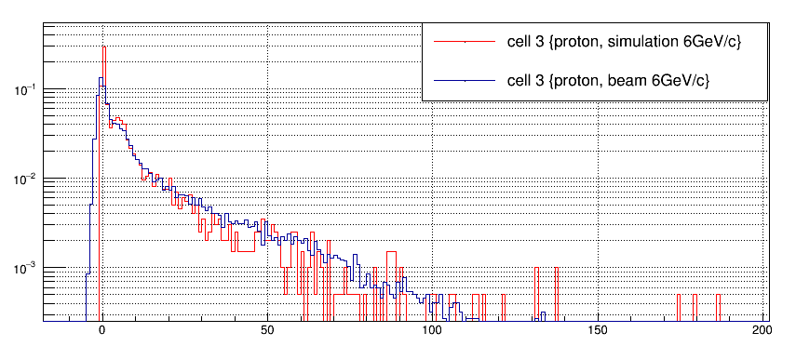
Comparison of amplitude spectra in sections, protons 6 GeV/c.
----- MC
----- experiment
----- MC
----- experiment
Section 1
Section 2
E [MeV]
E [MeV]
----- MC
----- experiment
----- MC
----- experiment
Section 3
Section 4
E [MeV]
E [MeV]
Experimental and simulation spectra are in good agreement.

Slide 14
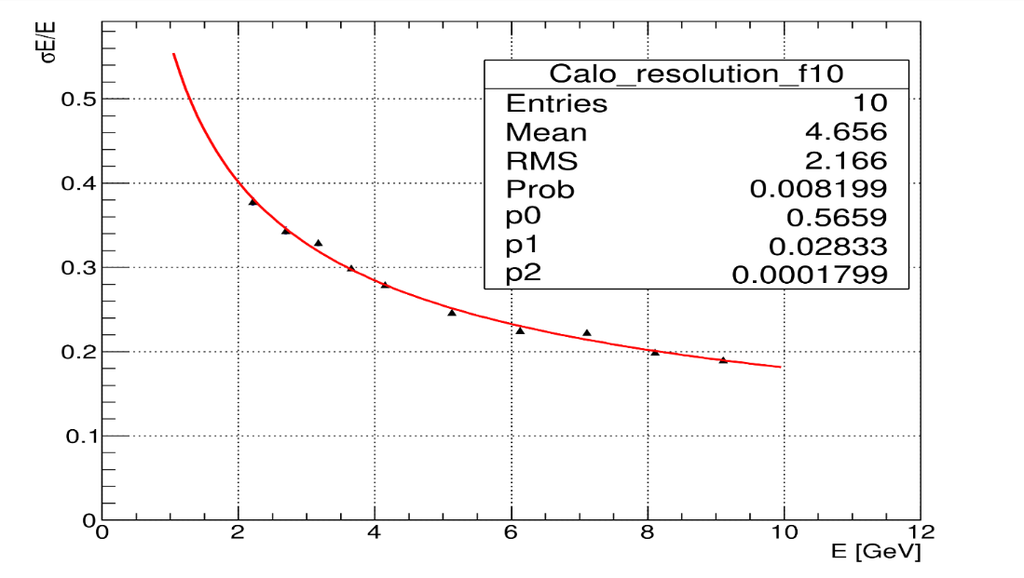
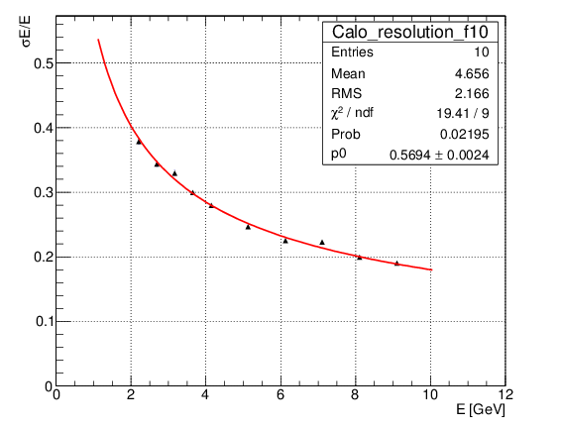
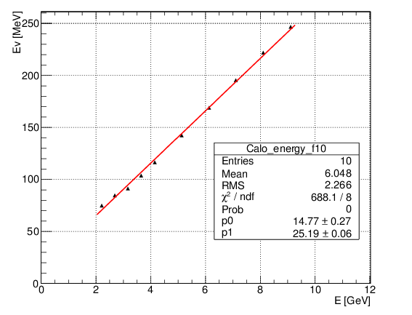
Energy resolution for full supermodule.
$\frac{σE}{E}=\frac{a}{\sqrt{E}}$⨁b ⨁ $\frac{c}{E}$
$$\frac{σE}{E}=\frac{a}{\sqrt{E}}$$
Linearity of response.
The stochastic term of ~56% practically doesn't depend on the fitting function.
Good agreement with MC results.
The noise term is almost zero.

Slide 15
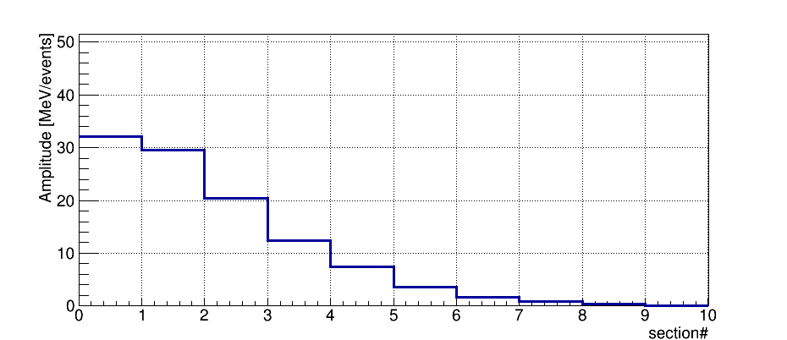
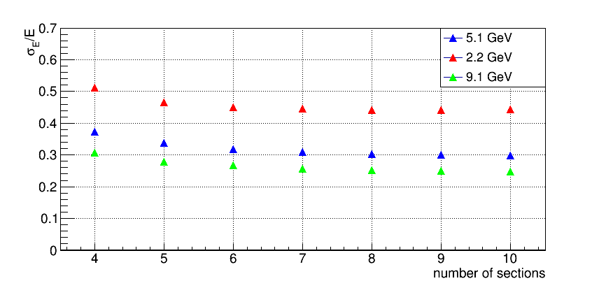
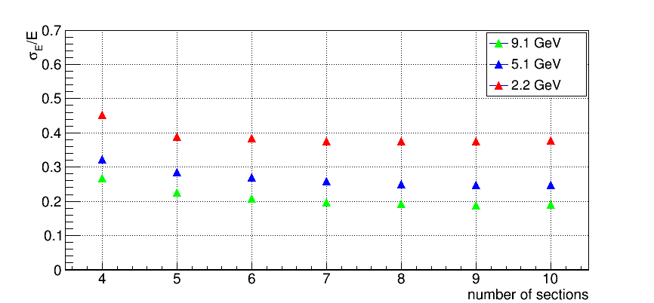
Dependence of energy resolution on supermodule length.
Longitudinal profile of hadron shower in central module.
p= 6 GeV/c
The energy resolution for central module and for full supermodule is practically constant starting from the 7 longitudinal sections.
Central module
Full supermodule
Length of 4λ_{I} or 7 longitudinal sections is optimum for momentum range 3-6 GeV/c

Slide 16
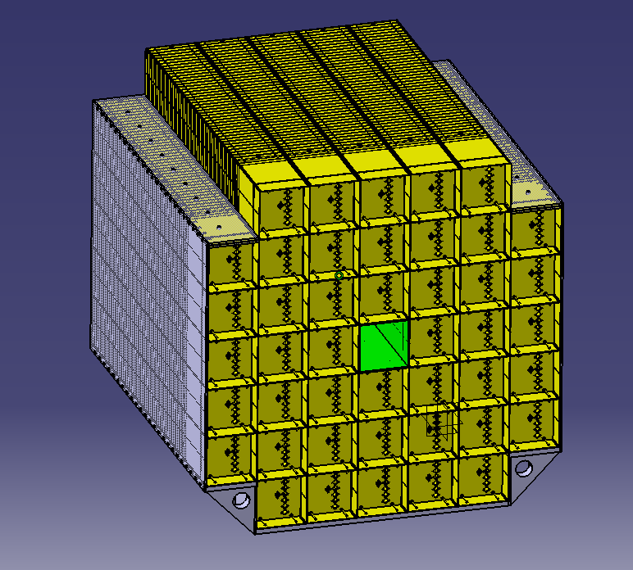
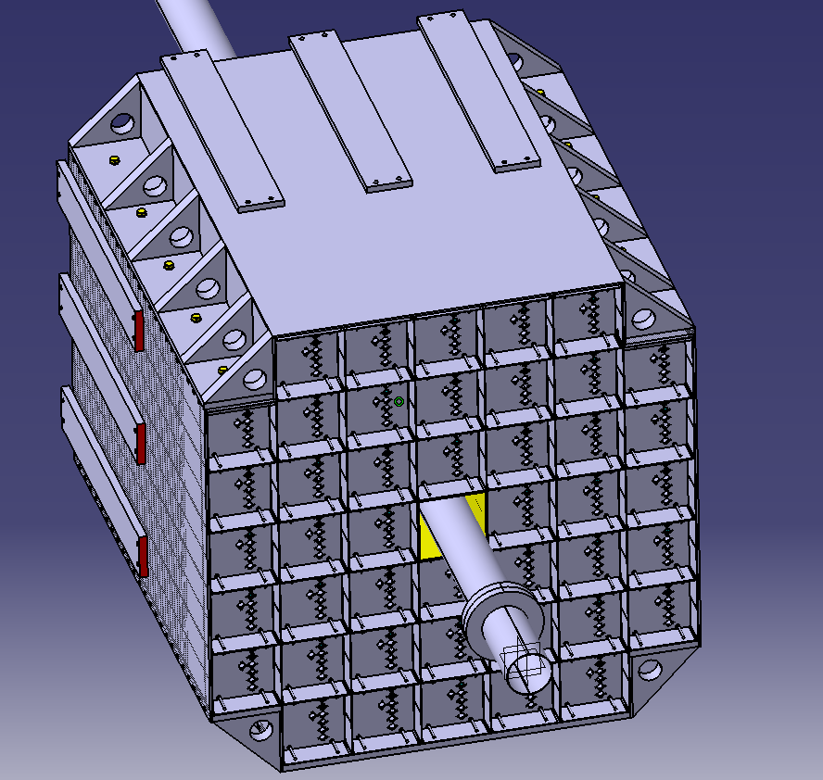
Mechanical platform is under design at JINR now.
Magnet pole alone (left), with FHCal (middle) and endcup detectors (right).

Slide 17
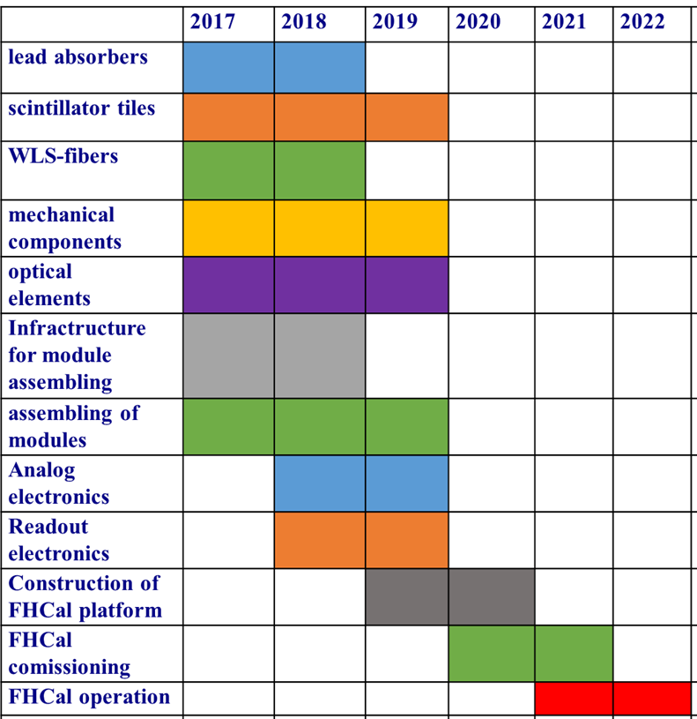
Timetable.

Slide 18
Conclusions.
Technical design of the MPD FHCal is finished.
First half of FHCal modules is produced already.
The basic components are purchased almost for the full calorimeter production.
First samples of Front-End and readout electronics are ready and tested.
Beam tests at NICA energies (T9, CERN) confirmed the expected parameters of FHCal modules.
Tests and the calibration of FHCal modules with cosmic rays are ongoing.
Service systems are in development state.
The production of all 90 FHCAl modules is expected in 2019.
Notes:
That is all. In conclusion I would like to say that:

Slide 19
Thank you!

Slide 20
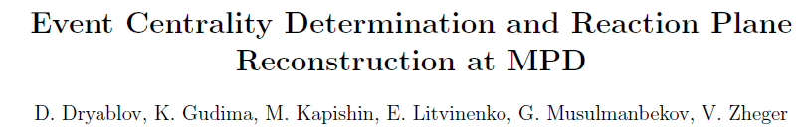
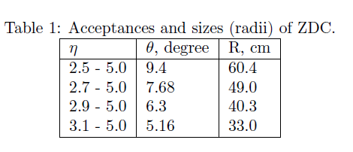
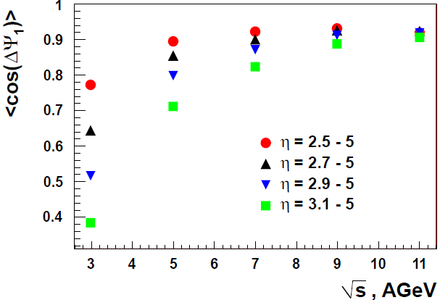
Influence of FHCal acceptance at event pane reconstruction.
Calorimeter with diameter 100-120 cm has an appropriate accuracy in event plane reconstruction in all range of beam energies.

Slide 21
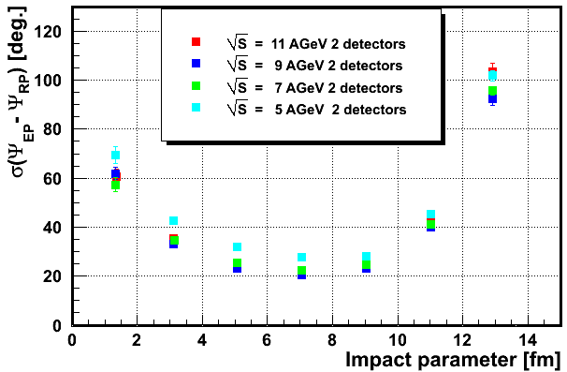
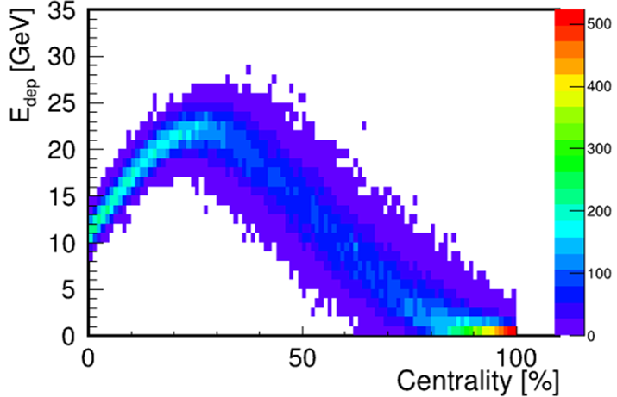
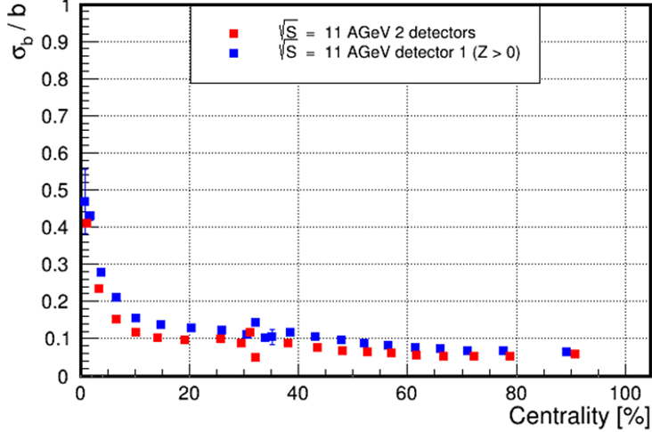

Event plane and centrality resolution.
Modules 15x15 cm² are optimum choice and fit the transverse size of hadron showers (interaction length of lead+scint. λ_{I}~20 cm).
The event plane resolution of 20⁰-25⁰: two arms of FHCal (maximum spectator multiplicity) and no influence of magnet field.
Energy deposition in FHCal isn’t monotonic due to beam hole and can’t resolve the central and peripheral events.
$\sqrt{s}$=11 GeV
The ambiguity in centrality determination can be resolved by taking track multiplicity in TPC.
Or by using other observables in FHCal.

Slide 22
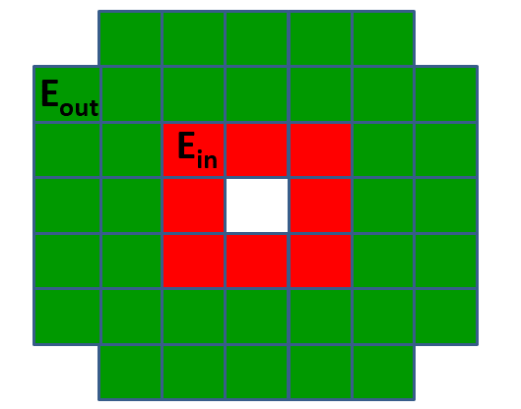
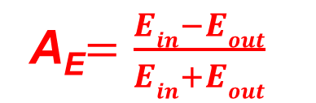
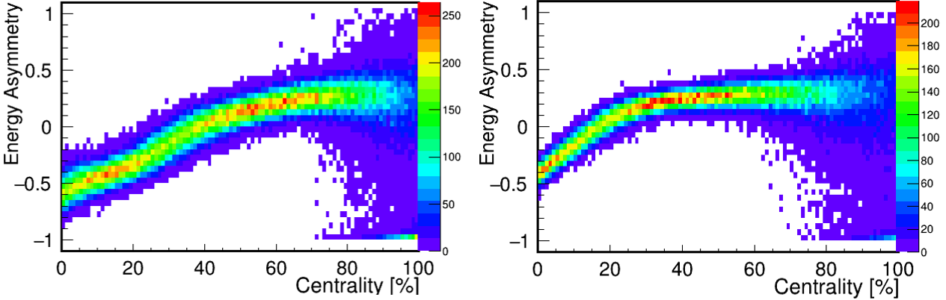


Other FHCal observable for the centrality measurement.
π⁺ π⁻
π⁺ π⁻
π⁺ π⁻
Mainly, fragments are produced in peripheral collisions and located near beam hole.
while pions are produced
in central collisions.
d ³He
t ⁴He
Depending on centrality there must be difference in the energy depositions in inner and outer parts of calorimeter.
Let’s construct energy asymmetry:
$\sqrt{s}$=5 GeV
$\sqrt{s}$=11 GeV

Slide 23
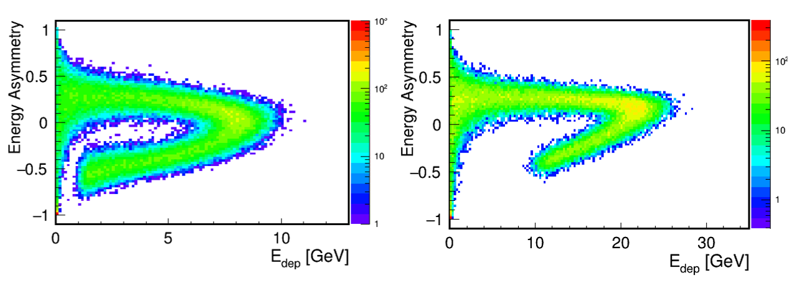

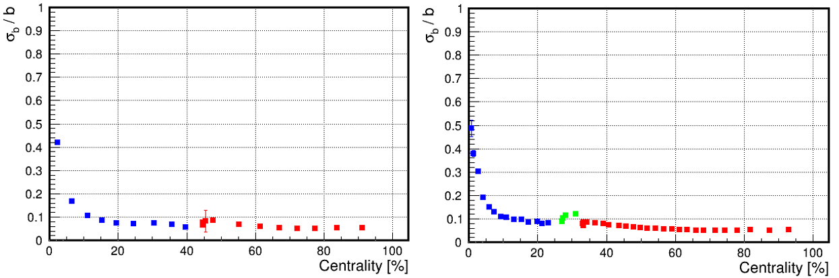
Calculation of centrality from energy asymmetry – energy correlation.
The resolution of impact parameter for central events is determined by low spectator multiplicity.
Energy and asymmetry bins are used for the calculations.
More advanced analysis can improve the resolution!
Inspite of beam hole FHCal can resolve the central and peripheral events.

Slide 24
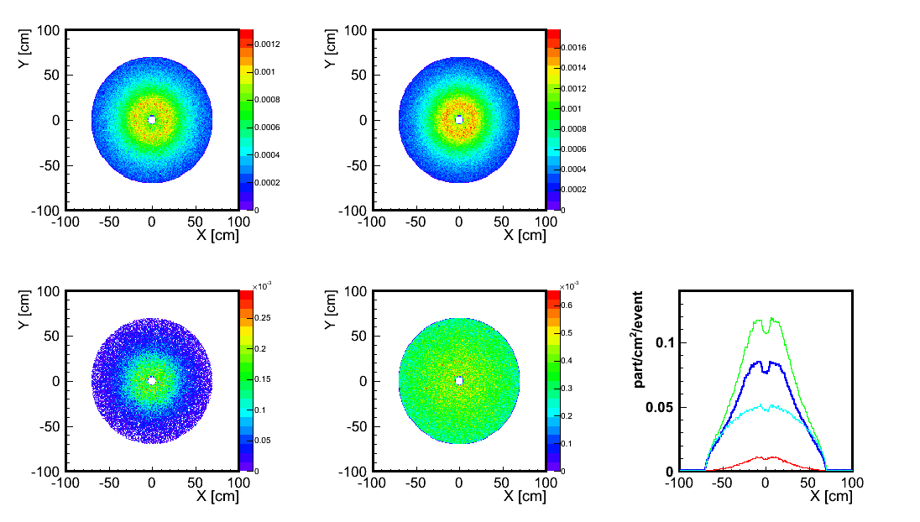
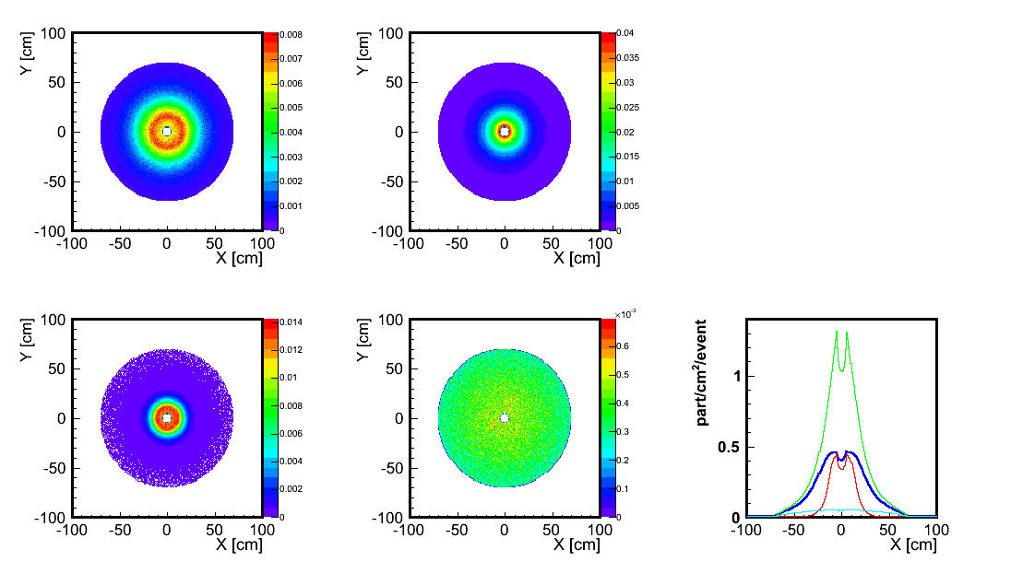
Occupancy (particles/events/cm²) at front of FW/FHCAL.
b < 6 fm
b > 6 fm
Protons
Neutrons
Protons
Neutrons
Fragments
Pions
Fragments
Pions
Protons
Neutrons
Fragments
Pions
Projection at X-axis

Slide 25
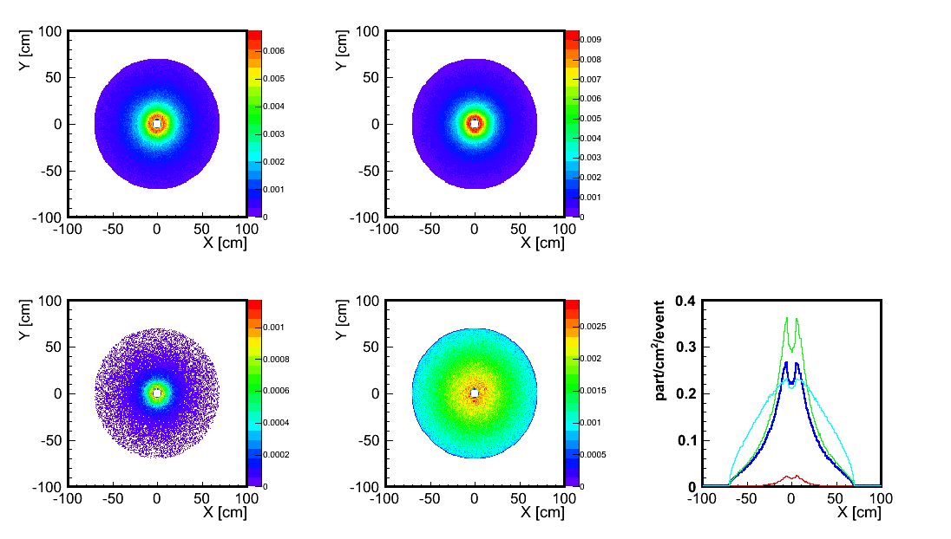
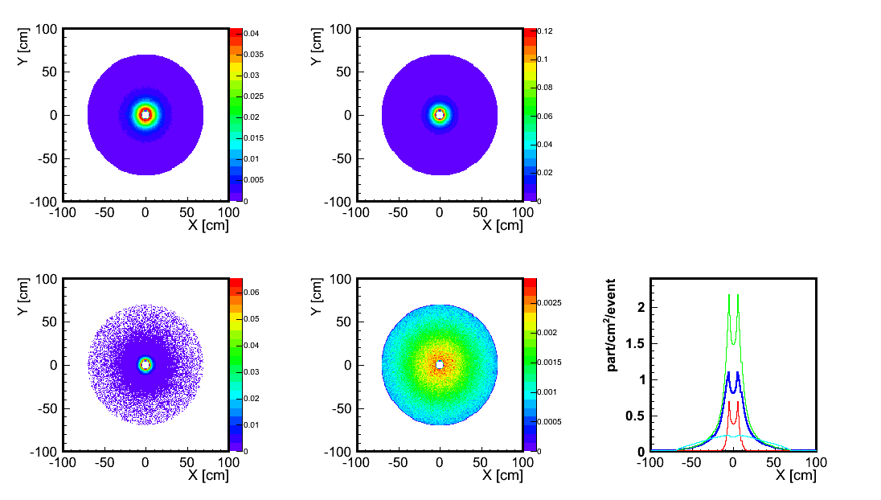
Occupancy (particles/events/cm²) in front of FW/FHCAL.
b < 6 fm
b > 6 fm
Protons
Neutrons
Neutrons
Protons
Fragments
Pions
Fragments
Pions
Protons
Neutrons
Fragments
Pions
Projection at X-axis

Slide 26


Pseudorapidity distributions in FW/FHCal acceptance
Without FWALL acceptance cut
All particles
AuAuss11mb AuAuss5mb
Acceptance of FW/FHCAL
Protons + neutrons
Fragments
Pions

Slide 27


Angular resolution of event plane for FW at different energies.
Weight w_{i}=1.
only charged spectators (protons and fragments)
All charged particles (+pions)
The best resolution of event plane is about 30⁰-40⁰ in case of charged spectators only.
For all charged particles the resolution increases to 50⁰-60⁰ for low energies and is drastically worse at highest energy.

Slide 28





Centrality resolution with FW at different energies.
The FW centrality resolution is significantly worse comparing to FHCal.

Slide 29



First CBM module is already installed at BM@N.
Ar-peak in CBM module.
Shower profile
MeV
MeV
section#
Notes:
That is all. In conclusion I would like to say that:

