Slide 1

a₀ baseline
Fast Vertexing update: new class and minbias results
update Dec.2025 C++ library NXV4

Slide 2




Contents
Vertexing - short reminder
What is new: code overhawl
MinBias - results
Conclusion

Slide 3



Contents
Vertexing - short reminder
What is new: code overhawl
MinBias - results
Conclusion

Slide 4
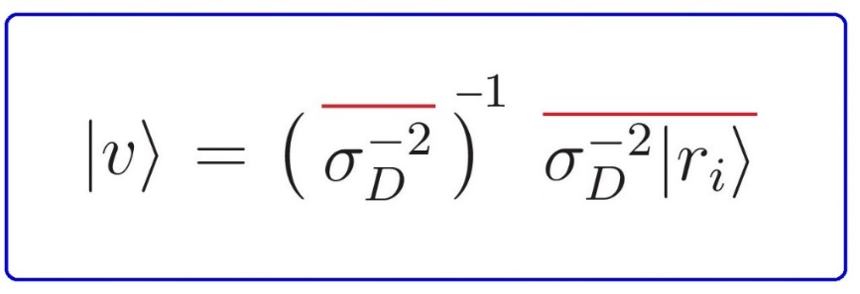
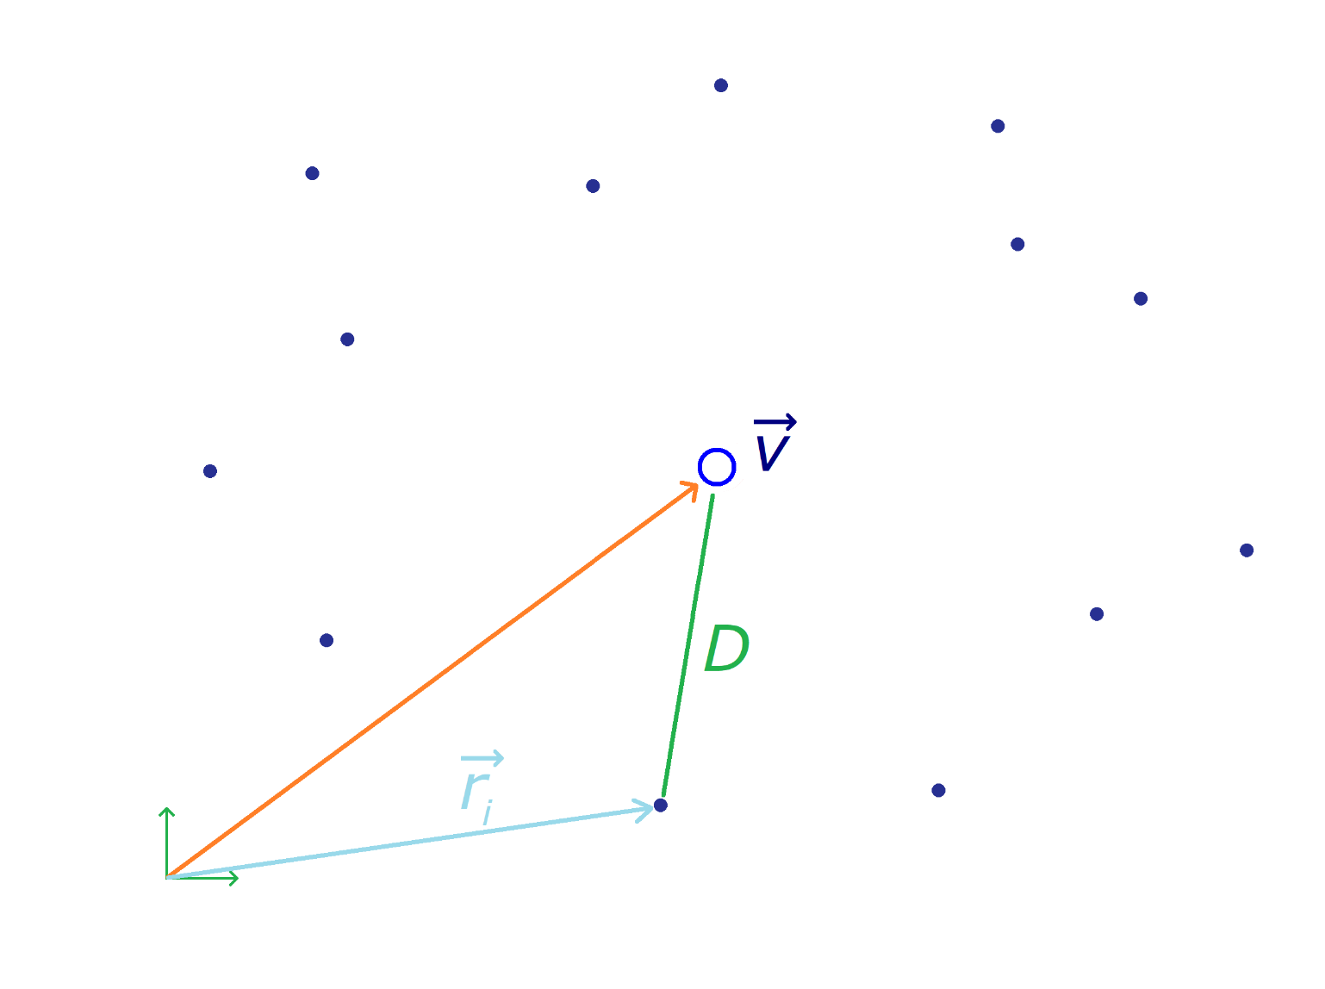
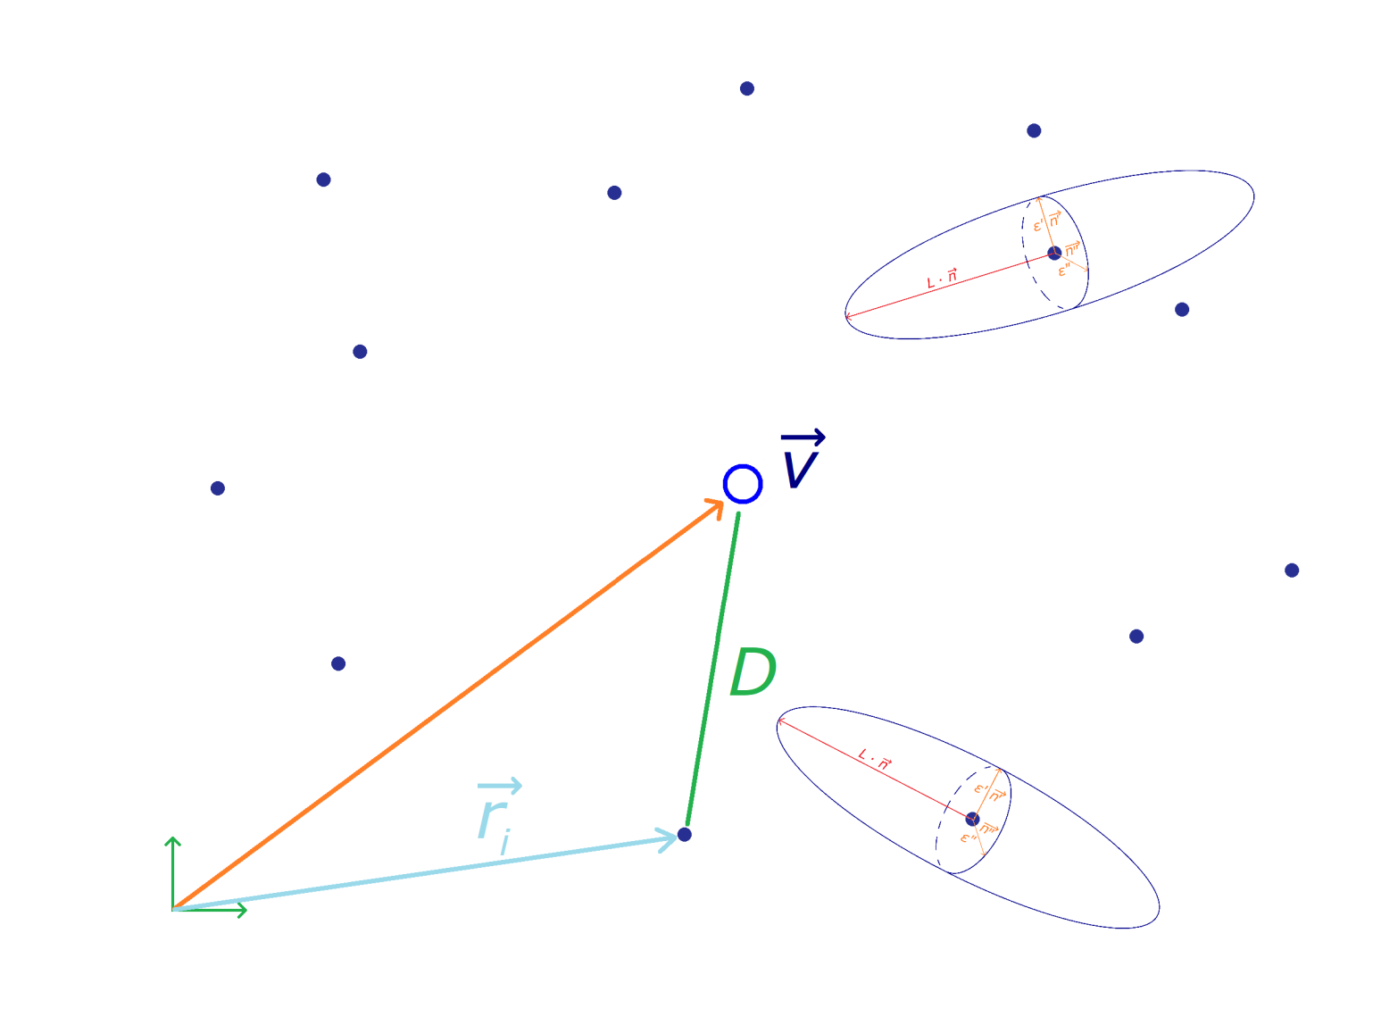
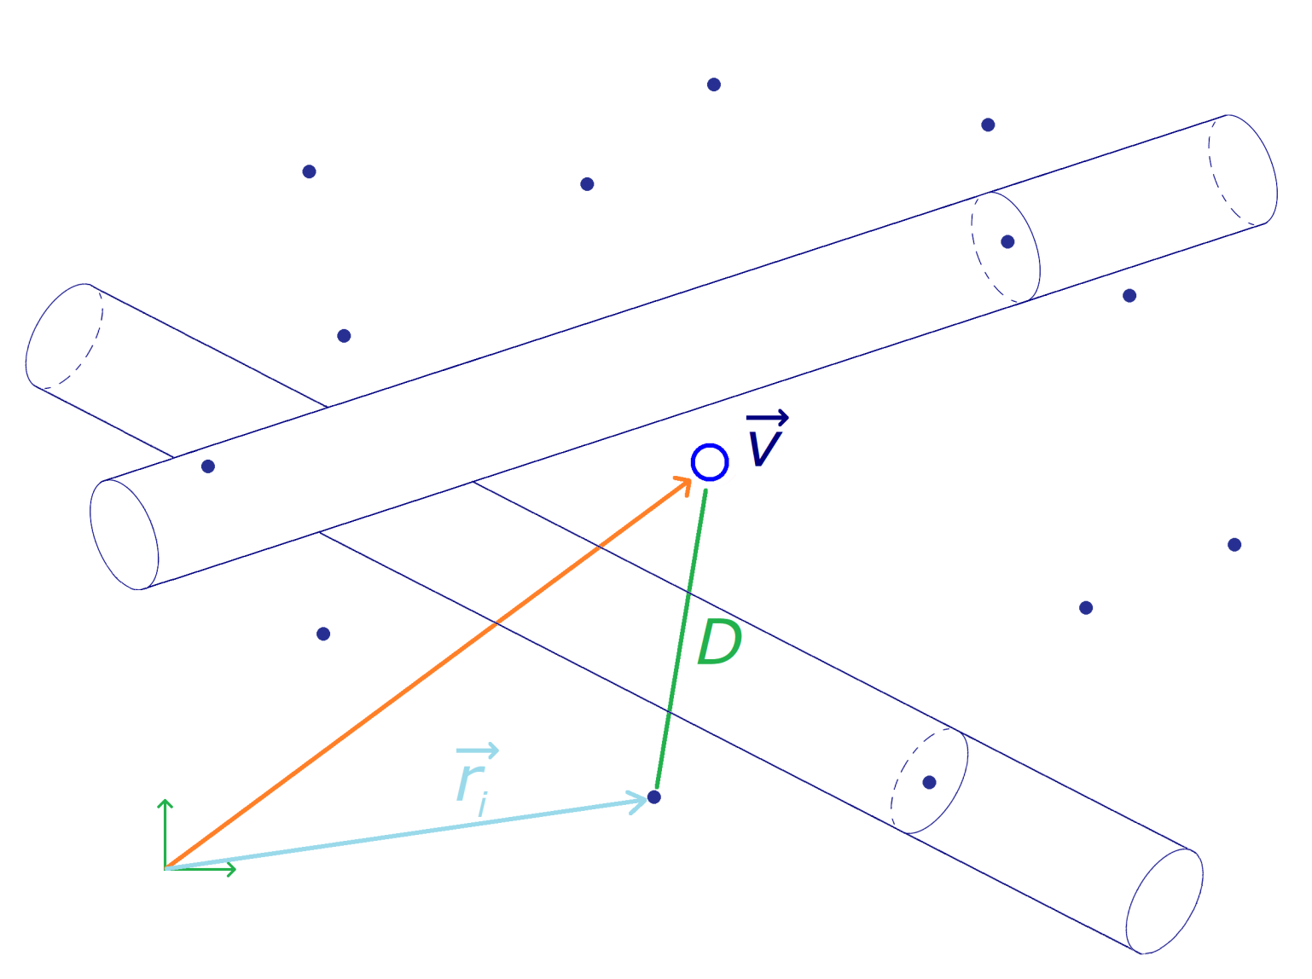
Short Reminder

Slide 5

Contents
Vertexing - short reminder
What is new: code overhawl
MinBias - results
Conclusion

Slide 6
Code - reminder
Steps - reminder
- data - DOCA_{xyz} and p_{xyz}
- initial selection - calculates the first value of the vertex
- vertex loop - calculates the vertex again by adding tighter conditions
- loop stop condition = less than 3 tracks or 10 iterations
Last talk - conditions
Initial selection
Iterative selection
- DOCA_{xy} < 3mm
- DOCA_{xy} -= 0.3mm
- DOCA_{z} < 10mm
- DOCA_{z} -= 1.0mm
- pT > 0.5 GeV/c
- pT += 0.05 GeV/c

Slide 7
Code - updates
Updates:
- now a class
- more modular
- more functional
- newDOCA method
- eliminate the worst track
- still working on conditions
- selection cuts: in sigmas, not absolute val.; χ²/dof; no. hits

Slide 8
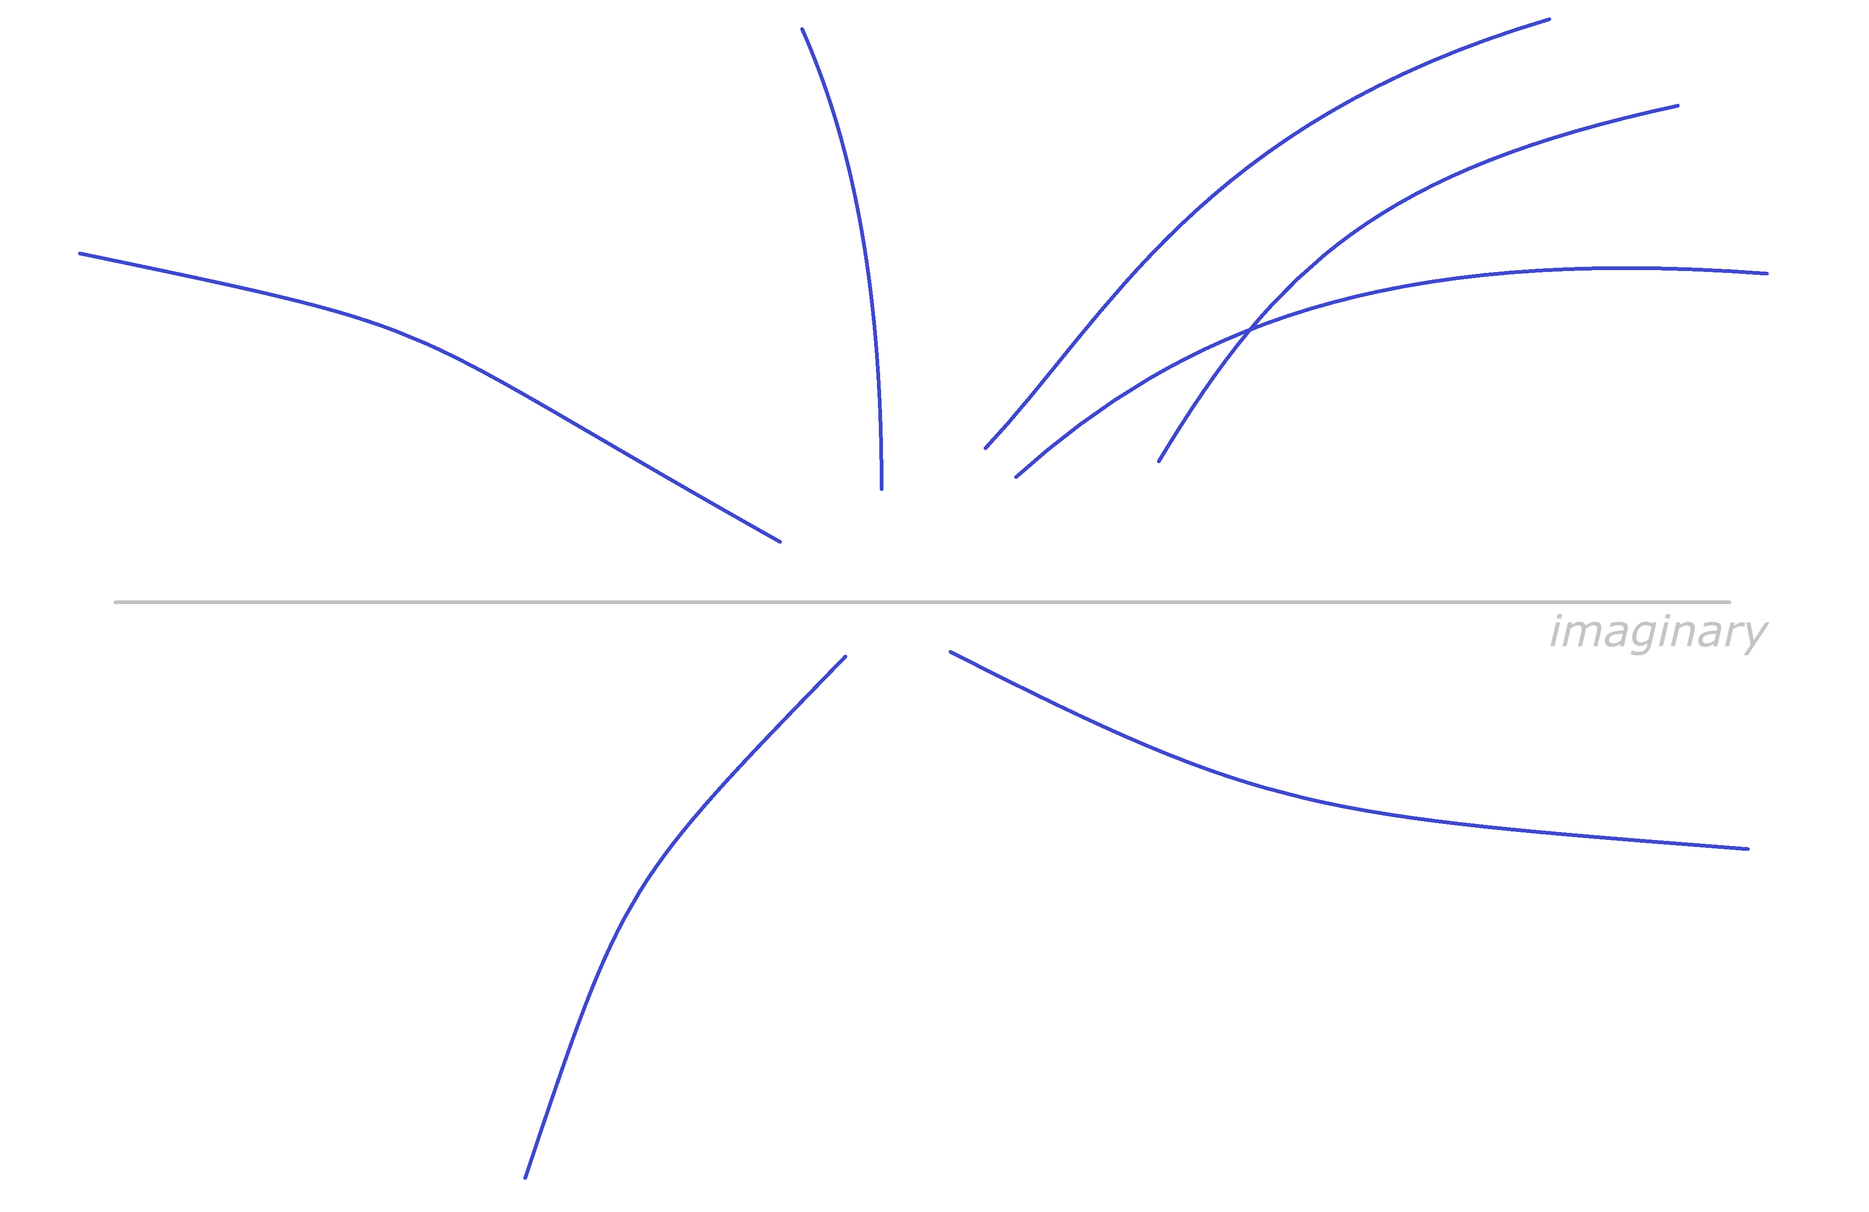
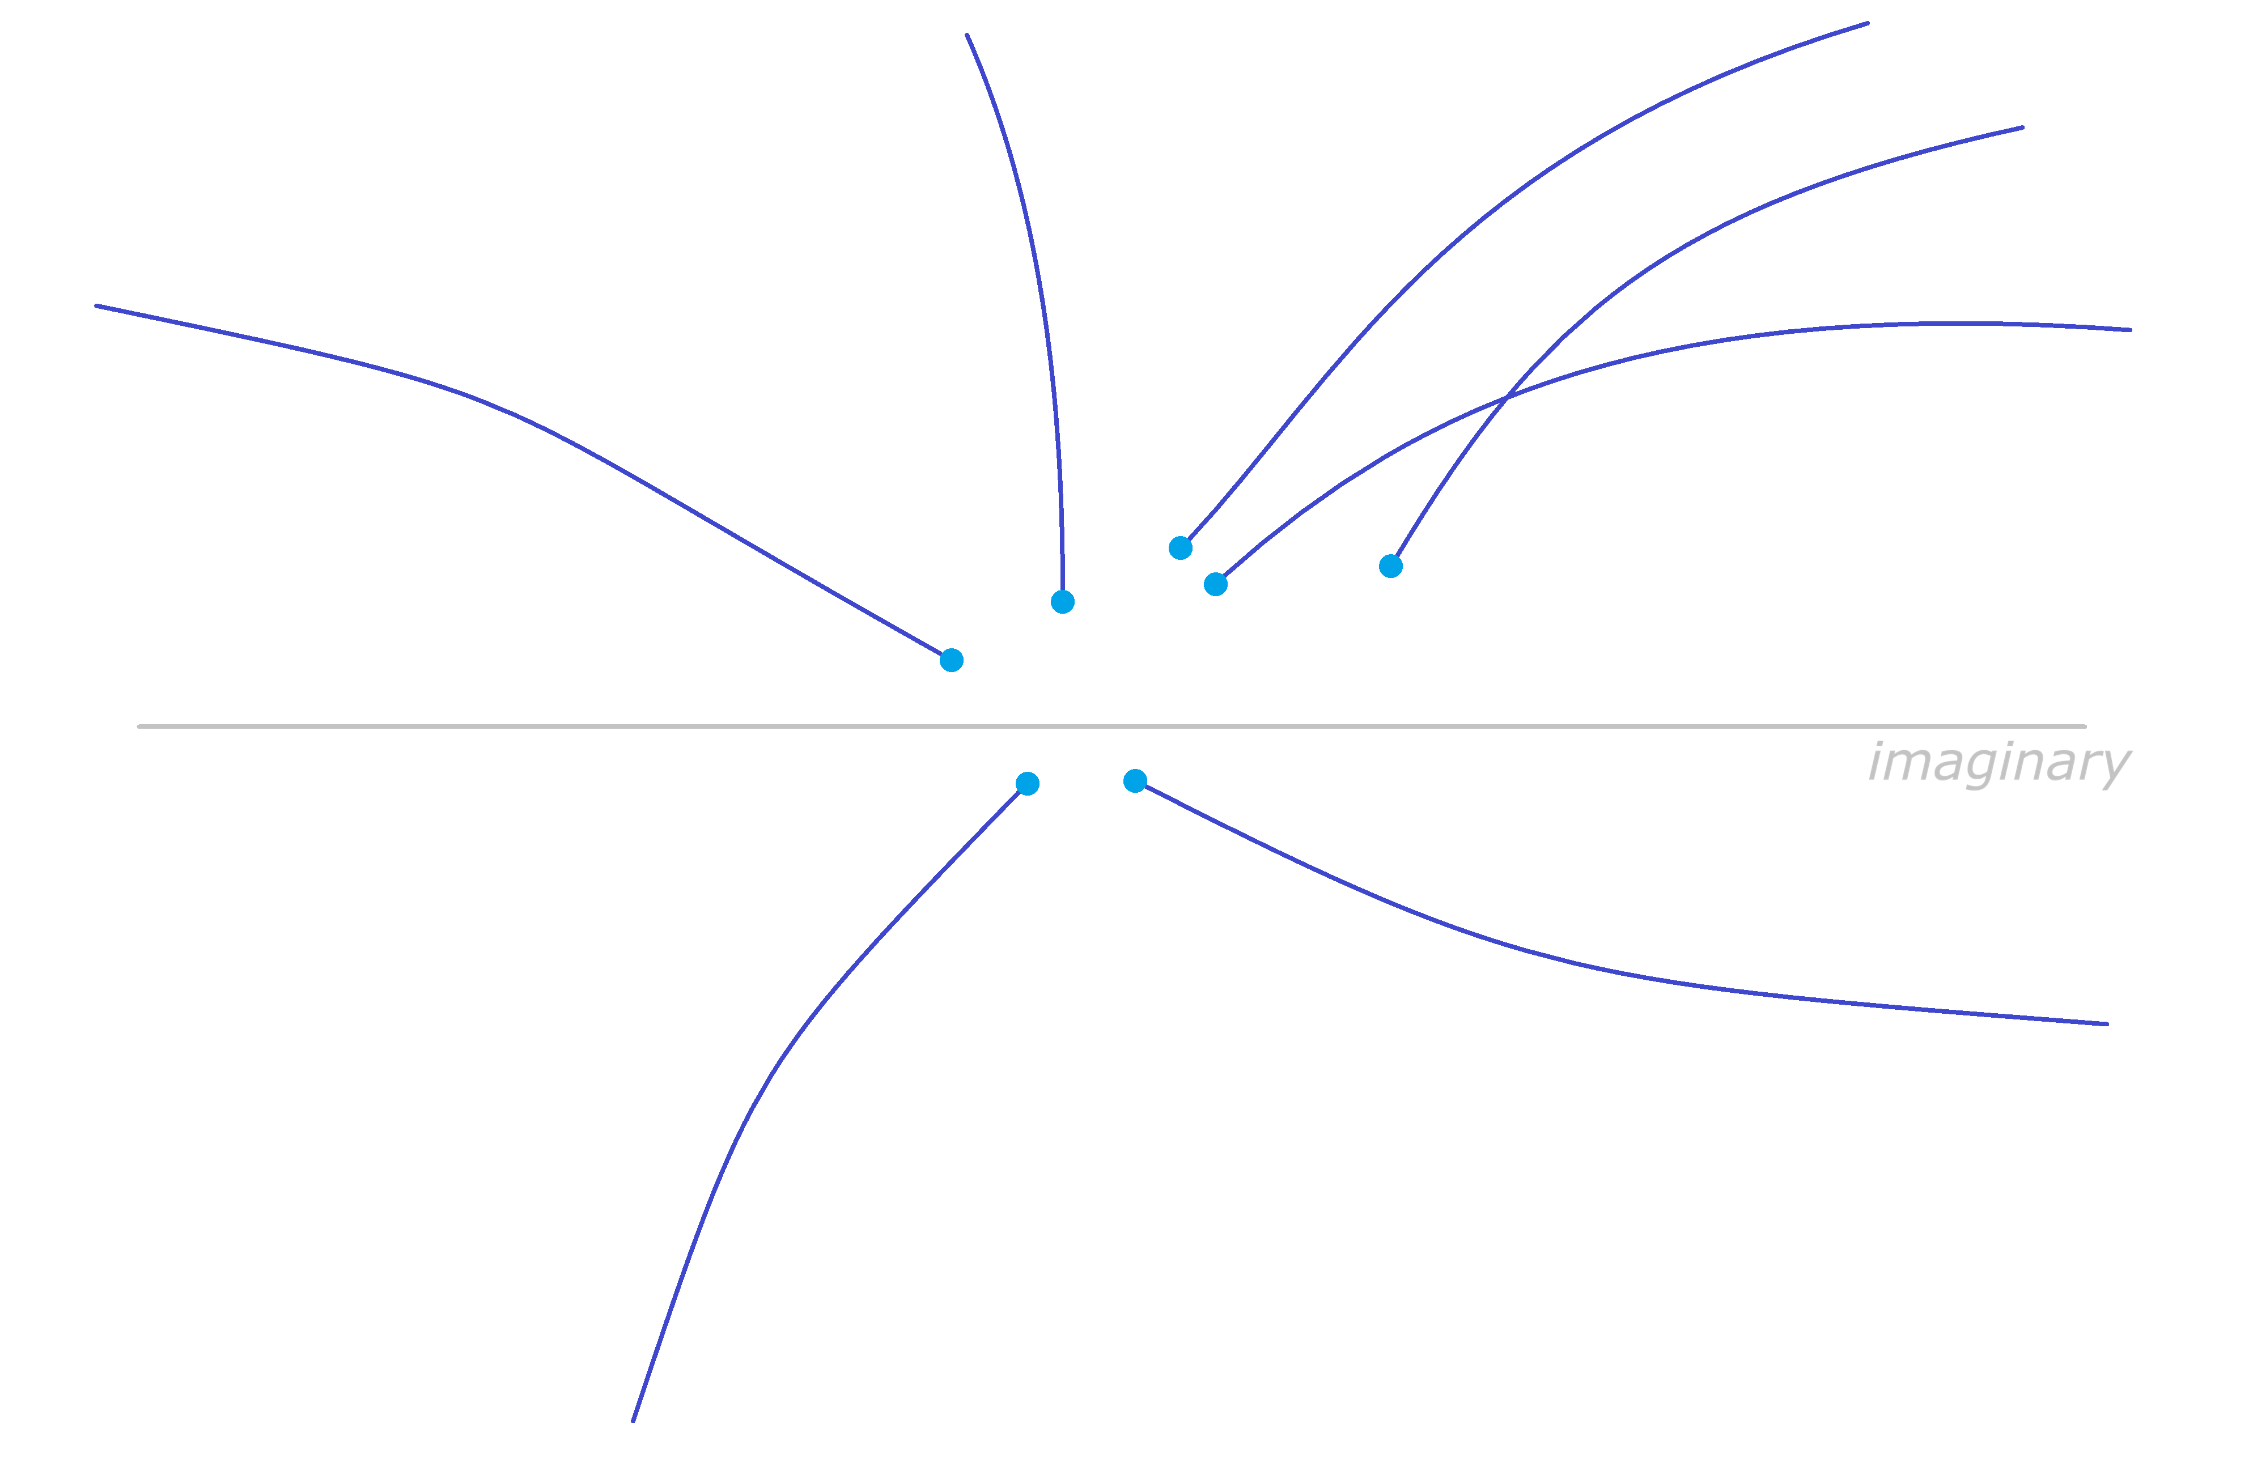
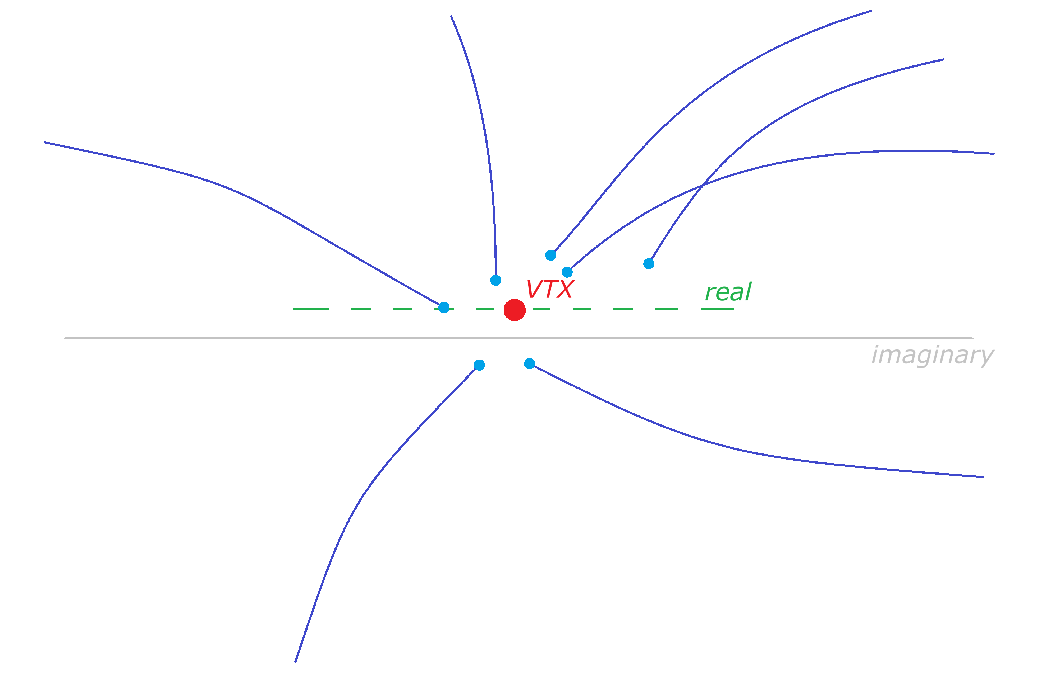
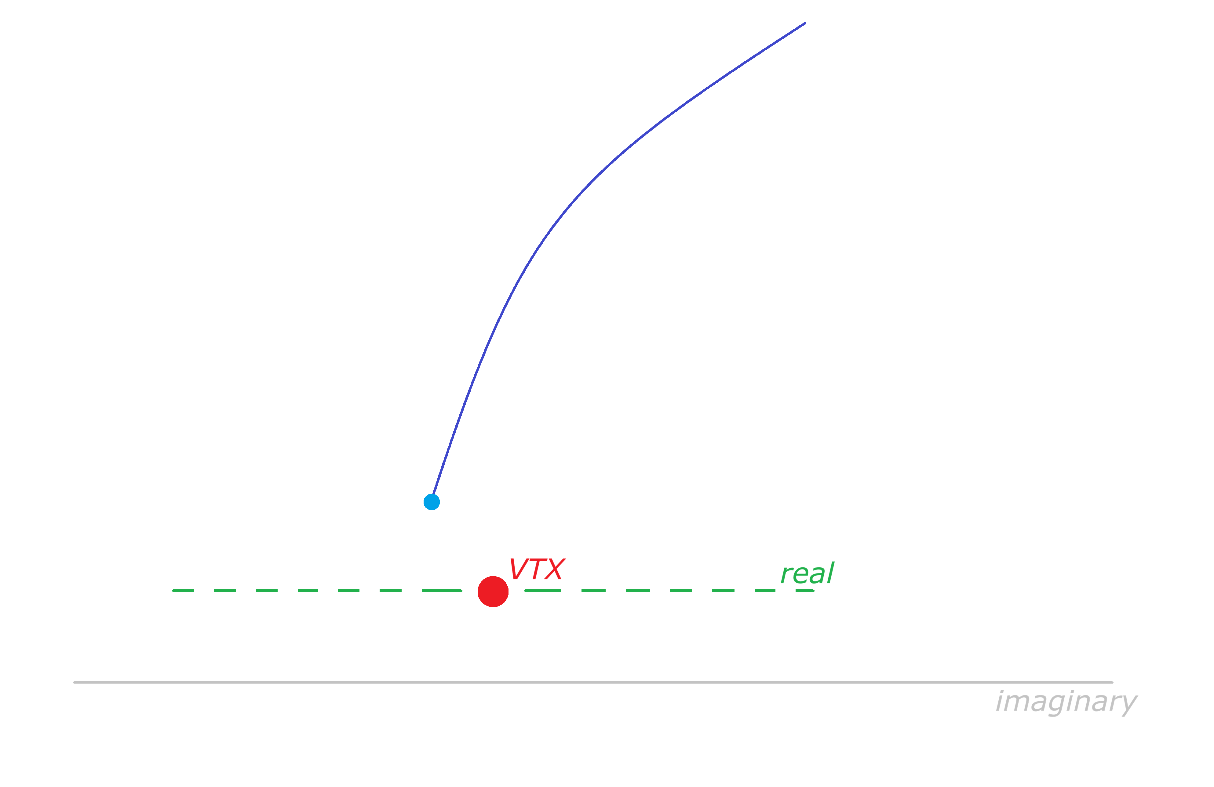
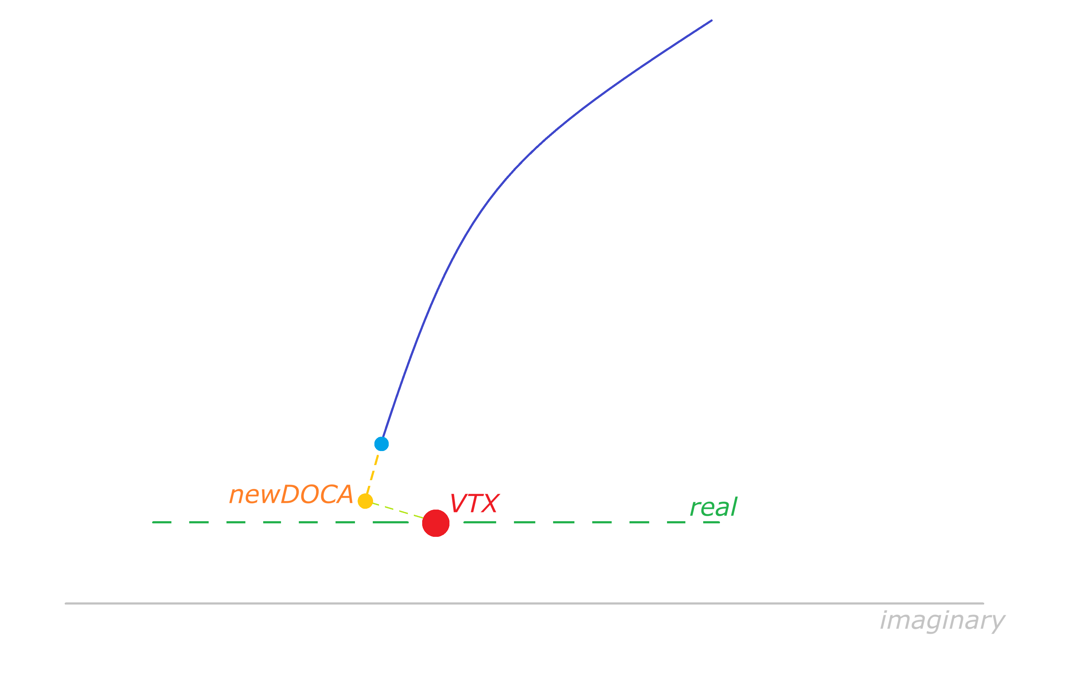
newDOCA method
- newDOCA = updated DOCA
closer to the first VTX_{computed}
newDOCA allows track lineariation to be more precise

Slide 9
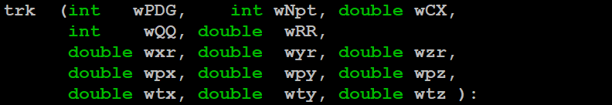
Vertexing Class
Fast vertexing code ⇒ is now a class of its own
- selection of tracks
- worst track
- vertexing
- newDOCA
- track summaries are a class

Slide 10
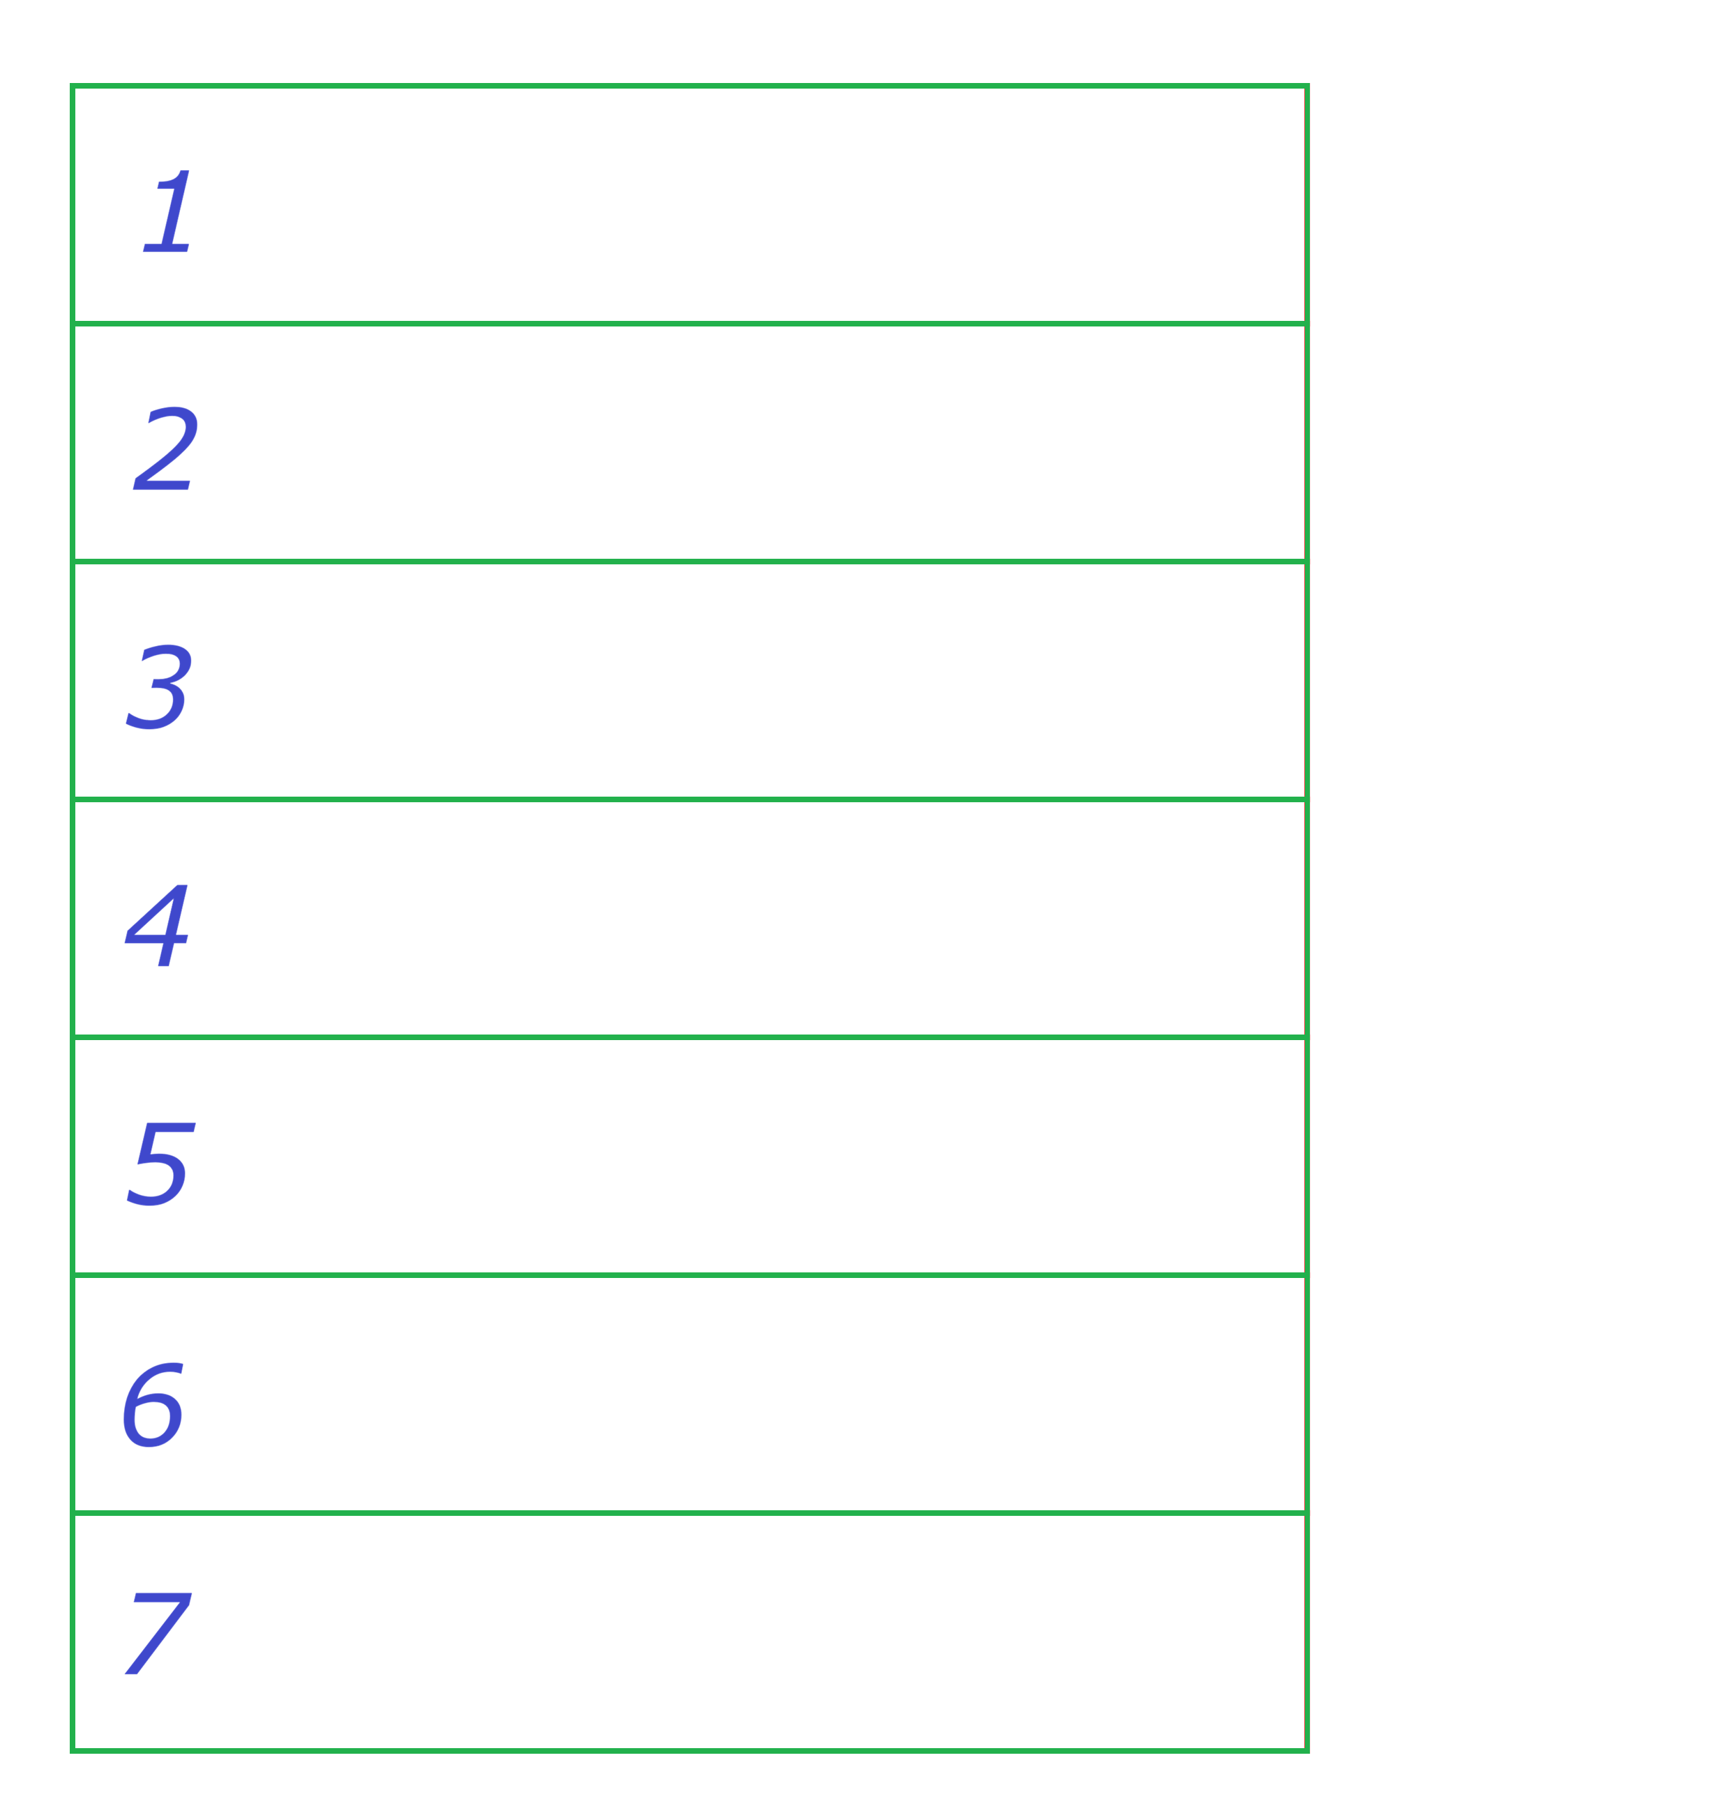
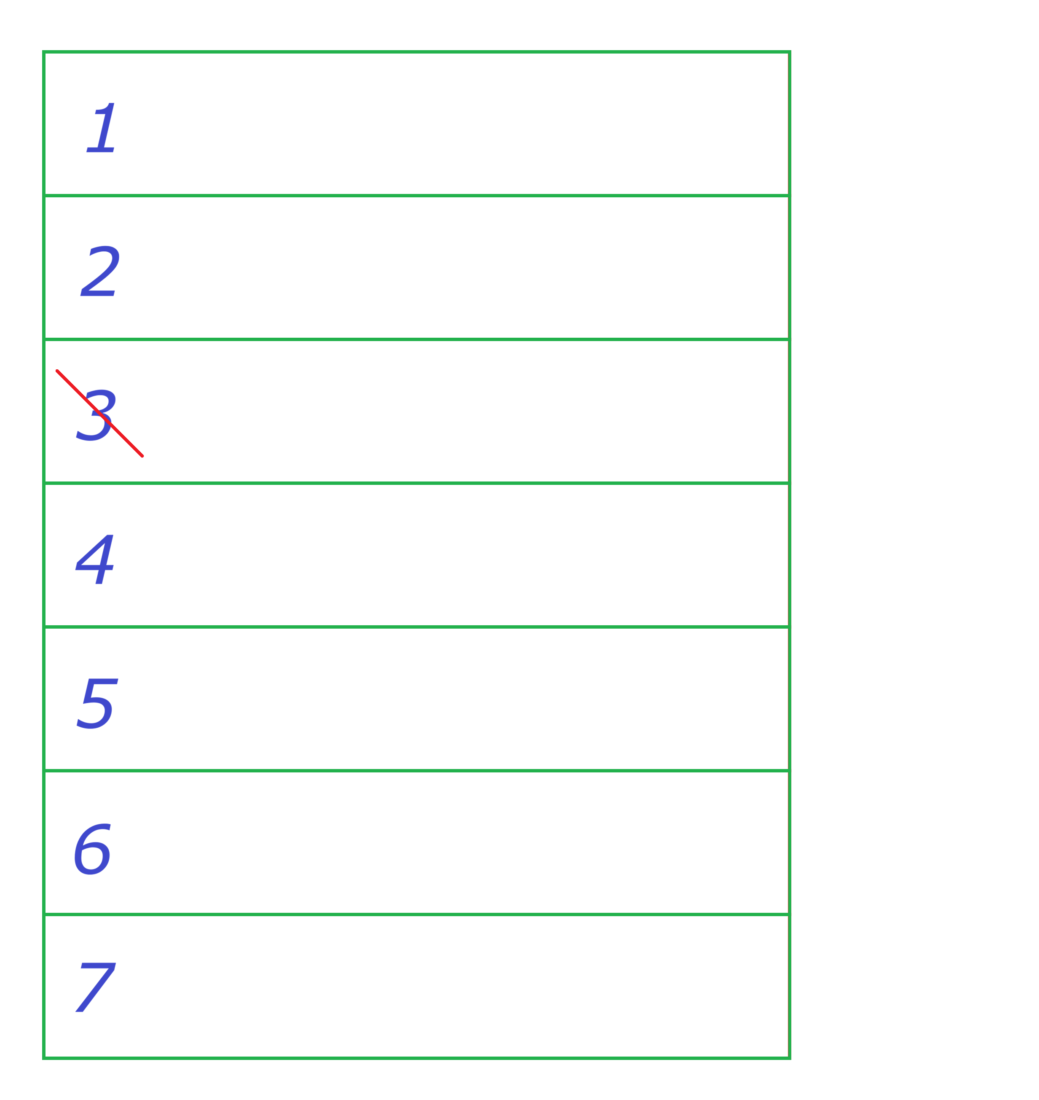
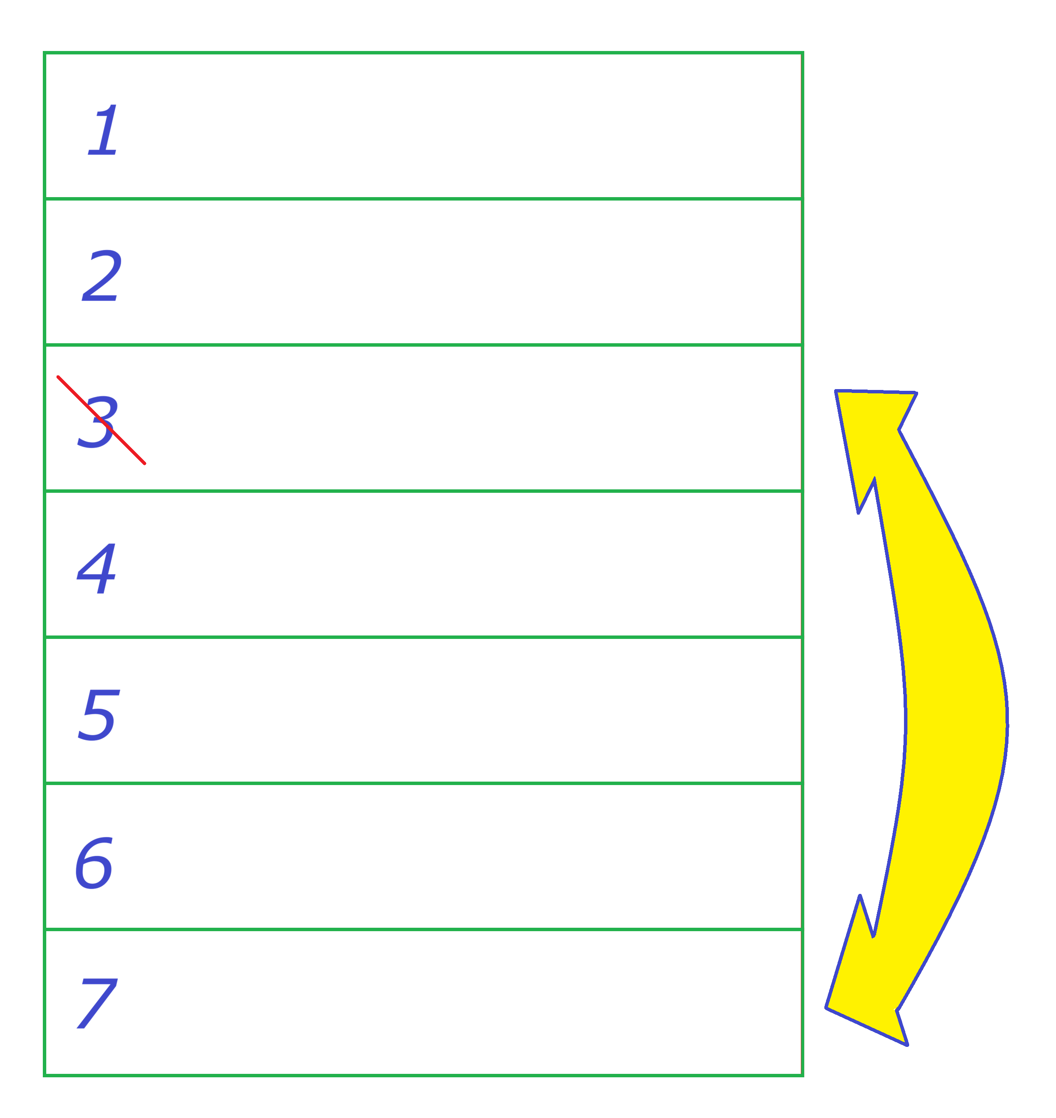
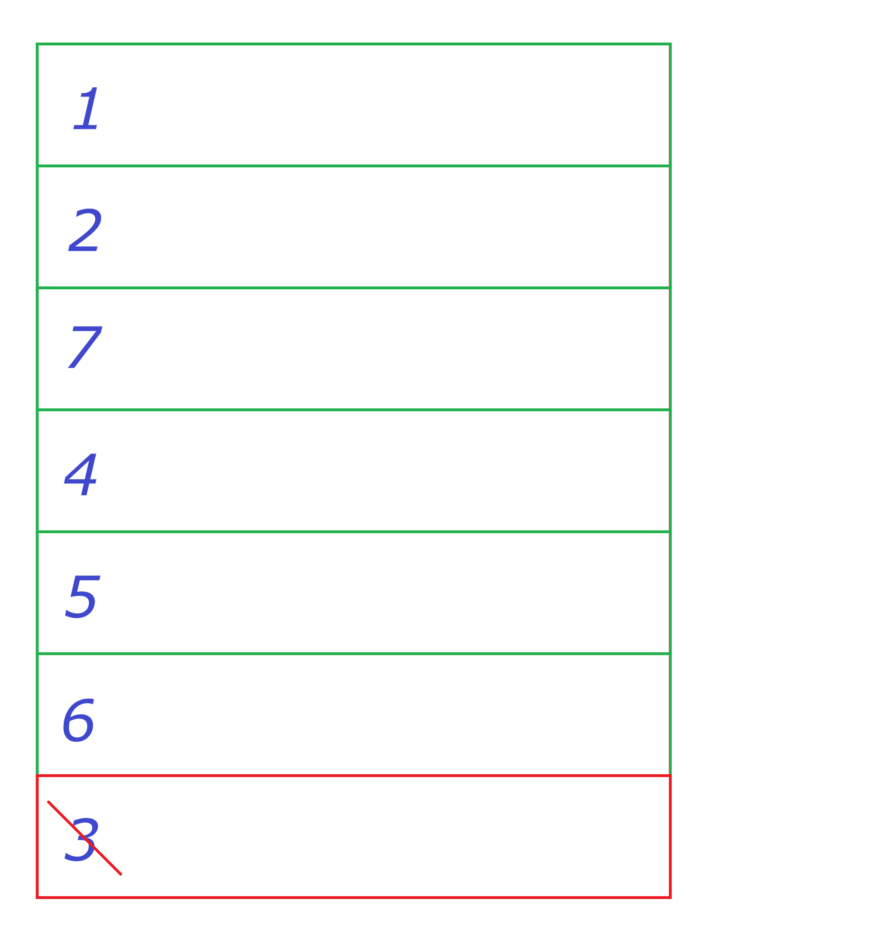
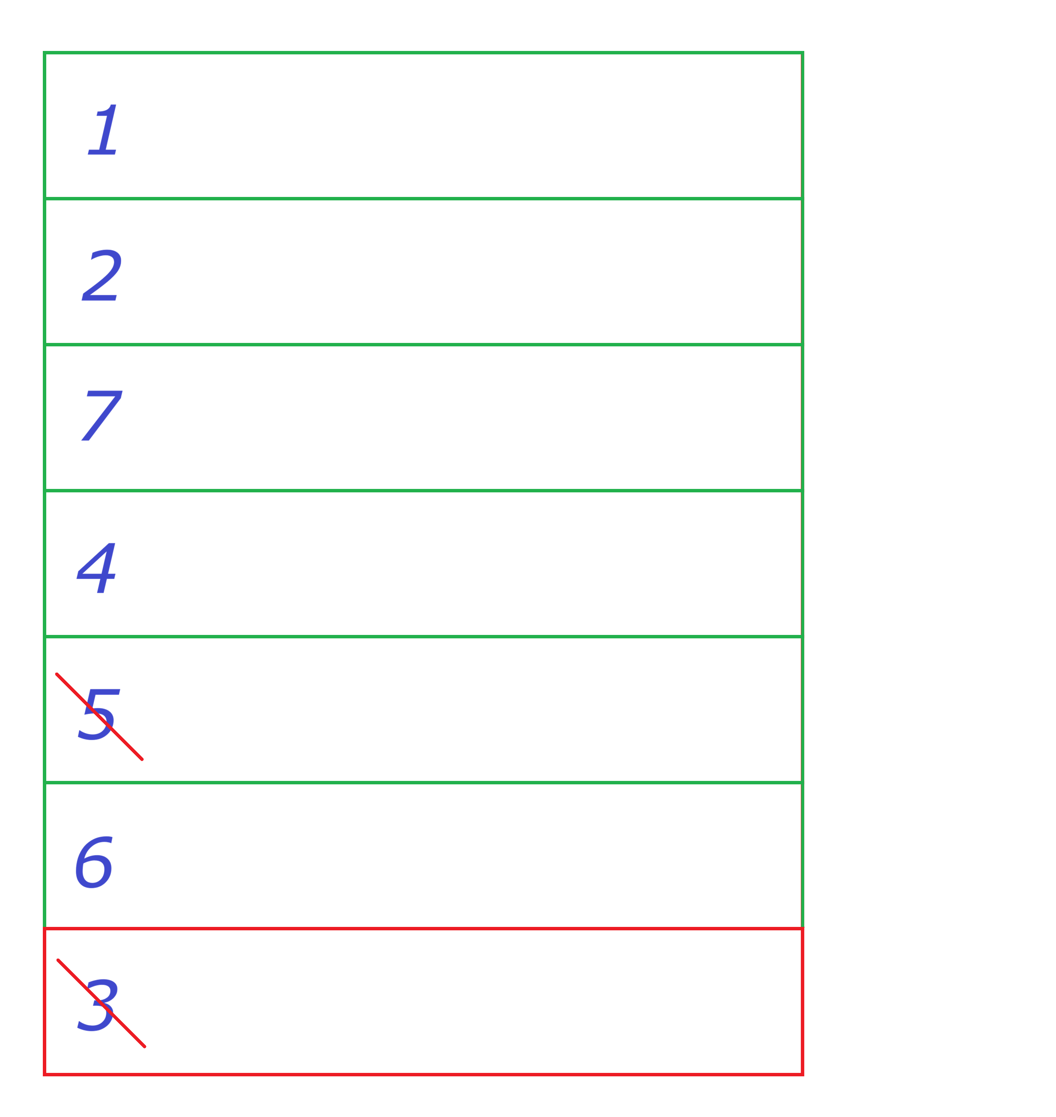
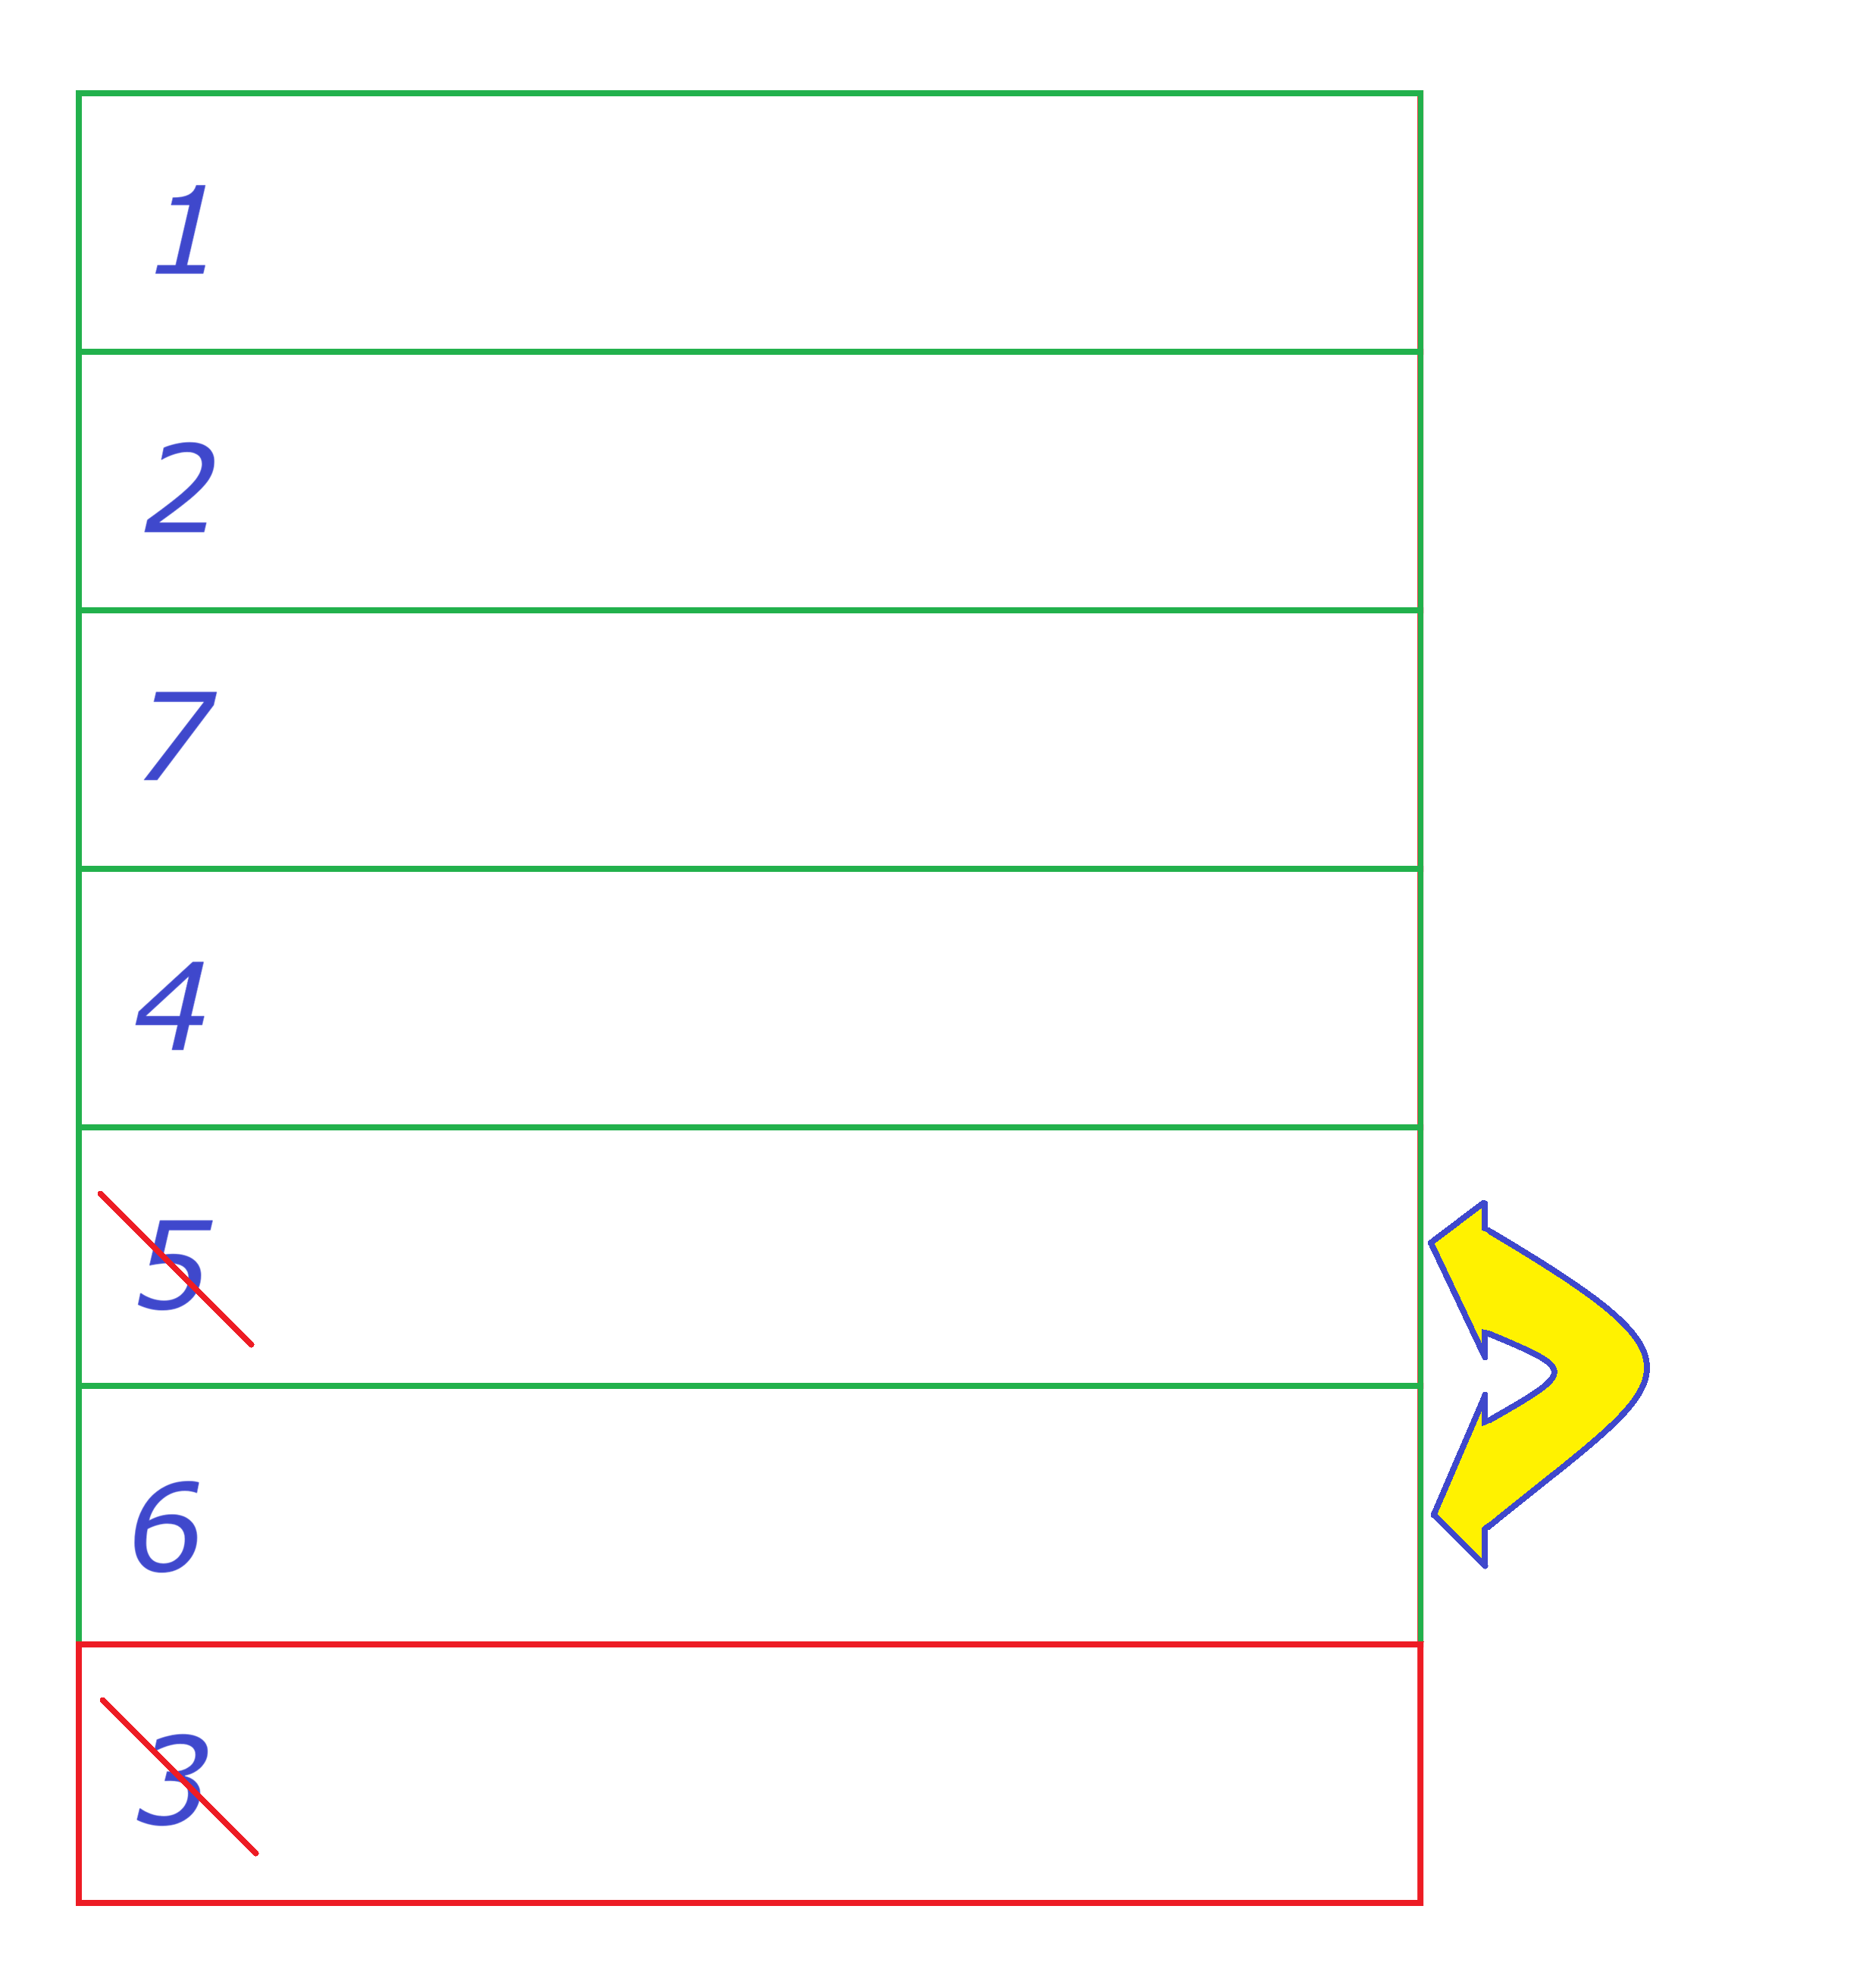
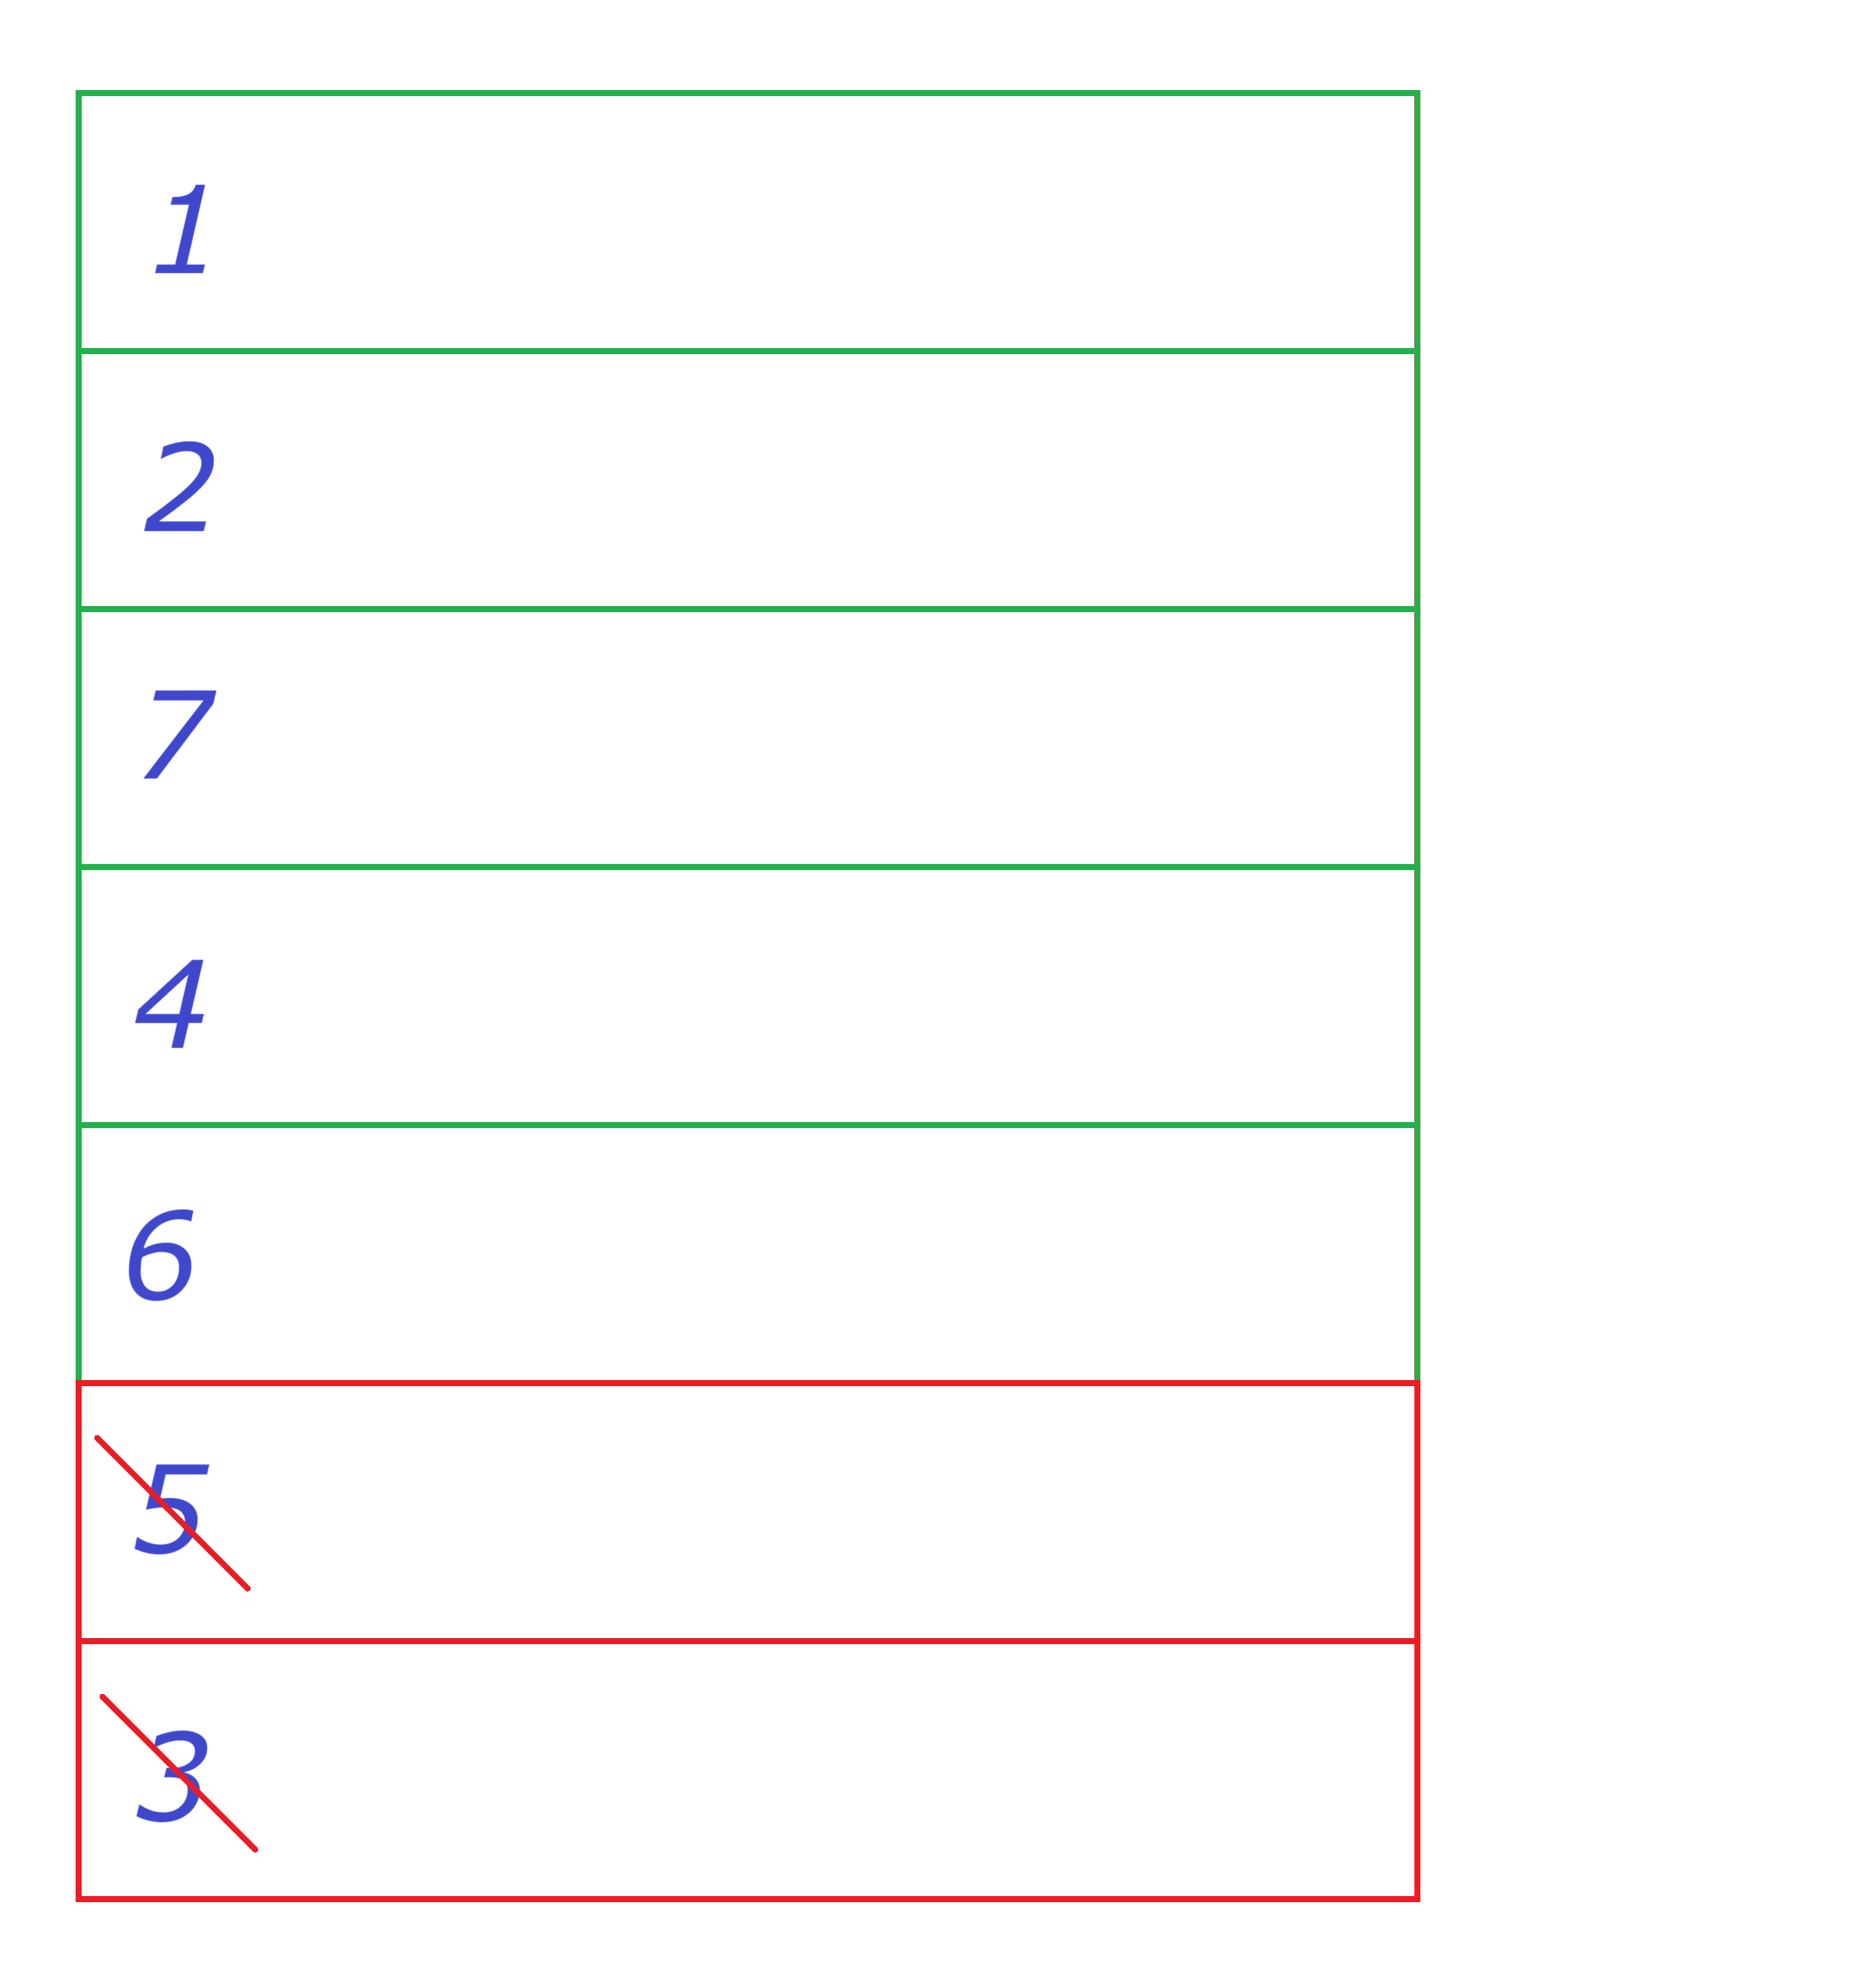
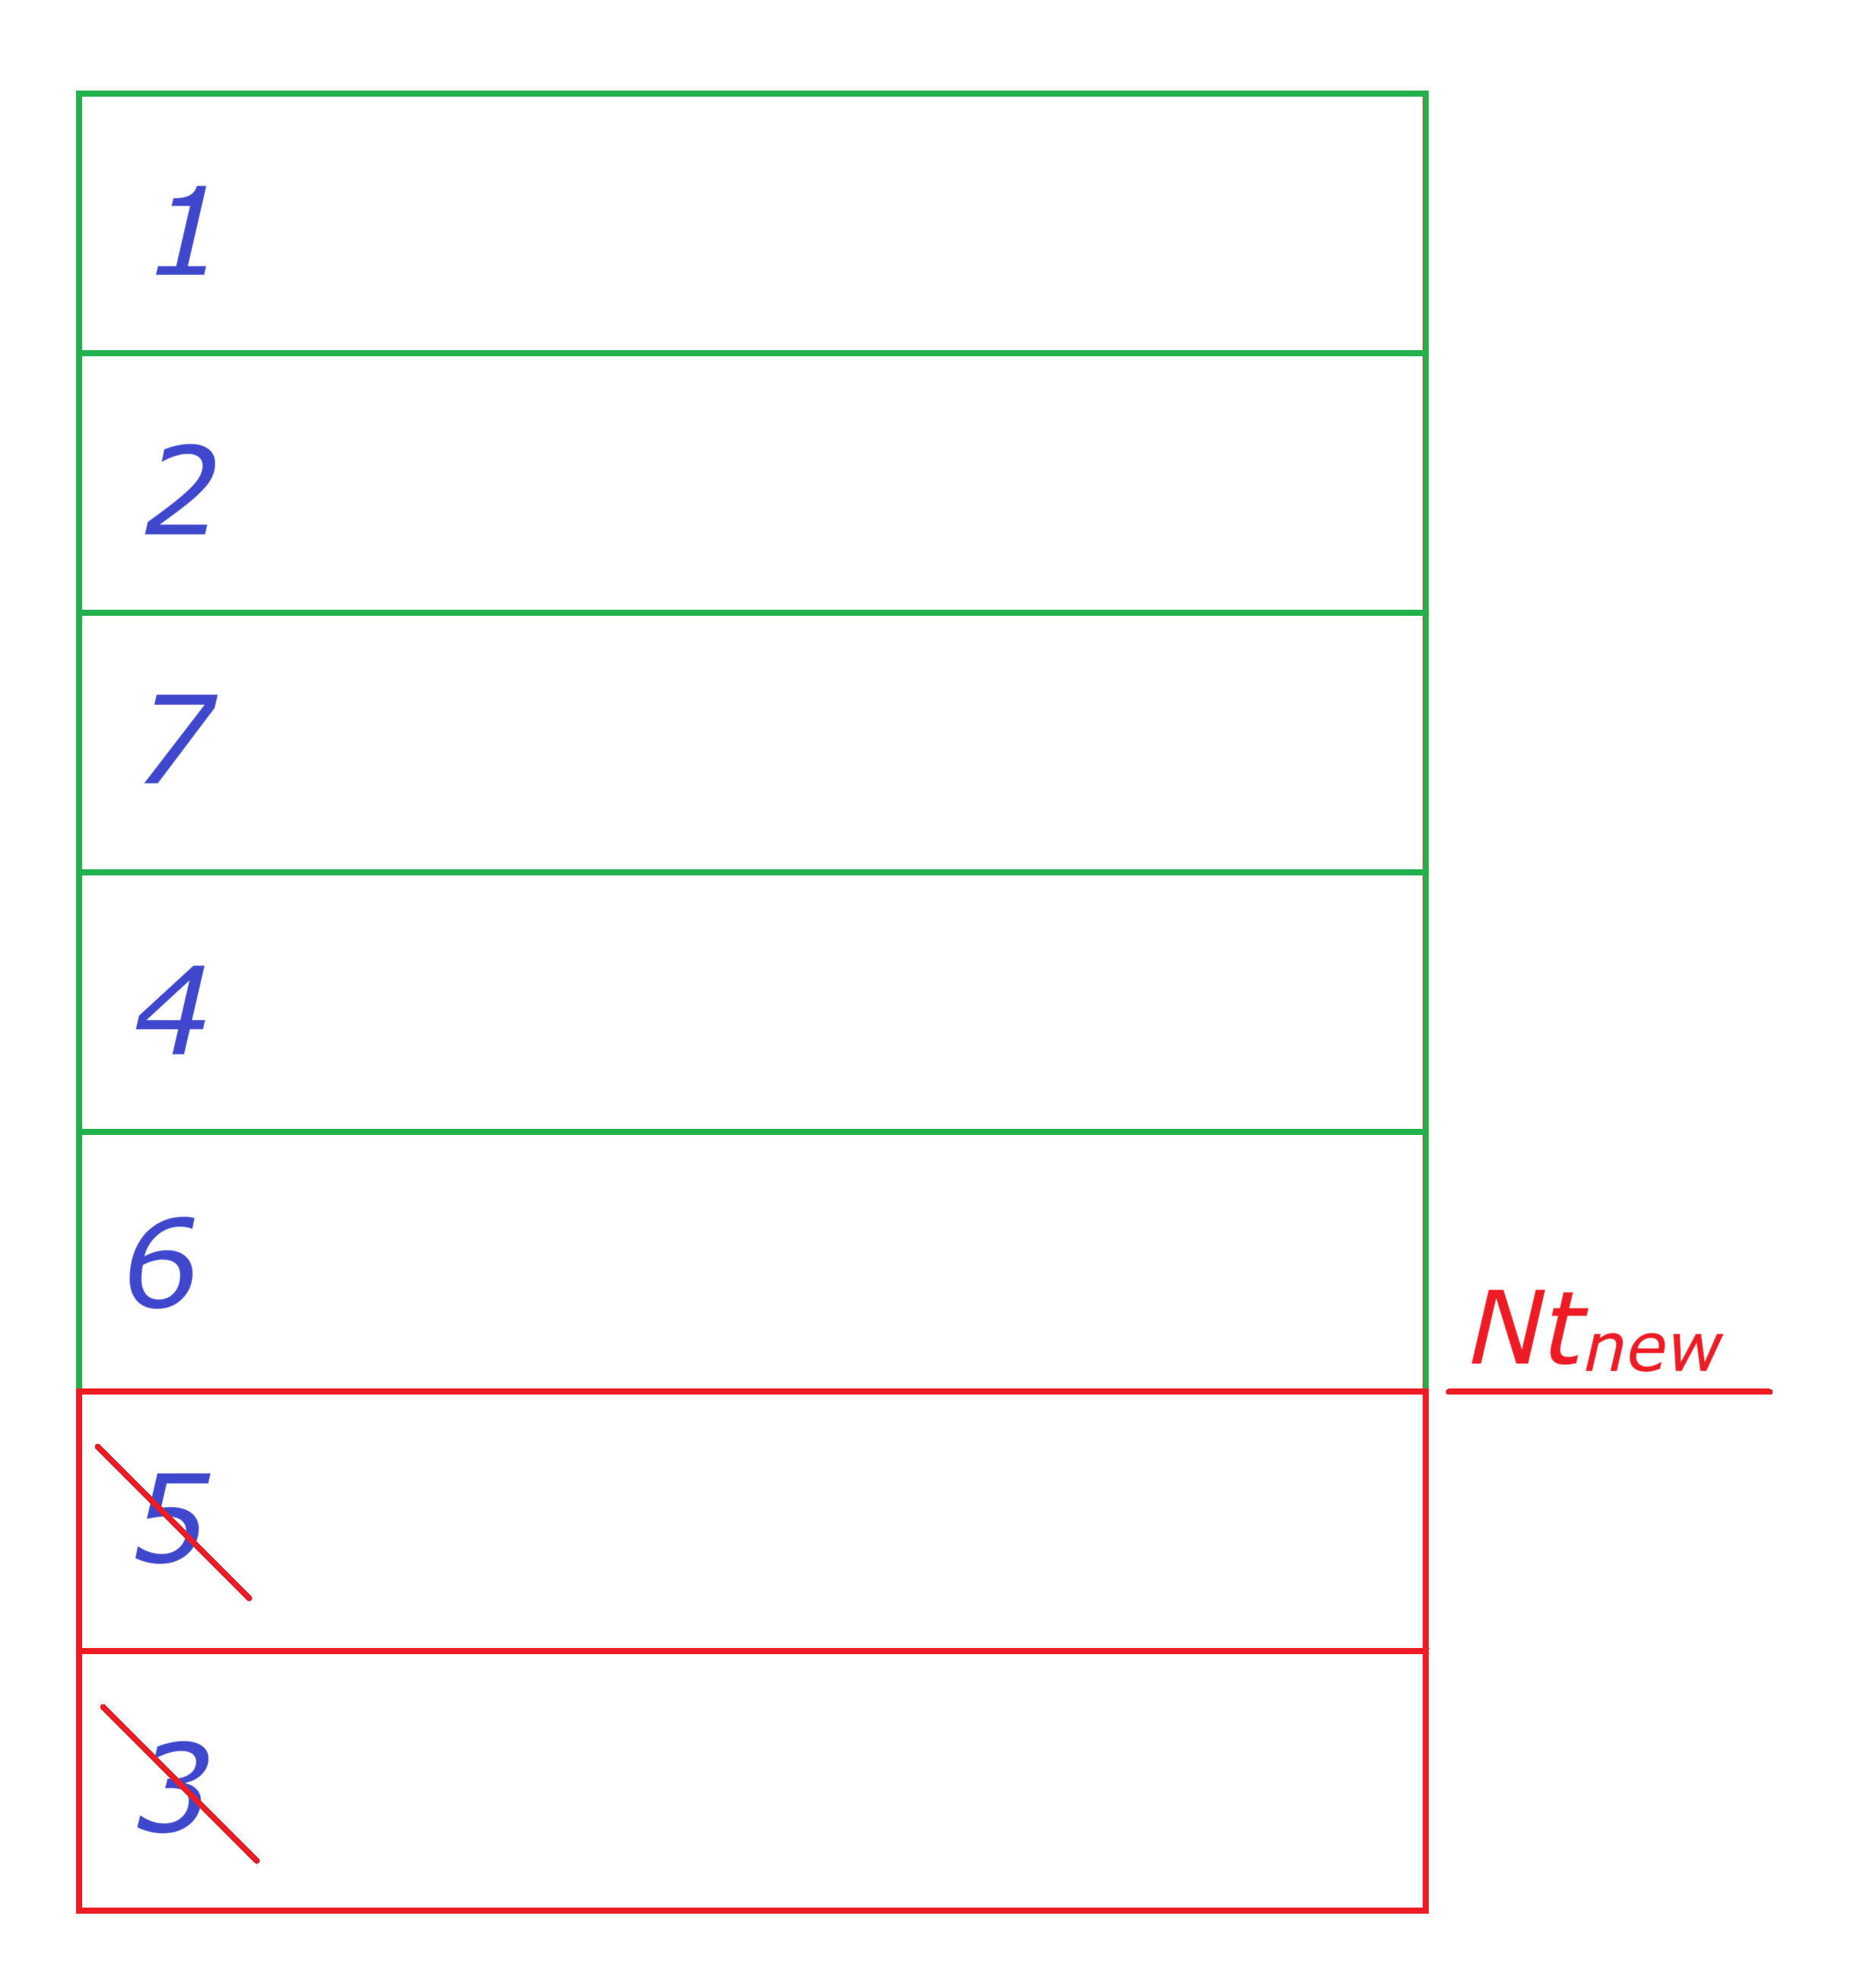
Vertexing Class
Selection of tracks
- next iterations - till Nt_{new}
- faster !

Slide 11
Contents
Vertexing - short reminder
What is new: code overhawl
MinBias - results
Conclusion

Slide 12
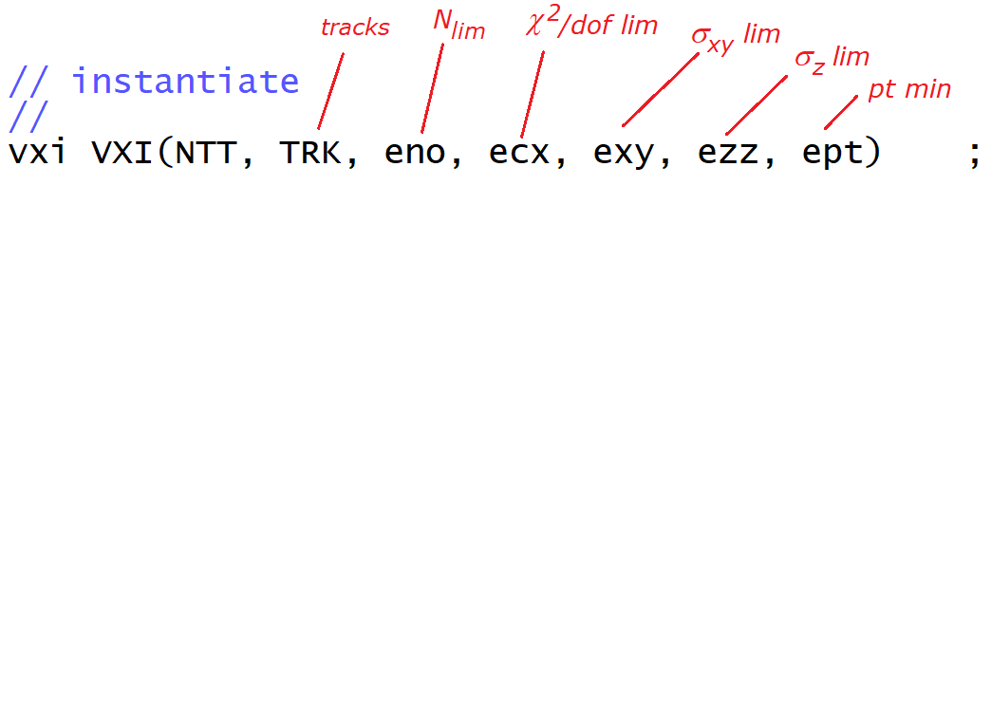
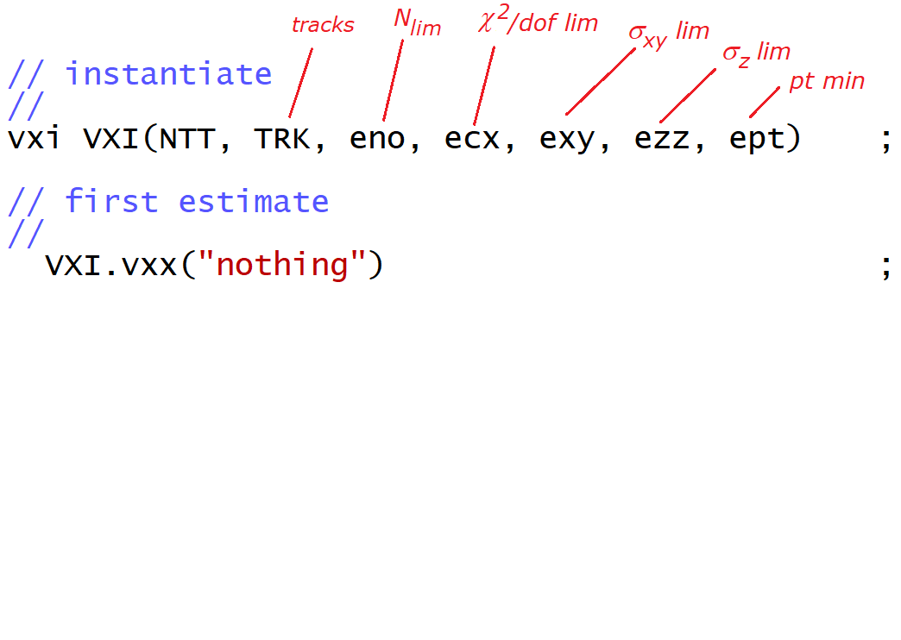
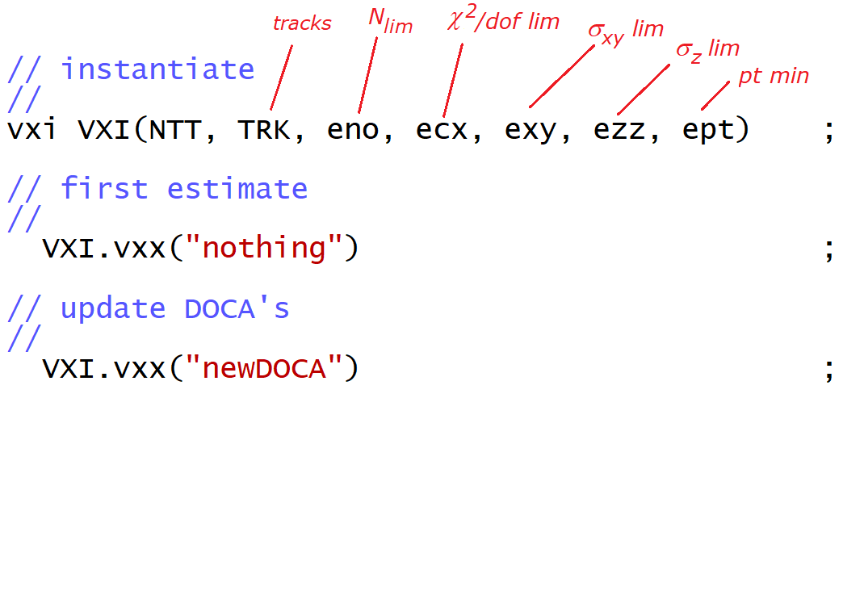
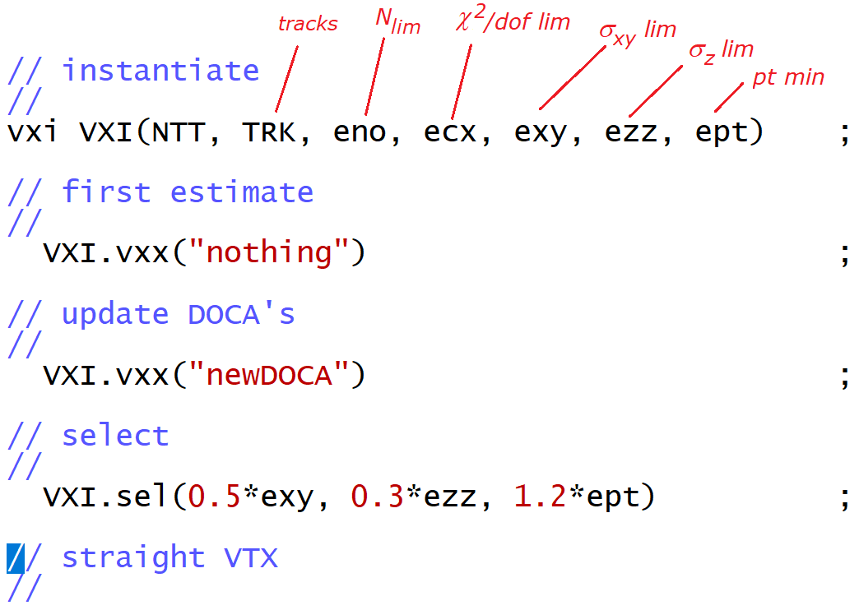
MinBias - code

Slide 13
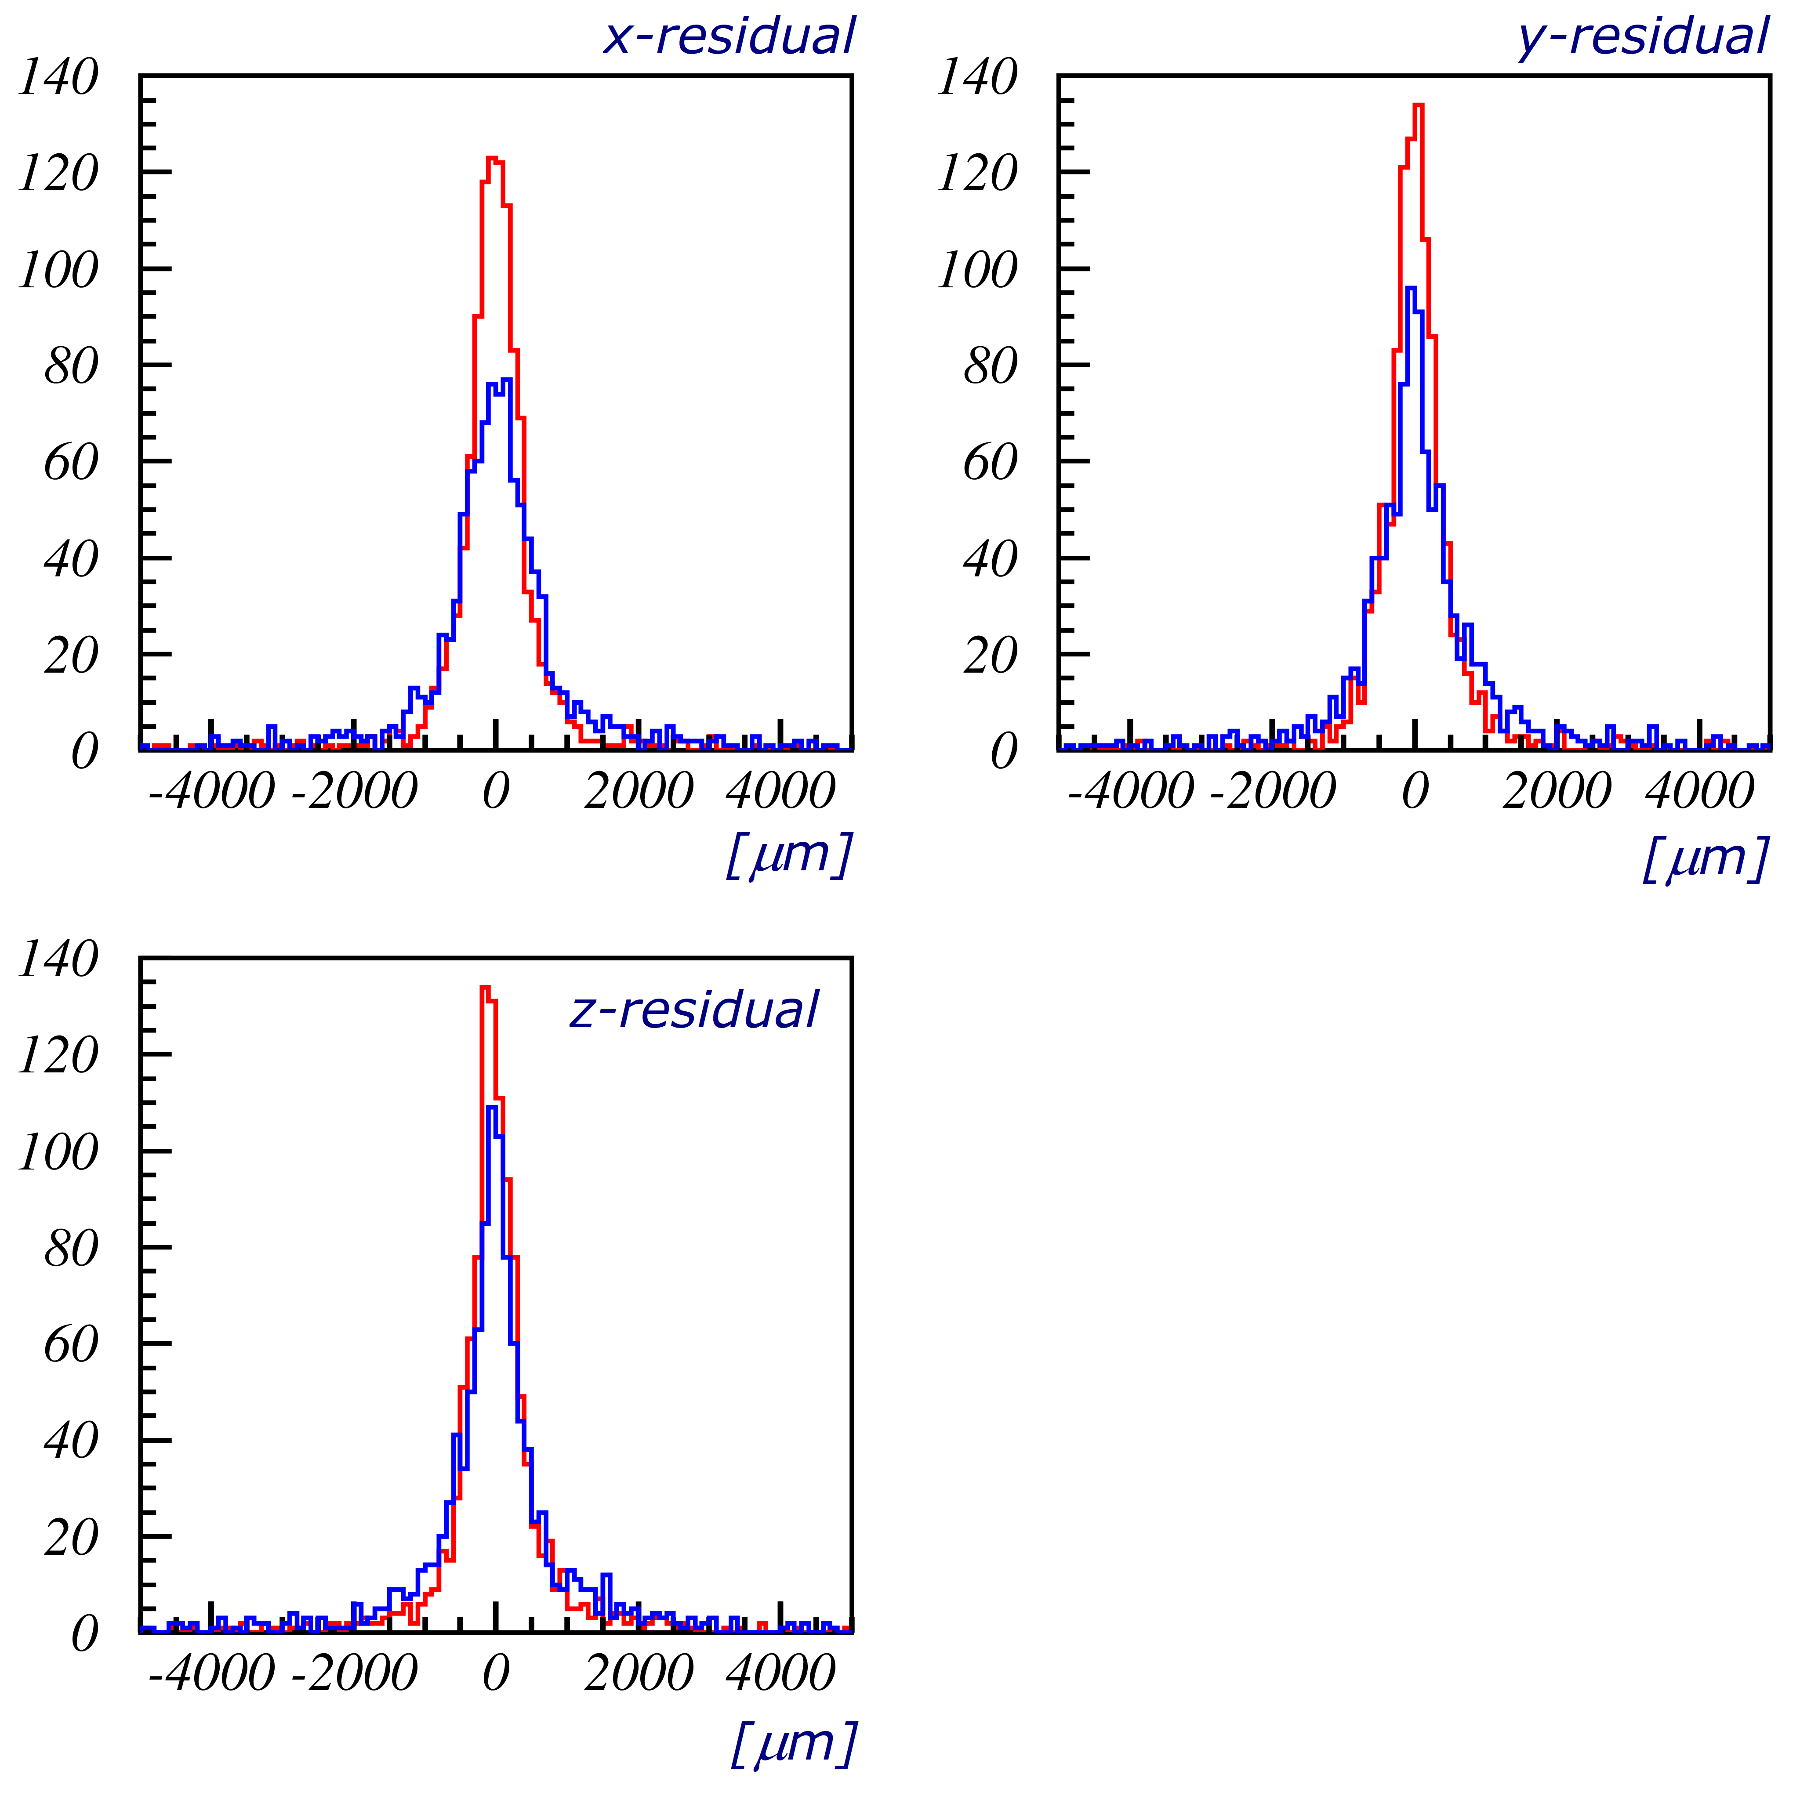
MinBias - results
Initial selection
ecx = 5.00; eno = 3
exy = 9.00; // sigma
ezz = 9.00; // sigma
ept = 0.05
Next selection - 2 times:
- newDOCA
- 0.5*exy, 0.3*ezz, 1.2*ept
- straight VTX

Slide 14
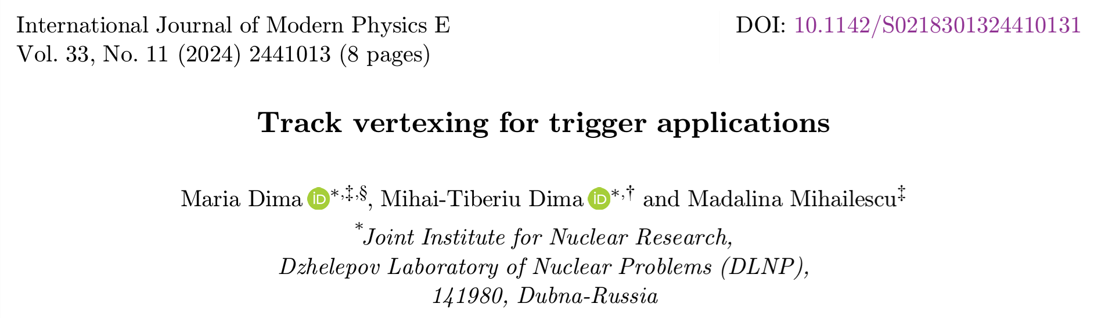
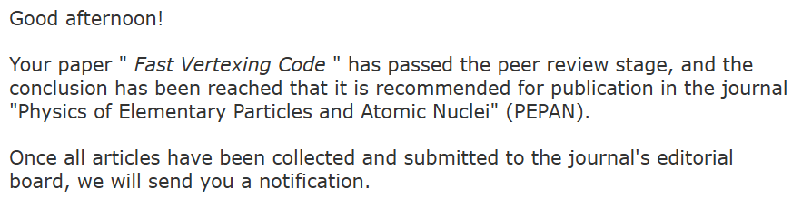
Conclusions
MinBias - SPDroot data
Vertexing - Updates
- now a class
- more modular
- more functional
- newDOCA method
- eliminate the worst track - working on cond.
- selection cuts: in sigmas, not absolute val.
- Results
- very good resolution
- CPU likely faster than pervious (110 ns/trk)
In preparation - Ideas
- vertex with curved tracks
- allows use of lower pt tracks also
Спасибо !

