Slide 1
The GERDA experiment: results of Phase I and future perspectives
Rumyantseva N., JINR
on behalf of the GERDA collaboration
IV ежегодная конференция молодых ученых и специалистов «Нейтрон и нейтрино: фундаментальные свойства,
эксперименты и прикладные исследования» (Алушта-2015)

Slide 2
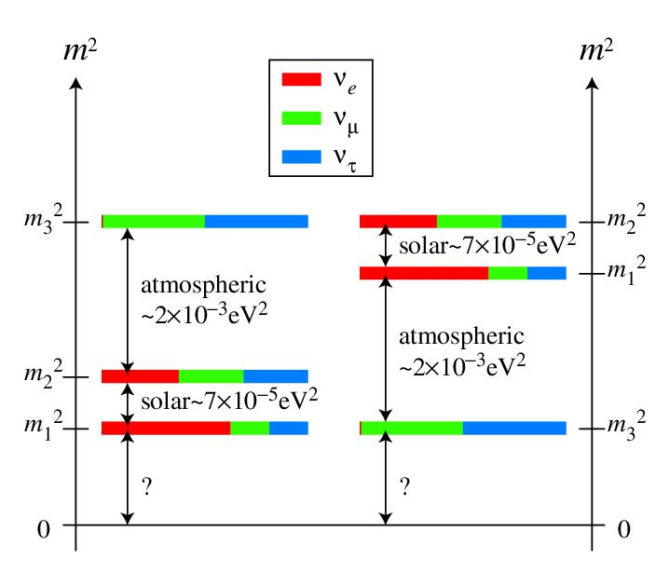
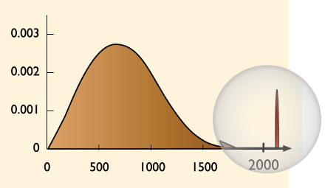
Double beta-decay
The GERDA experiment is an ultra-low background experiment aimed to search for 0νββ decay of ⁷⁶Ge.
Searching for 0νββ helps to understand:
Nature of ν (Dirac or Majorana)
Neutrino mass scale
Neutrino hierarchy
A= 76
2νββ
arbitrary units
0νββ
good energy resolution is needed
Energy (keV)
Ge detector

Slide 3
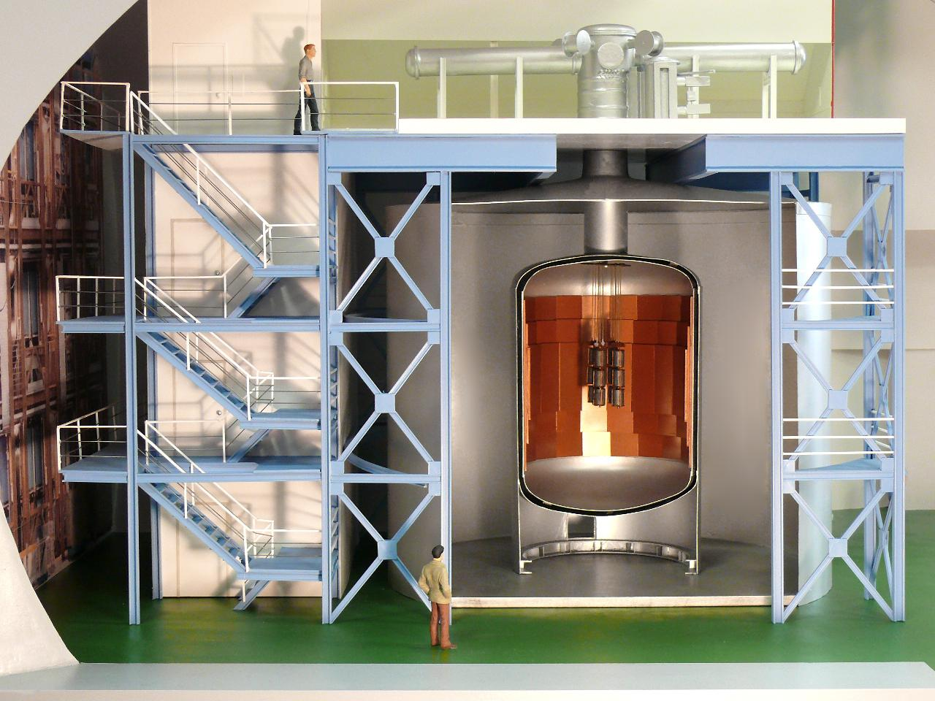
Scheme of GERDA
Clean room
Plastic μ-veto
Lock system
Cryostat with
internal Cu shield
Detector array
Water tank
with HP water
and μ-veto
HP liquid Ar
The GERDA experiment is located in Hall A of LNGS in Italy (3400 m.w.e.)

Slide 4
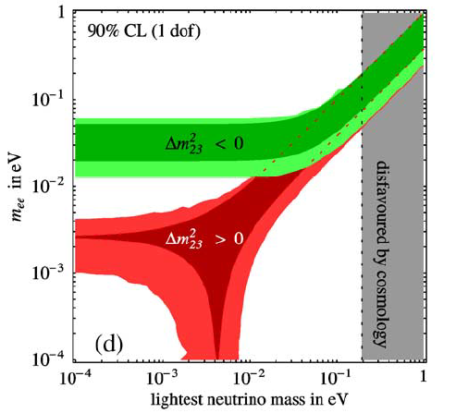
Phases of GERDA
Best limits on (0νββ )-decay half-life, have been obtained with enriched HPGe detectors in Heidelberg-Moscow & IGEX
Part of HdM Collaboration claimed evidence for 0νββ observation
T_{1/2} = 1.2×10²⁵ y, | m_{ee} | = 0.44 eV
* (H.V. Klapdor-Kleingrothaus, et.al, NIM A 522 (2004))
Three phases of GERDA experiment:
Phase I: 8 existing enriched detectors (18 kg in total (15 kg of ⁷⁶Ge)) and 6 natural HPGe detectors (in total 15 kg of natural Ge).
Exp. BI: ~ 0.01 counts/(keV∙kg∙year)
Phase II: additional BEGe detectors (>20 kg of ⁷⁶Ge).
Exp. BI: ~ 0.001 counts/(keV∙kg∙year)
Phase III: Depending on the results of phase II possible worldwide collaboration.
Exp. BI: ~ 0.0001 counts/(keV∙kg∙year)
KKC
I
II
III

Slide 5
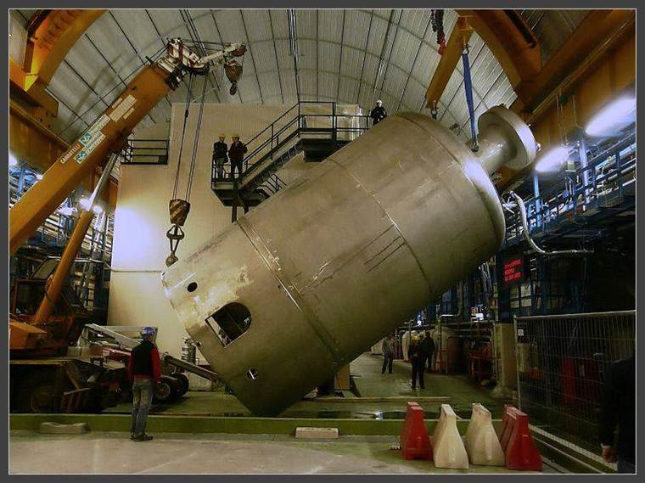
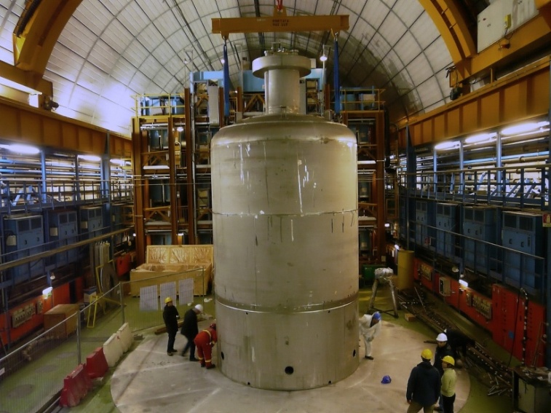
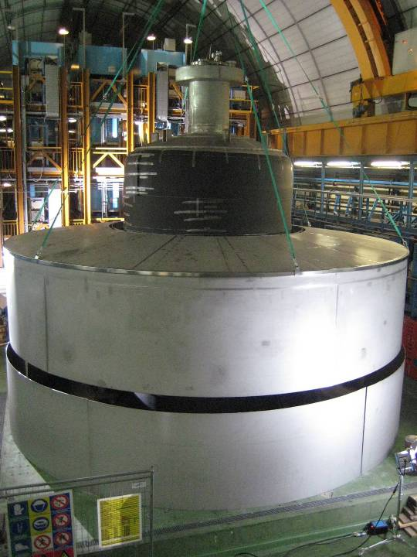
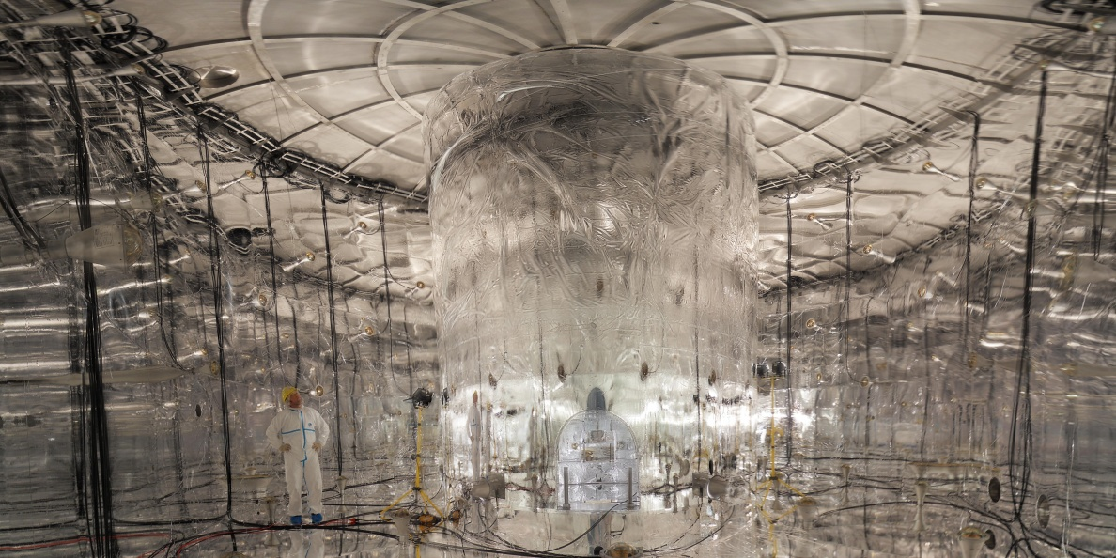
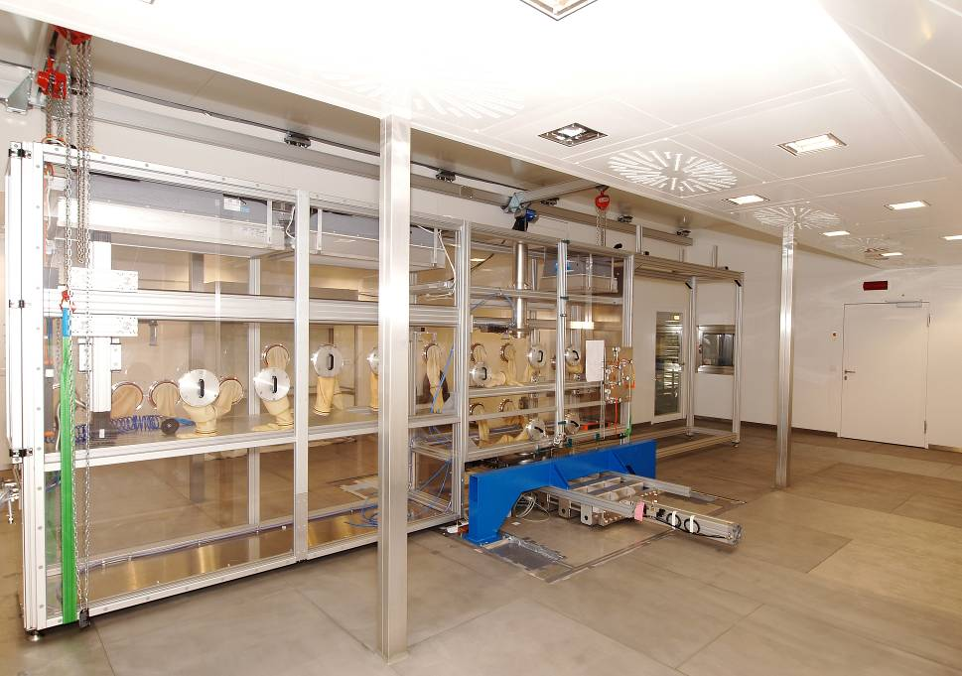
Stages of installation process

Slide 6
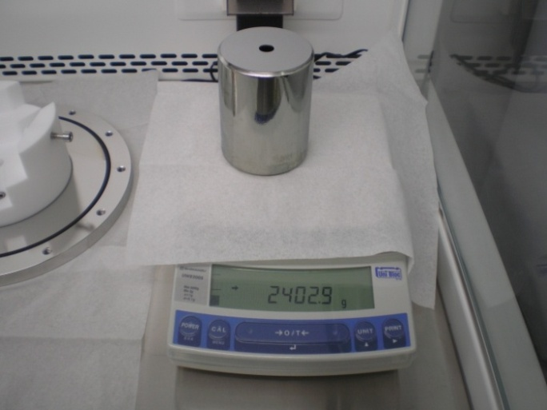
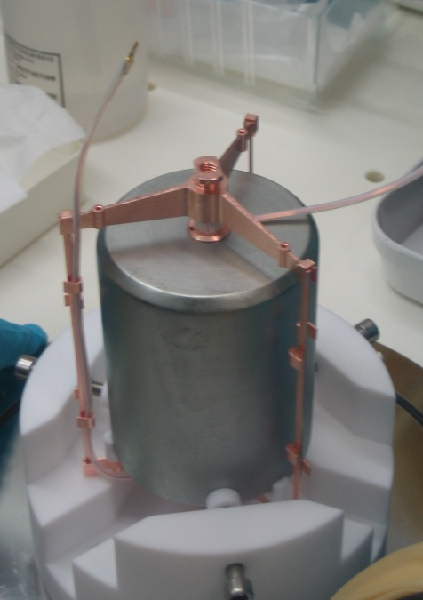
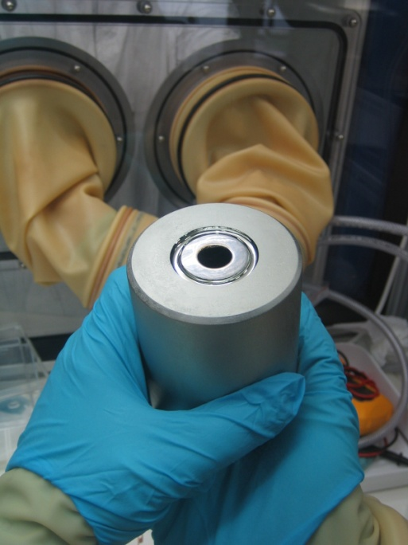
Phase I detectors:
8 diodes (from HdM, IGEX):
Enriched 86% in ⁷⁶Ge
Total mass 17.66 kg
All diodes reprocessed and optimized for LAr
Well tested procedure for detector handling
Long term stability in LAr established
Energy resolution in LAr: ~2.5 keV (FWHM) @1.3 MeV
6 diodes from Genius-TF:
^{nat}Ge
Total mass: 15.60 kg

Slide 7
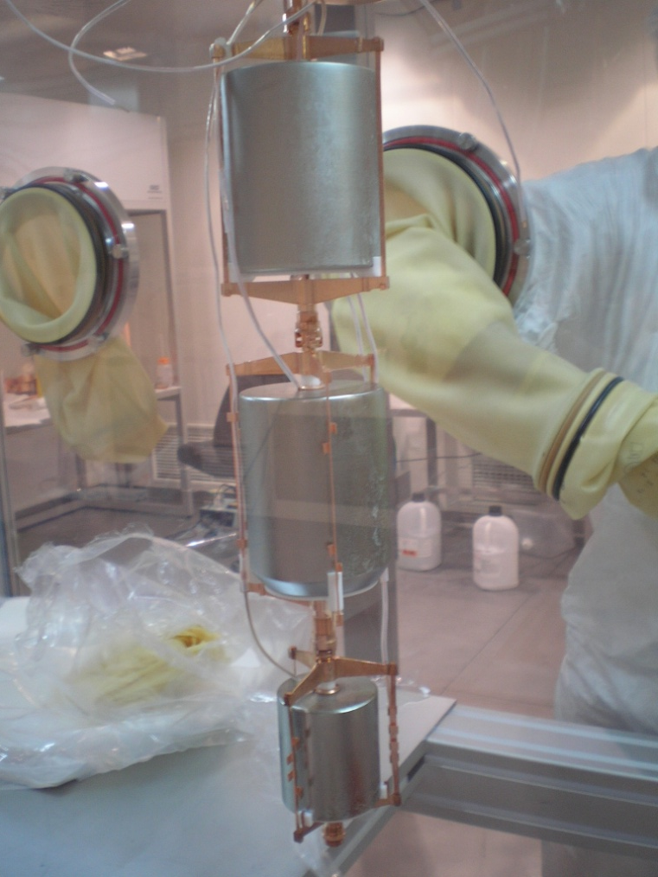
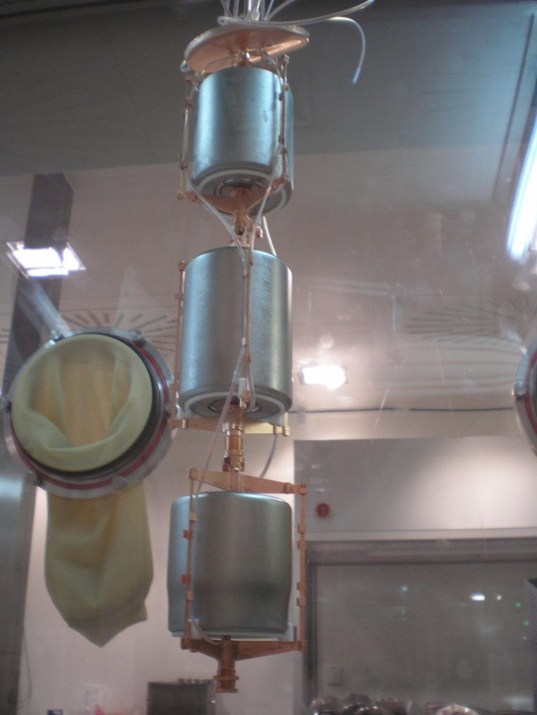
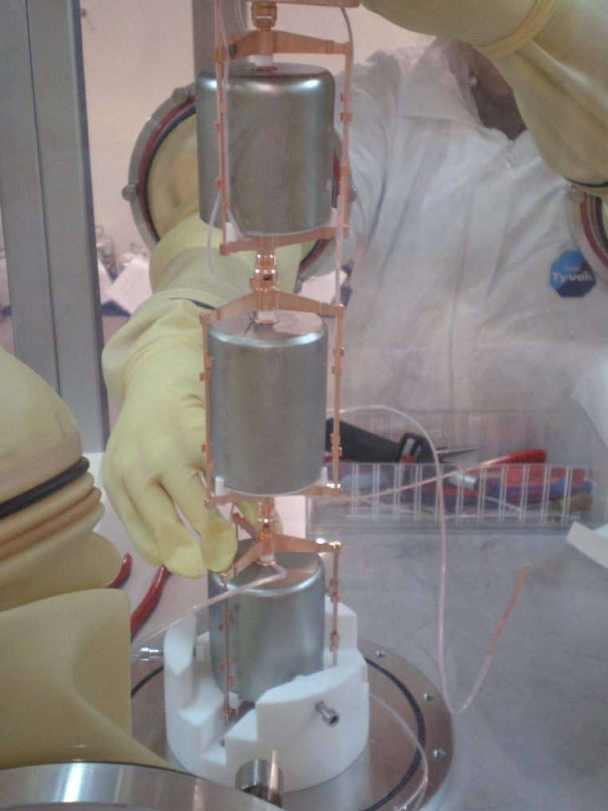
Installation of Phase I detectors (8 enriched + 1 non-enriched)
GTF 112
ANG 3
RG 1
ANG 2
ANG 5
ANG 4
ANG 1
RG 3
RG 2

Slide 8
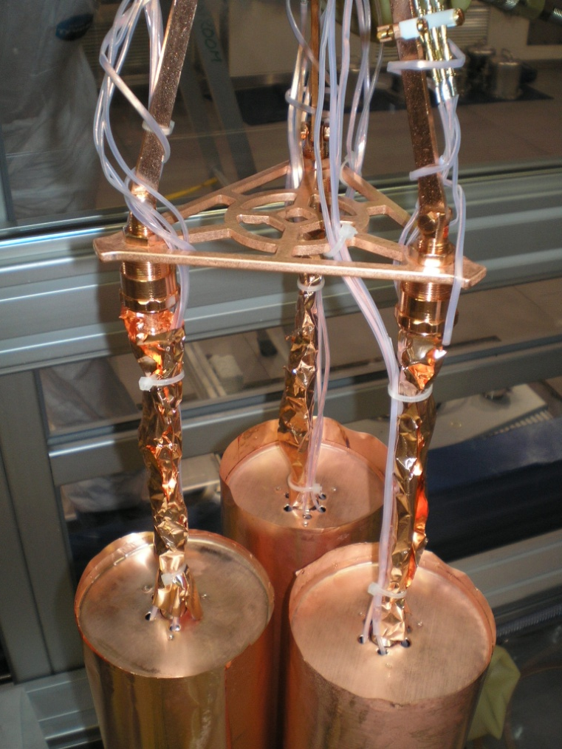
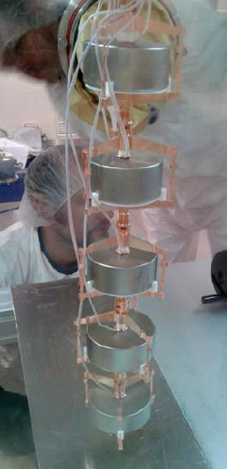
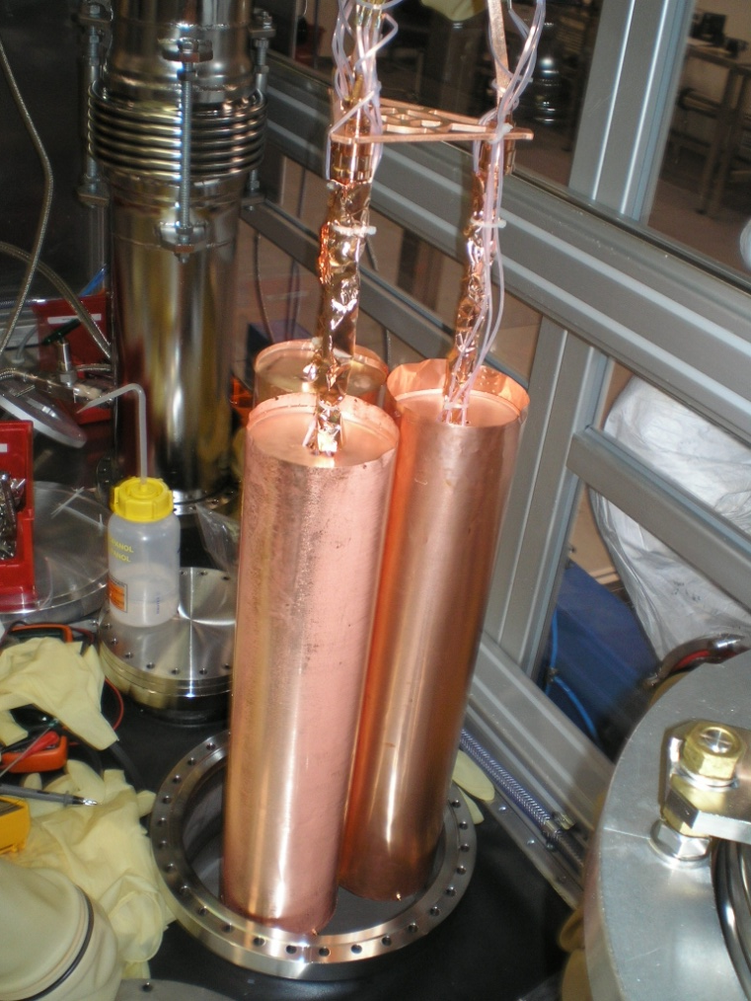
Installation of Phase I detectors (copper mini-shroud + 1 string of BEGe detectors)

Slide 9
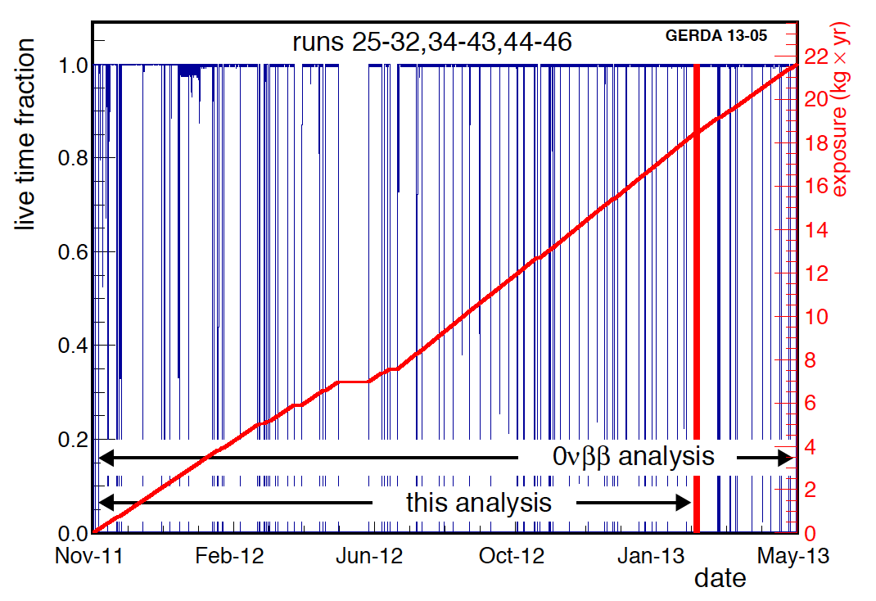
Live time & exposure
background paper
2νββ analysis (5.04 kg yr)
Insertion of 5 Phase II ^{enr}BEGe
Total exposure for 0νββ analysis: 21.6 kg yr

Slide 10
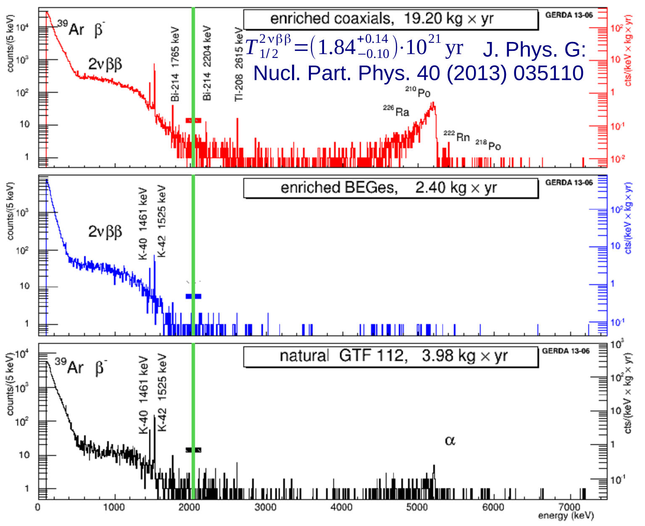
GERDA energy spectra
Blinding at Q_{ββ} ± 20 keV

Slide 11
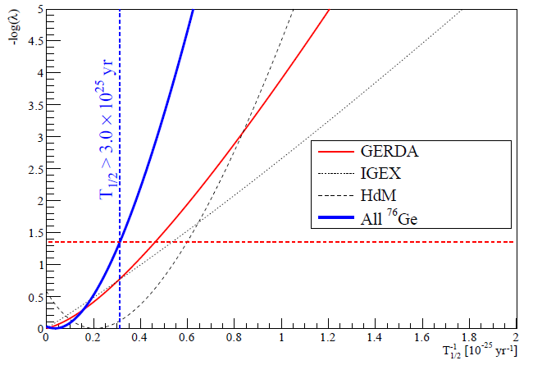
After the unblinding: the analysis
Baseline analysis with a frequentist approach (profile likelihood)
Maximum likelihood spectral fit (3 datasets, common 1/T_{1/2})
Bayesian version also available
arXiv: 1307.4720
PRL 111 (2013) 122503
Gerda only
Best fit: N^{0ν} = 0
N^{0ν} < 3.5 cts @ 90% C.L.
T_{1/2}^{0ν} > 2.1 x 10²⁵ yr @ 90% CL
GERDA+HdM [1] +IGEX [2]
Best fit: N^{0ν} = 0
T_{1/2}^{0ν} > 3.0 x 10²⁵ yr @ 90% CL
[1] Eur. Phys. J. A 12, 147 (2001)
[2] Phys. Rev. D 65, 092007 (2002),
Phys. Rev. D 70 078302 (2004)

Slide 12
Limits from combined analysis of double beta decay experiments
$$\frac{1}{T_{1/2}^{0ν}}=G_{0ν}{\left|M_{ν}\right|}^{2}{{\left|m_{ee}^{ν}\right|}^{2}}^{ }$$
$G_{0ν}$ - phase space factor
$M_{ν}$ - nuclear matrix element (NME)
$m_{ee}^{ν}$ - effective Majorana neutrino mass
$$T_{1/2}^{0ν}=\frac{ln2 Exp}{{ N}_{lim}}$$
$$\text{GERDA}\text{, }\text{HdM}\text{, }\text{IGEX}\text{, }\text{EXO}\text{−200, }\text{KamLAND}\text{−}\text{Zen}$$
$76Ge, 136Xe[1]: T_{1/2}^{combined }$> [4.8 - 20.7] ∙10²⁵ yr.
Limit on majorana neutrino mass: <m_{ν}> < [85.4 – 197.0] meV
$$\text{GERDA}\text{, }\text{HdM}\text{, }\text{IGEX}\text{, }\text{EXO}\text{−200, }\text{KamLAND}\text{−}\text{Zen}\text{,}\text{NEMO}\text{−3, }\text{CUORICINO}$$
$76Ge,136Xe,100Mo[2], 130Te[3]: T_{1/2}^{combined }$> [5.1 - 21.2] ∙10²⁵ yr.
Limit on majorana neutrino mass: <m_{ν}> < [83.7 – 157.1] meV
[1] Albert J.B. et al. arXiv:1402.695
Asakura A. et al. arXiv:1409.0077v1
Gando A. et al. Phys.Rev.Let. 2013. V.110. P.062502
[2] Arnold R. et al. Phys.Rev.D. 2014. V.89. P.111101-1-6
[3] Andreotti E. et al. Astroparticle Phys. 2011. V.34. P. 822

Slide 13
Transition to Phase II
Increase mass: additional 30 enriched BEGe detectors (~ 20 kg)
already produced by Canberra Olen and tested at Hades (underground laboratory in Belgium)
5 out of 30 enriched BEGe detectors have been already used in Phase I
No anomalies found with internal and surface background (very low ²¹⁰Po)
all diodes are in Gran Sasso ready to be mounted.
Suppress background by an order of magnitude with respect to Phase I
New HV and signal cabling with improved radiopurity and Rn emanation
PSA discrimination with the BEGe's
Liquid argon veto instrumentation
Commissioning with one string of BEGe detectors is ongoing
Start of Phase II data taking before end of 2015

Slide 14
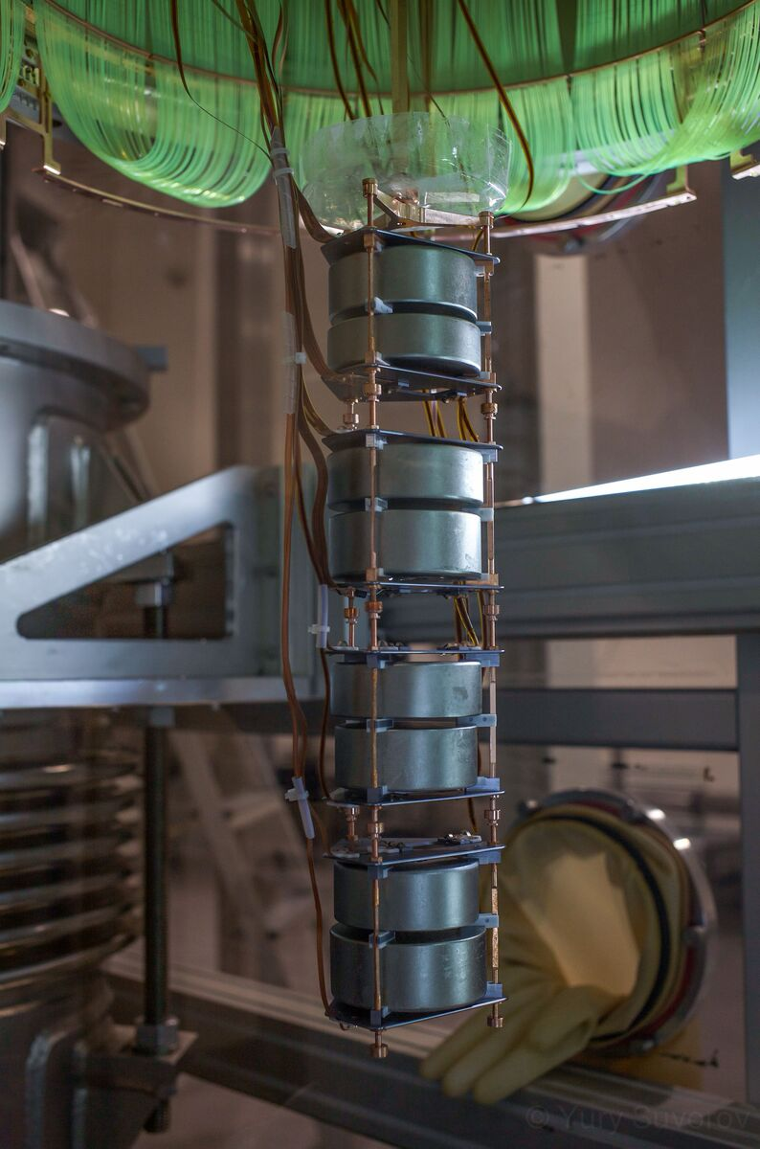
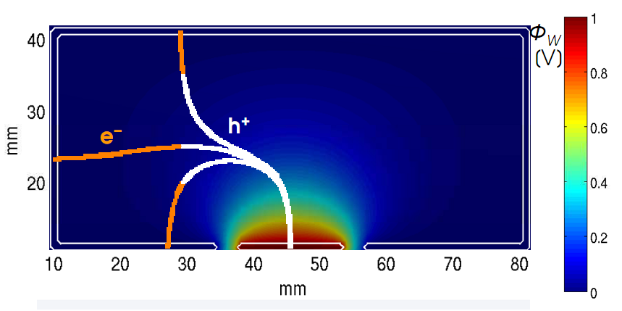
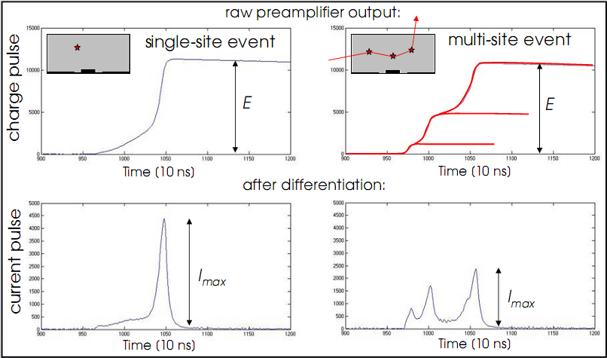
BEGe detectors
А
А

Slide 15
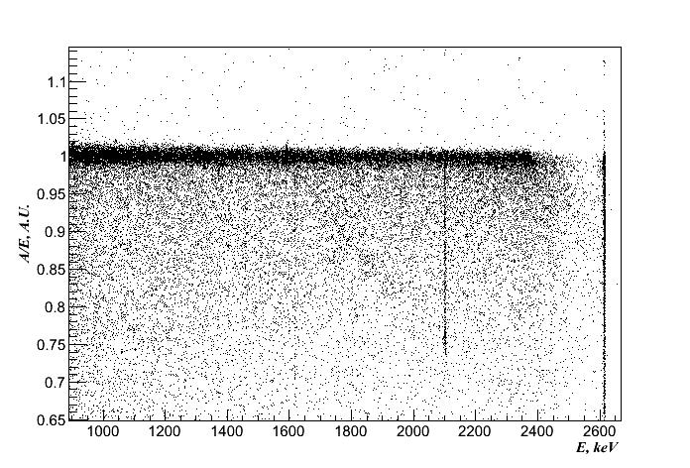
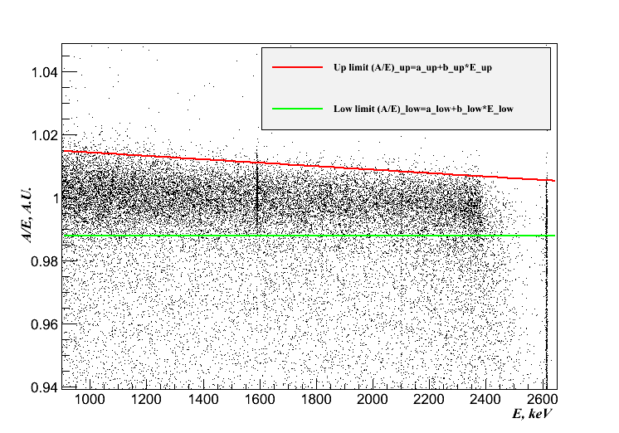
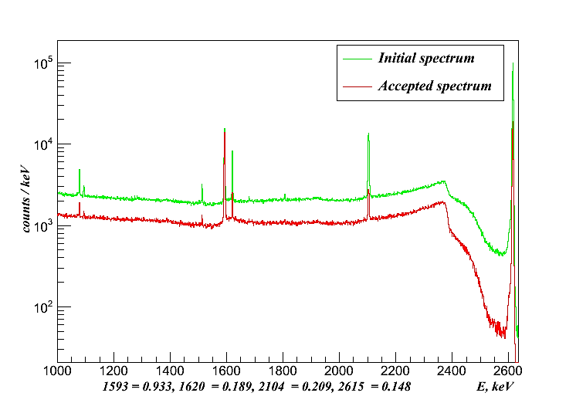
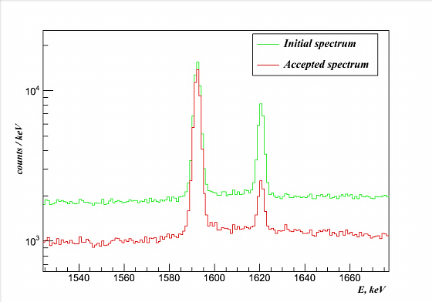
Pulse Shape Discrimination (PSD)
Th-228calibration spectra A/E&E distributions
PSD band
DEP
1592.5 keV
SEP
1620.5 keV
SEP
2103.5 keV
FEP
2614.5 keV
Th-228 spectra before and after TRAP PSD

Slide 16
Summary
GERDA Phase I design goals reached:
Background index after PSD: 0.01 cts / (keV kg yr)
Exposure 21.6 kg yr
No 0νββ-signal observed at Q_{ββ} = 2039 keV; best fit: N^{0ν}=0
Background-only hypothesis H₀ strongly favored
5 publications in 2013 after finishing Phase I
0νββ half-life limit for ⁷⁶Ge:
GERDA: T_{1/2}^{0ν} > 2.1×10²⁵ yr (90% C.L.) (<m_{ee}> < 0.2-0.4 eV)
GERDA+IGEX+HdM: T_{1/2}^{0ν} > 3.0×10²⁵ yr (90% C.L.) (<m_{ee}> < 0.17-0.34 eV)
Phase II is approaching…

Slide 17
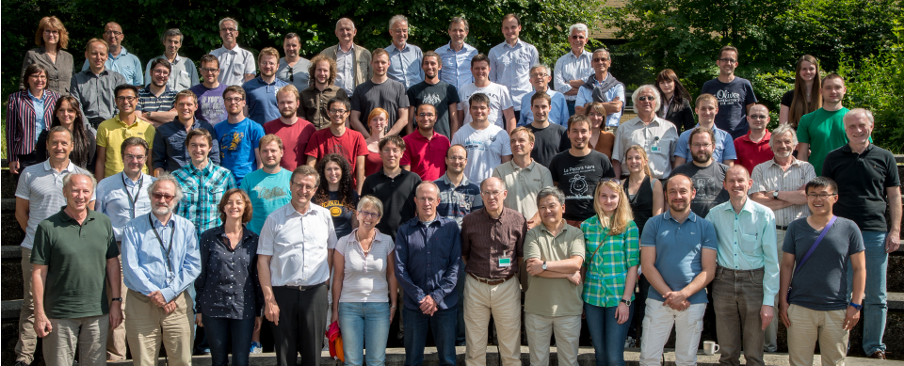
GERDA collaboration
~ 100 physicists, 17 institutes, 7 countries

Slide 18
Thank you for your attention!

Slide 19
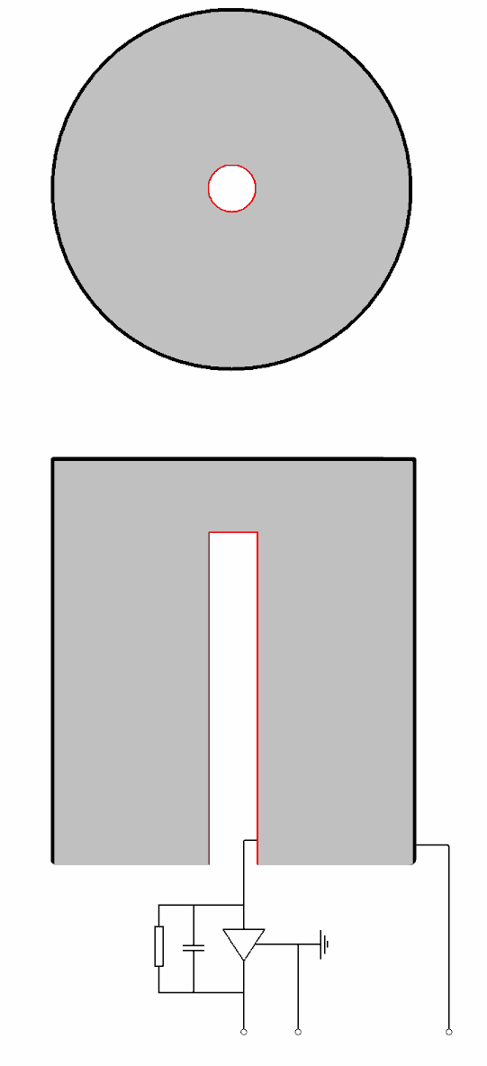
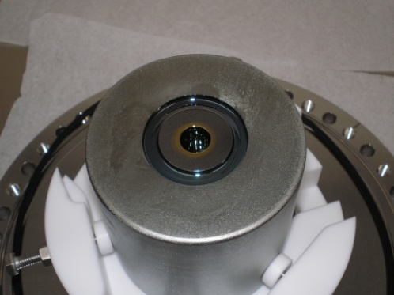
Germanium detectors: principle and advantages
ionizing
radiation
detector-grade semiconductors are high-purity materials (low background)
established detector technologies ⇒ industrial support
very good energy resolution: ~2-3 keV for Ge
good detection efficiency
holes drift to p+ contact
n+ contact
p-type germanium
p-n junction
depleted region (active volume)
p+ contact
HdM, IGEX (finished), GERDA&Majorana: Ge detectors
Cryogenic operation
signal
high
voltage
(+)
germanium detector operating principle
Coaxial p-type detector
BEGe detector

Slide 20
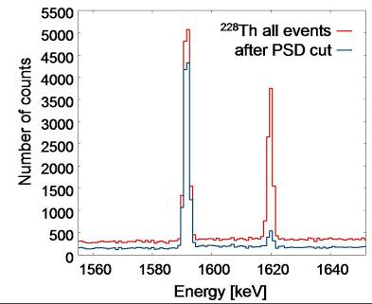
GERDA: Phase II preparations – BEGe detectors
Signal shape provides clear topology for event-by-event signal ID / bgd discrimination:
SSE/MSE discrimination
Surface events:
n+ slow pulses
p+: ‘amplified’ current pulses
D. Budjas et al., JINST 4 P10007 (2009)

Slide 21
GERDA analysis strategy
All data are taken, but not summed up (separate analysis)
Maximizes information, avoids "worse data" to spoil better ones
Three datasets used ("golden coax", "silver coax", "BEGes"), with independent backgrounds and resolutions
Blind analysis (new in the field of 0n2b search)
Events in a 40 keV range around Q_{bb} (energy & waveforms) are not made available for the analysis
Develop and validate the background model and the PSD cuts before the unblinding (all parameters frozen prior to unblinding)

Slide 22
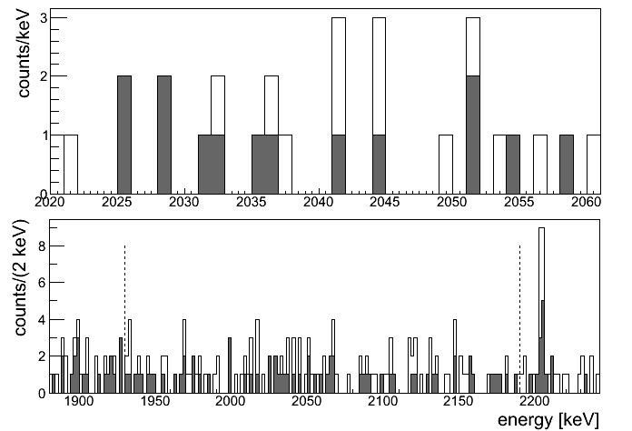
After the unblinding: the spectra
Sum spectrum, 21.6 kg yr
arXiv: 1307.4720
PRL 111 (2013) 122503
Without PSD
With PSD
2204 keV from ²¹⁴Bi
~ 18 cts w/o PSD
→ 0.83 cts/(kg·yr)
~ 9 cts w/ PSD
HdM w/o PSD [1]: (8.1±0.5) cts/(kg·yr)
[1] O. Chkvorets, Ph.D. thesis, 2008

Slide 23
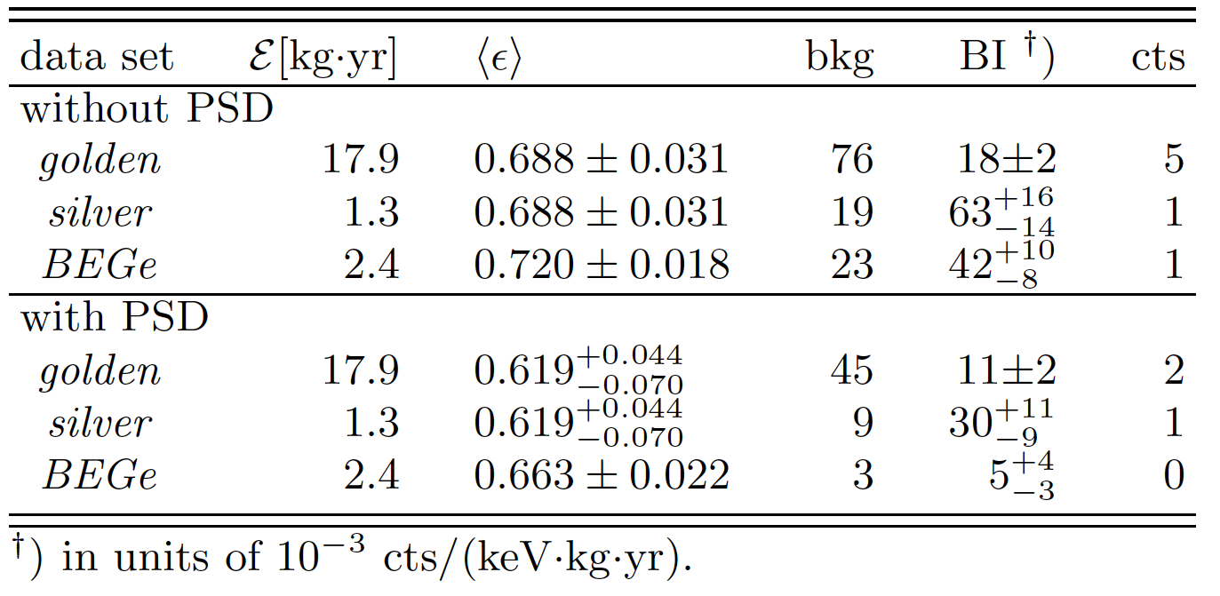
After the unblinding: the events
Expected from background only
3.3
0.8
1.0
2.0
0.4
0.1
arXiv: 1307.4720
PRL 111 (2013) 122503

