Slide 1
Accelerators as source for NN
G.Trubnikov
Alushta, 4th run of AYSS school

Slide 2
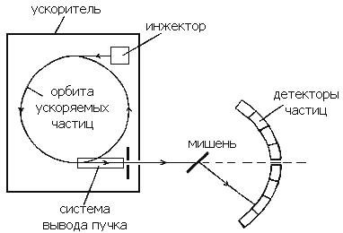
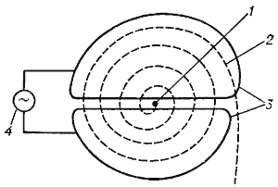
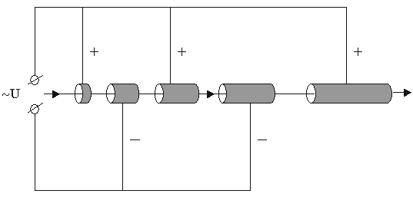


accelerator
Cathode
Anode
injector
Electron beam
particle
orbit
Particle
detectors
~ U
target
Beam extraction
system
Trajectory form
Linear
Cyclic

Slide 3
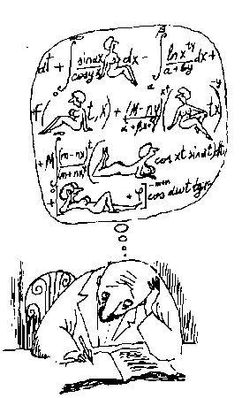
… portion
of
theory…

Slide 4
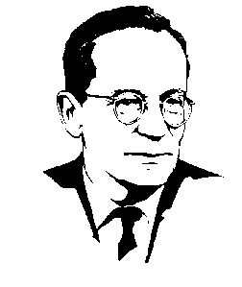
Particle motion
Transverse plane:
Horizontal + vertical
Longitudinal plane:
Longitudinal (Synchrotron) Oscillations
Transverse (Betatron) Oscillations
Mathematical
pendulum
with external
force (acc.gap)‏
Academician V.I.Veksler, 1944

Slide 5
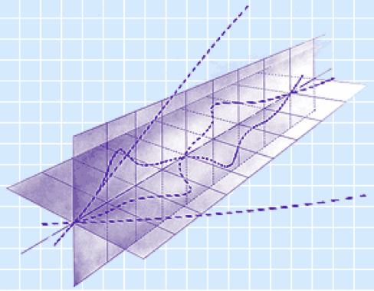
Strong focusing: N.Christofilos;
E.Curant, M.Livingston, H.Snyder (Brookhaven, USA, 1952)‏
Alternate focusing
Transformation
matrix

Slide 6
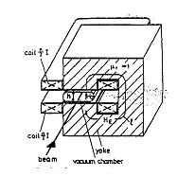
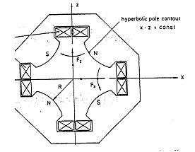
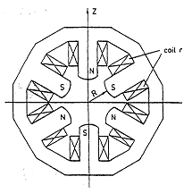
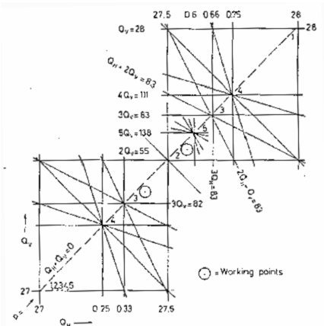
Dipole magnet
Quadrupole magnet
Sextupole magnet
Stability
diagram

Slide 7
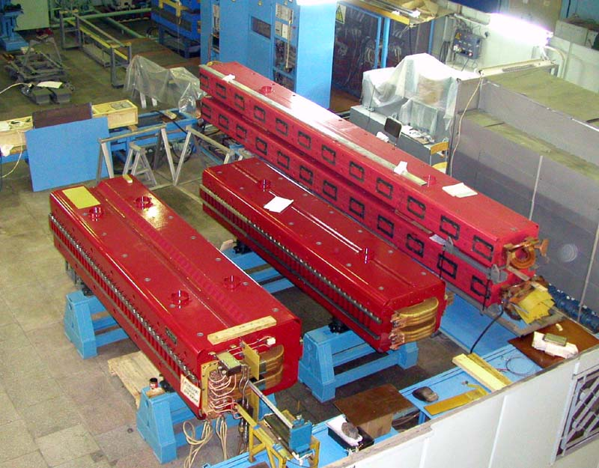
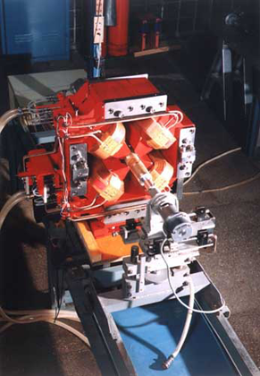
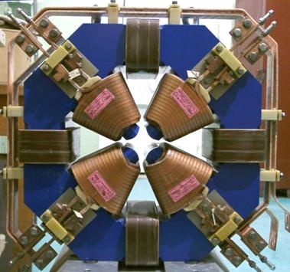
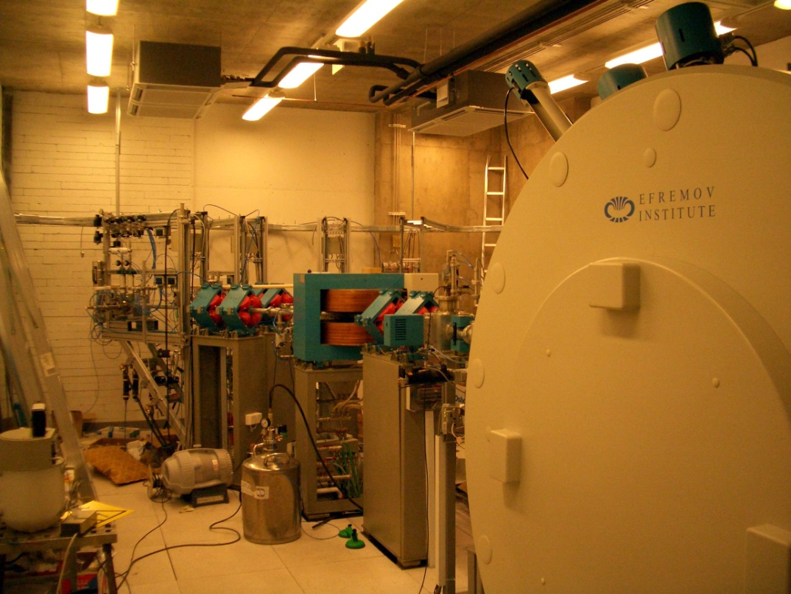
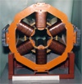

Slide 8
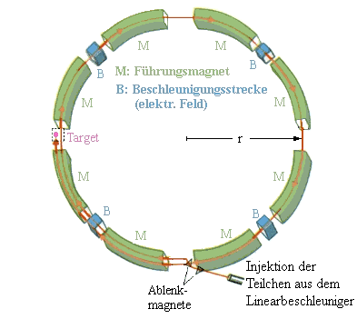
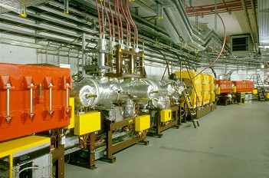
Synchrotron

Slide 9
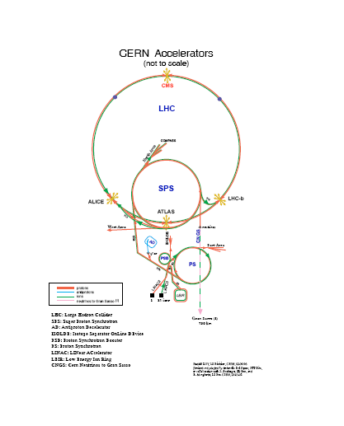
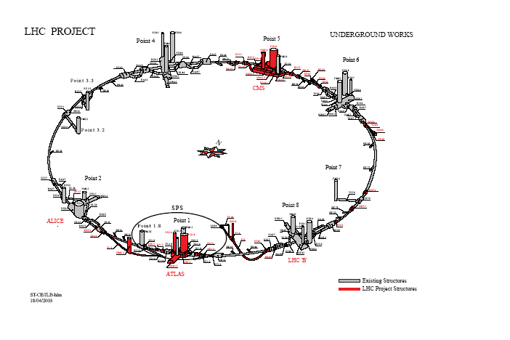
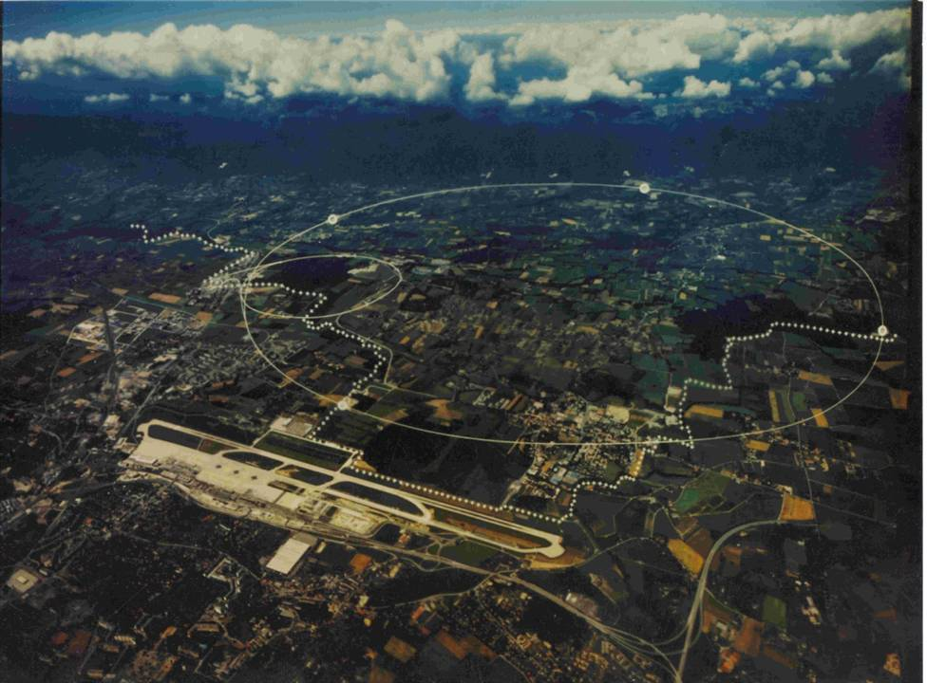
Hadron colllider LHC
Large Hadron Collider
Machine Circumference 26658.883 m
Revolution frequency 11.2455 kHz
pp-collisions Collision energy 7 TeV
Injection energy 450 GeV
Number of particles 3.23⋅10¹⁴
DC beam current 0.582 A
Luminosity 1.0⋅10³⁴ cm⁻²⋅s⁻¹
Pb⁸²⁺ x Pb⁸²⁺
Collision energy 2.76 TeV/u
Number of ions 4⋅10¹⁰
DC beam current 6.1 mA
Luminosity (β_{collision} = 0.5 m) 1.0⋅10²⁷ cm­²s­¹

Slide 10
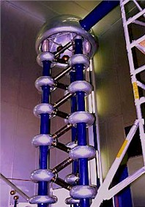
Cascade generator
First accelerator used for nuclear physics – cascade generator on 700 keV energy
was created by J.Cockraft and A.Walton – England 1931.
First controlled nuclear reaction
Step-up transformer
The basic method implemented in the cascade generator is a voltage multiplication across the plates of a capacitor. A set of capacitors are charged through appropriately placed diodes from an alternating current source

Slide 11
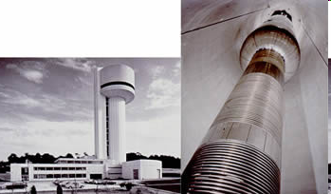
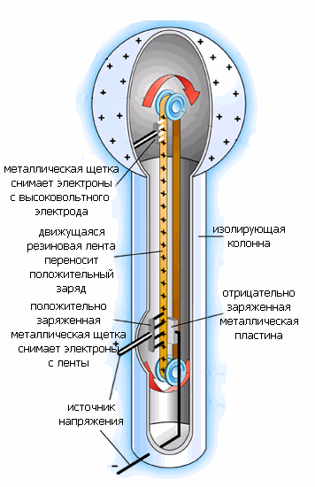
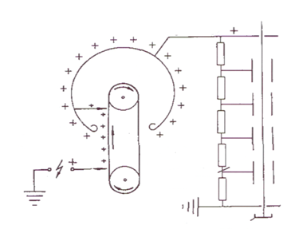
Electrostatic accelerators
Van de Graaf (1931) generator
Electrostatic generator – particles or ions are
accelerated due to passing through huge constant
potential V (which reach magnitude up to 20 MV).
Particle having charge Ze takes in such an
accelerator kinetic energy T=ZeV. The great
advantage of such a machine – continuous very
intensive and very stable in energy (0,01 %)
accelerated beam. Beam current is about several mA.
The Nuclear Structure Facility (NSF)[12] at Daresbury Laboratory commissioned in 1981. It consisted of a tandem Van de Graaff generator operating routinely at 20 MV, housed in a distinctive building 70 metres high. During its lifetime, it accelerated 80 different ion beams for experimental use, ranging from protons to uranium. A particular feature was the ability to accelerate rare isotopic and radioactive beams. Important discovery made on the NSF was that of super-deformed nuclei.
metal brush takes
electrons from the
high voltage electrode
Isolating
column
moving rubber
tape delivers
positive charge
positively charged
metal brush takes
electrons
from the tape
negatively charged
metal
plate
Voltage
source
1937, St. Bartholomew’s Hospital, London, 1 MeV HV accelerator
First medicine application

Slide 12

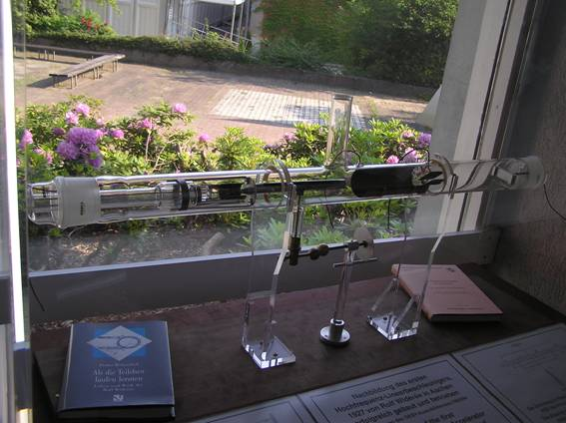
First RF accelerator (Drift Tube Linac – DTL structure)
In DTL ions are accelerated in a gap between drift tubes. When the field becomes decelerating the ions drift inside the tube
synchronism:
(R.Wideroe, 1928)
DESY, Hamburg

Slide 13
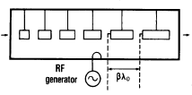
Alvarez – type DTL (E-cavities)
In Alvaretz structure the electric field in all the gaps has the same
direction and phase, therefore the synchronism condition is

Slide 14
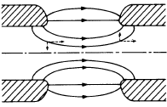
Particle transverse motion in DTL
The radial components are focusing
at the gap entrance and defocusing at the end.
Stability of the particle longitudinal motion
corresponds to unstable transverse motion
(defocusing prevails)
Methods of the focusing
Greed focusing
Solenoidal focusing
Focusing by Static Quadrupoles (Strong focusing)
Focusing by the accelerating field

Slide 15
Beginning of accelerator history
The end of the Second World War
1944. V.Veksler “auto phasing” principle
1945. L.Alvarez – first RF proton accelerator
1945. Biggest cyclotron in the world – Tokio, Nishina
1949. Phasotron in Dubna
1952. Strong focusing in Linacs by J.P.Blewett

Slide 16
Atomic projects
Isotop separation | Reactor breeder | Accelerator breeder
To increase concentration of ₂₃₅U from 0.7% to 95% 1. Centrifugal 2. Gas diffusion 3. Electromagnetic (mass spectrometers) | Irradiation of U by neutrons leads to formation of Pu. Chemical separation. First reactor was constructed by E.Fermi, in SU – I.Kurchatov | The same as reactor. Instead of neutrons – protons at 50 -100 MeV and ~ 1 A of continuous current (!!!). Livermore (Naval research laboratory) Cheljabinsk-sity in SU

Slide 17
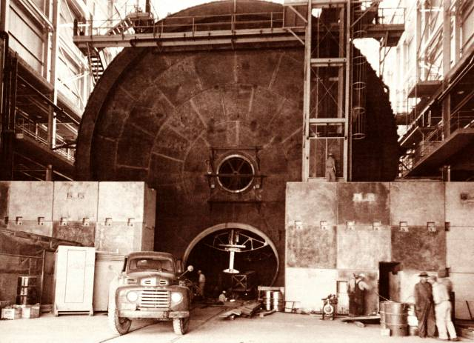
First proton accelerators
The first one constructed in 1945 was 17 m in diameter and 19 m of length. The drift tubes had inner diameter of 2 m and aperture diameter of 90 cm. It worked at λ = 12.5 m (41.6 MHz). Inside the drift tubes focusing solenoids were located.
Second Alvarez-type accelerator for 80 MHz
After strong focusing application typical frequency is 150 – 300 MHz (d ~ 1.5 – 3 m)

Slide 18
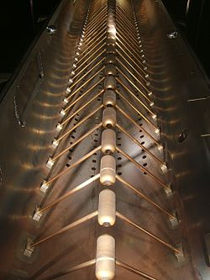
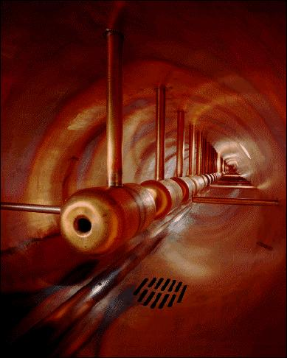
Alvarez – type DTL
To the end of 70-th the proton (ion) Linacs are used mainly as injectors of large cyclic
Accelerators. “Standard” configuration: HV foreinjector (~ 700 kV) + Alvarez
(up to 600 MeV). Quadrupole lenses are located inside the drift tubes.

Slide 19

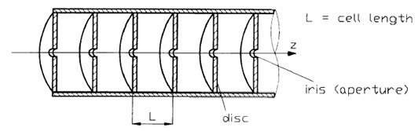
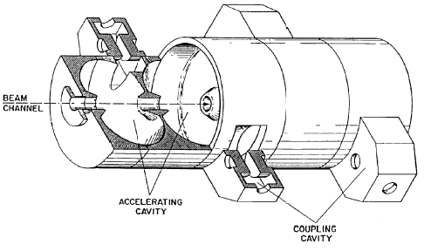
Traveling wave structures
For acceleration of relativistic particles different types of traveling wave structures operated at frequency from a few hundreds of MHz to a few GHz are used.
Disc loaded round wave guide
Side coupled structure

Slide 20
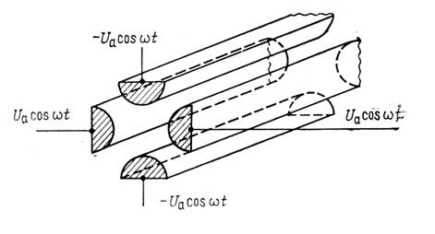
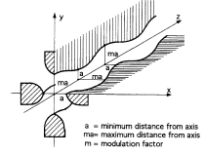
RFQ
Four-road line with quadrupole symmetry
The RFQ is a four-vanes resonator with quadrupol symmetry which provides a transverse electric gradient for transverse focusing (at low velocity, magnetic focusing is not efficient because of the v term which appears in the force equation). Modulated pole shapes lead to a longitudinal variation of the transverse field gradient giving a longitudinal electric component for acceleration and bunching.

Slide 21
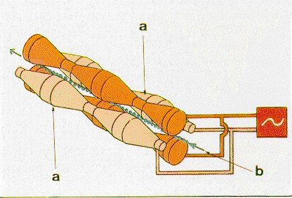

Slide 22
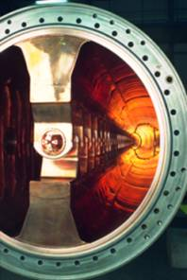
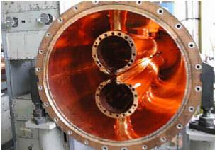
RFQ
Does not require HV foreinjector, provides current up to 0.5 A
2H cavity
IHEP, Protvino, initial part of URAL-30
GSI, RFQ based on IH cavity
for medicine accelerator

Slide 23
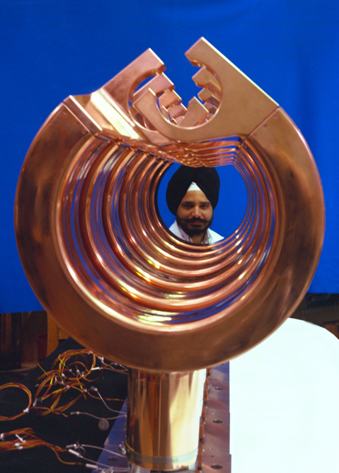
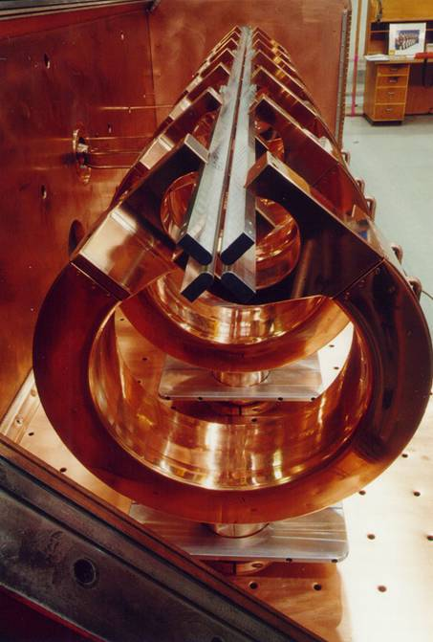

Slide 24
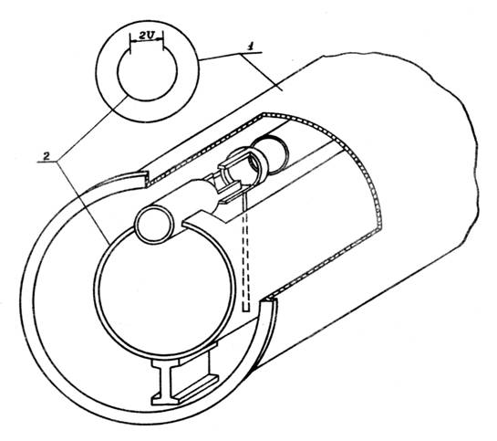
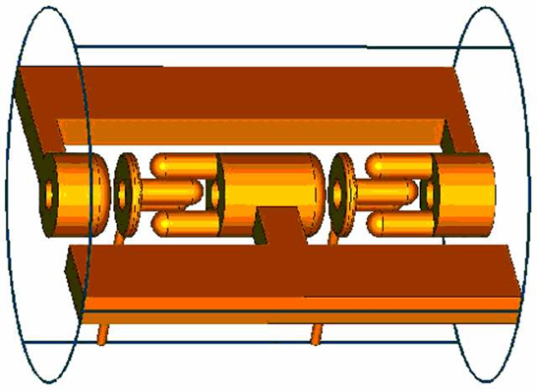
Structures based on Interdigital H- cavity
Firstly realized by V.Tepljakov
(IHEP, USSR): RFQ DTL

Slide 25
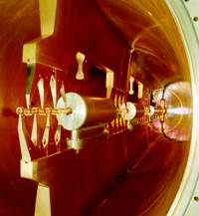
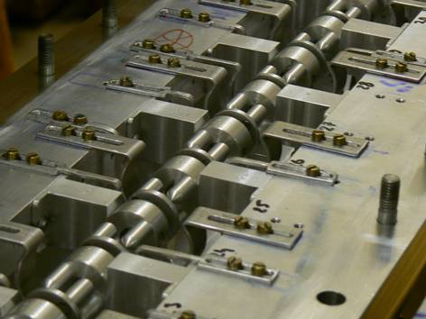
Hybrid focusing
RFQ - DTL
U. Ratzinger (1988)
GSI, Heavy ion linac
RF model for CERN 352.2 MHz linac
for SPL project. (Developed in IHEP)

Slide 26
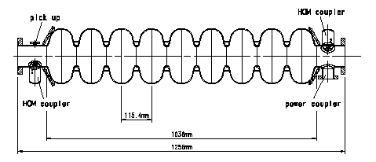
Superconductivity in Linacs
Standing wave accelerator consists of a multi-gap RF cavity. Synchronism between
a particle and RF voltage is provided by appropriate phase shift between the fields in the cavities
Electric Field
電場
Electron
(positron)‏
(陽)電子

Slide 27
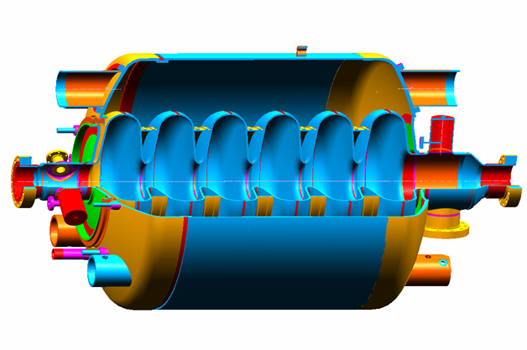
SNS Titanium Helium Vessel
Stiffening Rings
Titanium Bellows
2 - Phase Return Header
NbTi Dished Head
NbTi Dished Head
Field Probe
HOM Coupler
HOM Coupler
Fundamental Power Coupler
Medium Beta Cavity

Slide 28
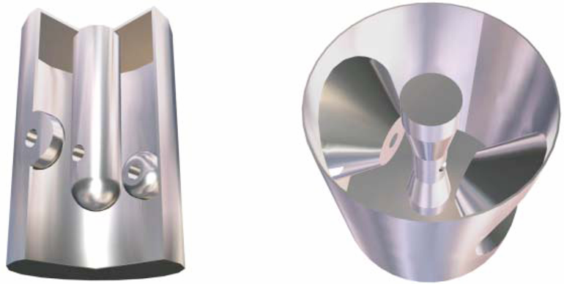
SC cavities for ion linacs
λ/4 cavity
λ/2 cavity
The accelerator is a chain of independent cavities

Slide 29
Applications of linear accelerators
Medicine and technology
Neutron generators
Neutral particle beams
Energy recovery linacs ERL (synchrotron radiation sources)
X-ray free electron laser X-FEL
High energy phisics – Linear collider

Slide 30
Episode IV: Star Wars
The idea was proposed in Los Alamos laboratory
in the beginning of 70-th
Usage of a neutral particle beam in the cosmic space
to destroy electronics on Enemies rockets
Generation of H⁻ beam
Acceleration to the energy of 50 – 100 MeV
Neutralization in a gas or plasma target
Required beam current is about 50 mA
1971-discovery of Cesium Catalysis in Budker Institute (Novosibirsk):
The current was increased from 100 μA up to 1 A (Dudnikov, Dymov)
1972 – commissioning of first RFQ accelerator
(V.Tepljakov, I.Kapchinsky, IHEP Protvino)
1983 USA Strategic Defender Initiative

Slide 31
Bear on a rocket
13 July 1989 in 8-30 AM from White Sand in New Mexico
Areas rocket was started with BEAR facility on a board
BEAR –Beam Experiment Aboard a Rocket
After 11 minutes of flight the BEAR was successfully landed
without mechanical damages.
1 MeV, 10 mA of equivalent current
the neutral particle beam was injected into space
Price of the experiment was 794 M$
1993 the program was closed.

Slide 32
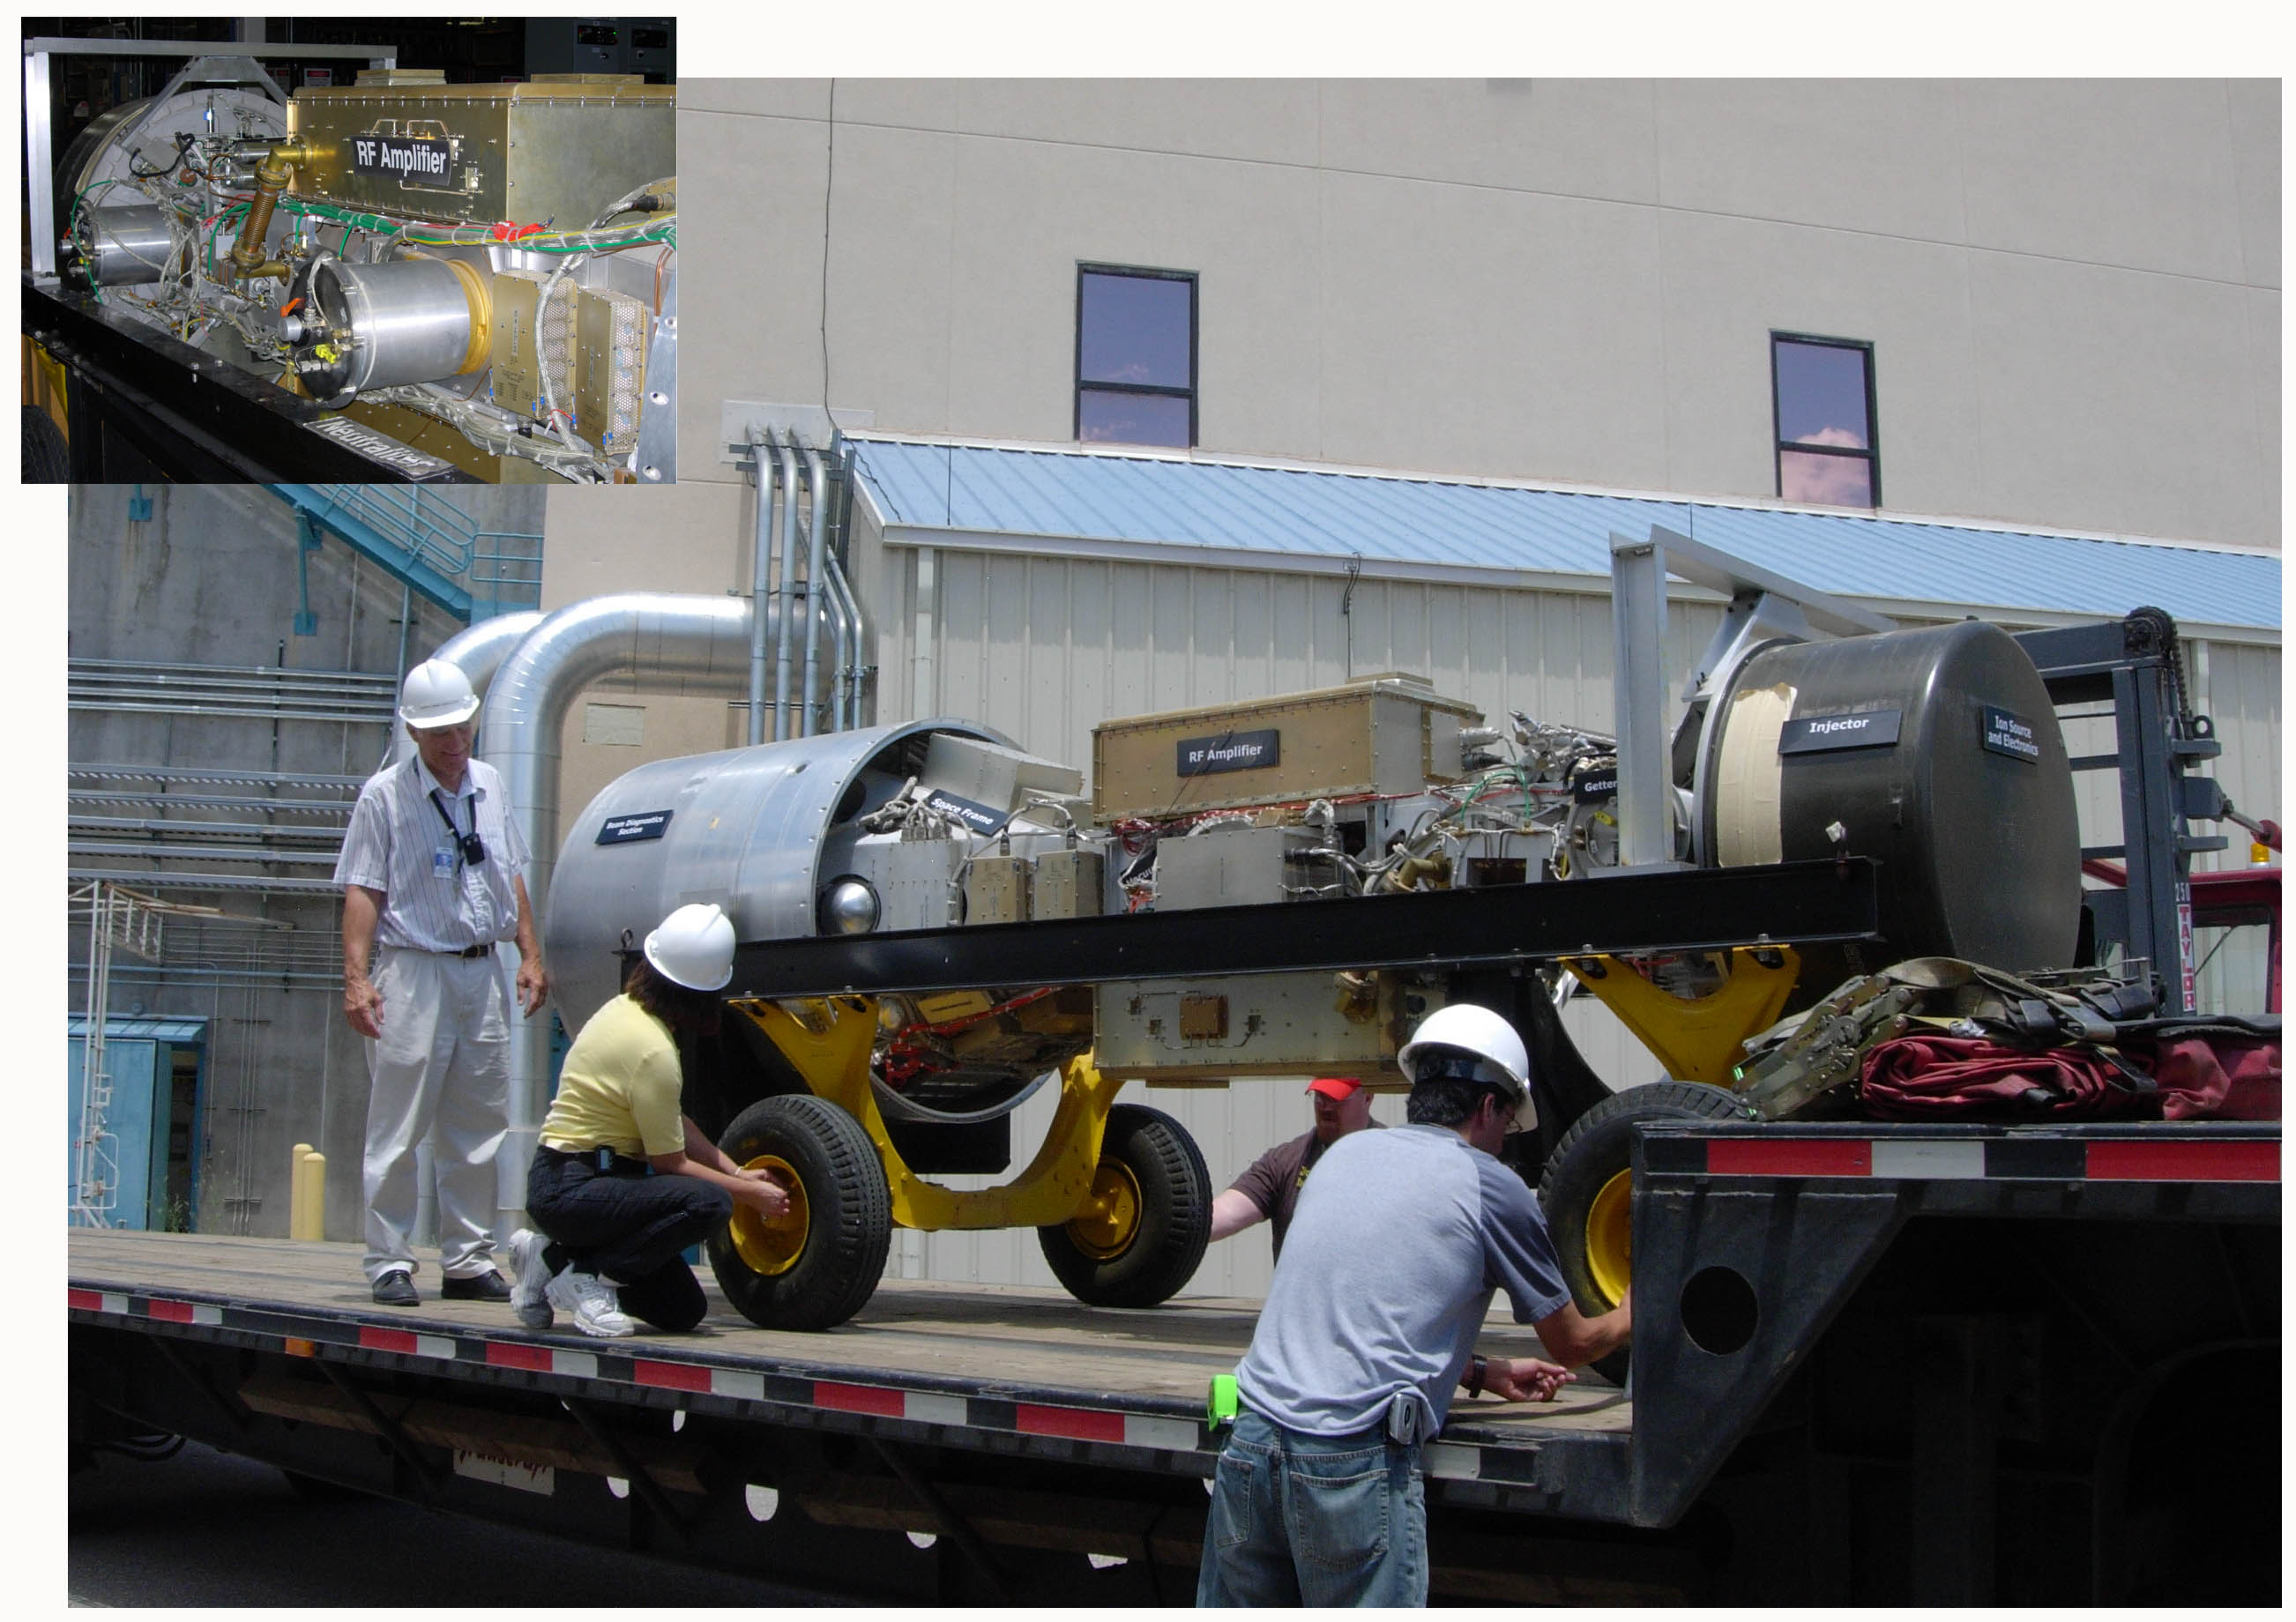
BEAR goes from Los Alamos
to Washington DC international airport to aerospace museum (2006)

Slide 33
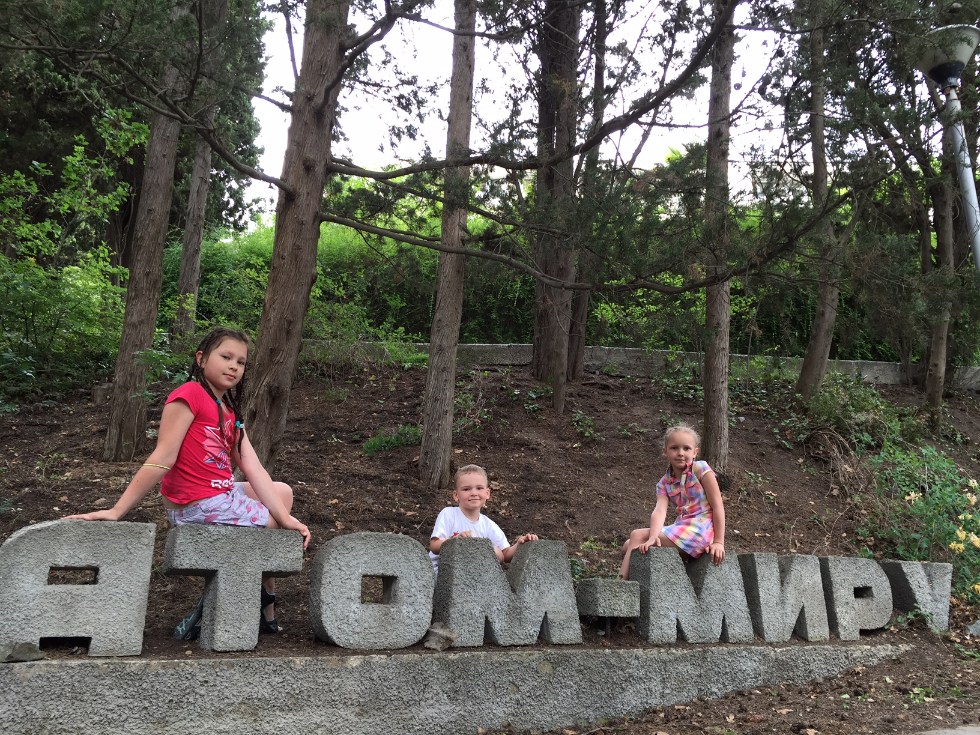

Slide 34
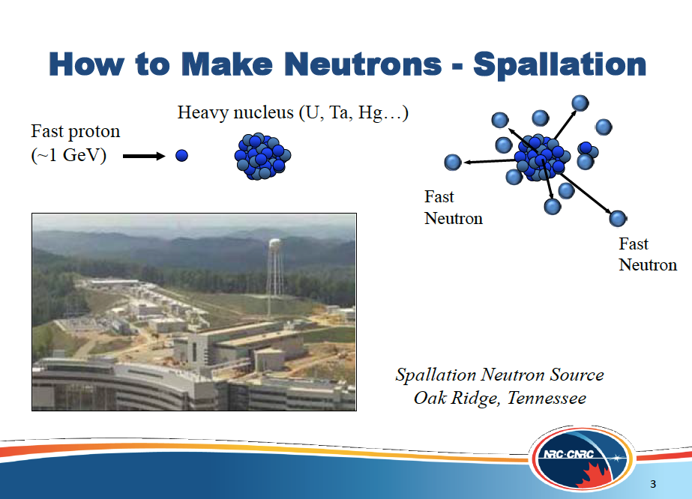

Slide 35
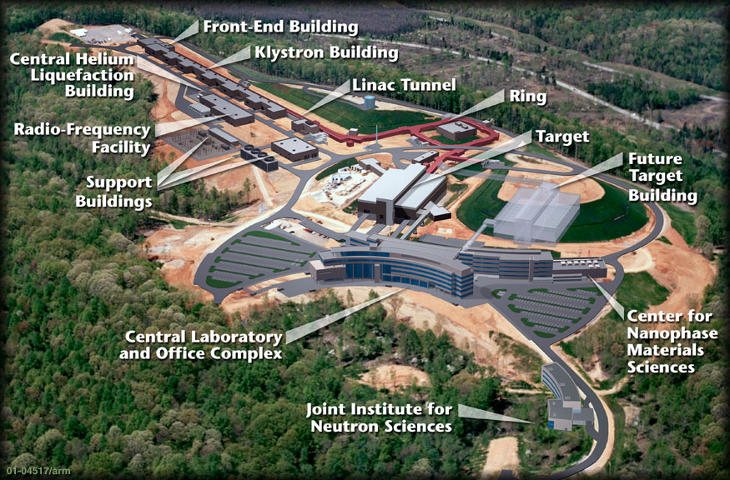
The Spallation Neutron Source
ORNL
1.3 GeV proton accelerator
Accumulator ring
2 MW Mercury target

Slide 36
SNS parameters
Primary proton beam energy - 1.3 GeV
Intensity - 9.6 ⋅ 10¹⁵ protons/sec
Pulse duration - 380ns (FWHM)
Repetition rate - 60Hz
Total power - 2 MW
Liquid Mercury target
Number of neutrino produced ~ 3⋅10²²/year

Slide 37


Slide 38


Slide 39


Slide 40


Slide 41


Slide 42


Slide 43


Slide 44


Slide 45


Slide 46

Линейный ускоритель Института ядерных исследований РАН - сильноточный ускоритель протонов и ионов H- со следующими параметрами: энергия 600 МэВ, средний ток 500 мкА, импульсный ток 50 мА, длительность импульса 100 мкс, частота повторения импульсов 100 Гц. Ускоритель включает в себя 2 инжектора (ионы Н+ и Н- ), инжекционный тракт, начальную часть ускорителя до энергии 100 МэВ и основную часть до энергии 600 МэВ. Начальная часть состоит из пяти ускоряющих резонаторов с трубками дрейфа, работающих на частоте 198,2 МГц, основная - из 27 четырех секционных резонаторов с шайбами и диафрагмами, работающих на частоте 991 МГц. Предусмотрен промежуточный вывод пучка с энергией 160 МэВ.

Slide 47



The injector complex includes two injectors - protons and Н- ions, - and the corresponding injection lines. Both injectors use accelerating tubes and HV pulse transformers initially providing the energy of 750 keV.

Slide 48

Сильноточный линейный ускоритель протонов и отрицательных ионов водорода с энергией до 600 МэВ, средним током пучка до 0,5 мА, , находящийся в одном ряду по мощности в пучке вместе с LANSCE (Лос-Аламос, США) и SNS (Ок-Ридж, США). Длина ускорителя более 500 м.
Обеспечивает проведение экспериментов в области фундаментальной ядерной физики и прикладных исследований, исследований по производству различных радионуклидов медицинского, научного и промышленного применения, работу Нейтронного комплекса и центра лучевой терапии.
- Нейтронный комплекс, состоящий из импульсного источника нейтронов позволяющего получать импульсы нейтронов длительностью до 320 нс с интенсивностью порядка 10¹⁵ н/с, спектрометра по времени замедления нейтронов в свинце и установки для радиационного материаловедения.
- Комплекс производства радиоактивных изотопов для медицины и промышленности (82Sr, 68Ge, 109Cd, 22Nа и др.).

Slide 49


Slide 50

SNS is a Unique Neutrino Source
The SNS will produce 3.2x10¹⁵ neutrinos/sec in 60Hz pulses
It will be the most intense, pulsed, low energy neutrino source in the world!
The pulsed source drastically reduces backgrounds from cosmic rays. Reduction is equivalent to 1 km of rock overburden.
Beam time structure allows separation of ν_{μ} from ν_{μ} and ν_{e}
Spectra of ν_{μ}, ν_{μ} and ν_{e} are well known
ν_{e} is highly suppressed

Slide 51
Accelerator long baseline experiments
The first long baseline experiment to have come into operation was K2K, which took data from June of 1999 to November of 2004. The primary goal of this experiment was to study the oscillation parameters that govern atmospheric neutrino oscillations, by looking at the disappearance of muon neutrinos over a baseline of 250 kilometers. Another experiment with the same primary goal is MINOS, presently taking data.
In the near future, the CNGS (CERN to Gran Sasso) project will also start, in this case with the goal to verify explicitly that the atmospheric oscillation is indeed the conversion of ν_{μ} to ν_{τ}.

Slide 52
The beam for K2K (KEK to Kamioka) was produced by focusing positive pions produced in collisions of 12 GeV protons from the KEK-PS accelerator. The focusing is achieved by a system of two magnetic horns, located next to the proton target. Following the horns the pions enter a 200m long decay pipe where they are allowed to decay into muons and neutrinos.
The MINOS (Main Injector Neutrino Oscillation Search) experiment is a long baseline experiment presently taking data. The main objective of the experiment is to study the oscillation parameters of atmospheric neutrino oscillations by looking for μ disappearance in an accelerator neutrino beam, in particular to improve the measurement of Δm²₂₃. The experiment uses the NuMI (Neutrinos at the Main Injector) beam at the Fermi National Laboratory. The neutrino beam is produced with 120 GeV protons from the main injector, which are extracted every 1.9s with a spill of 8.7 μs .
The CERN to Gran Sasso (CNGS) project includes another two long baseline experiments aiming at the confirmation of the atmospheric oscillations, this time by seeing explicitly the oscillation ν_{μ} to ν_{τ} through the identification of τ leptons produced by ν_{τ} interactions in the far detector. The baseline of the project is almost identical to that of MINOS, 732 km. Two experiments are foreseen: OPERA and ICARUS, based on a liquid Argon TPC. The beam is produced from protons of the CERN SPS and its energy is optimized for identification of ν_{τ} interactions. The optimization involves two competing effects: the oscillation probability which is maximum at about 1.3 GeV for the CERN to GS distance, and then decreases as sin² (1.2Δm²₂₃L/E ) with increasing energy, and the probability of interactions, which grows linearly with E_{ντ}. It turns out that the optimal energy is at about 17 GeV, which is the design energy of the beam.

Slide 53

This Science has attracted Competition:
The Proton Source Landscape
This Decade...
Project-X
Pulsed machines driving neutrino horns:
SPS (0.5 MW), Main Injector ( 0.3 MW now, 0.7 MW for Nova),
JPARC (plan for 1.7 MW)
Cyclotrons and synchrotrons driving muon programs
PSI (1.3 MW, 600 MeV), JPARC RCS (0.1-0.3 MW)
Synchrotrons driving kaon physics programs.
SPS (0.015 MW), JPARC (goal of >0.1 MW), Tevatron (0.1 MW)
Linear machines driving nuclear and neutron programs:
SNS, LANL, FRIB….not providing CW light-nuclei beams.
13

Slide 54
The Project-X. Research Program
Long baseline neutrino oscillation experiments:
Driven by a high-power proton source with proton energies between 50 and 120 GeV that would produce intense neutrino beams directed toward massive detectors at a distant deep underground laboratory.
Kaon, muon, nuclei & neutron precision experiments driven by high intensity proton beams running simultaneously with the neutrino program:
These could include world leading experiments searching for muon-to-electron conversion, nuclear and neutron electron dipole moments (edms), and world-leading precision measurements of ultra-rare kaon decays.
Platform for evolution to a Neutrino Factory and Muon Collider
3

Slide 55






Sample with bullet points
Long Baseline Neutrino Experiment
First Bullet
Second Bullet
  More
  Yet more
  Still more
      Less important
        Trivial
New Neutrino Beam at Fermilab…
…Directed towards NSF’s proposed DUSEL
Precision Near Detector on the Fermilab site
100 kT fiducial volume Water Cherenkov Far Detector
17 kT fiducial volume Liquid Argon TPC Far Detector
55
J.Strait, Fermilab - DOE Science & Technology Review July 12-14, 2010
10
Notes:
55

Slide 56

56
Sample Communication Talk
24
Notes:
56

Slide 57


Slide 58


Slide 59


Slide 60
Project-X Accelerator Performance Goals
CW Linac
Particle Type H⁻
Beam Kinetic Energy 3.0 GeV
Average Beam Current 1 mA
Linac pulse rate CW
Beam Power 3000 kW
Beam Power to 3 GeV program 2870 kW
RCS/Pulsed Linac
Particle Type protons/H⁻
Beam Kinetic Energy 8.0 GeV
Pulse rate 10 Hz
Pulse Width 0.002/4.3 msec
Cycles to MI 6
Particles per cycle to Recycler 2.6×10¹³
Beam Power to 8 GeV program 200 kW
Main Injector/Recycler
Beam Kinetic Energy (maximum) 120 GeV
Cycle time 1.4 sec
Particles per cycle 1.6×10¹⁴
Beam Power at 120 GeV 2200 kW
simultaneous
16

Slide 61
Slow Extracted Beam: The Standard Tool to Drive Ultra Rare Decay Experiments
Techniques developed in the late 1960’s to “slow spill” beam from a synchrotron.
Technique operates at the edge of stability - Betatron oscillations are induced which interact with material in the beam (wire septum) to eject particles from the storage ring beam phase space.
Technique limited by septum heating & damage, beam losses, and space charge induced instabilities. Works better at higher energies where the beam-power/charge ratio is more favorable.
Performance milestones:
Tevatron 800 GeV FT: 64 kW of SEB in 1997.
BNL AGS 24 GeV beam, 50-70 kW of SEB.
JPARC Goal: 300 kW of SEB someday, a few kW within reach now.

Slide 62


Slide 63


Slide 64

3 GeV Super-conducting CW Linac: High Power and High Duty Factor
1 μsec period at 3 GeV
mu2e pulse (9e7) 162.5 MHz, 100 nsec 600 kW
Kaon pulse (9e7) 27 MHz 1200 kW
Nuclear pulse (9e7) 27 MHz 1200 kW
Separation scheme with traverse kicker ala JLAB.
17

Slide 65





Project X: new experiments
Neutrinos
  Matter-antimatter asymmetry
  Neutrino mass spectrum
  Neutrino- antineutrino differences
  Anomalous interactions
  Proton decay
  SuperNova bursts
Kaons
  Physics beyond the Standard Model
  Elucidation of LHC discoveries
  Two to three orders of magnitude increase in sensitivity
Muons
  Oscillation in charged leptons
  Physics beyond the Standard Model
  Elucidation of LHC physics
  Sensitive to energy/mass scales three orders of magnitude beyond LHC
Nuclei
  New generation of symmetry-test experiments
  Electric Dipole Moments
  Three or more orders of magnitude increase in Francium, Radium, Actinium isotopes
Energy Applications
  Transmutation experiments with nuclear waste
  Spallation target configurations
  Materials test under high irradiation
  Neutron fluxes under various configurations relevant to ADS

Slide 66


Neutrino Factory Baseline
Proton driver
  Proton beam ~8 GeV on target
Target, capture and decay
  Create π, decay into μ (MERIT)
Bunching and phase rotation
  Reduce ΔE of bunch
Cooling
  Reduce transverse emittance (MICE)
Acceleration
  120 MeV→ 10 GeV with RLAs or additional FFAG (EMMA)
Decay ring
  Store for ~100 turns
  Long straight sections
549 m
IDS-NF 2012/3.0
Neutrino spectra
calculable to high
accuracy

Slide 67
Proton Driver
Requirements:
Choice is regional decision
LINAC based (SPL) proton driver at CERN: most advanced
Synchrotron(s)/FFAG based proton driver (green field
solution) – under study at RAL.
Project X LINAC based solution at Fermilab.

Slide 68
Proton Driver (SPL)
Superconducting Proton LINAC, SPL, at CERN: 5 GeV
Accumulator
[120 ns pulses -
60 ns gaps]
Accumulation | Duration = 400 μs
Compression | t = 0 μs
 | t = 12 μs
 | t = 24 μs
 | t = 36 μs
 | etc. until t = 96 μs
SPL beam
[42 bunches -
21 gaps]
Compressor
[120 ns bunch -
V(h=3) = 4 MV]
Target
[2 ns bunches – 6 times]

Slide 69

Proton Driver (FFAG)
Hardware options: 4 MW operation
    Fixed Field Alternating Gradient Synchrotron (FFAG)
Rees, Prior (RAL)
10 GeV non-scaling FFAG
n = 5, h = 40, radius = twice booster radius = 127.576 m
3 GeV RCS booster
mean radius = 63.788 m
Bunch compression for 5 bunches:
Longitudinal bunch area =
0.66 eV-s
1.18 MV/turn compresses to
2.1 ns rms
Add h = 200, 3.77 MV/turn for
1.1 ns rms
n=5, h=5
180 MeV H^{ˉ} linac
Achromatic Hˉ collimation line

Slide 70

Proton Driver (Project X)
Hardware options: 4 MW operation
    Project X at Fermilab

Slide 71


Target R&D: MERIT
MERIT experiment tested Hg jet in 15-T solenoid
  24 GeV proton beam from CERN PS
    Ran Autumn 2007
15-T solenoid during tests at MIT
MERIT experiment showed proof-of-principle of Hg jet system in magnetic field – rated up to 8 MW

Slide 72


Muon Front End
p
π→μ
FE Target
Solenoid
Drift
Buncher
Rotator
Cooler
18.9 m
~60.7 m
~33m
~42 m
~75 m
Cooling channel:
  100 cells of 0.75 m length
  Total length: 75 m
  100 normal conducting RF cavities with SC coils
  RF frequency 201.25 MHz
  Gradient 15 MV/m
  LiH absorbers (11 cm)

Slide 73


Decay Ring Geometry
Racetrack geometry (469 m straight)
Decay electron energy used to measure muon polarization
469 m

Slide 74


Performance 10 GeV Neutrino Factory
Optimisation for 10 GeV Neutrino Factory with 100 kton MIND at 2000 km gives best sensitivity to CP violation, even at latest value of sin²2θ₁₃~0.09
arXiv:1203.5651
NF yields Δδ~5º, regardless
of value of δ

Slide 75











Accelerator R&D
Wakefield accelerator facilities
Future colliders New methods
New technologies Applications

Slide 76

U-70 accelerator complex (IHEP)

Slide 77


Slide 78


Slide 79
NICA accelerator complex
Linac (5MeV/u)
source
Booster (25 Tm)
Acceleration
up to
~ 0,6 GeV/u
Nuclotron
45 Tm
E ~ 6 GeV

Slide 80

NICA-V accelerator complex
SC p-linac (10MV/m)
p-source
Booster (25 Tm)
Acceleration
up to
~ 1,3 GeV/u
Two collider rings
SC magnets ~ 5 T;
~ 100 T⋅m
E ~ 30 GeV (p)
Intensity ~ 1e13
Extracted high-intense p-beam
Nuclotron
45 Tm
E ~ 12 GeV
μ-target
Goal: MW proton beam to the target

Slide 81
Dubna
ν_{e}->ν_{μ}->ν_{τ}
~ 4500 km
Baikal

Slide 82
Спасибо за внимание !

Slide 83



Project X and the big questions
Where does mass come from?
Why is matter dominant?
What are the neutrino masses and what do they say?
  Where are the heavy neutrino partners?
  Why are there three families of quarks and leptons?
  Do the forces unify?
  Does nature use supersymmetry or other new symmetries?
  Are there extra dimensions of space?
  What is dark matter?
  What is dark energy?
neutrinos
muons
kaons
Nuclei
(EDMs..)

Slide 84


Slide 85


Slide 86


Slide 87


Slide 88


Slide 89


Slide 90


Slide 91


Slide 92


Slide 93


Slide 94

…As seen by charwoman…

Slide 95


Slide 96
Средний радиус Земли, принимаемой за шар - 6371,2 км.
Тогда центральный угол, опирающийся на хорду Москва-Петербург равен 634/6371,2=0,099510296 радиан. Длина хорды (туннеля) равна 2*6371,2*sin(0,099510296/2)=633,738 км. Глубина в середине туннеля равна 6371,2(1-*cos(0,099510296/2))=7,885 км.
Угол: 4500/6370 = 0,70643642 радиан
Длина хорды равна = 2*6370*sin(0,70643642/2) = 4407 км.
Глубина в середине туннеля равна 6371,2(1-*cos(0,70643642/2)) = 393,3 км.

