Slide 1
Creating cloud storage system at JINR
Semenov Roman (LIT, JINR)
01.oct.2015

Slide 2
Requirements List
The reliability of data storage
- replication - high availability
Efficient use of disk space (Different Replication Levels)
Management flexibility
The minimum cost (Freeware, OpenSource)

Slide 3
Available systems
FS

Slide 4
CephFS Architecture
mds.1
mds.N
mon.1
mon.N
mon.2
osd.N
osd.1
osd.2
osd.3
osd.4

Slide 5
GlusterFS Architecture (Distributed Replicated Volumes)
Host1
Host N
Host 2
Brick 1
Brick 3
Brick N
Brick 2
Brick 4
Brick M

Slide 6
LizardFS Architecture
master
metalogger
shadow
chunk1
chink2
chinkN
disk
disk
disk
disk
disk

Slide 7
Limitations
CephFS
- Non production version (!)
- Do not recommend use more than one Mds
GlusterFS
- Management is not enough flexible
LizardFS
- High Availability only manually

Slide 8
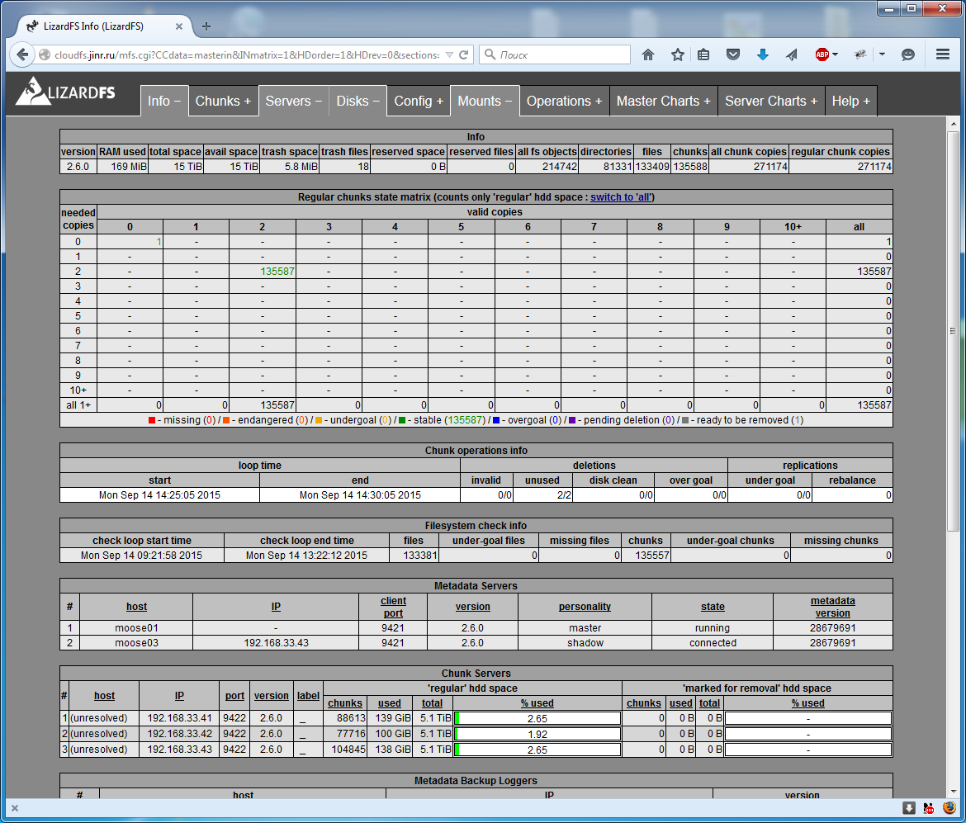
Our decision

Slide 9
Pre-producton Storage Resources(JINR)
Hardware: 3 Servers (2U)
Storage: 9 HDD (2TB each)
Total Space:16 TB

Slide 10
Cloud Storage Architecture at JINR
Server 3
Server 1
Server 2
shadow
master
metalogger
chunk3
chunk1
chunk2
3 Disks
3 Disks
3 Disks

Slide 11
Using
$ /usr/bin/mfsmount /var/lib/one/datastores -H lizardfs.host.com -S /cloud
$ df -h /var/lib/one/datastores
Filesystem Size Used Avail Use% Mounted on
mfs#lizardfs:9421 16T 64G 16T 1% /var/lib/one/datastores

Slide 12
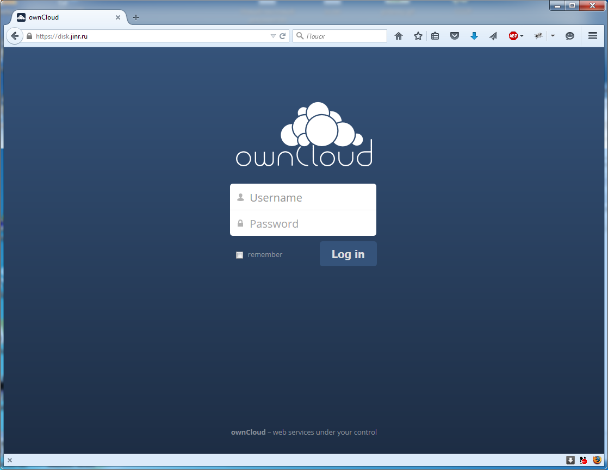
Additional use-case

Slide 13
ownCloud Features
File storage in conventional directory structures or via WebDAV.
Sharing of content across groups or public URLs.
Encryption of user files.
Synchronization of clients running Windows (Windows XP, Vista, 7 and 8), Mac OS X (10.6 or later), or Linux.
Calendar (also as CalDAV)
Task scheduler.
Address book (also as CardDAV)
Music streaming (through Ampache)
User and group administration (via OpenID or LDAP)
Online text editor with syntax highlighting and code folding
Bookmarking
URL shortening Suite
Photo gallery.
Video viewer.
PDF viewer (using PDF.js)
Viewer for ODF Files (.odt, .odp, .ods)
Mozilla Sync hosting - If you are a Mozilla Firefox user, all history, form data, bookmarks etc. can be stored in your OwnCloud server.
RSS/Atom feed reader.
Connecting external storages (if you have accounts on Dropbox, GoogleDrive, or Amazon S3, you can mount those storages into your OwnCloud installation)
Customizable with one-click-install apps.
Logging Module: supports logging of file-related actions, logs, who accessed what, when and from where (only available in the OwnCloud Business, Enterprise and Education editions).

Slide 14
Thank you for your attention!

