Slide 1




DAQ ELECTRONICS at BM@N
AFI Electronics group:
Andrey Terletskiy, Ilya Slepnev, Alexey Shutov, Alexey Baskakov, Andrey Schipunov, Ivan Fillipov, Nikita Tarasov, Vyacheslav Slepnev, Sergey Bazylev

Slide 2
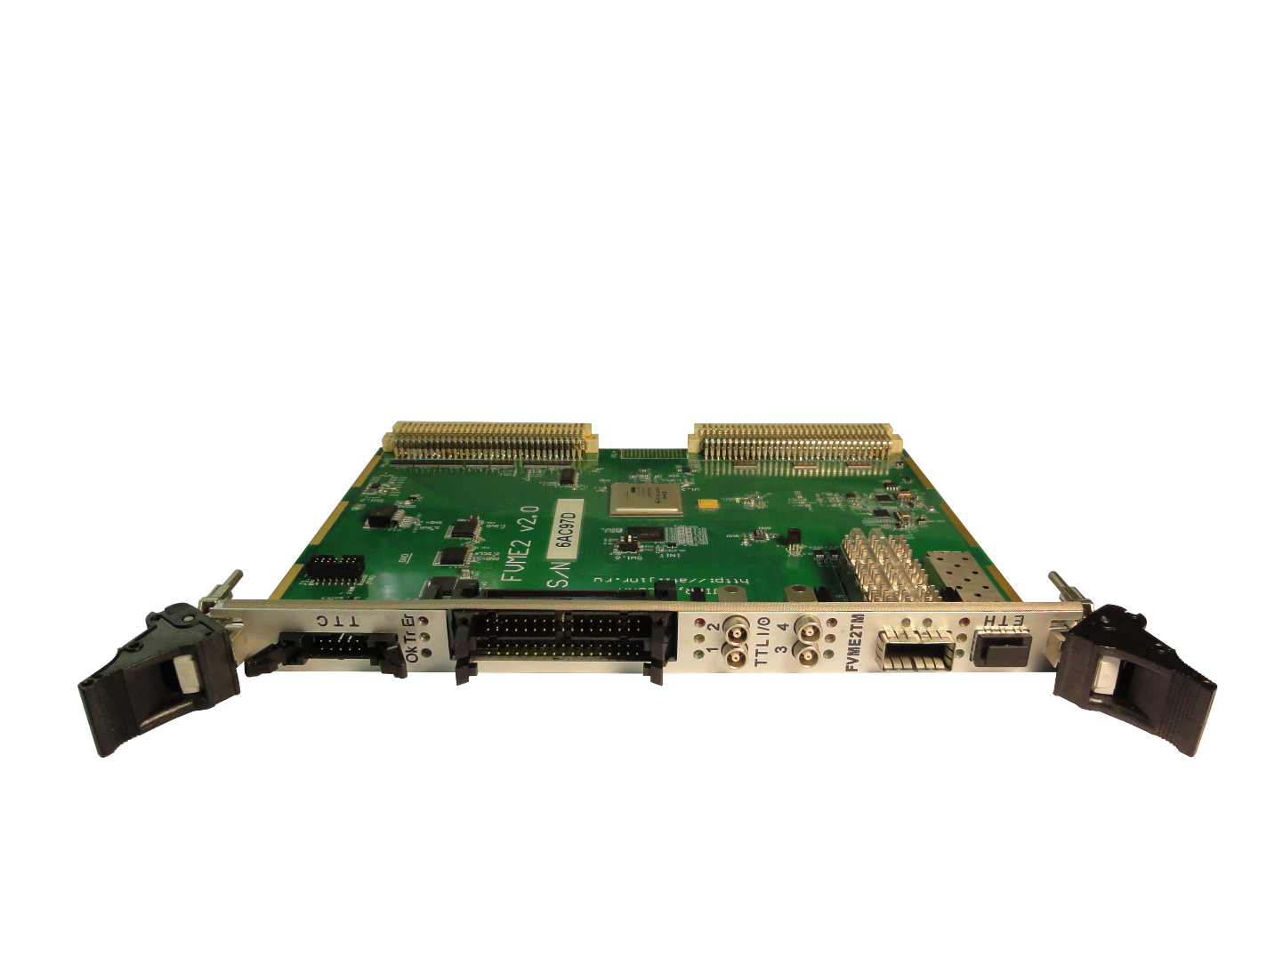
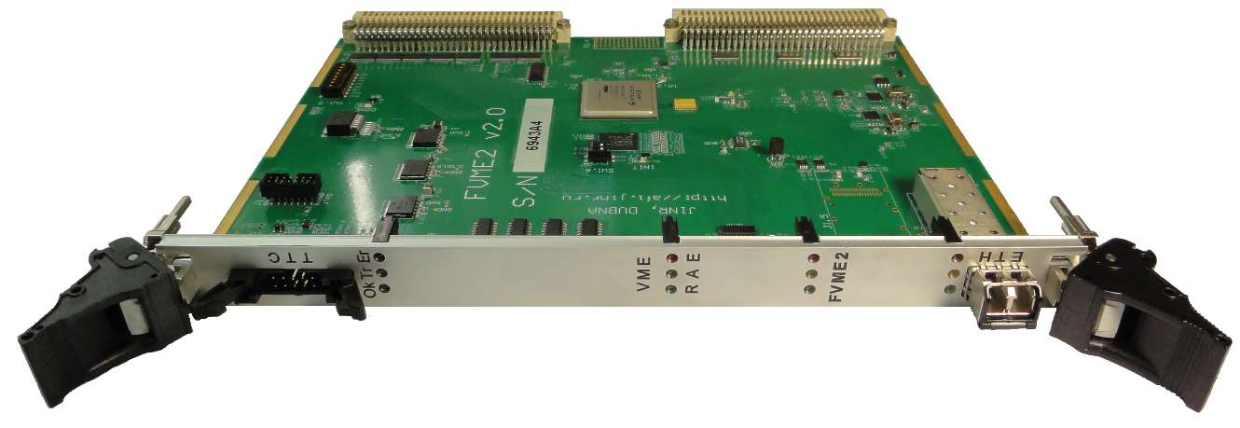
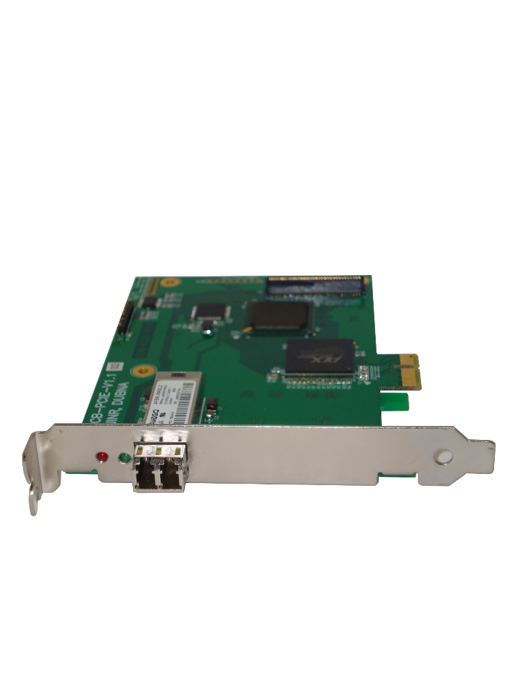
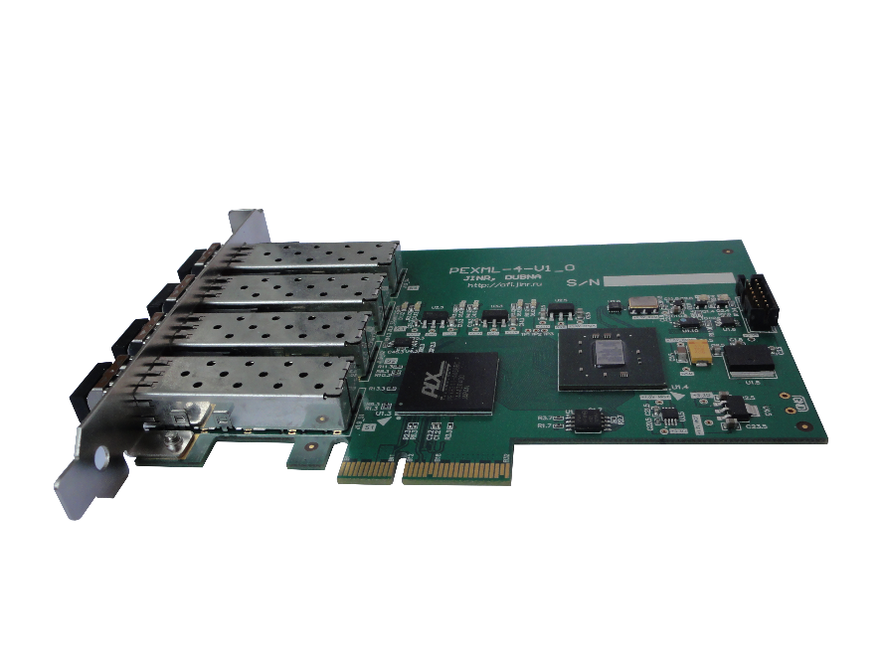
Interface Modules

Slide 3


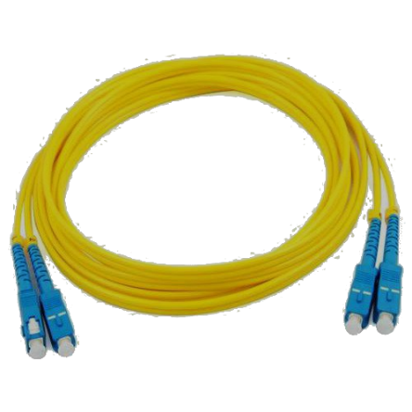
FVME2 & CCB-PCIe
PCI-Express M-Link interface
VME64x Master, System Controller
SFP serial link 2 Gbps
TTC Bus input for spill and trigger
Optional VXS

Slide 4


FVME2TMWR
Trigger, Timing and Control Module for VMEDAQ system
TTC Bus master. Generate clock, trigger and spill signals
4 software configurable TTL I/O
32 ECL/LVDS trigger inputs
White Rabbit time synchronization support
QSFP connector for clock, trigger synchronization
Optional VXS

Slide 5
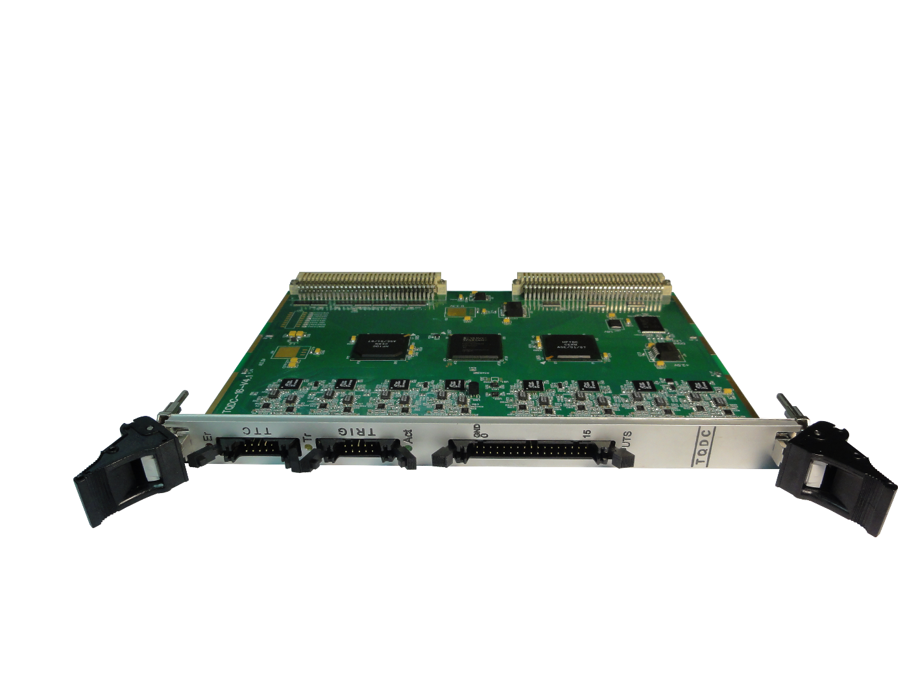
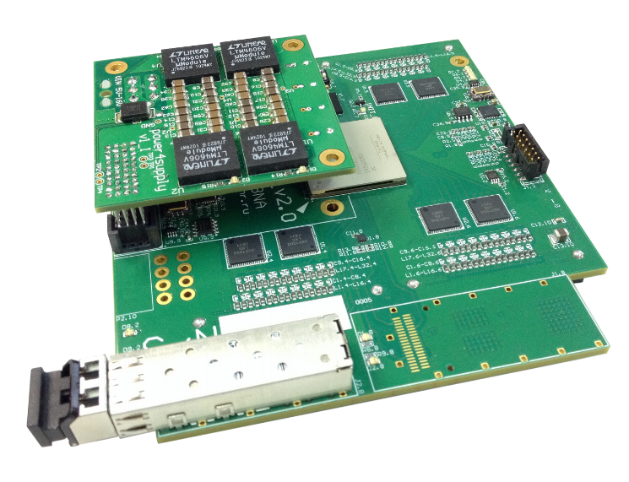
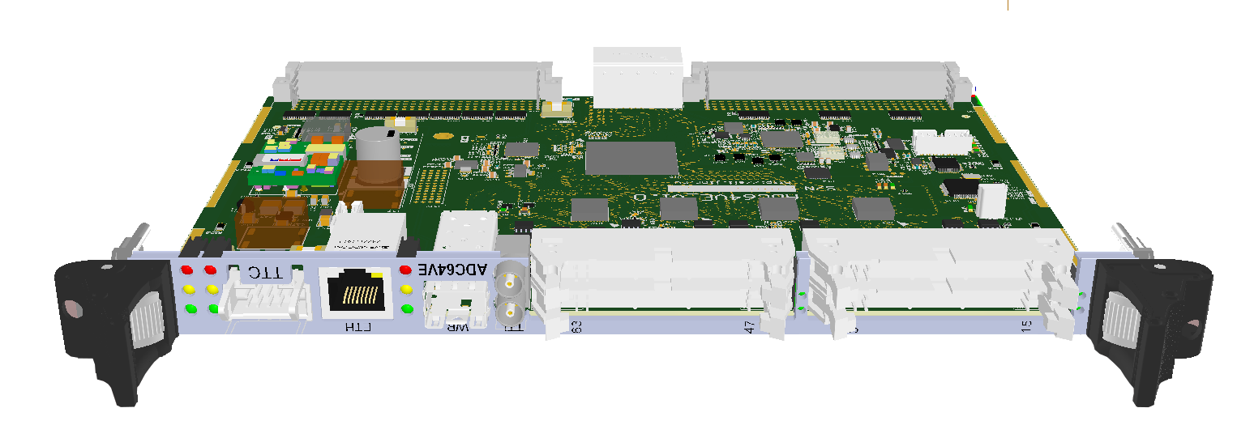
Waveform digitizers

Slide 6

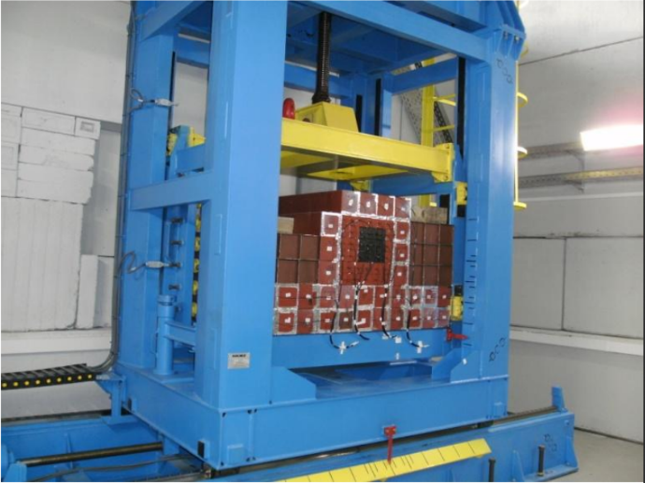
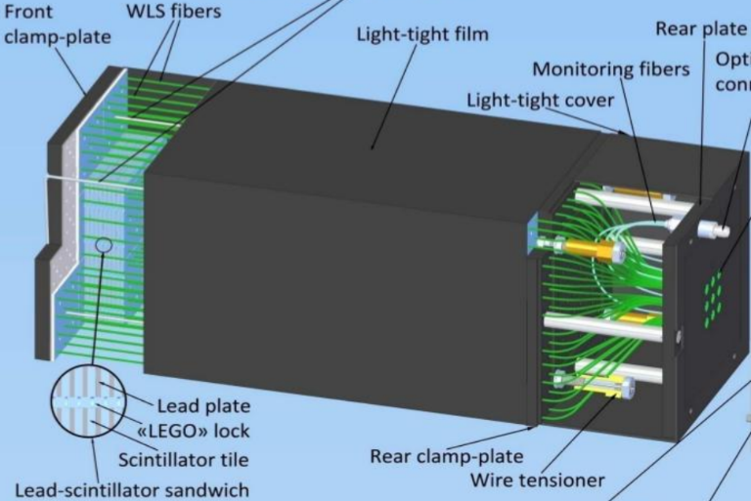
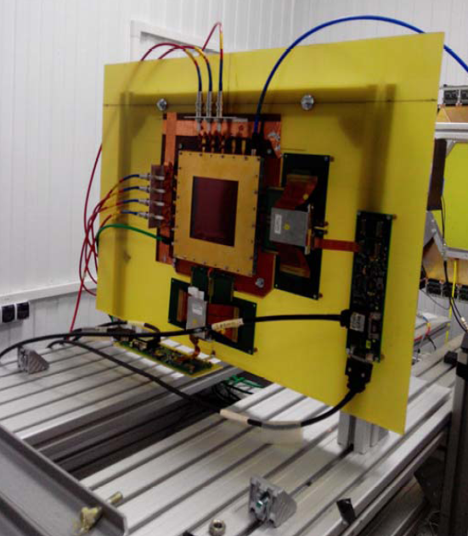
ADC64s2
Used for digitizing signals from:
ECAL
ZDC
GEM
(ADC64VE)

Slide 7

ADC64s2
64-channel 12-bit 62.5 MS/s ADC device with signal processing core and Ethernet interface
Capable of time synchronization by White Rabbit network
Optional QSFP connector may be used to provide external clock for very high precision measurements as well as trigger and readout links
Low noise power supply mezzanine board P4S with input range from 5 V to 12 V
2 hardware configurable LEMO TTL/IO

Slide 8
ADC64VS
In Production
64 single ended or differential inputs
14 bit 62.5 Msps ADC
TTC (VME mode) or White Rabbit (Standalone mode) synchronization
PoE or VME power supply
2 hardware configurable LEMO TTL I/O
Ethernet or VME64x data transfer
Optional VXS

Slide 9
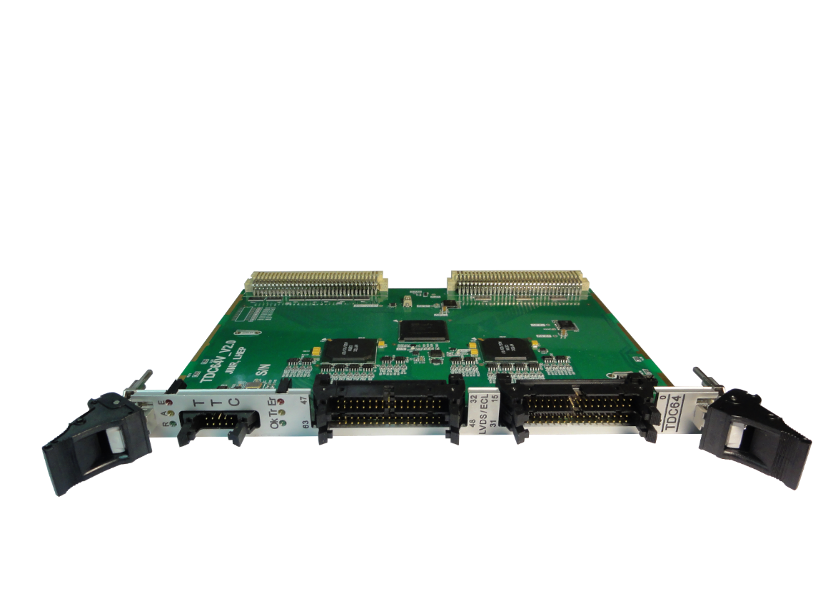
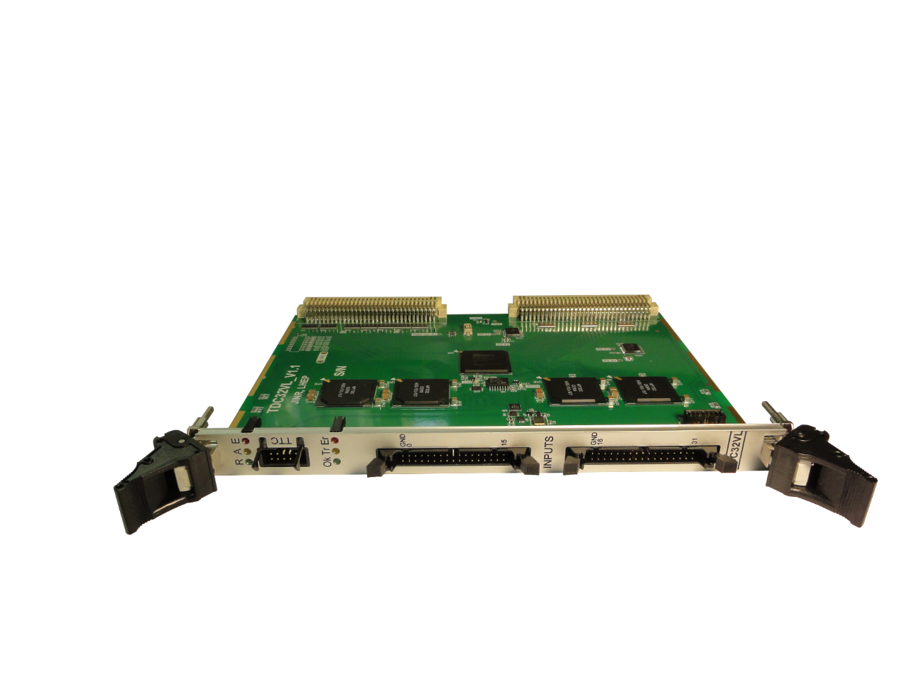
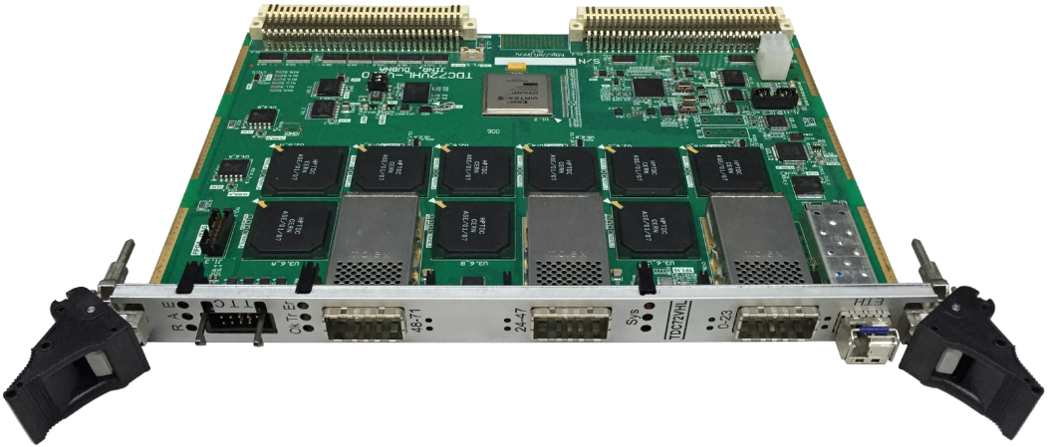
Time to Digital Converters

Slide 10
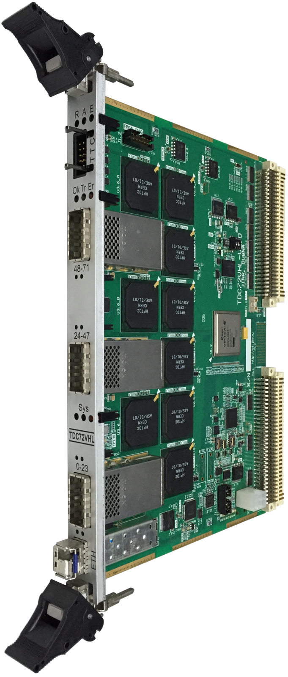
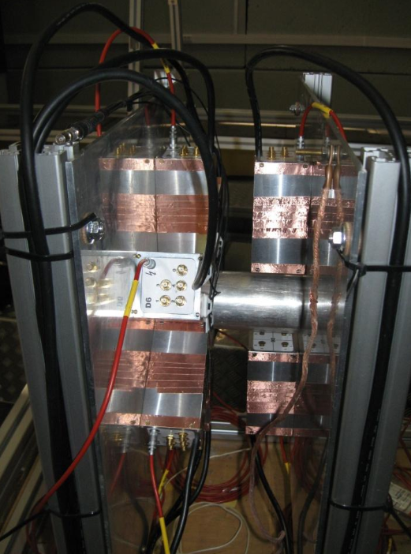
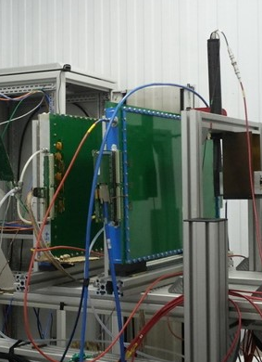
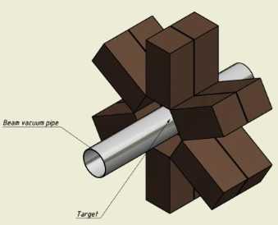
TDC72vhl
is VME64x 72-channel 25 ps multihit timestamping TDC
mRPC (ToF-400)
T0

Slide 11
TDC72vhl
is VME64x 72-channel 25 ps multihit timestamping TDC
72 differential 100 Ω LVDS inputs
VME mode:
  VME64x for data transfer
  TTC Bus for Clock and Trigger
Standalone mode:
  Ethernet or M-Link data transfer
  Time synchronization by White Rabbit

Slide 12

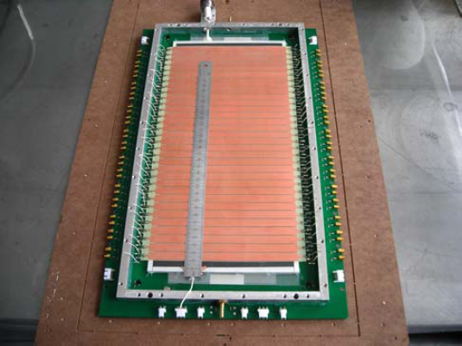
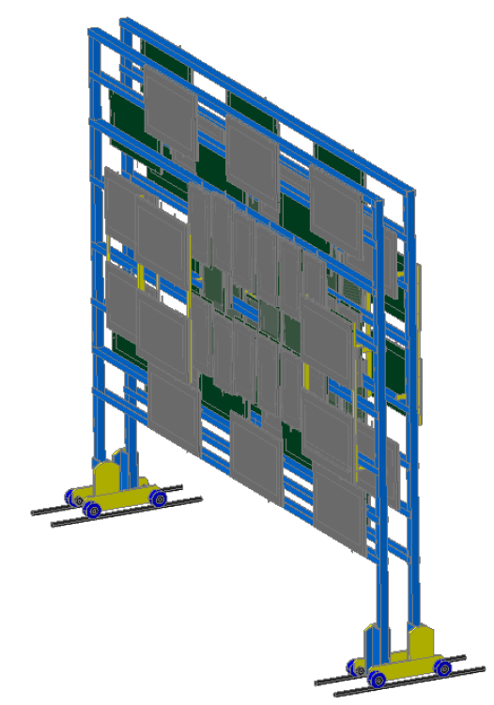
TDC32VL
32-channel LVDS 25 ps multihit timestamping TDC
mRPC-2 (ToF-700)

Slide 13
TDC32VL
32-channel LVDS 25 ps multihit timestamping TDC
32 differential 100 Ω LVDS inputs
VME64x interface
TTC Bus for clocking and triggering
TDC64VHLE under development:
  64-channel 25ps multihit timestamping TDC
  White Rabbit supported
  VME or Standalone mode
  VME64x or Ethernet data transfer
  PoE or VME power supply

Slide 14
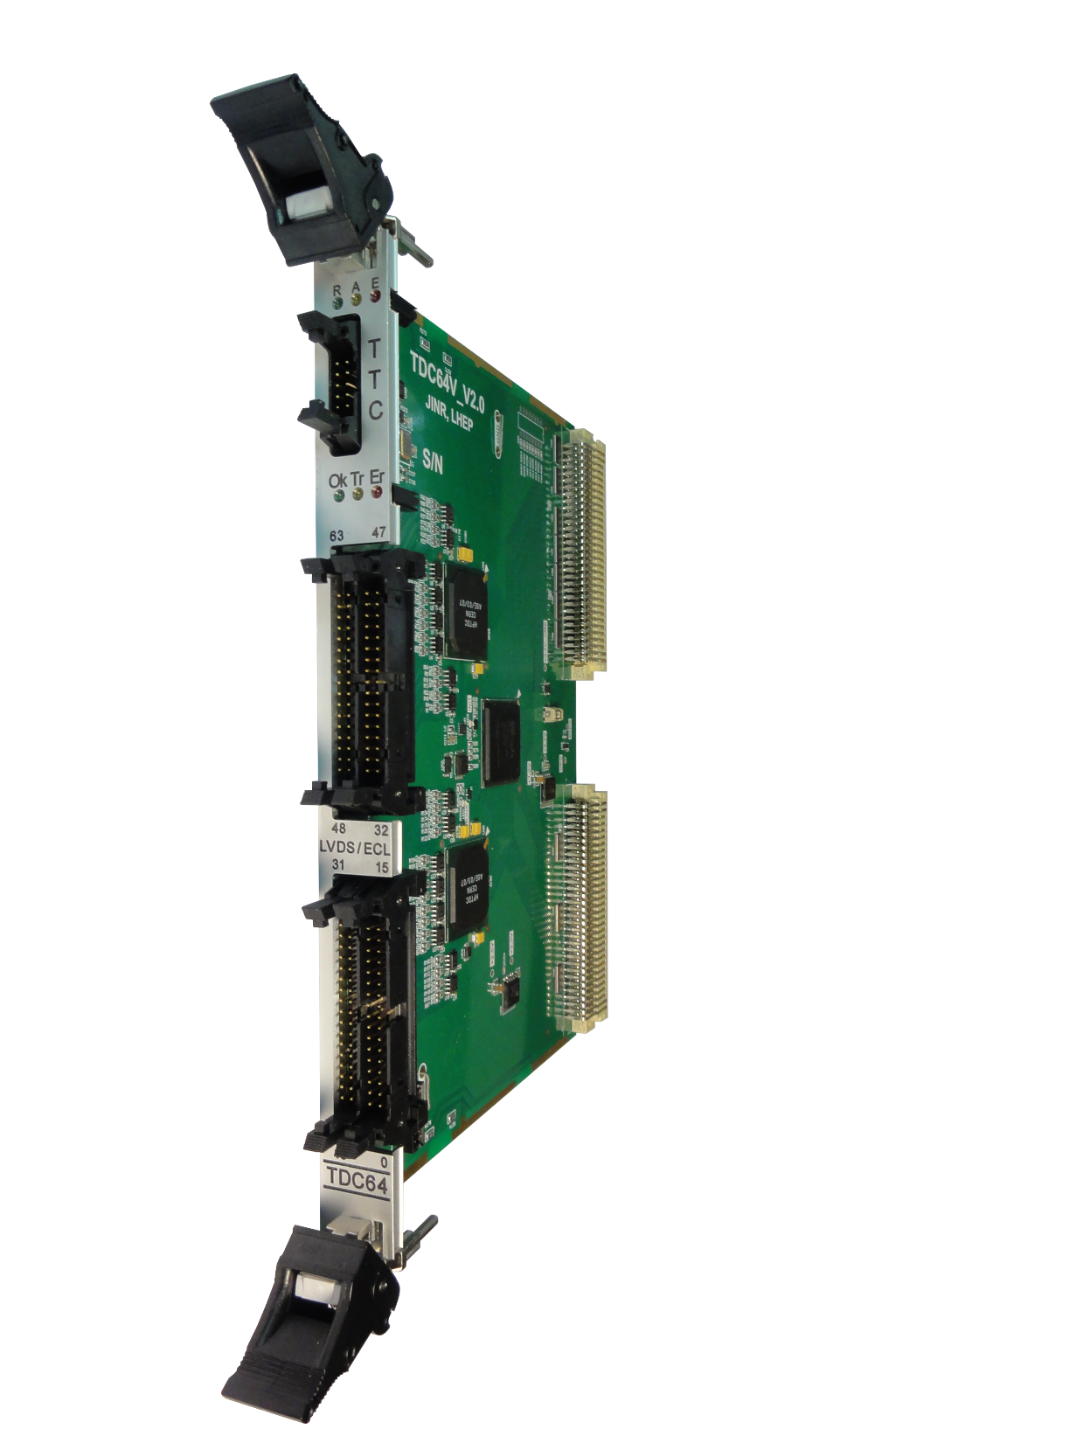
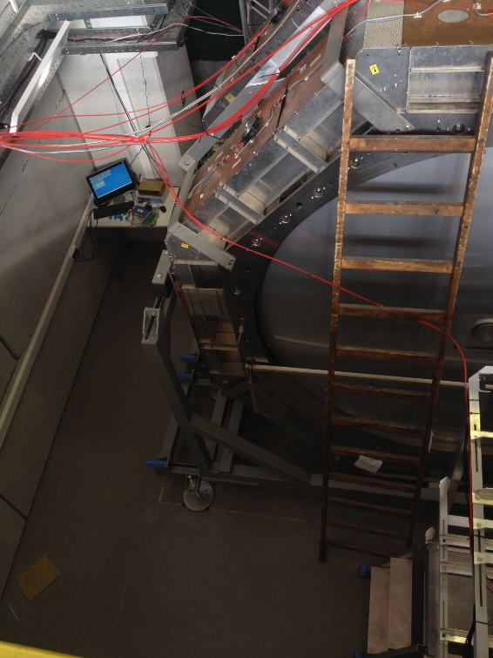
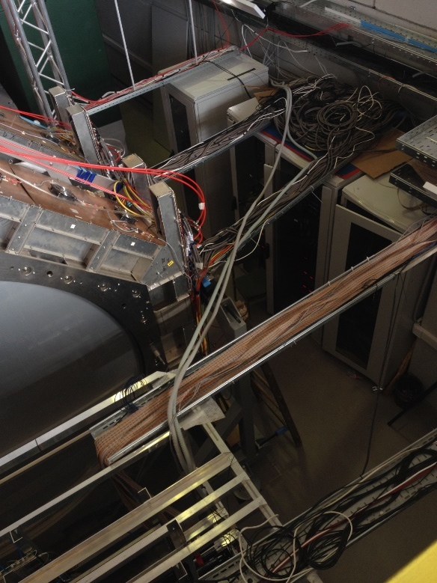
TDC64
VME64x 64-channel 100 ps multihit timestamping TDC
Drift Chambers

Slide 15
TDC64
VME64x 64-channel 100 ps multihit timestamping TDC
64 differential 100 Ω ECL,PECL or LVDS inputs
VME64x interface
TTC Bus for clocking and triggering

Slide 16
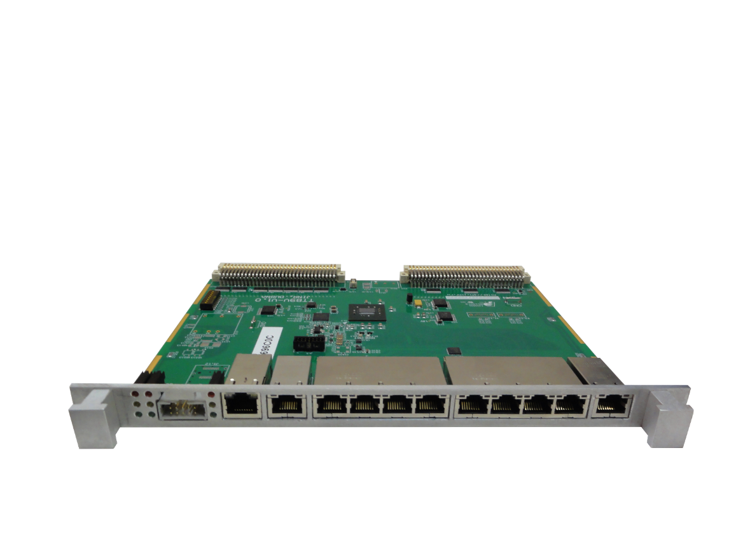
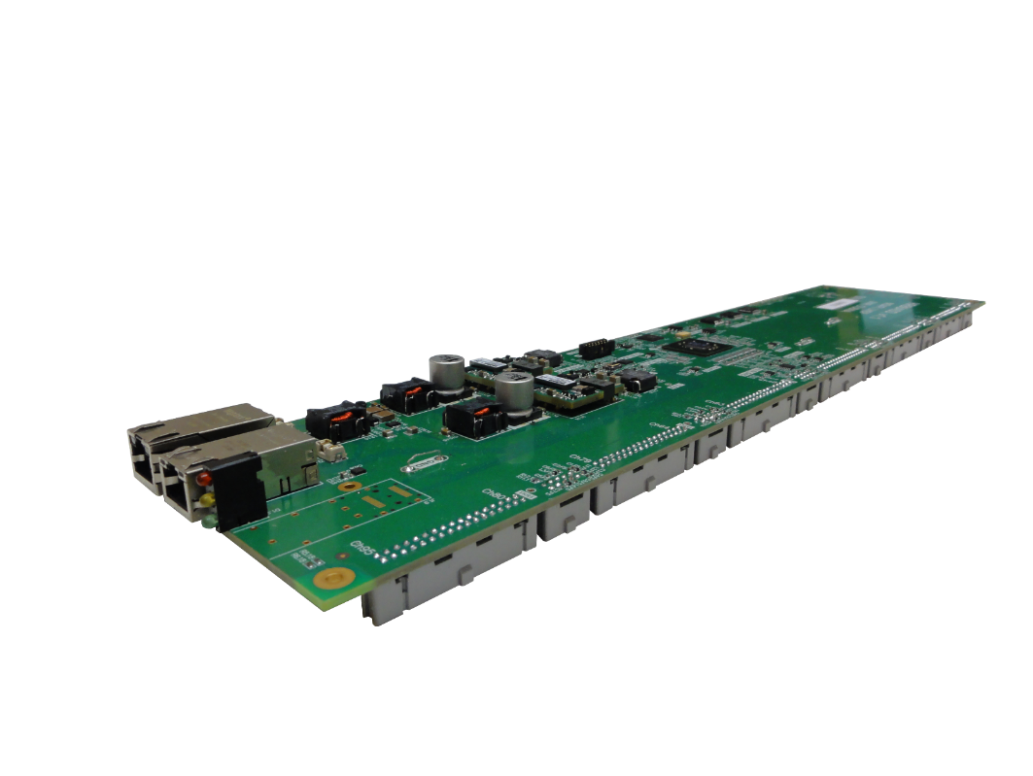
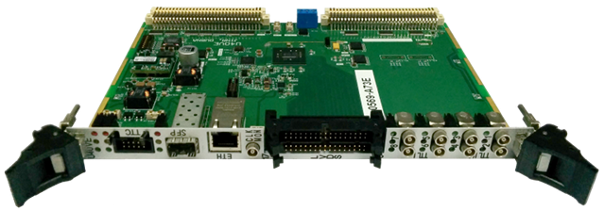
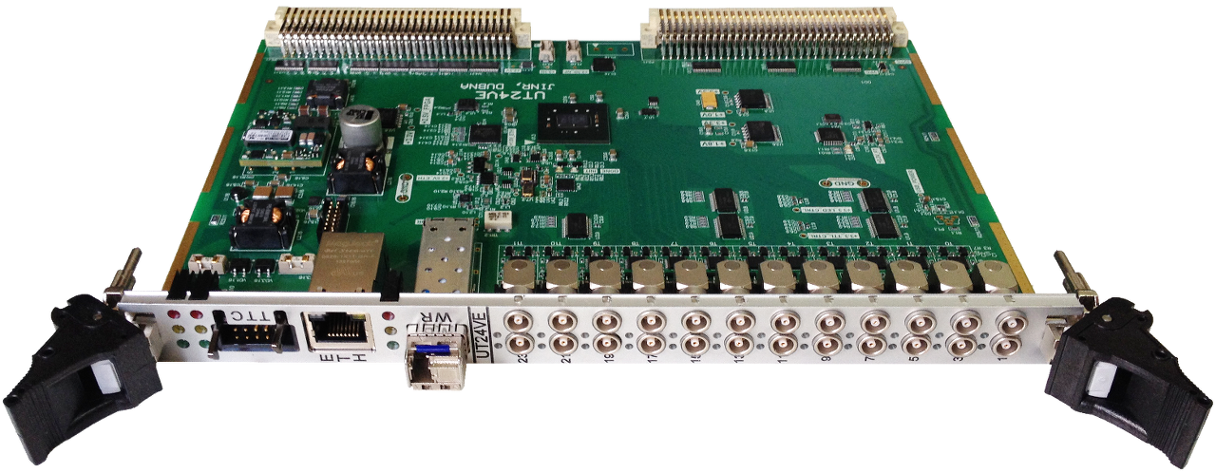
DRE & Auxiliary modules

Slide 17

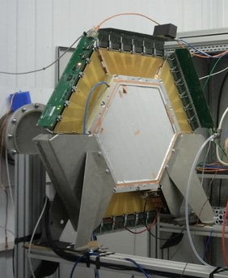
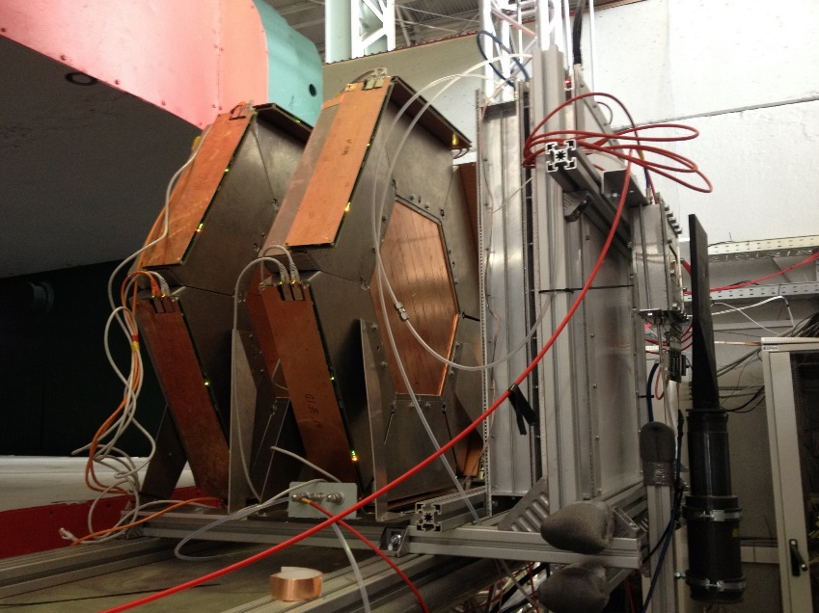
HRB6ASD
96 channels readout module for MWPC
MWPC

Slide 18
HRB6ASD
96 channels readout module for MWPC
96 differential inputs
Ethernet data transfer
RJ45: clock, trigger, timestamp, spill, busy
PoE power supply
Optional: SFP for white rabbit

Slide 19

TTB9
Trigger and Timing Distribution Board for HRB6ASD
9 RJ45 for trigger and timing distribution
TTC Bus or White Rabbit synchronization

Slide 20
U40VE
Universal 40 I/O VME64x board with White Rabbit support
40 sofware configurable I/O
TTC or WR synchronization
PoE, VME or external power supply

Slide 21
UT24VE
24 software configurable TTL I/O (trigger out/ busy in)
WR or TTC synchronization
PoE, VME or external power supply

Slide 22
Thank you

