Slide 1

Automatization of control channel 8 of Phasotron at DLNP of JINR.
Software Side view
Andrey Yudin, DLNP, JINR, Russia

Slide 2
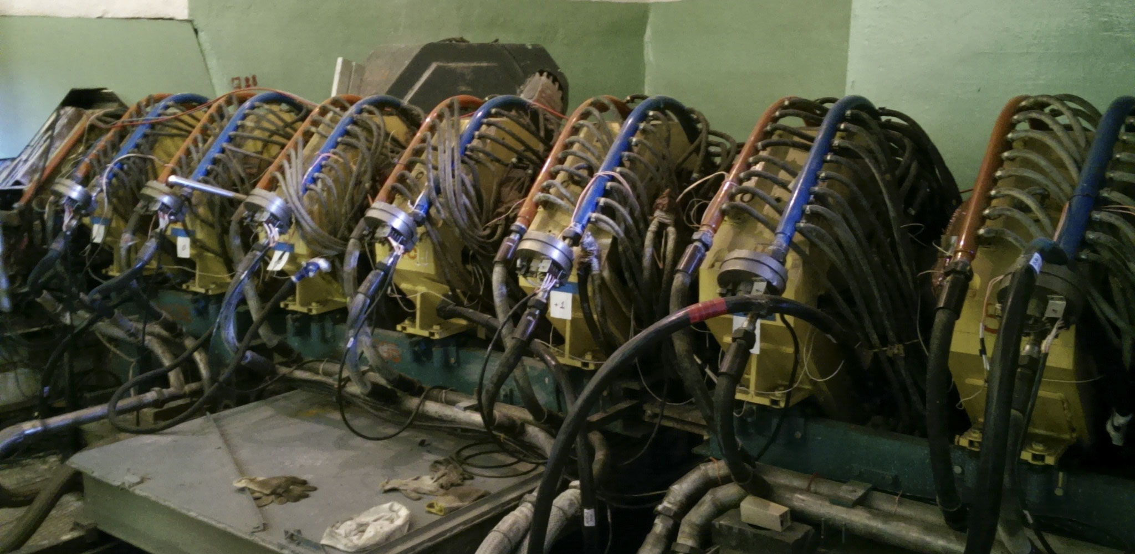
Channel 8 of
Phasotron
Need to control 13 elements

Slide 3
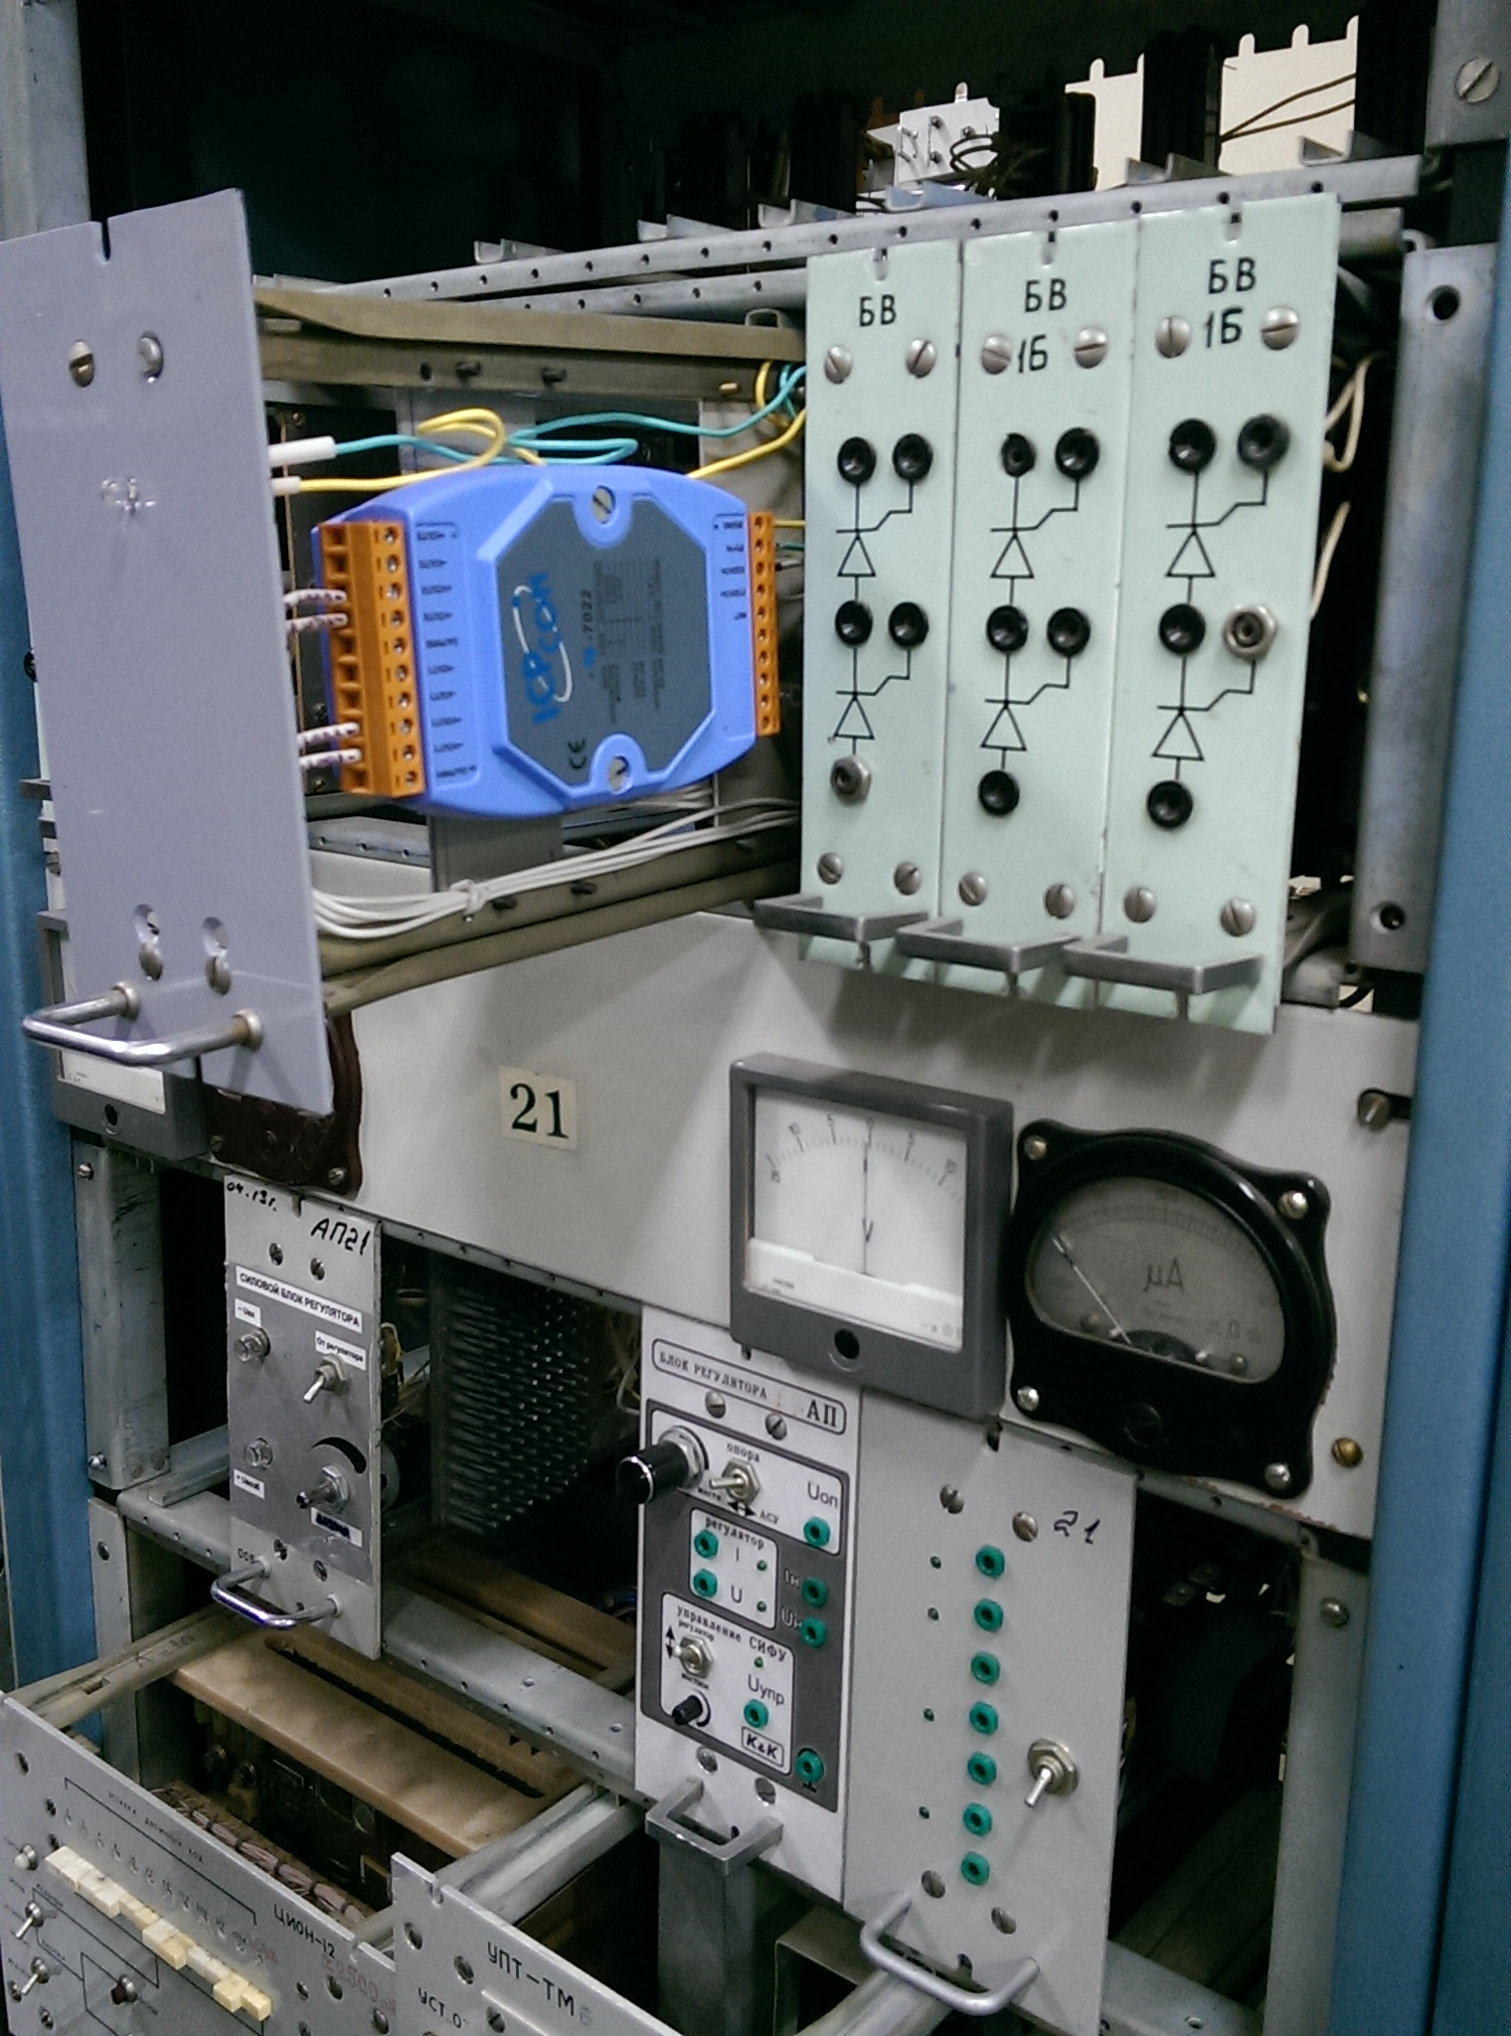
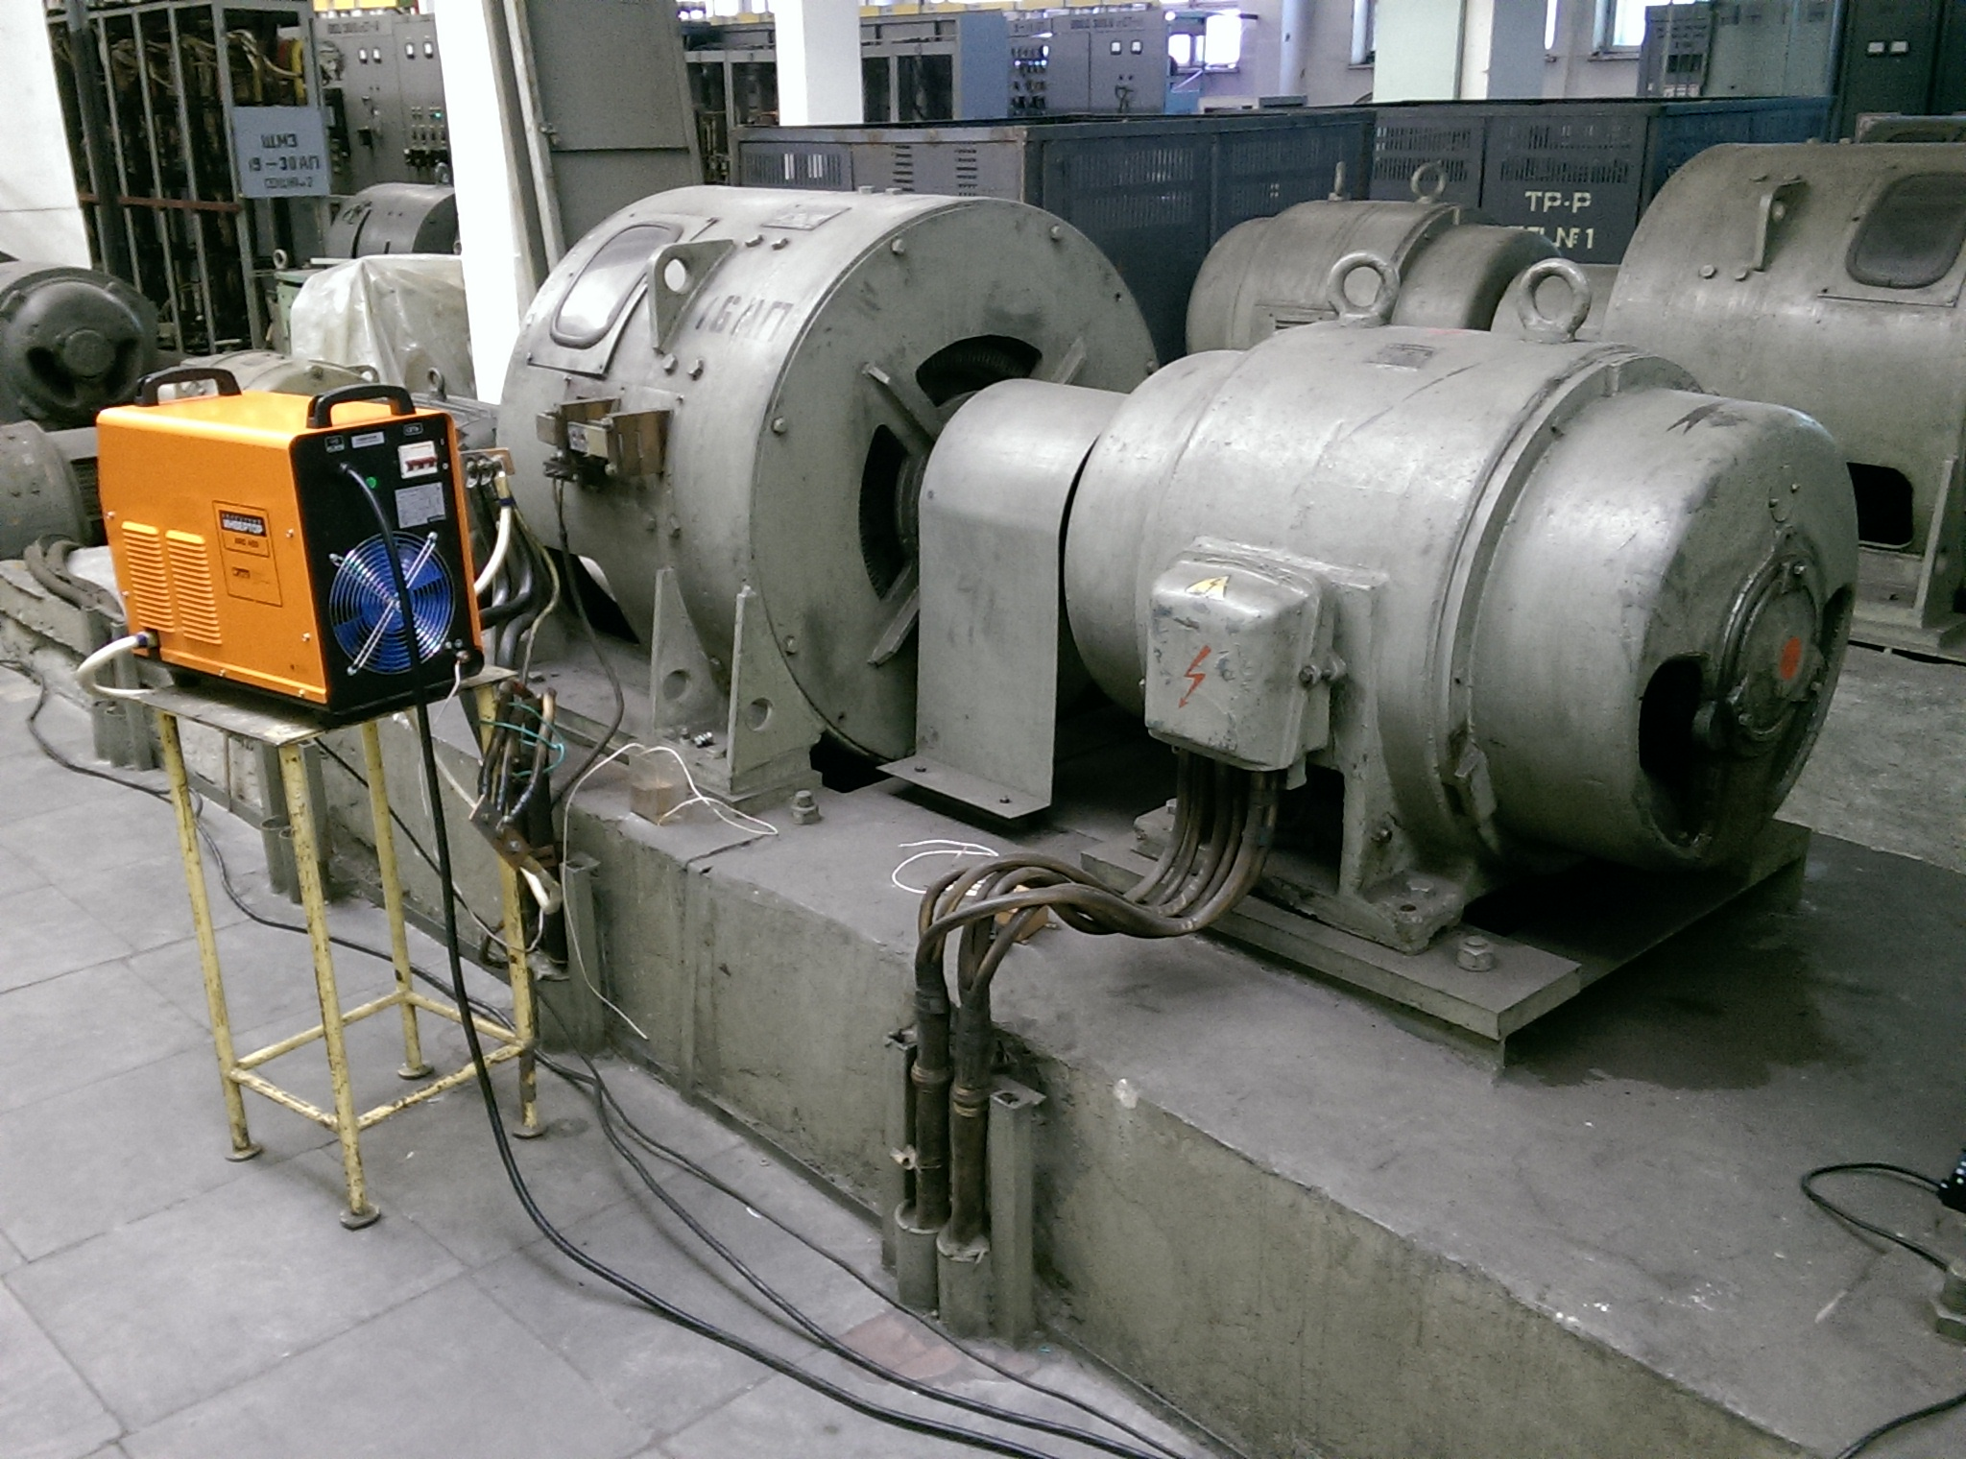
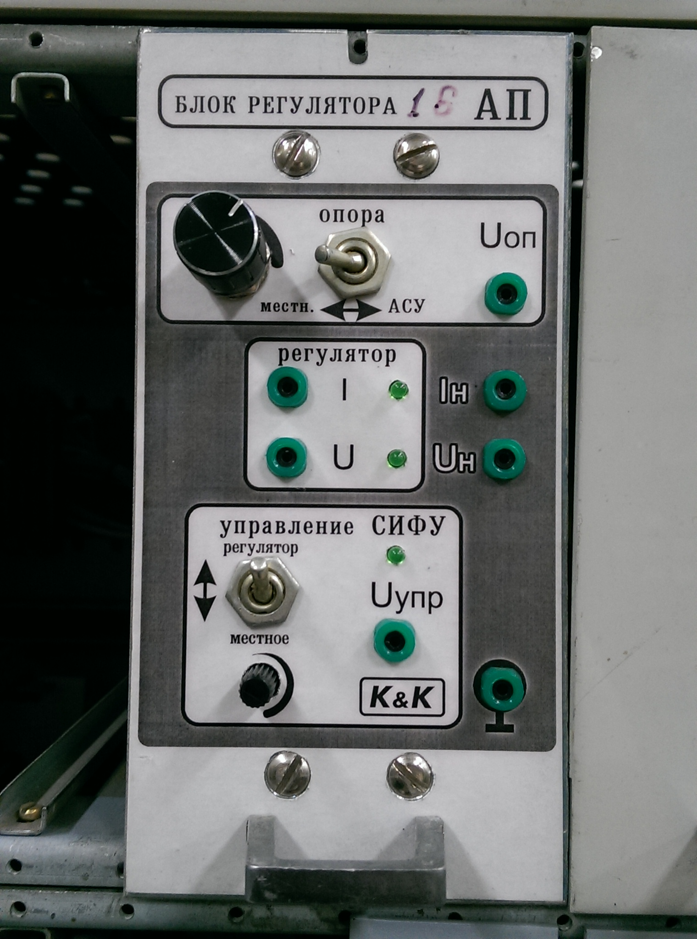
Single Element Control diagram

Slide 4
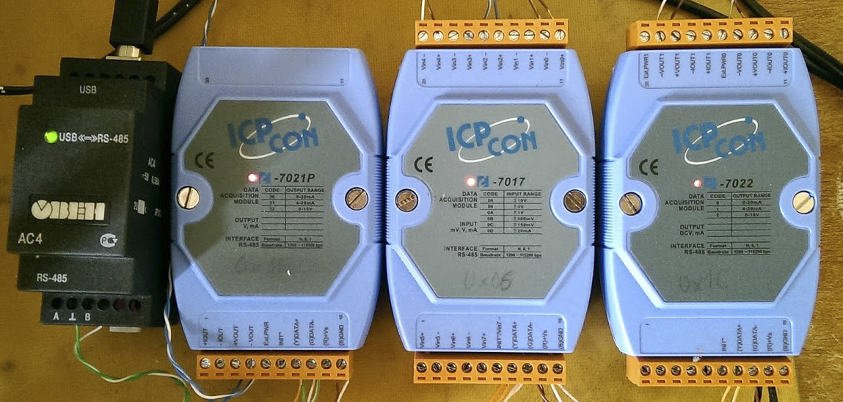
The black and the blue boxes
USB to RS485 bridge: Owen AC4
DAC: ICP CON 7021, 7022
ADC: ICP CON 7017
Inexpensive!

Slide 5
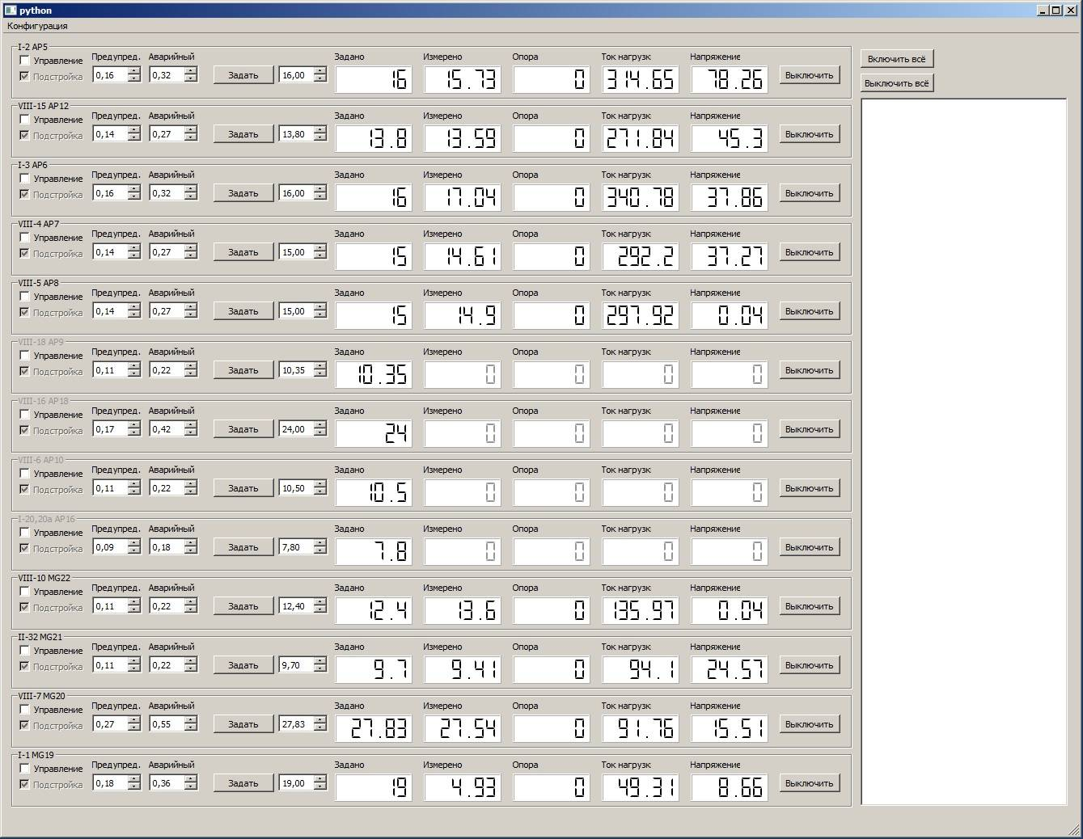
The
APP
Python 3:
PyQT
PySerial
Crossplatform

Slide 6
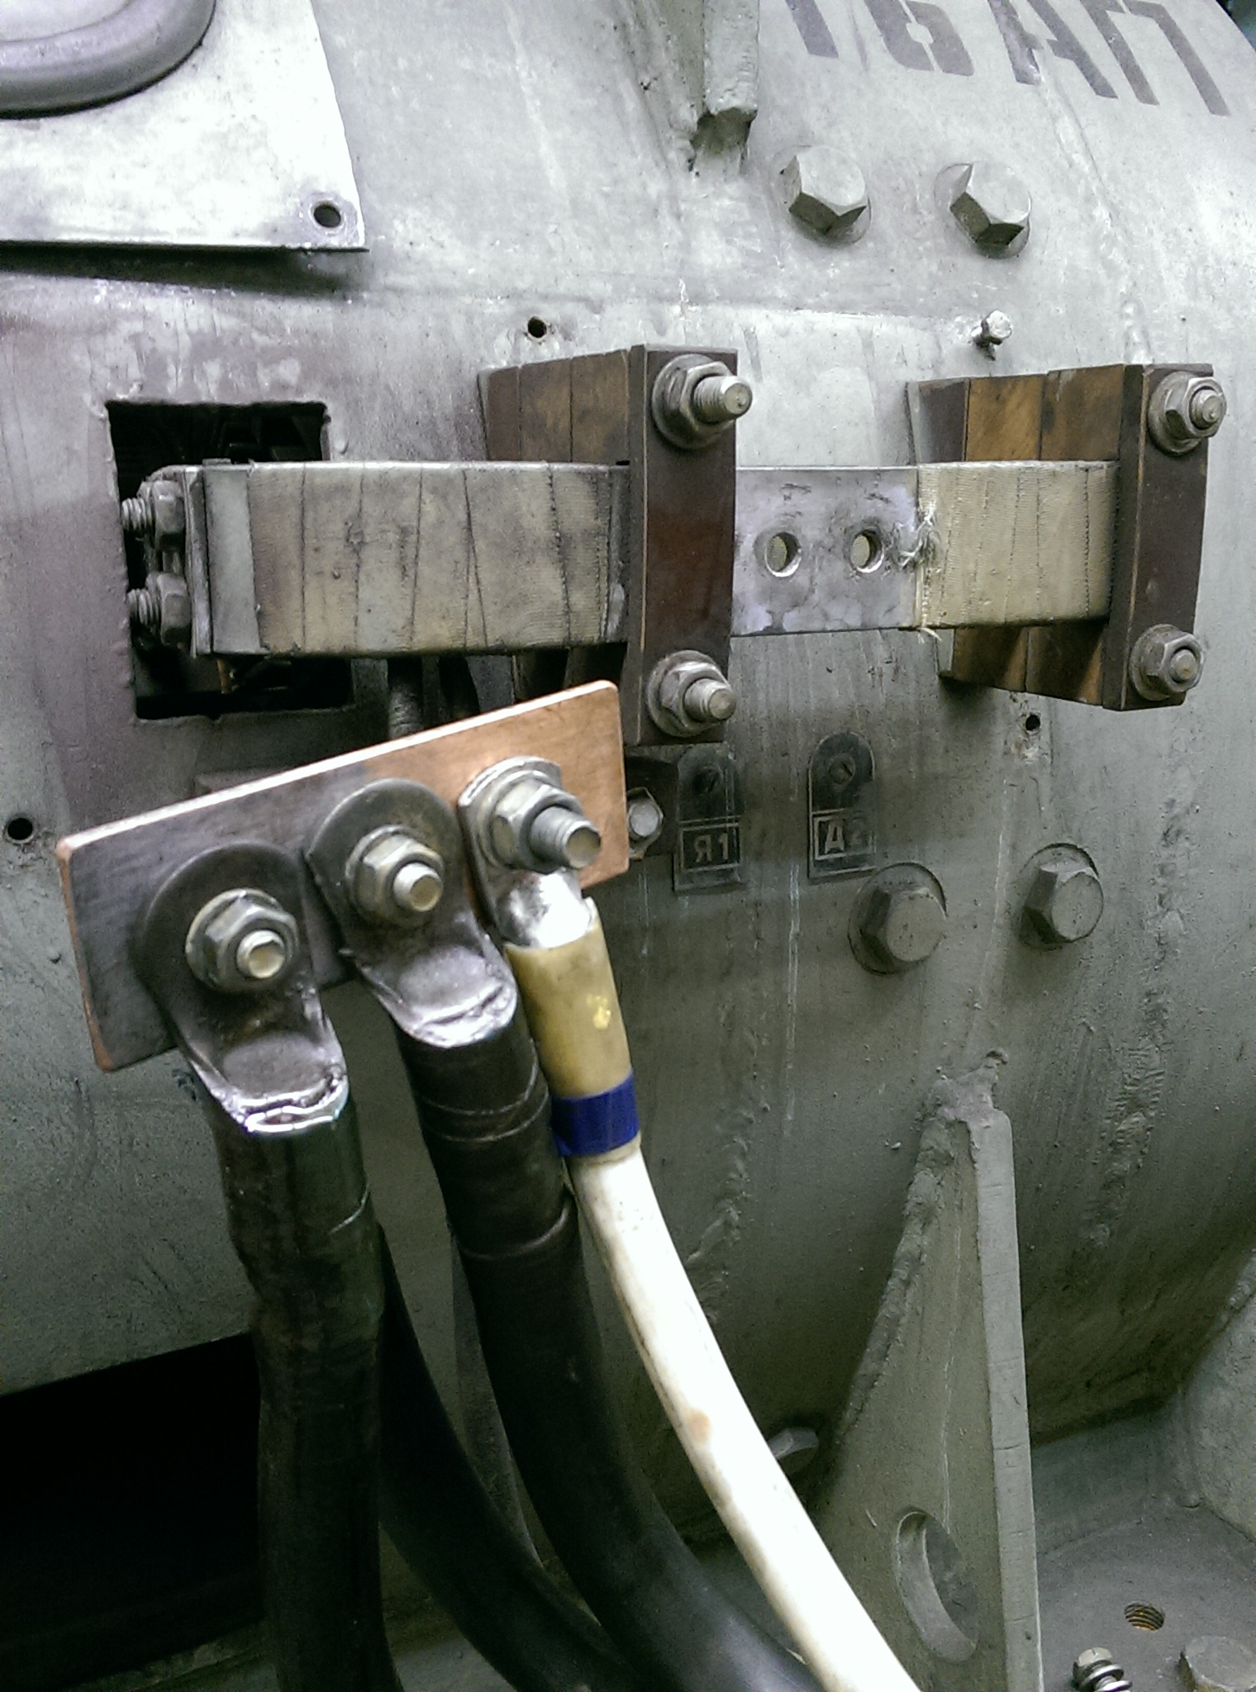
Some hardware details
Smooth voltage change is required. The inertia of the system is present.
Fluctuations and shifts of the measured values.
No notification of the change of operating mode now.

Slide 7
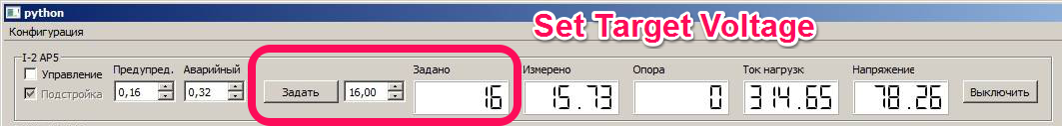
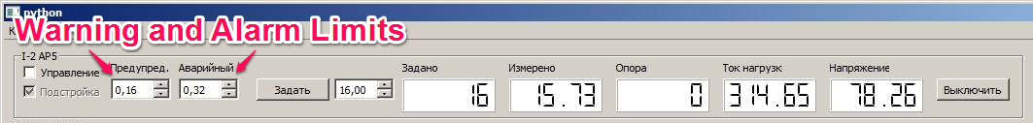
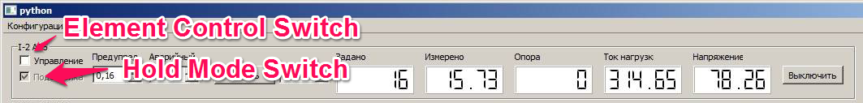
Smooth voltage change to the target value
Operator sets the target voltage for elements
Operator sets the allowable range for the target voltage
Voltage smoothly changes each cycle iteration to the target value
Alarm on exceeding allowable value range

Slide 8
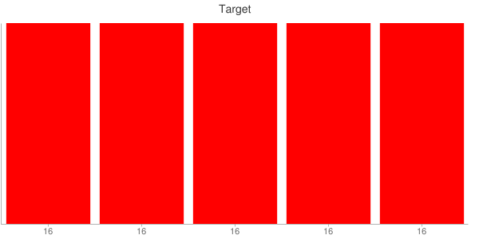
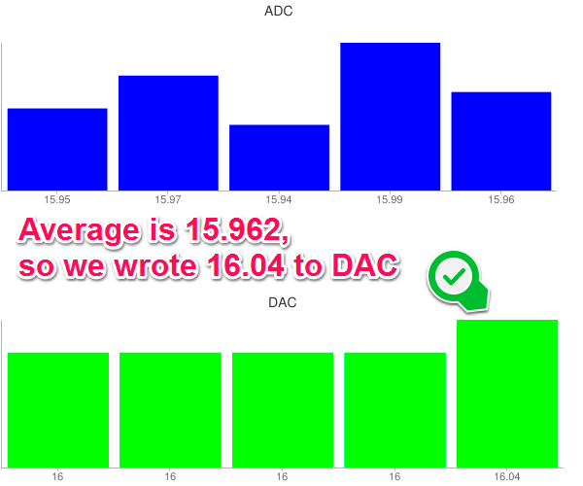
Compensation of voltage shift
Correction value is delta of average ADC voltage value of an element by 5 last cycles and voltage value in DAC.
Correction applies every 5 cycles.

Slide 9
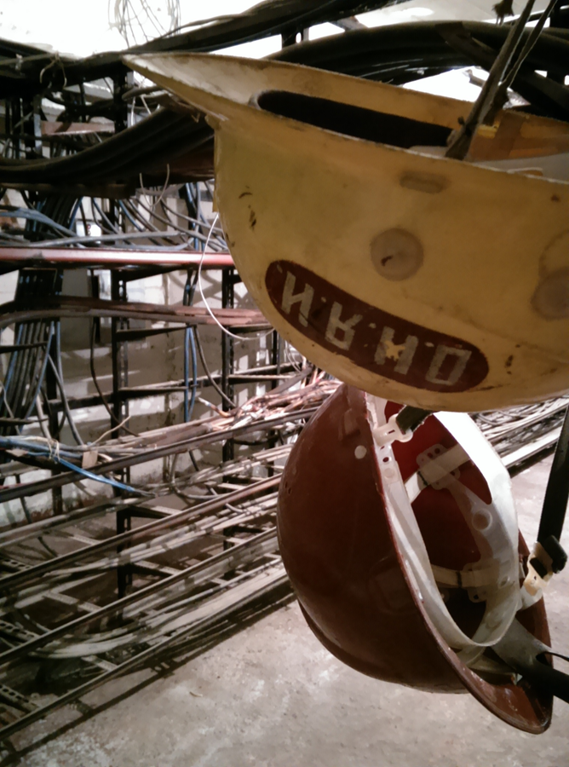
Detection of control ability
Out of control detected:
In smooth changing voltage mode: If the voltage of an element changes less than 1 step value in 5 cycles.
In compensation mode: Delta of target and current voltage is more than double step value

Slide 10
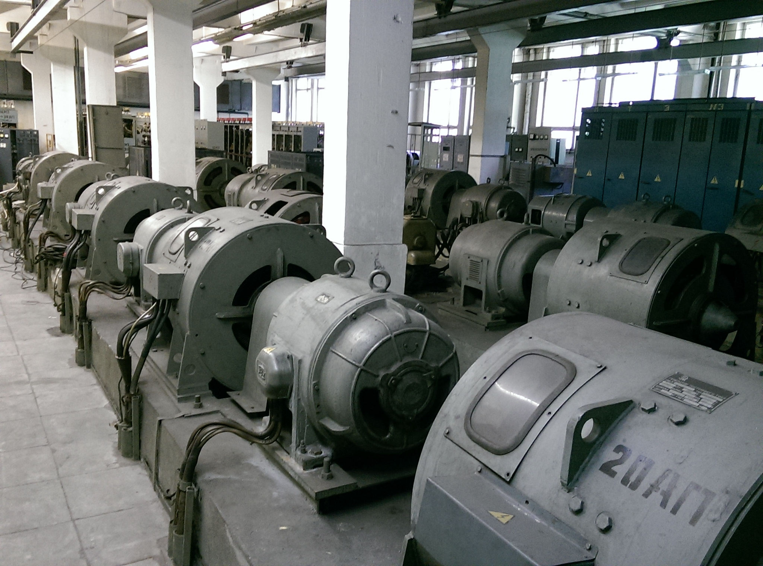
What’s
Next?
Add the ability of remote control from multiple locations at the same time (in progress).
Extend automatic software control to other channels of phasotron.

Slide 11
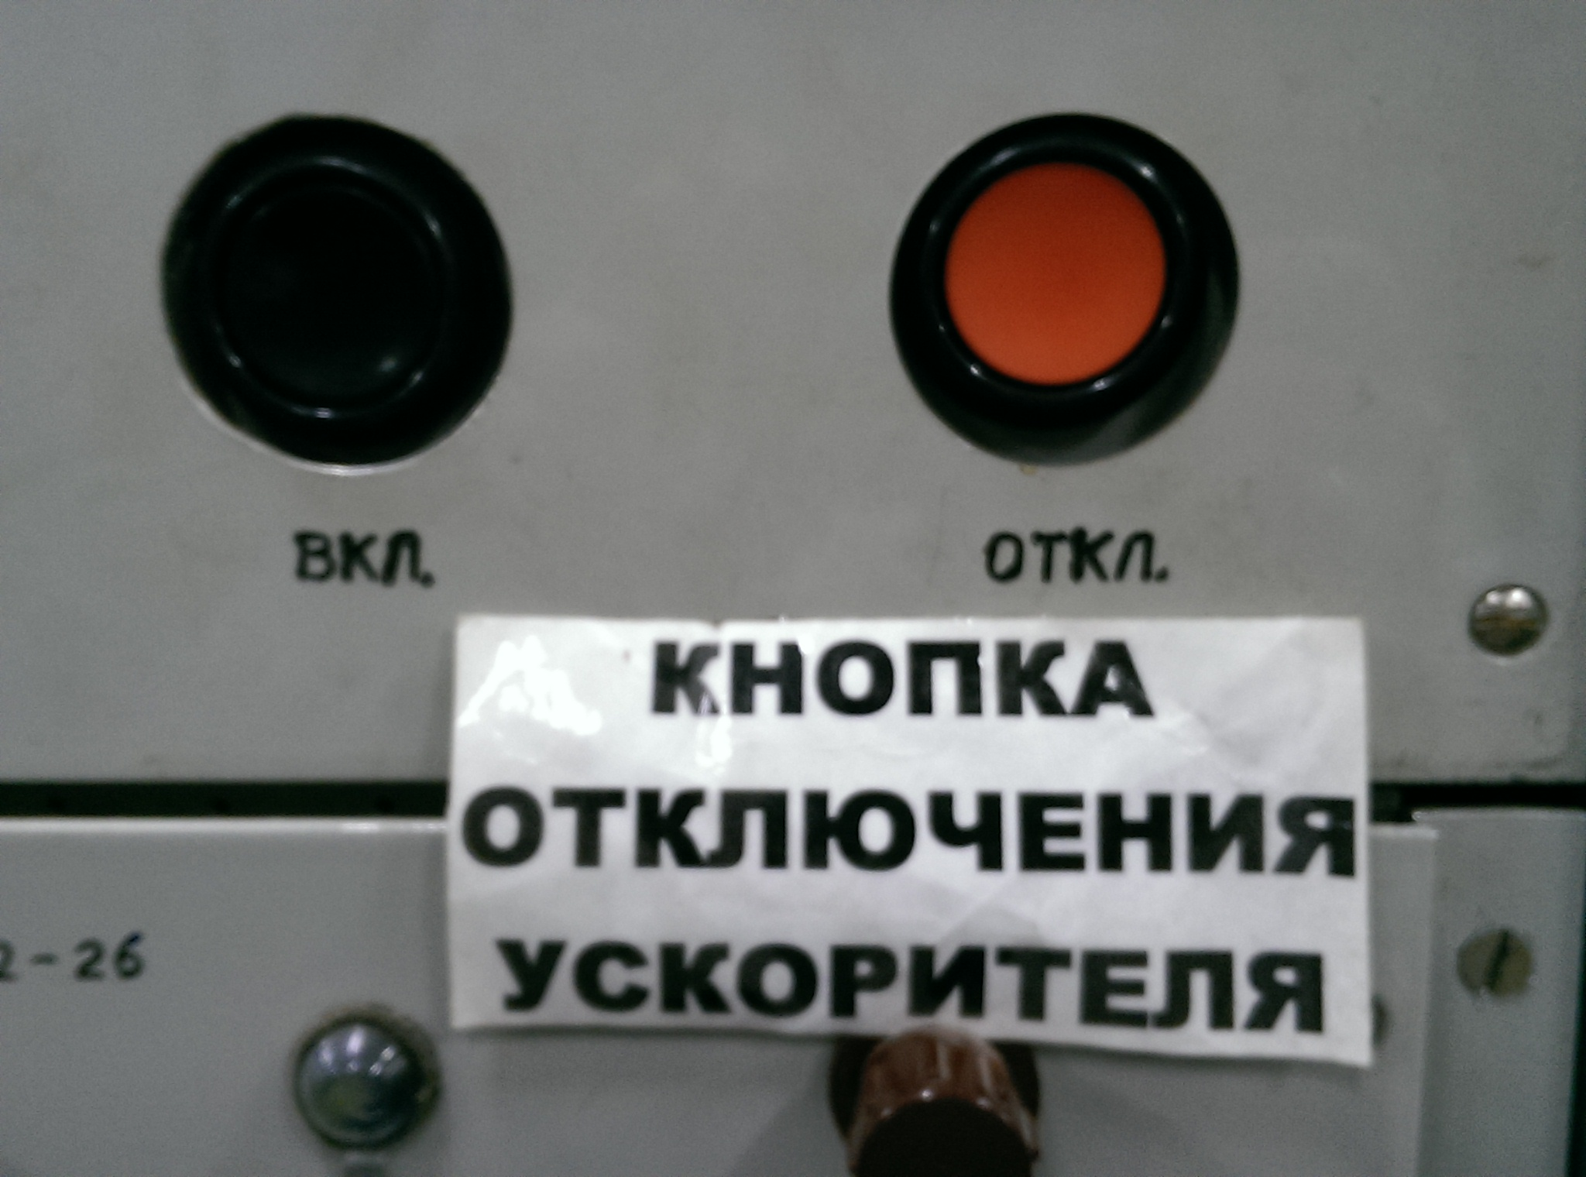
Thank you for your attention
I express my gratitude to Vladimir Halin for advices on the hardware part of this presentation.

